Slide 1
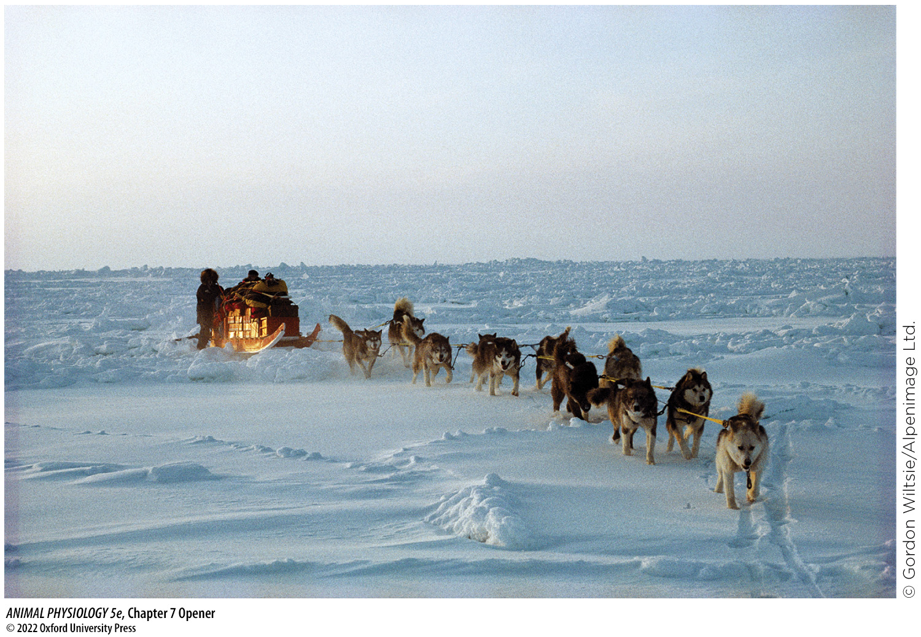
Chapter 7 Opener
Notes:
Chapter 7 Opener
The burden of food
A trek to the North Pole from the nearest land, without resupply along the way, requires that hundreds of pounds of food be hauled per explorer, to supply energy for the explorers and their dogs.

Slide 2
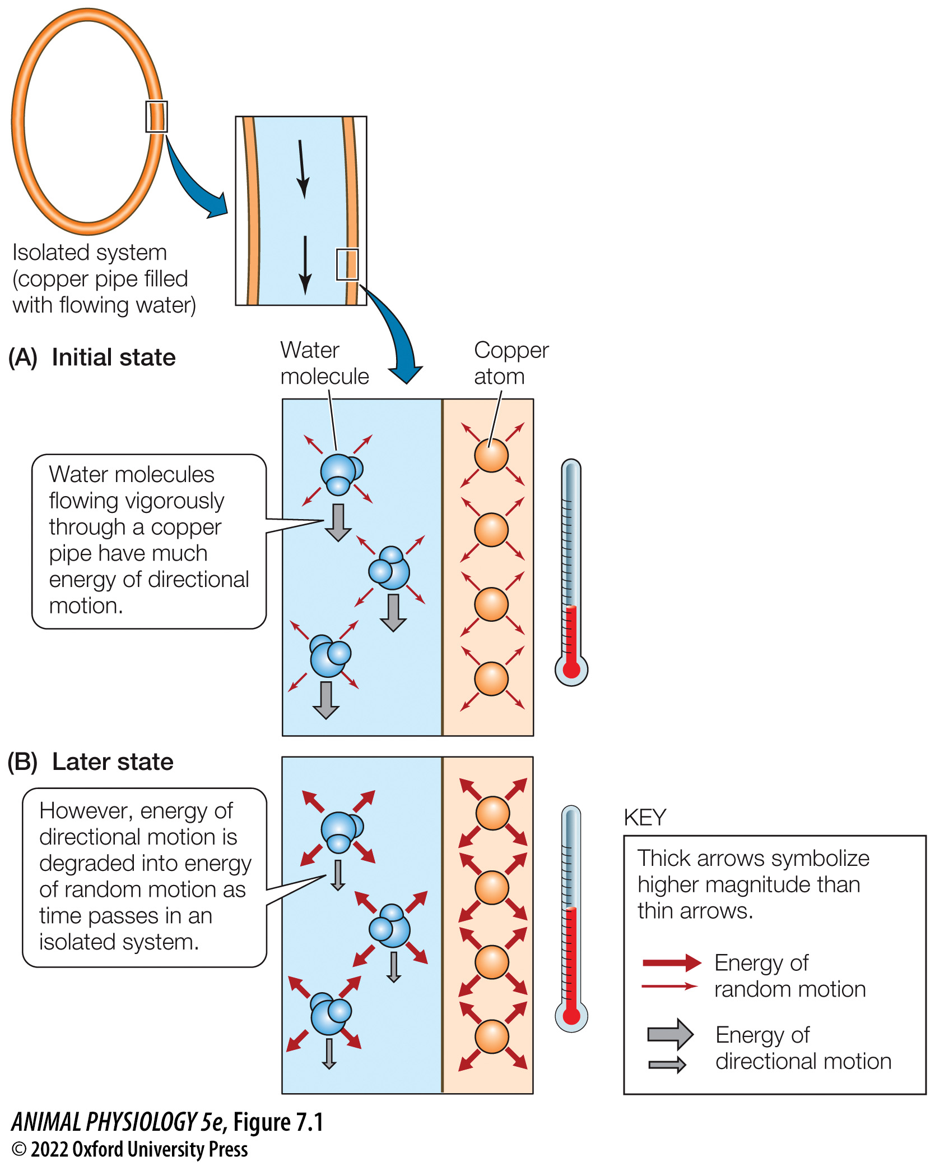
Figure 7.1 The second law of thermodynamics in action (1)
Notes:
Figure 7.1 The second law of thermodynamics in action
Energy of directional motion is converted to energy of random motion in this isolated system. This transformation of energy increases the intensity of random motions of both the water molecules and the copper atoms, causing the system temperature to rise (see thermometers at right).

Slide 3
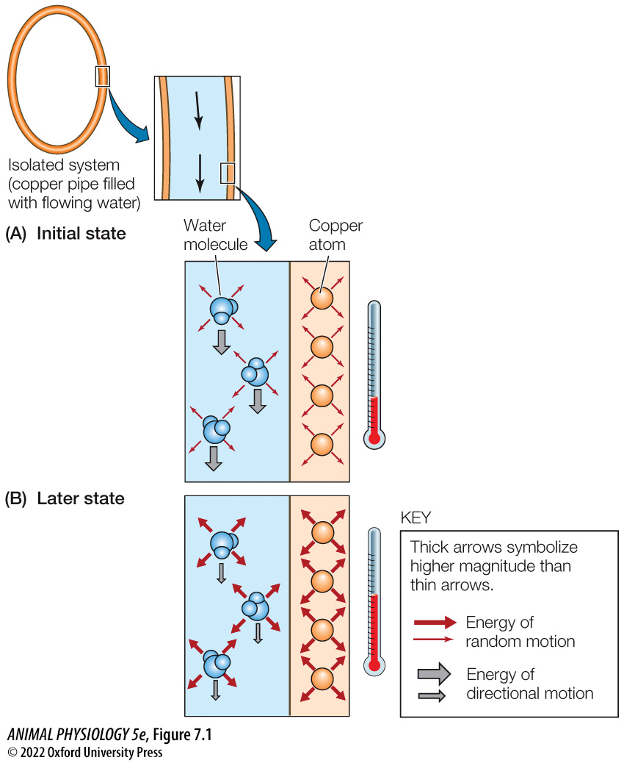
Figure 7.1 The second law of thermodynamics in action (2)
Notes:
Figure 7.1 The second law of thermodynamics in action
Energy of directional motion is converted to energy of random motion in this isolated system. This transformation of energy increases the intensity of random motions of both the water molecules and the copper atoms, causing the system temperature to rise (see thermometers at right).

Slide 4
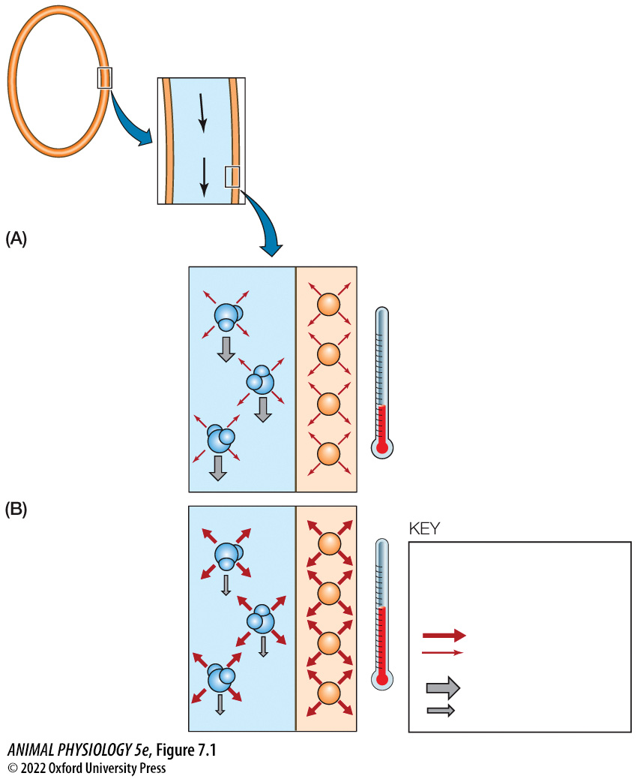
Figure 7.1 The second law of thermodynamics in action (3)
Notes:
Figure 7.1 The second law of thermodynamics in action
Energy of directional motion is converted to energy of random motion in this isolated system. This transformation of energy increases the intensity of random motions of both the water molecules and the copper atoms, causing the system temperature to rise (see thermometers at right).

Slide 5
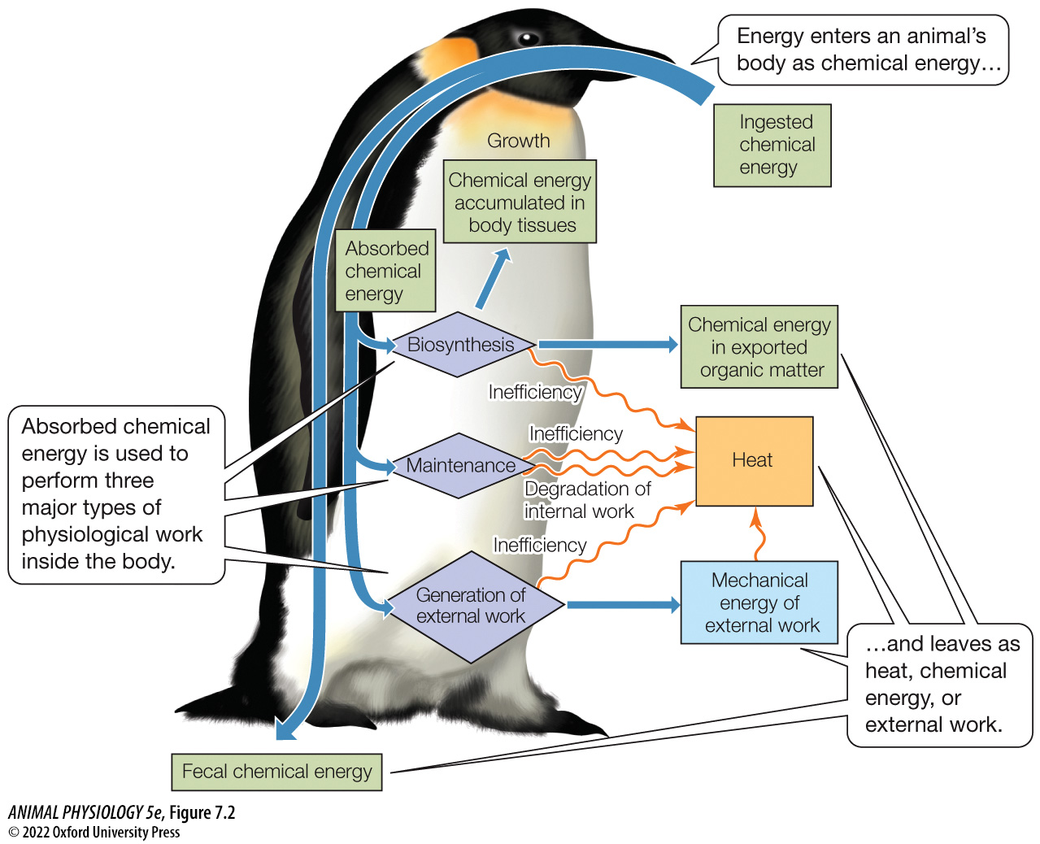
Figure 7.2 The uses of energy by an animal (1)
Notes:
Figure 7.2 The uses of energy by an animal
All the green boxes refer to chemical energy. At death, chemical energy in body tissues becomes ingested energy for other organisms, such as predators, scavengers, or decay microbes.

Slide 6
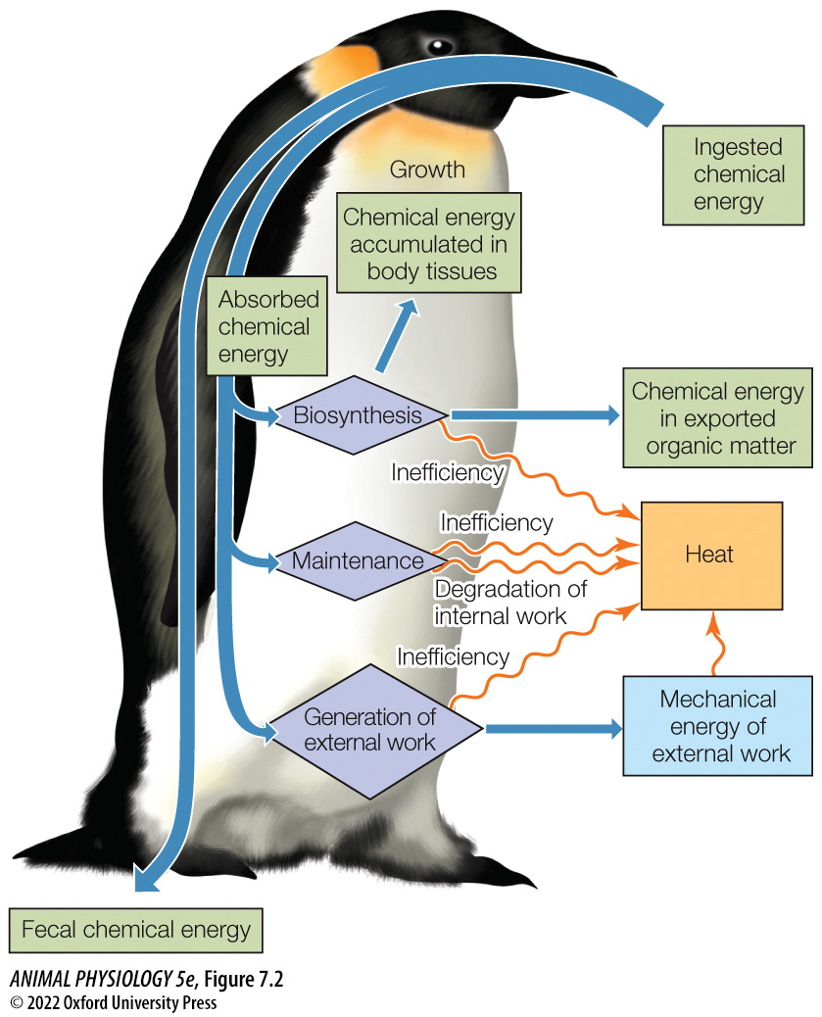
Figure 7.2 The uses of energy by an animal (2)
Notes:
Figure 7.2 The uses of energy by an animal
All the green boxes refer to chemical energy. At death, chemical energy in body tissues becomes ingested energy for other organisms, such as predators, scavengers, or decay microbes.

Slide 7

Figure 7.2 The uses of energy by an animal (3)
Notes:
Figure 7.2 The uses of energy by an animal
All the green boxes refer to chemical energy. At death, chemical energy in body tissues becomes ingested energy for other organisms, such as predators, scavengers, or decay microbes.

Slide 8
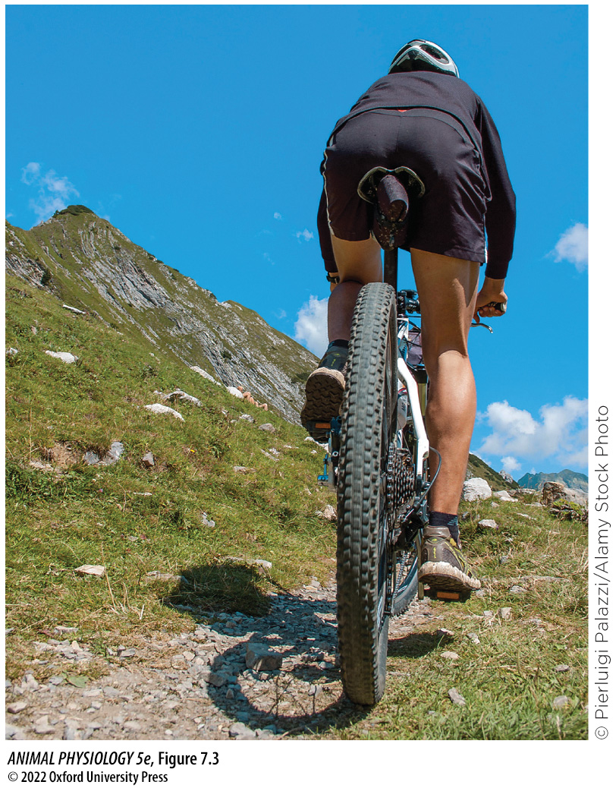
Figure 7.3 In this type of external work, some of the energy driving locomotion is converted to potential energy of position
Notes:
Figure 7.3 In this type of external work, some of the energy driving locomotion is converted to potential energy of position
As this bicyclist goes uphill, although much of his mechanical energy of external work is transformed into heat, a fraction is stored as potential energy because he is propelling the mass of his body and bicycle higher in Earth’s gravitational field.

Slide 9
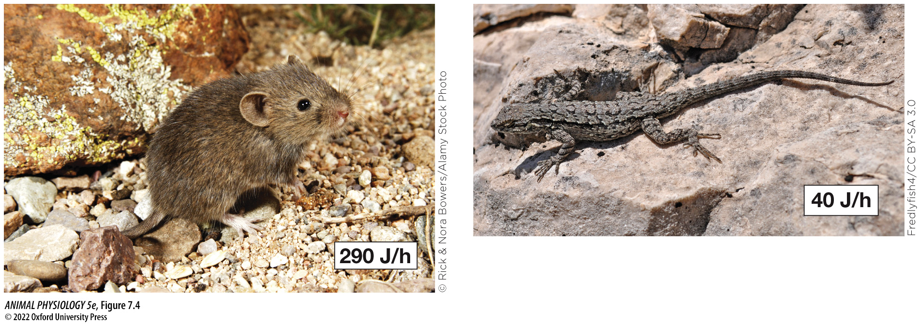
Figure 7.4 Average resting metabolic rates of two 7-gram vertebrates (1)
Notes:
Figure 7.4 Average resting metabolic rates of two 7-gram vertebrates
The individuals studied in both species were adults with the same body weight and living at the same air temperature (30°C–33°C). The mammal is Baiomys taylori, often called the pigmy mouse. The lizard is Sceloporus undulatus, the Eastern fence lizard. Both are native to North America. (Data for Baiomys from J. W. Hudson. 1965. Physiol. Zool. 38: 243–254; data for Sceloporus from M. J. Angilletta, Jr. 2001. Physiol.
Biochem. Zool. 74: 11–21.)

Slide 10
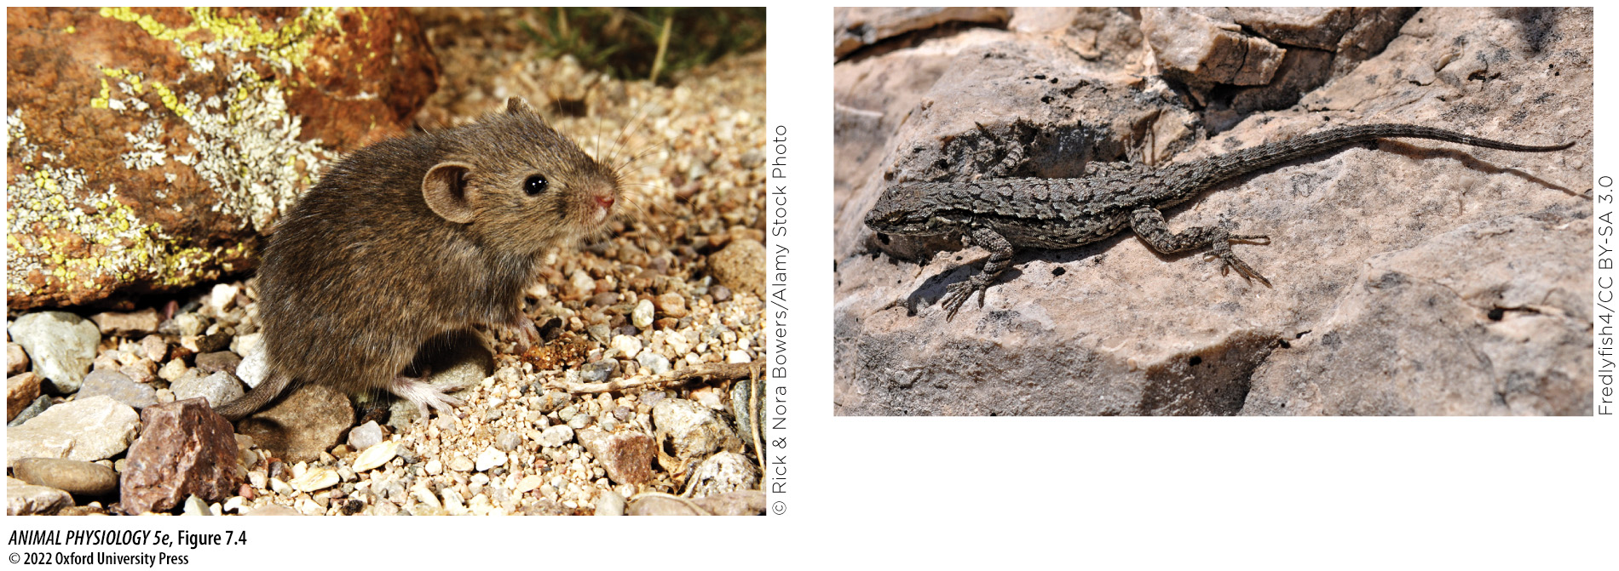
Figure 7.4 Average resting metabolic rates of two 7-gram vertebrates (2)
Notes:
Figure 7.4 Average resting metabolic rates of two 7-gram vertebrates
The individuals studied in both species were adults with the same body weight and living at the same air temperature (30°C–33°C). The mammal is Baiomys taylori, often called the pigmy mouse. The lizard is Sceloporus undulatus, the Eastern fence lizard. Both are native to North America. (Data for Baiomys from J. W. Hudson. 1965. Physiol. Zool. 38: 243–254; data for Sceloporus from M. J. Angilletta, Jr. 2001. Physiol.
Biochem. Zool. 74: 11–21.)

Slide 11
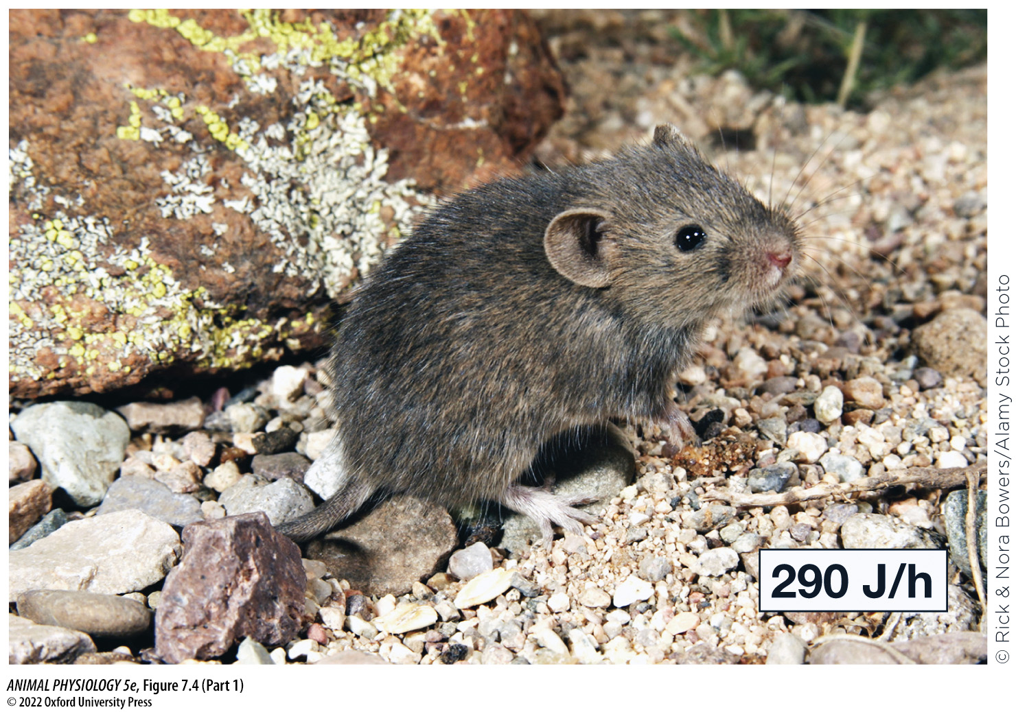
Figure 7.4 Average resting metabolic rates of two 7-gram vertebrates (Part 1) (1)
Notes:
Figure 7.4 Average resting metabolic rates of two 7-gram vertebrates
The individuals studied in both species were adults with the same body weight and living at the same air temperature (30°C–33°C). The mammal is Baiomys taylori, often called the pigmy mouse. The lizard is Sceloporus undulatus, the Eastern fence lizard. Both are native to North America. (Data for Baiomys from J. W. Hudson. 1965. Physiol. Zool. 38: 243–254; data for Sceloporus from M. J. Angilletta, Jr. 2001. Physiol.
Biochem. Zool. 74: 11–21.)

Slide 12
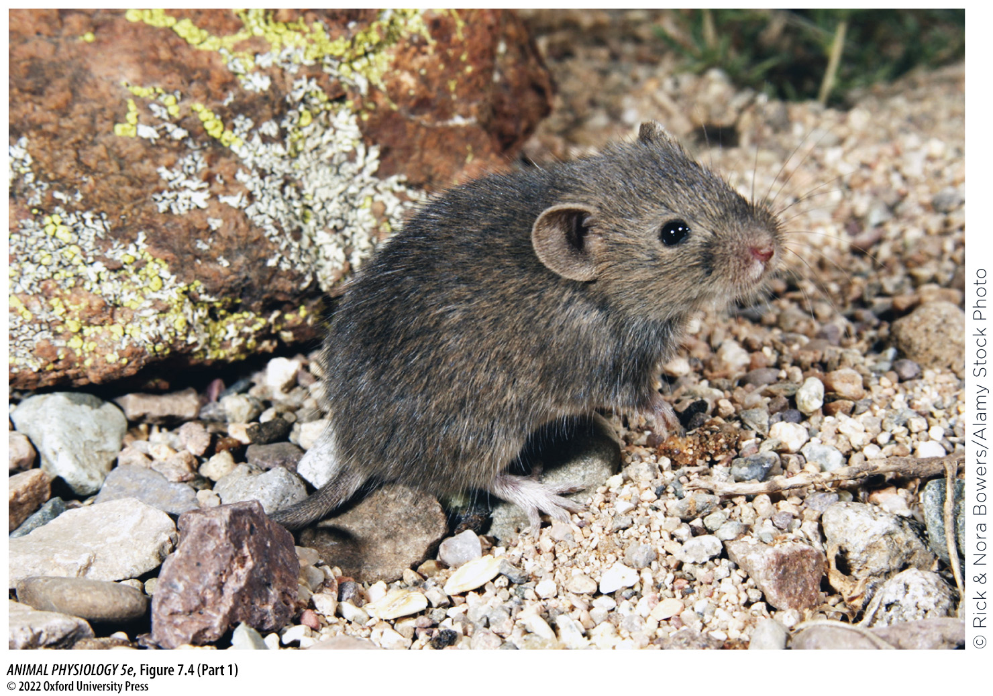
Figure 7.4 Average resting metabolic rates of two 7-gram vertebrates (Part 1) (2)
Notes:
Figure 7.4 Average resting metabolic rates of two 7-gram vertebrates
The individuals studied in both species were adults with the same body weight and living at the same air temperature (30°C–33°C). The mammal is Baiomys taylori, often called the pigmy mouse. The lizard is Sceloporus undulatus, the Eastern fence lizard. Both are native to North America. (Data for Baiomys from J. W. Hudson. 1965. Physiol. Zool. 38: 243–254; data for Sceloporus from M. J. Angilletta, Jr. 2001. Physiol.
Biochem. Zool. 74: 11–21.)

Slide 13
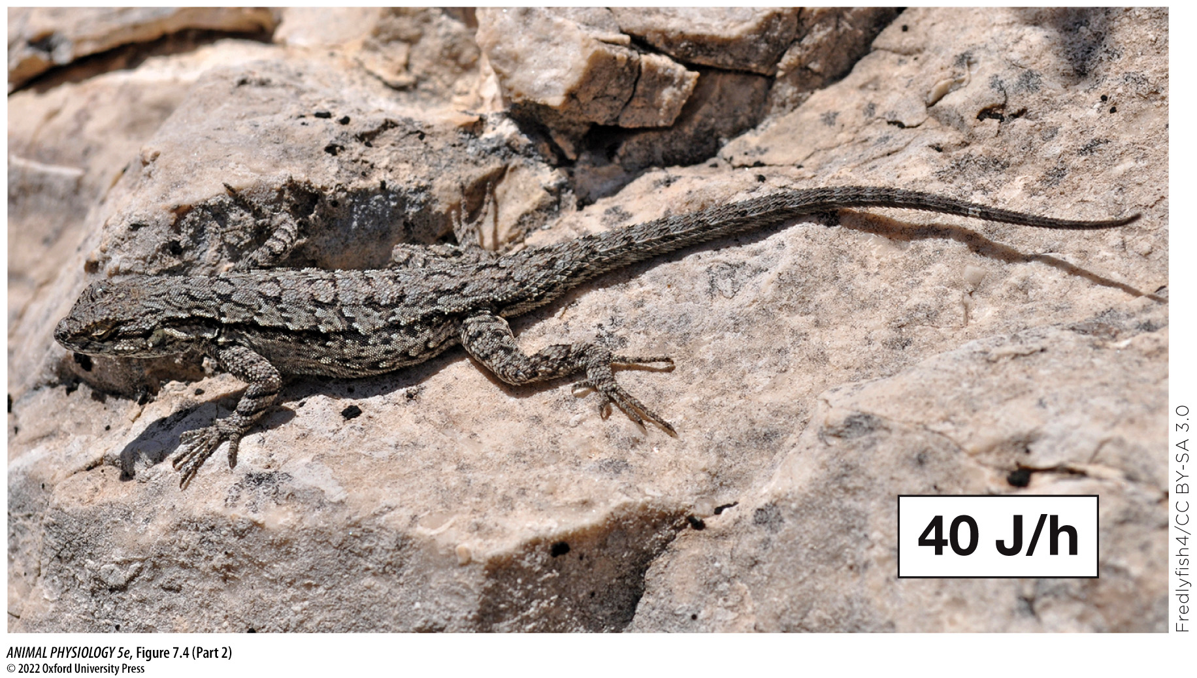
Figure 7.4 Average resting metabolic rates of two 7-gram vertebrates (Part 2) (1)
Notes:
Figure 7.4 Average resting metabolic rates of two 7-gram vertebrates
The individuals studied in both species were adults with the same body weight and living at the same air temperature (30°C–33°C). The mammal is Baiomys taylori, often called the pigmy mouse. The lizard is Sceloporus undulatus, the Eastern fence lizard. Both are native to North America. (Data for Baiomys from J. W. Hudson. 1965. Physiol. Zool. 38: 243–254; data for Sceloporus from M. J. Angilletta, Jr. 2001. Physiol.
Biochem. Zool. 74: 11–21.)

Slide 14
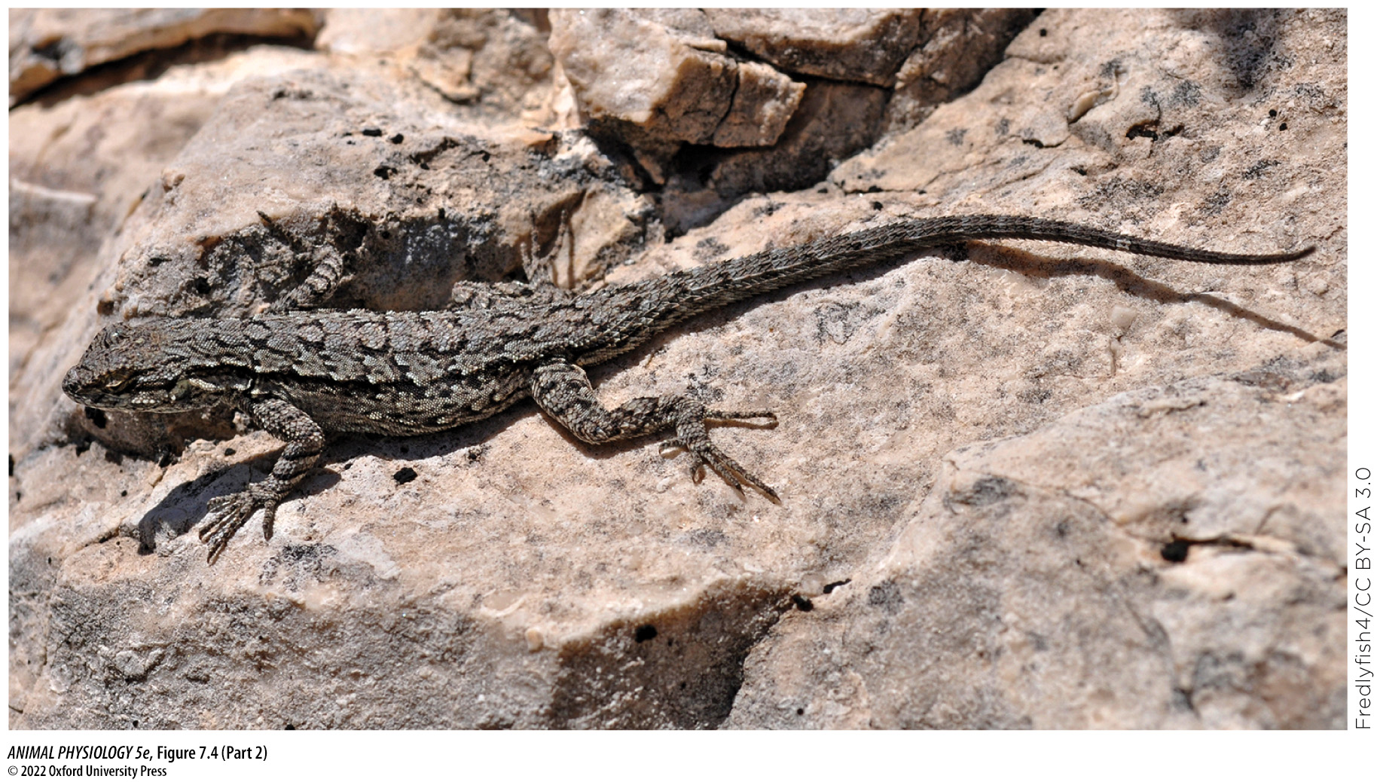
Figure 7.4 Average resting metabolic rates of two 7-gram vertebrates (Part 2) (2)
Notes:
Figure 7.4 Average resting metabolic rates of two 7-gram vertebrates
The individuals studied in both species were adults with the same body weight and living at the same air temperature (30°C–33°C). The mammal is Baiomys taylori, often called the pigmy mouse. The lizard is Sceloporus undulatus, the Eastern fence lizard. Both are native to North America. (Data for Baiomys from J. W. Hudson. 1965. Physiol. Zool. 38: 243–254; data for Sceloporus from M. J. Angilletta, Jr. 2001. Physiol.
Biochem. Zool. 74: 11–21.)

Slide 15
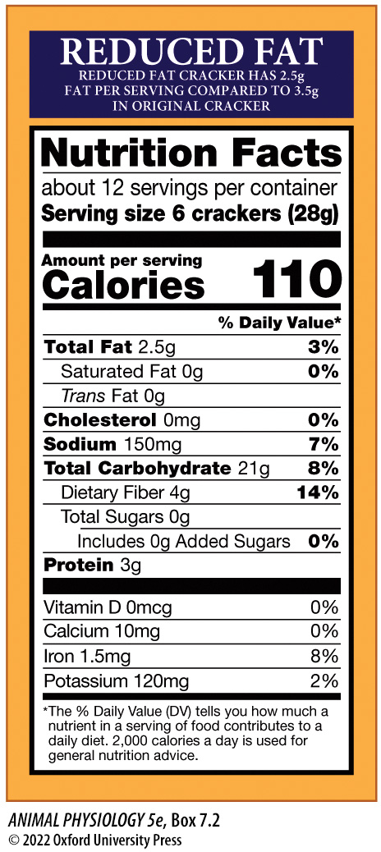
BOX 7.2 “Nutrition Facts” and Food Choice
Notes:
BOX 7.2 “Nutrition Facts” and Food Choice
A Nutrition Facts label for reduced-fat crackers sold in the United States. The format is highly standardized. In most parts of the world, energy values are given in unambiguous SI units, but not in the U.S.A.

Slide 16
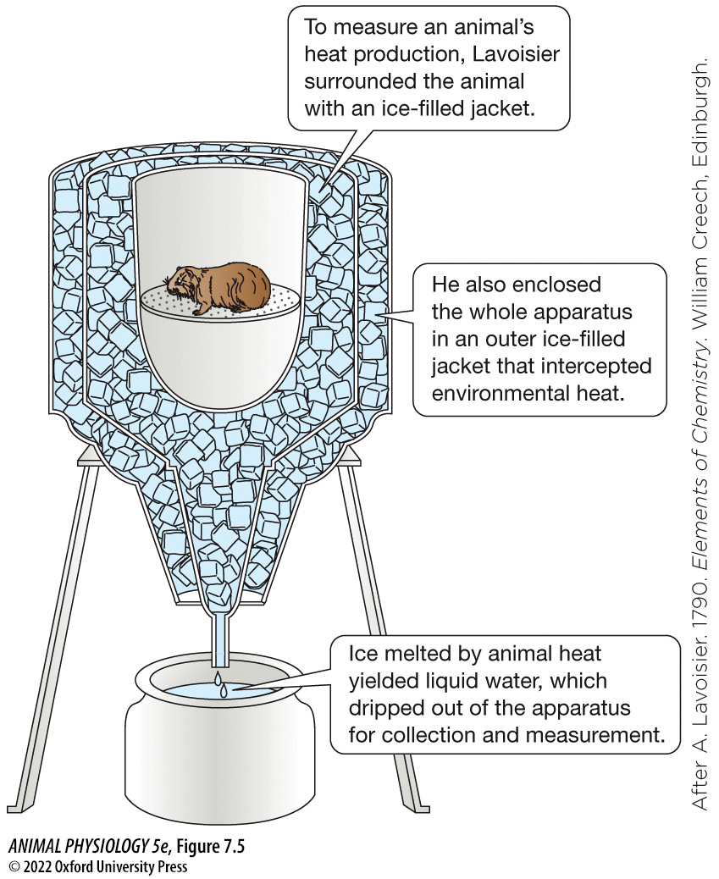
Figure 7.5 Lavoisier’s direct calorimeter (1)
Notes:
Figure 7.5 Lavoisier’s direct calorimeter
Heat from the general environment must be excluded from measurement of animal heat. In Lavoisier’s device, heat entering from the air surrounding the calorimeter was intercepted by an outer ice-filled jacket, which prevented the environmental heat from melting the same ice as the animal heat. Modern direct calorimeters, although they measure heat in a different way and more precisely, still reflect the fundamental design considerations that Lavoisier introduced. (After A. Lavoisier. 1790. Elements of Chemistry. William Creech, Edinburgh.)

Slide 17
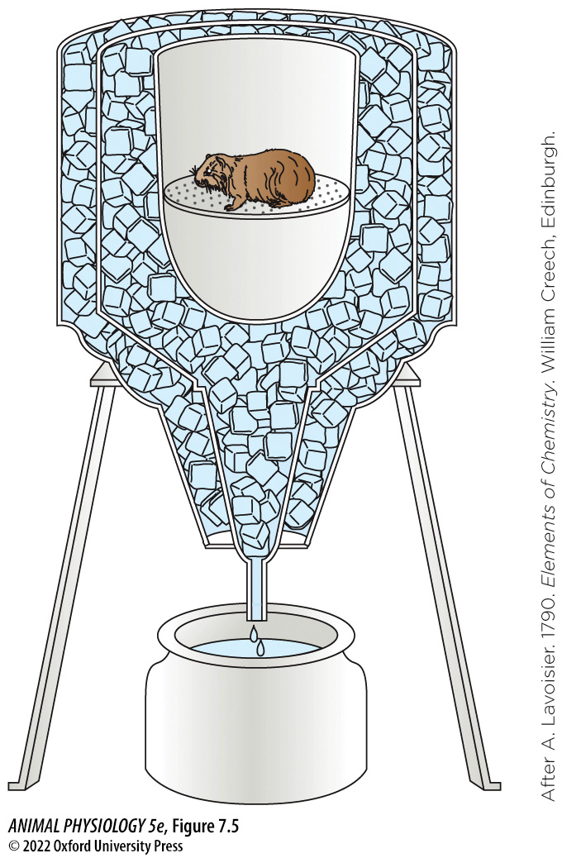
Figure 7.5 Lavoisier’s direct calorimeter (2)
Notes:
Figure 7.5 Lavoisier’s direct calorimeter
Heat from the general environment must be excluded from measurement of animal heat. In Lavoisier’s device, heat entering from the air surrounding the calorimeter was intercepted by an outer ice-filled jacket, which prevented the environmental heat from melting the same ice as the animal heat. Modern direct calorimeters, although they measure heat in a different way and more precisely, still reflect the fundamental design considerations that Lavoisier introduced. (After A. Lavoisier. 1790. Elements of Chemistry. William Creech, Edinburgh.)

Slide 18
TABLE 7.1 Ratios of heat production to O₂ consumption, and heat production to CO₂ production, during the aerobic catabolism of carbohydrates, lipids, and proteins
Values given are for representative mixtures of each of the three foodstuffs. Gas volumes are at Standard Conditions of Temperature and Pressure, STP (see Appendix C).
Foodstuff | Heat produced per unit of O₂ consumed (J/mL O₂) | Heat produced per unit of CO₂ produced (J/mL CO₂)
Carbohydrates | 21.1 | 21.1
Lipids | 19.8 | 27.9
Proteinsª | 18.7 | 23.3
Source: After A. C. Brown and G. Brengelmann. 1965. Energy metabolism. In T. C. Ruch and H. D. Patton (eds.), Physiology and Biophysics, 19th ed., pp. 1030–1049. Saunders, Philadelphia.
ª For proteins, values depend on the metabolic disposition of nitrogen; the values tabulated here apply to mammals and other animals in which urea is the dominant nitrogenous end product.
Notes:
TABLE 7.1 Ratios of heat production to O₂ consumption, and heat production to CO₂ production, during the aerobic catabolism of carbohydrates, lipids, and proteins

Slide 19
TABLE 7.2 Respiratory quotients (RQ values) during the aerobic catabolism of carbohydrates, lipids, and proteins
Foodstuff | Respiratory quotient
Carbohydrates | 1.0
Lipids | 0.71
Proteins | 0.83ª
Source: After M. Kleiber. 1975. The Fire of Life, 2nd ed. Krieger, Huntington, NY.
ª The value listed for proteins is for animals such as mammals in which urea is the dominant nitrogenous end product. Different values apply to animals that produce ammonia or uric acid as their principal nitrogenous end product.
Notes:
TABLE 7.2 Respiratory quotients (RQ values) during the aerobic catabolism of carbohydrates, lipids, and proteins

Slide 20
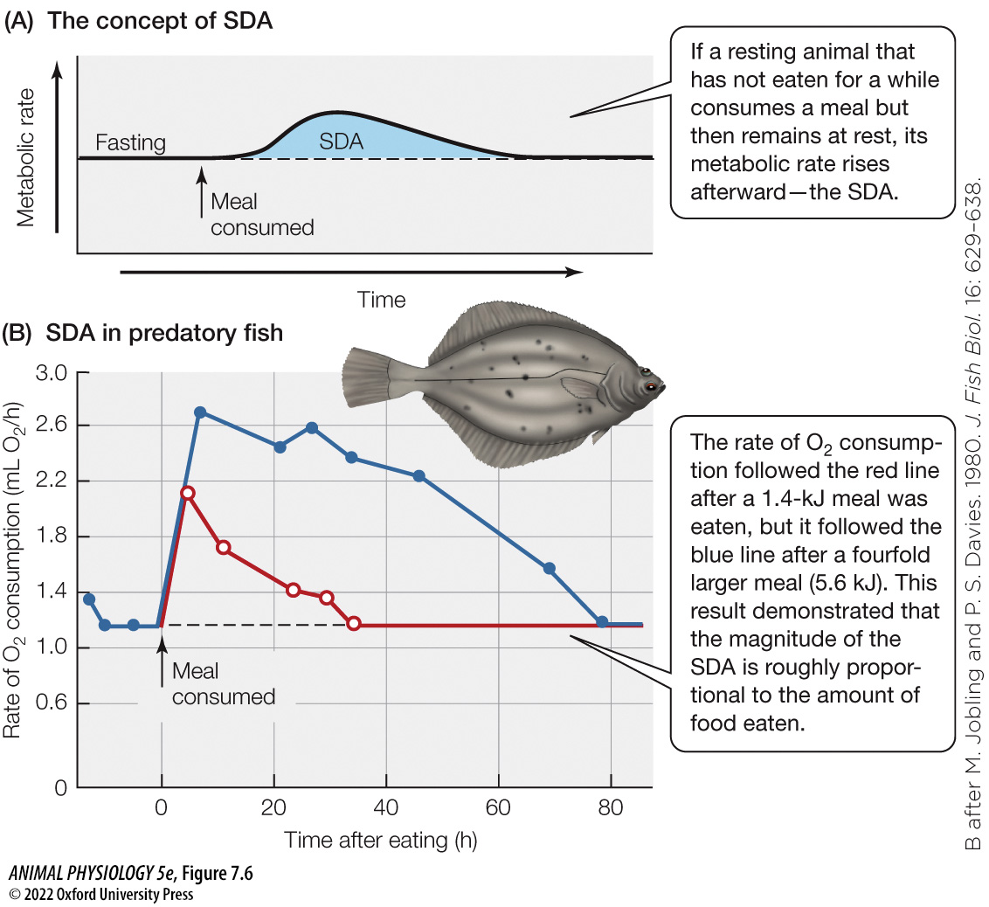
Figure 7.6 Specific dynamic action (SDA) (1)
Notes:
Figure 7.6 Specific dynamic action (SDA)
(A) Following a meal, the SDA often begins after a delay, which may be up to 1 h. The solid line shows the animal’s actual metabolic rate. The dashed line depicts what the rate would have been, had the meal not been eaten. The area shaded blue is the magnitude of the SDA. The timing of the process varies enormously; the SDA might last for just a few hours in a mouse, 12 h in a cow, and 1–3 days in a fish. “Fasting” means the animal has not eaten for long enough that the SDA of its last meal is over. (B) Actual data for predatory flatfish (Pleuronectes) fed two different-sized meals of fish meat. The apparent absence of a delay in the beginning of the SDA is an artifact of the sampling schedule: Data were not gathered right after feeding, when the delay would have been evident. (B after M. Jobling and P. S. Davies. 1980. J. Fish Biol. 16: 629–638.)

Slide 21
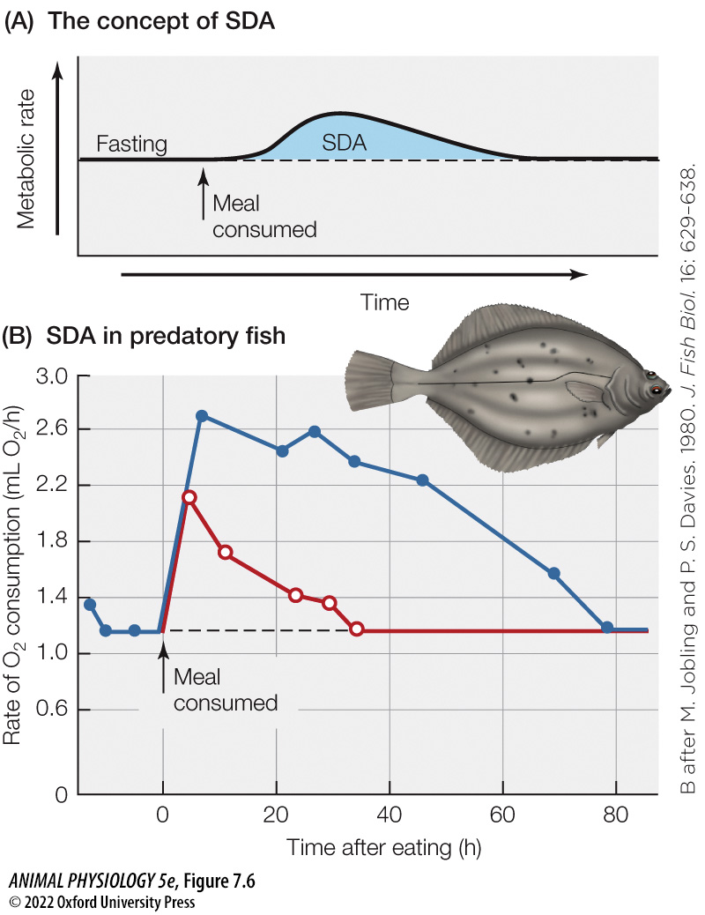
Figure 7.6 Specific dynamic action (SDA) (2)
Notes:
Figure 7.6 Specific dynamic action (SDA)
(A) Following a meal, the SDA often begins after a delay, which may be up to 1 h. The solid line shows the animal’s actual metabolic rate. The dashed line depicts what the rate would have been, had the meal not been eaten. The area shaded blue is the magnitude of the SDA. The timing of the process varies enormously; the SDA might last for just a few hours in a mouse, 12 h in a cow, and 1–3 days in a fish. “Fasting” means the animal has not eaten for long enough that the SDA of its last meal is over. (B) Actual data for predatory flatfish (Pleuronectes) fed two different-sized meals of fish meat. The apparent absence of a delay in the beginning of the SDA is an artifact of the sampling schedule: Data were not gathered right after feeding, when the delay would have been evident. (B after M. Jobling and P. S. Davies. 1980. J. Fish Biol. 16: 629–638.)

Slide 22
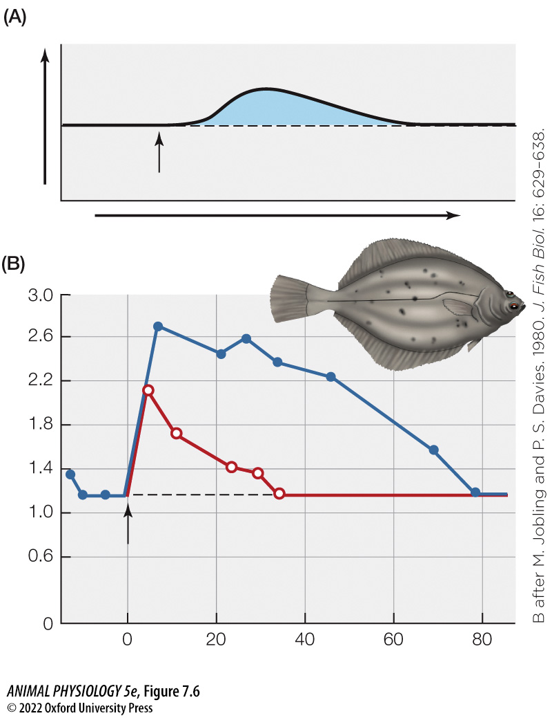
Figure 7.6 Specific dynamic action (SDA) (3)
Notes:
Figure 7.6 Specific dynamic action (SDA)
(A) Following a meal, the SDA often begins after a delay, which may be up to 1 h. The solid line shows the animal’s actual metabolic rate. The dashed line depicts what the rate would have been, had the meal not been eaten. The area shaded blue is the magnitude of the SDA. The timing of the process varies enormously; the SDA might last for just a few hours in a mouse, 12 h in a cow, and 1–3 days in a fish. “Fasting” means the animal has not eaten for long enough that the SDA of its last meal is over. (B) Actual data for predatory flatfish (Pleuronectes) fed two different-sized meals of fish meat. The apparent absence of a delay in the beginning of the SDA is an artifact of the sampling schedule: Data were not gathered right after feeding, when the delay would have been evident. (B after M. Jobling and P. S. Davies. 1980. J. Fish Biol. 16: 629–638.)

Slide 23
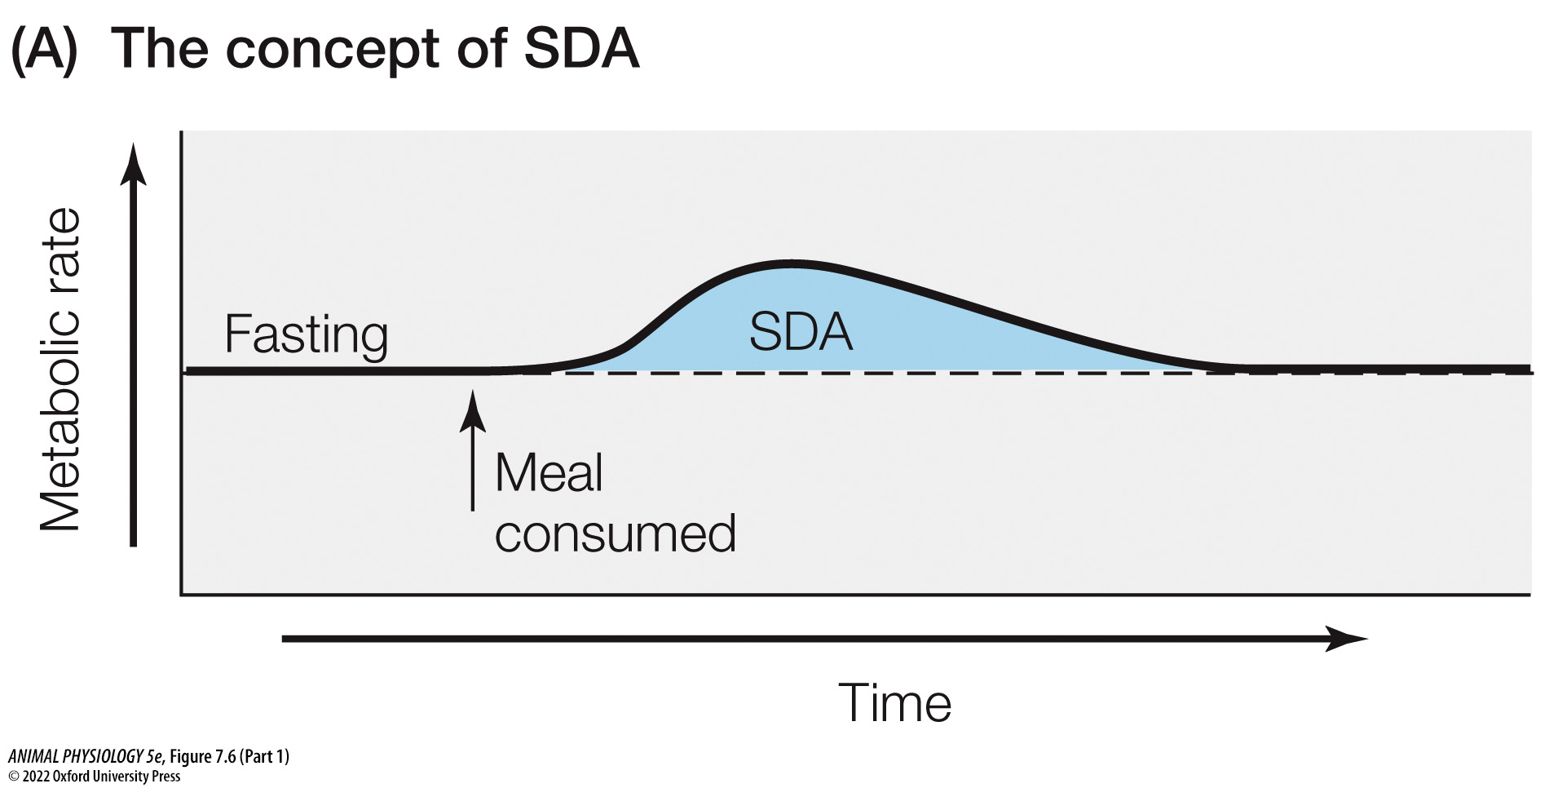
Figure 7.6 Specific dynamic action (SDA) (Part 1) (1)
Notes:
Figure 7.6 Specific dynamic action (SDA)
(A) Following a meal, the SDA often begins after a delay, which may be up to 1 h. The solid line shows the animal’s actual metabolic rate. The dashed line depicts what the rate would have been, had the meal not been eaten. The area shaded blue is the magnitude of the SDA. The timing of the process varies enormously; the SDA might last for just a few hours in a mouse, 12 h in a cow, and 1–3 days in a fish. “Fasting” means the animal has not eaten for long enough that the SDA of its last meal is over. (B) Actual data for predatory flatfish (Pleuronectes) fed two different-sized meals of fish meat. The apparent absence of a delay in the beginning of the SDA is an artifact of the sampling schedule: Data were not gathered right after feeding, when the delay would have been evident. (B after M. Jobling and P. S. Davies. 1980. J. Fish Biol. 16: 629–638.)

Slide 24
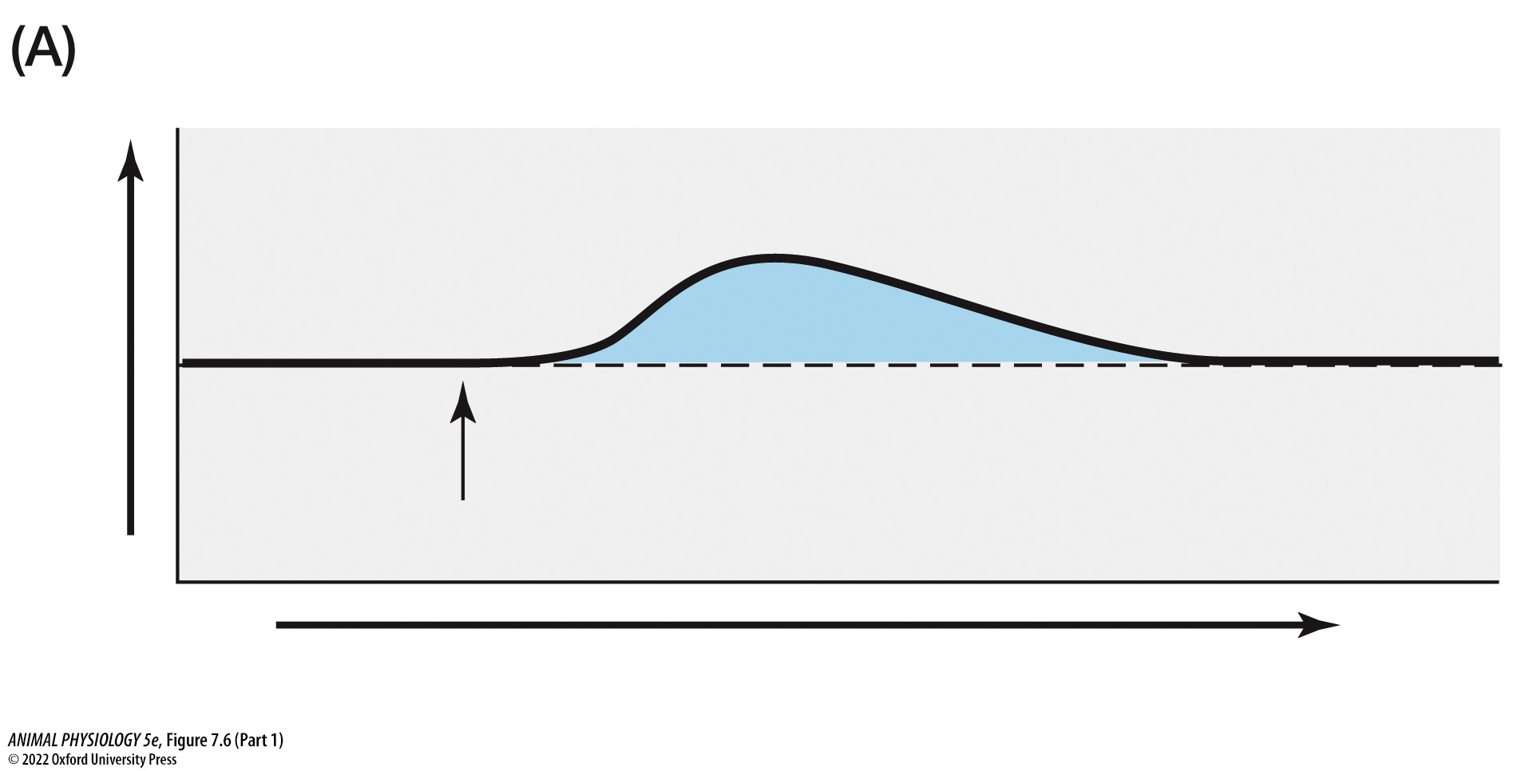
Figure 7.6 Specific dynamic action (SDA) (Part 1) (2)
Notes:
Figure 7.6 Specific dynamic action (SDA)
(A) Following a meal, the SDA often begins after a delay, which may be up to 1 h. The solid line shows the animal’s actual metabolic rate. The dashed line depicts what the rate would have been, had the meal not been eaten. The area shaded blue is the magnitude of the SDA. The timing of the process varies enormously; the SDA might last for just a few hours in a mouse, 12 h in a cow, and 1–3 days in a fish. “Fasting” means the animal has not eaten for long enough that the SDA of its last meal is over. (B) Actual data for predatory flatfish (Pleuronectes) fed two different-sized meals of fish meat. The apparent absence of a delay in the beginning of the SDA is an artifact of the sampling schedule: Data were not gathered right after feeding, when the delay would have been evident. (B after M. Jobling and P. S. Davies. 1980. J. Fish Biol. 16: 629–638.)

Slide 25
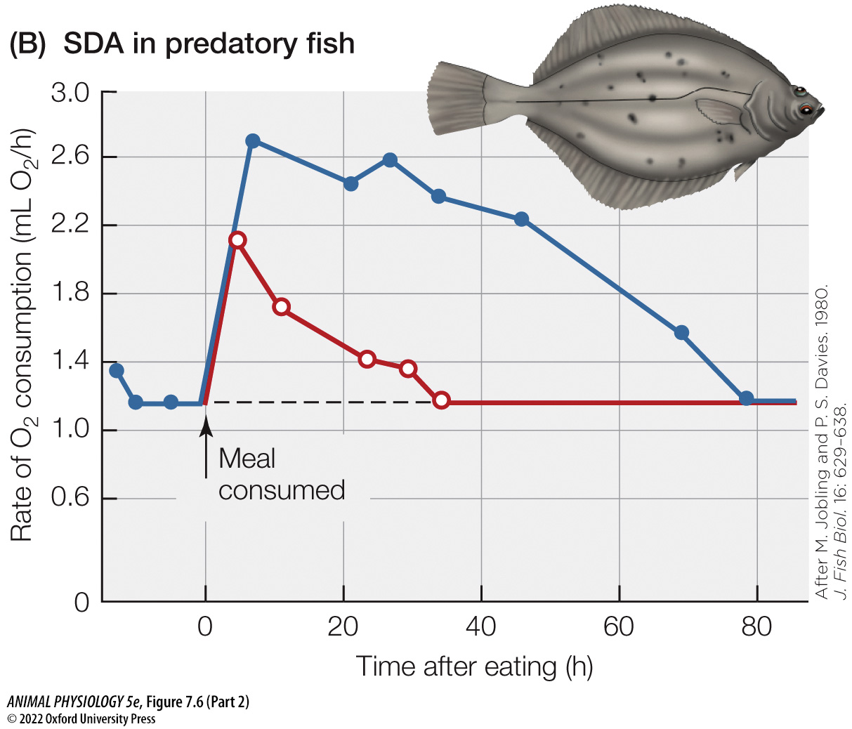
Figure 7.6 Specific dynamic action (SDA) (Part 2) (1)
Notes:
Figure 7.6 Specific dynamic action (SDA)
(A) Following a meal, the SDA often begins after a delay, which may be up to 1 h. The solid line shows the animal’s actual metabolic rate. The dashed line depicts what the rate would have been, had the meal not been eaten. The area shaded blue is the magnitude of the SDA. The timing of the process varies enormously; the SDA might last for just a few hours in a mouse, 12 h in a cow, and 1–3 days in a fish. “Fasting” means the animal has not eaten for long enough that the SDA of its last meal is over. (B) Actual data for predatory flatfish (Pleuronectes) fed two different-sized meals of fish meat. The apparent absence of a delay in the beginning of the SDA is an artifact of the sampling schedule: Data were not gathered right after feeding, when the delay would have been evident. (B after M. Jobling and P. S. Davies. 1980. J. Fish Biol. 16: 629–638.)

Slide 26
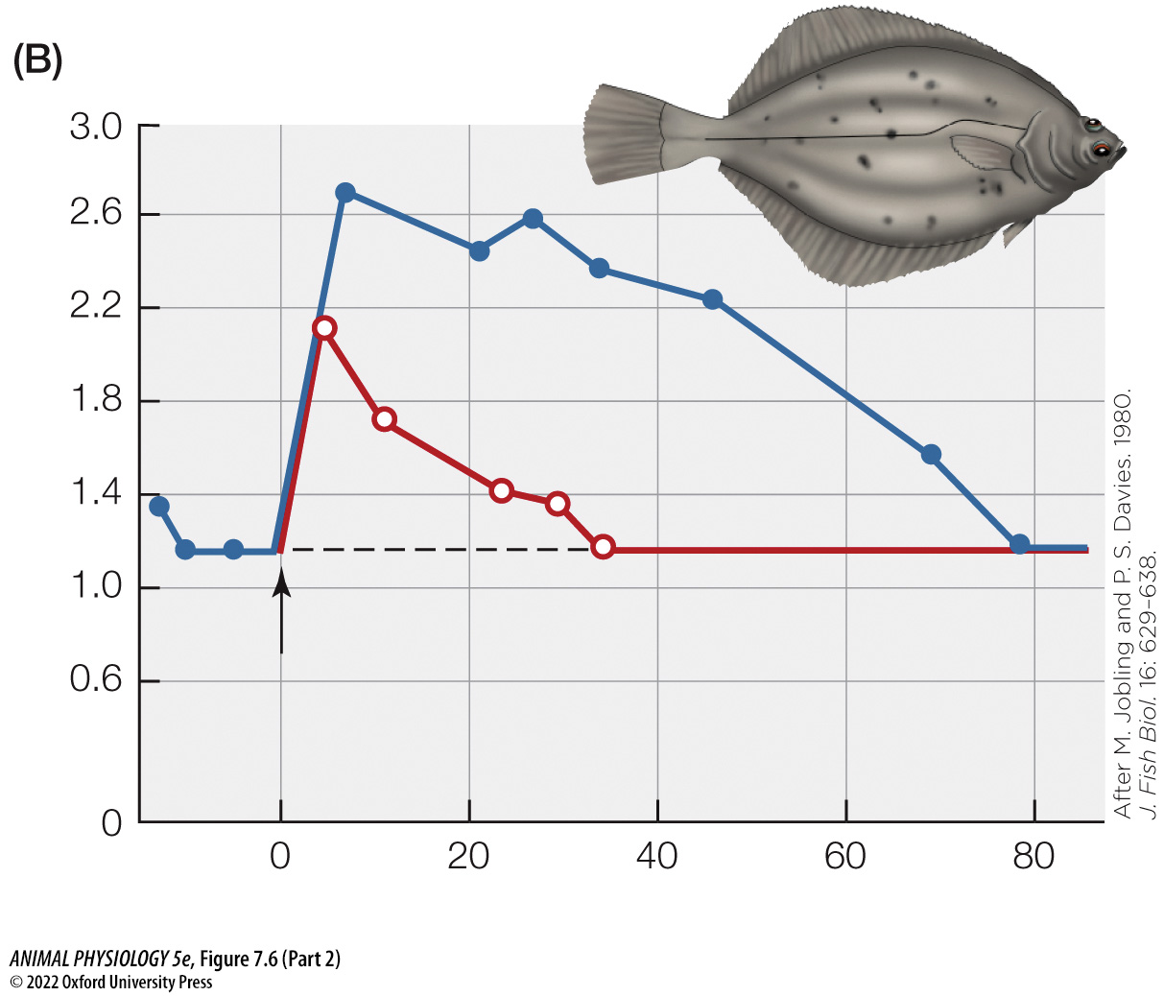
Figure 7.6 Specific dynamic action (SDA) (Part 2) (2)
Notes:
Figure 7.6 Specific dynamic action (SDA)
(A) Following a meal, the SDA often begins after a delay, which may be up to 1 h. The solid line shows the animal’s actual metabolic rate. The dashed line depicts what the rate would have been, had the meal not been eaten. The area shaded blue is the magnitude of the SDA. The timing of the process varies enormously; the SDA might last for just a few hours in a mouse, 12 h in a cow, and 1–3 days in a fish. “Fasting” means the animal has not eaten for long enough that the SDA of its last meal is over. (B) Actual data for predatory flatfish (Pleuronectes) fed two different-sized meals of fish meat. The apparent absence of a delay in the beginning of the SDA is an artifact of the sampling schedule: Data were not gathered right after feeding, when the delay would have been evident. (B after M. Jobling and P. S. Davies. 1980. J. Fish Biol. 16: 629–638.)

Slide 27
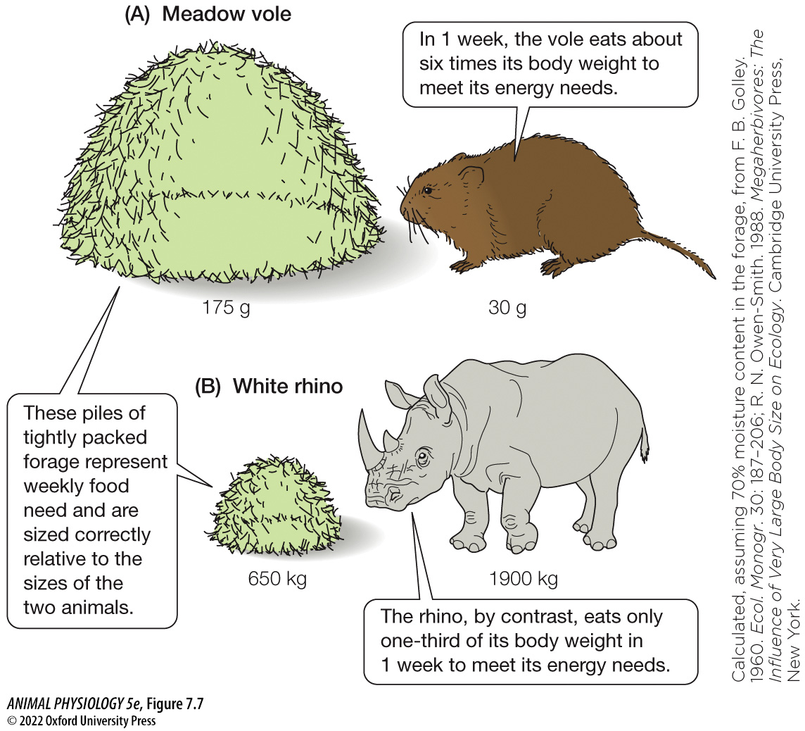
Figure 7.7 Weekly food requirements: The effect of body size (1)
Notes:
Figure 7.7 Weekly food requirements: The effect of body size
Both species—(A) the 30-g meadow vole (Microtus pennsylvanicus) and (B) the 1900-kg white rhino (Ceratotherium simum)—are pure grazers. (Calculated, assuming 70% moisture content in the forage, from F. B. Golley. 1960. Ecol. Monogr. 30: 187–206; R. N. Owen-Smith. 1988. Megaherbivores: The Influence of Very Large Body Size on Ecology. Cambridge University Press, New York.)

Slide 28
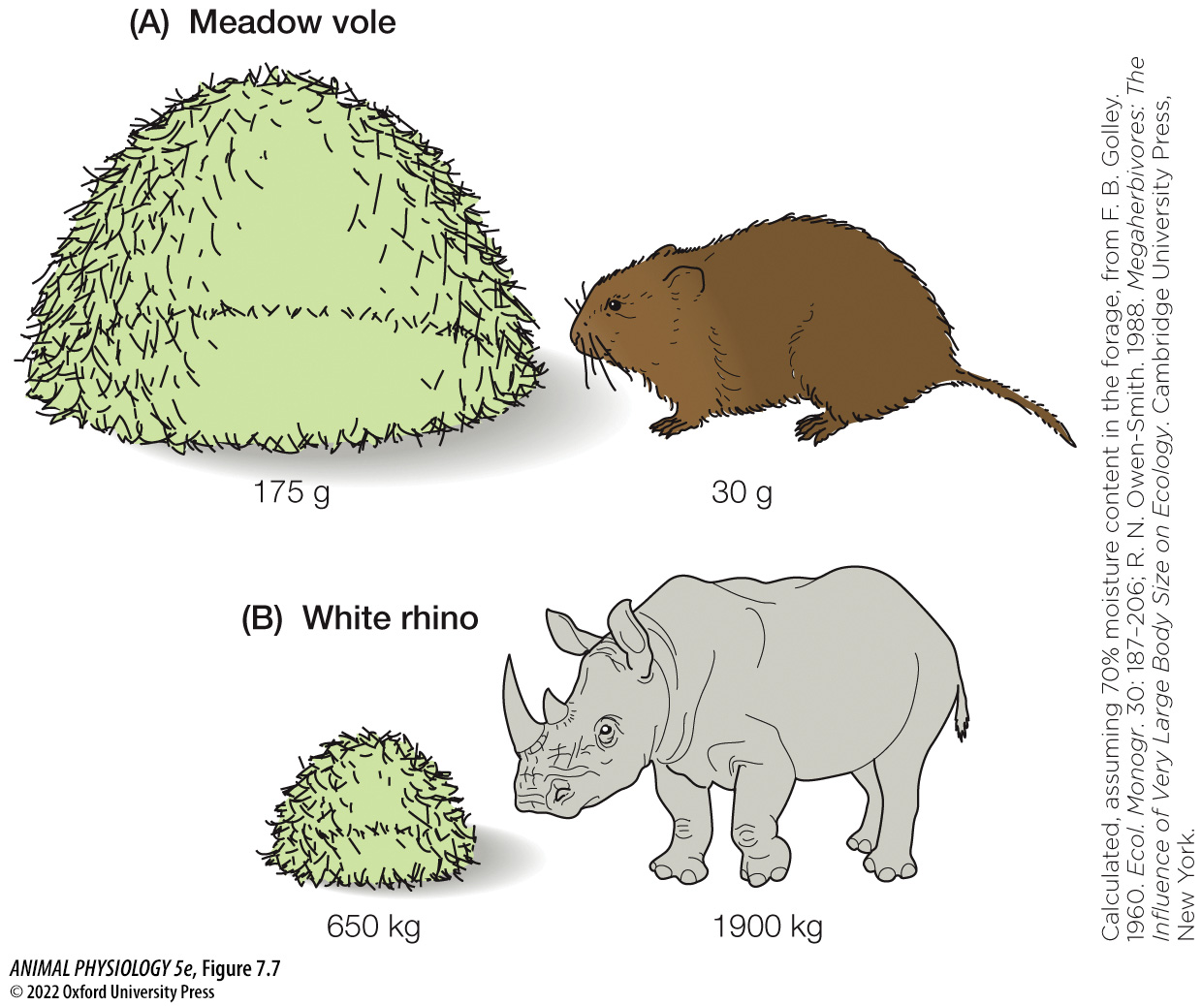
Figure 7.7 Weekly food requirements: The effect of body size (2)
Notes:
Figure 7.7 Weekly food requirements: The effect of body size
Both species—(A) the 30-g meadow vole (Microtus pennsylvanicus) and (B) the 1900-kg white rhino (Ceratotherium simum)—are pure grazers. (Calculated, assuming 70% moisture content in the forage, from F. B. Golley. 1960. Ecol. Monogr. 30: 187–206; R. N. Owen-Smith. 1988. Megaherbivores: The Influence of Very Large Body Size on Ecology. Cambridge University Press, New York.)

Slide 29

Figure 7.7 Weekly food requirements: The effect of body size (3)
Notes:
Figure 7.7 Weekly food requirements: The effect of body size
Both species—(A) the 30-g meadow vole (Microtus pennsylvanicus) and (B) the 1900-kg white rhino (Ceratotherium simum)—are pure grazers. (Calculated, assuming 70% moisture content in the forage, from F. B. Golley. 1960. Ecol. Monogr. 30: 187–206; R. N. Owen-Smith. 1988. Megaherbivores: The Influence of Very Large Body Size on Ecology. Cambridge University Press, New York.)

Slide 30
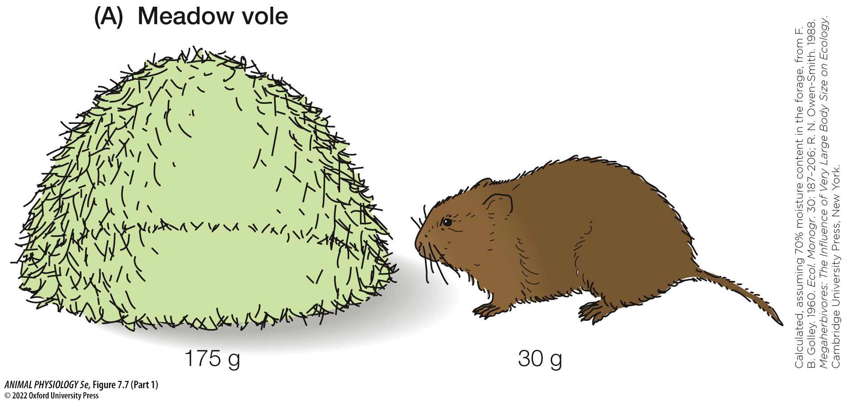
Figure 7.7 Weekly food requirements: The effect of body size (Part 1) (1)
Notes:
Figure 7.7 Weekly food requirements: The effect of body size
Both species—(A) the 30-g meadow vole (Microtus pennsylvanicus) and (B) the 1900-kg white rhino (Ceratotherium simum)—are pure grazers. (Calculated, assuming 70% moisture content in the forage, from F. B. Golley. 1960. Ecol. Monogr. 30: 187–206; R. N. Owen-Smith. 1988. Megaherbivores: The Influence of Very Large Body Size on Ecology. Cambridge University Press, New York.)

Slide 31
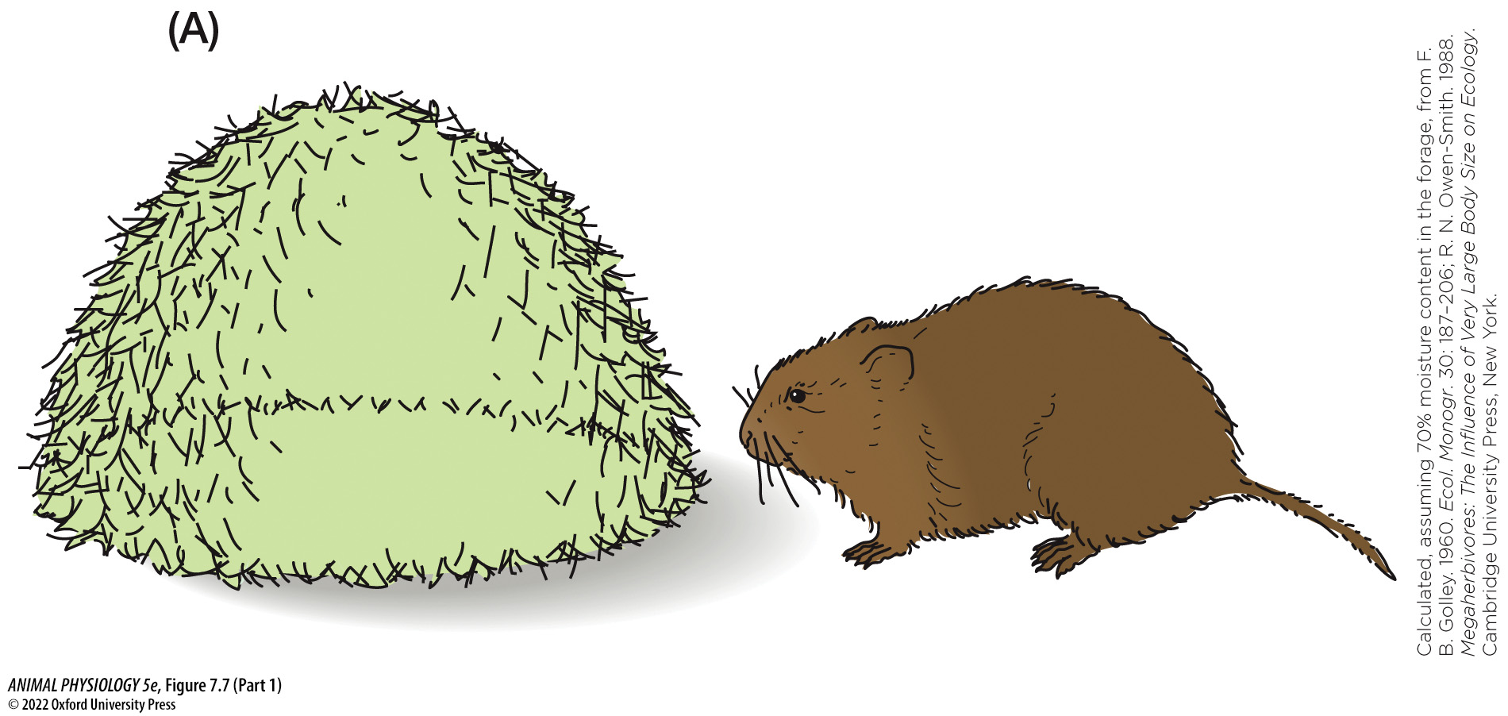
Figure 7.7 Weekly food requirements: The effect of body size (Part 1) (2)
Notes:
Figure 7.7 Weekly food requirements: The effect of body size
Both species—(A) the 30-g meadow vole (Microtus pennsylvanicus) and (B) the 1900-kg white rhino (Ceratotherium simum)—are pure grazers. (Calculated, assuming 70% moisture content in the forage, from F. B. Golley. 1960. Ecol. Monogr. 30: 187–206; R. N. Owen-Smith. 1988. Megaherbivores: The Influence of Very Large Body Size on Ecology. Cambridge University Press, New York.)

Slide 32
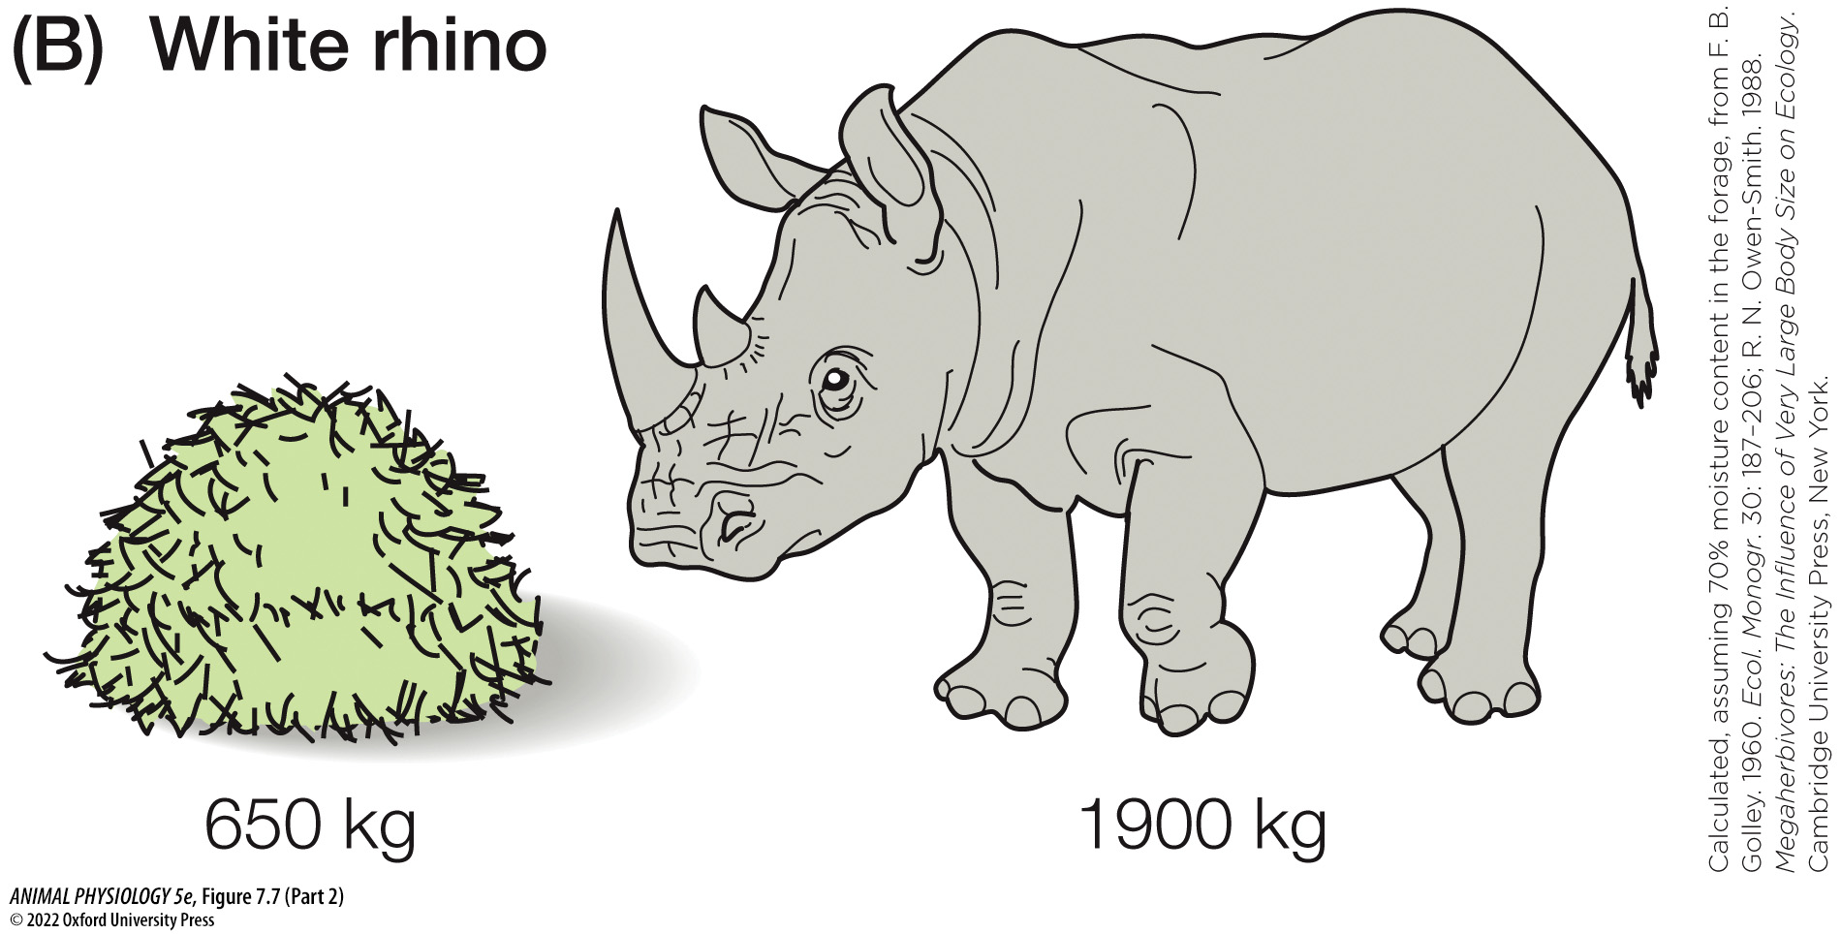
Figure 7.7 Weekly food requirements: The effect of body size (Part 2) (1)
Notes:
Figure 7.7 Weekly food requirements: The effect of body size
Both species—(A) the 30-g meadow vole (Microtus pennsylvanicus) and (B) the 1900-kg white rhino (Ceratotherium simum)—are pure grazers. (Calculated, assuming 70% moisture content in the forage, from F. B. Golley. 1960. Ecol. Monogr. 30: 187–206; R. N. Owen-Smith. 1988. Megaherbivores: The Influence of Very Large Body Size on Ecology. Cambridge University Press, New York.)

Slide 33
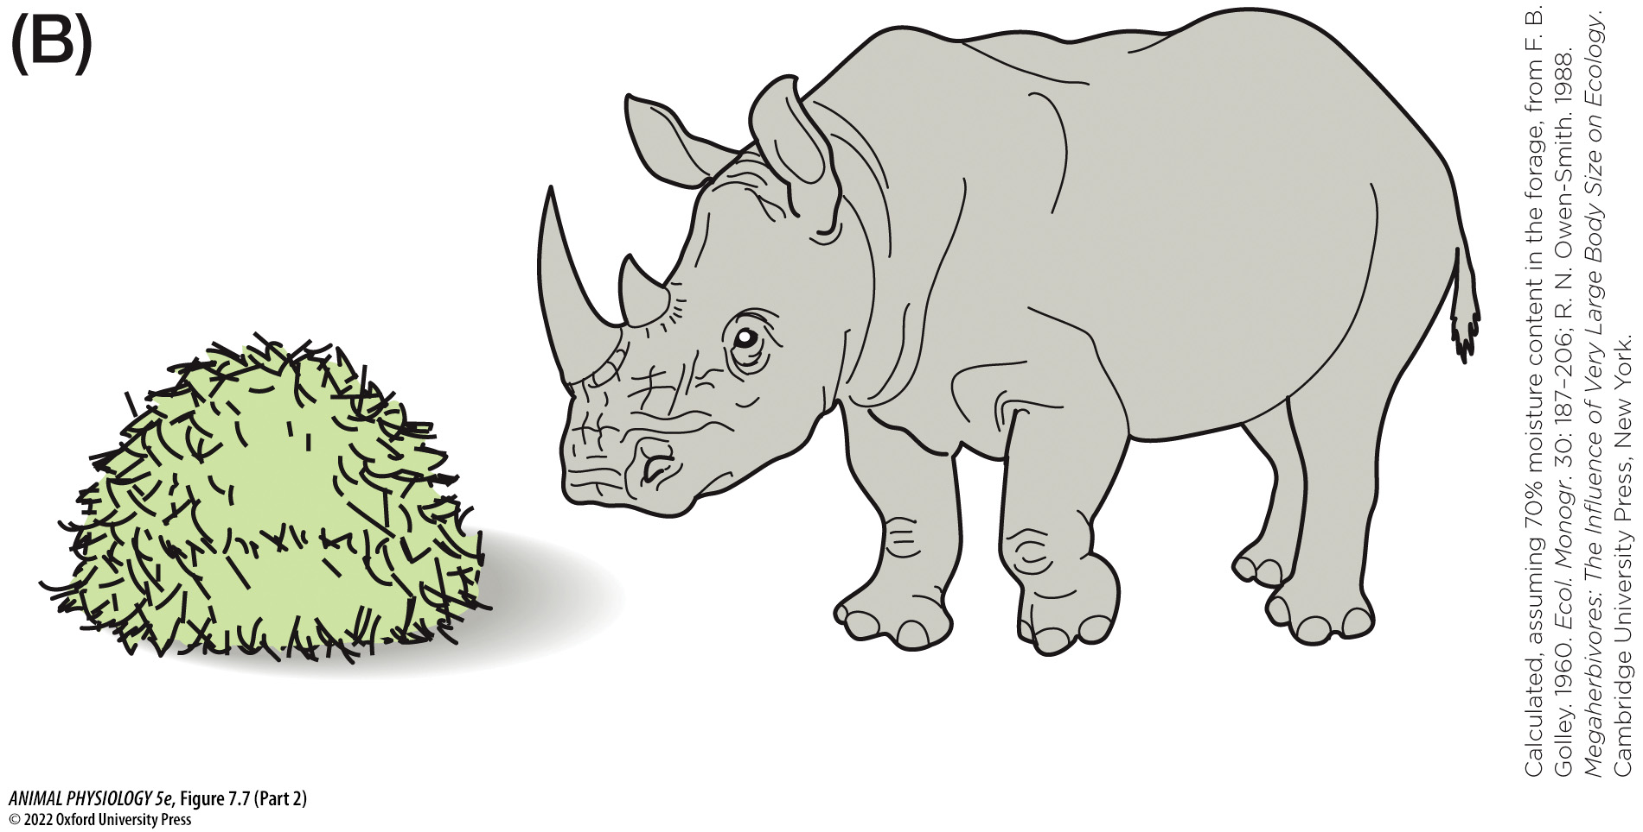
Figure 7.7 Weekly food requirements: The effect of body size (Part 2) (2)
Notes:
Figure 7.7 Weekly food requirements: The effect of body size
Both species—(A) the 30-g meadow vole (Microtus pennsylvanicus) and (B) the 1900-kg white rhino (Ceratotherium simum)—are pure grazers. (Calculated, assuming 70% moisture content in the forage, from F. B. Golley. 1960. Ecol. Monogr. 30: 187–206; R. N. Owen-Smith. 1988. Megaherbivores: The Influence of Very Large Body Size on Ecology. Cambridge University Press, New York.)

Slide 34
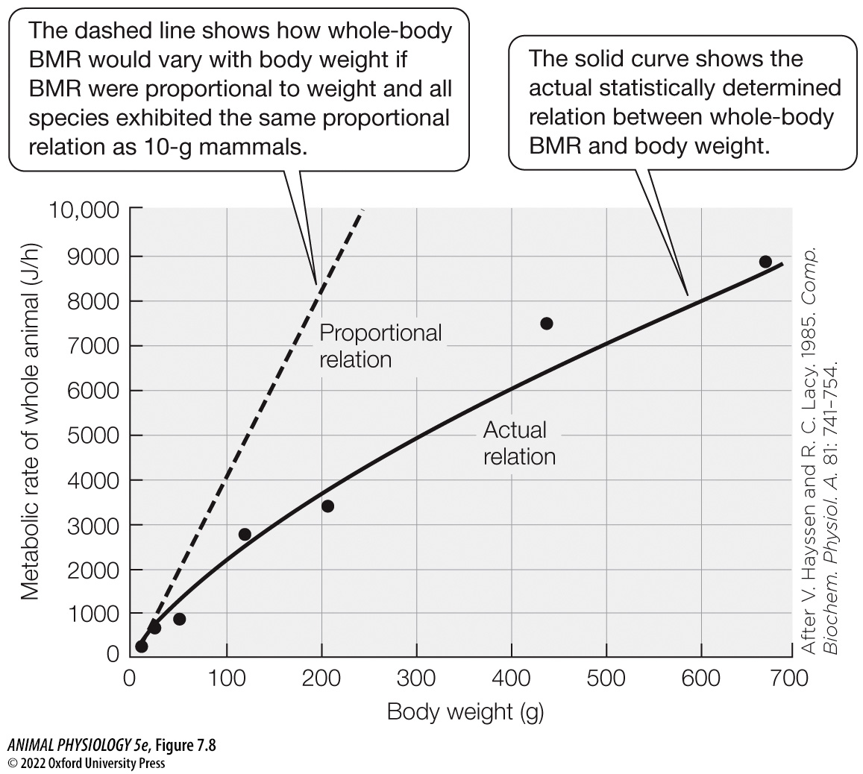
Figure 7.8 Whole-body BMR as a function of body weight in various species of placental mammals (1)
Notes:
Figure 7.8 Whole-body BMR as a function of body weight in various species of placental mammals
The solid curve—showing the actual relation—is statistically fitted to data for all sizes of mammals, although this plot includes body weights up to only 700 g. The points are data for seven North American species (see Figure 7.9 for identifications), illustrating that although the statistical line runs through the data, individual species do not necessarily fall right on the line. (After V. Hayssen and R. C. Lacy. 1985. Comp. Biochem. Physiol. A. 81: 741–754.)

Slide 35
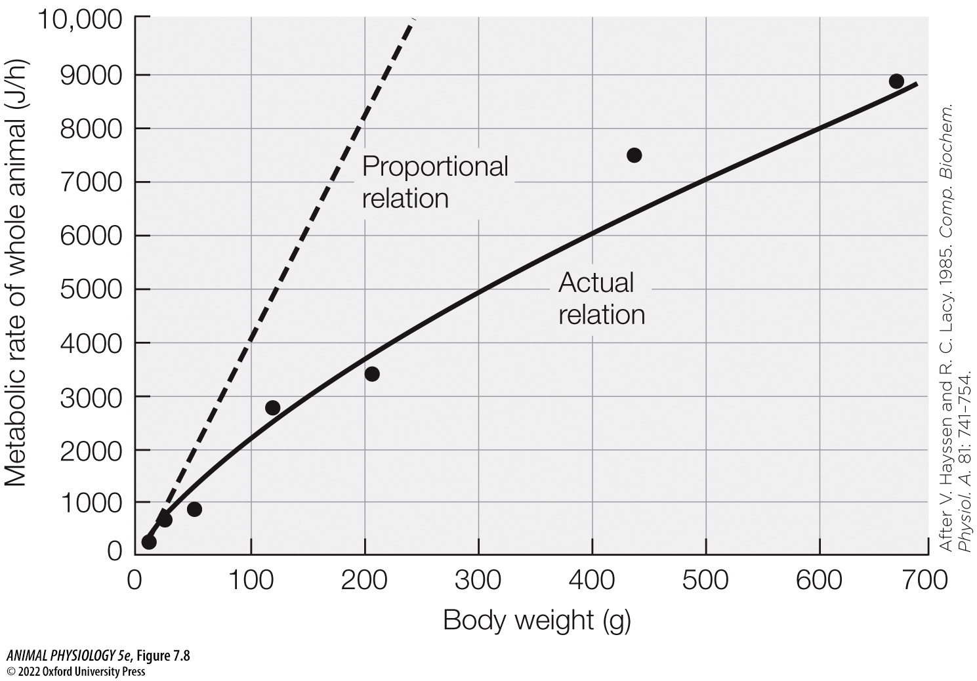
Figure 7.8 Whole-body BMR as a function of body weight in various species of placental mammals (2)
Notes:
Figure 7.8 Whole-body BMR as a function of body weight in various species of placental mammals
The solid curve—showing the actual relation—is statistically fitted to data for all sizes of mammals, although this plot includes body weights up to only 700 g. The points are data for seven North American species (see Figure 7.9 for identifications), illustrating that although the statistical line runs through the data, individual species do not necessarily fall right on the line. (After V. Hayssen and R. C. Lacy. 1985. Comp. Biochem. Physiol. A. 81: 741–754.)

Slide 36
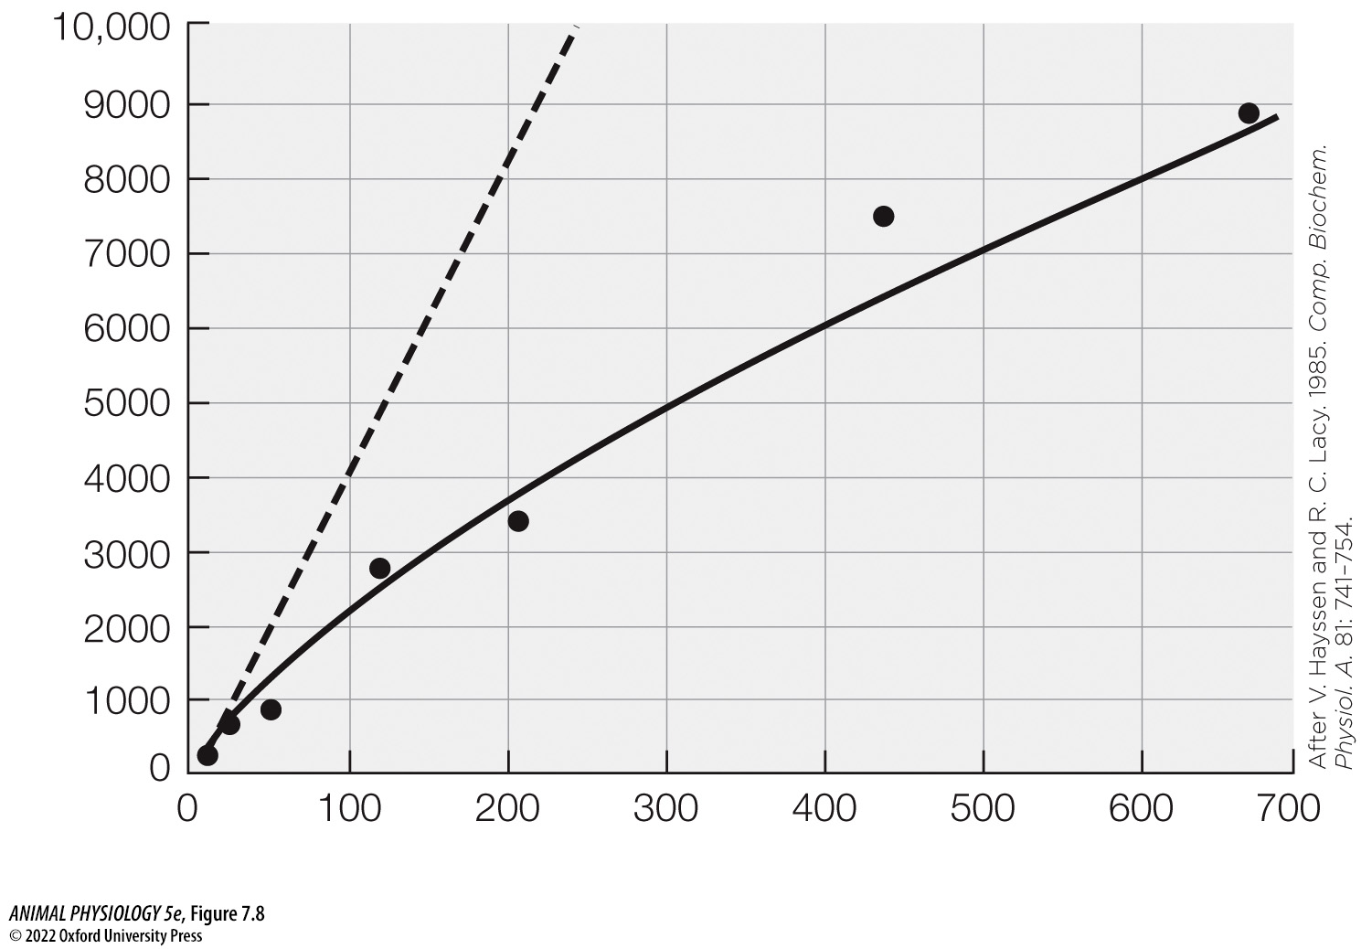
Figure 7.8 Whole-body BMR as a function of body weight in various species of placental mammals (3)
Notes:
Figure 7.8 Whole-body BMR as a function of body weight in various species of placental mammals
The solid curve—showing the actual relation—is statistically fitted to data for all sizes of mammals, although this plot includes body weights up to only 700 g. The points are data for seven North American species (see Figure 7.9 for identifications), illustrating that although the statistical line runs through the data, individual species do not necessarily fall right on the line. (After V. Hayssen and R. C. Lacy. 1985. Comp. Biochem. Physiol. A. 81: 741–754.)

Slide 37
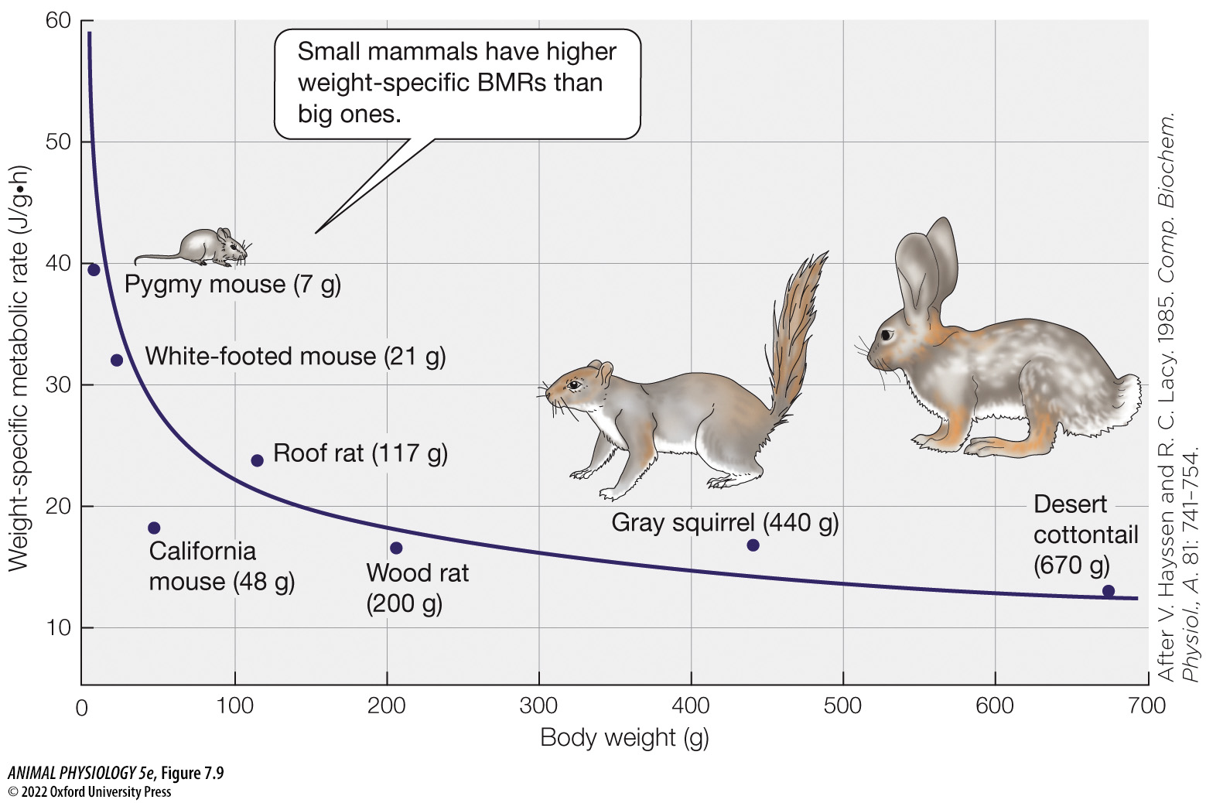
Figure 7.9 Weight-specific BMR as a function of body weight in various species of placental mammals (1)
Notes:
Figure 7.9 Weight-specific BMR as a function of body weight in various species of placental mammals
Although the x axis (body weight) and animals are the same as in Figure 7.8, here the BMRs (y axis) are expressed per gram of body weight. (After V. Hayssen and R. C. Lacy. 1985. Comp. Biochem. Physiol., A. 81: 741–754.)

Slide 38
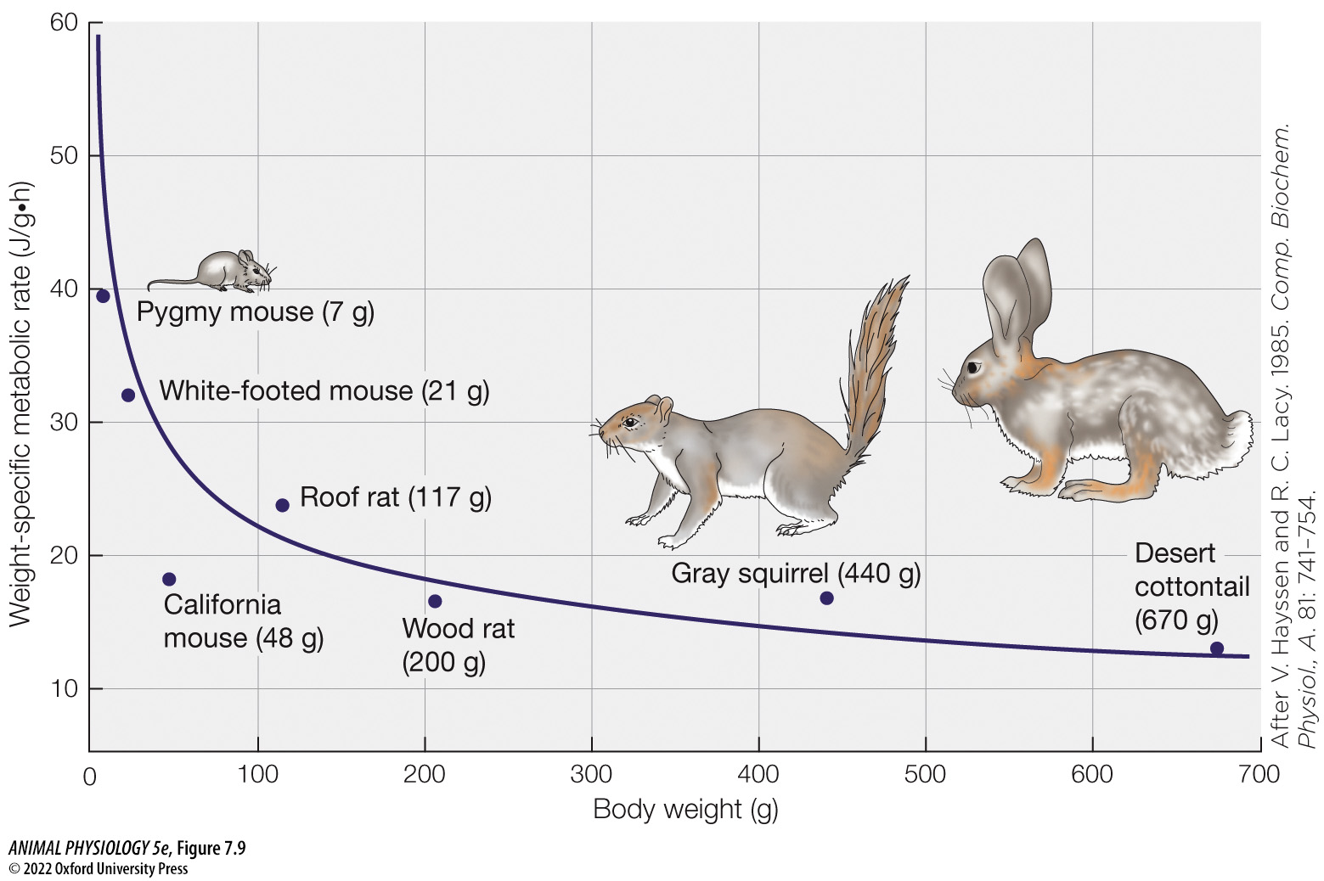
Figure 7.9 Weight-specific BMR as a function of body weight in various species of placental mammals (2)
Notes:
Figure 7.9 Weight-specific BMR as a function of body weight in various species of placental mammals
Although the x axis (body weight) and animals are the same as in Figure 7.8, here the BMRs (y axis) are expressed per gram of body weight. (After V. Hayssen and R. C. Lacy. 1985. Comp. Biochem. Physiol., A. 81: 741–754.)

Slide 39
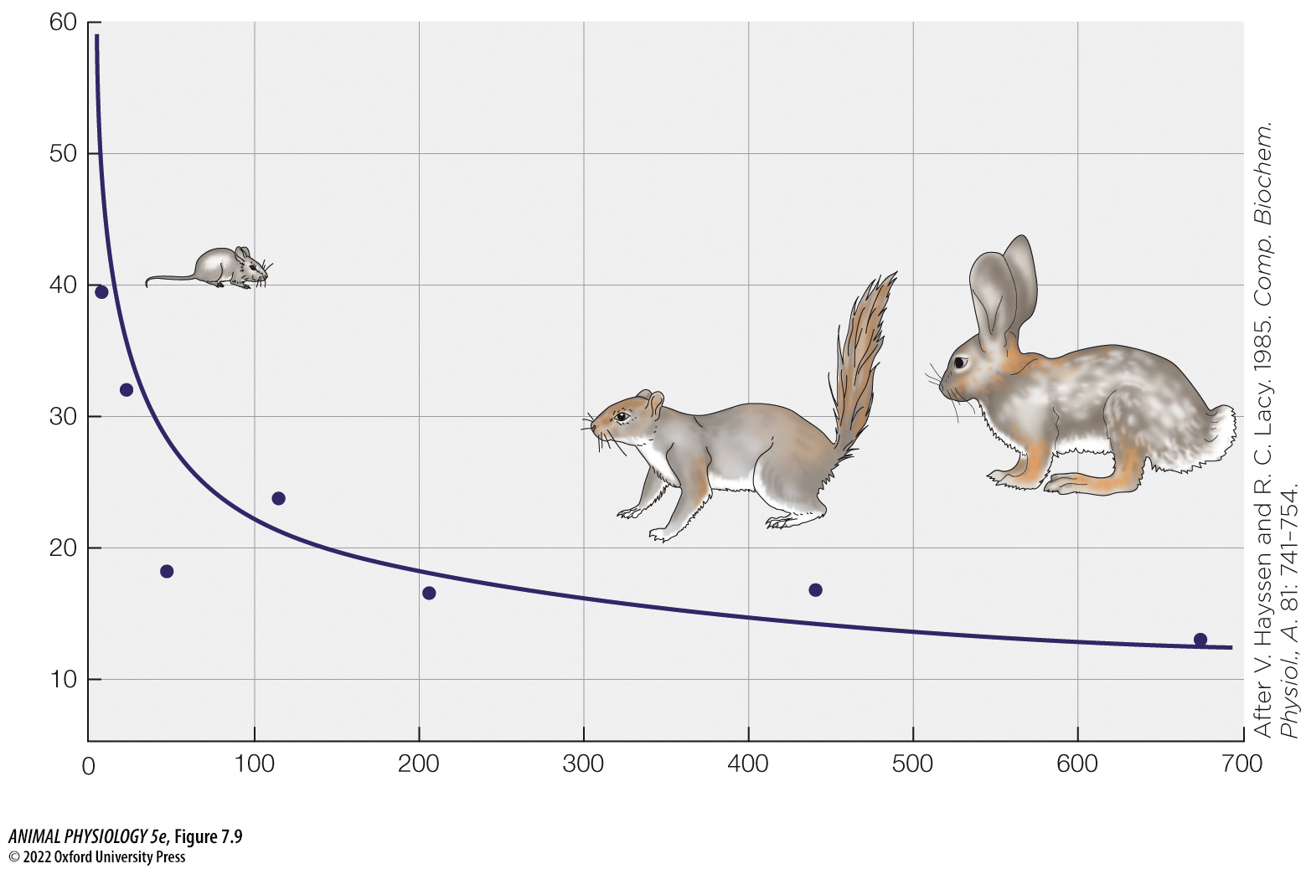
Figure 7.9 Weight-specific BMR as a function of body weight in various species of placental mammals (3)
Notes:
Figure 7.9 Weight-specific BMR as a function of body weight in various species of placental mammals
Although the x axis (body weight) and animals are the same as in Figure 7.8, here the BMRs (y axis) are expressed per gram of body weight. (After V. Hayssen and R. C. Lacy. 1985. Comp. Biochem. Physiol., A. 81: 741–754.)

Slide 40
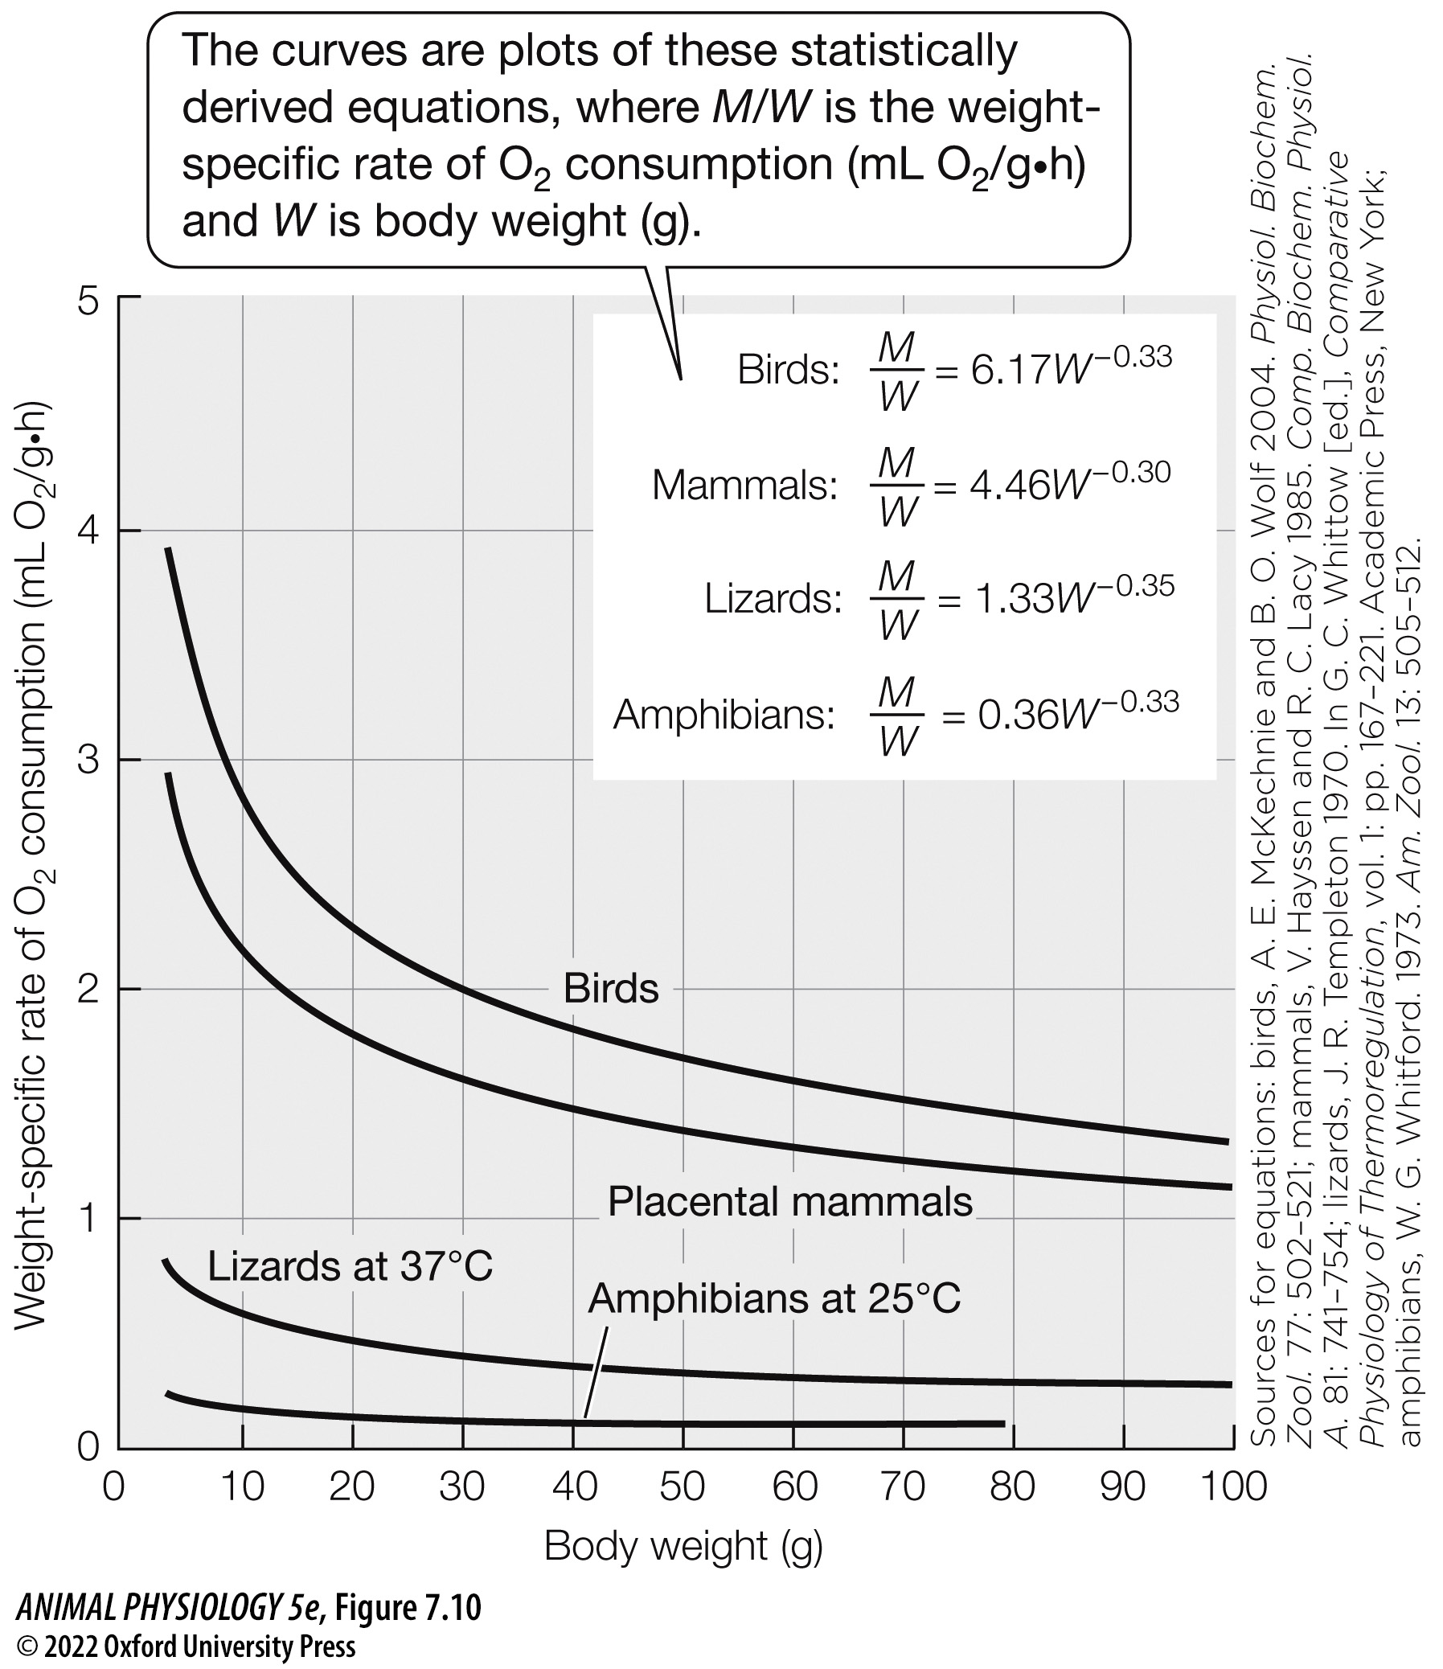
Figure 7.10 Weight-specific resting metabolic rate as a function of body weight in four groups of vertebrates (1)
Notes:
Figure 7.10 Weight-specific resting metabolic rate as a function of body weight in four groups of vertebrates
The lines for birds and mammals show BMRs. The line for lizards shows the SMR when the lizards are at the same body temperature as placental mammals, 37°C. The line for amphibians shows the SMR in temperate-zone anurans and salamanders at a body temperature of 25°C. (Sources for equations: birds, A. E. McKechnie and B. O. Wolf 2004. Physiol. Biochem. Zool. 77: 502–521; mammals, V. Hayssen and R. C. Lacy 1985. Comp. Biochem. Physiol. A. 81: 741–754; lizards, J. R. Templeton 1970. In G. C. Whittow [ed.], Comparative Physiology of Thermoregulation, vol. 1: pp. 167–221. Academic Press, New York; amphibians, W. G. Whitford. 1973. Am. Zool. 13: 505–512.)

Slide 41
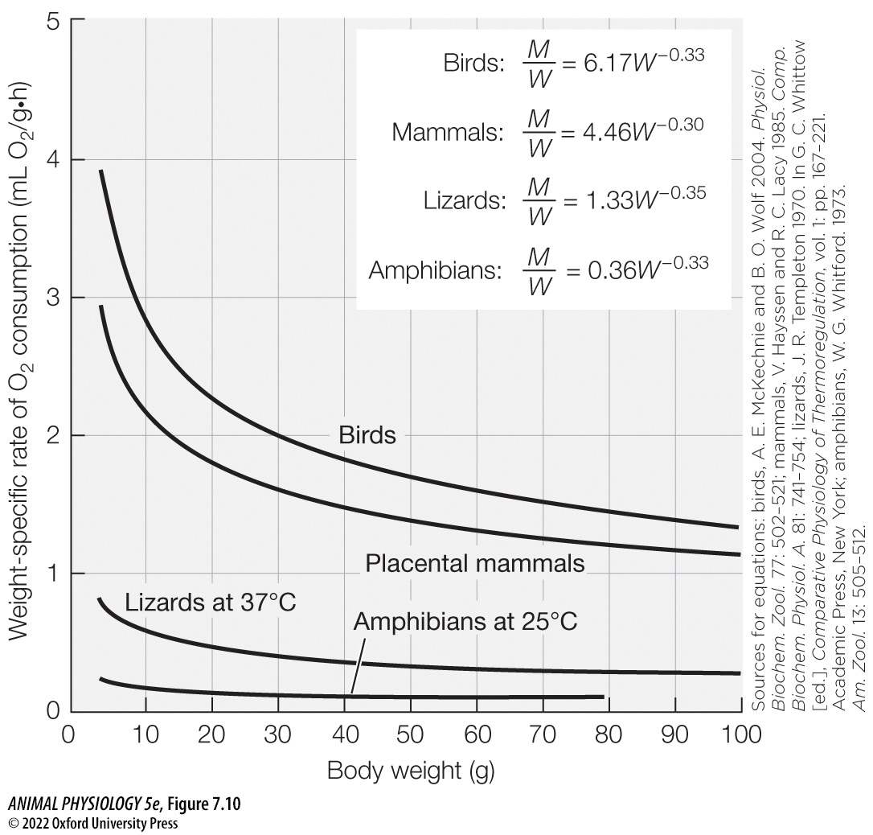
Figure 7.10 Weight-specific resting metabolic rate as a function of body weight in four groups of vertebrates (2)
Notes:
Figure 7.10 Weight-specific resting metabolic rate as a function of body weight in four groups of vertebrates
The lines for birds and mammals show BMRs. The line for lizards shows the SMR when the lizards are at the same body temperature as placental mammals, 37°C. The line for amphibians shows the SMR in temperate-zone anurans and salamanders at a body temperature of 25°C. (Sources for equations: birds, A. E. McKechnie and B. O. Wolf 2004. Physiol. Biochem. Zool. 77: 502–521; mammals, V. Hayssen and R. C. Lacy 1985. Comp. Biochem. Physiol. A. 81: 741–754; lizards, J. R. Templeton 1970. In G. C. Whittow [ed.], Comparative Physiology of Thermoregulation, vol. 1: pp. 167–221. Academic Press, New York; amphibians, W. G. Whitford. 1973. Am. Zool. 13: 505–512.)

Slide 42
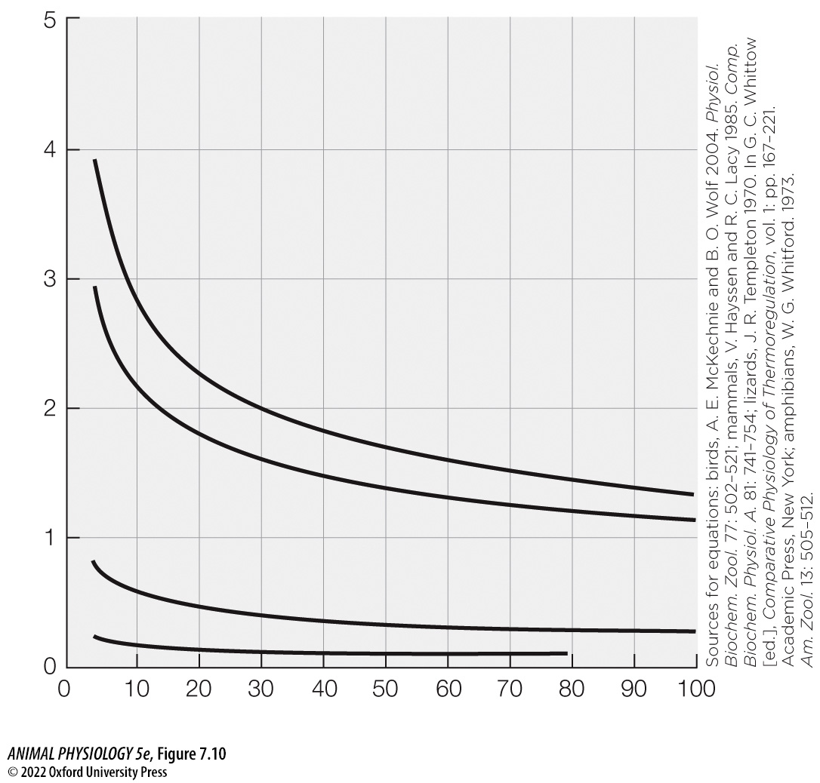
Figure 7.10 Weight-specific resting metabolic rate as a function of body weight in four groups of vertebrates (3)
Notes:
Figure 7.10 Weight-specific resting metabolic rate as a function of body weight in four groups of vertebrates
The lines for birds and mammals show BMRs. The line for lizards shows the SMR when the lizards are at the same body temperature as placental mammals, 37°C. The line for amphibians shows the SMR in temperate-zone anurans and salamanders at a body temperature of 25°C. (Sources for equations: birds, A. E. McKechnie and B. O. Wolf 2004. Physiol. Biochem. Zool. 77: 502–521; mammals, V. Hayssen and R. C. Lacy 1985. Comp. Biochem. Physiol. A. 81: 741–754; lizards, J. R. Templeton 1970. In G. C. Whittow [ed.], Comparative Physiology of Thermoregulation, vol. 1: pp. 167–221. Academic Press, New York; amphibians, W. G. Whitford. 1973. Am. Zool. 13: 505–512.)

Slide 43
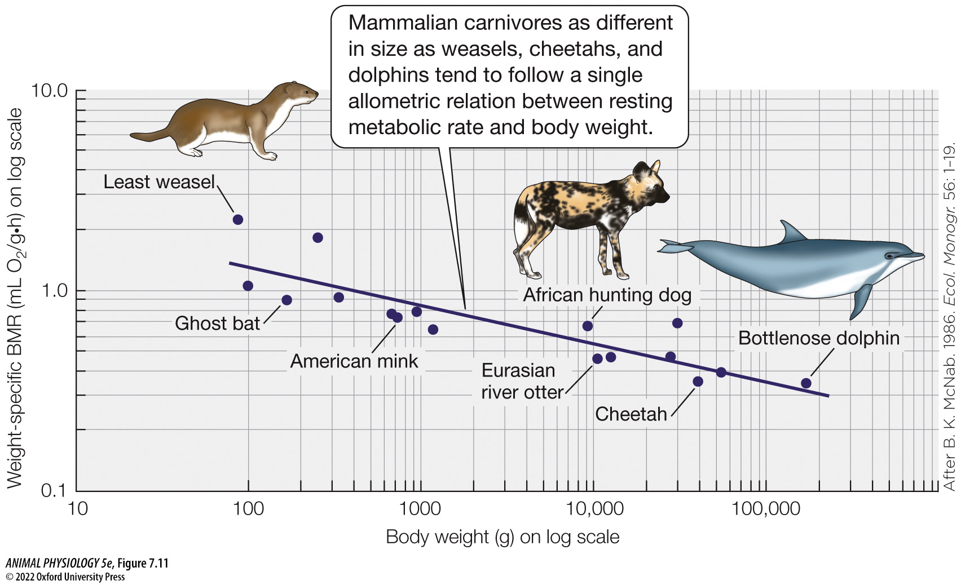
Figure 7.11 Metabolic rate and body weight are related linearly on log–log coordinates, as illustrated by carnivorous mammals (1)
Notes:
Figure 7.11 Metabolic rate and body weight are related linearly on log–log coordinates, as illustrated by carnivorous mammals
Using log–log coordinates, weight-specific BMR is plotted as a function of body weight for mammalian species that eat primarily vertebrate flesh. The points represent individual species; the line is statistically fitted to them. See Appendix D for information on the axis layouts. (After B. K. McNab. 1986. Ecol. Monogr. 56: 1–19.)

Slide 44
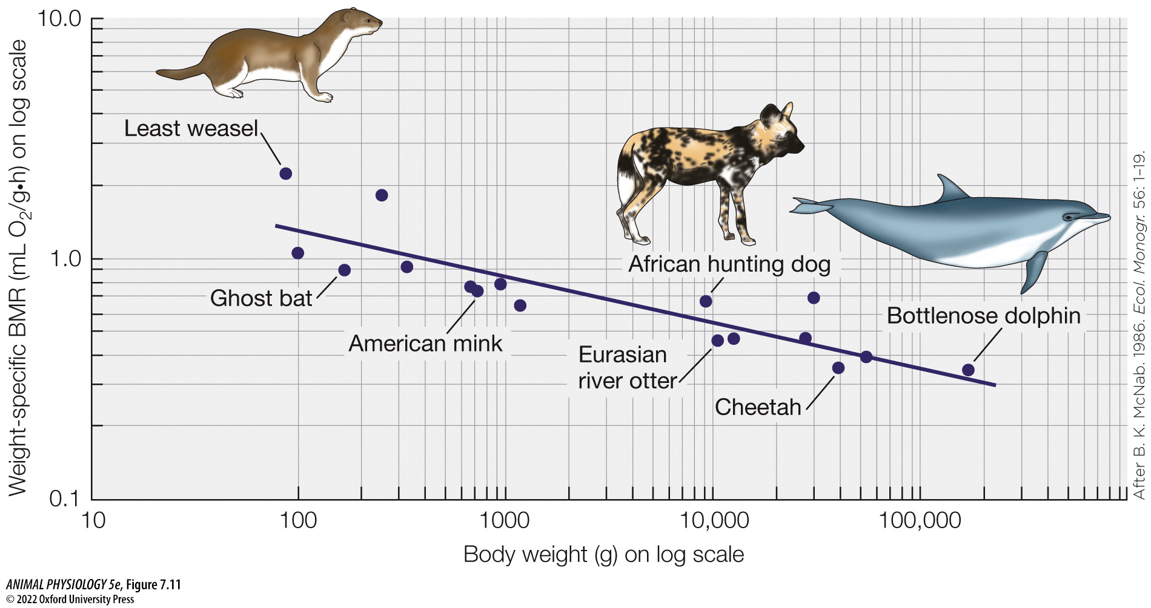
Figure 7.11 Metabolic rate and body weight are related linearly on log–log coordinates, as illustrated by carnivorous mammals (2)
Notes:
Figure 7.11 Metabolic rate and body weight are related linearly on log–log coordinates, as illustrated by carnivorous mammals
Using log–log coordinates, weight-specific BMR is plotted as a function of body weight for mammalian species that eat primarily vertebrate flesh. The points represent individual species; the line is statistically fitted to them. See Appendix D for information on the axis layouts. (After B. K. McNab. 1986. Ecol. Monogr. 56: 1–19.)

Slide 45
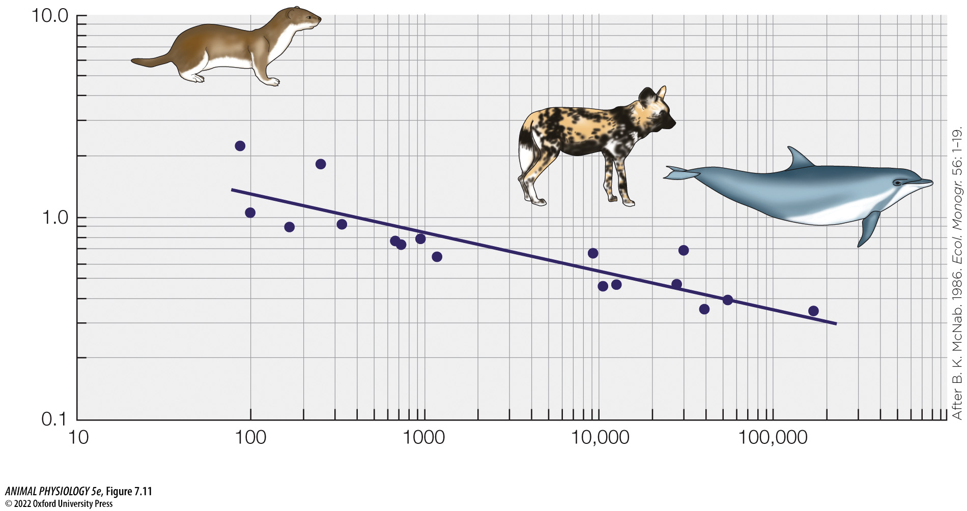
Figure 7.11 Metabolic rate and body weight are related linearly on log–log coordinates, as illustrated by carnivorous mammals (3)
Notes:
Figure 7.11 Metabolic rate and body weight are related linearly on log–log coordinates, as illustrated by carnivorous mammals
Using log–log coordinates, weight-specific BMR is plotted as a function of body weight for mammalian species that eat primarily vertebrate flesh. The points represent individual species; the line is statistically fitted to them. See Appendix D for information on the axis layouts. (After B. K. McNab. 1986. Ecol. Monogr. 56: 1–19.)

Slide 46
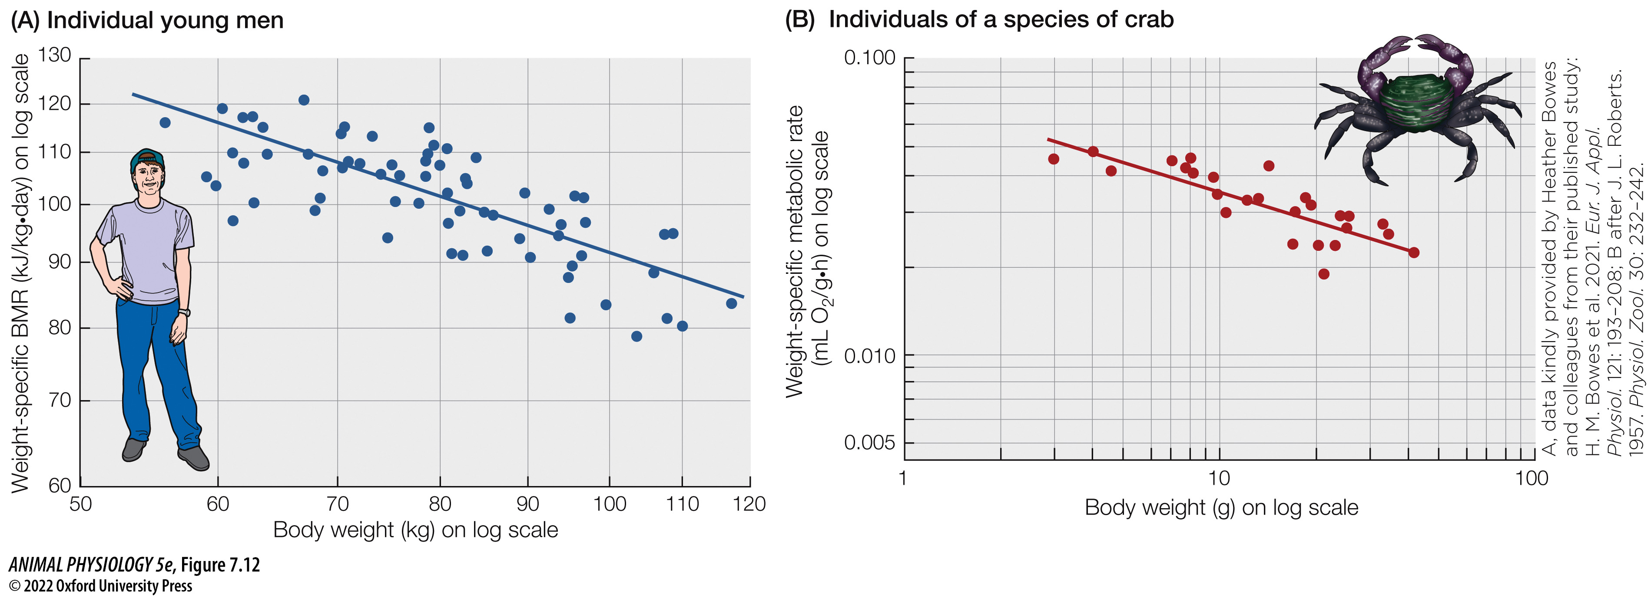
Figure 7.12 Within a species, resting metabolic rate often varies allometrically with individual body size (1)
Notes:
Figure 7.12 Within a species, resting metabolic rate often varies allometrically with individual body size
Log–log plots of weight-specific metabolic rate as a function of body weight. Each point represents one individual (e.g., one person or crab). (A) BMR in young men. (B) Resting metabolic rate at a body temperature of 16°C in common Pacific shore crabs (Pachygrapsus crassipes). (A, data kindly provided by Heather Bowes and colleagues from their published study: H. M. Bowes et al. 2021. Eur. J. Appl. Physiol. 121: 193–208; B after J. L. Roberts. 1957. Physiol. Zool. 30: 232–242.)

Slide 47
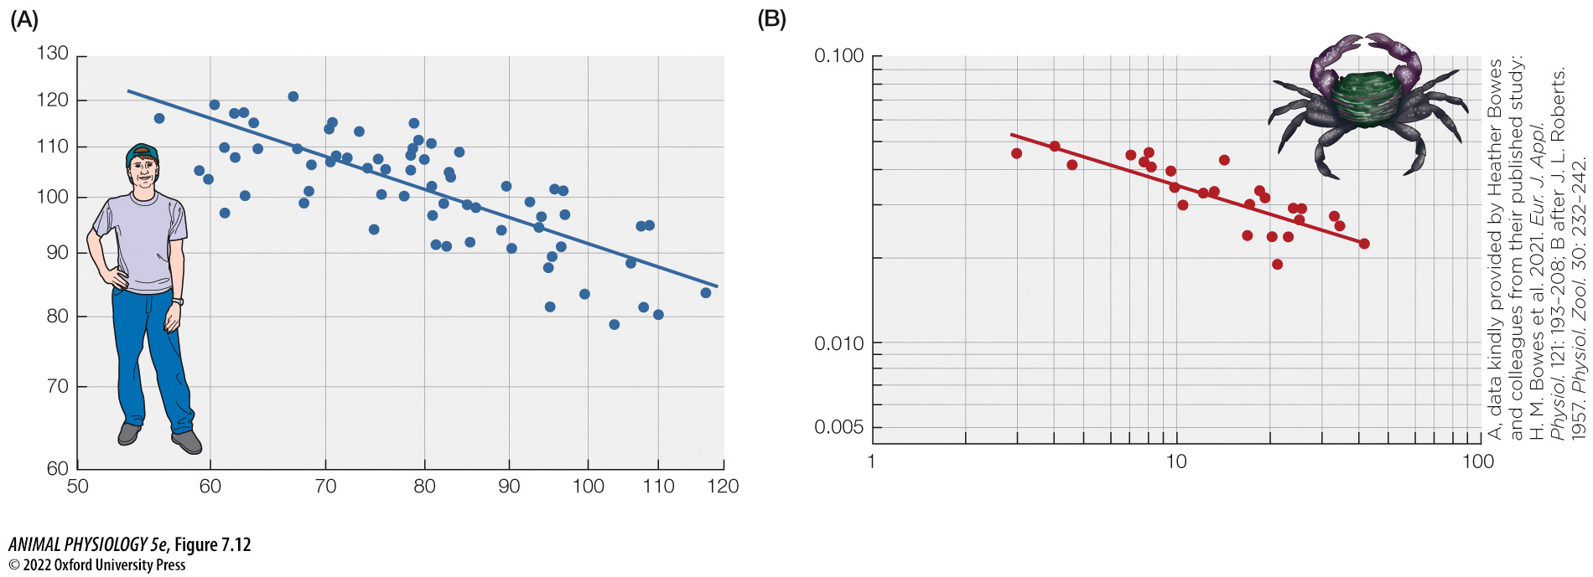
Figure 7.12 Within a species, resting metabolic rate often varies allometrically with individual body size (2)
Notes:
Figure 7.12 Within a species, resting metabolic rate often varies allometrically with individual body size
Log–log plots of weight-specific metabolic rate as a function of body weight. Each point represents one individual (e.g., one person or crab). (A) BMR in young men. (B) Resting metabolic rate at a body temperature of 16°C in common Pacific shore crabs (Pachygrapsus crassipes). (A, data kindly provided by Heather Bowes and colleagues from their published study: H. M. Bowes et al. 2021. Eur. J. Appl. Physiol. 121: 193–208; B after J. L. Roberts. 1957. Physiol. Zool. 30: 232–242.)

Slide 48
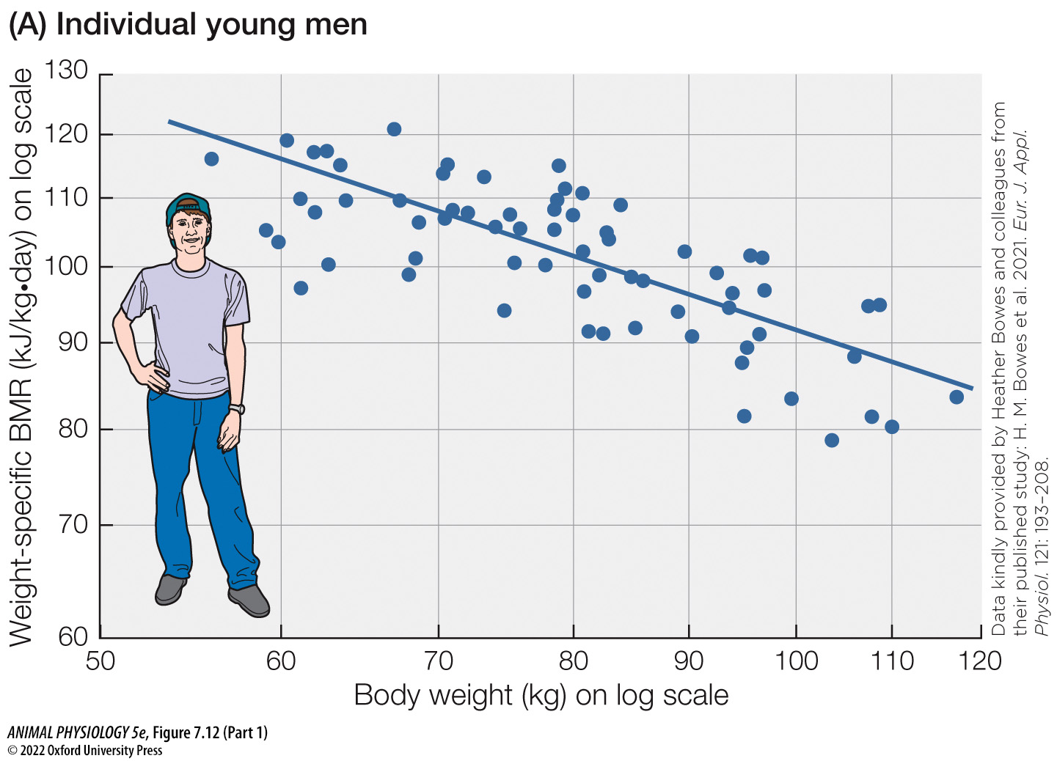
Figure 7.12 Within a species, resting metabolic rate often varies allometrically with individual body size (Part 1) (1)
Notes:
Figure 7.12 Within a species, resting metabolic rate often varies allometrically with individual body size
Log–log plots of weight-specific metabolic rate as a function of body weight. Each point represents one individual (e.g., one person or crab). (A) BMR in young men. (B) Resting metabolic rate at a body temperature of 16°C in common Pacific shore crabs (Pachygrapsus crassipes). (A, data kindly provided by Heather Bowes and colleagues from their published study: H. M. Bowes et al. 2021. Eur. J. Appl. Physiol. 121: 193–208; B after J. L. Roberts. 1957. Physiol. Zool. 30: 232–242.)

Slide 49
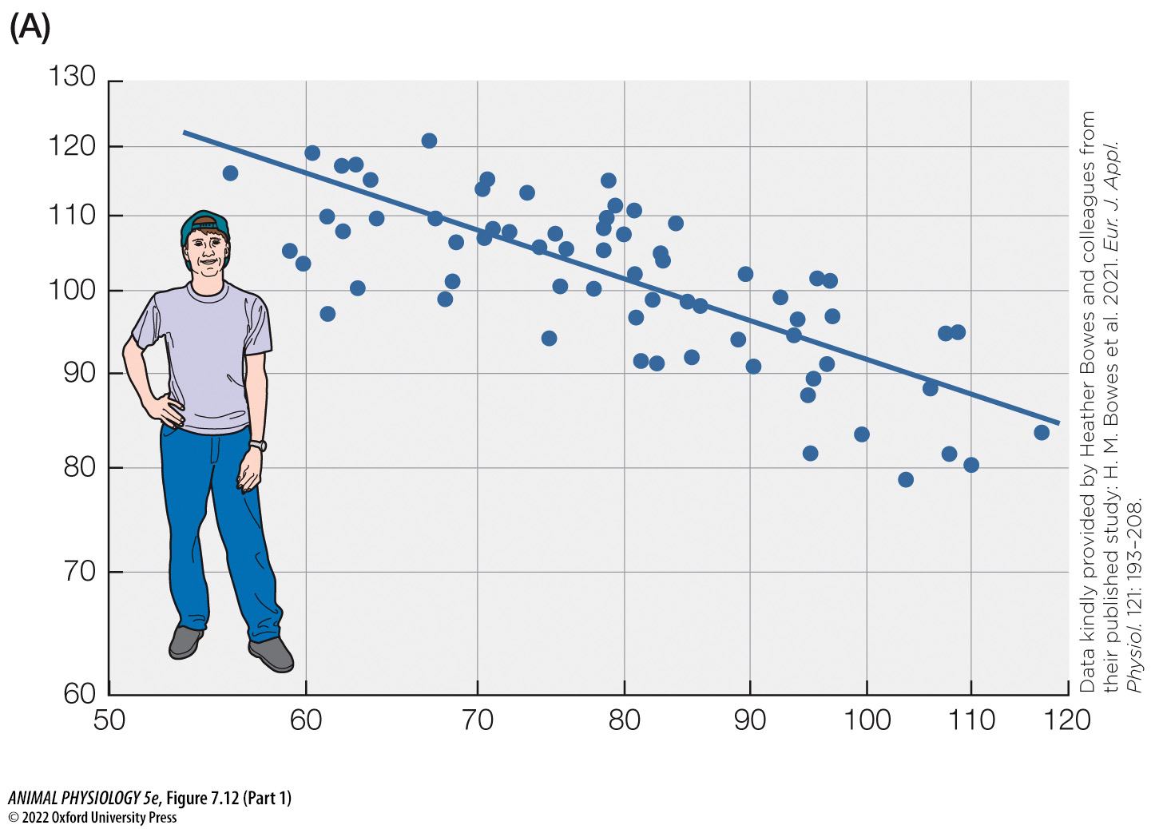
Figure 7.12 Within a species, resting metabolic rate often varies allometrically with individual body size (Part 1) (2)
Notes:
Figure 7.12 Within a species, resting metabolic rate often varies allometrically with individual body size
Log–log plots of weight-specific metabolic rate as a function of body weight. Each point represents one individual (e.g., one person or crab). (A) BMR in young men. (B) Resting metabolic rate at a body temperature of 16°C in common Pacific shore crabs (Pachygrapsus crassipes). (A, data kindly provided by Heather Bowes and colleagues from their published study: H. M. Bowes et al. 2021. Eur. J. Appl. Physiol. 121: 193–208; B after J. L. Roberts. 1957. Physiol. Zool. 30: 232–242.)

Slide 50
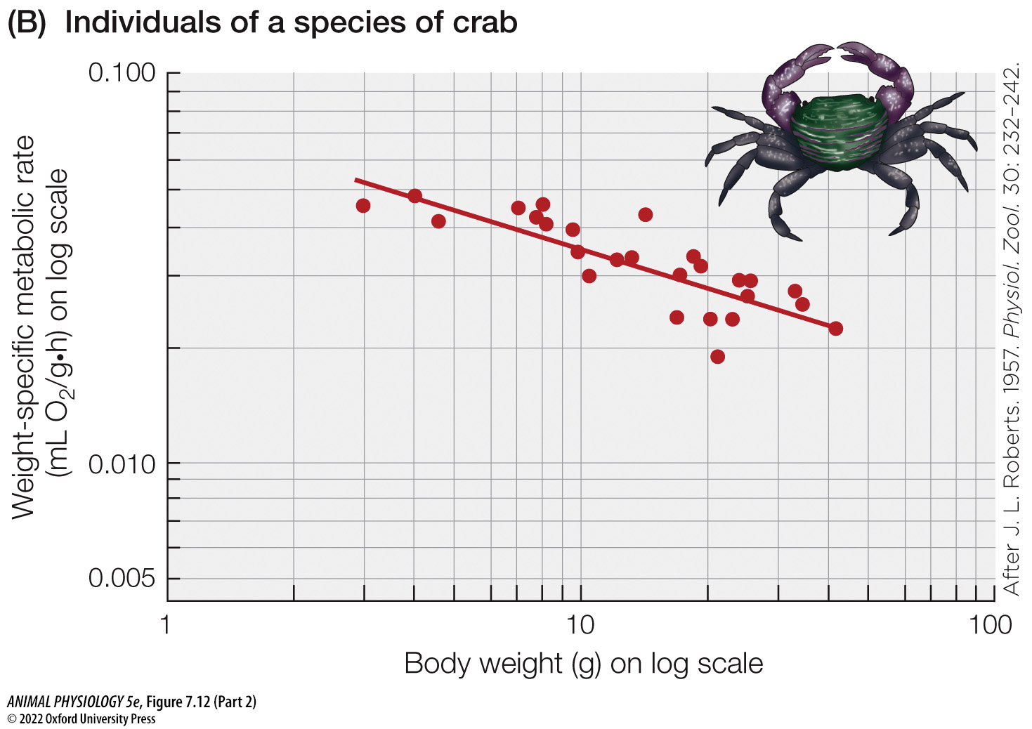
Figure 7.12 Within a species, resting metabolic rate often varies allometrically with individual body size (Part 2) (1)
Notes:
Figure 7.12 Within a species, resting metabolic rate often varies allometrically with individual body size
Log–log plots of weight-specific metabolic rate as a function of body weight. Each point represents one individual (e.g., one person or crab). (A) BMR in young men. (B) Resting metabolic rate at a body temperature of 16°C in common Pacific shore crabs (Pachygrapsus crassipes). (A, data kindly provided by Heather Bowes and colleagues from their published study: H. M. Bowes et al. 2021. Eur. J. Appl. Physiol. 121: 193–208; B after J. L. Roberts. 1957. Physiol. Zool. 30: 232–242.)

Slide 51
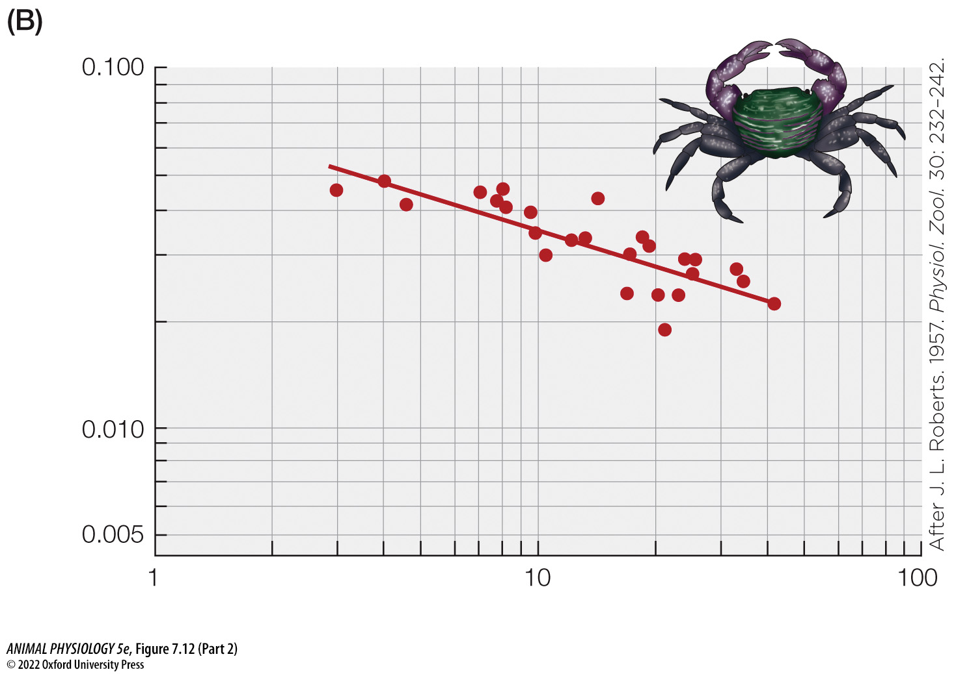
Figure 7.12 Within a species, resting metabolic rate often varies allometrically with individual body size (Part 2) (2)
Notes:
Figure 7.12 Within a species, resting metabolic rate often varies allometrically with individual body size
Log–log plots of weight-specific metabolic rate as a function of body weight. Each point represents one individual (e.g., one person or crab). (A) BMR in young men. (B) Resting metabolic rate at a body temperature of 16°C in common Pacific shore crabs (Pachygrapsus crassipes). (A, data kindly provided by Heather Bowes and colleagues from their published study: H. M. Bowes et al. 2021. Eur. J. Appl. Physiol. 121: 193–208; B after J. L. Roberts. 1957. Physiol. Zool. 30: 232–242.)

Slide 52
TABLE 7.3 Resting heart rate, and heart size relative to body weight, in seven species of mammals
Species are listed in order of decreasing individual size.
Species and average body weight | Resting heart rate (beats/min)ª | Heart weight per unit of body weight (g/kg)^{b}
African elephant (4100 kg) | 40 | 5.5
Horse (420 kg) | 47 | 7.5
Human (69 kg) | 70 | 5.2
Domestic dog (19 kg) | 105 | 9.2
Domestic cat (3 kg) | 179 | 4.1
Roof rat (0.34 kg) | 340 | 2.9
Lab mouse (0.03 kg) | 580 | 4.0
Source: After R. S. Seymour and A. J. Blaylock. 2000. Physiol. Biochem. Zool. 73: 389–405.
ªAccording to the source of these data, the statistical relation between resting heart rate (RHR ) and body weight (W) in mammals is RHR (beats/min) = 227W^{–0.23}, where W is in kilograms.
^{b}Although heart weight per unit of body weight varies, it shows little or no consistent relation to body size
Notes:
TABLE 7.3 Resting heart rate, and heart size relative to body weight, in seven species of mammals

Slide 53
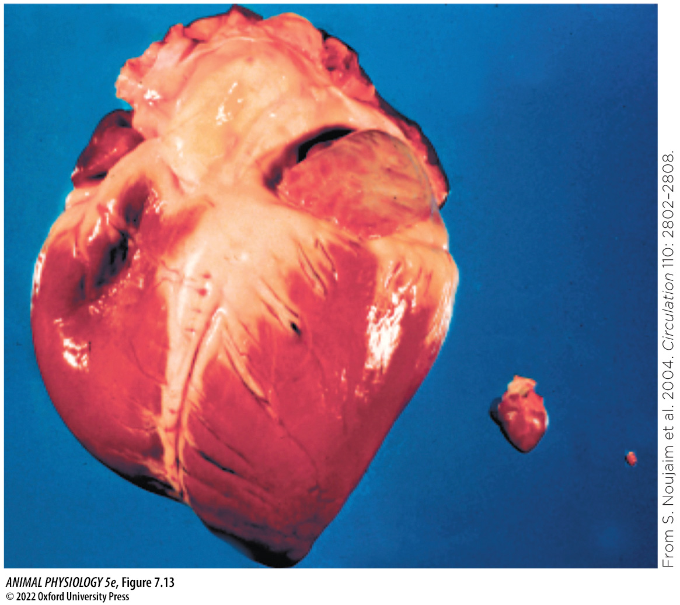
Figure 7.13 Hearts of a horse, cat, and mouse: Heart size in mammals is roughly proportional to body size
Notes:
Figure 7.13 Hearts of a horse, cat, and mouse: Heart size in mammals is roughly proportional to body size
As a corollary, the relatively high weight-specific O₂ demands of small species are not met by pumping more blood, relative to body size, per heartbeat. Instead, the number of heartbeats per minute is far greater in small species than in large ones. (Courtesy of Sami Noujaim and José Jalife.)

Slide 54
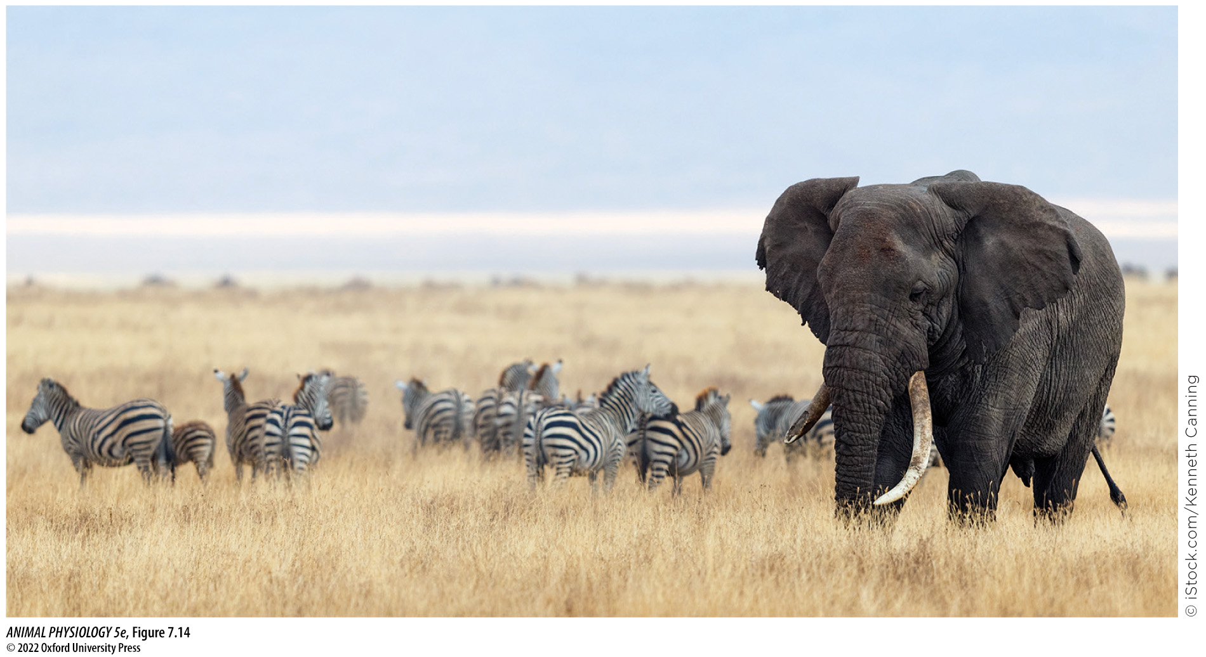
Figure 7.14 Herbivores of different body sizes coexisting on an African grassland
Notes:
Figure 7.14 Herbivores of different body sizes coexisting on an African grassland
When extensive landscapes are analyzed statistically, species are found to vary in population biomass in a way that depends in part on individual body size and metabolic allometry.

Slide 55
TABLE 7.4 Biomasses of populations of selected herbivores living in mixed communities in African national parks
Species are listed in order of increasing individual size. These species were chosen for listing because they are statistically about average in population biomass for their body sizes.
Species | Average biomass of entire population per square kilometer (kg/km²) | Average individual body weight (kg)
Oribi (Ourebia ourebi) | 44 | 13
Gray duiker (Sylvicapra grimmia) | 62 | 16
Gray rhebok (Pelea capreolus) | 105 | 25
Warthog (Phacochoerus aethiopicus) | 95 | 69
Waterbuck (Kobus ellipsiprymnus) | 155 | 210
Greater kudu (Tragelaphus strepsiceros) | 200 | 215
Plains zebra (Equus quagga) | 460 | 275
White rhino (Ceratotherium simum) | 2400 | 1900
African elephant (Loxodonta africana) | 1250 | 3900
Source: After R. N. Owen-Smith. 1988. Megaherbivores: The Influence of Very Large Body Size on Ecology. Cambridge University Press, New York.
Notes:
TABLE 7.4 Biomasses of populations of selected herbivores living in mixed communities in African national parks

Slide 56
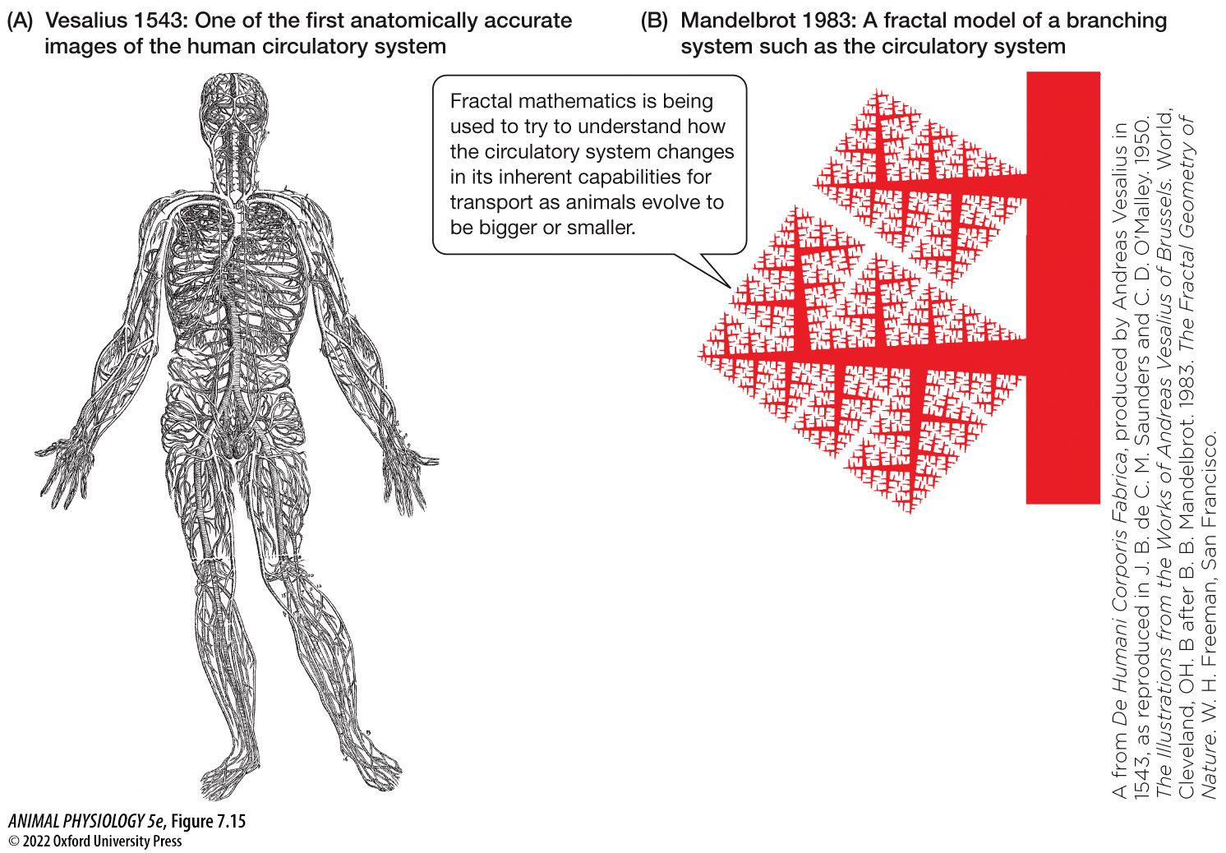
Figure 7.15 The fractal theory of metabolism–size allometry (1)
Notes:
Figure 7.15 The fractal theory of metabolism–size allometry
As the circulatory system of mammals is scaled up and down in size and extent over evolutionary time, constraints predicated on fractal geometry may help give rise to allometric metabolic scaling. About four centuries after Andreas Vesalius first drew the circulatory system of a mammal (A), Benoit Mandelbrot invented fractal mathematics, setting the stage for its application to circulatory systems. Fractal systems, as seen in (B), are “self-similar” at multiple scales, meaning that the patterns of branching of fine elements are miniatures of the patterns of branching of large elements. (A from De Humani Corporis Fabrica, produced by Andreas Vesalius in 1543, as reproduced in J. B. de C. M. Saunders and C. D. O'Malley. 1950. The Illustrations from the Works of Andreas Vesalius of Brussels. World, Cleveland, OH. B after B. B. Mandelbrot. 1983. The Fractal Geometry of Nature. W. H. Freeman, San Francisco.)

Slide 57

Figure 7.15 The fractal theory of metabolism–size allometry (2)
Notes:
Figure 7.15 The fractal theory of metabolism–size allometry
As the circulatory system of mammals is scaled up and down in size and extent over evolutionary time, constraints predicated on fractal geometry may help give rise to allometric metabolic scaling. About four centuries after Andreas Vesalius first drew the circulatory system of a mammal (A), Benoit Mandelbrot invented fractal mathematics, setting the stage for its application to circulatory systems. Fractal systems, as seen in (B), are “self-similar” at multiple scales, meaning that the patterns of branching of fine elements are miniatures of the patterns of branching of large elements. (A from De Humani Corporis Fabrica, produced by Andreas Vesalius in 1543, as reproduced in J. B. de C. M. Saunders and C. D. O'Malley. 1950. The Illustrations from the Works of Andreas Vesalius of Brussels. World, Cleveland, OH. B after B. B. Mandelbrot. 1983. The Fractal Geometry of Nature. W. H. Freeman, San Francisco.)

Slide 58

Figure 7.15 The fractal theory of metabolism–size allometry (3)
Notes:
Figure 7.15 The fractal theory of metabolism–size allometry
As the circulatory system of mammals is scaled up and down in size and extent over evolutionary time, constraints predicated on fractal geometry may help give rise to allometric metabolic scaling. About four centuries after Andreas Vesalius first drew the circulatory system of a mammal (A), Benoit Mandelbrot invented fractal mathematics, setting the stage for its application to circulatory systems. Fractal systems, as seen in (B), are “self-similar” at multiple scales, meaning that the patterns of branching of fine elements are miniatures of the patterns of branching of large elements. (A from De Humani Corporis Fabrica, produced by Andreas Vesalius in 1543, as reproduced in J. B. de C. M. Saunders and C. D. O'Malley. 1950. The Illustrations from the Works of Andreas Vesalius of Brussels. World, Cleveland, OH. B after B. B. Mandelbrot. 1983. The Fractal Geometry of Nature. W. H. Freeman, San Francisco.)

Slide 59

Figure 7.15 The fractal theory of metabolism–size allometry (Part 1) (1)
Notes:
Figure 7.15 The fractal theory of metabolism–size allometry
As the circulatory system of mammals is scaled up and down in size and extent over evolutionary time, constraints predicated on fractal geometry may help give rise to allometric metabolic scaling. About four centuries after Andreas Vesalius first drew the circulatory system of a mammal (A), Benoit Mandelbrot invented fractal mathematics, setting the stage for its application to circulatory systems. Fractal systems, as seen in (B), are “self-similar” at multiple scales, meaning that the patterns of branching of fine elements are miniatures of the patterns of branching of large elements. (A from De Humani Corporis Fabrica, produced by Andreas Vesalius in 1543, as reproduced in J. B. de C. M. Saunders and C. D. O'Malley. 1950. The Illustrations from the Works of Andreas Vesalius of Brussels. World, Cleveland, OH. B after B. B. Mandelbrot. 1983. The Fractal Geometry of Nature. W. H. Freeman, San Francisco.)

Slide 60

Figure 7.15 The fractal theory of metabolism–size allometry (Part 1) (2)
Notes:
Figure 7.15 The fractal theory of metabolism–size allometry
As the circulatory system of mammals is scaled up and down in size and extent over evolutionary time, constraints predicated on fractal geometry may help give rise to allometric metabolic scaling. About four centuries after Andreas Vesalius first drew the circulatory system of a mammal (A), Benoit Mandelbrot invented fractal mathematics, setting the stage for its application to circulatory systems. Fractal systems, as seen in (B), are “self-similar” at multiple scales, meaning that the patterns of branching of fine elements are miniatures of the patterns of branching of large elements. (A from De Humani Corporis Fabrica, produced by Andreas Vesalius in 1543, as reproduced in J. B. de C. M. Saunders and C. D. O'Malley. 1950. The Illustrations from the Works of Andreas Vesalius of Brussels. World, Cleveland, OH. B after B. B. Mandelbrot. 1983. The Fractal Geometry of Nature. W. H. Freeman, San Francisco.)

Slide 61

Figure 7.15 The fractal theory of metabolism–size allometry (Part 2) (1)
Notes:
Figure 7.15 The fractal theory of metabolism–size allometry
As the circulatory system of mammals is scaled up and down in size and extent over evolutionary time, constraints predicated on fractal geometry may help give rise to allometric metabolic scaling. About four centuries after Andreas Vesalius first drew the circulatory system of a mammal (A), Benoit Mandelbrot invented fractal mathematics, setting the stage for its application to circulatory systems. Fractal systems, as seen in (B), are “self-similar” at multiple scales, meaning that the patterns of branching of fine elements are miniatures of the patterns of branching of large elements. (A from De Humani Corporis Fabrica, produced by Andreas Vesalius in 1543, as reproduced in J. B. de C. M. Saunders and C. D. O'Malley. 1950. The Illustrations from the Works of Andreas Vesalius of Brussels. World, Cleveland, OH. B after B. B. Mandelbrot. 1983. The Fractal Geometry of Nature. W. H. Freeman, San Francisco.)

Slide 62

Figure 7.15 The fractal theory of metabolism–size allometry (Part 2) (2)
Notes:
Figure 7.15 The fractal theory of metabolism–size allometry
As the circulatory system of mammals is scaled up and down in size and extent over evolutionary time, constraints predicated on fractal geometry may help give rise to allometric metabolic scaling. About four centuries after Andreas Vesalius first drew the circulatory system of a mammal (A), Benoit Mandelbrot invented fractal mathematics, setting the stage for its application to circulatory systems. Fractal systems, as seen in (B), are “self-similar” at multiple scales, meaning that the patterns of branching of fine elements are miniatures of the patterns of branching of large elements. (A from De Humani Corporis Fabrica, produced by Andreas Vesalius in 1543, as reproduced in J. B. de C. M. Saunders and C. D. O'Malley. 1950. The Illustrations from the Works of Andreas Vesalius of Brussels. World, Cleveland, OH. B after B. B. Mandelbrot. 1983. The Fractal Geometry of Nature. W. H. Freeman, San Francisco.)

Slide 63

Figure 7.16 Net growth efficiency during each year of life in Pacific sardines (Sardinops sagax) (1)
Notes:
Figure 7.16 Net growth efficiency during each year of life in Pacific sardines (Sardinops sagax)
These fish are often a major food source for seals, predatory fish, birds, and humans. (After R. Lasker. 1970. Utilization of zooplankton energy by a Pacific sardine population in the California current. In J. H. Steele [ed.], Marine Food Chains, pp. 265–284. University of California Press, Berkeley.)

Slide 64

Figure 7.16 Net growth efficiency during each year of life in Pacific sardines (Sardinops sagax) (2)
Notes:
Figure 7.16 Net growth efficiency during each year of life in Pacific sardines (Sardinops sagax)
These fish are often a major food source for seals, predatory fish, birds, and humans. (After R. Lasker. 1970. Utilization of zooplankton energy by a Pacific sardine population in the California current. In J. H. Steele [ed.], Marine Food Chains, pp. 265–284. University of California Press, Berkeley.)

Slide 65

Figure 7.16 Net growth efficiency during each year of life in Pacific sardines (Sardinops sagax) (3)
Notes:
Figure 7.16 Net growth efficiency during each year of life in Pacific sardines (Sardinops sagax)
These fish are often a major food source for seals, predatory fish, birds, and humans. (After R. Lasker. 1970. Utilization of zooplankton energy by a Pacific sardine population in the California current. In J. H. Steele [ed.], Marine Food Chains, pp. 265–284. University of California Press, Berkeley.)

