Slide 1
A History of Africa
by Toyin Falola and Timothy Stapleton

Slide 2
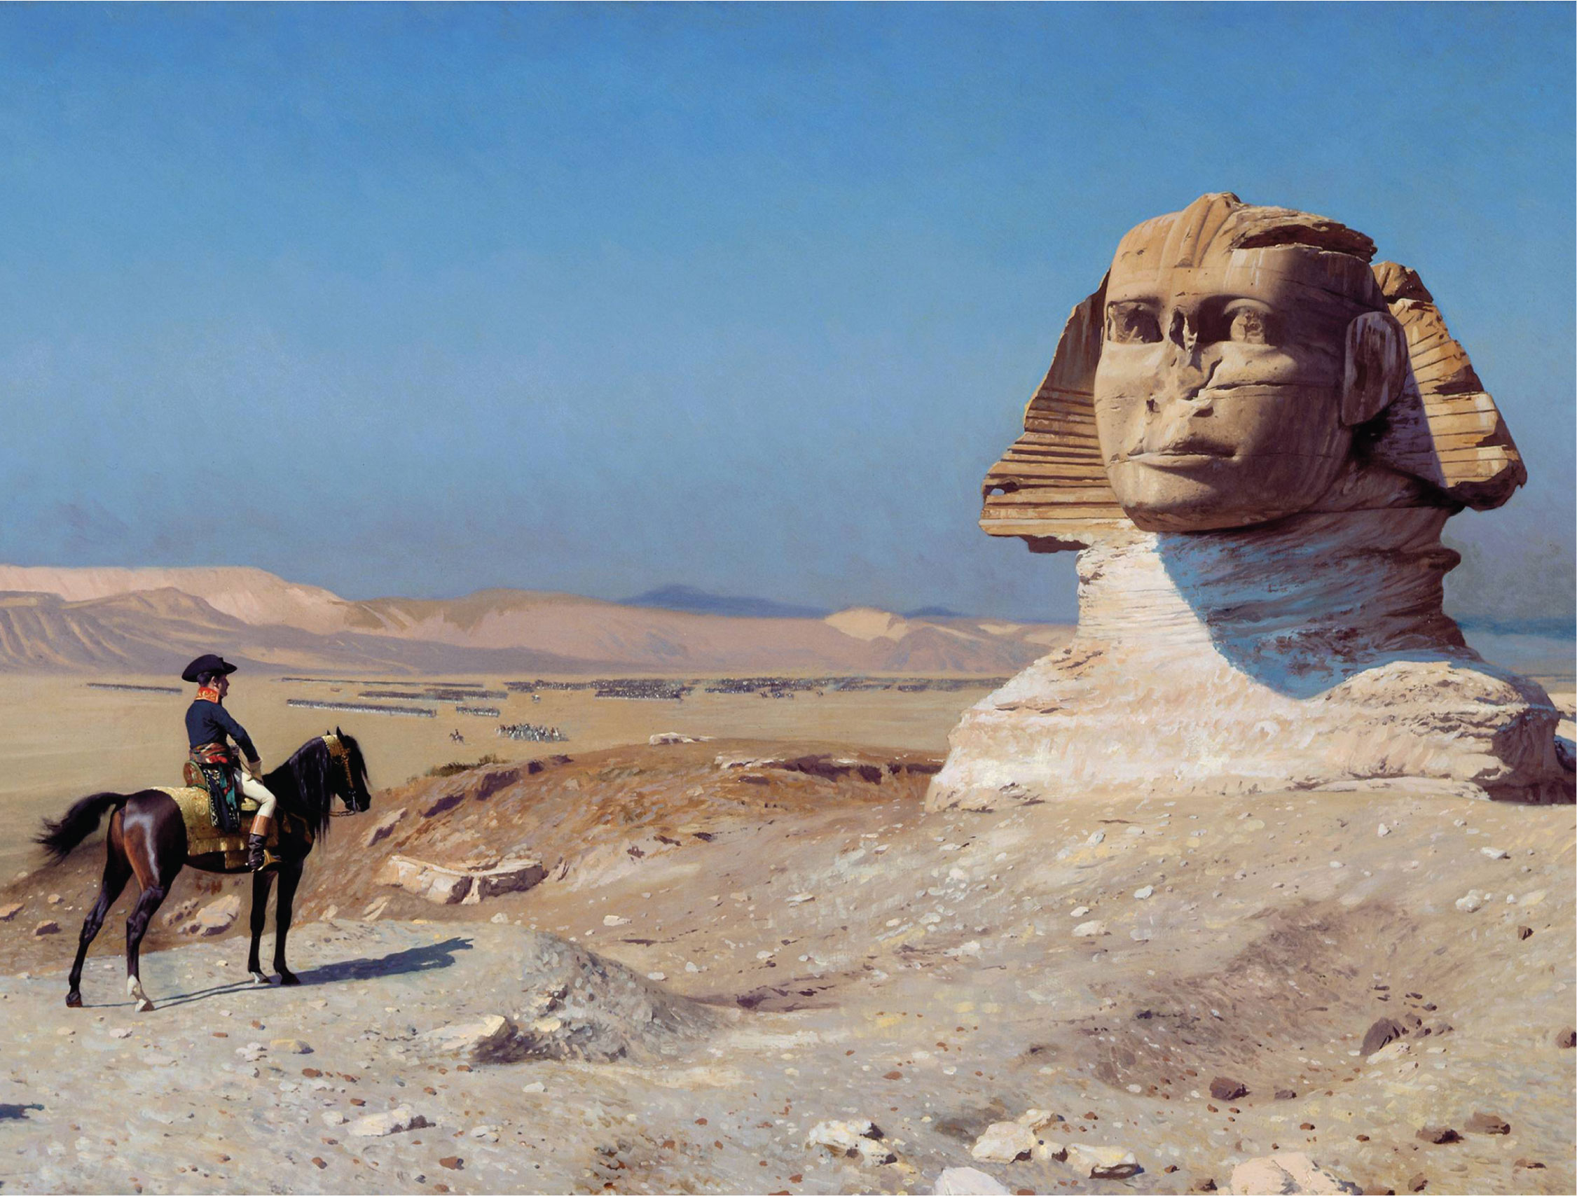
10
1

Slide 3
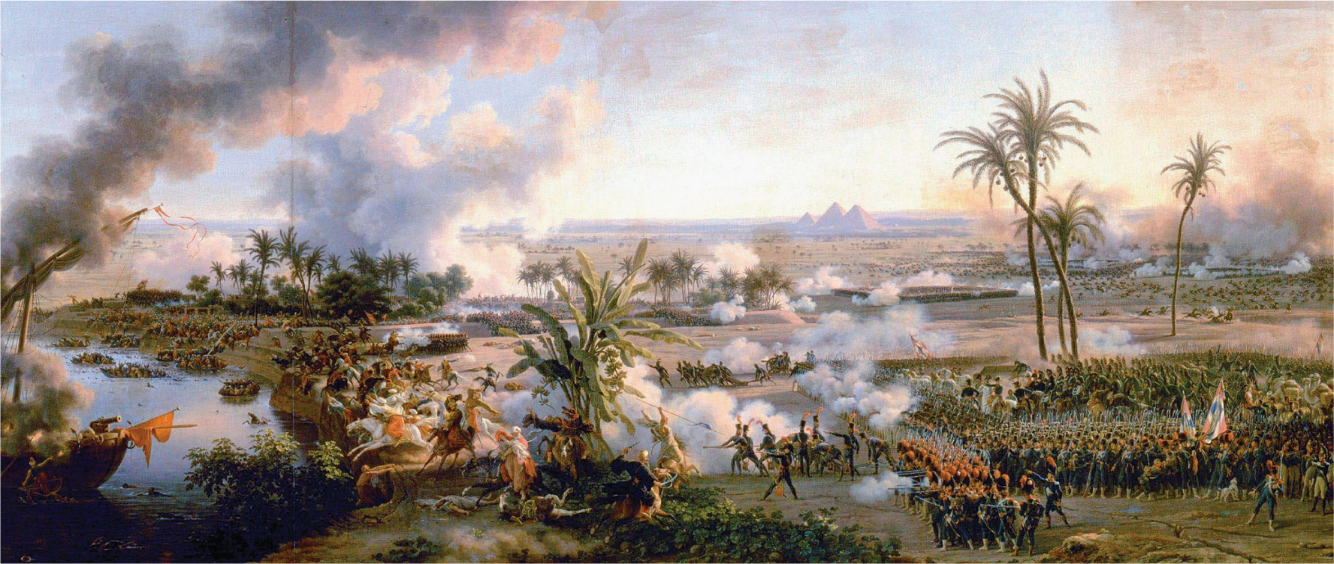
10
1

Slide 4
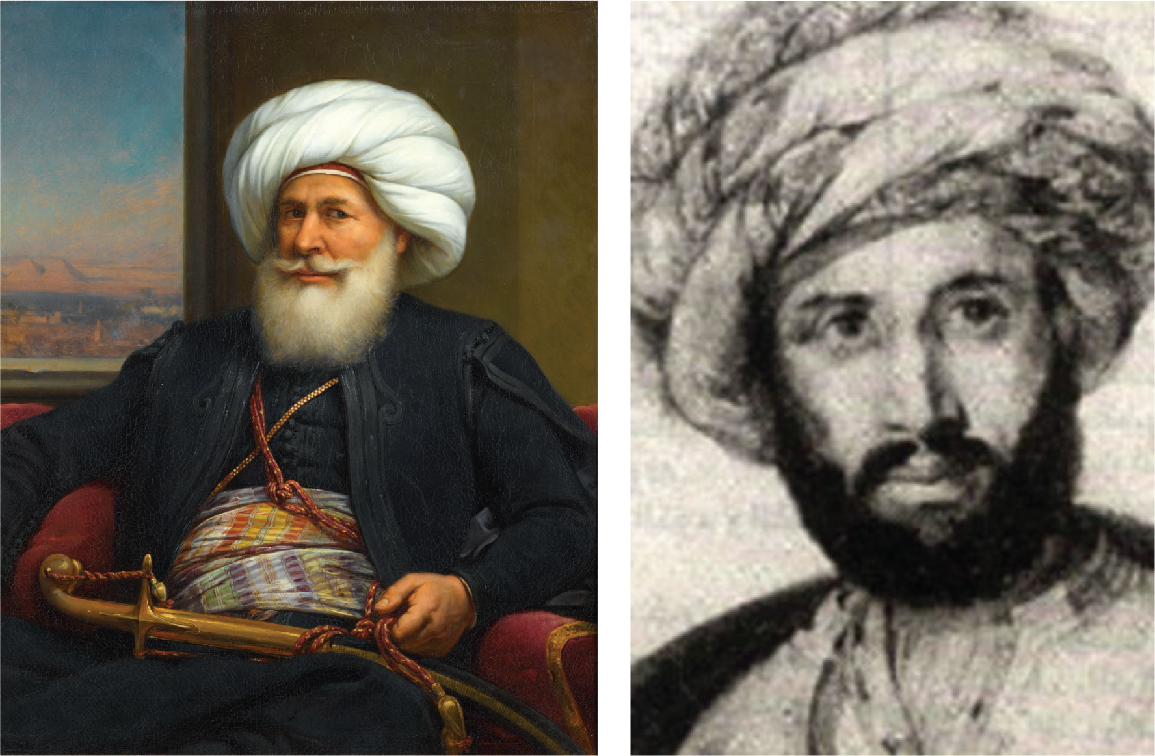
10
1

Slide 5
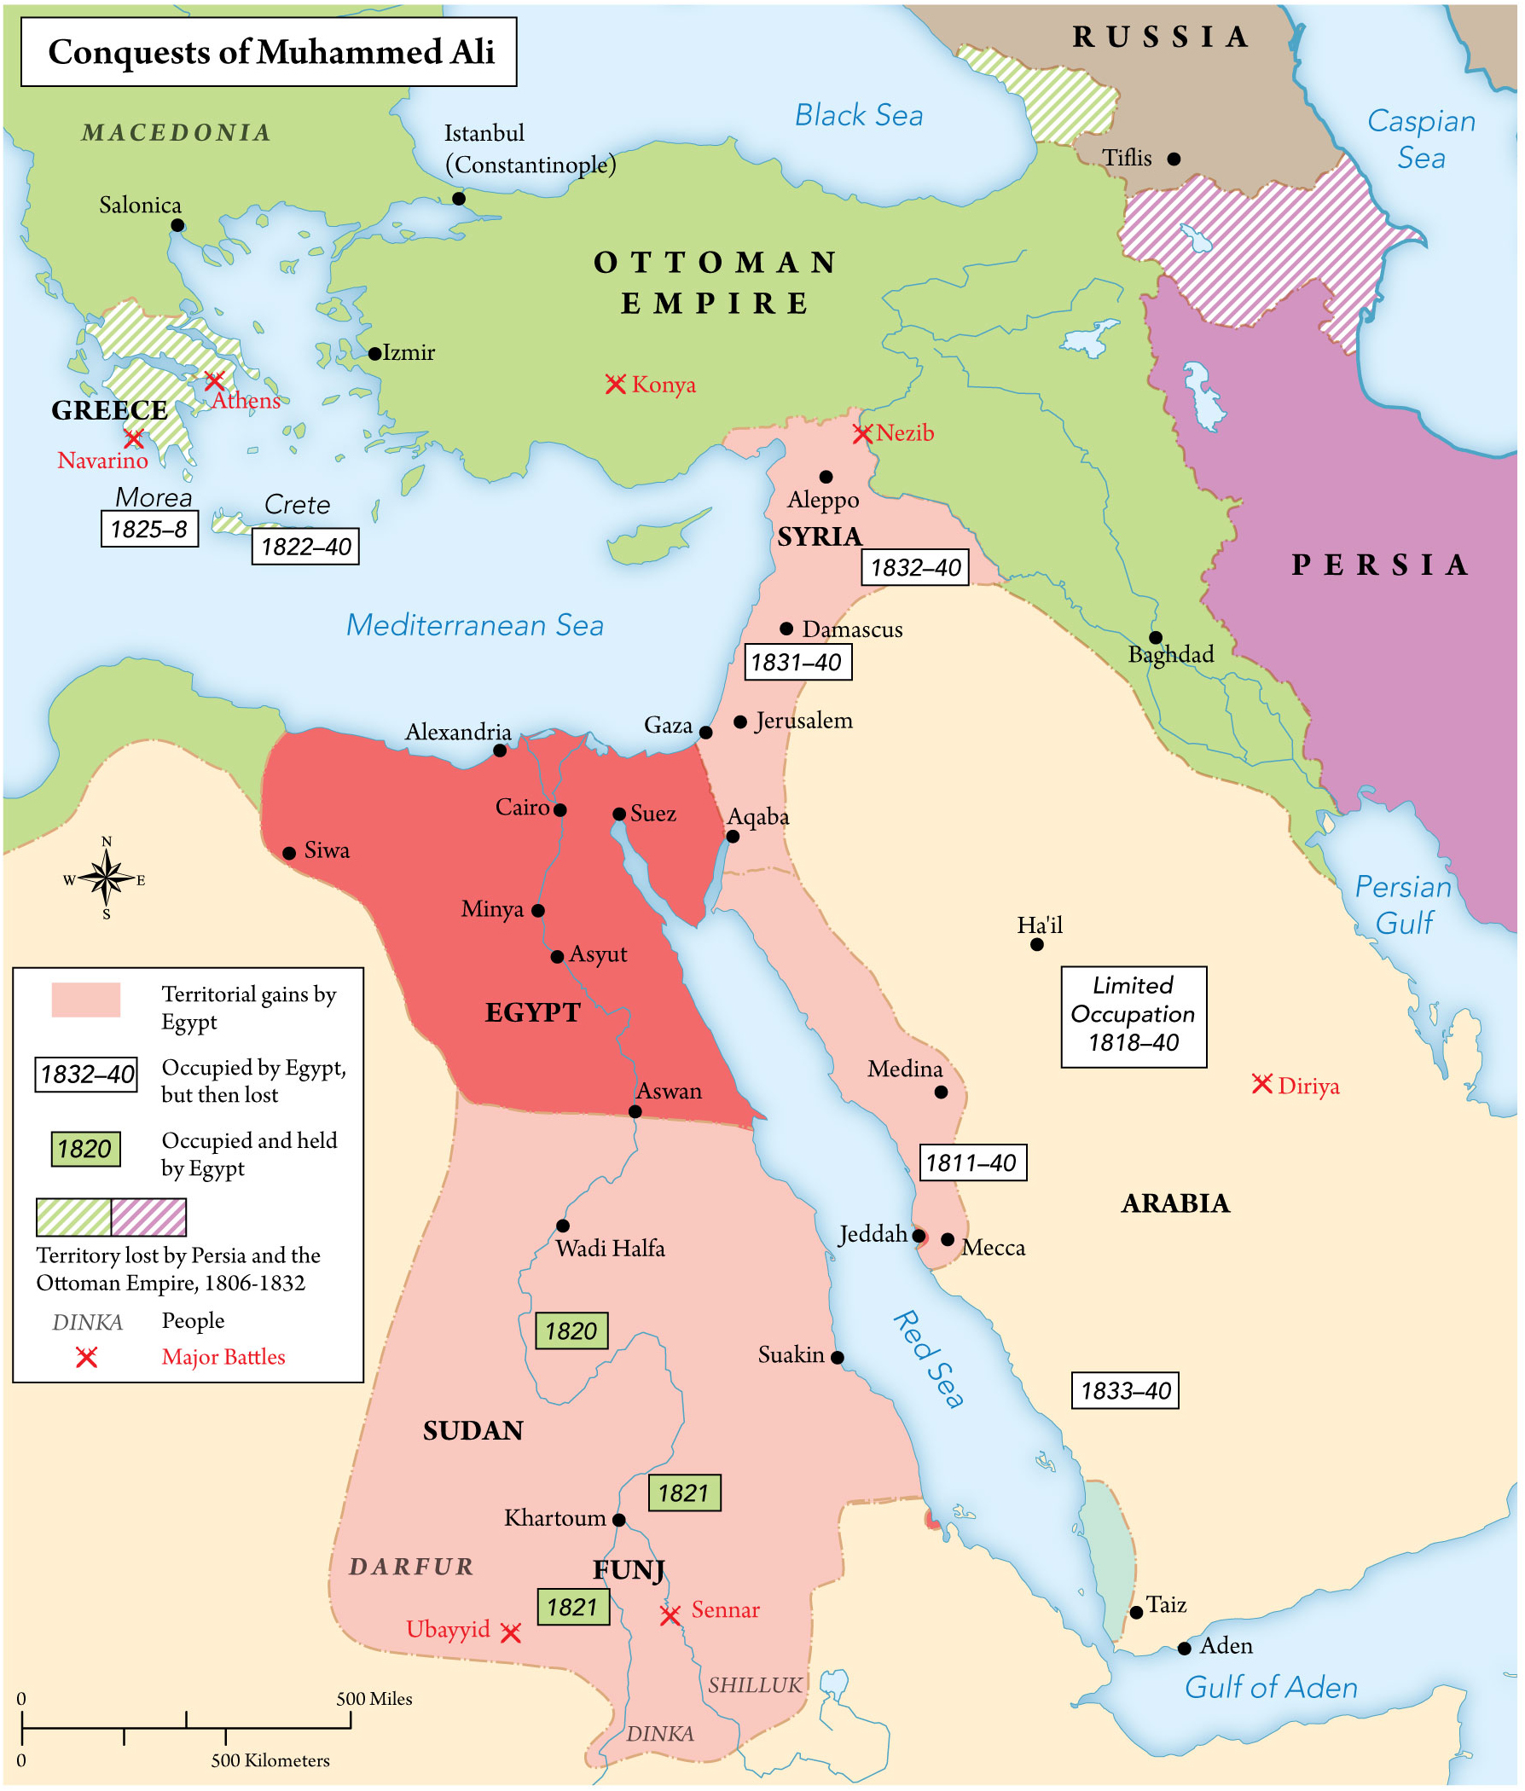
MAP 10.1

Slide 6
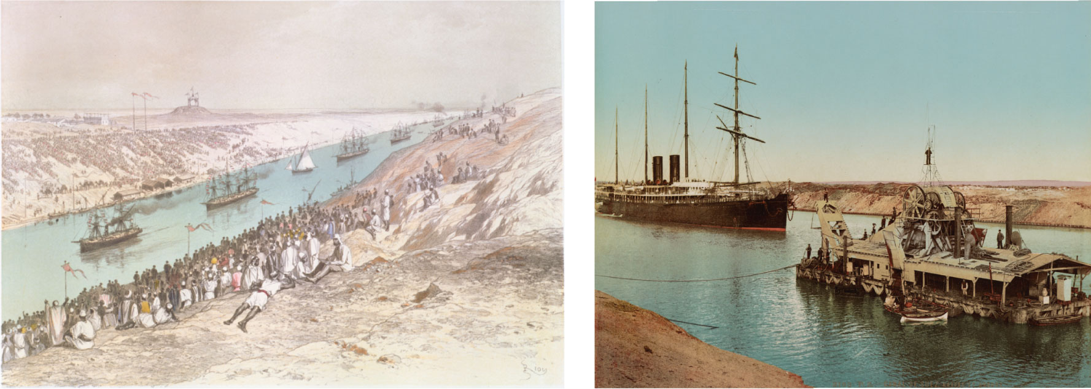
10
1

Slide 7
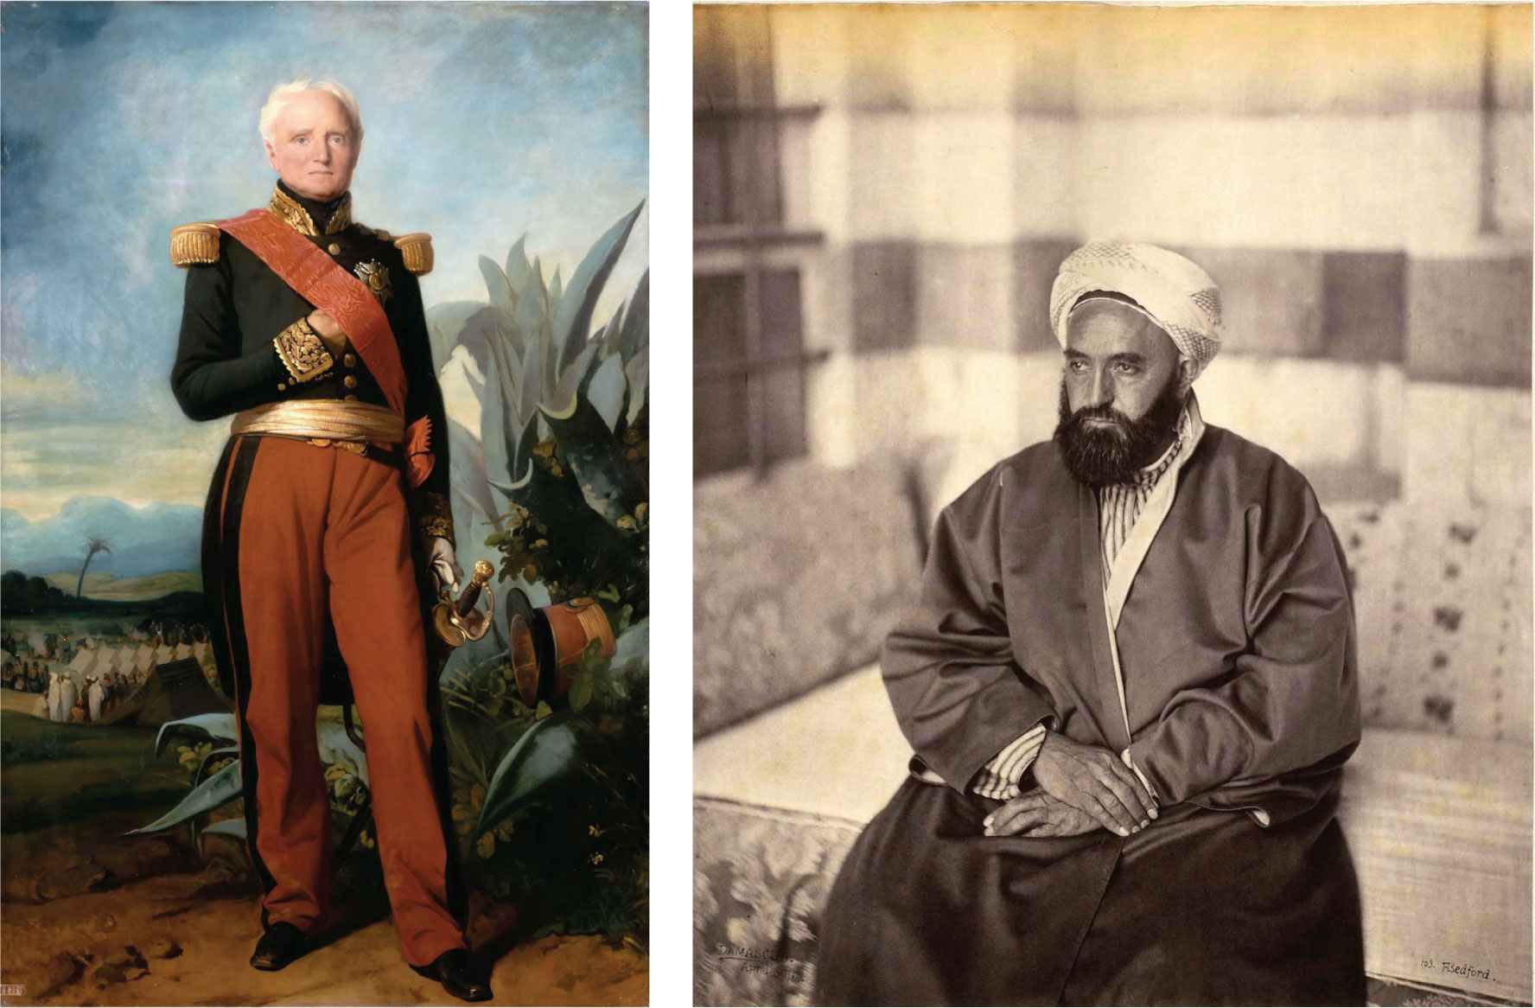
10
1

Slide 8
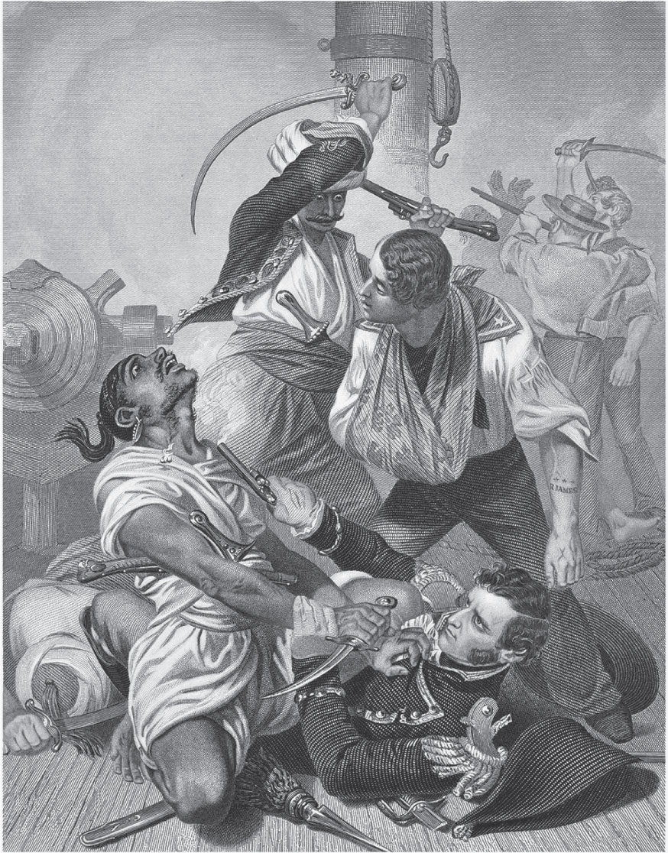
10
1

Slide 9
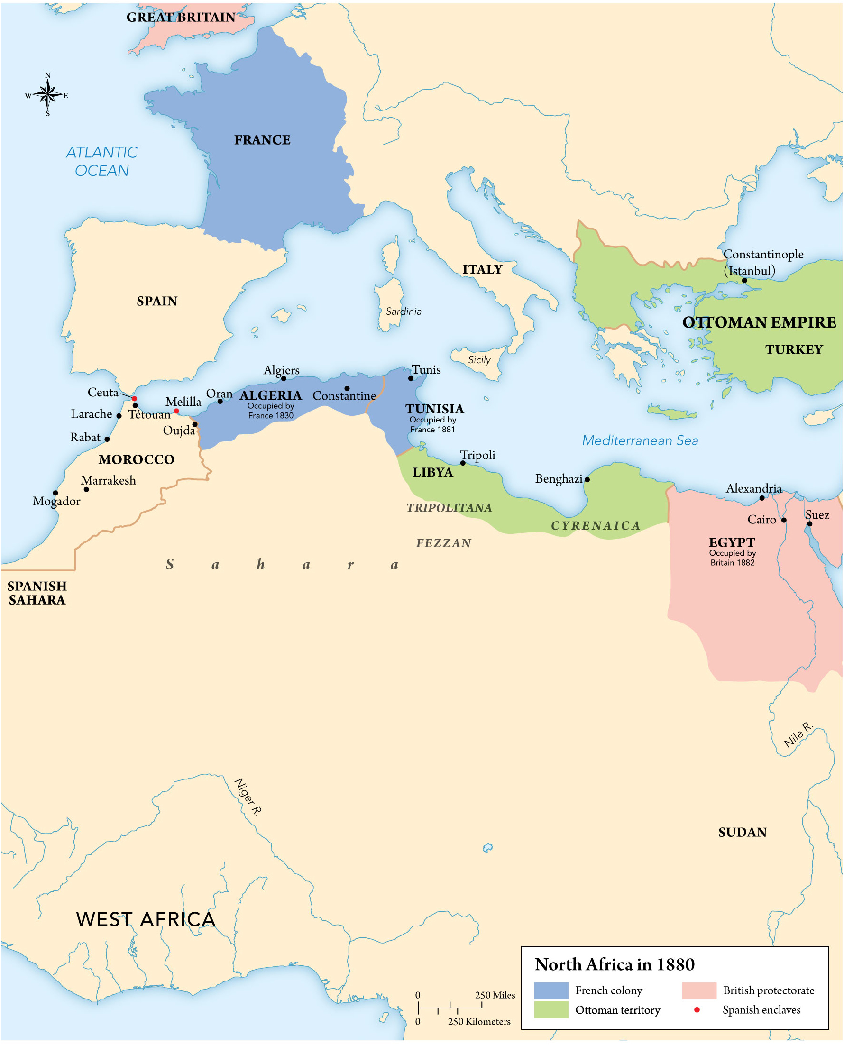
MAP 10.2

