Slide 1
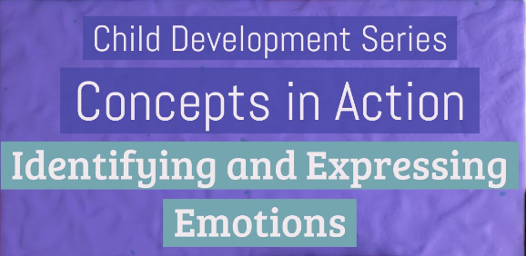
Chapter 7: Emotional and Social Development in Infancy and Toddlerhood

Slide 2

What emotion is this child experiencing?
Anger
Fear
Surprise
Disgust
Happiness
Sadness
Notes:
Correct Answer: A. Anger
Source: https://www.researchgate.net/figure/Examples-of-each-of-the-posed-facial-expressions-in-the-CAFE-set_fig1_271331770

Slide 3
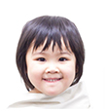
What emotion is this child experiencing?
Anger
Fear
Surprise
Disgust
Happiness
Sadness
Notes:
Correct Answer: E. Happiness
Source: https://www.researchgate.net/figure/Examples-of-each-of-the-posed-facial-expressions-in-the-CAFE-set_fig1_271331770

Slide 4
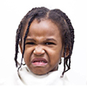
What emotion is this child experiencing?
Anger
Fear
Surprise
Disgust
Happiness
Sadness
Notes:
Correct Answer: D. Disgust
Source: https://www.researchgate.net/figure/Examples-of-each-of-the-posed-facial-expressions-in-the-CAFE-set_fig1_271331770

Slide 5
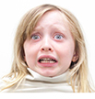
What emotion is this child experiencing?
Anger
Fear
Surprise
Disgust
Happiness
Sadness
Notes:
Correct Answer: B. Fear
Source: https://www.researchgate.net/figure/Examples-of-each-of-the-posed-facial-expressions-in-the-CAFE-set_fig1_271331770

Slide 6

What emotion is this child experiencing?
Anger
Fear
Surprise
Disgust
Happiness
Sadness
Notes:
Correct Answer: F. Sadness
Source: https://www.researchgate.net/figure/Examples-of-each-of-the-posed-facial-expressions-in-the-CAFE-set_fig1_271331770

Slide 7

What emotion is this child experiencing?
Anger
Fear
Surprise
Disgust
Happiness
Sadness
Notes:
Correct Answer: C. Surprise
Source: https://www.researchgate.net/figure/Examples-of-each-of-the-posed-facial-expressions-in-the-CAFE-set_fig1_271331770

Slide 8
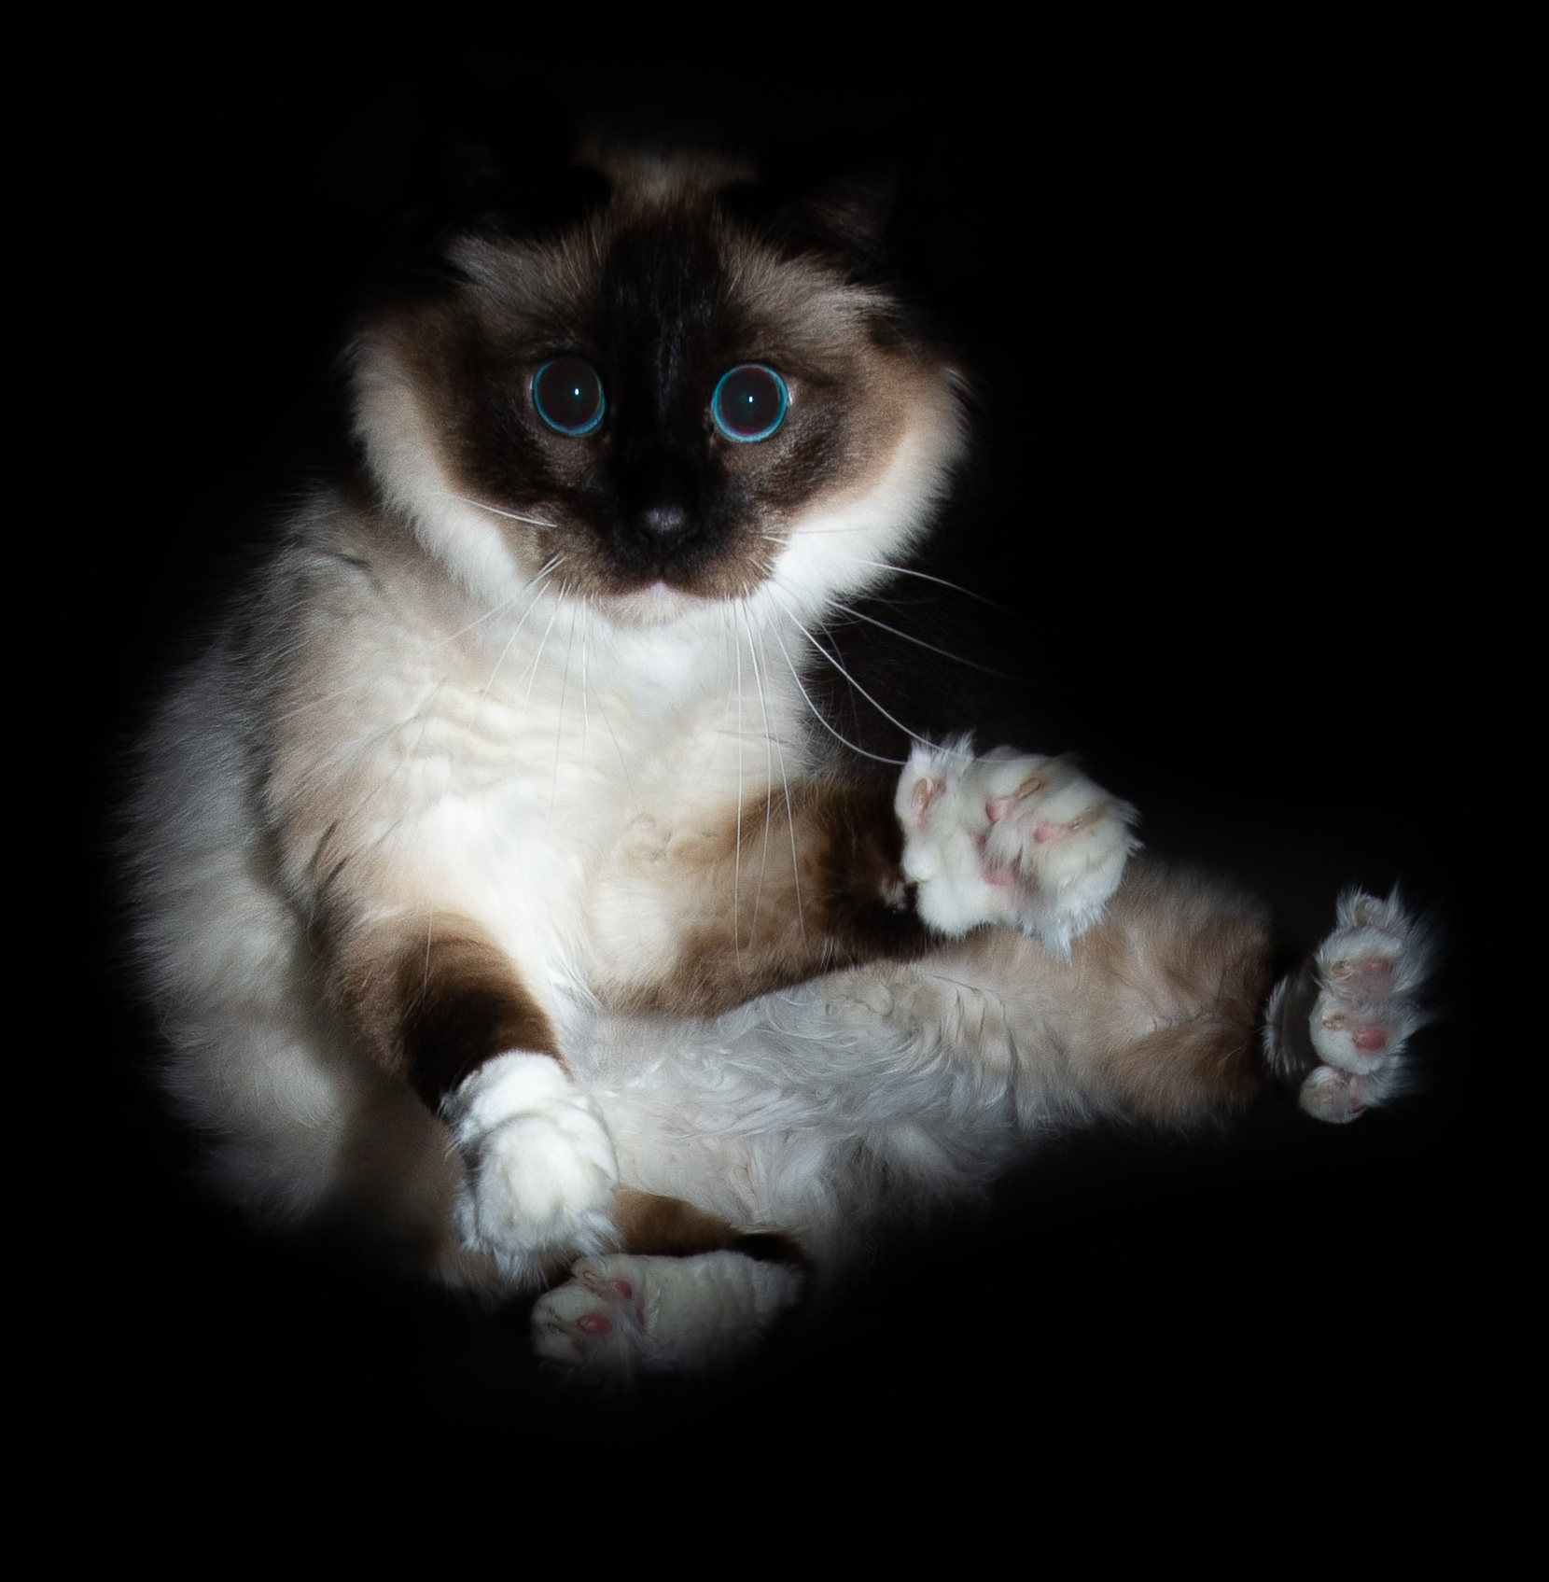
What emotion is this animal experiencing?
Anger
Fear
Surprise
Disgust
Happiness
Sadness
Notes:
Correct Answer: B. Fear
Source: Photo by Max Kleinen on Unsplash

Slide 9
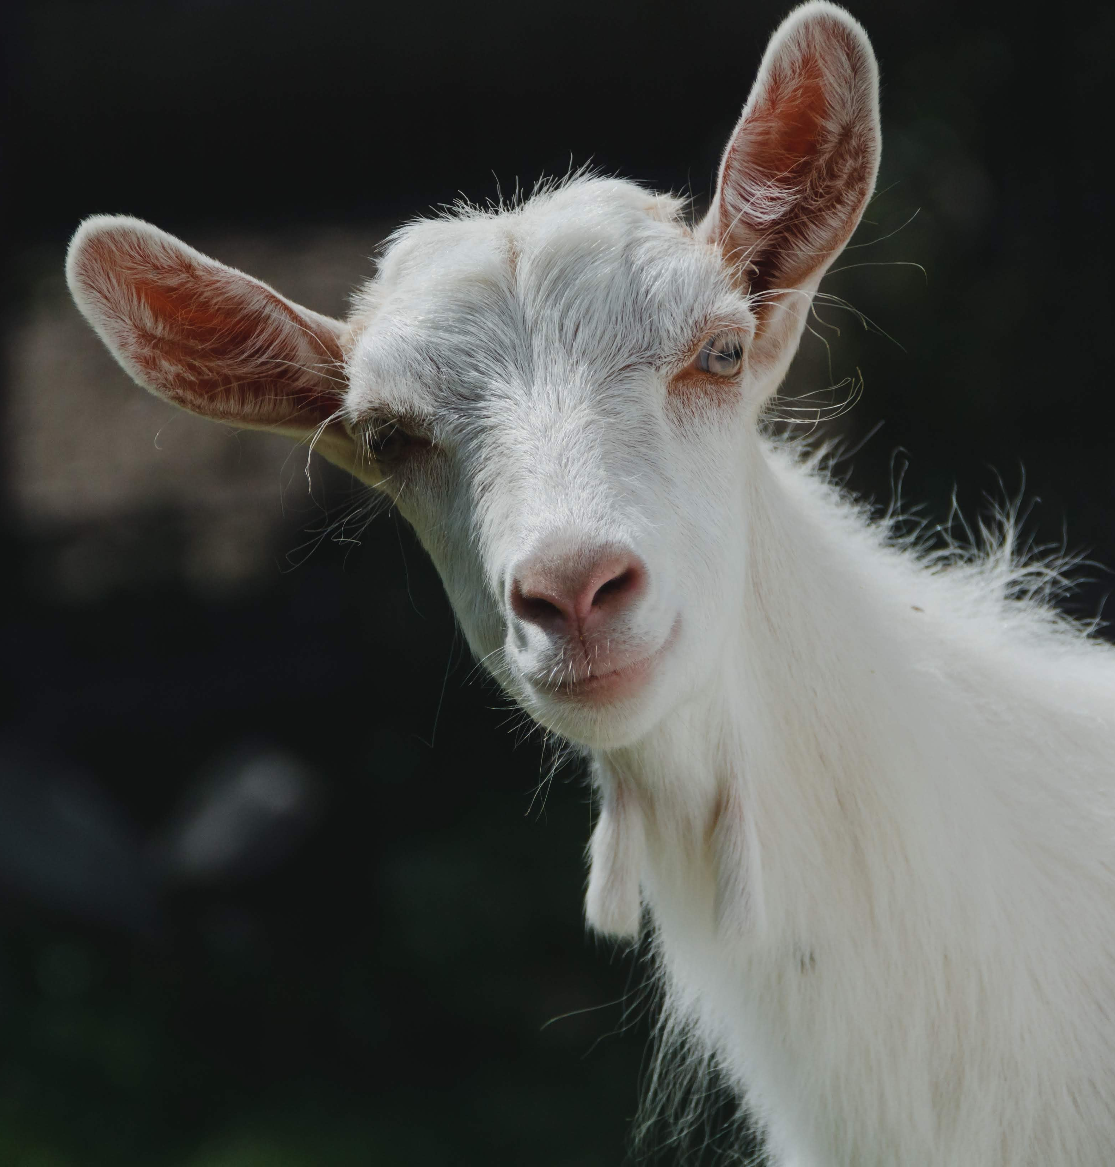
What emotion is this animal experiencing?
Anger
Fear
Surprise
Disgust
Happiness
Sadness
Notes:
Correct Answer: E. Happiness
Source: Photo by Sergiu Vălenaș on Unsplash

Slide 10

Which face matches the voice?
A B
Notes:
Correct Answer: B. Anger
Source: https://www.researchgate.net/figure/Examples-of-each-of-the-posed-facial-expressions-in-the-CAFE-set_fig1_271331770

Slide 11
Which face matches the voice?
A B
Notes:
Correct Answer: A. Happiness
Source: https://www.researchgate.net/figure/Examples-of-each-of-the-posed-facial-expressions-in-the-CAFE-set_fig1_271331770

Slide 12
Which face matches the voice?
A B
Notes:
Correct Answer: B. Disgust
Source: https://www.researchgate.net/figure/Examples-of-each-of-the-posed-facial-expressions-in-the-CAFE-set_fig1_271331770

Slide 13
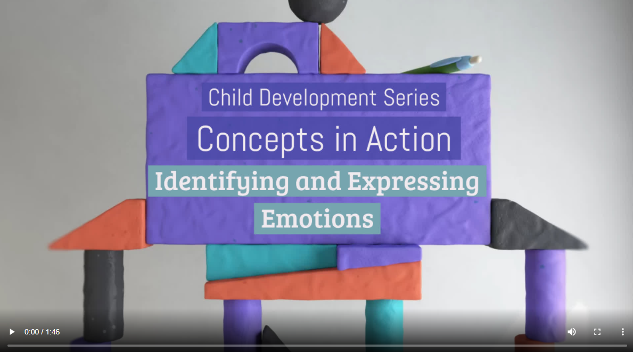
Watch this Video
Notes:
A fully accessible version of this video is available by logging on to Oxford LearningLink and selecting the appropriate Concept in Action video.
https://learninglink.oup.com/access/tamis-lemonda1e-student-resources#tag_concepts-in-action-videos

