Slide 1
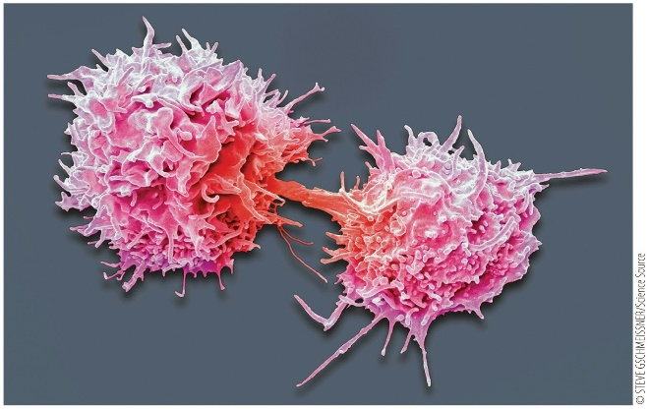
Development of T Lymphocytes
Notes:
Chapter 5 Opener

Slide 2
Chapter 5 Development of T Lymphocytes
5.1 What is the role of the thymus in T-cell development?
5.2 Which cells are precursors to developing thymocytes?
5.3 What is the role of Notch1 in T-cell development?
5.4 What are the stages of T-cell development?
5.5 How does a developing thymocyte pass through the β-chain checkpoint?
5.6 How does a developing thymocyte pass through the α-chain checkpoint?
5.7 How does positive and negative selection of T cells occur?
5.8 How is T-cell receptor diversity achieved?

Slide 3
5.1 What is the role of the thymus in T-cell development? 1
Thymus
Primary lymphoid organ responsible for T-cell development
Undifferentiated lymphocyte precursor cells migrate from the bone marrow and blood to the thymus, where T cells develop and mature.
Notes:
Instructor Notes:
Thymus function: the ability of a T-cell receptor (TCR) to recognize MHC:peptide complexes. Tolerance to self peptides -that T-cell receptors (TCRs) cannot bind too tightly to MHC:self-peptide complexes and cause autoreactivity.
The thymus plays an important role in promoting recombination events within the developing T cell, and thymic cells are essential to the selection events required to ensure tolerance and prevent T-cell autoreactivity.
An individual with a small or missing thymus, as in DiGeorge syndrome, will have impaired T-cell production and may experience frequent infections. DGS is most commonly associated with the deletion of a small part of chromosome 22, which can result in abnormal development of the thymus and impaired T-cell production.

Slide 4
5.1 What is the role of the thymus in T-cell development? 2
Anatomy of the thymus
The thymus has two lobes: each have an outer cortex and inner medulla
Immature T cells (thymocytes) undergo key developmental steps to ensure proper TCR expression in the cortex.
The medulla is where mature thymocytes undergo negative selection and finish their development into naïve T cells.
Notes:
Instructor Notes:
Thymocytes must receive the correct signals to promote their development, activate pathways required for the development process, test cells at designated checkpoints, and prevent self-recognition.

Slide 5
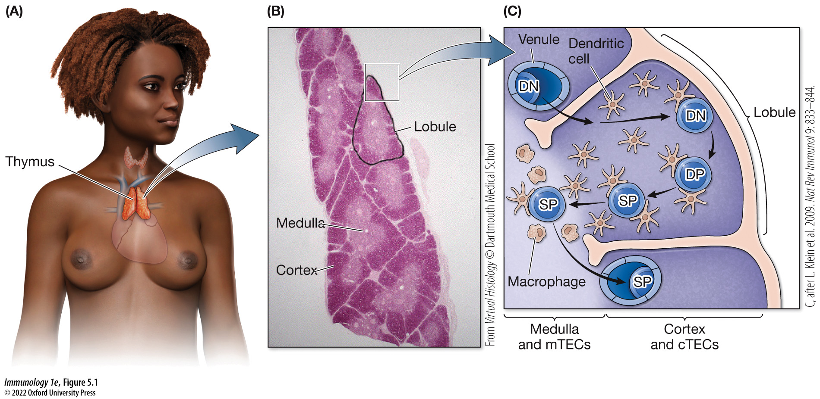
Figure 5.1 Anatomy of the thymus
Notes:
FIGURE 5.1 Anatomy of the thymus
(A) The thymus, the primary lymphoid tissue for T-cell development, is located just above the heart and below the thyroid gland. (B) The thymus contains many lobules, each consisting of cortex and medulla, where thymo­cytes develop into T cells (used with permission of Dartmouth College). (C) Developing thymocytes enter the thymus as double-negative (DN) thymocytes and interact with cortical thymic epithelial cells (cTECs) to begin their development into T cells. DN thymocytes under­go cell-surface changes that transform them into double-­positive (DP) thymocytes. Further maturation of DP thymocytes occurs in the medulla, where they are tested for self-reactivity by medullary thymic epithelial cells (mTECs), dendritic cells, and macro­phages before they exit the thymus as single-positive (SP) T cells. (C, after L. Klein et al. 2009. Nat Rev Immunol 9: 833–844.)

Slide 6
5.1 What is the role of the thymus in T-cell development? 3
Cells of the thymus
Resident cells of the thymus drive the development of thymocytes into naïve T cells
Thymic epithelial cells (TECs)
Macrophages
Dendritic cells
Hassall’s corpuscles
Notes:
Instructor Notes:
Thymic epithelial cells play an important role in activating genes required for thymocyte development and in their maturation. They also play a role in several key developmental checkpoints of thymocyte differentiation.
Macrophages remove thymocytes that have not developed properly and have undergone apoptosis (programmed cell death). The cellular debris that remains is phagocytosed by resident macrophages.
Dendritic cells present self-antigens to developing thymocytes to test the functionality of the T-cell receptor and to define tolerance to self-molecules.
The medulla contains the (also known as thymic corpuscles), which contain epithelial cells that express an important protein, thymic stromal lymphopoietin (TSLP). The TSLP protein triggers thymic dendritic cells to activate a subset of thymocytes to develop into regulatory T cells by activating a transcription factor known as FOXP3 (forkhead box P3) within the engaged thymocytes.

Slide 7
5.1 What is the role of the thymus in T-cell development? 4
EVOLUTION AND IMMUNITY
Thymus Organogenesis
How did the thymus evolve?
A primitive thymus, known as the thymoid, has been described in lamprey, a jawless fish.
Lymphocyte-like cells with multiple leucine-rich repeat (LRR) domains, termed variable-lymphocyte receptors (VLRs) are found in lamprey.
Notes:
Instructor Notes:
A thymus can be found in humans and mice, as well as jawed fish, the most primitive surviving jawed vertebrates.
T-cell receptor diversity arose abruptly in jawed fish. It is likely that T-cell development had to arise according to a similar evolutionary timeframe.
The thymus in these animals is arranged in a very similar manner to that of humans and mice, suggesting similar biological function.
The LRRs present in these lamprey lymphocyte-like cells are highly variable at the amino-acid level.
VLR genes are reorganized from the germline structure via somatic gene rearrangement resulting in a unique VLR in each lymphocyte.
Within the lamprey thymoid, cells with improperly recombined VLR genes are associated with high apoptosis activity.

Slide 8
5.2 Which cells are precursors to developing thymocytes?
Hematopoietic stem cells are characterized by cell-surface markers present on the stem cell precursors, along with the absence of lineage-specific markers.
CD34 and CD38 are expressed on both human and mouse T cells.
Notes:
Instructor Notes:
Progenitor cells give rise to T cells, B cells, dendritic cells, and natural killer cells.
It is known that IL-7 is secreted by thymic epithelial cells as a signaling molecule, as individuals who are homozygous recessive for a nonfunctional mutant IL-7 receptor are immunocompromised due to a lack of T cells.
A stem cell must first differentiate into a lymphoid progenitor cell.
Mouse lymphoid progenitors express the IL-7 receptor, while human cells committed to becoming thymocytes do not express the IL-7 receptor until they have been further differentiated.
Human and mouse hematopoietic stem cells differ in their cell-surface markers.

Slide 9
5.3 What is the role of Notch1 in T-cell development?
Lymphoid progenitors are precursors to several cell types
Lymphoid progenitors must receive the appropriate signal to commit to a differentiated cell type.
The Notch signaling pathway regulates cell proliferation and differentiation
The protein Notch is a cell-surface receptor that interacts with transmembrane ligands on adjacent cells.
Notes:
Instructor Notes:
In mammals, there are four different Notch receptors that play a role in a variety of processes, including neuronal development, growth of blood vessels, and cardiac function.
Notch1 has been shown to be vital in committing a lymphoid progenitor to the T-cell lineage, presumably by inhibiting B-cell development within the thymus.

Slide 10
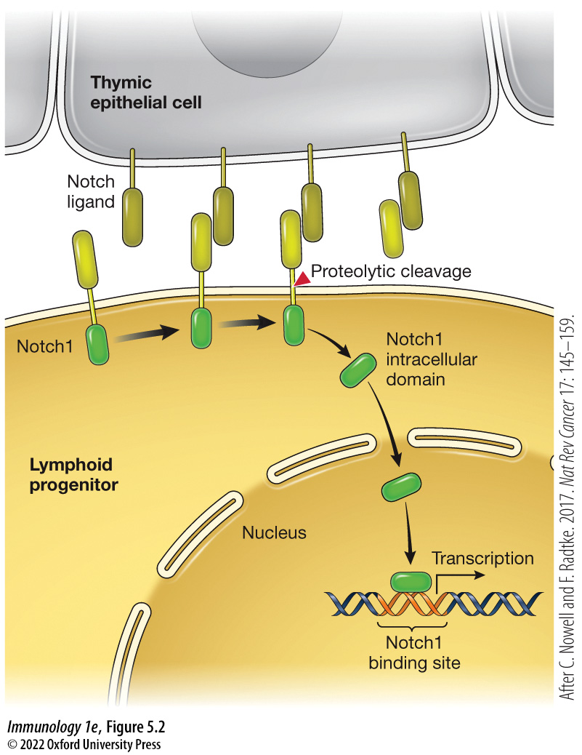
Figure 5.2 Notch1 signaling commits thymocytes to T-cell development
Notes:
FIGURE 5.2 Notch1 signaling commits thymocytes to T-cell development
Binding of Notch1 on the surface of lymphoid progenitor cells to Notch ligand on thymic epithelial cells promotes the proteolytic cleavage of Notch1. This releases the intracellular domain of Notch1 from the membrane, allowing it to translocate to the nucleus to initiate transcription of genes necessary for development into T cells. (After C. Nowell and F. Radtke. 2017. Nat Rev Cancer 17: 145–159.)
Instructor Notes:
As shown in Figure 5.2, this activation occurs through the proteolytic cleavage of Notch1 at the plasma membrane of the lymphoid progenitor, which releases an active cytosolic domain. The cytosolic Notch1 domain translocates into the nucleus, where it activates gene expression required for T-cell differentiation.
Thymic epithelial cells secrete IL-7, a signal required for T-cell development and rearrangement of T-cell receptor genes.

Slide 11
5.4 What are the stages of T-cell development? 1
Developmental stages
Double-negative thymocyte does not express either coreceptor (CD4 or CD8) and is found in the thymic cortex during initial development
Begins somatic recombination at the TCR loci and continues until both subunits of the receptor have properly rearranged.
At this point, both coreceptors (CD4 and CD8) are expressed.
Notes:
Instructor Notes:
A thymocyte progresses through several developmental stages. At each stage, the term used to describe the thymocyte is based on the presence or absence of T-cell receptor and coreceptor components on its surface.
The primary goal of these developmental stages is to produce a population of T cells with a diverse array of T-cell receptors.

Slide 12
5.4 What are the stages of T-cell development? 2
Developmental stages (cont’d)
Double-positive thymocyte expresses a fully rearranged TCR, and both CD4 and CD8
Several possible fates
Some develop into regulatory T cells.
Some develop into NK T cells.
Others begin the process of positive and negative selection to test the TCR and select for a single coreceptor to become a single-positive thymocyte.
Notes:
Instructor Notes:
During these developmental stages, important checkpoints test to ensure that proper recombination events have taken place at the T-cell receptor loci.

Slide 13
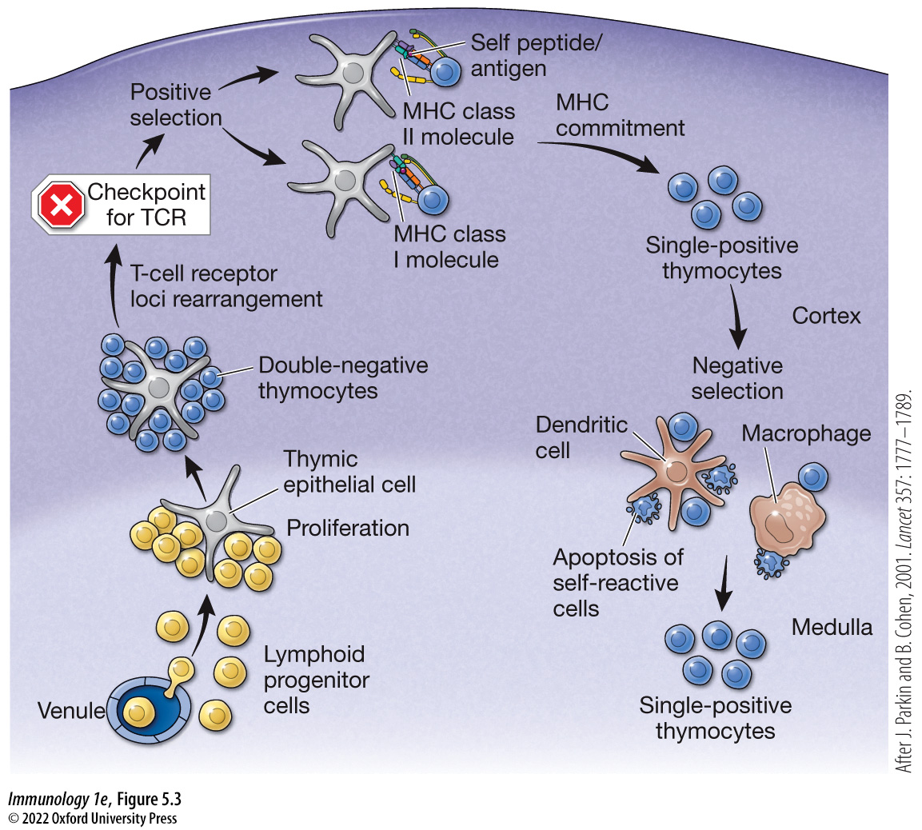
Figure 5.3 Key steps in T-cell development
Notes:
FIGURE 5.3 Key steps in T-cell development
During the development process, lymphoid progenitor cells within the thymus receive signals from thymic epithelial cells to initiate proliferation and commitment to the T-cell lineage. Developing thymocytes undergo gene rearrangement at their T-cell receptor loci and are tested to ensure productive rearrangements occur before continuing their developmental process. Two checkpoints for productive rearrangement of T-cell receptor loci occur, one for rearrangement of the β chain and one for rearrangement of the α chain. Cells that fail to pass either checkpoint die by apoptosis. After positive selection of the T-cell receptor, T cells undergo MHC commitment based on the affinity of the T-cell receptor with either MHC class I or MHC class II self-peptide complexes to express either the coreceptor CD4 or CD8. These single-positive thymocytes undergo negative selection to promote central tolerance, and self-reactive cells are removed by apoptosis. The resulting single-positive thymocytes enter the circulation to function as circulating naive T cells. (After J. Parkin and B. Cohen, 2001. Lancet 357: 1777–1789.)

Slide 14
5.4 What are the stages of T-cell development? 3
Differences in cell-surface markers
Initial development of the double-negative thymocyte has various stages in humans
Differ from mouse thymocytes in regard to the cell-surface molecules present during the developmental process.
Human lymphoid progenitor cells in the thymus shut down expression of the stem cell marker CD34; begin expressing the adhesion and signaling molecules CD2, CD5, and CD7.
As they continue their development they begin to express CD1 at their cell surface.
They do not express CD4 or CD8 and are double-negative thymocytes early in development.
Notes:
Instructor Notes:
In mice, lymphoid progenitor cells migrating from the bone marrow to the thymus express two important cell-surface molecules (c-kit/CD117 and CD44 and are referred to as DN1 (double-negative 1) thymocytes.
Mouse thymocytes committed to development into T cells become DN2 cells and begin to express CD25.
As mouse thymocytes continue their development, they become DN3 cells.
DN3 cells have gone through somatic recombination of their β chain and turned off expression of CD44.
After successfully completing the β-chain checkpoint, it continues its development into a DN4 cell.
Ultimately expressing a low level of c-kit/CD117 and no longer expressing CD44 or CD25 at the surface.

Slide 15
5.4 What are the stages of T-cell development? 4
Critical checkpoints
There are three key checkpoints that a thymocyte must pass to continue development and become a functional naïve T cell
Checkpoint of the γδ subunit of the T-cell receptor
Checkpoint of the β subunit of the T-cell receptor
Checkpoint of the α subunit of the T-cell receptor
Notes:
Instructor Notes:
Checkpoint 1: A thymocyte that has properly gone through development can only express either an αβ TCR or a γδ TCR. Rearrangement of the T-cell receptor loci begins at the β, γ, and δ genes, and a T cell that has properly recombined both the γ and δ loci is destined to become a γδ T cell.
Checkpoint 2: This checkpoint occurs during the somatic recombination events to test the β subunit of the TCR. Βετα recombines at the same time as the γ and δ subunits. If the β subunit recombines properly, somatic recombination is inactivated to allow for the next developmental stage.
Checkpoint 3: To test the α subunit of the T-cell receptor.

Slide 16
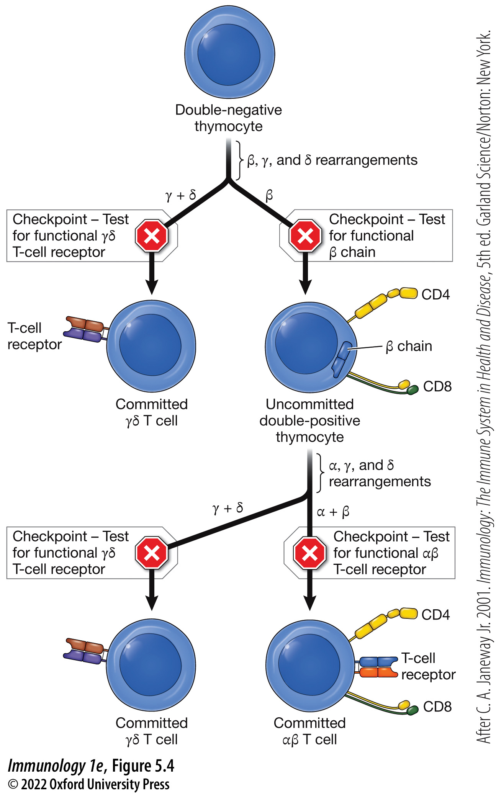
Figure 5.4 Timing of somatic recombination in T-cell development
Notes:
FIGURE 5.4 Timing of somatic recombination in T-cell development
Thymocytes rearrange their T-cell receptor loci and test these rearrangements at defined checkpoints before continuing their developmental process. Developing thymocytes can commit to the γδ T-cell lineage if they first productively rearrange their γ and δ T-cell receptor loci, or they can commit to the αβ T-cell lineage if they first productively rearrange their α and β T-cell receptor loci. (After C. A. Janeway Jr. 2001. Immunology: The Immune System in Health and Disease, 5th ed. Garland Science/Norton: New York.)

Slide 17
5.4 What are the stages of T-cell development? 5
Development into one of two T-cell lineages
γδ T cells represent 0.5% of T cells in mice and 3.5% in humans.
Why are γδ T cells important?
They protect the fetus during development.
In adults, γδ T cells play an important role in protecting mucosal surfaces.
Notes:
Instructor Notes:
Because γδ T cells require two successful recombination events, adults do not have a large quantity of γδ T cells.
They are the first T cells produced and work to protect the fetus.
These cells can recognize unconventional antigens, including lipids, using their γδ T-cell receptors
If the γ and δ genes recombine properly, the thymocyte will be committed to becoming a γδ T cell.
As developing thymocytes induce somatic recombination events to create a functional T-cell receptor, the race is on. The factor that determines whether a developing thymocyte becomes an αβ T cell or a γδ T cell is how fast the receptor genes recombine. Initially, recombination events target the β, γ, and δ loci of the T-cell receptor genes.

Slide 18
5.4 What are the stages of T-cell development? 6
MAKING CONNECTIONS
Hematopoiesis and the Commitment to the T-cell Lineage
Hematopoiesis produces all cell types of the circulatory system from a common stem cell.
T cells begin their life in the bone marrow as a common lymphoid progenitor.
Migration of common lymphoid progenitors to the thymus along with signals given by cells commit the common lymphoid progenitors to the T-cell lineage.

Slide 19
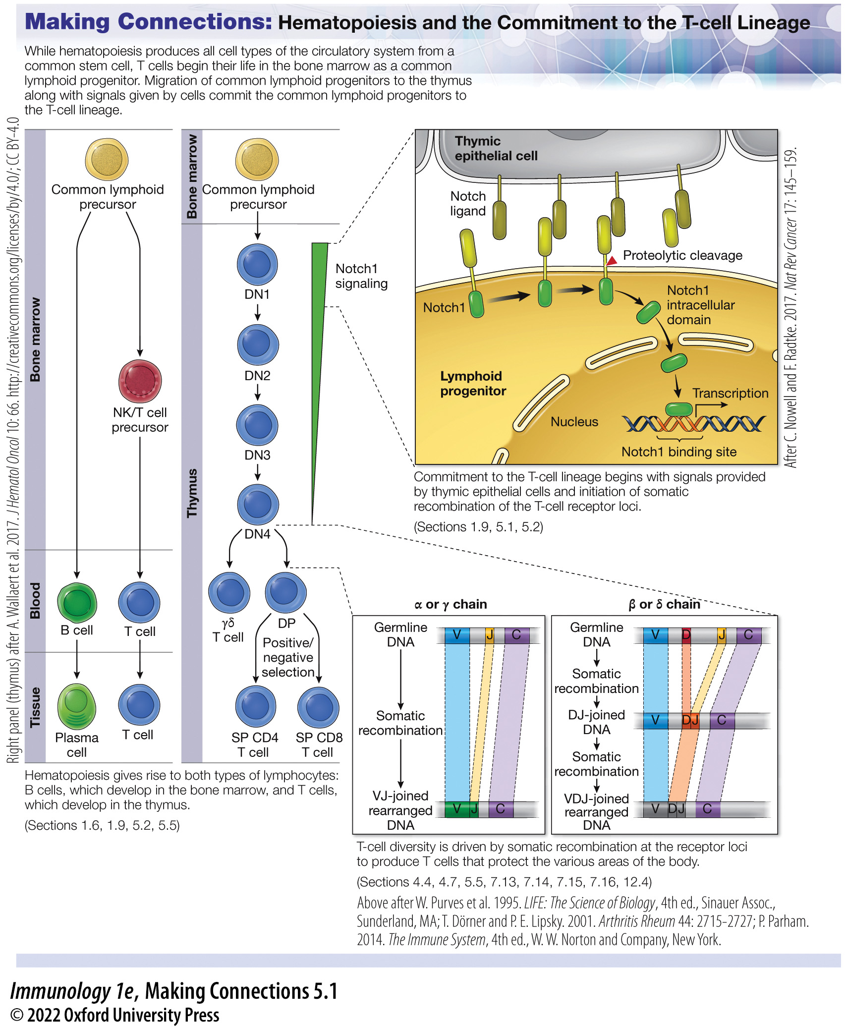
Making Connections: Hematopoiesis and the Commitment to the T-cell Lineage
Notes:
Making Connections: Hematopoiesis and the Commitment to the T-cell Lineage

Slide 20
5.5 How does a developing thymocyte pass through the β-chain checkpoint? 1
Somatic recombination is activated through the expression of the RAG1 and RAG2 proteins.
Recombination events begin at the β, γ, and δ loci of the TCR.
If productive rearrangements occur at the γ and δ loci, the thymocyte becomes a γδ T cell.
There are four possible productive β-chain rearrangements.
Most T cells will express the β-chain.
Notes:
Instructor Notes:
There are both β1 and β2 D and J segments on each chromosome, providing an opportunity for a β-chain V segment to rearrange with either a β1 D and J segment or to rearrange with a β2 D and J segment on either chromosome, providing four possible opportunities for a productive β-chain rearrangement.
Only a single productive rearrangement of the β-chain locus is required to reach the β-chain checkpoint before rearrangement of the γ and δ loci occurs.

Slide 21
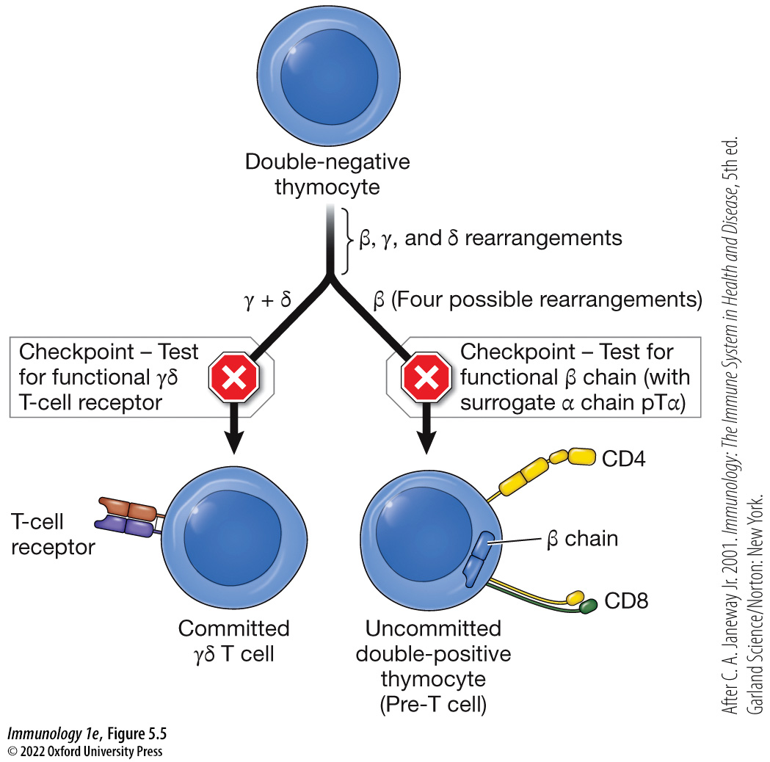
Figure 5.5 First series of recombination events during T-cell development
Notes:
FIGURE 5.5 First series of recombination events during T-cell development
Double-negative thymocytes first recombine the β, γ, and δ chain T-cell receptor loci. If both the γ- and δ-chain loci are productively recombined, the cell is committed to the γδ T-cell lineage. If the β-chain loci recombines first, it is tested with a surrogate α-chain pT α before becoming a pre-T cell. If all recombination events are unproductive, the thymocyte dies by apoptosis. (After C. A. Janeway Jr. 2001. Immunology: The Immune System in Health and Disease, 5th ed. Garland Science/Norton: New York.)

Slide 22
5.5 How does a developing thymocyte pass through the β-chain checkpoint? 2
To test for a productive arrangement of the β chain, the developing thymocyte must assemble a surrogate T-cell receptor complex.
Recombination of the α-chain locus occurs once the β-chain checkpoint has been passed.
Pre-T α chain (pTα), a surrogate alpha chain, assembles with the rearranged β chain and the CD3 complex to form the pre-TCR.
This pre-T cell receptor complex ensures that a functioning T-cell receptor can signal via the same transduction pathways used to activate T cells.
Notes:
Instructor Notes:
A surrogate α chain must be used to permit assembly of a receptor complex.
The CD3 complex plays a role in downstream signaling events upon T-cell receptor engagement.
If a thymocyte does not properly rearrange the β-chain locus (and has also not rearranged the γ and δ chain loci), it is removed by apoptosis.
Pre-T cells (express pTα) and can form a complex (the pre-TCR) and continue their development.
The large number of thymocytes that do not pass the checkpoints undergo apoptosis and are removal by resident macrophages.

Slide 23
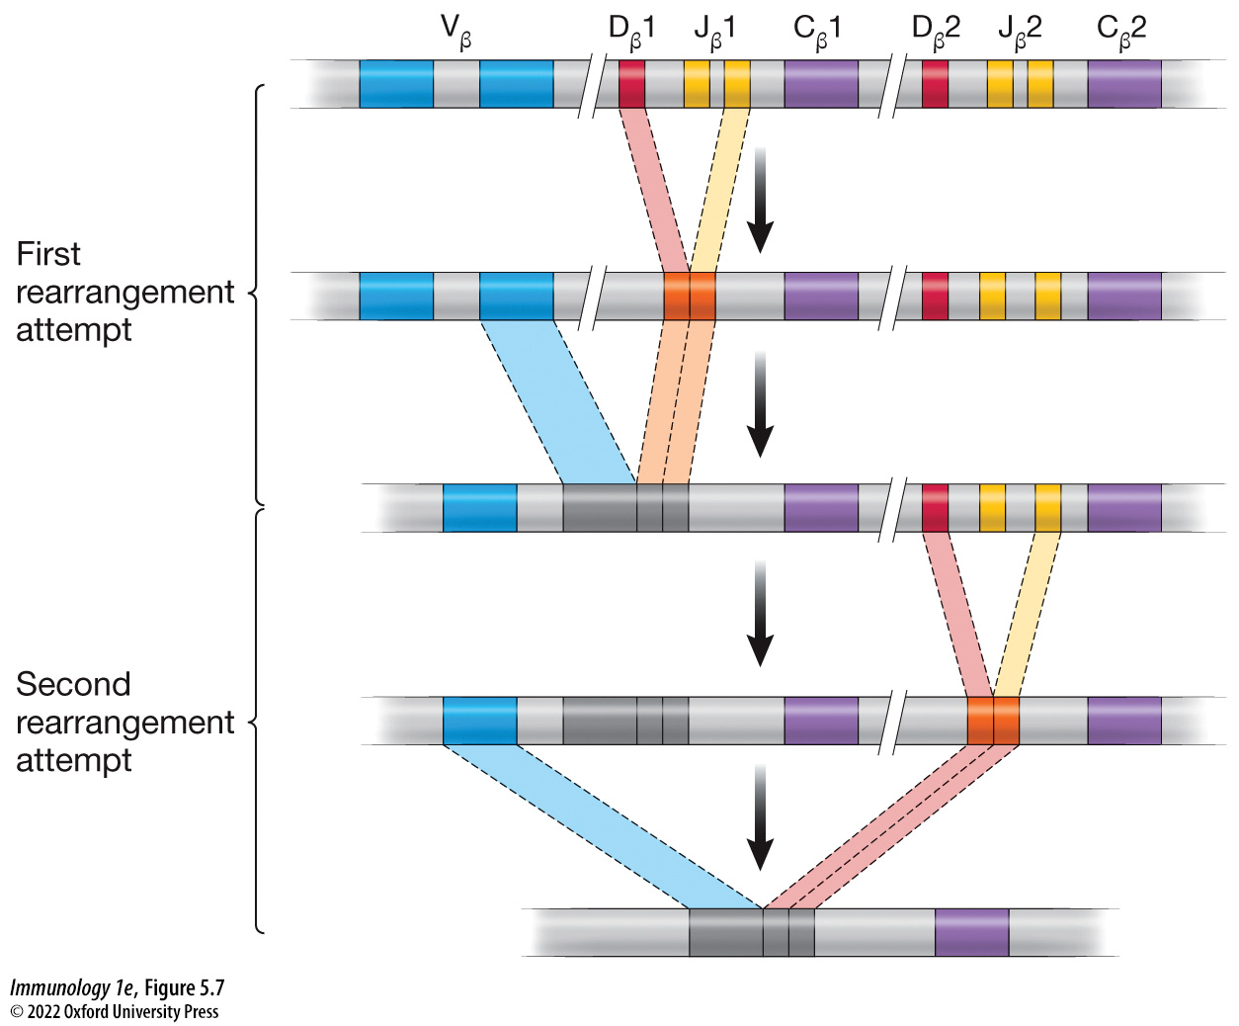
Figure 5.7 Four possible rearrangement attempts to produce a functional β chain
Notes:
Figure 5.7 Four possible rearrangement attempts to produce a functional β chain
Each β-chain locus has two constant regions preceded by two regions that contain D and J segments. Each constant region with its corresponding D and J segments may be recombined with a V segment to attempt to produce a functional β chain. All somatic cells have two chromosomes. Because there are two constant regions and two possible rearrangement attempts per chromosome, there are four possible rearrangement attempts of a β-chain locus.

Slide 24
5.5 How does a developing thymocyte pass through the β-chain checkpoint? 3
Once through the β-chain checkpoint, the cell
Proliferates.
Expresses RAG1 and RAG2 again.
Which begins recombination at the other T-cell receptor loci (α, γ, and δ).
Undergoes allelic exclusion.
Notes:
Instructor Notes:
Allelic exclusion prevents further recombination of the β−chain locus.
Once through the β-chain checkpoint, the cell begins to proliferate and produces a large number of clones that express the same β chain.
To produce a productive rearrangement event of the α chain, a Vα and Jα gene segment must recombine.
This rearrangement event must also be tested, leading to another developmental checkpoint.

Slide 25
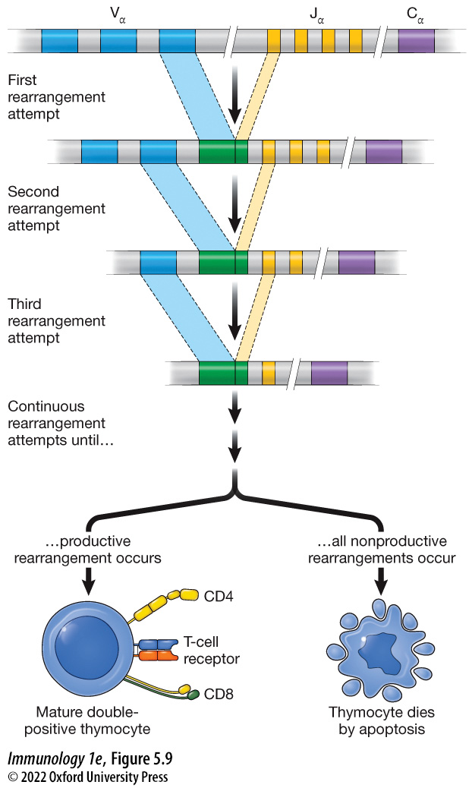
Figure 5.9 Possible rearrangement attempts to produce a functional α chain
Notes:
Figure 5.9 Possible rearrangement attempts to produce a functional α chain
Each α-chain locus has a constant region preceded by many V and J segments, and each V and J segment can randomly recombine. Each recombined locus will be tested to determine whether it can produce a functional α chain capable of interacting with the recombined β chain to form a T-cell receptor.

Slide 26
5.5 How does a developing thymocyte pass through the β-chain checkpoint? 4
CLICKER QUESTION 1
When is RAG1 and RAG1 expressed in the T cell?
Both before and after the β-chain checkpoint
Only before the β-chain checkpoint
Only after the β-chain checkpoint
Notes:
Instructor Notes:
Correct answer: a

Slide 27
5.6 How does a developing thymocyte pass through the α-chain checkpoint?
Rearrangement of the α chain must be tested to ensure TCR function.
The α chain is tested at the ER membrane.
If the expressed α chain does not function properly, the α-chain locus is further rearranged.
If a functional α chain is produced, the developing thymocyte continues development into a naïve T cell.
Notes:
Instructor Notes:
All membrane-bound components are translocated to the ER membrane to test functionality. TCR complex, upon activation of the expression of the α chain, it is translocated into the endoplasmic reticulum (ER) membrane.
This rearrangement and testing process continues until a functional α chain can be produced or until α-chain loci rearrangement can no longer occur.

Slide 28
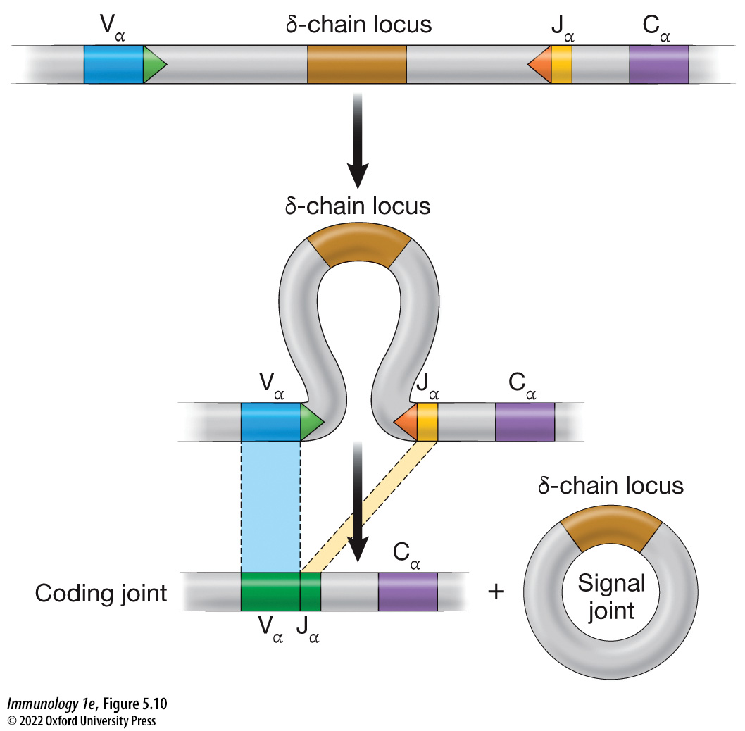
Figure 5.10 Structure of the α chain T-cell receptor loci
Notes:
Figure 5.10 Structure of the α chain T-cell receptor loci
After the T-cell receptor β chain is tested for productive rearrangement, recombination continues at the α, γ, and δ T-cell receptor loci. Productive rearrangement of the α-chain locus (tested at the αβ-chain checkpoint) results in removal of the δ-chain locus in the signal joint, thus preventing a T cell from being able to express both an αβ T-cell receptor and a γδ T-cell receptor.
Instructor Notes:
Successful α-chain rearrangement eliminates the possibility of producing a γδ T cell because the δ chain locus is positioned in the middle of the recombining α-chain locus.

Slide 29
5.7 How does positive and negative selection of T cells occur? 1
Thymocytes that have successfully passed through both checkpoints can now continue through the later stages of development.
Positive selection: promotes the selection of thymocytes that can bind to self-MHC molecules (MHC restriction)
Negative selection: prevents the release of thymocytes that can recognize MHC-self-peptide complexes with high-affinity (self-tolerance)
Notes:
Instructor Notes:
Have functional α and β chains and a functional TCR complex.
Become double-positive thymocytes, expressing both the CD4 and CD8 coreceptors.

Slide 30
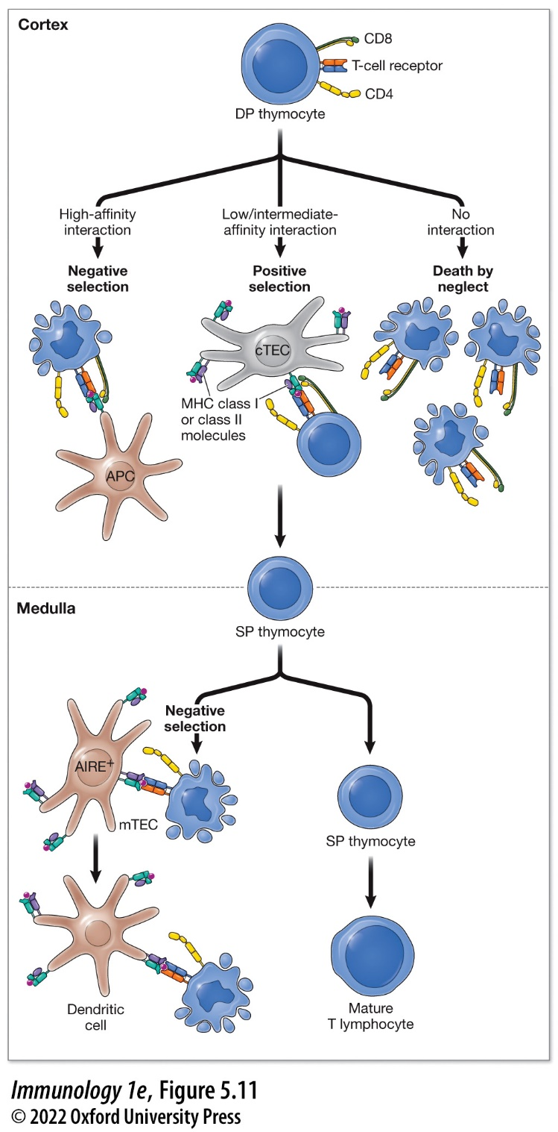
Figure 5.11 Positive and negative selection of developing thymocytes in the thymus
Notes:
Figure 5.11 Positive and negative selection of developing thymocytes in the thymus
Double-positive (DP) thymocytes that have passed the checkpoints that occur during somatic recombination are tested by antigen-presenting cells (APCs) or cortical thymic epithelial cells (cTECs) for the affinity of their T-cell receptor for MHC class I or II molecules presenting antigen. Thymocytes that cannot bind to MHC molecules or that bind with too high an affinity die by apoptosis. Those with a low or moderate affinity for MHC class I or II molecules presenting antigen first select for their coreceptor to become single-positive (SP) thymocytes and then undergo a second round of negative selection in the medulla. SP thymocytes in the medulla that bind to MHC molecules presenting antigen on the surface of either medullary thymic epithelial cells (mTECs) or dendritic cells die by apoptosis. Self antigens from endocrine tissues are expressed in mTECs due to the action of autoimmune regulator (AIRE). SP thymocytes that pass this round of negative selection exit the thymus as mature T lymphocytes.
Instructor Notes:
Most thymocytes that have passed through the α and β checkpoints (about 98% of the double-positive thymocytes) die by apoptosis and are removed at this stage.

Slide 31
5.7 How does positive and negative selection of T cells occur? 2
MAKING CONNECTIONS
T-Cell Development and Somatic Recombination
Development of T cells in the thymus involves somatic recombination of T-cell receptor loci.
Thymocytes can rearrange their α and β receptor loci or their γ and δ receptor loci.
At several stages in their development, thymocytes are tested for their ability to produce a functional T-cell receptor subunit before they can continue their developmental process.

Slide 32
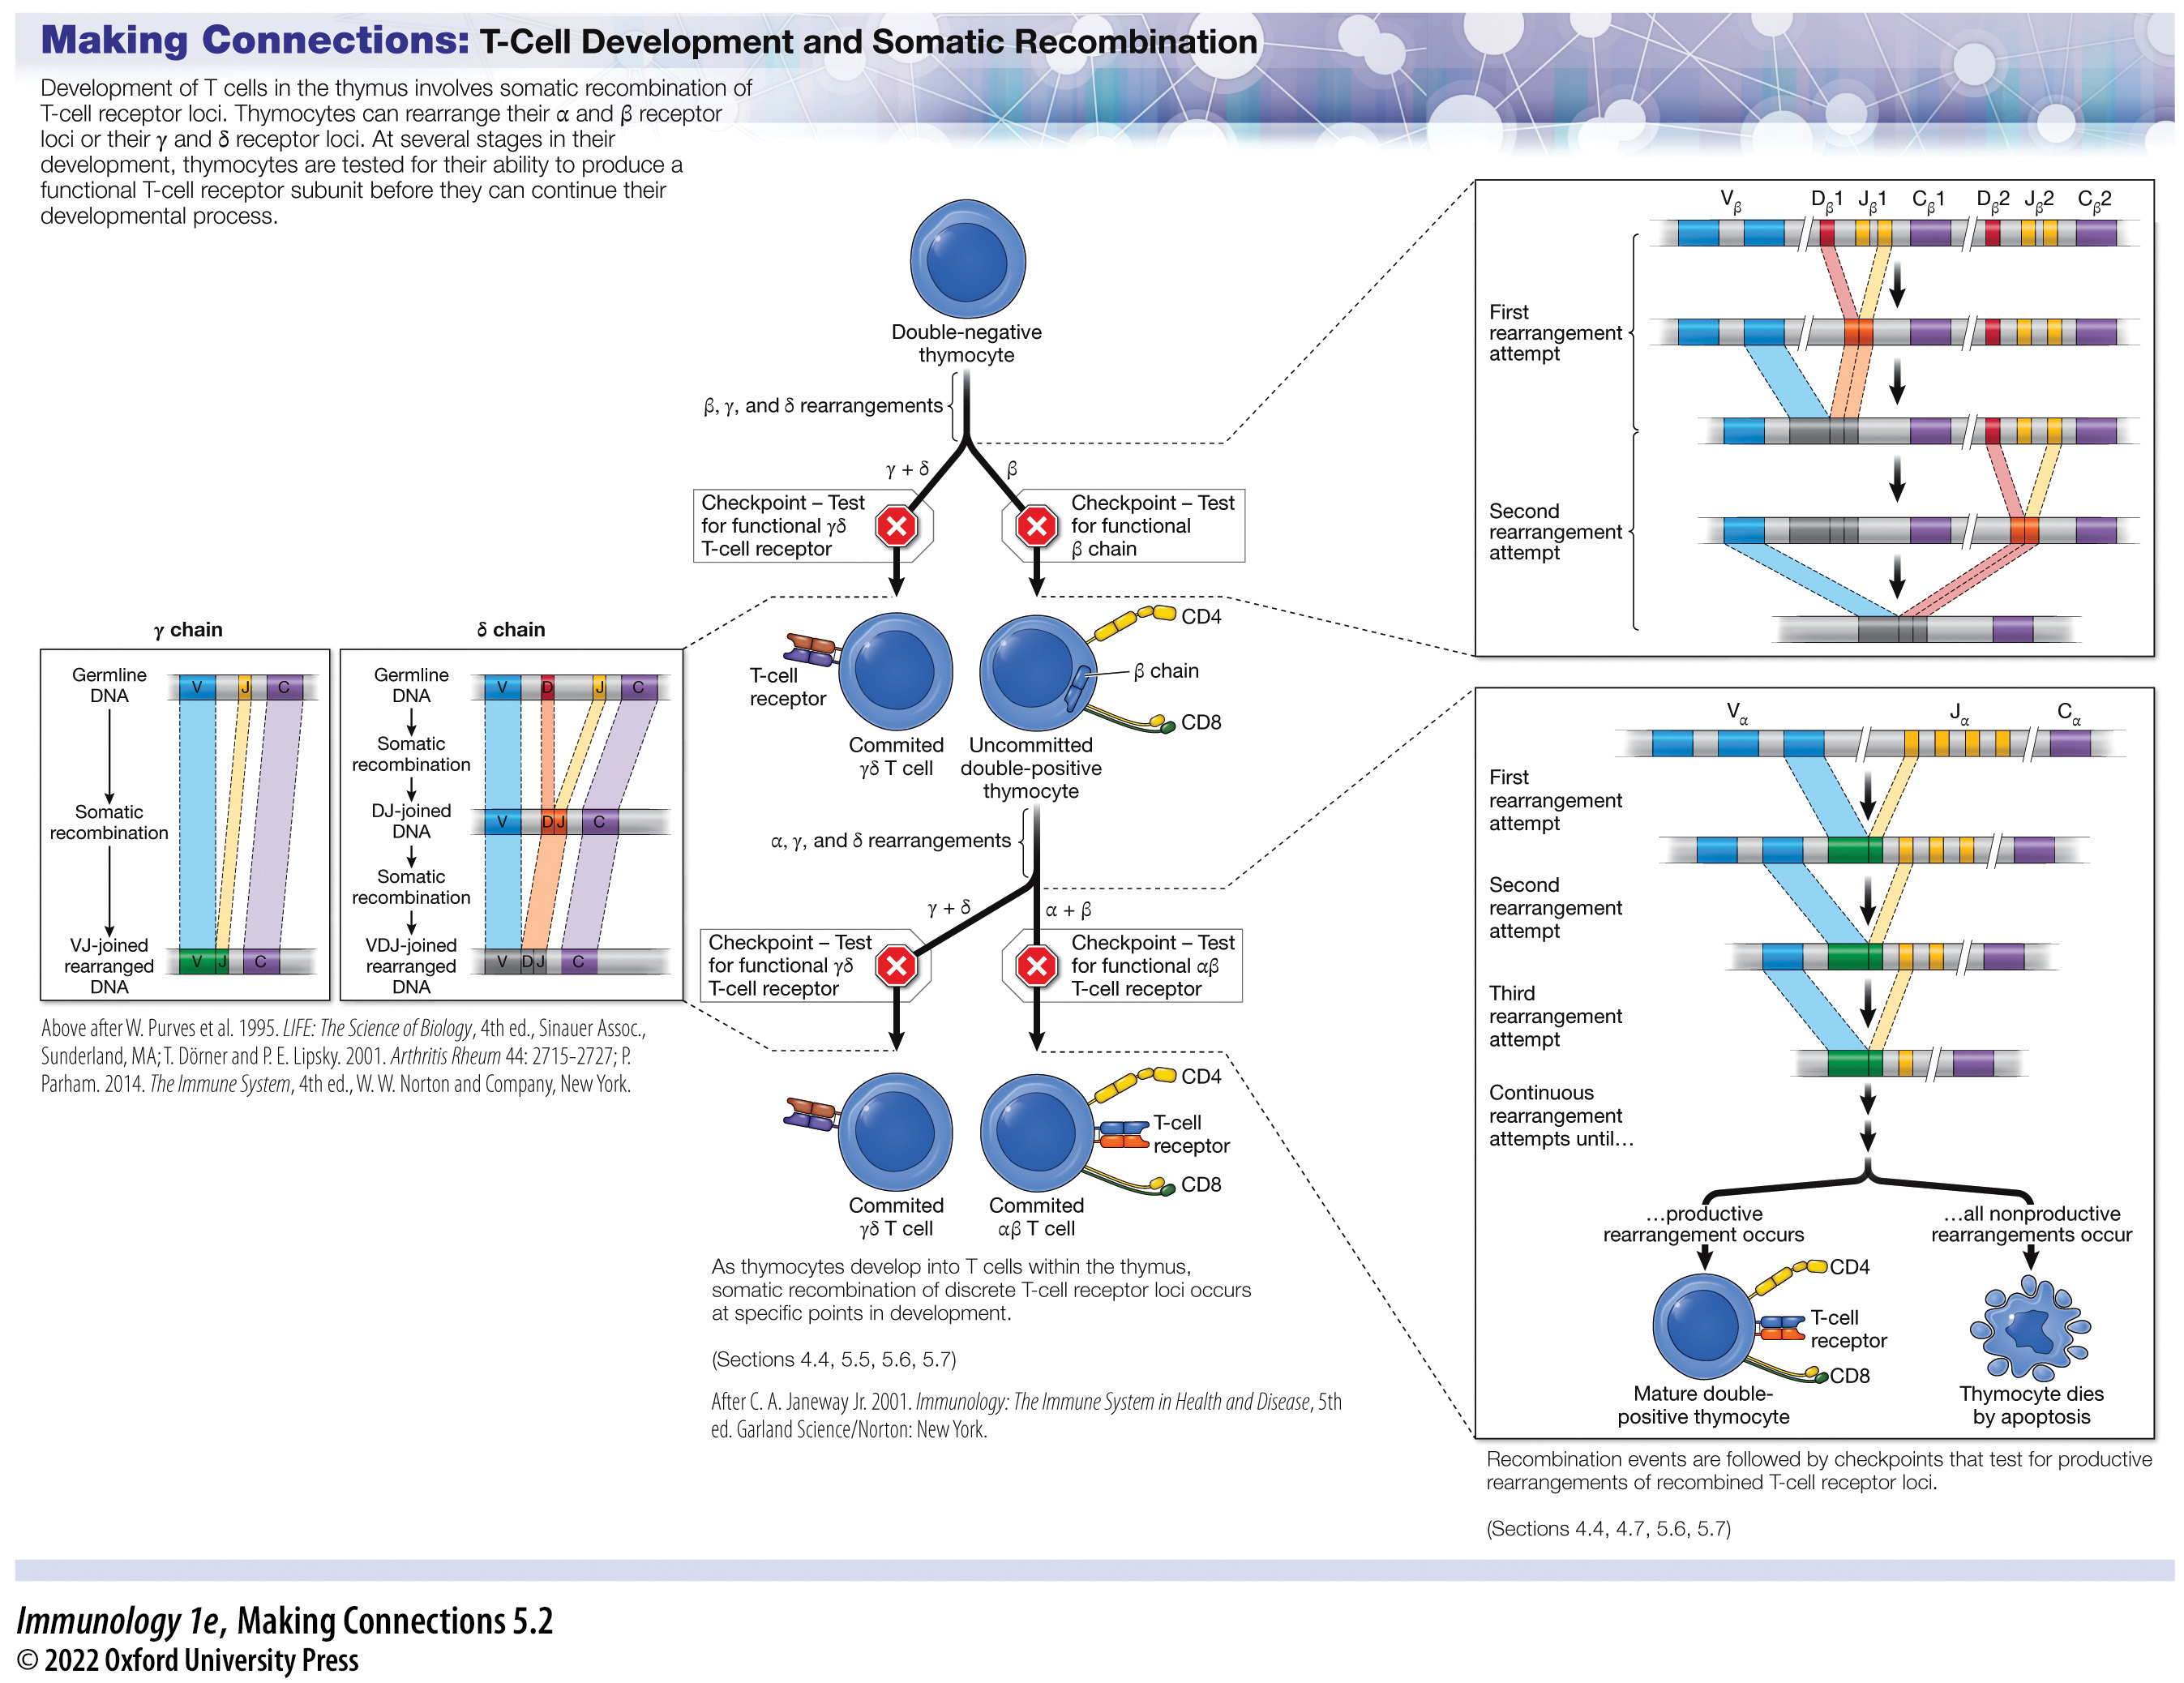
Making Connections: T-Cell Development and Somatic Recombination
Notes:
Making Connections: T-Cell Development and Somatic Recombination

Slide 33
5.7 How does positive and negative selection of T cells occur? 3
Selection within the thymic cortex
Double-positive thymocytes interact with cortical thymic epithelial cells (cTECs) to test the affinity of the TCR with MHC–peptide complexes at the cell surface.
cTECs can express both MHC class I and class II molecules.
cTECs can present a variety of self-peptides to promote positive selection of double-positive thymocytes – positively selecting those with the ability of the TCR to interact with MHC.
The selection process is based on the affinity of the T-cell receptor for the MHC–peptide complexes.

Slide 34
5.7 How does positive and negative selection of T cells occur? 4
Selection within the thymic cortex (cont’d)
This view of positive selection suggests three possible outcomes:
Death by neglect: Double-positive (DP) thymocytes cannot interact with any MHC–peptide complexes.
Negative selection: DP thymocytes bind too tightly with an MHC–peptide complex.
Positive selection: DP thymocytes with TCRs that can interact with an MHC–peptide complex with a low or intermediate affinity survive and proliferate.
Notes:
Instructor Notes:
Death by neglect: These cells cannot recognize self-MHC molecules and so are of no use to the organism in regard to an adaptive immune response. These cells do not receive survival signals from thymic epithelial cells because they cannot interact with those cells, and the lack of a survival signal causes them to die by apoptosis.
Negative selection: DP thymocytes bind too tightly with an MHC–peptide complex on the surface of thymic epithelial cells are potentially dangerous to the organism. These cells could mount an adaptive immune response against self-molecules, so they are negatively selected and die by apoptosis (see KEY DISCOVERIES).
Positive selection: DP thymocytes with TCRs that can interact with an MHC–peptide complex with a low or intermediate affinity (about three times lower than negatively selected cells) are positively selected. These cells survive and proliferate.

Slide 35
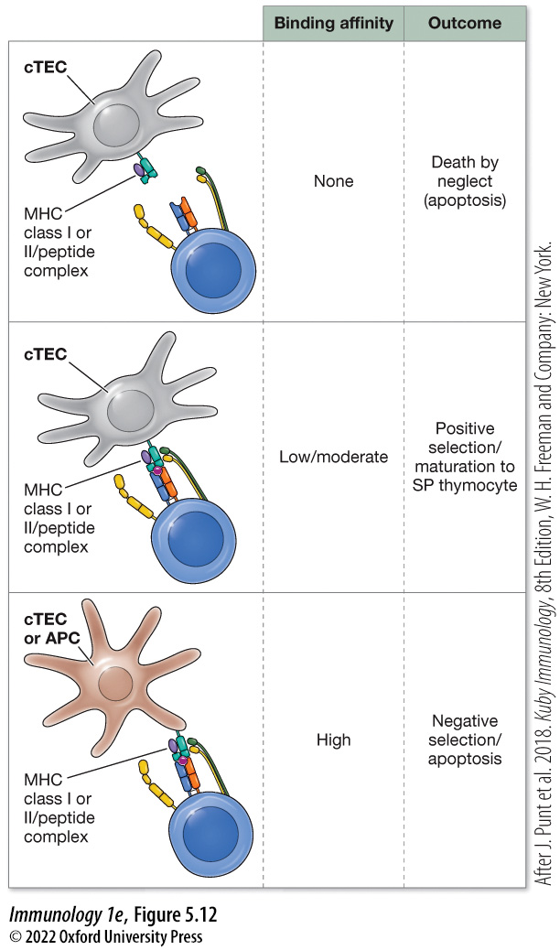
Figure 5.12 Possible fates of developing thymocytes in the thymic cortex
Notes:
FIGURE 5.12 Possible fates of developing thymocytes in the thymic cortex
Double-positive (DP) thymocytes that have passed the checkpoints during somatic recombination are tested by antigen-presenting cells (APCs) or cortical thymic epithelial cells (cTECs) for the affinity of their T-cell receptor for MHC class I or II molecules presenting antigen. Thymocytes that cannot bind to MHC molecules or that bind with too high an affinity die by apoptosis. Thymocytes with a low or moderate affinity for MHC class I or II molecules presenting antigen first select for their coreceptor to become single-positive (SP) thymocytes. (After J. Punt et al. 2018. Kuby Immunology, 8th ed., W. H. Freeman and Company: New York.)

Slide 36
5.7 How does positive and negative selection of T cells occur? 5
MHC restriction and lineage commitment
During selection within the thymic cortex, DP thymocytes further develop and express only a single coreceptor (either CD4 or CD8).
Lineage commitment (commitment of a thymocyte to express a single coreceptor).
Both transcriptional control and epigenetics likely play roles in this process.
Two models have been proposed: Instructive and Kinetic signaling
Notes:
Instructor Notes:
T cells use CD4 or CD8 to fully engage an MHC–peptide complex.
Epigenetics: changing the phenotype by modifying gene expression rather than the DNA sequence itself.

Slide 37
5.7 How does positive and negative selection of T cells occur? 6
Instructive model
Interaction-driven selection.
If a TCR engages an MHC class I molecule presenting a peptide, the interaction will also promote CD8 interaction with the complex and shut down CD4 expression.
If a TCR engages an MHC class II molecule presenting a peptide, the CD4 coreceptor will engage in the interaction, and the thymocyte will receive a signal to prevent CD8 expression.
Notes:
Instructor Notes:
Instructive Model: The interaction between the TCR on a DP thymocyte and the MHC–peptide complex on a thymic epithelial cell drives the selection of the coreceptor.

Slide 38
5.7 How does positive and negative selection of T cells occur? 7
Kinetic signaling model
Signal strength-driven selection.
Positively selected thymocytes will become CD4⁺ if the T-cell receptor/ coreceptor signal is continuous.
Positively selected thymocytes will become CD8⁺ if this signal is interrupted.
Notes:
Instructor Notes:
Kinetic Signaling Model: Stronger signaling events can drive CD4 expression, and weaker signaling events can drive CD8 expression.
This model also suggests that interruption in this signal does not prevent thymocyte development and is likely rescued by the cytokine IL-7, which can drive lineage commitment to CD8.
Although this model is also simplistic and not the whole story, it takes into account data from experiments that demonstrated that CD4+ or CD8+ thymocytes could be reprogrammed to express the other coreceptor by modulating the signaling strength within the thymocyte.

Slide 39
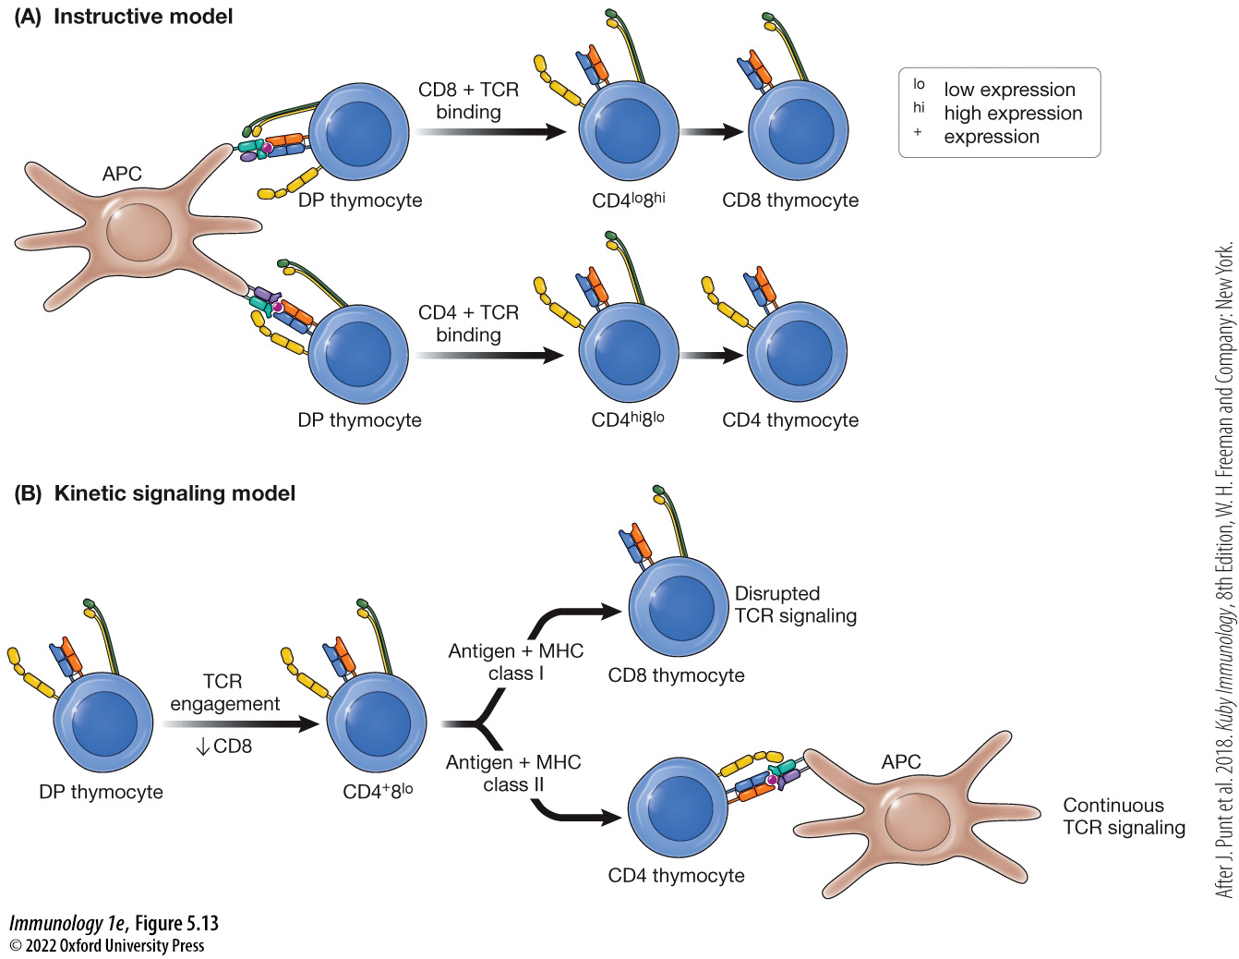
Figure 5.13 Two models of MHC restriction of coreceptors on developing thymocytes
Notes:
FIGURE 5.13 Two models of MHC restriction of coreceptors on developing thymocytes
(A) The instructive model states that binding of the T-cell receptor and the correct coreceptor to an MHC molecule “instructs” the cell to express only the engaged coreceptor. (B) The kinetic signaling model states that all double-positive (DP) thymocytes first express high levels of CD4 coreceptor on the surface. Engagement of the CD4 coreceptor and T-cell receptor with MHC class II/antigen complexes promotes T-cell signaling and maintenance of CD4 as the coreceptor. If the T-cell receptor cannot signal (because it is only capable of binding to MHC class I/antigen complexes), the thymocyte switches coreceptor expression from CD4 to CD8. (After J. Punt et al. 2018. Kuby Immunology, 8th ed., W. H. Freeman and Company: New York.)

Slide 40
5.7 How does positive and negative selection of T cells occur? 8
KEY DISCOVERIES
How did we learn that self-reactive thymocytes are eliminated from the thymocyte population via negative selection?
Early research
In the late 1980s, two research groups detected an autoreactive β chain within thymic cortex DP thymocytes and not in thymocytes in the medulla or in peripheral T cells.
These findings suggested that a mechanism prevented the autoreactive β chain from progressing beyond positive selection.
Notes:
Instructor Notes:

Slide 41
5.7 How does positive and negative selection of T cells occur? 9
KEY DISCOVERIES (cont’d)
How did we learn that self-reactive thymocytes are eliminated from the thymocyte population via negative selection?
Two possibilities
Thymocytes containing the autoreactive β chain were deleted
The autoreactive β chain was absent or masked within more advanced thymocytes and peripheral T cells
Notes:
Instructor Notes:

Slide 42
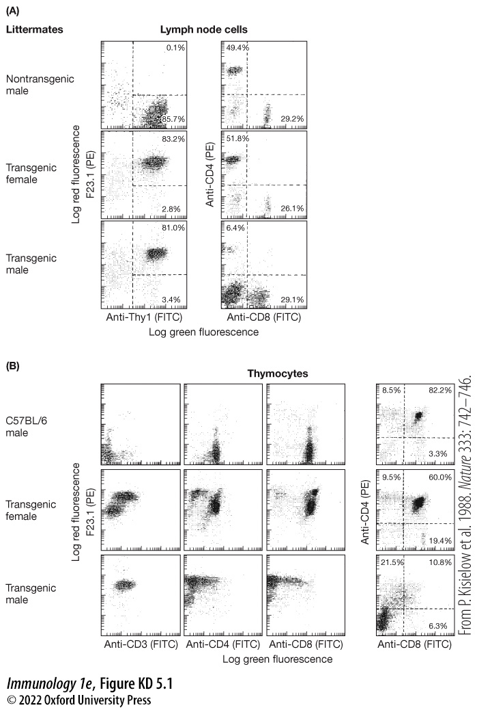
FIGURE KD 5.1 T cells expressing a T-cell receptor that recognizes the male-specific antigen H-Y are removed from the T-cell population in male mice
Notes:
FIGURE KD 5.1 T cells expressing a T-cell receptor that recognizes the male-specific antigen H-Y are removed from the T-cell population in male mice
(A) While female mice expressing a T-cell receptor transgene capable of recognizing a male-specific self-antigen (H-Y) contain similar populations of T cells isolated from lymph nodes as that of their nontransgenic littermates, T cells from male mice expressing the transgene are mainly double-negative with a small population of CD8 T cells that express the coreceptor at low levels. (B) Similar data to those observed in T cells isolated from lymph nodes were obtained when observing thymocytes developing in the thymus of male and female mice expressing the T-cell receptor transgene. Females contained thymocytes that were double-positive for the coreceptors, while males contained double-negative thymocytes, suggesting the removal of transgene-expressing thymocytes by negative selection. (From P. Kisielow et al. 1988. Nature 333: 742–746.)

Slide 43
5.7 How does positive and negative selection of T cells occur? 10
Negative selection within the thymic medulla
Negative selection of DP thymocytes can occur if the T-cell receptor:MHC-peptide complex has too high an affinity.
Central tolerance: Negative selection processes that occur in primary lymphoid tissues that are responsible for the removal of self-reactive lymphocytes.
AIRE: A transcriptional activator (autoimmune regulator) allows cells to express genes not normally expressed by epithelial cells of the thymus (promiscuous gene expression).
Notes:
Instructor Notes:
Epithelial cells within the thymic medulla (mTECs) express tissue-specific antigens by utilizing the transcriptional activator AIRE (autoimmune regulator).
One extremely complicating factor in the process of central tolerance is that certain endocrine tissues within the body are the source of very specific proteins. For instance, insulin is only produced by the pancreas.
Epithelial cells within the thymic medulla (mTECs) express AIRE.

Slide 44
5.7 How does positive and negative selection of T cells occur? 11
AIRE contains:
a CARD domain (caspase recruitment domain)
a SAND domain (SP100, AIRE1, NucP41/PP75, and DEAF1)
and two PHD domains (plant homeodomain)
AIRE also acts as a “gas pedal” for RNA polymerase II, causing transcription of tissue-restricted genes and presentation of tissue-specific antigens on MHC I within mTECs.
Notes:
Instructor Notes:
AIRE ensures that genes of tissue-specific antigens are activated in thymic epithelial cells to promote the expression and processing of these antigens within the thymus.
PHD domains: These domains work together to allow AIRE to interact with histones within chromatin of thymic epithelial cells.
These protein products can be processed and tissue-specific self-peptides presented via MHC class I molecules on the surface.
Any CD8⁺ thymocyte that strongly engages such an MHC I–tissue-specific peptide complex will be negatively selected and will die by apoptosis.

Slide 45
5.7 How does positive and negative selection of T cells occur? 12
Medullary thymic dendritic cells can engulf mTECs and present tissue-specific antigens via MHC class II.
Allows for negative selection of CD4⁺ thymocytes that bear a TCR that interacts too strongly with an MHC class II–tissue-specific antigen peptide.
Negative selection drives central tolerance and limits the circulation of self-reactive T cells.
Notes:
Instructor Notes:
Failure of this negative selection process can lead to autoimmune disorders.

Slide 46
5.7 How does positive and negative selection of T cells occur? 13
A subset of CD4 T cells that express a self-reactive TCR will begin to express the transcription factor FOXP3.
CD4⁺, FOXP3⁺ cells continue development to become natural regulatory T cells (nTregs).
nTregs are released into circulation to promote peripheral tolerance.

Slide 47
5.7 How does positive and negative selection of T cells occur? 14
MAKING CONNECTIONS
T-Cell Selection and Tolerance
T cells that have rearranged their T-cell receptor loci undergo both positive and negative selection in the thymus.
T cells undergo positive selection to ensure that they have a functional receptor and negative selection to ensure that they are not self-reactive.
A further means of tolerance is provided by the action of regulatory T cells, which can inactivate self-reactive T cells in the periphery.

Slide 48
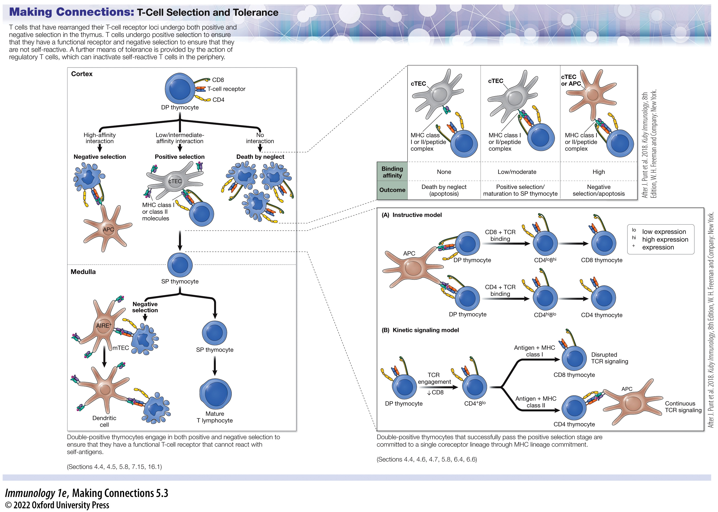
Making Connections: T-Cell Selection and Tolerance
Notes:
Making Connections: T-Cell Selection and Tolerance

Slide 49
5.7 How does positive and negative selection of T cells occur? 15
CLICKER QUESTION 2
How does AIRE play a role in the negative selection process of thymocytes?
AIRE assesses the affinity of the TCR:MHC-peptide binding.
AIRE promotes expression of non-thymus genes in the thymus (promiscuous gene expression).
AIRE is expressed by natural T regulatory cells.
Notes:
Instructor Notes:
Correct answer: b

Slide 50
5.8 How is T-cell receptor diversity achieved? 1
T cells either directly target pathogens for destruction or activate other immune system components for this purpose.
The majority of circulating T cells express an αβ T-cell receptor.
When activated, αβ T-cells can differentiate into effector T cells that activate a range of innate or adaptive immune responses, or directly destroy an infected cell.
They may be a target for infection and destruction by SARS-CoV-2, the virus responsible for COVID-19.
Notes:
Instructor Notes:
Extensive TCR diversity exists due to somatic recombination and gene rearrangement of TCR loci (more so with αβ T cells).

Slide 51
5.8 How is T-cell receptor diversity achieved? 2
A small subset of T cells in the body express a γδ T-cell receptor.
Reside mainly within the gut mucosa as intraepithelial lymphocytes.
Or express a γδ T-cell receptor that behaves like a pattern recognition receptor of the innate immune system.
Notes:
Instructor Notes:
The receptors that mimic pattern recognition receptors are produced through somatic recombination but are limited in their diversity.

Slide 52
5.8 How is T-cell receptor diversity achieved? 3
T-cell receptor diversity is driven in part by:
The number of V, D, and J subunits present for all chains associated with the receptor.
Junctional diversity: adding or removing P and N nucleotides during recombination.
Random association of subunits.
Notes:
Instructor Notes:
Recombination of variable segments is random, and the diversity is extensive. There are approximately 45 Vα segments and 50 Jα segments. So about 2,150 different combinations are possible to create a functional TCR α chain.
There are approximately 42 different Vβ segments, 2 different Dβ segments, and 13 different Jβ segments. So about 1,092 different combinations can occur to create a functional β chain.
Research has shown that in terminal deoxynucleotidyl transferase (TdT)-deficient mice, there are approximately 10% fewer circulating T cells with different TCRs than seen in wild-type mice.
This suggests that junctional diversity may increase the number of different T-cell receptors to 2.3 × 10⁷!
Any subunit of a TCR that has properly recombined needs to associate with another randomly recombined subunit.
Random association of α and β chains can result in 2.3 × 10⁶ different TCRs.

Slide 53
5.8 How is T-cell receptor diversity achieved? 4
EMERGING SCIENCE
Does the causative agent of COVID-19 target the destruction of T cells?
Lymphocyte and leukocyte numbers in 286 severe cases of SARS-CoV-2 in Wuhan, China, were analyzed
Patients had fewer lymphocytes in circulation (14% compared to the normal range of 20%–50%).
Further analysis revealed a significant decrease in circulating CD4⁺ T cells and regulatory T cells, as compared to relatively normal amounts of NK cells and B cells.
Notes:
Instructor Notes:

Slide 54
TABLE ES 5.1 Lymphocyte Counts in Patients with Mild to Severe Cases of COVID-19
 | Normal range | Mean (SD) All patients (n=44 | Mean (SD) Non-severe (n=17) | Mean (SD) Severe (n=27) | P value
T cells+B cells+NK cells/μl | 1100.0–3200.0 | 852.9 (412.0) | 1020.1 (396.5) | 743.6 (384.4) | 0.032
B cells/μl | 90.0–560.0 | 179.7 (143.1) | 196.1 (144.9) | 169.0 (140.9) | 0.559
T cells/μl | 955.0–2860.0 | 541.5 (292.7) | 663.8 (291.3) | 461.6 (264.7) | 0.027
NK cells/μl | 150.0–1100.0 | 131.7 (83.1) | 160.2 (90.8) | 113.0 (71.8) | 0.072
CD4 T cells/μl | 550.0–1440.0 | 338.6 (196.3) | 420.5 (207.8) | 285.1 (168.0) | 0.027
Regulatory T cells/μl | 5.36–6.30 | 4.1 (1.2) | 4.5 (0.9) | 3.7 (1.3) | 0.040
Source: Data from C. Qin et al. 2020. Clin Infect Dis 71: 762–768. doi.org/10.1093/cid/ciaa248.
Notes:
TABLE ES 5.1 Lymphocyte Counts in Patients with Mild to Severe Cases of COVID-19

