Slide 1
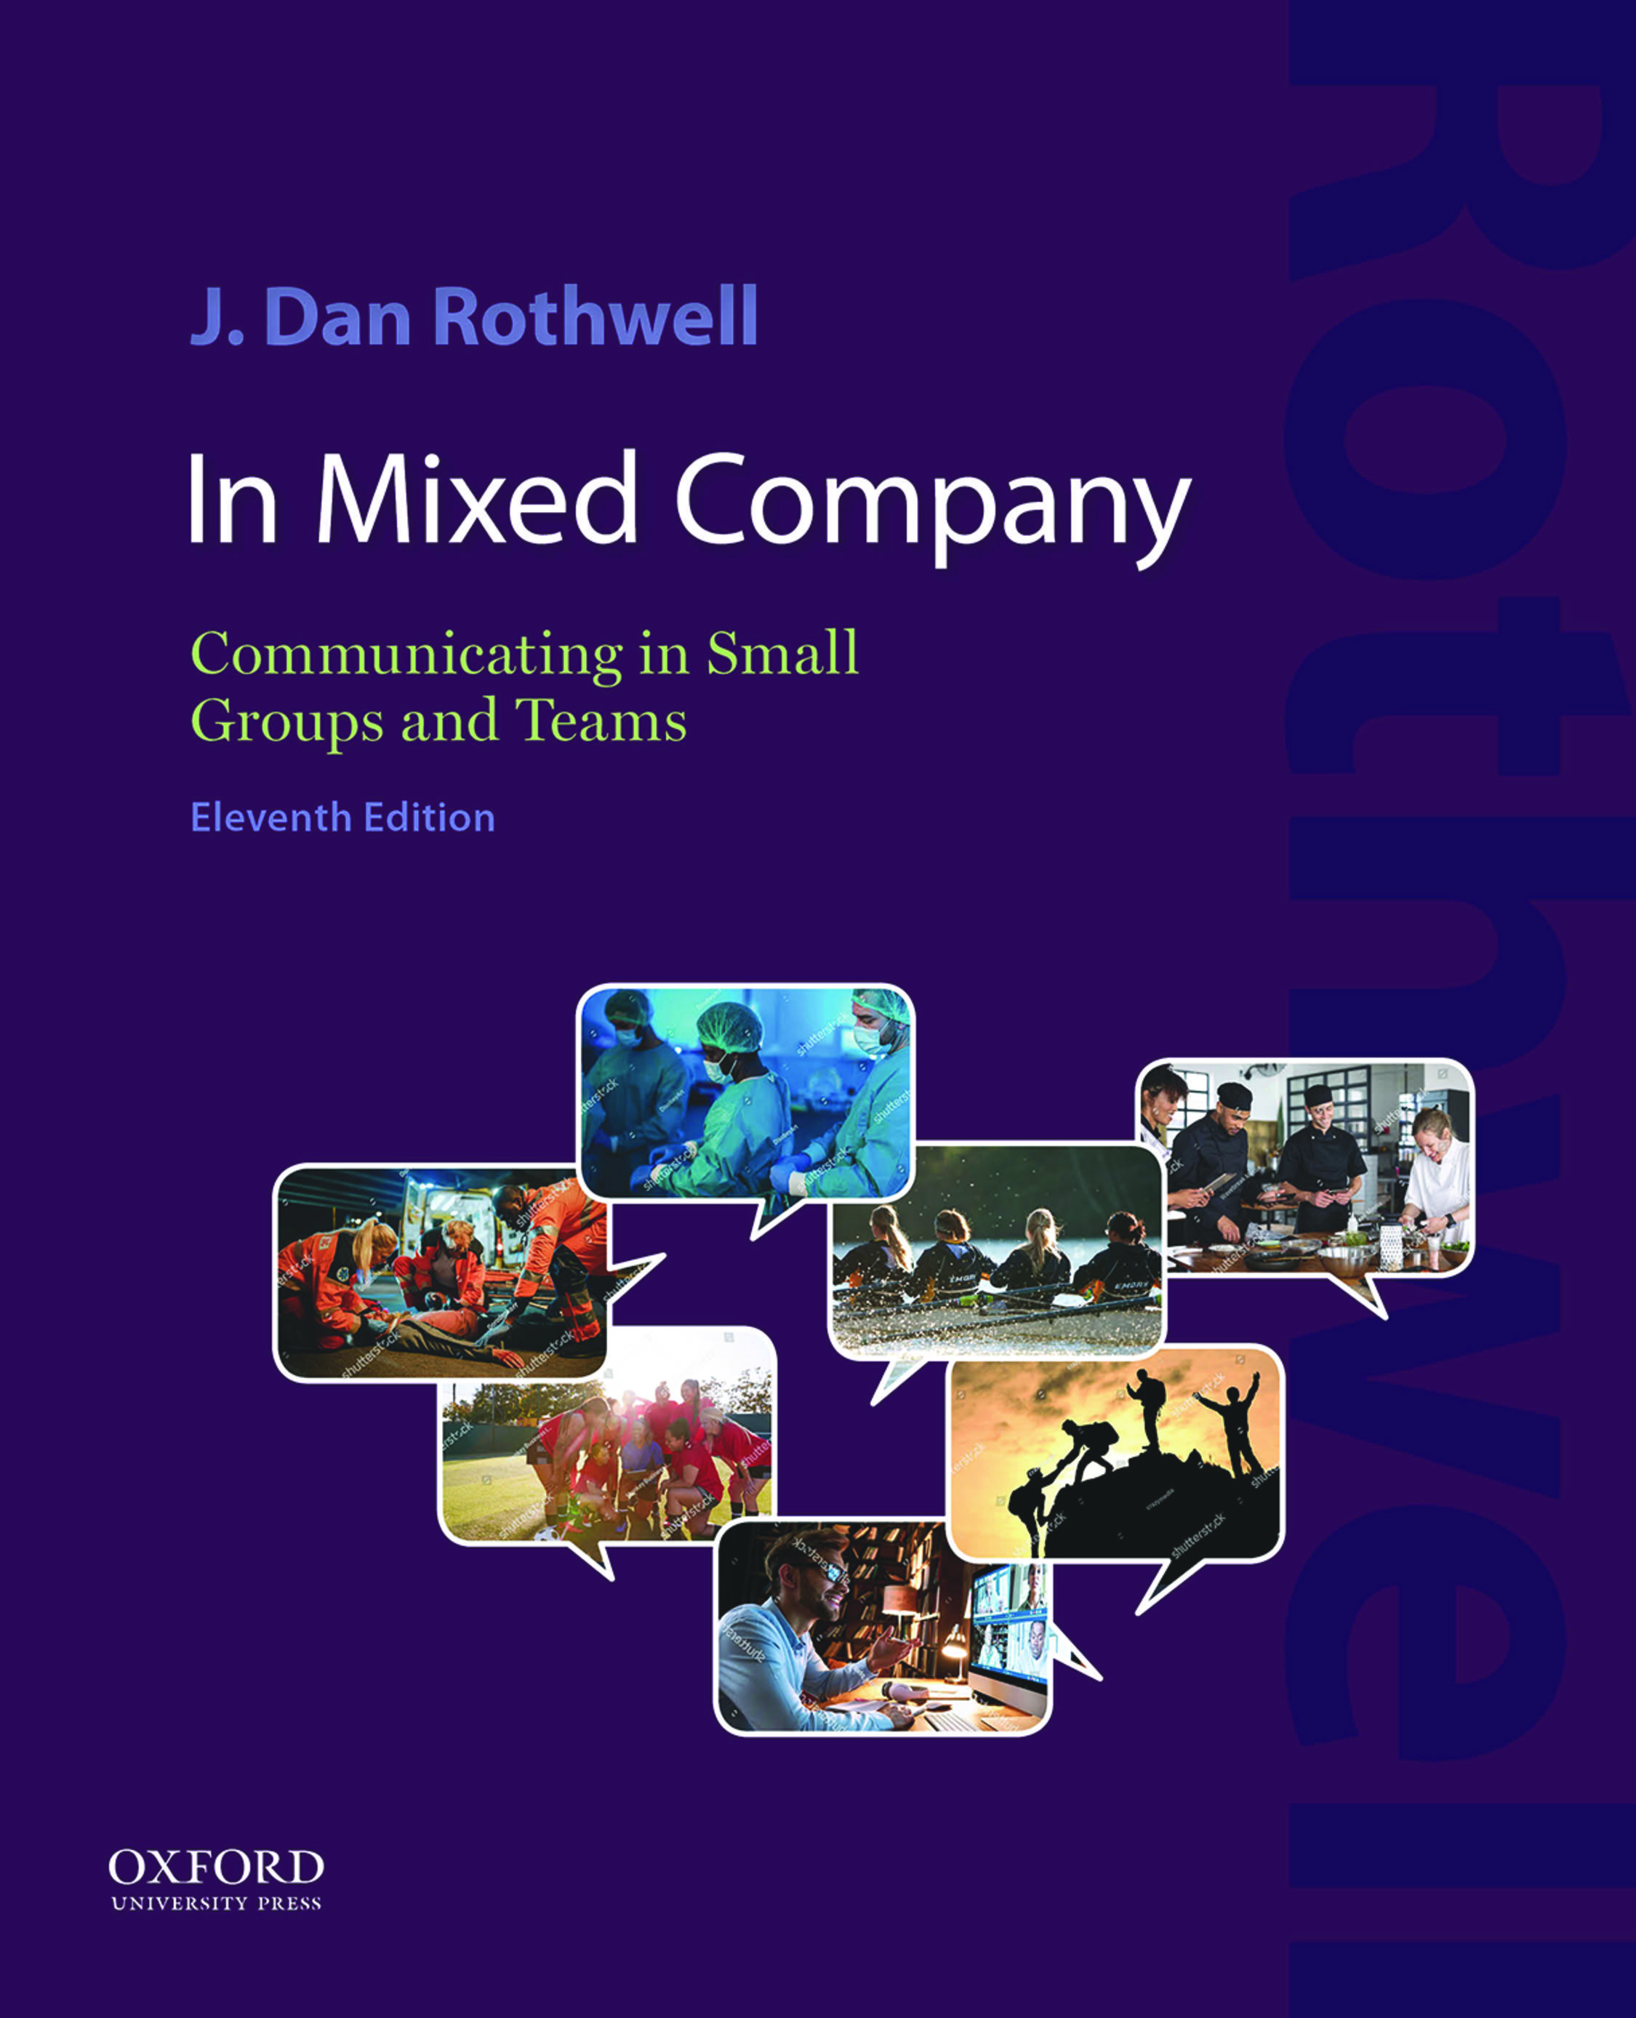

IN MIXED COMPANY
Communicating in Small Groups and Teams
by J. Dan Rothwell

Slide 2
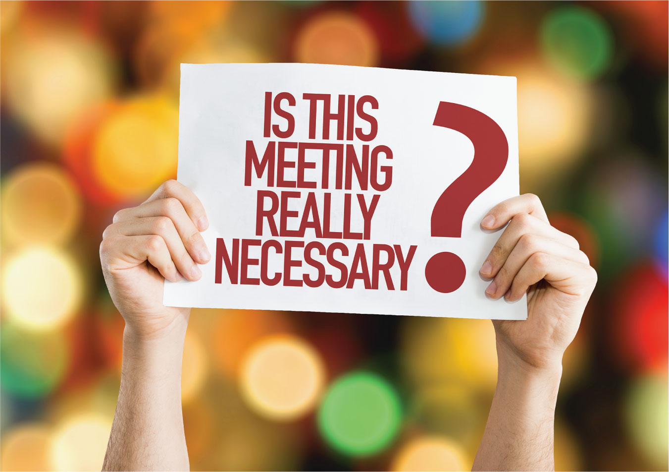
3
1
Notes:
This is the question on everyone’s mind: Is this meeting really necessary? Be clear on your meeting purpose before calling one and reiterate it to all in the agenda and again when the meeting begins.

Slide 3
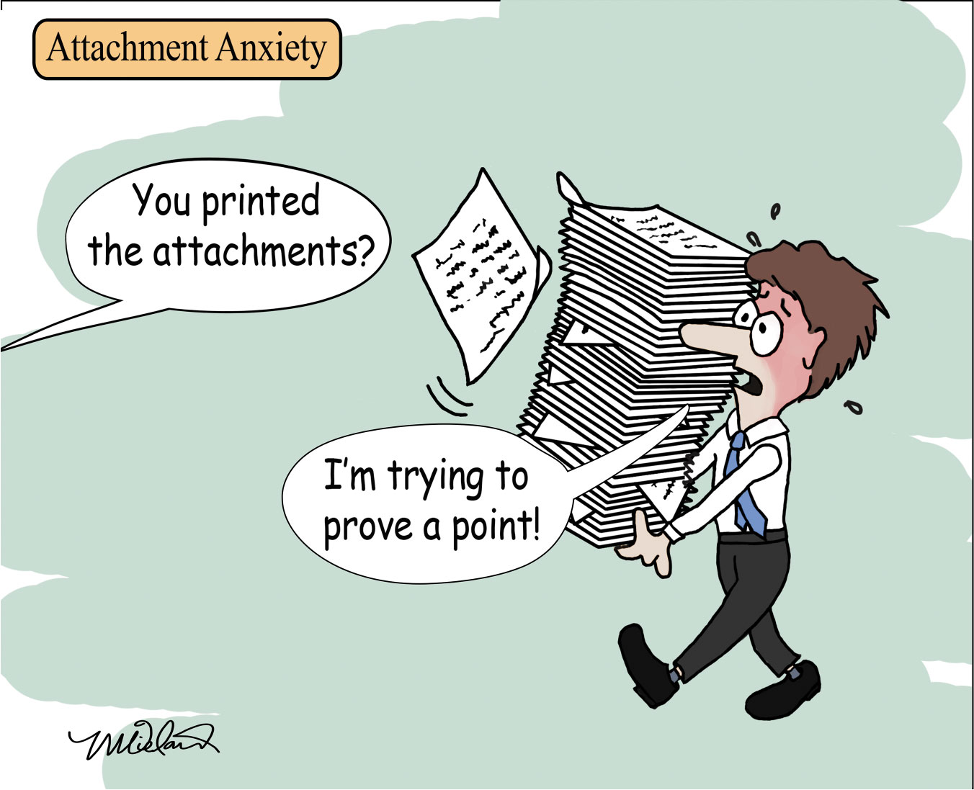
9
1
Notes:
Attachments (pre-reads) can easily become unmanageable and stressful. No group member is likely to pre-read lengthy attachments, so they usually become useless appendages to emailed agendas. Brevity should be the watchword for attachments whenever possible.

Slide 4

4
1
Notes:
The standard “I talk / you listen” process is tedium times tedium equals tedium squared. Try periodically breaking free from this traditional meeting equation.

Slide 5
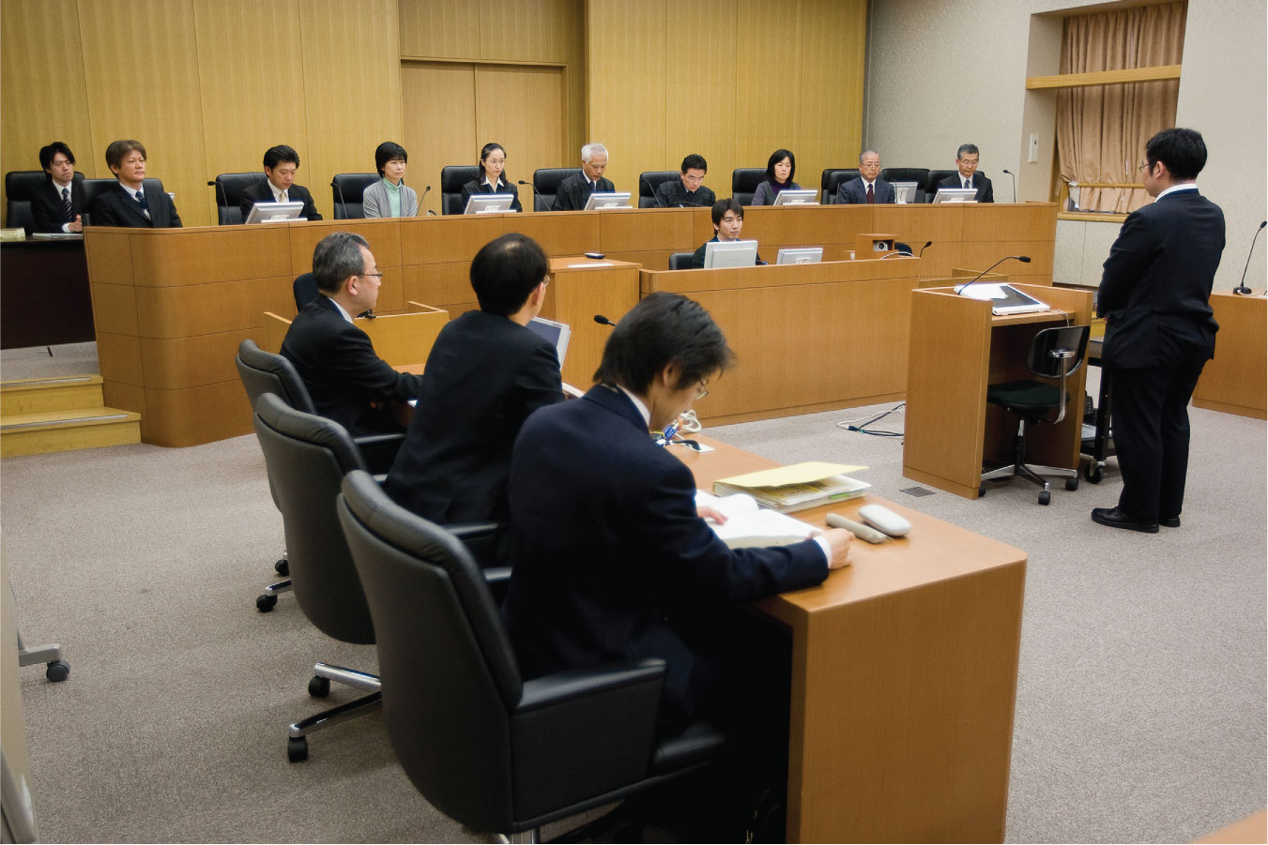
5
1
Notes:
Japanese do not view participation in jury deliberations with particular relish. Americans don’t especially look forward to jury duty either, but when placed on a jury, Americans are much more likely to embrace active group discussion about the court case. This image is one of the many mock trials conducted to prepare Japanese citizens to be jurors in real trials. Small group participation is not universally valued.

Slide 6

6
1
Notes:
Remember that an audioconference is not merely a phone conversation. You’re conducting an efficient meeting. The conference call should be necessary, focused, organized, and as short as feasible. This meeting is utilizing a classic Polycom Soundstation to conduct the meeting. More sophisticated equipment is available, but this version works well (Hanson & Turner, 2020). Simple cellphone conference calls are also easily available when student groups need to connect as a team. The easy availability of an option such as Zoom has made audioconferences instead of videoconferences less common.

Slide 7

7
1
Notes:
Nonverbal communication challenges escalate in two-dimensional meetings as we struggle to interpret meaning beyond words. Gestures can appear forced or awkward, even hidden from view if the camera angle becomes just a headshot. When everyone but the speaker is muted to screen out barking dogs, rustling papers, and other background noise, applause that might normally erupt naturally during in-person meetings cannot be heard. Some virtual groups have taken to doing a jazz hands version of silent applause. It is a different world we occupy online.

Slide 8
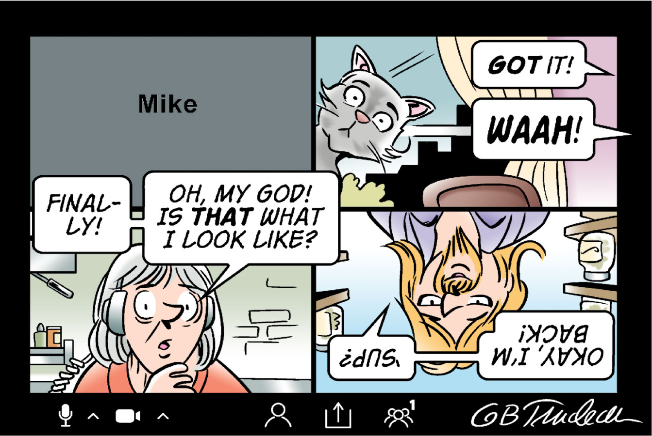
8
1
Notes:
Videoconferencing can be a challenge. Preparation and following “A Participant’s Guide to Successful Video Conferences” provided in Table 3.2 are critical.

