Slide 1
12.2 number of RTAs still in force in 2016, by date of entry into force

Slide 2
12.3a share of imports according to margin of preference (percent), 2008

Slide 3
12.3b share of imports according to margin of preference (percent), 2008

Slide 4
12.4 type of RTAs still in force in 2016; number, by date of entry into force

Slide 5
12.5 development status of regional trade agreements

Slide 6
12.6 share of trade agreement covering non-tariff measures (per cent)

Slide 7
12.7 customs union and welfare I: trade-creation
Price
demand
supply
p_{C}+T
p_{B}+T
p_{C}
A
D
p_{B}
H₁
H₂
q^{s}_{cu}
q^{s}_{in}
Quantity
q^{d}_{in}
q^{d}_{cu}

Slide 8
12.8 customs union and welfare II: trade-diversion
Price
demand
supply
p_{C}+T
p_{B}+T
p_{C}
A
D₁
p_{B}
D₂
H₁
H₂
q^{s}_{cu}
q^{s}_{in}
Quantity
q^{d}_{in}
q^{d}_{cu}

Slide 9
12.9 regionalism model and total welfare

Slide 10
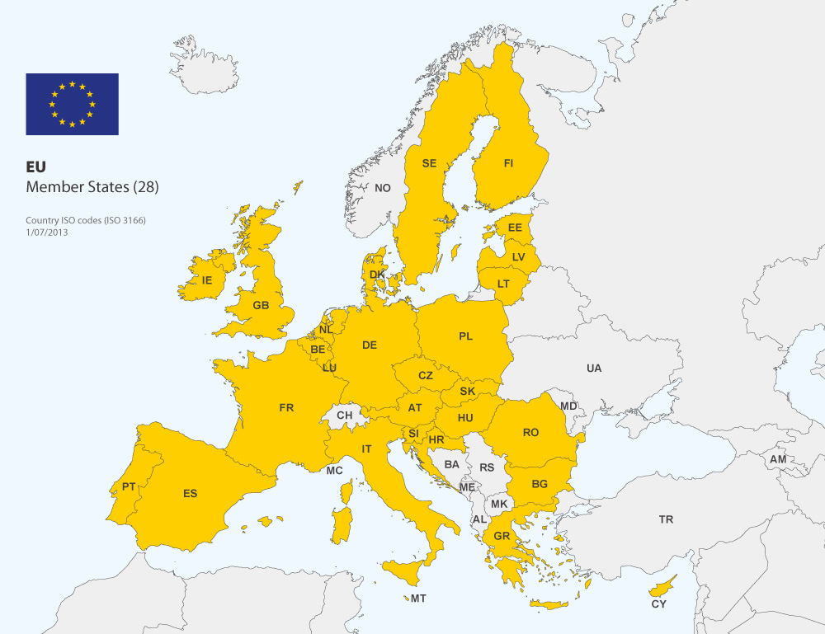
12.10 European Union in 2016

Slide 11
12.11 historical expansion of the European Union; population (million)

Slide 12
12.12 EU diversity in size, population, and income per capita, 2014
bubbles proportional to population size

Slide 13
12.13 distribution of power in European Parliament, 2014

Slide 14
12.14 value of the British pound; 24 and 27 June, 2016

Slide 15
12.15 economic development and EU+US export dependence; per cent of total

Slide 16
12.16 hypothetical impact of TTIP on trade flows; relative change in per cent

