Slide 1
6.2 sector 71 exports; pearls, precious stones, metals, coins, etc., 2014

Slide 2
6.3 sector 85 exports; electrical, electronic equipment, 2014

Slide 3


















$$w_{m}$$
$$M_{2}$$
6.4 sector-specific capital
$$w_{f}$$
$$M_{1}$$
$$F_{0}$$
$$F_{1}$$
$$M_{0}$$
$$w_{m1}$$
$$E_{1}$$
$$w_{m0}$$
$$E_{2}$$
$$E_{3}$$
$$w_{f0}$$
$$E_{0}$$
$$O_{m}$$
$$L_{m}$$
$$L_{f}$$
$$O_{f}$$

Slide 4
6.5 construction of the Edgeworth box
4
5
3
2
1

Slide 5
6.6 the Edgeworth box

Slide 6
6.7 the contract curve

Slide 7
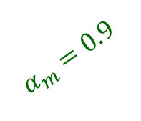
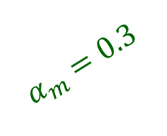

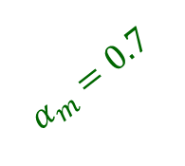
6.8 contract curve for different capital intensities
$$α_{m}=0.9$$
$$α_{m}=0.7$$
$$α_{m}=0.5$$
$$α_{m}=0.3$$

Slide 8











6.9 the Rybczynski proposition; expansion of labour force
$$O_{f}$$
$$O_{f}′$$
$$K$$
$$K_{f}/L_{f}$$
$$K_{f}/L_{f}$$
$$E_{1}$$
$$E_{0}$$
$$K_{m}/L_{m}$$
$$O_{m}$$
$$L_{0}$$
$$L_{1}$$

Slide 9
6.10 consumer optimization problem

Slide 10
6.11 homothetic iso-utility curves are radial blow-ups

Slide 11
6.12 production possibility frontier

Slide 12
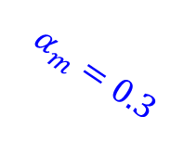
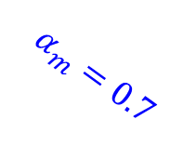
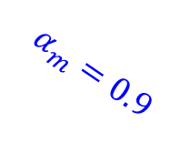
6.13 production possibility frontiers; impact of changing capital intensity
$$α_{m}=0.9$$
$$α_{m}=0.7$$
$$α_{m}=0.3$$

Slide 13
6.14 impact of a change in capital on the PPF and the Rybczynski line

Slide 14
6.15 income per capita and human capital per worker, 2011
bubbles proportional to population size

Slide 15


6.16 equilibrium structure
delivery of manufactures
(spending $δ_{m}$ on manufactures)
capital owners
capital services
(rental income)
production of food
consumers
labourers
labour services
(wage income)
production of manufactures
delivery of food
(spending $1−δ_{m}$ on food)
direction goods flows
(direction money flows)

Slide 16
6.17 autarky production and consumption

Slide 17
6.18 international trade equilibrium

Slide 18
6.19 share of USA and world trade in different type of products, per cent

