Slide 1
5.2 global intra- and inter-regional trade flows, % of total
4.2
1.9
3.2
1.8
2.5
EUR
1.6
CAS
NAM
2.6
2.9
2.3
EAS
1.0
2.2
2.6
1.4
MNA
SAS
2.1
1.1
2.9
SSA
SEA
LAC
1.3
1.0
PAC
Bubbles proportional to size of trade flows in 2011; light-shaded area is extra-regional trade; dark-shaded area is intra-regional trade; weight of inter-regional trade flow is proportional to size (in percent); only flows of 1 percent or more are shown.

Slide 2
5.3 international trade flows
bubbles are proportional to a country’s trade flows in 2011 located at the geographic centre

Slide 3
5.4 income per capita and capital per worker, 2011
bubbles proportional to population size

Slide 4
5.5 sector 27 exports; mineral fuels, oils, distillation products, etc., 2014

Slide 5
5.6 an isoquant

Slide 6
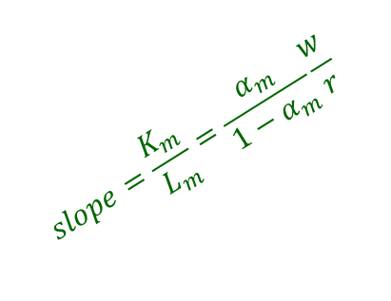

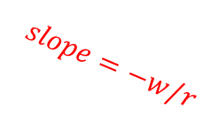





5.7 unit cost minimization
$$M=1$$
$$B$$
$$A$$
$$slope=−w/r$$
$$K_{m}(w,r)$$
$$C$$
$$slope=\frac{K_{m}}{L_{m}}=\frac{α_{m}}{1−α_{m}}\frac{w}{r}$$
$$L_{m}(w,r)$$

Slide 7








5.8 impact of lower wage on cost-minimizing inputs
$$D$$
$$C$$
$$K_{m}(w_{0},r)$$
$$K_{m}(w_{1},r)$$
$$E$$
$$M=1$$
$$L_{m}(w_{0},r)$$
$$L_{m}(w_{1},r)$$

Slide 8



$$M=2$$
$$M=3$$
5.9 constant returns to scale and isoquants
$$M=1$$

Slide 9


$$M=2$$
5.10 constant returns to scale and cost minimization
$$M=1$$
$$M=3$$

Slide 10



5.11 unit value isocost line; effect of an increase in the rental rate
$$1/r_{0}$$
$$1/r_{1}$$
$$1/w$$

Slide 11



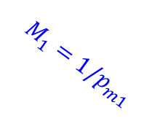

5.12 unit value isoquants; effect of an increase in the price of manufactures
$$F=1/p_{f}$$
$$A$$
$$M_{1}=1/p_{m1}$$
$$M_{0}=1/p_{m0}$$
$$B$$

Slide 12
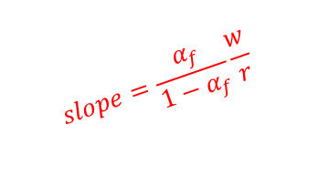

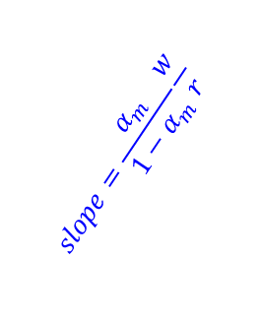





5.13 the Lerner diagram
$$F=1/p_{f}$$
$$1/r$$
$$A$$
$$M=1/p_{m}$$
$$slope=\frac{α_{m}}{1−α_{m}}\frac{w}{r}$$
$$B$$
$$slope=\frac{α_{f}}{1−α_{f}}\frac{w}{r}$$
$$1/w$$

Slide 13




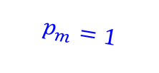
5.14 Stolper-Samuelson in the dual approach
$$p_{f}=1$$
$$p_{m}=5/4$$
$$E_{0}$$
$$E_{1}$$
$$p_{m}=1$$

Slide 14











5.15 analysis of an increase in the price of manufactures
$$1/r_{0}$$
$$F=1/p_{f}$$
$$A$$
$$1/r_{1}$$
$$A′$$
$$M_{0}=1/p_{m0}$$
$$B$$
$$M_{1}=1/p_{m1}$$
$$B′$$
$$1/w_{0}$$
$$1/w_{1}$$

Slide 15
5.16 sector 61 exports; articles of apparel, accessories, knit or crochet, 2014

