Slide 1
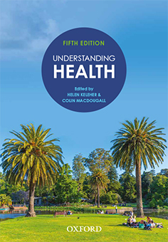
Lecture slides
Understanding Health
Fifth Edition
Edited by Helen Keleher and Colin MacDougall
Teaching and Learning Resource material prepared by Colin MacDougall, based on content from Understanding Health, fifth edition
USER AGREEMENT
These slides include resources from Understanding Health, fifth edition, and are made available for teaching use only to those using the book as a text in their courses. Users are free to copy and modify the material as needed for teaching purposes (e.g. incorporating them into lecture notes/slides or student handouts), provided that the authors are acknowledged. The slides can be placed on university-controlled unit or subject-related websites (that are password protected), as long as these are restricted to student use and not accessible to the public at large. Permission from the publisher should be sought to use the slides in any other manner.
© Oxford University Press 2022

Slide 2
CHAPTER 19
PUBLIC HEALTH IN THE POST-TRUTH WORLD

Slide 3
CHAPTER 19
PUBLIC HEALTH IN THE POST-TRUTH WORLD
KEY QUESTIONS
How does the post-truth world affect public health?
What do public health professionals need to understand about the landscape of post-truth?
What skills do public health professionals need to cut through the challenges posed by fake news, misinformation and disinformation?

Slide 4
CHAPTER 19
PUBLIC HEALTH IN THE POST-TRUTH WORLD
KEY CONCEPTS
Post-truth
Misinformation
Disinformation
Information super-spreaders
Fake news
Values-based framing for messaging

Slide 5
CHAPTER 19
PUBLIC HEALTH IN THE POST-TRUTH WORLD
DISCUSSION QUESTIONS
How would you explain the concept of ‘post-truth’ to someone else?
In what ways does misinformation affect the general public’s perceptions of public health?
In what ways is public health a ‘common cause’ for the public’s health?

