Slide 1

Hard Road to Freedom: The Story of Black America
by Lois E. Horton and James Oliver Horton

Slide 2
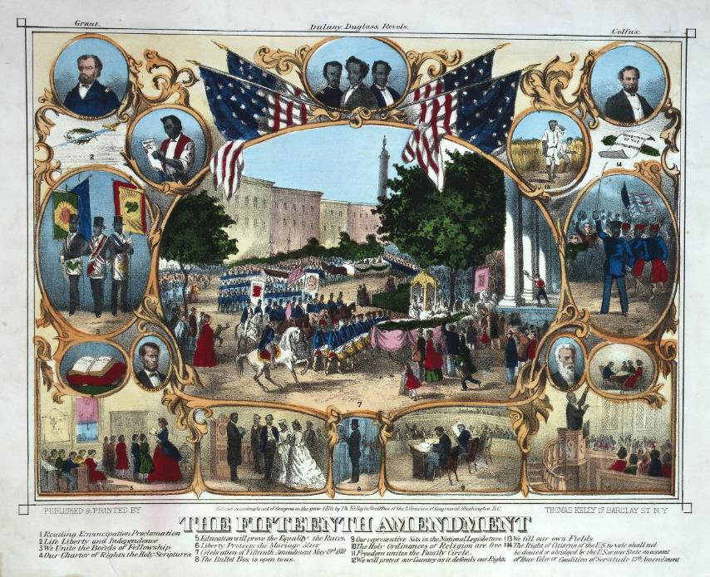
Chapter 8
From Reconstruction to Jim Crow
The War’s End and Lincoln’s Assassination
Aid for Freed People
Black Politics and Black Politicians
Progress and White Terrorist Backlash
Emigration from the South
Legalized Racial Control
Notes:
A print celebrating the ratification of the Fifteenth Amendment in February 1870.

Slide 3
Chapter 8 Learning Objectives
8.1 Understand the impact of Lincoln’s changing views on race and equality on Black Americans.
8.2 Summarize the various types of aid that freed people received after the war and analyze their effectiveness.
8.3 Appraise the impact Black voters had on the South during Radical Reconstruction.

Slide 4
Chapter 8 Learning Objectives
8.4 Describe the methods and intentions of various white terrorist organizations that arose during Reconstruction.
8.5 Understand the reasons that many newly freed people chose to emigrate from the South
8.6 Appraise how the resurgence of Democratic control in the South led to racial discrimination and segregation. Understand the consequences of Plessy v. Ferguson for Black Americans

Slide 5
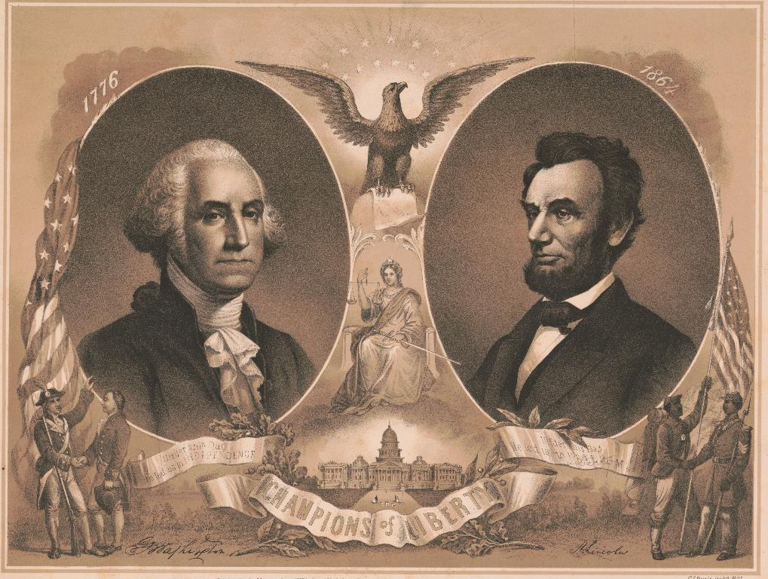
The War’s End and Lincoln’s Assassination
African Colonization Society
Fort Pillow massacre
Emancipation Proclamation
Notes:
Champions of Liberty (1865) Print produced following Lincoln’s assassination, depicting his election in status to match that of the nation’s revered first president.

Slide 6
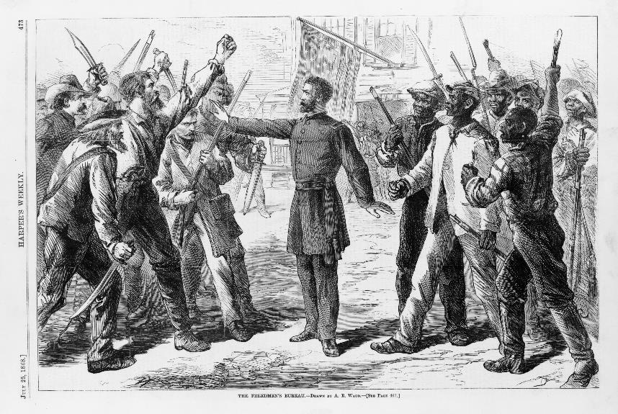
Aid for Freed People
Port Royal Experiment
Freedmen’s Bureau
Howard University, Washington, DC
Fisk University, Nashville
Radical Reconstruction

Slide 7
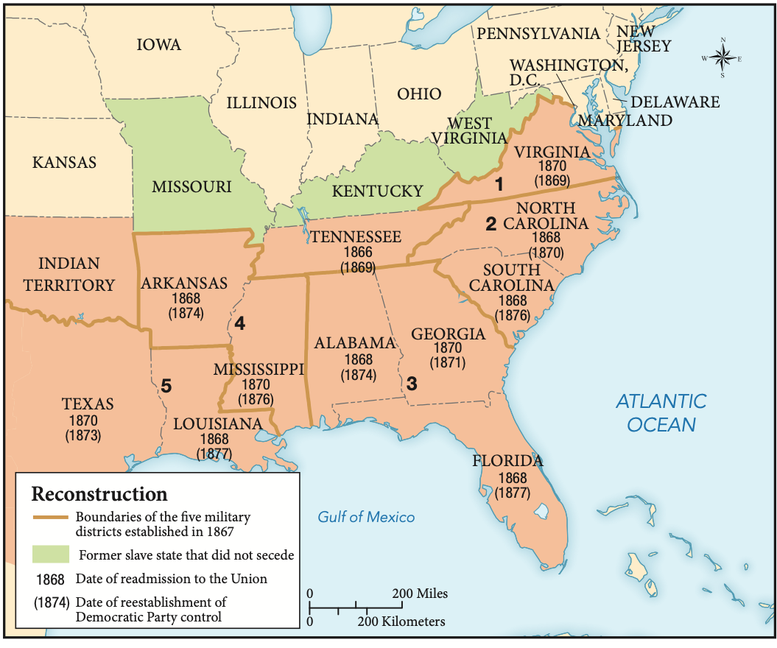
Reconstruction

Slide 8
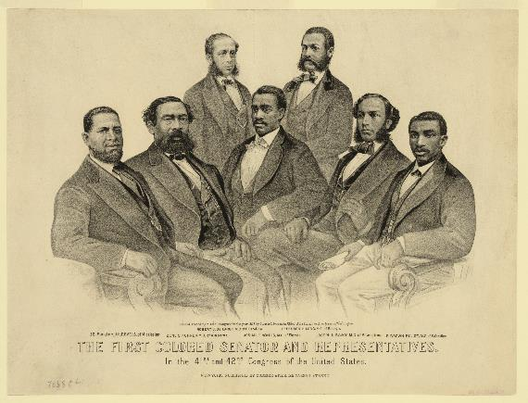
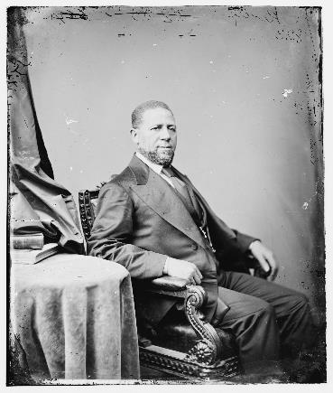
Black Politics and Black Politicians
Thirteenth Amendment
Fourteenth Amendment
Fifteenth Amendment
Hiram Revels
Voting rights limited to men
Notes:
Top: African Americans in the Forty-first and Forty-second Congress of the United States, 1872.
Bottom: Hiram Revels, US senator from Mississippi

Slide 9
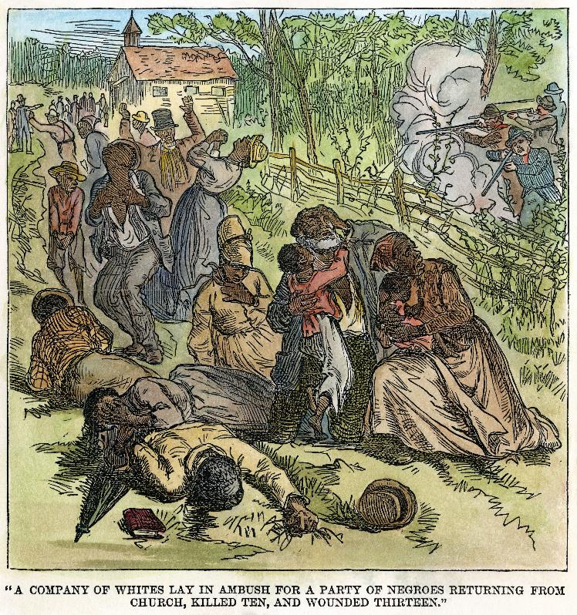
Progress and White Terrorist Backlash
Sharecropping
Ku Klux Klan
Intimidation, violence limited Black rights
Most active in areas where Black Americans were a minority
Notes:
A band of white supremacists fire on a group of Black people returning from church services in Choctaw County, Alabama, August 1, 1874.

Slide 10
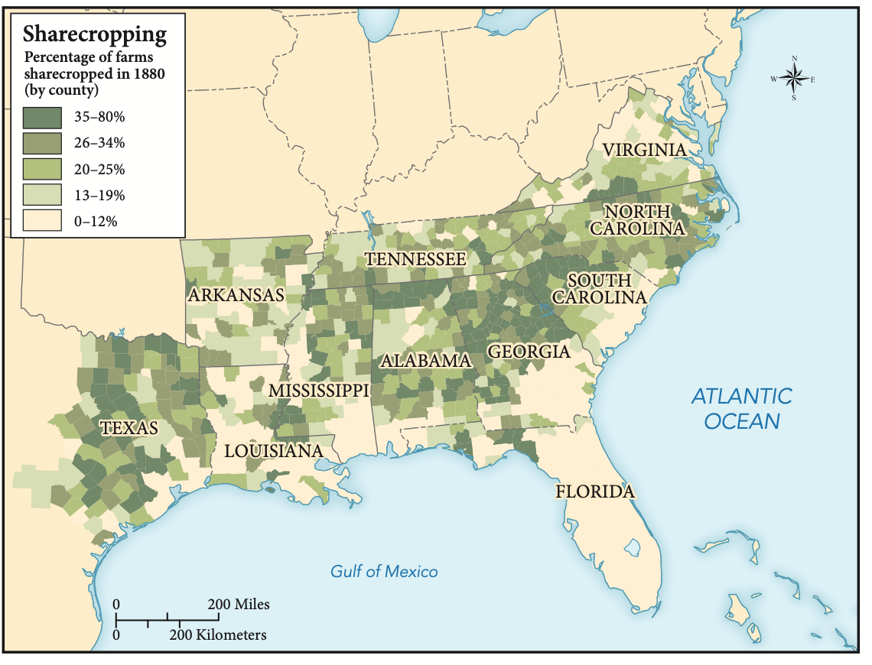
Sharecropping

Slide 11
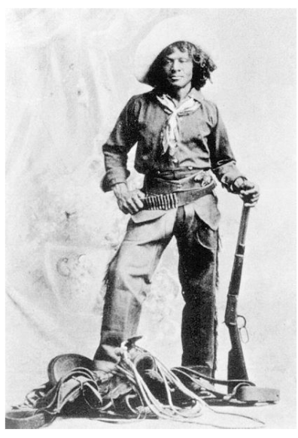
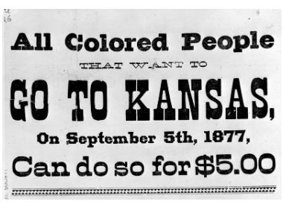
Emigration from the South
Exodusters
Freedmen’s Relief Association
Buffalo Soldiers
Notes:
Top: Nat Love, the Black cowboy also known as “Deadwood Dick.”
Bottom: A handbill from Lexington, Kentucky, urges Black people to migrate to Kansas, 1877.

Slide 12
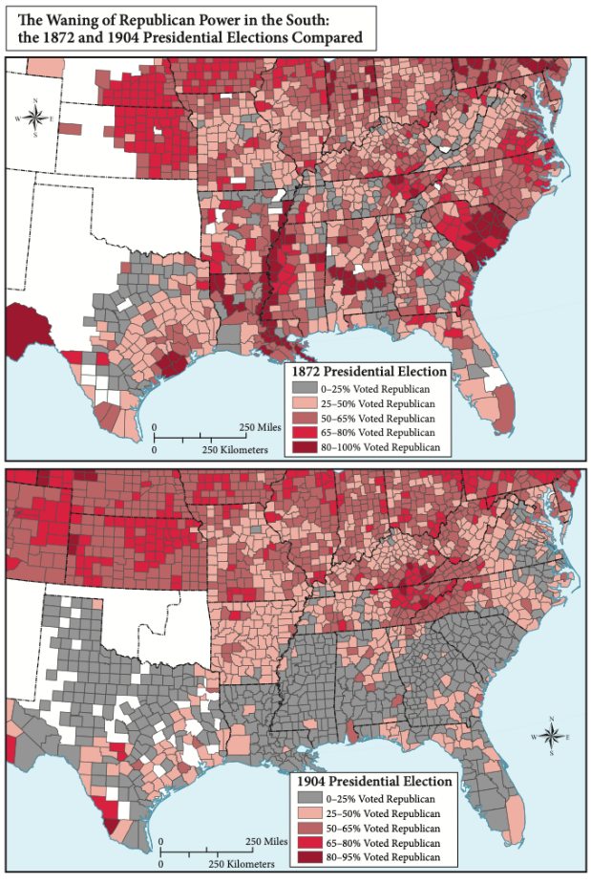
Legalized Racial Control
Plessy v. Ferguson
Racial segregation
Jim Crow laws

Slide 13
Review Questions
8.1 How did Lincoln’s changing views of race and equality impact Black Americans?
8.2 What types of aid did freed people receive after the war? How effective were these measures?
8.3 How did Black voters alter the political landscape of the South during Radical Reconstruction? What are some of the lasting accomplishments achieved during this period?

Slide 14
Review Questions
8.4 What were the intentions and motives of white terrorist organizations?
8.5 Why did newly freed Black people choose to emigrate? Who were the Exodusters?
8.6 How did the resurgence of Democratic control in the South lead to racial discrimination and segregation? What were the consequences of Plessy v. Ferguson?

