Slide 1
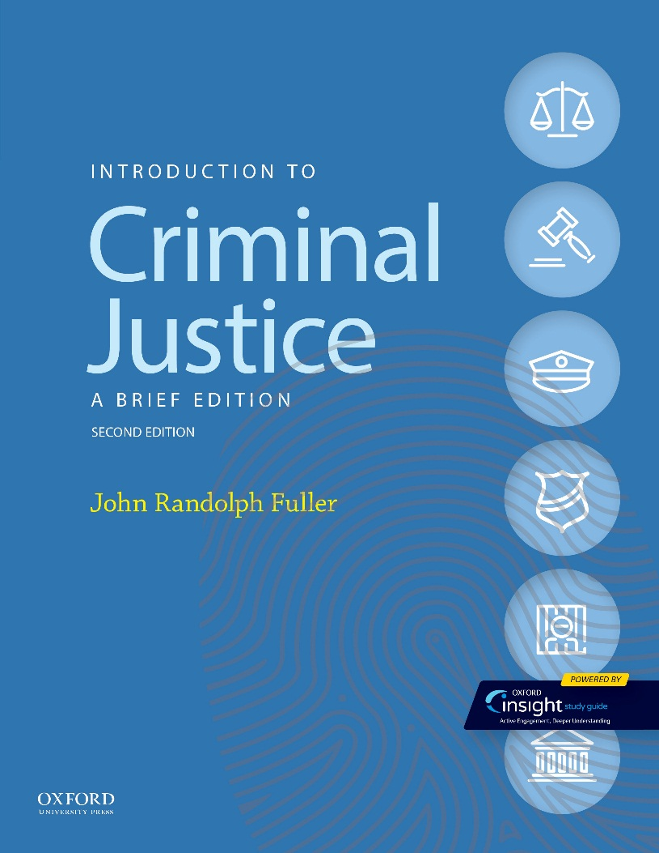
Criminal Justice by John Randolph Fuller

Slide 2
Part I Crime: Problems, Measurement, and Law Chapter 03 Criminal Law

Slide 3
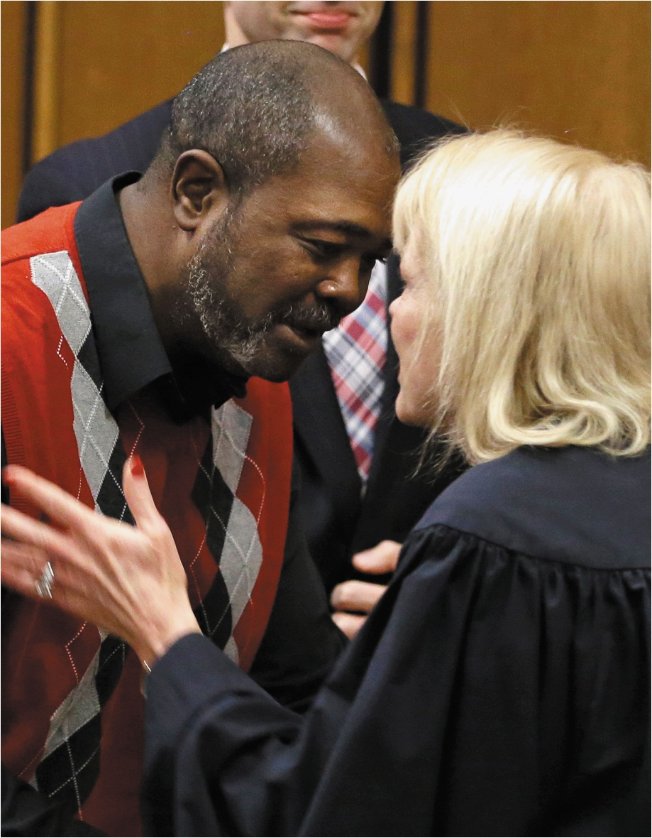
Criminal Law

Slide 4
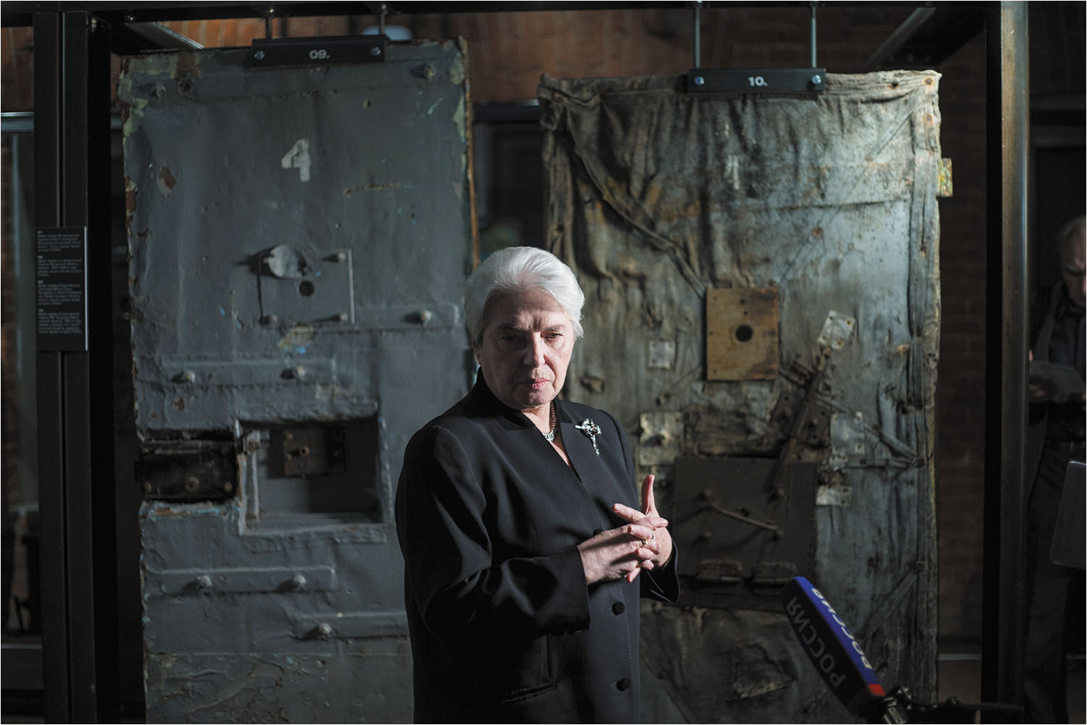
During the Soviet era, millions of people died of harsh labor and cruel treatment in the giant Gulag prison camp system. Here, Natalya Solzhenitsyn, the widow of Russian writer Alexander Solzhenitsyn, speaks at the opening of the Gulag history museum in Moscow, Russia. What laws ensure that U.S. citizens are not subjected to this type of treatment from the government?

Slide 5
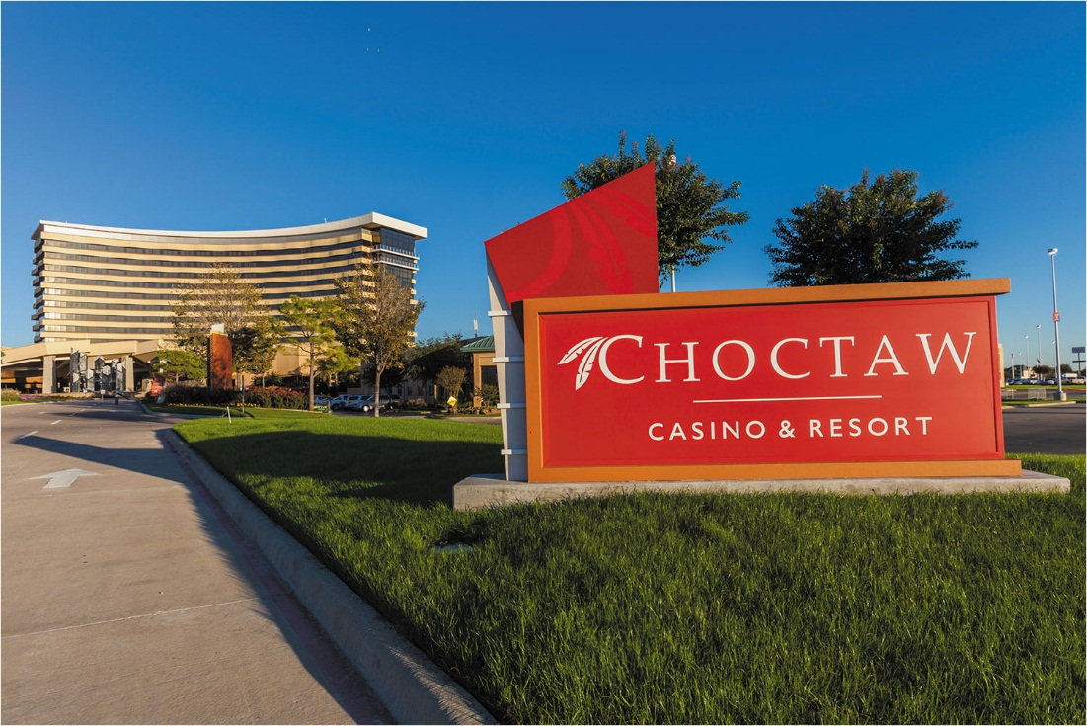
The Choctaw Nation of Oklahoma owns the Choctaw Casino & Resort. Why is gambling allowed only on tribal properties in many states?

Slide 6
The Code of Hammurabi as inscribed on a basalt stele. These laws stand as one of the first written codes of law in recorded history. What is your interpretation of the “eye-for-an-eye” philosophy of this code?

Slide 7
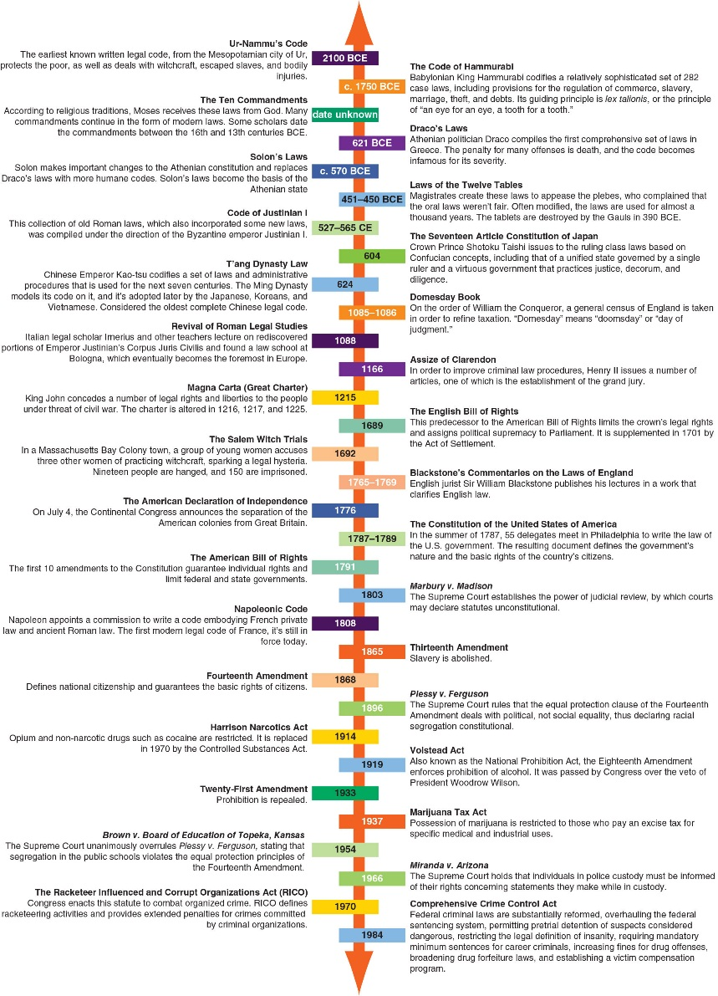
FIGURE 3.1 A Partial List of Historical Documents That Have Influenced the Development of Modern Laws

Slide 8
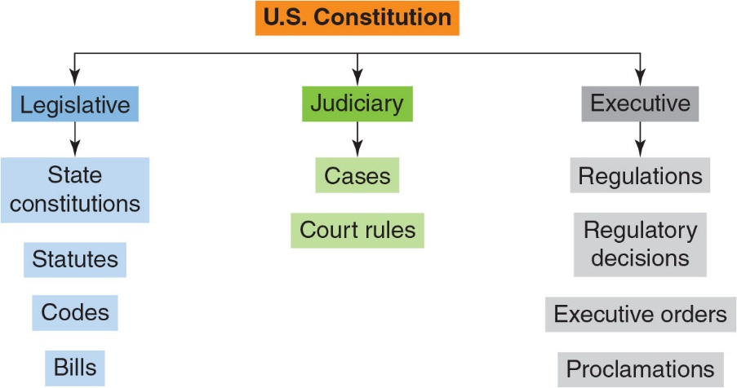
FIGURE 3.2 Sources of Law Which sources of law are you most familiar with? The least familiar with?

Slide 9
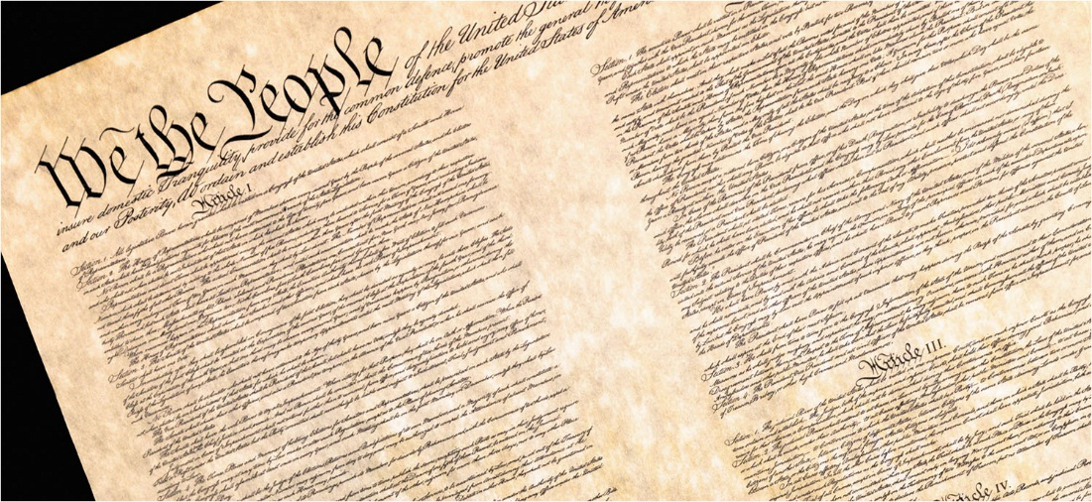
The Preamble to the Constitution. In what ways does the Bill of Rights serve as a foundation of the criminal law?

Slide 10
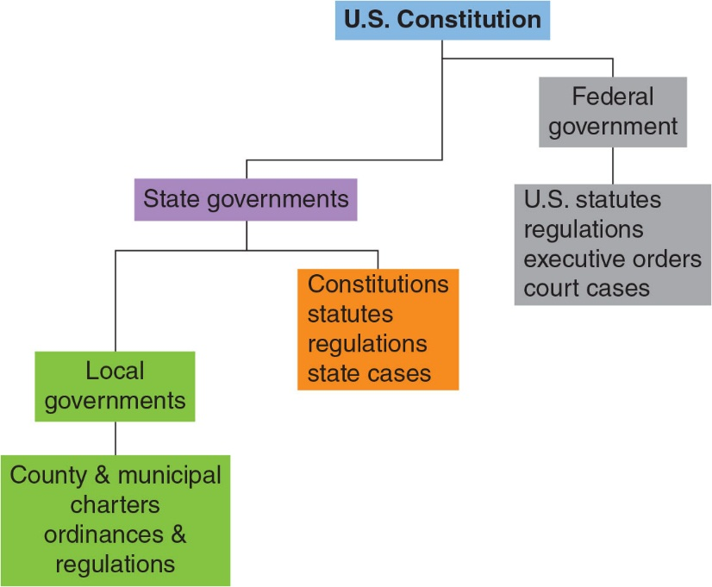
FIGURE 3.3 The Hierarchy of the U.S. Legal System Why might the hierarchy be structured this way? For example, why does the federal government rank higher than state governments?

Slide 11
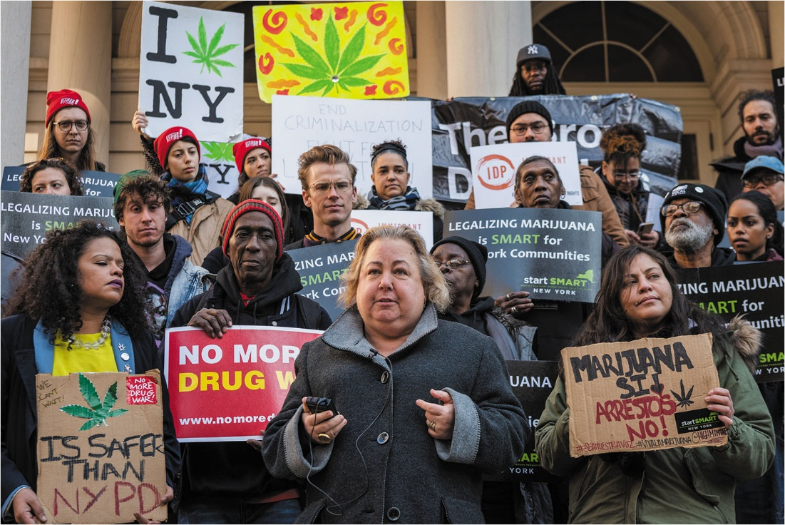
State Senator Liz Krueger, co-sponsor of the Marijuana Regulation and Taxation Act (MRTA), speaks at a rally alongside
the bill’s supporters. The law would legalize and regulate the use of marijuana in New York State, ending disproportionate policing and providing millions of dollars in tax revenue. How would legalizing cannabis affect the crime rate?

Slide 12
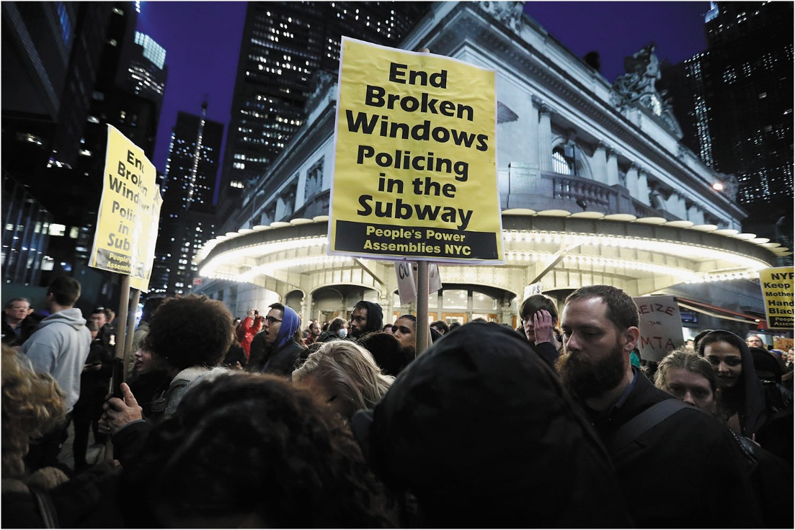
Demonstrators gather outside Grand Central Terminal in New York City to protest violent arrests targeting people of color. How much discretion do police have in deciding which laws to enforce?

Slide 13
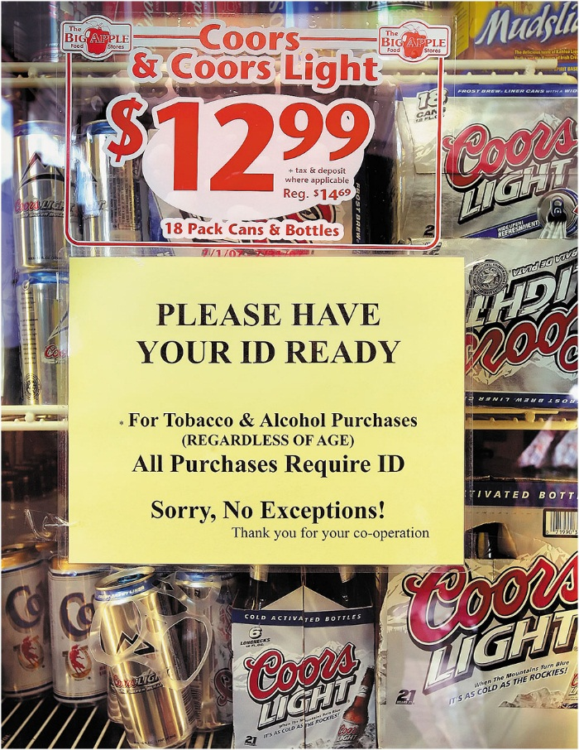
Convenience stores, bars, and other establishments that sell alcohol and tobacco products typically display signs alerting customers to have identification ready when purchasing such products. Does displaying such warnings protect an establishment from strict liability offenses?

Slide 14
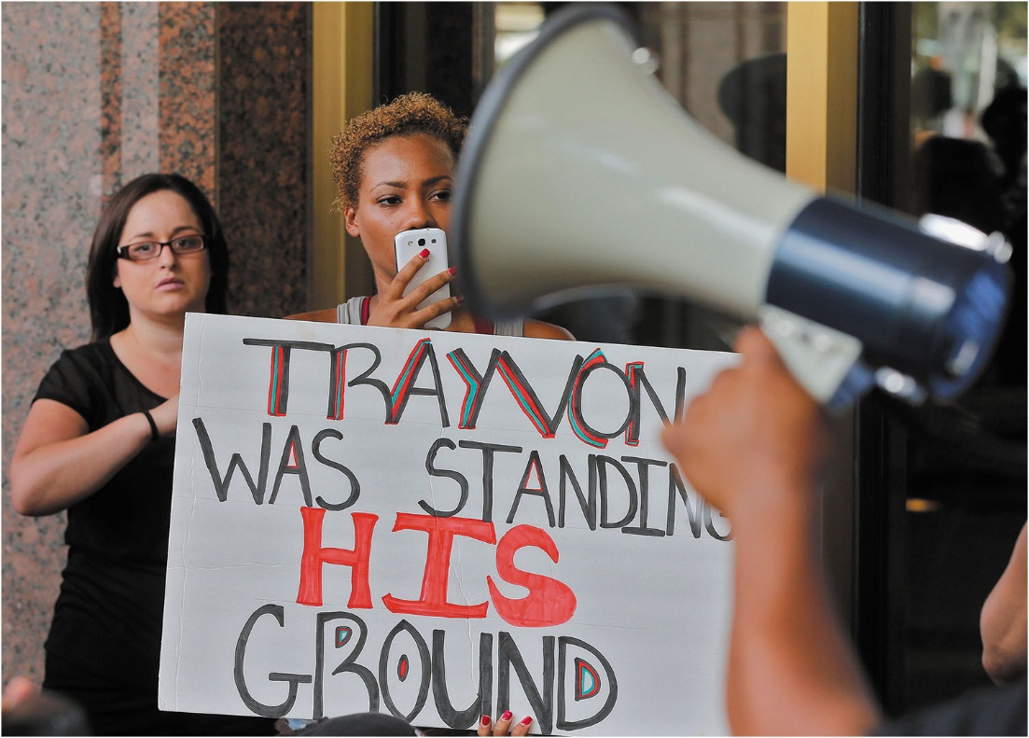
Many people participated in marches throughout the country, calling for federal civil rights charges to be filed against George Zimmerman after his acquittal. Why do so many people believe that the amount of force used in this case was excessive?

Slide 15
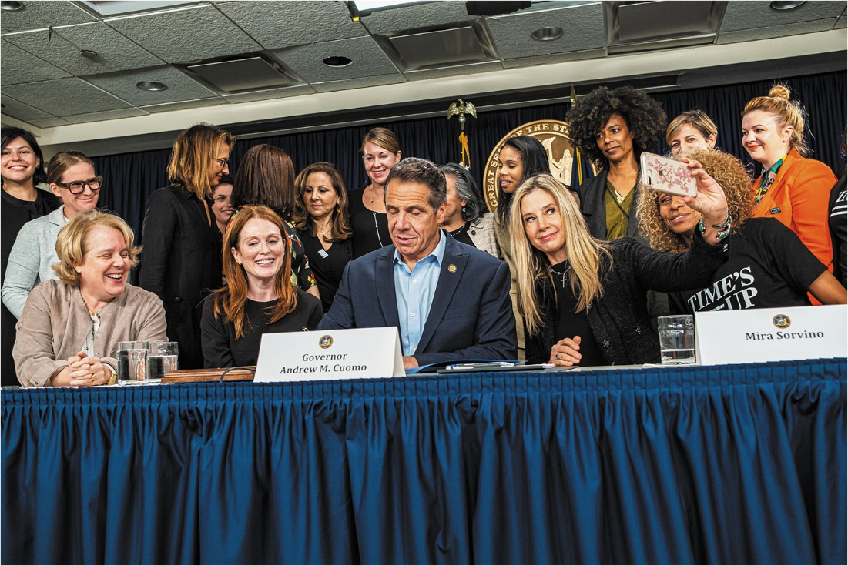
In September 2019, New York Governor Andrew Cuomo signed into law a bill that increased the statute of limitations in
rape cases. Actresses Julianne Moore, left, and Mira Sorvino, right, and members of the Time’s Up movement against
sexual harassment and assault, were supporters of the bill. Why has extending the statute of limitations on serious cases such as rape gained support in recent years?

