Slide 1
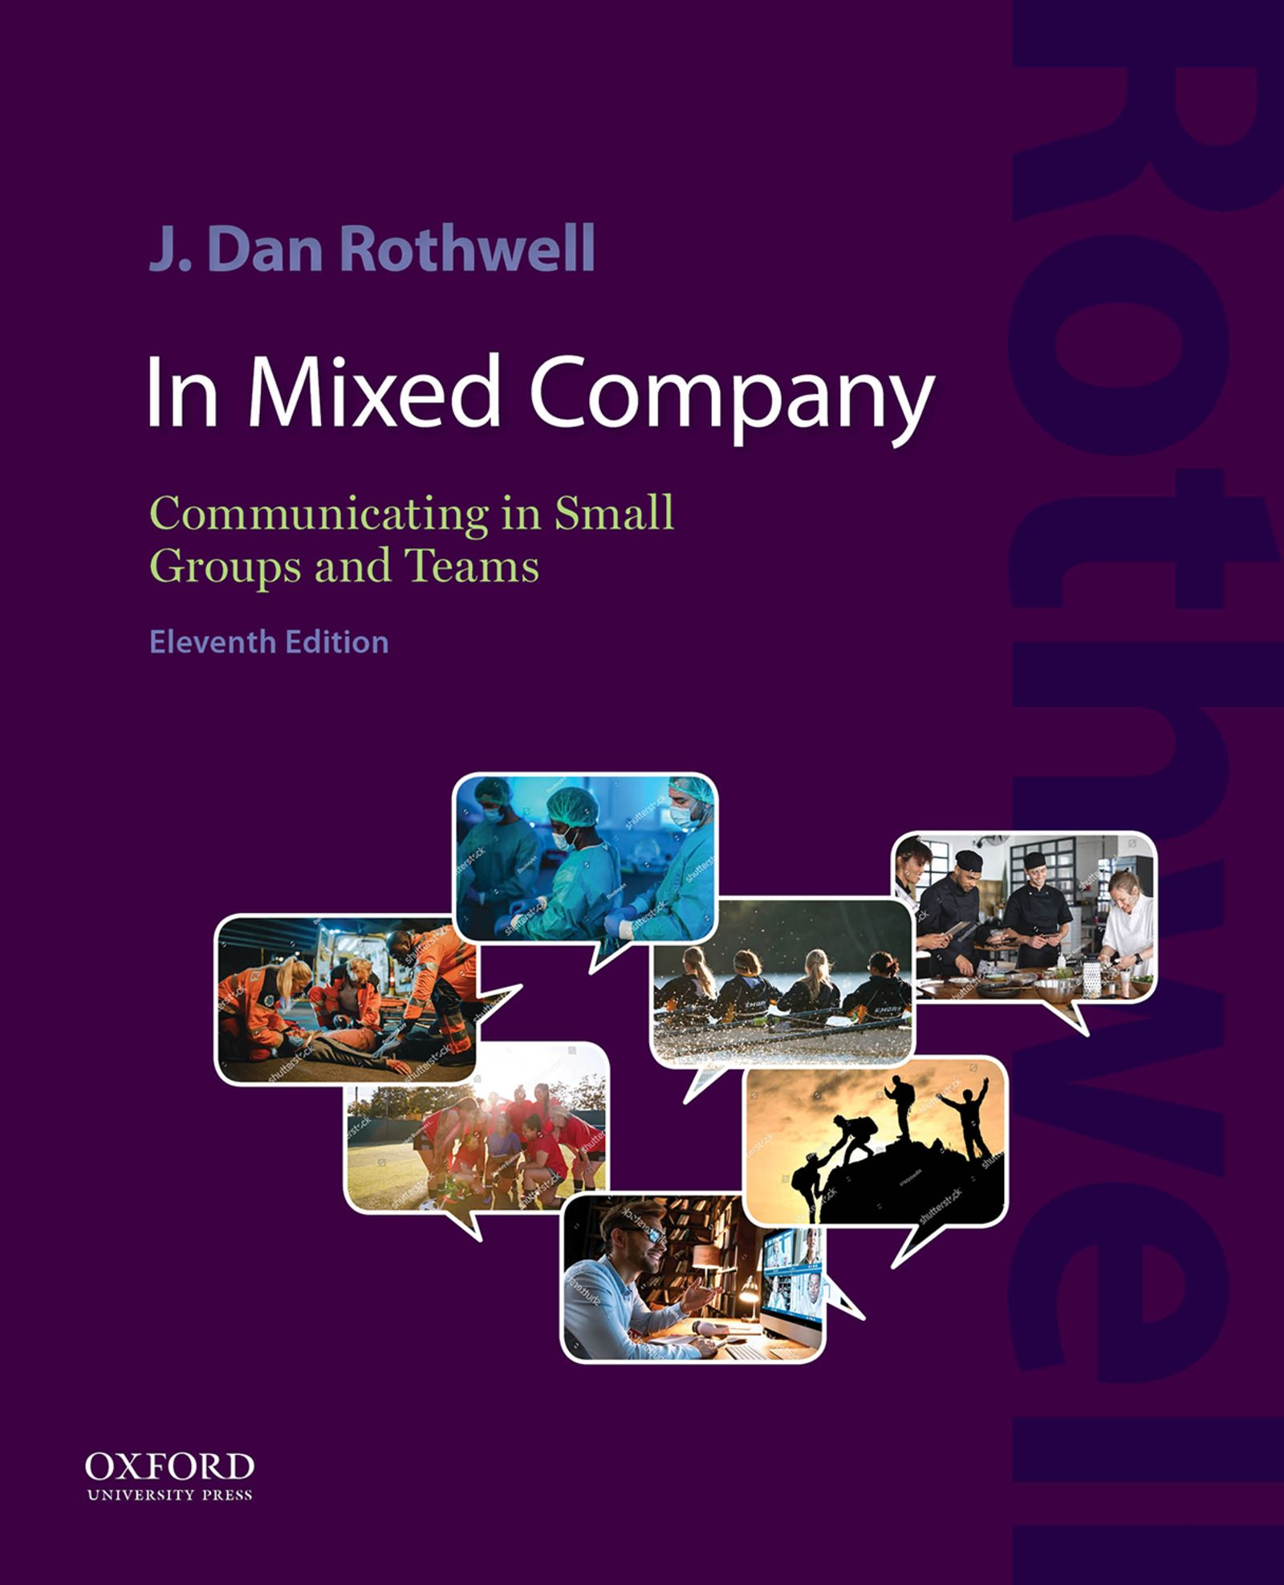

In Mixed Company
by J. Dan Rothwell

Slide 2
Chapter 3 Meetings: Standard and Virtual
Standard Meeting Preparation
Conducting a Meeting
Participating in Meetings
Virtual Meetings

Slide 3
Chapter 3 Learning Objectives
3.1 Determine what to do before, during, and after a meeting when you are in charge.
3.2 Explore how to use communication competence to participate fully in any meeting, regardless of your role.
3.3 Learn how to navigate virtual meetings with ease.

Slide 4
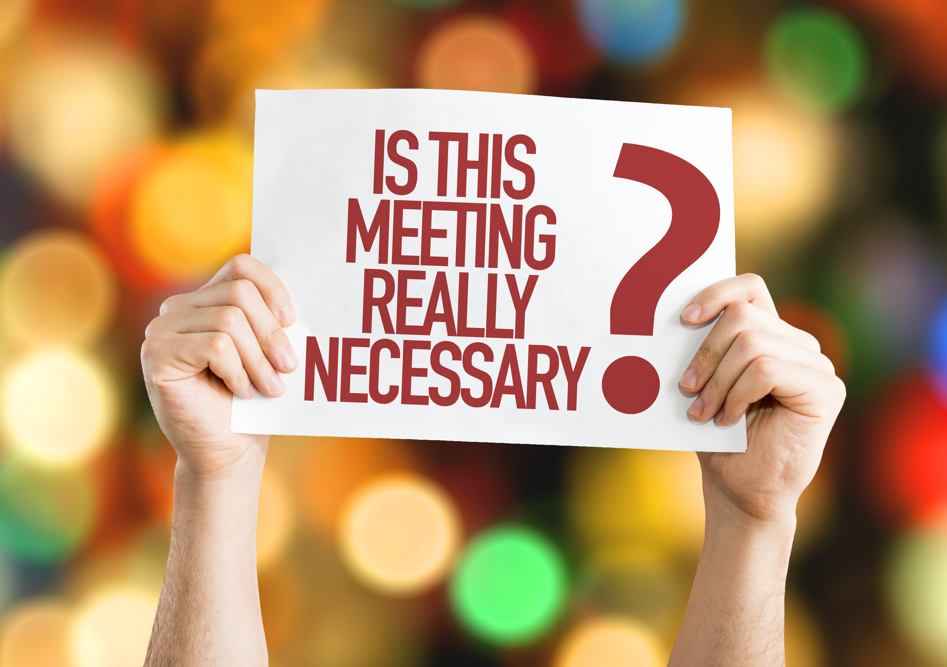
Chapter Introduction Group Meetings: Common Complaints
Unclear purpose for the meeting
Unprepared participants
Late beginning and ending of meetings
Poorly organized meetings
Participants distracted by social media
Late or absent members
Unrelated discussions
Domination of conversation by some participants
Unimplemented decisions

Slide 5
Standard Meeting Preparation Clarify the Purpose: Avoid Aimlessness (1)
Is the following generally a good reason to have a meeting? Yes or No
A meeting is always scheduled each week.
An immediate response from the group is required.
Group participation is essential.
Information needs to be shared.
Key players can be present.
New ideas need to be tried out on group members.
Participants are prepared to discuss and act on issues.
Notes:
Instructor Notes:
Answers
No
Yes
Yes
No
Yes
No
Yes

Slide 6
Standard Meeting Preparation Clarify the Purpose: Avoid Aimlessness (2)
Determine the purpose – what result needs to be achieved by meeting?
Overall purpose
To generate ideas
To solve problems
To make decisions
Decisions
Who to invite
What to discuss
How to discuss it

Slide 7
Standard Meeting Preparation Clarify the Purpose: Avoid Aimlessness (3)
Which of the following is a better purpose/impact (P/I) statement? Why?
1. The purpose of Monday’s meeting is to check in with everyone in order to be updated.
2. The purpose of Monday’s meeting is to review project group members’ weekly progress on assigned tasks in order to identify any problems that need solving.
Notes:
Instructor Notes:
#1. Fails to signify the importance of the meeting and the stated impact is weak at best.
#2 is a better P/I statement.

Slide 8
Standard Meeting Preparation Create an Effective Meeting Agenda: Simple Steps (1)
For more formal meetings:
Print the purpose/impact (P/I) statement at the top
Draft agenda items from the P/I statement
List agenda items as questions
Identify the item leader
Manage your guest list
Seek input
Estimate the time needed
Create your final agenda

Slide 9
Standard Meeting Preparation Create an Effective Meeting Agenda: Simple Steps (2)
Sample agenda:
Agenda for Group Project Team Meeting
When: Monday, 8:00 – 9:00 am
Location: Library Study Room (reserved)
Purpose/Impact: The purpose of our brainstorming session is to gather a minimum of three strong focus areas to consider in order to make progress on our final group project.
Notes:
Instructor Notes:
Note the following qualities of a good agenda:
Print the purpose/impact (P/I) statement at the top
Draft agenda items from the P/I statement
List agenda items as questions
Identify the item leader
Estimate the time needed
Create your final agenda

Slide 10
Standard Meeting Preparation Create an Effective Meeting Agenda: Simple Steps (3)
Time | Topic/Question | Leader
8:00–8:05 (5 minutes) | Welcome: What is the purpose of this meeting? | Anne
8:05–8:10 (5 minutes) | Assignment review: What are the criteria for the final group project? | Anne
8:10–8:20 (10 minutes) | Brainstorm in pairs: What topics could we present and why? | All
8:20–8:35 (15 minutes) | Group brainstorm: Report best ideas. | All
8:35–8:45 (10 minutes) | Which ideas merit further exploration? Vote for top three. | Arun
8:45–8:55 (10 minutes) | Determine next steps: Who will do what by when (WWDWBW)? When will we meet again? | Anne and Arun
8:55–9:00 (5 minutes) | Revisit parking lot: Issue? Action item? Agenda? Rate the meeting. | Anne
Notes:
Instructor Notes:
Note the following qualities of a good agenda:
Print the purpose/impact (P/I) statement at the top
Draft agenda items from the P/I statement
List agenda items as questions
Identify the item leader
Estimate the time needed
Create your final agenda

Slide 11
Conducting a Meeting Stay on Track: Parking Lots, Jellyfish, and Perception Checks
Try different methods of involvement and inclusion:
Assign a timekeeper
Discourage stage hogs
Establish a “parking lot”
Use light and humorous methods (i.e., “jellyfish”)
Use perception checks
Notes:
Instructor Notes:
Other considerations:
What type of meeting – formal, informal, mixed
Begin on time, end on time
Procedural ground rules - turn off phones, start on time, etc.
Behavioral ground rules – stay on topic, etc.

Slide 12
Conducting a Meeting Concluding the Meeting: Don’t End with a Whimper
Close with a purpose:
WWDWBW = Who Will Do What By When
When concluding the meeting, ask the following questions:
Is there anything left that needs to be said before we adjourn? (Check for completion)
How do you feel about where we ended up? (Check alignment with decisions)
Who is doing what by when (WWDWBW) to ensure progress before our next meeting? (Ensure agreement on next steps)

Slide 13
Conducting a Meeting After the Meeting: Clean-Up Time
Jot down must-dos or reminders (i.e., WWDWBW)
Update anyone outside of meeting as necessary
Revisit the parking lot and follow up as necessary
Start planning next meaning
Follow up on decisions
Distribute minutes

Slide 14
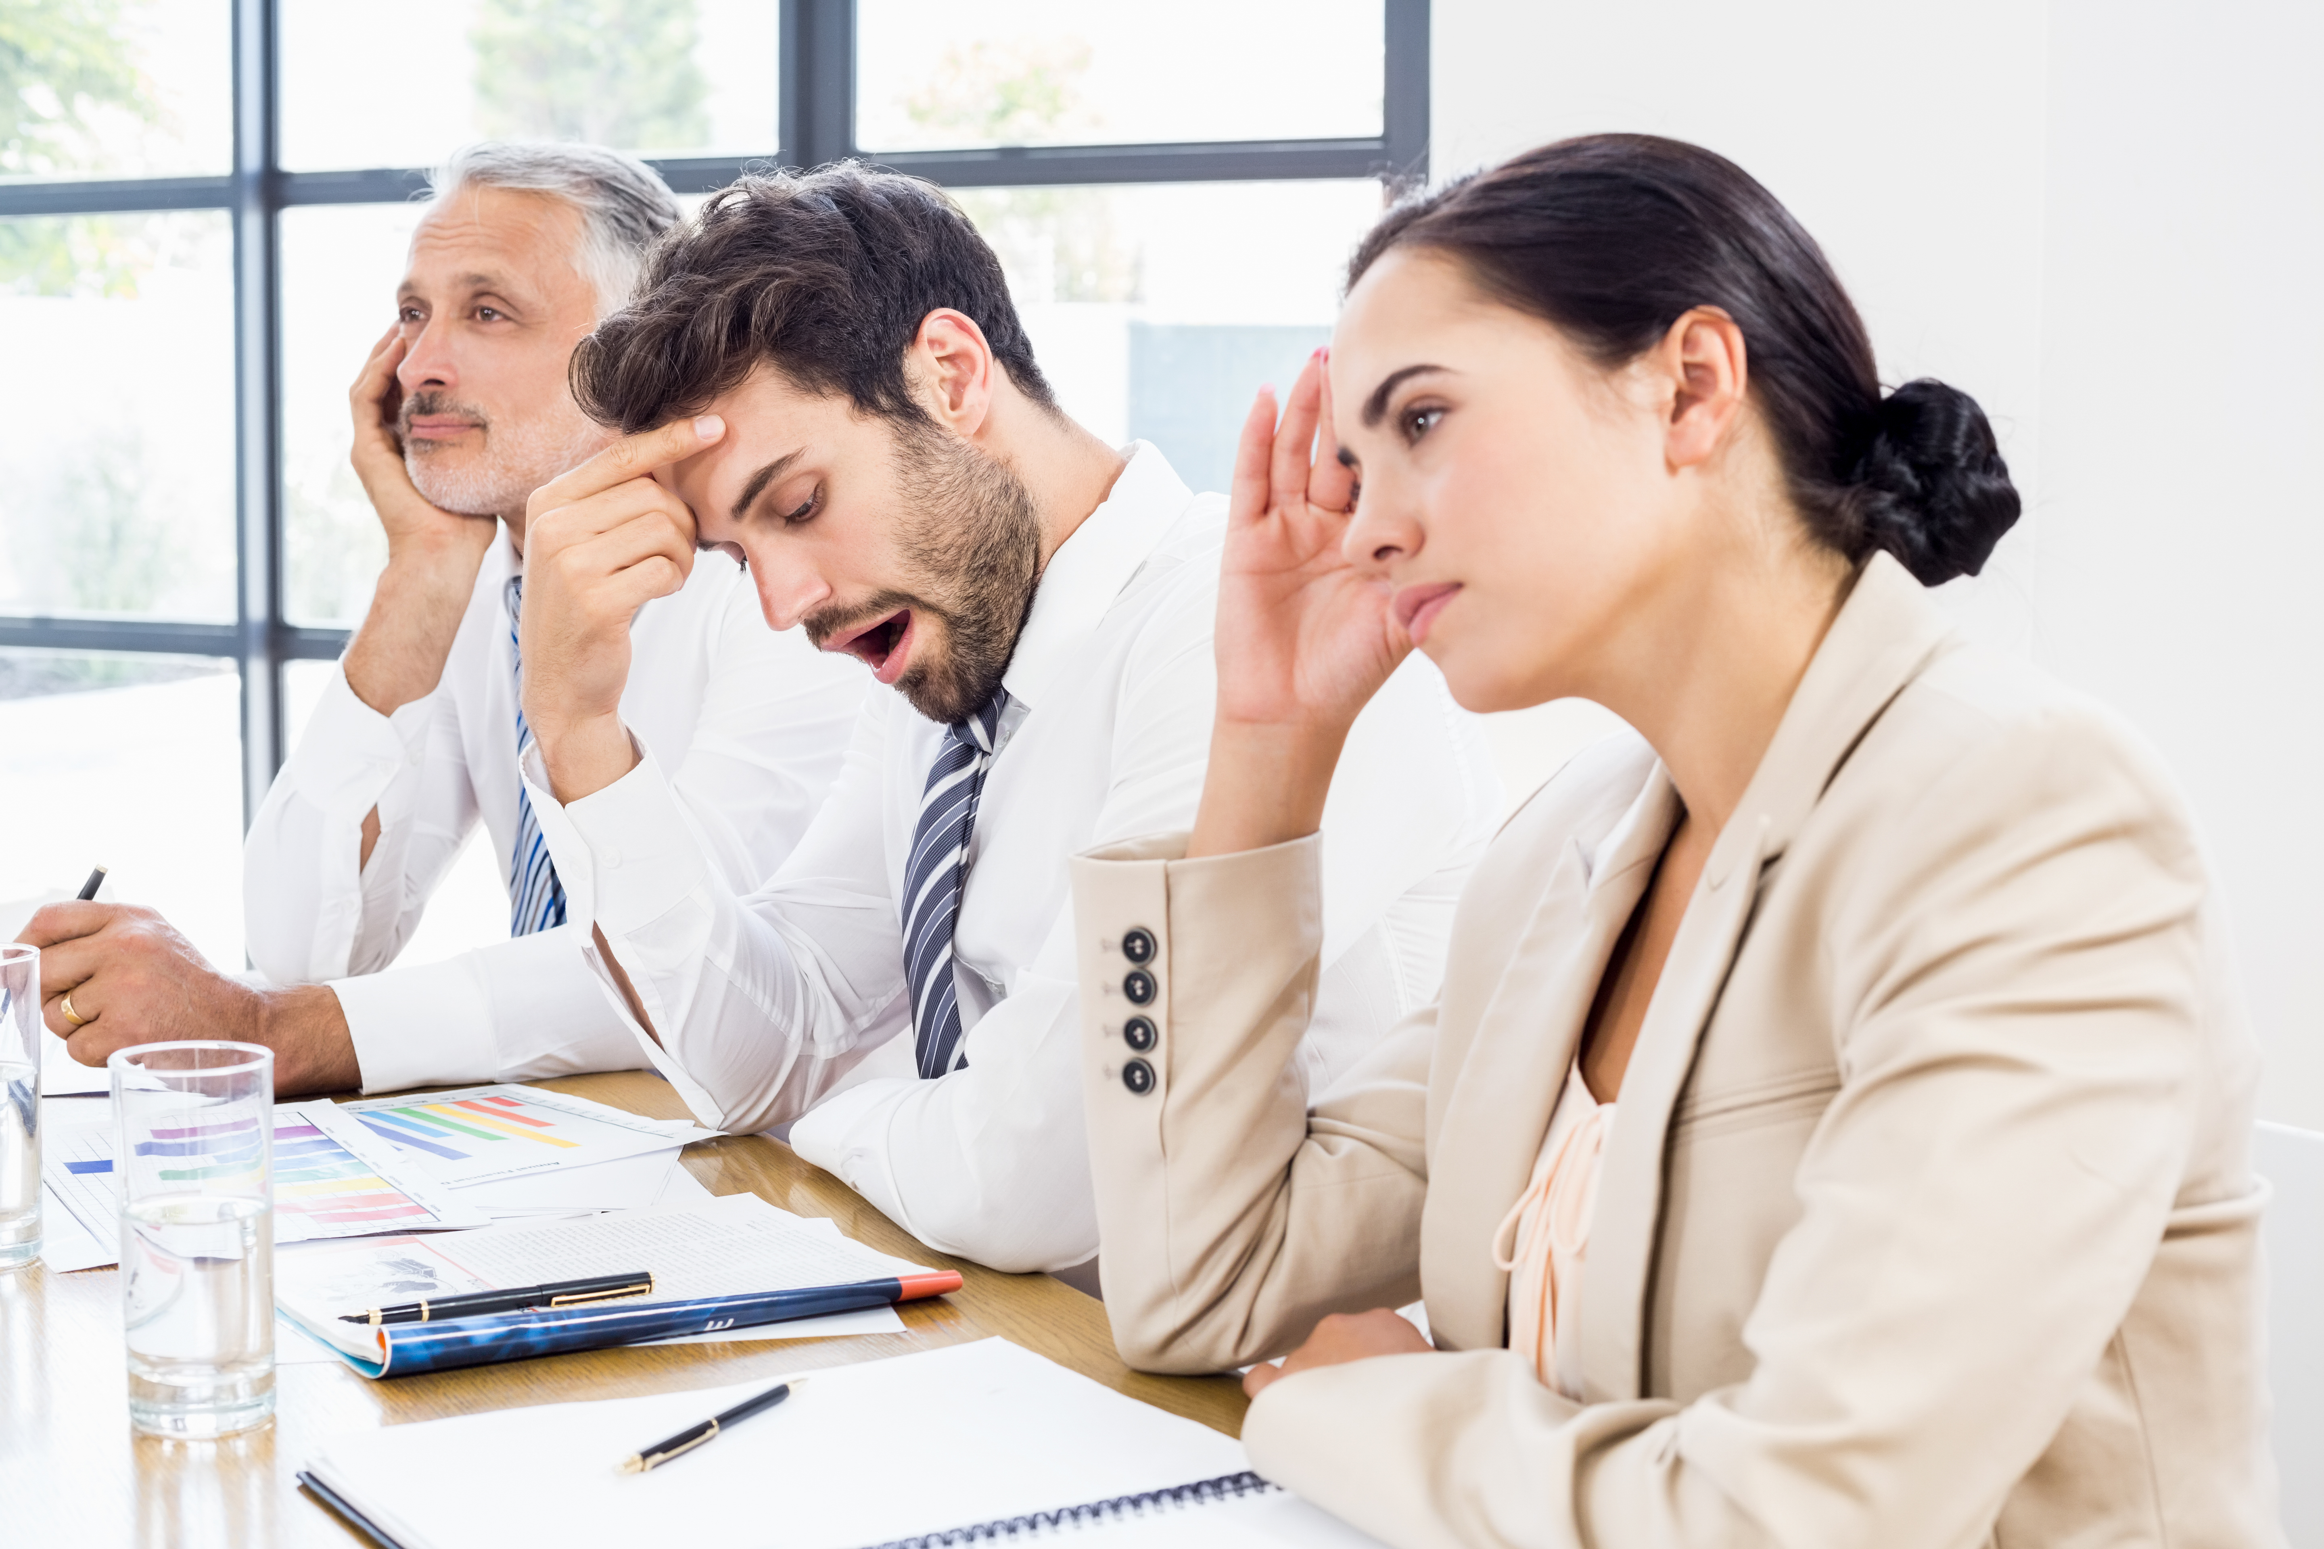
Participating in Meetings Increase Participation: Constructive Engagement
Encourage contributions from low participators
Make issues and problems relevant to the interests of low participators
Give low participators responsibility for certain tasks
Establish a cooperative group climate
Notes:
Instructor Notes:
Other considerations:
Be prepared
WAIT = Why Am I Talking?
Avoid stage hogging
Be attentive
Recognize cultural differences, types/levels of participation

Slide 15
Virtual Meetings Facilitating a Virtual Meeting: New Challenges
Specify cameras-on expectations in meeting invitation
Make sure group members are well versed in the technology (i.e., how to mute mics, raise hands, etc.)
Check equipment before the meeting; log on early (camera, mic, volume, internet connection)
Know how to mute yourself
Consider rotating roles (i.e., timekeeper, notetaker)
Call on people directly
Notes:
Instructor Notes:
Other considerations:
Audio versus Visual
Videoconferencing
Pluses – work from anywhere, etc.
Limitations – distractions, low participation, miscommunications, etc.

Slide 16
Virtual Meetings Virtual Meeting Participation: A Few Unique Considerations (1)
Before the video conference:
Log on to the website or set up your call early
Make time to download any necessary software, test your connection and equipment (i.e., mic and camera)
Know how to mute yourself
Dress as you would dress in the office or classroom
Notes:
Instructor Notes:
Other considerations:
Audio versus Visual
Videoconferencing
Pluses – work from anywhere, etc.
Limitations – distractions, low participation, miscommunications, etc.

Slide 17
Virtual Meetings Virtual Meeting Participation: A Few Unique Considerations (2)
Get ready for your close up:
Position webcam at eye level (no higher than hairline)
Sit facing light source (3-point lighting is best)
Clear the clutter
Beware of glare on your eye glasses
Dress appropriately
Test virtual background
Keep pen and paper handy for notes

Slide 18

Virtual Meetings Virtual Meeting Participation: A Few Unique Considerations (3)
During the meeting:
Monitor nonverbals
Posture
Eye contact
Vocal qualities
Facial expressions
Gestures
Avoid multi-tasking
Participate
Mute when not talking
Unmute when you have something to say
Notes:
Instructor Notes:
Other considerations:
Exit with ease!

Slide 19
Chapter 3 Questions for Critical Thinkers
1. Is there ever a time when an agenda might actually interfere with the smooth, effective functioning of a group meeting?
2. Would you ever use an agenda during a group study session for an exam?
3. Can you have too many procedural and ground rules for effective group meetings?
4. Clearly, you can have too many meetings, but can you ever have too few? If so, what determines this?

Slide 20
Chapter 3 Review of Learning Objectives
3.1 Determine what to do before, during, and after a meeting when you are in charge.
3.2 Explore how to use communication competence to participate fully in any meeting, regardless of your role.
3.3 Learn how to navigate virtual meetings with ease.

