Slide 1




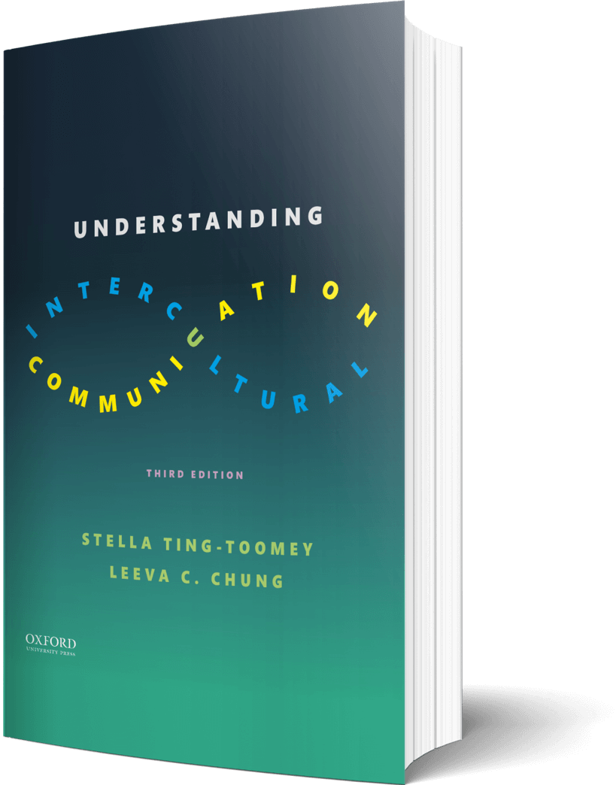

Intercultural Student
TOUR
Your adventure continues…
©2022

Slide 2

Prompt
Picture this…
While working on a tight deadline, a frustrated virtual global team member tells a more introverted group member, “Why are you always so quiet? Can’t you contribute to our project?!” As the team leader, how can you mediate this microaggression and help your team members understand their communication styles and cultural differences?
Enter your answers in the journal on the next page…

Slide 3

Journal
How will you react? How will you help?

Slide 4

Learn
Reflect
After reading the three principles of human perception, which of the three principles do you need to work more on?
Enter your answers in the journal on the next page…

Slide 5

Journal
Of the three principles of human perception, I need to work on….

Slide 6

Apply
Imagine
Read this interesting article. What is your initial reaction? What are some specific ways you can be an advocate to stem the growing health care disparities?
Enter your answers in the journal on the next page…

Slide 7

Journal
How I can become an advocate…

Slide 8
?of
Checklist
1
PROMPT
CHAPTER 8
2
LEARN
3
APPLY
4
CHECKOUT the practice quiz
Intercultural Student
5
CHECKOUT glossary-matching quizzes
TOUR

