Slide 1
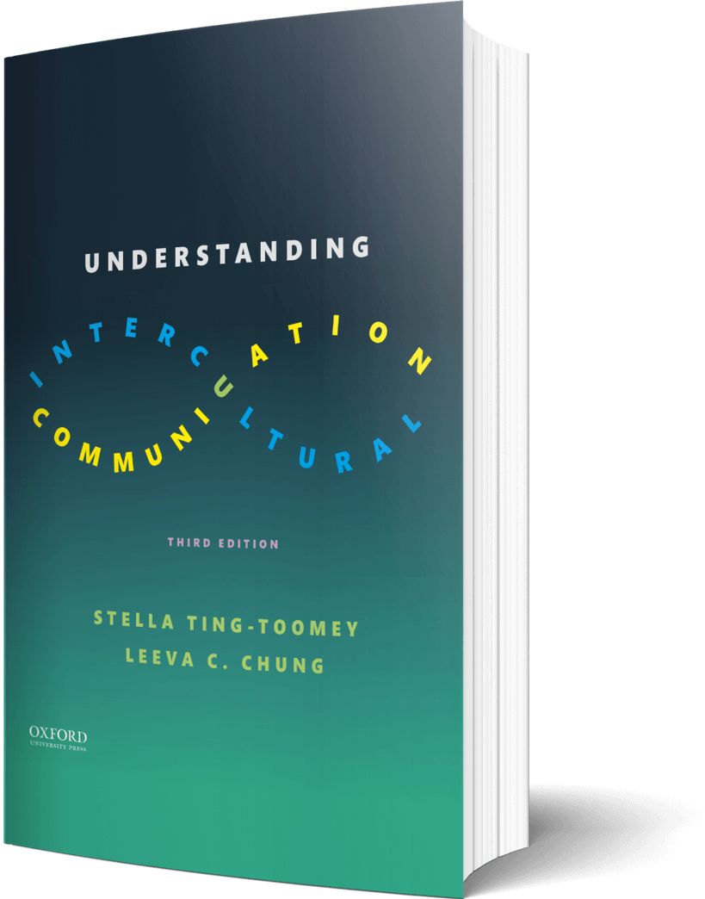
Intercultural Student
TOUR
Your adventure concludes!
©2022

Slide 2
Prompt
Picture this…
You are about to meet with your new global work team. How will you use the five steps of cultural empathetic responsiveness to be a consciously competent “global” team member?
Enter your answers in the journal on the next page…

Slide 3
Journal
How will you use the five steps…

Slide 4
Prompt
Learn
What is the best example, story, or visual to explain the term “ethical relativism?”
Explain the term in the journal on the next page…

Slide 5
Journal
“Ethical relativism” is…

Slide 6
Apply
Connect
Draw or add an image that represents flexible communication.
Draw your image in the journal on the next page…

Slide 7
Draw
Draw or add an image that represents flexible communication…

Slide 8
Imagine
In Conclusion…
“Global harmony starts with the self.” To earn your last stamp and complete the intercultural tour, list three ways you will work towards aligning your moral values and connecting with others this year. Be specific!
Enter your answers in the journal on the next page…

Slide 9
List three ways…
1 –
2 –
3 –

Slide 10
?of
Checklist
1
PROMPT
CHAPTER 12
2
LEARN
3
APPLY
4
IMAGINE…
Intercultural Student
5
CHECKOUT the practice quiz
TOUR
6
CHECKOUT glossary-matching quizzes

