Slide 1




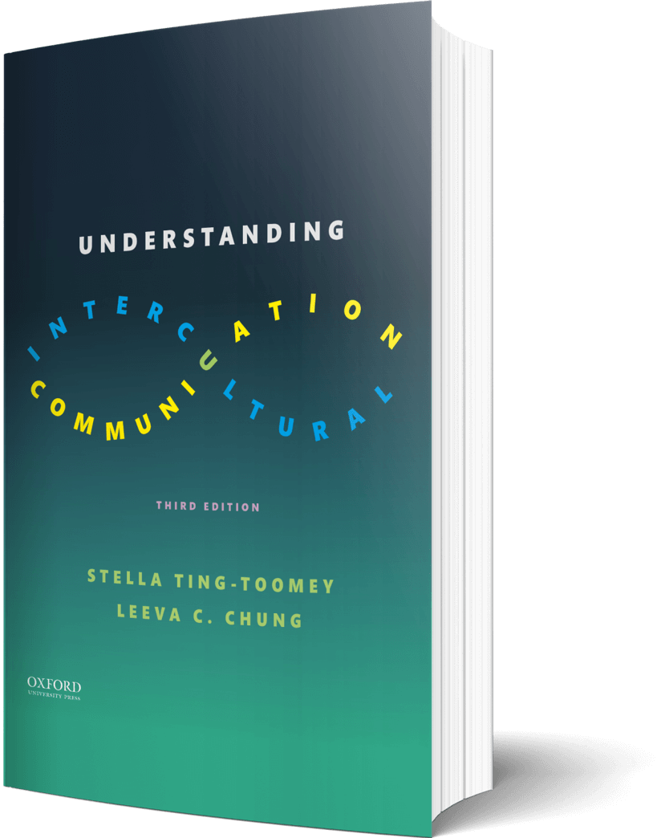

Intercultural Student
TOUR
Your adventure continues…
©2022

Slide 2

Prompt
Picture this…
As you wait to be interviewed with your dream company, you want do a quick prep! You open your “notes” app to review nonverbal gestures to be ready for in the interview. What are three gestures? Why these three?
Enter your answers in the journal on the next page…

Slide 3

Journal
The three nonverbal gestures to be ready for…
1 -
2 –
3 -

Slide 4

Prompt
Learn
In his TED Talk, Joe Navarro talks about the power of nonverbal communication and empathy. After watching this talk, write down two points that resonated with you about how you can change your nonverbal communication and express empathy.
Enter your answers in the journal on the next page…

Slide 5

Journal
Two ways that resonated with you…
1 –
2 –

Slide 6

Apply
Connect
Think about a time where you were emotionally struggling. Do you remember if you used Hwang and Matsumoto’s rules to modify your facial or tonal expressions? Which rules?
Enter your answers in the journal on the next page…

Slide 7

Journal
Modified facial or tonal expressions…

Slide 8

Imagine
Take a pic…
Get out your cell phone and take a pic of a daily hand gesture you use. Do some research – what does this hand gesture mean in a different country and cultural community?
Enter your answers in the journal on the next page…

Slide 9

Journal
My hand gesture or picture is….
What does this hand gesture mean in a different country and cultural community?

Slide 10
?of
Checklist
1
PROMPT
CHAPTER 7
2
LEARN
3
APPLY
4
IMAGINE…
Intercultural Student
5
CHECKOUT the practice quiz
TOUR
6
CHECKOUT glossary-matching quizzes

