Slide 1




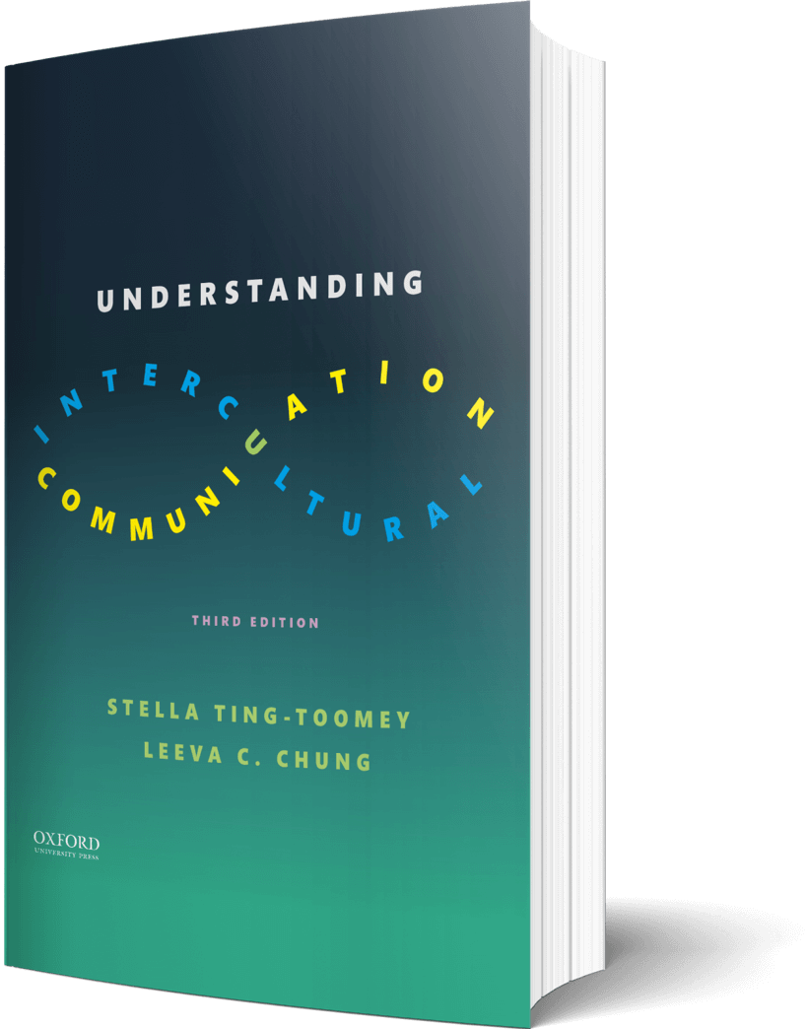

Intercultural Student
TOUR
Your adventure begins continues…
©2022

Slide 2

Prompt
Picture this…
Think about an inside joke or references you have with close friends or an ingroup. Write one or two down. What would people outside of your ingroup think about the joke or references? Would they understand what the joke or references mean?
Enter your answers in the journal on the next page…

Slide 3

Journal
Write your joke and/or references…

Slide 4

Learn
Play
Words and language are arbitrary and vary from culture to culture. With the scrambled letters on the next slide, take time to make your own word by using all the letters. Create a definition of your new made-up word, the pronunciation, and how it would be used in a sentence.
Enter your answers in the journal on the next page…

Slide 5

AJTFSE
A - Definition -
B - Pronunciation -
C - Sentence -

Slide 6

Apply
Connect
This week, make a request (like asking a friend to get lunch together) in your non-preferred communication style. Use the journal predict what will be different from your preferred communication style--how you ask and how your friend might react!
Enter your predictions in the journal on the next page…

Slide 7

Journal
Start predicting the reaction…

Slide 8

Imagine
Listen
Write down a country unfamiliar to you. Go on YouTube and find one of your favorite songs sung from a member of this country. How does this song translate? What is your initial reaction after listening to it?
Enter your answers in the journal on the next page…

Slide 9

Translate
How does this song translate?

Slide 10
?of
Checklist
1
PROMPT
CHAPTER 6
2
LEARN
3
APPLY
4
IMAGINE…
Intercultural Student
5
CHECKOUT the practice quiz
TOUR
6
CHECKOUT glossary-matching quizzes

