Slide 1
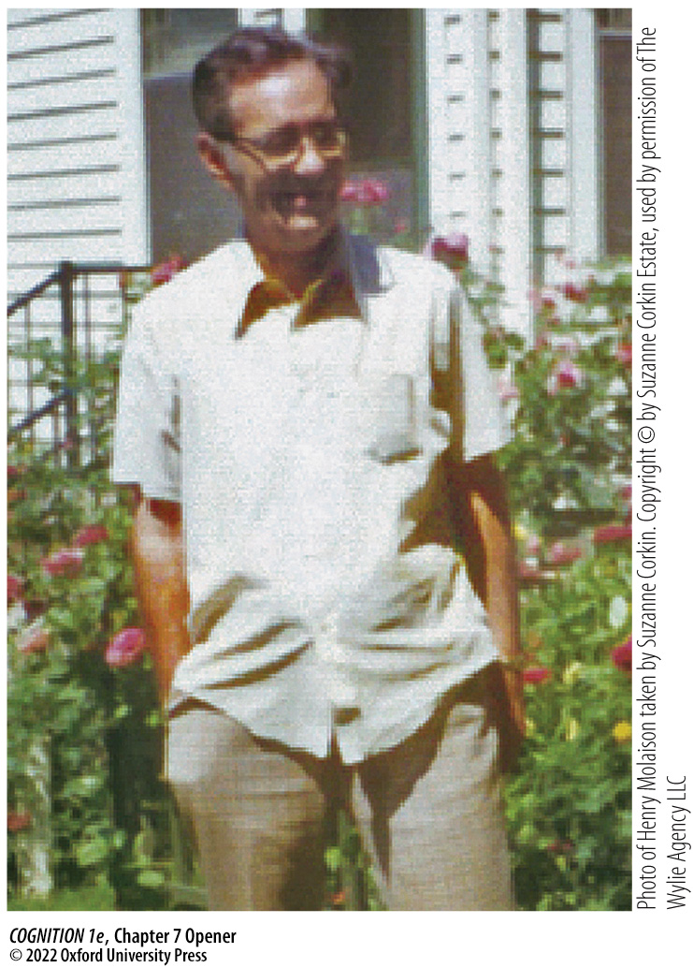
Chapter 7 Opener
Notes:
Chapter 7 Opener
The famous patient H.M. in 1974, at the age of 48. As a result of radical surgery to control his epileptic seizures, he lost his ability to remember new information, yet he retained many other high-level cognitive functions.

Slide 2
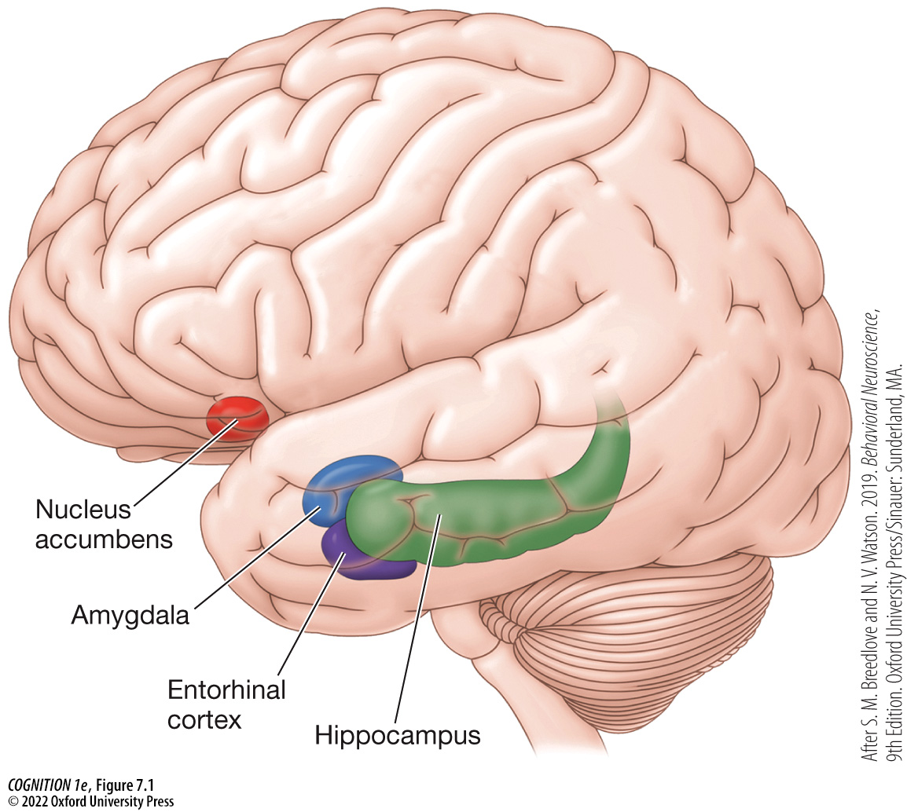
Figure 7.1 Schematic of the medial temporal lobe
Notes:
Figure 7.1 Schematic of the medial temporal lobe
Key structures include the hippocampus, entorhinal cortex, and the amygdala; not depicted here are the parahippocampal cortex and perirhinal cortex. (After S. M. Breedlove and N. V. Watson. 2019. Behavioral Neuroscience, 9th Edition. Oxford University Press/Sinauer: Sunderland, MA.)

Slide 3
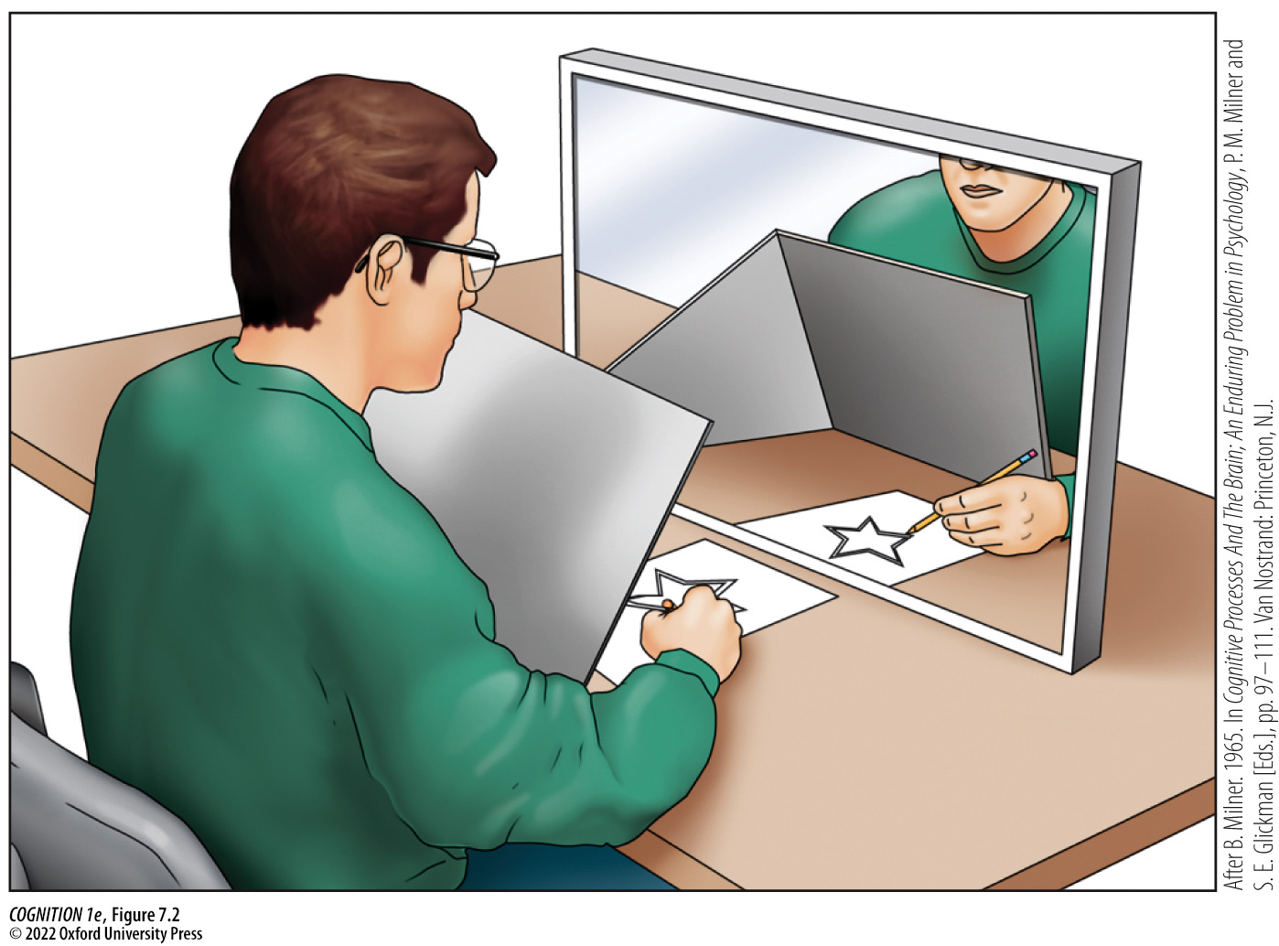
Figure 7.2 H.M.’s performance on a mirror-tracing task
Notes:
Figure 7.2 H.M.’s performance on a mirror-tracing task
Brenda Milner tested H.M.’s ability to learn new skills, which involves the formation of “motor memories,” with this star-tracing experiment. (After B. Milner. 1965. In Cognitive Processes And The Brain; An Enduring Problem in Psychology, P. M. Milner and S. E. Glickman [Eds.], pp. 97–111. Van Nostrand: Princeton, N.J.)

Slide 4
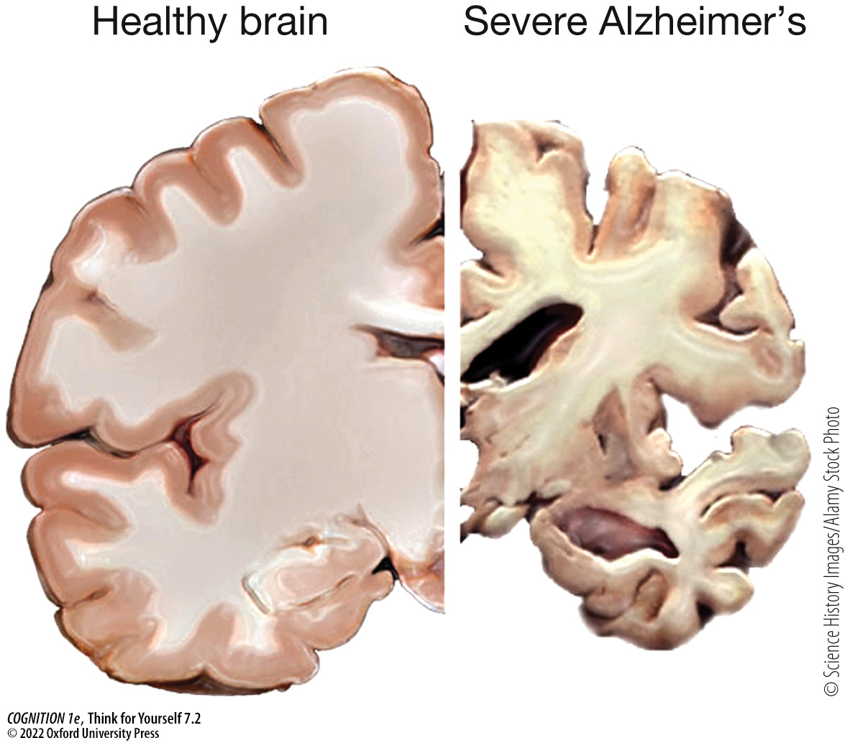
Think for Yourself 7.2
Notes:
Think for Yourself 7.2
A healthy brain compared with one showing severe damage from Alzheimer’s disease.

Slide 5
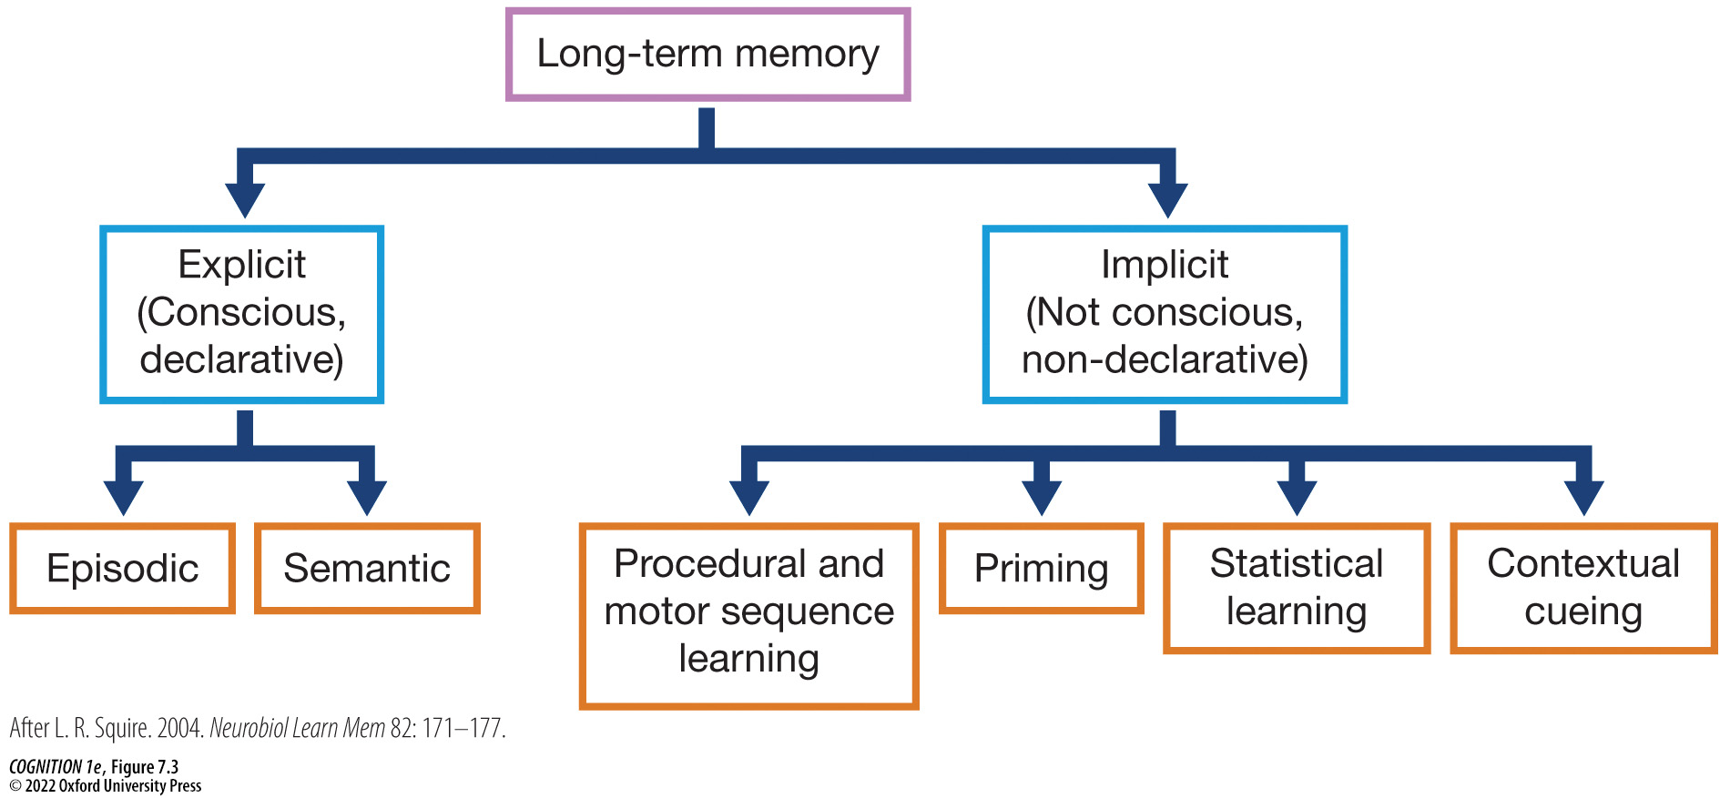
Figure 7.3 A taxonomy of long-term memory systems
Notes:
Figure 7.3 A taxonomy of long-term memory systems
This is modified to show the types of learning discussed in this chapter. (After L. R. Squire. 2004. Neurobiol Learn Mem 82: 171–177.)

Slide 6

See for Yourself 7.1
Notes:
See for Yourself 7.1
Mirror-Reversed Words
(After N. J. Cohen and L. R. Squire. 1980. Science 210: 207–210.)

Slide 7
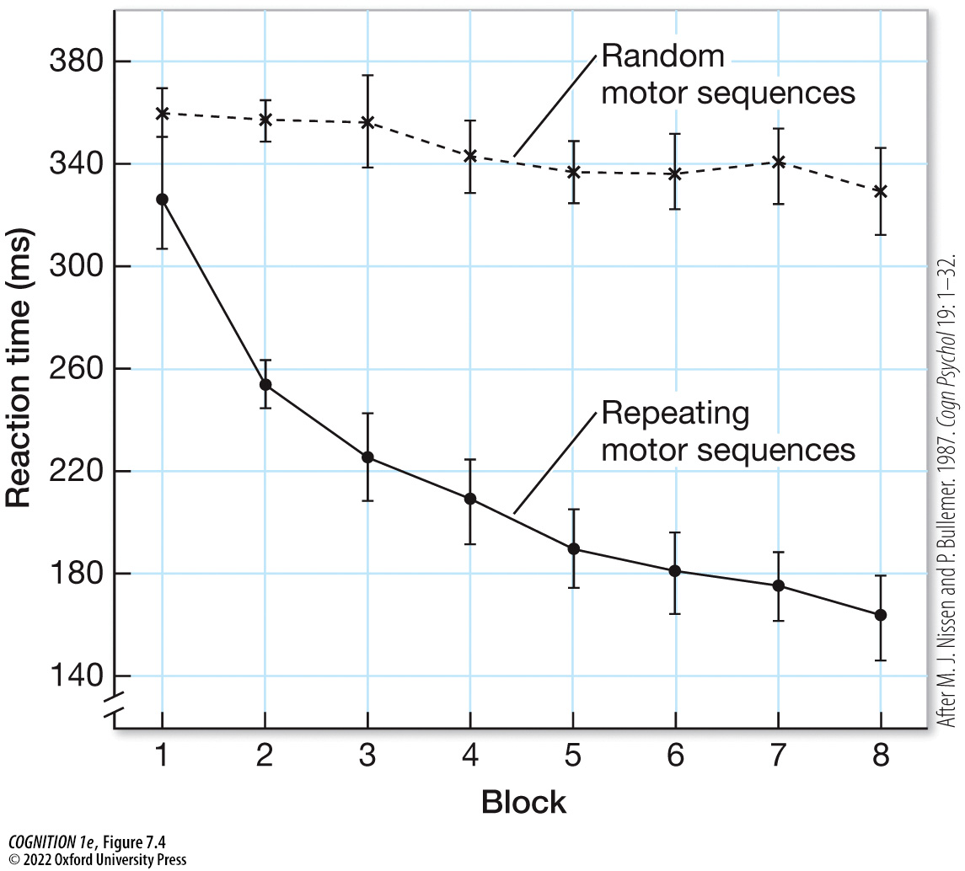
Figure 7.4 Response time is faster for repeating motor sequences (solid line) than for random motor sequences (dashed line)
Notes:
Figure 7.4 Response time is faster for repeating motor sequences (solid line) than for random motor sequences (dashed line)
Performance improves over time, reflecting motor sequence learning. (After M. J. Nissen and P. Bullemer. 1987. Cogn Psychol 19: 1–32.)

Slide 8
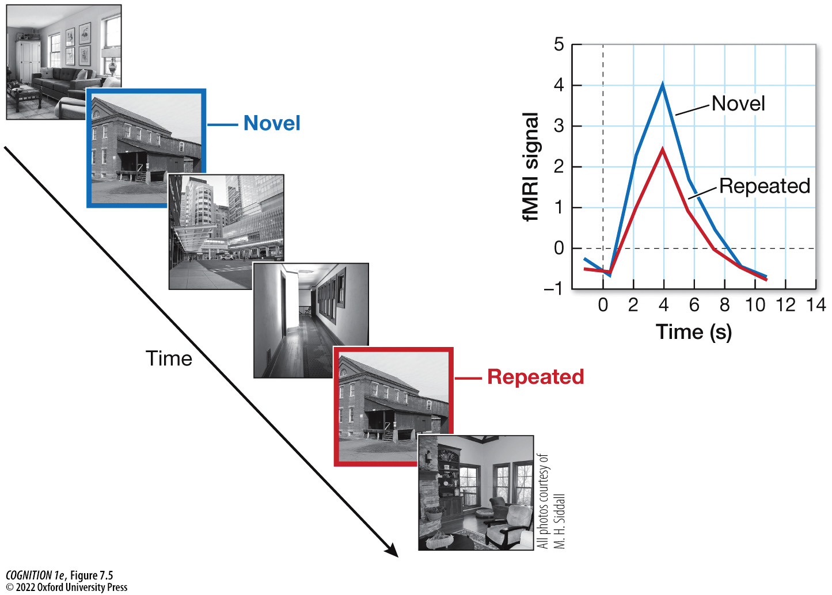
Figure 7.5 Perceptual priming and repetition suppression
Notes:
Figure 7.5 Perceptual priming and repetition suppression
When presented with a series of scenes and asked to make an indoor or outdoor judgment in response to each scene, observers are faster to respond to scenes that appeared before (repeated). The fMRI response in the place area is smaller for repeated scenes than for novel scenes, and this difference is known as repetition suppression.

Slide 9
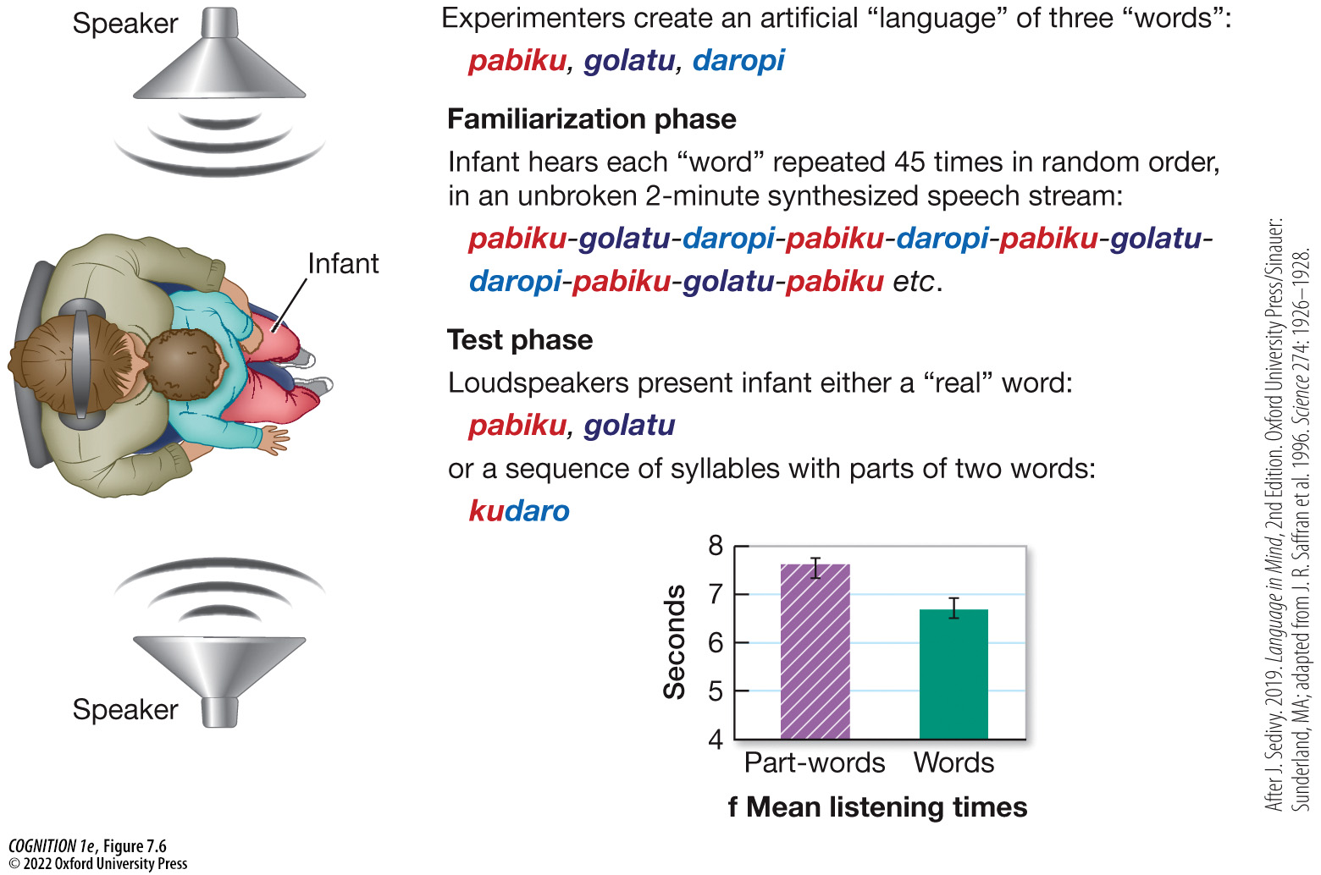
Figure 7.6 Statistical learning in language
Notes:
Figure 7.6 Statistical learning in language
During training, infants and adults are exposed to continuous speech streams in which artificial words (e.g., “pabiku”) are repeated. Then they are tested on these artificial words, or are presented with part-words (“kudaro”) that span word boundaries, and hence appeared less frequently (although the individual syllables all appeared the same number of times). Participants show familiarity for the repeated artificial words, showing that based on the statistics of how the syllables string together, they can segment the word boundaries. (After J. Sedivy. 2019. Language in Mind, 2nd Edition. Oxford University Press/Sinauer: Sunderland, MA; adapted from J. R. Saffran et al. 1996. Science 274: 1926–1928.)

Slide 10
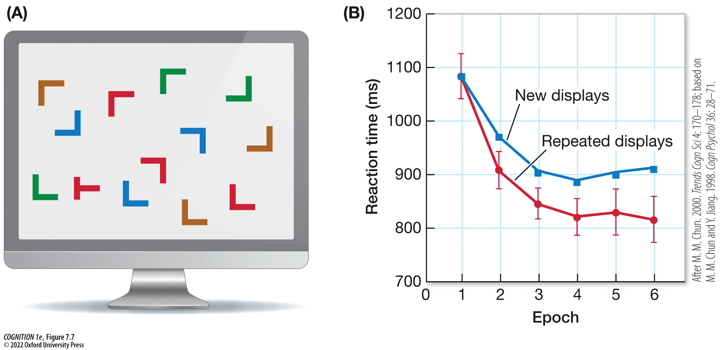
Figure 7.7 Computer-based visual search task
Notes:
Figure 7.7 Computer-based visual search task
(A) A sample search array. The task is to search for a rotated T as quickly as possible. (B) Average search times are faster for targets in old, repeated displays than in new displays. The benefit for old configurations is called contextual cuing, as memory for visual context serves to guide search (attention) to the target. The memory traces were implicit (observers were unable to distinguish old contexts from new). (After M. M. Chun. 2000. Trends Cogn Sci 4: 170–178; based on M. M. Chun and Y. Jiang. 1998. Cogn Psychol 36: 28–71.)

Slide 11
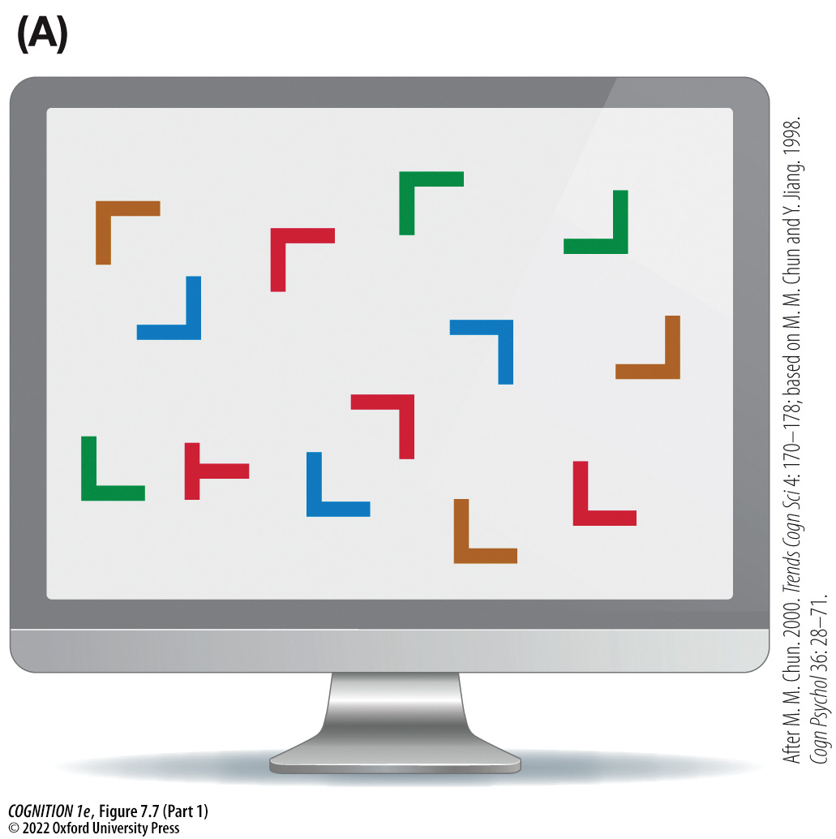
Figure 7.7 Computer-based visual search task (Part 1)
Notes:
Figure 7.7 Computer-based visual search task
(A) A sample search array. The task is to search for a rotated T as quickly as possible. (B) Average search times are faster for targets in old, repeated displays than in new displays. The benefit for old configurations is called contextual cuing, as memory for visual context serves to guide search (attention) to the target. The memory traces were implicit (observers were unable to distinguish old contexts from new). (After M. M. Chun. 2000. Trends Cogn Sci 4: 170–178; based on M. M. Chun and Y. Jiang. 1998. Cogn Psychol 36: 28–71.)

Slide 12
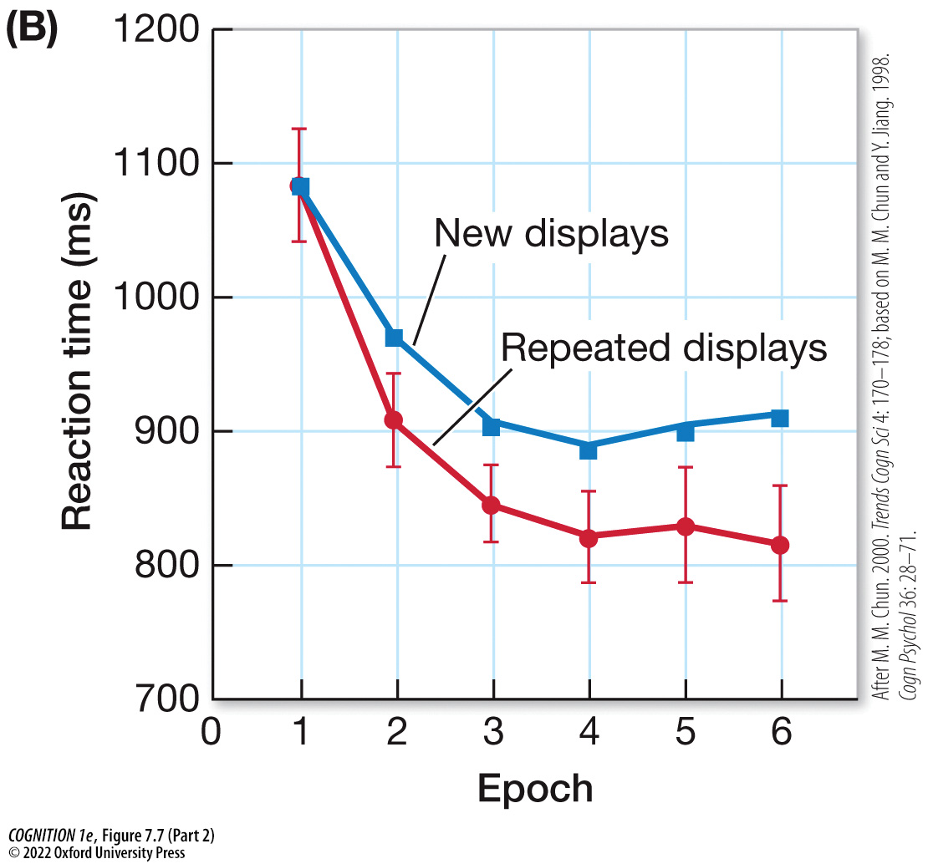
Figure 7.7 Computer-based visual search task (Part 2)
Notes:
Figure 7.7 Computer-based visual search task
(A) A sample search array. The task is to search for a rotated T as quickly as possible. (B) Average search times are faster for targets in old, repeated displays than in new displays. The benefit for old configurations is called contextual cuing, as memory for visual context serves to guide search (attention) to the target. The memory traces were implicit (observers were unable to distinguish old contexts from new). (After M. M. Chun. 2000. Trends Cogn Sci 4: 170–178; based on M. M. Chun and Y. Jiang. 1998. Cogn Psychol 36: 28–71.)

Slide 13
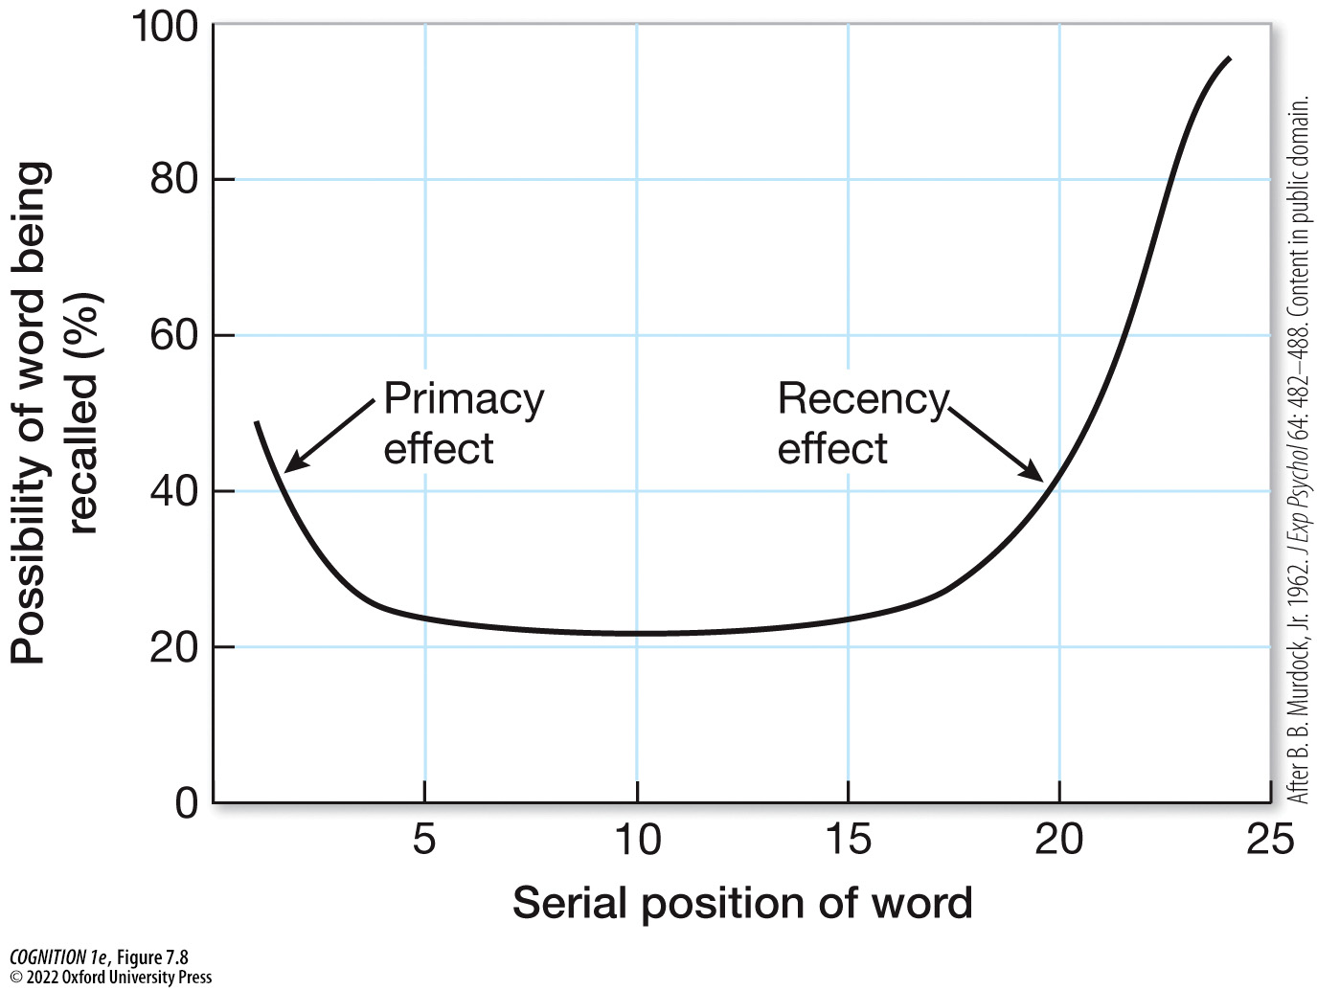
Figure 7.8 A serial position curve
Notes:
Figure 7.8 A serial position curve
Better memory for items appearing at the early part of the list is called the primacy effect, and better memory for items appearing toward the end of the list is called the recency effect. (After B. B. Murdock, Jr. 1962. J Exp Psychol 64: 482–488. Content in public domain.)

Slide 14
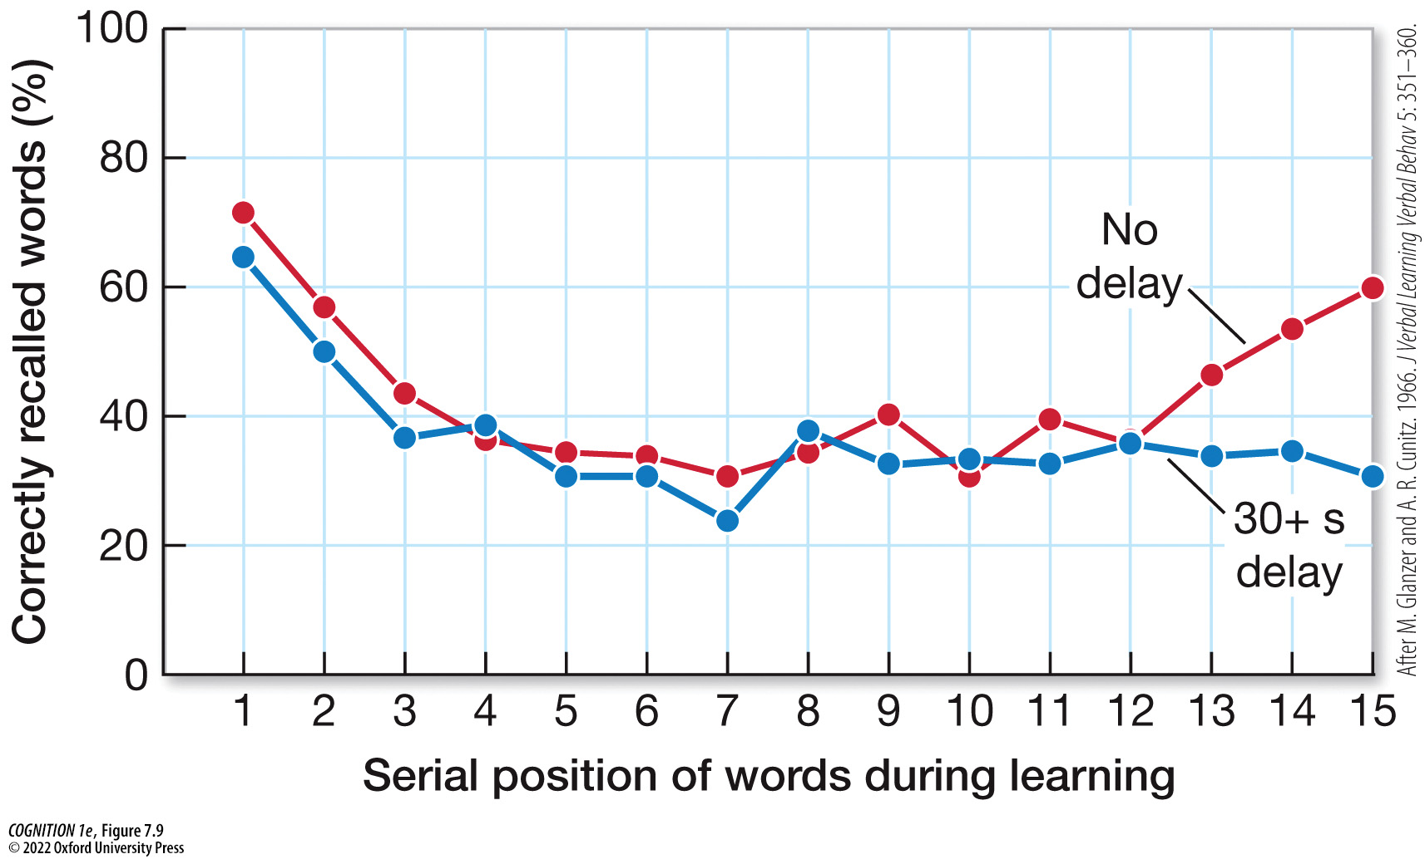
Figure 7.9 The recency effect is eliminated if a delay or distracting task is introduced at the end of the list
Notes:
Figure 7.9 The recency effect is eliminated if a delay or distracting task is introduced at the end of the list
This suggests that the recency effect reflects short-term memory, which is disrupted by delay or distraction. (After M. Glanzer and A. R. Cunitz. 1966. J Verbal Learning Verbal Behav 5: 351–360.)

Slide 15
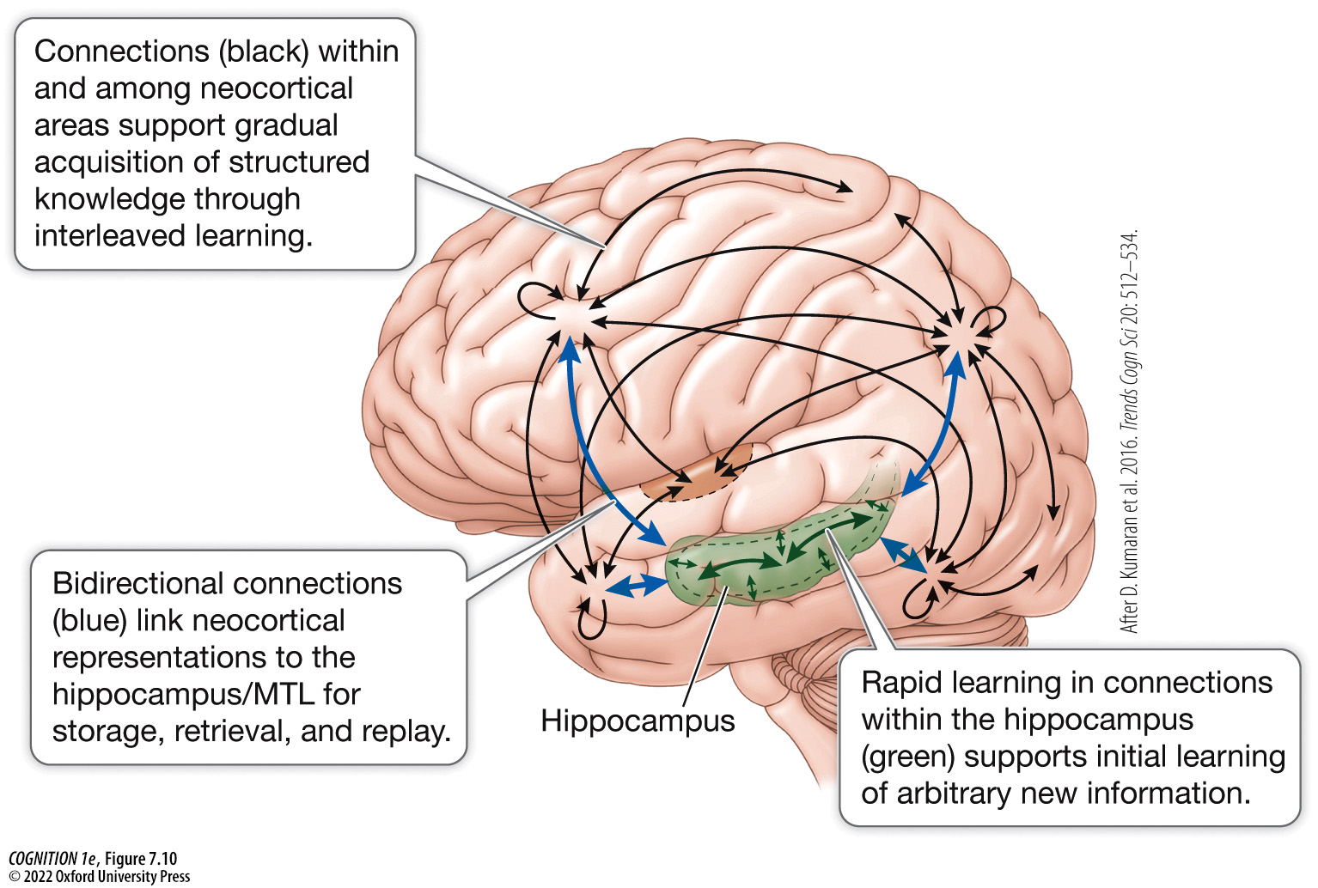
Figure 7.10 The hippocampus and neocortex form a complementary memory system (1)
Notes:
Figure 7.10 The hippocampus and neocortex form a complementary memory system
The hippocampus, which lies deep within the brain, supports rapid learning, while neocortical areas support gradual learning. MTL, medial temporal lobe. (After D. Kumaran et al. 2016. Trends Cogn Sci 20: 512–534.)

Slide 16
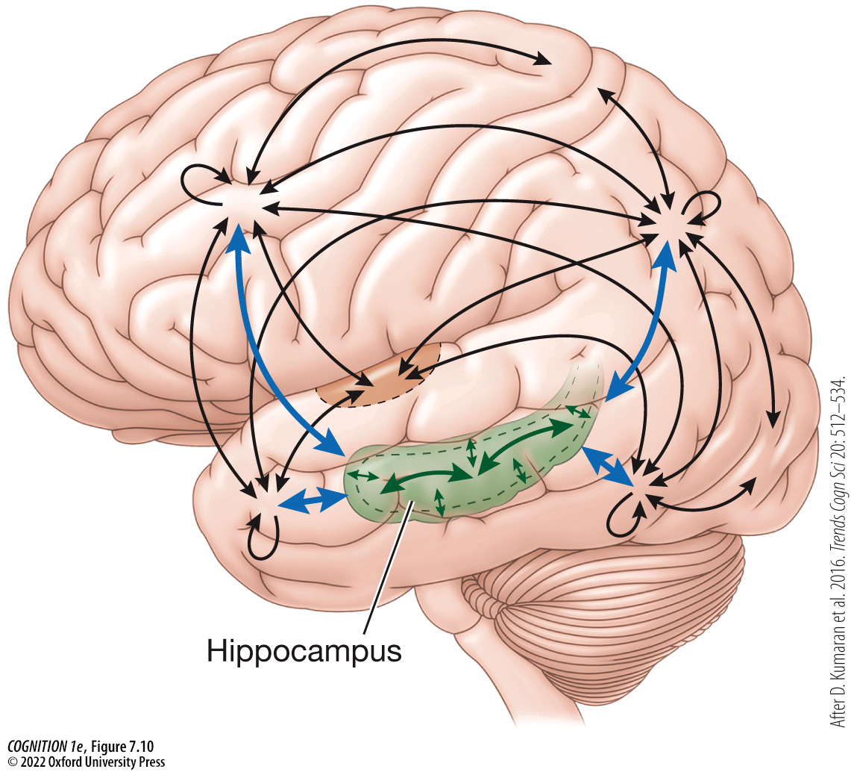
Figure 7.10 The hippocampus and neocortex form a complementary memory system (2)
Notes:
Figure 7.10 The hippocampus and neocortex form a complementary memory system
The hippocampus, which lies deep within the brain, supports rapid learning, while neocortical areas support gradual learning. MTL, medial temporal lobe. (After D. Kumaran et al. 2016. Trends Cogn Sci 20: 512–534.)

Slide 17
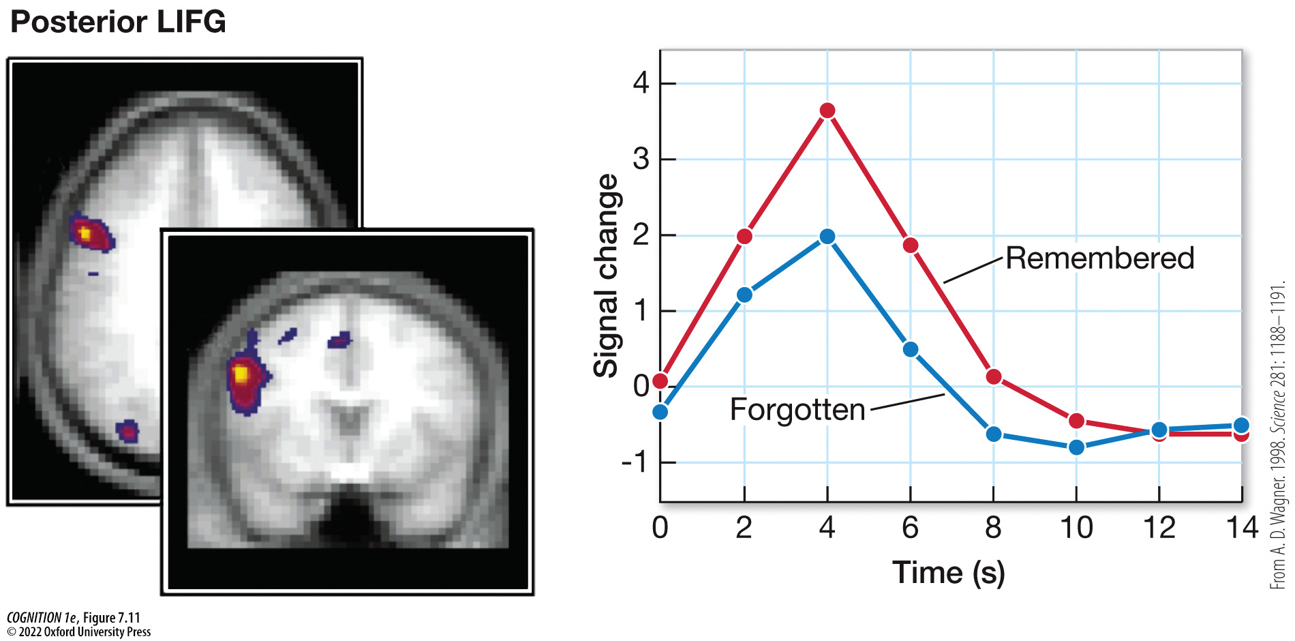
Figure 7.11 The subsequent memory effect
Notes:
Figure 7.11 The subsequent memory effect
Brain activity is higher at the time of initial encoding of items that are subsequently remembered versus items that are subsequently forgotten. LIFG, left inferior frontal gyrus. (From A. D. Wagner. 1998. Science 281: 1188–1191.)

Slide 18
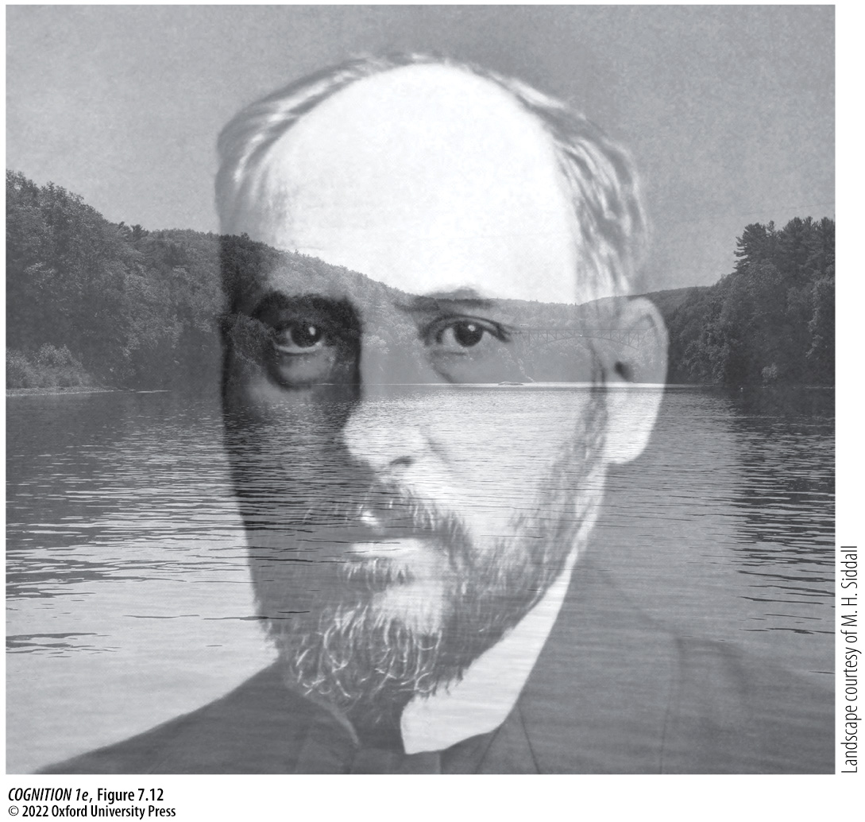
Figure 7.12 You can attend to either the face or the scene when they overlap like this
Notes:
Figure 7.12 You can attend to either the face or the scene when they overlap like this
Memory is better for the attended category. (The face is that of the famous neuroscientist Santiago Ramón y Cajal.)

Slide 19
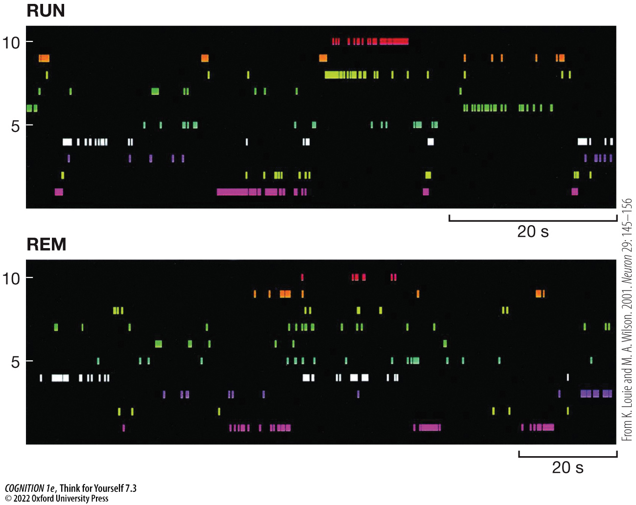
Think for Yourself 7.3
Notes:
Think for Yourself 7.3
Patterns of neural activity across several place cells during maze running (top) correspond well with the activity of the same cells during REM sleep (bottom).

Slide 20
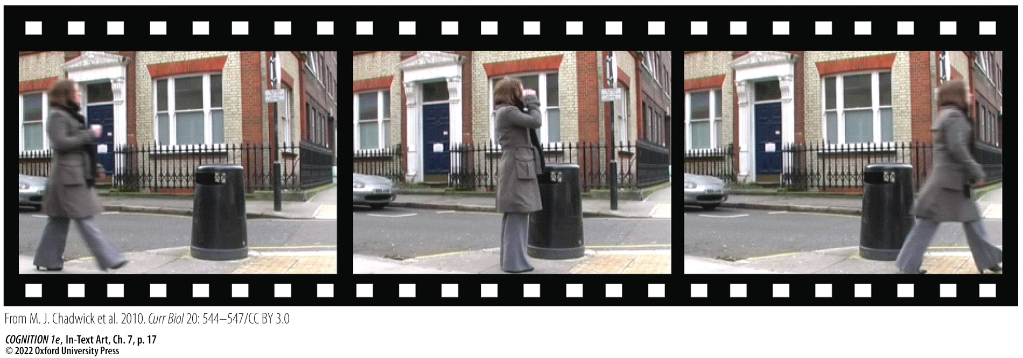
In-Text Art, Ch. 7, p. 17
Notes:
In-Text Art, Ch. 7, p. 17
fMRI can decode recall of short film clips—in this example, of a woman taking a drink from a cup and disposing of it in a trash can.

Slide 21
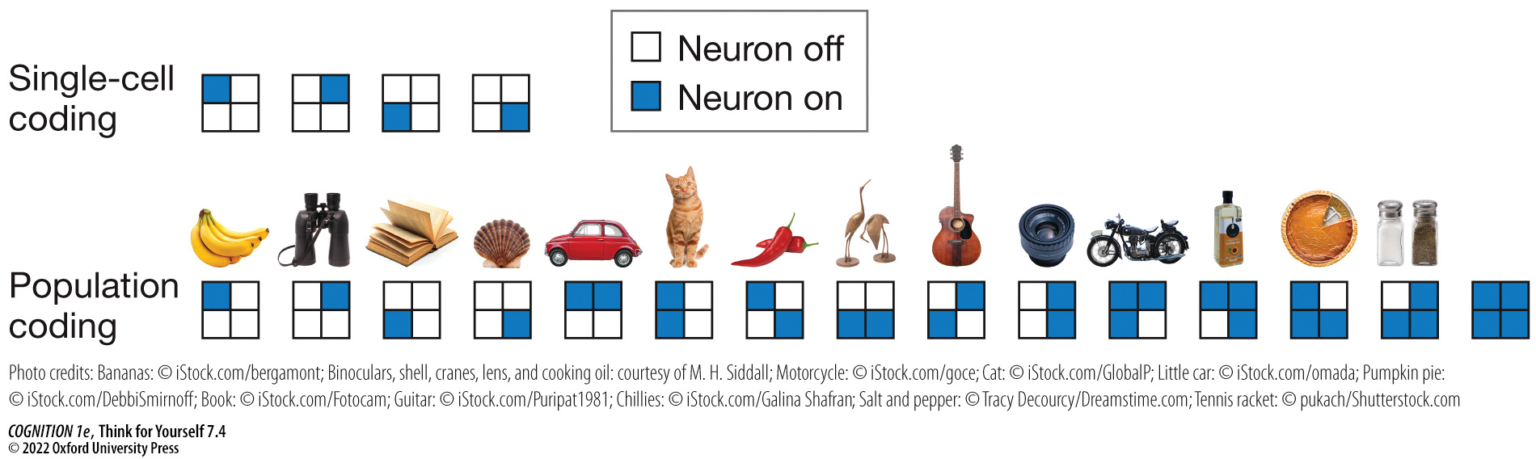
Think for Yourself 7.4
Notes:
Think for Yourself 7.4
The grid depicts an ensemble of four neurons, each represented by a cell that can be either off (blank) or on (blue) in response to a stimulus. Compared with a single-cell coding scheme (top row), in which each cell codes one type of stimulus (banana, binoculars, book, shell), population coding (bottom row) allows the same ensemble to represent many more stimuli with unique patterns of activity. (Photo credits: Bananas: © iStock.com/bergamont; Binoculars, shell, cranes, lens, and cooking oil: courtesy of M. H. Siddall; Motorcycle: © iStock.com/goce; Cat: © iStock.com/GlobalP; Little car: © iStock.com/omada; Pumpkin pie: © iStock.com/DebbiSmirnoff; Book: © iStock.com/Fotocam; Guitar: © iStock.com/Puripat1981; Chillies: © iStock.com/Galina Shafran; Salt and pepper: © Tracy Decourcy/Dreamstime.com; Tennis racket: © pukach/Shutterstock.com.)

Slide 22
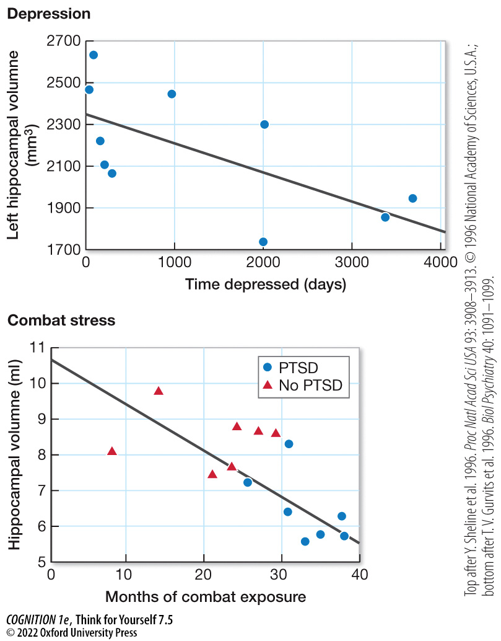
Think for Yourself 7.5
Notes:
Think for Yourself 7.5
The longer a person has suffered from depression or combat stress, the smaller the volume of their hippocampus is. PTSD, post-traumatic stress disorder. (Top after Y. Sheline et al. 1996. Proc Natl Acad Sci USA 93: 3908–3913. © 1996 National Academy of Sciences, U.S.A.; bottom after T. V. Gurvits et al. 1996. Biol Psychiatry 40: 1091–1099.)

Slide 23
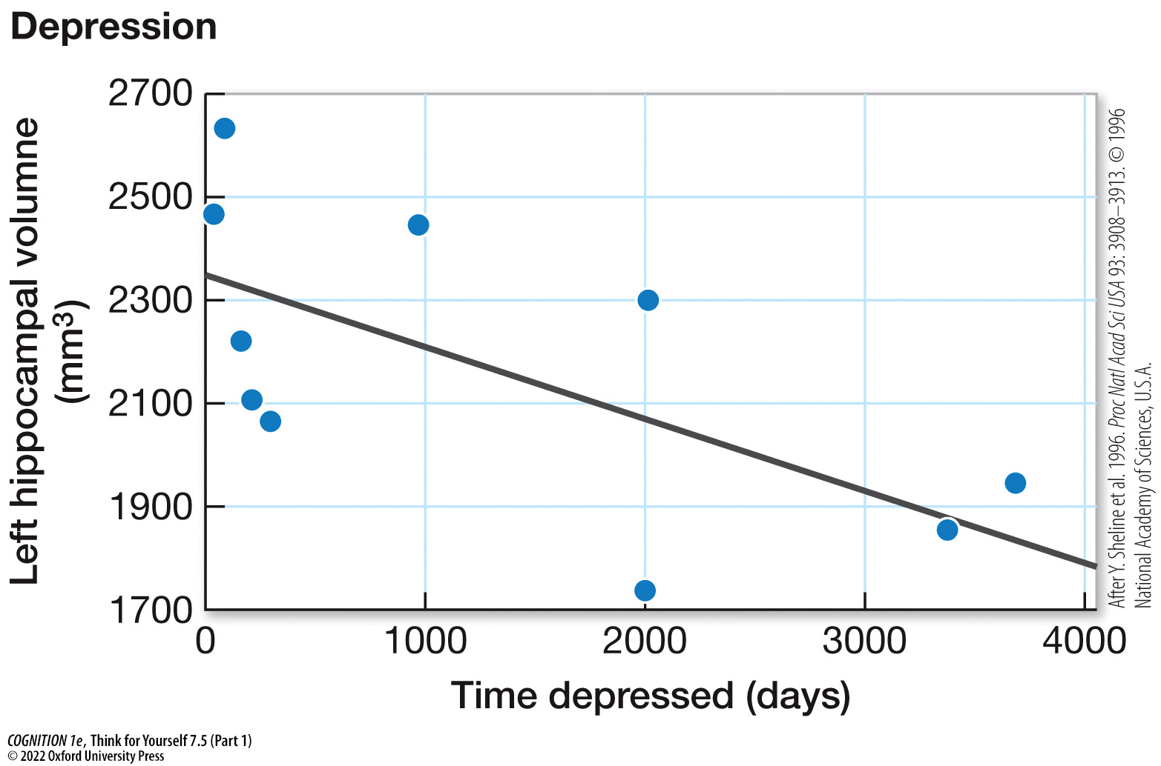
Think for Yourself 7.5 (Part 1)
Notes:
Think for Yourself 7.5
The longer a person has suffered from depression or combat stress, the smaller the volume of their hippocampus is. PTSD, post-traumatic stress disorder. (Top after Y. Sheline et al. 1996. Proc Natl Acad Sci USA 93: 3908–3913. © 1996 National Academy of Sciences, U.S.A.; bottom after T. V. Gurvits et al. 1996. Biol Psychiatry 40: 1091–1099.)

Slide 24
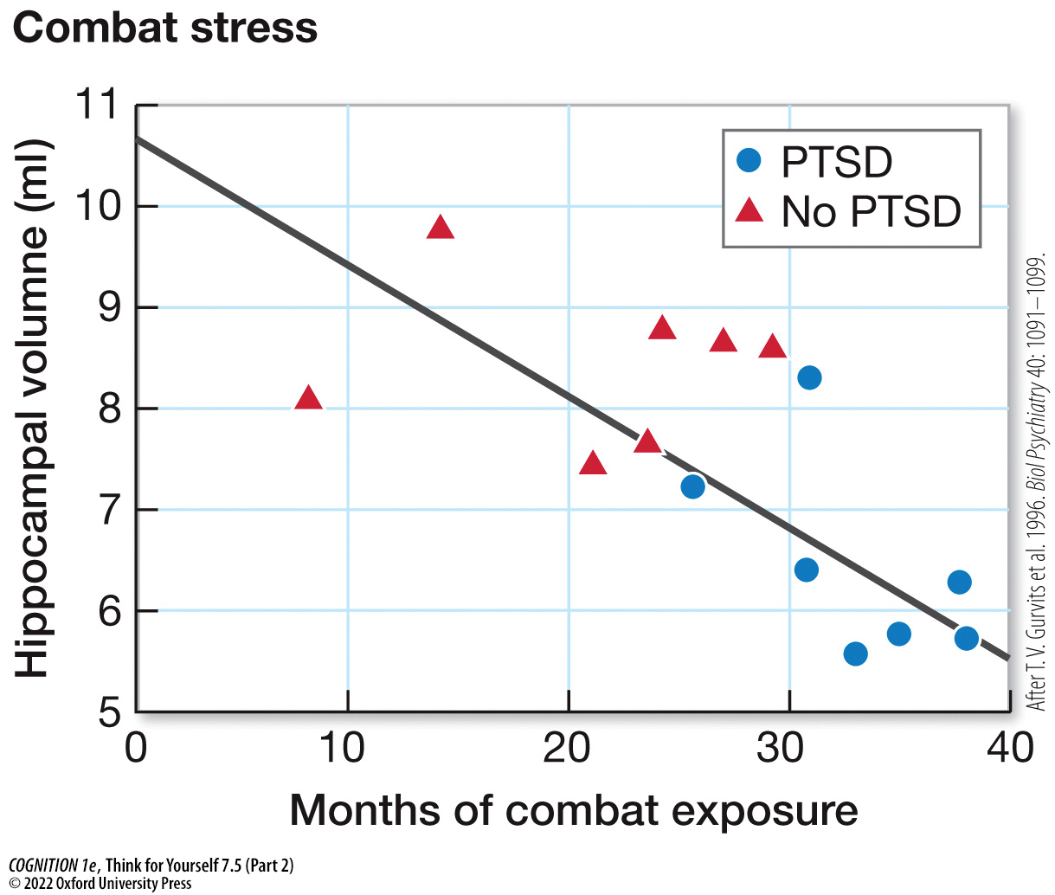
Think for Yourself 7.5 (Part 2)
Notes:
Think for Yourself 7.5
The longer a person has suffered from depression or combat stress, the smaller the volume of their hippocampus is. PTSD, post-traumatic stress disorder. (Top after Y. Sheline et al. 1996. Proc Natl Acad Sci USA 93: 3908–3913. © 1996 National Academy of Sciences, U.S.A.; bottom after T. V. Gurvits et al. 1996. Biol Psychiatry 40: 1091–1099.)

Slide 25
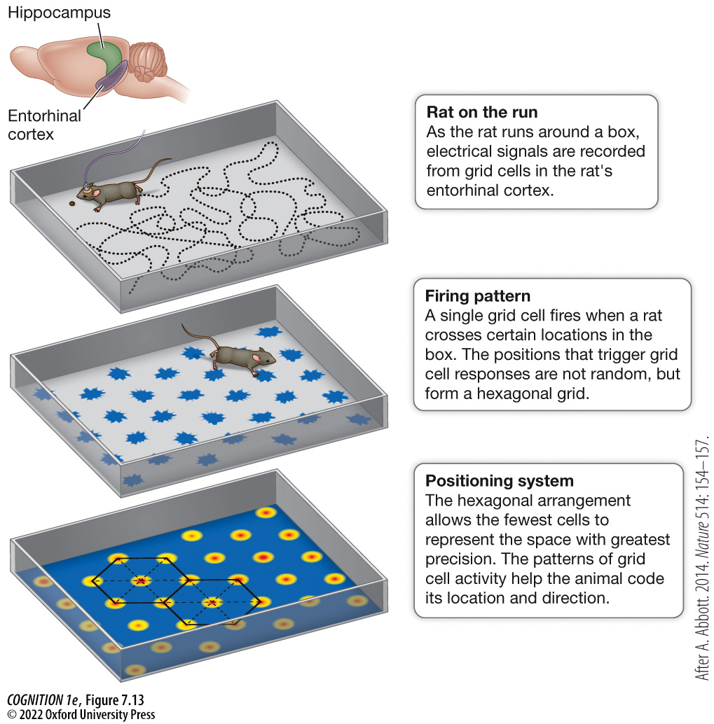
Figure 7.13 Recording from grid cells while a rat runs around a box (top panel) activates different grid cells depending on location (middle panel)
Notes:
Figure 7.13 Recording from grid cells while a rat runs around a box (top panel) activates different grid cells depending on location (middle panel)
These firing patterns reveal a grid arrangement (bottom panel), which turns out to be an efficient way to code location in space. (After A. Abbott. 2014. Nature 514: 154–157.)

Slide 26
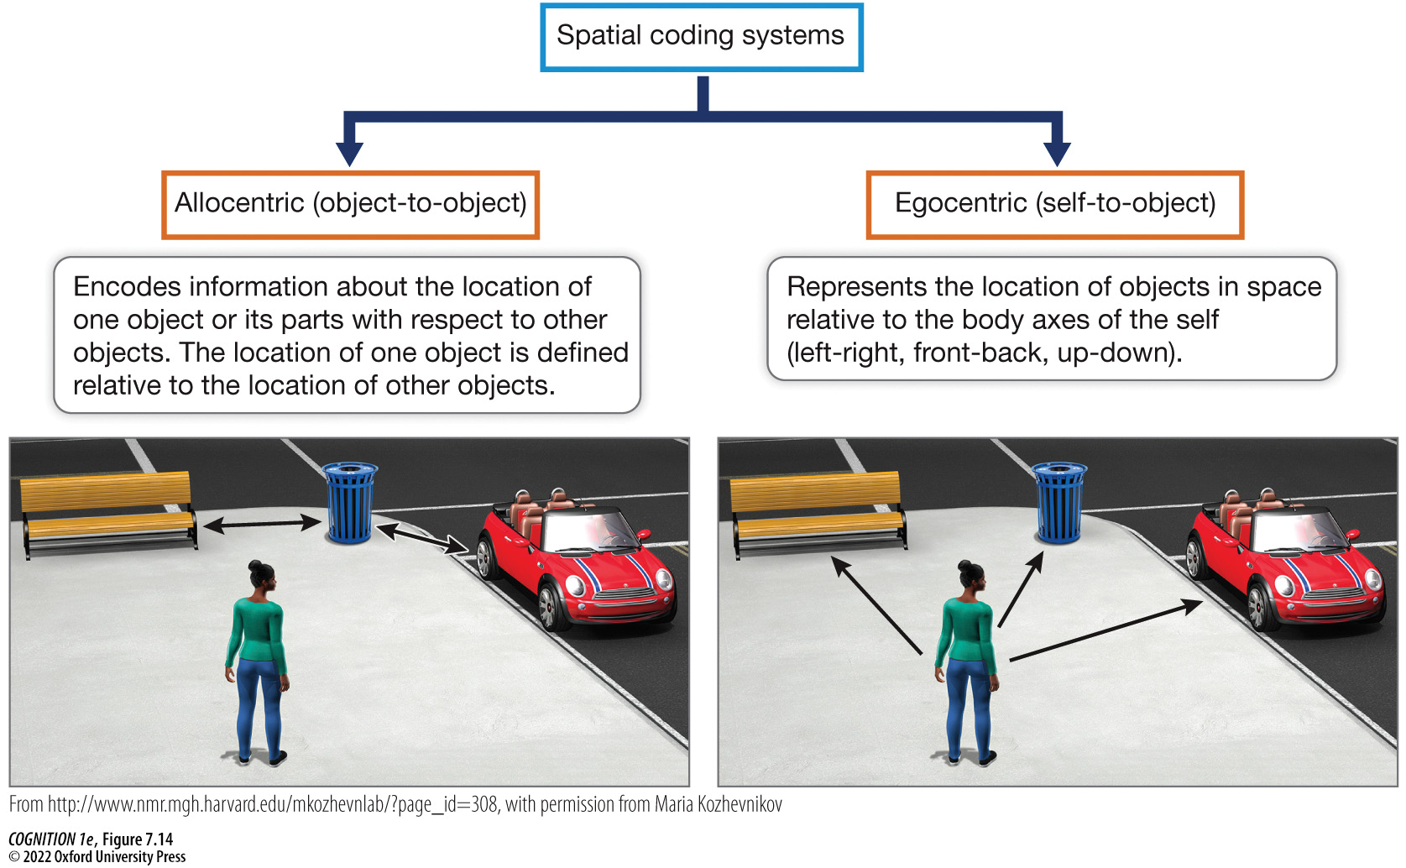
Figure 7.14 People can code space in an allocentric way or an egocentric way
Notes:
Figure 7.14 People can code space in an allocentric way or an egocentric way
In an allocentric coding system, the location of the trashcan is referenced with respect to the bench and car. In an egocentric coding system, the location of the trashcan is referenced as located ahead of where the person is facing. (From http://www.nmr.mgh.harvard.edu/mkozhevnlab/?page_id=308, with permission from Maria Kozhevnikov.)

