Slide 1

1
American Women
A Concise History
By Susan Ware

Slide 2
Chapter 04
Reconstruction and Beyond, 1865–1890

Slide 3
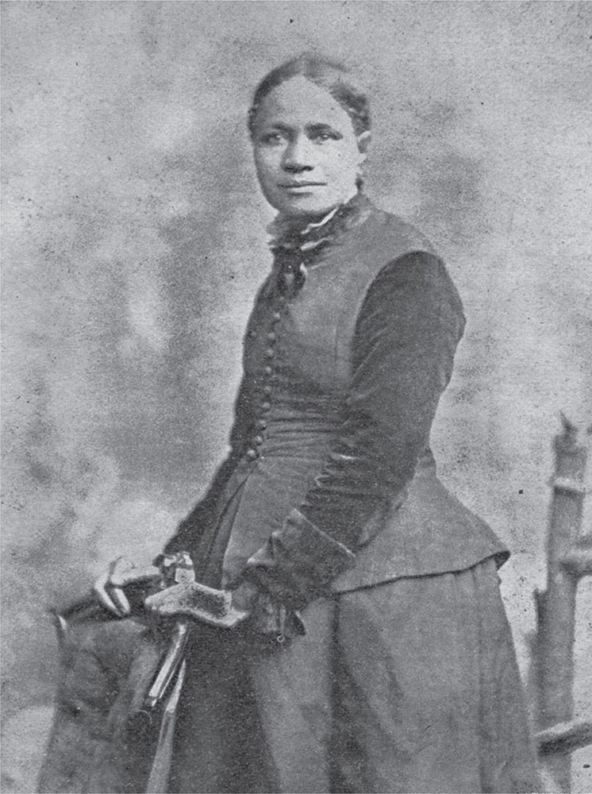
3

Slide 4
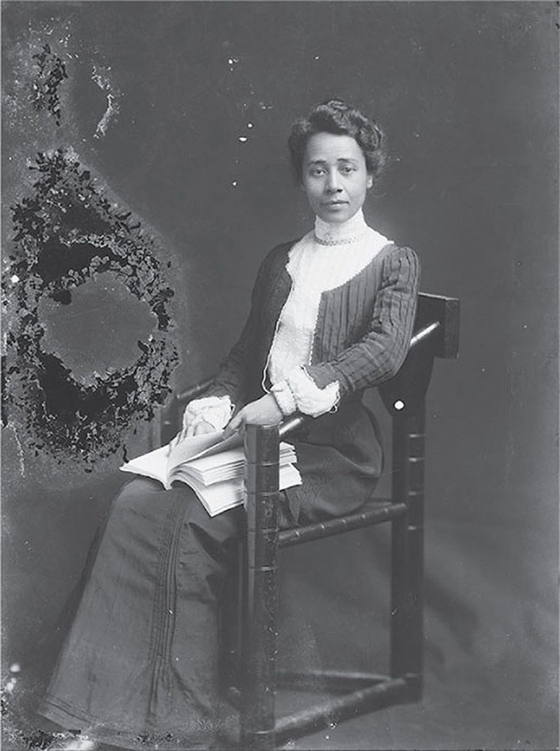
4

Slide 5
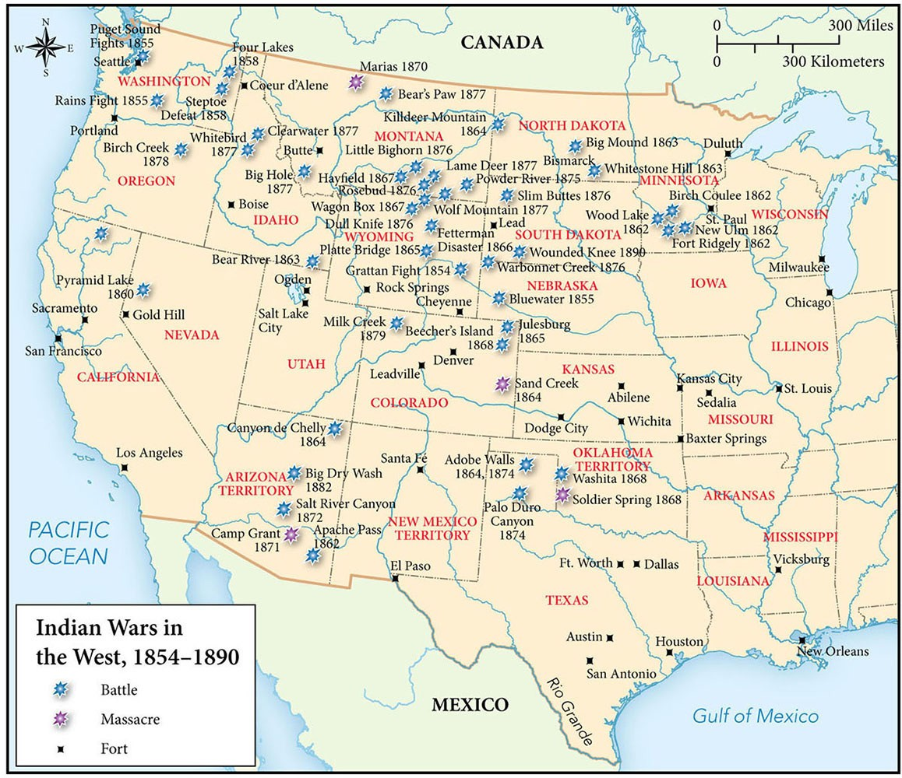
5
Map 4.1 Indian Wars in the West, 1854–1890

Slide 6
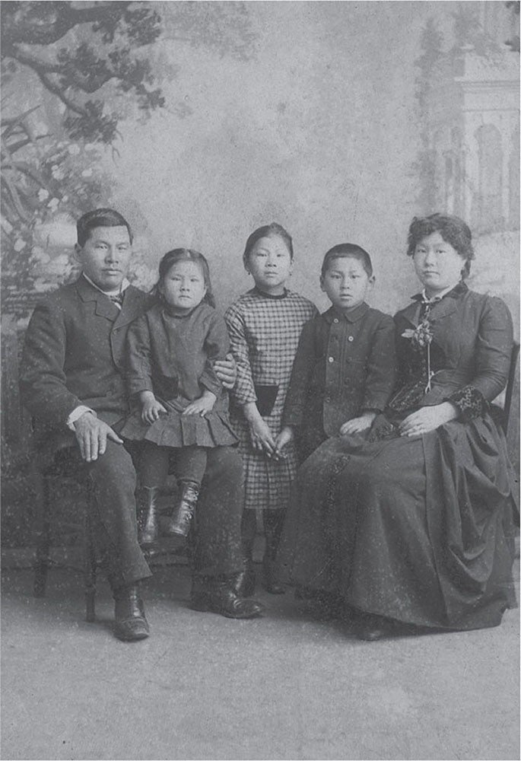
6

Slide 7
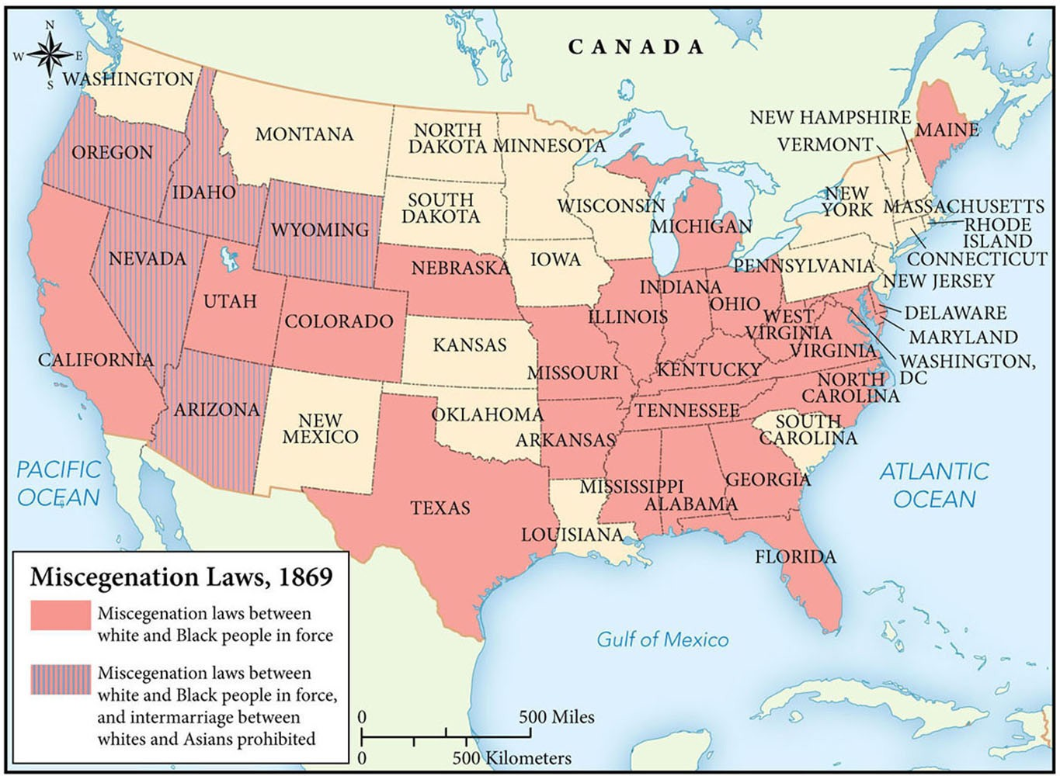
7
Map 4.2 Miscegenation Laws, 1869

Slide 8
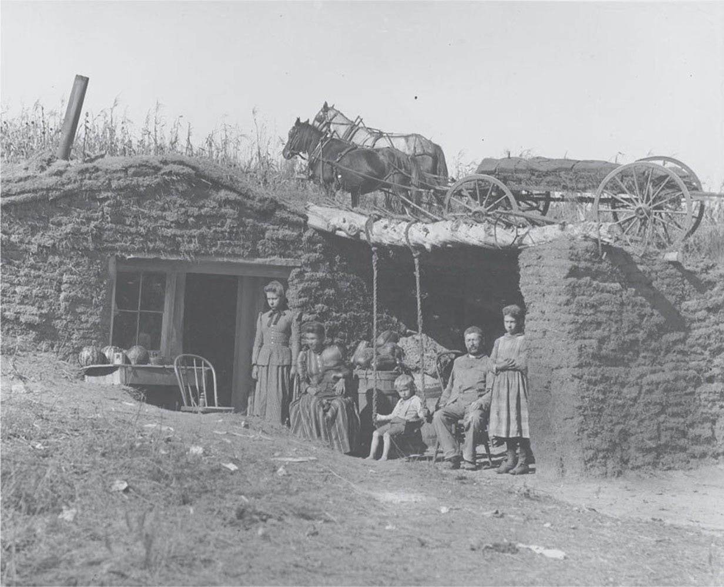
8

Slide 9
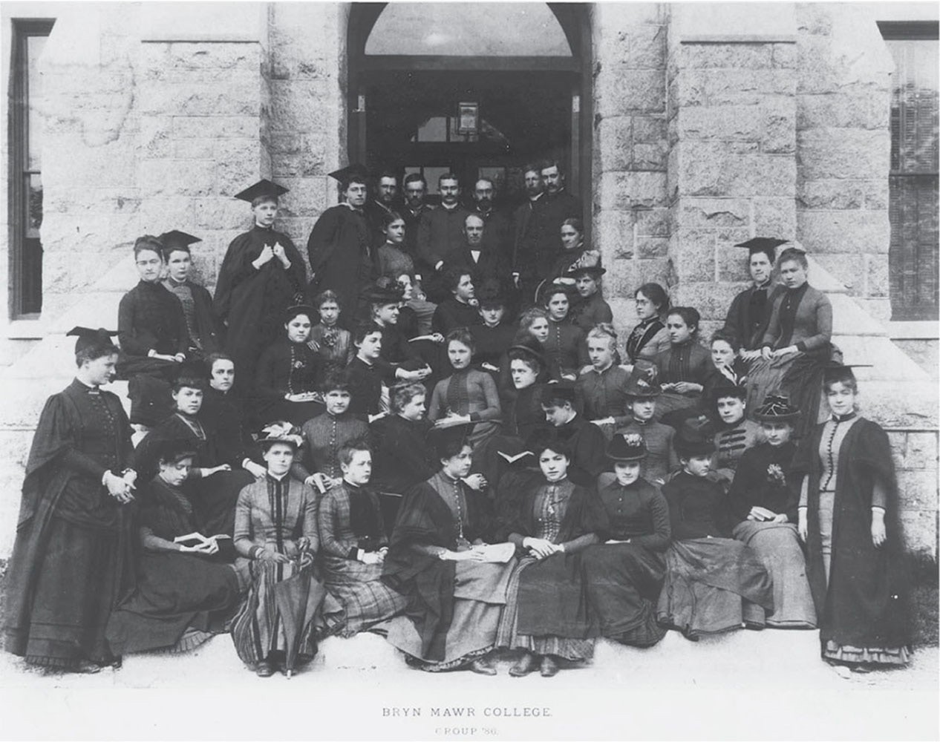
9

Slide 10
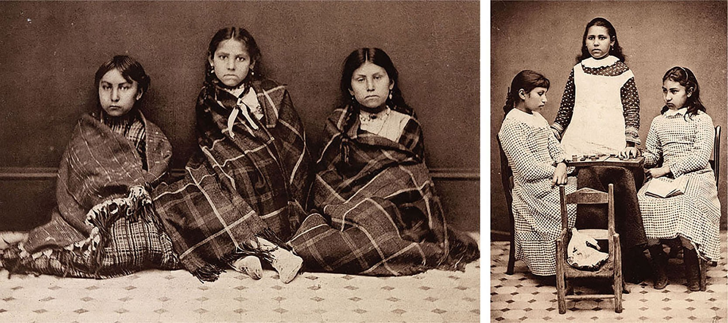
10

Slide 11

11

