Slide 1
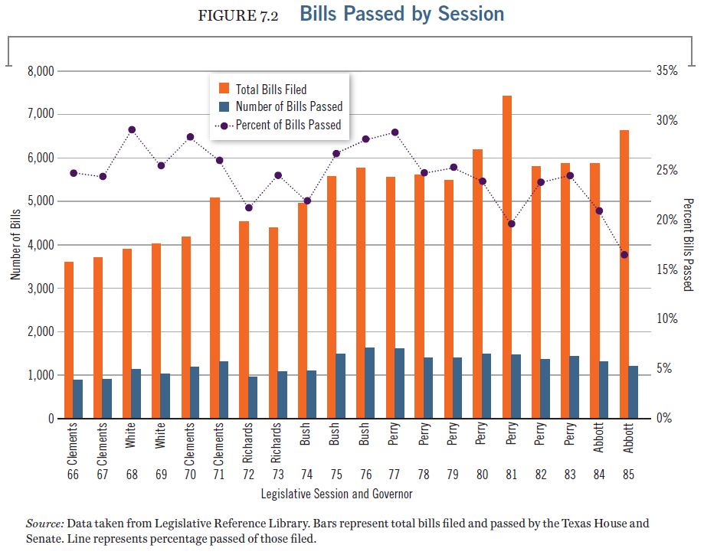
Trends in number of laws introduced and passed

Slide 2
Communication: What are the trends in laws introduced and passed over time? (1 of 12)

Slide 3
Communication: What are the trends in laws introduced and passed over time? (2 of 12)
• Orange bars show bills filed.
• Blue bars show bills passed.

Slide 4
Communication: What are the trends in laws introduced and passed over time? (3 of 12)
• Purple dots show the percent of bills filed that were passed.

Slide 5
Communication: What are the trends in laws introduced and passed over time? (4 of 12)
How has the number laws filed changed since the 66th session of the legislature?
The number has increased.
The number has decreased.
The number has stayed about the same.

Slide 6
Communication: What are the trends in laws introduced and passed over time? (5 of 12)
How has the number laws filed changed since the 66th session of the legislature?
The number has increased.
The number has decreased.
The number has stayed about the same.

Slide 7
Communication: What are the trends in laws introduced and passed over time? (6 of 12)
How has the number laws passed changed since the 66th session of the legislature?
The number has increased.
The number has decreased.
The number has stayed about the same.

Slide 8
Communication: What are the trends in laws introduced and passed over time? (7 of 12)
How has the number laws passed changed since the 66th session of the legislature?
The number has increased.
The number has decreased.
The number has stayed about the same.

Slide 9
Communication: What are the trends in laws introduced and passed over time? (8 of 12)
How has the percent of laws passed changed since the 66th session of the legislature?
The percent has increased.
The percent has decreased.
The percent has stayed about the same.

Slide 10
Communication: What are the trends in laws introduced and passed over time? (9 of 12)
How has the percent of laws passed changed since the 66th session of the legislature?
The percent has increased.
The percent has decreased.
The percent has stayed about the same.

Slide 11
Communication: What are the trends in laws introduced and passed over time? (10 of 12)
• The total number of bills filed has risen sharply since the sixty-sixth legislature to the present, from 3,500 to more than 7,300.

Slide 12
Communication: What are the trends in laws introduced and passed over time? (11 of 12)
• The total number of bills filed has risen sharply since the sixty-sixth legislature to the present, from 3,500 to more than 7,300.
• This growth (more than 108 percent) has exceeded the growth in the state population during that time.

Slide 13
Communication: What are the trends in laws introduced and passed over time? (12 of 12)
• The total number of bills filed has risen sharply since the sixty-sixth legislature to the present, from 3,500 to more than 7,300.
• This growth (more than 108 percent) has exceeded the growth in the state population during that time.
• The percentage of bills passed (out of bills filed) is lower now than a decade ago.

Slide 14
Critical thinking: Why the difference between legislation filed and legislation passed? (1 of 3)

Slide 15
Critical thinking: Why the difference between legislation filed and legislation passed? (2 of 3)
• More students in public schools and state universities, an expanding criminal justice system, booming populations, and a growing economy all create a rising need for new laws.

Slide 16
Critical thinking: Why the difference between legislation filed and legislation passed? (3 of 3)
• More students in public schools and state universities, an expanding criminal justice system, booming populations, and a growing economy all create a rising need for new laws.
• Lower percentages of bills passed in the last few sessions reflect the increasing dominance of conservatives, including the governor, who favor fewer laws and less regulation, in the legislature.

