Slide 1
The End of Globalization?

Slide 2
The context
As discussed in chapter 4, some argue that free trade makes everyone better off in the long run.
States should minimize tariffs on imports and subsidies for domestic producers.
States should instead aim to specialize in their “comparative advantage.”
Historically, though, we have seen states oscillate between free trade and protectionism.

Slide 3
“Waves of Globalization”
Historians speak of a couple major “waves of globalization” over the last couple centuries.
The first runs from the early 19th century (just after influential arguments for free trade saw their systematic development in the writings of Smith and Ricardo) to the start of World War I.
The second covers much of the second half of the 20th century and the beginnings of the 21st.

Slide 4
What distinguished these periods?
In other words, what do we mean by “globalization” in this context?
Large-scale international mobility of capital (foreign investment)
Large-scale international mobility of labor (migration)
Arguably, large-scale international mobility of ideas (technological innovations, institutions, and perhaps even cultural values)

Slide 5
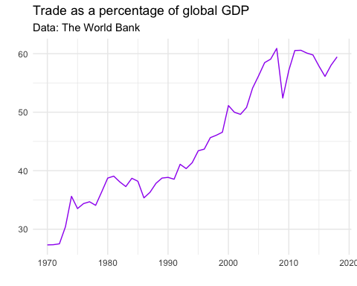
Trade over time

Slide 6
Consequences of growth in international trade over the years
Note that most political economists think that increasing trade has mainly produced economic benefits, including lifting hundreds of millions out of poverty.
Classical theory of “comparative advantage” going back to Smith and Ricardo (see chapter 4)
Perhaps trade builds ties of dependence that reduce the probability of conflict, as some have argued?

Slide 7
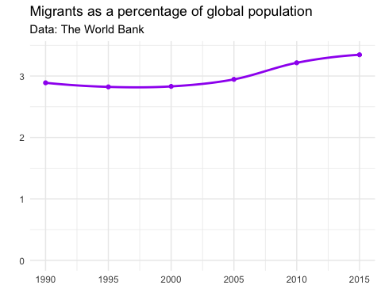
In recent years, the percentage of the global population who are migrants has been gradually increasing

Slide 8
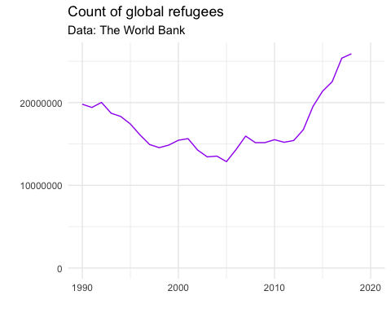
In part, this has been due to an increase in global refugees

Slide 9
Are we seeing an end to this second wave?
Some commentators think that we might
Diverse mechanisms: let’s think separately for a moment about migration and the rest of economic globalization.

Slide 10
Potential pressures against continued high migration
If there is less conflict producing fewer refugees.
If gaps in economic opportunities between countries narrow.
If barriers to entry and exist increase (e.g., greater and more militarized border enforcement, more hostility and discrimination).

Slide 11
Potential pressures against globalization more generally
Global populism on the left and right
Trade war?
COVID-19

Slide 12
Pressures against globalization from the left
Some research indicates that increased exposure to international trade might, at least in the short term, make some workers worse off (Case and Deaton 2019).
Does it expand income inequality (an emergent concern in recent years)?

Slide 13
Pressures against globalization from the right
Identity concerns seem to be paramount
Anti-immigrant rhetoric prominent in the Brexit movement and around right-leaning governments in Europe, the US, and elsewhere

Slide 14
A trade war between the US and China?
The Trump administration in the US has implemented a number of protectionist policies against China
Some have been reciprocated.
Tensions are real and there are major points of potential conflict, including intellectual property, espionage, trade policy, geographic spheres of influence, and human rights questions.

Slide 15
COVID - 19
Near halt on global travel in the short-to-medium term, reducing overall migration.
Possible increase in xenophobia as well as reduced economic opportunities slowing or reversing migratory waves (e.g., Venezuelan refugees returning from Peru and elsewhere)
Supply chain breakdowns. If they persist, producers may find alternatives. Possible lasting decline in global supply chains?
Does COVID-inspired fear of foreign “others” reinforce existing trends on the populist right?

Slide 16
Consequences of declines in globalization
How much will growth fall?
How much future growth won’t be achieved?
Impacts on migration and remittances?
Geopolitical reodering?

Slide 17
Impacts on migration and remittances?
Impact on migration likely different for different groups and given different barriers.
Will travel for education return to pre-pandemic levels? If not, possible implications for human capital formation in numerous countries.
Remittances could decline because migrants have fewer resources to send.
Remittances could decline because fewer people migrate.
Note that remittances are very economically important in some countries and regions.

Slide 18
Political economists arguing for more nuanced understandings of the role of the state in economic development
Dani Rodrik and others have argued that the old “states versus markets” debate is too limiting.
Is there a middle way between protectionism and total free trade?
States may need to shield workers from some of the short-term costs of trade.
See discussion in chapters 4-5.

Slide 19
The end of globalization?
Almost certainly not. Too many have too much to gain from restricting global ties.
But there are headwinds.
Can we identify some of the questions that might influence how much it may slow down?

Slide 20
What will happen with COVID?
With vaccines now available, when, how widely will it be distributed, who will get them first?
How and when will lower-income countries access vaccines and what will be the consequences of any delays?
Will continued and renewed lockdowns be required and how will they impact global supply chains?
If they’re prolonged, will producers in some places develop new supply chains within narrower ranges of countries?
If so, how will this interact with shifting geopolitical dynamics (e.g., to what extent will it align with competition between the United States and China)?

Slide 21
What will happen with global populism?
Some evidence suggests that populism may be waning in some places, but this is far from clear at present.
Will publics turn against right wing populists, perhaps due to challenges in combatting COVID?

Slide 22
Will responses to the pandemic shift the role of the state in the economy?
In the short run, many states are borrowing to provide relief to both workers and businesses.
Could this lead to a lasting shift in spending priorities and more activist states?
Note that sometimes this can arguably be “globalist” (e.g., summer 2020 EU fiscal and budgetary decisions)

