Slide 1
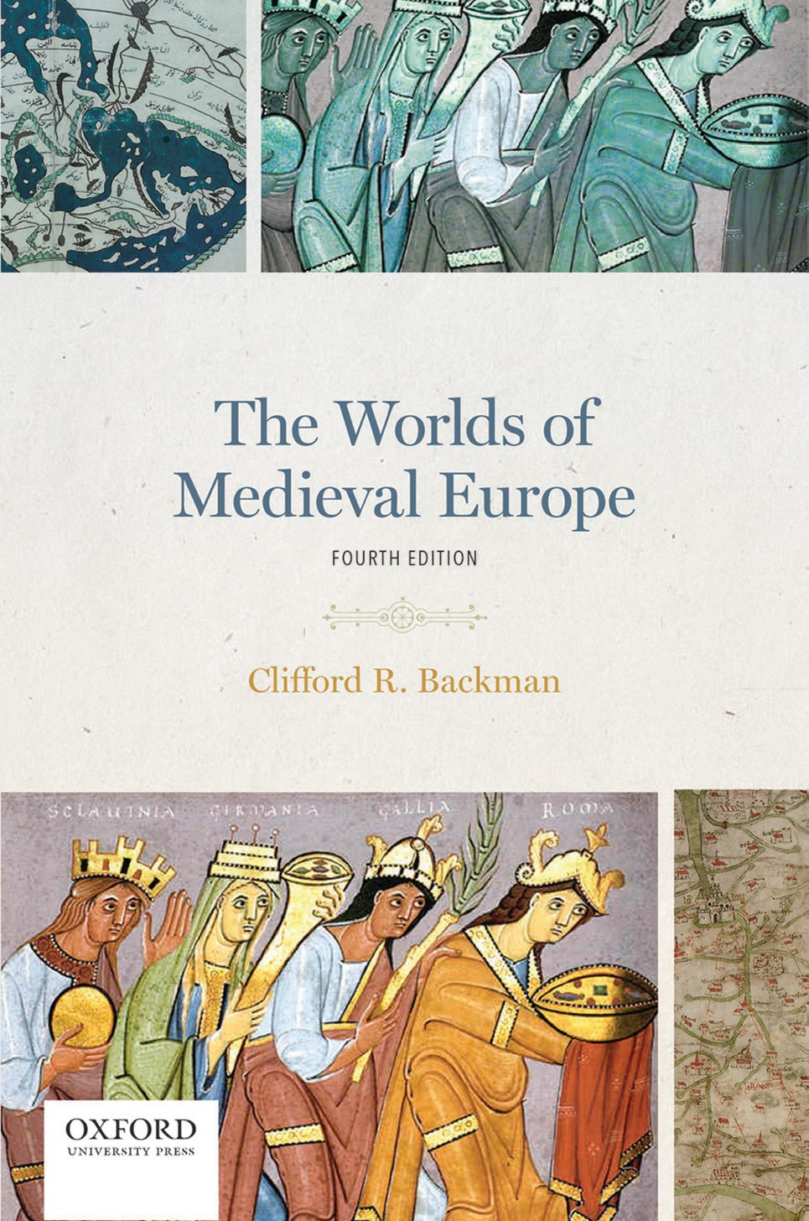
1
The Worlds of Medieval Europe
By Clifford R. Backman

Slide 2
2
Part 01
The Early Middle Ages:
The Third Through Ninth Centuries
Chapter 05
The Emergence of the Medieval Worlds

Slide 3
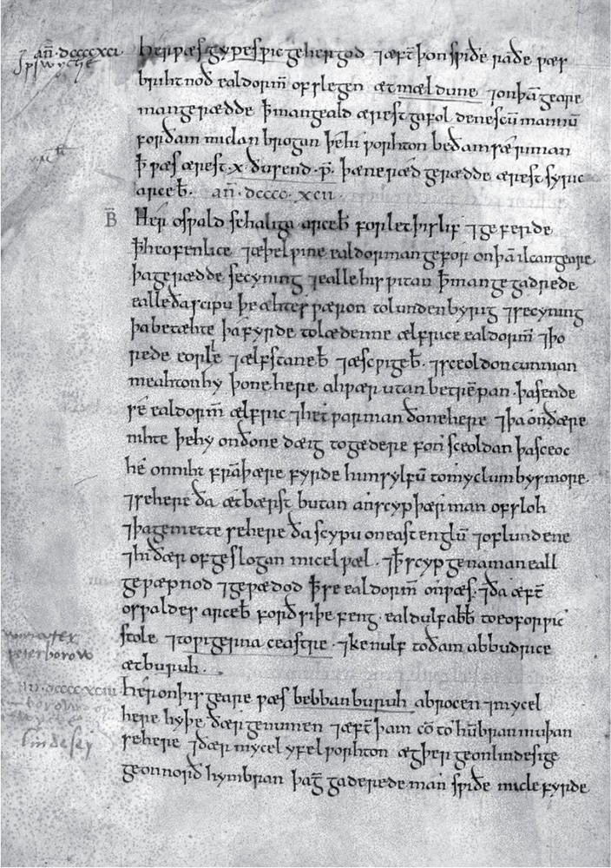
3

Slide 4
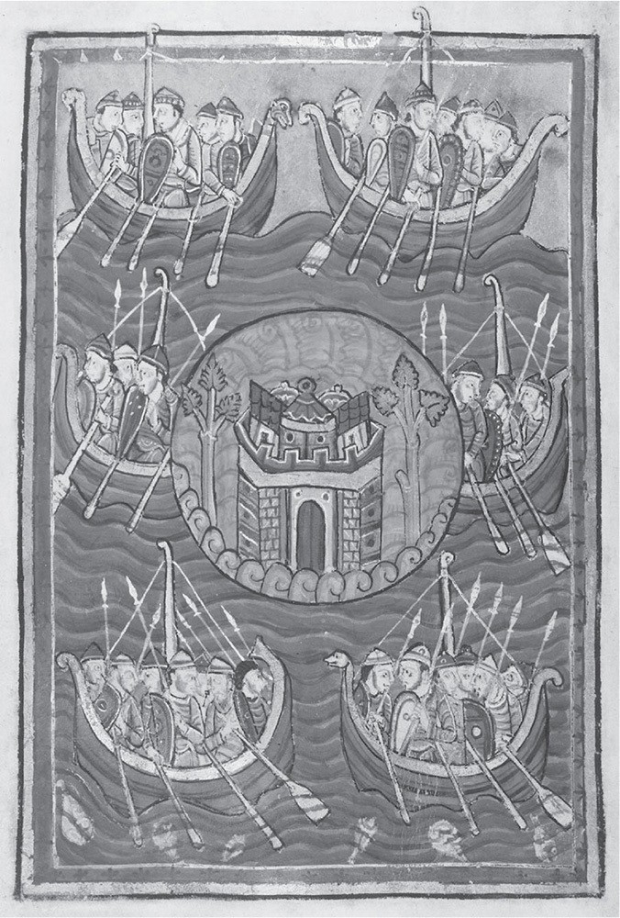
4

Slide 5
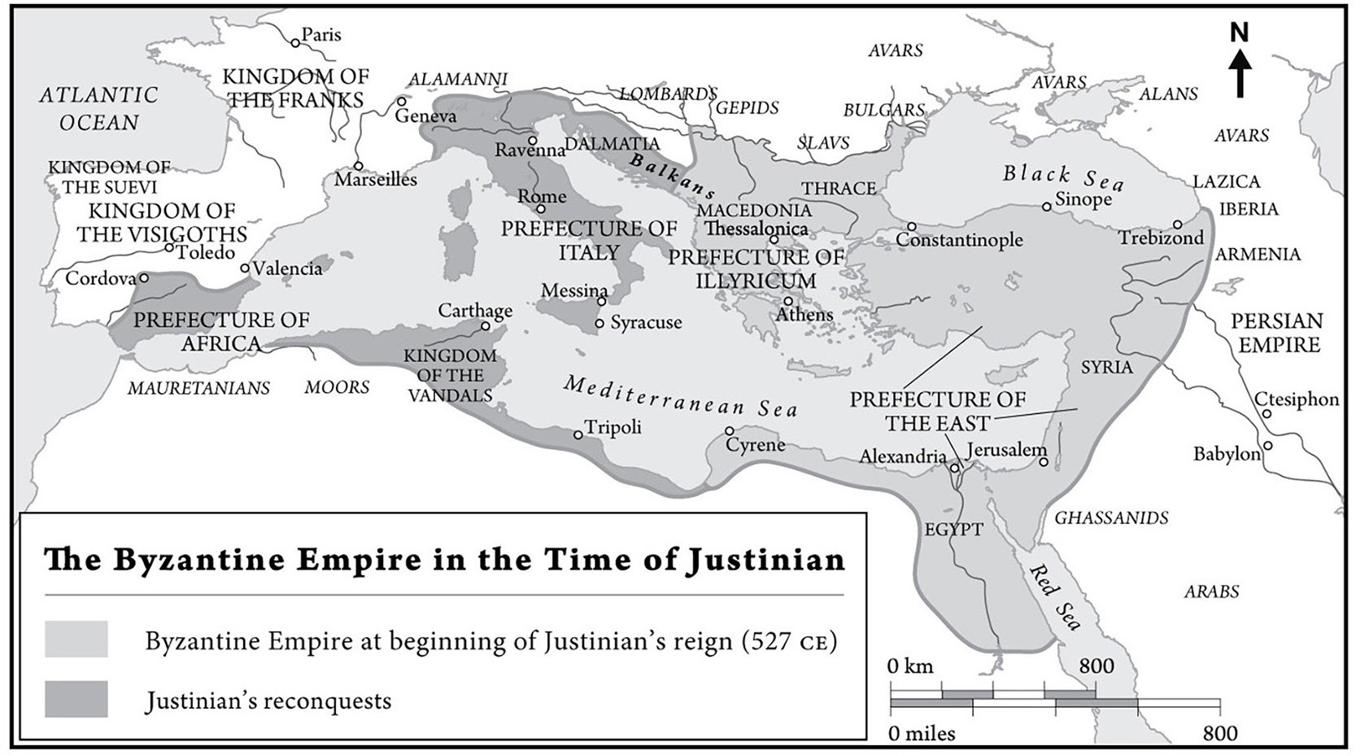
5
Map 5.1 The Byzantine Empire in the Time of Justinian

Slide 6
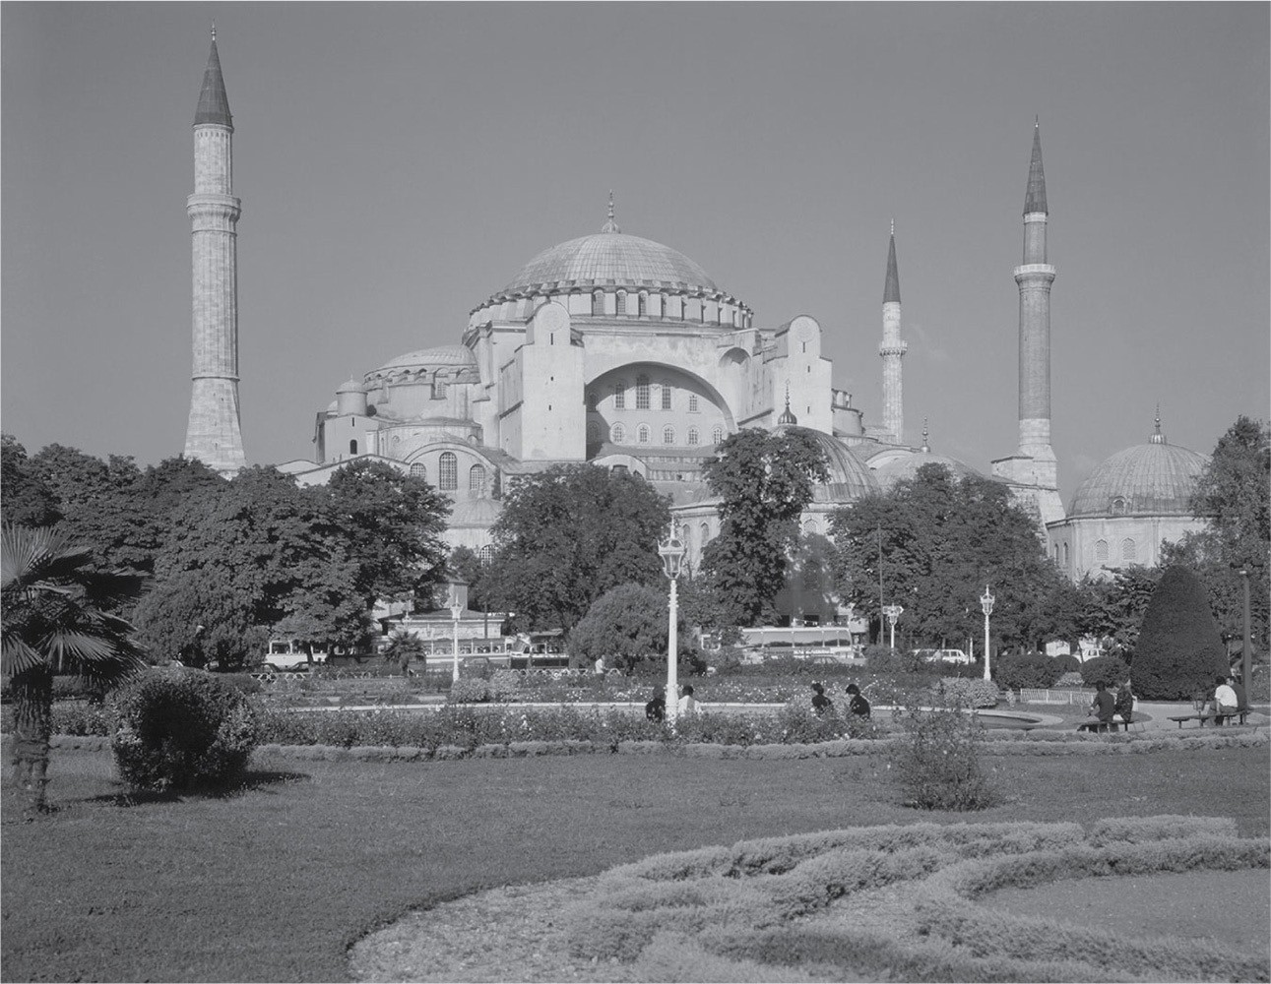
6

Slide 7
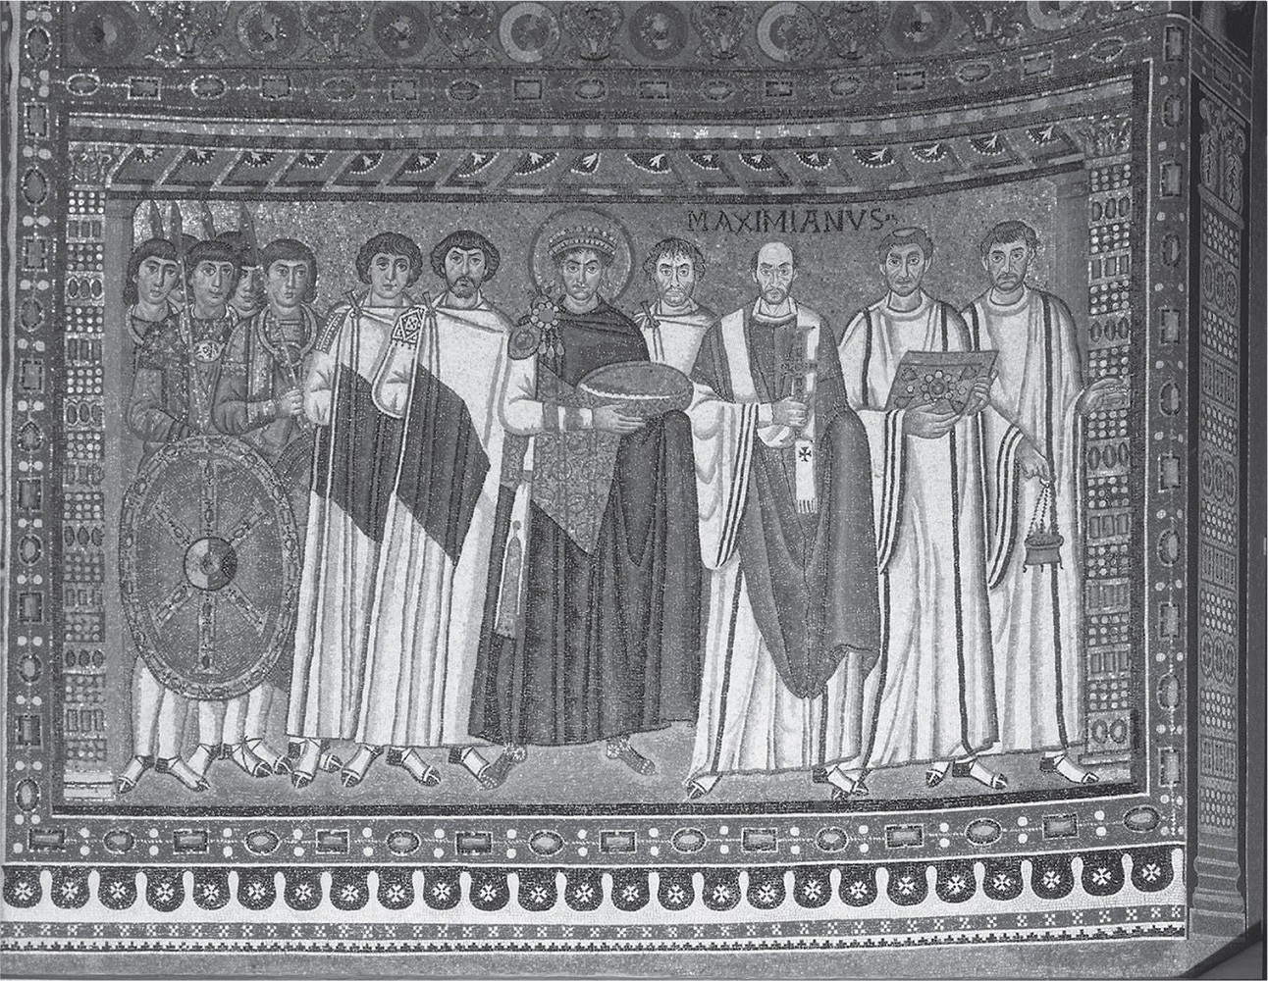
7

Slide 8
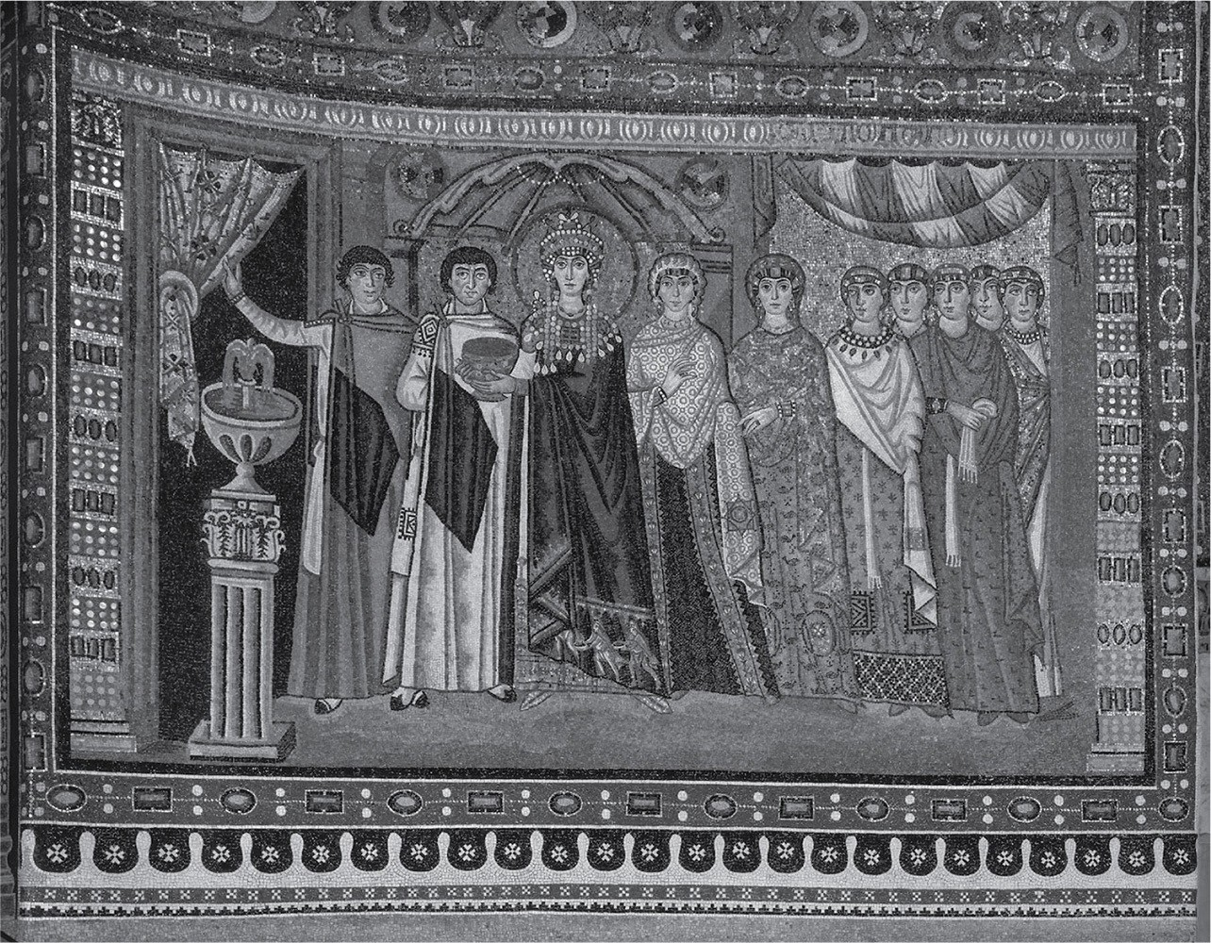
8

Slide 9
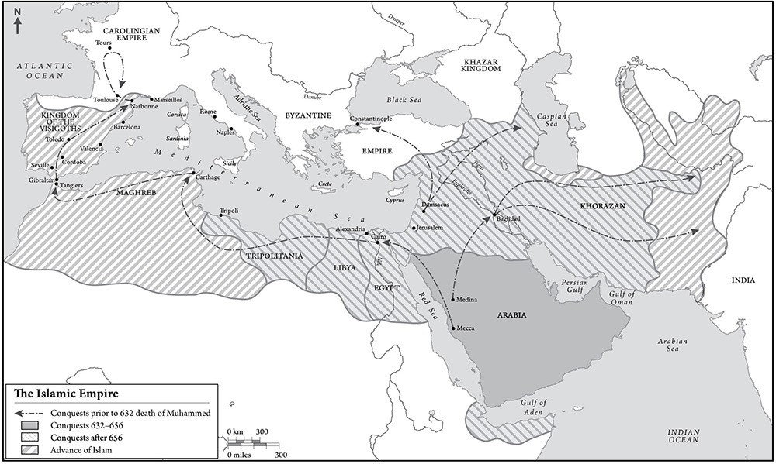
9
Map 5.2 The Islamic Empire

Slide 10
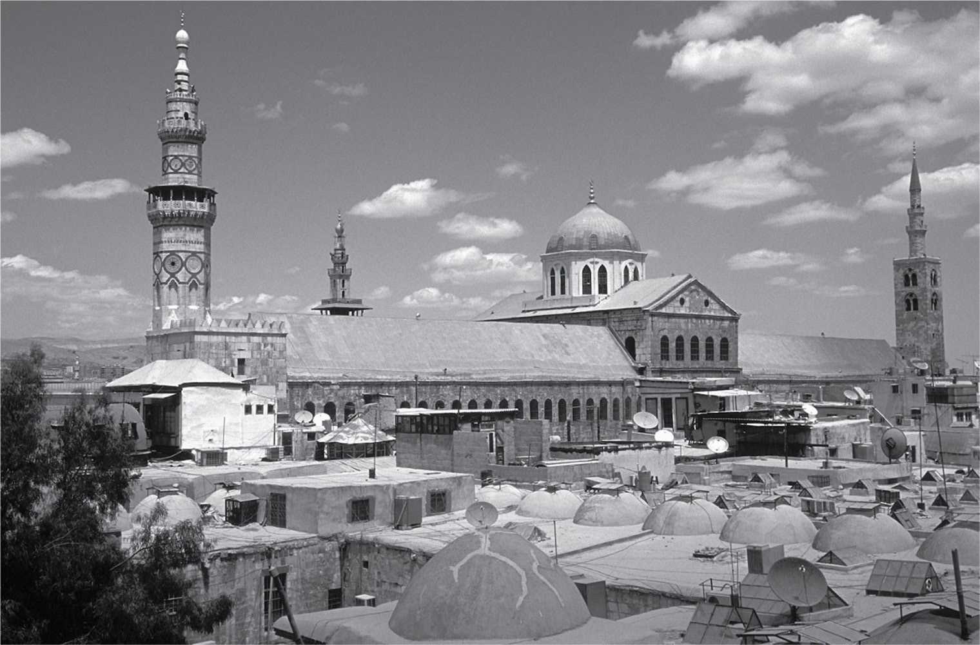
10

