Slide 1
2
A Policy Framework for Mental Health Practice in Canada

Slide 2
Background
Constitution Act
Sets out differentiation between federal and provincial responsibilities
Controversies remain regarding jurisdiction in individual circumstances
Charter of Rights and Freedoms
Takes precedence over legislation

Slide 3
Background, cont’d
The Charter (s. 2) identifies the following fundamental freedoms for all Canadians:
Freedom of conscience and religion
Freedom of thought, belief, opinion, and expression, including freedom of the press and other media of communication
Freedom of peaceful assembly
Freedom of association
Rights under the Charter also include democratic rights, mobility rights, legal rights, equality rights, language rights, minority language education rights, and Indigenous rights

Slide 4
Health Policy in Canada
Core values in Canadian health care:
Equity
Quality
Informed choice
The right to live in a healthy environment
Accountability in the health care system
Efficiency in the use of resources
Citizen participation and decision-making in personal health care
Andreae, 2002

Slide 5
Health Policy in Canada, cont’d
1900s
Fee for service
1939
First Canadian Blue Cross health insurance plan in Manitoba for those who could pay premiums
1947–1961
All provinces enter into cost-sharing agreements with federal government for hospital care
1962
Saskatchewan begins first universal health care system
1972
All provinces have universal health care plan

Slide 6
Health Policy in Canada, cont’d
Principles of the Canada Health Act (1984):
Public administration
Comprehensiveness
Universality
Portability
Accessibility

Slide 7
Health Policy in Canada, cont’d
Recommendations of the Kirby Report (2002):
Reduce wait times and ensure that patients get services within a specified period of time
Expand public health insurance to cover catastrophic drug costs and homecare costs
Increase federal contribution to development of health-care technology, evaluation of system performance and outcomes, and wellness and illness prevention
Additional federal revenue and investment in health care
Changes to health human resources

Slide 8
Health Policy in Canada, cont’d
The Romanow Report (2002) presented three overarching themes for health care reform:
Strong leadership and improved governance
More responsive, efficient, and accountable system
Strategic investments: short term to address priority concerns; long term to place the system on a more sustainable footing

Slide 9
Health Policy in Canada, cont’d
Social Determinants of Health
Income and social status
Social support networks
Education
Employment
Social environments
Physical environments
Healthy child development
Health services
Personal health practices and coping
Biology and genetic endowment
Gender
Culture

Slide 10
Health Policy in Canada, cont’d
Suggested expansion of social determinants to include:
Indigenous status
Disability
Race
Social exclusion

Slide 11
Mental Health Policy in Canada: History and Reform
Fend for self/placed in jails
1836
First mental health hospital opened in New Brunswick
1980s
Agenda of mental health reform
Late 1800s–early 1900s
Treatment focused on containment and moral interventions
1960s
Period of deinstitutionalization
1900s–1950s
Psychoanalysis, neuropsychiatry, and medication

Slide 12
Mental Health Policy in Canada, cont’d
The Time Is Now (2002):
The Ontario mental health system is fragmented
The needs of people with mental illness are not met equitably across the province: disparities exist related to region, culture, and gender
There is a need for increased community-based services to address housing, education, employment, and income security
The system lacks accountability and performance indicators

Slide 13
Mental Health Policy in Canada, cont’d
Out of the Shadows at Last (2006) led to the creation of the first Mental Health Commission of Canada, which had three strategic initiatives:
Develop a national mental health strategy
Conduct a ten-year anti-stigma campaign
Build a national knowledge exchange centre

Slide 14
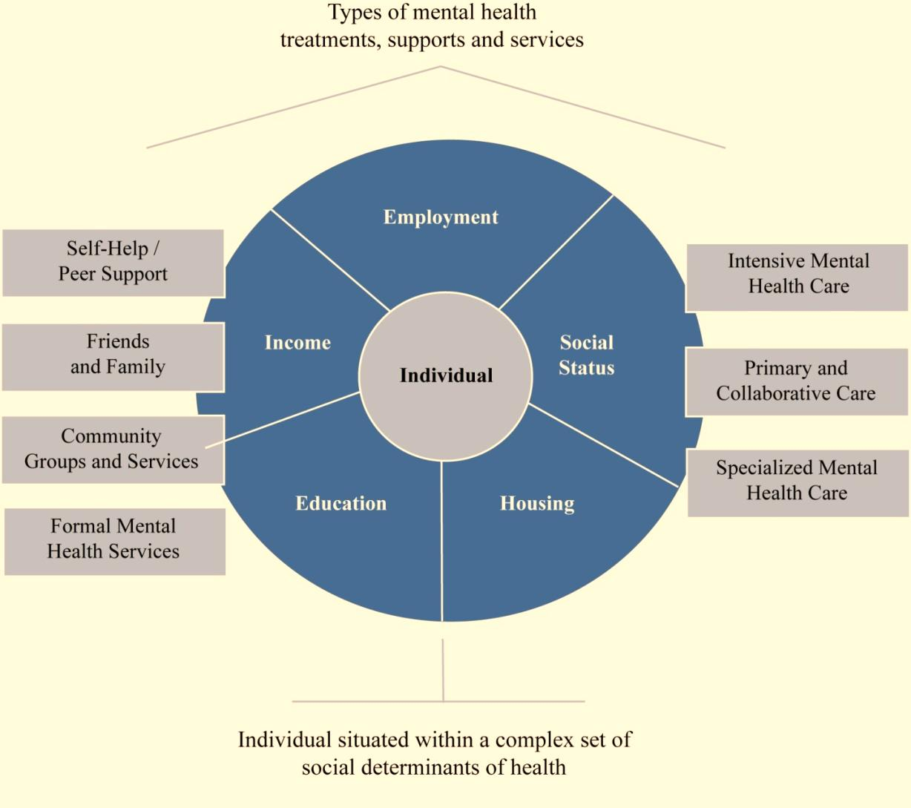

Slide 15
Mental Health Policy in Canada, cont’d
Changing Directions, Changing Lives (2012):
Promote mental health across the lifespan
Foster recovery and uphold rights
Provide access to the right combination of services, treatments, and supports
Reduce disparities in risk factors and access to services
Work with First Nations, Inuit, and Métis
Mobilize leadership, improve knowledge, and foster collaboration

Slide 16
Mental Health Policy in Canada, cont’d
The Mental Health Commission of Canada
Signed onto a recovery declaration in 2014
Produced a Framework for Action (2015), working with community groups, service providers, and others to create broad-based approaches to mental health
Developed a national standard for workplace psychological health and safety in 2013
Developed a Standard on Psychological Health and Safety for Post-Secondary Students in 2020
Individual provinces began moving forward with consultation processes to develop their own mental health strategies

