Slide 1
Chapter 4
Hinduism
Notes:
© 2022 Oxford University Press

Slide 2
Hinduism
Hinduism has neither a single founder nor a single sacred text, and there is no single event that marks its birth.
To the nineteenth century, the word “Hinduism” did not exist. The word Hindu was initially a term used by the ancient Persians to describe people who lived beyond the Indus River.
Today, approximately 80 percent of the populations of India and Nepal are Hindu.

Slide 3
The Teachings of Hinduism
Hindu Beliefs about Divine Reality
Monistic/dualistic or devotional
Names of the divine reality
Brahman
God
Various deities: Vishnu, Shiva, Hanuman, et al.
Mahadevi (“Great Goddess”)
One divine reality, many gods
Divine reality as sound
OM
The divine in nature

Slide 4
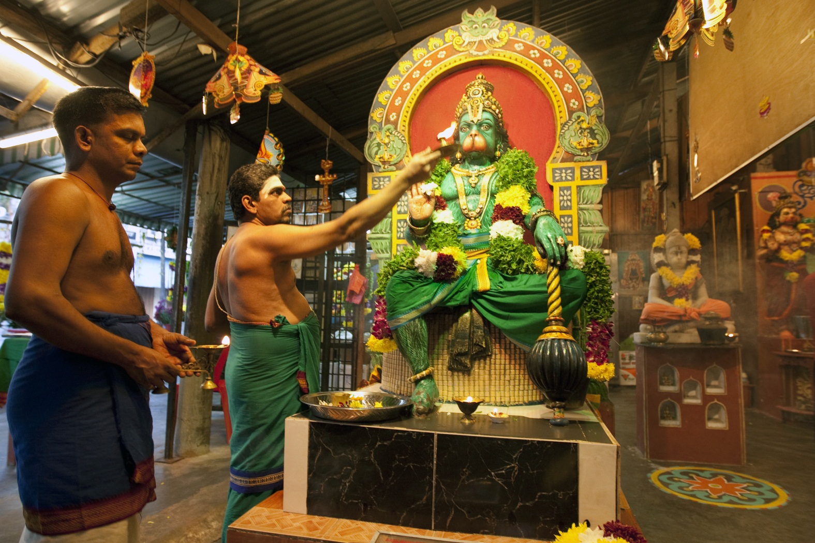
Page 121
Hindu priests perform arati, waving a lamp of burning camphor before an image of Hanuman (the monkey god of the Ramayana) at a temple in Kuala Lumpur, Malaysia, during the festival of Diwali.
Notes:
AP Photo/Rajesh Kumar Singh

Slide 5
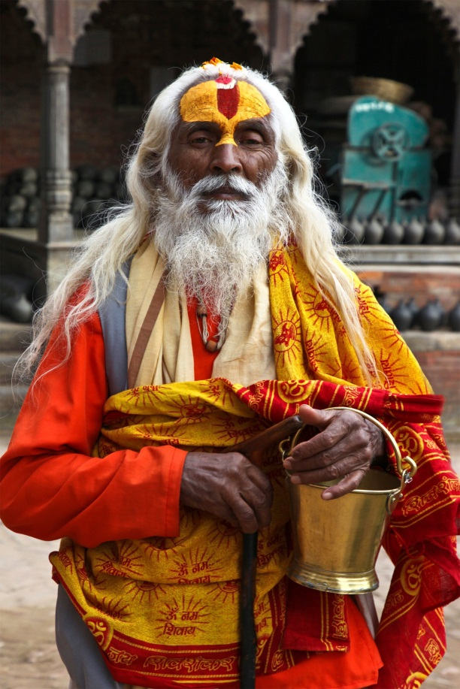
Page 110
A sannyasi, or Hindu ascetic. His sectarian affiliation is indicated by his forehead marking, which demonstrates that he is a worshipper of Vishnu.
Notes:
© Shutterstock.com/O'SHI

Slide 6
The Teachings of Hinduism 2
Hindu Beliefs about Divine Reality
Ten avatars of Vishnu
Krishna
Rama
Kalki

Slide 7
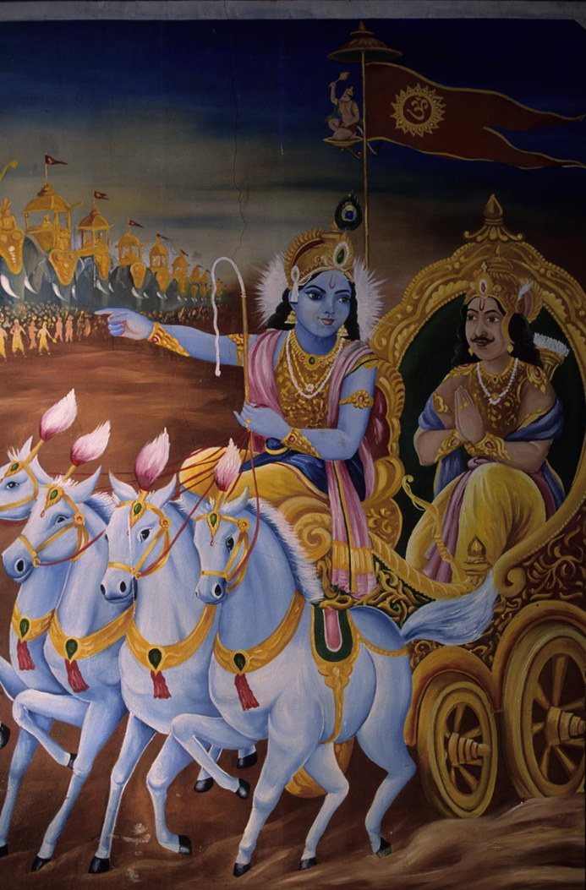
Page 123
Krishna, in the guise of Arjuna’s charioteer, counsels the warrior on the verge of battle against his kinsmen. The battle scene in Mahabharata is the setting of the Bhagavad Gita.
Notes:
Nordicphotos / Alamy

Slide 8
The Teachings of Hinduism 3
The Individual and the Quest for Liberation
Atman
Karma
Dharma
Samsara
Moksha

Slide 9
The Teachings of Hinduism 4
Three Paths to Liberation
Karma marga
Bhakti marga
Jnana marga
Vedanta: The Predominant School of Hindu Philosophy
Advaita Vedanta
Vishishta-Advaita
Dvaita Vedanta

Slide 10
The Teachings of Hinduism 5
The Individual and Society
The Caste System
Four classes:
Brahmin
Kshatriya
Vaishya
Shudra
“Untouchables” or “outcastes”
The Four Stages of Life
1. Student
2. Householder
3. Forest-dwelling hermit
4. Renouncer (sannyasi)

Slide 11
The Teachings of Hinduism 6
The Individual and Society
The Four Aims of Life
Dharma
Kama
Artha
Moksha
Hindu Sacred Texts
Vedas
Upanishads
Ramayana
Mahabharata
Bhagavad Gita
Puranas

Slide 12
The Teachings of Hinduism 7
The Sects of Hinduism
Vaishnavism
Shaivism
Shaktism

Slide 13
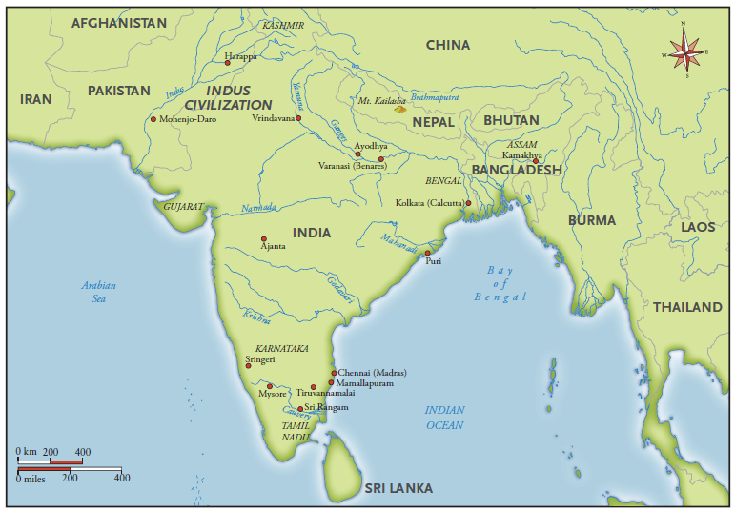
Significant sites in the history of Hinduism (page 127)

Slide 14
The History of Hinduism
Indus Valley Civilization
The Aryans
The Vedic Period

Slide 15
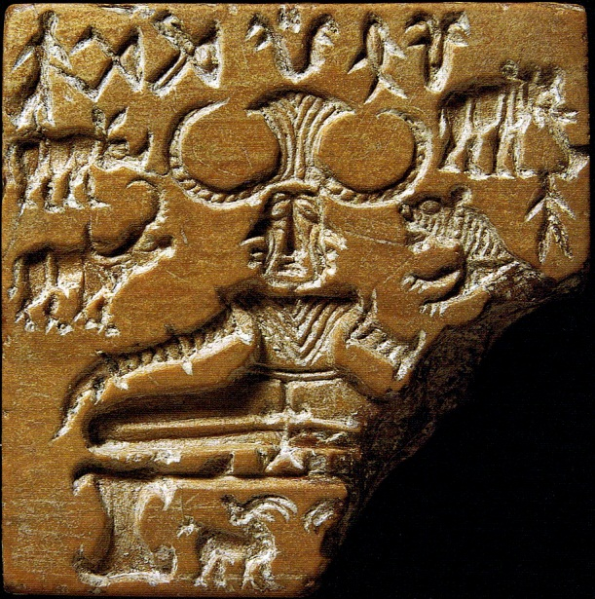
Page 127
The Proto-Shiva seal. The male figure, sometimes called the “Lord of the Animals,” is surrounded by various totemic animals, such as an elephant, a tiger, a rhinoceros, a water buffalo, and two antelopes or deer.
Notes:
Wikimedia Commons, http://commons.wikimedia.org/wiki/File:Shiva_Pashupati.jpg

Slide 16
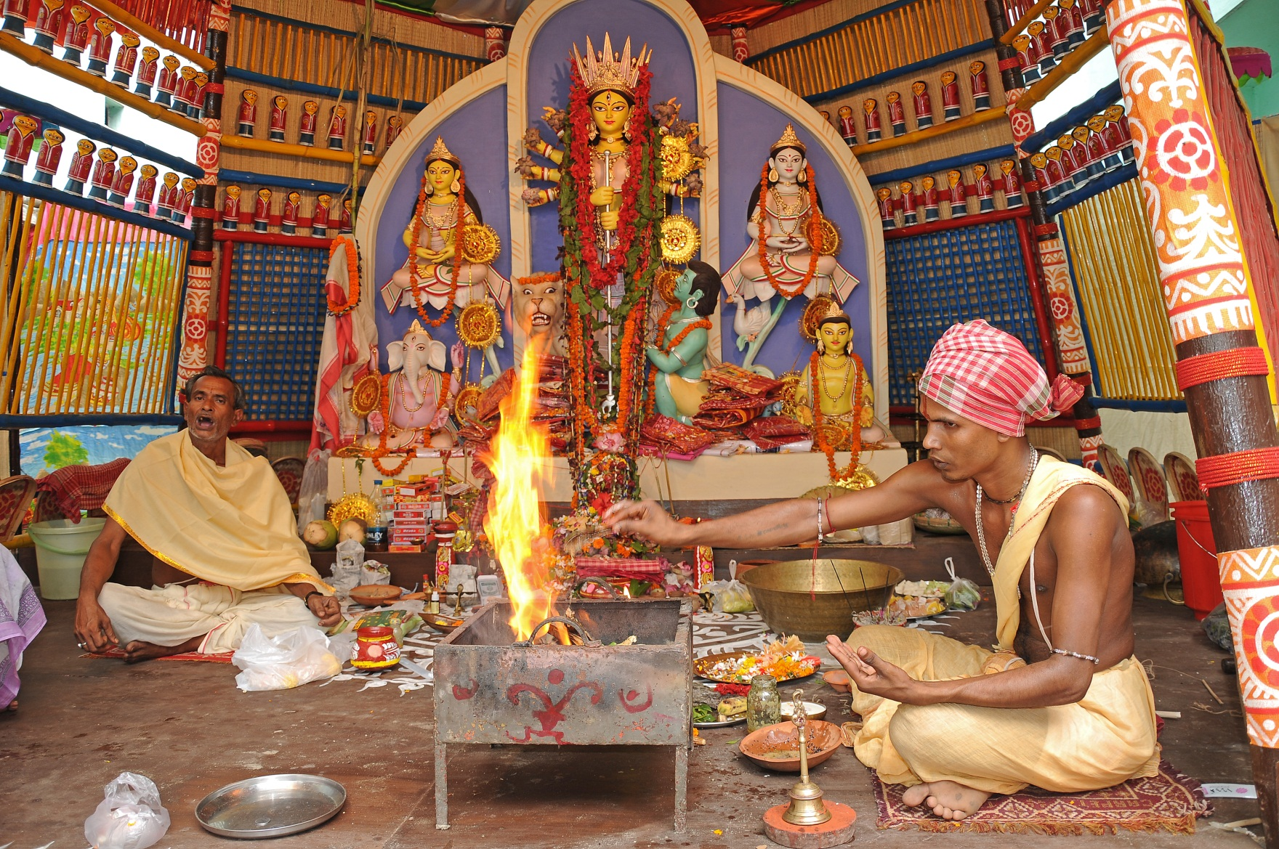
Page 129
A yajna or fire sacrifice, which is one of the most archaic of Hindu rites, is performed by priests before an image of Durga during the Durga Puja festival in Calcutta, India.
Notes:
© Shutterstock.com/neelsky

Slide 17
The History of Hinduism 2
Age of the Guptas
Development of Bhakti
Tantra
Hinduism and Islam, the Mughal Dynasty
Colonial Critique and the Hindu Reformers
Gandhi and the Struggle for Indian Independence
Hindu Nationalism and Hindutva

Slide 18
Hinduism as a Way of Life
Temples and Icons
Darshan

Slide 19
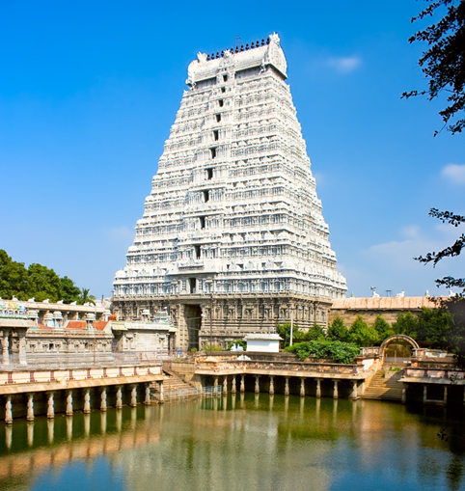
Page 141
The majestic gate of a Shiva temple in southern India is reflected in one of the two ritual bathing tanks found within its precincts. These towers are erected in the four directions and are often covered in sculptural imagery that refers to the sacred myths of the gods venerated within. Arunachaleswar Temple, Tiruvannamalai, India, eleventh century.
Notes:
© Shutterstock.com/Aleksandar Todorovic

Slide 20
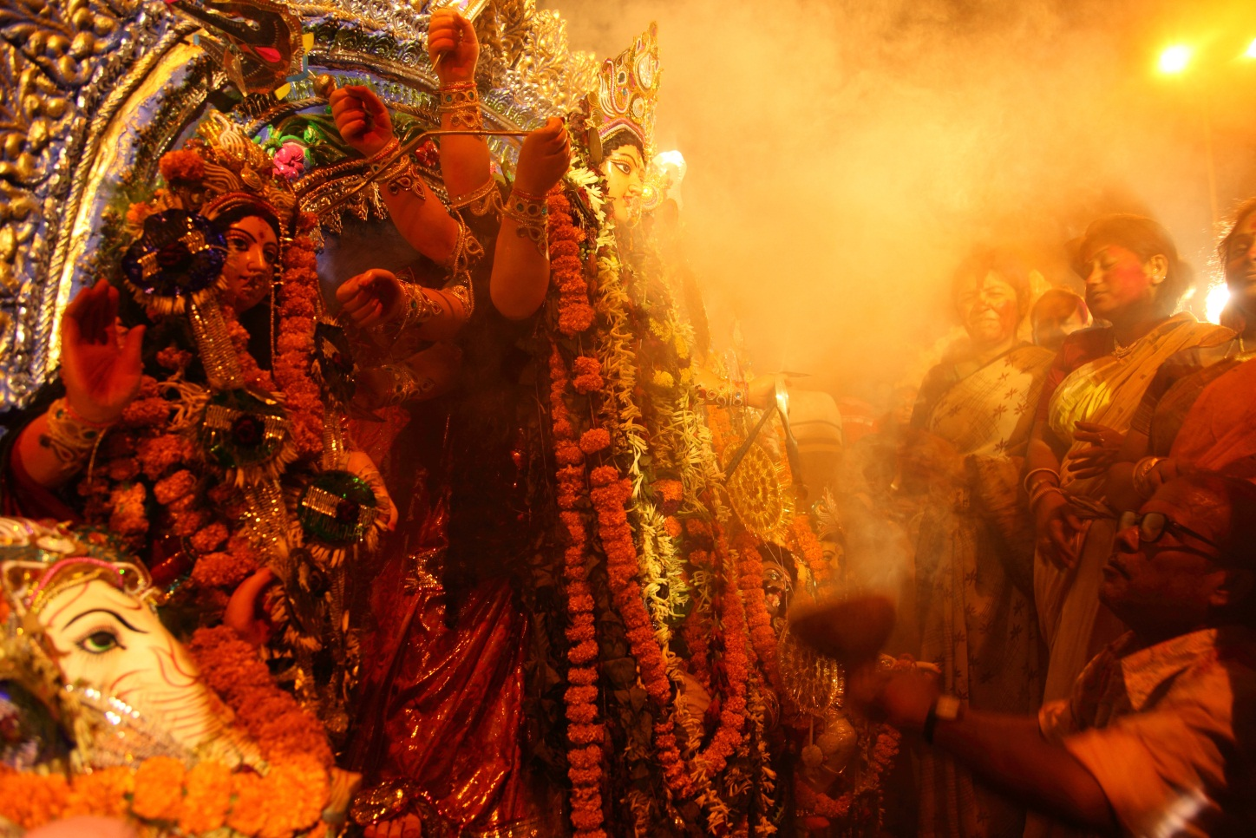
Page 141 2
Clouds of incense billow from a terracotta censer as devotees pray before a multi-armed clay icon of Durga (upper center), Ganesha (lower left), and other deities. This is the final opportunity for darshan, as the icon is about to be dissolved by immersion into the Ganges River at the conclusion of the festival of Durga Puja. Kolkata, India.
Notes:
© Shutterstock.com/AJP

Slide 21
Hinduism as a Way of Life 2
Forms of Worship
Puja
Arati
Mantras
Sacrifice
Yoga

Slide 22
Hinduism as a Way of Life 3
Rites of Passage
A Boy’s Initiation
A Girl’s First Menstrual Period
Marriage
Death
Pilgrimage

Slide 23
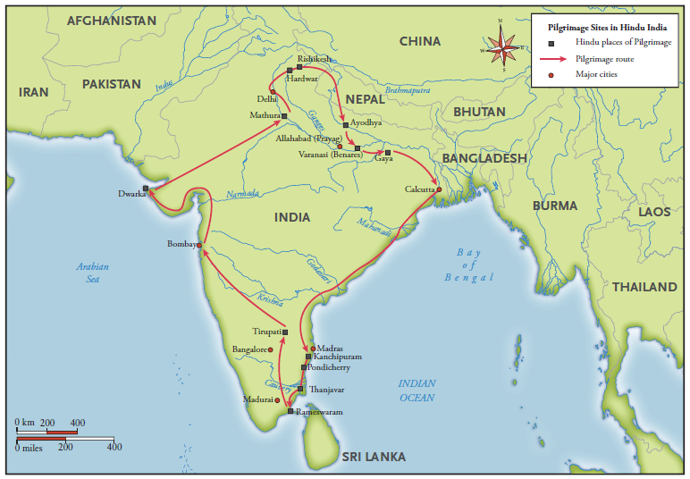
Hindu pilgrimage roots in India (page 145)

Slide 24
Hinduism as a Way of Life 4
Women in Hinduism
Vrata
Festivals and Holidays
Navaratri or Dussehra
Diwali
Holi
Performance Traditions
Ram Lila
Bhajan and Kirtan
Storytelling

Slide 25
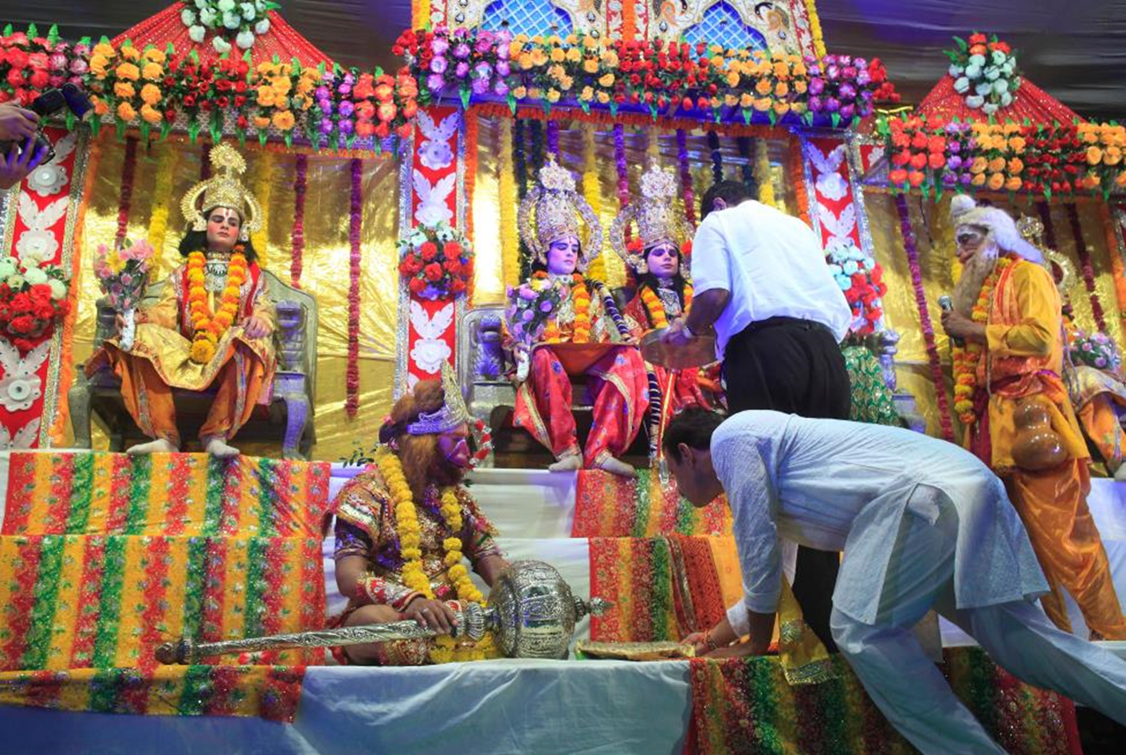
Page 147
A performance in Mumbai, India, of Ram Lila, the very popular enactment of the Ramayana.
Notes:
ZUMA Press, Inc. / Alamy Stock Photo

Slide 26
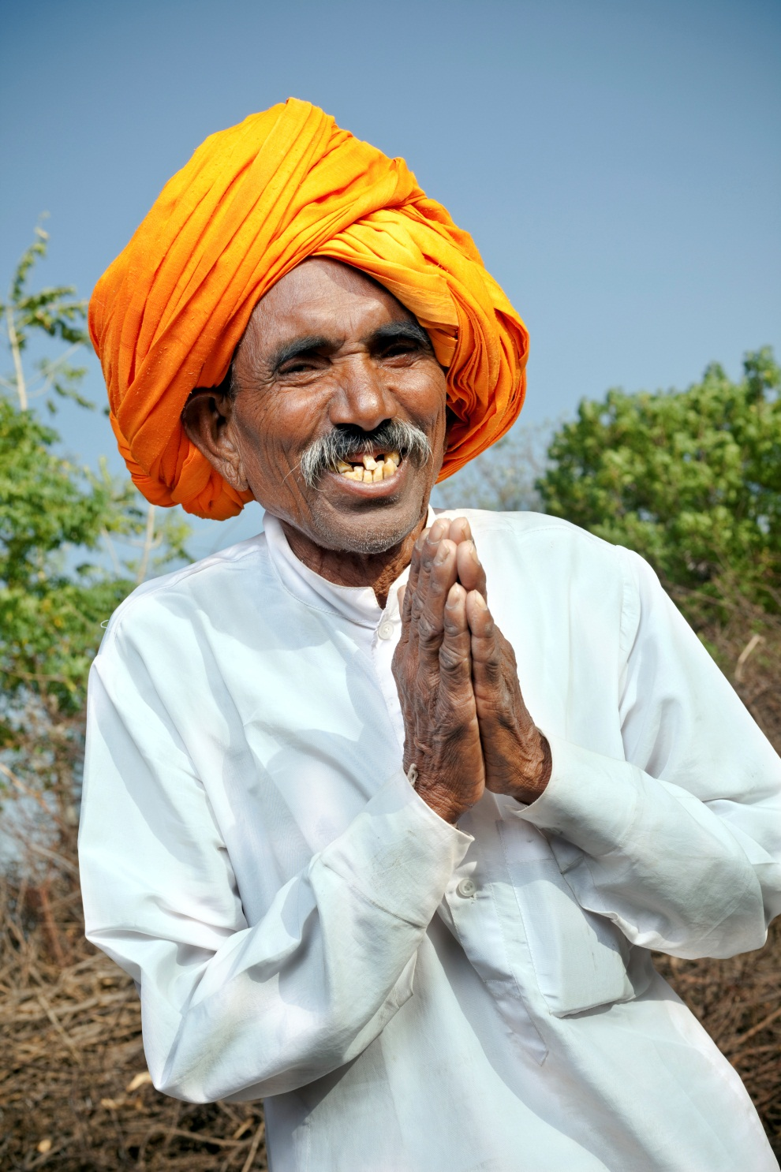
Page 139
In Hinduism, folding one’s hands and offering salutations by saying namaste (nom-us-tay) is a simple way of giving a respectful greeting, as well as saying, “I bow to the divine in you.”
Notes:
© iStockphoto.com/VikramRaghuvanshi

Slide 27
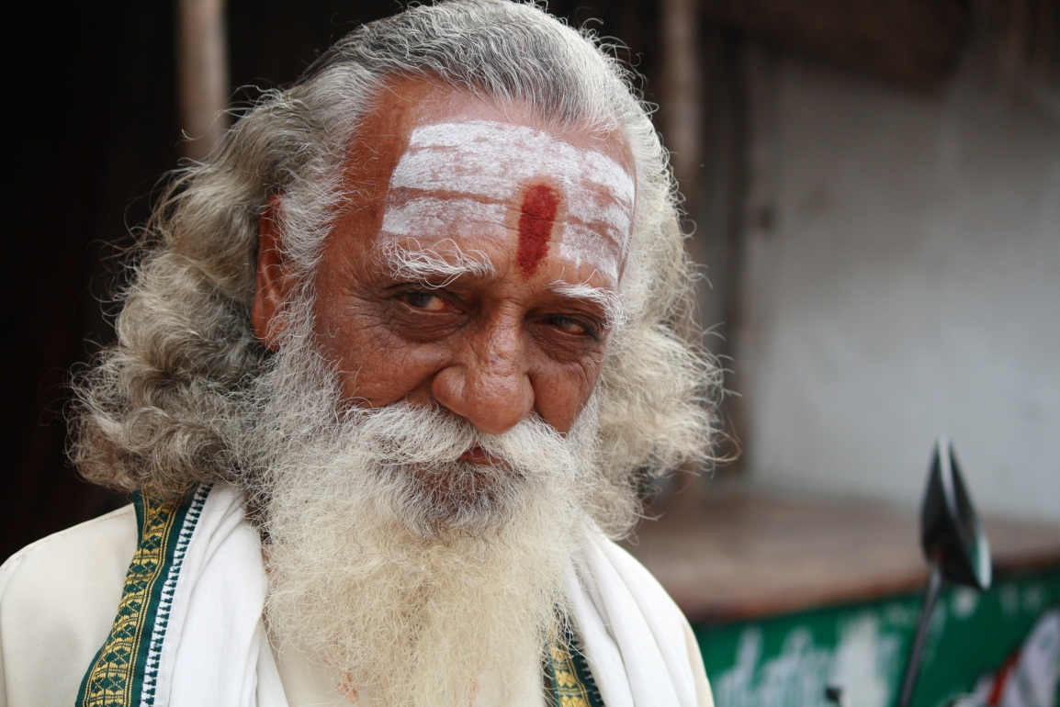
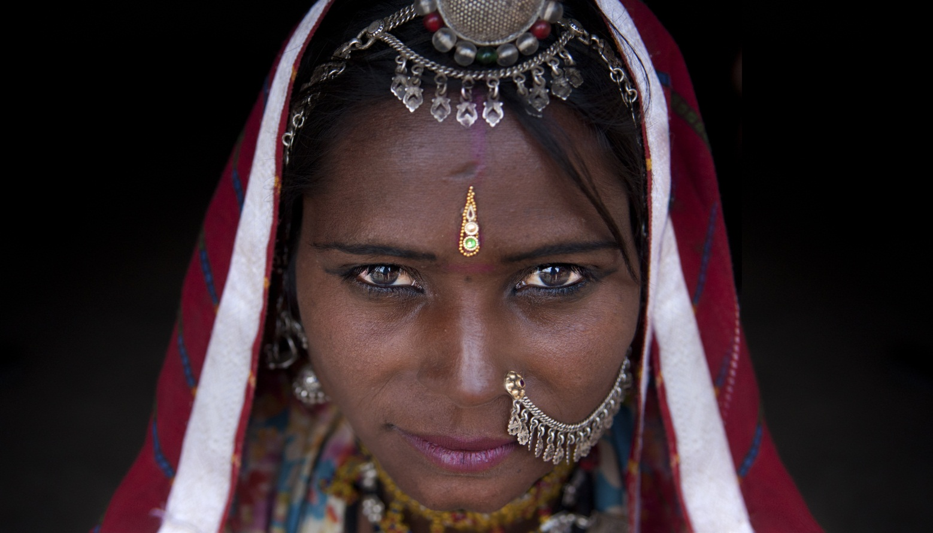
Hindu forehead markings
Hindu forehead markings: bindi, tripundra, and namam. Bindi (drop) is a decorative mark on the forehead signifying auspiciousness. An additional “dot” is often applied by married women to the top of the head where the hair is parted. The mark between the eyes is situated to signify the “third eye” (the faculty of perception beyond ordinary sight). Some forehead markings denote sectarian affiliation, such as the three horizontal lines of sacred ash worn by worshipers of Shiva and the vertical “V” of the worshipers of Vishnu. The red "drop” in the middle represents the descent of grace in the form of Lakshmi, the goddess of fortune; page 139
Notes:
© Shutterstock.com/wong yu liang
© Shutterstock.com/AJP

Slide 28
What Is Ultimate Reality?
Monistic Hindus believe that Brahman is the supreme, unitary reality, the ground of all being.
Understood as undifferentiated and without attributes, Brahman manifests itself in the world, in all its particular forms.
For dualistic or devotional Hindus, ultimate reality is typically understood to be fully embodied in a deity, such as Vishnu or Shiva.

Slide 29
How Should We Live in This World?
Powerfully attracted to the samsaric realm of particulars, human beings are caught up in the continual cycle of death and rebirth.
Hinduism prescribes living in a manner that moves the self toward liberation from samsara.
Three paths lead to moksha: karma (action), jnana (knowledge), and bhakti (devotion).
All the while, Hindus are required to live in conformity with dharma, upholding the cosmic and social order.

Slide 30
What Is Our Ultimate Purpose?
Moksha is liberation from samsara.
Almost impossible to describe fully from the perspective of this world, the experience of moksha is said to be one of infinite awareness and eternal bliss.
For monistic Hindus, moksha involves the full realization of the identity of the self with Brahman rather than with this world.
For dualistic or devotional Hindus, moksha is the complete realization of the soul’s perpetual and deep loving relationship with God.

