Slide 1
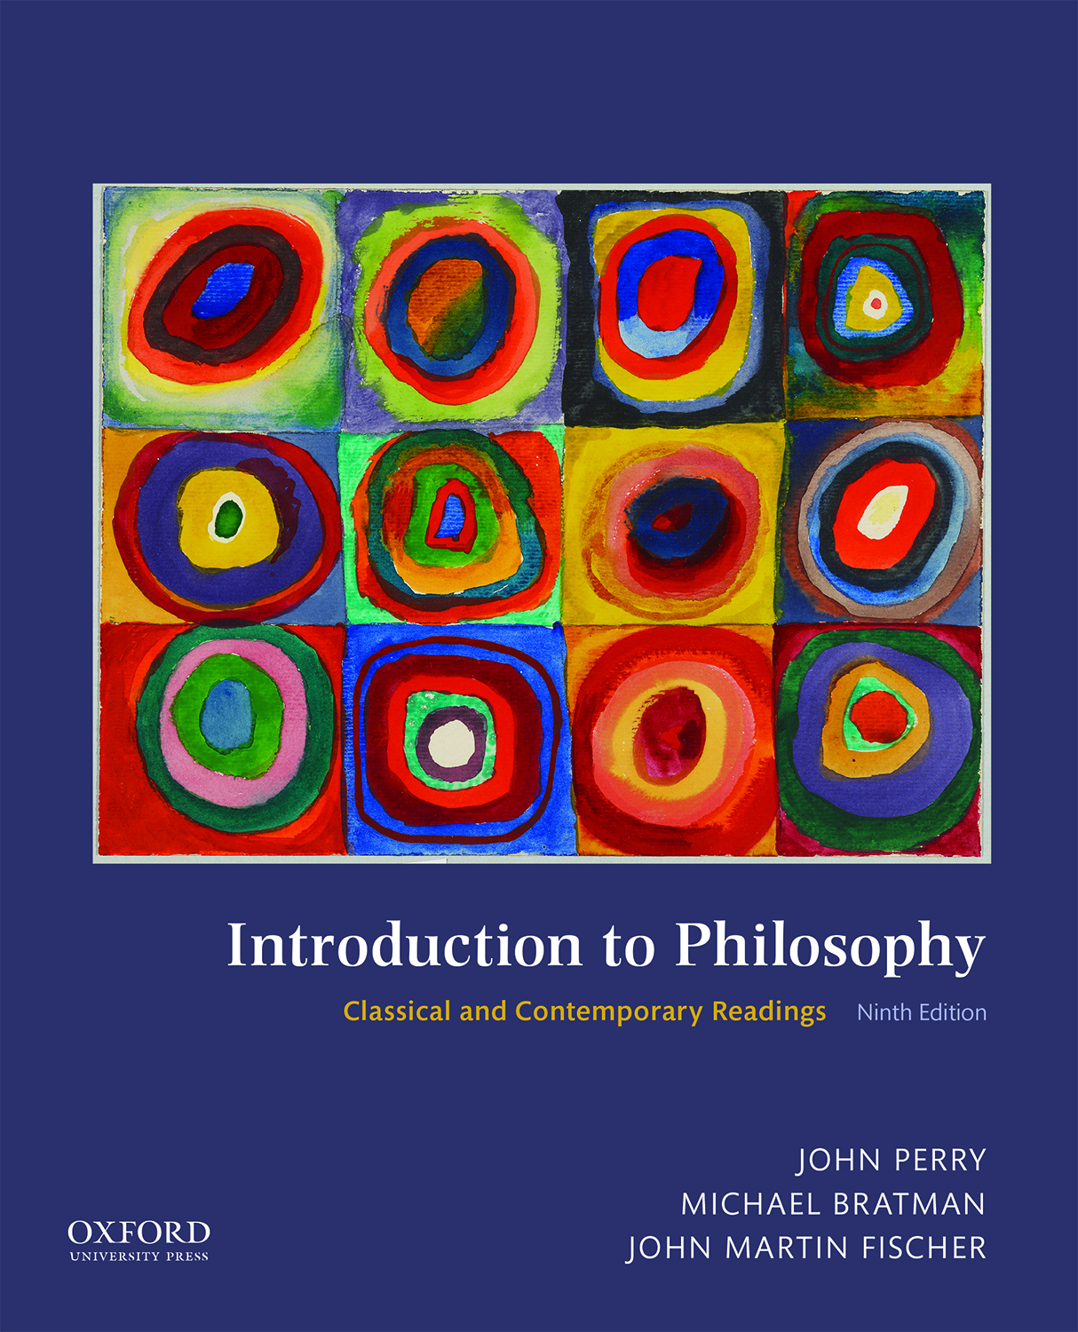
Introduction to Philosophy:
Classical and Contemporary Readings (9th Edition)
by Perry, Bratman, and Fischer

Slide 2
PART 1
Philosophy

Slide 3
“The Value of Philosophy”
Bertrand Russell (1872–1970)

Slide 4
“The Value of Philosophy” (1 of 2)
According to Russell, philosophy is not valuable for the same reason that the physical sciences are valuable (viz., the physical sciences have brought about many useful inventions that made our lives better).
If the study of philosophy helps others, it can only do so indirectly.

Slide 5
“The Value of Philosophy” (2 of 2)
Concerning the true value of philosophy, Russell concludes the following:
  Philosophy is to be studied, not for the sake of any definite answers to its questions, since no definite answers can, as a rule, be known to be true, but rather for the sake of the questions themselves; because these questions enlarge our conception of what is possible, enrich our intellectual imagination and diminish the dogmatic assurance which close the mind against speculation; but above all because, through the greatness of the universe which philosophy contemplates, the mind is also rendered great, and becomes capable of that union with the universe which constitutes its highest good (21).

Slide 6
“Apology: Defence of Socrates”
Plato (428 B.C.E.–348 B.C.E.)

Slide 7
“Apology: Defence of Socrates” (1 of 3)
Socrates has been charged with “corrupting Athens’ youths.”
Here he offers a defense (i.e., an apology) for his actions.
Socrates is concerned with wisdom.

Slide 8
“Apology: Defence of Socrates” (2 of 3)
Concerning the source of his wisdom, Socrates claims, “If I do not know something, I do not think that I do,” (21d).
Thus, for Socrates, wisdom requires that we are able to recognize the limits of our understanding.

Slide 9
“Apology: Defence of Socrates” (3 of 3)
Socrates defends his search for wisdom by saying, “An unexamined life is no life for a human being to live” (38a).
Socrates is sentenced to death for his “crimes.”
Q: If the examined life results in death, do you agree with Socrates that it is worth pursuing?

