Slide 1
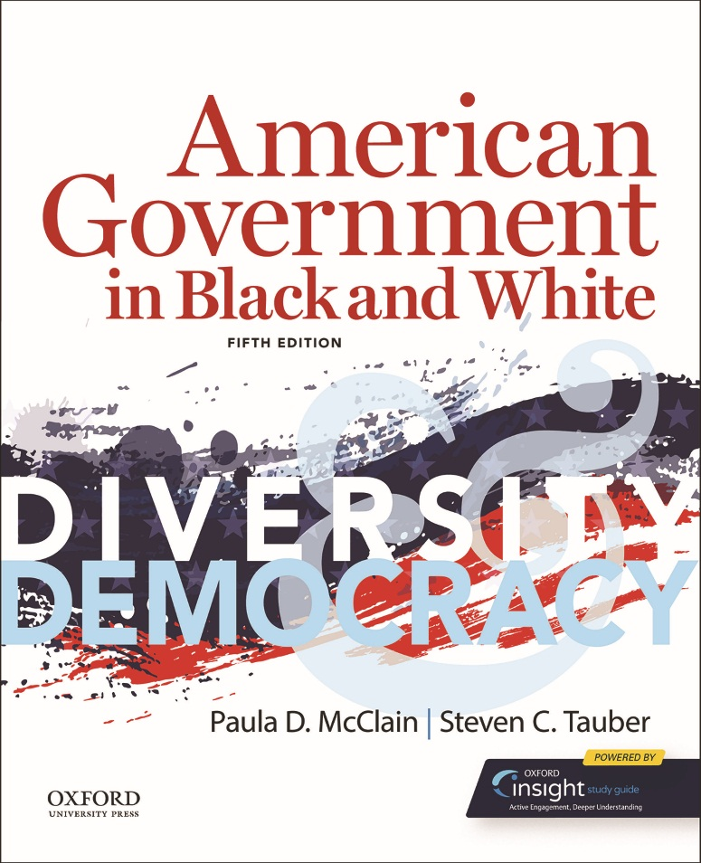
American Government in Black and White Diversity & Democracy by Paula D. McClain and Steven C. Tauber

Slide 2
Chapter 05 Civil Rights: Inequality and Equality

Slide 3
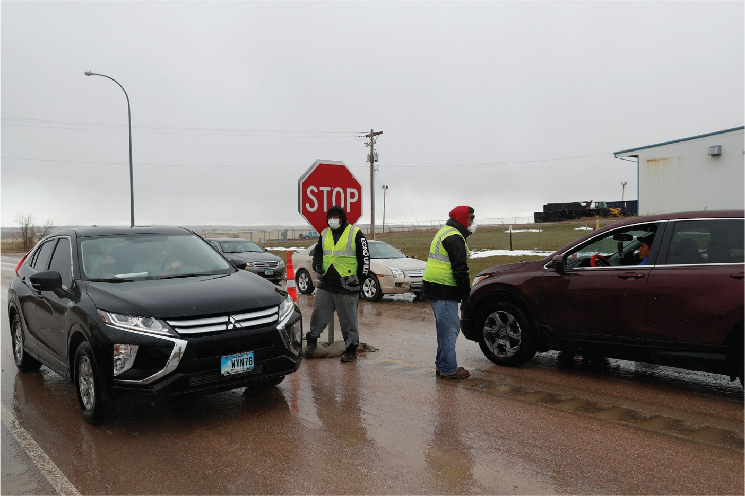
A COVID-19 checkpoint at the entrance of Pine Ridge, which exists in the state of South Dakota but is controlled by the Oglala Lakota Sioux Tribe. Indigenous tribes in South Dakota established checkpoints on state and interstate highways contained in their land to protect their people from the coronavirus, especially after South Dakota Governor Kristi Noem (R) refused to issue any stay-at-home orders. Governor Noem demanded the tribes remove their checkpoints, even threatening to sue them, but they refused. As of September 2020, the checkpoints have remained.

Slide 4
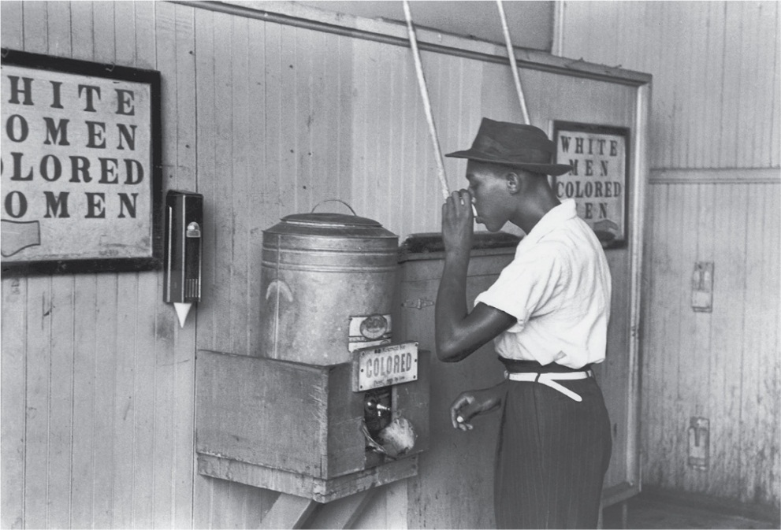
During the era of Jim Crow segregation and before the Civil Rights Act, Blacks and Whites were forced to use different restrooms and drink from different fountains.

Slide 5
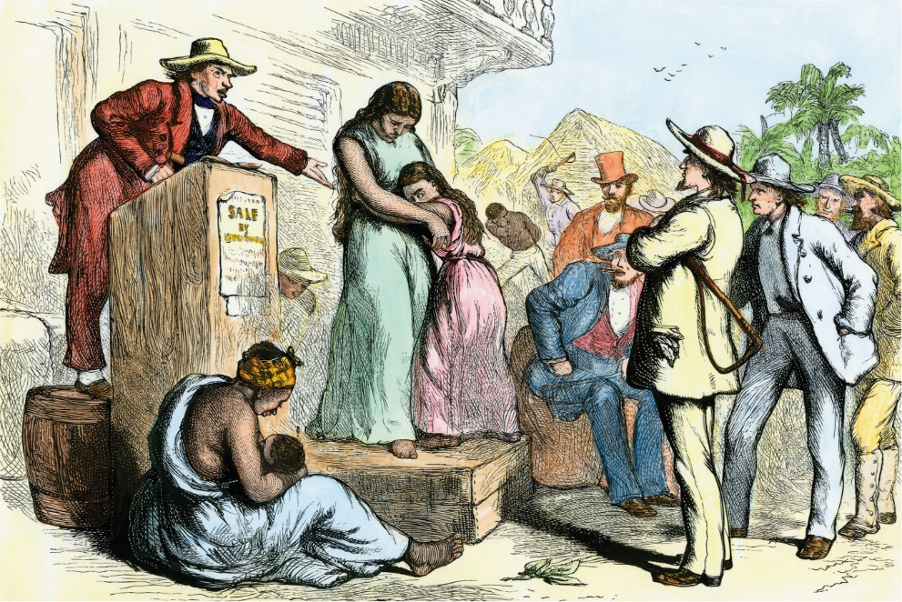
One of the most despicable aspects of the slave trade was dividing families, even separating parents from their children.

Slide 6
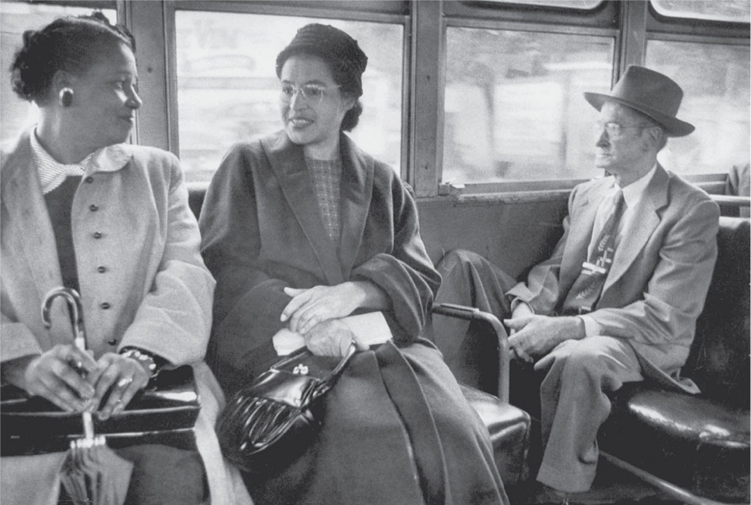
Rosa Parks sitting on a bus in Montgomery, Alabama. In 1955, Ms. Parks refused to relinquish her seat to a White rider, despite the city rule that Blacks must sit in the back of the bus. Her arrest sparked a boycott of the Montgomery bus system, an important catalyst for the Civil Rights Movement of the 1950s and 1960s.

Slide 7
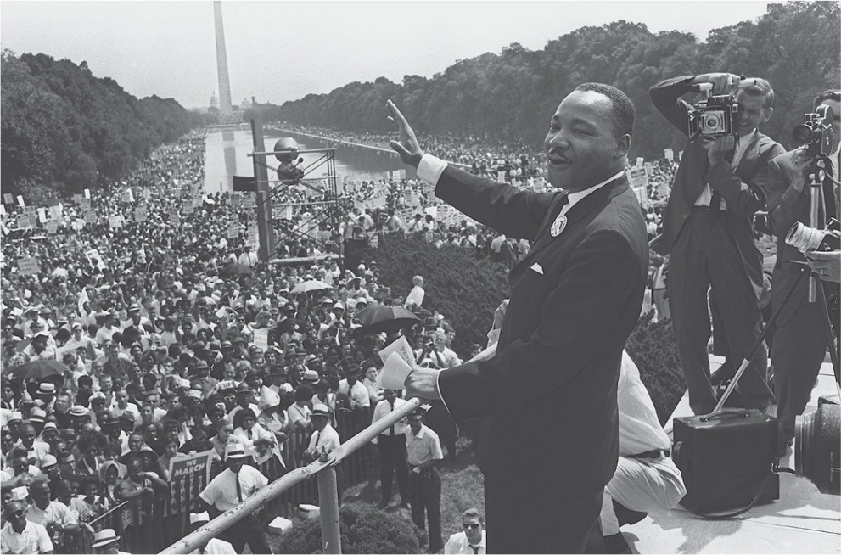
The historic 1963 March on Washington exemplifies the goals of the Civil Rights Movement during the 1960s. Media coverage of this march demonstrated to the American public and political leaders the seriousness of racial discrimination and the widespread support to end it.

Slide 8
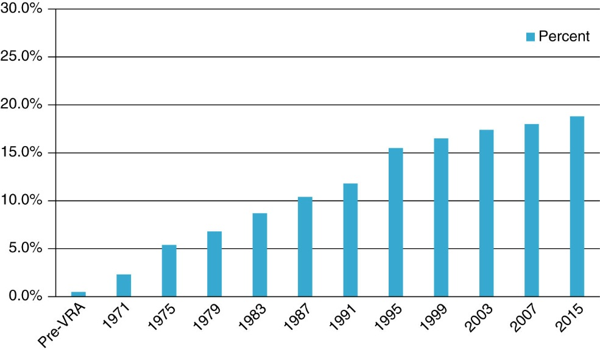
Figure 5.1 Combined percentage of Southern state legislators who are Black from pre-Voting Rights Act era through 2015 (the most recent data available). The states include Alabama, Arkansas, Florida, Georgia, Louisiana, Mississippi, North Carolina, South Carolina, Tennessee, Texas, and Virginia.

Slide 9
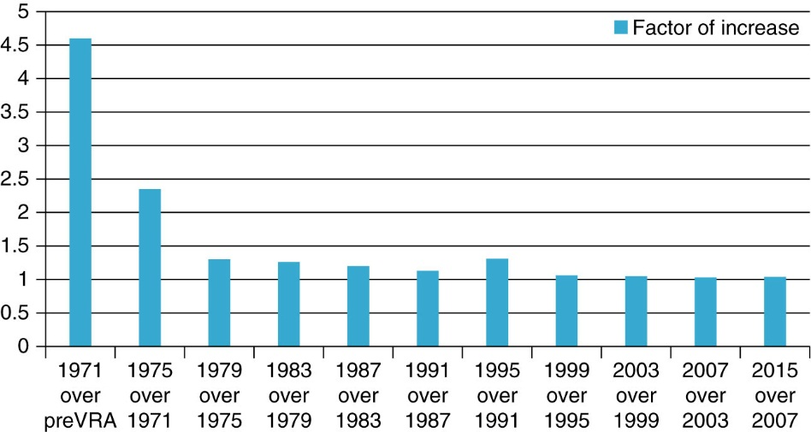
Figure 5.2 Extent of the increase (from the previous time) in the combined percentage of Southern state legislators who are Black. The states include Alabama, Arkansas, Florida, Georgia, Louisiana, Mississippi, North Carolina, South Carolina, Tennessee, Texas, and Virginia.

Slide 10
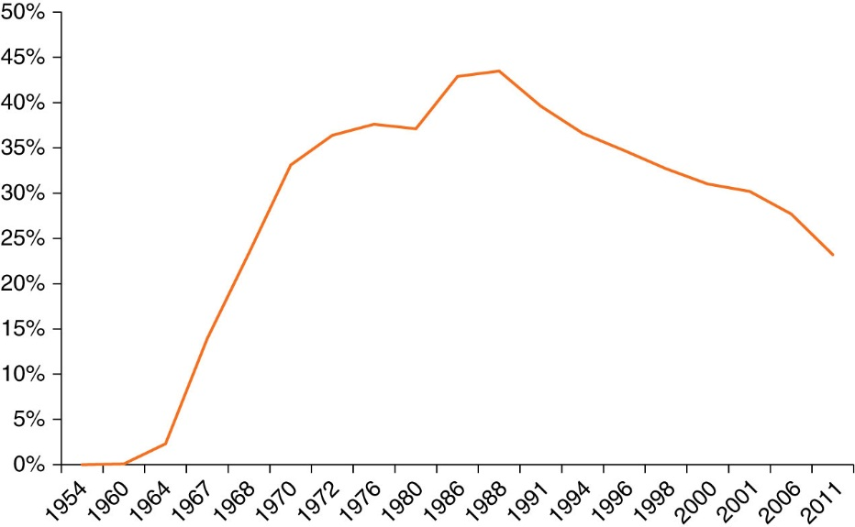
Figure 5.3 Percentage of African American Students Who Attend Majority-White Schools in the United States, 1954–2011

Slide 11
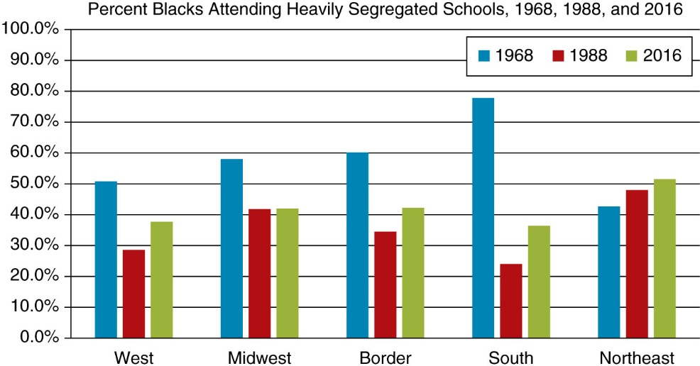
Figure 5.4 Percentage of Black Students Attending Schools with More than 90 percent Minority Students, 1988 and 2016, by Region.

Slide 12
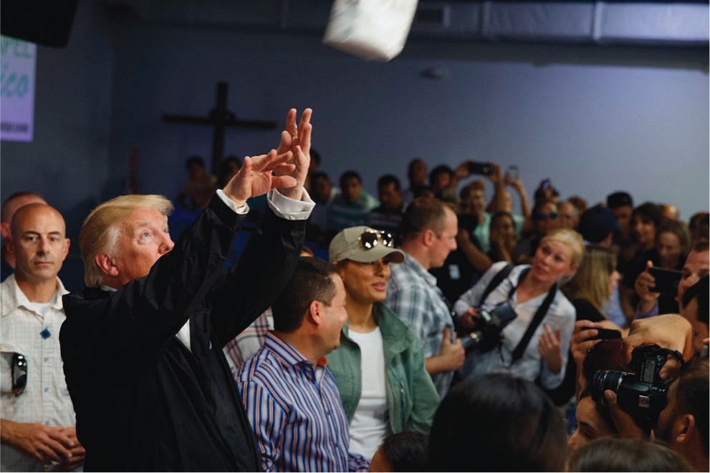
During his visit to Puerto Rico after Hurricane Maria, President Donald Trump appears not to appreciate the seriousness of the situation as he cavalierly throws paper towel rolls to a crowd, as if he is shooting a basketball.

Slide 13
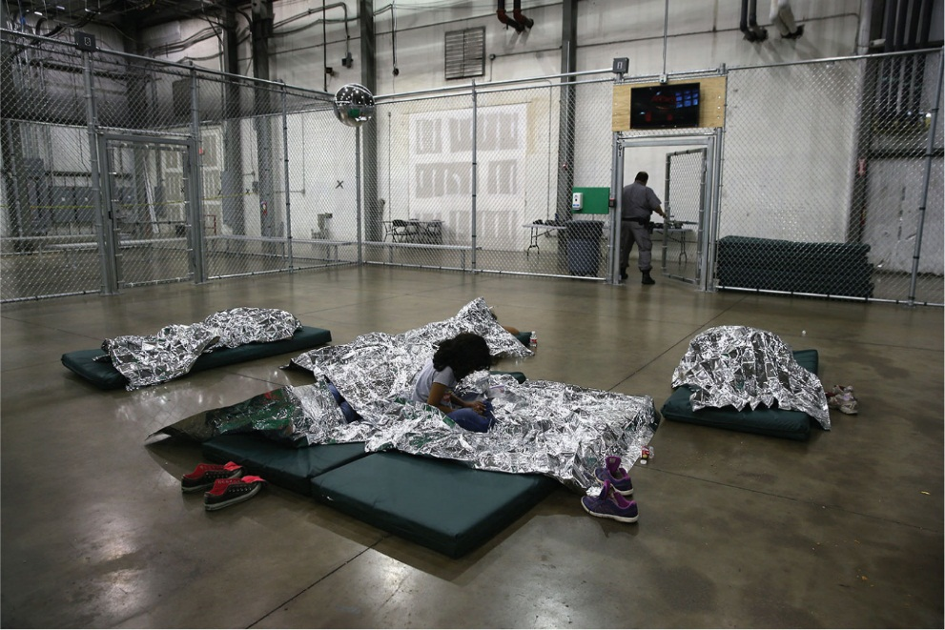
Children detained in a facility in McAllen, Texas. The Trump administration’s Zero Tolerance Policy resulted in separating children from their parents who were undocumented immigrants or asylum-seekers. After considerable controversy, the administration ended the program, but some children have still not been reunited with their parents.

Slide 14
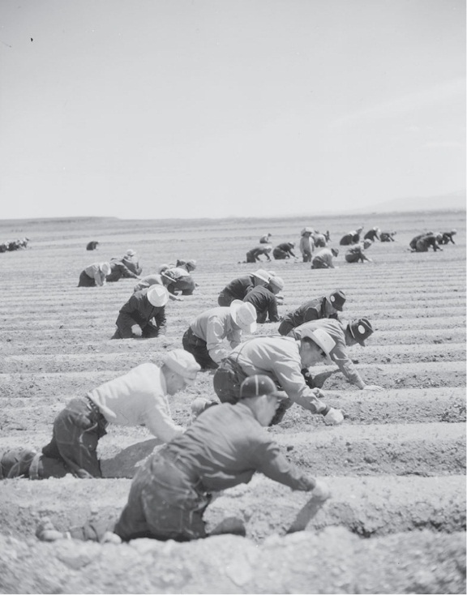
Japanese Americans working in agricultural fields at the Tule Lake internment camp in northeastern California. Despite the Constitution’s prohibition against racial discrimination, during World War II the U.S. government mistrusted the loyalty of Japanese Americans and confined many of them, including native-born citizens, in harsh internment camps like this one.

Slide 15
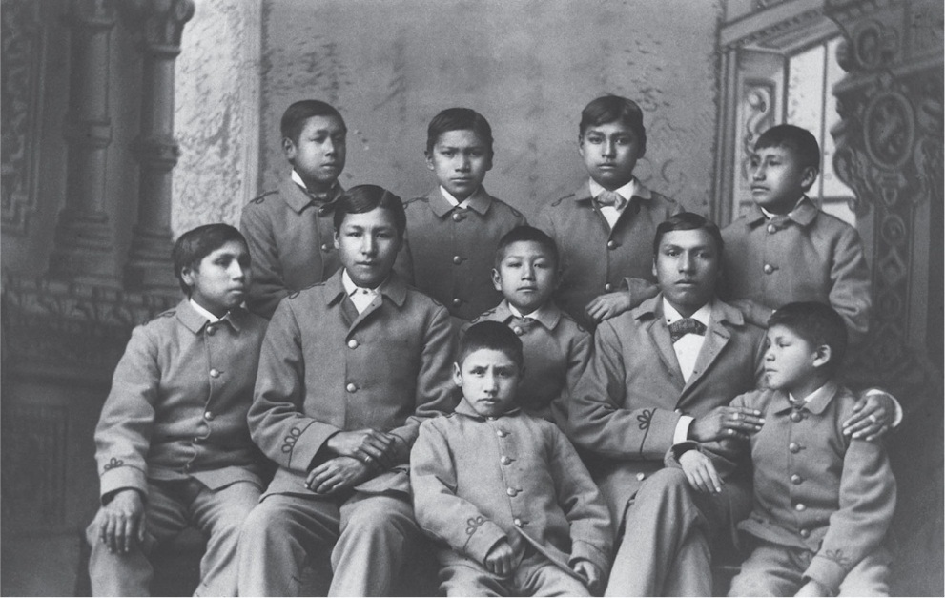
Omaha boys at the Carlisle Indian Industrial School in Carlisle, Pennsylvania, circa 1880. This boarding school was one of many throughout the United States that sought to assimilate American Indians into White culture. In addition to receiving education and training, students were forced to cut their hair and were punished for speaking their native language.

Slide 16
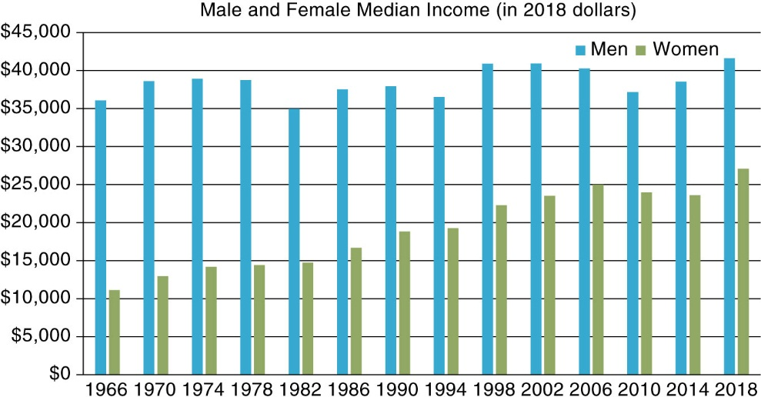
Figure 5.5 Median Income of Male and Female Workers, 1966–2018 (All figures in 2018 dollars)

Slide 17
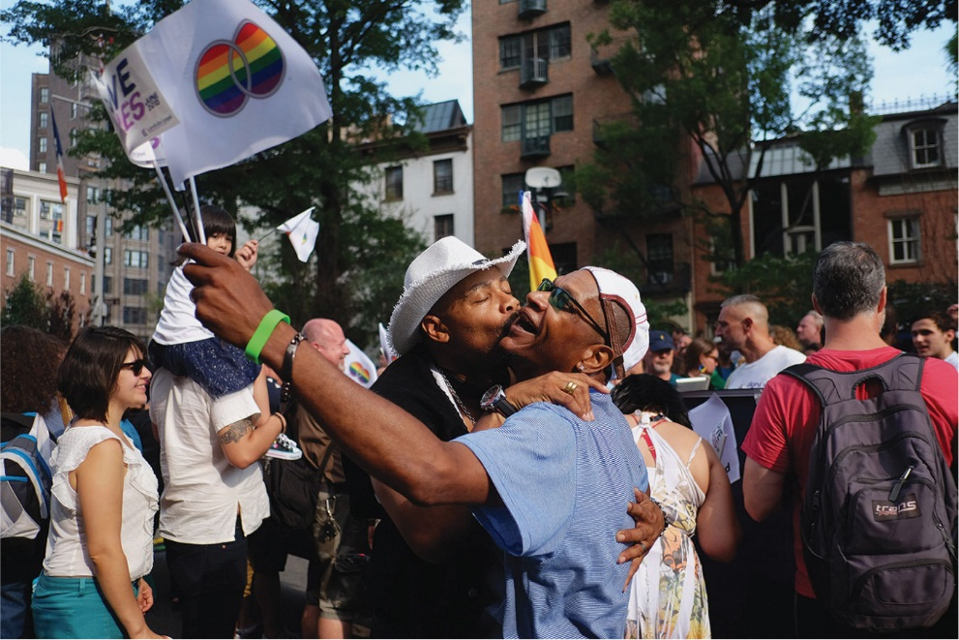
At the turn of the twenty-first century, no states allowed same-sex marriage, but since then states gradually allowed it. In 2015, the U.S. Supreme Court ruled that laws banning same-sex marriage were unconstitutional, which legalized it throughout the United States. However, some local judges and government officials have steadfastly refused to sanction same-sex marriages, citing religious opposition.

Slide 18
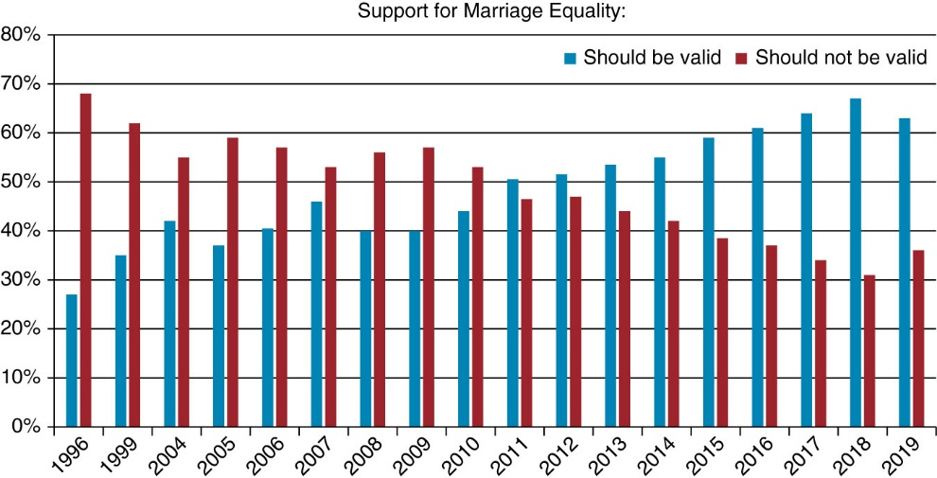
Figure 5.6 Public Opinion on Whether Same-Sex Marriage Should Be Valid (Percentage Saying It Should Be Valid Versus Percentage Saying It Should Not Be Valid), 1996–2019. Results were averaged over the year when the poll was taken more than once in a calendar year.

Slide 19
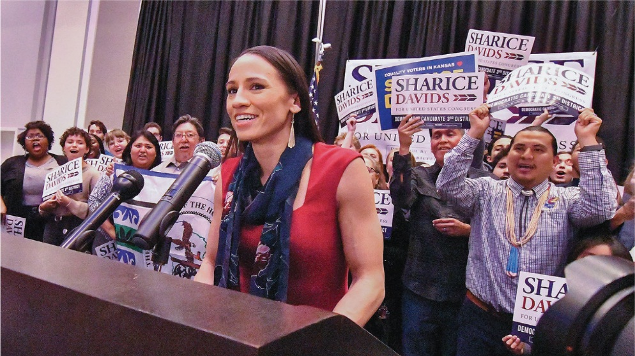
Sharice Davids gives her victory speech after winning the state’s 3rd congressional district race on November 6, 2018, in Olathe, Kansas. Davids is not only one of the two first American Indian women elected to Congress, but she is also the first member of the LGBTQ+ community elected to represent Kansas in the U.S. House of Representatives.

