Slide 1
Federalism and Nationalism

Slide 2
Chapter 4 Federalism and Nationalism
In this chapter you will learn:
What federalism is
The strengths of federal and state governments
How federalism works—how it has evolved
Contemporary challenges of federalism
American nationalism and the conflicts that surround it

Slide 3
Forging Federalism
Two Choices in 1776
Unitary governments
Most common during colonial times
National polity governed as a single unit
Central government exercised political authority
Confederation
Power in the states
Weak central authority provides common defense or economic benefits
Americans tried under Articles of Confederation

Slide 4
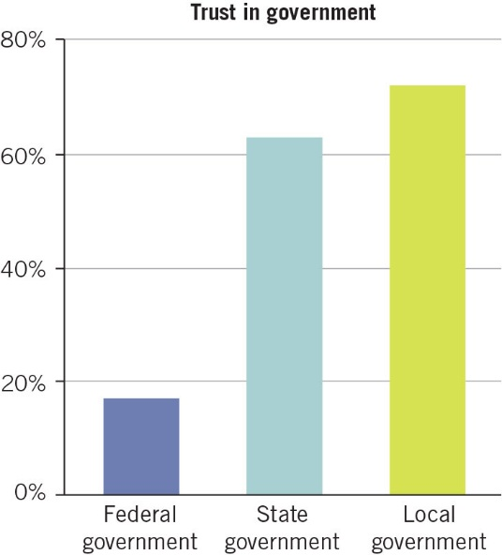
Figure 4.1
Notes:
FIGURE 4.1 Trust in government gets stronger as government gets closer to the public. (Gallup)

Slide 5
Forging Federalism 2
Constitutional Convention Delegates Devised a New Government: Federal System
Power divided between national and state governments
Conflict is built into the system
United States has many layers making it more difficult

Slide 6
Who Holds Government Authority?
Most Important Issue in Federalism: Who Decides What
Advantages of State-Level Policy
States more responsive to citizen needs and desires
States offer more protection for individual rights
Federalism fosters political innovation
Federalism gives people more choices

Slide 7
Who Holds Government Authority ? 2
Advantages of National Policy
More fair
Equalize resources across the nation
Standardize best practices
Problems of coordination

Slide 8
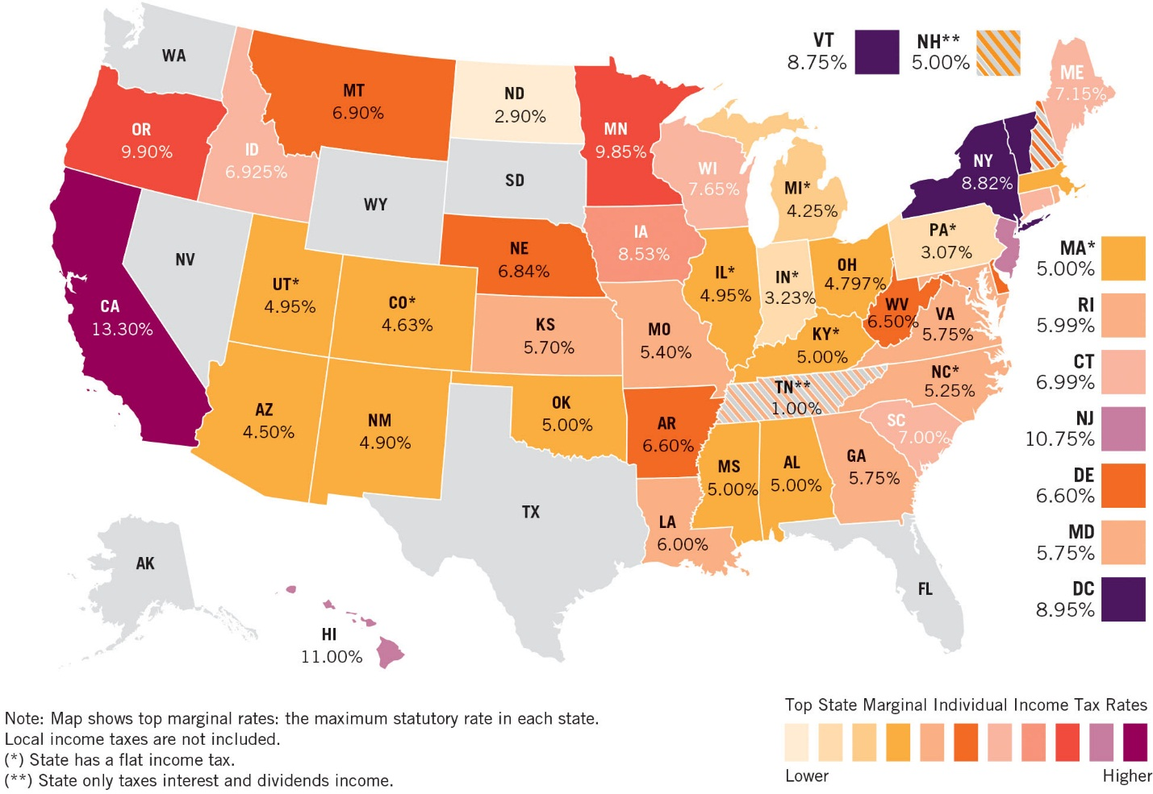
Figure 4.2
Notes:
FIGURE 4.2 Individual income tax rates in each state. Note the vast differences: earn $100 in North Dakota, and state taxes peel off less than $3; in California, more than $13 goes to the state treasury. Seven states, colored gray on map, levy no income taxes; two others tax only dividends and interest income. Here’s the tough question: Can Americans really pick up and move to a state that reflects their own values? (Tax Foundation)

Slide 9
How Federalism Works 3
The Constitution Sets the Ground Rules
Nineteen powers vested in national government: delegated powers
Commerce Clause: empowers Congress to regulate commerce
Necessary and proper clause: Congress’s constitutional authority to exercise the necessary and proper powers to carry out its designated functions: implied powers
Supremacy Clause: national government’s authority prevails over any conflict
Inherent powers: neither specified or implied but necessary for government to fulfil their duties

Slide 10
How Federalism Works 4
Constitution Protects State Authority
State authority guaranteed by the 10th Amendment
Reserves to states all powers not specifically granted to the national branches
Constitution Authorizes Shared Power
State and national authorities share many responsibilities
Concurrent powers: authority shared by national and state governments
Full faith and credit clause: each state recognize and upholds laws passed by any other state

Slide 11
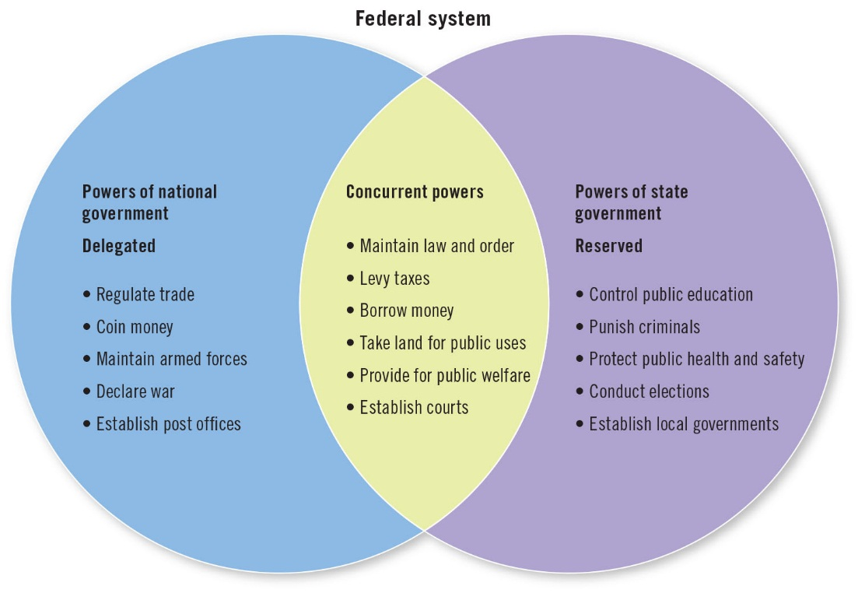
Figure 4.3
Notes:
FIGURE 4.3 The Constitution delegates some powers to the federal government, reserves some to the states, and allocates some to both. Those joint (or concurrent powers) have stretched dramatically over the years.

Slide 12
How Federalism Works 5
Dual Federalism (1789-1933)
State and national governments had relatively clear responsibilities
States had as much authority as federal government
Layer cake federalism: levels of government fall into separate layers
National government in charge
International relations
Internal improvements
Regulated relations and commerce between the states
States retained control over individual citizens

Slide 13
How Federalism Works 6
Cooperative Federalism (1933-1981)
New Deal, dual arrangement collapsed
President Roosevelt and large Democratic majorities in Congress strengthened national government’s role
Active federal government, blurred lines of authority
Marble cake: different government functions all swirled together
Federal funds through grants-in-aid with specific instructions about how the money could be spent

Slide 14
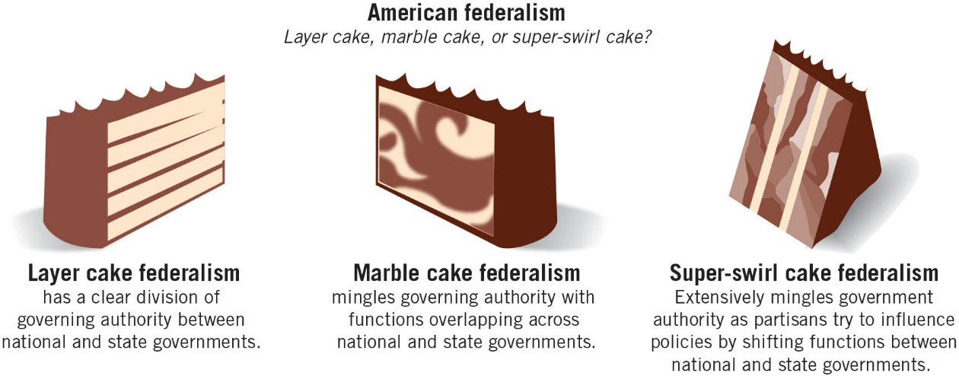
Figure 4.4
Notes:
FIGURE 4.4 Different federalist styles throughout U.S. history.

Slide 15
How Federalism Works 7
Federalism Today
Reagan tipped pendulum of power away from national officials, more authority to states
Swirl Cake Federalism: government authority mingling governing authority with high partisan conflict
New Federalism: authority from federal officials to state and local governments
Block Grants: gave federal dollars to specific policy area with fewer restrictions
Progressive Federalism: national government sets program goals, states determine how to achieve them

Slide 16
How Federalism Works 8
Federalism Today
Trump trying to go back to Reagan era New Federalism
Fewer federal dollars, fewer federal regulations

Slide 17
Issues in Federalism
Unfunded Mandates
Obligation imposed by federal legislation without sufficient federal funding for costs
How Government Grows
Some problems necessitate grater national government role
Local governments face problems beyond their capacity to solve

Slide 18
Issues in Federalism 2
Reducing the Federal Government
Debate reflects desire to reduce the size and scope of government
Devolution: transfer of responsibility for government programs form nation to state and local and then to private sector
Republicans prefer state and local control
Democrats seek Washington-based solutions
Both parties press for national authority or defer to states in reality

Slide 19
Issues in Federalism 3
On Both Sides of the Issue
Both parties stray from party position regularly
Republicans criticized for being hard-hearted budget cutters-introduce new social policies
Democrats criticized for spending too much, rely more on state innovation
Our Three-Dimensional Political Chess
Conservatives want less federal government, liberals want more
Policy debate in Washington, 50 state capitals, and thousands of municipalities and governing agencies

Slide 20
Federalism and the Courts
Disputes about drawing a line where national power ends and states’ authority begins
Favored national prerogative in early republic and then moved to favoring state and private corporations
One explanation: party in power changed
Current court shifting power from national government to the states

Slide 21
Nationalism, American Style
American public’s sense of identity as Americans
Helps maintain federal balance
Can turn inward and exclude others
Double-edged sword
Mutual support and loyalty
Strict boundaries around who counts as an American

Slide 22
Nationalism, American Style 2
America’s Weak National Government
Strong nationalism linked to weak governing institutions
Strength measured by three main principles
Size
Authority
Independence

Slide 23
Nationalism, American Style 3
Size
Many years American government smaller
Grew during World War I, Great Depression, World War II, Cold War, Great Society of the 1960s
Authority
Mid-nineteenth century nations had powerful and efficient national bureaucracies, civil service
American government did not have a strong central bureaucracy
American civic voluntarism: citizens participate in public life without government incentives or coercion

Slide 24
Nationalism, American Style 4
Independence
Separate and divide governing power
Vertical dimension, power shared among different levels of government
Each level has internal checks
Checks and balances at every level

