Slide 1
Inside Texas Politics Power, Policy, and Personality of the Lone Star State by Brandon Rottinghaus

Slide 2
Chapter 07 The Legislature

Slide 3
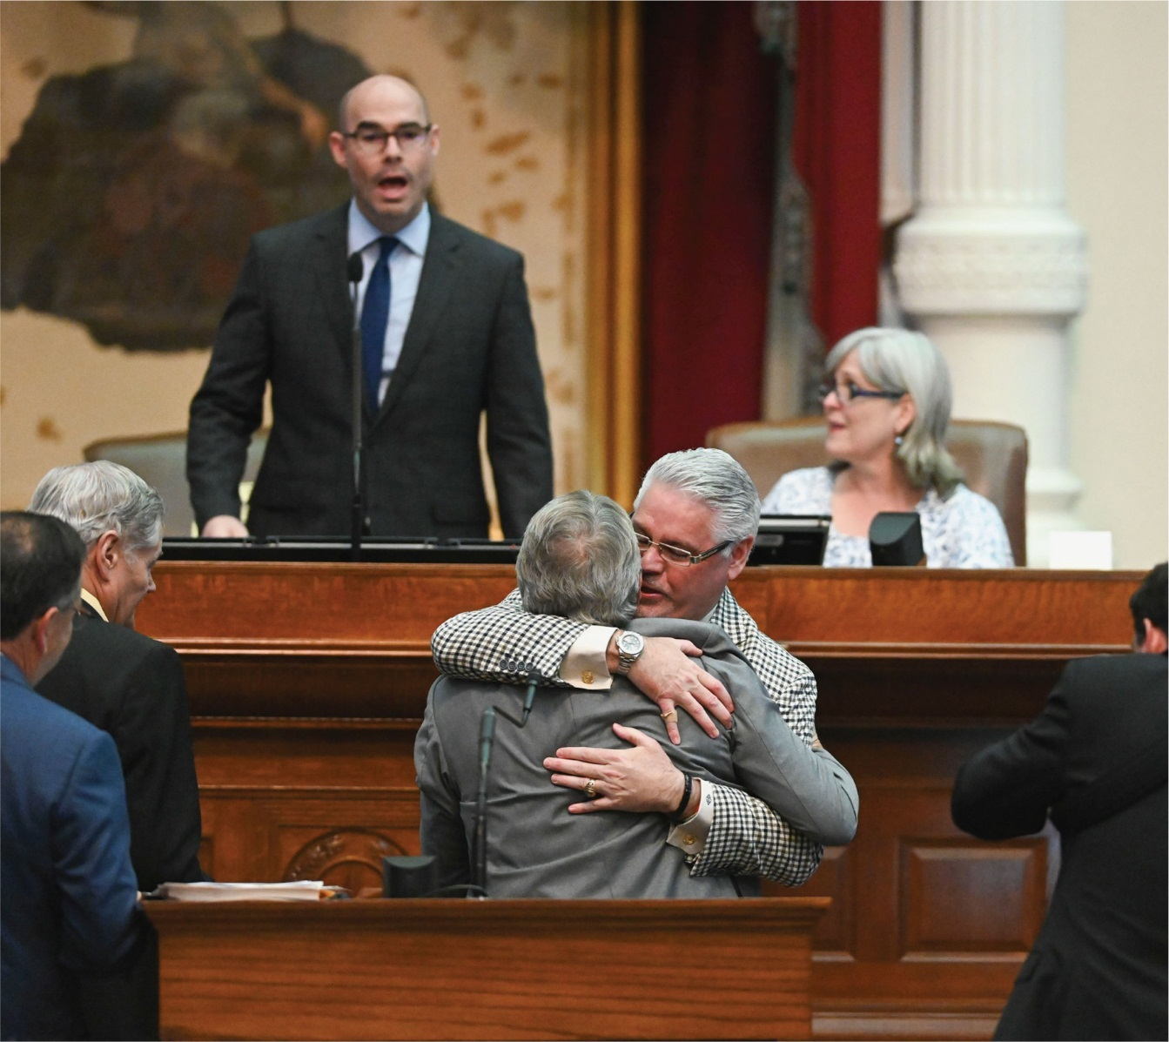
Outgoing Speaker Dennis Bonnen attempts to get the attention of the chamber as Representative Dan Huberty bear hugs Senator Larry Taylor in celebration of passage of a massive education spending bill.

Slide 4
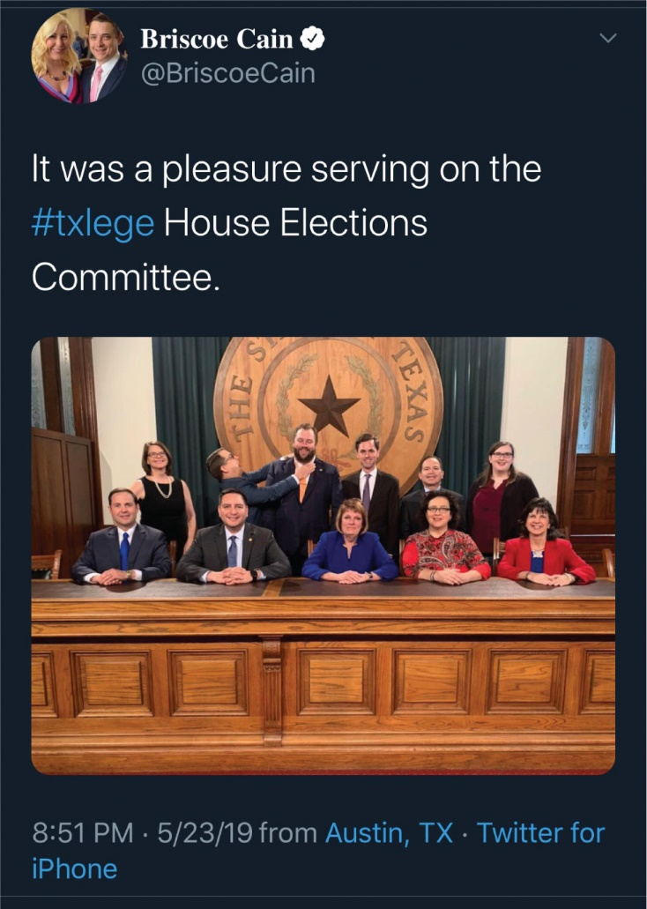
Texas Representative Briscoe Cain (a Republican) jokingly strangles fellow Representative John Bucy (a Democrat).

Slide 5
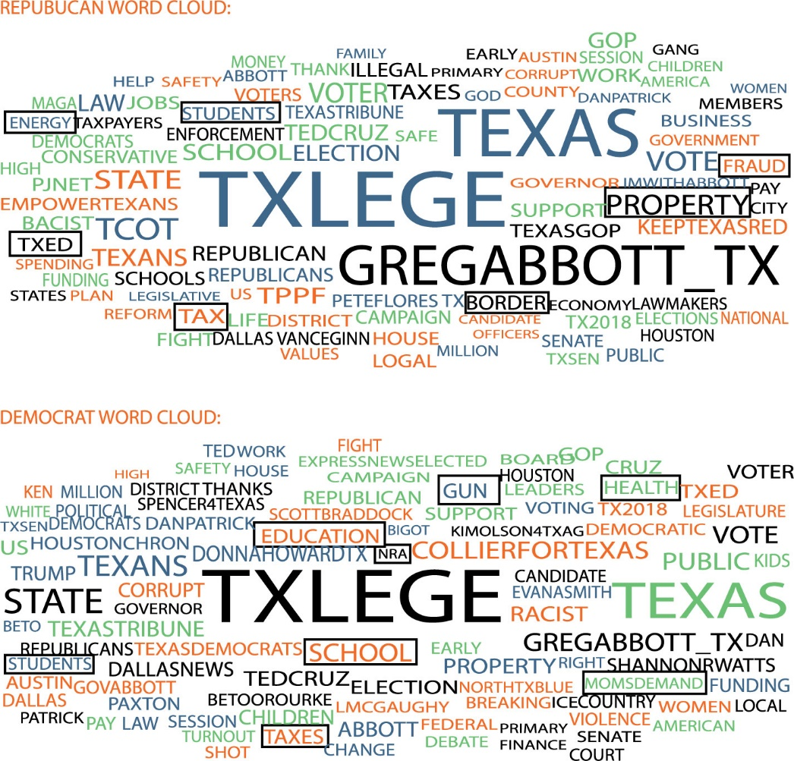
Figure 7.1 Issues Tweeted before the 86th Legislature Using #txlege Hashtag by Party

Slide 6
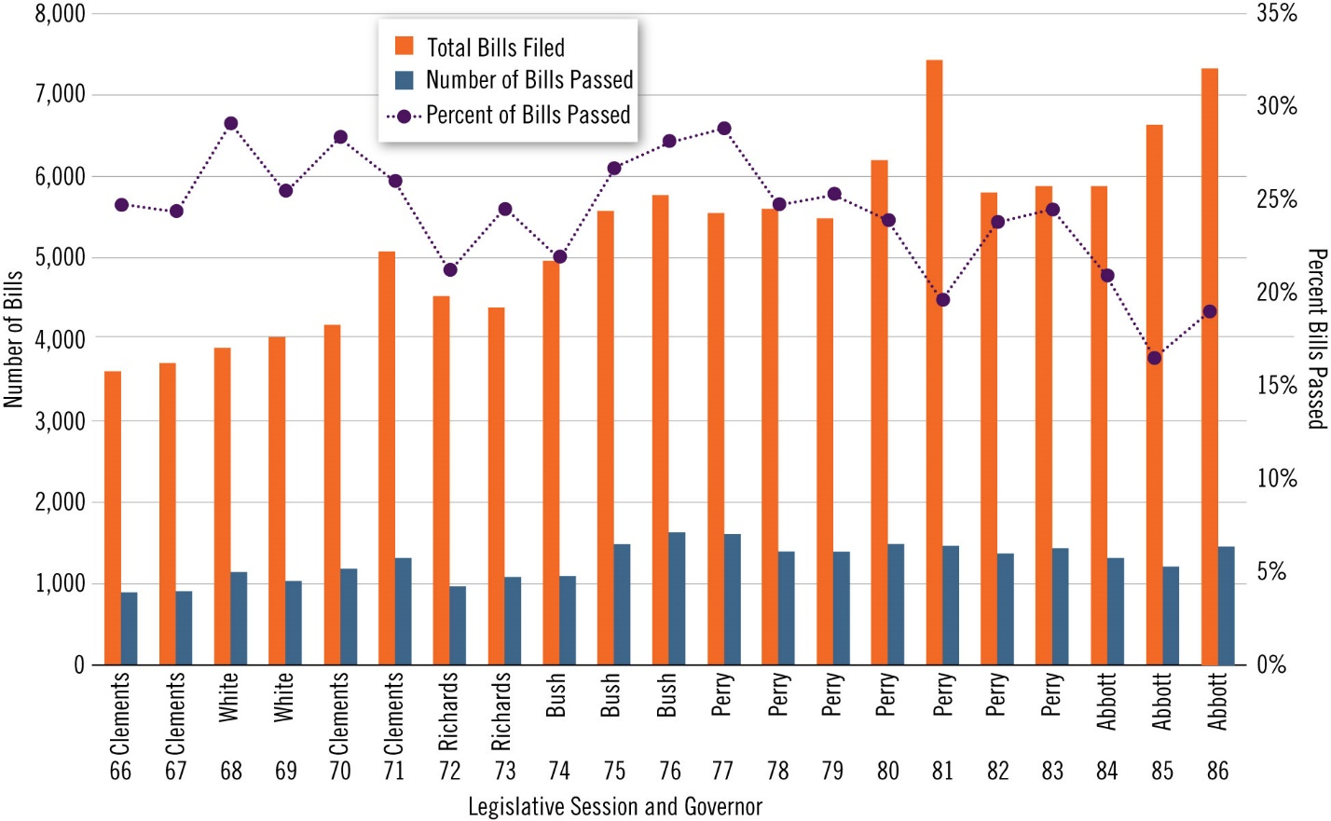
Figure 7.2 Bills Passed by Session

Slide 7
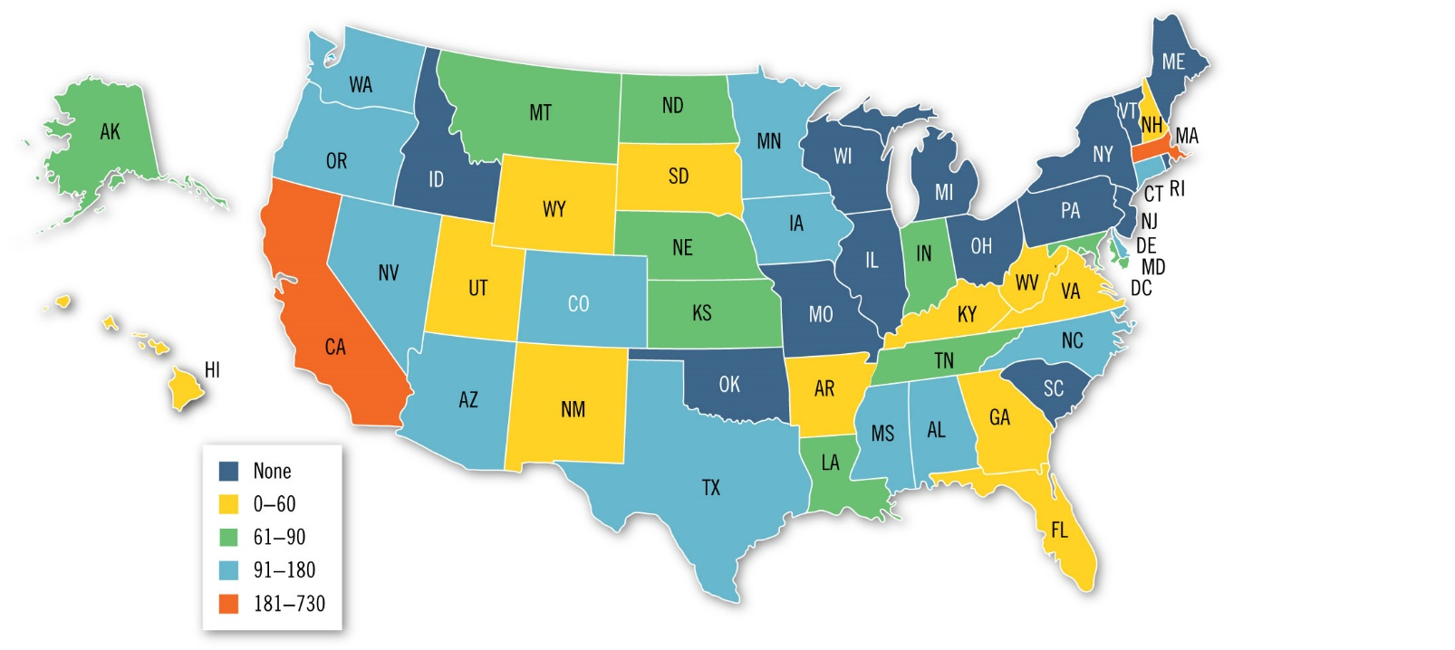
Figure 7.3 Length of Legislative Session

Slide 8
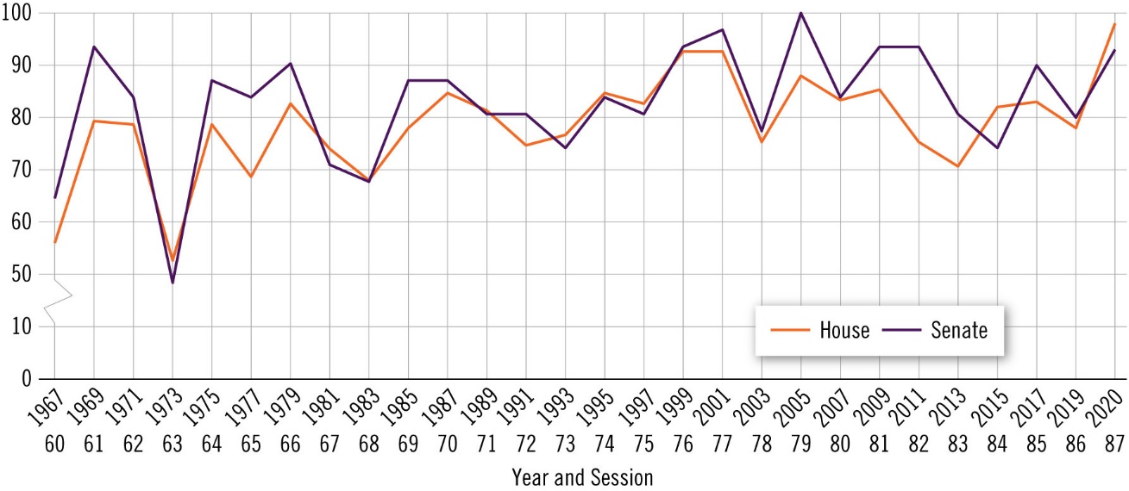
Figure 7.4 Incumbents’ Reelection Rate

Slide 9
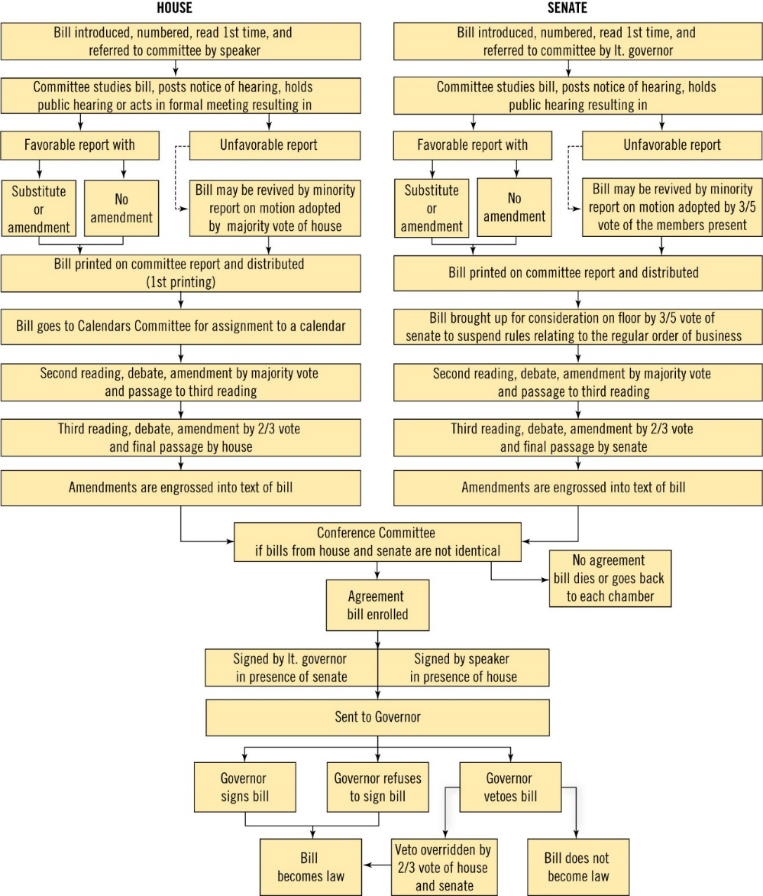
Figure 7.5 How A Bill Becomes a Law in Texas

Slide 10
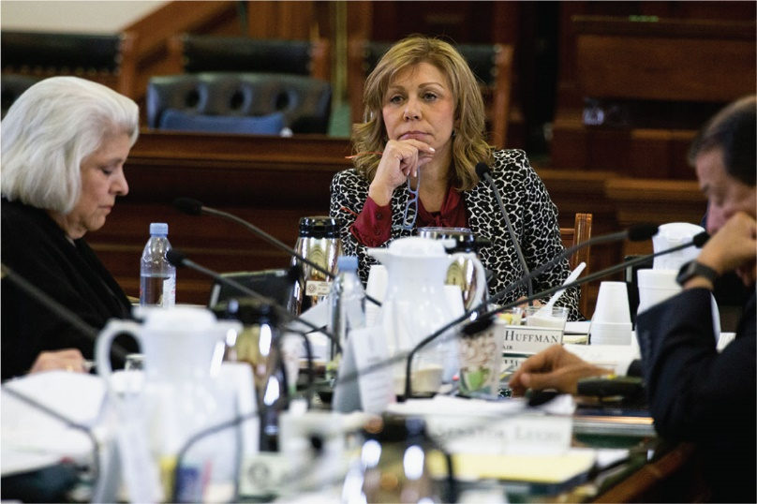
Senator Joan Huffman listens during a Senate State Affairs Committee hearing on legislation to raise the smoking age from 18 to 21. The bill passed out of the committee, was approved by the house and senate, and signed by the governor into law.

Slide 11
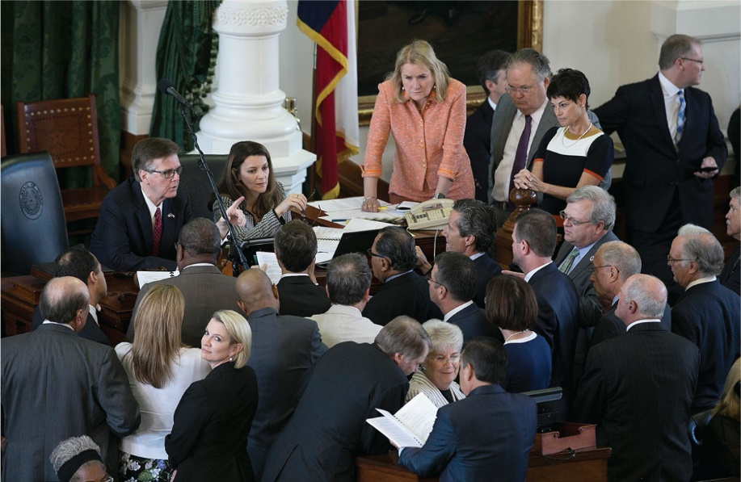
Lawmakers confer and jockey for attention to their issues, pressured by the calendar, their party, interest groups, and voters.

Slide 12
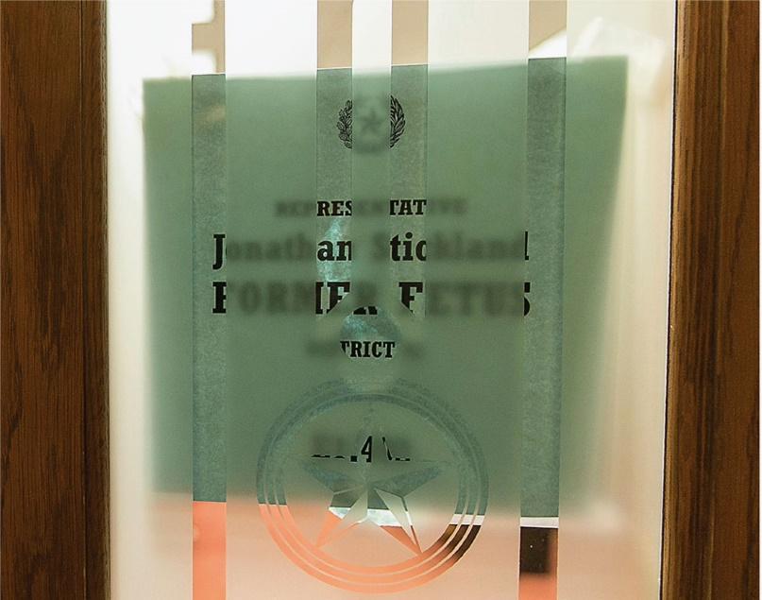
Republican Representative Jonathan Stickland changed the nameplate on his office door to “Representative Jonathan Stickland, FORMER FETUS, District 92, E1.402” to greet visitors on the day Planned Parenthood lobbied the Texas Capitol. The house’s chief rule-enforcer promptly removed the sign, saying the State Preservation Board prohibits such displays. Underlying the skirmish was the presence of a growing lack of civility among the members of the chamber.*

Slide 13
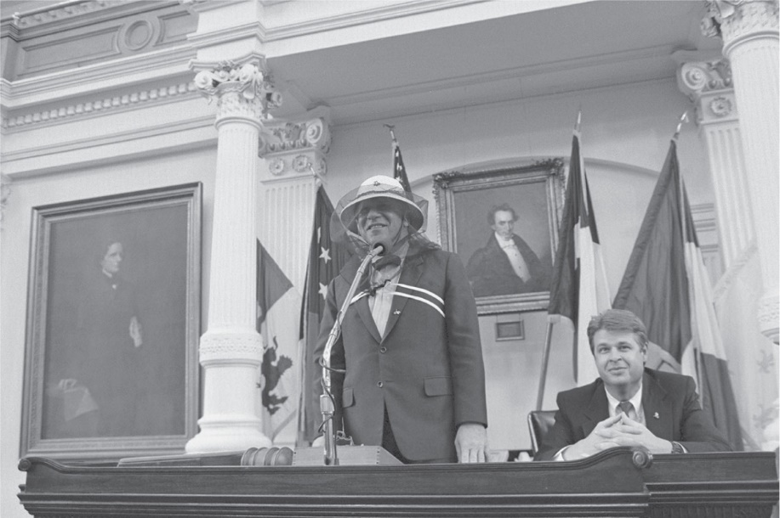
After the Killer Bees incident, the group reunited to celebrate their anniversary at Scholz Beer Garten in Austin. Lieutenant Governor Hobby sent the Texas Rangers to bring the group to a reception in the Capitol. Clad in a beekeeper’s hat, he jokingly greeted them from the dais.

Slide 14
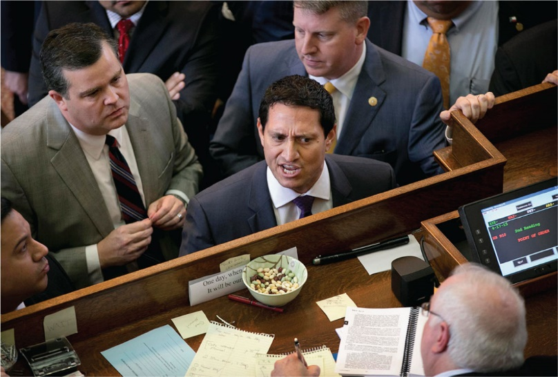
Trey Martinez Fischer, Democrat of San Antonio, made his name in part with his frequent use of the point of order (POO). Texas Monthly crowned him the “prince of POO” in 2013.

Slide 15
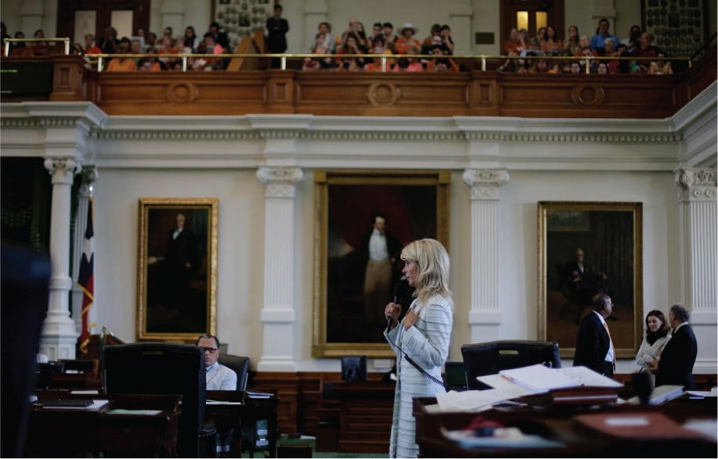
In one of the most noteworthy filibusters in Texas history, Democratic Senator Wendy Davis held the senate floor to delay a vote on a controversial abortion bill.

Slide 16
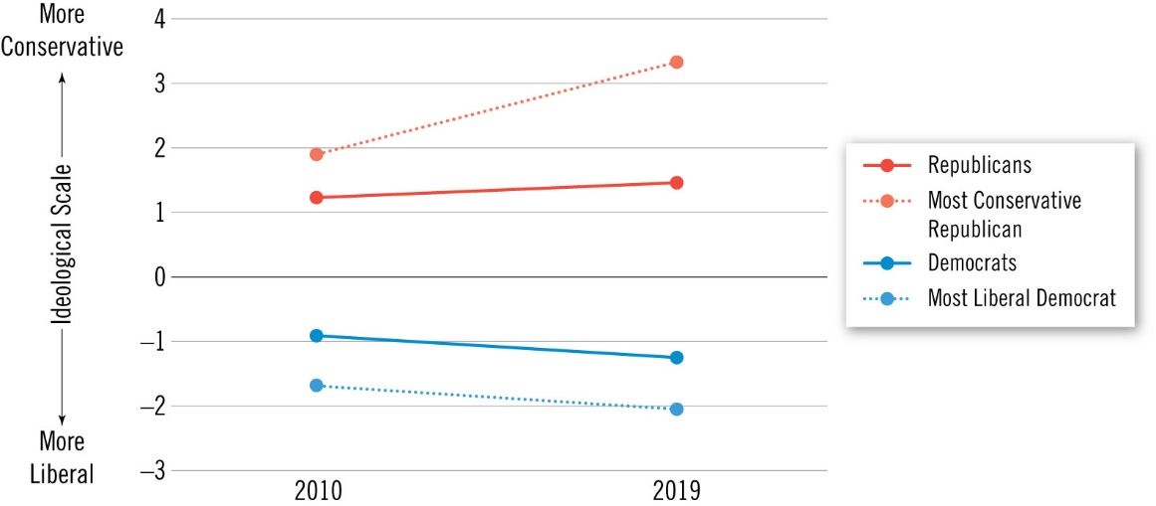
Figure 7.6 Increasing Polarization in the Texas Legislature

Slide 17
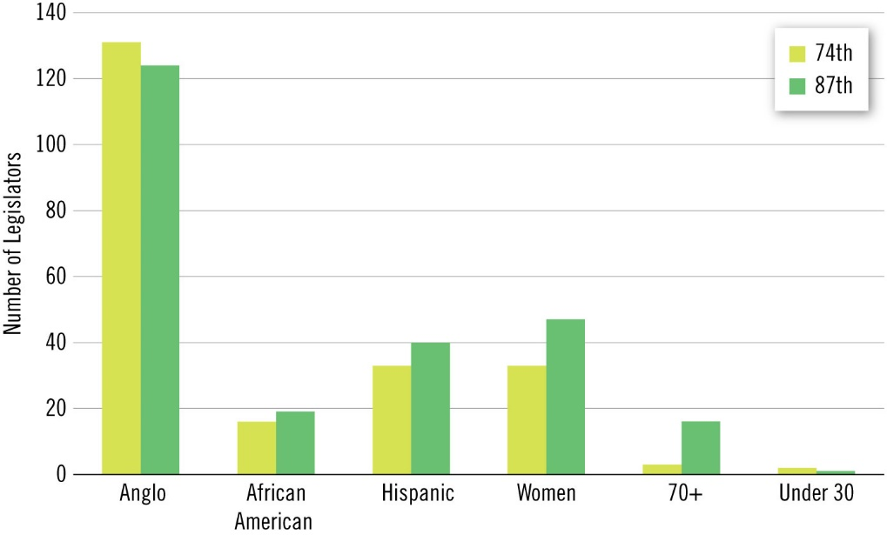
Figure 7.7 Demographics of the Texas Legislature, 74th to 87th Sessions

Slide 18
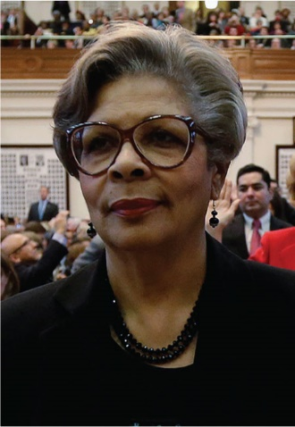
Senfronia Thompson, State Representative, Houston, Texas

Slide 19
Figure 7.8 Education Attainment among Texas Legislators and Texans

