Slide 1
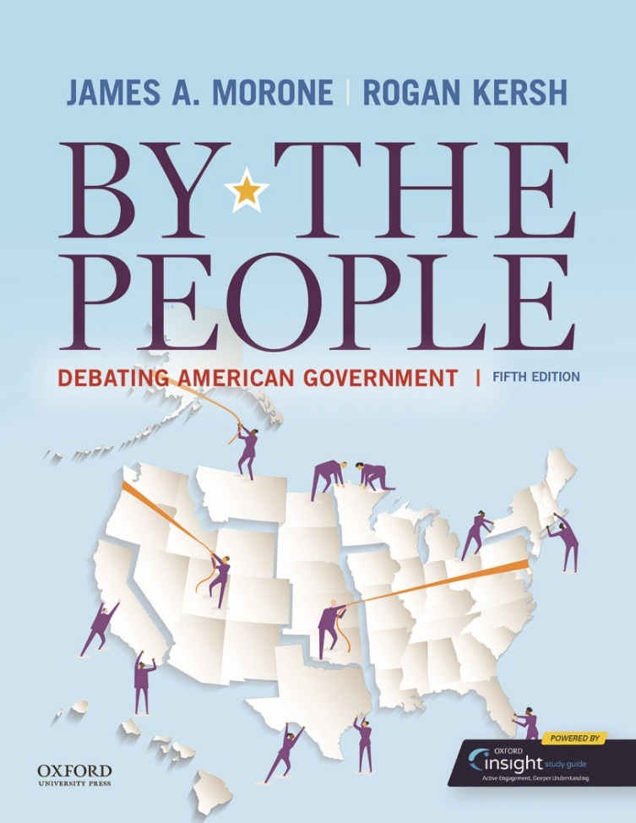
By The People Debating American Government by James A. Morone and Rogan Kersh

Slide 2
Part I Ideas and Rights Chapter 04 Federalism and Nationalism

Slide 3
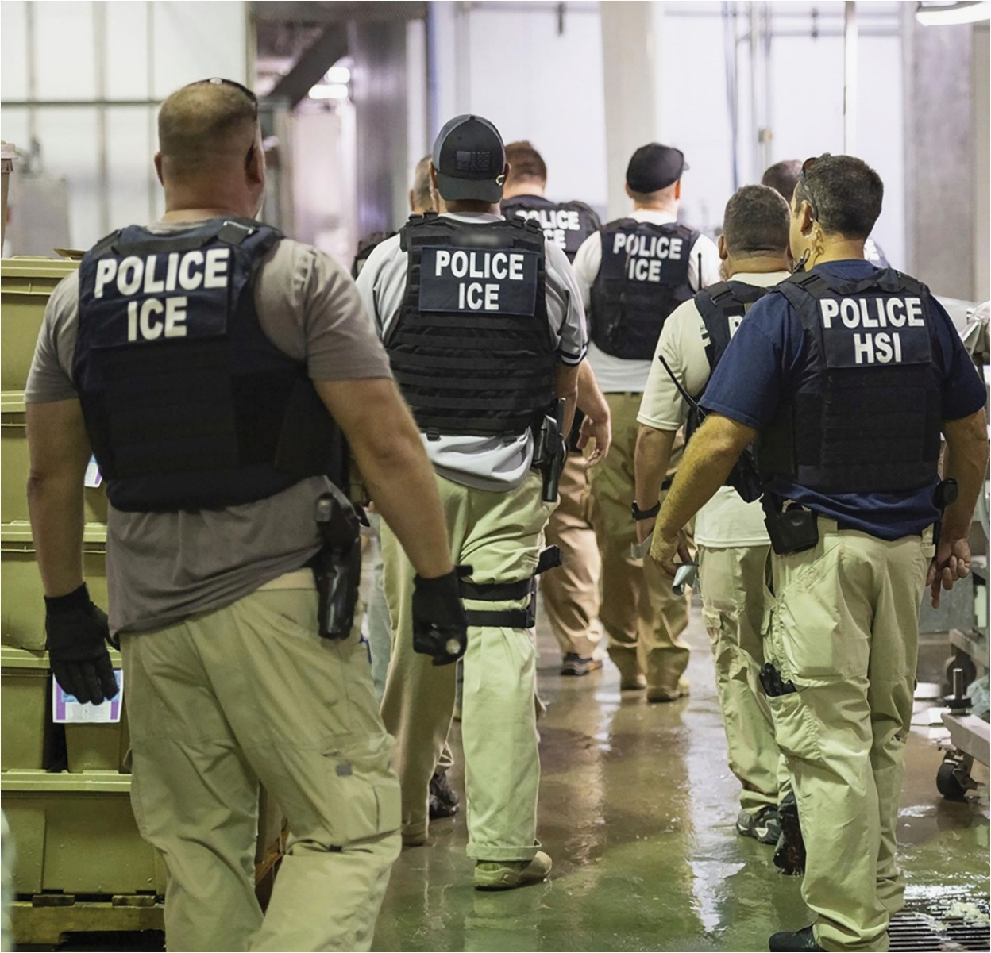
Agents from U.S. Immigration and Customs Enforcement conduct raids on people without documents. The federal force and local police sometimes operate under different orders; this represents federalism in action: Federal, state, and local authorities sometimes cooperate and sometimes clash.

Slide 4
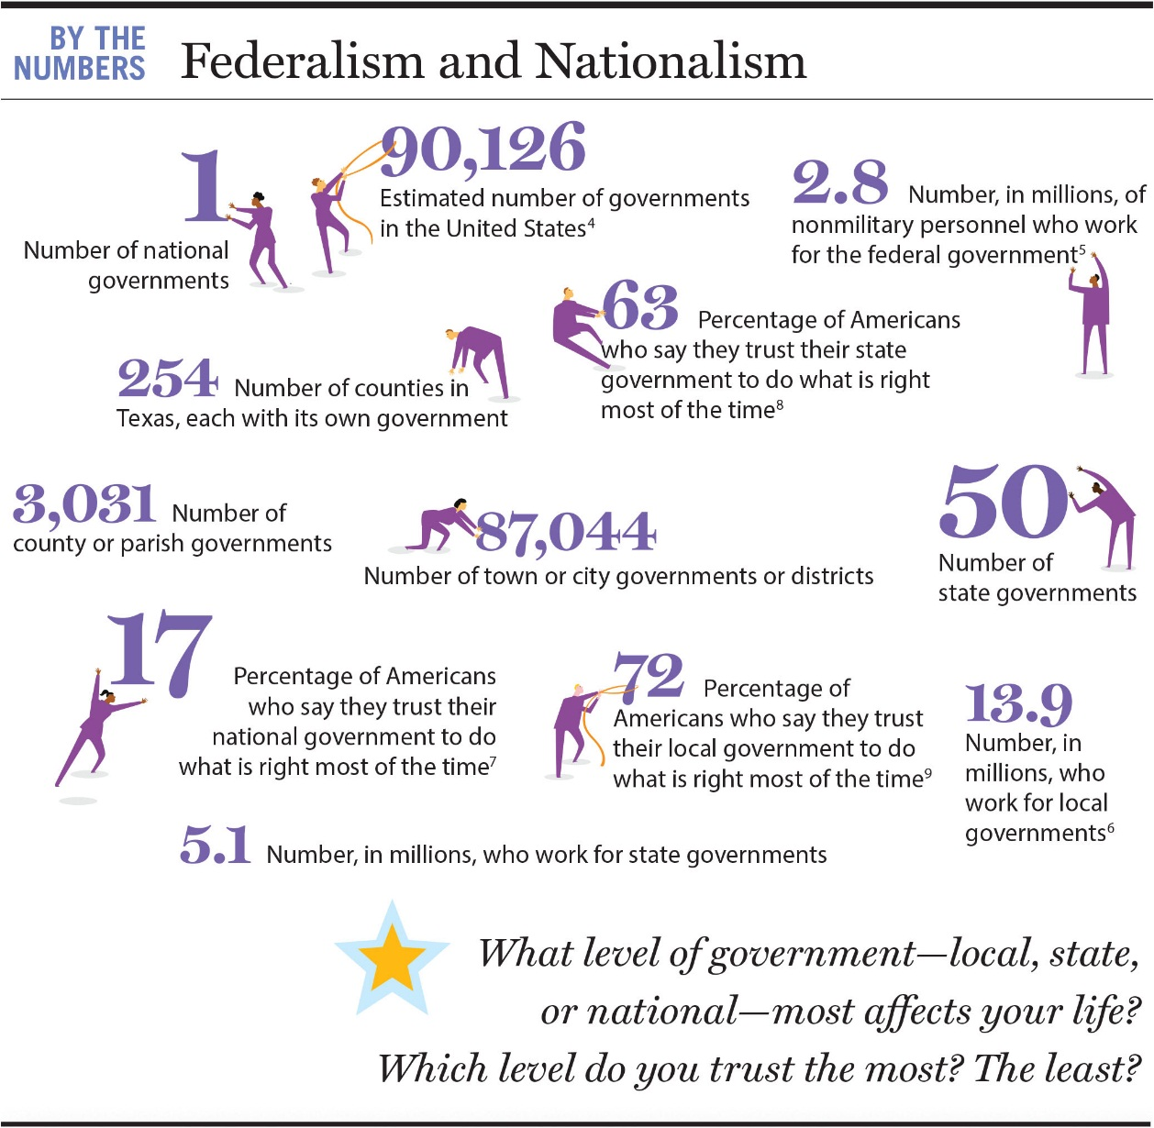
CHAPTER 4 BY THE NUMBERS

Slide 5
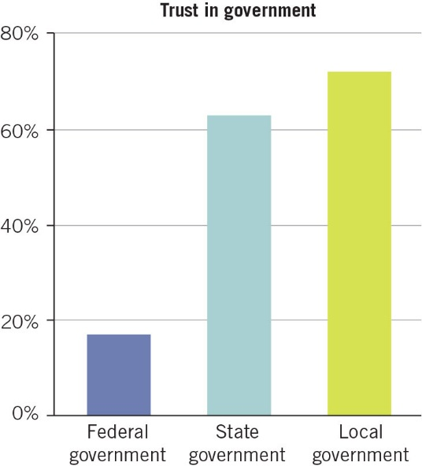
FIGURE 4.1 Trust in government gets stronger as government gets closer to the public. (Gallup)

Slide 6
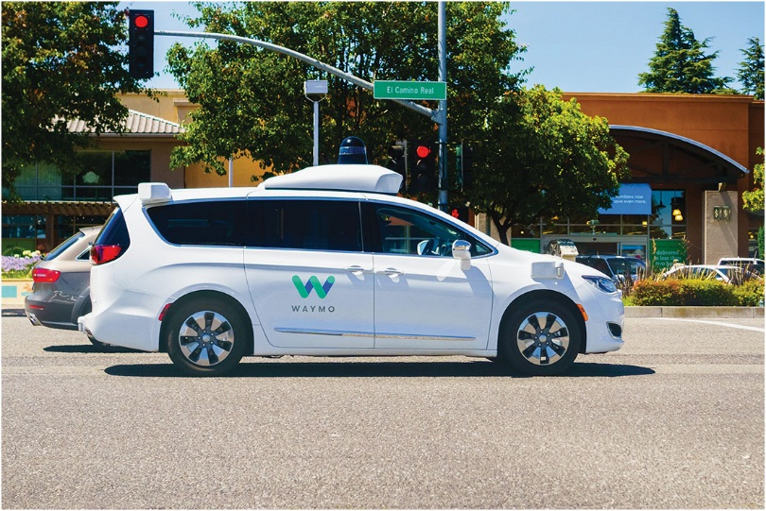
Congress debates whether and how to regulate self-driving cars. States were first to pass such regulations, which vary from strong (in California and Pennsylvania, for example) to weaker (Arizona). Now Washington, DC officials debate whether to adopt national standards.

Slide 7
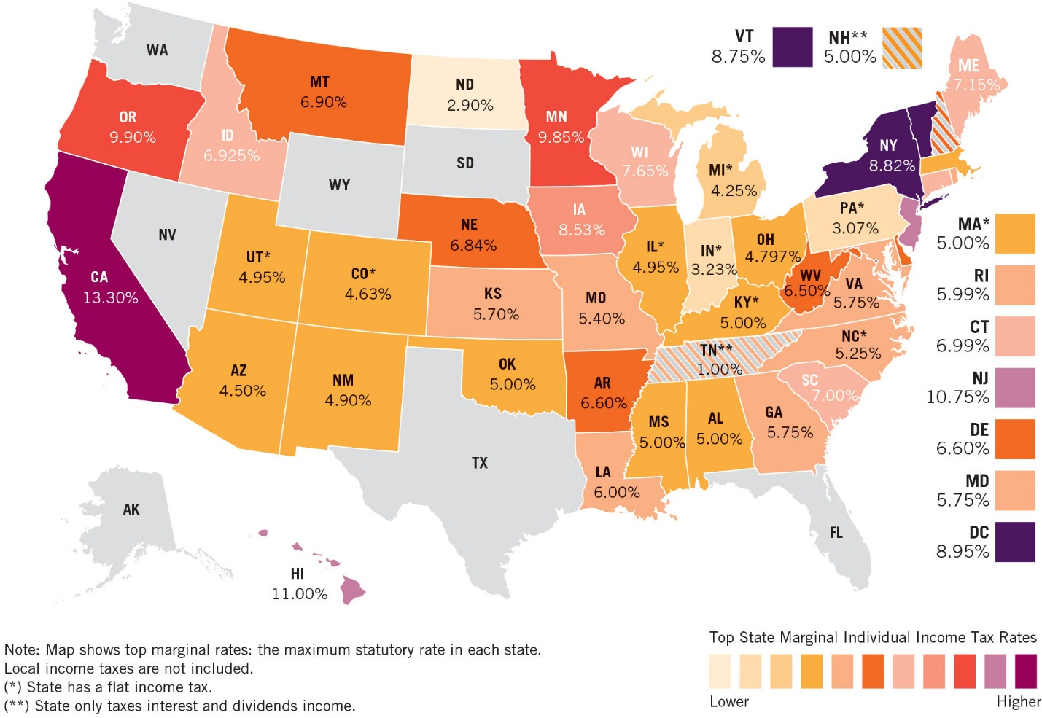
FIGURE 4.2 Individual income tax rates in each state. Note the vast differences: earn $100 in North Dakota, and state taxes peel off less than $3; in California, more than $13 goes to the state treasury. Seven states, colored gray on map, levy no income taxes; two others tax only dividends and interest income. Here’s the tough question: Can Americans really pick up and move to a state that reflects their own values? (Tax Foundation)

Slide 8
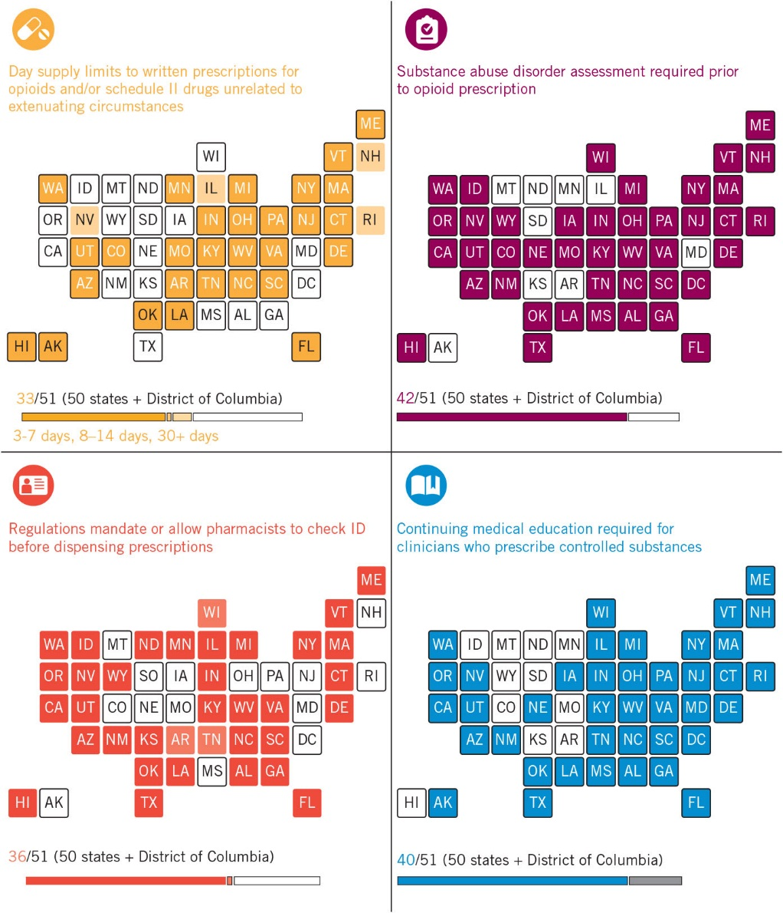
THINK ABOUT IT Connecticut, New York, and Massachusetts have low rates of opioid use. Which of the regulations have each of these states adopted? Based on this evidence, are the regulations successful? What can other states learn from these three states? What regulations does your own state have to fight the opioid epidemic? Do you believe they are excessive, sufficient, or not extensive enough? Do you think it would be better if the federal government mandated these policies?

Slide 9
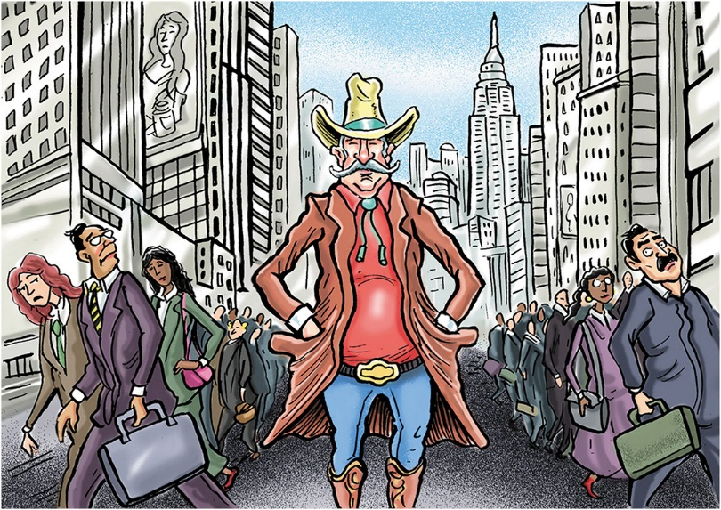
Federalism as a source of interstate conflict: should California or Massachusetts, with strong gun laws, be required to honor much more lenient gun-carrying rules, in nearby states like Arizona or Vermont?

Slide 10
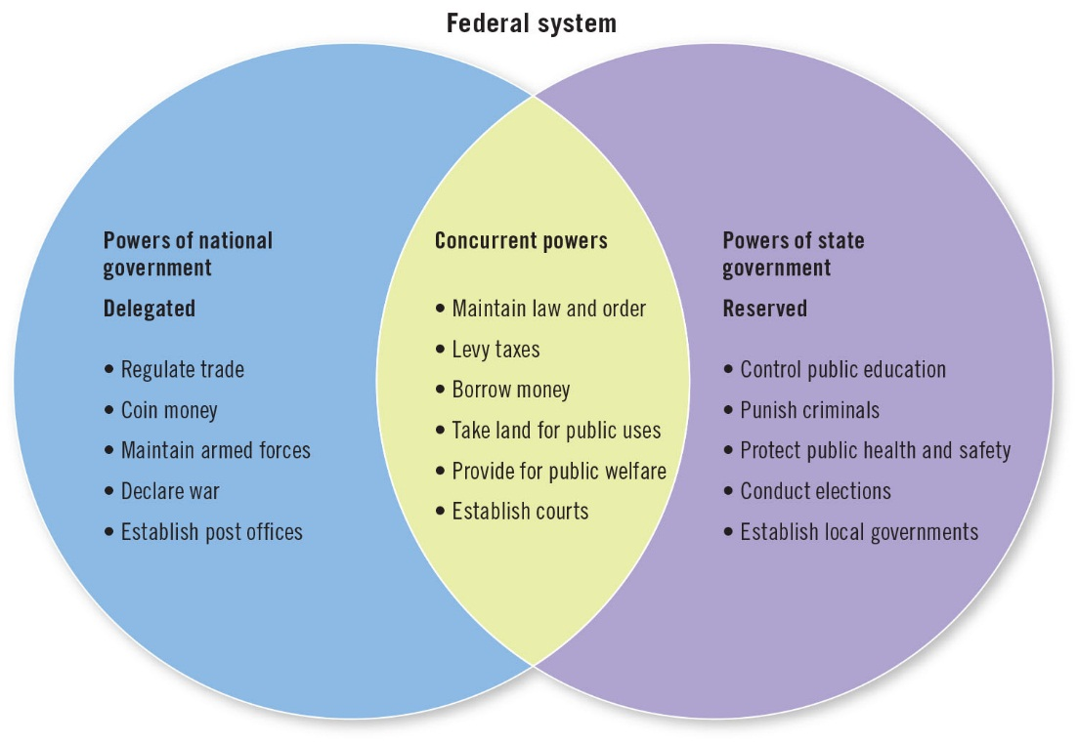
FIGURE 4.3 The Constitution delegates some powers to the federal government, reserves some to the states, and allocates some to both. Those joint (or concurrent powers) have stretched dramatically over the years.

Slide 11
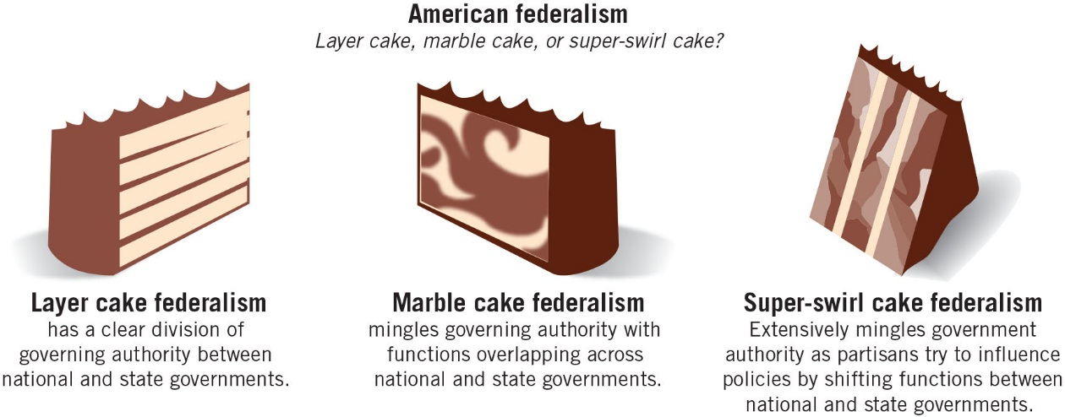
FIGURE 4.4 Different federalist styles throughout U.S. history.

Slide 12
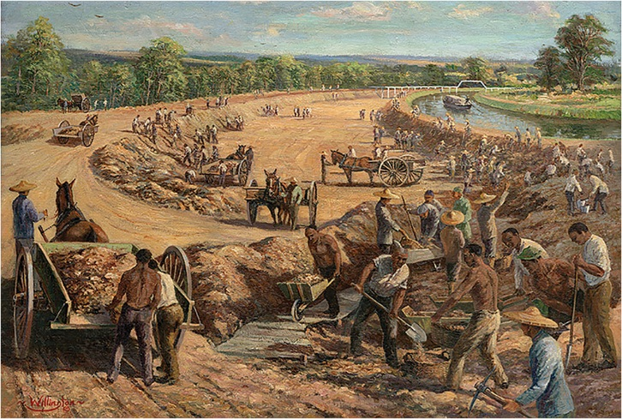
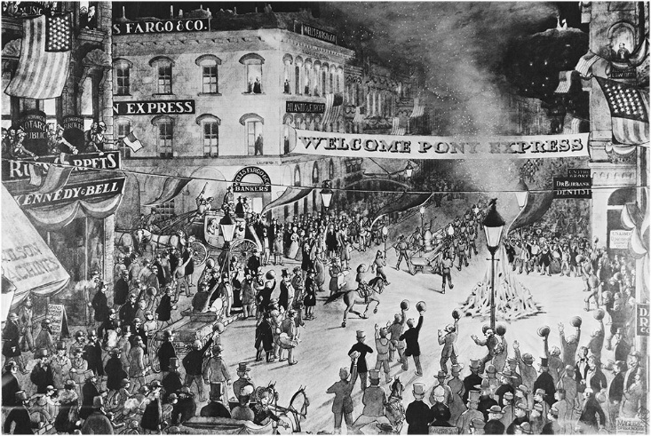
Constructing canals, bridges, roads—and later, railroads—was a major national government responsibility in the nineteenth century, as was delivering the mail, a task that briefly included the Pony Express (right).

Slide 13
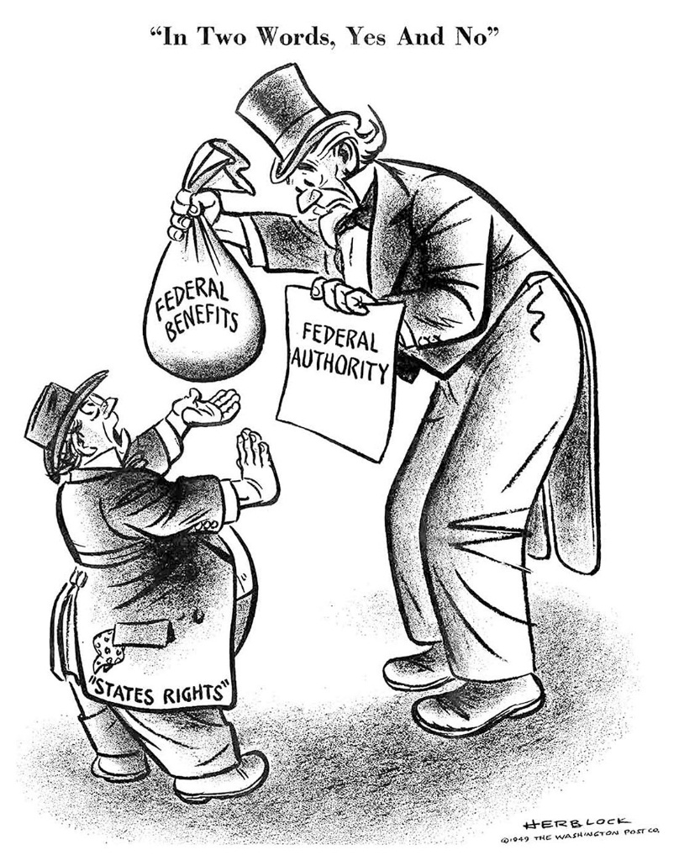
Cooperative federalism means a trade-off—captured in 1949 and still an issue, more than seventy years later.

Slide 14
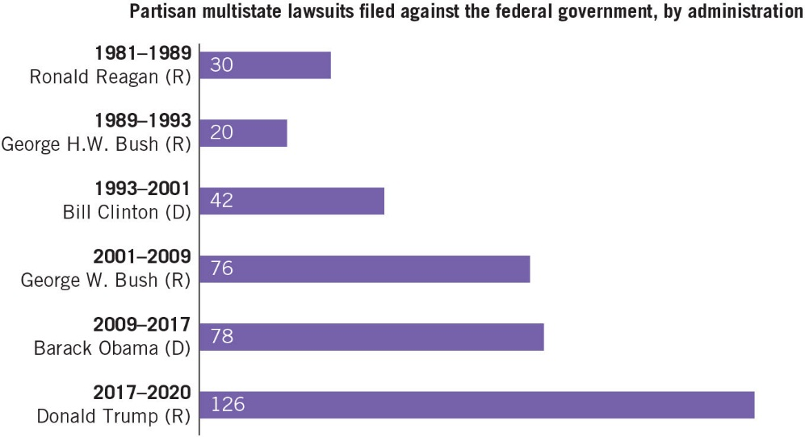
FIGURE 4.5 Multi-State Lawsuits Against the Federal Government, 1981–2020 Contested federalism in action: when multiple states team up to sue the federal government. Notice the big rise in such lawsuits after the 2000 election, the outcome of which was disputed for weeks after Election Day and helped fuel the partisan fires that characterize American politics in the twenty-first century.

Slide 15
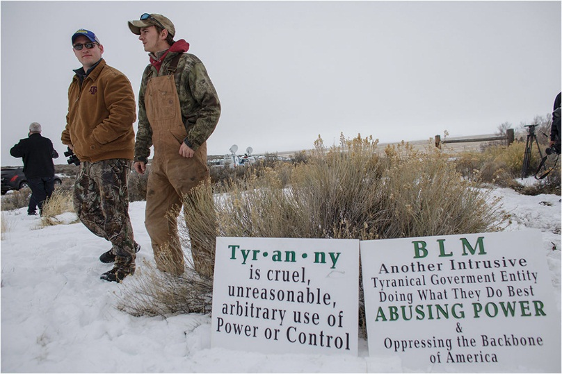
Members of an armed antigovernment militia monitor the entrance to the Malheur National Wildlife Refuge Headquarters near Burns, Oregon, in 2016. The occupation of a wildlife refuge by armed protesters in Oregon reflects a decades-old dispute over land rights in the United States, where local communities have increasingly sought more voice in the use of public land.

Slide 16
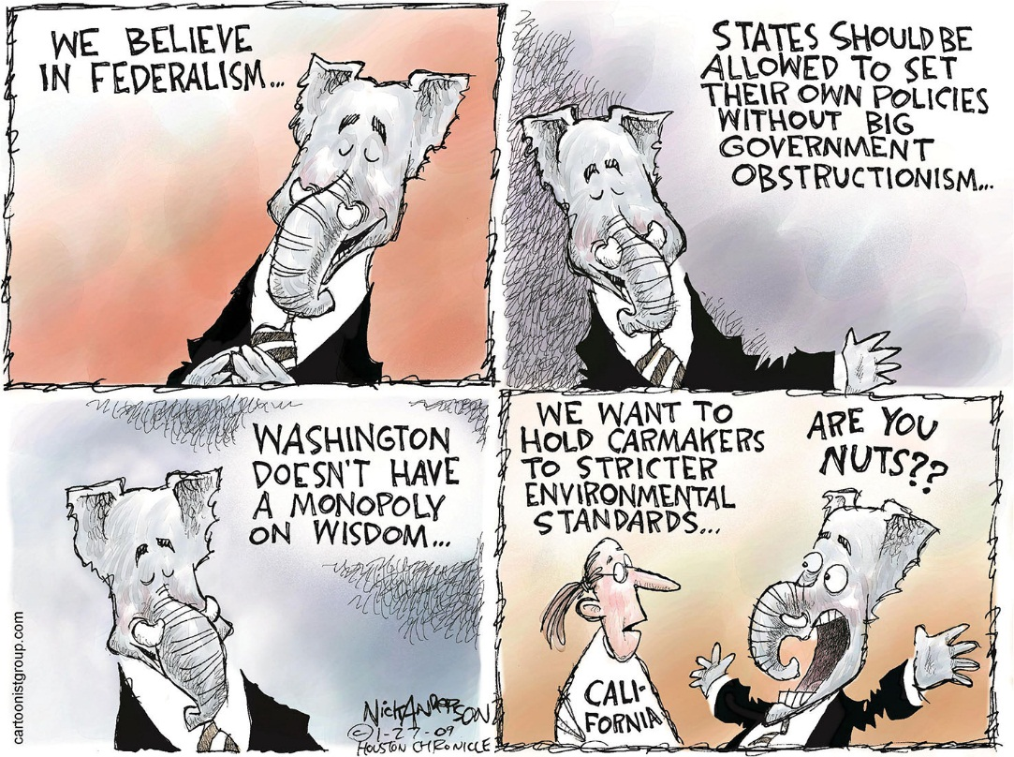
As this cartoon humorously shows, which level of our federalist government a politician supports generally depends on the issue in question. (Nick Anderson)

Slide 17
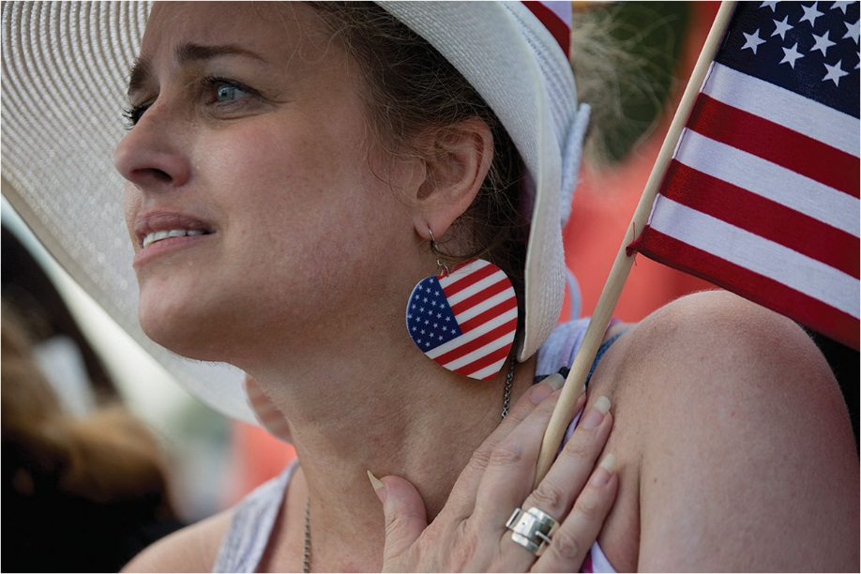
The Pledge of Allegiance still evokes strong nationalist sentiment among many Americans.

Slide 18
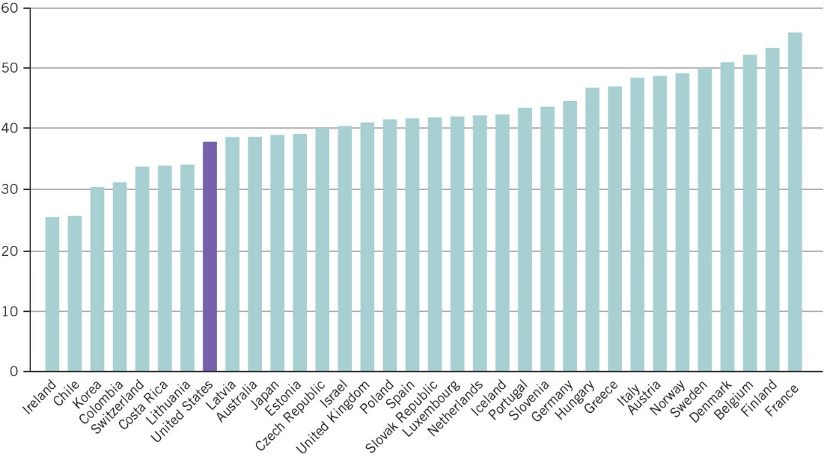
COMPARING NATIONS 4.1 Although U.S. levels of government spending are lower per capita, they have held steady for the past decade, while in much of Europe spending levels have fallen. (Organisation for Economic Co-operation and Development)

Slide 19
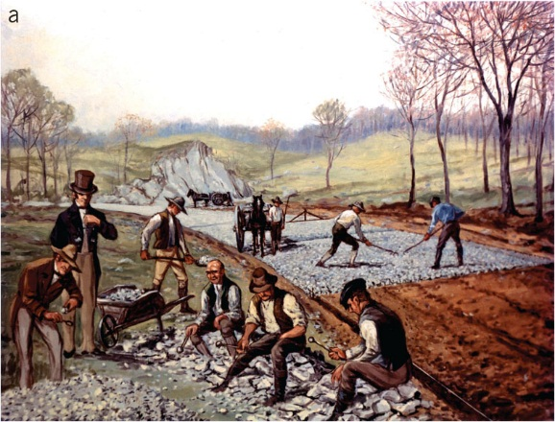
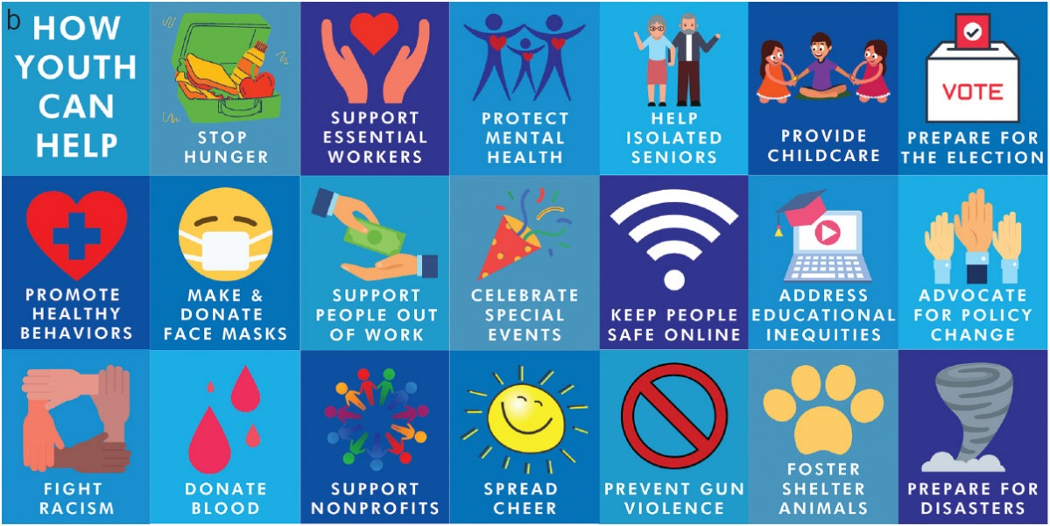
(a) Civic voluntarism in action—a source of wonder for nineteenth-century European visitors such as Tocqueville— and a key feature of American-style federalism and nationalism; (b) Youth Service America’s list of how young volunteers can help their communities during the COVID-19 pandemic.

