Slide 1
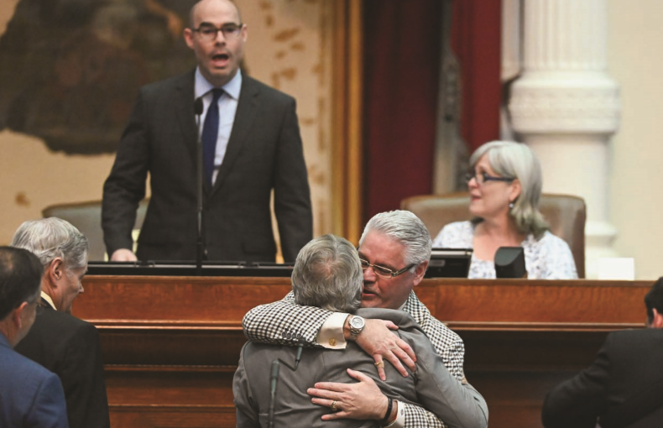
Chapter 7 – The Legislature
Notes:
The Texas legislature ended its 2019 session in uncharacteristic fashion — with the Governor, Lieutenant Governor, and House Speaker celebrating their successes with a picnic. Many times, however, the Texas legislative session does not end so happily, and has seen from its members over its long history menacing gestures, threats of violence, disrespectful rhetoric, ridicule, and actual fist-fighting. This chapter explores how the legislature is structured, what it is supposed to do, and how it works, with illustrative examples of what has happened there.
Chapter 7 Opener
Outgoing Speaker Dennis Bonnen attempts to get the attention of the chamber as Representative Dan Huberty bear hugs Senator Larry Taylor in celebration of passage of a massive education spending bill.
Source: Bob Daemmrich

Slide 2
Chapter 7: The Legislature
Learning Objectives
7.1 Identify the functions of the legislature and legislators.
7.2 Compare the strength of the Texas legislature to other state legislatures.
7.3 Describe the organizational structure and leadership of the legislature.
7.4 Outline the legislative process.
7.5 Assess how legislative tools are used to speed up or slow down legislation.
7.6 Explain how legislators represent their constituents demographically.

Slide 3
The Functions of the Legislature and Legislators (1 of 9)
The Texas Legislature
Texas legislature is a bicameral legislature
  two houses or chambers: the House of Representatives and the Senate
Montesquieu conceived of this division
  no one chamber dominated the other.
  minority would have a voice not shouted down by the majority
Notes:
The Texas Legislature (aka the “Lege”) is a bicameral legislature, with two chambers that are called the House of Representatives (w/ 150 seats) and the Senate (w/ 31 seats). It meets in the spring of odd-numbered years in the (pinkish colored) Texas Capitol in Austin.

Slide 4
The Functions of the Legislature and Legislators (2 of 9)
Powers of the Legislature
Chief responsibility: create and pass legislation
Laws
  establish and reinforce economic interactions
  resolve disputes between individuals or groups
  protect individual rights and liberties
Notes:
The legislature passes laws, conducts oversight over the executive branch, and has the power to impeach. There are general laws, local laws, special laws; joint resolutions, concurrent resolutions, and simple resolutions. Oversight is conducted primarily through committee hearings focusing on various executive agencies and actions. Impeachment, as at the federal level, starts in the House, and the Senate holds the trial to determine removal.

Slide 5
The Functions of the Legislature and Legislators (3 of 9)
Powers of the Legislature
General law: law where the bill potentially affects all Texans
Local law: law that only affect units of government at the local level
Special law: law that exempts businesses or individuals from state laws

Slide 6
The Functions of the Legislature and Legislators (4 of 9)
Resolutions
Legislation that conveys the will of the chamber
Joint Resolution
  Propose amendments
Concurrent Resolution
  Passed separately but at the same time by both chambers
  Give directions to state agencies on procedural issues
Simple Resolution
  Passed by single chamber
  Rules of procedure
  Congratulations or condolences

Slide 7
The Functions of the Legislature and Legislators (5 of 9)
Texas House of Representatives
More representative
More responsive
More accountable to popular will
150 members, two year terms
Members: 21 years of age, Texas citizen for two years, resident of district for one year
Notes:
Both chambers have the same general function, but they differ in the fact that the House is designed to respond to the will of the people, while the Senate should be more deliberative. The House has 150 members that are elected to two-year terms and that are all at least 21 years old, Texas residents for two years, residents of their district for one year.

Slide 8
The Functions of the Legislature and Legislators (6 of 9)
Texas Senate
More deliberative
31 members, four year terms
  Half of the membership elected every two years
Members: 26 years of age, Texas citizen for five years, resident of district for one year
Notes:
The Senate has 31 members elected to four-year terms (half every two years), all at least 26 years old, residents of Texas 5 years and their district 1 year. The Senate has a unique relationship with the executive branch that the House lacks, confirming various appointments by the governor.

Slide 9
The Functions of the Legislature and Legislators (7 of 9)
Responsibilities
House has responsibilities belonging to the people
Senate vehicle for protecting minority interests against the majority
Revenue bills originate in the house
House and Senate alternate originating budget bill
Senate confirms governor’s appointments

Slide 10
The Functions of the Legislature and Legislators (8 of 9)
Casework
Legislators and staff assist constituents in their districts with specific requests
Outside the legislature
Act as facilitators or advocates
Notes:
All legislators do casework, take positions on issues and claim credit on various matters.

Slide 11
The Functions of the Legislature and Legislators (9 of 9)
Position Taking
Proclaiming where they stand on certain issues
Trustee: a legislator who votes in accordance with their interpretation of what his or her district would want
Delegate: a legislator who is simply a mouthpiece for the wishes of his or her constituency
Credit claiming: point out positive things done in office
Notes:
Some act as trustees, voting their conscience on legislation, while others act as delegates, simply relaying their constituents’ preferences.

Slide 12
The Texas Legislature in Context (1 of 9)
Weak Legislature
Political scientists classify legislatures as “strong” or “weak”
“Strong” legislatures: full-time, professional, well-paid legislators, year-round or annual sessions, plentiful legislative staff, and competitive elections.
Texas has a “weak” legislature—due to the length of its sessions, salary, staff, and boards that facilitate the legislative process
Notes:
State legislatures are designated as either weak or strong, based on the resources they have. By almost every measure the Texas Legislature is weak.

Slide 13
The Texas Legislature in Context (2 of 9)
The Legislative Session
The Texas legislature meets biennially (every two years)
Regular session: legislative session meeting for 140 days in January of odd-numbered years
Special session: legislative session that can be called by the governor on any issue the governor decides requires attention
  Limited to 30 days
Notes:
State legislatures are designated as either weak or strong, based on the resources they have. By almost every measure the Texas Legislature is weak. The weakest aspect is perhaps that the Texas Legislature meets biennially, every odd numbered year, starting in January and lasting for 140 days. Sine Die brings the sessions to an end as the meeting is adjourned. Only three other states do not meet annually. In addition, the governor may call a special session that can last up to 30 days. The governor gets to set the agenda for special sessions.

Slide 14
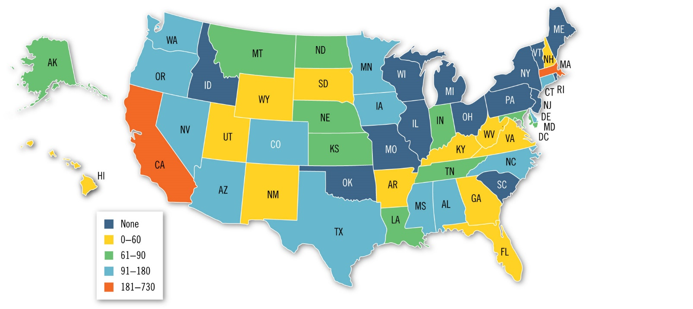
The Texas Legislature in Context (3 of 9)
Notes:
Figure 7.3 Length of Legislative Session
Source: National Council of State Legislatures. Number indicates the maximum number of legislative days or, if the session had different lengths for different years, the longer of the two session dates. “None” signals that the chamber decides how long the session lasts.

Slide 15
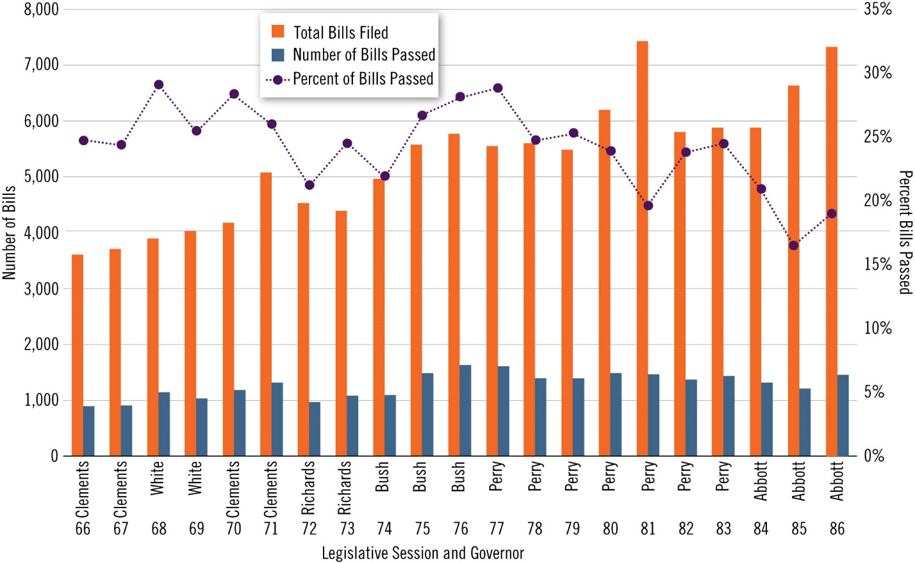
The Texas Legislature in Context (4 of 9)
Notes:
Figure 7.2 Bills Passed by Session
Source: Data taken from Legislative Reference Library. Bars represent total bills filed and passed by the Texas House and Senate. Line represents percentage passed of those filed.

Slide 16
The Texas Legislature in Context (5 of 9)
Legislative Staff
Staff salary budgets low
Use campaign funds to supplement
Creates opening for organized interest groups
Legislative Boards and Councils
Legislative power to boards and councils
Legislative Budget Board
Legislative Council
Notes:
Legislative staff salary budget is low. Legislative Boards and Councils are needed to help the part time legislature complete its essential functions on time. For example, the Legislative Budget Board consists of the Lt. Governor, the Speaker of the House, and four members from each chamber. The LBB creates the initial budget that is submitted to the legislature.

Slide 17
The Texas Legislature in Context (6 of 9)
Salaries
Legislators’ annual salary at $7,200—the lowest set legislative salary in the nation.
$190 per diem for meals and travel
Lawmaking in Texas is not designed to be a full-time occupation
  Lawmakers have other jobs
Notes:
The $7,200 annual salary of Texas state legislators is the lowest of any state in the US. Members are marginally helped by the fact that they are paid a per diem of $190 every day that the legislature is in session. This works out to $26,600 across the entire regular session.

Slide 18
The Texas Legislature in Context (7 of 9)
Incumbency and Turnover
Incumbent: an individual who currently holds a public office
Turnover: when incumbents lose their seats or leave their seats and new members (freshmen) are voted into office
Institutional memory: a collective understanding of the way an organization works held by those who run it
Notes:
Because of the small salaries members are paid, the Texas Legislature must deal with a relatively high level of turnover. With so many members leaving, it can leave the legislature with a lack of institutional memory.

Slide 19
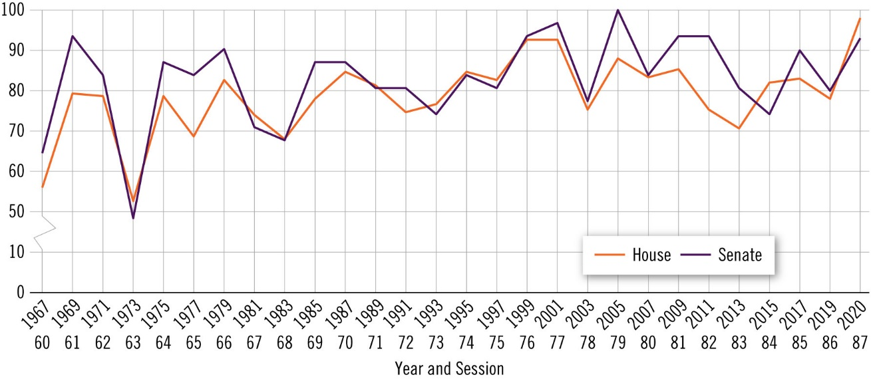
The Texas Legislature in Context (8 of 9)
Notes:
Figure 7.4 Incumbents’ Reelection Rate
Source: Texas Legislature Online. Includes only races where an incumbent ran for reelection.

Slide 20
The Texas Legislature in Context (9 of 9)
Consequences of the Texas Legislative Structure
Hinder representation
Hinder public policy development
Less contact with constituents
Less attentive to constituents
More influenced by party leadership
More influenced by governor
Less willing to take on government reforms
Less willing to enact complex, innovative policies
Notes:
. Research indicates several negative consequences of having a part-time legislature. Legislators are in less contact with their constituency and more apt to follow party leadership. In addition, part-time legislatures are less likely to tackle complex and difficult government reform.

Slide 21
How the Legislature Is Organized (1 of 4)
The Committee System
Committee: a small group of legislators who investigate, craft, assess, and take action on legislation before it is considered by the whole chamber
Standing Committees: permanent committees that deal with a specific issue or topic
Select Committee: a committee that is temporary and has a fixed issue to investigate or legislation to consider
Notes:
Committees provide a division of labor in the legislature and are responsible for most of the legislative tasks. All members serve on one or more committees, and membership on committees is determined by seniority, expertise, and politics. There are permanent standing committees (such as those assigned to the budget) and temporary select committees. For example, in 2017, there was a select Opioid and Substance Abuse Committee.

Slide 22
How the Legislature Is Organized (2 of 4)
The Speaker of the House
Presiding officer in the Texas House: the most influential member of the chamber
Elected by a simple majority of the house
Resolves all questions of process and procedure within the House
Assigns committees not determined by seniority
  Can be used to reward or punish
Notes:
The Speaker is the presiding officer of the House and its most influential member. The Speaker is chosen by a majority vote of all House members at the beginning of each legislative session. The Speaker selects chairs for committees and assign members to half of the seats on most committees (seniority determines the other half). Committee assignments can be an effective way to reward loyalists and punish opponents.

Slide 23
How the Legislature Is Organized (3 of 4)
The Speaker of the House
Controls the Calendar Committee that determines the order of bills
Recognizes house members allowing them to speak during bill discussion
Lengthen discussion or end debate on bills

Slide 24
How the Legislature Is Organized (4 of 4)
The Lieutenant Governor
One of the most powerful elected officials in state government
Presiding officer of the Senate
The lieutenant governor only casts a vote in the case of a tie
Appoint senators to committees and as committee chairs
Assigns legislation to specific committees, influence the chances of a bill becoming law
Notes:
The lieutenant governor is one of the most powerful politicians in the state. Even though he is not a member of the Senate (only voting to break ties) the lieutenant governor is that chamber’s presiding officer and is referred to as the President of the Senate. He appoints the 2/3 of committee seats that are not affected by seniority and assigns bills to committees.

Slide 25
The Legislative Process (1 of 6)
How a Bill Becomes a Law
In Committee: For a bill to become law in Texas, each chamber has to hear it three times. These are referred to as the three readings.
First Reading: legislation considered at the committee stage
Amend: the process of bill
Markup: where legislators add, subtract, or replace part of the original legislation so that it meets the preferences of the committee
Notes:
The process of creating laws in Texas is patterned after the federal process, but the short regular session in Texas makes the process even more difficult. Bills must make their way through committee and to the chamber floor for debate and final vote in order to get to the governor for signature. The process involves three readings of the bill.

Slide 26
The Legislative Process (2 of 6)
How a Bill Becomes a Law
On the Floor: In the second reading—the floor stage— the full chamber debates the measure and amends it as desired (with a simple majority backing).
Second Reading: legislation considered at the floor stage
Members publicly debate legislation
Third Reading: final stage, voting stage

Slide 27
The Legislative Process (3 of 6)
House and Senate Agreement
Both chambers have to agree on legislation for it to arrive at the governor’s desk
Disagreements about specific aspects of legislation can be resolved in committee
Can substitute a senate bill with a house bill or vice versa
Bill can go to conference committee made up of lawmakers from both chambers
Notes:
A bill must pass both chambers in order to become law. The House and Senate versions must be identical or the bill cannot go to the governor. This is sometimes accomplished by replacing one chamber’s version of the bill with the opposite chamber’s version. Or, instead, a compromise bill can come out of the conference committee, which is made up of five members from each chamber. If a single bill is generated it is sent back to both chambers to be voted on without changes. It is then sent to the governor.

Slide 28
The Legislative Process (4 of 6)
In Conference Committee
Five members from each chamber
Two of Senate members must be from original bill committee
Limited to points of disagreement
Committee report summarizes changes
If not agreement reached bill returns to originating chamber
If agreement reached sent to governor for signature

Slide 29
The Legislative Process (5 of 6)
The Real Enemy: The Calendar
Rules allow for bills to be “pre-filed” from Monday following general election to first 60 days of regular session
After first 60 days only local bills, emergencies or matters submitted by governor filed
Committee on Local and Consent Calendars and Calendars Committee make schedule
  set priorities
Due to limited time any delay can kill a bill
Notes:
In the House, the order that bills are debated is set by the Local and Consent Calendar Committee and the Regular Calendar Committee. In the Senate, the secretary of the Senate usually establishes the order based on Senate rules. Overall, many “rules rule” both chambers.

Slide 30
The Legislative Process (6 of 6)
Rules Rule the Chambers
Formal and informal rules govern both chambers
Deadlines
  Bills clear committees
  Passed by full house and senate
  Cleaned up

Slide 31
Working Together (1 of 5)
Each chamber has unique rules and traditions
The process is designed slow
  Ensure careful consideration of laws passed
  Restricts number of bills passed
Logrolling: trading favors, votes, or influence for legislative actions
Notes:
The Texas legislative system is designed to move slowly, so many legislators engage in tit-for-tat negotiations called logrolling to move things along. Of course, things can work in the opposite direction, as legislators try to slow down their opponents.

Slide 32
Working Together (2 of 5)
Slowing it Down
“Taking a Walk”: legislator leaves chamber so not enough present to bring up a bill
Point of Order: technical objection to an error in a bill
Stuffing the Box: debate noncontroversial bills to use up time
Talk it to Death: talk about bill for ten minutes to stall vote
Party of Five: five house representatives oppose bill, bill dies
Filibuster: when a senator holds the floor and restrains the chamber from moving forward on legislation
Chubbing: generic term for delay
Tagging: informally putting a bill on hold for twenty-four hours

Slide 33
Working Together (3 of 5)
Speeding It Up
Suspending Twenty-Four Hour Waiting Period
Discharge Petition
Suspending Normal Business

Slide 34
Working Together (4 of 5)
Increasing Partisanship
Obstacle to cooperation
Gap between liberals and conservatives defines politics
Political polarization: voters’ opinions on policy and political matters become more strictly defined by their identification with a political party
Notes:
Political Polarization has been increasing over the past several decades. Ideology used to cross cut partisanship, but now it reinforces it. For many years in the House, the majority party would run over the minority party, but there would be bi-partisanship in the Senate. Recently the Senate has become more like the House.

Slide 35
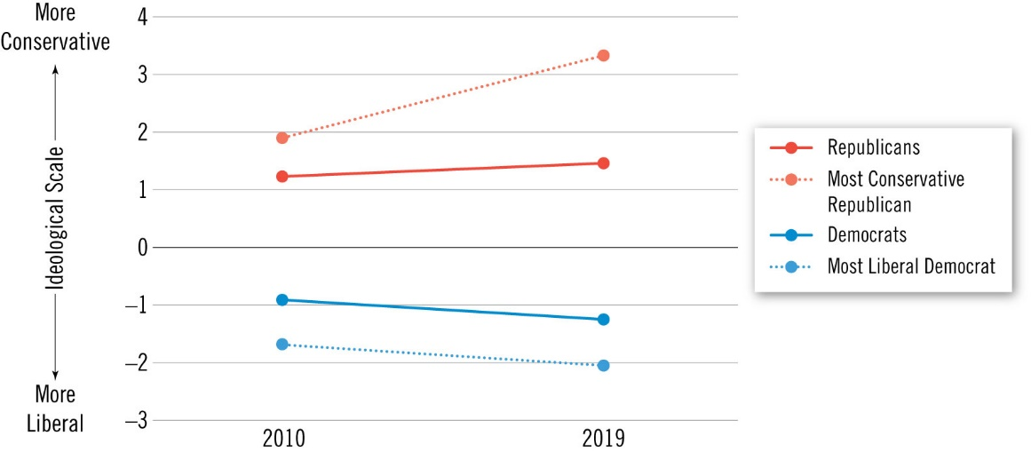
Working Together (5 of 5)
Notes:
Figure 7.6 Increasing Polarization in the Texas Legislature
Source: State Ideologies Project, Boris Shor. Positive numbers designate conservative ideologies for median voter; negative numbers designate more liberal ideologies for median voter.

Slide 36
Demographic Representation
Women Legislators
African Americans
Hispanics
Race, Religion and Other Factors
  Diverse occupations and backgrounds
  Highly educated
    Bachelors degree or higher
    Most alumni of the University of Texas
  Christian
Notes:
The capitol has become more diverse, which has led to more policy that addresses the needs of the minority community. Still there are groups that are over-represented and groups that are under-represented in the Texas Legislature. Most members of the Texas Legislature have a college degree, which sets them apart from the majority of Texans. In contrast, most legislators do reflect the state in terms of their Christian religion.
The number of female legislators has increased, but is still low. Prior to the 1960’s it was not uncommon for male members to hold male-only meetings. Things have improved in recent times, but some members still face sexism. In terms of racial and ethnic minorities, prior to the Civil Rights Era, districts were drawn to purposely split up African-American and Hispanic communities to ensure that they were not elected to the legislature. After the passage of the Voting Rights Act things changed. In 1966 Curtis Graves became the first African-American elected to the Texas House since Reconstruction. In 1971, there was only 10 Hispanics in the Texas House, but by 1999 Texas led all states in Latino representation.

