Slide 1
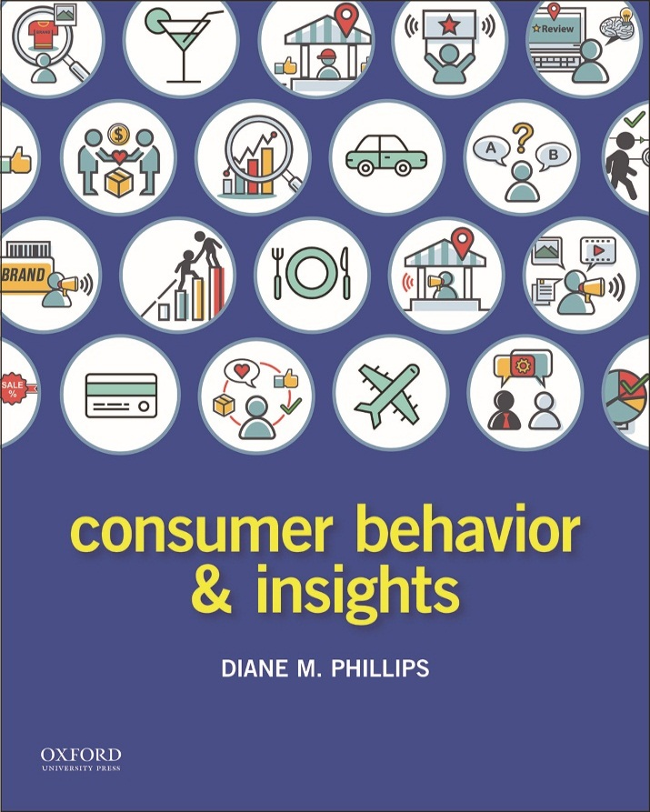
Consumer Behavior & Insights by Diane M. Phillips

Slide 2
Part I Establishing A Framework Chapter 3 Consumer Research

Slide 3
Chapter 3 Opener

Slide 4
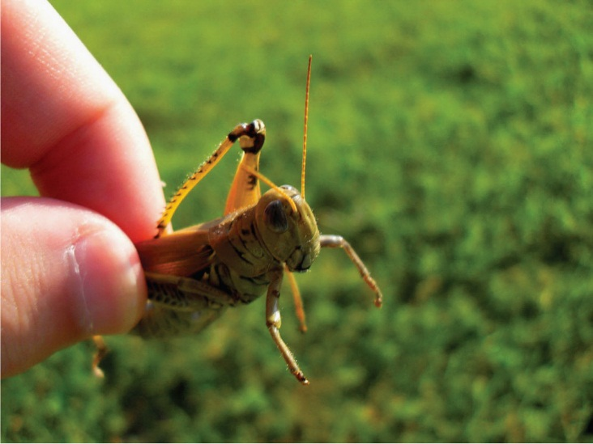
Photo 3.1 Dinner anyone?

Slide 5
Figure 3.1 The consumer research process

Slide 6
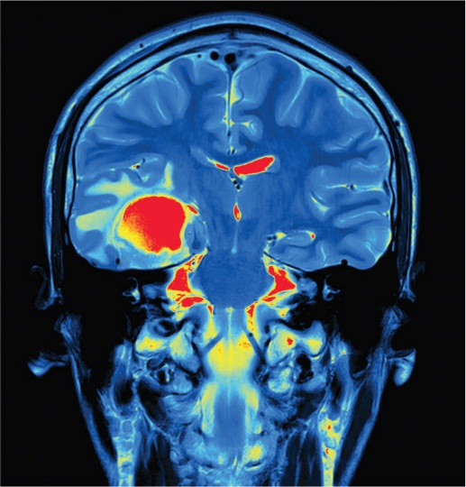
Photo 3.2 A functional magnetic resonance image of a brain

Slide 7
Photo 3.3 The Bark & Co. people are crazy dog people

Slide 8
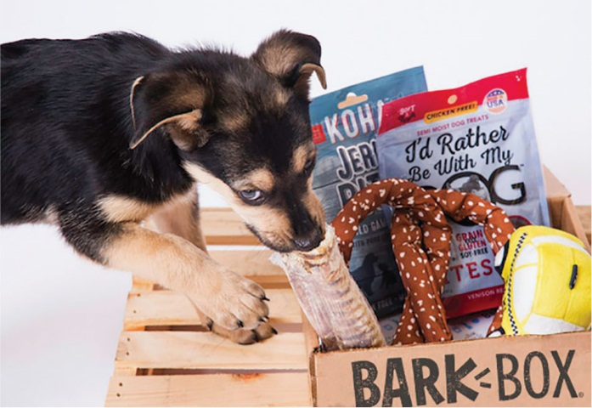
Photo 3.4 Happy BarkBox consumer

Slide 9
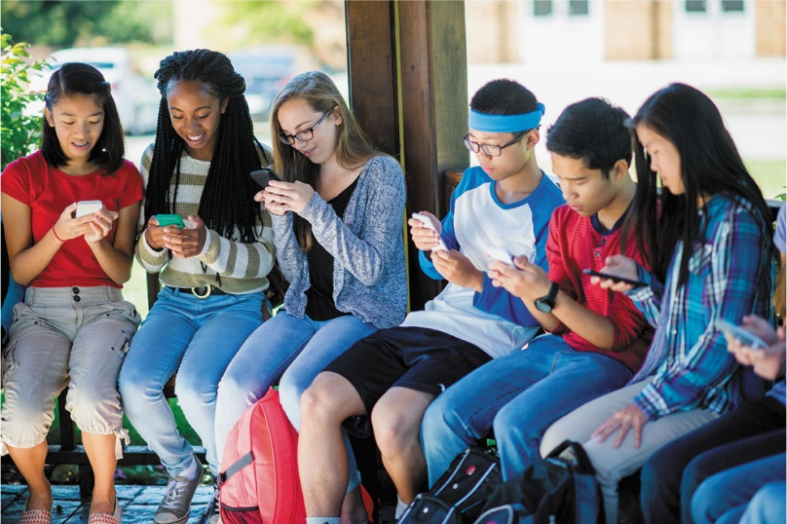
Photo 3.5 School kids texting before class

Slide 10
Photo 3.6 Researchers want to make sure that their research sample is representative of the target audience

Slide 11
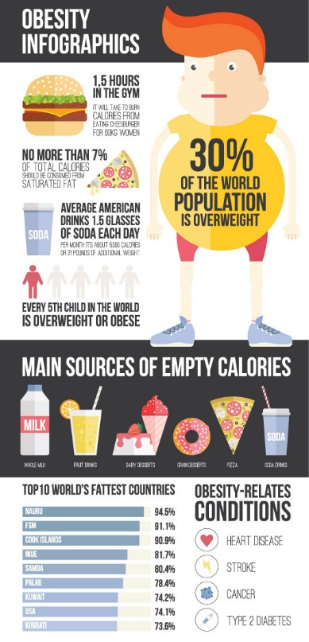
Photo 3.7 Data Visualization of the Global Obesity Epidemic

Slide 12
Joan Hoenninger

Slide 13
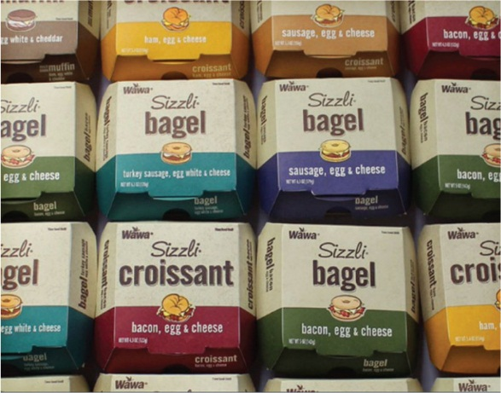
Photo 3.8 Wawa’s updated Sizzli® packaging

Slide 14
Wawa logo

Slide 15
Photo 3.9 Data are collected from scanners every time you buy something at the store

Slide 16
Figure 3.2 The Behavioral Research Perspective and Methods

Slide 17
Figure 3.3 The Cognitive Research Method and Perspectives

Slide 18
Photo 3.10 Consumer researcher conducting a focus group

Slide 19
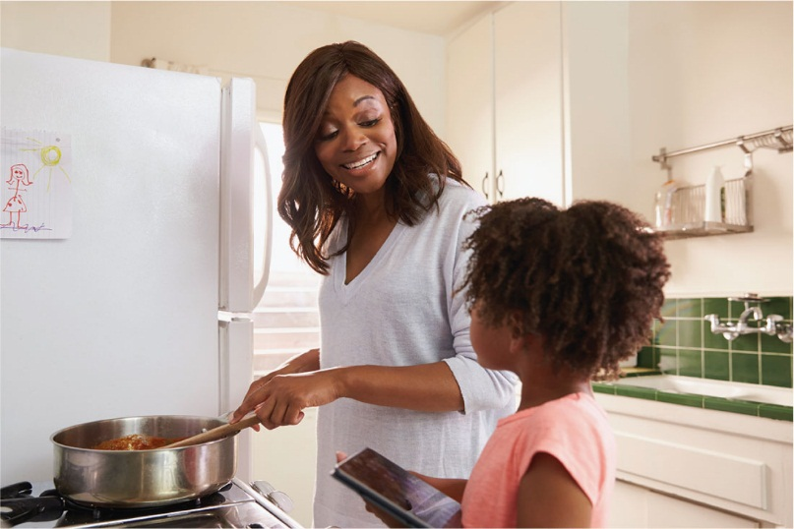
Photo 3.11 Ethnographic studies could involve a researcher coming into the home of a family and learning what they do as they prepare meals together

Slide 20
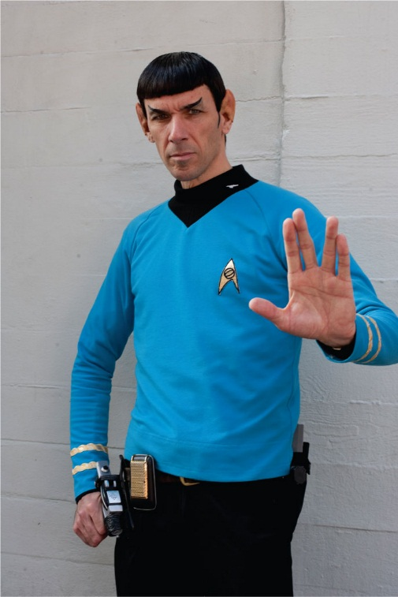
Photo 3.12 A fan dresses up like Star Trek character Mr. Spock

Slide 21
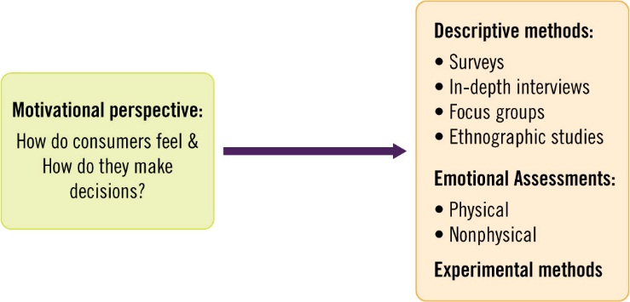
Figure 3.4 Motivational research perspective and methods

Slide 22
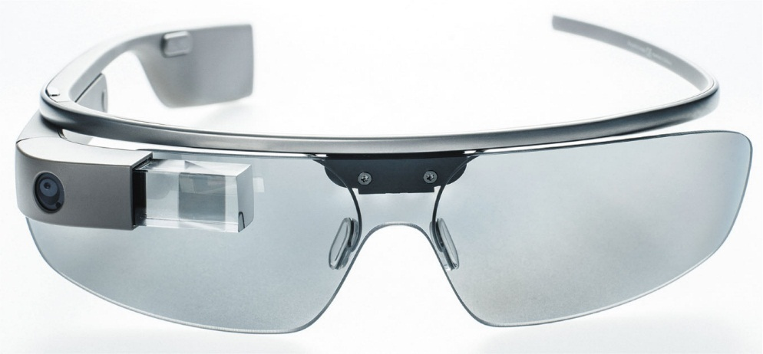
Photo 3.13 Google Glass

