Slide 1
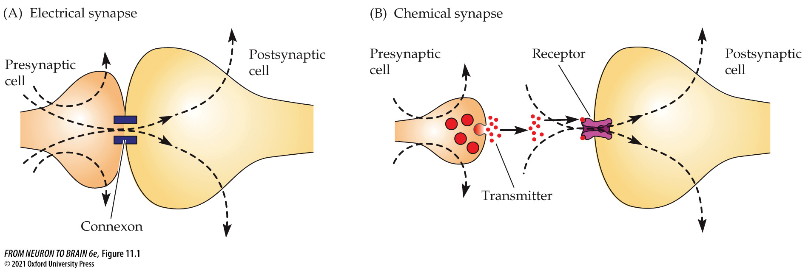
FIGURE 11.1 Electrical and Chemical Synaptic Transmission
Notes:
FIGURE 11.1 Electrical and Chemical Synaptic Transmission. (A) At electrical synapses, current flows directly from one cell to another through connexons (intercellular channels that cluster to form gap junctions). (B) At chemical synapses, depolarization of the presynaptic nerve terminal triggers the release of neurotransmitter molecules, which open ion channel receptors on the postsynaptic membrane, causing excitation or inhibition. Dashed lines show the direction of positive current flow.

Slide 2
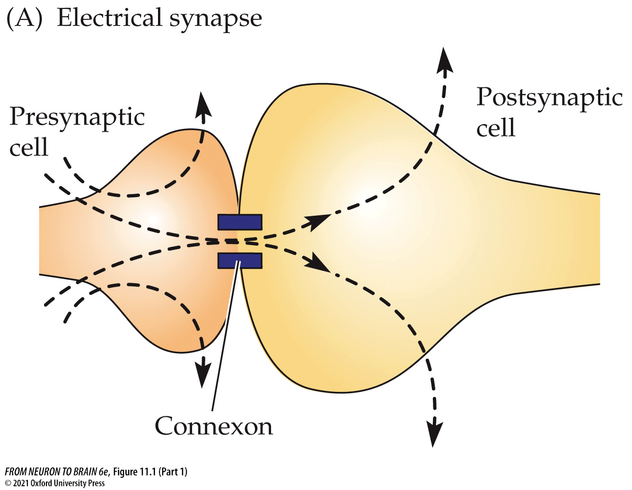
FIGURE 11.1 Electrical and Chemical Synaptic Transmission (Part 1)
Notes:
FIGURE 11.1 Electrical and Chemical Synaptic Transmission. (A) At electrical synapses, current flows directly from one cell to another through connexons (intercellular channels that cluster to form gap junctions). (B) At chemical synapses, depolarization of the presynaptic nerve terminal triggers the release of neurotransmitter molecules, which open ion channel receptors on the postsynaptic membrane, causing excitation or inhibition. Dashed lines show the direction of positive current flow.

Slide 3
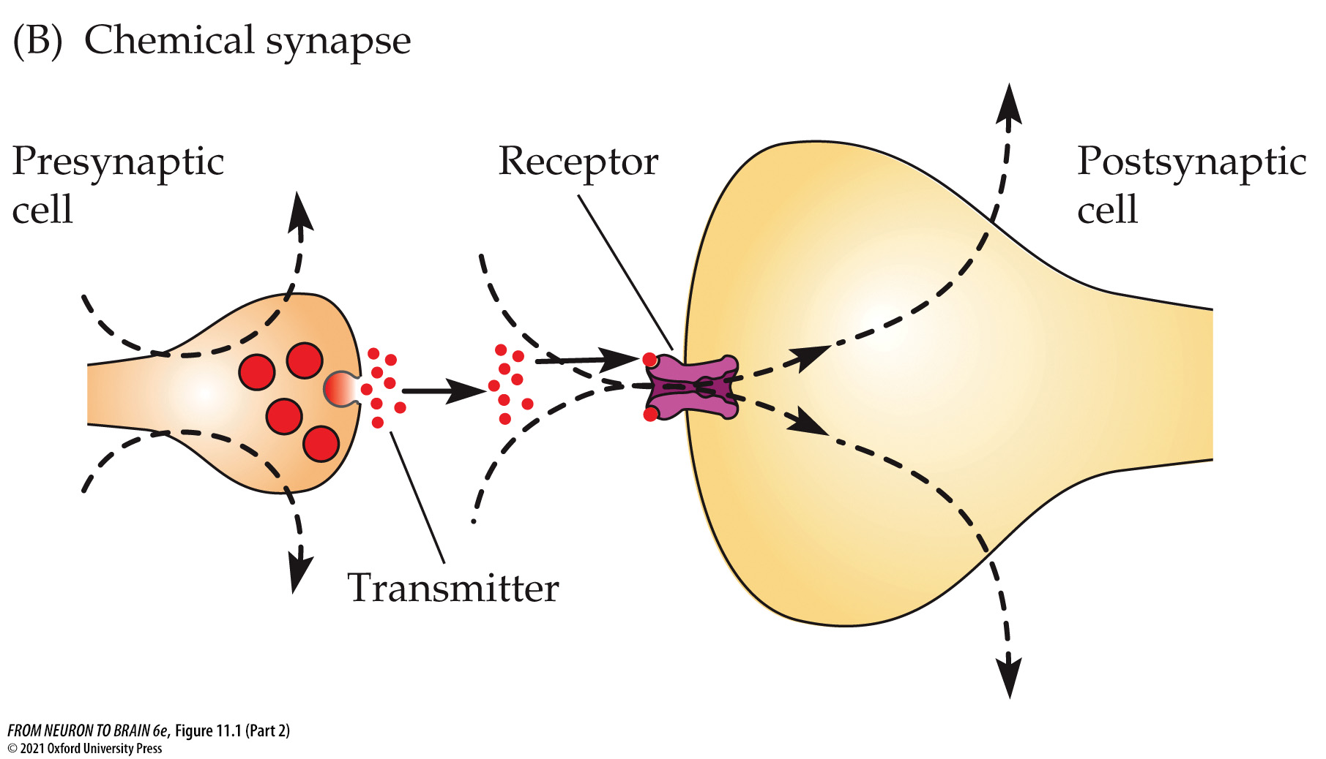
FIGURE 11.1 Electrical and Chemical Synaptic Transmission (Part 2)
Notes:
FIGURE 11.1 Electrical and Chemical Synaptic Transmission. (A) At electrical synapses, current flows directly from one cell to another through connexons (intercellular channels that cluster to form gap junctions). (B) At chemical synapses, depolarization of the presynaptic nerve terminal triggers the release of neurotransmitter molecules, which open ion channel receptors on the postsynaptic membrane, causing excitation or inhibition. Dashed lines show the direction of positive current flow.

Slide 4
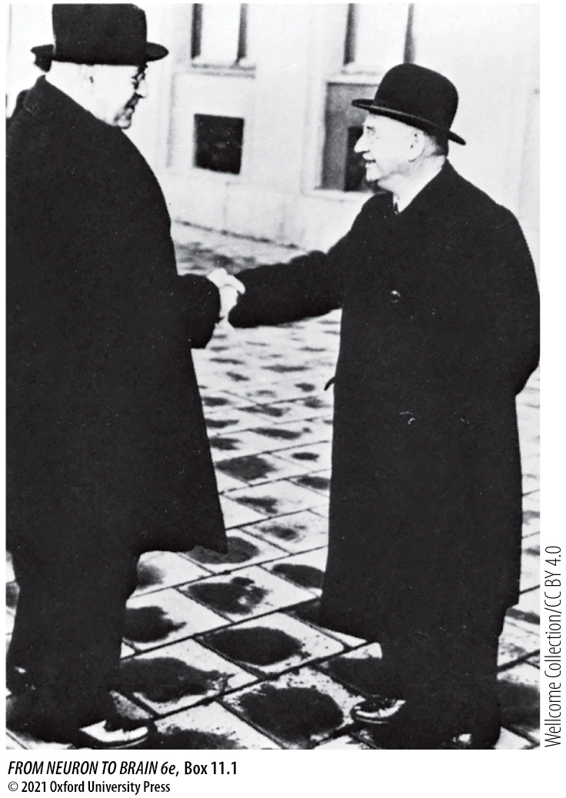
BOX 11.1 Electrical or Chemical Transmission?
Notes:
BOX 11.1 Electrical or Chemical Transmission?
Henry Dale (left) and Otto Loewi, mid-1930s.

Slide 5
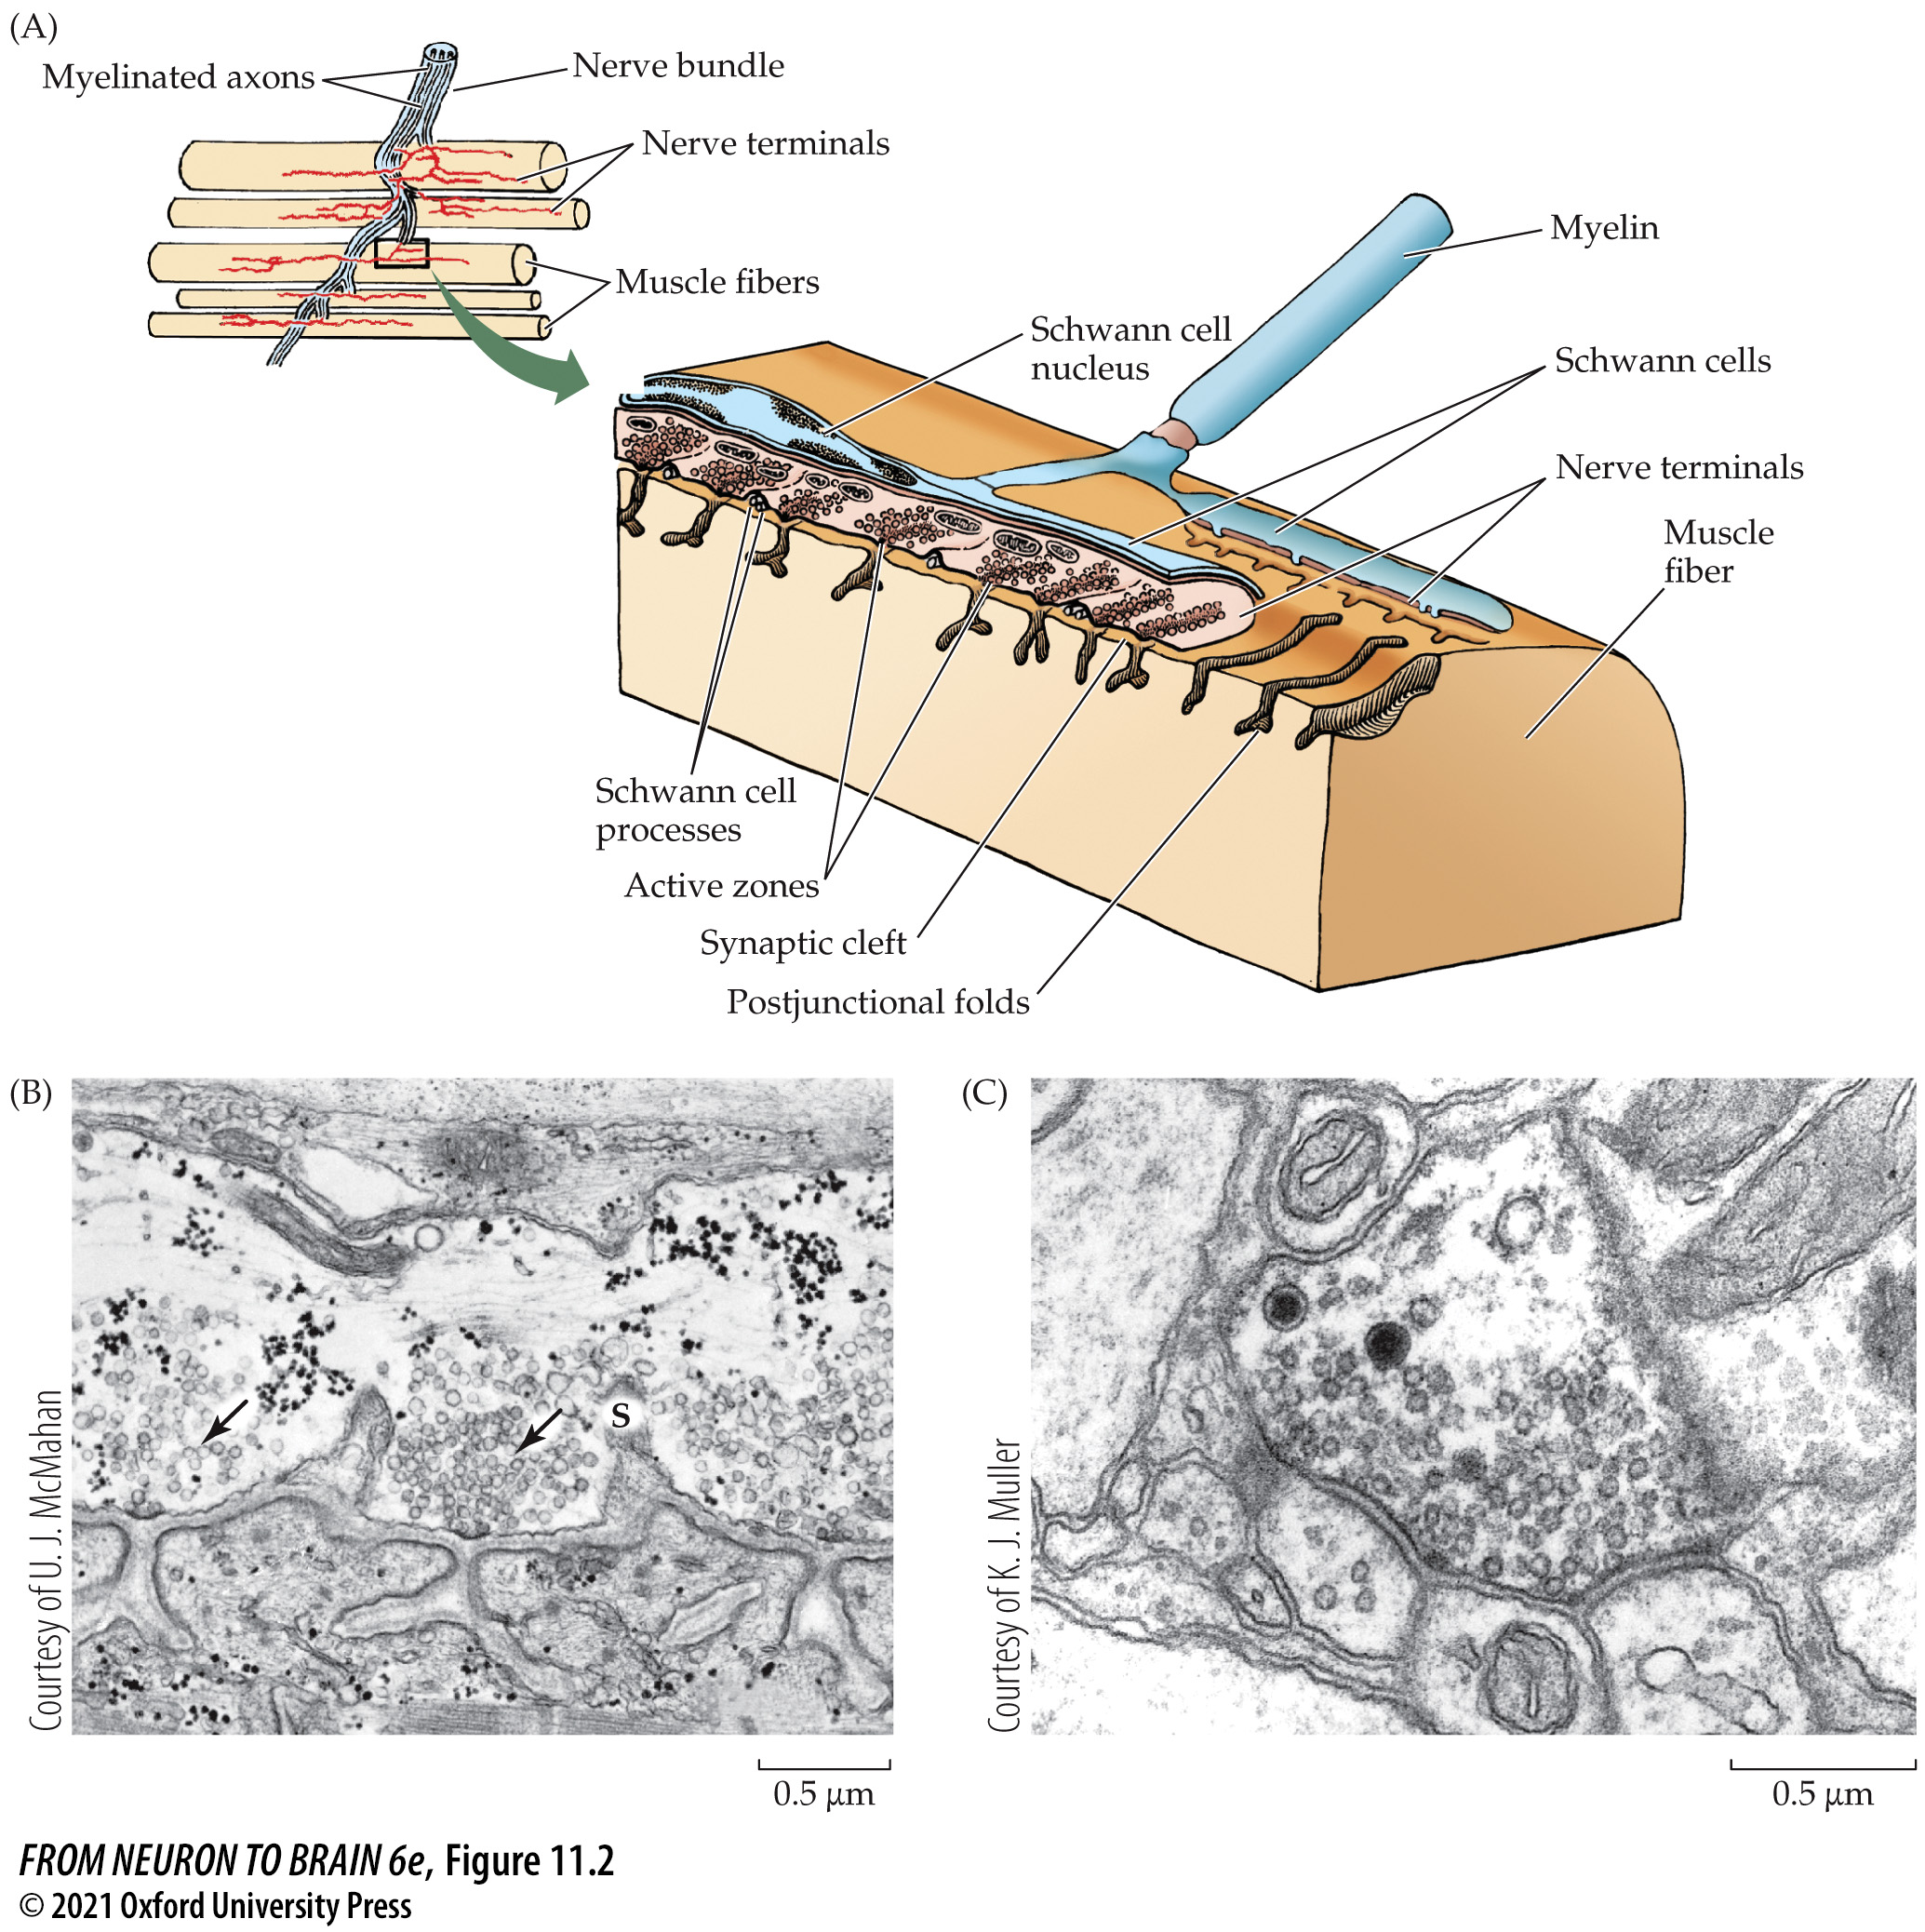
FIGURE 11.2 Structure of Chemical Synapses
Notes:
FIGURE 11.2 Structure of Chemical Synapses. (A) A three-dimensional sketch of part of the terminal arbor of a motor axon at the frog skeletal neuromuscular junction. The inset shows a camera lucida drawing of several skeletal muscle fibers and their innervation (motor nerve terminals are in red). Synaptic vesicles are clustered in the nerve terminal in special regions opposite the openings of the postjunctional folds. These regions, called active zones, are the sites of transmitter release into the synaptic cleft. Fingerlike processes of Schwann cells extend between the terminal and the postsynaptic membrane, separating active zones. (B) Electron micrograph of a longitudinal section through a portion of the neuromuscular junction. In the nerve terminal, clusters of vesicles lie over thickenings in the presynaptic membrane—the active zones (arrows). Schwann cell processes (S) separate the clusters. In the muscle, postjunctional folds open into the synaptic cleft directly under the active zone. The band of fuzzy material in the cleft, which follows the contours of the postjunctional folds, is the synaptic basal lamina. (C) Electron micrograph of synapses in the CNS of the leech. As at the frog neuromuscular junction, clusters of synaptic vesicles are focused on dense regions of the presynaptic membrane, forming active zones, and are juxtaposed with postsynaptic densities.

Slide 6
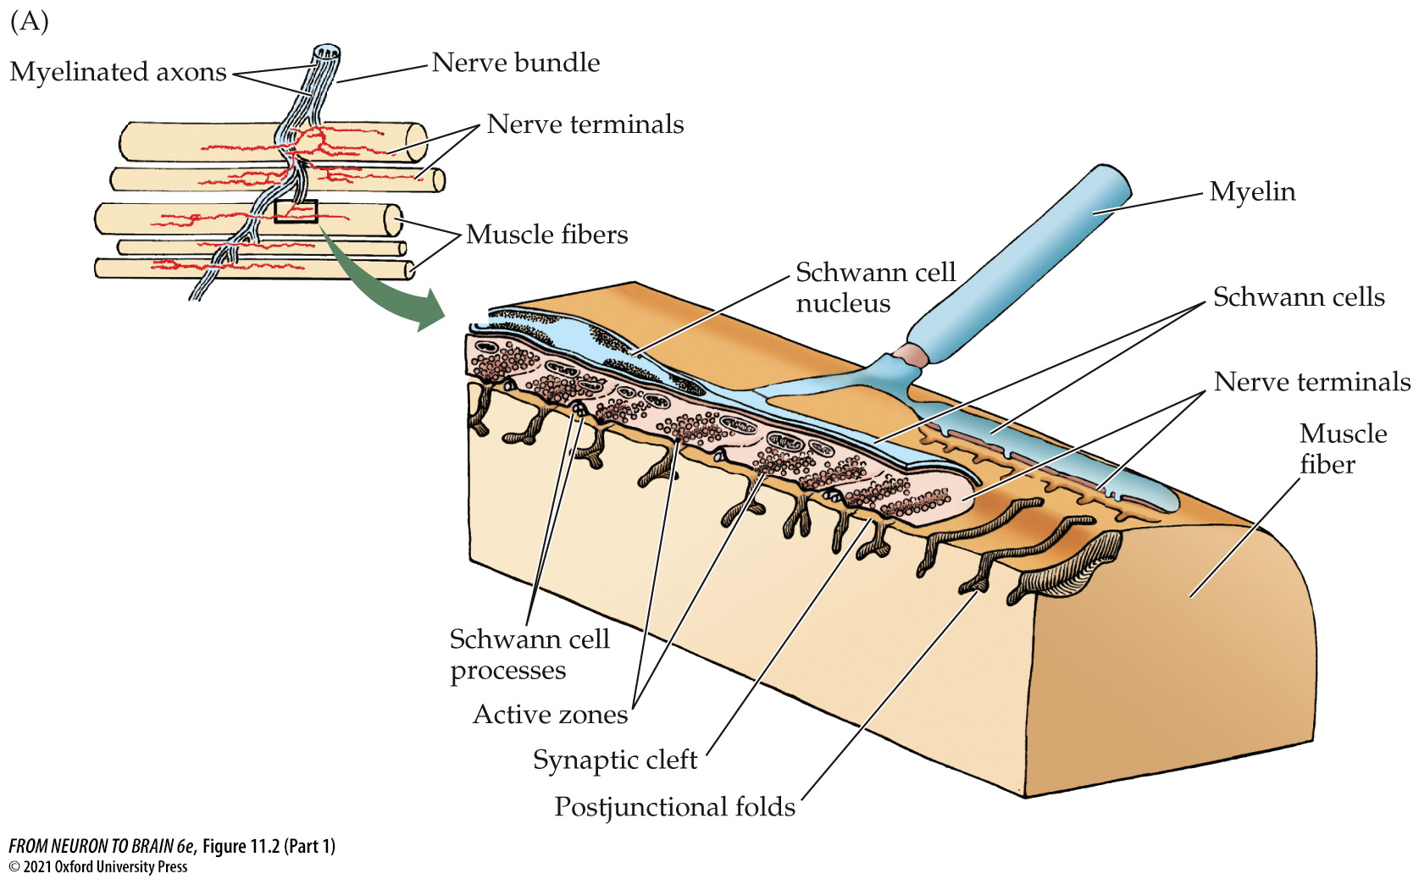
FIGURE 11.2 Structure of Chemical Synapses (Part 1)
Notes:
FIGURE 11.2 Structure of Chemical Synapses. (A) A three-dimensional sketch of part of the terminal arbor of a motor axon at the frog skeletal neuromuscular junction. The inset shows a camera lucida drawing of several skeletal muscle fibers and their innervation (motor nerve terminals are in red). Synaptic vesicles are clustered in the nerve terminal in special regions opposite the openings of the postjunctional folds. These regions, called active zones, are the sites of transmitter release into the synaptic cleft. Fingerlike processes of Schwann cells extend between the terminal and the postsynaptic membrane, separating active zones. (B) Electron micrograph of a longitudinal section through a portion of the neuromuscular junction. In the nerve terminal, clusters of vesicles lie over thickenings in the presynaptic membrane—the active zones (arrows). Schwann cell processes (S) separate the clusters. In the muscle, postjunctional folds open into the synaptic cleft directly under the active zone. The band of fuzzy material in the cleft, which follows the contours of the postjunctional folds, is the synaptic basal lamina. (C) Electron micrograph of synapses in the CNS of the leech. As at the frog neuromuscular junction, clusters of synaptic vesicles are focused on dense regions of the presynaptic membrane, forming active zones, and are juxtaposed with postsynaptic densities.

Slide 7
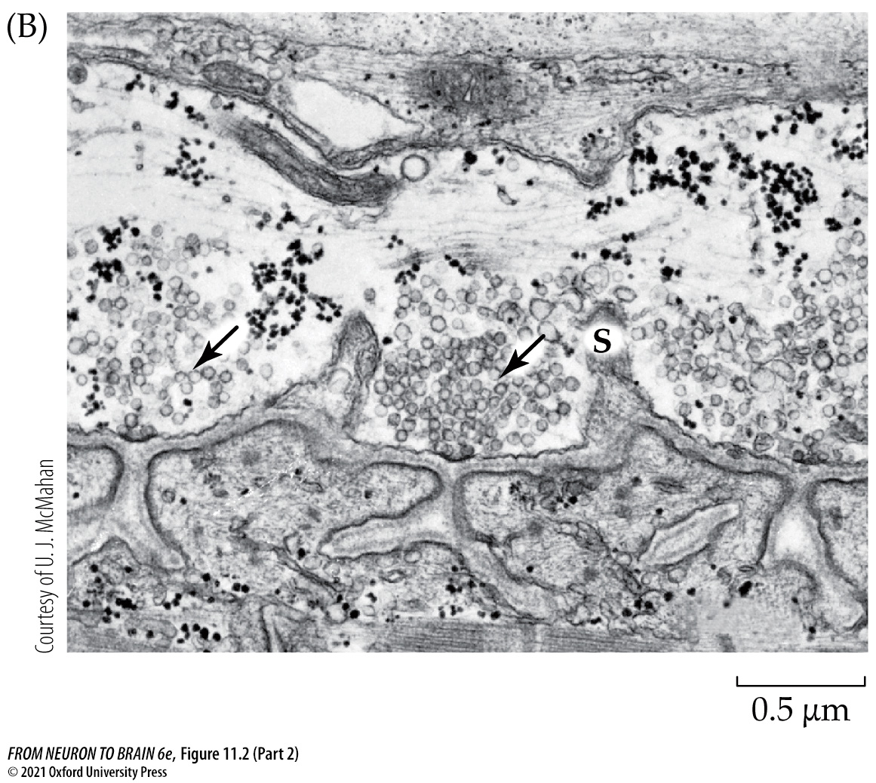
FIGURE 11.2 Structure of Chemical Synapses (Part 2)
Notes:
FIGURE 11.2 Structure of Chemical Synapses. (A) A three-dimensional sketch of part of the terminal arbor of a motor axon at the frog skeletal neuromuscular junction. The inset shows a camera lucida drawing of several skeletal muscle fibers and their innervation (motor nerve terminals are in red). Synaptic vesicles are clustered in the nerve terminal in special regions opposite the openings of the postjunctional folds. These regions, called active zones, are the sites of transmitter release into the synaptic cleft. Fingerlike processes of Schwann cells extend between the terminal and the postsynaptic membrane, separating active zones. (B) Electron micrograph of a longitudinal section through a portion of the neuromuscular junction. In the nerve terminal, clusters of vesicles lie over thickenings in the presynaptic membrane—the active zones (arrows). Schwann cell processes (S) separate the clusters. In the muscle, postjunctional folds open into the synaptic cleft directly under the active zone. The band of fuzzy material in the cleft, which follows the contours of the postjunctional folds, is the synaptic basal lamina. (C) Electron micrograph of synapses in the CNS of the leech. As at the frog neuromuscular junction, clusters of synaptic vesicles are focused on dense regions of the presynaptic membrane, forming active zones, and are juxtaposed with postsynaptic densities.

Slide 8
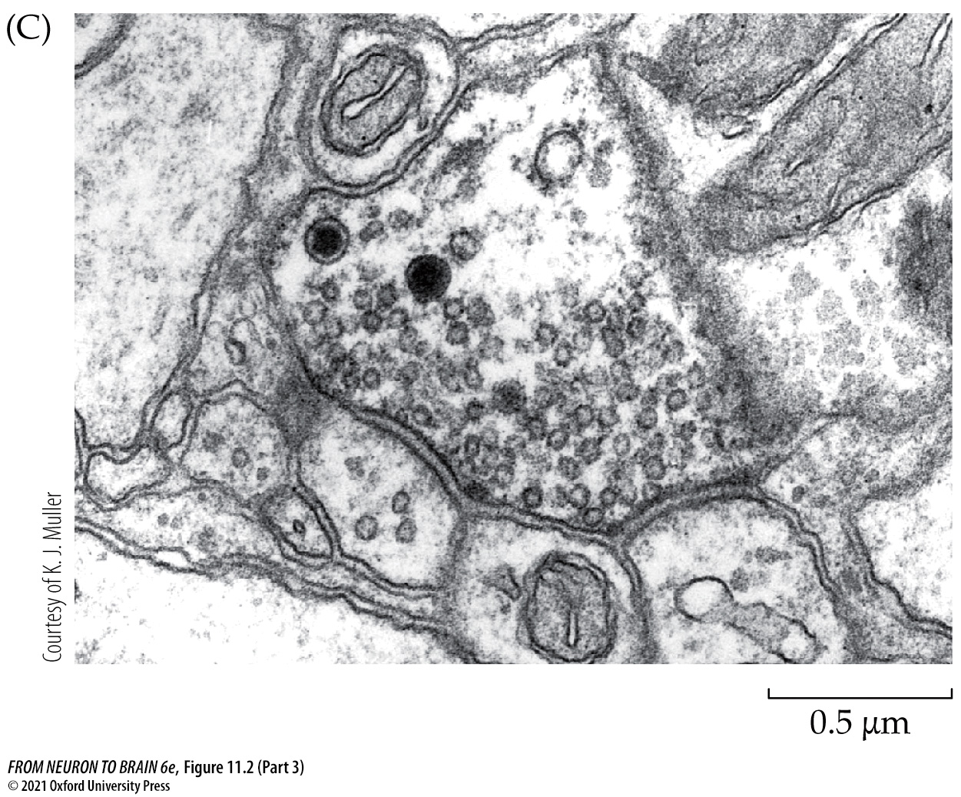
FIGURE 11.2 Structure of Chemical Synapses (Part 3)
Notes:
FIGURE 11.2 Structure of Chemical Synapses. (A) A three-dimensional sketch of part of the terminal arbor of a motor axon at the frog skeletal neuromuscular junction. The inset shows a camera lucida drawing of several skeletal muscle fibers and their innervation (motor nerve terminals are in red). Synaptic vesicles are clustered in the nerve terminal in special regions opposite the openings of the postjunctional folds. These regions, called active zones, are the sites of transmitter release into the synaptic cleft. Fingerlike processes of Schwann cells extend between the terminal and the postsynaptic membrane, separating active zones. (B) Electron micrograph of a longitudinal section through a portion of the neuromuscular junction. In the nerve terminal, clusters of vesicles lie over thickenings in the presynaptic membrane—the active zones (arrows). Schwann cell processes (S) separate the clusters. In the muscle, postjunctional folds open into the synaptic cleft directly under the active zone. The band of fuzzy material in the cleft, which follows the contours of the postjunctional folds, is the synaptic basal lamina. (C) Electron micrograph of synapses in the CNS of the leech. As at the frog neuromuscular junction, clusters of synaptic vesicles are focused on dense regions of the presynaptic membrane, forming active zones, and are juxtaposed with postsynaptic densities.

Slide 9
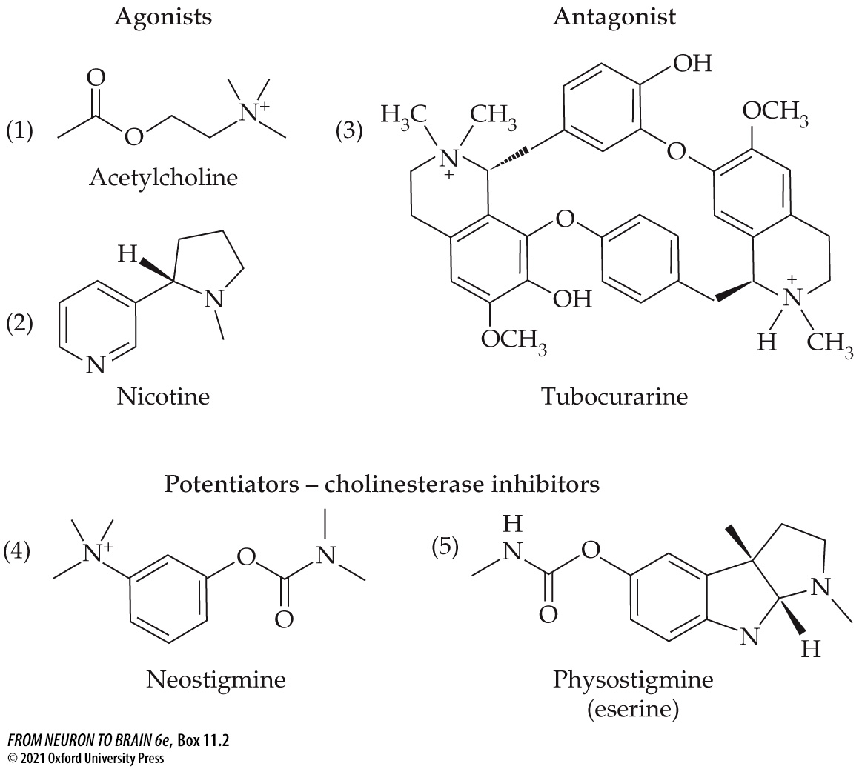
BOX 11.2 Drugs and Toxins Acting at the Neuromuscular Junction
Notes:
BOX 11.2 Drugs and Toxins Acting at the Neuromuscular Junction

Slide 10
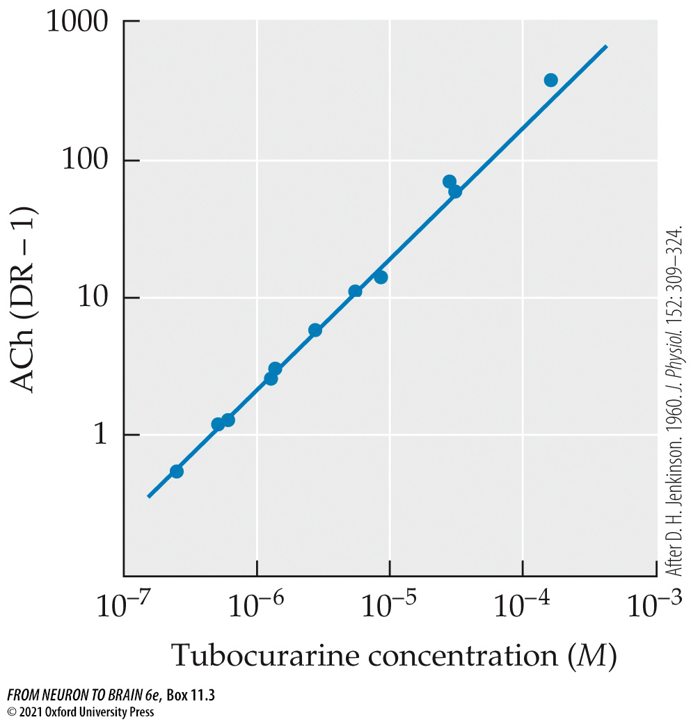
BOX 11.3 Action of Tubocurarine at the Motor End Plate
Notes:
BOX 11.3 Action of Tubocurarine at the Motor End Plate

Slide 11
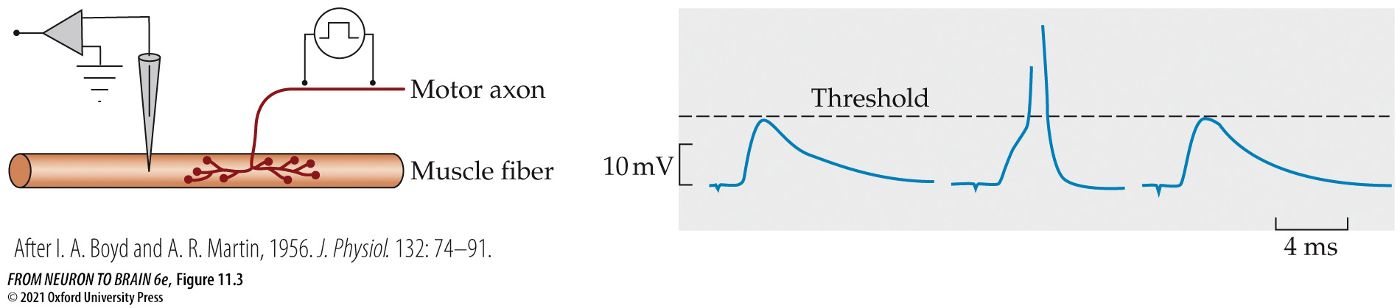
FIGURE 11.3 Synaptic Potentials Recorded with an Intracellular Microelectrode
Notes:
FIGURE 11.3 Synaptic Potentials Recorded with an Intracellular Microelectrode from a mammalian neuromuscular junction treated with curare. The curare concentration in the bathing solution was adjusted so that the amplitude of the synaptic potential was near threshold, and hence on occasion evoked an action potential in the muscle fiber. (After I. A. Boyd and A. R. Martin, 1956. J. Physiol. 132: 74–91.)

Slide 12
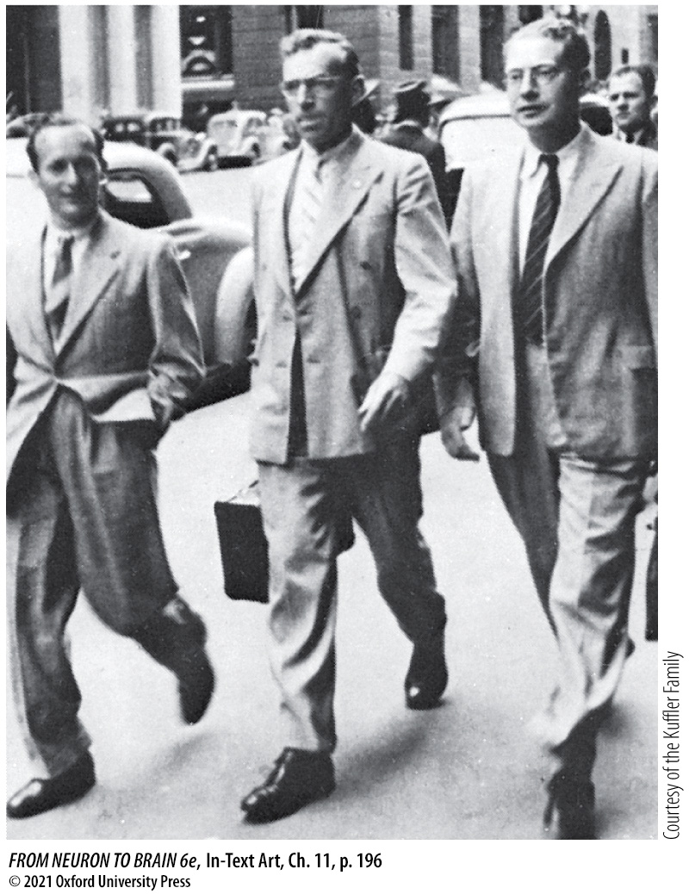
In-Text Art, Ch. 11, p. 196
Notes:
In-Text Art, Ch. 11, p. 196
Stephen Kuffler, John Eccles, and Bernard Katz (left to right) in Australia, about 1941.

Slide 13
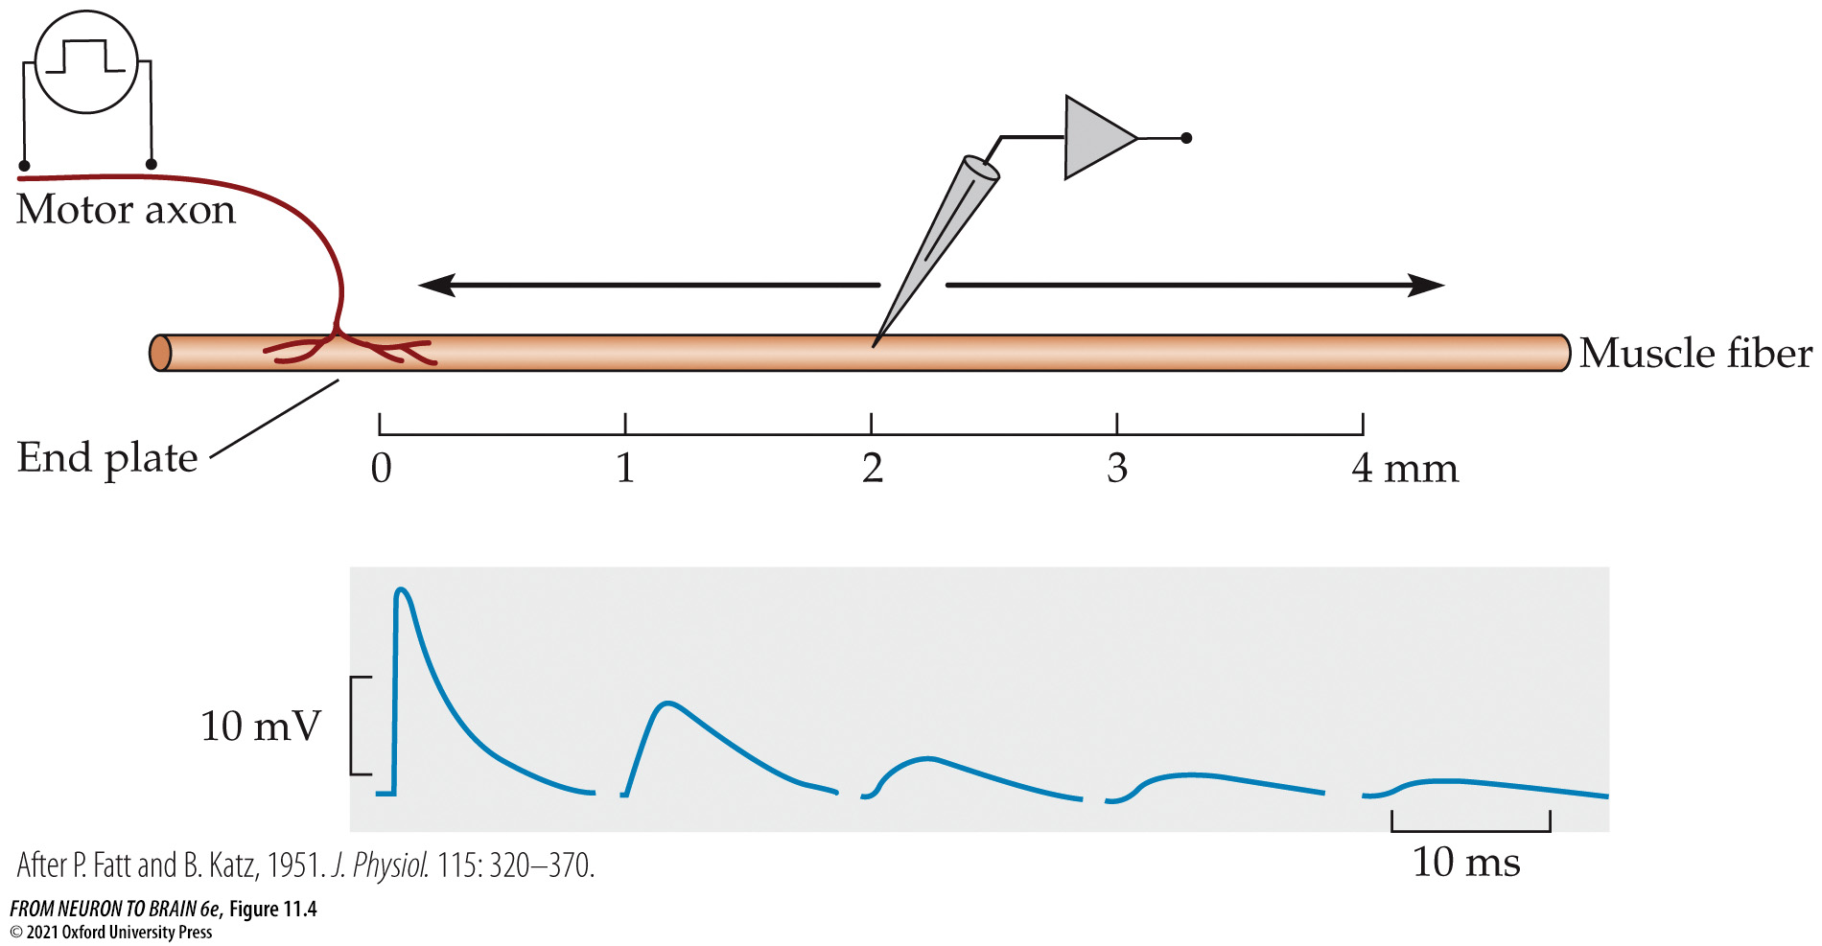
FIGURE 11.4 Decay of Synaptic Potentials with Distance from the End Plate Region of a Muscle Fiber
Notes:
FIGURE 11.4 Decay of Synaptic Potentials with Distance from the End Plate Region of a Muscle Fiber. As the distance from the end plate increases, synaptic potentials recorded by an intracellular electrode decrease in size and rise more slowly. (After P. Fatt and B. Katz, 1951. J. Physiol. 115: 320–370.)

Slide 14
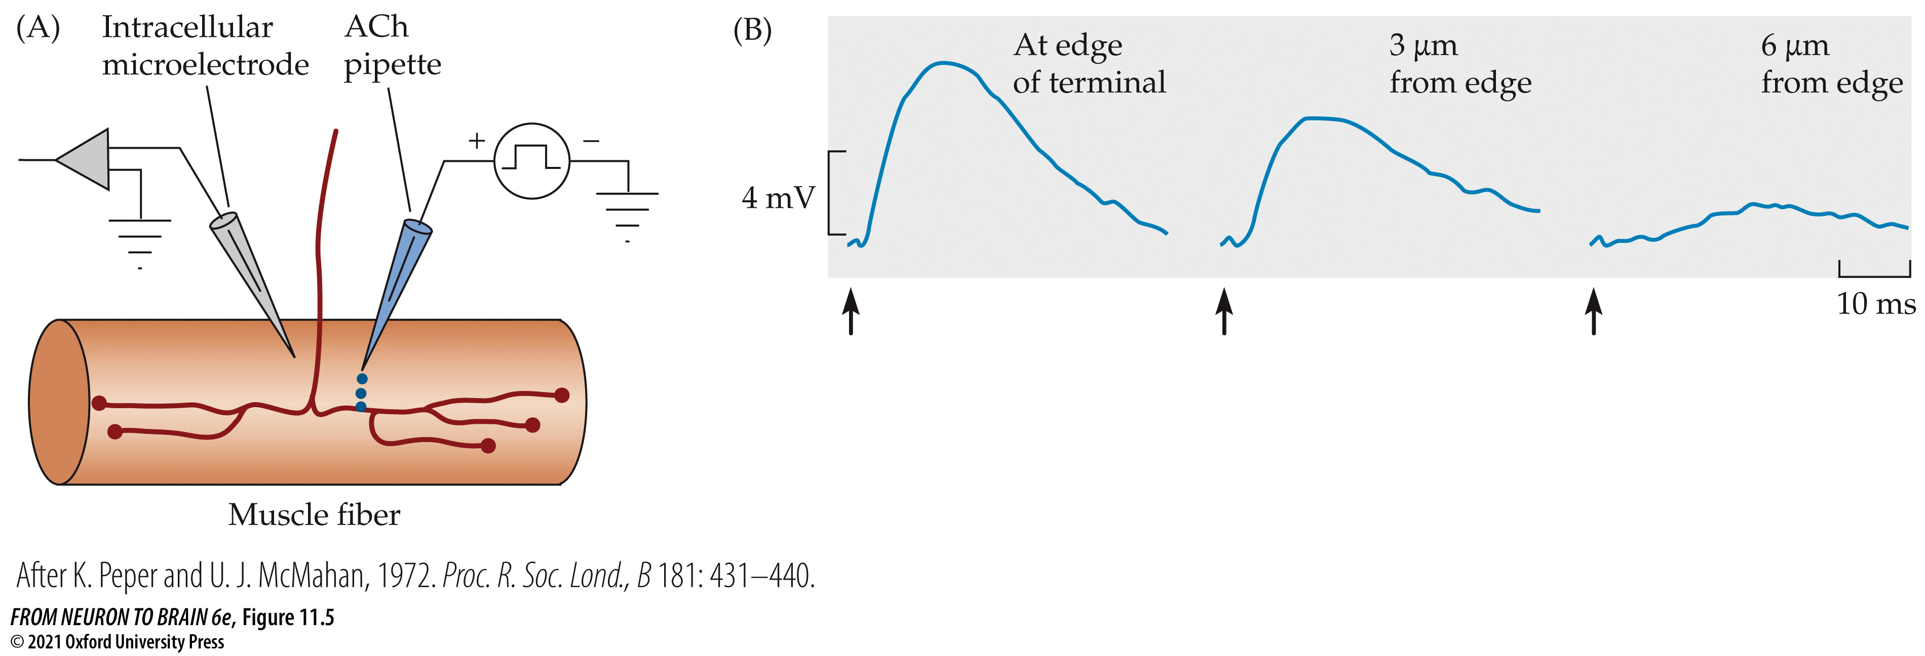
FIGURE 11.5 Mapping the Distribution of ACh Sensitivity by Ionophoresis at the Frog Neuromuscular Junction
Notes:
FIGURE 11.5 Mapping the Distribution of ACh Sensitivity by Ionophoresis at the Frog Neuromuscular Junction. (A) An ACh-filled pipette is placed close to the neuromuscular junction, and ACh is ejected from the tip by a brief, positive voltage pulse (ionophoresis). An intracellular microelectrode is used to record the response from the muscle fiber. (B) Responses to small ionophoretic pulses of ACh applied at different distances from the axon terminal (indicated by the blue dots in [A]). The amplitude and rate of rise of the response decrease rapidly as ACh is applied farther from the terminal. (After K. Peper and U. J. McMahan, 1972. Proc. R. Soc. Lond., B 181: 431–440.)

Slide 15
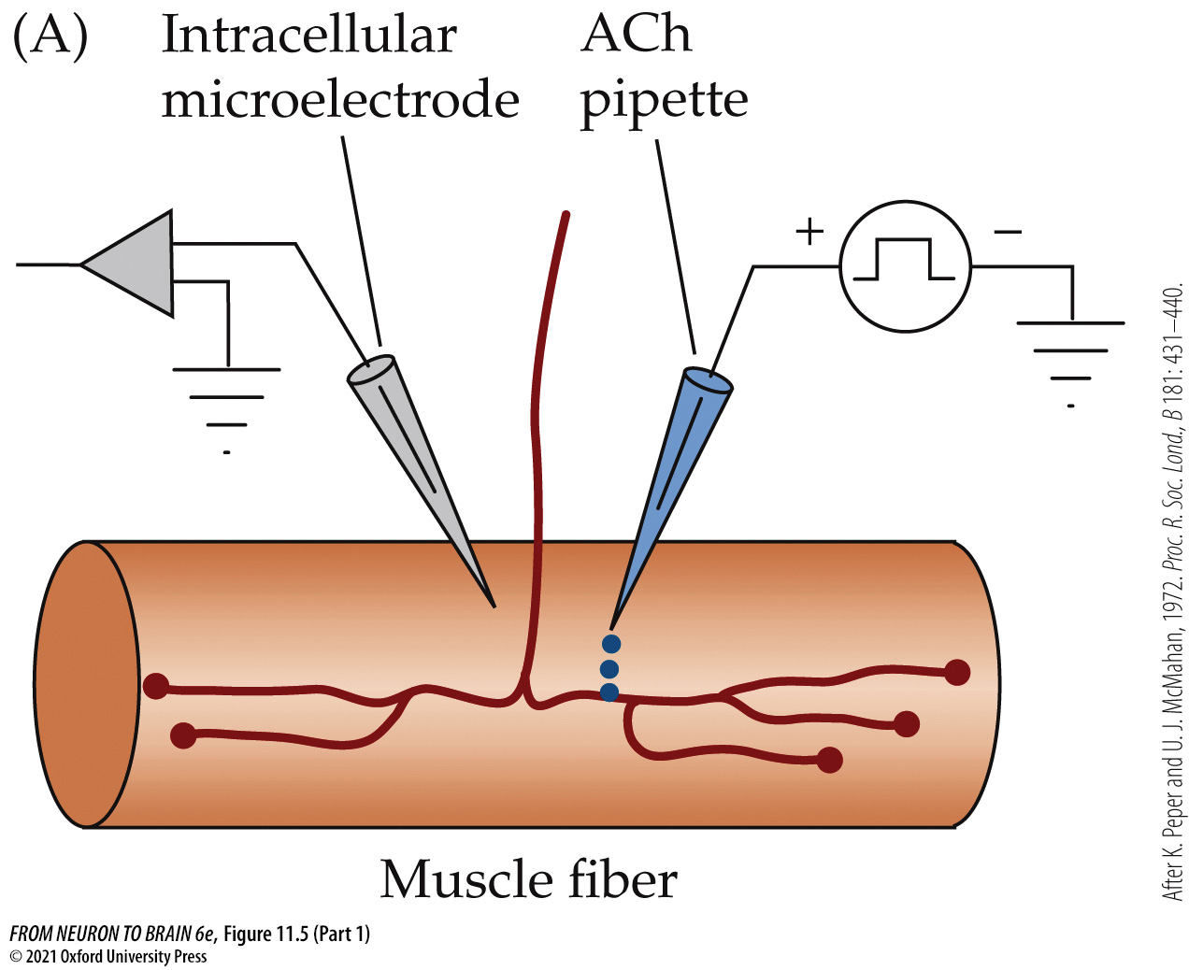
FIGURE 11.5 Mapping the Distribution of ACh Sensitivity by Ionophoresis at the Frog Neuromuscular Junction (Part 1)
Notes:
FIGURE 11.5 Mapping the Distribution of ACh Sensitivity by Ionophoresis at the Frog Neuromuscular Junction. (A) An ACh-filled pipette is placed close to the neuromuscular junction, and ACh is ejected from the tip by a brief, positive voltage pulse (ionophoresis). An intracellular microelectrode is used to record the response from the muscle fiber. (B) Responses to small ionophoretic pulses of ACh applied at different distances from the axon terminal (indicated by the blue dots in [A]). The amplitude and rate of rise of the response decrease rapidly as ACh is applied farther from the terminal. (After K. Peper and U. J. McMahan, 1972. Proc. R. Soc. Lond., B 181: 431–440.)

Slide 16
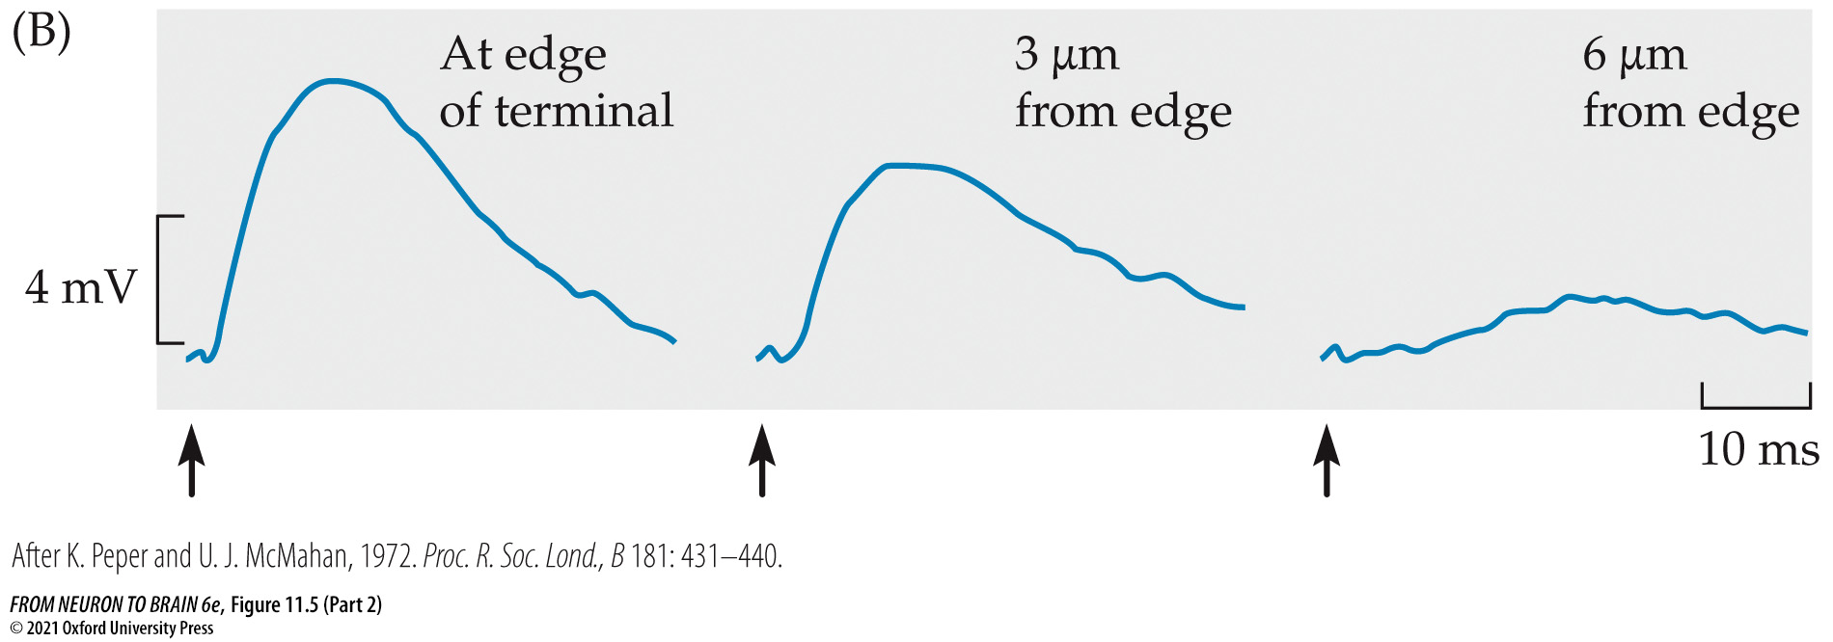
FIGURE 11.5 Mapping the Distribution of ACh Sensitivity by Ionophoresis at the Frog Neuromuscular Junction (Part 2)
Notes:
FIGURE 11.5 Mapping the Distribution of ACh Sensitivity by Ionophoresis at the Frog Neuromuscular Junction. (A) An ACh-filled pipette is placed close to the neuromuscular junction, and ACh is ejected from the tip by a brief, positive voltage pulse (ionophoresis). An intracellular microelectrode is used to record the response from the muscle fiber. (B) Responses to small ionophoretic pulses of ACh applied at different distances from the axon terminal (indicated by the blue dots in [A]). The amplitude and rate of rise of the response decrease rapidly as ACh is applied farther from the terminal. (After K. Peper and U. J. McMahan, 1972. Proc. R. Soc. Lond., B 181: 431–440.)

Slide 17
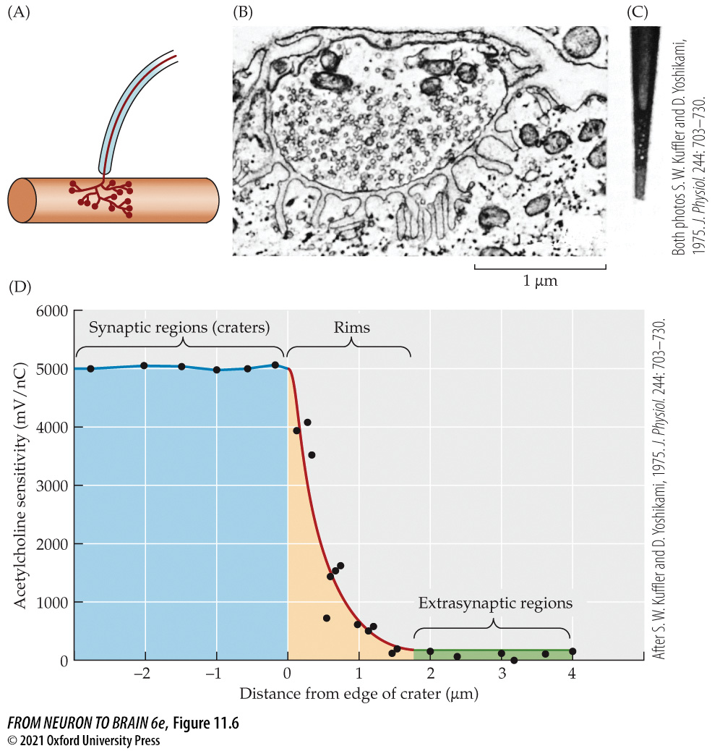
FIGURE 11.6 Acetylcholine Receptor Distribution at the Skeletal Neuromuscular Junction of the Snake
Notes:
FIGURE 11.6 Acetylcholine Receptor Distribution at the Skeletal Neuromuscular Junction of the Snake. (A) An end plate on a skeletal muscle of a snake. The axon terminates in a cluster of boutons. terminal, are 50 nanometers (nm) in diameter. (C) Electron micrograph of the tip of a micropipette used for ionophoresis of ACh, shown at the same magnification as (B). The pipette has an outer diameter of 100 nm and an opening of about 50 nm. (D) ACh was applied by ionophoresis across the postsynaptic crater left after the nerve terminal was removed with collagenase. The craters have a uniformly high sensitivity to ACh (5000 mV/nC), with the sensitivity declining steeply at the rims of the craters. Extrasynaptic regions have a uniformly low ACh sensitivity (100 mV/nC). (After S. W. Kuffler and D. Yoshikami, 1975. J. Physiol. 244: 703–730.)

Slide 18
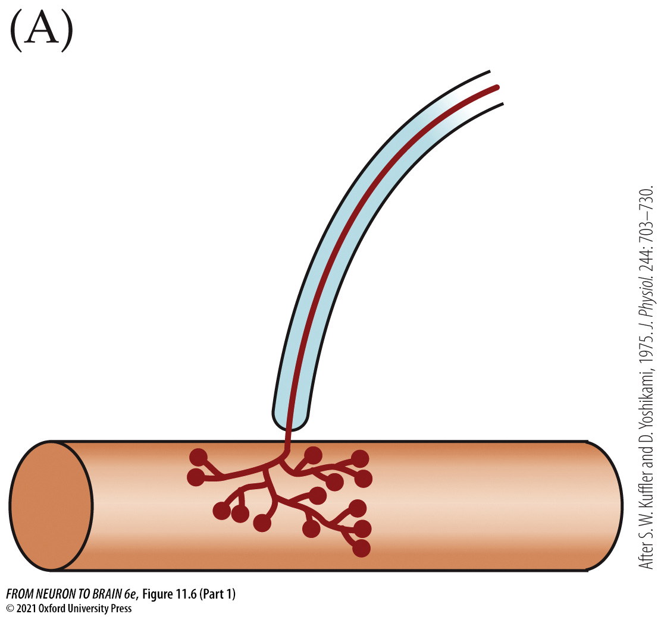
FIGURE 11.6 Acetylcholine Receptor Distribution at the Skeletal Neuromuscular Junction of the Snake (Part 1)
Notes:
FIGURE 11.6 Acetylcholine Receptor Distribution at the Skeletal Neuromuscular Junction of the Snake. (A) An end plate on a skeletal muscle of a snake. The axon terminates in a cluster of boutons. terminal, are 50 nanometers (nm) in diameter. (C) Electron micrograph of the tip of a micropipette used for ionophoresis of ACh, shown at the same magnification as (B). The pipette has an outer diameter of 100 nm and an opening of about 50 nm. (D) ACh was applied by ionophoresis across the postsynaptic crater left after the nerve terminal was removed with collagenase. The craters have a uniformly high sensitivity to ACh (5000 mV/nC), with the sensitivity declining steeply at the rims of the craters. Extrasynaptic regions have a uniformly low ACh sensitivity (100 mV/nC). (After S. W. Kuffler and D. Yoshikami, 1975. J. Physiol. 244: 703–730.)

Slide 19
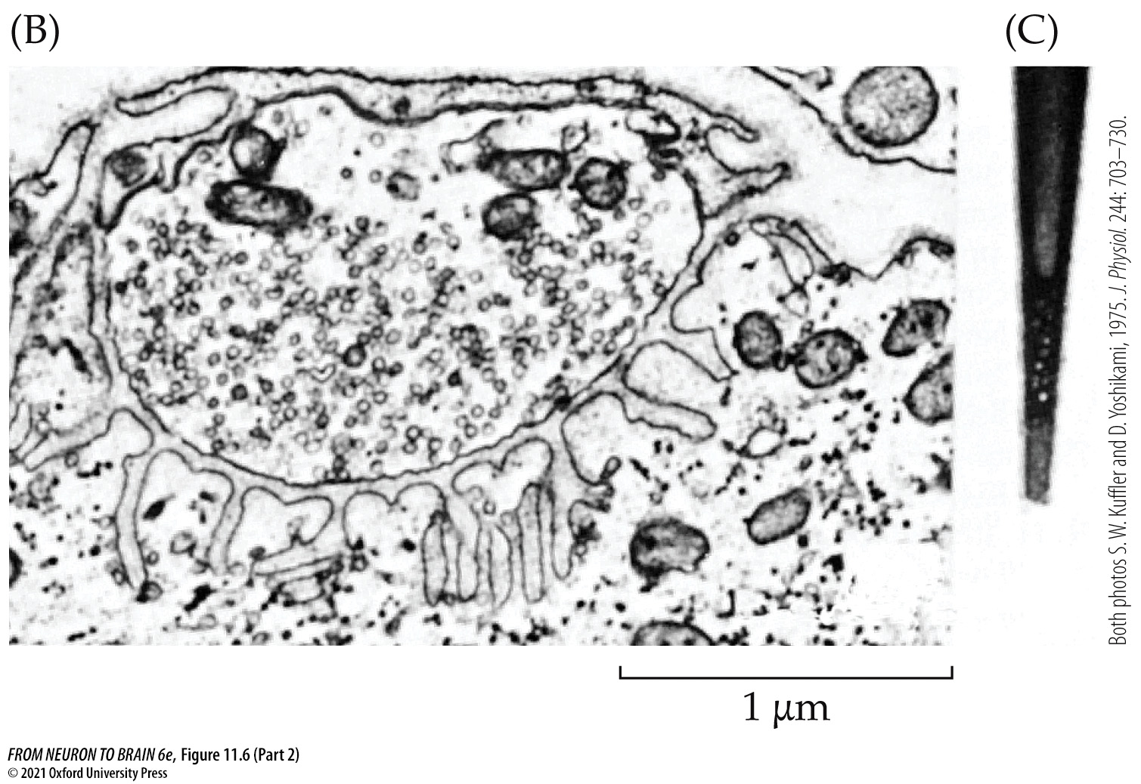
FIGURE 11.6 Acetylcholine Receptor Distribution at the Skeletal Neuromuscular Junction of the Snake (Part 2)
Notes:
FIGURE 11.6 Acetylcholine Receptor Distribution at the Skeletal Neuromuscular Junction of the Snake. (A) An end plate on a skeletal muscle of a snake. The axon terminates in a cluster of boutons. terminal, are 50 nanometers (nm) in diameter. (C) Electron micrograph of the tip of a micropipette used for ionophoresis of ACh, shown at the same magnification as (B). The pipette has an outer diameter of 100 nm and an opening of about 50 nm. (D) ACh was applied by ionophoresis across the postsynaptic crater left after the nerve terminal was removed with collagenase. The craters have a uniformly high sensitivity to ACh (5000 mV/nC), with the sensitivity declining steeply at the rims of the craters. Extrasynaptic regions have a uniformly low ACh sensitivity (100 mV/nC). (After S. W. Kuffler and D. Yoshikami, 1975. J. Physiol. 244: 703–730.)

Slide 20
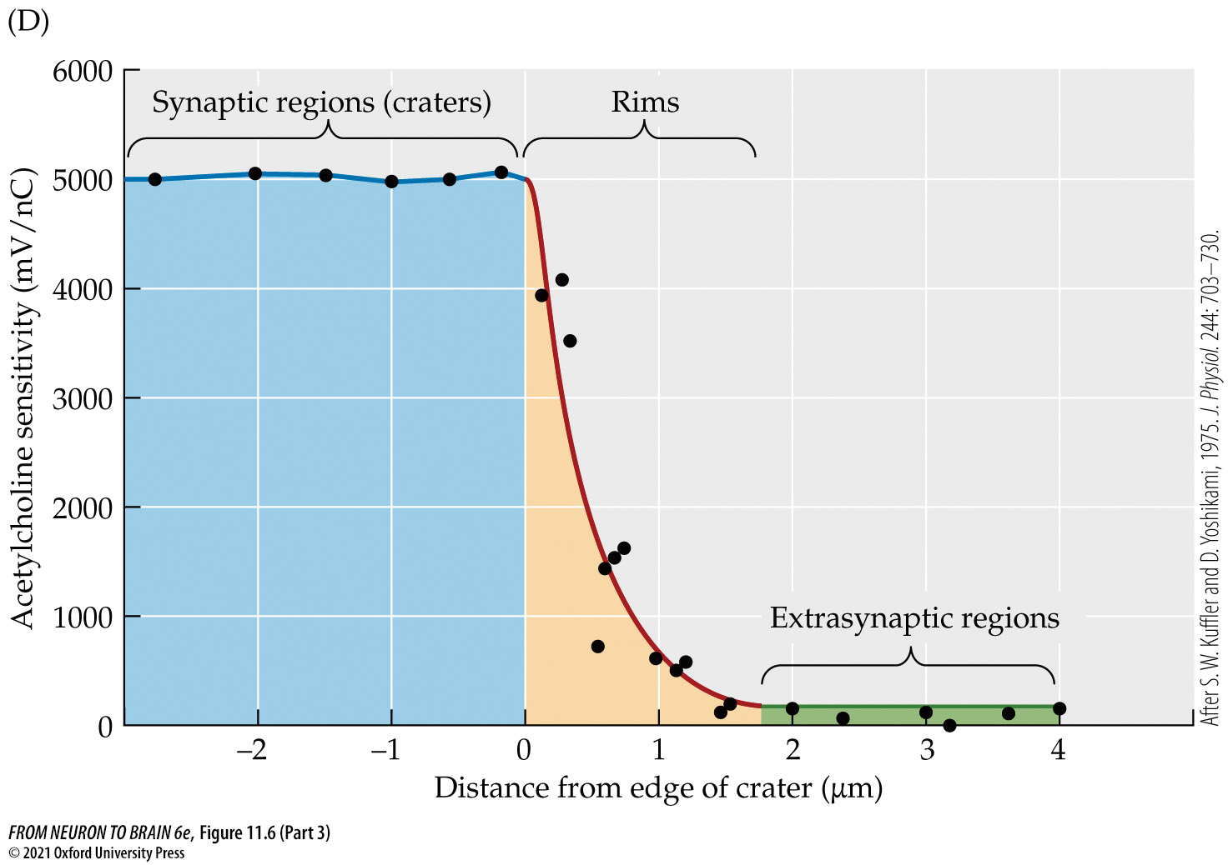
FIGURE 11.6 Acetylcholine Receptor Distribution at the Skeletal Neuromuscular Junction of the Snake (Part 3)
Notes:
FIGURE 11.6 Acetylcholine Receptor Distribution at the Skeletal Neuromuscular Junction of the Snake. (A) An end plate on a skeletal muscle of a snake. The axon terminates in a cluster of boutons. terminal, are 50 nanometers (nm) in diameter. (C) Electron micrograph of the tip of a micropipette used for ionophoresis of ACh, shown at the same magnification as (B). The pipette has an outer diameter of 100 nm and an opening of about 50 nm. (D) ACh was applied by ionophoresis across the postsynaptic crater left after the nerve terminal was removed with collagenase. The craters have a uniformly high sensitivity to ACh (5000 mV/nC), with the sensitivity declining steeply at the rims of the craters. Extrasynaptic regions have a uniformly low ACh sensitivity (100 mV/nC). (After S. W. Kuffler and D. Yoshikami, 1975. J. Physiol. 244: 703–730.)

Slide 21
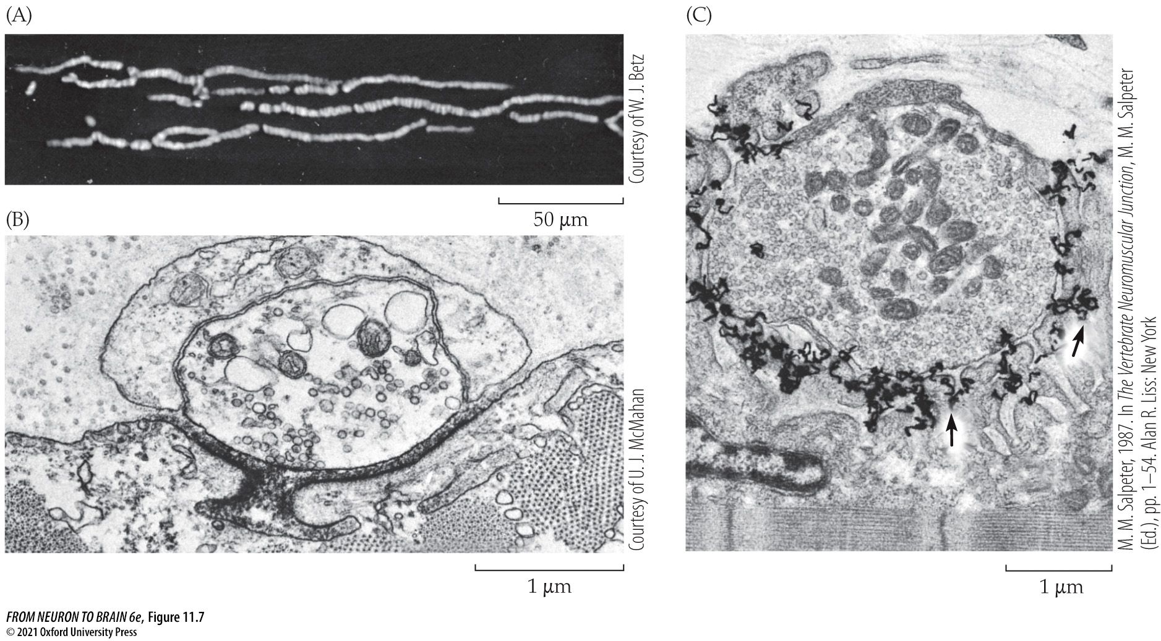
FIGURE 11.7 Visualizing the Distribution of ACh Receptors at the Neuromuscular Junction
Notes:
FIGURE 11.7 Visualizing the Distribution of ACh Receptors at the Neuromuscular Junction. (A) Fluorescence micrograph of a frog cutaneous pectoris muscle fiber stained with rhodamine α-bungarotoxin. (B) Electron micrograph of a cross section of a frog cutaneous pectoris neuromuscular junction labeled with horseradish peroxidase–α-bungarotoxin. A dense reaction product fills the synaptic cleft. (C) Autoradiograph of a neuromuscular junction in a lizard intercostal muscle labeled with [¹²⁵I]α-bungarotoxin. Silver grains (arrows) show that receptors are concentrated at the tops and along the upper third of the junctional folds. (C from M. M. Salpeter, 1987. Vertebrate neuromuscular junctions: General morphology, molecular organization, and functional consequences. In M. M. Salpeter [Ed.], The Vertebrate Neuromuscular Junction. Alan R. Liss, New York, pp. 1–54.)

Slide 22
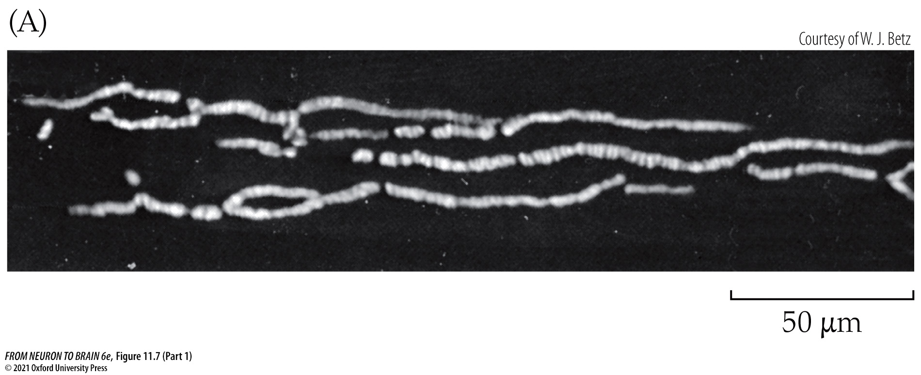
FIGURE 11.7 Visualizing the Distribution of ACh Receptors at the Neuromuscular Junction (Part 1)
Notes:
FIGURE 11.7 Visualizing the Distribution of ACh Receptors at the Neuromuscular Junction. (A) Fluorescence micrograph of a frog cutaneous pectoris muscle fiber stained with rhodamine α-bungarotoxin. (B) Electron micrograph of a cross section of a frog cutaneous pectoris neuromuscular junction labeled with horseradish peroxidase–α-bungarotoxin. A dense reaction product fills the synaptic cleft. (C) Autoradiograph of a neuromuscular junction in a lizard intercostal muscle labeled with [¹²⁵I]α-bungarotoxin. Silver grains (arrows) show that receptors are concentrated at the tops and along the upper third of the junctional folds. (C from M. M. Salpeter, 1987. Vertebrate neuromuscular junctions: General morphology, molecular organization, and functional consequences. In M. M. Salpeter [Ed.], The Vertebrate Neuromuscular Junction. Alan R. Liss, New York, pp. 1–54.)

Slide 23
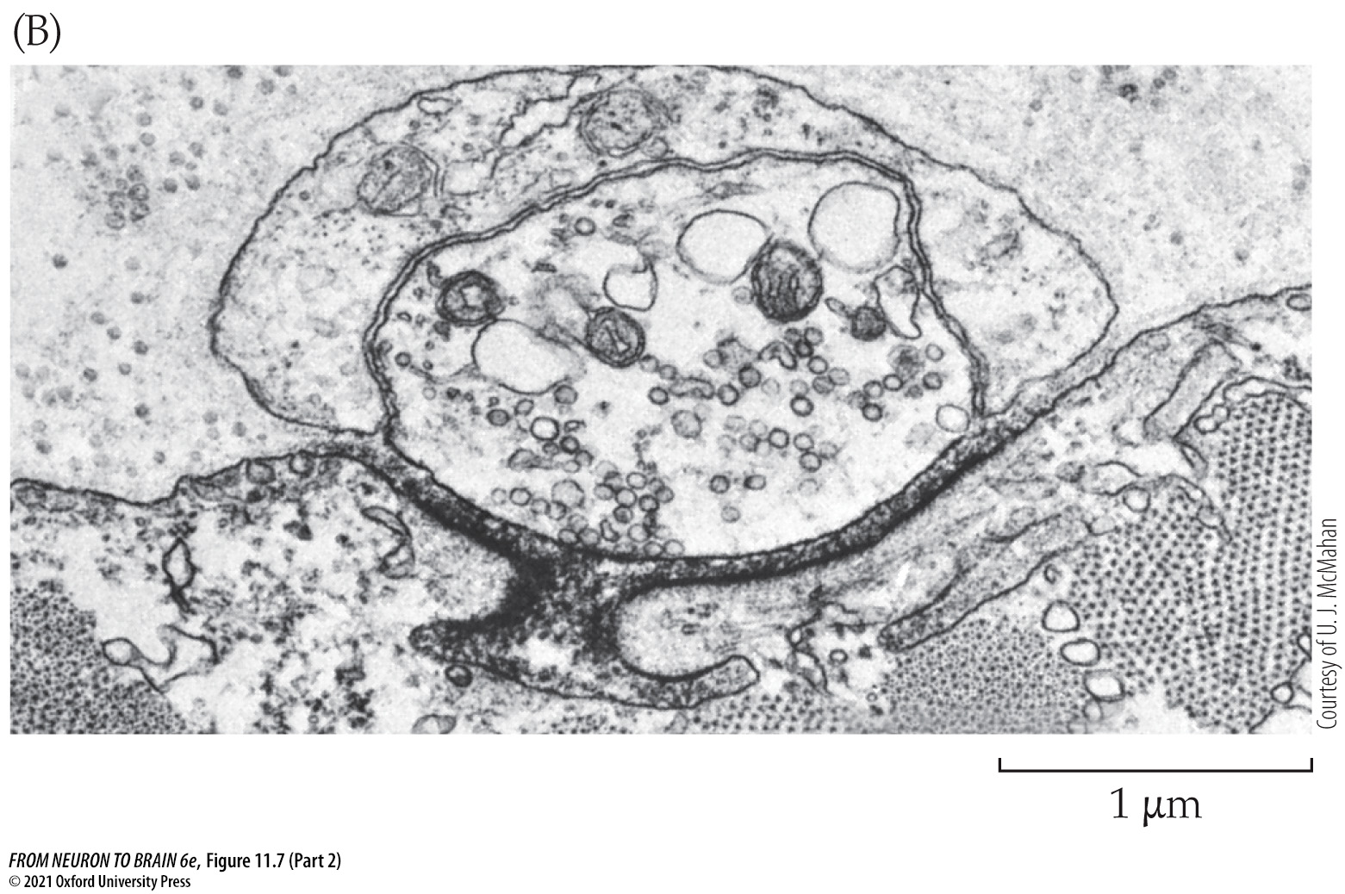
FIGURE 11.7 Visualizing the Distribution of ACh Receptors at the Neuromuscular Junction (Part 2)
Notes:
FIGURE 11.7 Visualizing the Distribution of ACh Receptors at the Neuromuscular Junction. (A) Fluorescence micrograph of a frog cutaneous pectoris muscle fiber stained with rhodamine α-bungarotoxin. (B) Electron micrograph of a cross section of a frog cutaneous pectoris neuromuscular junction labeled with horseradish peroxidase–α-bungarotoxin. A dense reaction product fills the synaptic cleft. (C) Autoradiograph of a neuromuscular junction in a lizard intercostal muscle labeled with [¹²⁵I]α-bungarotoxin. Silver grains (arrows) show that receptors are concentrated at the tops and along the upper third of the junctional folds. (C from M. M. Salpeter, 1987. Vertebrate neuromuscular junctions: General morphology, molecular organization, and functional consequences. In M. M. Salpeter [Ed.], The Vertebrate Neuromuscular Junction. Alan R. Liss, New York, pp. 1–54.)

Slide 24
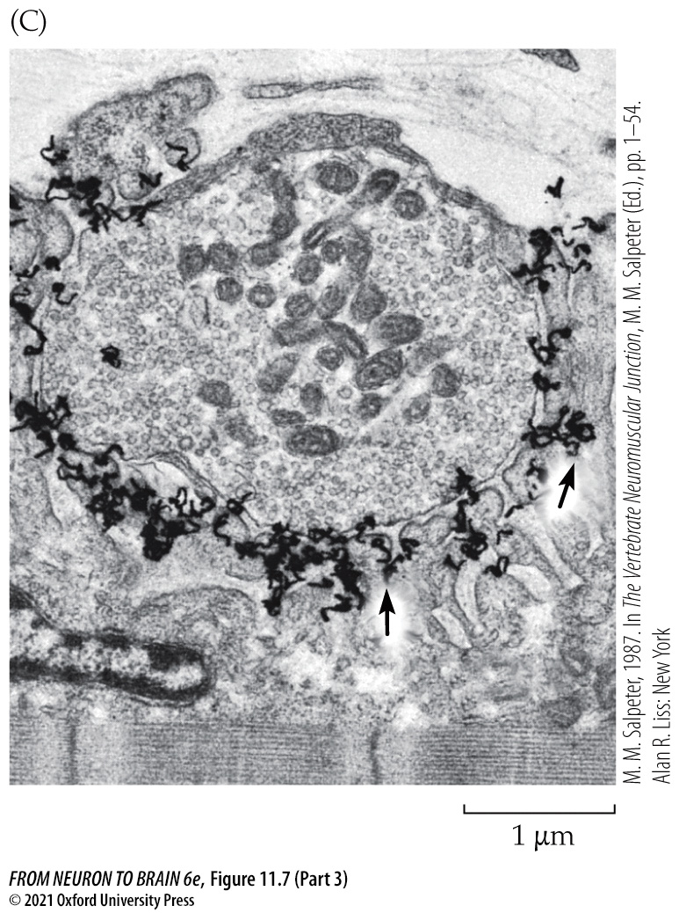
FIGURE 11.7 Visualizing the Distribution of ACh Receptors at the Neuromuscular Junction (Part 3)
Notes:
FIGURE 11.7 Visualizing the Distribution of ACh Receptors at the Neuromuscular Junction. (A) Fluorescence micrograph of a frog cutaneous pectoris muscle fiber stained with rhodamine α-bungarotoxin. (B) Electron micrograph of a cross section of a frog cutaneous pectoris neuromuscular junction labeled with horseradish peroxidase–α-bungarotoxin. A dense reaction product fills the synaptic cleft. (C) Autoradiograph of a neuromuscular junction in a lizard intercostal muscle labeled with [¹²⁵I]α-bungarotoxin. Silver grains (arrows) show that receptors are concentrated at the tops and along the upper third of the junctional folds. (C from M. M. Salpeter, 1987. Vertebrate neuromuscular junctions: General morphology, molecular organization, and functional consequences. In M. M. Salpeter [Ed.], The Vertebrate Neuromuscular Junction. Alan R. Liss, New York, pp. 1–54.)

Slide 25
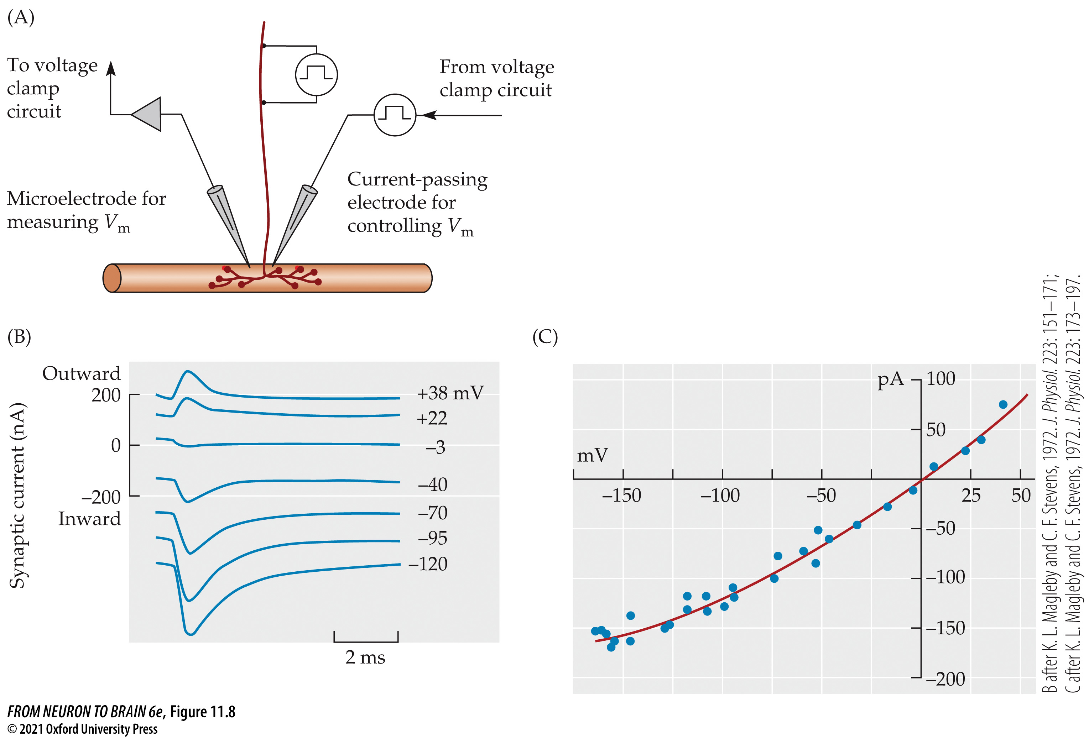
FIGURE 11.8 Reversal Potential for Synaptic Currents Measured by Voltage Clamp Recording
Notes:
FIGURE 11.8 Reversal Potential for Synaptic Currents Measured by Voltage Clamp Recording. (A) Scheme for voltage clamp recording at the motor end plate. (B) Synaptic currents recorded from a glycerol-treated muscle fiber at membrane potentials between –120 and +38 mV. When the muscle membrane potential is clamped below 0 mV, synaptic current flows into the muscle. Such inward current would depolarize the muscle if it were not voltage clamped. When the end plate potential is clamped above 0 mV, synaptic current flows out of the cell. (C) Plot of peak end plate current as a function of membrane potential. The relation is nearly linear, with the reversal potential close to 0 mV. (B after K. L. Magleby and C. F. Stevens, 1972. J. Physiol. 223: 151–171; C after K. L. Magleby and C. F. Stevens, 1972. J. Physiol. 223: 173–197.)

Slide 26
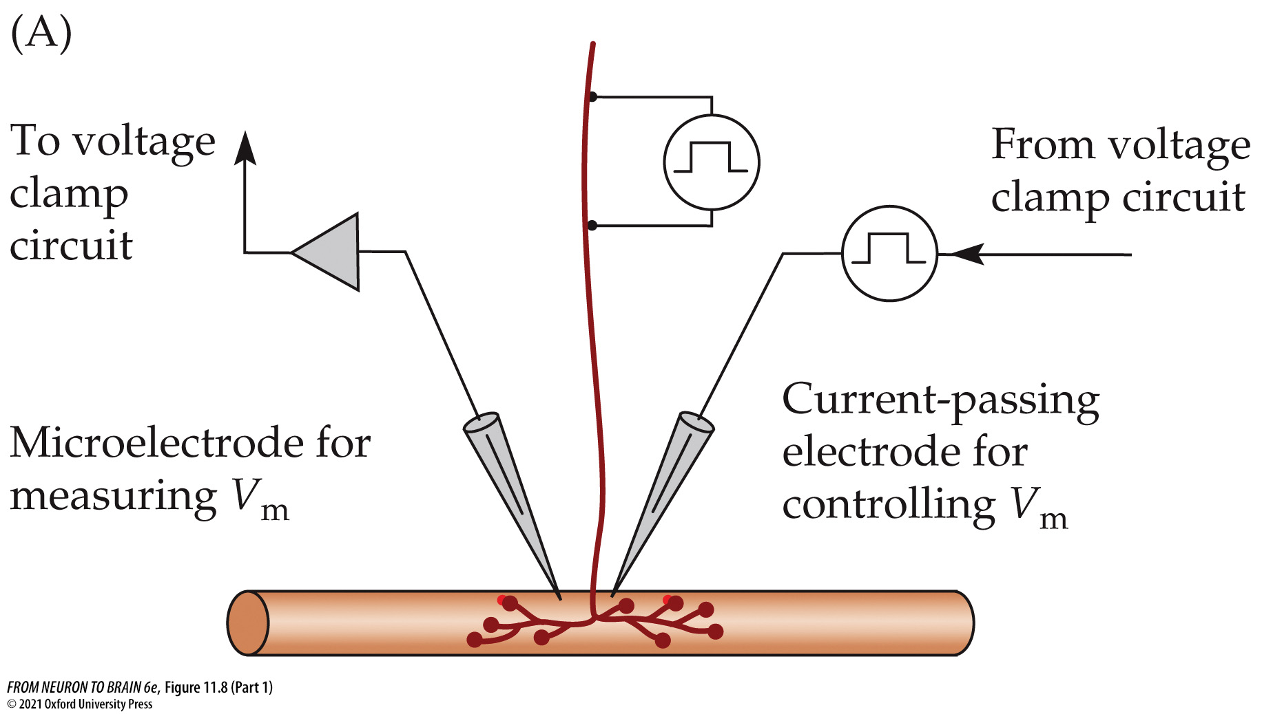
FIGURE 11.8 Reversal Potential for Synaptic Currents Measured by Voltage Clamp Recording (Part 1)
Notes:
FIGURE 11.8 Reversal Potential for Synaptic Currents Measured by Voltage Clamp Recording. (A) Scheme for voltage clamp recording at the motor end plate. (B) Synaptic currents recorded from a glycerol-treated muscle fiber at membrane potentials between –120 and +38 mV. When the muscle membrane potential is clamped below 0 mV, synaptic current flows into the muscle. Such inward current would depolarize the muscle if it were not voltage clamped. When the end plate potential is clamped above 0 mV, synaptic current flows out of the cell. (C) Plot of peak end plate current as a function of membrane potential. The relation is nearly linear, with the reversal potential close to 0 mV. (B after K. L. Magleby and C. F. Stevens, 1972. J. Physiol. 223: 151–171; C after K. L. Magleby and C. F. Stevens, 1972. J. Physiol. 223: 173–197.)

Slide 27
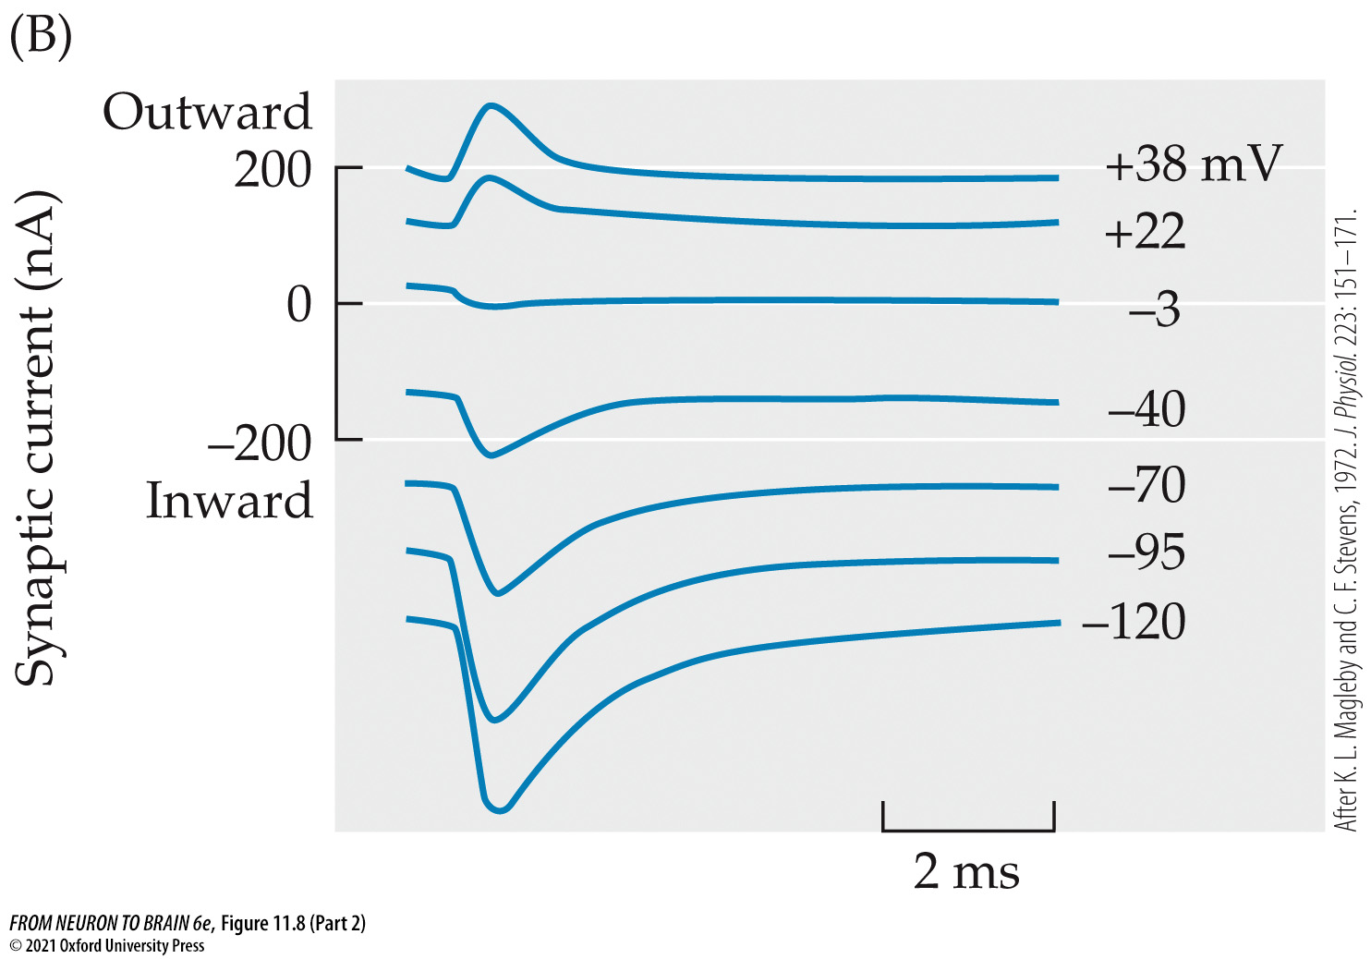
FIGURE 11.8 Reversal Potential for Synaptic Currents Measured by Voltage Clamp Recording (Part 2)
Notes:
FIGURE 11.8 Reversal Potential for Synaptic Currents Measured by Voltage Clamp Recording. (A) Scheme for voltage clamp recording at the motor end plate. (B) Synaptic currents recorded from a glycerol-treated muscle fiber at membrane potentials between –120 and +38 mV. When the muscle membrane potential is clamped below 0 mV, synaptic current flows into the muscle. Such inward current would depolarize the muscle if it were not voltage clamped. When the end plate potential is clamped above 0 mV, synaptic current flows out of the cell. (C) Plot of peak end plate current as a function of membrane potential. The relation is nearly linear, with the reversal potential close to 0 mV. (B after K. L. Magleby and C. F. Stevens, 1972. J. Physiol. 223: 151–171; C after K. L. Magleby and C. F. Stevens, 1972. J. Physiol. 223: 173–197.)

Slide 28
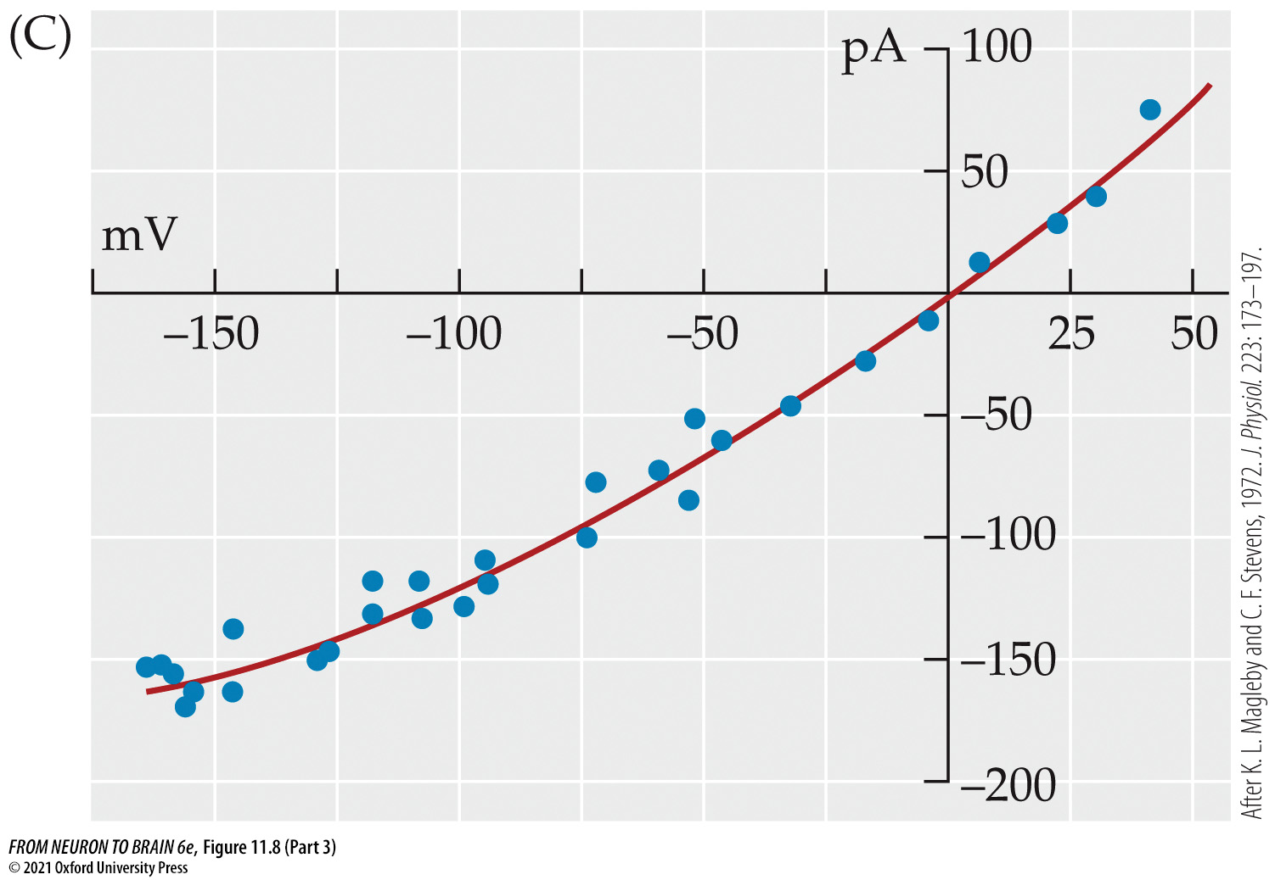
FIGURE 11.8 Reversal Potential for Synaptic Currents Measured by Voltage Clamp Recording (Part 3)
Notes:
FIGURE 11.8 Reversal Potential for Synaptic Currents Measured by Voltage Clamp Recording. (A) Scheme for voltage clamp recording at the motor end plate. (B) Synaptic currents recorded from a glycerol-treated muscle fiber at membrane potentials between –120 and +38 mV. When the muscle membrane potential is clamped below 0 mV, synaptic current flows into the muscle. Such inward current would depolarize the muscle if it were not voltage clamped. When the end plate potential is clamped above 0 mV, synaptic current flows out of the cell. (C) Plot of peak end plate current as a function of membrane potential. The relation is nearly linear, with the reversal potential close to 0 mV. (B after K. L. Magleby and C. F. Stevens, 1972. J. Physiol. 223: 151–171; C after K. L. Magleby and C. F. Stevens, 1972. J. Physiol. 223: 173–197.)

Slide 29
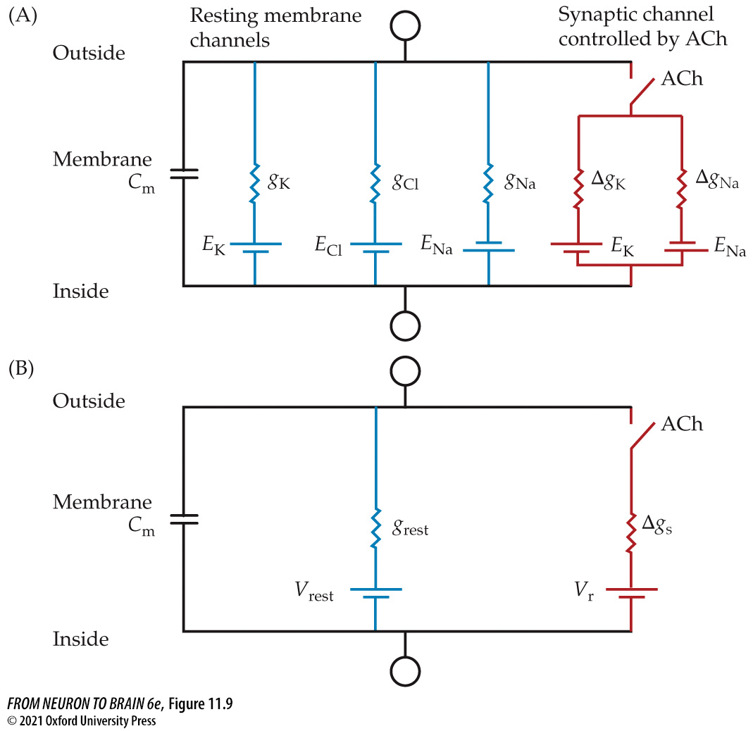
FIGURE 11.9 Electrical Model of the Postsynaptic Membrane
Notes:
FIGURE 11.9 Electrical Model of the Postsynaptic Membrane. Channels activated by ACh are in parallel with the resting membrane channels and with the membrane capacitance, C_{m}. (A) The synaptic channel opened by ACh is electrically equivalent to two independent pathways for sodium and potassium. The resting membrane has channels for potassium, chloride, and sodium. (B) The synaptic channel can be represented as a single pathway with conductance Δg_{s} and a battery equal to the reversal potential V_{r} . The resting membrane can be represented as a single pathway with conductance g_{rest} and a battery equal to V_{rest}.

Slide 30
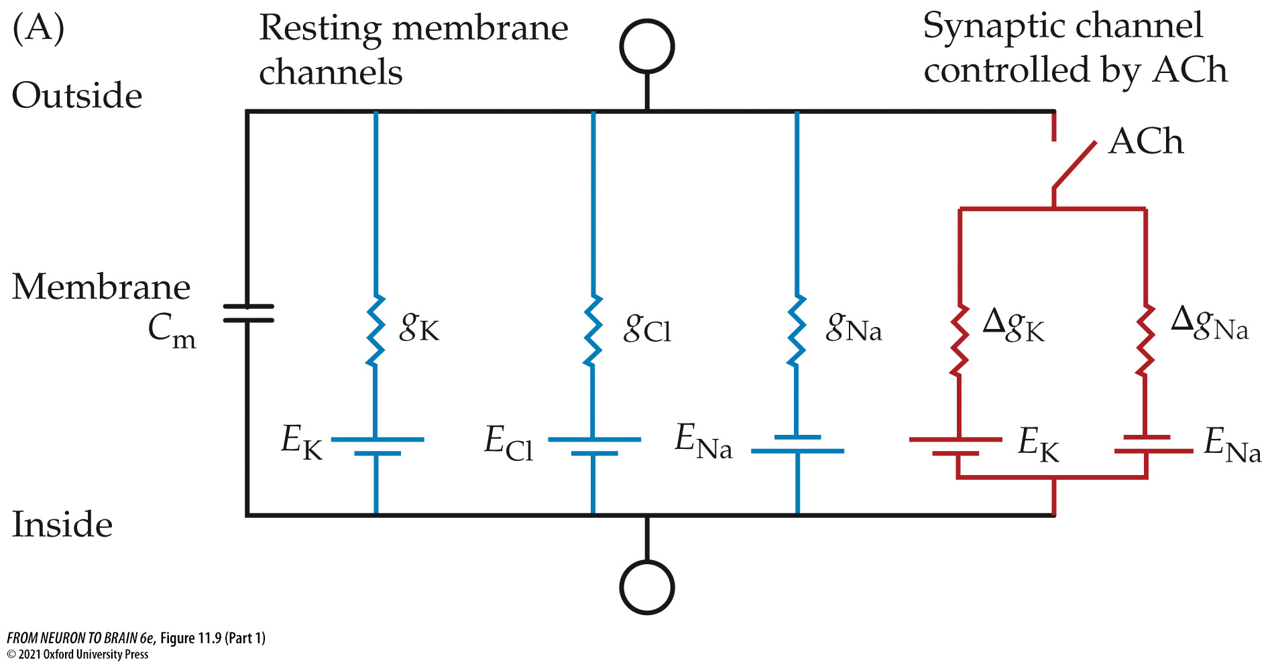
FIGURE 11.9 Electrical Model of the Postsynaptic Membrane (Part 1)
Notes:
FIGURE 11.9 Electrical Model of the Postsynaptic Membrane. Channels activated by ACh are in parallel with the resting membrane channels and with the membrane capacitance, C_{m}. (A) The synaptic channel opened by ACh is electrically equivalent to two independent pathways for sodium and potassium. The resting membrane has channels for potassium, chloride, and sodium. (B) The synaptic channel can be represented as a single pathway with conductance Δg_{s} and a battery equal to the reversal potential V_{r} . The resting membrane can be represented as a single pathway with conductance g_{rest} and a battery equal to V_{rest}.

Slide 31
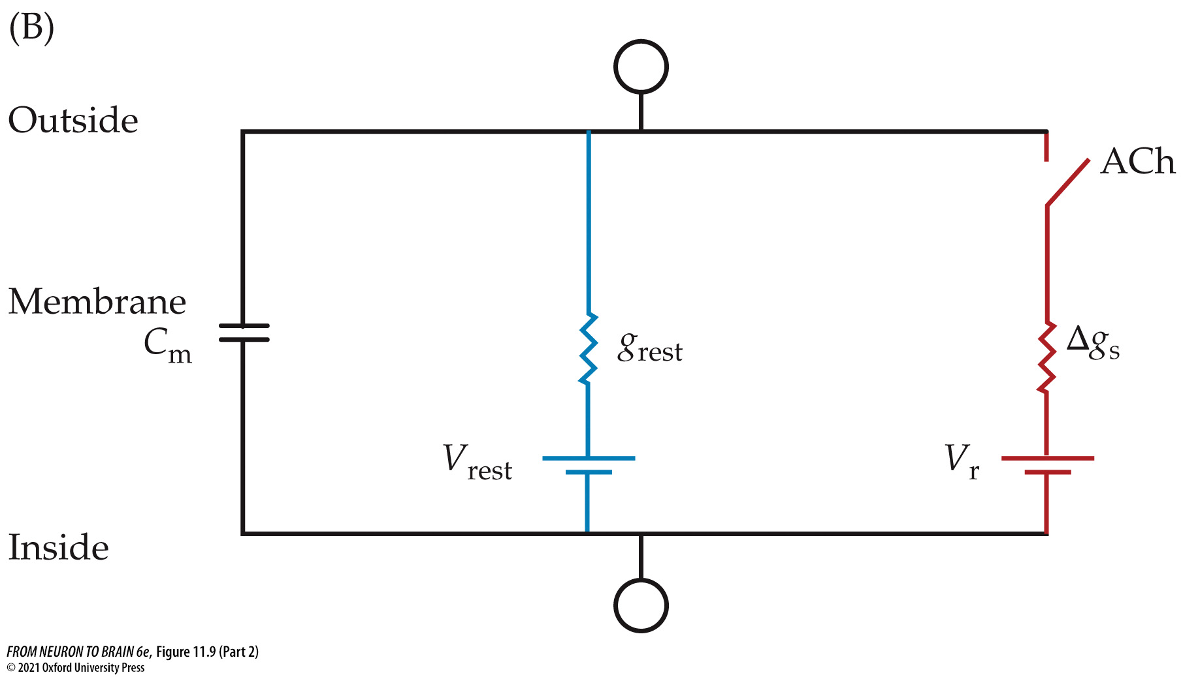
FIGURE 11.9 Electrical Model of the Postsynaptic Membrane (Part 2)
Notes:
FIGURE 11.9 Electrical Model of the Postsynaptic Membrane. Channels activated by ACh are in parallel with the resting membrane channels and with the membrane capacitance, C_{m}. (A) The synaptic channel opened by ACh is electrically equivalent to two independent pathways for sodium and potassium. The resting membrane has channels for potassium, chloride, and sodium. (B) The synaptic channel can be represented as a single pathway with conductance Δg_{s} and a battery equal to the reversal potential V_{r} . The resting membrane can be represented as a single pathway with conductance g_{rest} and a battery equal to V_{rest}.

Slide 32
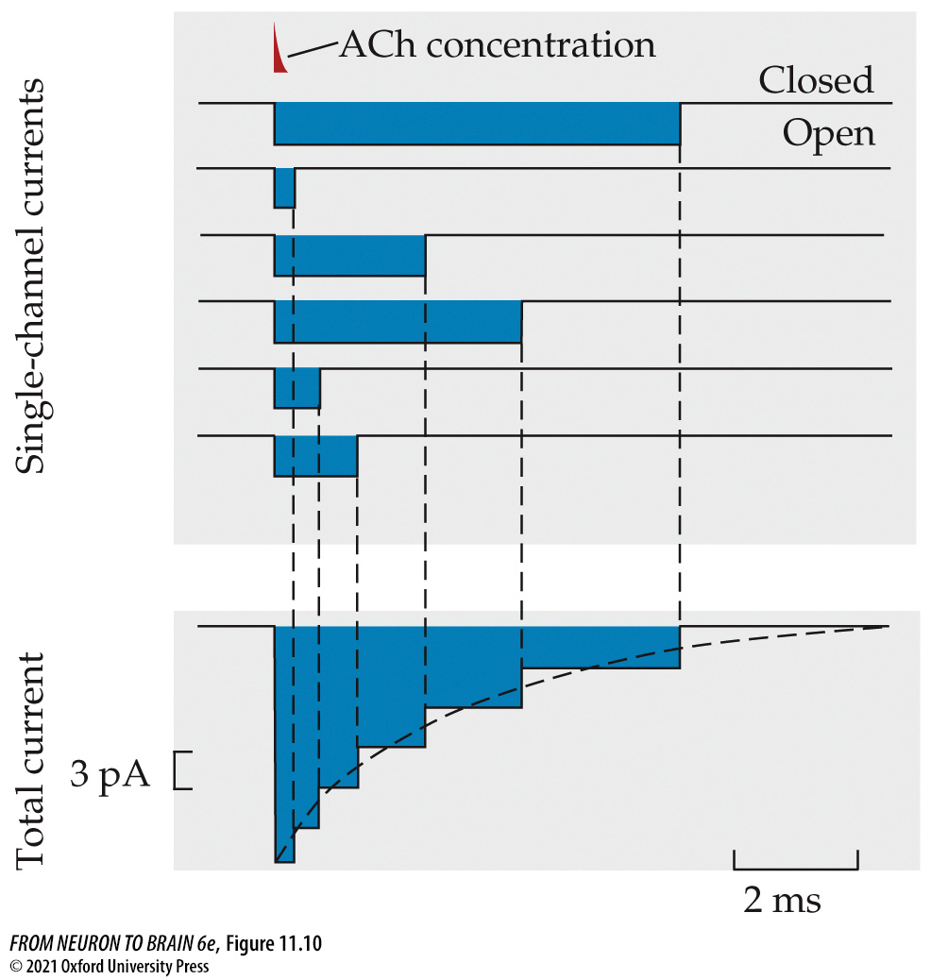
FIGURE 11.10 Total End Plate Current Is the Sum of Individual Channel Currents
Notes:
FIGURE 11.10 Total End Plate Current Is the Sum of Individual Channel Currents. Current flow through six individual channels is depicted in the top panel. Channels open instantaneously in response to ACh (added at the red marker point). ACh is rapidly hydrolyzed, so its concentration falls quickly (red marker), preventing any further channel openings. Channel open times are distributed exponentially. The individual channel currents sum to give the total end plate current (lower panel). The time constant of the decay of the total current is equal to the mean open time of the individual channels.

Slide 33
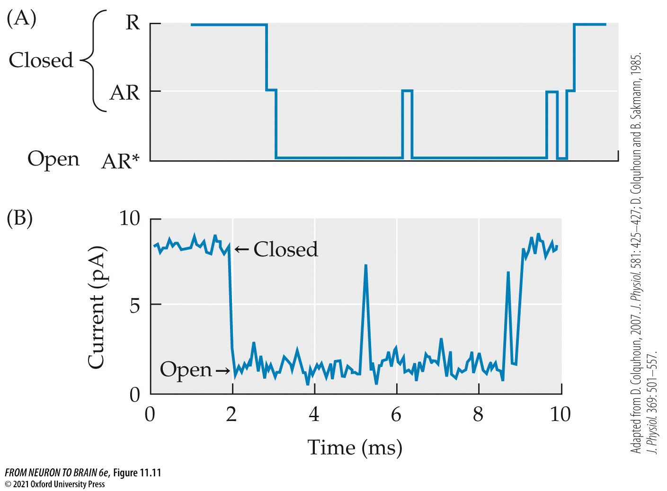
FIGURE 11.11 End Plate Nicotinic Acetylcholine Receptors Open in Bursts
Notes:
FIGURE 11.11 End Plate Nicotinic Acetylcholine Receptors Open in Bursts. (A) Predicted burst of three openings (AR*) assuming the fastest possible binding rate (5 × 10⁸ moles⁻¹ s⁻¹). The channel flips briefly to the ACh-bound state but returns to the shut (AR) state twice before the acetylcholine dissociates and the channel reverts to the R state. (B) High-resolution recording of an equivalent three-opening burst with two brief closures from a frog end plate receptor activated by the nicotinic agonist suberyldicholine. (Adapted from D. Colquhoun, 2007. J. Physiol. 581: 425–427; D. Colquhoun and B. Sakmann, 1985. J. Physiol. 369: 501–557.)

Slide 34
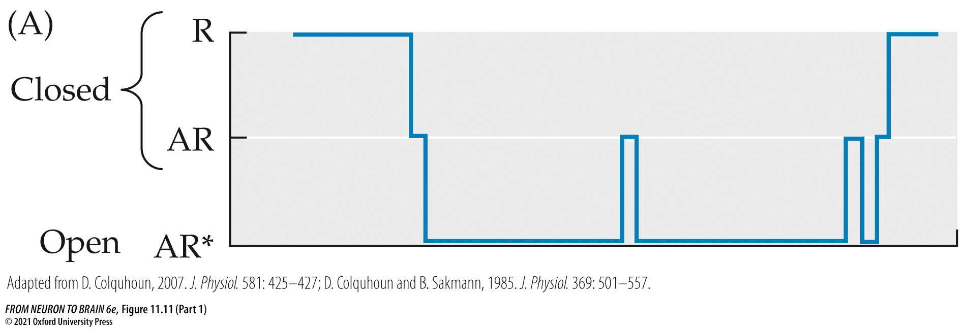
FIGURE 11.11 End Plate Nicotinic Acetylcholine Receptors Open in Bursts (Part 1)
Notes:
FIGURE 11.11 End Plate Nicotinic Acetylcholine Receptors Open in Bursts. (A) Predicted burst of three openings (AR*) assuming the fastest possible binding rate (5 × 10⁸ moles⁻¹ s⁻¹). The channel flips briefly to the ACh-bound state but returns to the shut (AR) state twice before the acetylcholine dissociates and the channel reverts to the R state. (B) High-resolution recording of an equivalent three-opening burst with two brief closures from a frog end plate receptor activated by the nicotinic agonist suberyldicholine. (Adapted from D. Colquhoun, 2007. J. Physiol. 581: 425–427; D. Colquhoun and B. Sakmann, 1985. J. Physiol. 369: 501–557.)

Slide 35
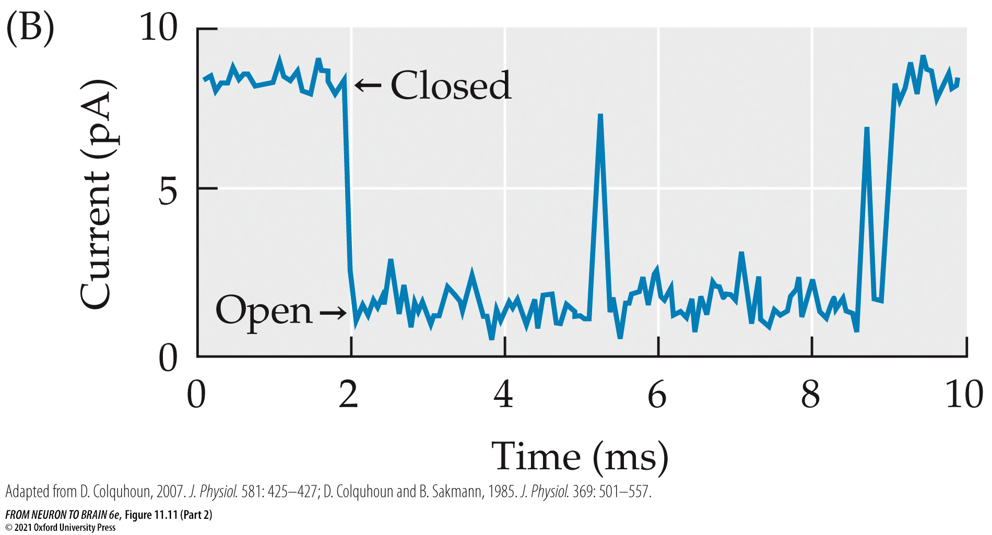
FIGURE 11.11 End Plate Nicotinic Acetylcholine Receptors Open in Bursts (Part 2)
Notes:
FIGURE 11.11 End Plate Nicotinic Acetylcholine Receptors Open in Bursts. (A) Predicted burst of three openings (AR*) assuming the fastest possible binding rate (5 × 10⁸ moles⁻¹ s⁻¹). The channel flips briefly to the ACh-bound state but returns to the shut (AR) state twice before the acetylcholine dissociates and the channel reverts to the R state. (B) High-resolution recording of an equivalent three-opening burst with two brief closures from a frog end plate receptor activated by the nicotinic agonist suberyldicholine. (Adapted from D. Colquhoun, 2007. J. Physiol. 581: 425–427; D. Colquhoun and B. Sakmann, 1985. J. Physiol. 369: 501–557.)

Slide 36
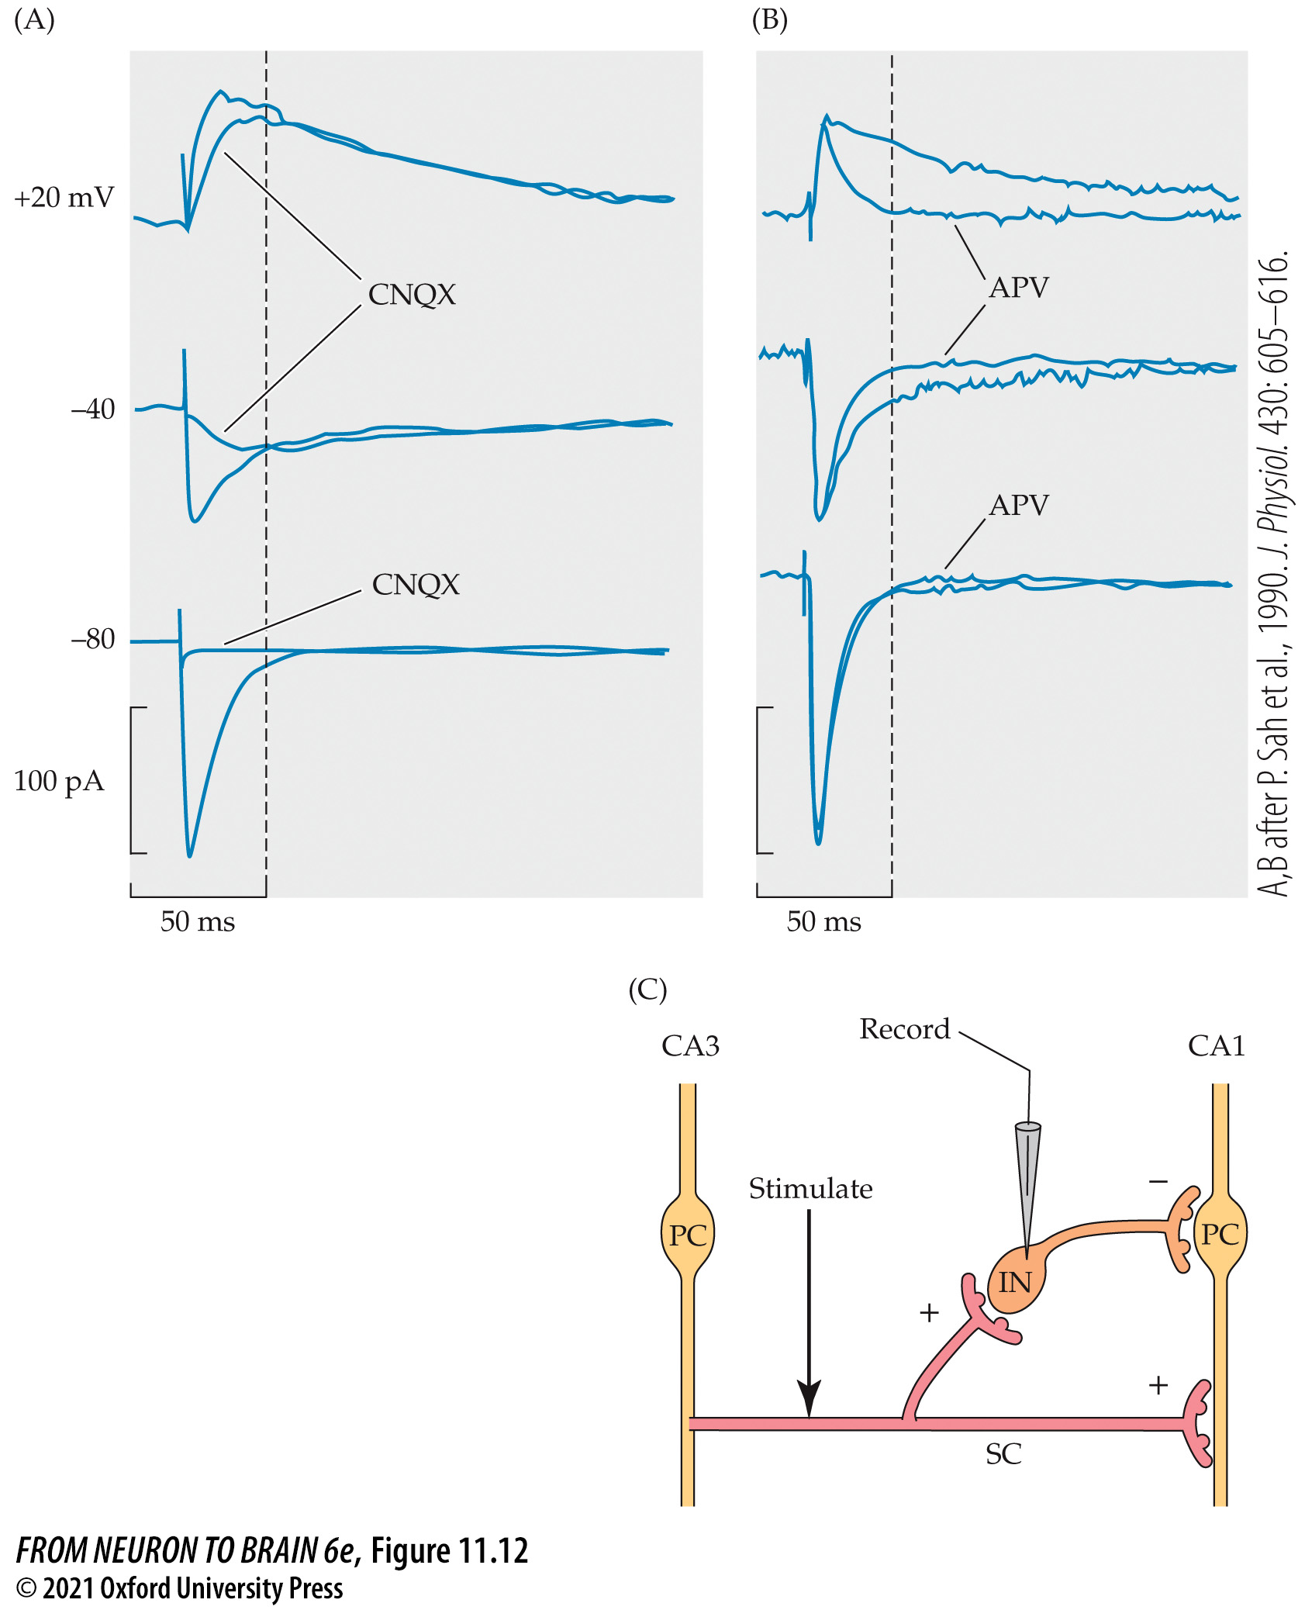
FIGURE 11.12 The Excitatory Neurotransmitter Glutamate Acts on Two Different Receptors to Produce Two Excitatory Postsynaptic Currents (EPSCs)
Notes:
FIGURE 11.12 The Excitatory Neurotransmitter Glutamate Acts on Two Different Receptors to Produce Two Excitatory Postsynaptic Currents (EPSCs). EPSCs were recorded with a patch electrode from an interneuron in the CA1 region of a rat hippocampal slice preparation. The synaptic potentials were produced by stimulating the glutamate-releasing afferent fibers in the Schaffer collaterals. The interneuron membrane potential was held at three different values, –80, –40, and +20 mV. (A) The traces show the effect of blocking the AMPA receptors with CNQX. This suppressed all of the EPSC at –80 mV but only the first part at +20 mV, leaving a large, slower component. The latter was due to the simultaneous activation of voltage-dependent NMDA receptors, since blocking the NMDA receptors with APV. (B) left a pure, fast AMPA receptor-mediated EPSC. (C) Schematic of recording. PC = pyramidal cells; IN = interneuron; SC = Schaffer collaterals; excitation (+); inhibition (–). (A,B after P. Sah et al., 1990. J. Physiol. 430: 605–616.)

Slide 37
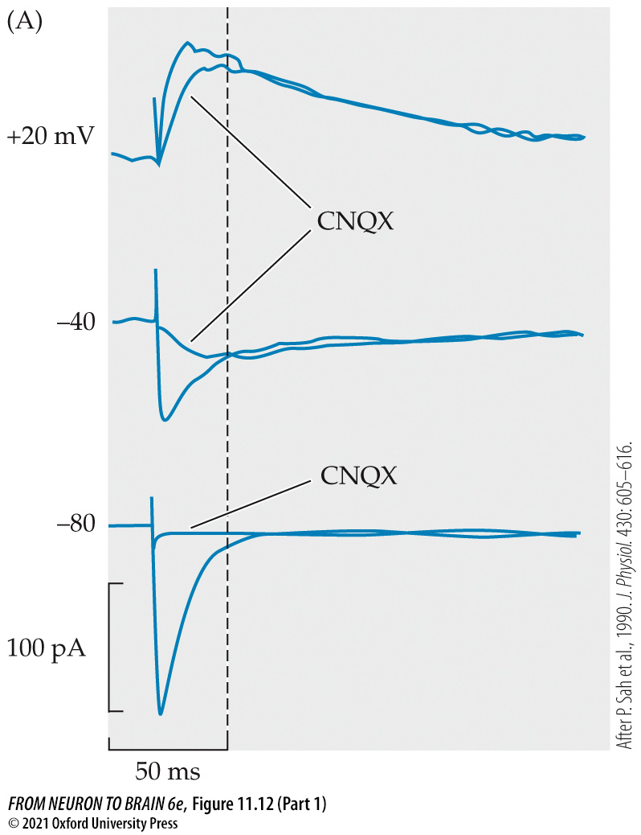
FIGURE 11.12 The Excitatory Neurotransmitter Glutamate Acts on Two Different Receptors to Produce Two Excitatory Postsynaptic Currents (EPSCs) (Part 1)
Notes:
FIGURE 11.12 The Excitatory Neurotransmitter Glutamate Acts on Two Different Receptors to Produce Two Excitatory Postsynaptic Currents (EPSCs). EPSCs were recorded with a patch electrode from an interneuron in the CA1 region of a rat hippocampal slice preparation. The synaptic potentials were produced by stimulating the glutamate-releasing afferent fibers in the Schaffer collaterals. The interneuron membrane potential was held at three different values, –80, –40, and +20 mV. (A) The traces show the effect of blocking the AMPA receptors with CNQX. This suppressed all of the EPSC at –80 mV but only the first part at +20 mV, leaving a large, slower component. The latter was due to the simultaneous activation of voltage-dependent NMDA receptors, since blocking the NMDA receptors with APV. (B) left a pure, fast AMPA receptor-mediated EPSC. (C) Schematic of recording. PC = pyramidal cells; IN = interneuron; SC = Schaffer collaterals; excitation (+); inhibition (–). (A,B after P. Sah et al., 1990. J. Physiol. 430: 605–616.)

Slide 38
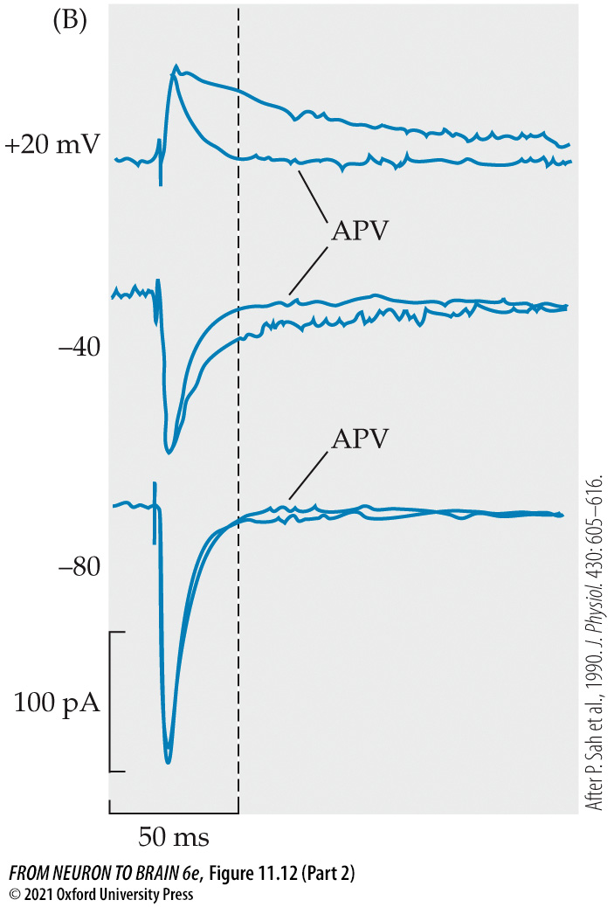
FIGURE 11.12 The Excitatory Neurotransmitter Glutamate Acts on Two Different Receptors to Produce Two Excitatory Postsynaptic Currents (EPSCs) (Part 2)
Notes:
FIGURE 11.12 The Excitatory Neurotransmitter Glutamate Acts on Two Different Receptors to Produce Two Excitatory Postsynaptic Currents (EPSCs). EPSCs were recorded with a patch electrode from an interneuron in the CA1 region of a rat hippocampal slice preparation. The synaptic potentials were produced by stimulating the glutamate-releasing afferent fibers in the Schaffer collaterals. The interneuron membrane potential was held at three different values, –80, –40, and +20 mV. (A) The traces show the effect of blocking the AMPA receptors with CNQX. This suppressed all of the EPSC at –80 mV but only the first part at +20 mV, leaving a large, slower component. The latter was due to the simultaneous activation of voltage-dependent NMDA receptors, since blocking the NMDA receptors with APV. (B) left a pure, fast AMPA receptor-mediated EPSC. (C) Schematic of recording. PC = pyramidal cells; IN = interneuron; SC = Schaffer collaterals; excitation (+); inhibition (–). (A,B after P. Sah et al., 1990. J. Physiol. 430: 605–616.)

Slide 39
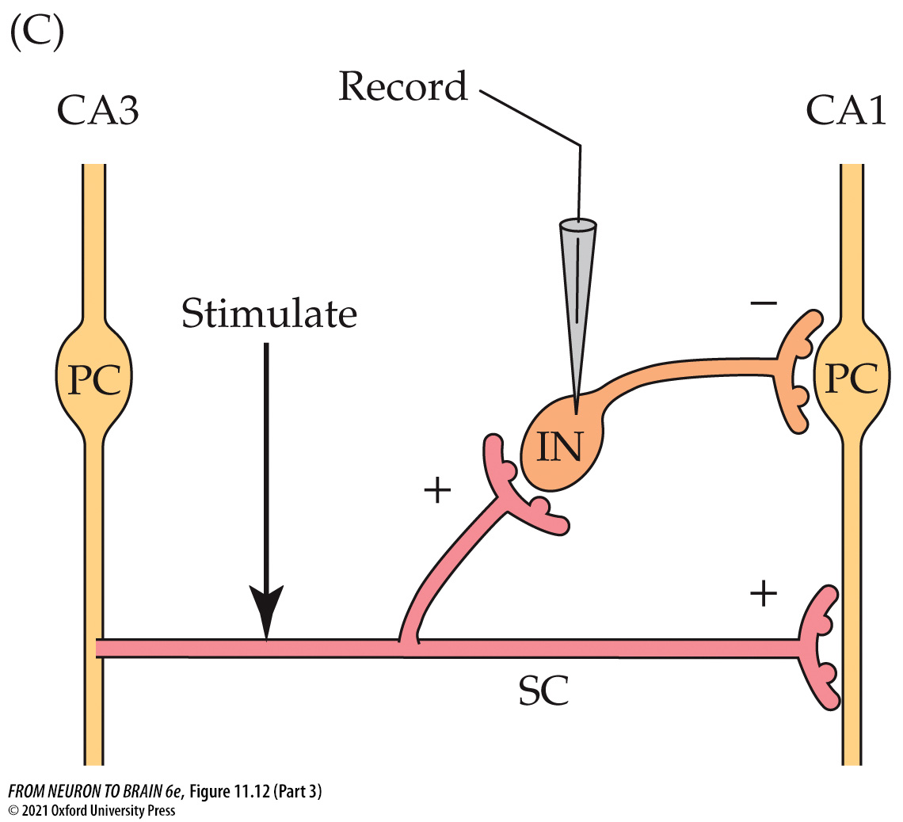
FIGURE 11.12 The Excitatory Neurotransmitter Glutamate Acts on Two Different Receptors to Produce Two Excitatory Postsynaptic Currents (EPSCs) (Part 3)
Notes:
FIGURE 11.12 The Excitatory Neurotransmitter Glutamate Acts on Two Different Receptors to Produce Two Excitatory Postsynaptic Currents (EPSCs). EPSCs were recorded with a patch electrode from an interneuron in the CA1 region of a rat hippocampal slice preparation. The synaptic potentials were produced by stimulating the glutamate-releasing afferent fibers in the Schaffer collaterals. The interneuron membrane potential was held at three different values, –80, –40, and +20 mV. (A) The traces show the effect of blocking the AMPA receptors with CNQX. This suppressed all of the EPSC at –80 mV but only the first part at +20 mV, leaving a large, slower component. The latter was due to the simultaneous activation of voltage-dependent NMDA receptors, since blocking the NMDA receptors with APV. (B) left a pure, fast AMPA receptor-mediated EPSC. (C) Schematic of recording. PC = pyramidal cells; IN = interneuron; SC = Schaffer collaterals; excitation (+); inhibition (–). (A,B after P. Sah et al., 1990. J. Physiol. 430: 605–616.)

Slide 40
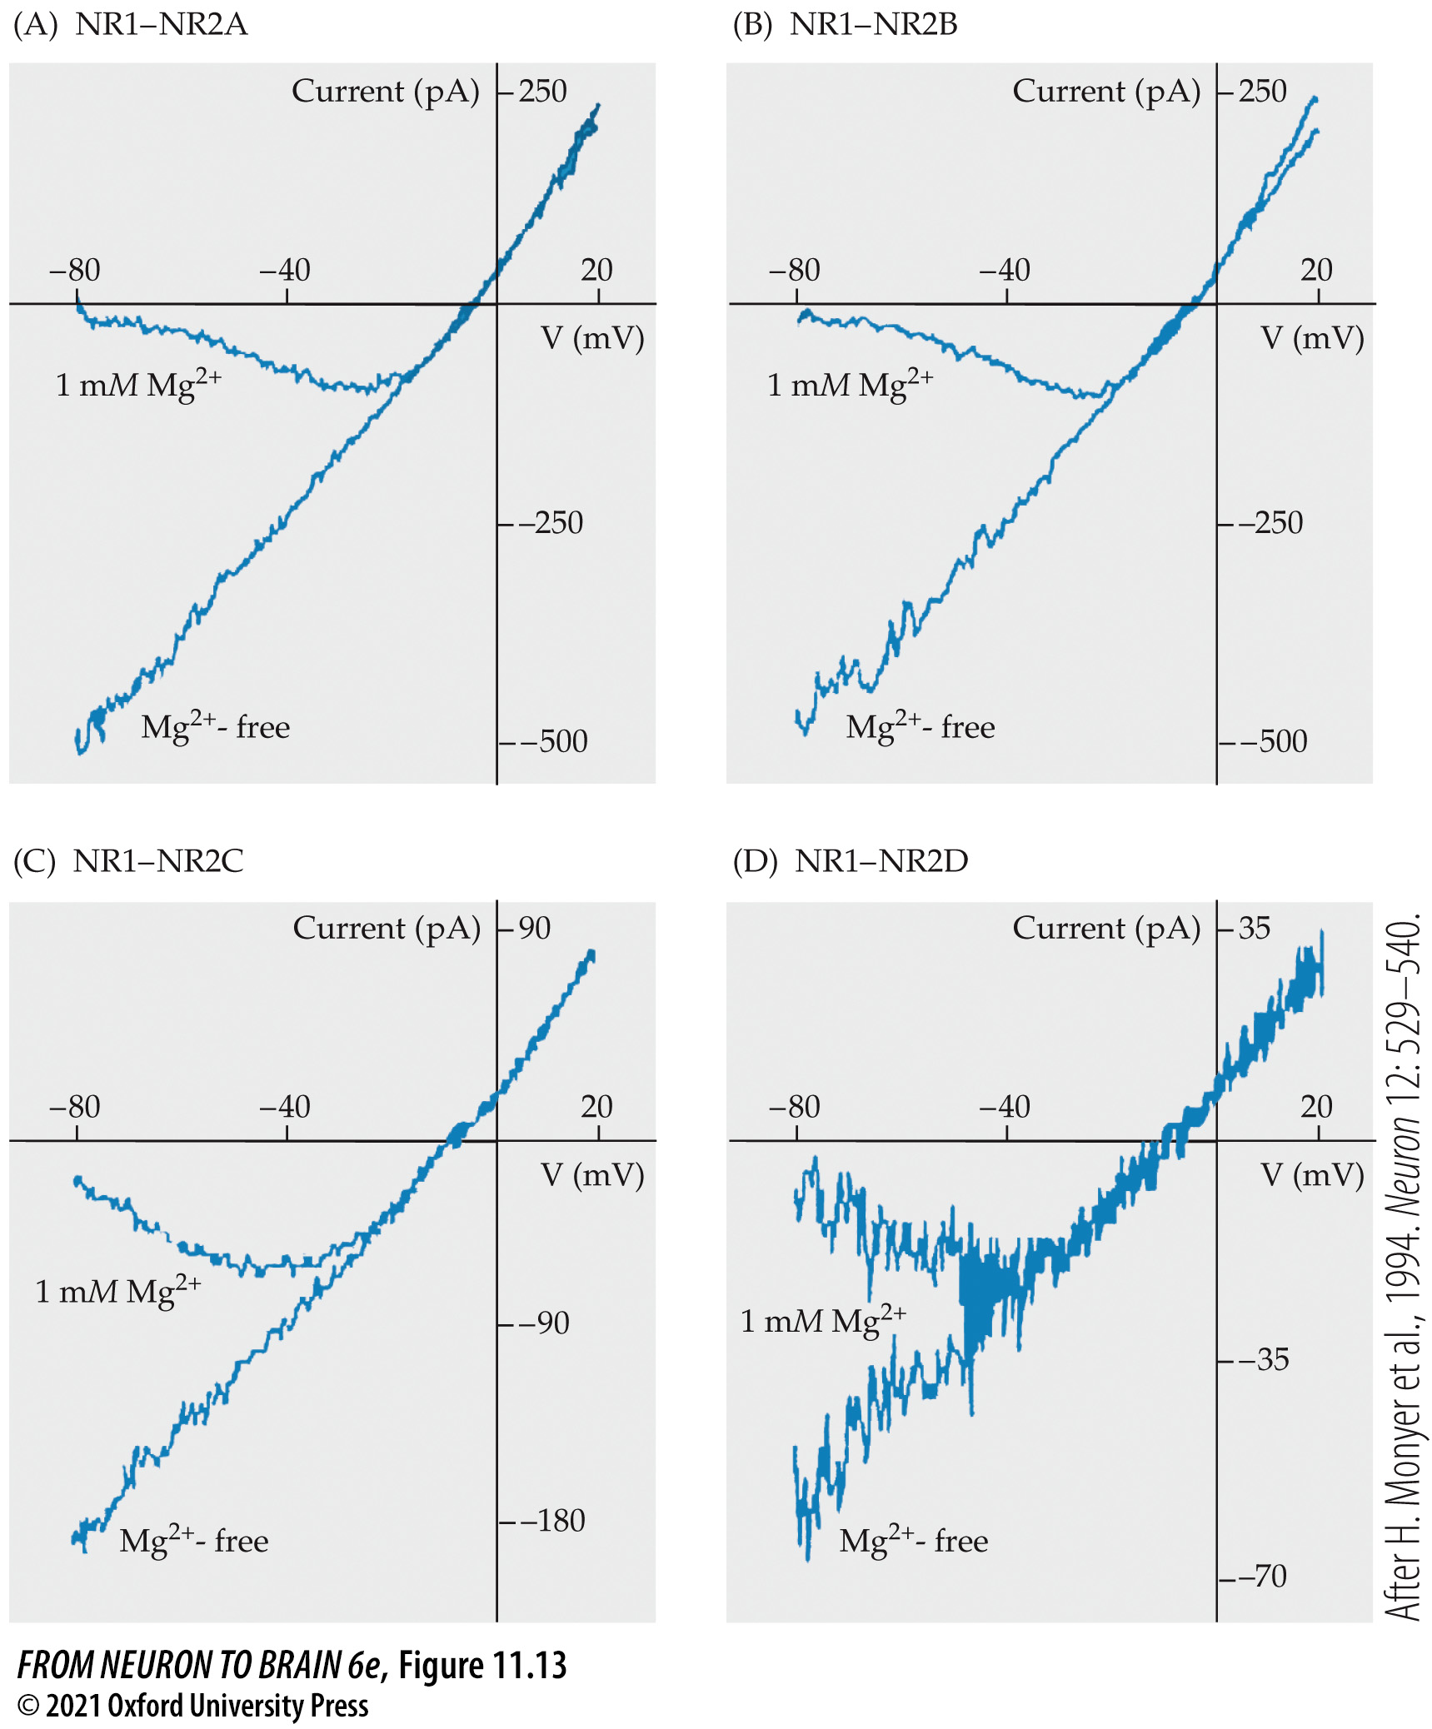
FIGURE 11.13 Mg²⁺-Dependent Rectification of Current–Voltage Curves for Recombinant NMDA Receptors
Notes:
FIGURE 11.13 Mg²⁺-Dependent Rectification of Current–Voltage Curves for Recombinant NMDA Receptors. Receptors were expressed in human embryonic kidney (HEK) cells by transfecting cDNA for the GluN1 subunit together with cDNA for the following GluN2 subunits: (A) GluN2A; (B) GluN2B; (C) GluN2C; (D) GluN2D. The HEK cells were then patched with a whole-cell patch pipette to record currents through the expressed channels. Records show currents (ordinates, pA) generated by changing the membrane potential (abscissae) between –80 and +20 mV, in the presence and absence of 1 mM external Mg²⁺. Note that the currents are linearly dependent on membrane voltage in the absence of external Mg²⁺ but strongly rectify at negative potentials in the presence of Mg²⁺. Note also that current scales are smaller in (C) and (D). (After H. Monyer et al., 1994. Neuron 12: 529–540.)

Slide 41
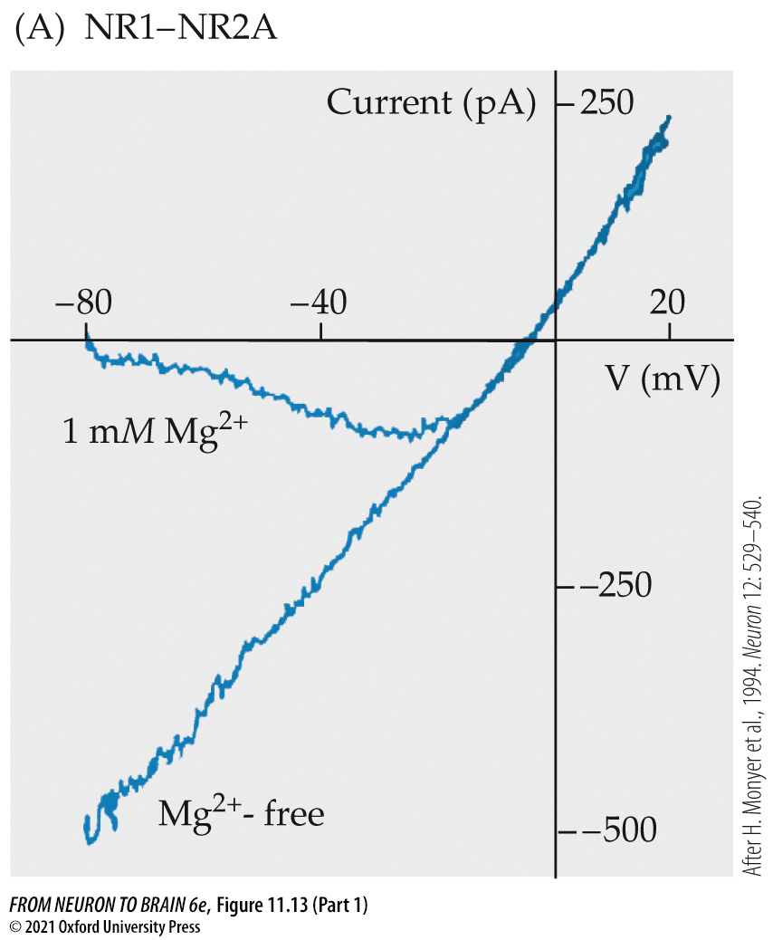
FIGURE 11.13 Mg²⁺-Dependent Rectification of Current–Voltage Curves for Recombinant NMDA Receptors (Part 1)
Notes:
FIGURE 11.13 Mg²⁺-Dependent Rectification of Current–Voltage Curves for Recombinant NMDA Receptors. Receptors were expressed in human embryonic kidney (HEK) cells by transfecting cDNA for the GluN1 subunit together with cDNA for the following GluN2 subunits: (A) GluN2A; (B) GluN2B; (C) GluN2C; (D) GluN2D. The HEK cells were then patched with a whole-cell patch pipette to record currents through the expressed channels. Records show currents (ordinates, pA) generated by changing the membrane potential (abscissae) between –80 and +20 mV, in the presence and absence of 1 mM external Mg²⁺. Note that the currents are linearly dependent on membrane voltage in the absence of external Mg²⁺ but strongly rectify at negative potentials in the presence of Mg²⁺. Note also that current scales are smaller in (C) and (D). (After H. Monyer et al., 1994. Neuron 12: 529–540.)

Slide 42
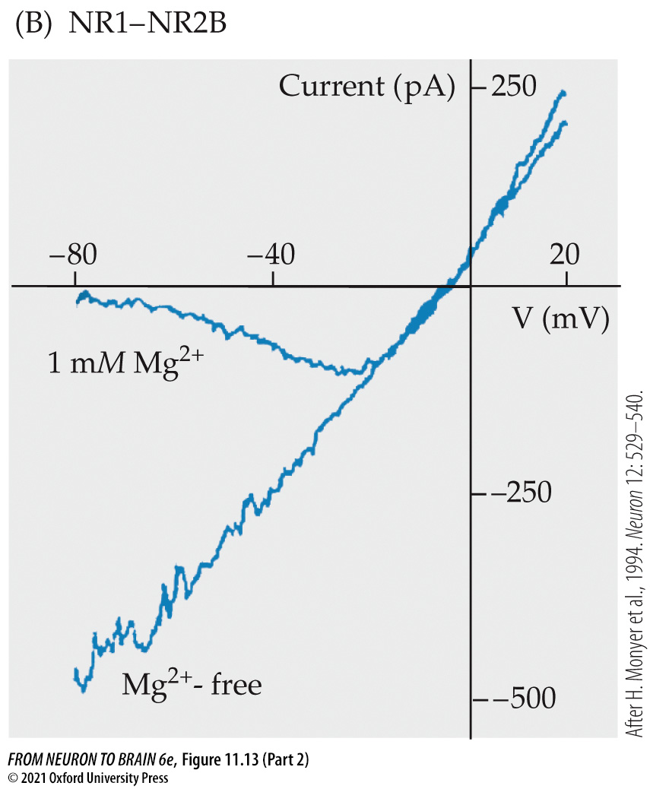
FIGURE 11.13 Mg²⁺-Dependent Rectification of Current–Voltage Curves for Recombinant NMDA Receptors (Part 2)
Notes:
FIGURE 11.13 Mg²⁺-Dependent Rectification of Current–Voltage Curves for Recombinant NMDA Receptors. Receptors were expressed in human embryonic kidney (HEK) cells by transfecting cDNA for the GluN1 subunit together with cDNA for the following GluN2 subunits: (A) GluN2A; (B) GluN2B; (C) GluN2C; (D) GluN2D. The HEK cells were then patched with a whole-cell patch pipette to record currents through the expressed channels. Records show currents (ordinates, pA) generated by changing the membrane potential (abscissae) between –80 and +20 mV, in the presence and absence of 1 mM external Mg²⁺. Note that the currents are linearly dependent on membrane voltage in the absence of external Mg²⁺ but strongly rectify at negative potentials in the presence of Mg²⁺. Note also that current scales are smaller in (C) and (D). (After H. Monyer et al., 1994. Neuron 12: 529–540.)

Slide 43
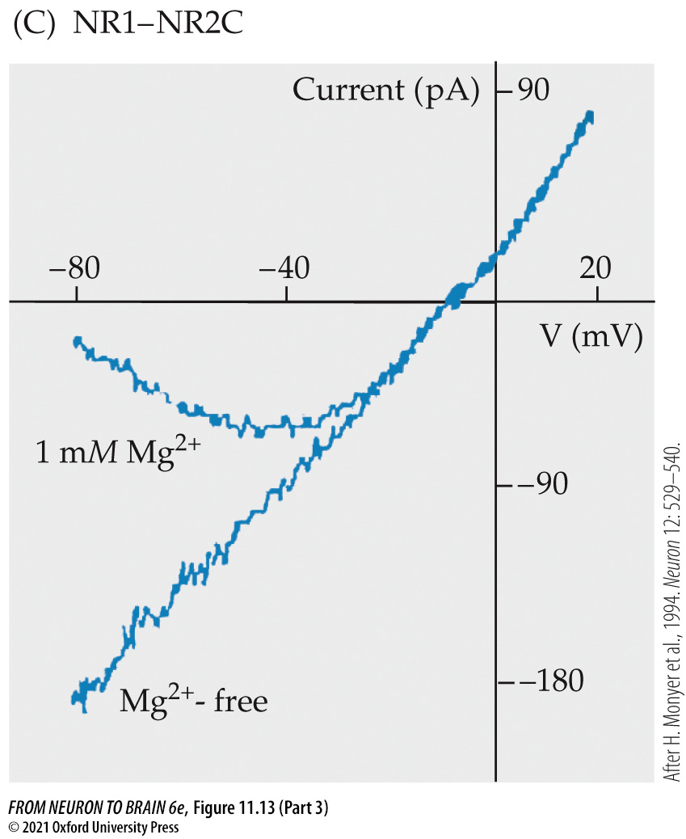
FIGURE 11.13 Mg²⁺-Dependent Rectification of Current–Voltage Curves for Recombinant NMDA Receptors (Part 3)
Notes:
FIGURE 11.13 Mg²⁺-Dependent Rectification of Current–Voltage Curves for Recombinant NMDA Receptors. Receptors were expressed in human embryonic kidney (HEK) cells by transfecting cDNA for the GluN1 subunit together with cDNA for the following GluN2 subunits: (A) GluN2A; (B) GluN2B; (C) GluN2C; (D) GluN2D. The HEK cells were then patched with a whole-cell patch pipette to record currents through the expressed channels. Records show currents (ordinates, pA) generated by changing the membrane potential (abscissae) between –80 and +20 mV, in the presence and absence of 1 mM external Mg²⁺. Note that the currents are linearly dependent on membrane voltage in the absence of external Mg²⁺ but strongly rectify at negative potentials in the presence of Mg²⁺. Note also that current scales are smaller in (C) and (D). (After H. Monyer et al., 1994. Neuron 12: 529–540.)

Slide 44
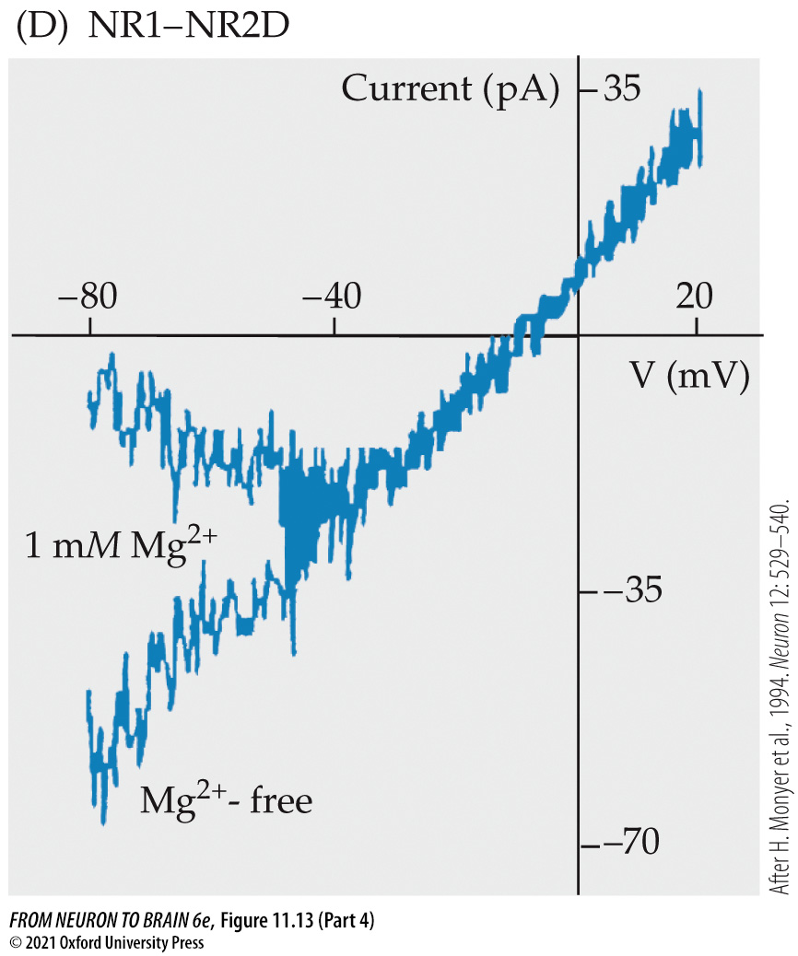
FIGURE 11.13 Mg²⁺-Dependent Rectification of Current–Voltage Curves for Recombinant NMDA Receptors (Part 4)
Notes:
FIGURE 11.13 Mg²⁺-Dependent Rectification of Current–Voltage Curves for Recombinant NMDA Receptors. Receptors were expressed in human embryonic kidney (HEK) cells by transfecting cDNA for the GluN1 subunit together with cDNA for the following GluN2 subunits: (A) GluN2A; (B) GluN2B; (C) GluN2C; (D) GluN2D. The HEK cells were then patched with a whole-cell patch pipette to record currents through the expressed channels. Records show currents (ordinates, pA) generated by changing the membrane potential (abscissae) between –80 and +20 mV, in the presence and absence of 1 mM external Mg²⁺. Note that the currents are linearly dependent on membrane voltage in the absence of external Mg²⁺ but strongly rectify at negative potentials in the presence of Mg²⁺. Note also that current scales are smaller in (C) and (D). (After H. Monyer et al., 1994. Neuron 12: 529–540.)

Slide 45
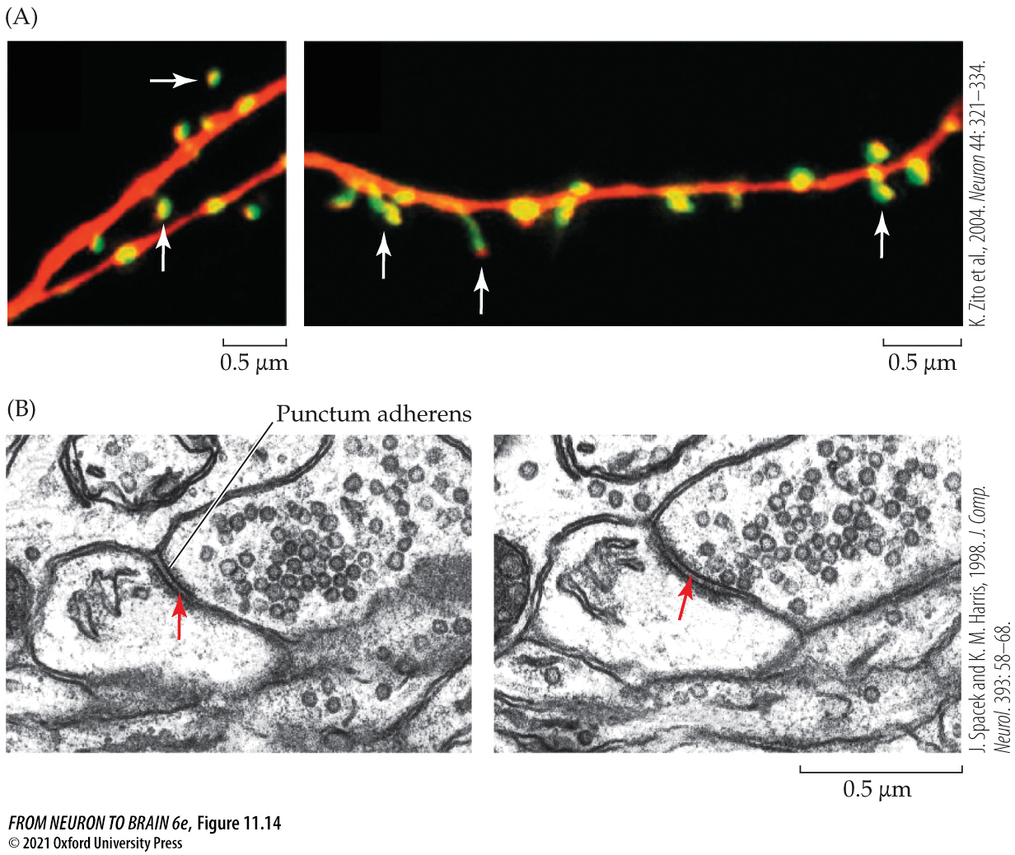
FIGURE 11.14 Dendritic Spines and Excitatory Spine Synapses in Hippocampal Pyramidal Neurons
Notes:
FIGURE 11.14 Dendritic Spines and Excitatory Spine Synapses in Hippocampal Pyramidal Neurons. (A) Dendrites labeled with red Alexa 594 and counterstained for green fluorescent protein (GFP)–labeled actin-binding protein. The latter is concentrated in the dendritic spines (white arrows). (B) Electron micrographs of vesicle-filled synaptic boutons contacting dendritic spines. The red arrows mark the postsynaptic spine apparatus projecting toward the punctum adherens (point of pre- and postsynaptic membrane adhesion). (A after K. Zito et al., 2004. Neuron 44: 321–334; B after J. Spacek and K. M. Harris, 1998. J. Comp. Neurol. 393: 58–68.)

Slide 46
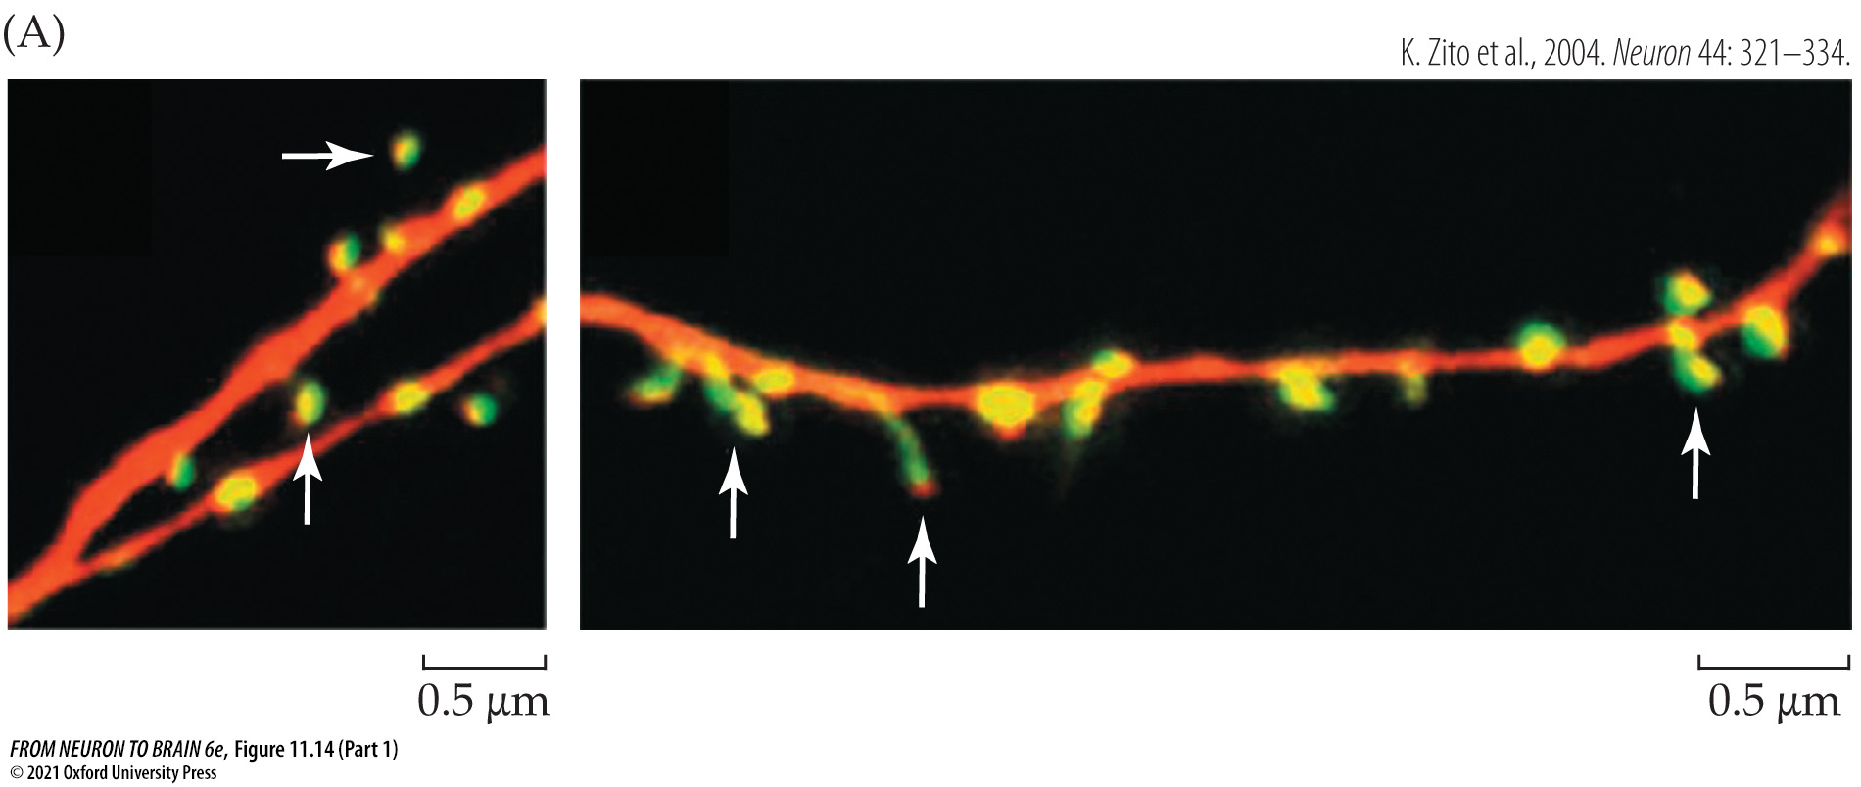
FIGURE 11.14 Dendritic Spines and Excitatory Spine Synapses in Hippocampal Pyramidal Neurons (Part 1)
Notes:
FIGURE 11.14 Dendritic Spines and Excitatory Spine Synapses in Hippocampal Pyramidal Neurons. (A) Dendrites labeled with red Alexa 594 and counterstained for green fluorescent protein (GFP)–labeled actin-binding protein. The latter is concentrated in the dendritic spines (white arrows). (B) Electron micrographs of vesicle-filled synaptic boutons contacting dendritic spines. The red arrows mark the postsynaptic spine apparatus projecting toward the punctum adherens (point of pre- and postsynaptic membrane adhesion). (A after K. Zito et al., 2004. Neuron 44: 321–334; B after J. Spacek and K. M. Harris, 1998. J. Comp. Neurol. 393: 58–68.)

Slide 47
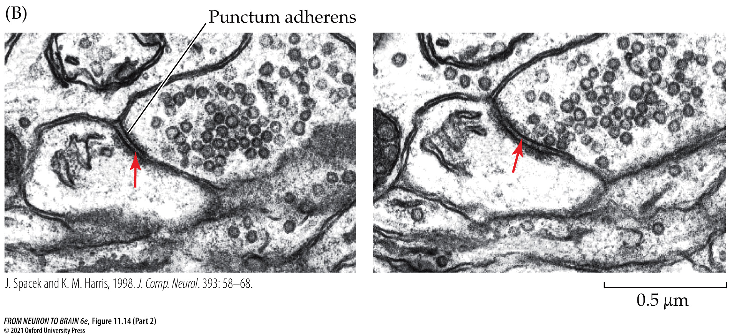
FIGURE 11.14 Dendritic Spines and Excitatory Spine Synapses in Hippocampal Pyramidal Neurons (Part 2)
Notes:
FIGURE 11.14 Dendritic Spines and Excitatory Spine Synapses in Hippocampal Pyramidal Neurons. (A) Dendrites labeled with red Alexa 594 and counterstained for green fluorescent protein (GFP)–labeled actin-binding protein. The latter is concentrated in the dendritic spines (white arrows). (B) Electron micrographs of vesicle-filled synaptic boutons contacting dendritic spines. The red arrows mark the postsynaptic spine apparatus projecting toward the punctum adherens (point of pre- and postsynaptic membrane adhesion). (A after K. Zito et al., 2004. Neuron 44: 321–334; B after J. Spacek and K. M. Harris, 1998. J. Comp. Neurol. 393: 58–68.)

Slide 48
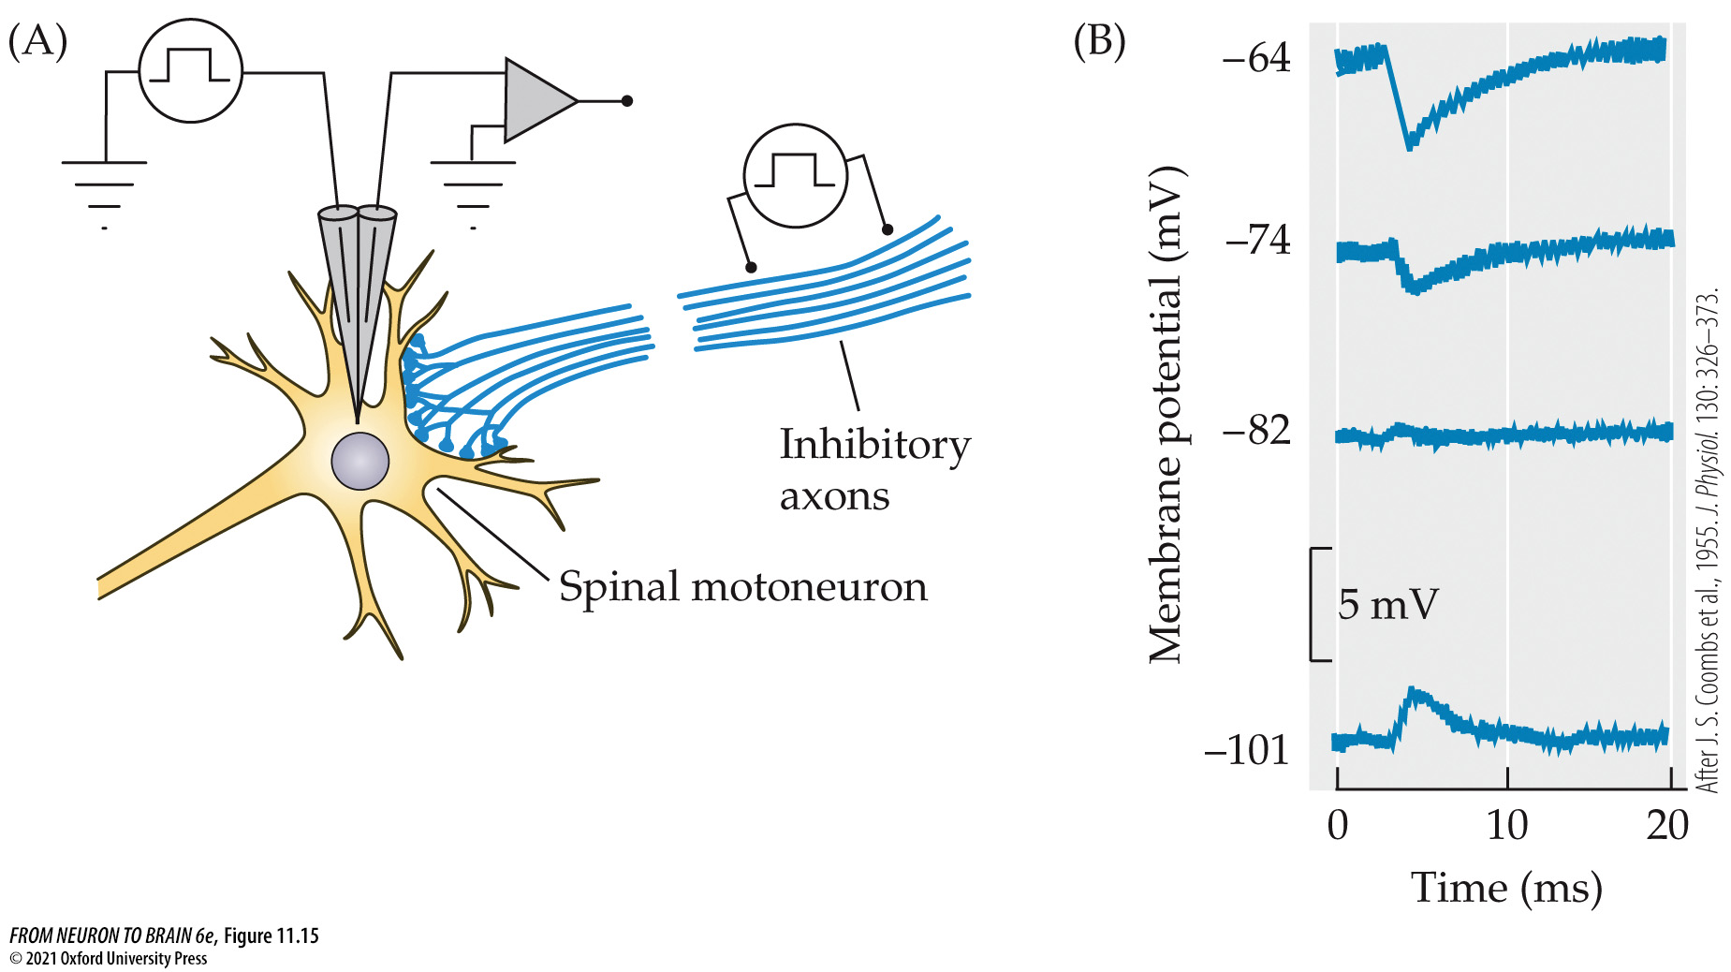
FIGURE 11.15 Direct Inhibitory Chemical Synaptic Transmission
Notes:
FIGURE 11.15 Direct Inhibitory Chemical Synaptic Transmission. (A) Scheme for intracellular recording from a cat spinal motoneuron and stimulation of inhibitory synaptic inputs. The membrane potential of the motoneuron is set to different levels by passing current through a second intracellular microelectrode. (B) Intracellular records of inhibitory postsynaptic potentials evoked at membrane potentials between –64 and –101 mV. The reversal potential is between –74 and –82 mV. (After J. S. Coombs et al., 1955. J. Physiol. 130: 326–373.)

Slide 49
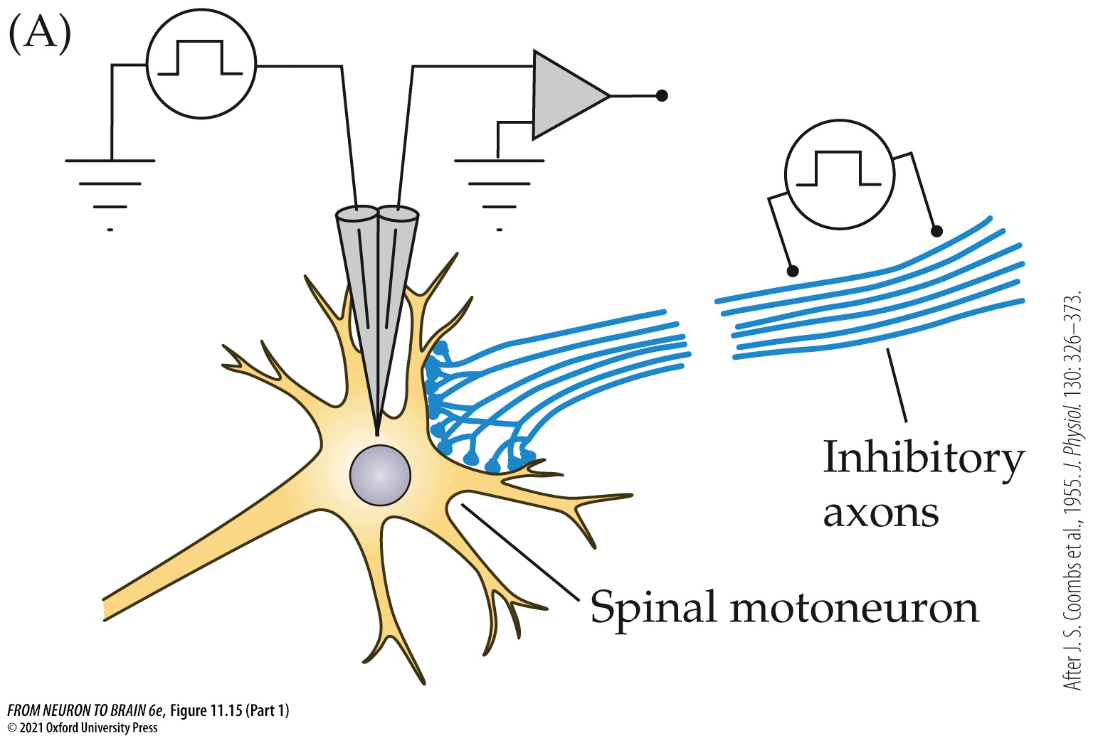
FIGURE 11.15 Direct Inhibitory Chemical Synaptic Transmission (Part 1)
Notes:
FIGURE 11.15 Direct Inhibitory Chemical Synaptic Transmission. (A) Scheme for intracellular recording from a cat spinal motoneuron and stimulation of inhibitory synaptic inputs. The membrane potential of the motoneuron is set to different levels by passing current through a second intracellular microelectrode. (B) Intracellular records of inhibitory postsynaptic potentials evoked at membrane potentials between –64 and –101 mV. The reversal potential is between –74 and –82 mV. (After J. S. Coombs et al., 1955. J. Physiol. 130: 326–373.)

Slide 50
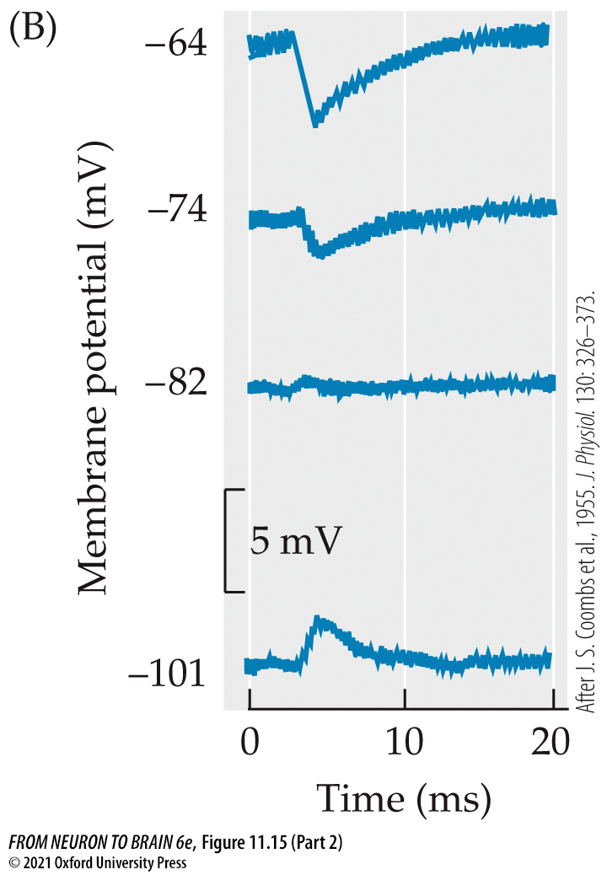
FIGURE 11.15 Direct Inhibitory Chemical Synaptic Transmission (Part 2)
Notes:
FIGURE 11.15 Direct Inhibitory Chemical Synaptic Transmission. (A) Scheme for intracellular recording from a cat spinal motoneuron and stimulation of inhibitory synaptic inputs. The membrane potential of the motoneuron is set to different levels by passing current through a second intracellular microelectrode. (B) Intracellular records of inhibitory postsynaptic potentials evoked at membrane potentials between –64 and –101 mV. The reversal potential is between –74 and –82 mV. (After J. S. Coombs et al., 1955. J. Physiol. 130: 326–373.)

Slide 51

FIGURE 11.16 Inhibitory Response to Glycine Depends on Chloride
Notes:
FIGURE 11.16 Inhibitory Response to Glycine Depends on Chloride. Intracellular microelectrode recordings from a neuron in the brainstem of the lamprey. (A) Resting membrane potential is –63 mV. Brief downward voltage deflections are produced by 10-nA current pulses from a second intracellular microelectrode; their amplitude indicates membrane resistance. On application of glycine (red bar), the cell is hyperpolarized by about 7 mV, and membrane resistance is reduced drastically. (B) After 20 minutes in chloride-free bathing solution, the response to glycine is abolished. (C) Five minutes after return to normal chloride solution, the response has recovered. (After M. R. Gold and A. R. Martin, 1983. J. Physiol. 342: 99–117.)

Slide 52

In-Text Art, Ch. 11, p. 208
Notes:
In-Text Art, Ch. 11, p. 208
Stephen W. Kuffler in 1975

Slide 53

FIGURE 11.17 Presynaptic Inhibition in a Crustacean Muscle Fiber Innervated by One Excitatory and One Inhibitory Axon
Notes:
FIGURE 11.17 Presynaptic Inhibition in a Crustacean Muscle Fiber Innervated by One Excitatory and One Inhibitory Axon. (A) Stimulation of the excitatory axon (E) produces a 2-mV EPSP. (B) Stimulation of the inhibitory axon (I) produces a depolarizing IPSP of about 0.2 mV. (C) If the inhibitory stimulus follows the excitatory one by a short interval, there is no effect on the EPSP. (D) If the inhibitory stimulus precedes the excitatory one by a few milliseconds, the EPSP is almost abolished. The importance of precise timing indicates that the inhibitory nerve is having a presynaptic effect, reducing the amount of excitatory neurotransmitter that is released. (After J. Dudel and S. W. Kuffler, 1961. J. Physiol. 155: 543–562.)

Slide 54

FIGURE 11.17 Presynaptic Inhibition in a Crustacean Muscle Fiber Innervated by One Excitatory and One Inhibitory Axon (Part 1)
Notes:
FIGURE 11.17 Presynaptic Inhibition in a Crustacean Muscle Fiber Innervated by One Excitatory and One Inhibitory Axon. (A) Stimulation of the excitatory axon (E) produces a 2-mV EPSP. (B) Stimulation of the inhibitory axon (I) produces a depolarizing IPSP of about 0.2 mV. (C) If the inhibitory stimulus follows the excitatory one by a short interval, there is no effect on the EPSP. (D) If the inhibitory stimulus precedes the excitatory one by a few milliseconds, the EPSP is almost abolished. The importance of precise timing indicates that the inhibitory nerve is having a presynaptic effect, reducing the amount of excitatory neurotransmitter that is released. (After J. Dudel and S. W. Kuffler, 1961. J. Physiol. 155: 543–562.)

Slide 55

FIGURE 11.17 Presynaptic Inhibition in a Crustacean Muscle Fiber Innervated by One Excitatory and One Inhibitory Axon (Part 2)
Notes:
FIGURE 11.17 Presynaptic Inhibition in a Crustacean Muscle Fiber Innervated by One Excitatory and One Inhibitory Axon. (A) Stimulation of the excitatory axon (E) produces a 2-mV EPSP. (B) Stimulation of the inhibitory axon (I) produces a depolarizing IPSP of about 0.2 mV. (C) If the inhibitory stimulus follows the excitatory one by a short interval, there is no effect on the EPSP. (D) If the inhibitory stimulus precedes the excitatory one by a few milliseconds, the EPSP is almost abolished. The importance of precise timing indicates that the inhibitory nerve is having a presynaptic effect, reducing the amount of excitatory neurotransmitter that is released. (After J. Dudel and S. W. Kuffler, 1961. J. Physiol. 155: 543–562.)

Slide 56

FIGURE 11.18 Presynaptic Auto-Inhibition at a GABA-Releasing Synapse in the Hippocampus
Notes:
FIGURE 11.18 Presynaptic Auto-Inhibition at a GABA-Releasing Synapse in the Hippocampus. (A) Inhibitory synaptic currents (IPSCs) in a pyramidal neuron of a hippocampal slice preparation produced by two successive stimuli, delivered 100 ms apart, to inhibitory fibers in the adjacent stratum oriens. Excitatory currents were blocked with glutamate antagonists. The IPSC evoked by the second stimulus is much smaller than that produced by the first stimulus (paired-pulse depression). This depression was largely due to activation of the presynaptic GABA_{B} receptors, since it was reduced by blocking these receptors with GABA_{B} antagonists (0.2 mM 2-hydroxy-saclofen or 0.2 mM CGP 35348; right-hand panels). (B) GABA released from the presynaptic terminal activates chloride-conducting GABA_{A} receptors on the postsynaptic membrane, producing an inhibitory postsynaptic current (IPSC). It also activates metabotropic GABA_{B} receptors on the presynaptic ending that inhibit calcium channels and reduce transmitter release. (A after C. H. Davies and G. L. Collingridge, 1993. J. Physiol. 472: 245–265.)

Slide 57

FIGURE 11.18 Presynaptic Auto-Inhibition at a GABA-Releasing Synapse in the Hippocampus (Part 1)
Notes:
FIGURE 11.18 Presynaptic Auto-Inhibition at a GABA-Releasing Synapse in the Hippocampus. (A) Inhibitory synaptic currents (IPSCs) in a pyramidal neuron of a hippocampal slice preparation produced by two successive stimuli, delivered 100 ms apart, to inhibitory fibers in the adjacent stratum oriens. Excitatory currents were blocked with glutamate antagonists. The IPSC evoked by the second stimulus is much smaller than that produced by the first stimulus (paired-pulse depression). This depression was largely due to activation of the presynaptic GABA_{B} receptors, since it was reduced by blocking these receptors with GABA_{B} antagonists (0.2 mM 2-hydroxy-saclofen or 0.2 mM CGP 35348; right-hand panels). (B) GABA released from the presynaptic terminal activates chloride-conducting GABA_{A} receptors on the postsynaptic membrane, producing an inhibitory postsynaptic current (IPSC). It also activates metabotropic GABA_{B} receptors on the presynaptic ending that inhibit calcium channels and reduce transmitter release. (A after C. H. Davies and G. L. Collingridge, 1993. J. Physiol. 472: 245–265.)

Slide 58

FIGURE 11.18 Presynaptic Auto-Inhibition at a GABA-Releasing Synapse in the Hippocampus (Part 2)
Notes:
FIGURE 11.18 Presynaptic Auto-Inhibition at a GABA-Releasing Synapse in the Hippocampus. (A) Inhibitory synaptic currents (IPSCs) in a pyramidal neuron of a hippocampal slice preparation produced by two successive stimuli, delivered 100 ms apart, to inhibitory fibers in the adjacent stratum oriens. Excitatory currents were blocked with glutamate antagonists. The IPSC evoked by the second stimulus is much smaller than that produced by the first stimulus (paired-pulse depression). This depression was largely due to activation of the presynaptic GABA_{B} receptors, since it was reduced by blocking these receptors with GABA_{B} antagonists (0.2 mM 2-hydroxy-saclofen or 0.2 mM CGP 35348; right-hand panels). (B) GABA released from the presynaptic terminal activates chloride-conducting GABA_{A} receptors on the postsynaptic membrane, producing an inhibitory postsynaptic current (IPSC). It also activates metabotropic GABA_{B} receptors on the presynaptic ending that inhibit calcium channels and reduce transmitter release. (A after C. H. Davies and G. L. Collingridge, 1993. J. Physiol. 472: 245–265.)

Slide 59

FIGURE 11.19 Postsynaptic Components of AChR-Rich Regions at the Vertebrate Skeletal Neuromuscular Junction
Notes:
FIGURE 11.19 Postsynaptic Components of AChR-Rich Regions at the Vertebrate Skeletal Neuromuscular Junction. The dystrophin glycoprotein complex (utrophin, α- and β-dystroglycan, and the sarcoglycans) links together the actin cytoskeleton, the membrane, and the extracellular matrix. Agrin, secreted by the motor nerves, binds to laminin and α-dystroglycan; it signals, through the receptor tyrosine kinase MuSK, to trigger formation of the postsynaptic apparatus during development (see Chapter 25). Rapsyn plays a key role in linking MuSK and AChRs to the cytoskeleton. RATL and MASC are as yet unidentified components that mediate interaction of MuSK with rapsyn and agrin, respectively. Src, Fyn and ErbB are tyrosine kinases. For further details, see Figure 27.12, and J. R. Sanes and J. W. Lichtman, 2001. Nat. Rev. Neurosci. 2: 791–805. (After G. B. Banks et al., 2003. J. Neurocytol. 32: 709–726.)

Slide 60

FIGURE 11.20 Glutamate Receptors Are Linked to a Postsynaptic Scaffold
Notes:
FIGURE 11.20 Glutamate Receptors Are Linked to a Postsynaptic Scaffold that includes proteins involved in intracellular signaling cascades. Metabotropic glutamate receptors, mGluRs, are described in Chapter 12. Stargazin is an ancillary protein that is required for normal trafficking and function of AMPA receptors (A. C. Jackson and R. A. Nicoll, 2011. Neuron 70: 178–199.). GRIP, PICK, PSD-95, and Homer are PDZ-containing proteins that bind directly to the receptors. Actinin and Shank are proteins that bind to the cytoskeletal protein F-actin. Yotiao AKAP, GKAP, and synaptic Ras GTPases (SynGAP) are scaffold proteins that anchor and activate enzymes: AKAP binds protein kinases A and C and the protein phosphatase calcineurin; GKAP binds guanylate kinase; and SynGAP binds and activates the small GTPase Ras. nNOS = neuronal nitric oxide synthase; IP₃ = inositol trisphosphate; CaMKII = calmodulin (CaM) kinase II; Src is a small GTPase protein; MyoV (myosin-V) is a actin-based motor protein. (After E. Kim and M. Sheng, 2004. Nat. Rev. Neurosci. 5: 771–781.)

Slide 61

FIGURE 11.21 Electrical Synaptic Transmission at a Giant Motor Synapse in the Crayfish Central Nervous System
Notes:
FIGURE 11.21 Electrical Synaptic Transmission at a Giant Motor Synapse in the Crayfish Central Nervous System. (A) The experimental preparation. The presynaptic lateral giant axon makes an electrical synapse with the postsynaptic giant motor axon in the abdominal nerve cord. (B) Depolarization of the presynaptic axon spreads immediately to the postsynaptic fiber. In this case each cell reaches threshold and fires an action potential. (C) When the postsynaptic axon is stimulated directly to produce an action potential, depolarization spreads poorly from the postsynaptic to the presynaptic axon. The synapse is said to rectify. (After E. J. Furshpan and D. D. Potter, 1959. J. Physiol. 145: 289–325.)

Slide 62

FIGURE 11.21 Electrical Synaptic Transmission at a Giant Motor Synapse in the Crayfish Central Nervous System (Part 1)
Notes:
FIGURE 11.21 Electrical Synaptic Transmission at a Giant Motor Synapse in the Crayfish Central Nervous System. (A) The experimental preparation. The presynaptic lateral giant axon makes an electrical synapse with the postsynaptic giant motor axon in the abdominal nerve cord. (B) Depolarization of the presynaptic axon spreads immediately to the postsynaptic fiber. In this case each cell reaches threshold and fires an action potential. (C) When the postsynaptic axon is stimulated directly to produce an action potential, depolarization spreads poorly from the postsynaptic to the presynaptic axon. The synapse is said to rectify. (After E. J. Furshpan and D. D. Potter, 1959. J. Physiol. 145: 289–325.)

Slide 63

FIGURE 11.21 Electrical Synaptic Transmission at a Giant Motor Synapse in the Crayfish Central Nervous System (Part 2)
Notes:
FIGURE 11.21 Electrical Synaptic Transmission at a Giant Motor Synapse in the Crayfish Central Nervous System. (A) The experimental preparation. The presynaptic lateral giant axon makes an electrical synapse with the postsynaptic giant motor axon in the abdominal nerve cord. (B) Depolarization of the presynaptic axon spreads immediately to the postsynaptic fiber. In this case each cell reaches threshold and fires an action potential. (C) When the postsynaptic axon is stimulated directly to produce an action potential, depolarization spreads poorly from the postsynaptic to the presynaptic axon. The synapse is said to rectify. (After E. J. Furshpan and D. D. Potter, 1959. J. Physiol. 145: 289–325.)

Slide 64

FIGURE 11.21 Electrical Synaptic Transmission at a Giant Motor Synapse in the Crayfish Central Nervous System (Part 3)
Notes:
FIGURE 11.21 Electrical Synaptic Transmission at a Giant Motor Synapse in the Crayfish Central Nervous System. (A) The experimental preparation. The presynaptic lateral giant axon makes an electrical synapse with the postsynaptic giant motor axon in the abdominal nerve cord. (B) Depolarization of the presynaptic axon spreads immediately to the postsynaptic fiber. In this case each cell reaches threshold and fires an action potential. (C) When the postsynaptic axon is stimulated directly to produce an action potential, depolarization spreads poorly from the postsynaptic to the presynaptic axon. The synapse is said to rectify. (After E. J. Furshpan and D. D. Potter, 1959. J. Physiol. 145: 289–325.)

Slide 65

FIGURE 11.22 Electrical and Chemical Synaptic Transmission in a Chick Ciliary Ganglion Cell
Notes:
FIGURE 11.22 Electrical and Chemical Synaptic Transmission in a Chick Ciliary Ganglion Cell. (A) Stimulation of the preganglionic nerve produces an action potential in the ganglion cell (blue trace, recorded with an intracellular microelectrode). (B) When the ganglion cell is hyperpolarized by passing current through the recording electrode (red trace), the cell reaches threshold later, revealing an earlier, transient depolarization (blue trace). This depolarization is an electrical synaptic potential (coupling potential), caused by current flow into the ganglion cell from the presynaptic terminal. In (A), the electrical synaptic potential depolarized the ganglion cell to threshold, initiating an action potential. (C) Slightly greater hyperpolarization prevents the ganglion cell from reaching threshold, exposing a slower chemical synaptic potential. The chemical synaptic potential follows the coupling potential with a synaptic delay of about 2 ms at room temperature. (After A. R. Martin and G. Pilar, 1963. J. Physiol. 168: 443–463.)

