Slide 1
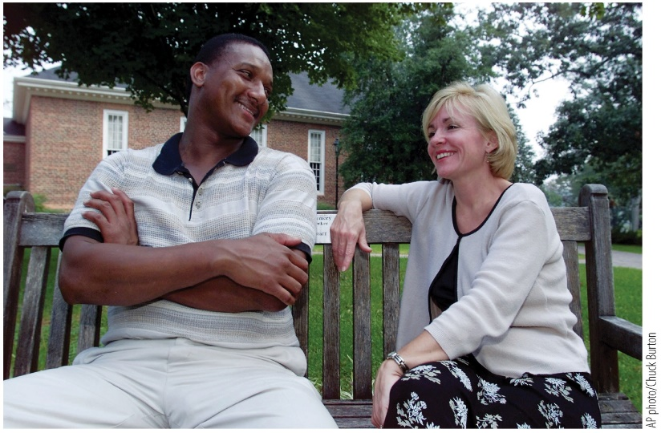
Everyday Memory
Notes:
Chapter 6 Opener
In 1984, college student Jennifer Thompson (right) was violently assaulted. She later misidentified her assailant as Ronald Cotton (left), who went to prison for someone else’s crime. Years later, after Cotton’s innocence was proven, the two became unlikely friends—bonded by circumstances caused by the frailty of memory.

Slide 2
Chapter 6 Everyday Memory 1
6.1 What Is Memory?
6.2 The Memory Paradox
6.3 Making Memory Work
6.4 Autobiographical Memory
6.5 Memory Failures
6.6 Implications for Eyewitness Testimony

Slide 3
Chapter 6 Everyday Memory 2
After reading this chapter, you should be able to:
6.1 Define short-term and long-term memory.
6.2 Describe instances of great memory ability and instances of memory failure.
6.3 Distinguish between encoding and retrieval, and discuss strategies and factors that can improve memory.
6.4 Describe how autobiographical memory is constructive.
6.5 Understand how memory failures can affect the way we perceive past experiences.
6.6 Explain how memory distortions can affect eyewitness testimony.

Slide 4
6.1 What Is Memory?
Memory: processes involved in encoding, storing, and retrieving information
Short-term memory
Limited capacity and short duration (seconds)
  Information fades if not attended to or moved to LTM
Long-term memory
Vast capacity and long duration (possibly decades)
  Unlike STM, which holds information “in mind”, information can be retrieved from long-term storage
Notes:
Instructor Notes:
Memory is a family of processes involved in encoding, storing, and retrieving (i.e., recalling or recognizing) information.
Short-term memory holds information “in mind” for a short time, with unattended information fading quickly unless it is moved to long-term memory.
Working memory is sometimes used interchangeably with short-term memory, though some draw a distinction between the two with short-term memory being a passive store of information and working memory involving active manipulation of the stored information.
Long-term memory has a vast, possibly unlimited, capacity with a much longer duration than short-term memory. Long-term memory can last for decades rather than seconds.

Slide 5
6.2 The Memory Paradox
Memory is fallible – memories can be lost or distorted.
Memory is extraordinary – ordinary individuals can become mnemonists by learning mnemonic strategies.
Method of loci: using locations within a familiar space as placeholders for information that you want to remember; each location serves as a retrieval cue.
Visualization: creating novel mental images to represent aspects of the encoded information
Notes:
Instructor Notes:
Memories can be lost or distorted. However, seemingly average individuals can become mnemonists (memory athletes) who are able to remember hundreds of digits or words at a time.
Mnemonists use strategies such as the method of loci and visualization.
In the method of loci, they imagine walking through a familiar place, and they use locations in that space as placeholders for the information they want to remember. They imagine different pieces of information in locations throughout the space, and each location becomes a retrieval cue for the piece of information that was stored there.
Visualization can be used with the method of loci, or on its own. With visualization, novel images are assigned to represent the information being encoded.
Our search for meaning leads us to sometimes erroneously fill in gaps, distorting memories, but it also can help us remember an amazing amount of information, using mnemonic strategies such as the method of loci.
Mnemonists don’t seem to have greater memory for details from their lives (autobiographical memory), suggesting their impressive memory for specific items is due to the strategies they use rather than innate ability.

Slide 6
6.3 Making Memory Work 1
Encoding
Multi-stage process that allows us to store memories in long-term memory.
  Sensory memory: highly detailed but short-lived impression of sensory information
  Iconic memory: visual sensory memory
Notes:
Instructor Notes:
Encoding is a multi-stage process that allows us to store memories in long-term memory. Stimuli are briefly held in sensory memory, which has a limited capacity and extremely short duration (milliseconds). Sensory is the faint afterimage of something you have seen or heard that quickly fades away. Iconic memory refers to the sensory memory for visual stimuli.
If attention is directed to the items in sensory memory, those items can then be held in short-term memory. Short-term memory has a slightly longer duration, but the information will fade away unless you keep attending to it. One way to retain information in short-term memory is rehearsal – repeating the information over and over to keep it fresh in your mind. However, rehearsal requires a fair amount of effort and focus, and interference can disrupt rehearsal. As short-term memory has a limited capacity and duration, we often use strategies that reduce the amount of information or transfer the information into long-term storage.

Slide 7
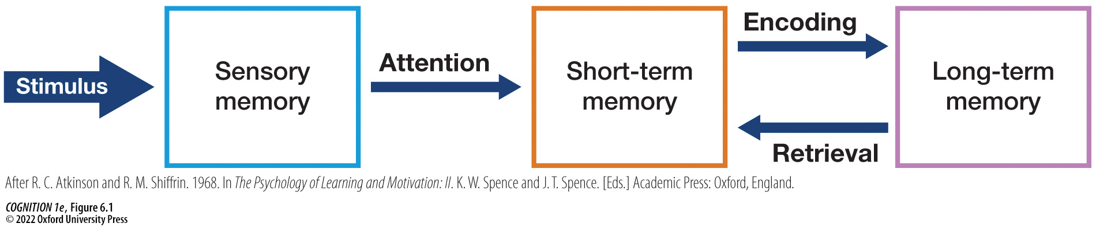
Figure 6.1 The relationship between sensory memory, short-term memory, and long-term memory as described in an influential model by Atkinson and Shiffrin (1968)
Notes:
Figure 6.1 The relationship between sensory memory, short-term memory, and long-term memory as described in an influential model by Atkinson and Shiffrin (1968)
After a stimulus appears, it persists for a fraction of a second in sensory memory before rapidly fading away. However, paying attention to a subset of its contents before they deteriorate can bring those contents into short-term memory. Although longer-lasting than sensory memory, short-term memory is also short-lived, so information must further be encoded into long-term memory in order to be recalled later. Such encoding can involve rehearsal, as well as other strategies. The contents of long-term memory can exist outside our immediate awareness. When we retrieve them (i.e., bring them into awareness), we temporarily bring them back into short-term memory (or working memory). (After R. C. Atkinson and R. M. Shiffrin. 1968. In The Psychology of Learning and Motivation: II. K. W. Spence and J. T. Spence. [Eds.] Academic Press: Oxford, England.)

Slide 8
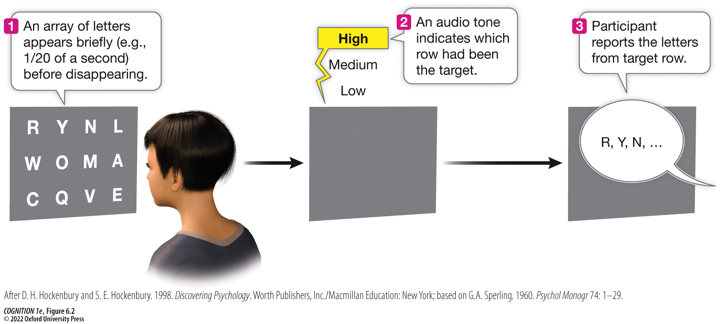
Figure 6.2 Sperling’s experiment demonstrating the duration of sensory memory 1
Notes:
Figure 6.2 Sperling’s experiment demonstrating the duration of sensory memory
In George Sperling’s famous studies of iconic memory (persisting sensory memory), participants saw brief arrays of letters and numbers arranged in rows (e.g., flashed for 50 milliseconds). In some trials, a tone played after the array disappeared, which indicated the row that participants should report. Participants were often accurate even though the arrays were already gone when the tone sounded, suggesting that the visual information continued to persist in sensory memory for a fraction of a second. (After D. H. Hockenbury and S. E. Hockenbury. 1998. Discovering Psychology. Worth Publishers, Inc./Macmillan Education: New York; based on G.A. Sperling. 1960. Psychol Monogr 74: 1–29.)

Slide 9
6.3 Making Memory Work 2
Think for Yourself 6.1 – Is Google Hurting Your Memory?
Google effect: when people expect to be able to access relevant information on the Internet or a computer, memory for that information is lowered
People are primed to think of search engines such as Google or Yahoo when they are prompted with difficult questions
People start to mistake access for understanding

Slide 10
6.3 Making Memory Work 3
Encoding Strategies
Help us efficiently store information.
As children mature, they develop better metacognition, which leads to better memory performance.
Metamemory: an understanding of how our own memory works, helps us use these strategies more effectively.
Notes:
Instructor Notes:
As short-term memory has a limited capacity and duration, we often use strategies that reduce the amount of information or transfer the information into long-term storage.
The hippocampus is involved in memory, and previous research has shown parts of the hippocampus are larger in people who need to remember a lot of detailed information (such as taxi drivers). However, structural differences have not been found in the brains of memory athletes. However, the activity within specific brain regions has been found to differ for memory athletes. Compared with control participants, memory athletes had greater activity in brain areas involved in spatial navigation and spatial attention (such as the hippocampus, retrosplenial cortex, and parietal cortex).
Encoding strategies include chunking, elaboration, hierarchical organization, and spacing.

Slide 11
6.3 Making Memory Work 4
Encoding Strategies (cont’d)
Chunking: breaking up information into smaller bits
Notes:
Instructor Notes:
Classroom activity on “chunking”
Instructions for students:
Over the next six slides, I’m going to flash three different sets of letters up on the screen for a few seconds, then there will be a pause.
Try to remember as many of the letters as you can during the pause.
When instructed, write down the letters in the same order they were displayed.

Slide 12
6.3 Making Memory Work 5
T T J H C X P U A V D
Notes:
Instructor Notes:
Set #1:
When you click, the letters should disappear.
Wait a moment, and then advance to the next slide and ask students to write down as many letters as they can in the correct order.

Slide 13
6.3 Making Memory Work 6
Write down the letters in the same order
they were displayed.

Slide 14
6.3 Making Memory Work 7
B R B T T Y L Y O L O
Notes:
Instructor Notes:
Set #2:
When you click, the letters should disappear.
Wait a moment, and then advance to the next slide and ask students to write down as many letters as they can in the correct order.
If you are familiar with the texting acronyms BRB, TTYL, and YOLO, you likely found it easier to remember this string of letters due to chunking. With chunking, the information you are encoding is broken into smaller bits, reducing the amount of information that needs to be stored (similar to compressing a high-resolution digital photo into a smaller file).

Slide 15
6.3 Making Memory Work 8
Write down the letters in the same order
they were displayed.

Slide 16
6.3 Making Memory Work 9
A D H D P T S D O C D
Notes:
Instructor Notes:
Set #3:
When you click, the letters should disappear.
Wait a moment, and then advance to the next slide and ask students to write down as many letters as they can in the correct order.
Chess players who are familiar with chess piece locations outperform non-chess players when asked to remember configurations of chess pieces, but only for meaningful configurations. Their familiarity with chess configurations allows them to use chunking.

Slide 17
6.3 Making Memory Work 10
Write down the letters in the same order
they were displayed.

Slide 18
6.3 Making Memory Work 11
Encoding Strategies (cont’d)
Elaboration: linking the material you are trying to learn to knowledge already in your long-term memory
Depth of encoding depends on what you attend to during encoding.
  Shallow encoding
  Intermediate encoding
  Deep encoding
Self-reference effect
Self-imaging
Notes:
Instructor Notes:
Elaboration is a powerful encoding strategy that involves making links between the material you are trying to learn and your previous knowledge.
It can be especially useful to relate the material to yourself or your own interests (self-reference effect).
Self-imagining refers to imagining something from a personal perspective. Self-imagining has been found to outperform other elaboration strategies, including some imagery-based strategies (Grilli & Glisky, 2011).

Slide 19
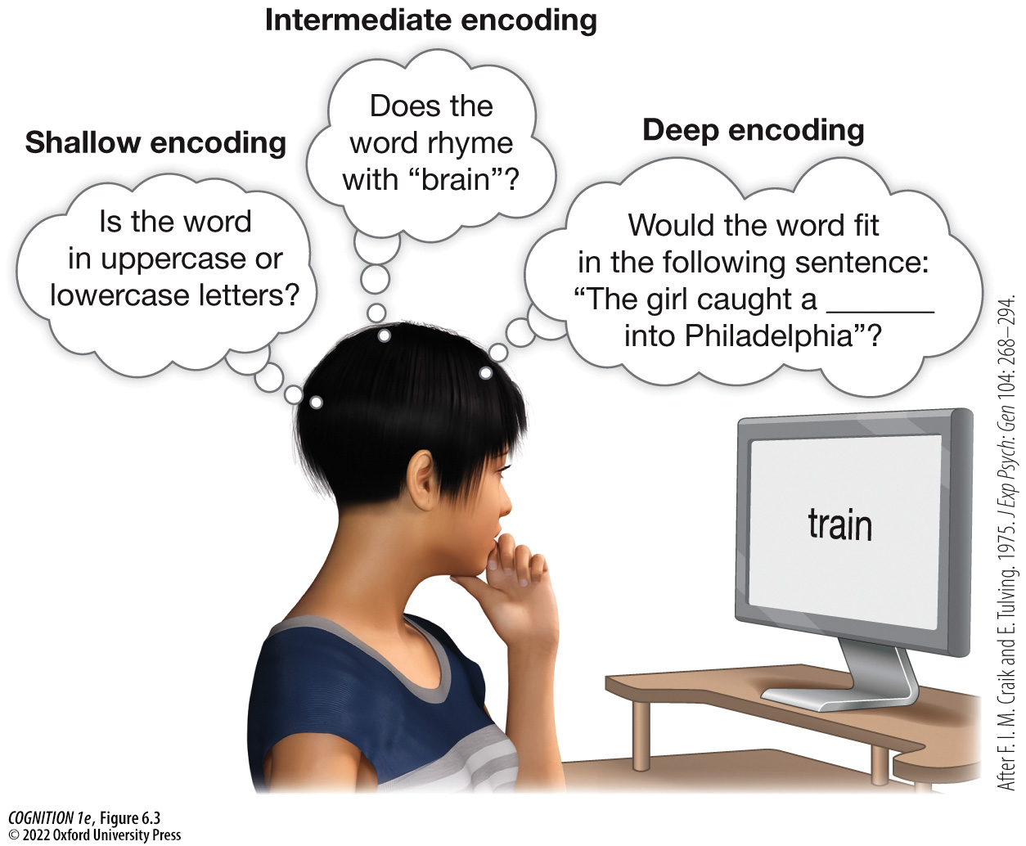
Figure 6.3 The deeper people encode the meaning of words, the better they remember them
Notes:
Figure 6.3 The deeper people encode the meaning of words, the better they remember them
In a study by Craik and Tulving (1975), shallow encoding was induced by asking people about typeface, intermediate encoding was induced by asking people about rhymes, and deep encoding was induced by asking people to fit words into sentences. Deep encoding led to better memory. (After F. I. M. Craik and E. Tulving. 1975. J Exp Psych: Gen 104: 268–294.)

Slide 20
6.3 Making Memory Work 12
Encoding Strategies (cont’d)
Hierarchical Organization: rearranging information into a meaningful network of associations
Items are linked to increasingly broader categories
Notes:
Instructor Notes:
Organization also matters. Rearranging the material you are trying to learn according to hierarchical organization has been found to improve memory. By organizing the items in this way, you are creating clues that help you reconstruct the information.

Slide 21
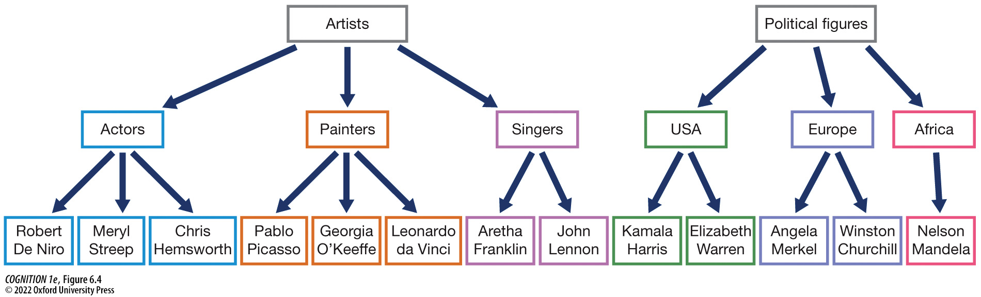
Figure 6.4 Hierarchical organization
Notes:
Figure 6.4 Hierarchical organization
One strategy for encoding information is to group it according to a hierarchy.

Slide 22
6.3 Making Memory Work 13
Encoding Strategies (cont’d)
Spacing Effect: studying in shorter, spaced out study sessions (instead of cramming)
Hermann Ebbinghaus found that distributed practice resulted in better memory performance than massed practice.
Notes:
Instructor Notes:
How far apart the study sessions should be spaced depends on the type of material and how far into the future you need to remember the information.

Slide 23
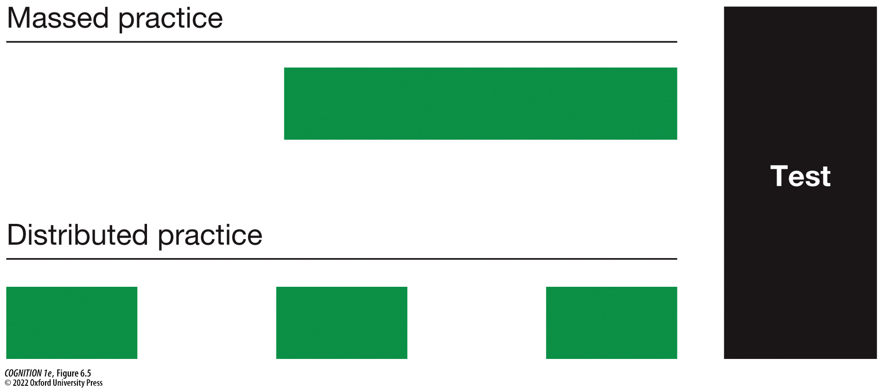
Figure 6.5 Massed vs. distributed practice
Notes:
Figure 6.5 Massed vs. distributed practice
Even when the total amount of time studying is the same, people tend to remember material better (e.g., such as on an exam) when their study sessions have been spaced out (“distributed practice”; bottom) than when crammed together in one session (“massed practice”; top).

Slide 24
6.3 Making Memory Work 14
Retrieval
Accessing memories from storage
Remembering is not like playing a recorded video. Memories can be distorted, often through a combination of encoding and retrieval problems.
Notes:
Instructor Notes:
Retrieval is somewhat similar to opening a computer file that you have previously saved, but this metaphor does not capture how memory truly works. Computer files are usually faithfully stored, while human memory can be prone to errors during encoding and retrieval.
Think back on a recent memory – does it feel vivid as if you are still experiencing it, or are do you remember general details and experience feelings of familiarity? What about older memories?

Slide 25
6.3 Making Memory Work 15
Retrieval (cont’d)
Testing Effect: enhanced memory after retrieval practice
Generation Effect: enhanced memory for a self-generated list of items, relative to items that were passively memorized
Testing Effect vs. Generation Effect: Participants who completed word fragments had better memory than those who had simply read the words a second time (Karpicke & Zaromb, 2010).
Notes:
Instructor Notes:
Evidence suggests that practice retrieving information leads to better memory for that material, relative to repeated studying. This is known as the testing effect and is sometimes called “retrieval practice.”
Keep this in mind when studying for exams! Instead of just re-reading the text or notes, make sure to actively quiz yourself on the concepts.
The generation effect refers to enhanced memories for a list of items a person has generated, versus a list that a person was simply asked to memorize.
The testing effect and generation effect are related but distinct. Research by Karpicke & Zaromb (2010) found that participants asked to complete word fragments had better memory for words than those who had simply read the words a second time. In a third condition, participants were told to use the word fragments as a retrieval cue, and this explicit instruction led to even better recall. This suggests that retrieval practice is more beneficial than simply generating information.

Slide 26
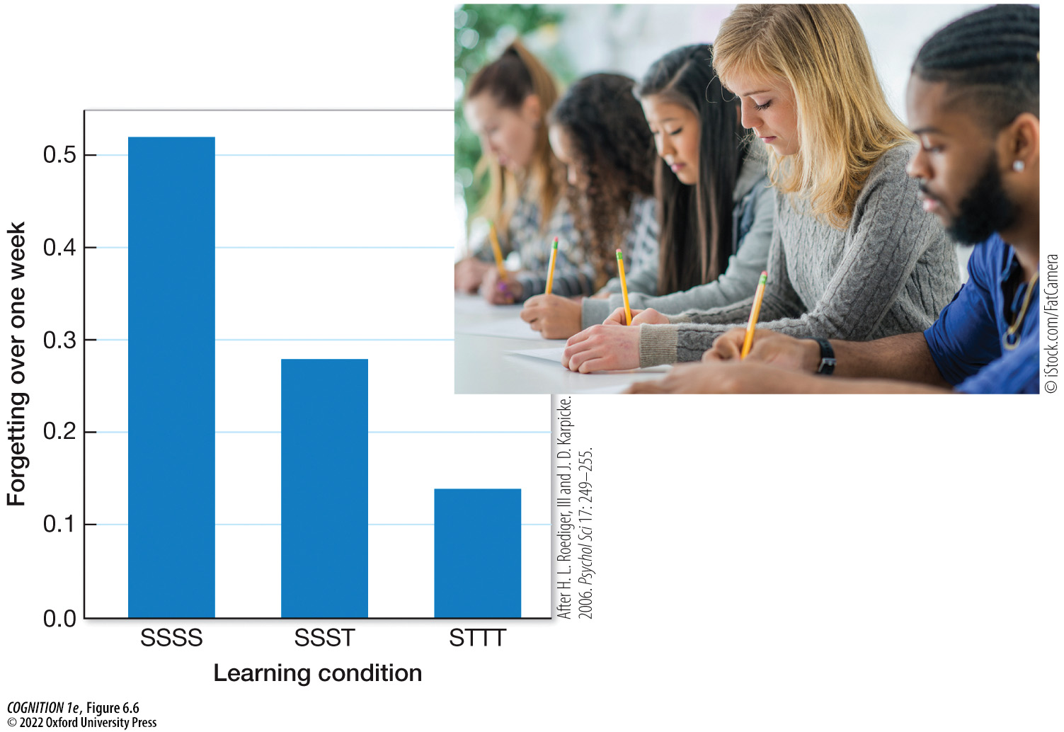
Figure 6.6 The testing effect
Notes:
Figure 6.6 The testing effect
In one study, people (A) studied material over the course of four study sessions (SSSS), (B) studied over three sessions followed by a single testing session (SSST), or (C) studied for one session followed by three testing sessions (STTT). Consistent with the testing effect, those who studied once and then were tested three times forgot the least amount of material by a week later. (After H. L. Roediger, III and J. D. Karpicke. 2006. Psychol Sci 17: 249–255.)

Slide 27
6.3 Making Memory Work 16
Retrieval (cont’d)
Retrieval Cues: clues in the environment or in our stored representations of experiences
Context-dependent memory: improved memory when the retrieval context matches the learning context
State-dependent memory: improved memory when internal state at retrieval matches internal state at encoding
Mood-dependent memory: memory improved when emotional state is similar for encoding and retrieval
Notes:
Instructor Notes:
Our memories are vulnerable to error partly because we need to reconstruct them each time we access them. We rely on assumptions and preexisting knowledge to fill in gaps and reassemble memories. How we use retrieval cues affects our memory.
One example of the importance of retrieval cues is context-dependent memory. Research has shown better memory when the test environment matches the study environment.
State-dependent memory is a related phenomenon in which memory is better when the internal state one experiences during retrieval is similar to the state they experienced during study. This includes mood-dependent memory.

Slide 28
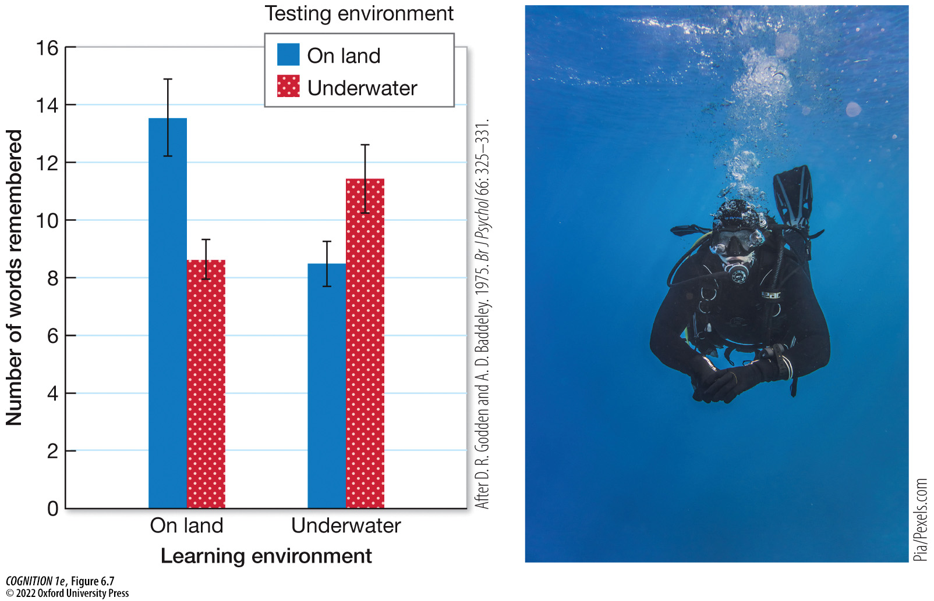
Figure 6.7 Context dependent memory
Notes:
Figure 6.7 Context dependent memory
When divers learned lists of words underwater, they had better memory for them when tested underwater than when tested on land. When they learned the lists on land, they remembered more when tested on land than when tested underwater. (After D. R. Godden and A. D. Baddeley. 1975. Br J Psychol 66: 325–331.)

Slide 29
6.4 Autobiographical Memory 1
Autobiographical memory: memory of the events in one’s life
Infantile amnesia: inability to remember the earliest years of our lives
Hyperthymestic syndrome: a rare condition in which people have significantly superior autobiographical memory
Notes:
Instructor Notes:
Most people cannot remember autobiographical memories from before the age of 3 or 4, possibly due to the late development of brain regions involved in memory (such as the hippocampus and prefrontal cortex). This failure to remember the earliest years of our lives is known as infantile amnesia. Autobiographical memory may become less specific as we age, which may be associated with changes to the connectivity between the prefrontal cortex and hippocampus as we age.
Some individuals have remarkable autobiographical memory. This rare condition is known as hyperthymestic syndrome. An example is Jill Price, who can remember every day of her life since she was 14. Jill seems to have superior memory only for autobiographical information and not other information such as strings of letters or digits.
Questions for in-class discussion:
What would be the benefits of superior autobiographical memory?
What would be some disadvantages?
Do you think that you would like to have superior autobiographical memory?
Unlike memory athletes, evidence suggests people with highly superior autobiographical do appear to have brains that physically differ in regions that are thought to play a role in autobiographical memory, including the inferior and middle temporal gyri, temporal pole, anterior insula, and parahippocampal gyrus. Researchers have also found significantly more white matter in individuals with hyperthymestic syndrome, which may suggest more efficient transmission of neural signals. Keep in mind these differences are not necessarily causal. These associations do not tell us one thing causes the other. It’s possible that a lifetime of practice recalling autobiographical events might lead to these differences, rather than the brain differences causing the superior memory.

Slide 30
6.4 Autobiographical Memory 2
Memory and Emotion
Flashbulb memories: vivid memories associated with particularly emotional events
Studies suggest that flashbulb memories seem more vivid and are associated with greater confidence, but these emotional memories are just as susceptible to distortion as everyday memories are (Talarico & Rubin, 2003; Strange & Takarangi, 2015).
Retrograde memory enhancement: increasing emotional arousal just after learning information can improve retention
Notes:
Instructor Notes:
Brown and Kulik (1977) introduced the term flashbulb memories. They studies people’s memories of impactful events such as the assassination of JFK. Brown and Kulik determined that events that involve a high level of surprise and emotional arousal produce flashbulb memories.
Studies show that flashbulb memories and everyday memories fade at a similar rate, but participants maintain a higher level of confidence and sense of vividness for flashbulb memories. This suggests that despite a flashbulb memory feeling very vivid and convincing, these memories are just as susceptible to distortion as everyday memories are.
However, emotional arousal can strengthen memory. Research shows that learning material just before emotions are triggered facilitates memory of the learned material. This effect is called retrograde memory enhancement. While stress experienced before or during learning impairs memory (Shields et al., 2017), an increase in stress hormones shortly after learning material appears to improve memory consolidation (Liang et al., 1986). This could lead to a therapeutic intervention aimed at preventing intrusive memories after a traumatic experience.

Slide 31
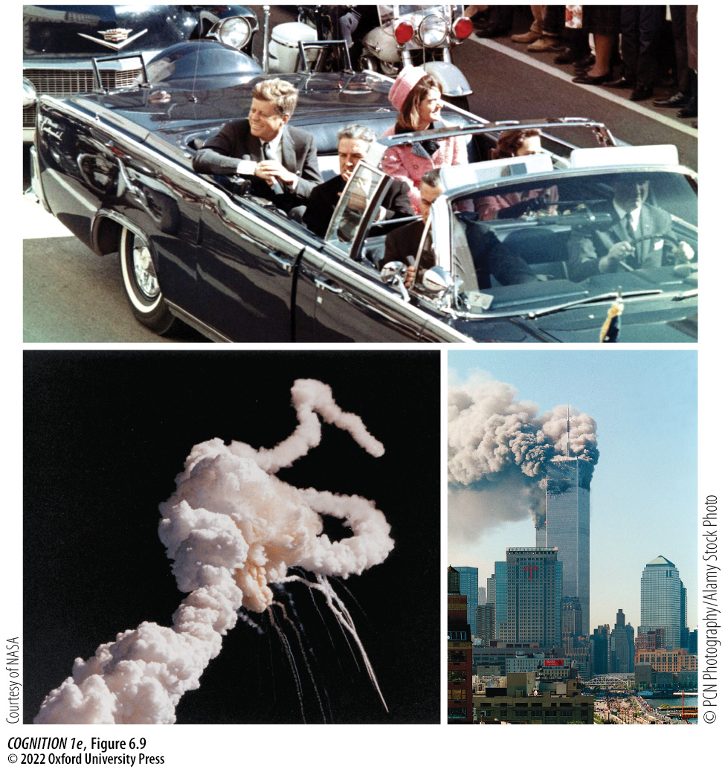
Figure 6.9 Flashbulb memories
Notes:
Figure 6.9 Flashbulb memories
Many people experience “flashbulb memories” of emotional or traumatic moments in their lives. For example, depending on their age, many people feel they have a vivid and clear memory of where they were and what they were doing when they heard about the assassination of John F. Kennedy, the explosion of the space shuttle Challenger, or the 9/11 terrorist attack on New York’s World Trade Center. What events in your own life have led to the feeling of a flashbulb memory?

Slide 32
6.4 Autobiographical Memory 3
Research Focus 6.2 - A Pill to Eliminate PTSD?
Trauma-exposed patients were given either a beta-blocker or a placebo shortly after the trauma. Months later, patients listened to recordings describing the traumatic event while researchers recorded physiological measures of emotional arousal.
About half of the patients who received the placebo showed increased physiological activity, but none of the experimental group did, suggesting beta-blockers may be effective at preventing PTSD.
Notes:
Instructor Notes:
The mechanisms underlying emotion-driven memory enhancement might play a role in the type of traumatic, intrusive memories at the core of post-traumatic stress disorder (PTSD). If so, then might it be possible to prevent PTSD by administering a beta-blocker soon after a traumatic event?

Slide 33
6.4 Autobiographical Memory 4
See for Yourself 6.2 - The Deese/Roediger-McDermott Effect
Participants often falsely recall words that are meaningfully related to items that did appear on the list.
The Deese/Roediger-McDermott paradigm exploits our tendency to seek meaning to induce false memories.
Notes:
Instructor Notes:
Due to our tendency to seek meaning, the Deese/Roediger-McDermott paradigm can induce false memories. Participants often falsely recall a word that is meaningfully related to items that did appear on the list. This is known as the Deese/Roediger-McDermott Effect.
One reason that this effect is thought to occur is because of how people organize information in their minds, clustering bits and pieces together according to shared meaning and connections with other knowledge

Slide 34
6.5 Memory Failures 1
Daniel Schacter identified seven “sins” of memory:
  Transience
  Absent-mindedness
  Blocking
  Misattribution
  Suggestibility
  Bias
  Persistence
Notes:
Instructor Notes:
Throughout the next slides, we will look at each of these seven “sins” of memory.

Slide 35
6.5 Memory Failures 2
Transience
The fading of memories over time
Forgetting curve: shows how quickly information fades from memory
Forgetting occurs most rapidly soon after learning and then starts to level off.
Savings measure: how much less you would need to study material in a second study session, compared with a first, in order to learn it perfectly.
Notes:
Instructor Notes:
Sometimes memories simply fade over time. Ebbinghaus conducted much of his research by learning nonsense words, which are difficult to link with meanings that might affect how long they linger in memory (e.g., “dax,” “yat”), and then testing his memory for them after various intervals of time. By doing so, Ebbinghaus was able to trace what is known as the forgetting curve—an estimate of the rate at which information fades from memory.

Slide 36
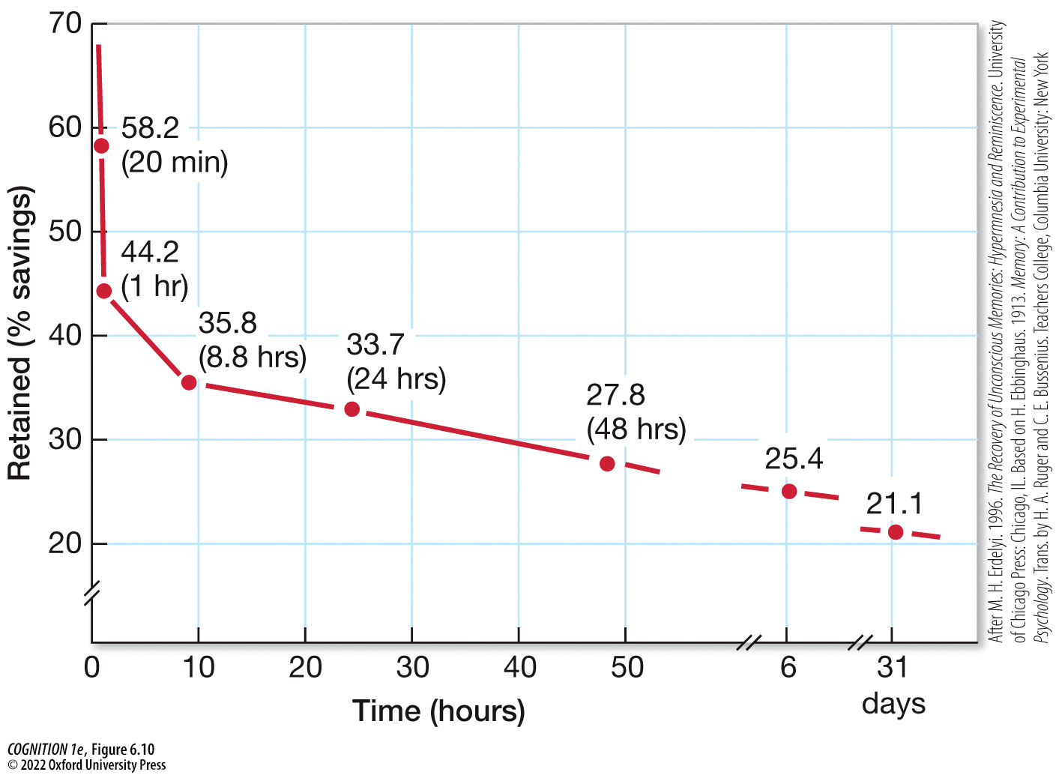
Figure 6.10 Ebbinghaus’s forgetting curve
Notes:
Figure 6.10 Ebbinghaus’s forgetting curve
The curve demonstrates that the relationship between time since studying and how much is retained in memory is curvilinear. Forgetting occurs most rapidly soon after learning and then starts to level off. (After M. H. Erdelyi. 1996. The Recovery of Unconscious Memories: Hypermnesia and Reminiscence. University of Chicago Press: Chicago, IL. Based on H. Ebbinghaus. 1913. Memory: A Contribution to Experimental Psychology. Trans. by H. A. Ruger and C. E. Bussenius. Teachers College, Columbia University: New York.)

Slide 37
6.5 Memory Failures 3
Absent-Mindedness
Inattention and distraction can disrupt encoding, preventing later retrieval.
To simulate distractions, researchers ask participants to do two tasks at the same time (divided-attention tasks).
Weapon focus occurs when attention is so focused on a threatening weapon that other aspects of a scene are neglected
Notes:
Instructor Notes:
For a classroom activity, try See for Yourself 6.3 – Study Phase.
See slide 40 on Blocking for the rest of the activity.

Slide 38
6.5 Memory Failures 4
Blocking
  Tip-of-the-tongue phenomenon: feeling of being able to bring
  A-B, A-C learning paradigm: used to study memory interference
    Retroactive interference
    Proactive interference
The fan effect shows that increased associations between elements leads to greater interference.
Notes:
Instructor Notes:
The tip-of-the-tongue phenomenon is a specific type of blocking, where you feel like you cannot remember a word but you can remember aspects of it, such as the number of syllables, which syllable is stressed, and several letters from the word.
Retrieval failure is a common cause of forgetting. When memories compete with each other, making it harder to remember, that is known as interference.
Retroactive interference occurs when something learned later interferes with previously learned information.
With proactive interference, an earlier memory impairs recall of something that happened later.

Slide 39
6.5 Memory Failures 5
Blocking (cont’d)
Retrieval-induced forgetting: retrieval of target memories causes unselected memories to be lost
Study phase: participants learn several items from different categories (See for Yourself 6.3)
Retrieval phase: participants practice retrieving only half of the items from a category, cued with word-completion tasks.
Test phase: recall all items (both fruit and drink categories)
Recalling some fruits inhibits memory for others, resulting in worse memory for unprobed fruits than control items (drinks).
Notes:
Instructor Notes:
This is tested in a three-phase experiment that includes study, retrieval, and test.
In the study phase, participants learn several items from different categories, as you did for the categories Fruits and Drinks in See for Yourself 6.3 (slide 38).
During the retrieval phase, participants practice retrieving only half of the items from a category, cued with word-completion tasks.
In the test phase, all of the examples from all the categories are probed. However, recall of these items makes it harder to remember the other items from the same category (banana, cantaloupe, and lemon).
As a control, the memory for these “inhibited” words is even worse than that for any of the words in the category of Drinks, which were also not practiced in the retrieval phase. This shows that the act of retrieving target memories in the Fruits category impaired or caused forgetting of other memories in that category.

Slide 40
6.5 Memory Failures 6
Misattribution
Source monitoring difficulties can cause misattribution.
Source misattribution: confusions about the sources of our memories
  External source monitoring
  Internal source monitoring
  Source confusion: trouble distinguishing memories of external events from memories of internally generated information

Slide 41
6.5 Memory Failures 7
Clicker Question #1
Jenna studied German last year, but this semester she is studying Swedish. Sometimes when she tries to remember a Swedish word, she remembers the German term instead. What is causing her memory failure?
Proactive interference
Retroactive interference
Misattribution
Notes:
Instructor Notes:
Correct answer: a

Slide 42
6.5 Memory Failures 8
Suggestibility
Memory suggestibility: the altering of memory through leading questions and cues
Altering memories of experiences
The verb “smashed” led to faster speed estimates than “hit” (Loftus & Palmer, 1974)
Implanting false memories
Leichtman & Ceci (1995) showed that misleading information prior to an event and misleading questions afterwards could distort children’s memories, especially when combined in the stereotype-plus-suggestion condition.

Slide 43
6.5 Memory Failures 9
Research Focus 6.3 - Individual Differences in Suggestibility
A version of the Deese/Roediger-McDermott task was given to four groups of women.
The data suggested the women who reported recovered memories were more prone to false memories than the other groups, suggesting they may have been susceptible to memory distortions.
Notes:
Instructor Notes:
Due to the severe negative impact false memories of abuse have on both the accused and the victim, some researchers focus on how memories are distorted and how to distinguish distorted memories from accurate memories.

Slide 44
6.5 Memory Failures 10
Bias
Schemas: knowledge or expectations about an event
Consistency bias: a tendency to remember the impact of events through the lens of their impact on us today

Slide 45
6.5 Memory Failures 11
Persistence
Forgetting can be beneficial - many people who have experienced trauma suffer from intrusive memories (flashbacks)

Slide 46
6.5 Memory Failures 12
Clicker Question #2
Which “sin” of memory illustrates the advantage of forgetting?
Transience
Blocking
Persistence
Notes:
Instructor Notes:
Correct answer: c

Slide 47
6.6 Implications for Eyewitness Testimony 1
Several operating procedures and interview techniques may increase the likelihood of false identification and false memories.
“Double-blind” lineup: officers supervising the lineup are not aware of who the suspect is
Sequential lineup: lineup members are shown one at a time
Simultaneous lineup: lineup members are shown simultaneously
Cognitive interview: asking mostly open-ended questions at a slow pace to allow witnesses to focus on their memory
Notes:
Instructor Notes:
There is still some debate about which lineup is the best, but evidence suggests that under some conditions simultaneous lineups decrease errors (Seale-Carlisle et al., 2019).
Psychologists have pushed for police to use what are known as cognitive interviews when interviewing eyewitnesses. A cognitive interview involves mostly open-ended questions asked at a slow pace, minimizing interruptions and allowing the witness to better focus on their memory. Studies have shown that cognitive interviews may produce as much as 35-75% more information than standard police interviews, while also leading to fewer errors.

Slide 48
6.6 Implications for Eyewitness Testimony 2
Clicker Question #3
Which type of lineup is most likely to encourage “relative judgments,” leading to false identifications?
“Double-blind”
Simultaneous
Sequential
Notes:
Instructor Notes:
Correct answer: b

