Slide 1
Civil Rights: Inequality and Equality
Chapter 5

Slide 2
Civil Rights in Action
Class discussion:
What do “civil rights” mean to you?
What protections do you expect the government to provide for you?
Indicate the ways in which DACA immigrants can show that their civil rights have been violated.

Slide 3
Civil Rights Terms and Concepts
Civil rights: The protections against unequal treatment that the government guarantees to all groups
Group designation
Race
Ethnicity
Gender

Slide 4
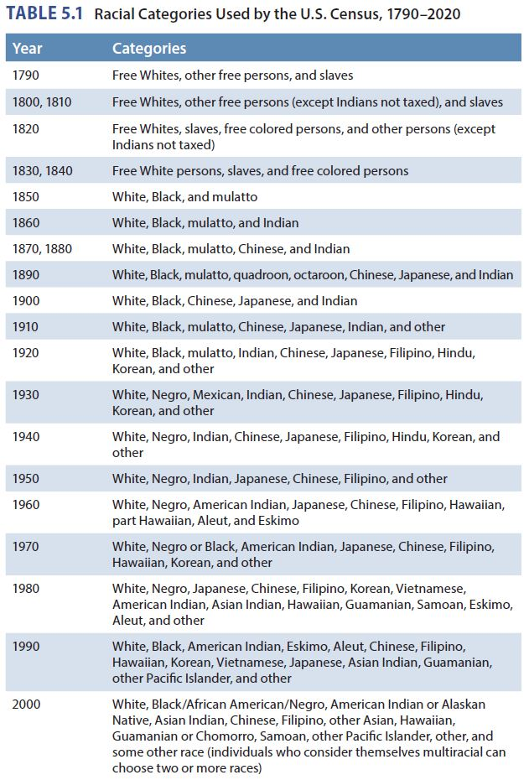

Slide 5
Civil Rights Terms and Concepts
Forms of inequality
Inequality of opportunity
Inequality of outcome
Segregation
De jure
De facto

Slide 6
Race, Ethnicity, and Civil Rights
Blacks
Enslavement of Blacks (1600s–1865)
Abolitionists
Prigg v. Pennsylvania (1842)
Dred Scott v. Sandford (1857)

Slide 7
Race, Ethnicity, and Civil Rights
Blacks (cont.)
The Civil War and Reconstruction (1861–1873)
Emancipation Proclamation
Thirteenth Amendment
Black codes
See “Our Voices: South Carolina’s Black Codes”
Fourteenth Amendment
Equal protection clause
Fifteenth Amendment
Reconstruction

Slide 8
Race, Ethnicity, and Civil Rights
Blacks (cont.)
The era of segregation and discrimination
End of Reconstruction and President Rutherford B. Hayes
Jim Crow laws
Plessy v. Ferguson (1896)
Separate but equal principle
Resurgence of the Ku Klux Klan

Slide 9
Race, Ethnicity, and Civil Rights
Blacks (cont.)
The era of segregation and discrimination
Disenfranchisement
Literacy tests
Grandfather clauses
Poll taxes

Slide 10
Race, Ethnicity, and Civil Rights
Blacks (cont.)
The civil rights era
Fair Employment Practices Committee
Interest groups and social movements
NAACP
Guinn and Beal v. United States (1915)
NAACP Legal Defense and Education Fund
Brown v. Board of Education (1954)

Slide 11
Race, Ethnicity, and Civil Rights
Blacks (cont.)
The civil rights era
Sit-ins
Civil Rights Act of 1964
Voting Rights Act of 1965

Slide 12
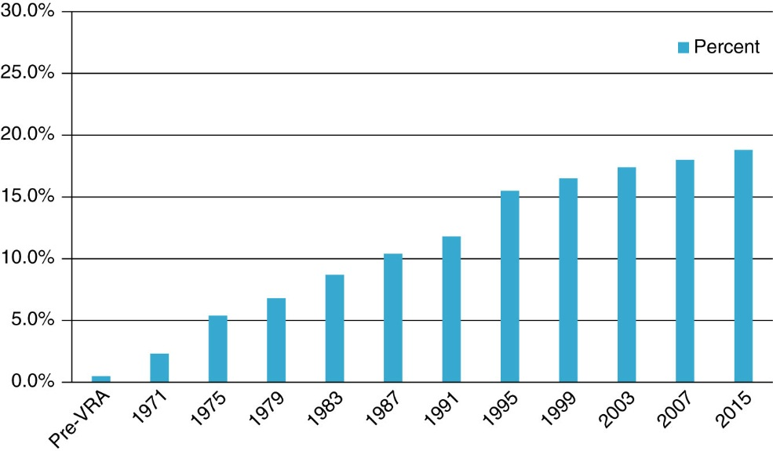

Slide 13
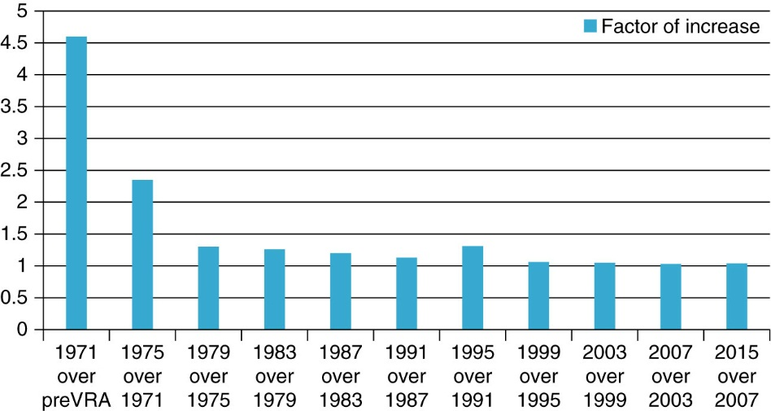

Slide 14
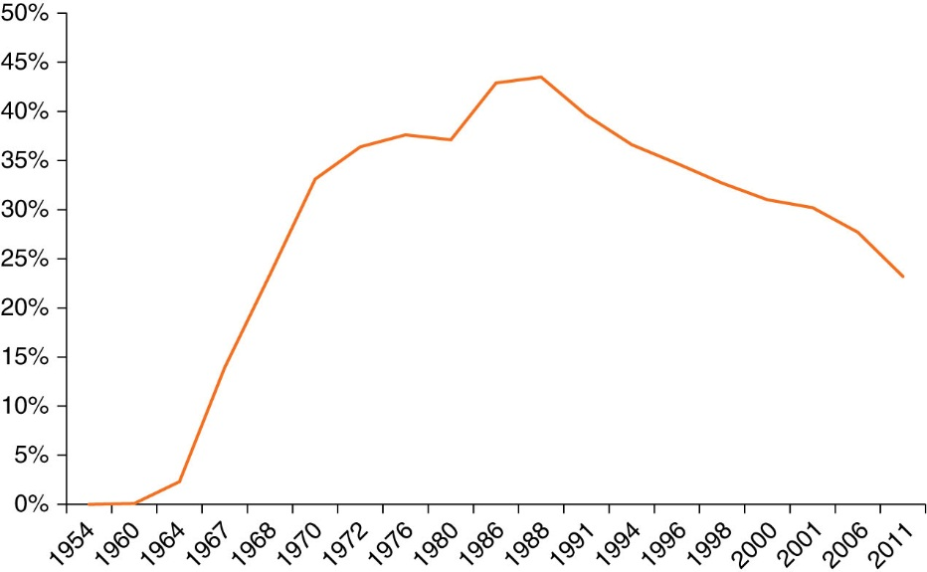

Slide 15
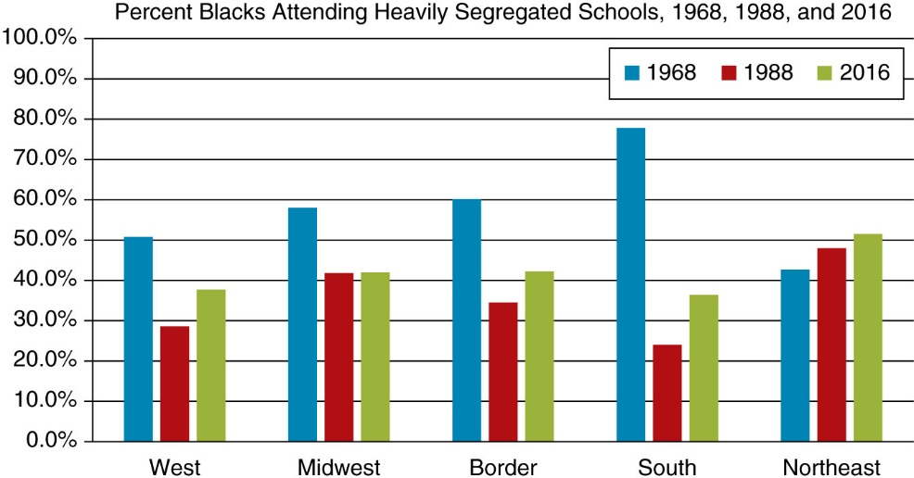

Slide 16
Race, Ethnicity, and Civil Rights
Blacks (cont.)
De facto segregation and busing
Affirmative action
Regents of the University of California v. Bakke (1978)
Recent changes in voting laws
Voter ID laws

Slide 17
Race, Ethnicity, and Civil Rights
Blacks (cont.)
Criminal justice
Black Lives Matter movement
George Floyd killing and national protests
Reparations
Debate for and against

Slide 18
Race, Ethnicity, and Civil Rights
Latinos
Mexican Americans
Civil rights movement began in the nineteenth century
League of United Latin American Citizens (LULAC)
United Farm Workers Union
Puerto Ricans
United States assumed control of Puerto Rico in 1899 after the Spanish–American War
Jones Act of 1917 conferred citizenship
Have also faced discrimination and segregation on the mainland

Slide 19
Race, Ethnicity, and Civil Rights
Latinos (cont.)
Cuban Americans
1959: Communist takeover of Cuba
Immigrants readily accepted into America
Despite this preferred status, Cuban Americans (just as all other Latinos) have experienced discrimination and segregation
1980: Marielitos

Slide 20
Race, Ethnicity, and Civil Rights
Latinos (cont.)
Immigration
Issue of legal and illegal immigration affects nearly all Latino subgroups
Trump:
2016 campaign rhetoric
Administration policies
The border wall
DACA
Family separation

Slide 21
Race, Ethnicity, and Civil Rights
Asian Americans
1800s: Chinese Americans used as cheap labor
Chinese Exclusion Act of 1882
California Alien Land Act of 1913
Executive Order 9066: Japanese American internment
Korematsu v. United States (1944)
Asian Americans were exposed to state-sponsored segregation and discrimination
McCarran–Walter Immigration Act of 1952
Japanese American Citizens League (JACL)

Slide 22
Race, Ethnicity, and Civil Rights
American Indians
Indigenous people of the United States
Government-sponsored genocide, discrimination, and segregation
1830s: Trail of Tears
Reservations
The Dawes Act of 1887

Slide 23
Race, Ethnicity, and Civil Rights
American Indians (cont.)
Indian Citizenship Act of 1924
Indian Reorganization Act of 1934
American Indian movement (AIM)
Sovereignty

Slide 24
Nonracial and Ethnic Struggles for Civil Rights
Women
Suffrage movement
Seneca Falls Convention (1848)
Nineteenth Amendment
National Organization for Women (NOW)
1963: Equal Pay Act
1972: Equal Rights Amendment (ERA)
Sexual harassment and #MeToo

Slide 25
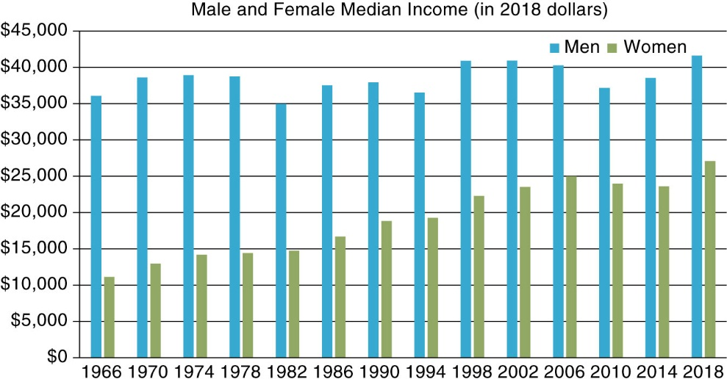

Slide 26
Nonracial and Ethnic Struggles for Civil Rights
Lesbians, Gay, Bisexual, Transgender, Queer, and Questioning People (LGBTQ+)
Prior to the 1970s, most states criminalized homosexual activity and these groups experienced a great deal of discrimination
Beginning in the 1970s, LGBT groups organized protests and demonstrations against unfair treatment
Stonewall 1969
Civil unions
Same-sex marriage: Obergefell v. Hodges (2015)
Challenges and protections for transgender people

Slide 27
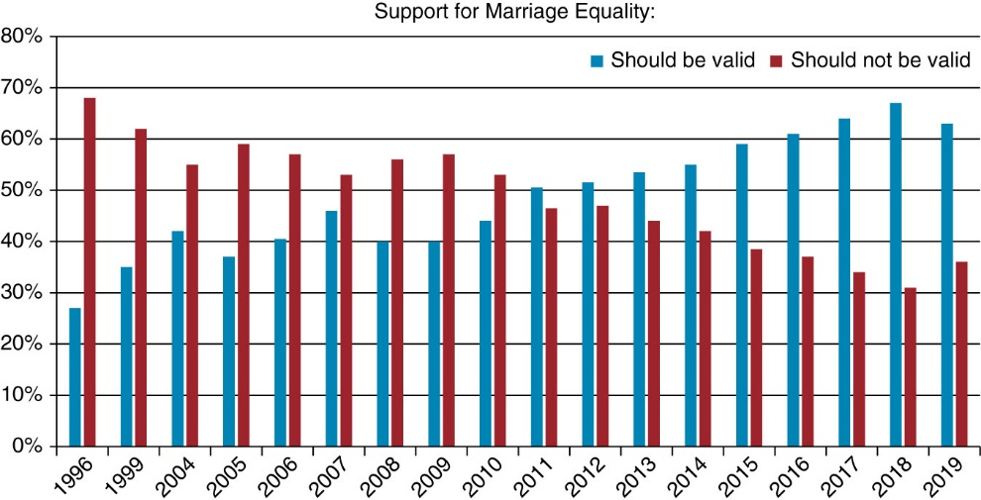

Slide 28
Nonracial and Ethnic Struggles for Civil Rights
Older Adults and People with Disabilities
1967: Age Discrimination in Employment Act
1990: Americans with Disabilities Act
Disability Rights & Education Fund
Intersectionality and civil rights

