Slide 1
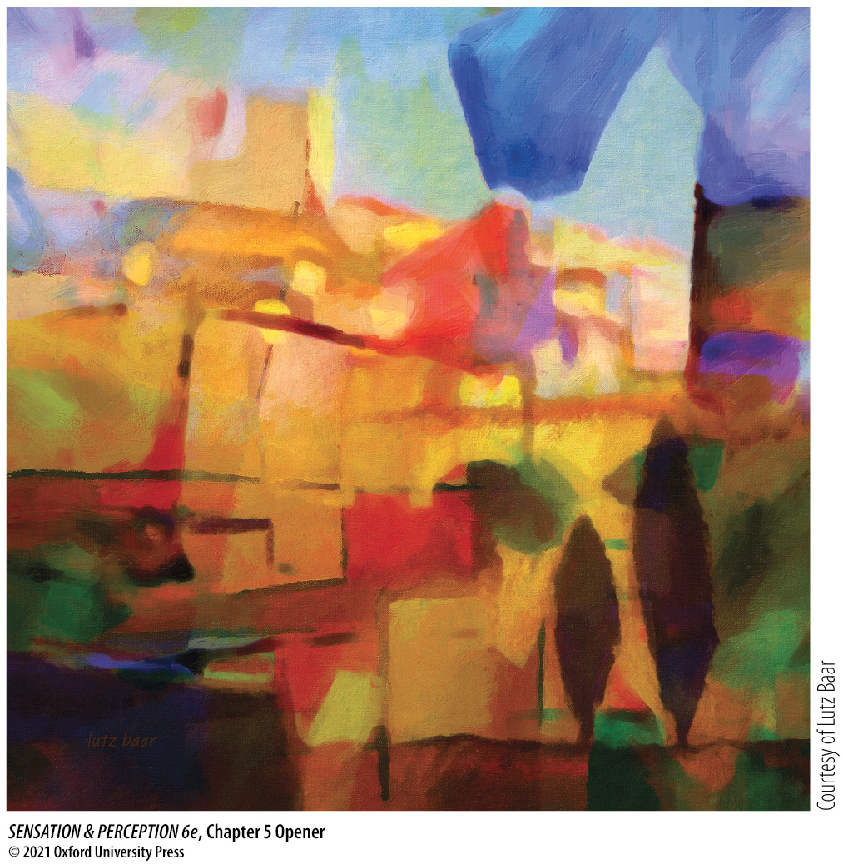
Chapter 5 Opener
Notes:
Chapter 5 Opener
Lutz Baar, French Abstract, 2014

Slide 2
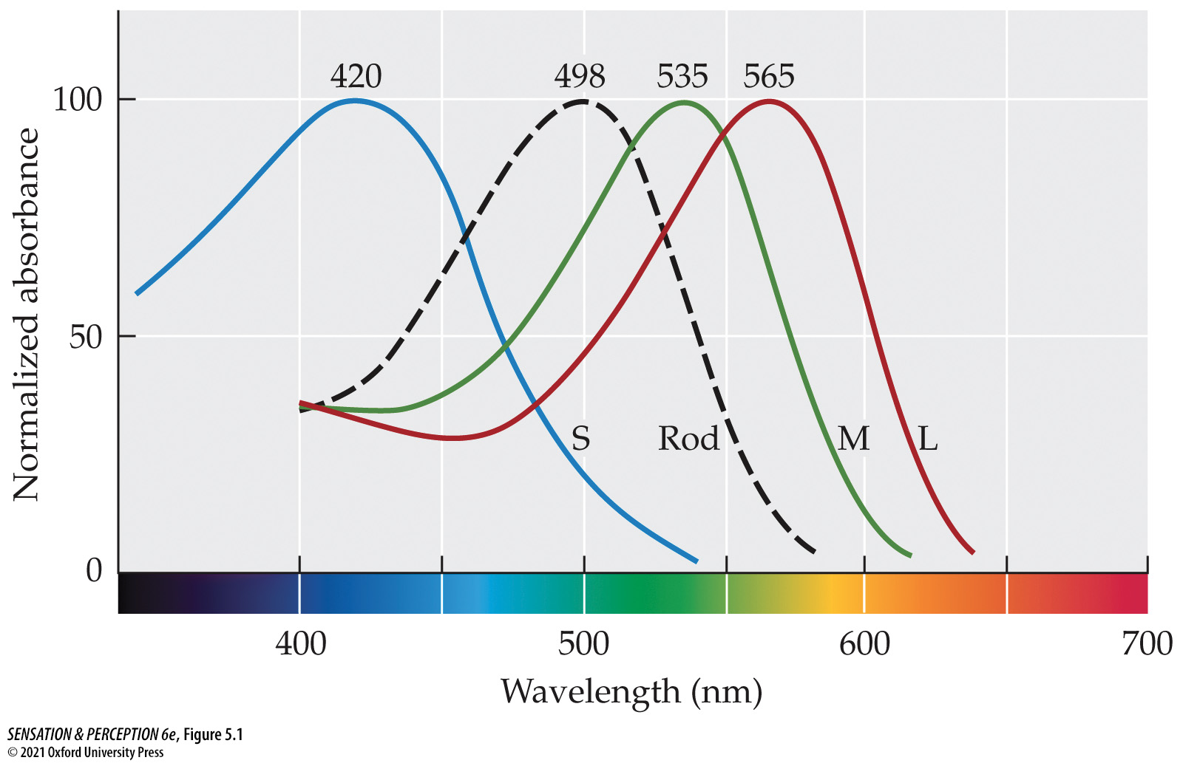
Figure 5.1 Photoreceptor types
Notes:
Figure 5.1 Photoreceptor types
The retina contains four types of photoreceptors. These differ in their sensitivity to the wavelengths of light. Three cone types are maximally sensitive at short (S), medium (M), and long (L) wavelengths. The single type of rod photoreceptor has its peak sensitivity between those of the S- and M-cones.

Slide 3
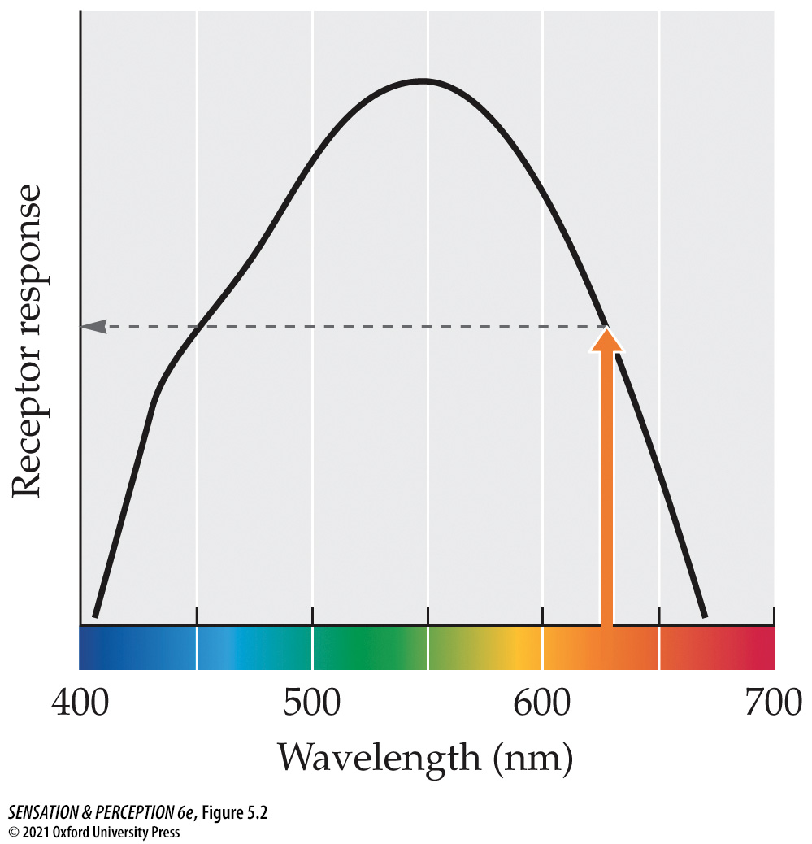
Figure 5.2 Responding to one wavelength
Notes:
Figure 5.2 Responding to one wavelength
A single photoreceptor shows different responses to lights of different wavelengths but the same intensity. A 625 nm light of this intensity, indicated by the arrow, produces a response midway between the maximum and minimum responses.

Slide 4
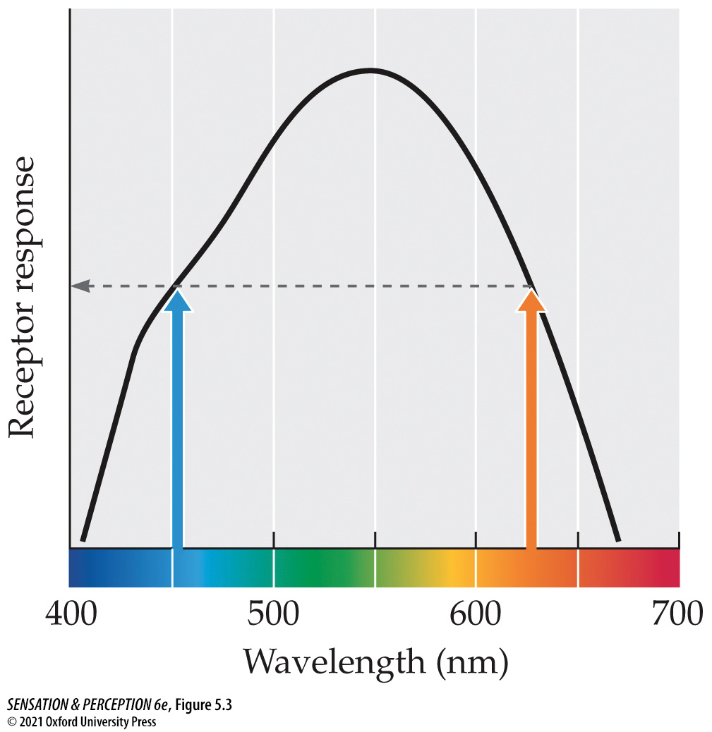
Figure 5.3 Univariance
Notes:
Figure 5.3 Univariance
Lights of 450 and 625 nm both elicit the same response from the photoreceptor whose responses are shown here and in Figure 5.2. This situation illustrates the principle of univariance.

Slide 5
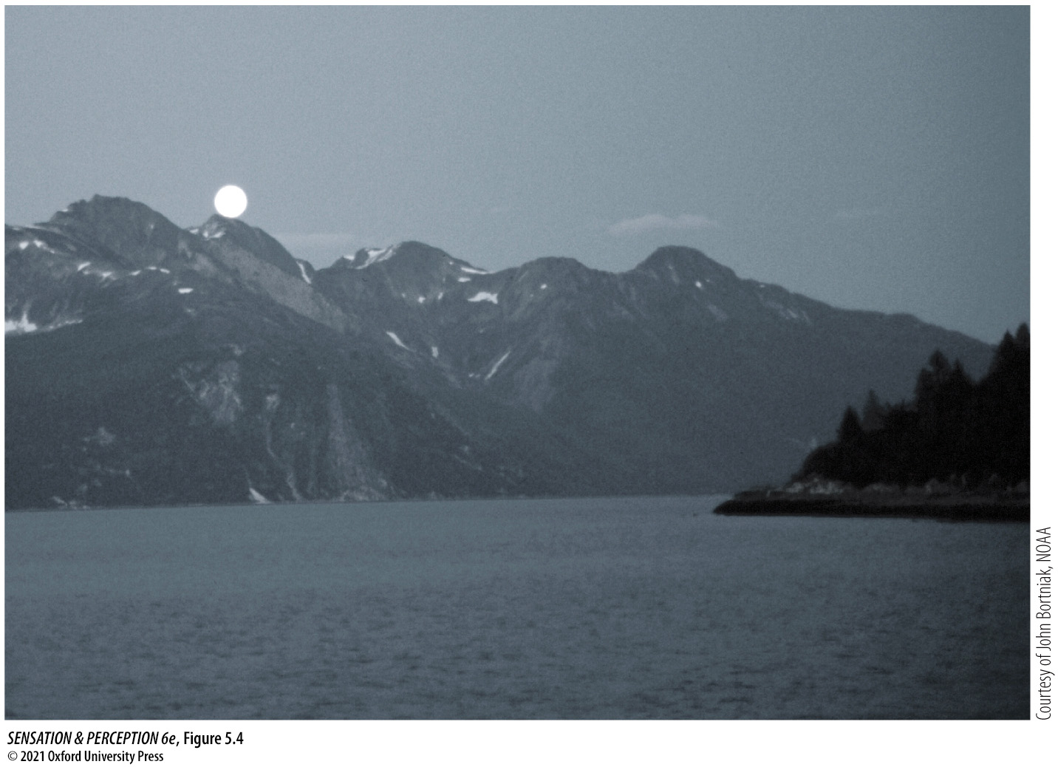
Figure 5.4 Rod vision
Notes:
Figure 5.4 Rod vision
The moonlit world appears drained of color because we have only one type of rod photoreceptor transducing light under these scotopic conditions. With just one type of photoreceptor, we cannot make discriminations based on wavelength, so we cannot see color.

Slide 6
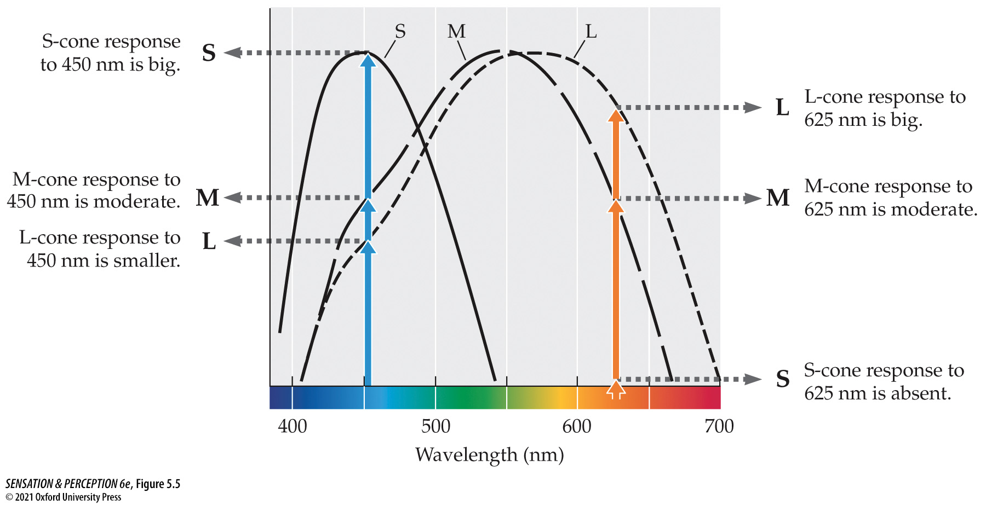
Figure 5.5 Solving univariance
Notes:
Figure 5.5 Solving univariance
The two wavelengths that produce the same response from one type of cone (M) produce different patterns of responses across the three types of cones (S, M, and L).

Slide 7
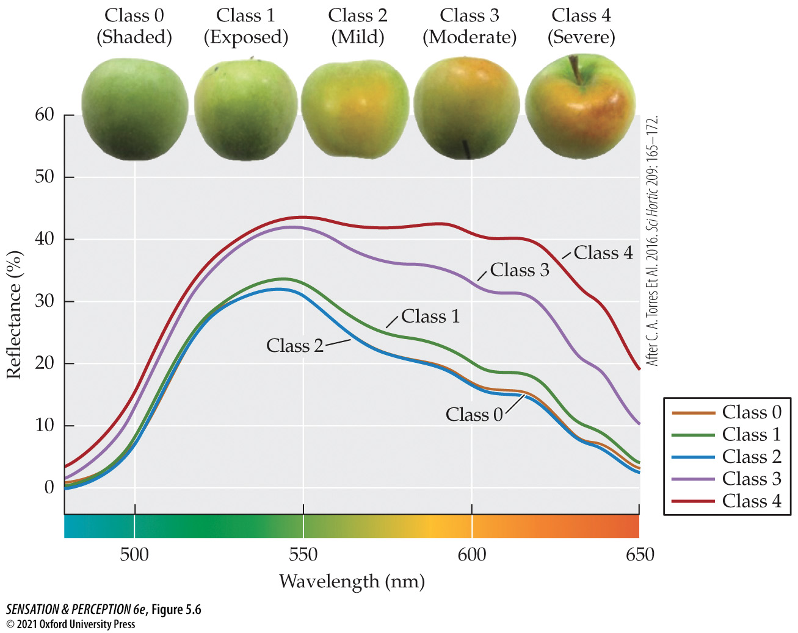
Figure 5.6 Real world reflectance functions
Notes:
Figure 5.6 Real world reflectance functions
Objects in the real world reflect light across the spectrum in different amounts. This graph plots the reflectances of sun injury development in Granny Smith apples. You can see how the appearance changes as the amount of reflected long-wavelength light changes. (After C. A. Torres et al. 2016. Sci Hortic 209: 165–172.)

Slide 8
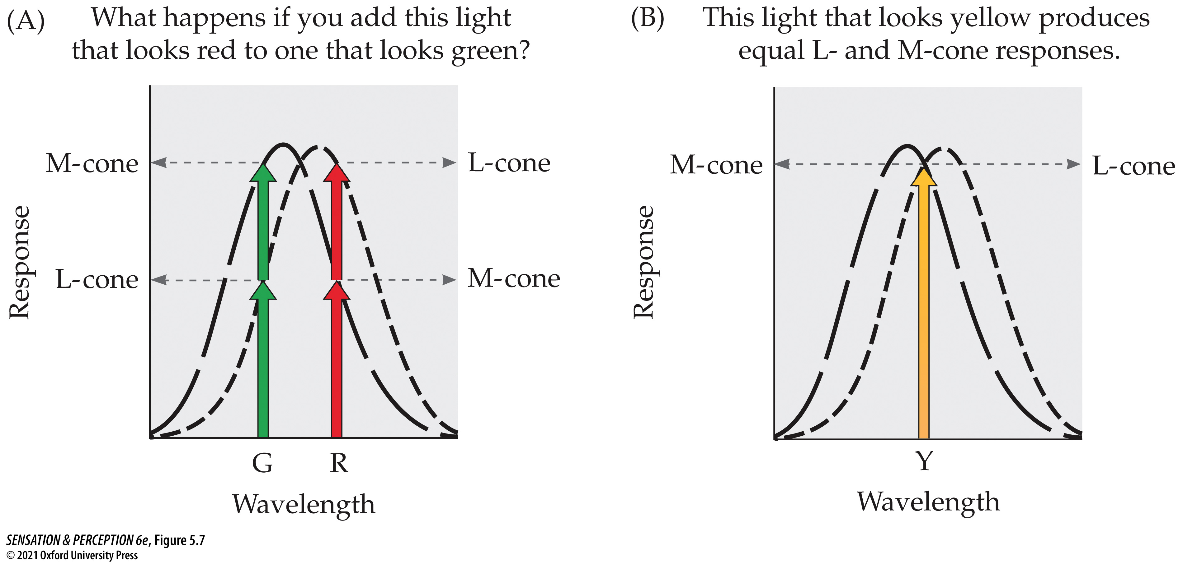
Figure 5.7 Metamers
Notes:
Figure 5.7 Metamers
In (A), the long-wavelength light that looks red and the shorter-wavelength light that looks green mix together to produce the same response from the cones as does the medium-wavelength light that looks yellow in (B). If two sets of lights produce the same responses, they are metamers and must look identical, so the red plus the green will look yellow.

Slide 9
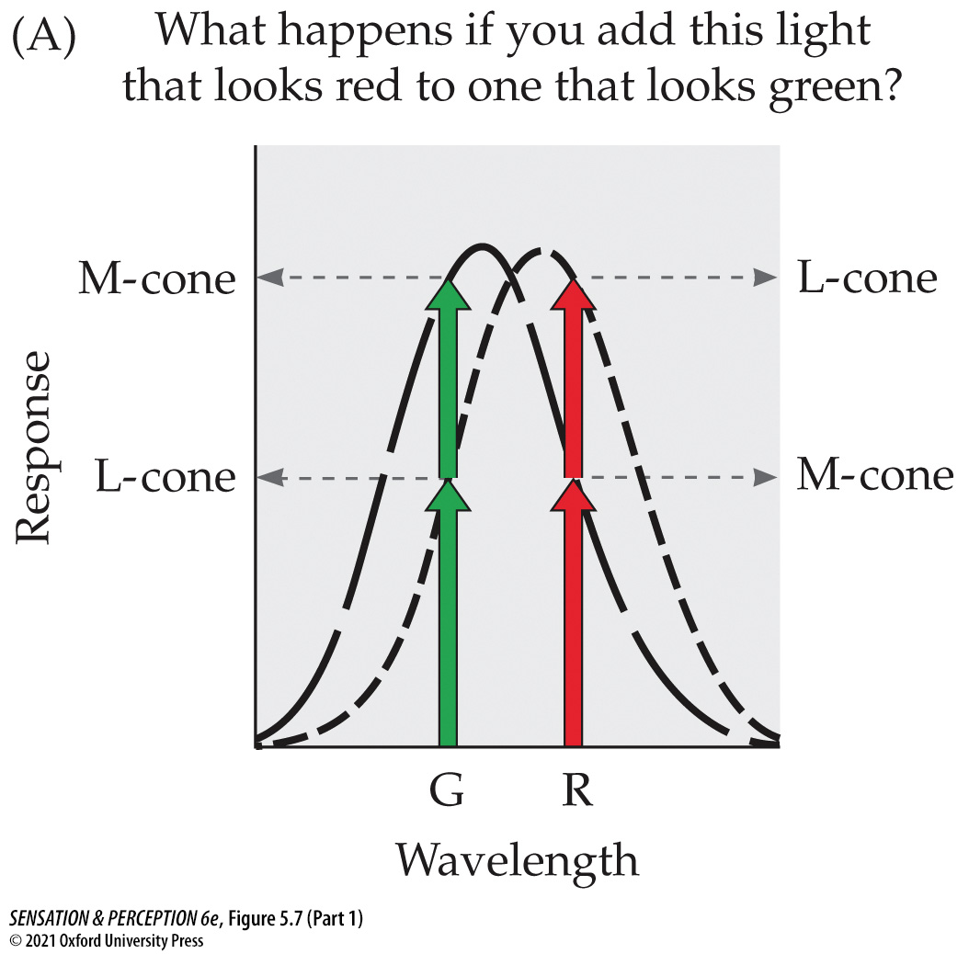
Figure 5.7 Metamers (Part 1)
Notes:
Figure 5.7 Metamers
In (A), the long-wavelength light that looks red and the shorter-wavelength light that looks green mix together to produce the same response from the cones as does the medium-wavelength light that looks yellow in (B). If two sets of lights produce the same responses, they are metamers and must look identical, so the red plus the green will look yellow.

Slide 10
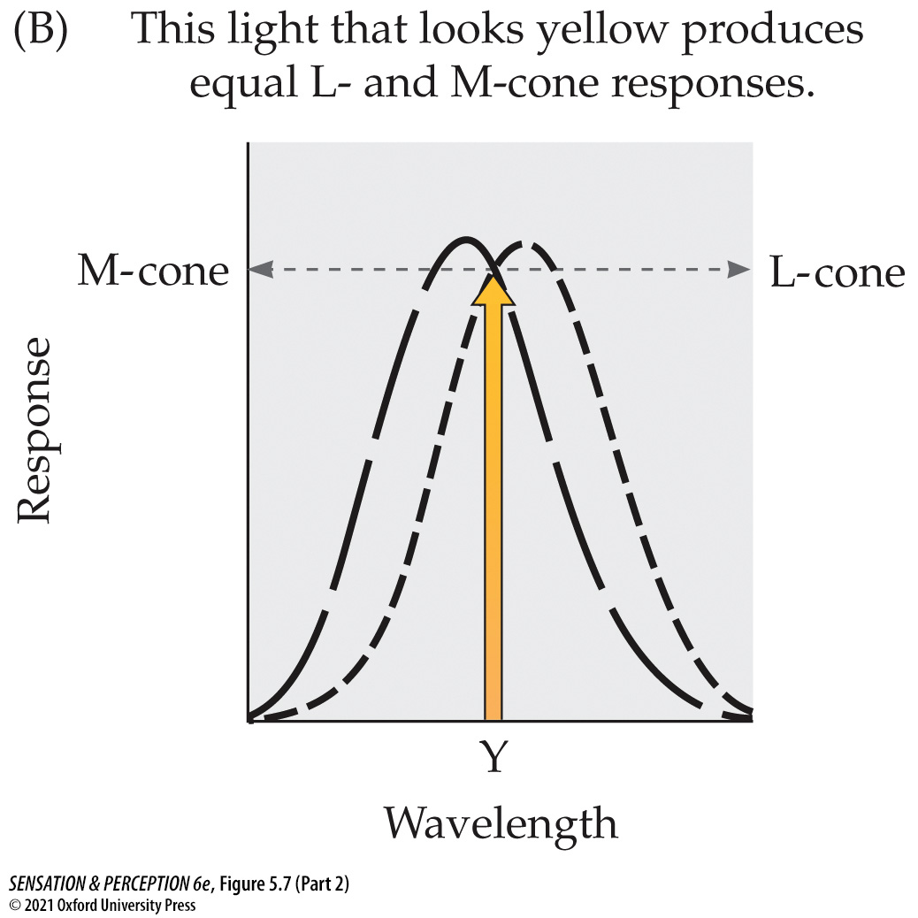
Figure 5.7 Metamers (Part 2)
Notes:
Figure 5.7 Metamers
In (A), the long-wavelength light that looks red and the shorter-wavelength light that looks green mix together to produce the same response from the cones as does the medium-wavelength light that looks yellow in (B). If two sets of lights produce the same responses, they are metamers and must look identical, so the red plus the green will look yellow.

Slide 11
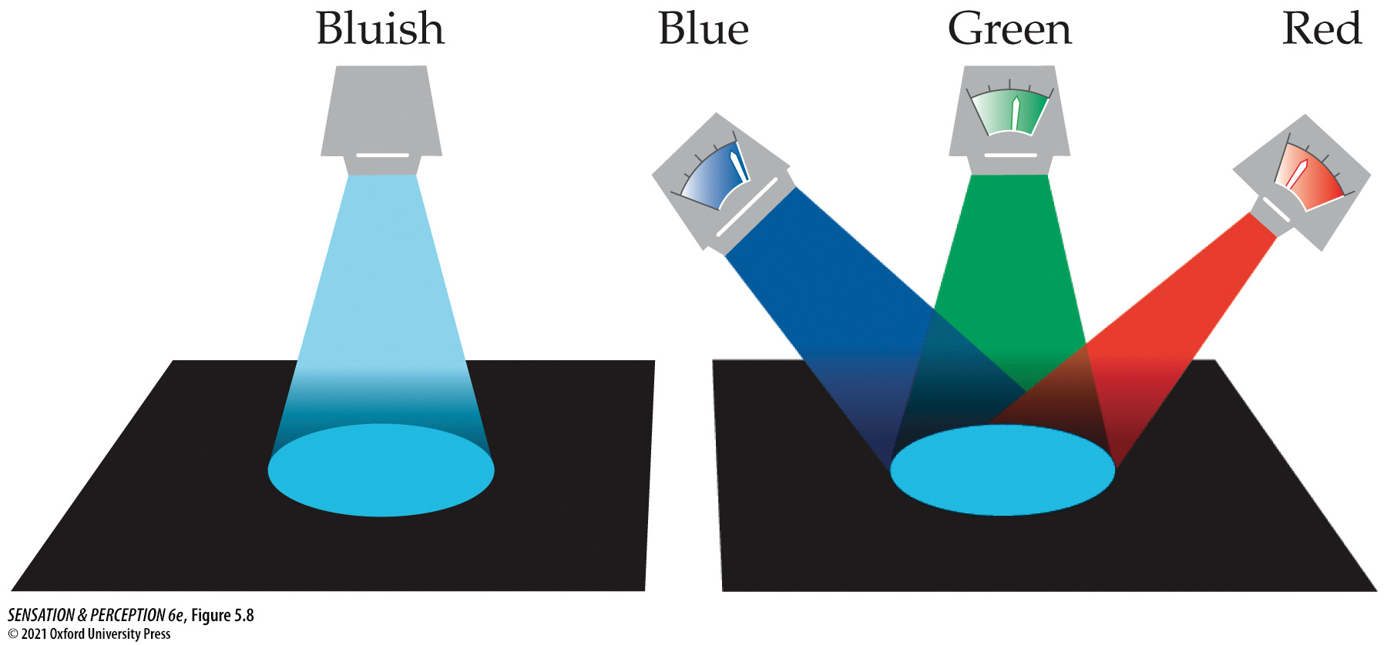
Figure 5.8 Maxwell’s color-matching experiment
Notes:
Figure 5.8 Maxwell’s color-matching experiment
A color is presented on the left. On the right, the observer adjusts a mixture of the three lights to match the color on the left.

Slide 12
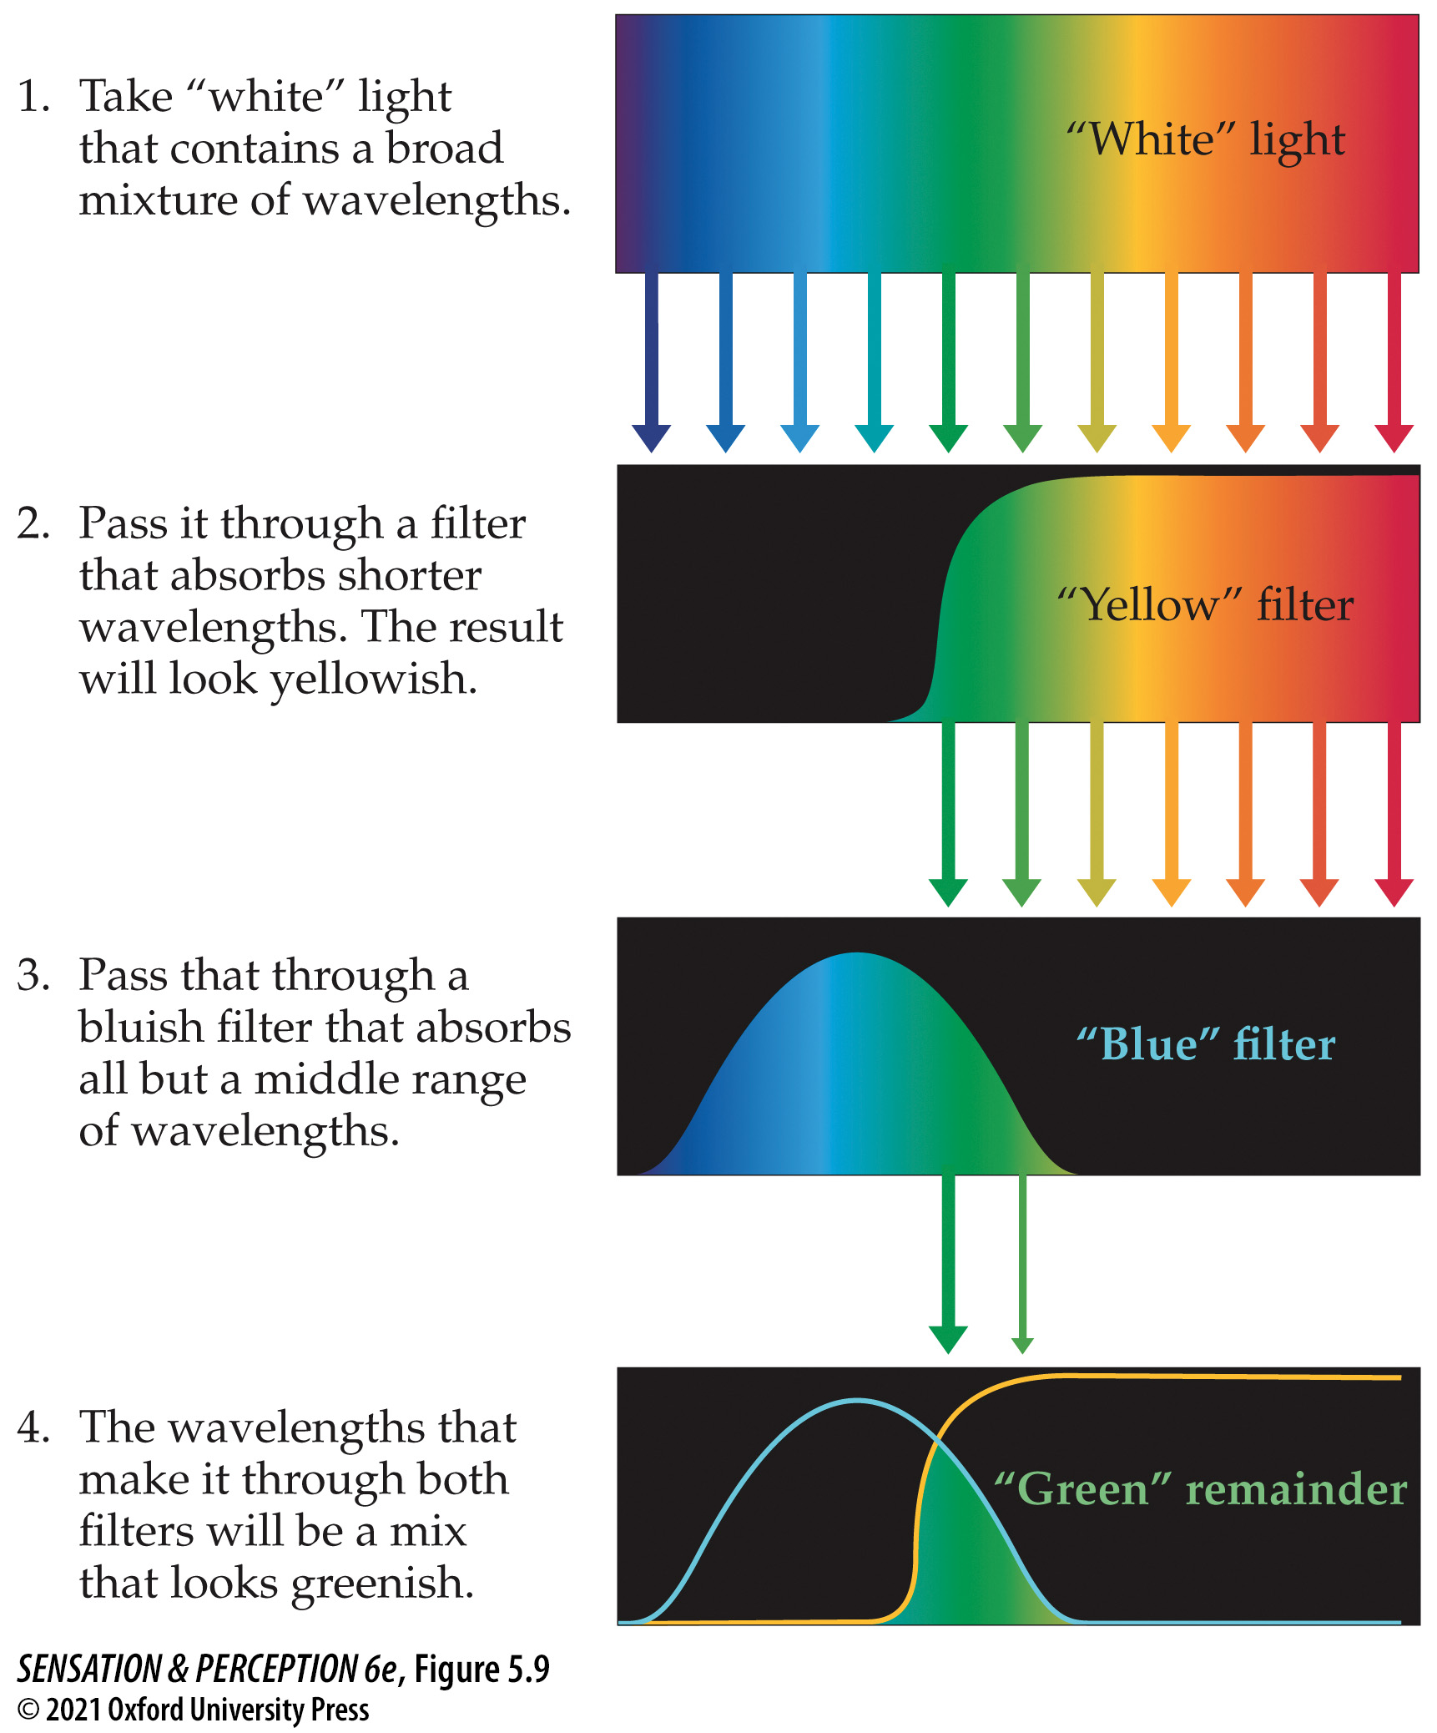
Figure 5.9 Subtractive color mixture
Notes:
Figure 5.9 Subtractive color mixture
In this example, “white”—broadband—light is passed through two filters. The first one absorbs (“subtracts”) shorter wavelengths, transmitting a mix of wavelengths that looks yellow. The second absorbs longer wavelengths and the shortest wavelengths, transmitting a mix that looks blue. The wavelengths that can pass through both filters without being subtracted are a middle range of wavelengths that appear green.

Slide 13
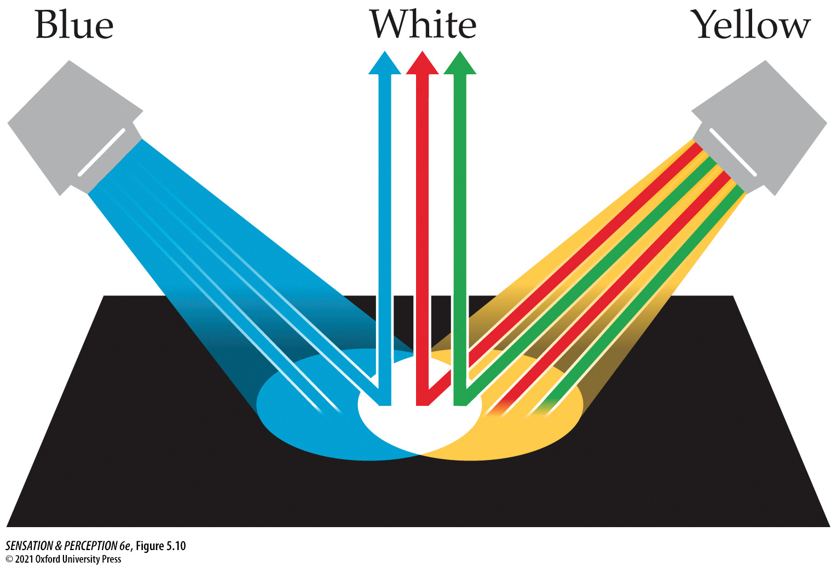
Figure 5.10 Additive color mixture
Notes:
Figure 5.10 Additive color mixture
If we shine a light that looks blue and a light that looks yellow on the same patch of paper, the wavelengths will add, producing an additive color mixture. Remember that the light that looks yellow is equivalent to a mix of a long wavelength and a medium wavelength, so blue plus yellow results in a mix of short, medium, and long wavelengths. The mixture looks white (or gray, if it is not the brightest patch in view).

Slide 14
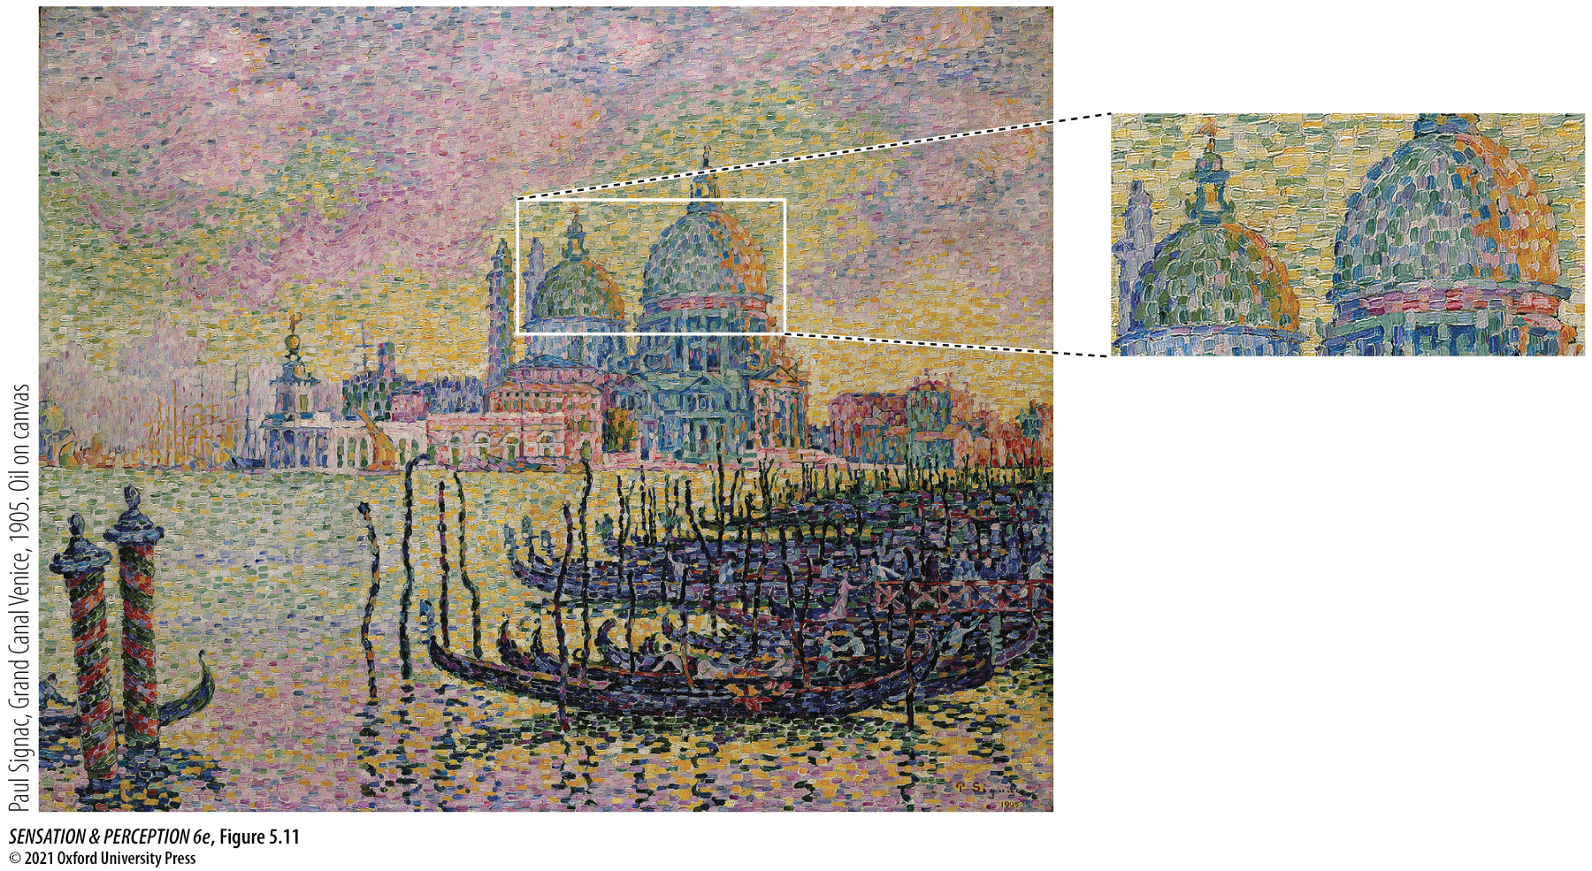
Figure 5.11 Pointillism
Notes:
Figure 5.11 Pointillism
Instead of the usual illustration with a picture by Seurat, here is a painting by Paul Signac (1863–1935) using additive color mixture in the manner of a modern computer monitor. Thus, from a distance the domes look grayish, even if, up close, they are composed of spots of blue, green, and white.

Slide 15
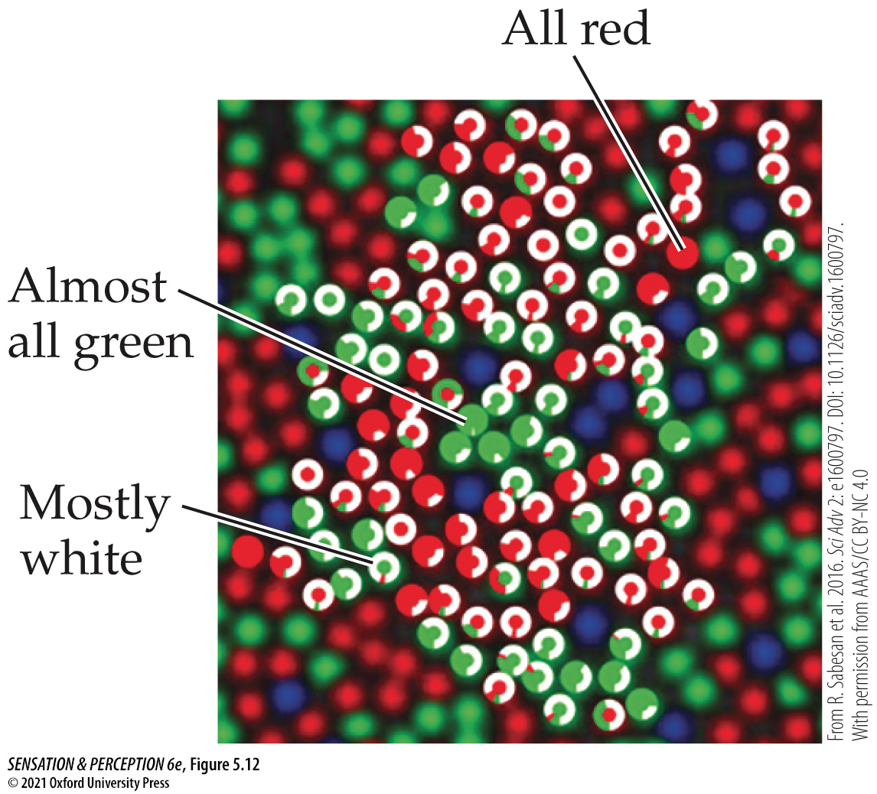
Figure 5.12 The retinal mosaic
Notes:
Figure 5.12 The retinal mosaic
A piece of the retina with the L-, M-, and S-cones colored red, green, and blue. On top of many cones are white rings of varying degrees of completion. Each shows the responses of that cone to tiny spots of light. A full white ring, for example, means the observer always said the spot looked white.

Slide 16
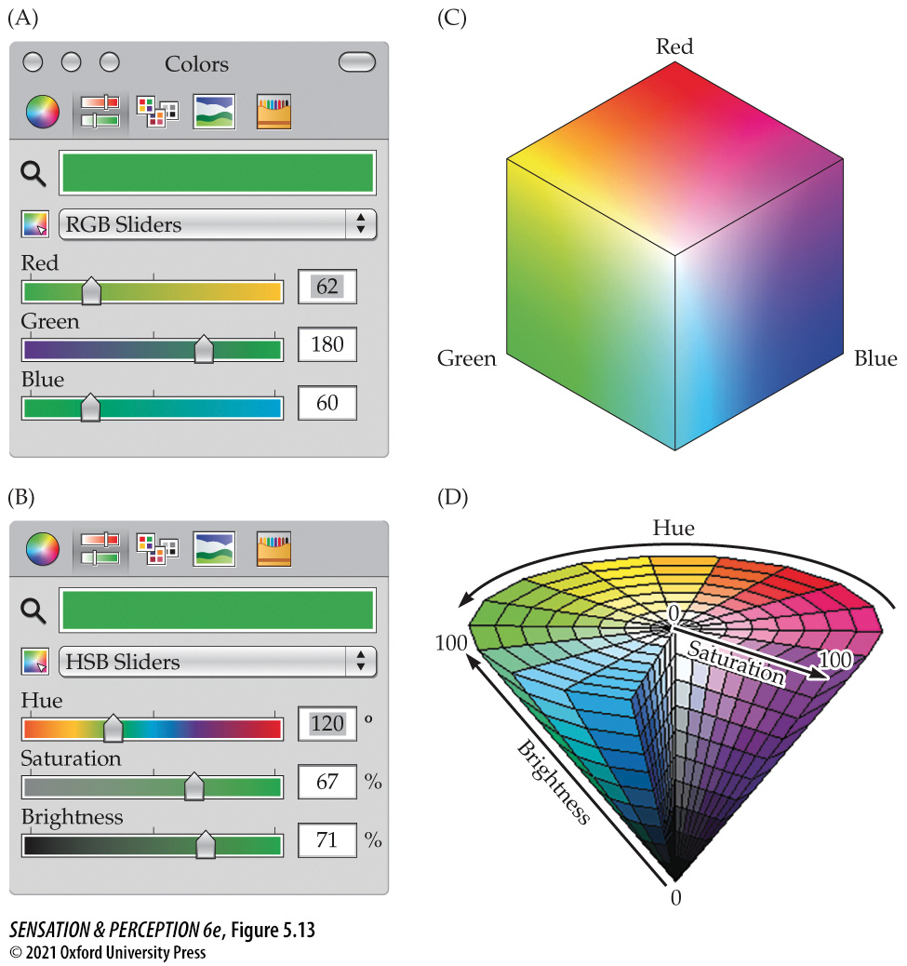
Figure 5.13 Computer color pickers may offer several ways to specify a color in a three-dimensional color space
Notes:
Figure 5.13 Computer color pickers may offer several ways to specify a color in a three-dimensional color space
These “sliders” from Microsoft® PowerPoint® are based on an RGB (red, green, blue) set of primaries in (A and C) and are based on HSB (hue, saturation, brightness) in (B and D). See the text for details.

Slide 17
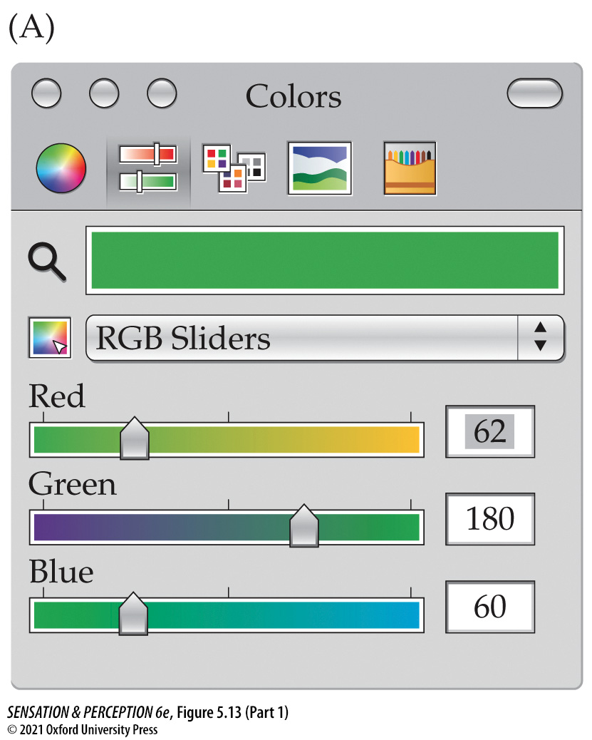
Figure 5.13 Computer color pickers may offer several ways to specify a color in a three-dimensional color space (Part 1)
Notes:
Figure 5.13 Computer color pickers may offer several ways to specify a color in a three-dimensional color space
These “sliders” from Microsoft® PowerPoint® are based on an RGB (red, green, blue) set of primaries in (A and C) and are based on HSB (hue, saturation, brightness) in (B and D). See the text for details.

Slide 18
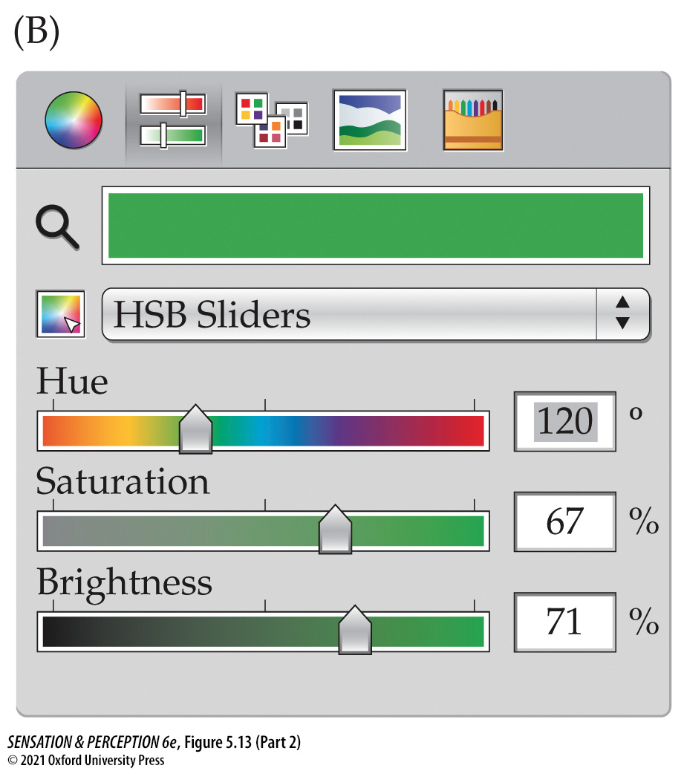
Figure 5.13 Computer color pickers may offer several ways to specify a color in a three-dimensional color space (Part 2)
Notes:
Figure 5.13 Computer color pickers may offer several ways to specify a color in a three-dimensional color space
These “sliders” from Microsoft® PowerPoint® are based on an RGB (red, green, blue) set of primaries in (A and C) and are based on HSB (hue, saturation, brightness) in (B and D). See the text for details.

Slide 19
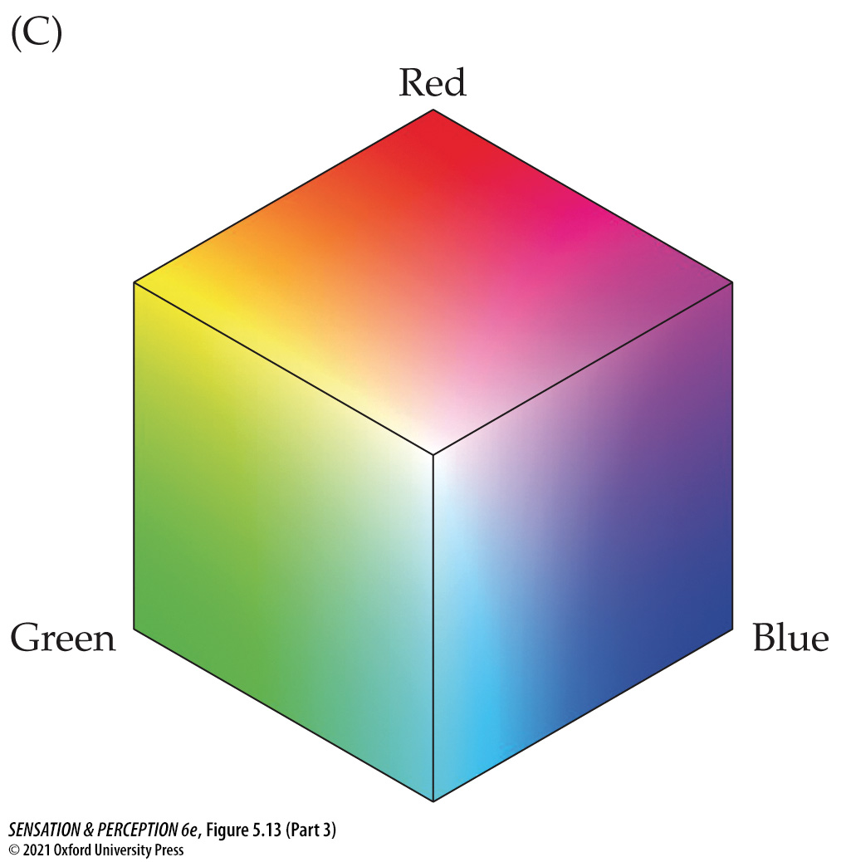
Figure 5.13 Computer color pickers may offer several ways to specify a color in a three-dimensional color space (Part 3)
Notes:
Figure 5.13 Computer color pickers may offer several ways to specify a color in a three-dimensional color space
These “sliders” from Microsoft® PowerPoint® are based on an RGB (red, green, blue) set of primaries in (A and C) and are based on HSB (hue, saturation, brightness) in (B and D). See the text for details.

Slide 20
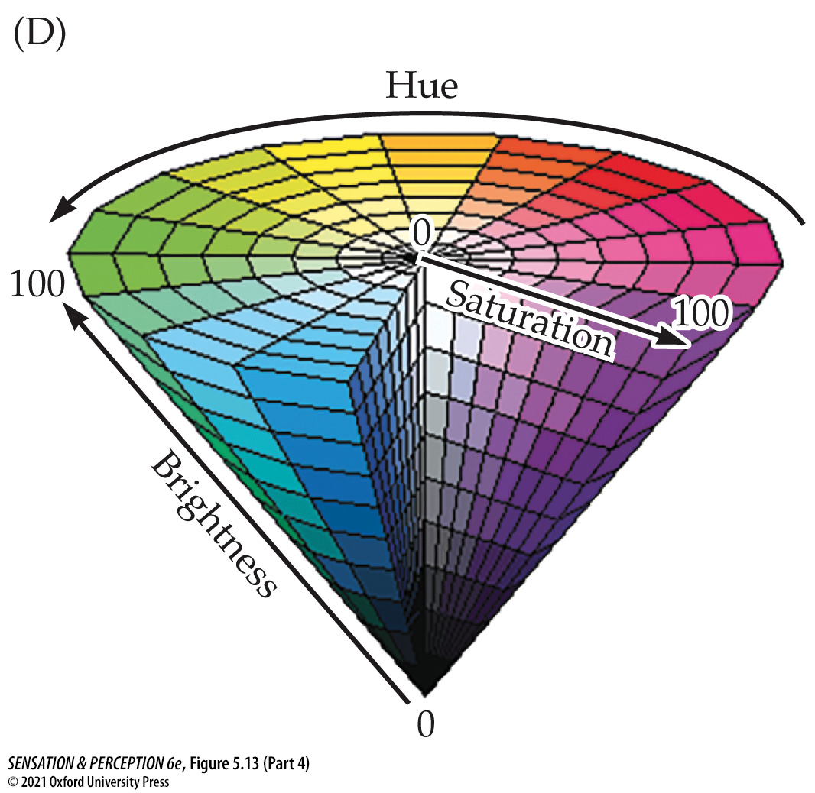
Figure 5.13 Computer color pickers may offer several ways to specify a color in a three-dimensional color space (Part 4)
Notes:
Figure 5.13 Computer color pickers may offer several ways to specify a color in a three-dimensional color space
These “sliders” from Microsoft® PowerPoint® are based on an RGB (red, green, blue) set of primaries in (A and C) and are based on HSB (hue, saturation, brightness) in (B and D). See the text for details.

Slide 21
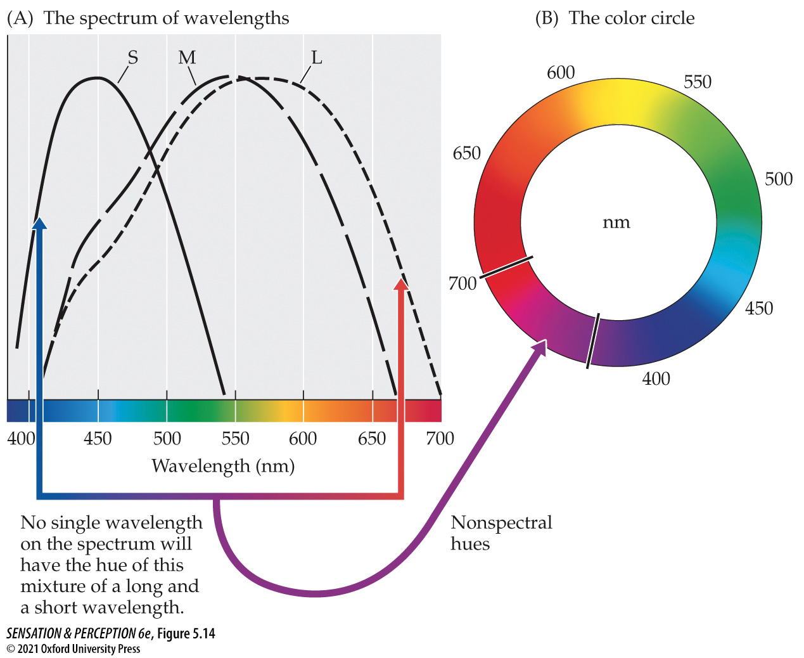
Figure 5.14 Nonspectral colors
Notes:
Figure 5.14 Nonspectral colors
If you combine lights that look red and blue, the result will look purple, but there is no purple on the spectrum (A). Purples are nonspectral colors that join the ends of the spectrum into a color circle (B).

Slide 22
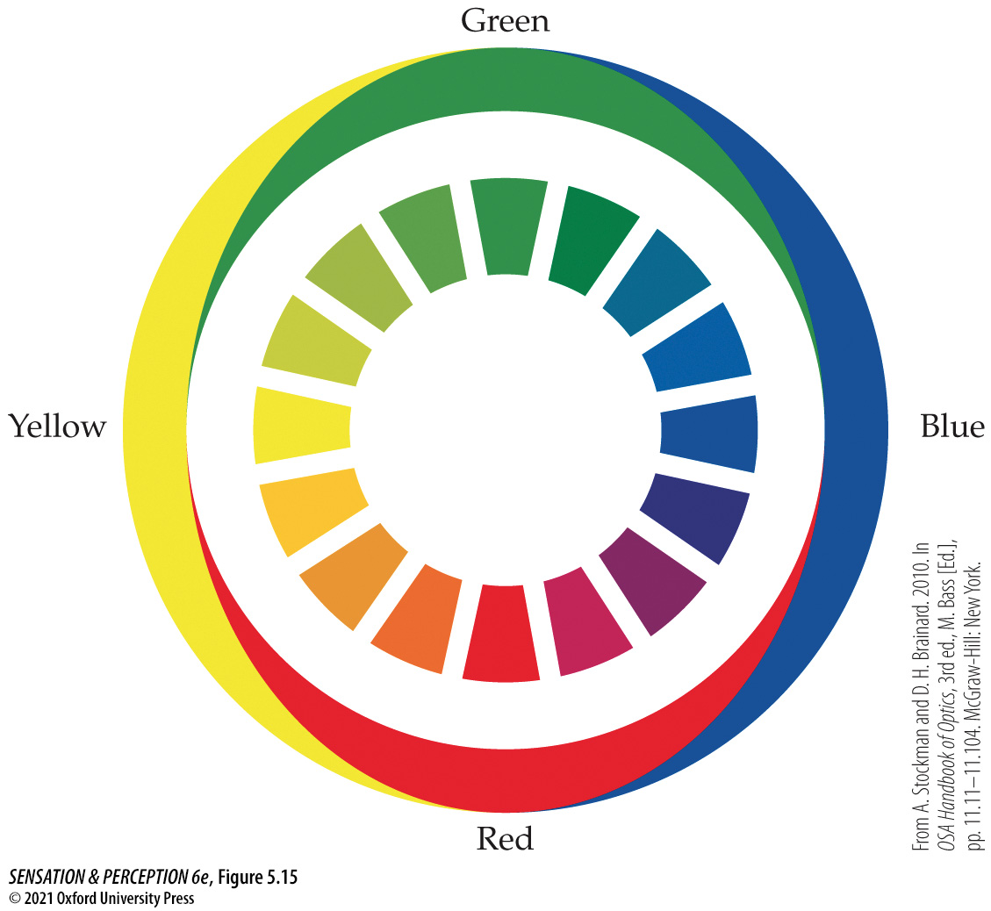
Figure 5.15 Opponent colors
Notes:
Figure 5.15 Opponent colors
Ewald Hering noted that all the colors on the “color circle” (the center ring) could be represented by two pairs of opposing colors: blue versus yellow, and red versus green (shown in the outer ring). Thus, a color could be a reddish yellow or a bluish green, but not a reddish green or a bluish yellow. (From A. Stockman and D. H. Brainard. 2010. In OSA Handbook of Optics, 3rd ed., M. Bass [Ed.], pp. 11.11–11.104. McGraw-Hill: New York.)

Slide 23
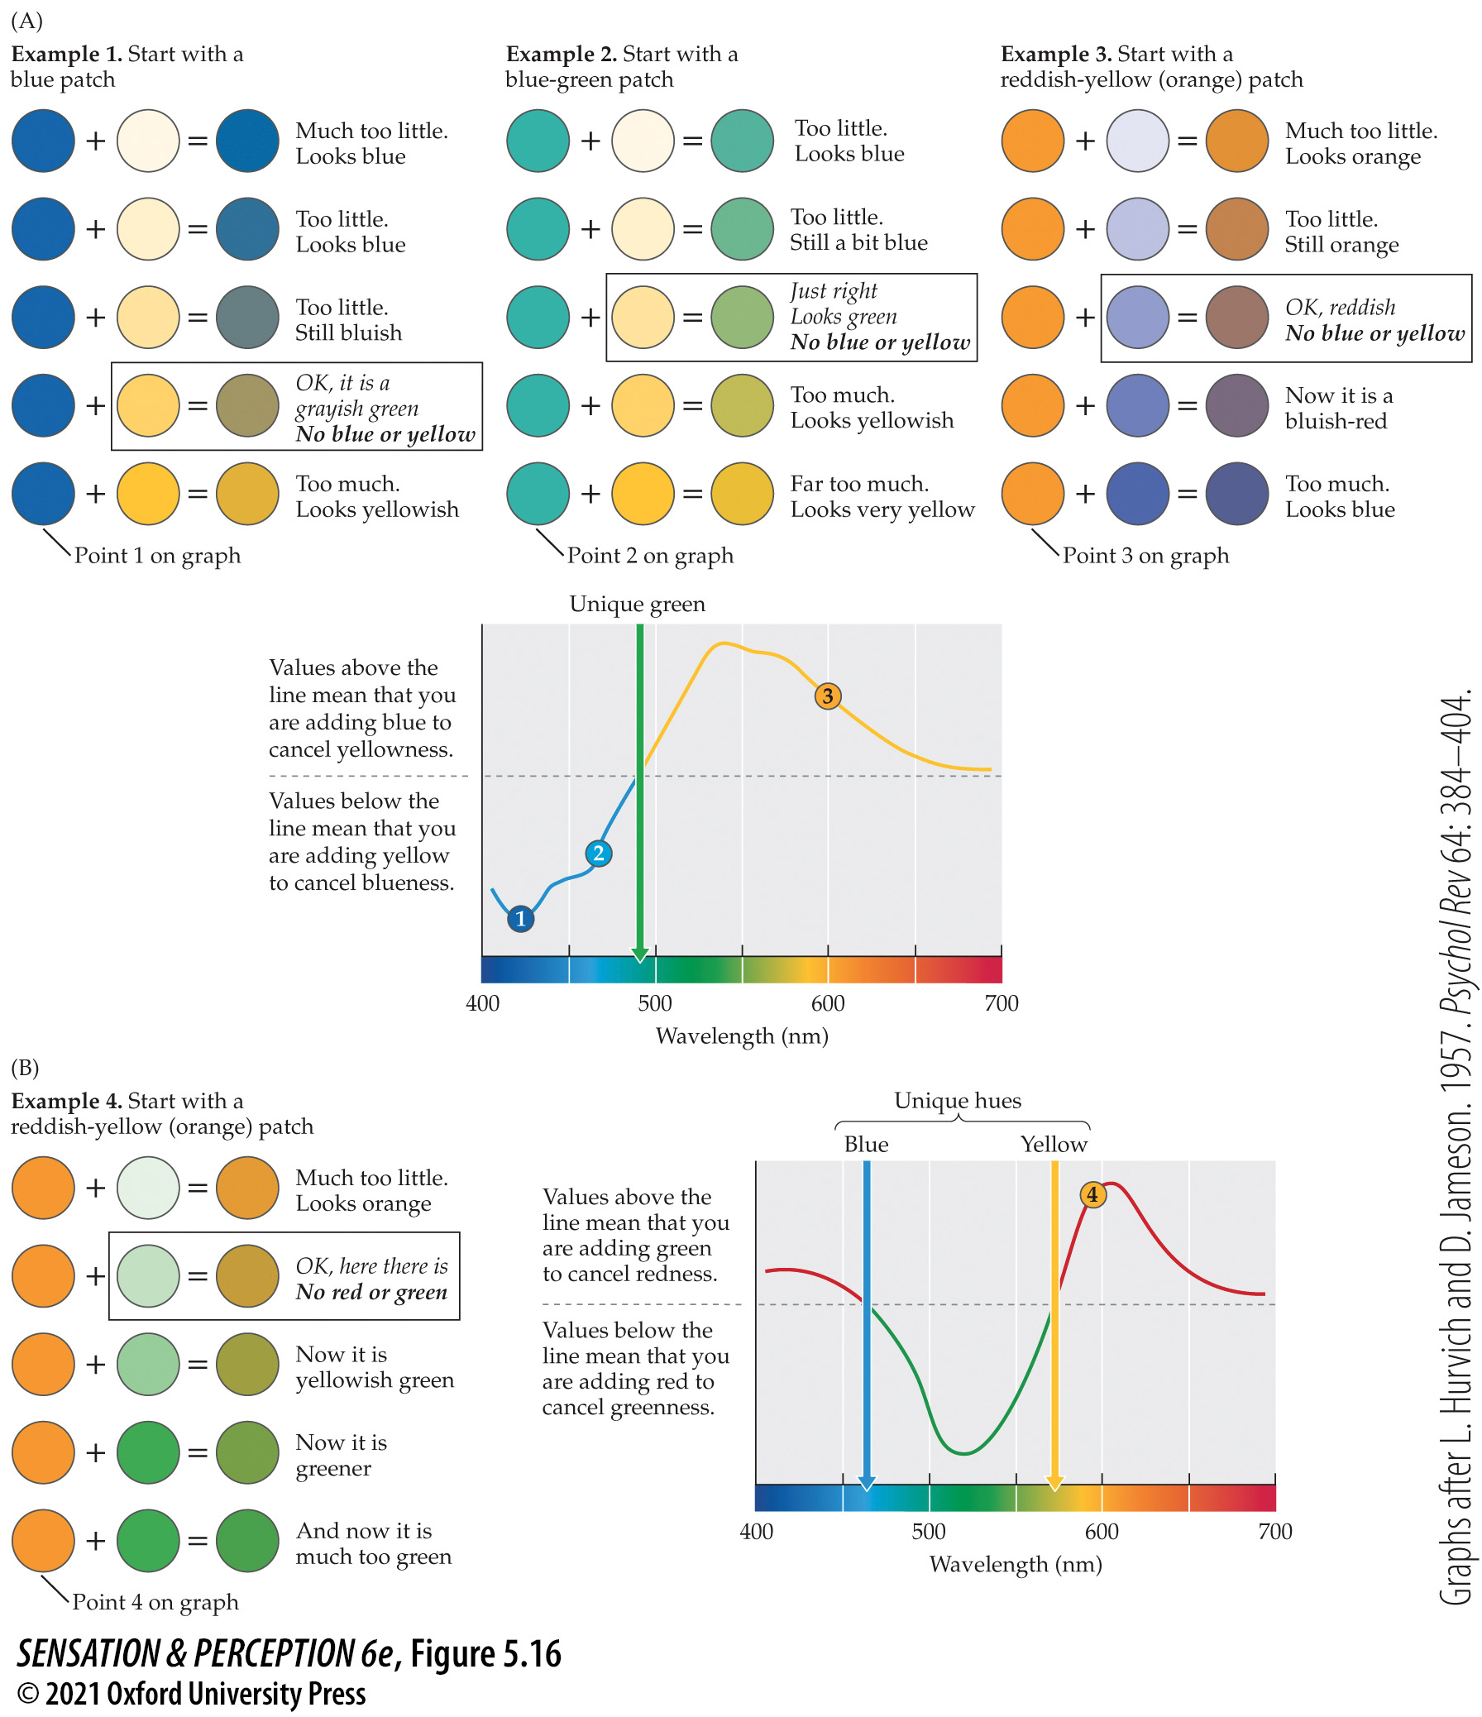
Figure 5.16 Color cancellation method
Notes:
Figure 5.16 Color cancellation method
Using color cancellation to measure opponent processes and unique hues in a blue-yellow (A) and a red-green (B) process. The locations where the hue cancellations cross the neutral midpoint are the locations of the unique green (A) and blue and yellow (B) hues—for example, the green hue with no hint of blue or yellow in it. (Graphs after L. Hurvich and D. Jameson. 1957. Psychol Rev 64: 384–404.)

Slide 24
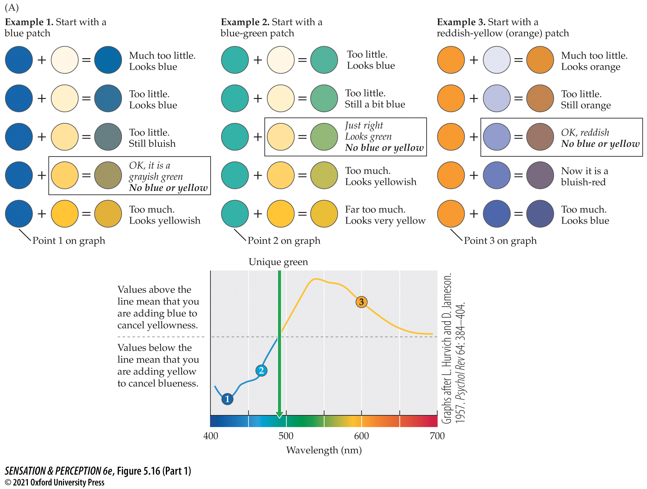
Figure 5.16 Color cancellation method (Part 1)
Notes:
Figure 5.16 Color cancellation method
Using color cancellation to measure opponent processes and unique hues in a blue-yellow (A) and a red-green (B) process. The locations where the hue cancellations cross the neutral midpoint are the locations of the unique green (A) and blue and yellow (B) hues—for example, the green hue with no hint of blue or yellow in it. (Graphs after L. Hurvich and D. Jameson. 1957. Psychol Rev 64: 384–404.)

Slide 25
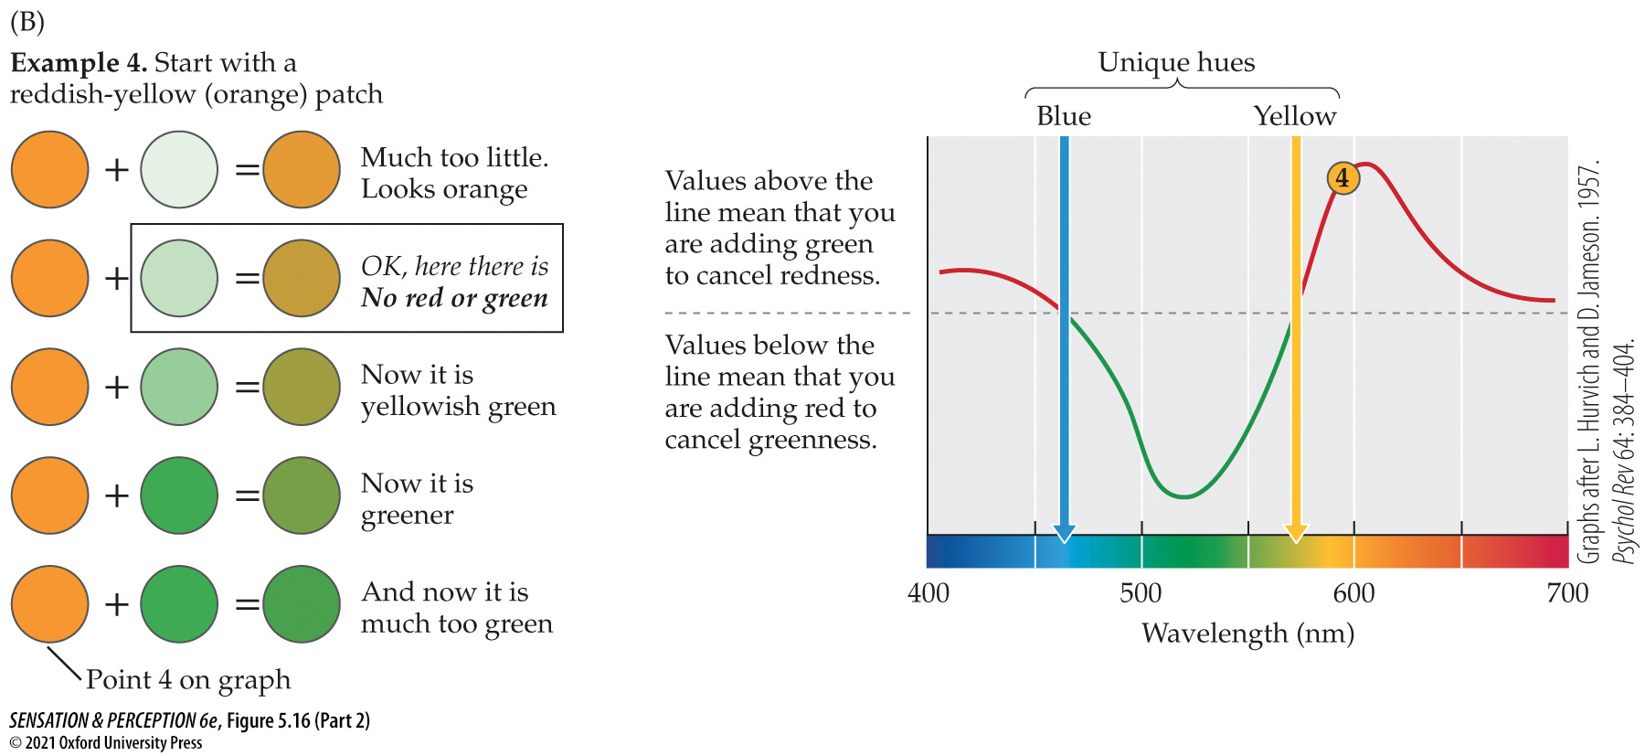
Figure 5.16 Color cancellation method (Part 2)
Notes:
Figure 5.16 Color cancellation method
Using color cancellation to measure opponent processes and unique hues in a blue-yellow (A) and a red-green (B) process. The locations where the hue cancellations cross the neutral midpoint are the locations of the unique green (A) and blue and yellow (B) hues—for example, the green hue with no hint of blue or yellow in it. (Graphs after L. Hurvich and D. Jameson. 1957. Psychol Rev 64: 384–404.)

Slide 26
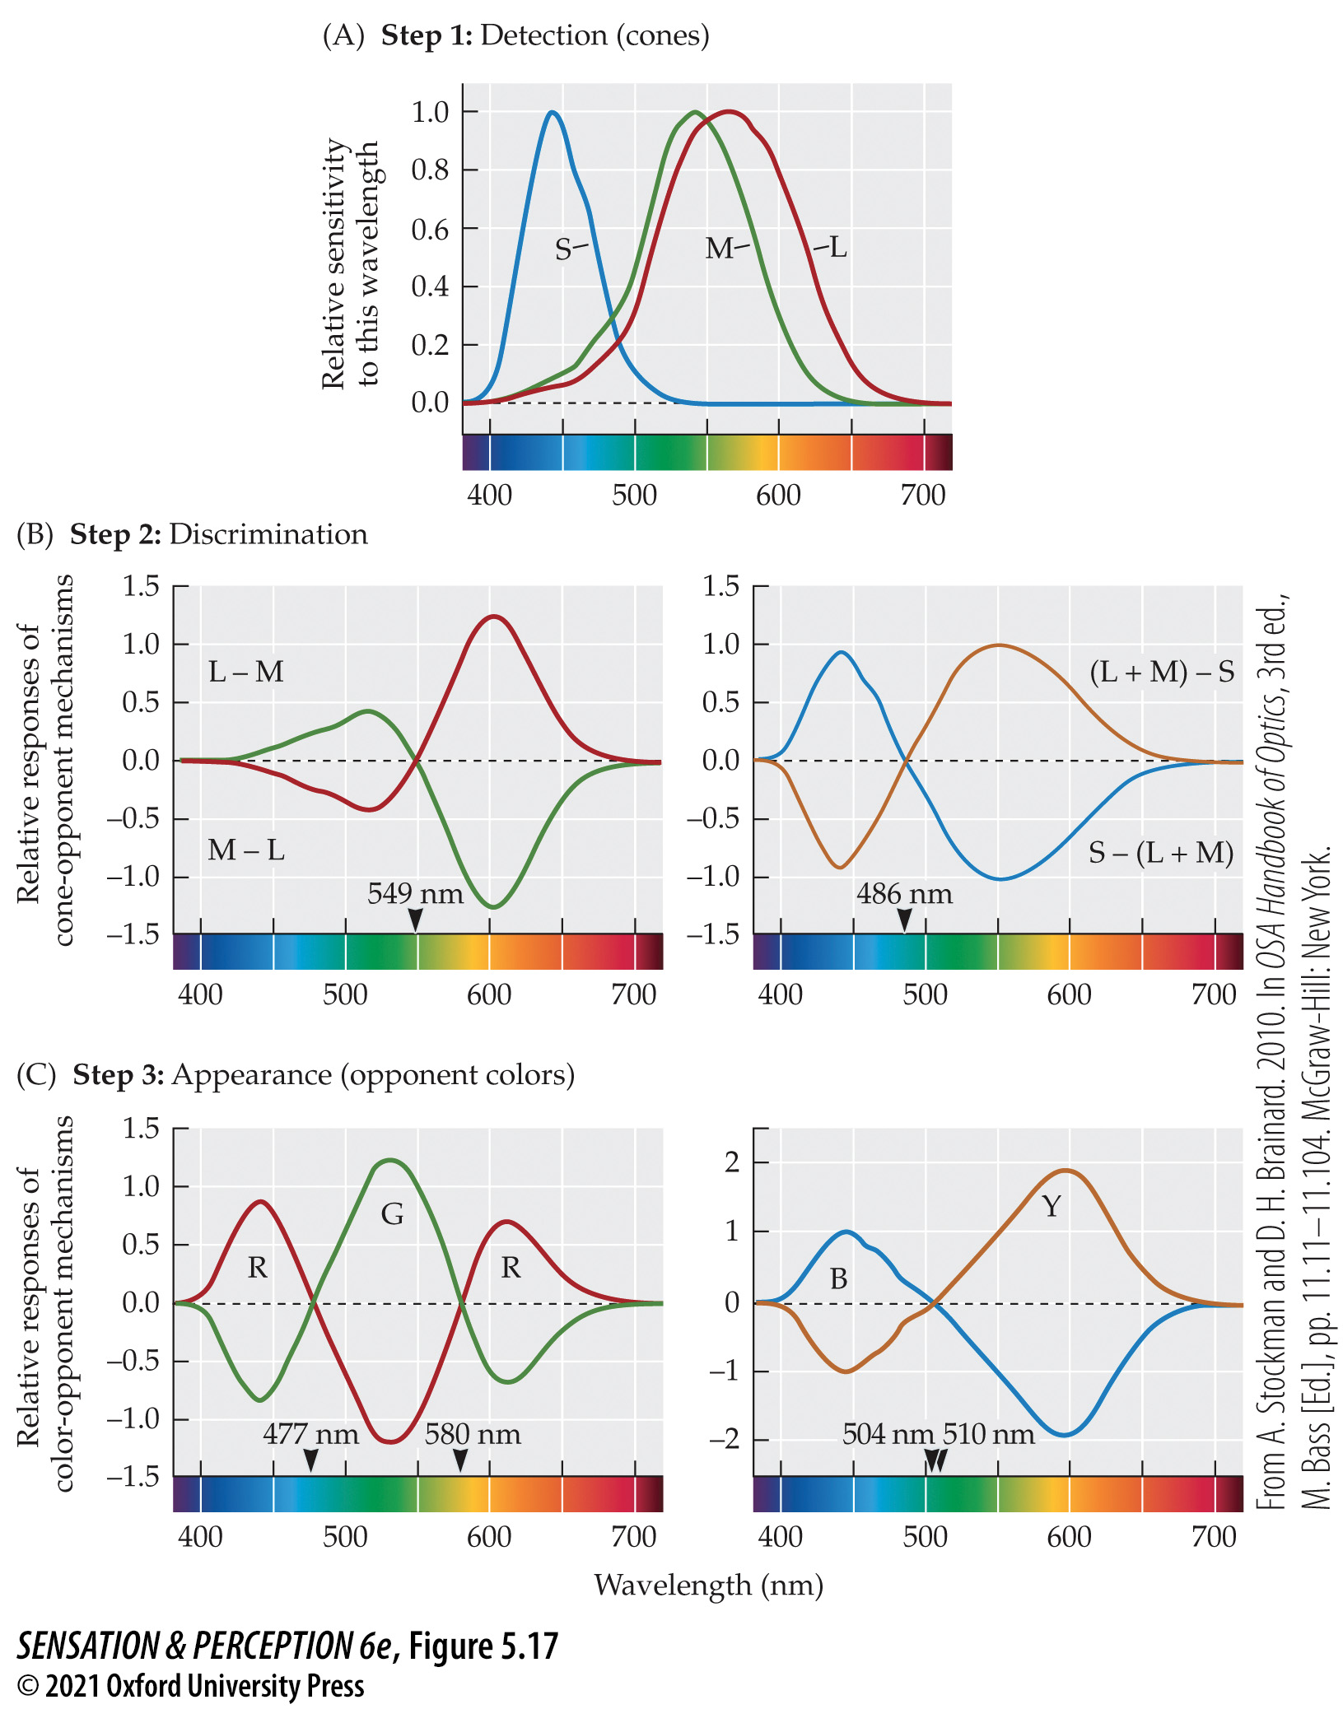
Figure 5.17 Three steps to color perception
Notes:
Figure 5.17 Three steps to color perception
(A) Detection: light is differentially absorbed by three photopigments in the cones. (B) Discrimination: differences are taken between cone types, creating cone-opponent mechanisms, important for wavelength discriminations. (C) Appearance: further recombination of the signals creates color-opponent processes that support the color-opponent nature of color appearance. (From A. Stockman and D. H. Brainard. 2010. In OSA Handbook of Optics, 3rd ed., M. Bass [Ed.], pp. 11.11–11.104. McGraw-Hill: New York.)

Slide 27
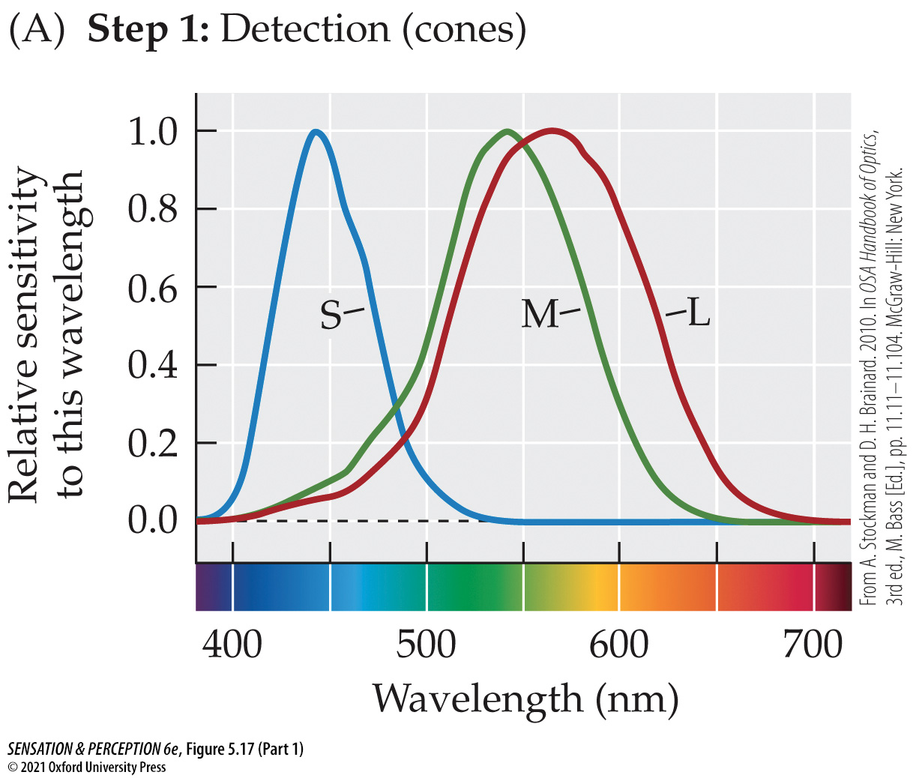
Figure 5.17 Three steps to color perception (Part 1)
Notes:
Figure 5.17 Three steps to color perception
(A) Detection: light is differentially absorbed by three photopigments in the cones. (B) Discrimination: differences are taken between cone types, creating cone-opponent mechanisms, important for wavelength discriminations. (C) Appearance: further recombination of the signals creates color-opponent processes that support the color-opponent nature of color appearance. (From A. Stockman and D. H. Brainard. 2010. In OSA Handbook of Optics, 3rd ed., M. Bass [Ed.], pp. 11.11–11.104. McGraw-Hill: New York.)

Slide 28
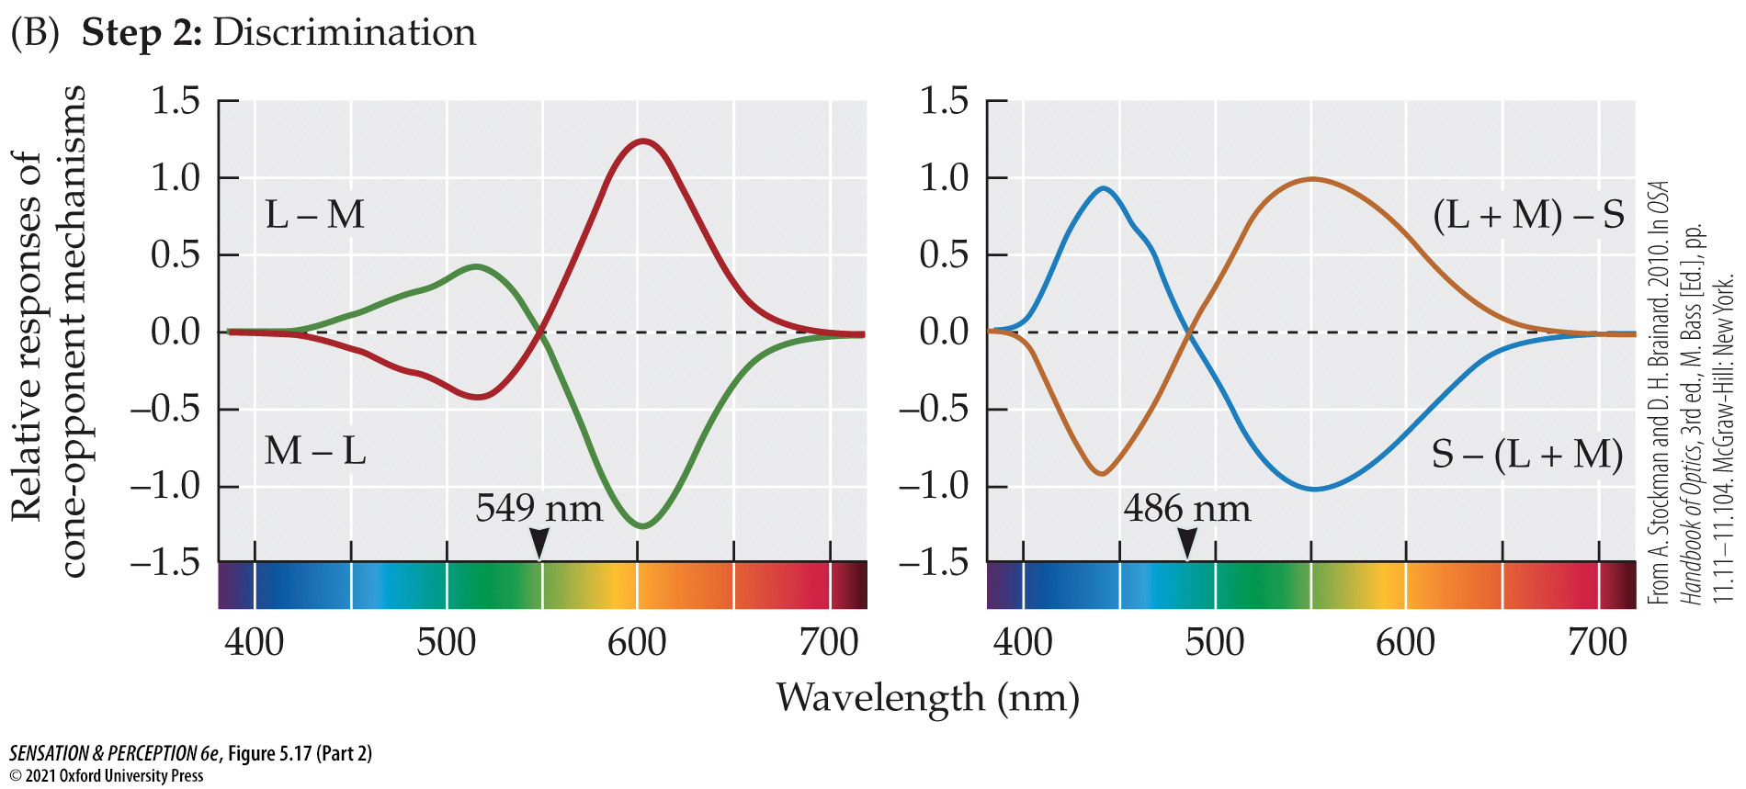
Figure 5.17 Three steps to color perception (Part 2)
Notes:
Figure 5.17 Three steps to color perception
(A) Detection: light is differentially absorbed by three photopigments in the cones. (B) Discrimination: differences are taken between cone types, creating cone-opponent mechanisms, important for wavelength discriminations. (C) Appearance: further recombination of the signals creates color-opponent processes that support the color-opponent nature of color appearance. (From A. Stockman and D. H. Brainard. 2010. In OSA Handbook of Optics, 3rd ed., M. Bass [Ed.], pp. 11.11–11.104. McGraw-Hill: New York.)

Slide 29
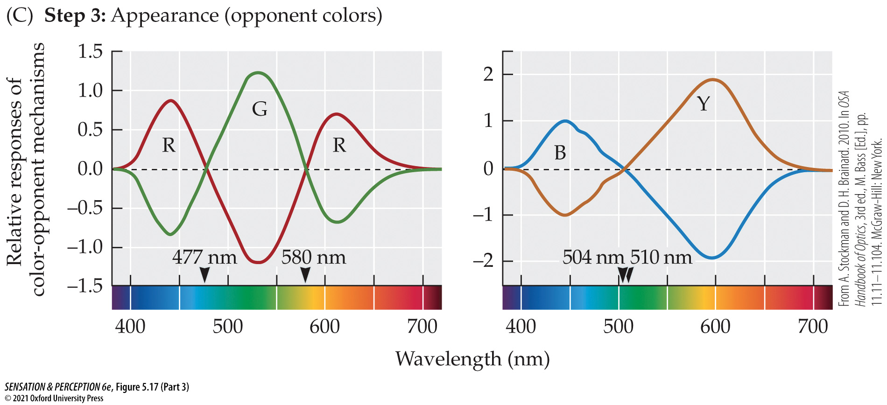
Figure 5.17 Three steps to color perception (Part 3)
Notes:
Figure 5.17 Three steps to color perception
(A) Detection: light is differentially absorbed by three photopigments in the cones. (B) Discrimination: differences are taken between cone types, creating cone-opponent mechanisms, important for wavelength discriminations. (C) Appearance: further recombination of the signals creates color-opponent processes that support the color-opponent nature of color appearance. (From A. Stockman and D. H. Brainard. 2010. In OSA Handbook of Optics, 3rd ed., M. Bass [Ed.], pp. 11.11–11.104. McGraw-Hill: New York.)

Slide 30
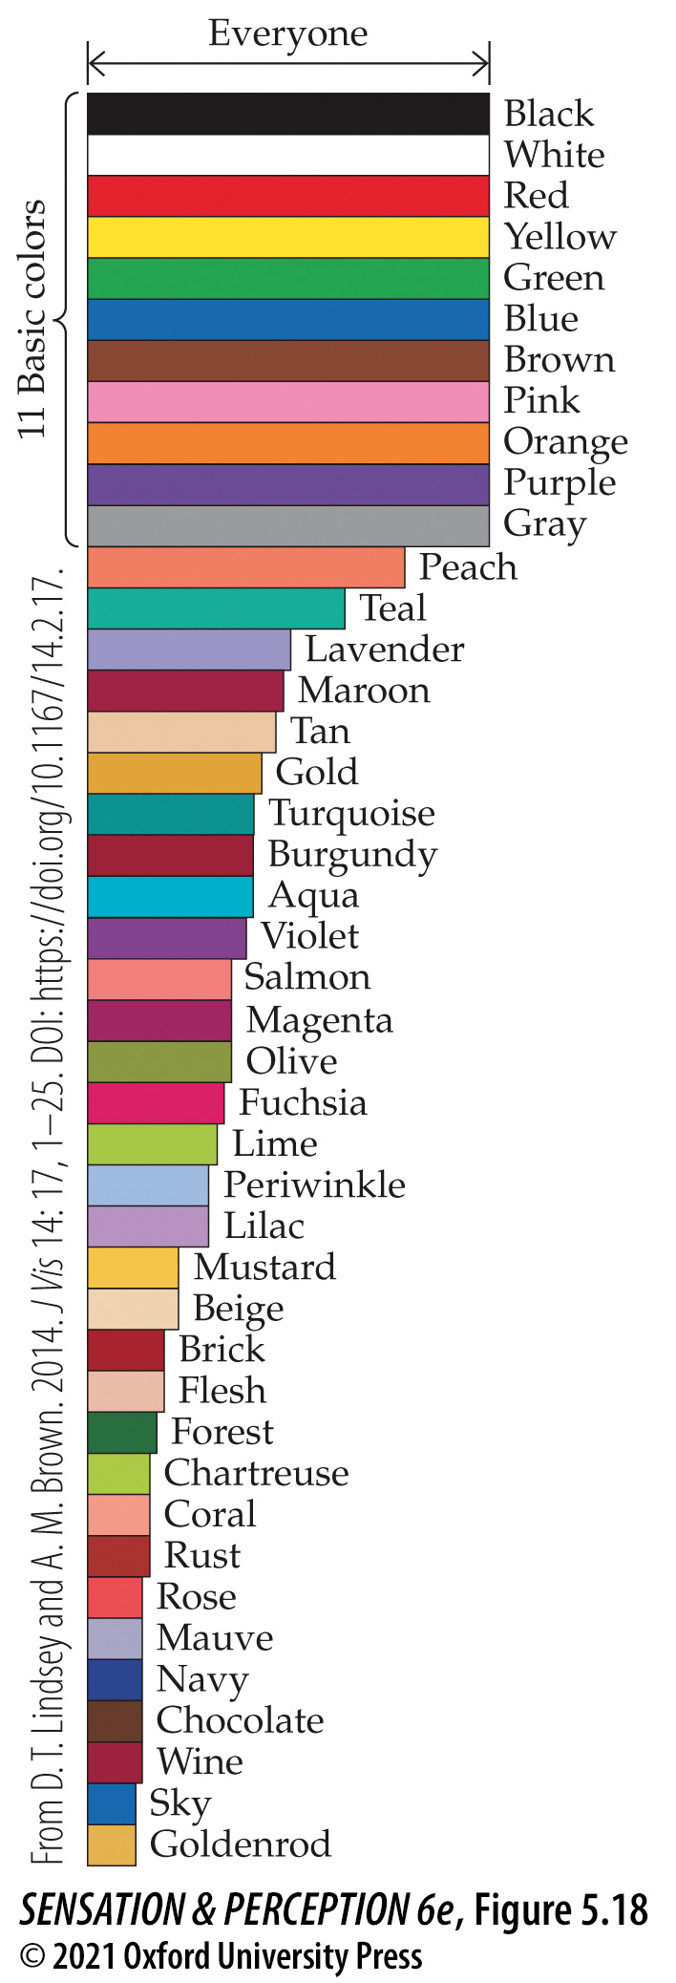
Figure 5.18 Basic color names
Notes:
Figure 5.18 Basic color names
When Lindsey and Brown (2014) asked Americans to name color patches, everyone used the 11 “basic” color names. The other color terms were used by fewer and fewer people, going toward the bottom of the graph. A few of these other terms, like peach and teal, may be considered basic color names over time. (From D. T. Lindsey and A. M. Brown. 2014. J Vis 14: 17, 1–25. DOI: https://doi.org/10.1167/14.2.17.)

Slide 31
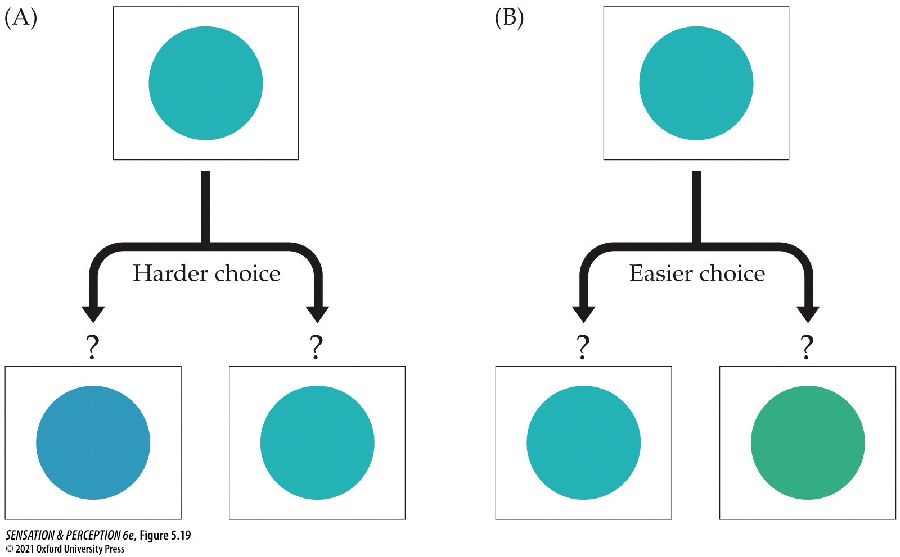
Figure 5.19 Color category boundaries
Notes:
Figure 5.19 Color category boundaries
It is easier to remember which of two colors you have seen if the choices are categorically different. For example, suppose you had to remember the “blue” patch shown at the top of each part of the Figure. Picking between two “blues,” as in (A), would be rather hard. The task would be easier if one of the choices were “blue” and the other “green,” as in (B), even if the distances in color space were the same in the two cases.

Slide 32
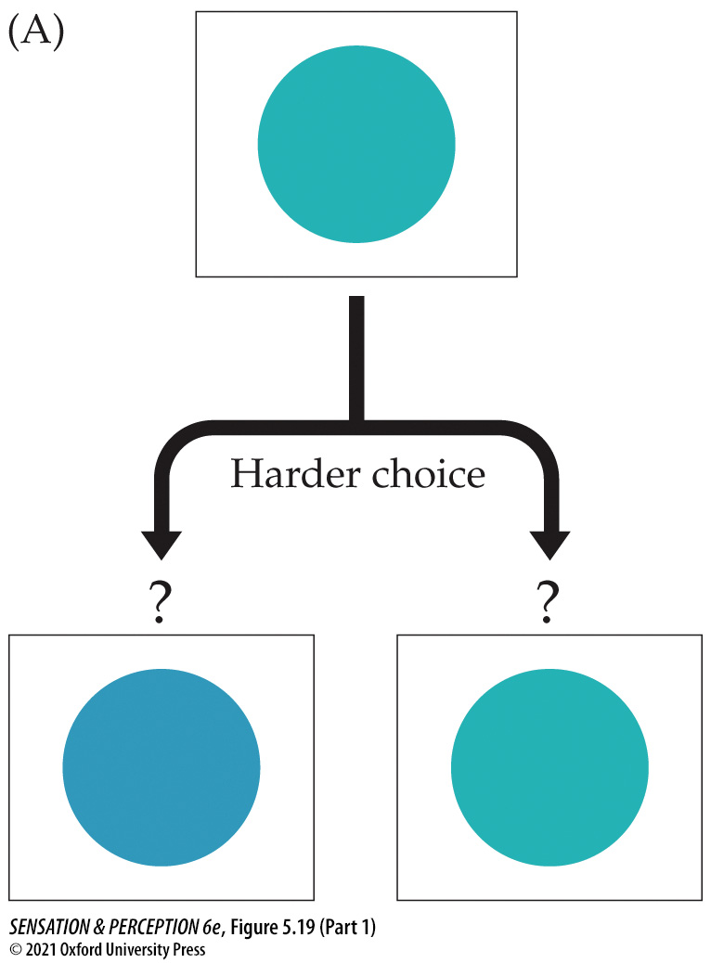
Figure 5.19 Color category boundaries (Part 1)
Notes:
Figure 5.19 Color category boundaries
It is easier to remember which of two colors you have seen if the choices are categorically different. For example, suppose you had to remember the “blue” patch shown at the top of each part of the Figure. Picking between two “blues,” as in (A), would be rather hard. The task would be easier if one of the choices were “blue” and the other “green,” as in (B), even if the distances in color space were the same in the two cases.

Slide 33
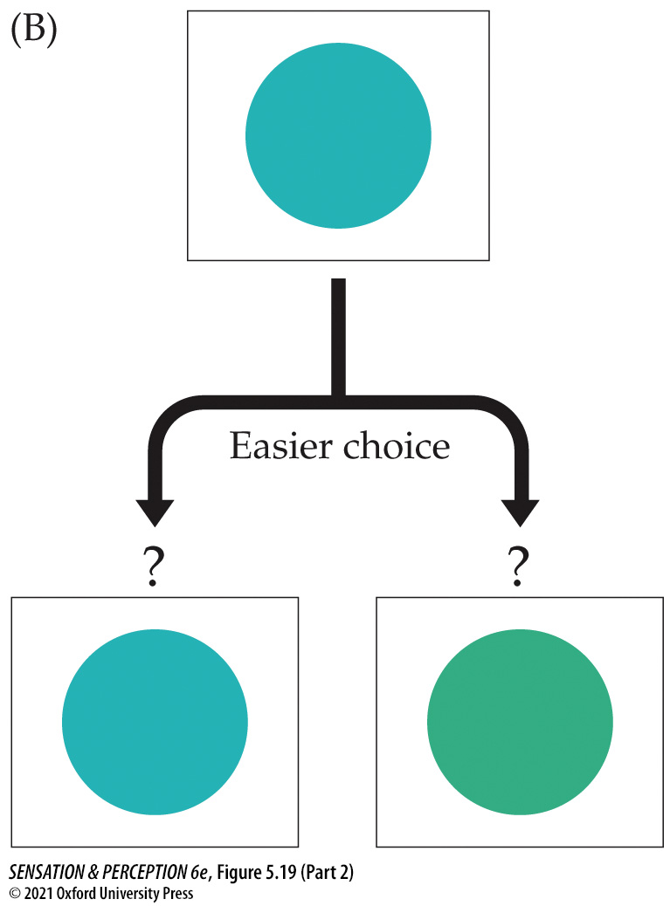
Figure 5.19 Color category boundaries (Part 2)
Notes:
Figure 5.19 Color category boundaries
It is easier to remember which of two colors you have seen if the choices are categorically different. For example, suppose you had to remember the “blue” patch shown at the top of each part of the Figure. Picking between two “blues,” as in (A), would be rather hard. The task would be easier if one of the choices were “blue” and the other “green,” as in (B), even if the distances in color space were the same in the two cases.

Slide 34
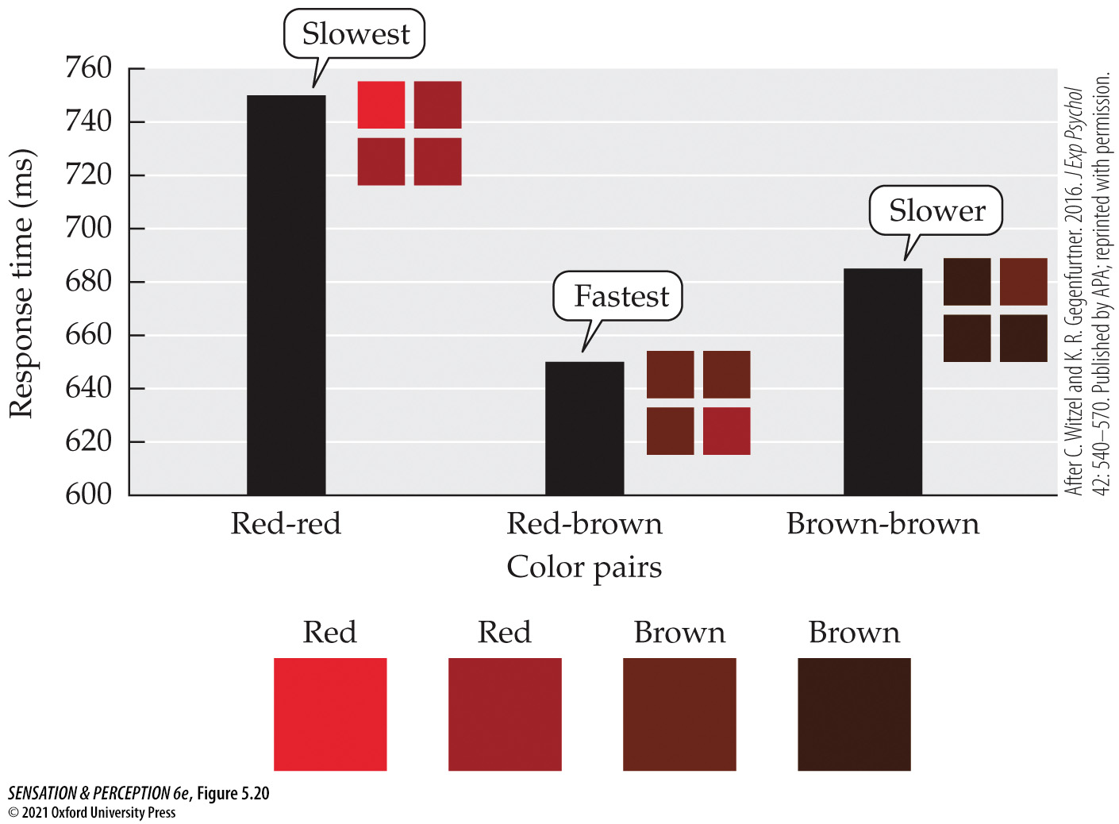
Figure 5.20 A color category experiment
Notes:
Figure 5.20 A color category experiment
Observers see four color patches and simply locate the one patch that is different from the other three. Responses are faster and more accurate when the two colors cross a color boundary—in this case, between red and brown. (After C. Witzel and K. R. Gegenfurtner. 2016. J Exp Psychol 42: 540–570. Published by APA; reprinted with permission.)

Slide 35
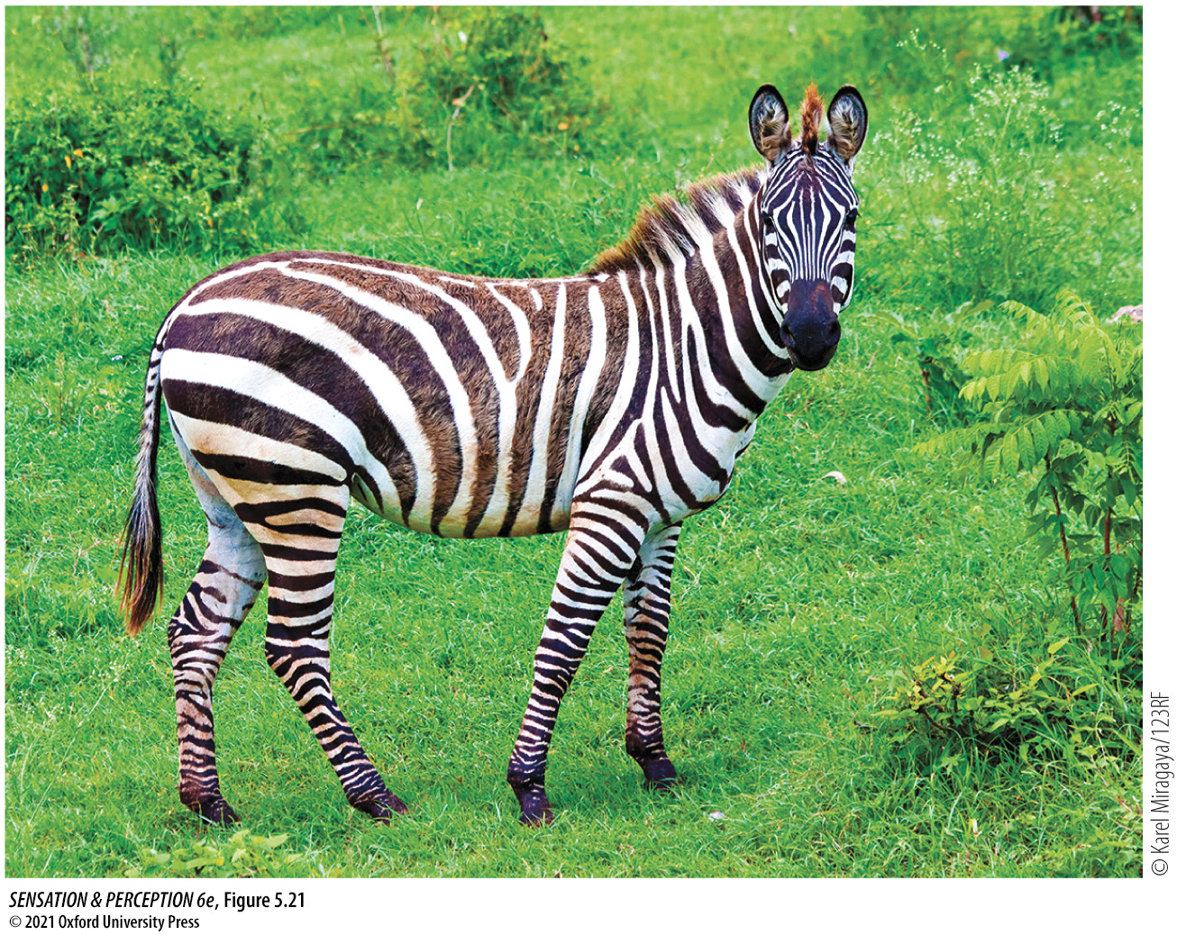
Figure 5.21 Color constancy
Notes:
Figure 5.21 Color constancy
This zebra looks like a black-and-white beast in a green field whether you are looking at this book under a dim yellow bulb inside, under the bright sky outside, or for that matter, on your computer screen. How does that work?

Slide 36
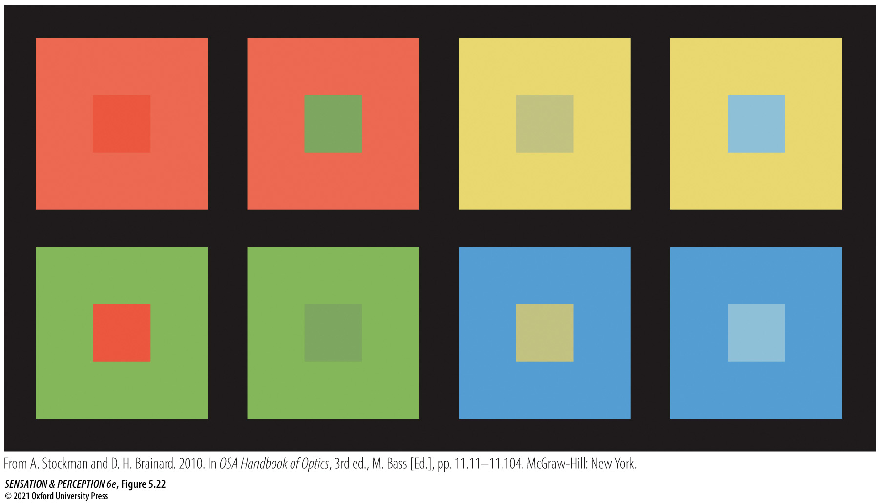
Figure 5.22 Color contrast
Notes:
Figure 5.22 Color contrast
The central square takes on chromatic attributes that are opposite those of the surround. For instance, the green central square in column 2, looks greener on the red background than on the green background. (From A. Stockman and D. H. Brainard. 2010. In OSA Handbook of Optics, 3rd ed., M. Bass [Ed.], pp. 11.11–11.104. McGraw-Hill: New York.)

Slide 37
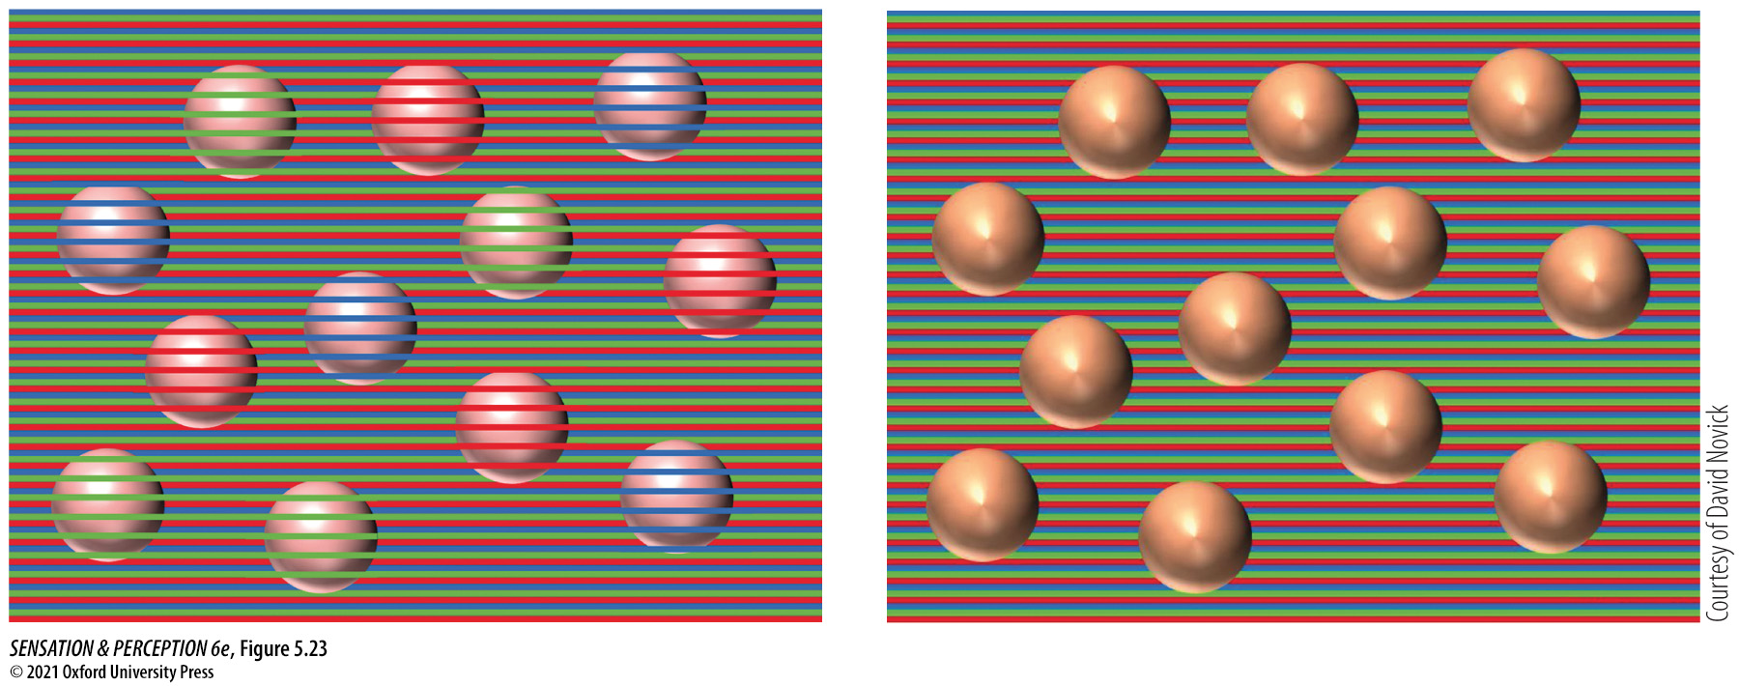
Figure 5.23 Color assimilation
Notes:
Figure 5.23 Color assimilation
Here, colors blend together locally. The apparent color of each sphere comes from stripes that lie on top of it in the group on the left. Remove the stripes, as on the right, and the spheres are all the same color.

Slide 38
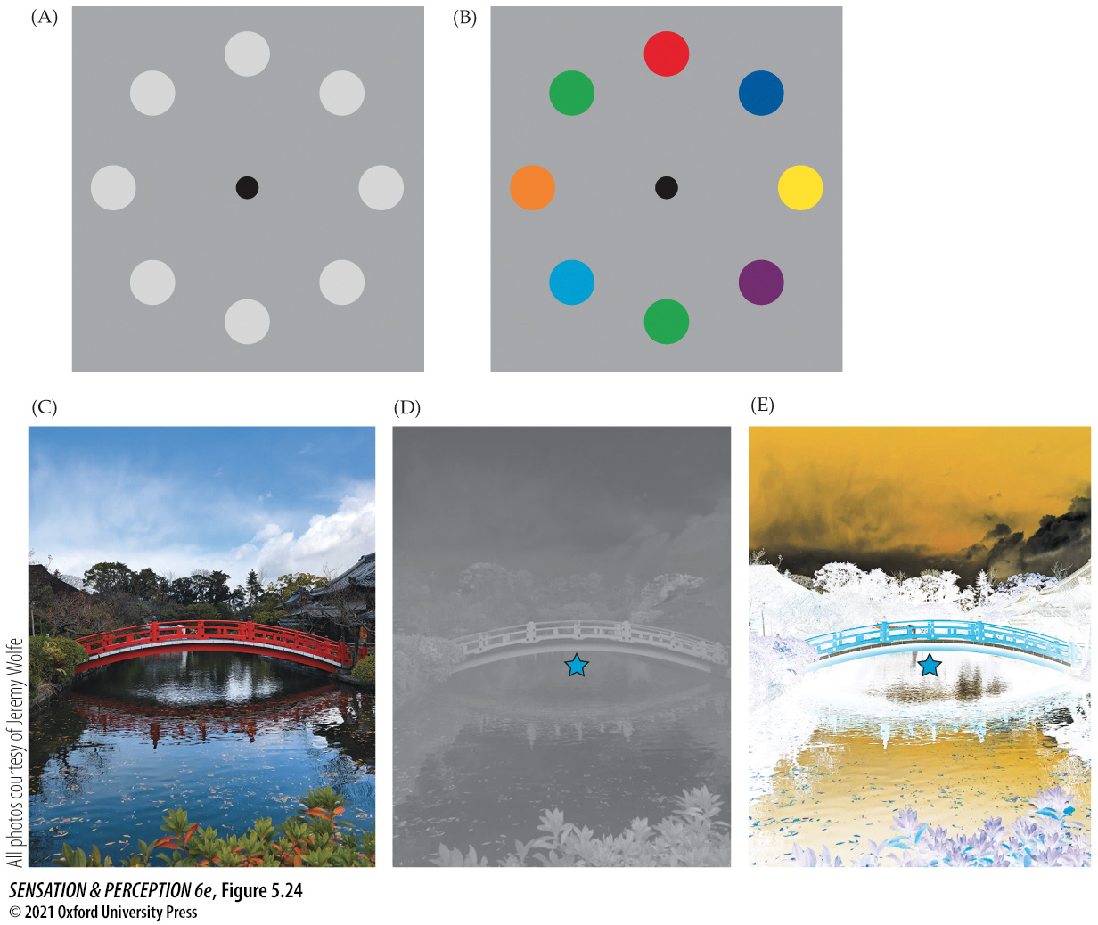
Figure 5.24 Negative afterimages
Notes:
Figure 5.24 Negative afterimages
Study the image in (A) and convince yourself that the ring of circles is gray. Now stare at the black dot in (B). After 10 seconds or so, shift your fixation to the black dot in (A). The circles should now look colored. This is a negative afterimage. Why does it happen? (If it didn’t happen, try fixating more rigorously. Really look at the black dot.) Now try with a real scene. Fixate the star in (E), and then flick your eyes to the same spot in (D). Looking back and forth helps. You should see a washed-out version of the colors in (C).

Slide 39
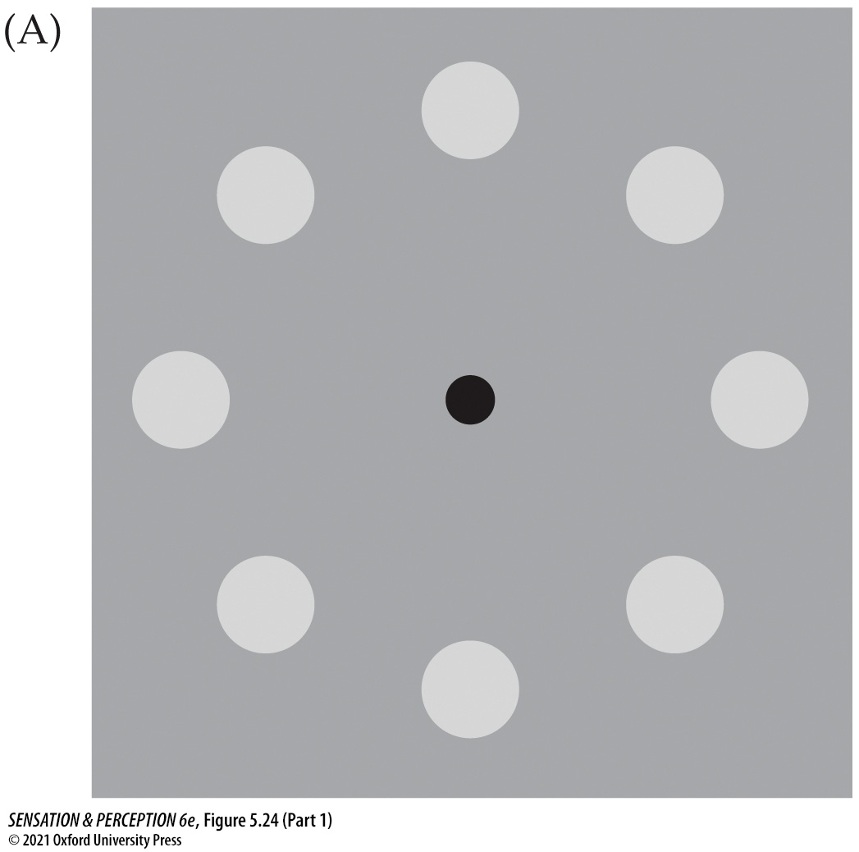
Figure 5.24 Negative afterimages (Part 1)
Notes:
Figure 5.24 Negative afterimages
Study the image in (A) and convince yourself that the ring of circles is gray. Now stare at the black dot in (B). After 10 seconds or so, shift your fixation to the black dot in (A). The circles should now look colored. This is a negative afterimage. Why does it happen? (If it didn’t happen, try fixating more rigorously. Really look at the black dot.) Now try with a real scene. Fixate the star in (E), and then flick your eyes to the same spot in (D). Looking back and forth helps. You should see a washed-out version of the colors in (C).

Slide 40
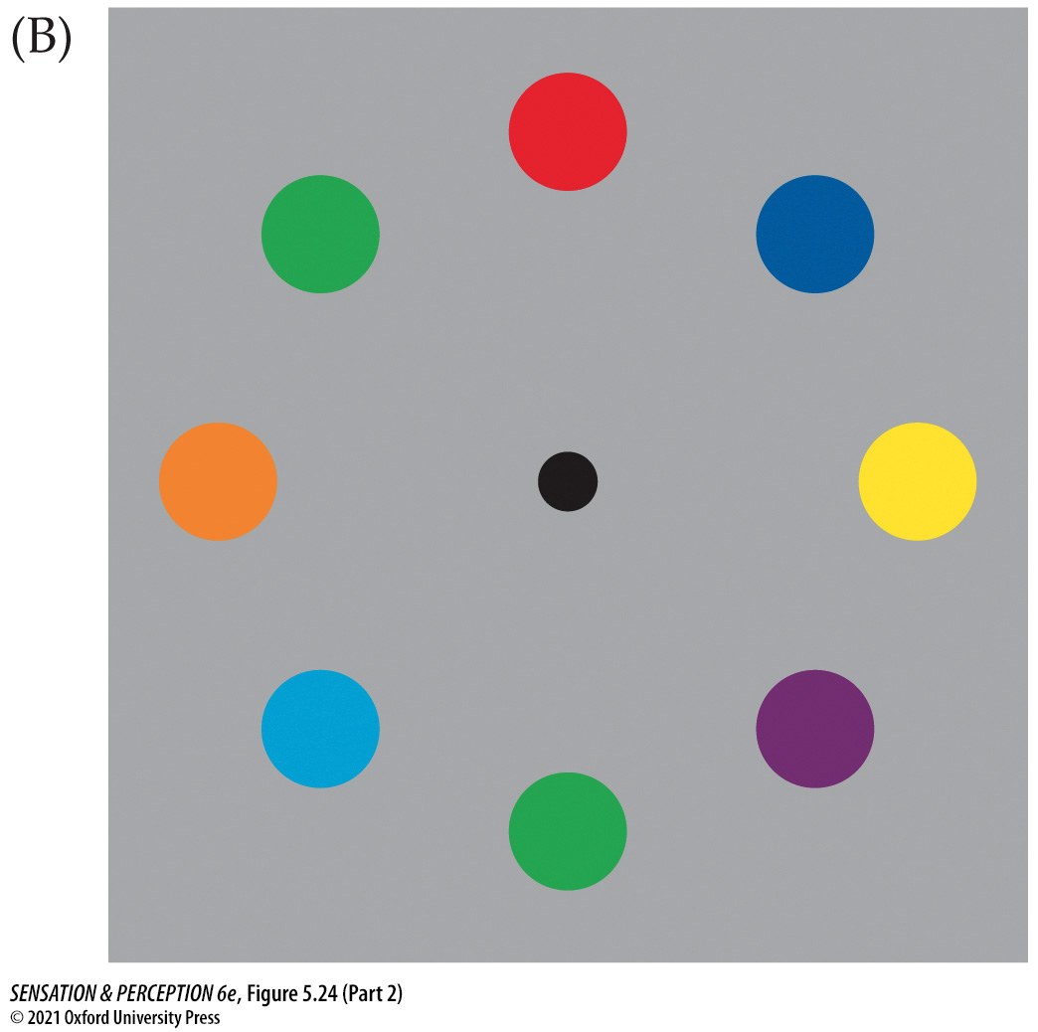
Figure 5.24 Negative afterimages (Part 2)
Notes:
Figure 5.24 Negative afterimages
Study the image in (A) and convince yourself that the ring of circles is gray. Now stare at the black dot in (B). After 10 seconds or so, shift your fixation to the black dot in (A). The circles should now look colored. This is a negative afterimage. Why does it happen? (If it didn’t happen, try fixating more rigorously. Really look at the black dot.) Now try with a real scene. Fixate the star in (E), and then flick your eyes to the same spot in (D). Looking back and forth helps. You should see a washed-out version of the colors in (C).

Slide 41
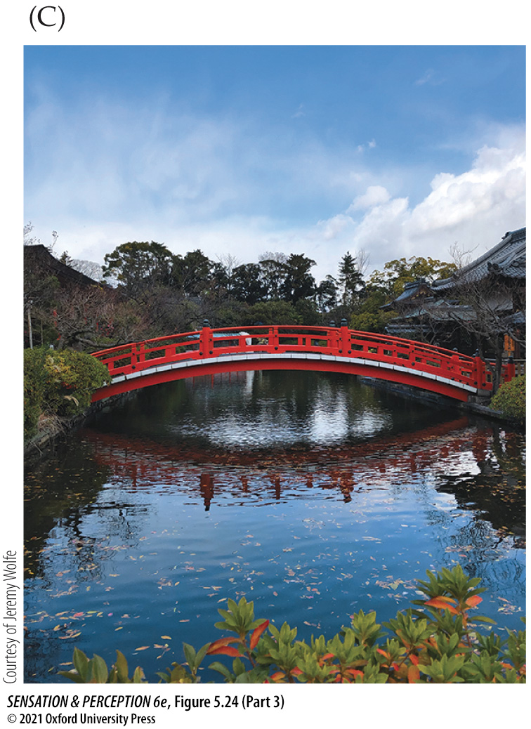
Figure 5.24 Negative afterimages (Part 3)
Notes:
Figure 5.24 Negative afterimages
Study the image in (A) and convince yourself that the ring of circles is gray. Now stare at the black dot in (B). After 10 seconds or so, shift your fixation to the black dot in (A). The circles should now look colored. This is a negative afterimage. Why does it happen? (If it didn’t happen, try fixating more rigorously. Really look at the black dot.) Now try with a real scene. Fixate the star in (E), and then flick your eyes to the same spot in (D). Looking back and forth helps. You should see a washed-out version of the colors in (C).

Slide 42
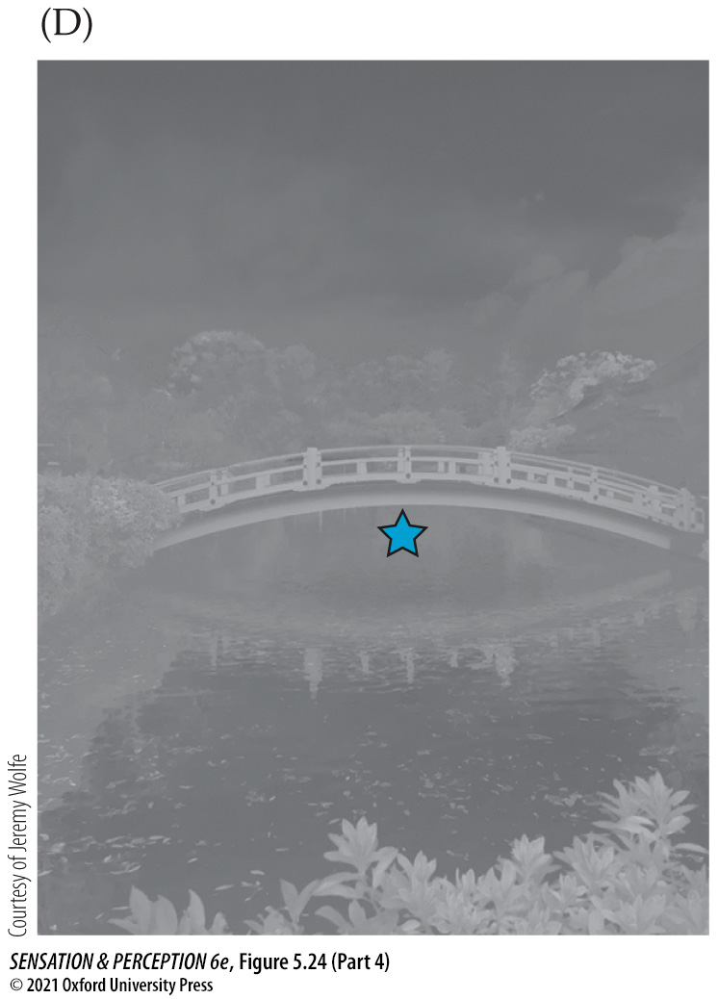
Figure 5.24 Negative afterimages (Part 4)
Notes:
Figure 5.24 Negative afterimages
Study the image in (A) and convince yourself that the ring of circles is gray. Now stare at the black dot in (B). After 10 seconds or so, shift your fixation to the black dot in (A). The circles should now look colored. This is a negative afterimage. Why does it happen? (If it didn’t happen, try fixating more rigorously. Really look at the black dot.) Now try with a real scene. Fixate the star in (E), and then flick your eyes to the same spot in (D). Looking back and forth helps. You should see a washed-out version of the colors in (C).

Slide 43
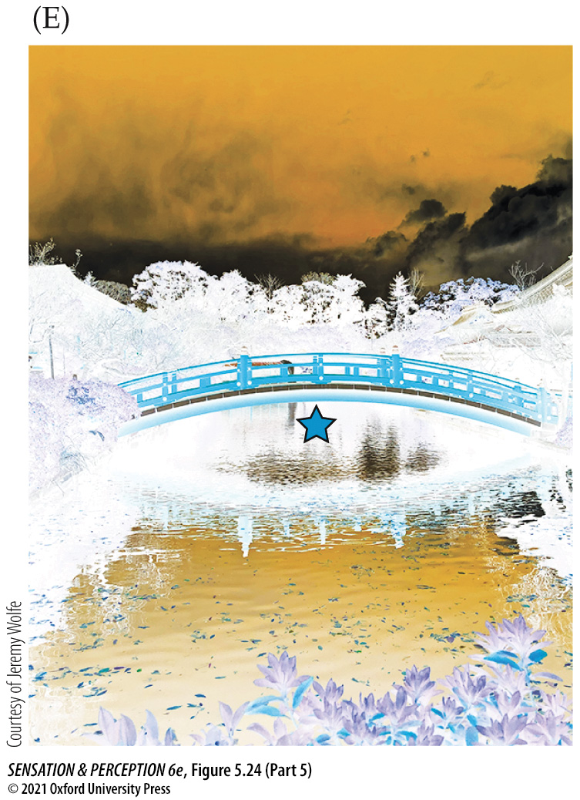
Figure 5.24 Negative afterimages (Part 5)
Notes:
Figure 5.24 Negative afterimages
Study the image in (A) and convince yourself that the ring of circles is gray. Now stare at the black dot in (B). After 10 seconds or so, shift your fixation to the black dot in (A). The circles should now look colored. This is a negative afterimage. Why does it happen? (If it didn’t happen, try fixating more rigorously. Really look at the black dot.) Now try with a real scene. Fixate the star in (E), and then flick your eyes to the same spot in (D). Looking back and forth helps. You should see a washed-out version of the colors in (C).

Slide 44
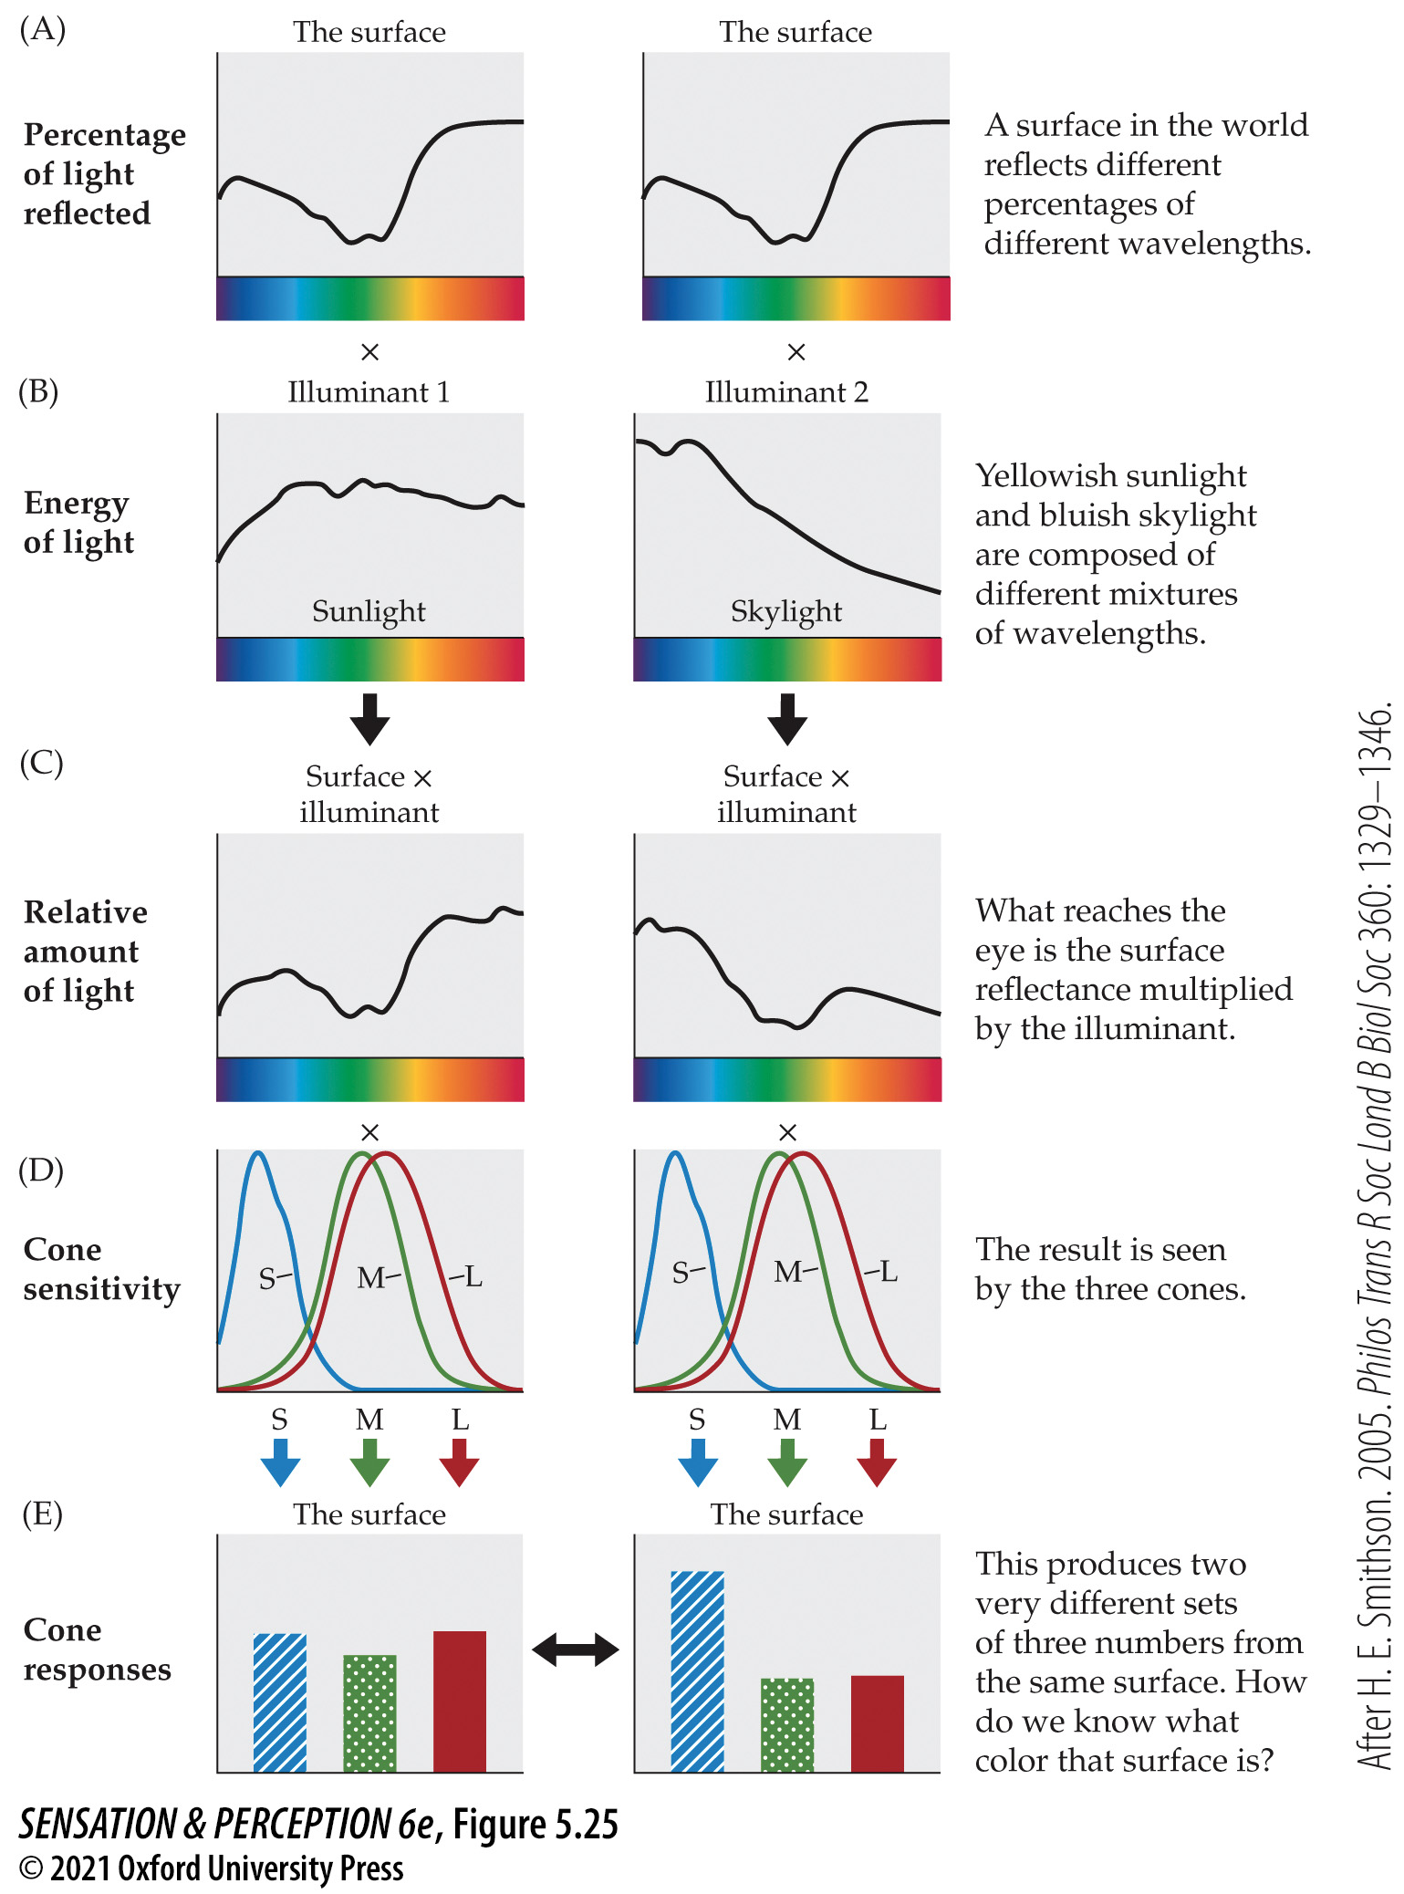
Figure 5.25 Color constancy
Notes:
Figure 5.25 Color constancy
The same surface (A) illuminated by two different lights (B) will generate two different patterns of activity in the S-, M-, and L-cones (C–E). However, the surface will appear to be the same color under both illuminants. This phenomenon is known as color constancy. (After H. E. Smithson. 2005. Philos Trans R Soc Lond B Biol Soc 360: 1329–1346.)

Slide 45
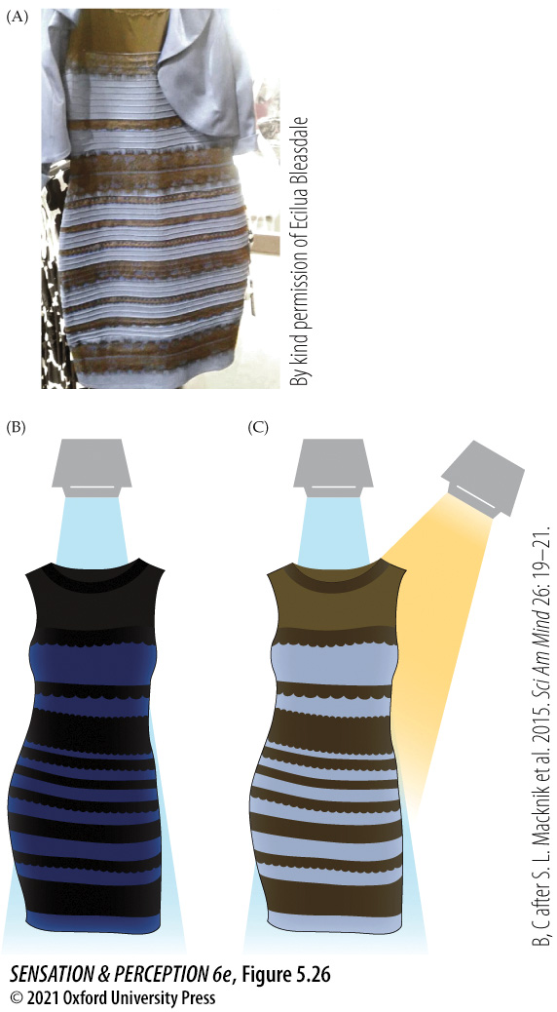
Figure 5.26 What color is this dress?
Notes:
Figure 5.26 What color is this dress?
(A) The color of this dress may not look the same to different people because each observer is making different assumptions about the nature of the light shining on the dress. (B) Maybe the light is just broadband white light. Then the dress appears to be blue and black. (C) Maybe there are a couple of light sources: one bluish and the other more yellow. Then the dress could appear to be white and gold. (B, C after S. L. Macknik et al. 2015. Sci Am Mind 26: 19–21.)

Slide 46
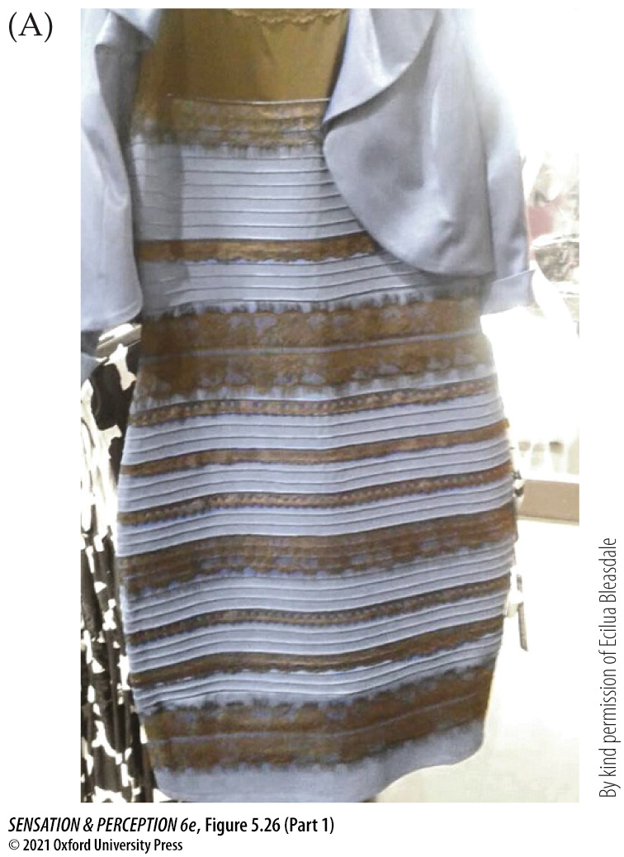
Figure 5.26 What color is this dress? (Part 1)
Notes:
Figure 5.26 What color is this dress?
(A) The color of this dress may not look the same to different people because each observer is making different assumptions about the nature of the light shining on the dress. (B) Maybe the light is just broadband white light. Then the dress appears to be blue and black. (C) Maybe there are a couple of light sources: one bluish and the other more yellow. Then the dress could appear to be white and gold. (B, C after S. L. Macknik et al. 2015. Sci Am Mind 26: 19–21.)

Slide 47
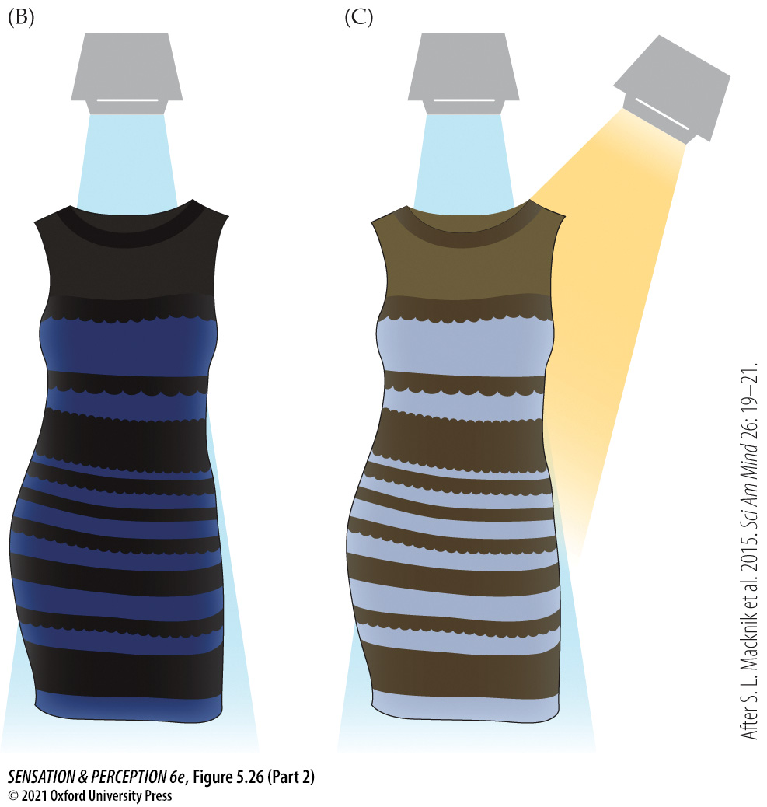
Figure 5.26 What color is this dress? (Part 2)
Notes:
Figure 5.26 What color is this dress?
(A) The color of this dress may not look the same to different people because each observer is making different assumptions about the nature of the light shining on the dress. (B) Maybe the light is just broadband white light. Then the dress appears to be blue and black. (C) Maybe there are a couple of light sources: one bluish and the other more yellow. Then the dress could appear to be white and gold. (B, C after S. L. Macknik et al. 2015. Sci Am Mind 26: 19–21.)

Slide 48
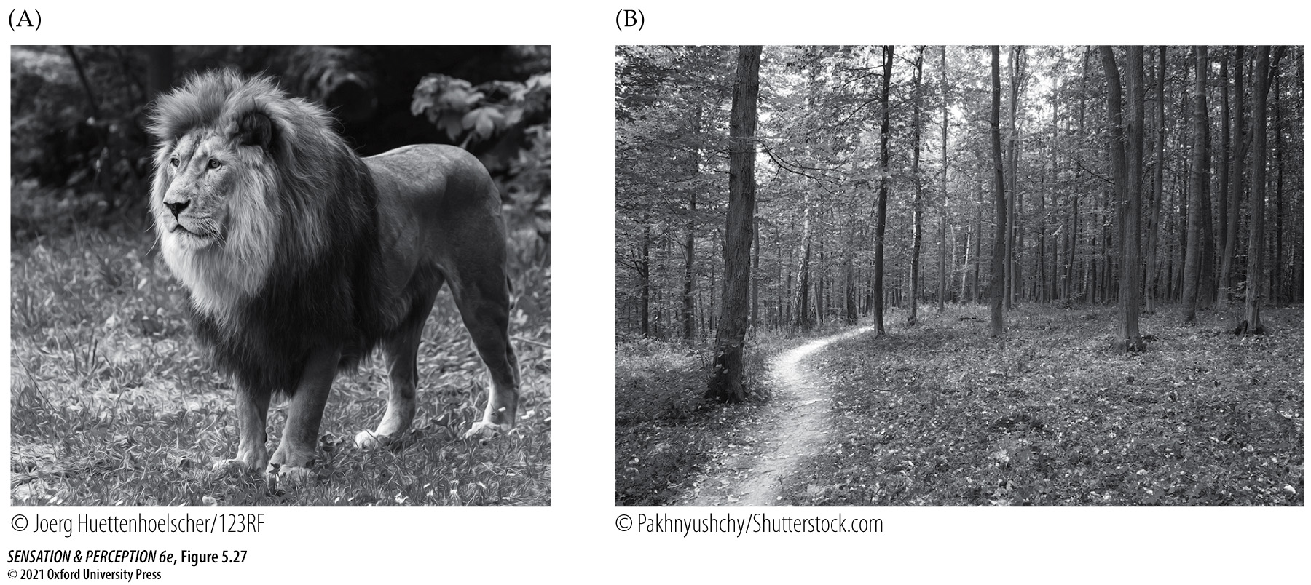
Figure 5.27 Do humans need color vision?
Notes:
Figure 5.27 Do humans need color vision?
(A) A black-and-white lion is still a lion, and (B) you could still find a path in the woods without color vision.

Slide 49
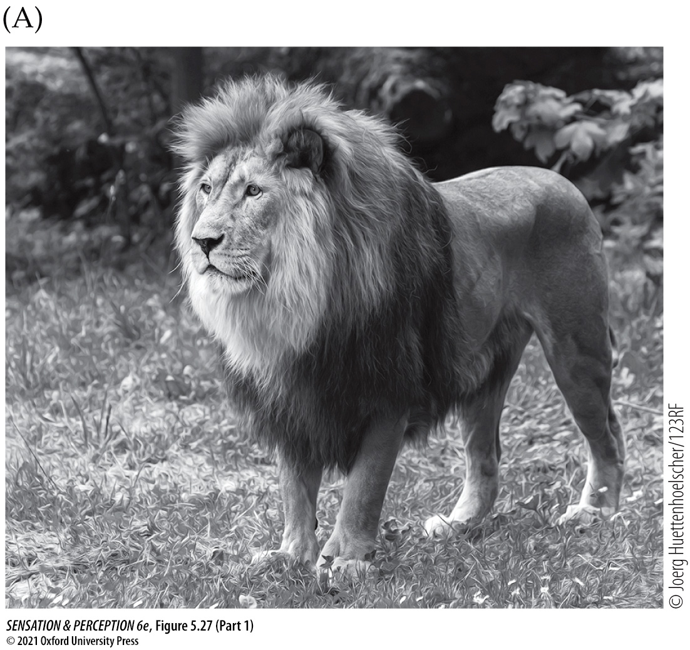
Figure 5.27 Do humans need color vision? (Part 1)
Notes:
Figure 5.27 Do humans need color vision?
(A) A black-and-white lion is still a lion, and (B) you could still find a path in the woods without color vision.

Slide 50
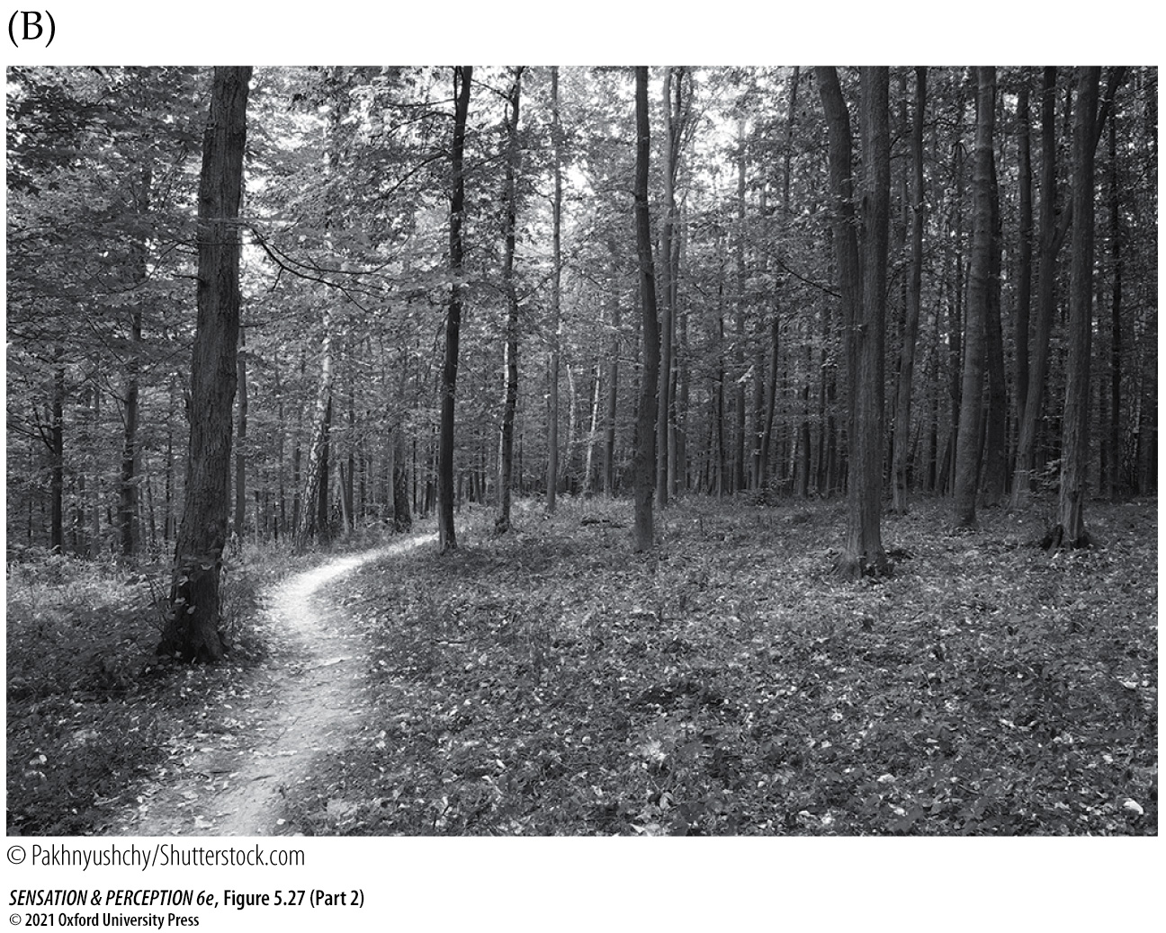
Figure 5.27 Do humans need color vision? (Part 2)
Notes:
Figure 5.27 Do humans need color vision?
(A) A black-and-white lion is still a lion, and (B) you could still find a path in the woods without color vision.

Slide 51

Figure 5.28 Using color vision
Notes:
Figure 5.28 Using color vision
Finding a raspberry is easier if you have color vision, as is deciding if that berry is ripe.

Slide 52

Figure 5.29 Color and flavor
Notes:
Figure 5.29 Color and flavor
The color of a food can change its reported flavor. Here white wine is reported to taste like rosé when it is colored pink. (After Q. J. Wang and C. Spence. 2019. Food Res Int 126: 108678.)

Slide 53

Figure 5.30 Color and sex
Notes:
Figure 5.30 Color and sex
The colors of animals—from (A) tropical fish to (B) peacocks to (C) mandrills—are often advertisements to potential mates.

Slide 54

Figure 5.30 Color and sex (Part 1)
Notes:
Figure 5.30 Color and sex
The colors of animals—from (A) tropical fish to (B) peacocks to (C) mandrills—are often advertisements to potential mates.

Slide 55

Figure 5.30 Color and sex (Part 2)
Notes:
Figure 5.30 Color and sex
The colors of animals—from (A) tropical fish to (B) peacocks to (C) mandrills—are often advertisements to potential mates.

Slide 56

Figure 5.30 Color and sex (Part 3)
Notes:
Figure 5.30 Color and sex
The colors of animals—from (A) tropical fish to (B) peacocks to (C) mandrills—are often advertisements to potential mates.

Slide 57

Figure 5.31 Extreme color vision
Notes:
Figure 5.31 Extreme color vision
(A) The absorption spectra of the 38 (!) different rod photopigments of the silver spinyfin (Diretmus argenteus). Notice that these pigments have peak sensitivity in the short wavelength (blue) end of the spectrum. These fish and other occupants of the deep sea emit their own light (a bit like fireflies), and that bioluminescence is in the short wavelengths. (B) The threadfin dragonfish (Echiostoma barbatum), another deep-sea fish with many photopigments. (A after Z. Musilova et al. 2019. Science 364: 588–592.)

Slide 58

Figure 5.31 Extreme color vision (Part 1)
Notes:
Figure 5.31 Extreme color vision
(A) The absorption spectra of the 38 (!) different rod photopigments of the silver spinyfin (Diretmus argenteus). Notice that these pigments have peak sensitivity in the short wavelength (blue) end of the spectrum. These fish and other occupants of the deep sea emit their own light (a bit like fireflies), and that bioluminescence is in the short wavelengths. (B) The threadfin dragonfish (Echiostoma barbatum), another deep-sea fish with many photopigments. (A after Z. Musilova et al. 2019. Science 364: 588–592.)

Slide 59

Figure 5.31 Extreme color vision (Part 2)
Notes:
Figure 5.31 Extreme color vision
(A) The absorption spectra of the 38 (!) different rod photopigments of the silver spinyfin (Diretmus argenteus). Notice that these pigments have peak sensitivity in the short wavelength (blue) end of the spectrum. These fish and other occupants of the deep sea emit their own light (a bit like fireflies), and that bioluminescence is in the short wavelengths. (B) The threadfin dragonfish (Echiostoma barbatum), another deep-sea fish with many photopigments. (A after Z. Musilova et al. 2019. Science 364: 588–592.)

Slide 60

Figure 5.32 Two ways to make photoreceptors with different spectral sensitivities
Notes:
Figure 5.32 Two ways to make photoreceptors with different spectral sensitivities
(A) Our S-, M-, and L-cones are different because they contain different photopigments. (B) Some animals have only one type of photopigment. These animals can have color vision because colored oil droplets sitting on top of photoreceptors create groups of photoreceptors with different sensitivities to wavelength.

Slide 61

Figure 5.32 Two ways to make photoreceptors with different spectral sensitivities (Part 1)
Notes:
Figure 5.32 Two ways to make photoreceptors with different spectral sensitivities
(A) Our S-, M-, and L-cones are different because they contain different photopigments. (B) Some animals have only one type of photopigment. These animals can have color vision because colored oil droplets sitting on top of photoreceptors create groups of photoreceptors with different sensitivities to wavelength.

Slide 62

Figure 5.32 Two ways to make photoreceptors with different spectral sensitivities (Part 2)
Notes:
Figure 5.32 Two ways to make photoreceptors with different spectral sensitivities
(A) Our S-, M-, and L-cones are different because they contain different photopigments. (B) Some animals have only one type of photopigment. These animals can have color vision because colored oil droplets sitting on top of photoreceptors create groups of photoreceptors with different sensitivities to wavelength.

Slide 63

Figure 5.33 The Sun et al. attention filter experiment
Notes:
Figure 5.33 The Sun et al. attention filter experiment
Column 1 shows sample stimuli. Observers would be asked to pay attention to just three dots in each image, defined by their color. Column 2 shows the “attention filter” that can be inferred from the data. Column 3 shows the hypothetical strength of the dots in the mind of the observer when the filter has been applied. When the dots differ in hue (top row), the filter leaves only the target dots. When the dots vary in saturation (bottom row), nontarget dots get past the filter and influence behavior. (After P. Sun et al. 2016. Proc Natl Acad Sci USA 113: E6712–E6720. doi: 10.1073/pnas.1614062113.)

