Slide 1
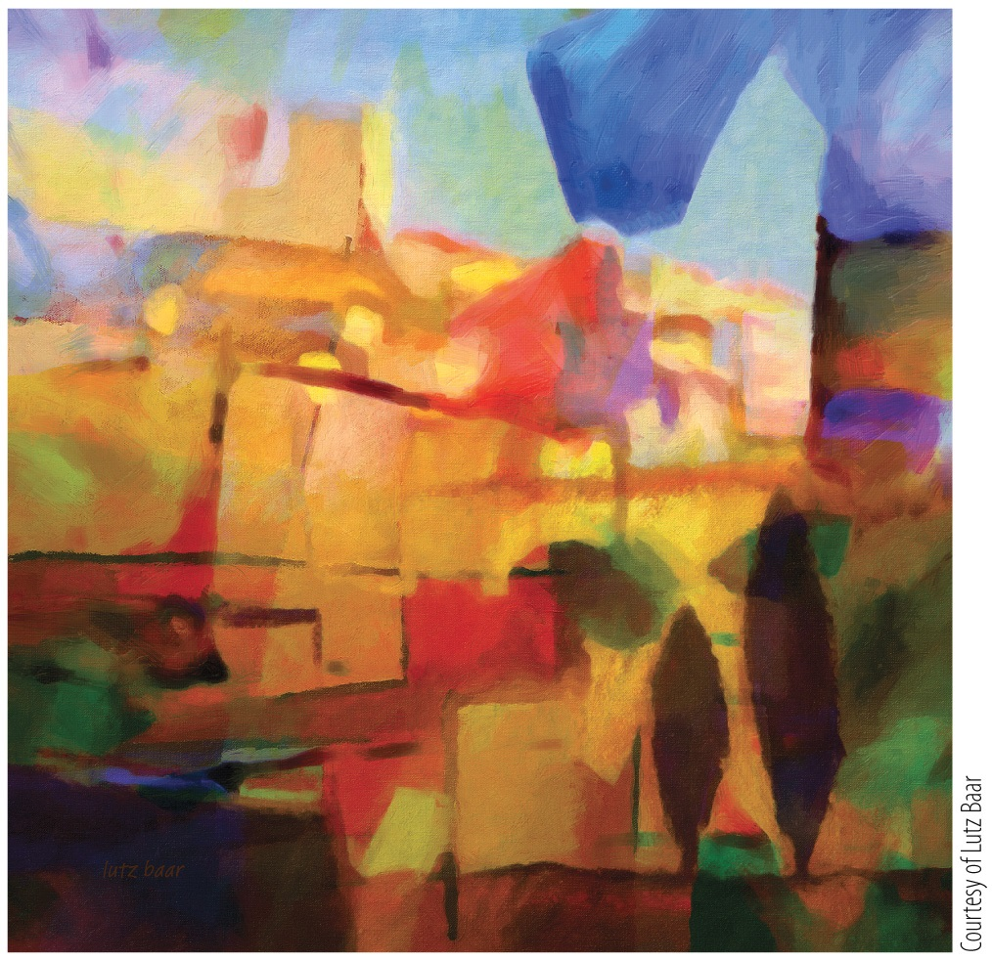
The Perception of Color
Notes:
Instructor Notes:
Organized as suggested presentation slides; text in italics is commentary directed to the instructor. This commentary is in a conversational tone and provides information that goes beyond the slides. It is also meant to help guide a lecture and tie into other topics in the course.
Chapter 5 Opener
Lutz Baar, French Abstract, 2014

Slide 2
Chapter 5 The Perception of Color
5.1 Basic Principles of Color Perception
5.2 Step 1: Color Detection
5.3 Step 2: Color Discrimination
5.4 Step 3: Color Appearance
5.5 Individual Differences in Color Perception
5.6 From the Color of Lights to a World of Color
5.7 What Is Color Vision Good For?

Slide 3
5.1 Basic Principles of Color Perception 1
Color is not a physical property but a psychophysical property.
“There is no red in a 700 nm light, just as there is no pain in the hooves of a kicking horse.” –Steven Shevell (2003)

Slide 4
5.1 Basic Principles of Color Perception 2
Most of the light we see is reflected.
Typical light sources: Sun, light bulb, fire
We see only part of the electromagnetic spectrum, between 400 and 700 nm.
Notes:
Instructor Notes:
Most light is reflected—This means that our brains are attuned to the ways in which light changes as it is reflected off of surfaces.
Important exceptions—Television, smartphones, and computer monitors, which emit light that we see directly.

Slide 5
5.1 Basic Principles of Color Perception 3
Three steps to color perception:
1. Detection: Wavelengths of light must be detected in the first place.
2. Discrimination: We must be able to tell the difference between one wavelength (or mixture of wavelengths) and another.
3. Appearance: We want to assign perceived colors to lights and surfaces in the world and have those perceived colors be stable over time, regardless of different lighting conditions.

Slide 6
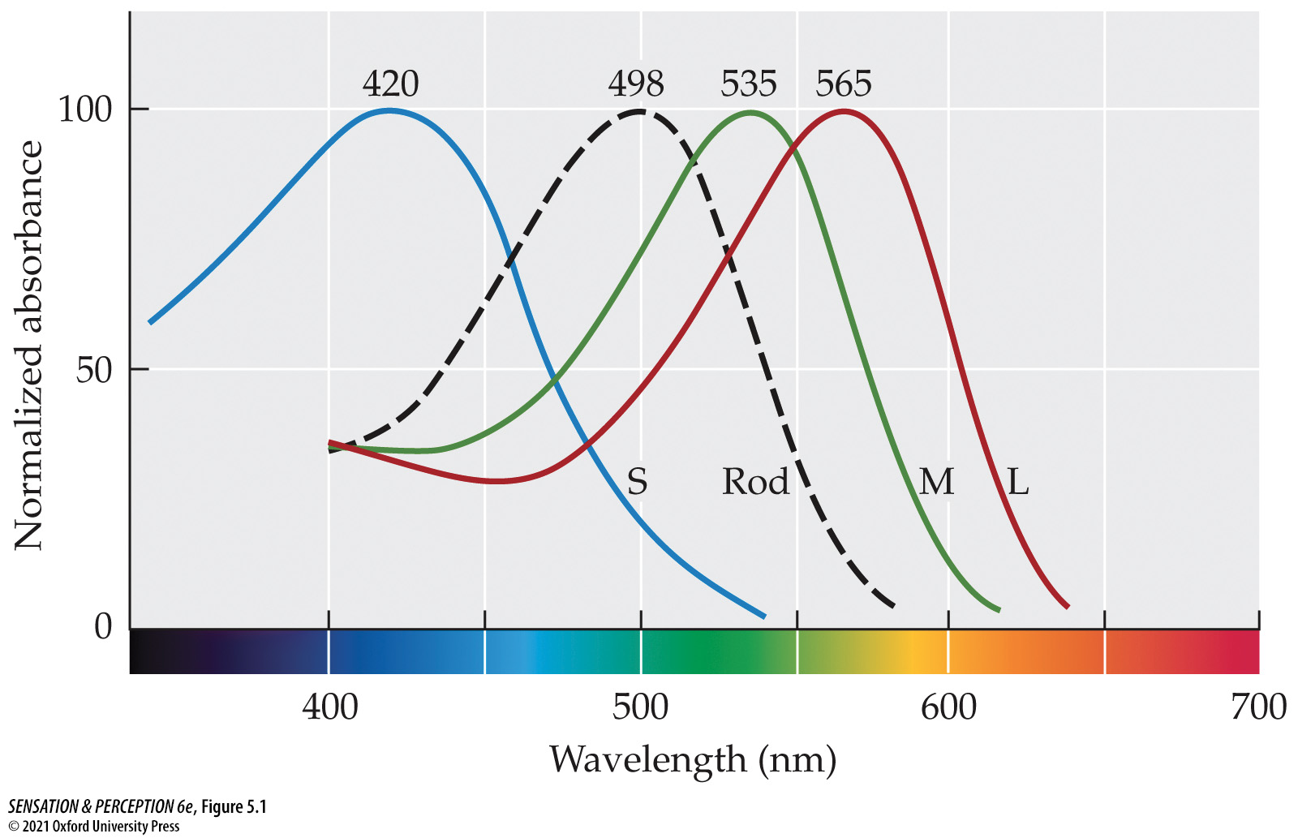
Figure 5.1 Photoreceptor types
Notes:
Figure 5.1 Photoreceptor types
The retina contains four types of photoreceptors. These differ in their sensitivity to the wavelengths of light. Three cone types are maximally sensitive at short (S), medium (M), and long (L) wavelengths. The single type of rod photoreceptor has its peak sensitivity between those of the S- and M-cones.
Instructor Notes:
On the x-axis is the frequency of light, with the corresponding color shown underneath.
On the y-axis is the receptor response—think of it as something like spike rate.

Slide 7
5.2 Step 1: Color Detection 1
Three types of cone photoreceptors:
S-cones detect short wavelengths (blue range).
M-cones detect medium wavelengths (green range).
L-cones detect long wavelengths (red range).

Slide 8
5.2 Step 1: Color Detection 2
More accurate to refer to the three cones as “short,” “medium,” and “long” rather than “blue,” “green,” and “red,” since they each respond to a variety of wavelengths.
The L-cone’s peak sensitivity is 565 nm, which corresponds to yellow, not red!

Slide 9
5.2 Step 1: Color Detection 3
Photopic: Light intensities that are bright enough to stimulate the cone receptors and bright enough to “saturate” the rod receptors to their maximum responses.
Sunlight and bright indoor lighting are both photopic lighting conditions.

Slide 10
5.2 Step 1: Color Detection 4
Scotopic: Light intensities that are bright enough to stimulate the rod receptors but too dim to stimulate the cone receptors.
Moonlight and extremely dim indoor lighting are both scotopic lighting conditions.
Notes:
Instructor Notes:
Question: What do you think you call the lighting condition in between photopic and scotopic—like at sunrise and sunset?
Answer: ”Mesopic”!

Slide 11
5.3 Step 2: Color Discrimination 1
The principle of univariance
An infinite set of different wavelength and intensity combinations can elicit exactly the same response from a single type of photoreceptor.
Therefore, one type of photoreceptor cannot make color discriminations based on wavelength.

Slide 12
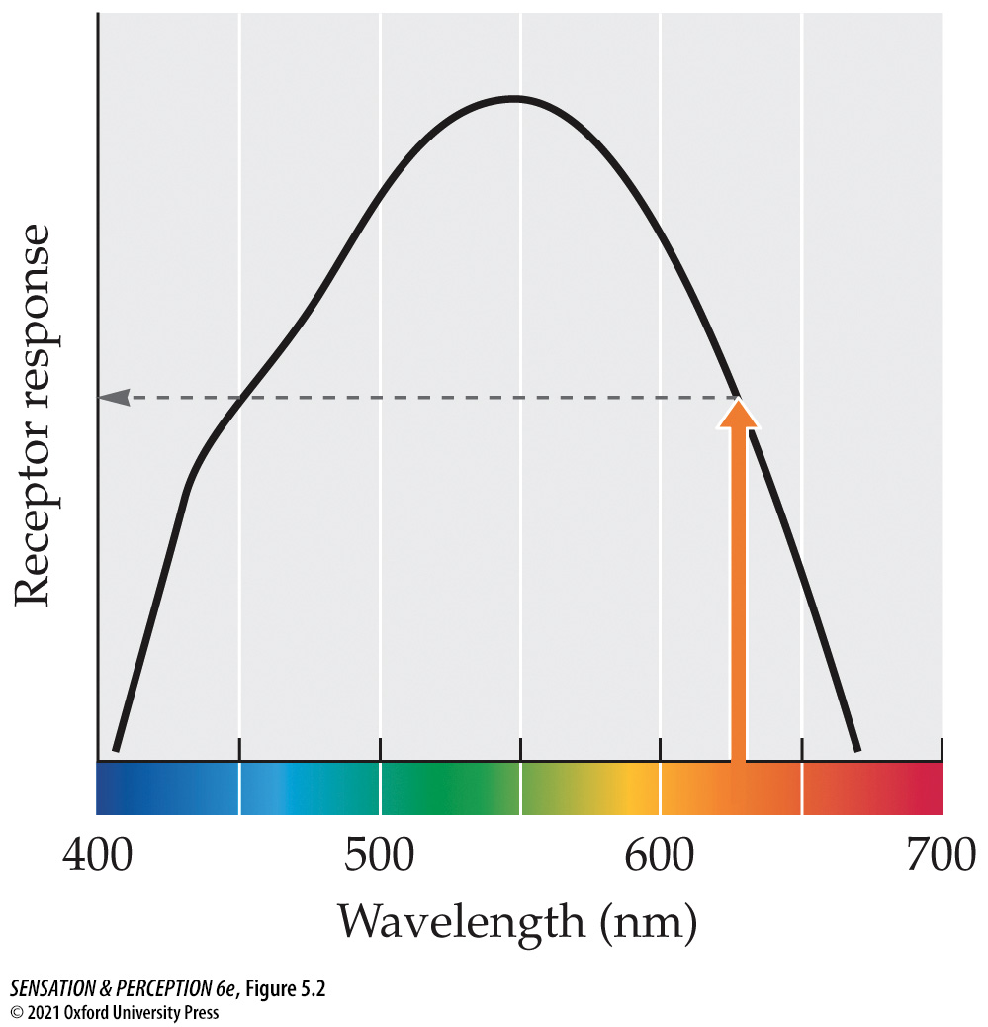
Figure 5.2 Responding to one wavelength
Notes:
Figure 5.2 Responding to one wavelength
A single photoreceptor shows different responses to lights of different wavelengths but the same intensity. A 625 nm light of this intensity, indicated by the arrow, produces a response midway between the maximum and minimum responses.
Instructor Notes:
Note that a 625-nm light (corresponding to orange) would cause the cone to have a moderate firing rate.

Slide 13
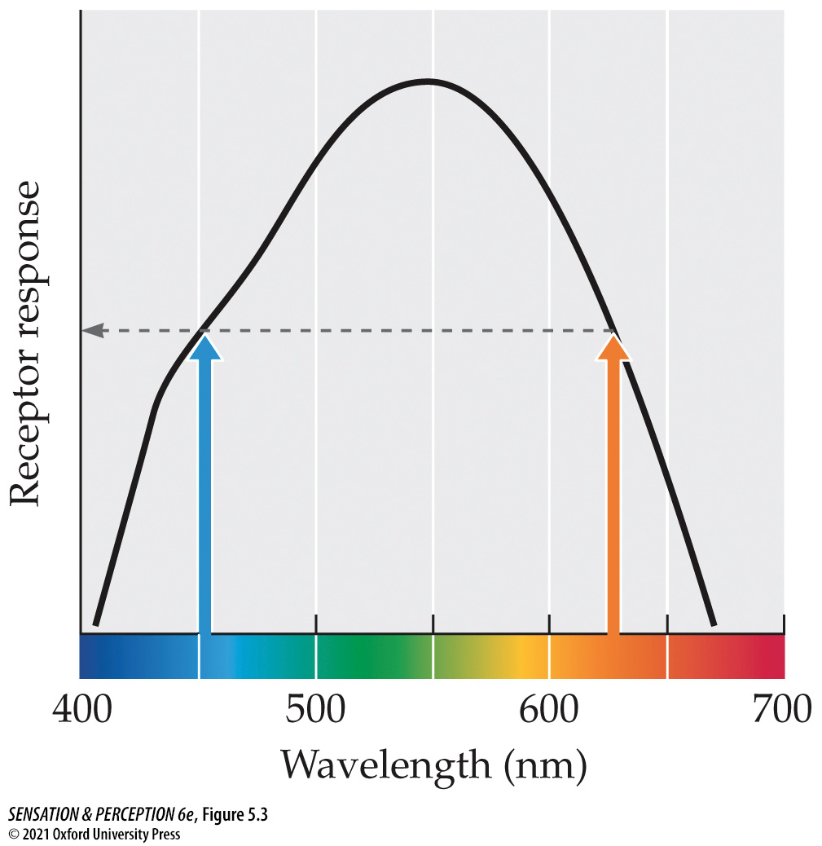
Figure 5.3 Univariance
Notes:
Figure 5.3 Univariance
Lights of 450 and 625 nm both elicit the same response from the photoreceptor whose responses are shown here and in Figure 5.2. This situation illustrates the principle of univariance.
Instructor Notes:
In this figure, the same level of photoreceptor response is elicited from two very different wavelengths of light.
Therefore, this photoreceptor would not be able to tell the difference between blue and orange.
Since all we know about color is from the responses of our photoreceptors, we could not perceive the difference between cyan and orange light in this case.

Slide 14
5.3 Step 2: Color Discrimination 2
Rods are sensitive to scotopic light levels.
All rods contain the same photopigment molecule: rhodopsin.
Therefore, all rods have the same sensitivity to different wavelengths of light.
Consequently, rods obey the principle of univariance and cannot sense differences in color.
Under scotopic conditions, only rods are active, so that is why the world seems drained of color.

Slide 15
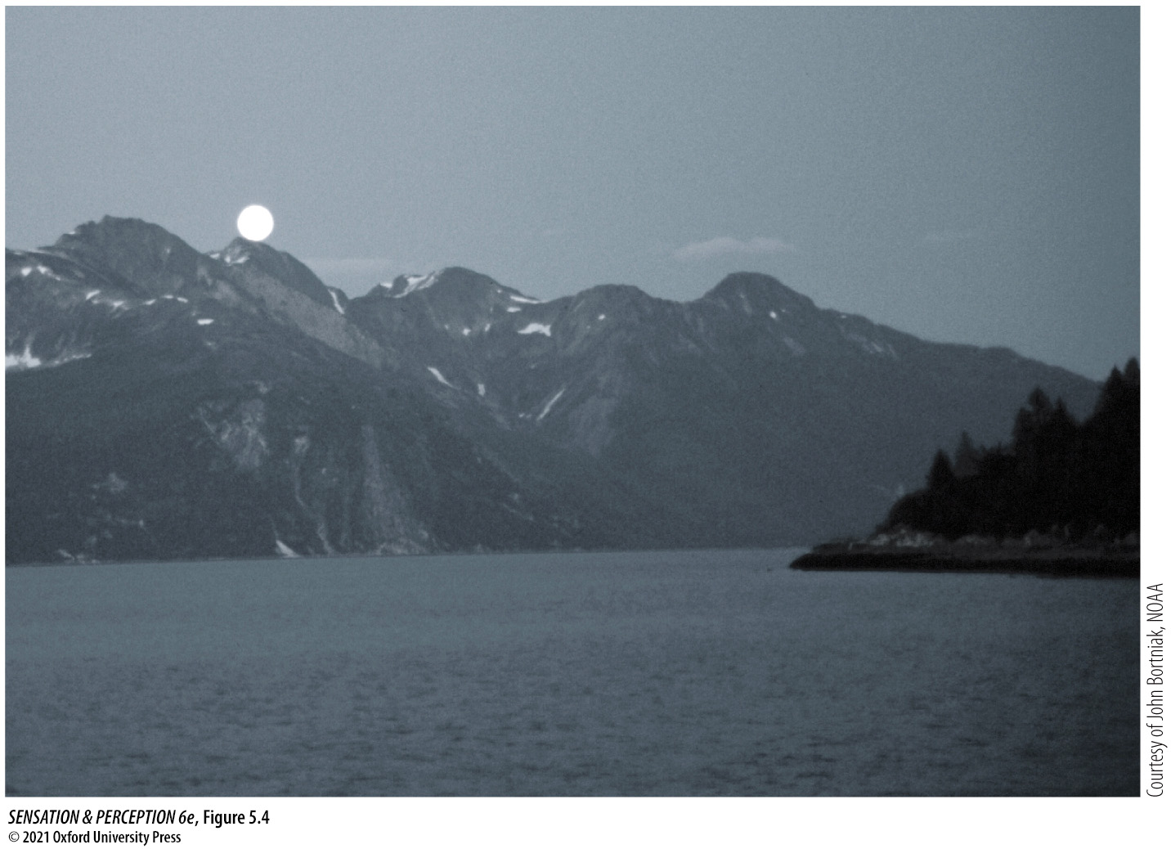
Figure 5.4 Rod vision
Notes:
Figure 5.4 Rod vision
The moonlit world appears drained of color because we have only one type of rod photoreceptor transducing light under these scotopic conditions. With just one type of photoreceptor, we cannot make discriminations based on wavelength, so we cannot see color.

Slide 16
5.3 Step 2: Color Discrimination 3
With three cone types, we can tell the difference between lights of different wavelengths.
Under photopic conditions, the S-, M-, and L-cones are all active.

Slide 17
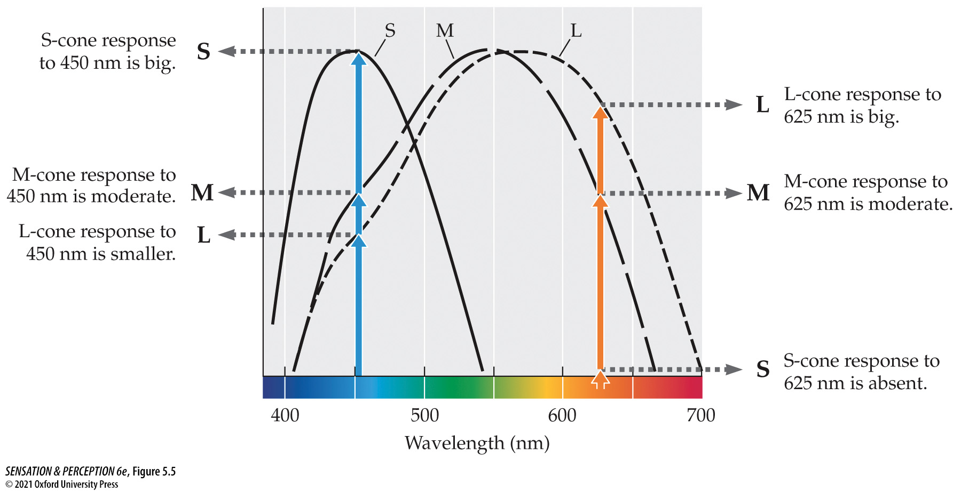
Figure 5.5 Solving univariance
Notes:
Figure 5.5 Solving univariance
The two wavelengths that produce the same response from one type of cone (M) produce different patterns of responses across the three types of cones (S, M, and L).
Instructor Notes:
Since we have three cones, we would get a different mix of responses from blue and orange light. This allows us to perceive them as different.

Slide 18
5.3 Step 2: Color Discrimination 4
Trichromacy (trichromatic theory of color vision)
The theory that the color of any light is defined in our visual system by the relationships of three numbers, the outputs of three receptor types now known to be the three cones.
Also known as the Young-Helmholtz theory
Notes:
Instructor Notes:
This also implies that any color we can perceive can be reproduced with just three colored lights: Red, green, and blue.
This is why we have RGB monitors—they have red, green, and blue pixels that can produce millions of colors.

Slide 19
5.3 Step 2: Color Discrimination 5
Metamers
Different mixtures of wavelengths that look identical; more generally, any pair of stimuli that are perceived as identical in spite of physical differences.

Slide 20
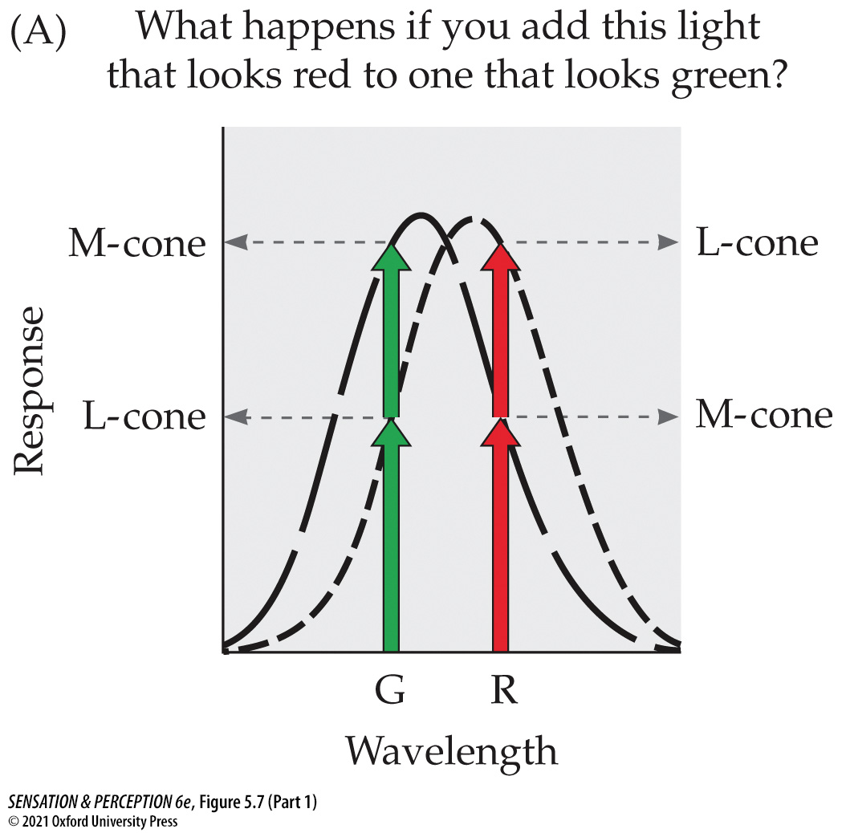
Figure 5.7 Metamers (Part 1)
Notes:
Figure 5.7 Metamers
In (A), the long-wavelength light that looks red and the shorter-wavelength light that looks green mix together to produce the same response from the cones as does the medium-wavelength light that looks yellow in (B). If two sets of lights produce the same responses, they are metamers and must look identical, so the red plus the green will look yellow.
Instructor Notes:
Since the red and green light produce the same maximum response in the M- and L-cones on the left as the yellow light does on the right, these two stimulus situations are metamers.
The implication here is that when red and green light are mixed together, they will appear yellow. This turns out to be true!

Slide 21
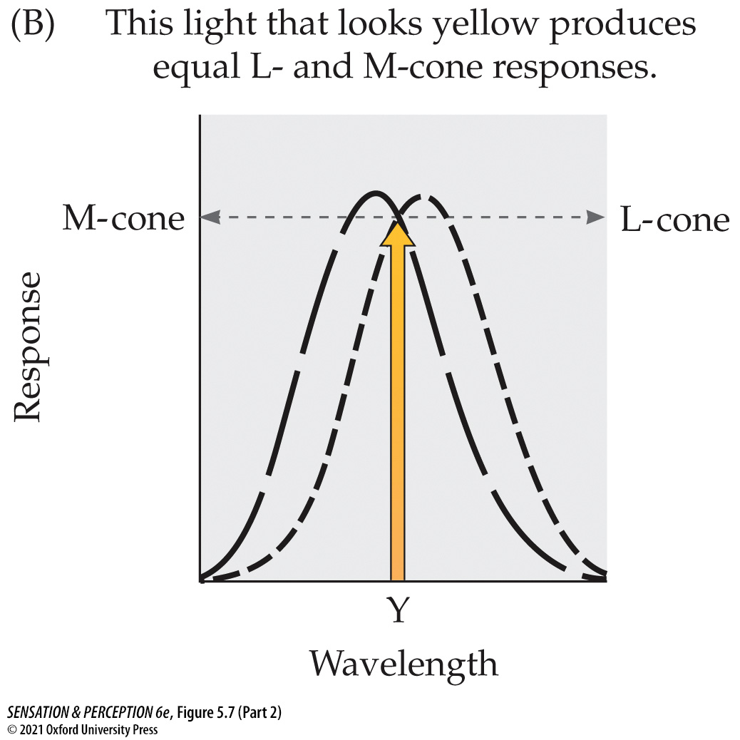
Figure 5.7 Metamers (Part 2)
Notes:
Figure 5.7 Metamers
In (A), the long-wavelength light that looks red and the shorter-wavelength light that looks green mix together to produce the same response from the cones as does the medium-wavelength light that looks yellow in (B). If two sets of lights produce the same responses, they are metamers and must look identical, so the red plus the green will look yellow.
Instructor Notes:
Since the red and green light produce the same maximum response in the M- and L-cones on the left as the yellow light does on the right, these two stimulus situations are metamers.
The implication here is that when red and green light are mixed together, they will appear yellow. This turns out to be true!

Slide 22
5.3 Step 2: Color Discrimination 6
History of color vision
Thomas Young (1773–1829) and Hermann von Helmholtz (1821–1894) independently discovered the trichromatic nature of color perception.
This is why trichromatic theory is called the “Young-Helmholtz theory.”
James Maxwell (1831–1879) developed a color-matching technique that is still being used today.

Slide 23
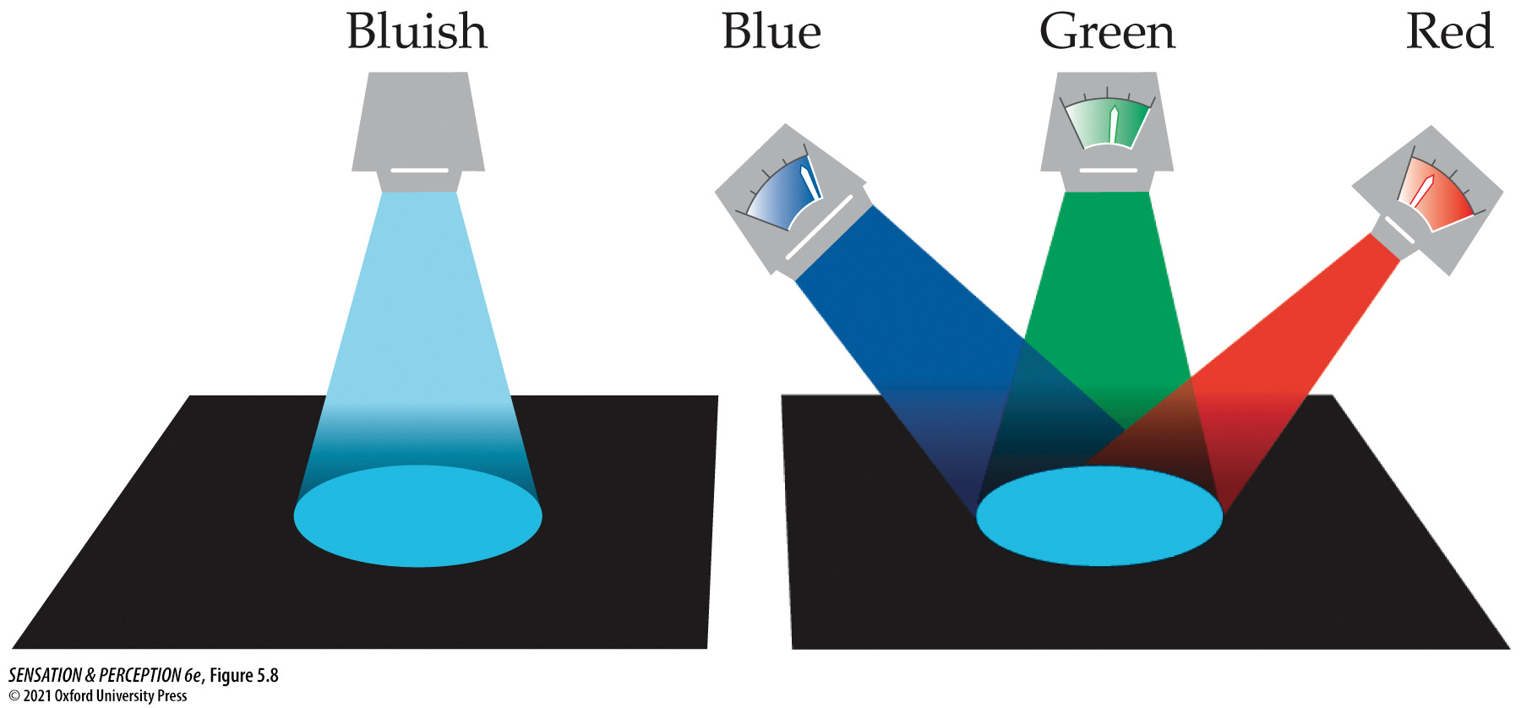
Figure 5.8 Maxwell’s color-matching experiment
Notes:
Figure 5.8 Maxwell’s color-matching experiment
A color is presented on the left. On the right, the observer adjusts a mixture of the three lights to match the color on the left.
Instructor Notes:
A test stimulus color is shown on the left.
The observer adjusts the mixture of three lights on the right to match the test stimulus. The experimenter records the settings on the three lights that the observer came up with.
This is a good example of the method of adjustment, as described in Chapter 1.

Slide 24
5.3 Step 2: Color Discrimination 7
Additive color mixing: A mixture of lights
If light A and light B are both reflected from a surface to the eye, in the perception of color, the effects of those two lights add together.

Slide 25
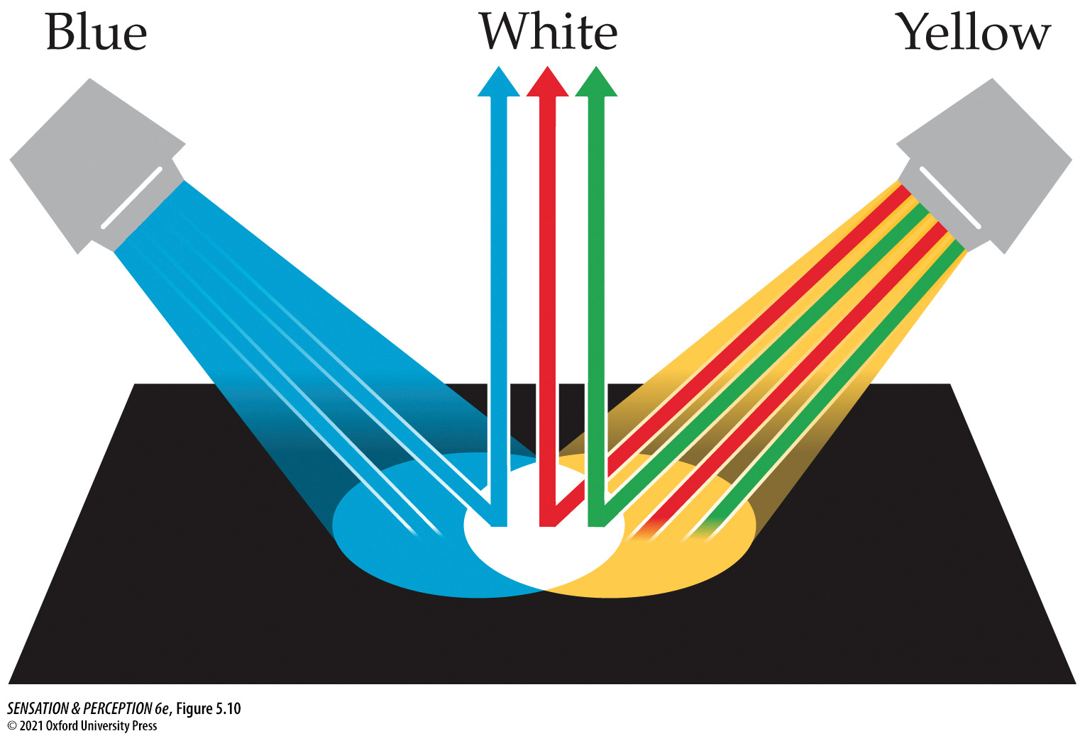
Figure 5.10 Additive color mixture
Notes:
Figure 5.10 Additive color mixture
If we shine a light that looks blue and a light that looks yellow on the same patch of paper, the wavelengths will add, producing an additive color mixture. Remember that the light that looks yellow is equivalent to a mix of a long wavelength and a medium wavelength, so blue plus yellow results in a mix of short, medium, and long wavelengths. The mixture looks white (or gray, if it is not the brightest patch in view).
Instructor Notes:
If we shine “blue” and “yellow” lights on the same patch of paper, the wavelengths will add, producing an additive color mixture.
Remember that “yellow” is equivalent to a mix of long and medium wavelengths, and “blue” is made up of short wavelengths.
When you add blue and yellow together, then you have long, medium, and short wavelengths all together and the light will appear white (or gray if it is not the brightest patch in view).

Slide 26
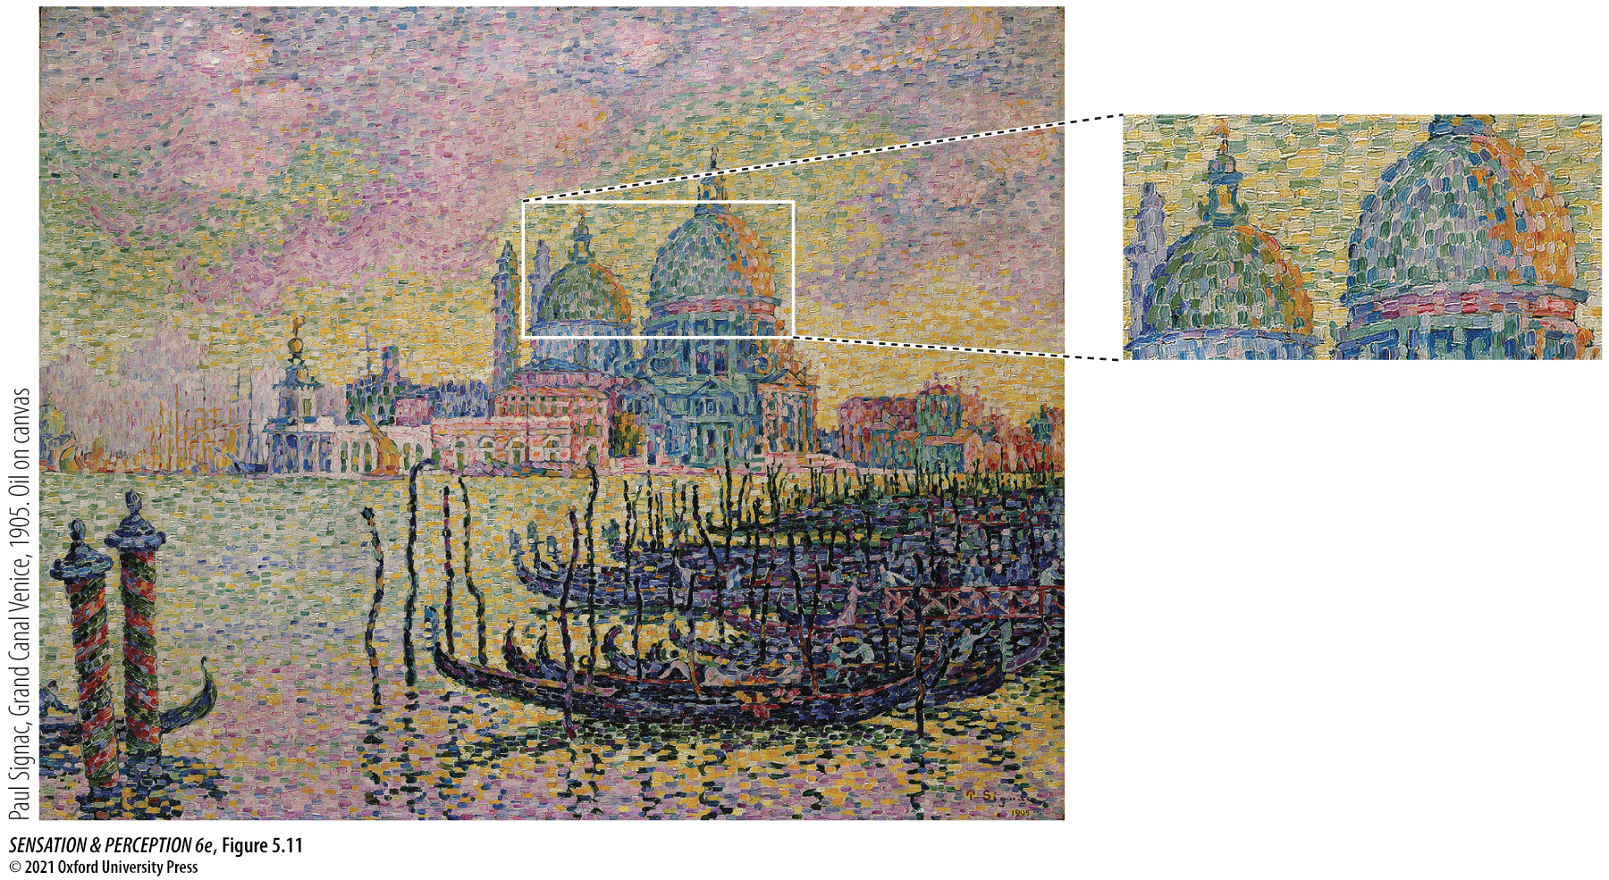
Figure 5.11 Pointillism
Notes:
Figure 5.11 Pointillism
Instead of the usual illustration with a picture by Seurat, here is a painting by Paul Signac (1863–1935) using additive color mixture in the manner of a modern computer monitor. Thus, from a distance the domes look grayish, even if, up close, they are composed of spots of blue, green, and white.
Instructor Notes:
This is a painting by Paul Signac.
The domes in the background seem to shimmer with the light from the setting sun and be solid, but in fact they are just composed of dabs of paint.
From a distance the individual specks of color cannot be resolved, so they all blend together. This results in additive color mixing.

Slide 27
5.3 Step 2: Color Discrimination 8
Subtractive color mixing: A mixture of pigments.
If pigment A and B mix, some of the light shining on the surface will be subtracted by A and some by B. Only the remainder contributes to the perception of color.
Notes:
Instructor Notes:
Paints and dyes look the color they do because when white light hits them, they absorb all wavelengths of light EXCEPT the color they appear to be. Those wavelengths of light bounce back towards the observer. So, a blue t-shirt looks blue because the medium and long wavelengths of light are absorbed by the shirt but the short wavelengths bounce off of it.
This is why white clothing tends to be cooler than black clothing on a hot, sunny day. White clothing looks white because all wavelengths of light that hit it bounce off of it. Black clothing looks black because it absorbs all wavelengths of light equally.

Slide 28
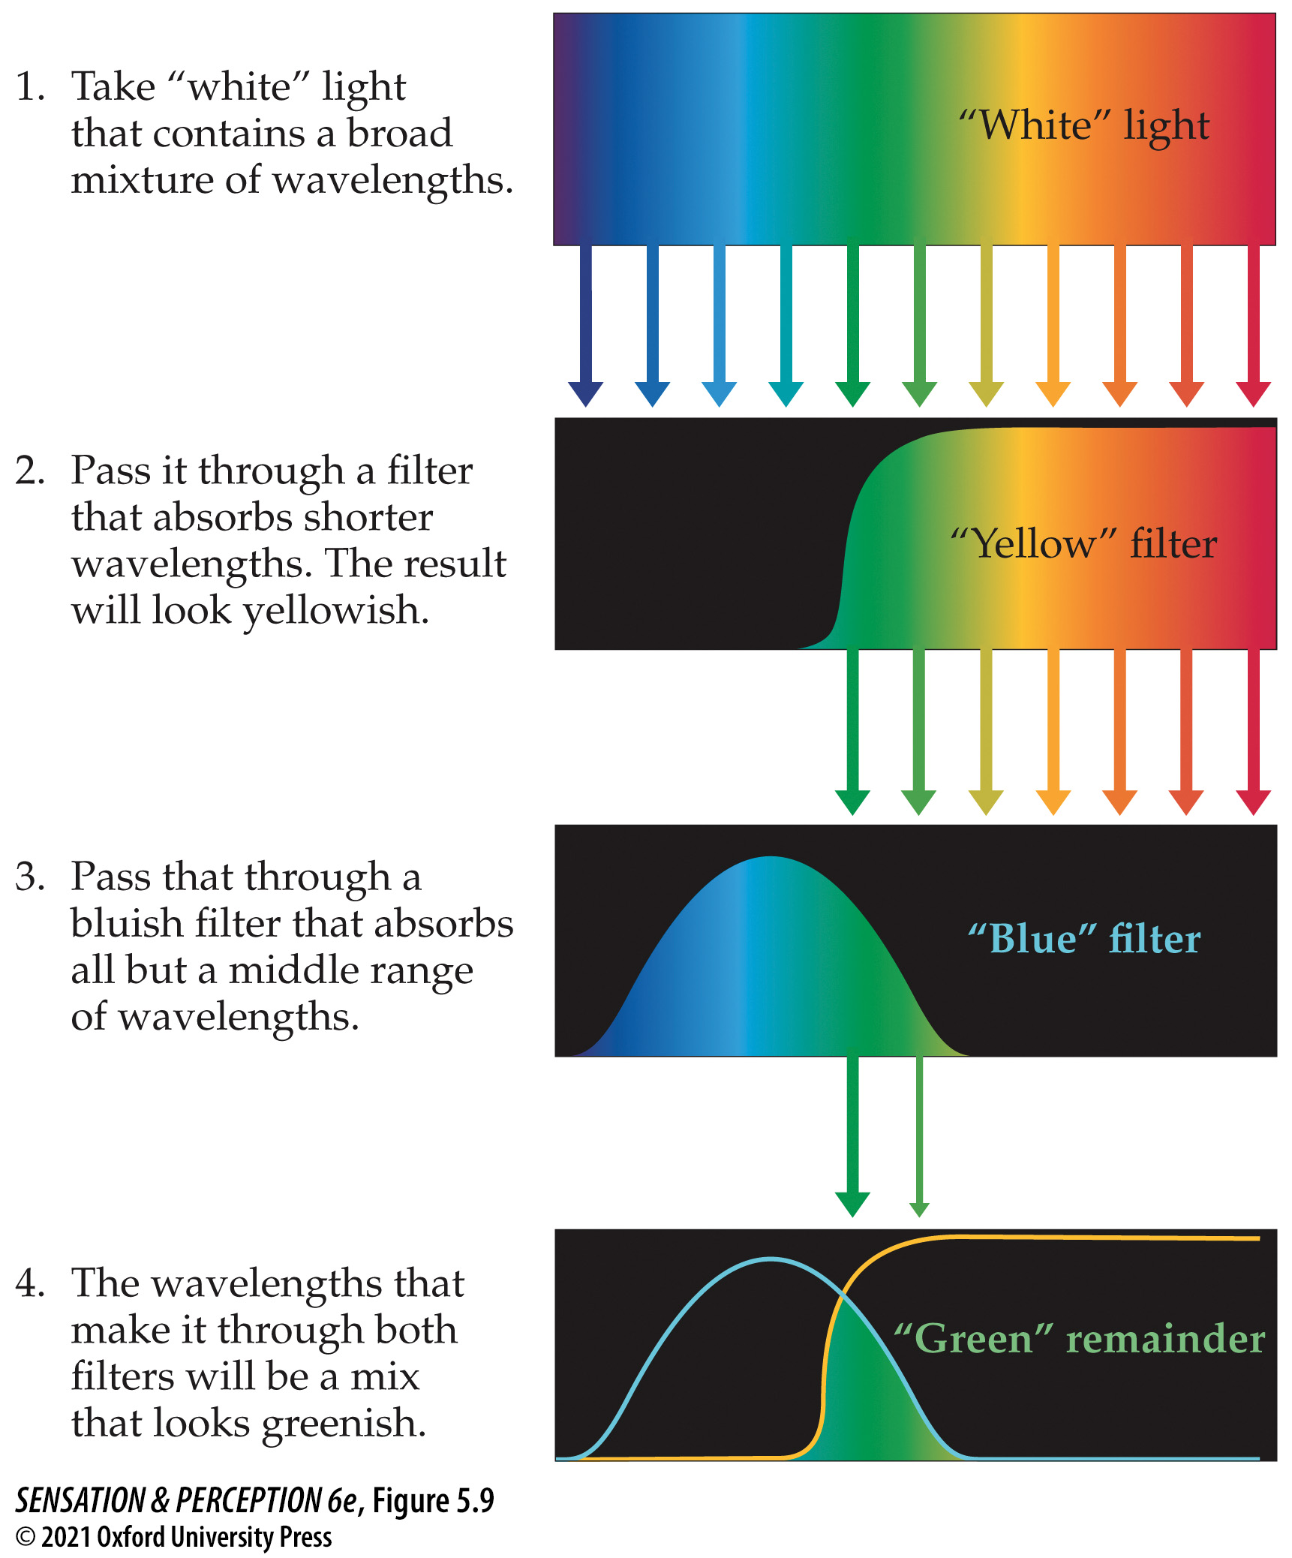
Figure 5.9 Subtractive color mixture
Notes:
Figure 5.9 Subtractive color mixture
In this example, “white”—broadband—light is passed through two filters. The first one absorbs (“subtracts”) shorter wavelengths, transmitting a mix of wavelengths that looks yellow. The second absorbs longer wavelengths and the shortest wavelengths, transmitting a mix that looks blue. The wavelengths that can pass through both filters without being subtracted are a middle range of wavelengths that appear green.
Instructor Notes:
1. White light is made up of a broad mixture of wavelengths.
2. If white light hits yellow paint or a yellow filter, the shorter wavelengths will be absorbed, resulting in medium and long wavelengths being reflected. Medium and long wavelengths together appear to be yellow. (Recall the previous discussion of metamers.)
3. If white light hits blue paint or a blue filter, the long wavelengths are absorbed, leaving colors in the medium and short end of the spectrum. Medium and short wavelengths together appear to be blue.
4. If both of these effects are combined, either by mixing yellow and blue paint or by placing a yellow filter in front of a blue filter, then the remaining wavelength that is not absorbed is in the medium range. Medium wavelength light alone appears green.
This is why when yellow and blue paint are mixed together, the result appears green. But when yellow and blue light are mixed together, the result appears white.

Slide 29
5.3 Step 2: Color Discrimination 9
Lateral geniculate nucleus (LGN) has cells that are maximally stimulated by spots of light.
Visual pathway stops in LGN on the way from retina to visual cortex.
LGN cells have receptive fields with center-surround organization.
Cone-opponent cell: A neuron whose output is based on a difference between sets of cones.
In LGN there are cone-opponent cells with center-surround organization.

Slide 30
5.4 Step 3: Color Appearance 1
Color space: A three-dimensional space that describes all colors. There are several possible color spaces.
RGB color space: Defined by the outputs of long, medium, and short wavelength lights (i.e., red, green, and blue).

Slide 31
5.4 Step 3: Color Appearance 2
HSB color space: Defined by hue, saturation, and brightness.
Hue: The chromatic (color) aspect of light.
Saturation: The chromatic strength of a hue.
Brightness: The distance from black in color space.
Notes:
Instructor Notes:
Hue – The color you are choosing.
Saturation - White has no saturation, pink is more saturated, and red is fully saturated. You can also conceptualize saturation as the number of color specks per unit area.
Brightness - You can also conceptualize brightness as the amount of light being reflected per color speck.

Slide 32
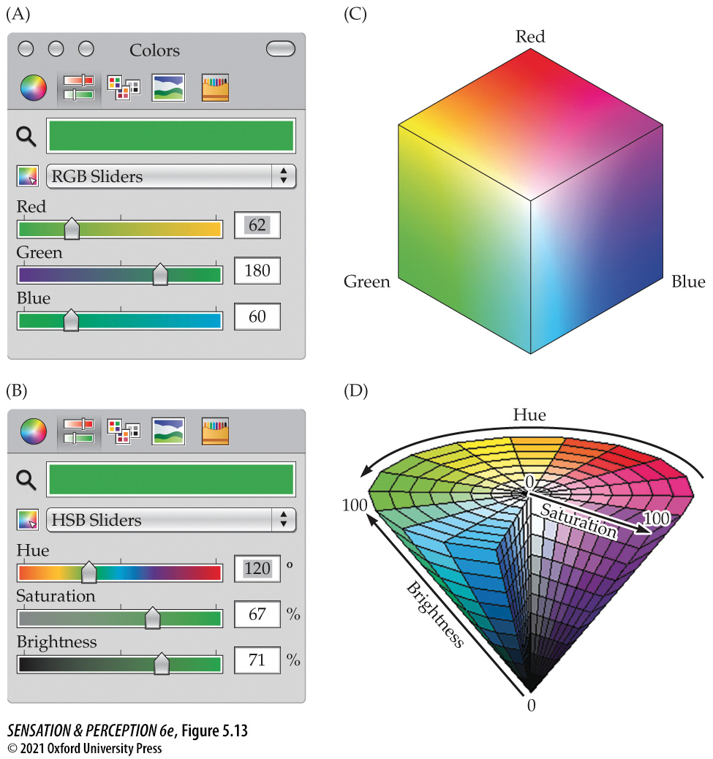
Figure 5.13 Computer color pickers may offer several ways to specify a color in a three-dimensional color space
Notes:
Figure 5.13 Computer color pickers may offer several ways to specify a color in a three-dimensional color space
These “sliders” from Microsoft® PowerPoint® are based on an RGB (red, green, blue) set of primaries in (A and C) and are based on HSB (hue, saturation, brightness) in (B and D). See the text for details.
Instructor Notes:
(a) The shade of green in terms of its red, green, and blue components (RGB color space).
(b) The same shade of green in terms of its hue, saturation, and brightness (HSB color space).
(c) A three-dimensional visualization of the RGB color space.
(d) A three-dimensional visualization of the HSB color space.

Slide 33
5.4 Step 3: Color Appearance 3
The Limits of the Rainbow
Nonspectral colors: Some colors that we see do not correspond to a single wavelength of light.
Purple and magenta are only perceived when both S- and L-cones are stimulated but M-cones are not.

Slide 34
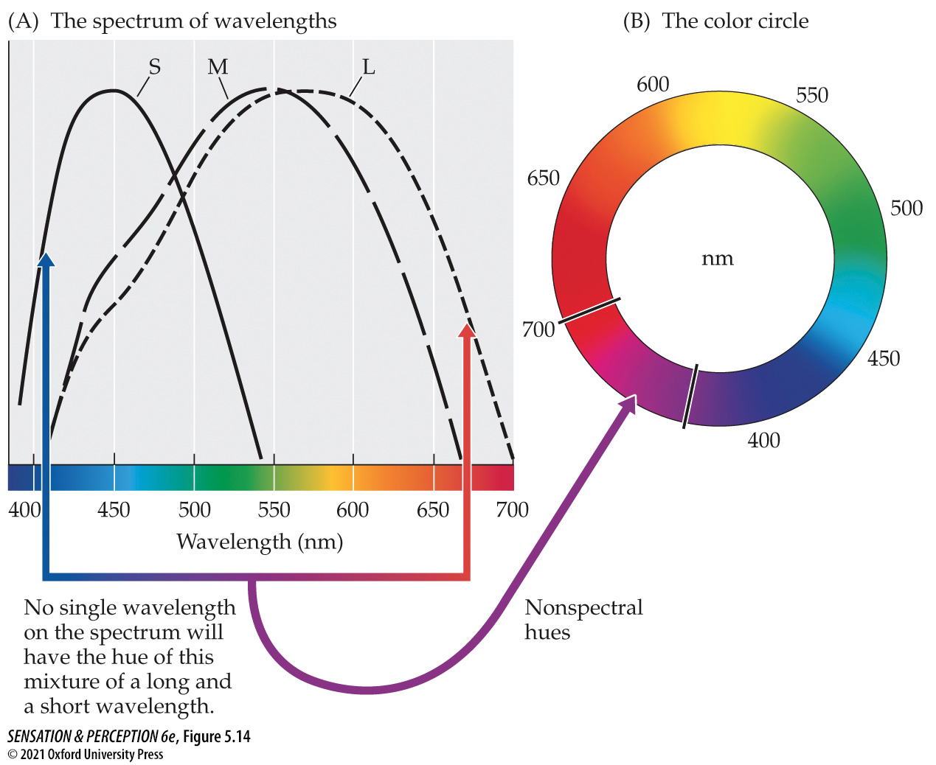
Figure 5.14 Nonspectral colors
Notes:
Figure 5.14 Nonspectral colors
If you combine lights that look red and blue, the result will look purple, but there is no purple on the spectrum (A). Purples are nonspectral colors that join the ends of the spectrum into a color circle (B).

Slide 35
5.4 Step 3: Color Appearance 4
Opponent color theory: The theory that perception of color depends on the output of three mechanisms, each of them based on an opponency between two colors: red–green, blue–yellow, and black–white.
Some LGN cells are excited by L-cone activation in center, inhibited by M-cone activation in their surround (and vice versa).
Red versus green

Slide 36
5.4 Step 3: Color Appearance 5
Other cells are excited by S-cone activation in center, inhibited by (L + M)-cone activation in their surround (and vice versa).
Blue versus yellow

Slide 37
5.4 Step 3: Color Appearance 6
Ewald Hering (1834–1918) noticed that some color combinations are “legal” while others are “illegal.”
We can have bluish green (cyan), reddish yellow (orange), or bluish red (purple).
We can not have reddish green or bluish yellow.
Notes:
Instructor Notes:
You might think that bluish yellow is green, but green is its own independent color.

Slide 38
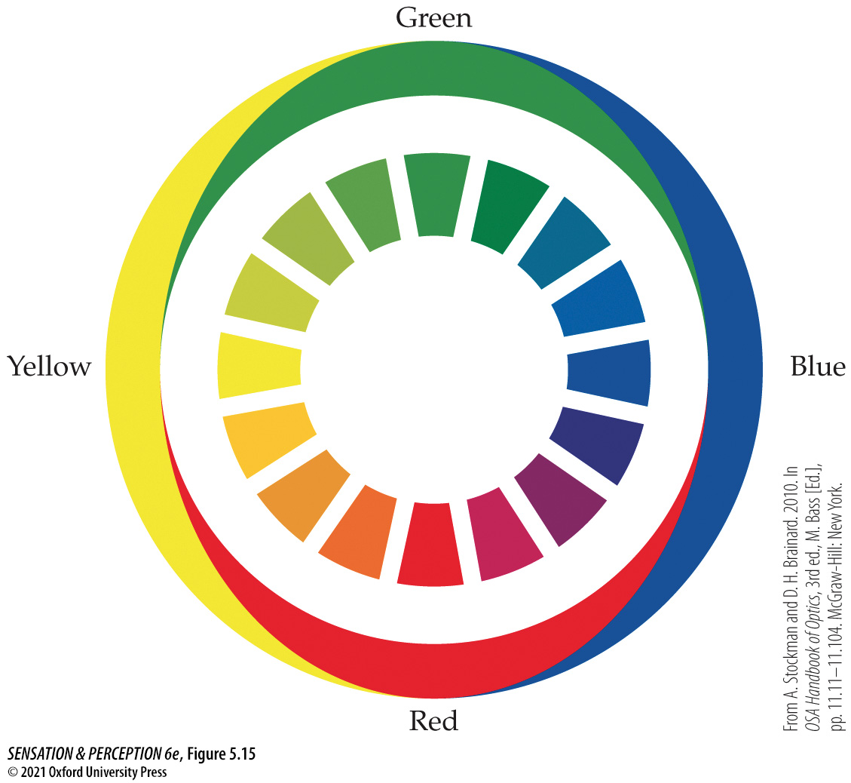
Figure 5.15 Opponent colors
Notes:
Figure 5.15 Opponent colors
Ewald Hering noted that all the colors on the “color circle” (the center ring) could be represented by two pairs of opposing colors: blue versus yellow, and red versus green (shown in the outer ring). Thus, a color could be a reddish yellow or a bluish green, but not a reddish green or a bluish yellow. (From A. Stockman and D. H. Brainard. 2010. In OSA Handbook of Optics, 3rd ed., M. Bass [Ed.], pp. 11.11–11.104. McGraw-Hill: New York.)
Instructor Notes:
Hering noted that the entire color circle (center ring) could be represented by two pairs of opposing colors: blue vs. yellow, and red vs. green (outer ring).
Thus, a color can be reddish yellow or bluish green, but not reddish green or bluish yellow.

Slide 39
5.4 Step 3: Color Appearance 7
Hue cancellation experiments
Start with a color, such as bluish green.
The goal is to end up with pure green with no hints of blue or yellow.
Shine some yellow light to cancel out the blue light.
Adjust the intensity of the yellow light until there is no sign of either blue or yellow in the green patch.

Slide 40
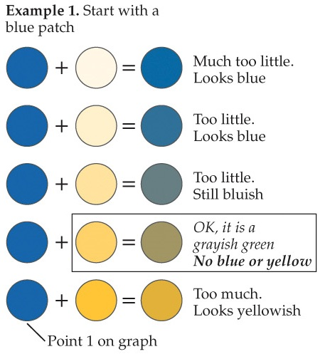
Figure 5.16 Color cancellation method (Example 1)
Notes:
Figure 5.16 Color cancellation method
Using color cancellation to measure opponent processes and unique hues in a blue-yellow (A) and a red-green (B) process. The locations where the hue cancellations cross the neutral midpoint are the locations of the unique green (A) and blue and yellow (B) hues—for example, the green hue with no hint of blue or yellow in it. (Graphs after L. Hurvich and D. Jameson. 1957. Psychol Rev 64: 384–404.)
A hue cancellation experiment starts with a color—here, blue—and attempts to determine how much of the opponent color of one of the starting color’s components must be added to eliminate any hint of that component from the starting color. In this example, the observer adds yellow to cancel blue, leaving only the grayish green component of the blue-green.
Instructor Notes:
Goal is to turn the blue patch of light into a grayish & greenish patch light that has no hint of blue or yellow
To do this, you must cancel out the blue in the light.
You cancel out blue light by adding yellow light.
Observer adjusts the amount of yellow light that is added to the blue patch until no more blue can be perceived in the patch.
The patch will appear to be just grayish green.

Slide 41
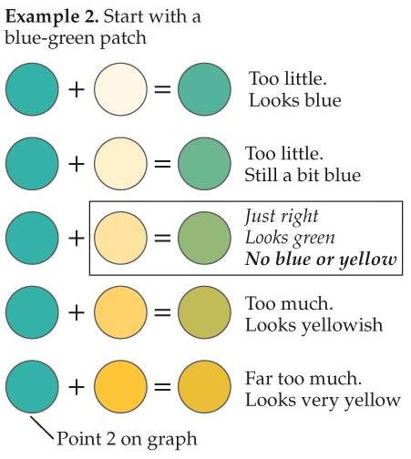
Figure 5.16 Color cancellation method (Example 2)
Notes:
Figure 5.16 Color cancellation method
Using color cancellation to measure opponent processes and unique hues in a blue-yellow (A) and a red-green (B) process. The locations where the hue cancellations cross the neutral midpoint are the locations of the unique green (A) and blue and yellow (B) hues—for example, the green hue with no hint of blue or yellow in it. (Graphs after L. Hurvich and D. Jameson. 1957. Psychol Rev 64: 384–404.)
A hue cancellation experiment starts with a color—here, blue-green—and attempts to determine how much of the opponent color of one of the starting color’s components must be added to eliminate any hint of that component from the starting color. In this example, the observer adds yellow to cancel blue, leaving only the green component of the blue-green.
Instructor Notes:
Goal is to turn the green-blue patch of light into a pure green patch light.
To do this, you must cancel out the blue in the light.
You cancel out blue light by adding yellow light.
Observer adjusts the amount of yellow light that is added to the green-blue light until no more blue can be perceived in the patch.
The patch will appear to be green without a hint of blue or yellow.

Slide 42
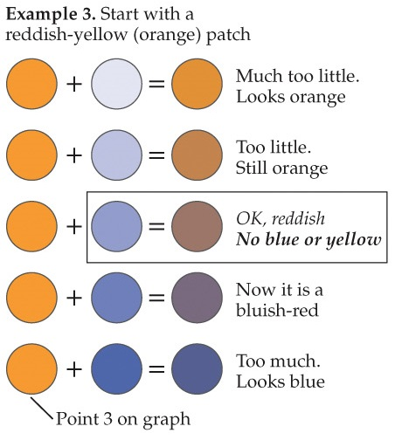
Figure 5.16 Color cancellation method (Example 3)
Notes:
Figure 5.16 Color cancellation method
Using color cancellation to measure opponent processes and unique hues in a blue-yellow (A) and a red-green (B) process. The locations where the hue cancellations cross the neutral midpoint are the locations of the unique green (A) and blue and yellow (B) hues—for example, the green hue with no hint of blue or yellow in it. (Graphs after L. Hurvich and D. Jameson. 1957. Psychol Rev 64: 384–404.)
A hue cancellation experiment starts with a color—here, orange—and attempts to determine how much of the opponent color of one of the starting color’s components must be added to eliminate any hint of that component from the starting color. In this example, the observer adds blue to cancel yellow, leaving only the red component of the orange.
Instructor Notes:
Goal is to turn the orange patch of light into a pure red patch light.
To do this, you must cancel out the yellow in the light.
You cancel out yellow light by adding blue light.
Observer adjusts the amount of blue light that is added to the orange light until no more yellow can be perceived in the patch.
The patch will appear to be reddish without a hint of blue or yellow.

Slide 43
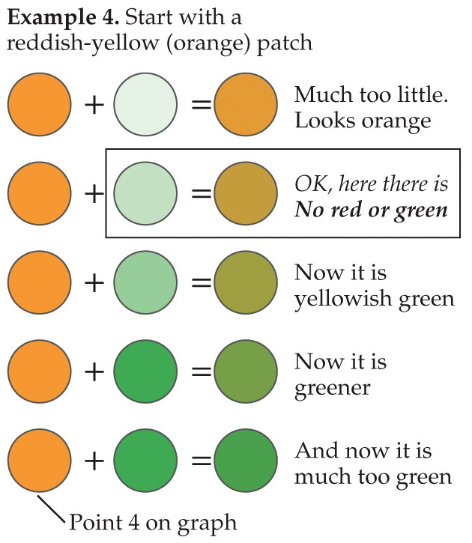
Figure 5.16 Color cancellation method (Example 4)
Notes:
Figure 5.16 Color cancellation method
Using color cancellation to measure opponent processes and unique hues in a blue-yellow (A) and a red-green (B) process. The locations where the hue cancellations cross the neutral midpoint are the locations of the unique green (A) and blue and yellow (B) hues—for example, the green hue with no hint of blue or yellow in it. (Graphs after L. Hurvich and D. Jameson. 1957. Psychol Rev 64: 384–404.)
A hue cancellation experiment starts with a color—here, orange—and attempts to determine how much of the opponent color of one of the starting color’s components must be added to eliminate any hint of that component from the starting color. In this example, the observer adds green to cancel red, leaving only the yellow component of the orange.
Instructor Notes:
Goal is to turn the orange patch of light into a pure yellow patch light.
To do this, you must cancel out the red in the light.
You cancel out red light by adding green light.
Observer adjusts the amount of green light that is added to the orange light until no more red can be perceived in the patch.
The patch will appear to be yellow without a hint of red or green.
Values above the dashed line indicate that there is more red than green in those colors.
For instance, orange is in this range.
The amount of red in the color is determined by how much green was necessary to cancel it out.
Values below the dashed line indicate that there is more green than red in those colors.
For instance, green is in this range.
The amount of green in the color is determined by how much red was necessary to cancel it out.

Slide 44
5.4 Step 3: Color Appearance 8
We can use the hue cancellation paradigm to determine the wavelengths of unique hues.
Unique hue: Any of four colors that can be described with only a single color term: red, yellow, green, blue.
For instance, unique blue is a blue that has no red or green tint.

Slide 45
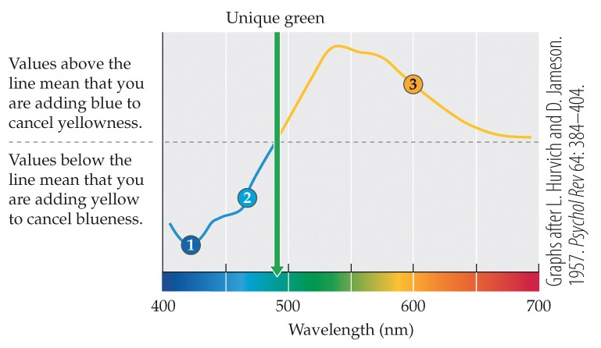
Figure 5.16 Color cancellation method (Part A)
Notes:
Figure 5.16 Color cancellation method
Using color cancellation to measure opponent processes and unique hues in a blue-yellow (A) and a red-green (B) process. The locations where the hue cancellations cross the neutral midpoint are the locations of the unique green (A) and blue and yellow (B) hues—for example, the green hue with no hint of blue or yellow in it. (Graphs after L. Hurvich and D. Jameson. 1957. Psychol Rev 64: 384–404.)
Results from a hue cancellation experiment. The locations where the hue cancellations cross the neutral midpoint are the locations of the unique green hue—for example, the green hue with no hint of blue or yellow in it. “Unique red” is not defined by just one spectral locus. (After Hurvich and Jameson, 1957.)
Instructor Notes:
Above the dotted line are colors with a yellowish tinge that had to be neutralized with blue.
Below the dotted line are bluish colors that were cancelled out with yellow.
The green arrow indicates a “pure” green that seemed to have neither a yellowish or bluish tint.

Slide 46
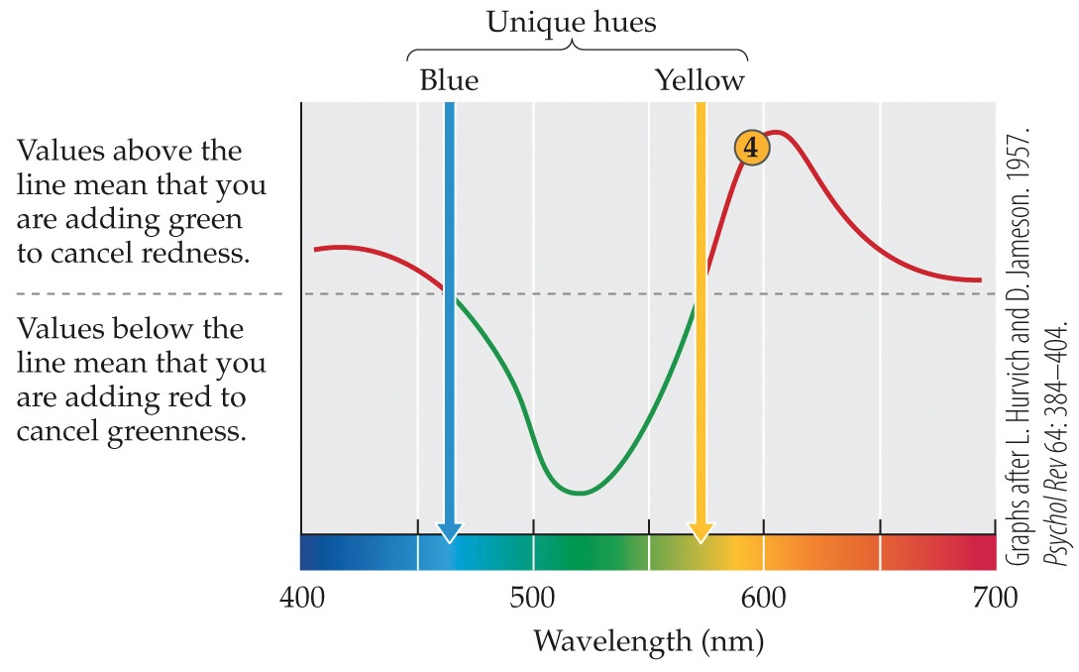
Figure 5.16 Color cancellation method (Part B)
Notes:
Figure 5.16 Color cancellation method
Using color cancellation to measure opponent processes and unique hues in a blue-yellow (A) and a red-green (B) process. The locations where the hue cancellations cross the neutral midpoint are the locations of the unique green (A) and blue and yellow (B) hues—for example, the green hue with no hint of blue or yellow in it. (Graphs after L. Hurvich and D. Jameson. 1957. Psychol Rev 64: 384–404.)
Results from a hue cancellation experiment. The locations where the hue cancellations cross the neutral midpoint are the locations of the unique blue and yellow hues—for example, the blue hue with no hint of red or green in it.
Instructor Notes:
Values above the dotted line indicate colors that have a predominantly red component to them. Therefore, green had to be added to cancel out the red.
Values below the dotted line indicate colors with a green component in them. Red had to be added to cancel out the green.
The arrows indicate the locations of unique blue and unique yellow.
These are wavelengths of color that did not appear to have any red or green in them.
These are “pure” blue and yellow.

Slide 47
5.4 Step 3: Color Appearance 9
The three steps of color perception, revisited
Step 1: Detection
S-, M-, and L-cones detect light.
Each cone responds to a different range of wavelengths of light.

Slide 48
5.4 Step 3: Color Appearance 10
The three steps of color perception, revisited
Step 2: Discrimination
Cone-opponent mechanisms discriminate wavelengths.
[L – M] and [M – L] compute something like red vs. green.
[L + M] – S and S – [L + M] compute something like blue vs. yellow.

Slide 49
5.4 Step 3: Color Appearance 11
The three steps of color perception, revisited
Step 3: Appearance
Further transformations of the signals create final color-opponent appearance.

Slide 50
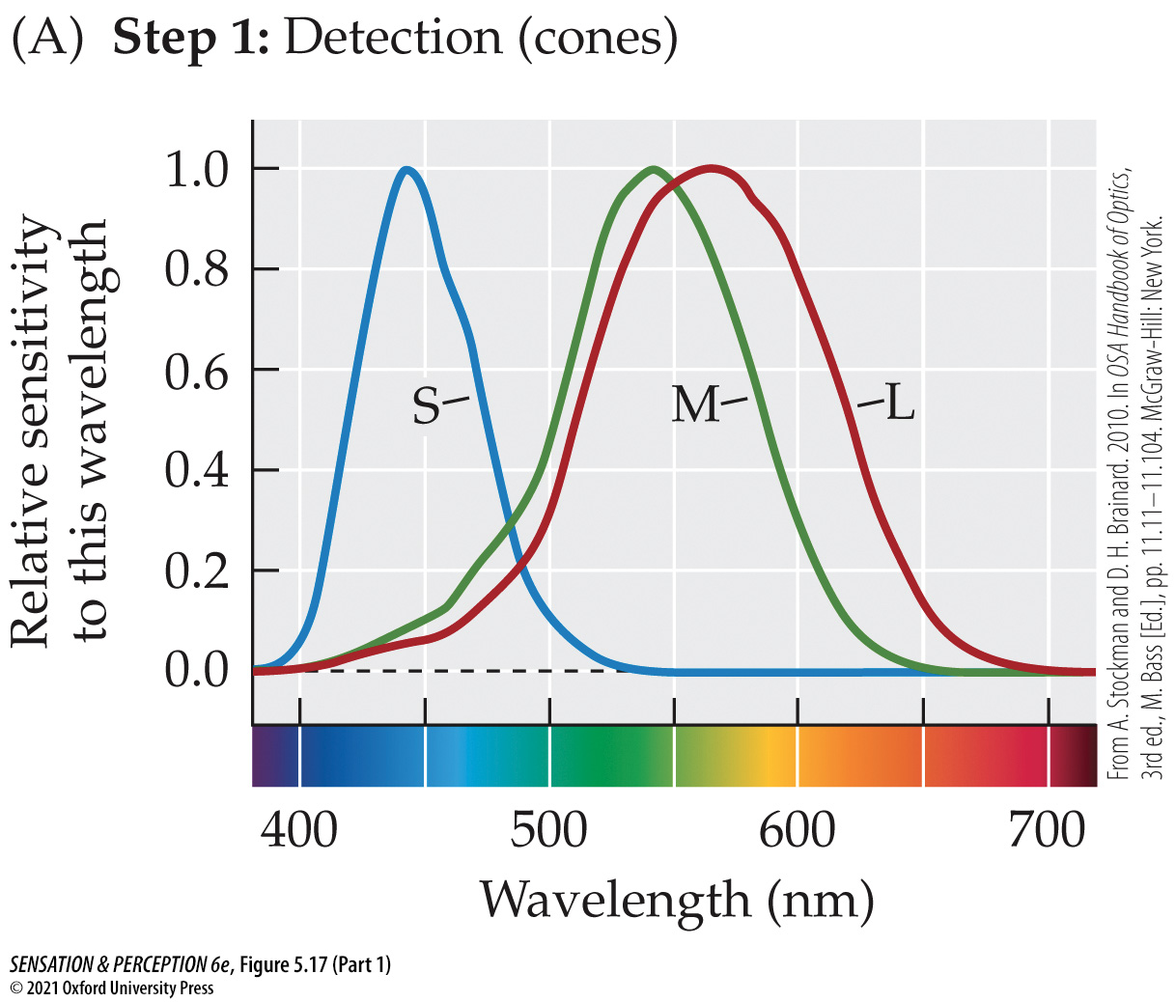
Figure 5.17 Three steps to color perception (Part 1)
Notes:
Figure 5.17 Three steps to color perception
(A) Detection: light is differentially absorbed by three photopigments in the cones. (B) Discrimination: differences are taken between cone types, creating cone-opponent mechanisms, important for wavelength discriminations. (C) Appearance: further recombination of the signals creates color-opponent processes that support the color-opponent nature of color appearance. (From A. Stockman and D. H. Brainard. 2010. In OSA Handbook of Optics, 3rd ed., M. Bass [Ed.], pp. 11.11–11.104. McGraw-Hill: New York.)
Instructor Notes:
(a) First, colors are detected by the cones.

Slide 51
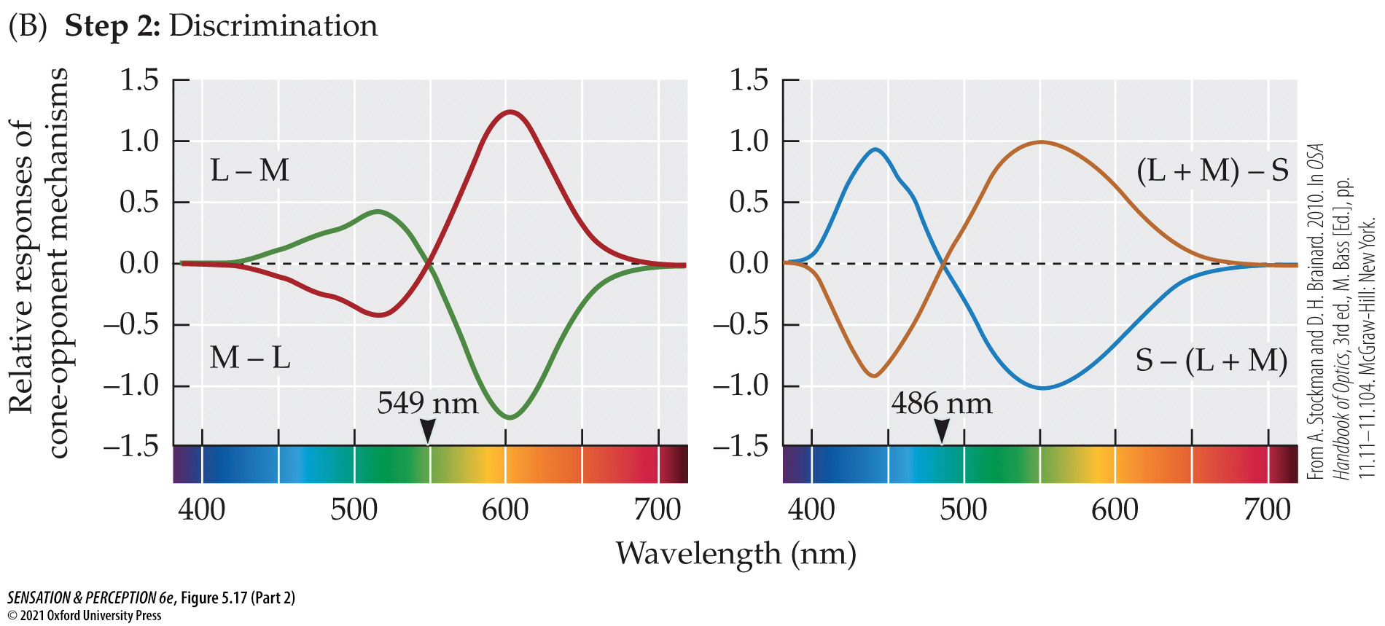
Figure 5.17 Three steps to color perception (Part 2)
Notes:
Figure 5.17 Three steps to color perception
(A) Detection: light is differentially absorbed by three photopigments in the cones. (B) Discrimination: differences are taken between cone types, creating cone-opponent mechanisms, important for wavelength discriminations. (C) Appearance: further recombination of the signals creates color-opponent processes that support the color-opponent nature of color appearance. (From A. Stockman and D. H. Brainard. 2010. In OSA Handbook of Optics, 3rd ed., M. Bass [Ed.], pp. 11.11–11.104. McGraw-Hill: New York.)
Instructor Notes:
(b) Next, cone outputs are compared to each other to discriminate different wavelengths of light.

Slide 52
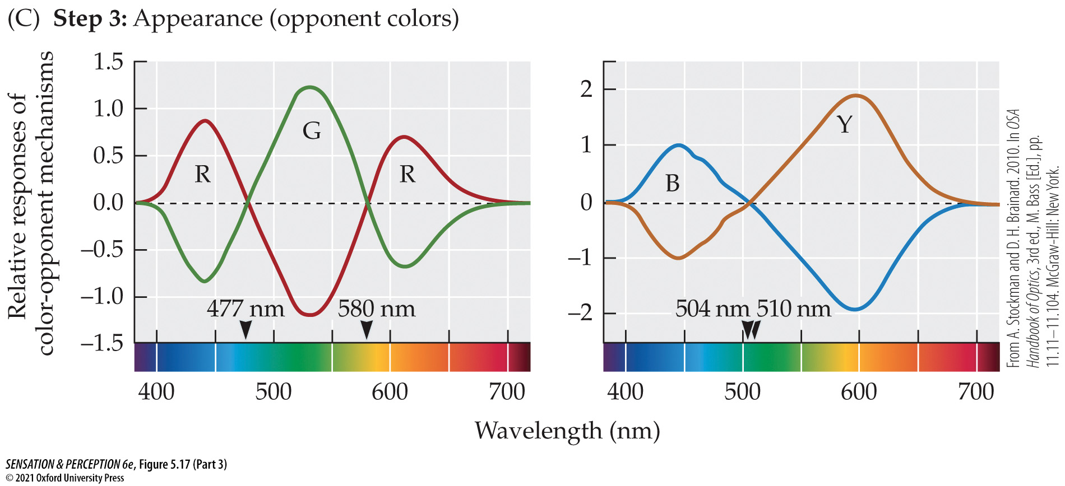
Figure 5.17 Three steps to color perception (Part 3)
Notes:
Figure 5.17 Three steps to color perception
(A) Detection: light is differentially absorbed by three photopigments in the cones. (B) Discrimination: differences are taken between cone types, creating cone-opponent mechanisms, important for wavelength discriminations. (C) Appearance: further recombination of the signals creates color-opponent processes that support the color-opponent nature of color appearance. (From A. Stockman and D. H. Brainard. 2010. In OSA Handbook of Optics, 3rd ed., M. Bass [Ed.], pp. 11.11–11.104. McGraw-Hill: New York.)
Instructor Notes:
(c) Finally, color discrimination functions are transformed again to produce the color opponent process first described by Hering.

Slide 53
5.4 Step 3: Color Appearance 12
Color in the Visual Cortex
Is there a particular place in the cortex specialized for color processing?
Not clear: V1, V2, and V4 all involved in color perception, but not exclusively.
Achromatopsia: Loss of color vision from brain damage.
Notes:
Instructor Notes:
People with achromatopsia have intact vision but do not experience color vision.
People with this disorder can find the boundaries between color regions but can’t tell you what color the regions are.

Slide 54
5.5 Individual Differences in Color Perception 1
Language and Color
General agreement on colors
Basic color terms: Single words that describe colors, are used with high frequency, and have meanings that are agreed upon by speakers of a language.

Slide 55
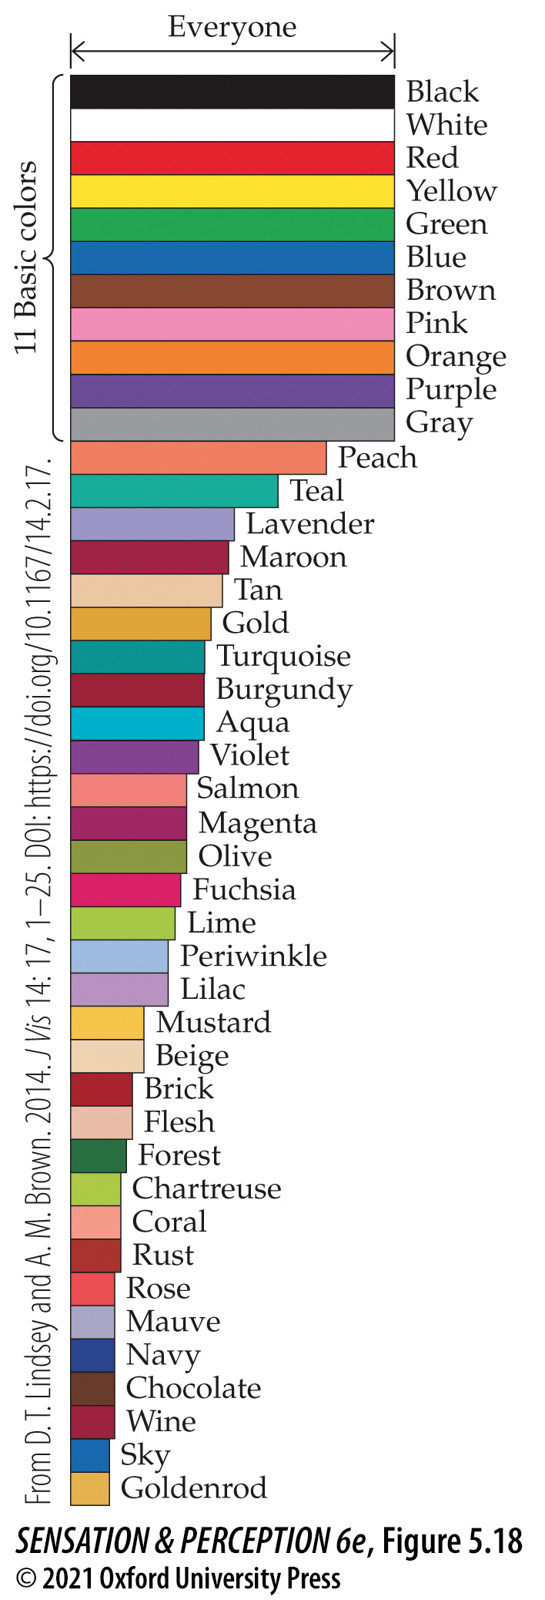
Figure 5.18 Basic color names
Notes:
Figure 5.18 Basic color names
When Lindsey and Brown (2014) asked Americans to name color patches, everyone used the 11 “basic” color names. The other color terms were used by fewer and fewer people, going toward the bottom of the graph. A few of these other terms, like peach and teal, may be considered basic color names over time. (From D. T. Lindsey and A. M. Brown. 2014. J Vis 14: 17, 1–25. DOI: https://doi.org/10.1167/14.2.17.)
Instructor Notes:
Figure 5.18 depicts Americans’ basic color terms for a variety of colors.
The 11 basic colors have broad agreement and then there is less agreement as you move down the list.
Peach and Teal are close to having broad enough agreement to be considered basic colors. They may become basic colors in the future.

Slide 56
5.5 Individual Differences in Color Perception 2
Various cultures describe color differently.
Cultural relativism: In sensation and perception, the idea that basic perceptual experiences (e.g., color perception) may be determined in part by the cultural environment.

Slide 57
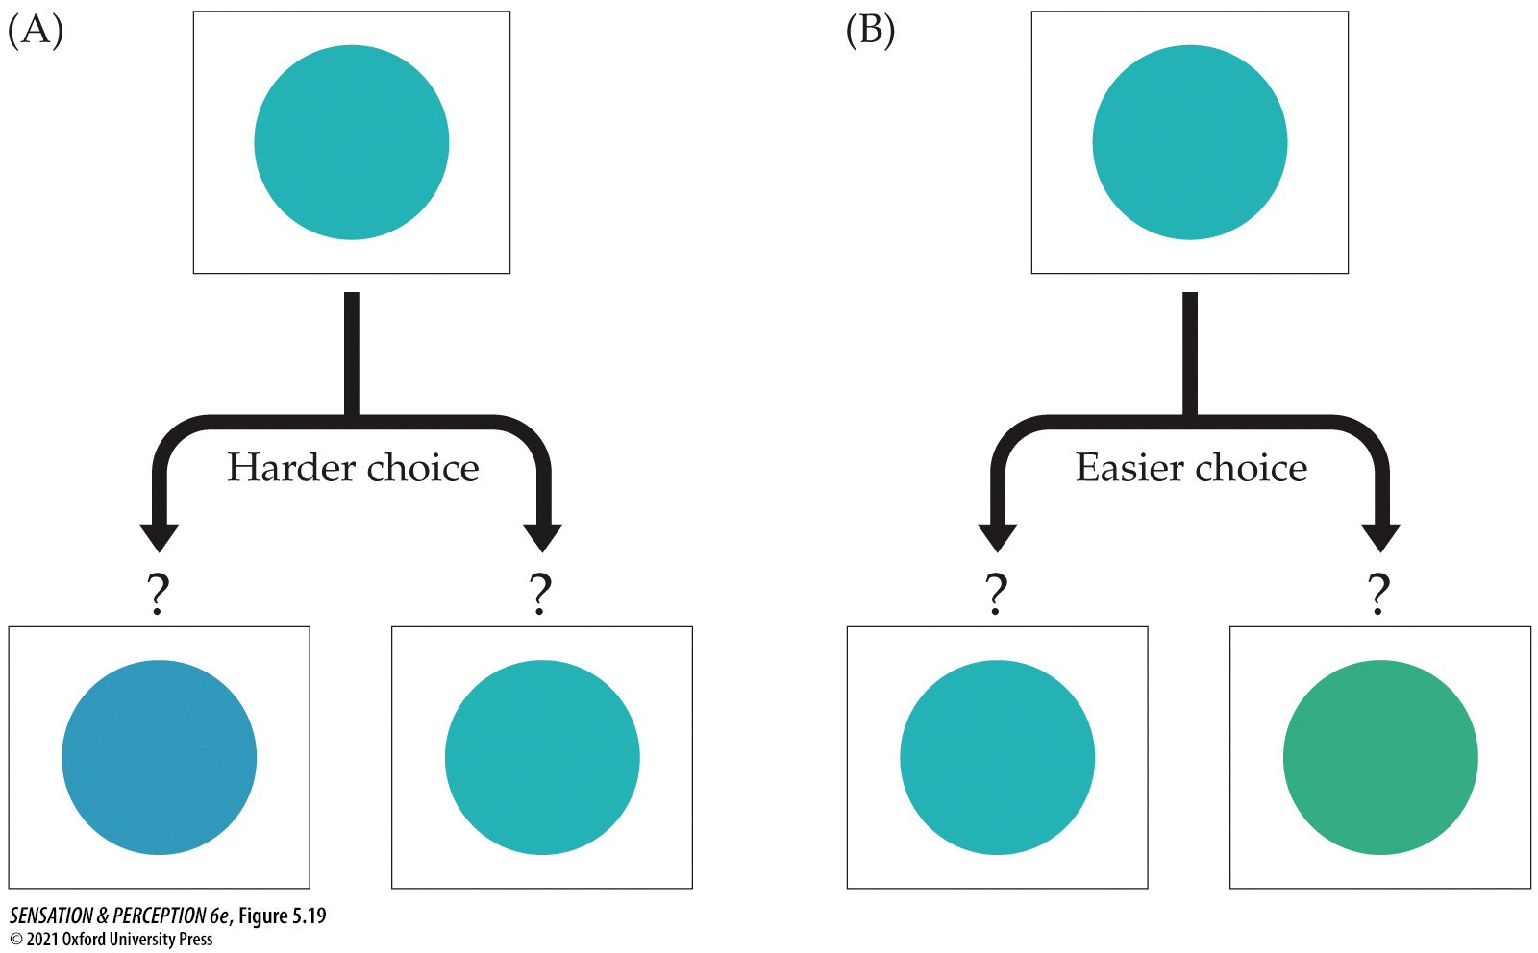
Figure 5.19 Color category boundaries
Notes:
Figure 5.19 Color category boundaries
It is easier to remember which of two colors you have seen if the choices are categorically different. For example, suppose you had to remember the “blue” patch shown at the top of each part of the Figure. Picking between two “blues,” as in (A), would be rather hard. The task would be easier if one of the choices were “blue” and the other “green,” as in (B), even if the distances in color space were the same in the two cases.
Instructor Notes:
Left side (a): If a color choice stays within a categorical boundary (both of the color patches on the bottom are “blue,”) then it is harder to remember which choice you saw.
Right side (b): If a color choice crosses a categorical boundary (one of the choices at bottom is “blue” and the other is “green”), then it is easier to remember which choice you saw.
If a culture does not make a distinction between “blue” and “green” in their language, then cultural relativism suggests that members of the culture would have a hard time perceiving the difference between blue and green.
In this case, there should be no difference in performance between the choices on the left and the choices on the right.
Eleanor Rosch found that people from cultures that do not have words distinguishing “blue” from “green” nonetheless are still better at remembering colors when the choices cross a categorical boundary than when they do not.

Slide 58
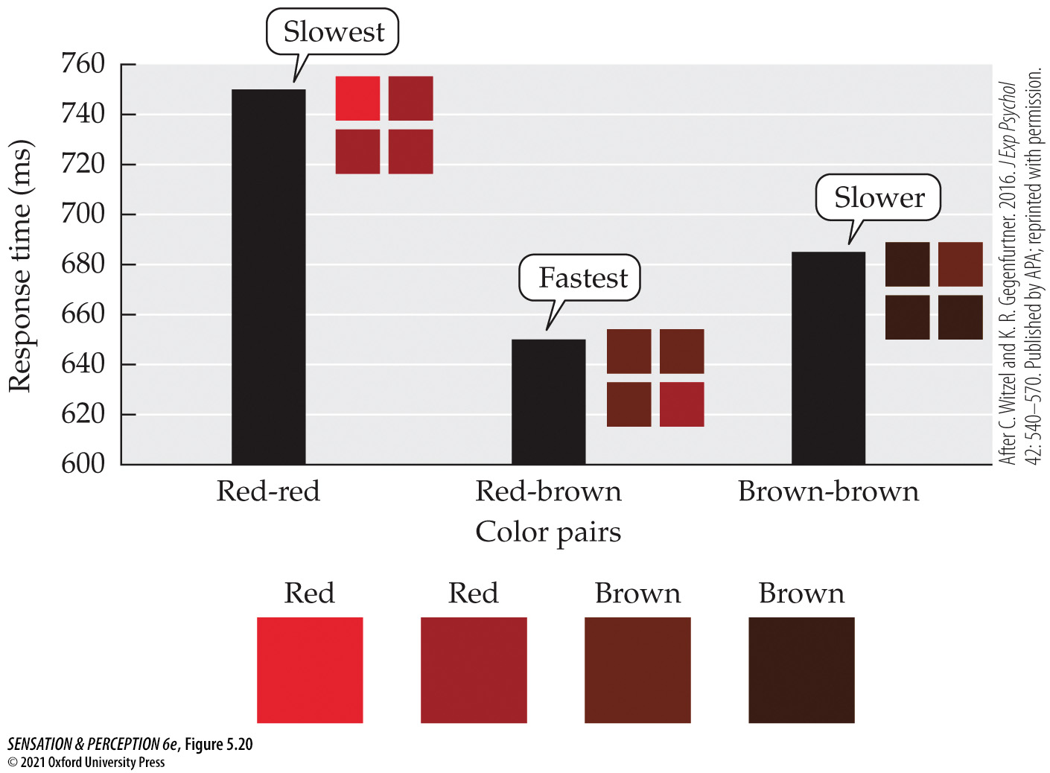
Figure 5.20 A color category experiment
Notes:
Figure 5.20 A color category experiment
Observers see four color patches and simply locate the one patch that is different from the other three. Responses are faster and more accurate when the two colors cross a color boundary—in this case, between red and brown. (After C. Witzel and K. R. Gegenfurtner. 2016. J Exp Psychol 42: 540–570. Published by APA; reprinted with permission.)
Instructor Notes:
This experiment shows that color boundaries have an influence, even if the task doesn’t have a memory component. When people name the odd color patch, they are faster when it crosses a linguistic color boundary.

Slide 59
5.5 Individual Differences in Color Perception 3
Genetic Differences in Color Perception
About 8% of males and 0.5% of females have some form of color vision deficiency: “color blindness.”
Color-anomalous: A term for what is usually called “color blindness.” Most “color-blind” individuals can still make discriminations based on wavelength. Those discriminations are just different from the norm.
Notes:
Instructor Notes:
More males are color blind than females because the M- and L-cone photopigments are coded on the X chromosome and males only get one where females get two.
If a female receives an X chromosome lacking the genes for either the M- or L-cone, they have another X chromosome that might be normal.
Some females can receive two different genetic mutations of the L- or M-cones on their two X chromosomes and end up having four cones – that is, they are tetrachromatic!

Slide 60
5.5 Individual Differences in Color Perception 4
Several types of color-blind/color-anamolous people
Deuteranope: Due to absence of M-cones.
Protanope: Due to absence of L-cones.
Tritanope: Due to absence of S-cones.
Notes:
Instructor Notes:
Many video games are starting to include a “color blind mode” in the settings.
This prevents the game from using only hue to distinguish between important elements (like friends being green and foes being red).
Some games even have different modes for deuteranopes, protanopes, and tritanopes.

Slide 61
5.5 Individual Differences in Color Perception 5
Cone monochromat: Has only one cone type; truly color-blind.
Rod monochromat: Has no cones of any type; truly color-blind and very visually impaired in bright light.
Anomia: Inability to name objects or colors in spite of the ability to see and recognize them. Typically due to brain damage.

Slide 62
5.5 Individual Differences in Color Perception 6
Synesthesia: When one stimulus evokes the experience of another stimulus that is not present.
Example: letters appearing to have colors (grapheme-color synesthesia) or sounds having tastes
About 4-5% of the population experiences synesthesia

Slide 63
5.6 From the Color of Lights to a World of Color 1
Colors very rarely appear in isolation. Usually, many colors are present in a scene.
When many colors are present, they can influence each other.
Color contrast: A color perception effect in which the color of one region induces the opponent color in a neighboring region.
Color assimilation: A color perception effect in which two colors bleed into each other, each taking on some of the chromatic quality of the other.

Slide 64
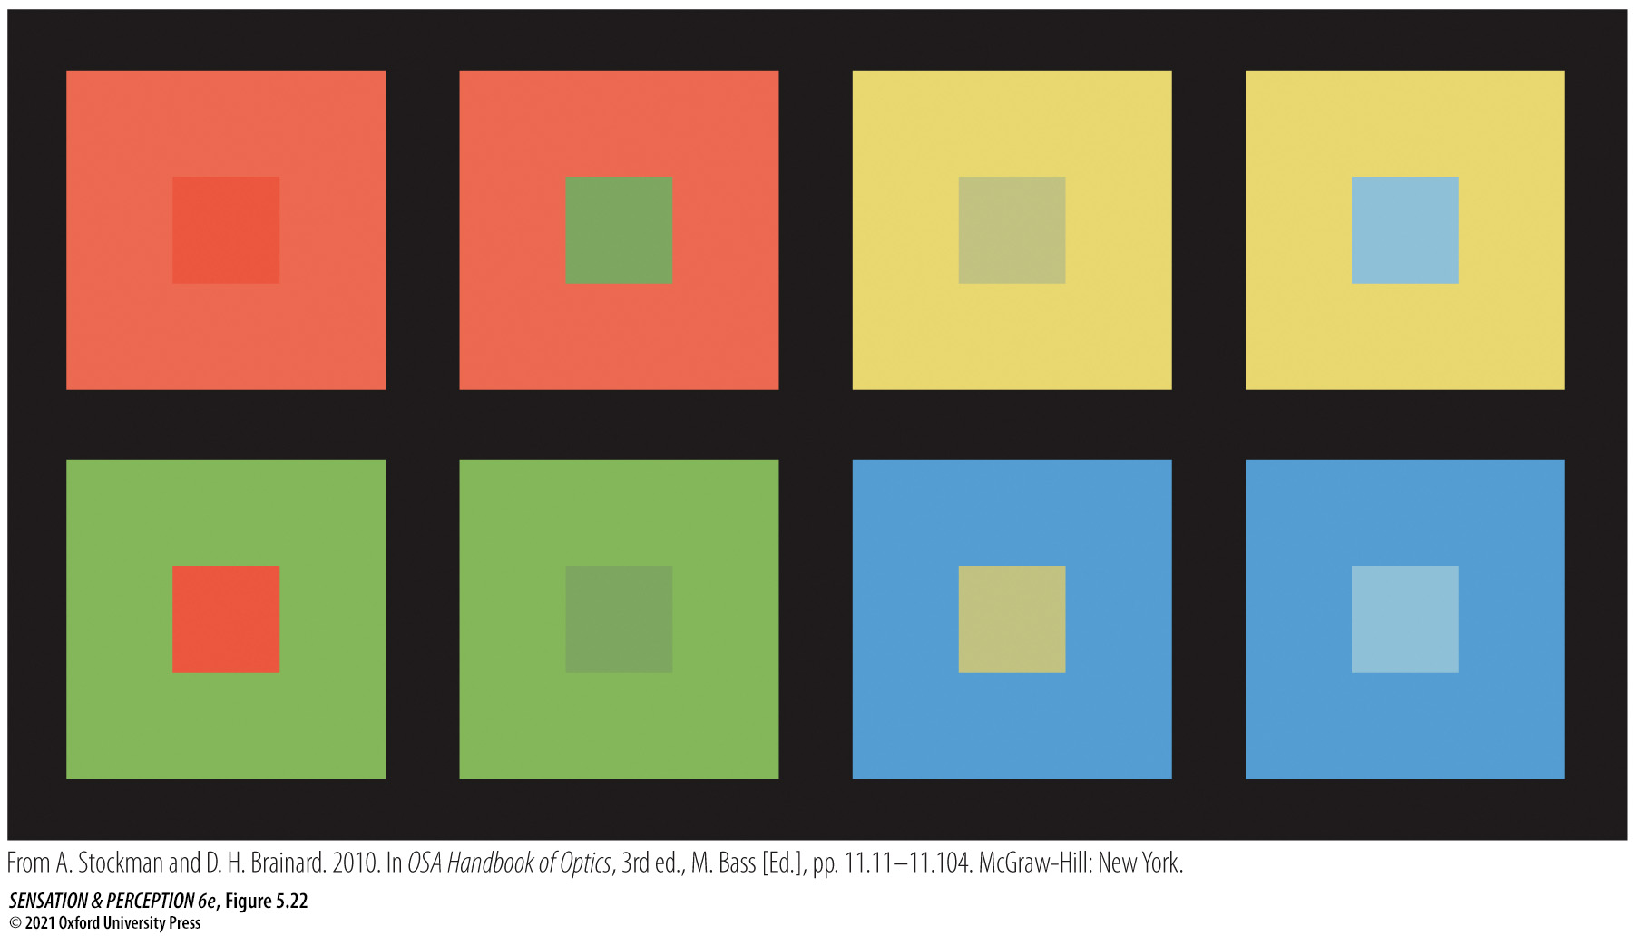
Figure 5.22 Color contrast
Notes:
Figure 5.22 Color contrast
The central square takes on chromatic attributes that are opposite those of the surround. For instance, the green central square in column 2, looks greener on the red background than on the green background. (From A. Stockman and D. H. Brainard. 2010. In OSA Handbook of Optics, 3rd ed., M. Bass [Ed.], pp. 11.11–11.104. McGraw-Hill: New York.)

Slide 65
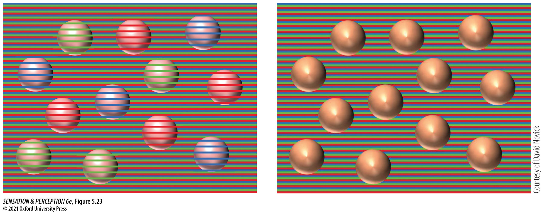
Figure 5.23 Color assimilation
Notes:
Figure 5.23 Color assimilation
Here, colors blend together locally. The apparent color of each sphere comes from stripes that lie on top of it in the group on the left. Remove the stripes, as on the right, and the spheres are all the same color.

Slide 66
5.6 From the Color of Lights to a World of Color 2
Unrelated color: A color that can be experienced in isolation.
Related color: A color, such as brown or gray, which is seen only in relation to other colors.
A “gray” patch in complete darkness appears white.

Slide 67
5.6 From the Color of Lights to a World of Color 3
Afterimages: A visual image seen after a stimulus has been removed.
Negative afterimage: An afterimage whose polarity is the opposite of the original stimulus.
Light stimuli produce dark negative afterimages.
Colors are complementary. Red produces green afterimages and blue produces yellow afterimages (and vice versa).
This is a way to see opponent colors in action.
Notes:
Instructor Notes:
Afterimages - A common example is seeing a black spot in your vision after having your picture taken. The bright white flash of the camera led to the black afterimage.

Slide 68
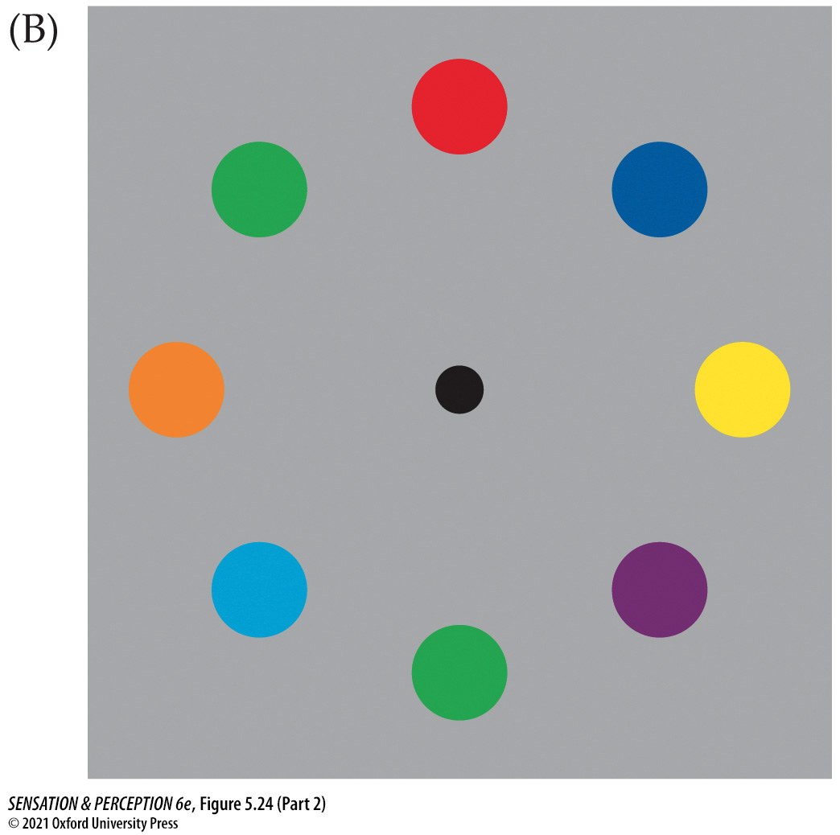
Figure 5.24 Negative afterimages (Part 2)
Notes:
Figure 5.24 Negative afterimages
Study the image in (A) and convince yourself that the ring of circles is gray. Now stare at the black dot in (B). After 10 seconds or so, shift your fixation to the black dot in (A). The circles should now look colored. This is a negative afterimage. Why does it happen? (If it didn’t happen, try fixating more rigorously. Really look at the black dot.) Now try with a real scene. Fixate the star in (E), and then flick your eyes to the same spot in (D). Looking back and forth helps. You should see a washed-out version of the colors in (C).
Instructor Notes:
Top Row
Stare at the figure here (on the right in the full figure [b]) for 10–20 seconds.
Ask students not to change their gaze as you advance to the next slide [figure on the left in the full figure [a]).
You should see negative afterimages in the white circles.
The white circles will seem to take on a slightly colored appearance.

Slide 69
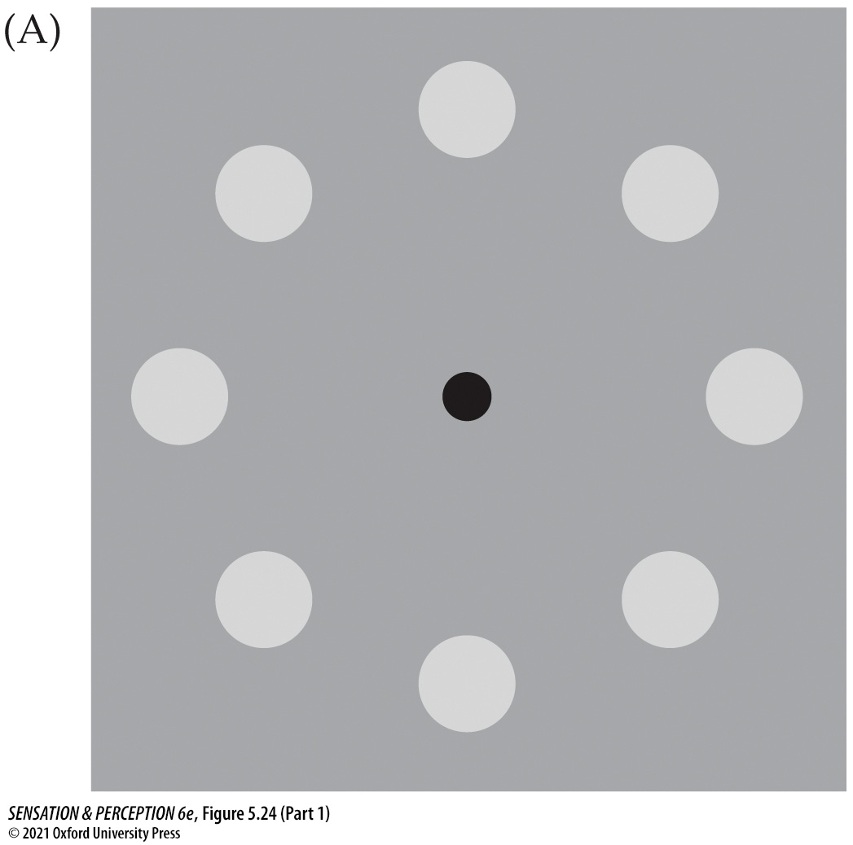
Figure 5.24 Negative afterimages (Part 1)
Notes:
Figure 5.24 Negative afterimages
Study the image in (A) and convince yourself that the ring of circles is gray. Now stare at the black dot in (B). After 10 seconds or so, shift your fixation to the black dot in (A). The circles should now look colored. This is a negative afterimage. Why does it happen? (If it didn’t happen, try fixating more rigorously. Really look at the black dot.) Now try with a real scene. Fixate the star in (E), and then flick your eyes to the same spot in (D). Looking back and forth helps. You should see a washed-out version of the colors in (C).
Instructor Notes:
Top Row
You should see negative afterimages in the white circles.
The white circles will seem to take on a slightly colored appearance.

Slide 70
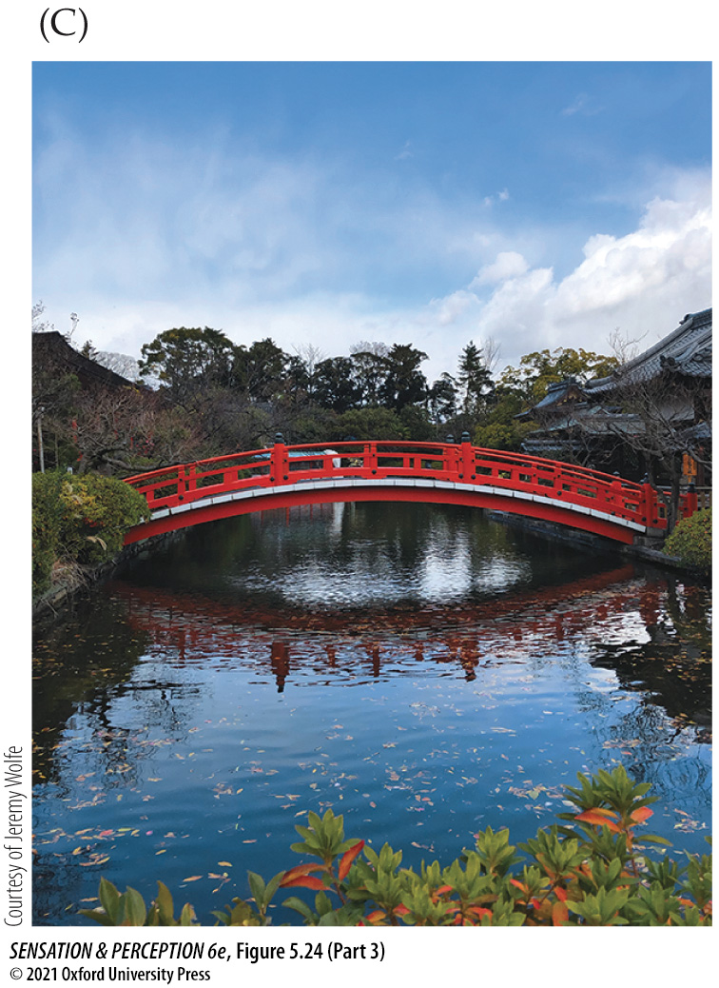
Figure 5.24 Negative afterimages (Part 3)
Notes:
Figure 5.24 Negative afterimages
Study the image in (A) and convince yourself that the ring of circles is gray. Now stare at the black dot in (B). After 10 seconds or so, shift your fixation to the black dot in (A). The circles should now look colored. This is a negative afterimage. Why does it happen? (If it didn’t happen, try fixating more rigorously. Really look at the black dot.) Now try with a real scene. Fixate the star in (E), and then flick your eyes to the same spot in (D). Looking back and forth helps. You should see a washed-out version of the colors in (C).
Instructor Notes:
Bottom Row
Stare at the figure here (figure on the left in whole figure [c]) for 10–20 seconds.
Look at the gray picture in the next slide (the middle image in whole figure [d]).
You should see the middle picture as colored like in (e).

Slide 71
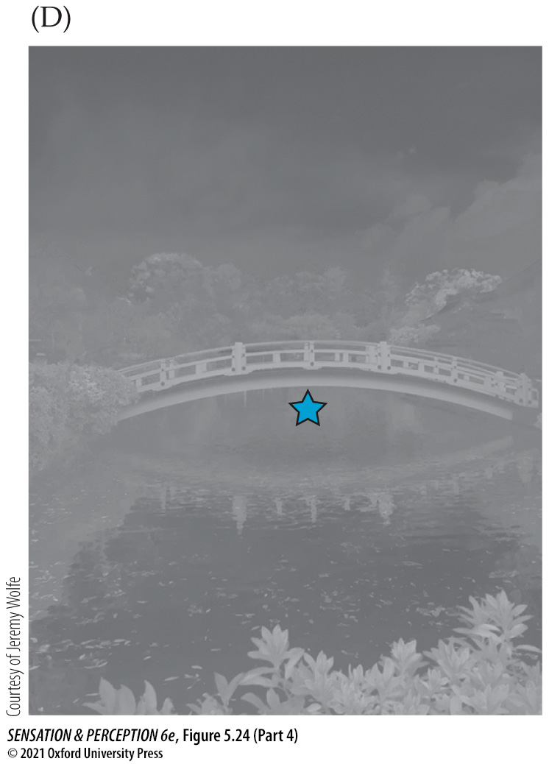
Figure 5.24 Negative afterimages (Part 4)
Notes:
Figure 5.24 Negative afterimages
Study the image in (A) and convince yourself that the ring of circles is gray. Now stare at the black dot in (B). After 10 seconds or so, shift your fixation to the black dot in (A). The circles should now look colored. This is a negative afterimage. Why does it happen? (If it didn’t happen, try fixating more rigorously. Really look at the black dot.) Now try with a real scene. Fixate the star in (E), and then flick your eyes to the same spot in (D). Looking back and forth helps. You should see a washed-out version of the colors in (C).
Instructor Notes:
Bottom Row
You should see the middle picture as colored like in (e).

Slide 72
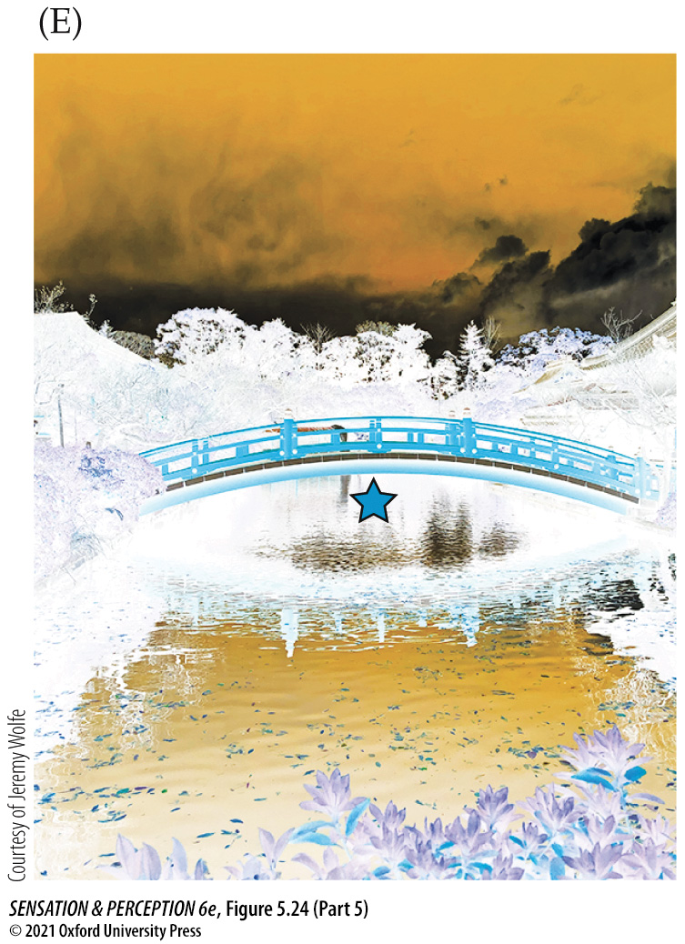
Figure 5.24 Negative afterimages (Part 5)
Notes:
Figure 5.24 Negative afterimages
Study the image in (A) and convince yourself that the ring of circles is gray. Now stare at the black dot in (B). After 10 seconds or so, shift your fixation to the black dot in (A). The circles should now look colored. This is a negative afterimage. Why does it happen? (If it didn’t happen, try fixating more rigorously. Really look at the black dot.) Now try with a real scene. Fixate the star in (E), and then flick your eyes to the same spot in (D). Looking back and forth helps. You should see a washed-out version of the colors in (C).
Instructor Notes:
Bottom Row
You should see the middle picture as colored like this.

Slide 73
5.6 From the Color of Lights to a World of Color 4
Color constancy: The tendency of a surface to appear the same color under a fairly wide range of illuminants.
Illuminant: The light that illuminates a surface.
To achieve color constancy, we must estimate how the color of the illuminant changes an object’s color on our retina so that we can determine the true color of the surface out in the world.

Slide 74
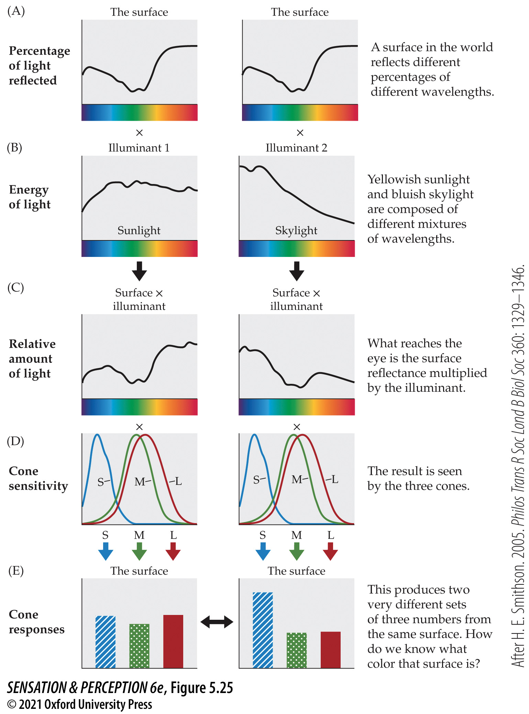
Figure 5.25 Color constancy
Notes:
Figure 5.25 Color constancy
The same surface (A) illuminated by two different lights (B) will generate two different patterns of activity in the S-, M-, and L-cones (C–E). However, the surface will appear to be the same color under both illuminants. This phenomenon is known as color constancy. (After H. E. Smithson. 2005. Philos Trans R Soc Lond B Biol Soc 360: 1329–1346.)
Instructor Notes:
(a) The same surface is shown on the left and the right. Same reflectance characteristics.
(b) Two different lights are illuminating the surface. Illuminant 1 has more yellow in it, while Illuminant 2 has more blue in it.
(c) Since the two Illuminants are so different, they create two different spectral patterns, which then lead to different stimulation of the cones.
(d) Even though the surfaces were the same, the illuminants were different, which led to two different patterns of cone responses.
To achieve color constancy, your brain must take into account the illuminant characteristics so they can be discounted in the final perception of color.

Slide 75
5.6 From the Color of Lights to a World of Color 5
Physical constraints make constancy possible.
Intelligent guesses about the illuminant
Most illuminants are “broadband” and contain many different wavelengths
Assumptions about surfaces
Most surfaces are “broadband” and reflect many different wavelengths
How does the illuminant interact with the surface?

Slide 76
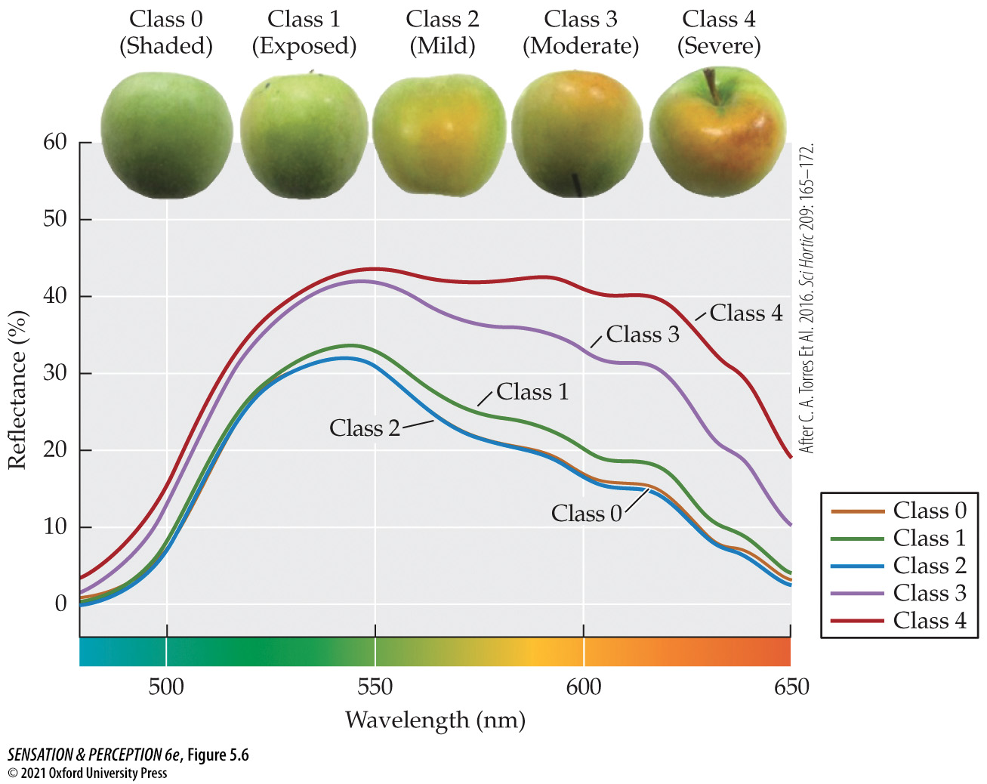
Figure 5.6 Real world reflectance functions
Notes:
Figure 5.6 Real world reflectance functions
Objects in the real world reflect light across the spectrum in different amounts. This graph plots the reflectances of sun injury development in Granny Smith apples. You can see how the appearance changes as the amount of reflected long-wavelength light changes. (After C. A. Torres et al. 2016. Sci Hortic 209: 165–172.)
Instructor’s Note
This is an example of how the color of a real world object includes many different wavelengths of light.

Slide 77
5.6 From the Color of Lights to a World of Color 6
“The Dress”
Caused controversy because people couldn’t agree on the colors of the dress
Black & Blue or White & Gold?
People perceived the dress differently, depending on their assumptions about the color of the illuminant
Assume yellow illuminant = Black & Blue
Assume blue illuminant = White & Gold

Slide 78
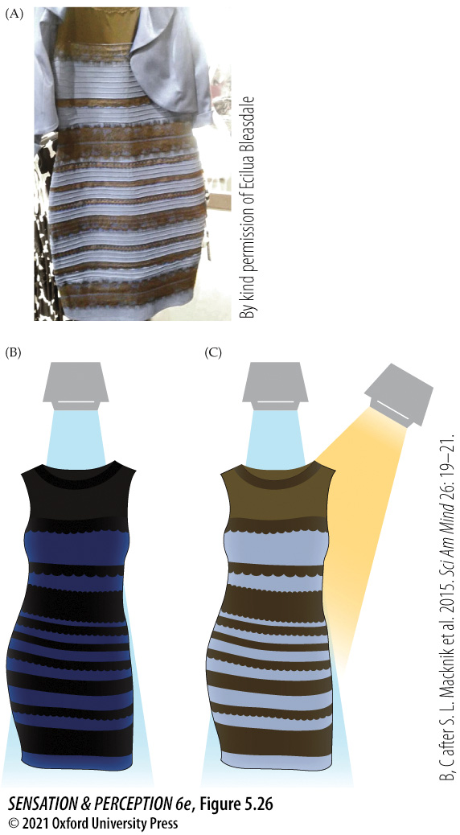
Figure 5.26 What color is this dress?
Notes:
Figure 5.26 What color is this dress?
(A) The color of this dress may not look the same to different people because each observer is making different assumptions about the nature of the light shining on the dress. (B) Maybe the light is just broadband white light. Then the dress appears to be blue and black. (C) Maybe there are a couple of light sources: one bluish and the other more yellow. Then the dress could appear to be white and gold. (B, C after S. L. Macknik et al. 2015. Sci Am Mind 26: 19–21.)

Slide 79
5.7 What Is Color Vision Good For? 1
Animals provide insight into color perception in humans
Food
It is easier to find berries and determine when they are ripe with color vision.
The perceived flavor of food can be affected by its color.
White wine dyed to look rosé tastes more like real rosé wine than white wine.

Slide 80
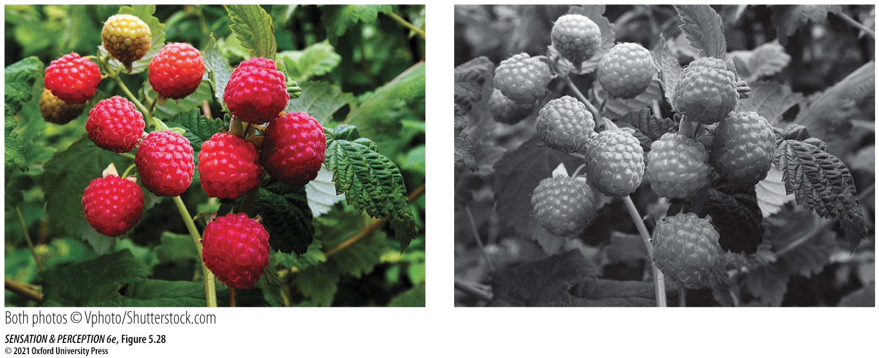
Figure 5.28 Using color vision
Notes:
Figure 5.28 Using color vision
Finding a raspberry is easier if you have color vision, as is deciding if that berry is ripe.

Slide 81
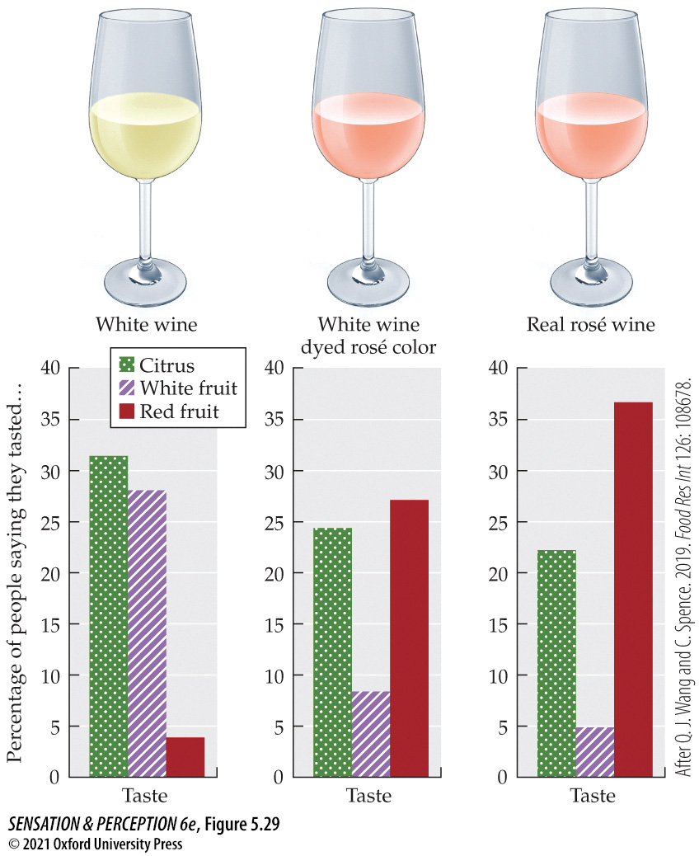
Figure 5.29 Color and flavor
Notes:
Figure 5.29 Color and flavor
The color of a food can change its reported flavor. Here white wine is reported to taste like rosé when it is colored pink. (After Q. J. Wang and C. Spence. 2019. Food Res Int 126: 108678.)

Slide 82
5.7 What Is Color Vision Good For? 2
Sex
Flower colors are advertisements for bees to trade food for sex (for pollination).
Colorful patterns on tropical fish and birds provide sexual signals.

Slide 83
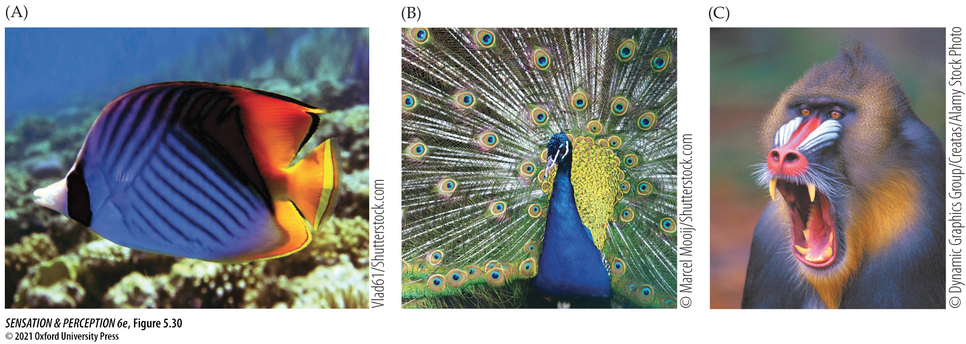
Figure 5.30 Color and sex
Notes:
Figure 5.30 Color and sex
The colors of animals—from (A) tropical fish to (B) peacocks to (C) mandrills—are often advertisements to potential mates.

Slide 84
5.7 What Is Color Vision Good For? 3
Many animals have different color vision systems than humans
Dogs are dichromats (similar to deuteranopes)
Chickens are tetrachromats
Mantis shrimp have 12 types of cones
The silver spinyfin fish lives in the deep sea and has two cone types and 38 rod types!

Slide 85
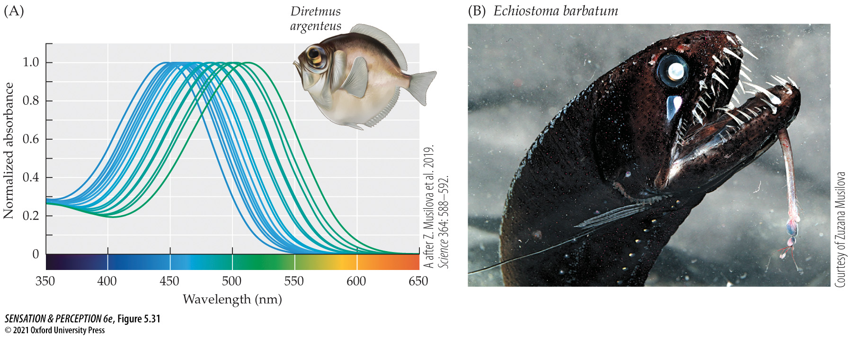
Figure 5.31 Extreme color vision
Notes:
Figure 5.31 Extreme color vision
(A) The absorption spectra of the 38 (!) different rod photopigments of the silver spinyfin (Diretmus argenteus). Notice that these pigments have peak sensitivity in the short wavelength (blue) end of the spectrum. These fish and other occupants of the deep sea emit their own light (a bit like fireflies), and that bioluminescence is in the short wavelengths. (B) The threadfin dragonfish (Echiostoma barbatum), another deep-sea fish with many photopigments. (A after Z. Musilova et al. 2019. Science 364: 588–592.)

Slide 86
5.7 What Is Color Vision Good For? 4
Humans and other mammals have color vision due to the different photopigments in our cones.
Other animals have evolved a different system for color vision.
Birds and some reptiles have colored oils over each photoreceptor, which tunes them to different wavelengths.

Slide 87
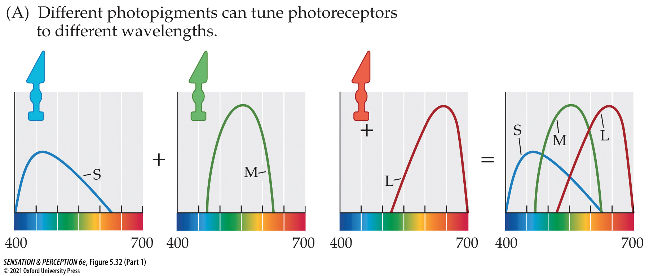
Figure 5.32 Two ways to make photoreceptors with different spectral sensitivities (Part 1)
Notes:
Figure 5.32 Two ways to make photoreceptors with different spectral sensitivities
(A) Our S-, M-, and L-cones are different because they contain different photopigments. (B) Some animals have only one type of photopigment. These animals can have color vision because colored oil droplets sitting on top of photoreceptors create groups of photoreceptors with different sensitivities to wavelength.
Instructor Notes:
S-, M-, and L- cones can be created with either different photopigments, as in humans, or by putting color drops of oil over photoreceptors, as in some birds and reptiles.

Slide 88
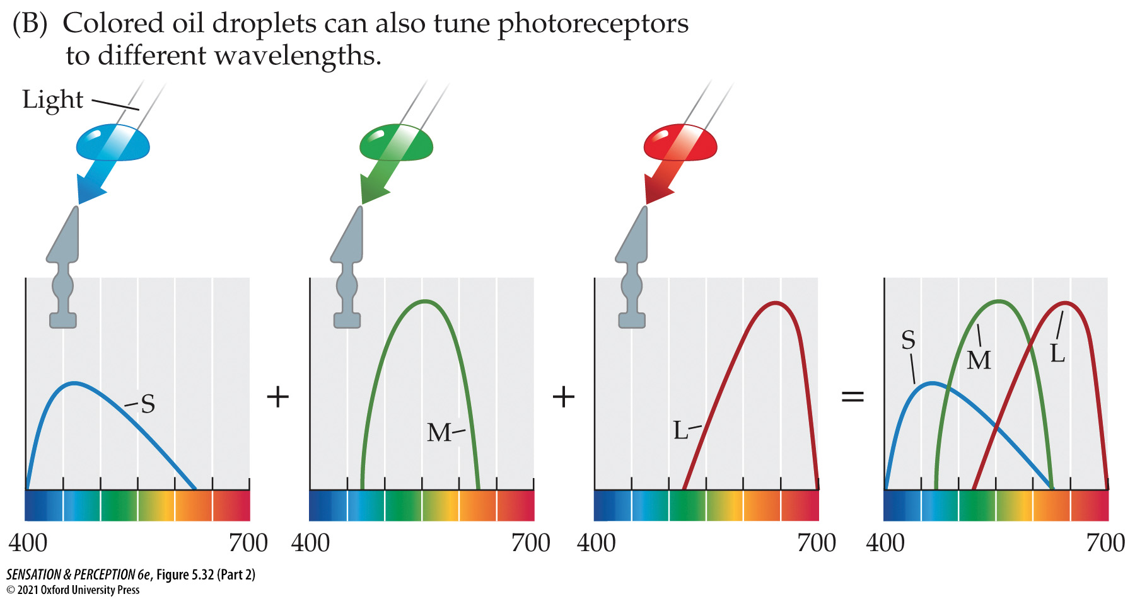
Figure 5.32 Two ways to make photoreceptors with different spectral sensitivities (Part 2)
Notes:
Figure 5.32 Two ways to make photoreceptors with different spectral sensitivities
(A) Our S-, M-, and L-cones are different because they contain different photopigments. (B) Some animals have only one type of photopigment. These animals can have color vision because colored oil droplets sitting on top of photoreceptors create groups of photoreceptors with different sensitivities to wavelength.
Instructor Notes:
S-, M-, and L- cones can be created with either different photopigments, as in humans, or by putting color drops of oil over photoreceptors, as in some birds and reptiles.

Slide 89
5.7 What Is Color Vision Good For? 5
How well can you direct your attention to one color?
Can people direct their attention to a specific color of green?
When the dots vary in hue, people are accurate.
When the dots vary in saturation, people are not very accurate.
Conclusion: Attention can select a group of items based on hue, not saturation.

Slide 90
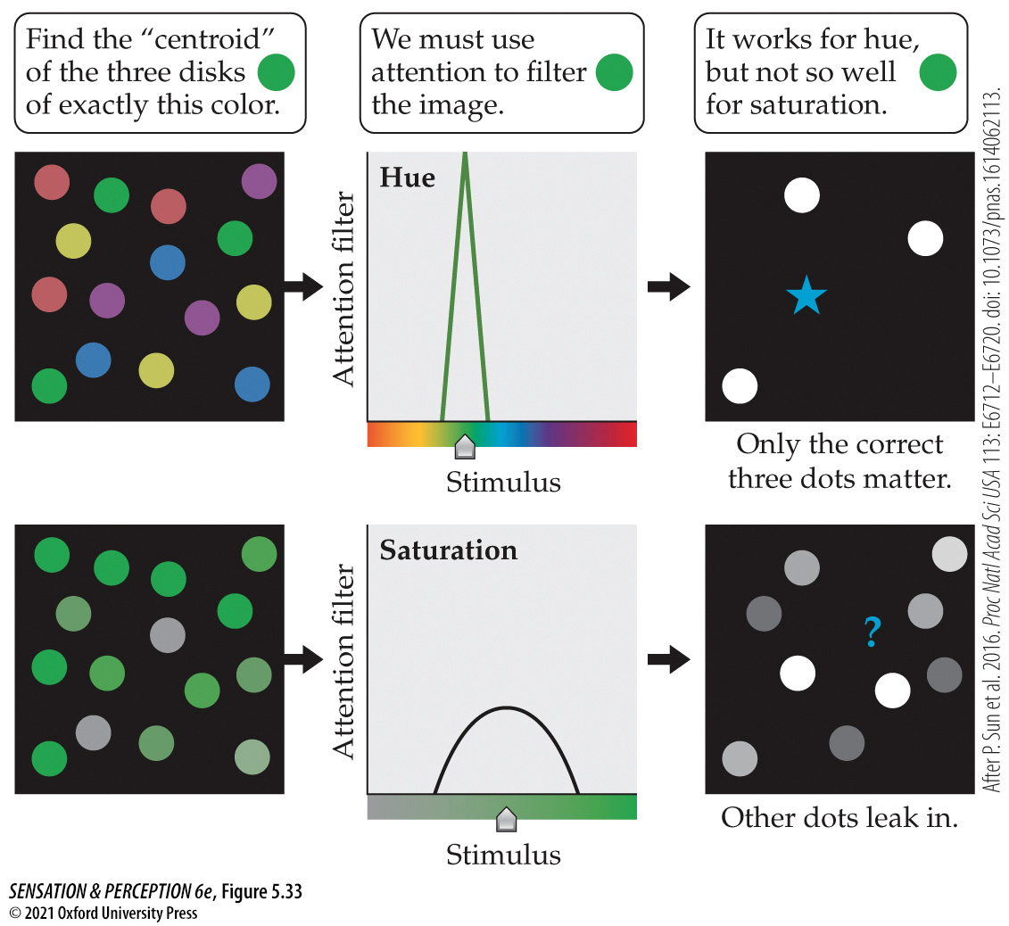
Figure 5.33 The Sun et al. attention filter experiment
Notes:
Figure 5.33 The Sun et al. attention filter experiment
Column 1 shows sample stimuli. Observers would be asked to pay attention to just three dots in each image, defined by their color. Column 2 shows the “attention filter” that can be inferred from the data. Column 3 shows the hypothetical strength of the dots in the mind of the observer when the filter has been applied. When the dots differ in hue (top row), the filter leaves only the target dots. When the dots vary in saturation (bottom row), nontarget dots get past the filter and influence behavior. (After P. Sun et al. 2016. Proc Natl Acad Sci USA 113: E6712–E6720. doi: 10.1073/pnas.1614062113.)

