Slide 1
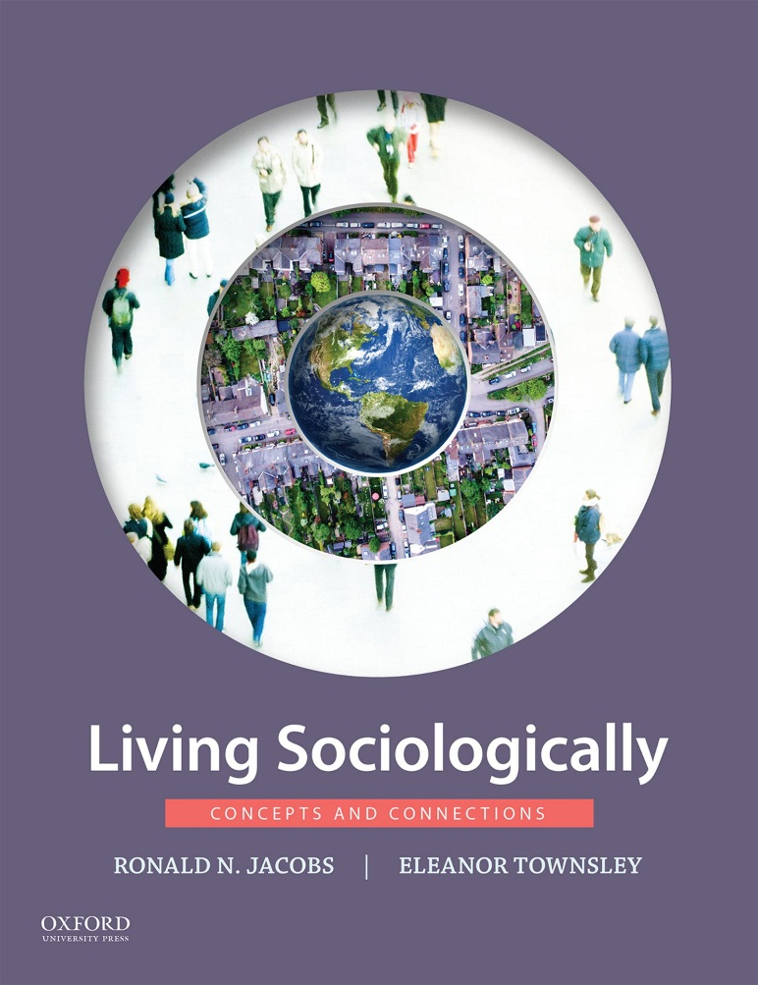
Living Sociologically by Ronald N. Jacobs and Eleanor Townsley

Slide 2
Part I: The Basics Chapter 01 What Is Sociology?

Slide 3
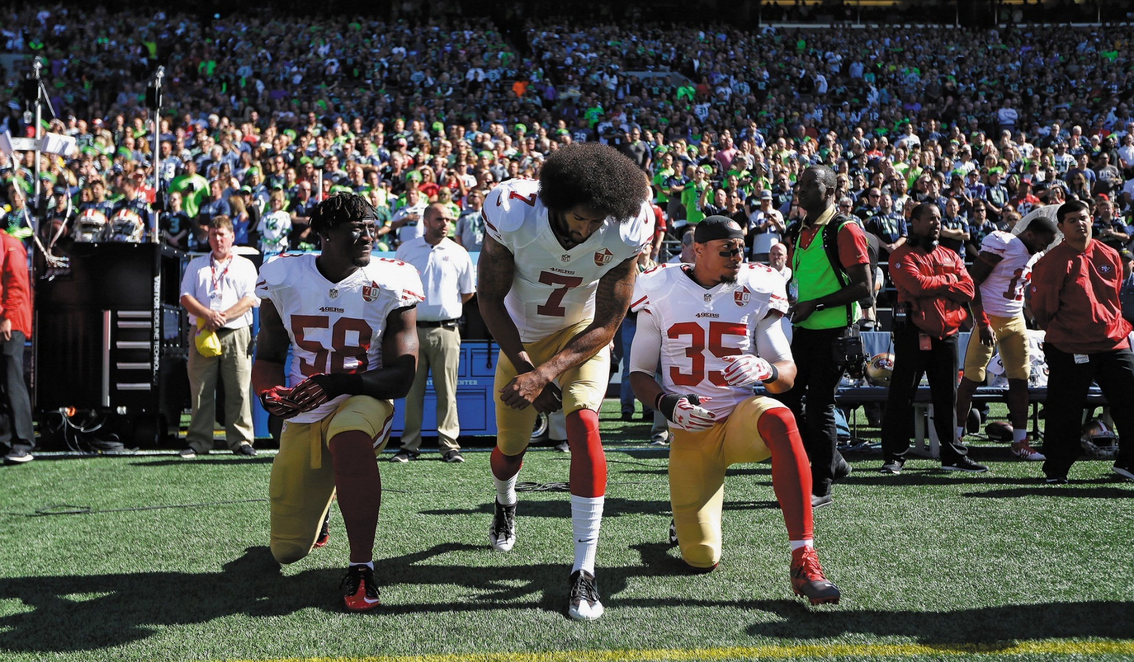
Sociology

Slide 4
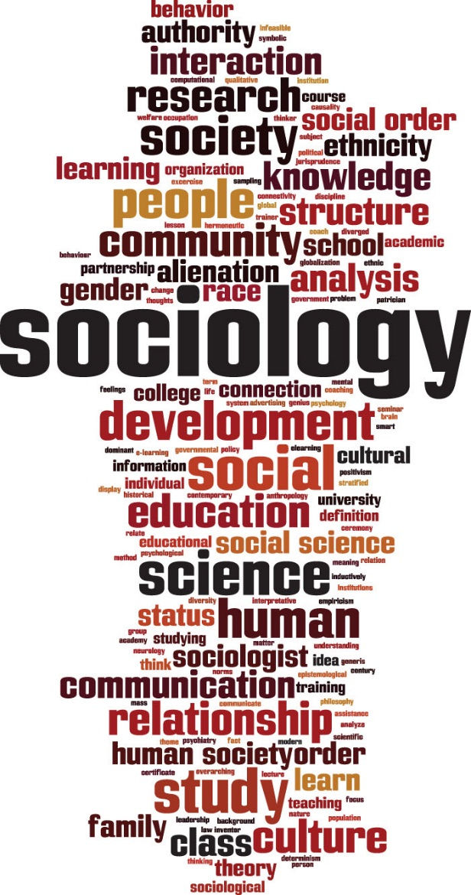
Sociology

Slide 5
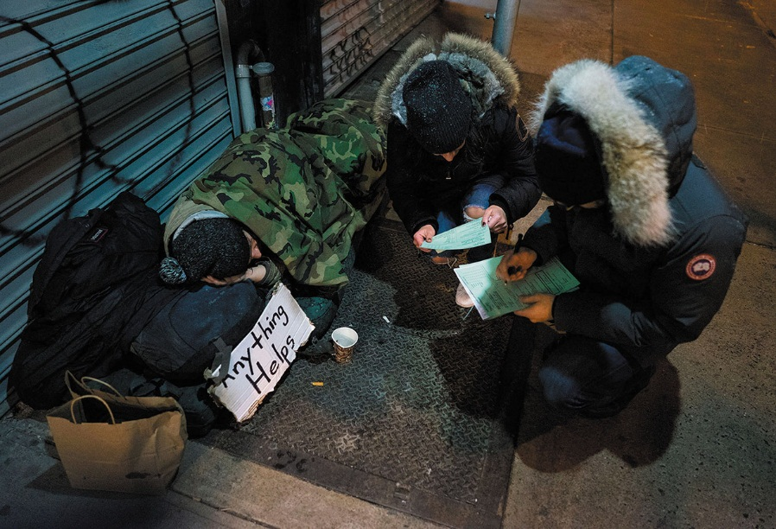
Counting the Homeless in New York City Workers from the Robin Hood Foundation, an organization that helps the poor, speak to a homeless person as they take part in a survey of homeless persons on the streets of New York. Hundreds of people fanned out across the city to conduct the survey just after midnight on February 9, 2016.

Slide 6
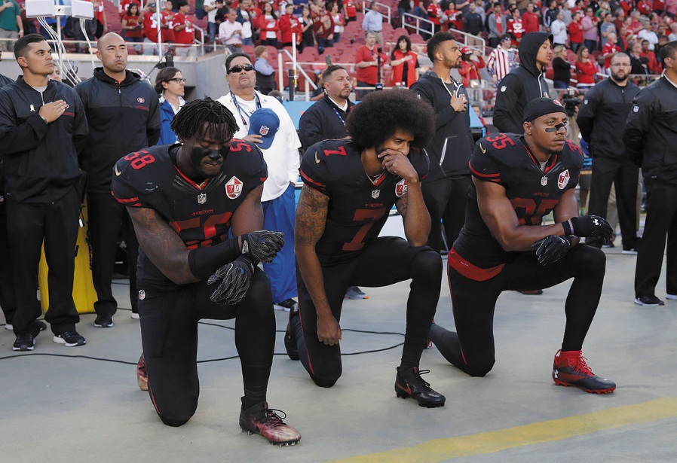
Kaepernick, Reid, and Harold kneel during the National Anthem, October 6, 2016 San Francisco 49ers Eli Harold, Colin Kaepernick, and Eric Reid kneel during the national anthem before the team’s game against the Arizona Cardinals in Santa Clara, California.

Slide 7
Honoring a history of athletes’ protest against racism Tommie Smith, left, and John Carlos pose for a photo at San Jose State University campus on October 17, 2018. The statue honors their iconic, black-gloved protest celebrating the 50th anniversary of their medal ceremonies at the 1968 Olympic Games in Mexico City.

Slide 8
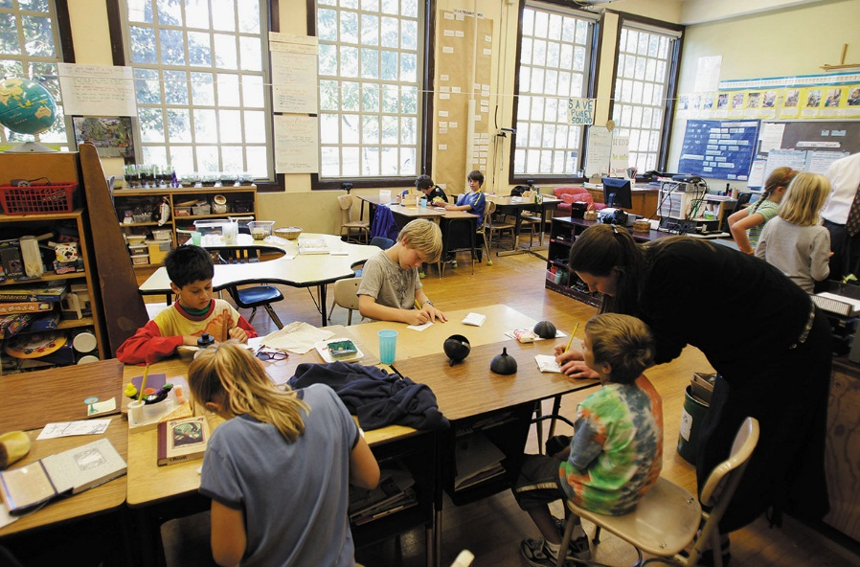
Classroom organization Fourth-grade students in Seattle work on assignments as the teacher helps one child. The children know they are students who are expected to follow directions and sit and do their work when asked by the teacher. The classroom defines roles for both student and teacher behavior.

Slide 9
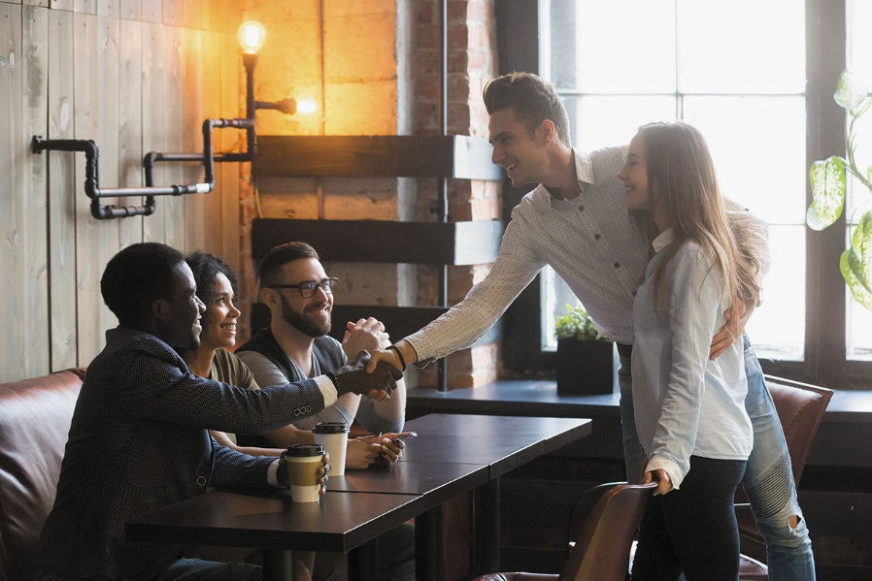
Greeting an acquaintance or introducing a friend When a new person is introduced into an existing group of friends, solidarity is created. Greeting rituals like a handshake provide a patterned format for making the connection.

Slide 10
Women marching in Los Angeles at the #MeToo women’s march, November 12, 2017 The #MeToo march in November 2017 took aim at sexual abuse and misconduct charges within the entertainment industry and other workplaces. In 2017, an estimated half a million women marched in the United States and an estimated 7 million women marched in 60 countries around the world.

Slide 11
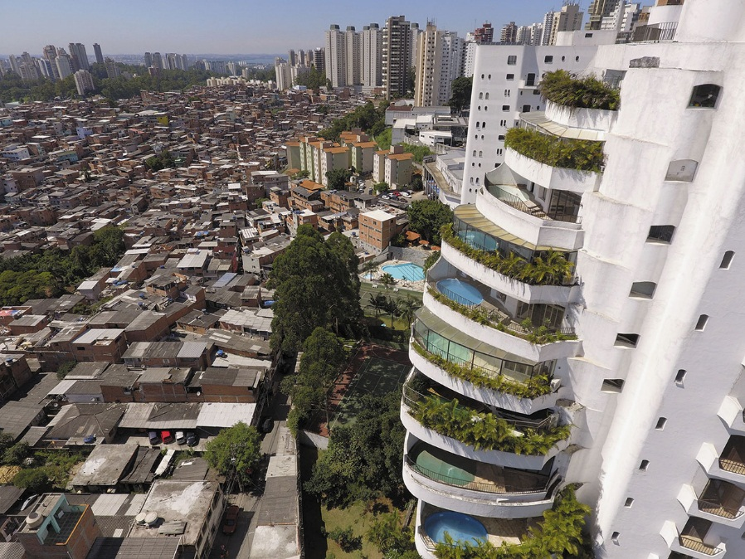
Privilege and inequality While most privileged people can insulate themselves from the poor by living in different neighborhoods and attending different schools, in these luxury buildings in São Paulo, Brazil, residents can see the Paraisópolis favela from the swimming pools on their balconies.

Slide 12
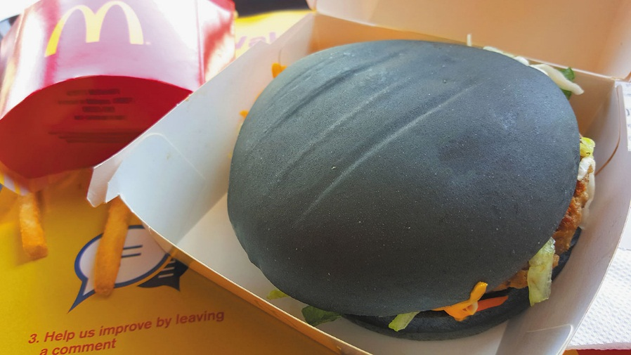
Global and local McDonald’s makes accommodations to local food cultures in different countries. It offers a McFalafel in Egypt, a McArabia in Morocco, a Wasabi Filet-o-Fish in Hong Kong, and a Nasi Lemak burger in Malaysia. This McDonald’s Spicy Korean Burger, sold in Malaysia, is a burger with kimchi on charcoal buns in place of the classic sesame seed-sprinkled buns.

Slide 13
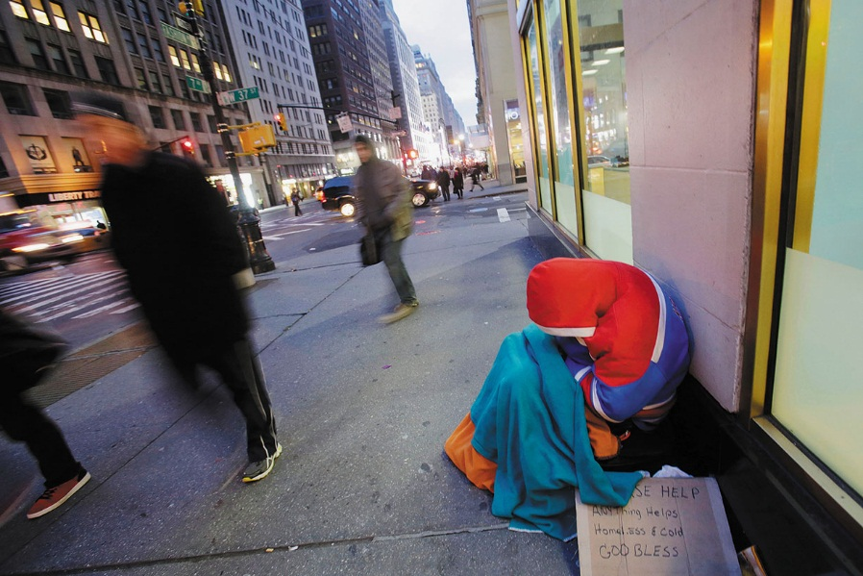
Structure and Contingency Economic downturn, ill health, family dysfunction, and natural disaster are all events that can affect people’s ability to find shelter. The lack of social resources and social care for people affected by such contingencies results in homelessness, with people sleeping on the sidewalk in very cold weather.

