Slide 1
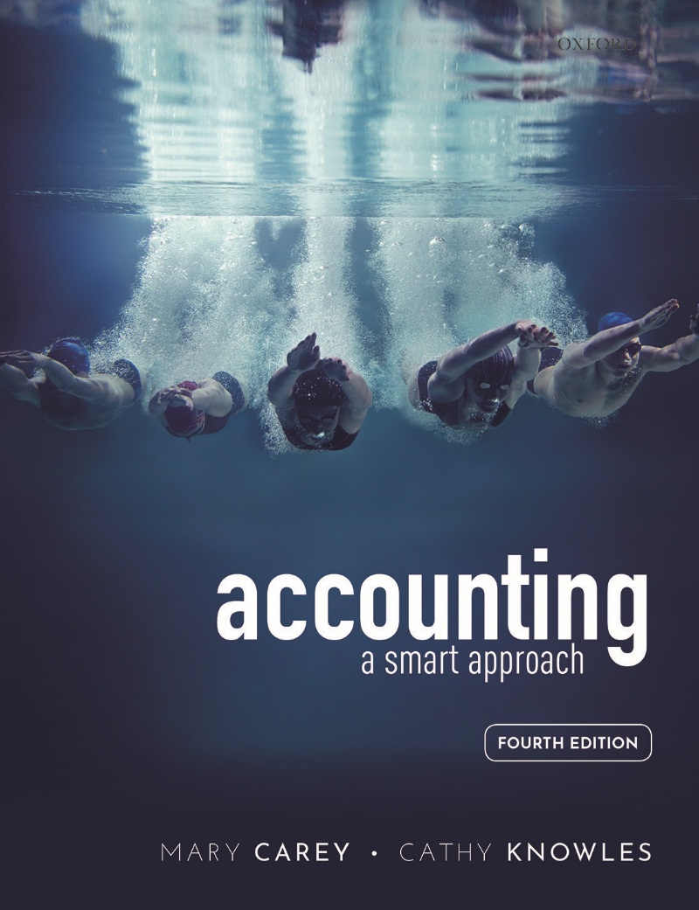
Accounting by Mary Carey and Cathy Knowles

Slide 2
Part II
Management Accounting
Chapter 11
Absorption and Activity-Based Costing

Slide 3


Slide 4
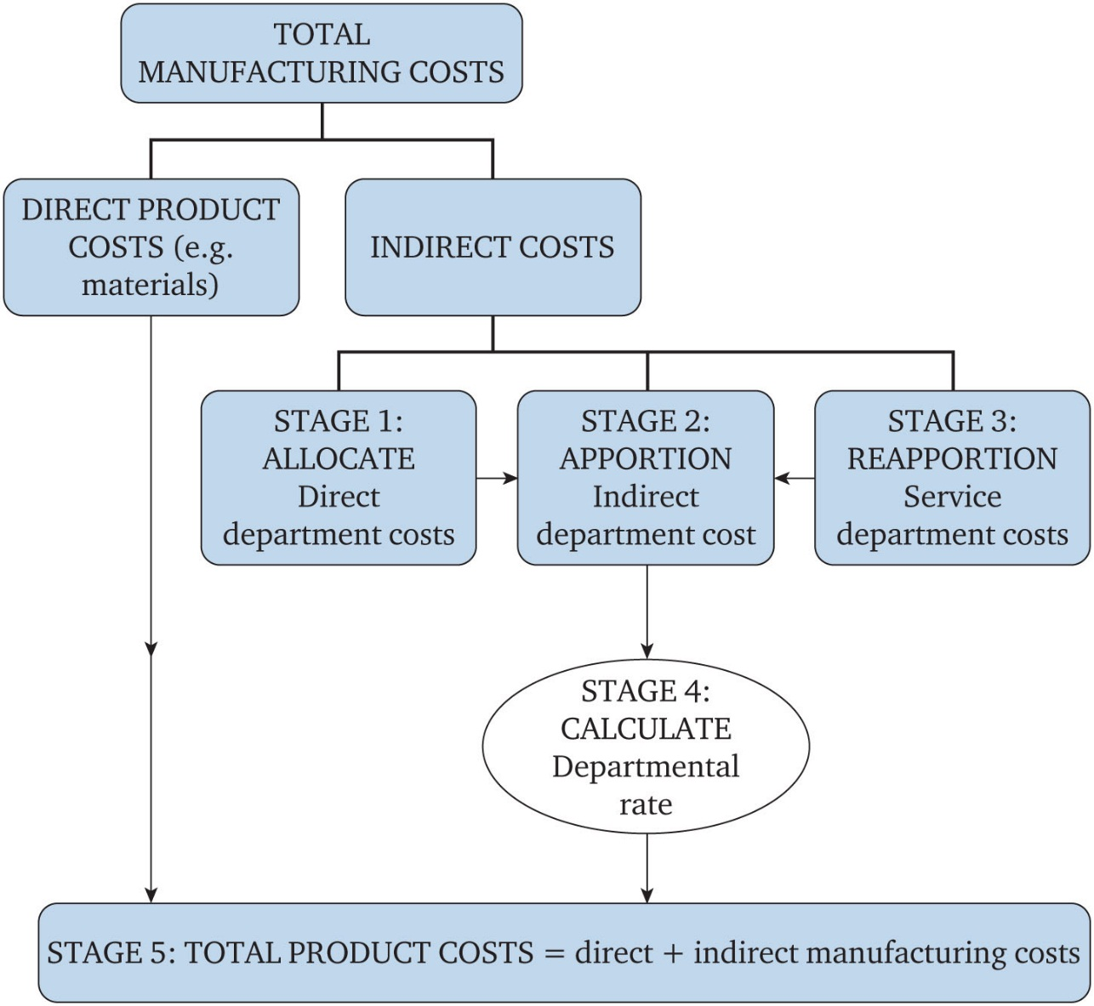
Figure 11.1 Calculating a departmental rate

Slide 5
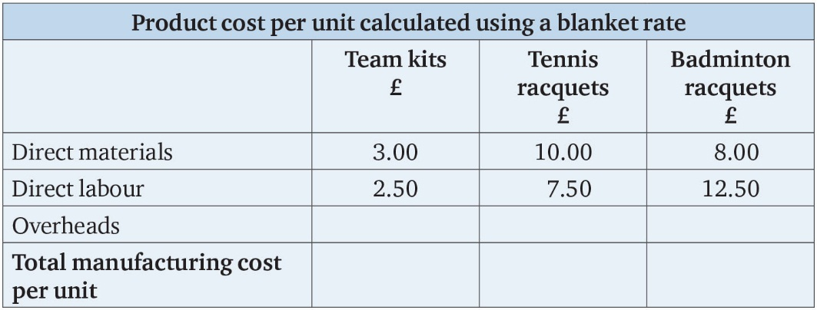
Table 11.1

Slide 6
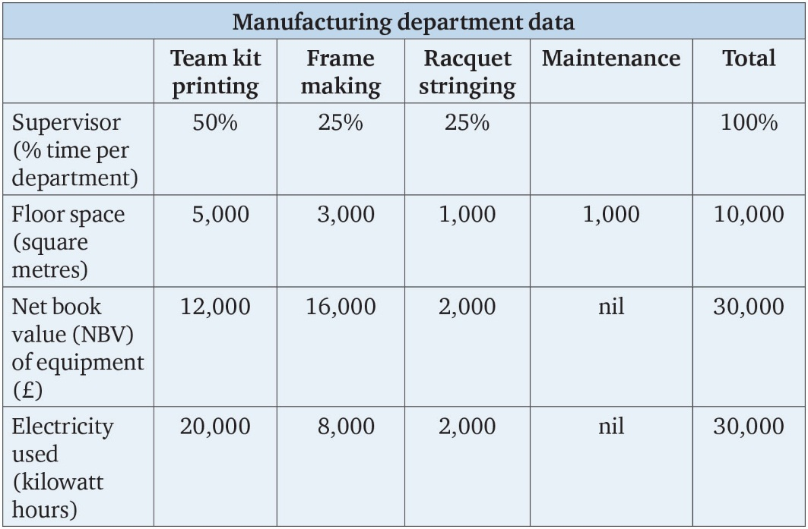
Table 11.2

Slide 7
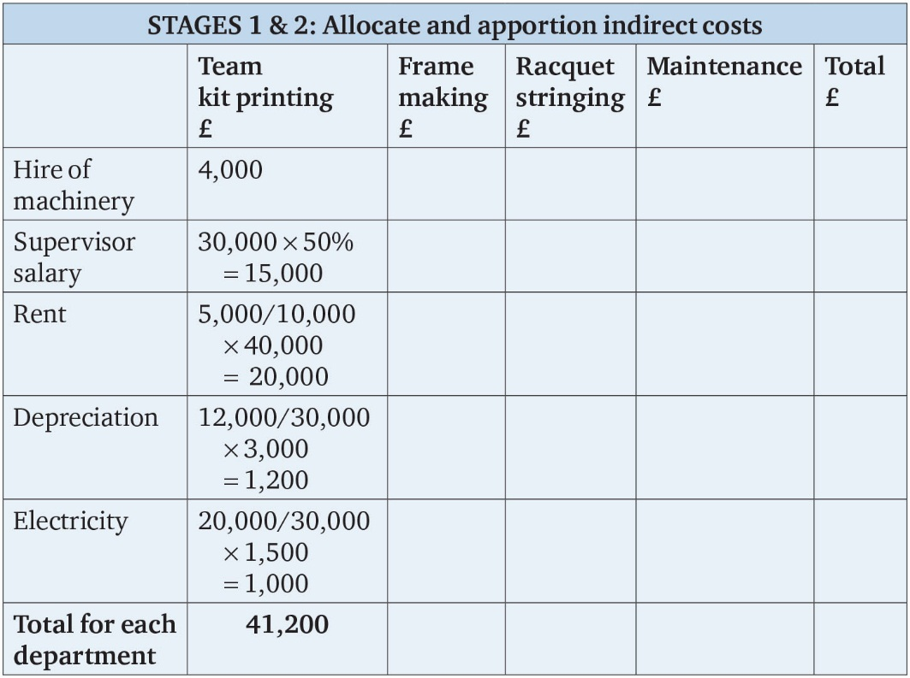
Table 11.3

Slide 8
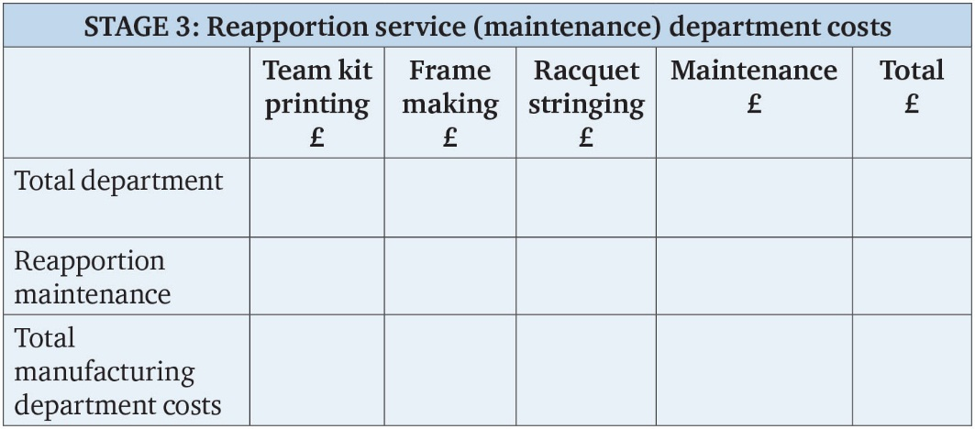
Table 11.4

Slide 9
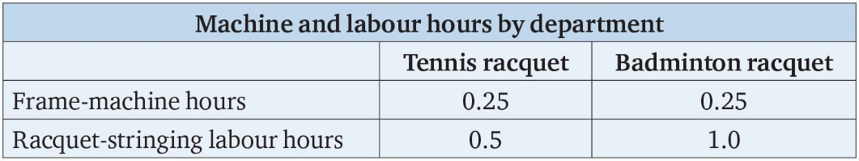
Table 11.5

Slide 10
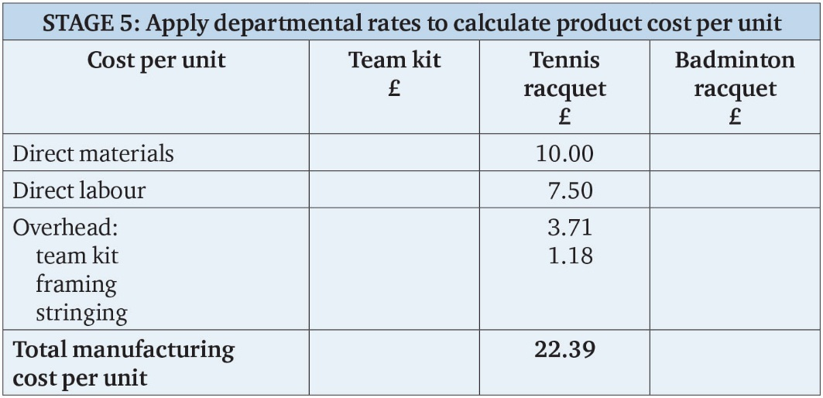
Table 11.6

Slide 11
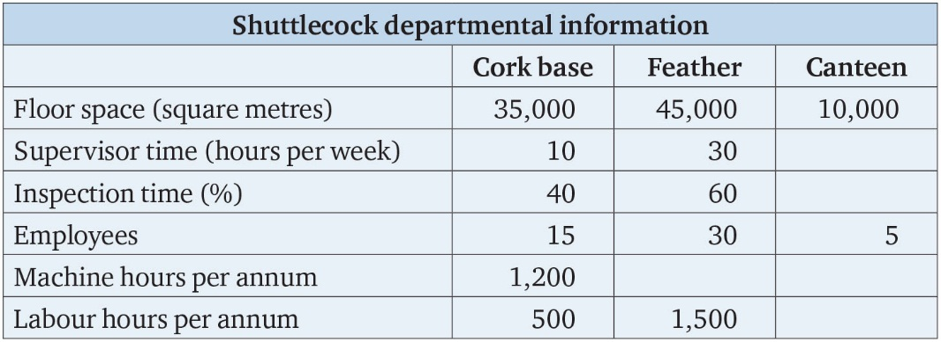
Table 11.7

Slide 12
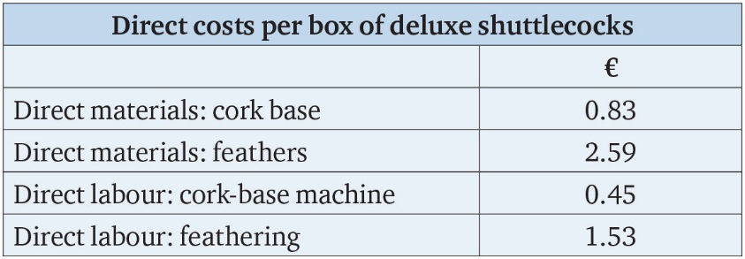
Table 11.8

Slide 13
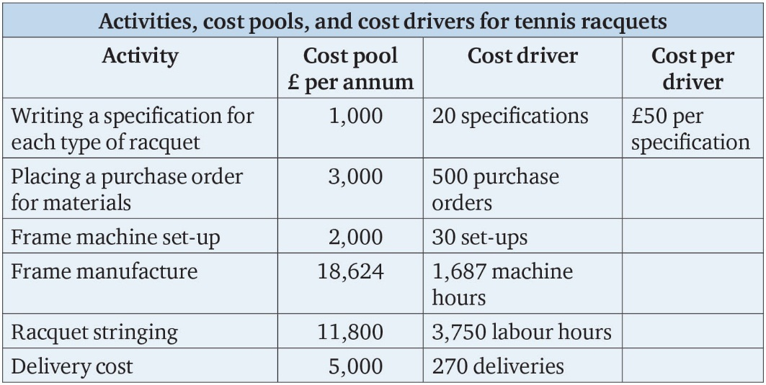
Table 11.9

Slide 14
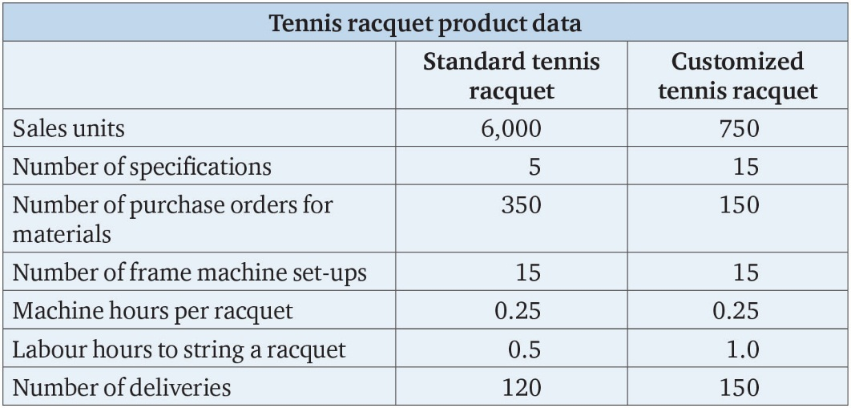
Table 11.10

Slide 15
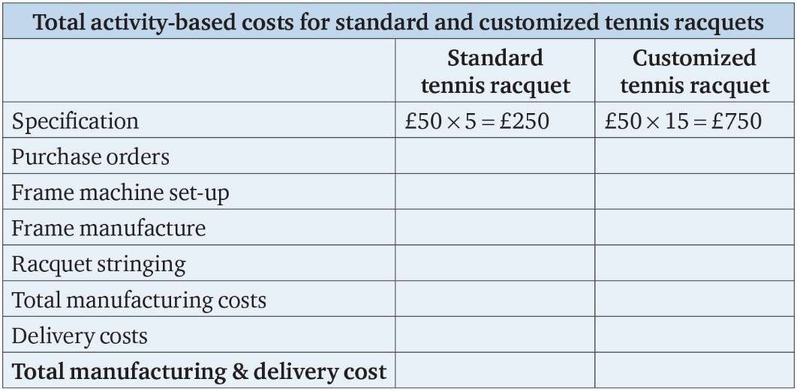
Table 11.11

Slide 16
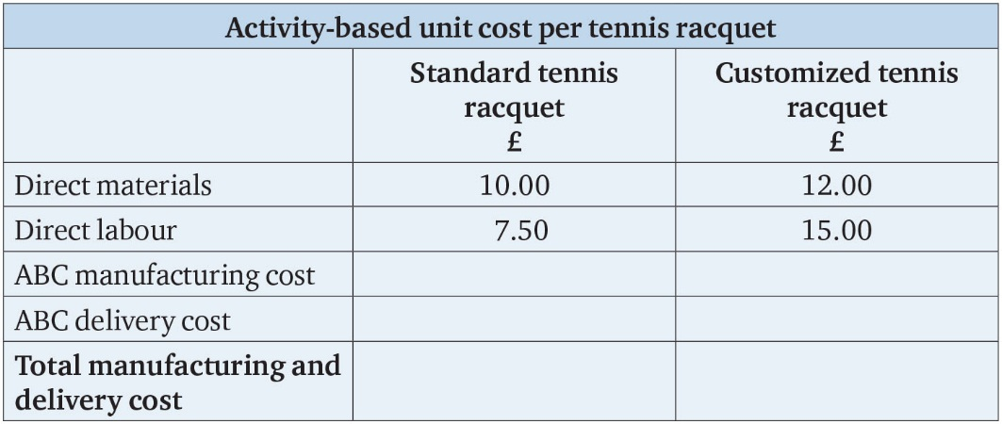
Table 11.12

Slide 17
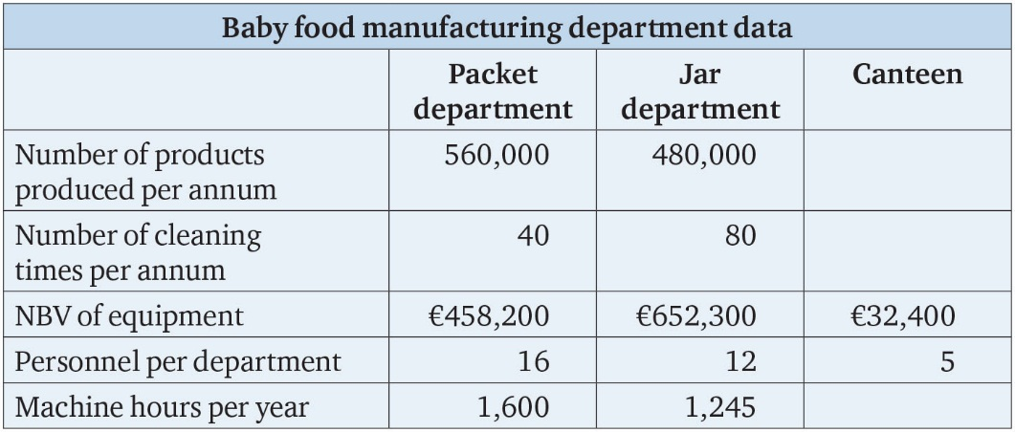
Table 11.13

