Slide 1
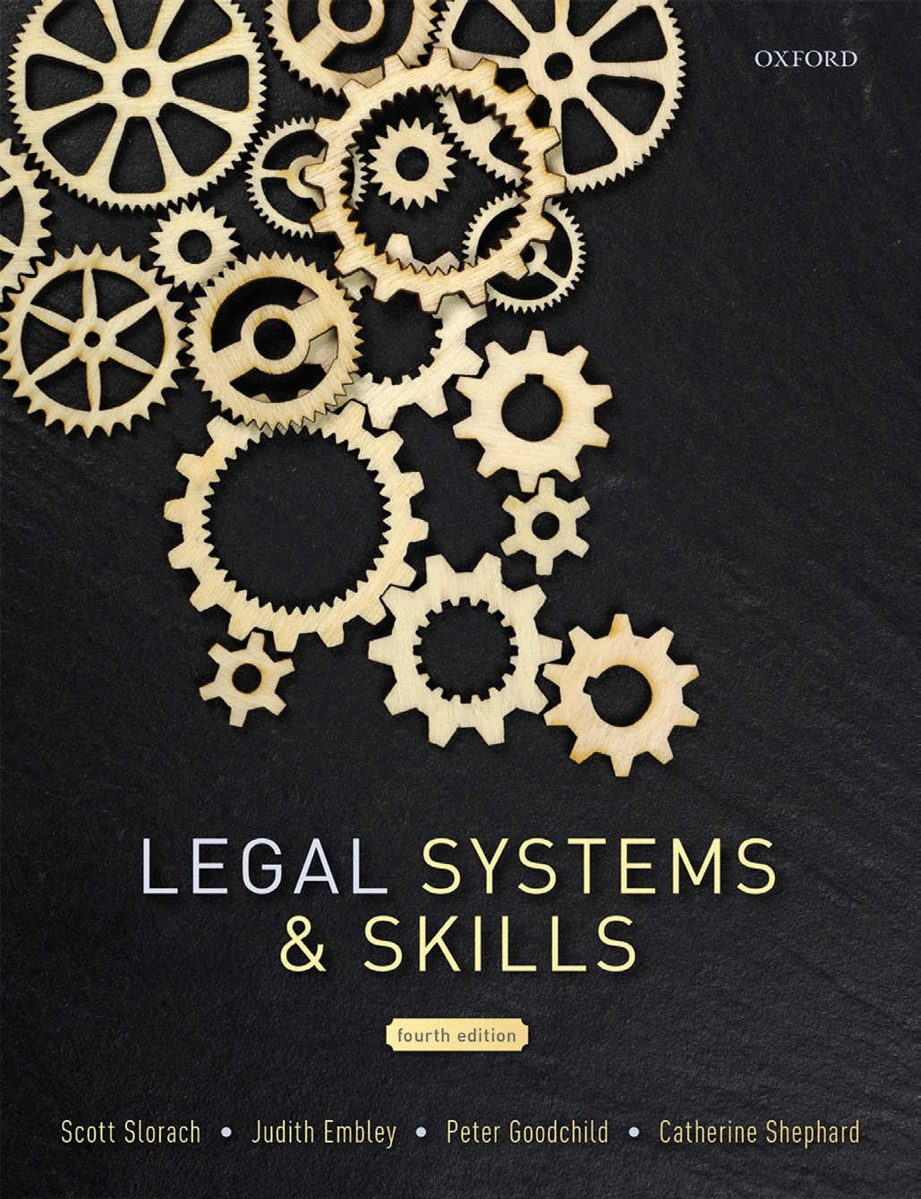
Legal Systems & Skills
by Scott Slorach, Judith Embley, Peter Goodchild and Catherine Shephard

Slide 2
Part 1
Legal Systems
Chapter 04
Legislation

Slide 3
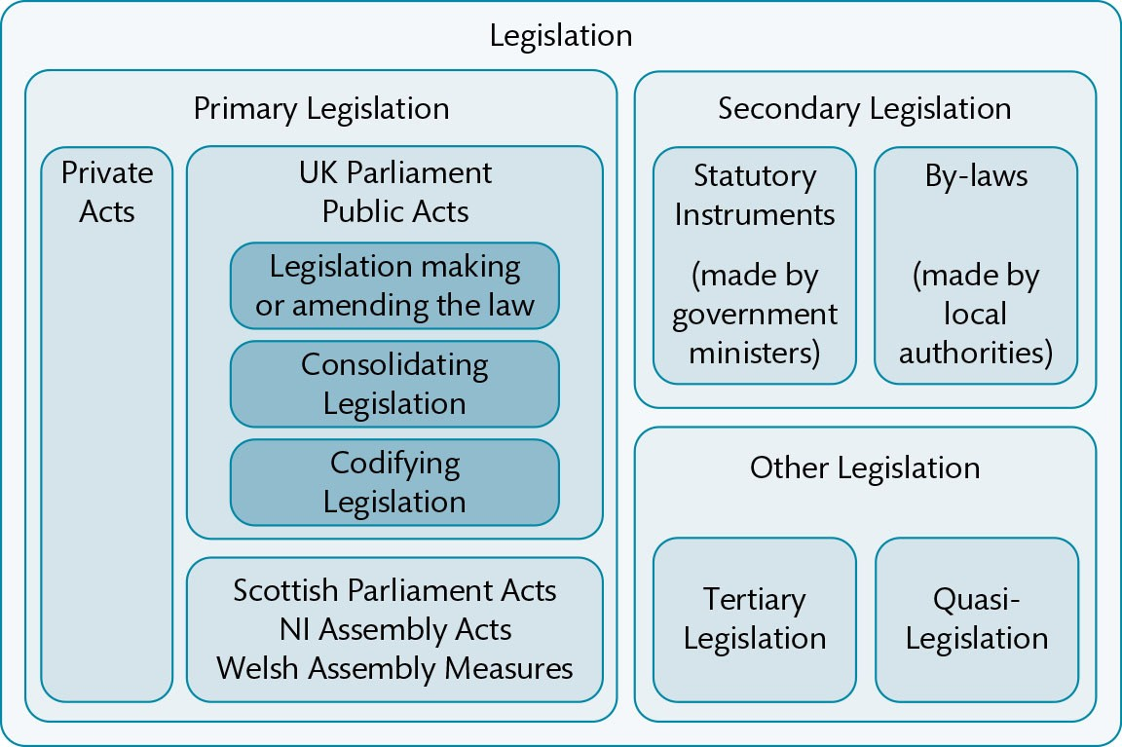
Figure 4.1 Types of legislation in the UK

Slide 4
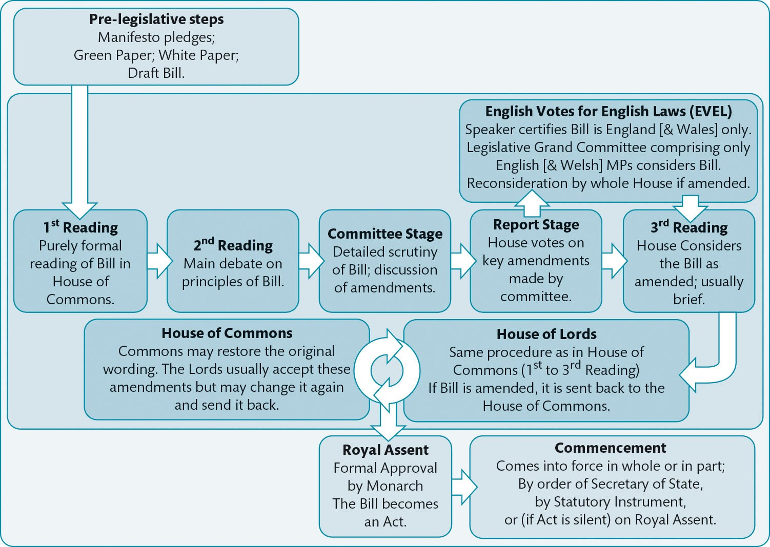
Figure 4.2 Creation of a statute

Slide 5
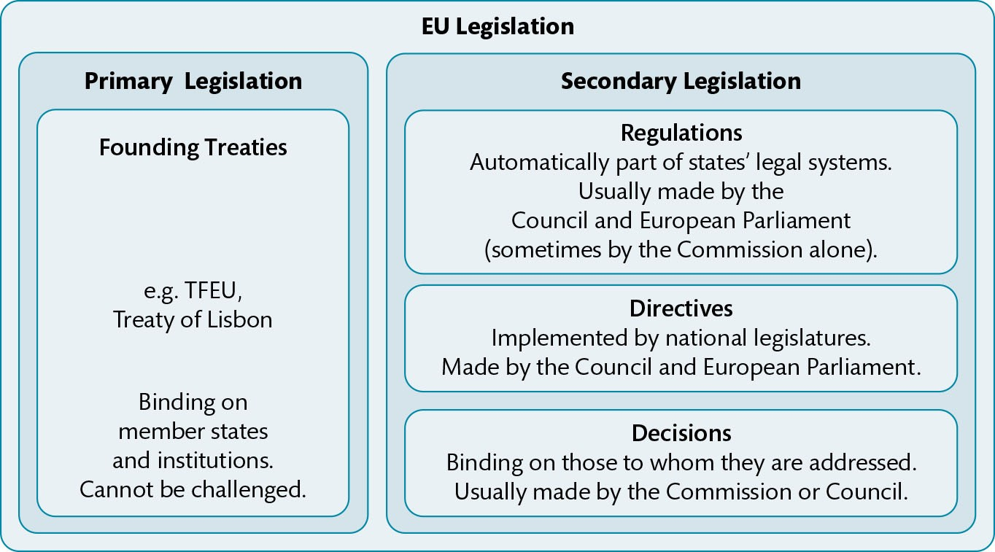
Figure 4.3 Binding EU legislation

Slide 6
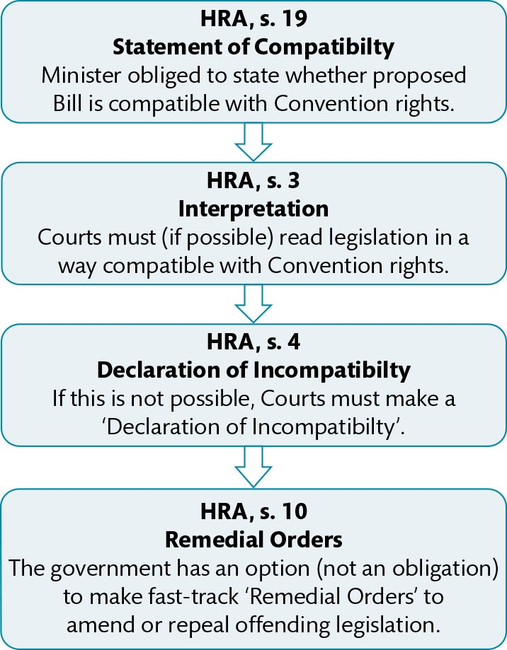
Figure 4.4 HRA process in relation to statutes

Slide 7
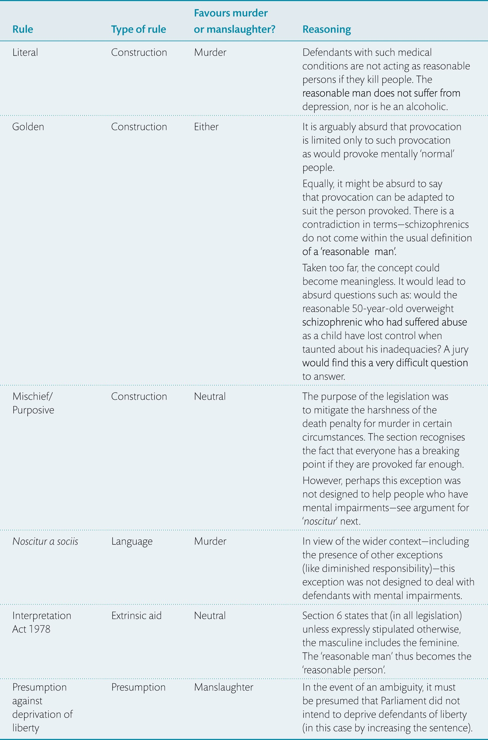
Table 4.1 Use of statutory interpretation: Homicide Act 1957, s. 3

Slide 8
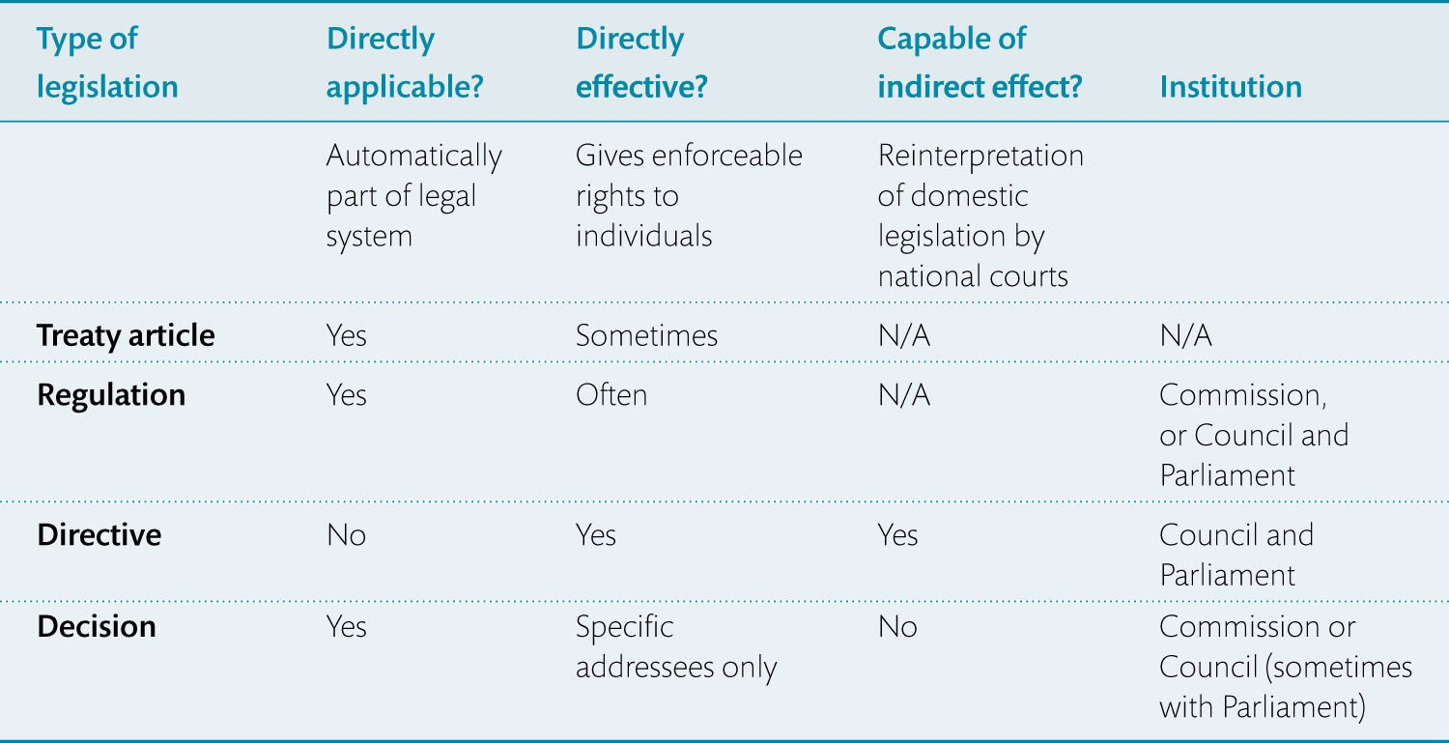
Table 4.2 Summary of EU legislation

Slide 9
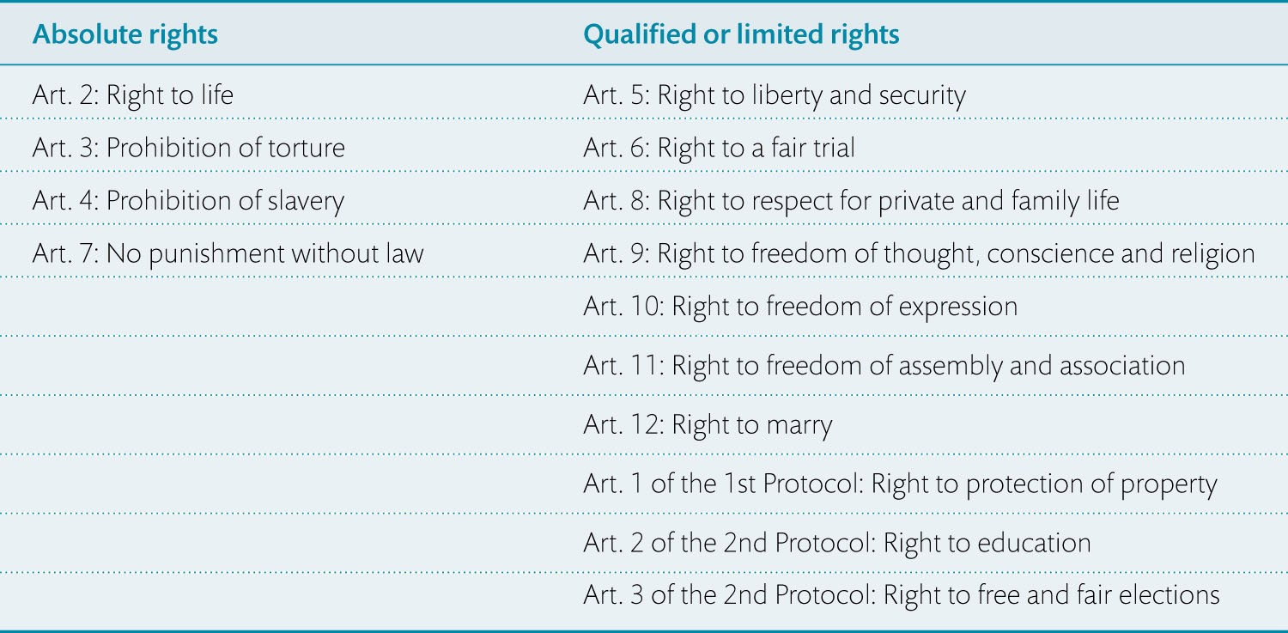
Table 4.3 The Convention rights

