Slide 1
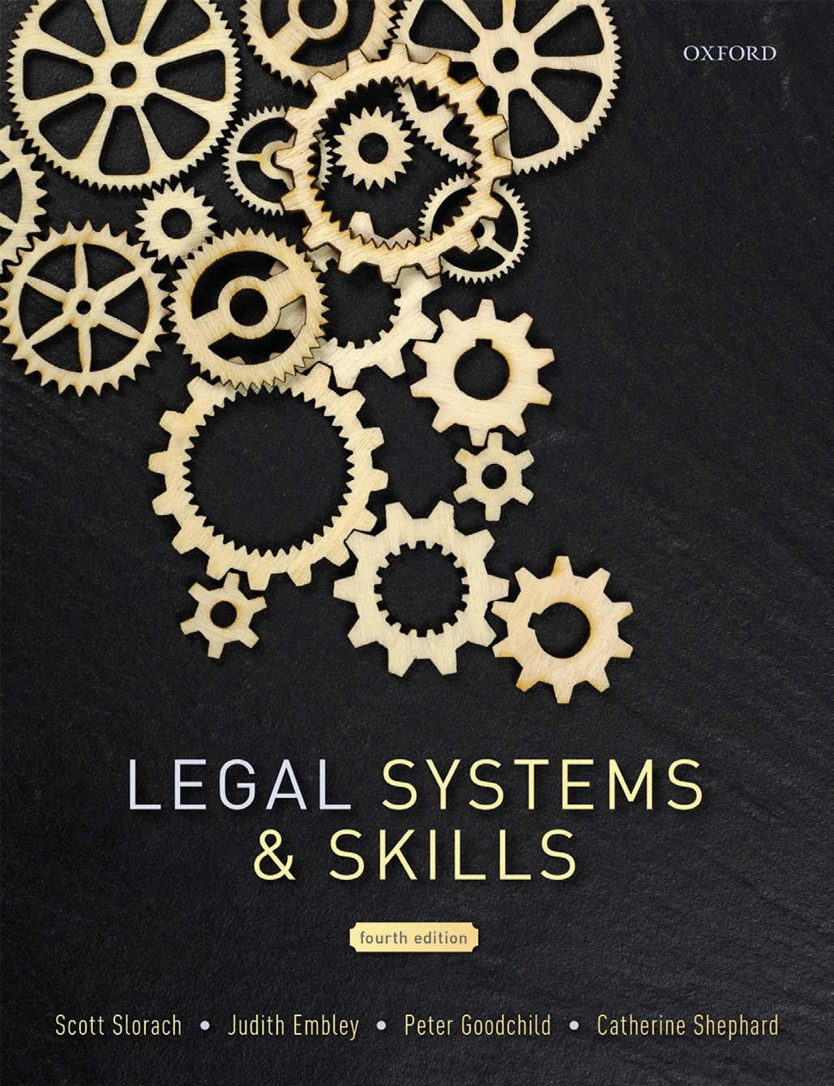
Legal Systems & Skills
by Scott Slorach, Judith Embley, Peter Goodchild and Catherine Shephard

Slide 2
Part 3
Employability and Commercial Awareness
Chapter 18
Businesses and the business environment

Slide 3
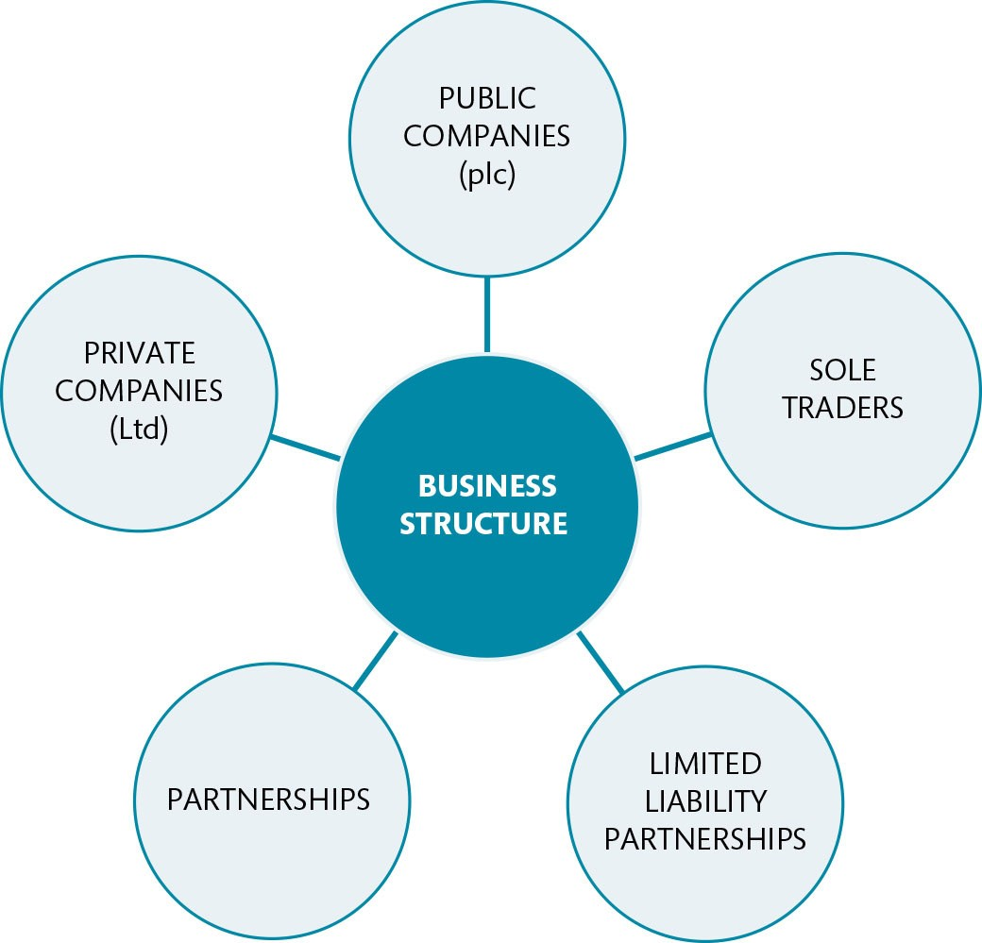
Figure 18.1 Types of business structure

Slide 4
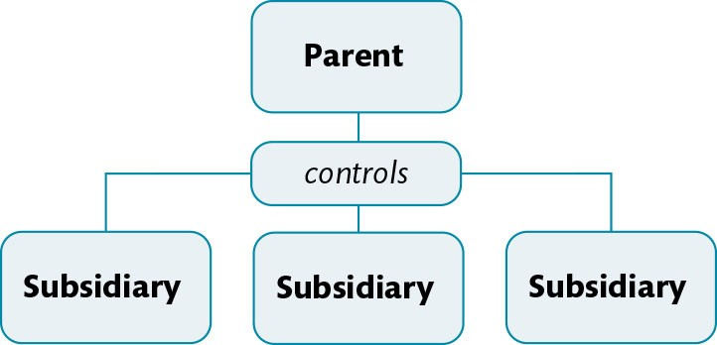
Figure 18.2 A group of companies

Slide 5
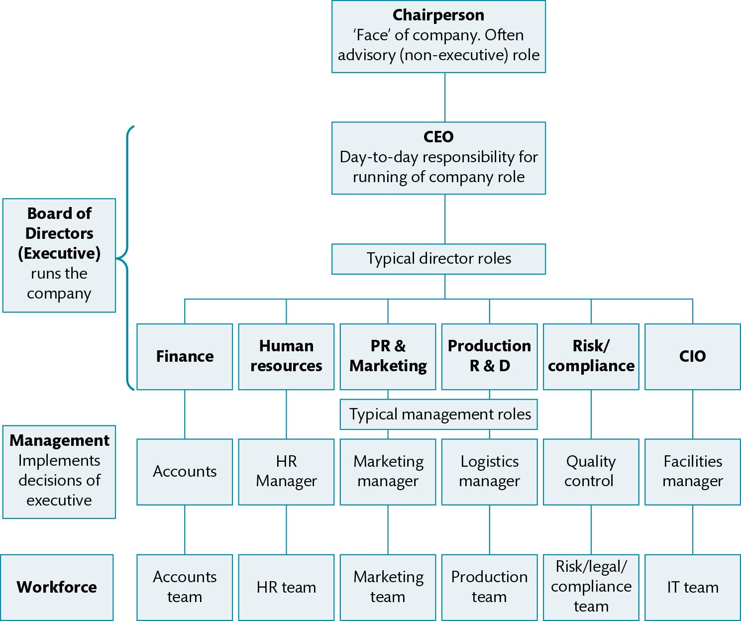
Figure 18.3 Management structure of a public company

Slide 6
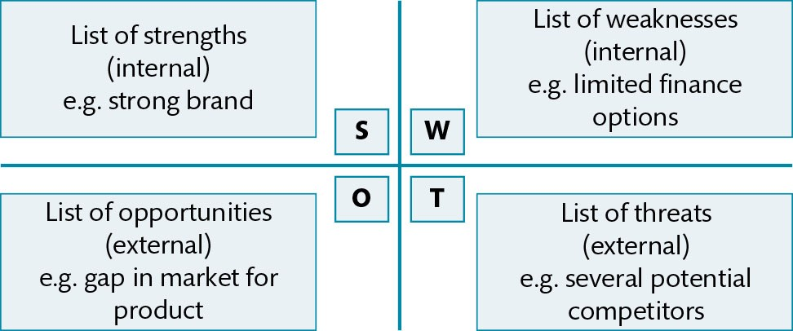
Figure 18.4 SWOT analysis grid

Slide 7
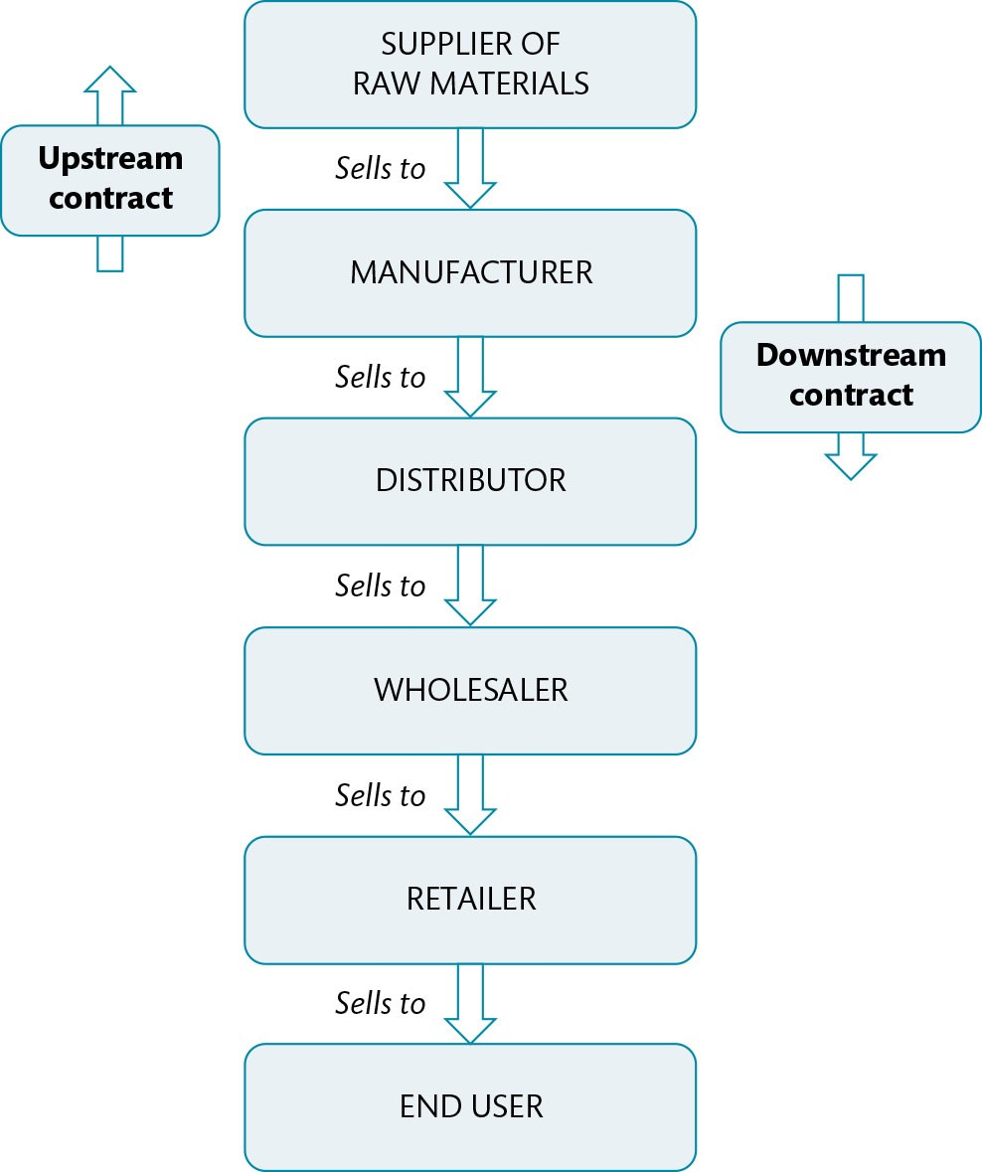
Figure 18.5 A simple supply chain

Slide 8
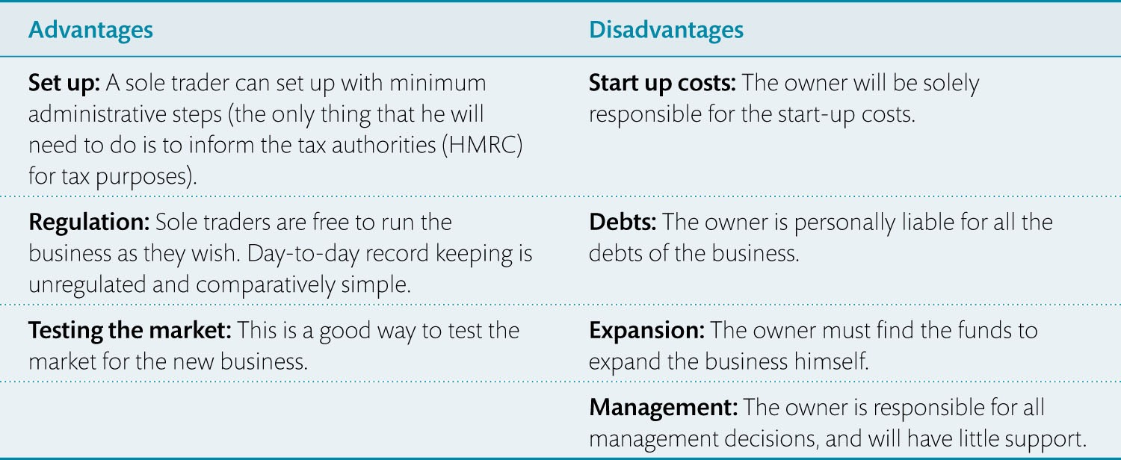
Table 18.1 Advantages and disadvantages for sole traders

Slide 9
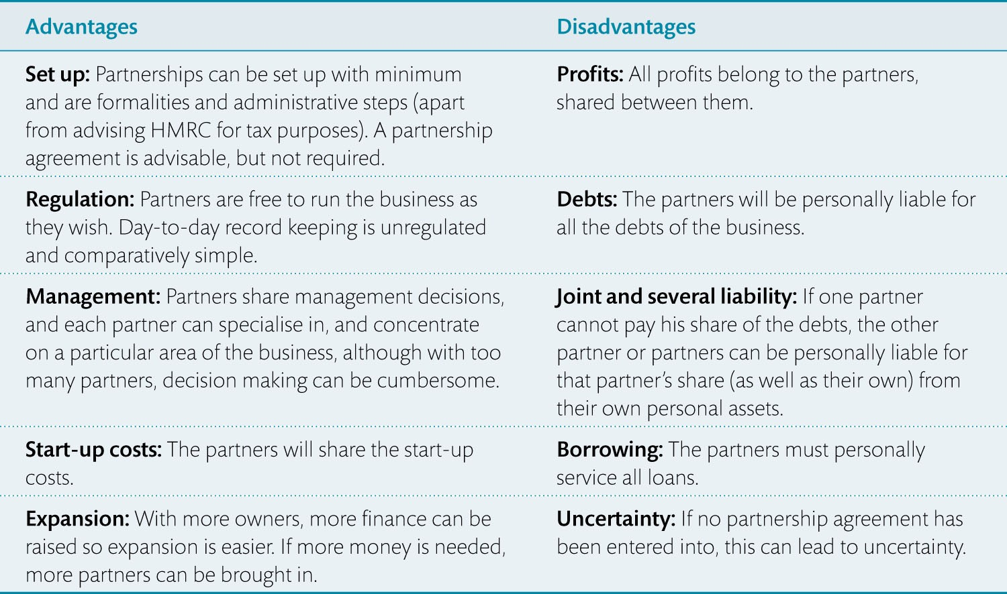
Table 18.2 Advantages and disadvantages of partnerships

Slide 10
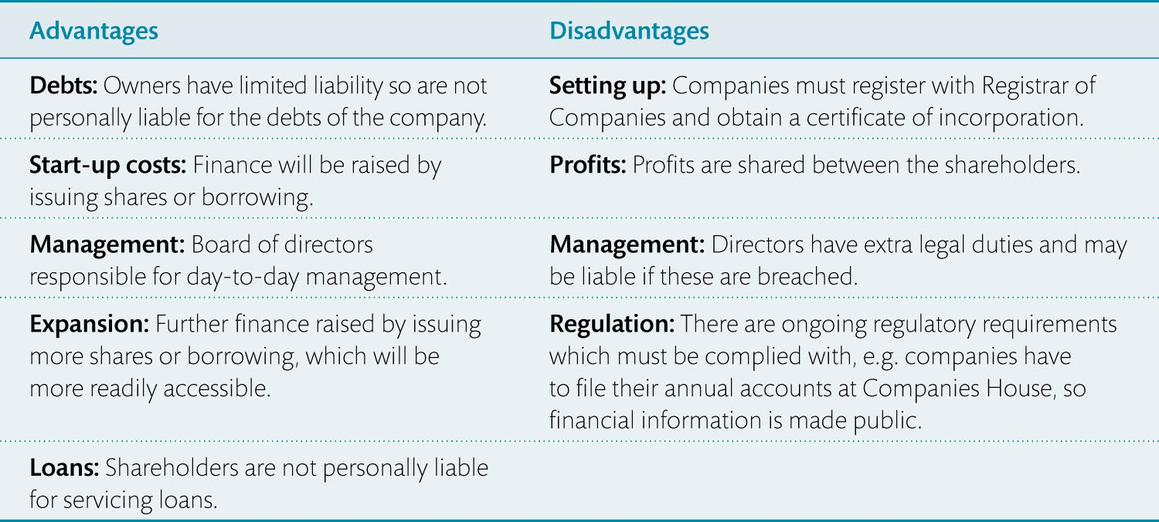
Table 18.3 Advantages and disadvantages of setting up a company

