Slide 1

Legal Systems & Skills
by Scott Slorach, Judith Embley, Peter Goodchild and Catherine Shephard

Slide 2
Part 3
Employability and Commercial Awareness
Chapter 20
Law firms as businesses

Slide 3
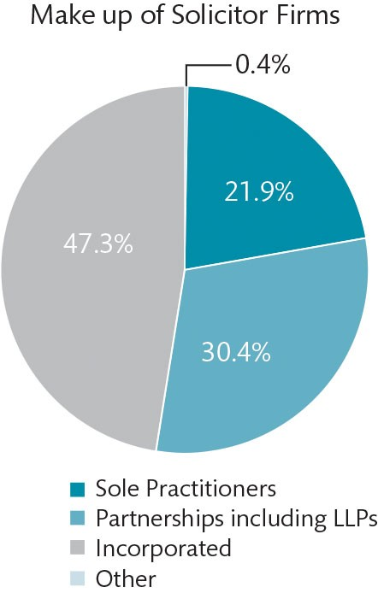
Figure 20.1 Make-up of law firms

Slide 4
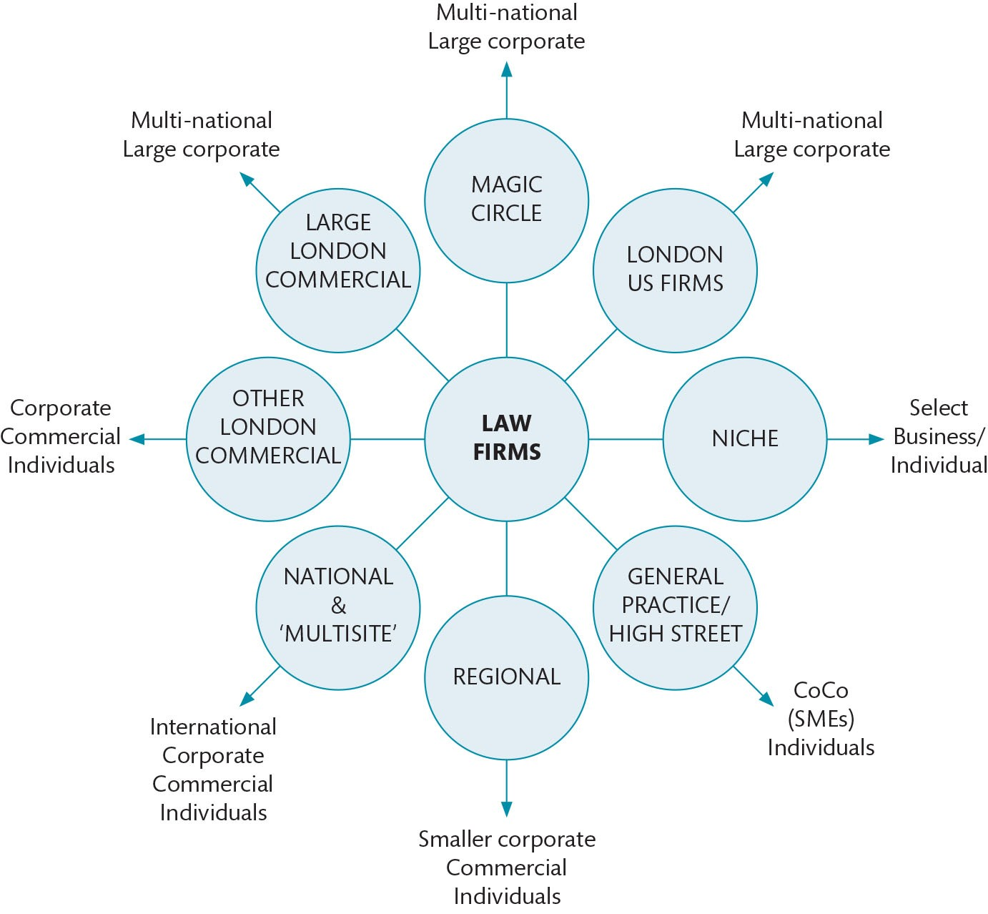
Figure 20.2 Law firms and their clients

Slide 5
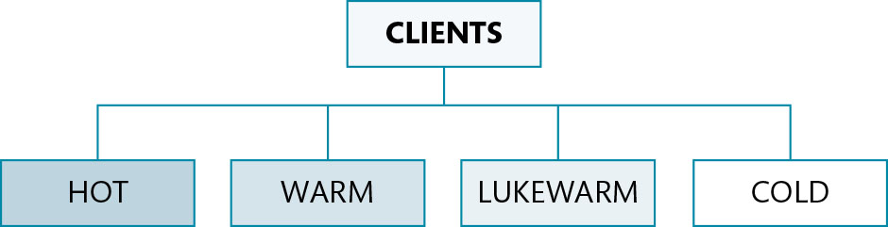
Figure 20.3 Client retention: categories of client

