Slide 1
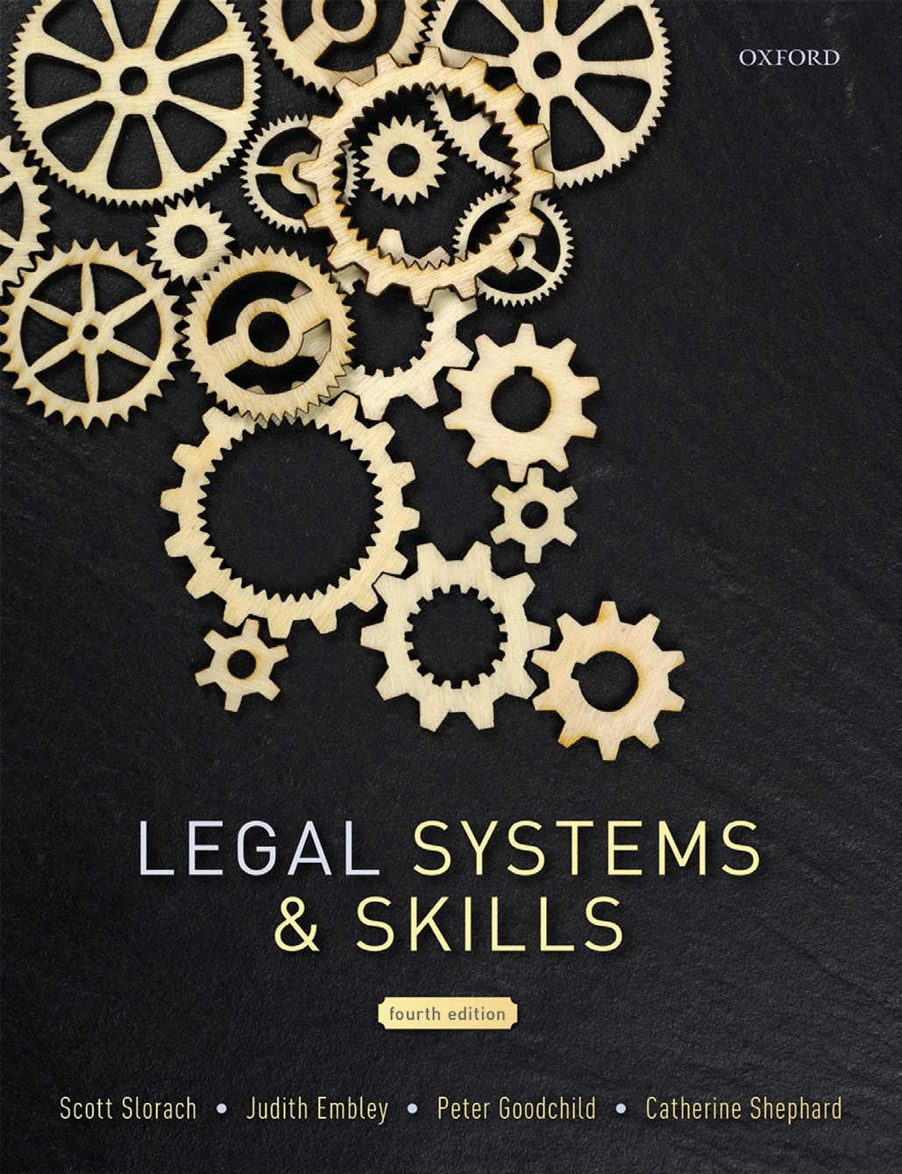
Legal Systems & Skills
by Scott Slorach, Judith Embley, Peter Goodchild and Catherine Shephard

Slide 2
Part 2
Legal Skills
Chapter 08
Research

Slide 3
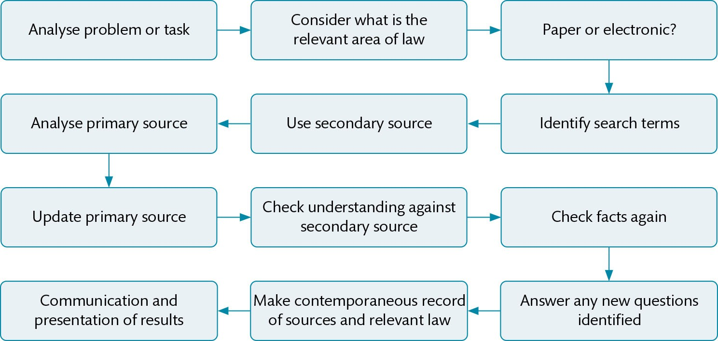
Figure 8.1 Legal research strategy

Slide 4
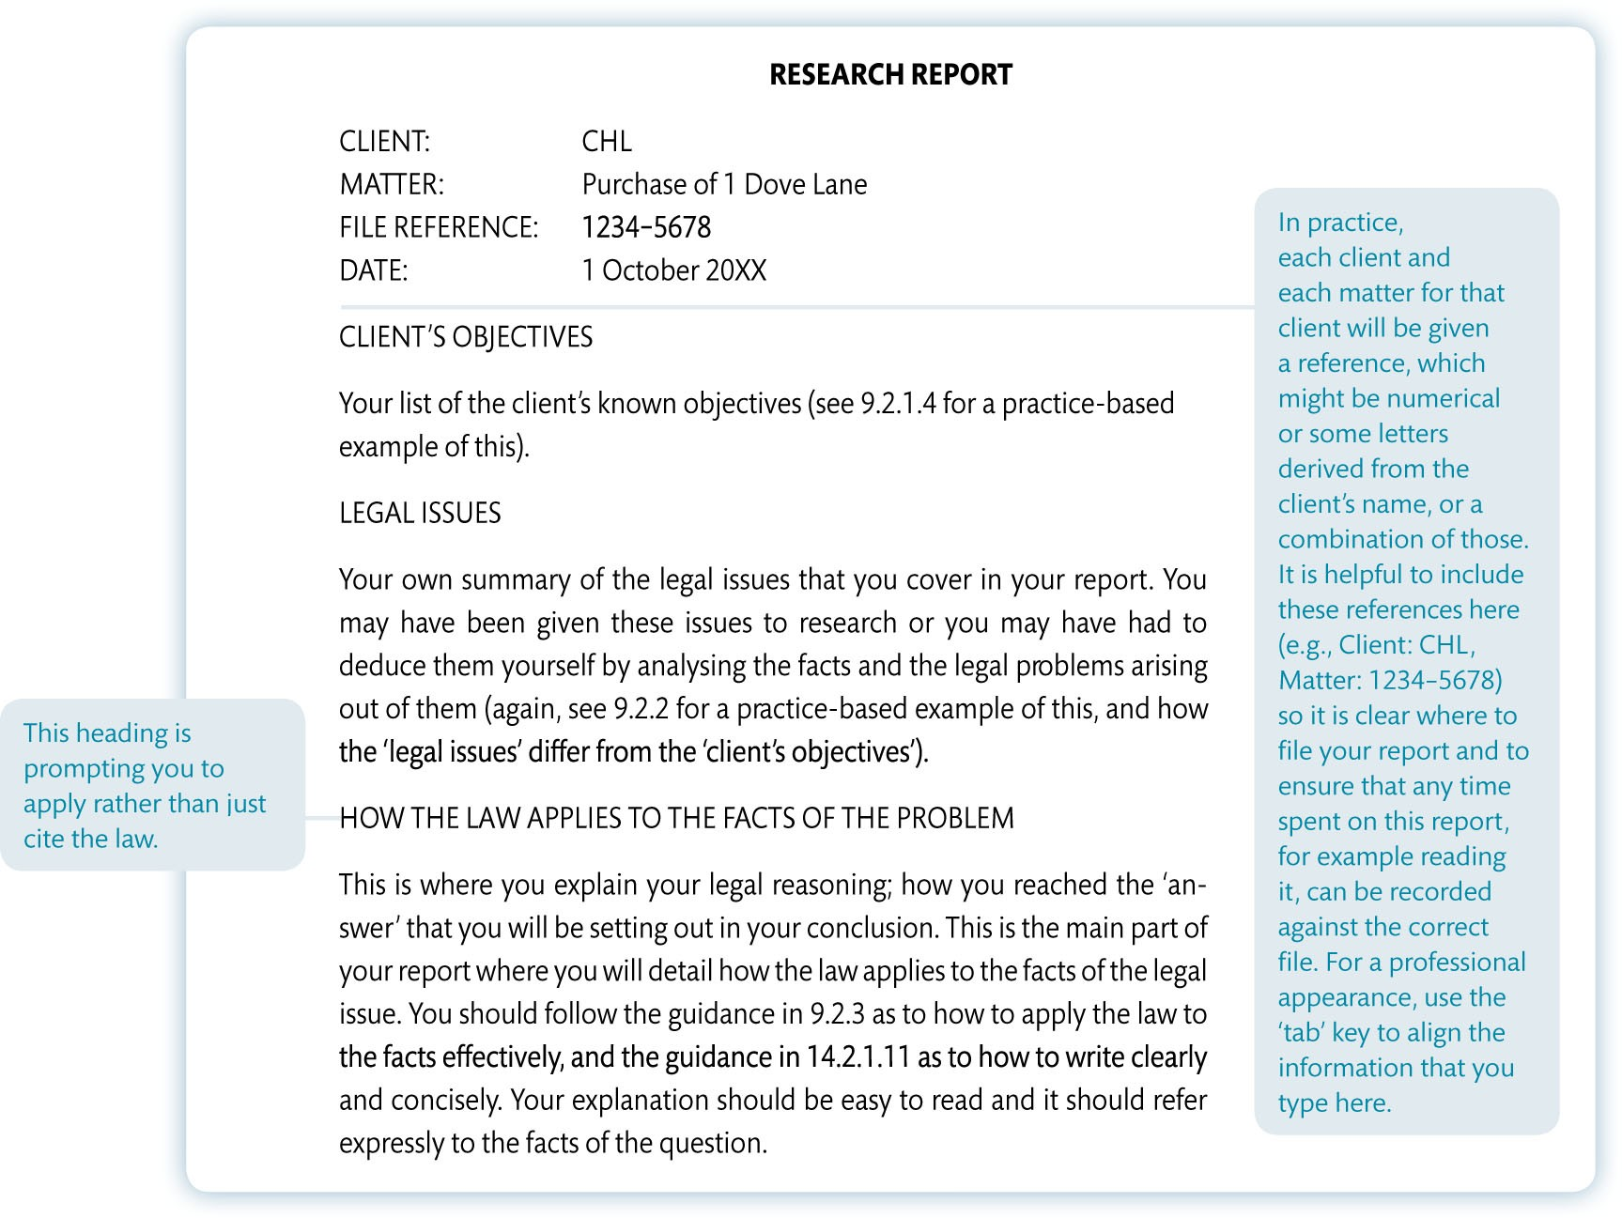
Figure 8.2 Legal research report template

Slide 5
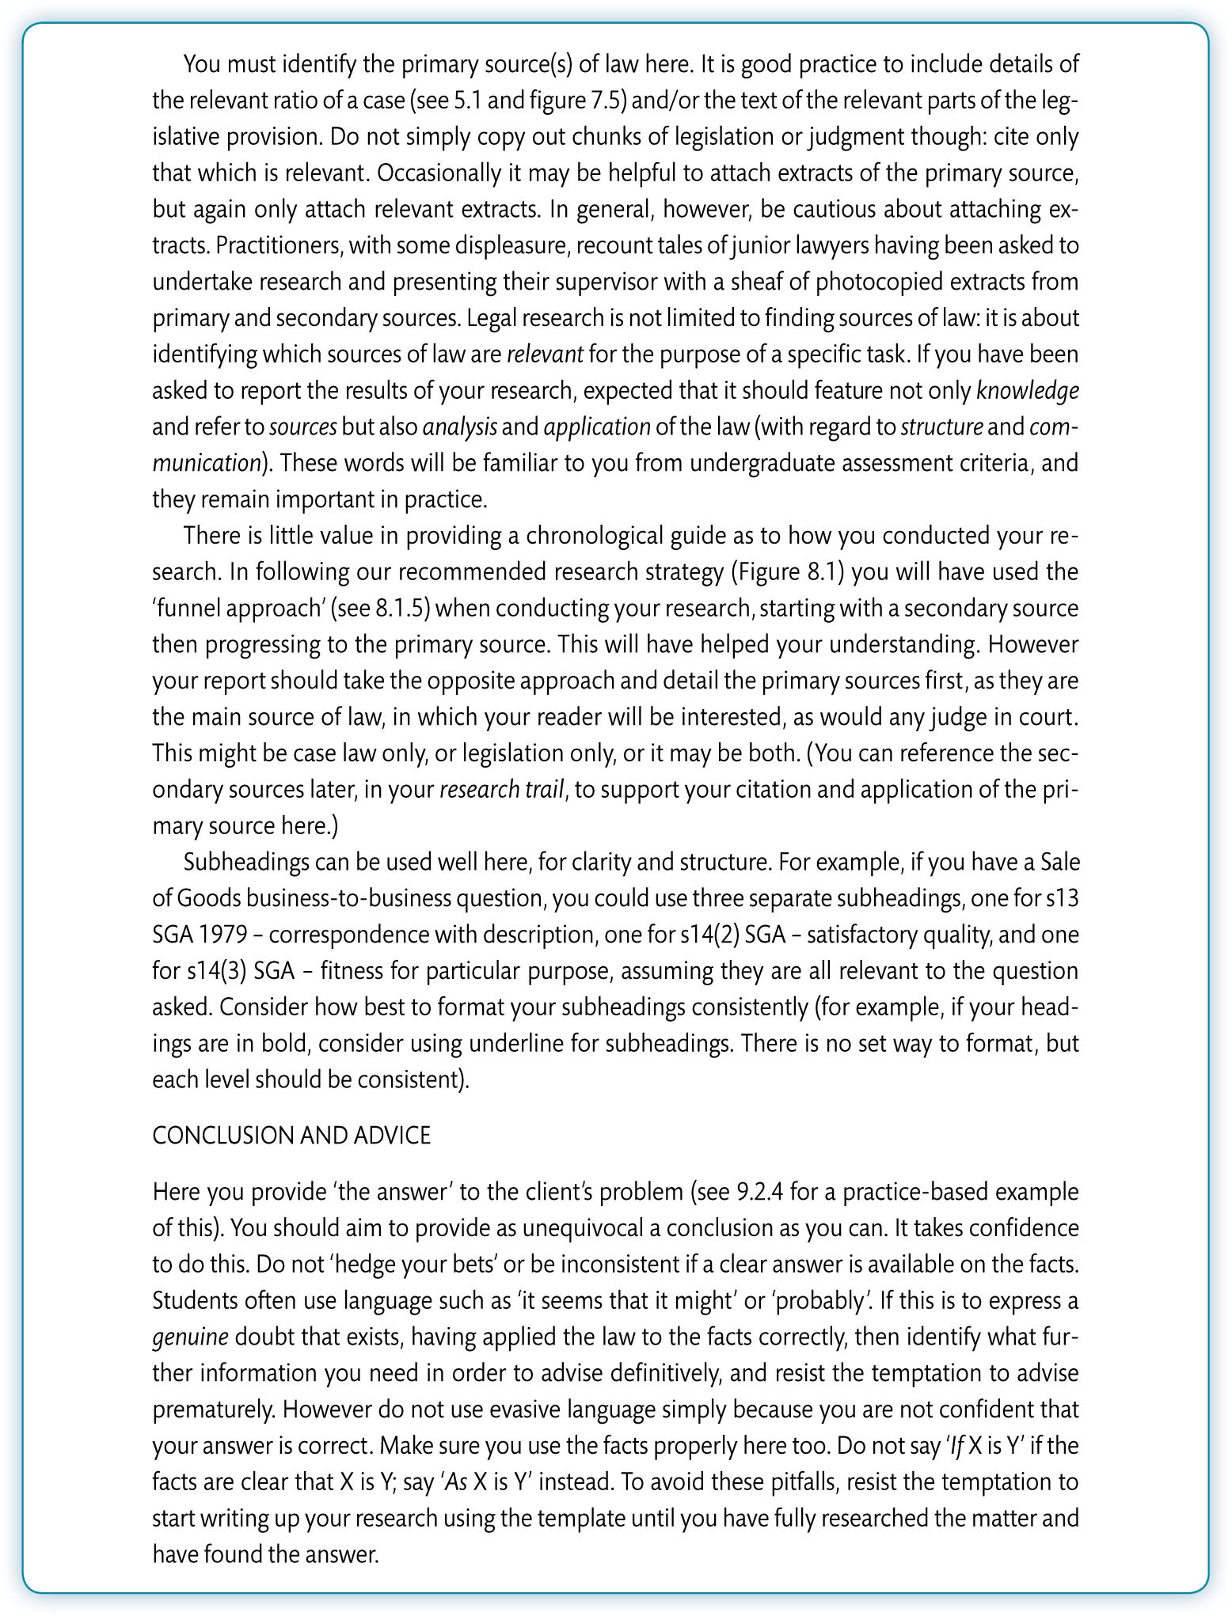
Figure 8.2 (Continued)

Slide 6
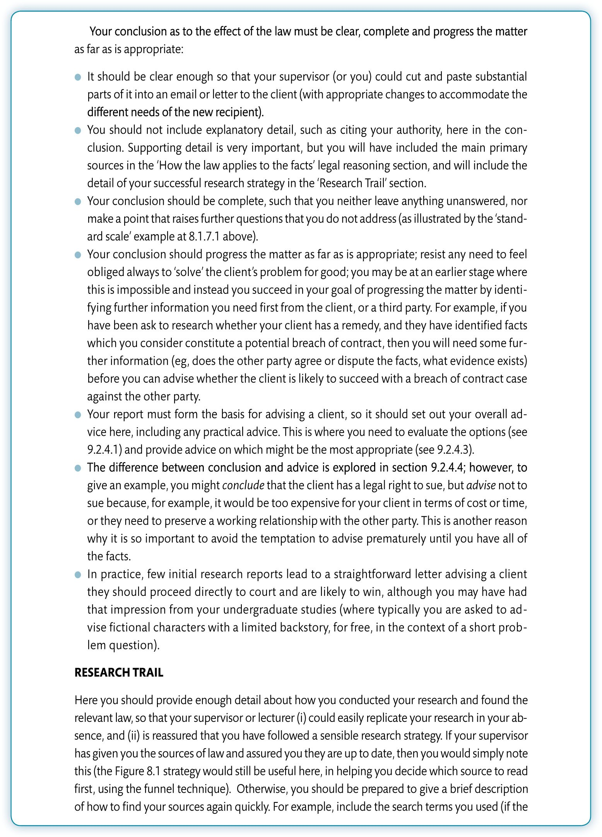
Figure 8.2 (Continued)

Slide 7
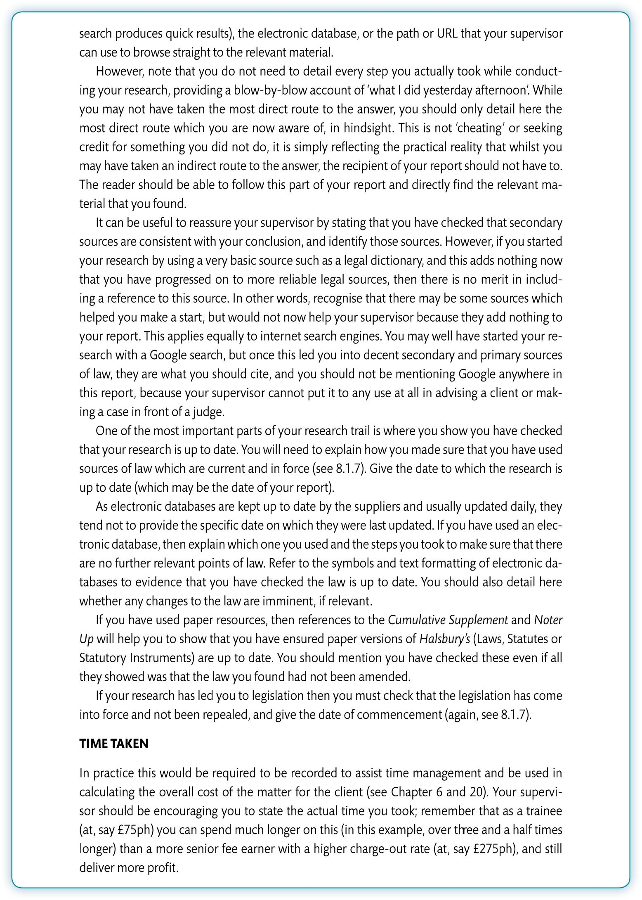
Figure 8.2 (Continued)

Slide 8
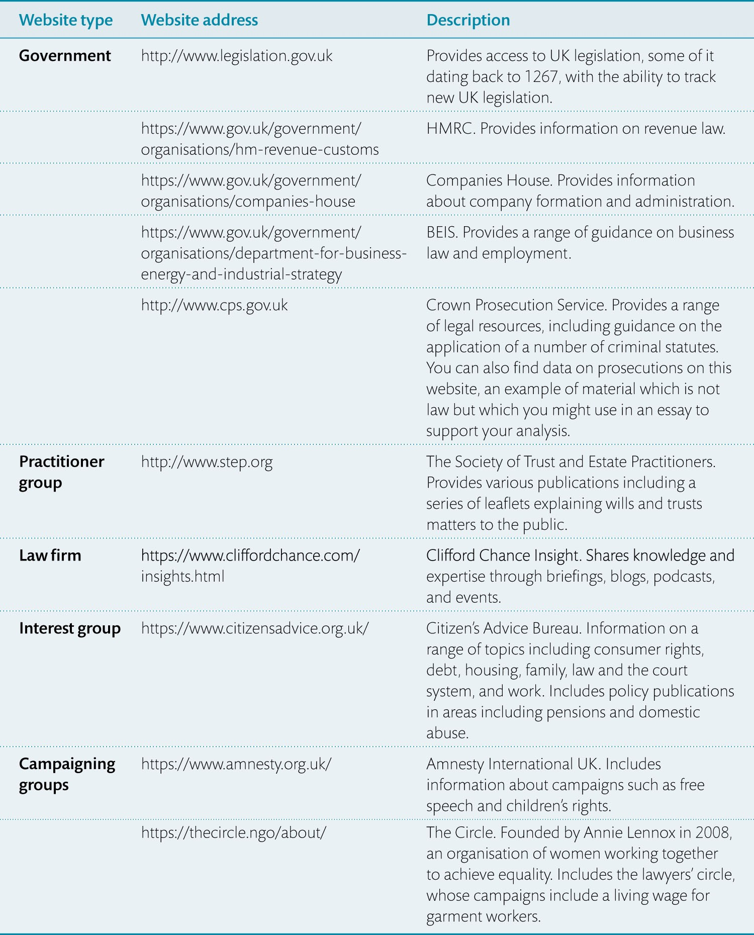
Table 8.1 Examples of government and other websites providing legal material and material to support legal analysis

Slide 9
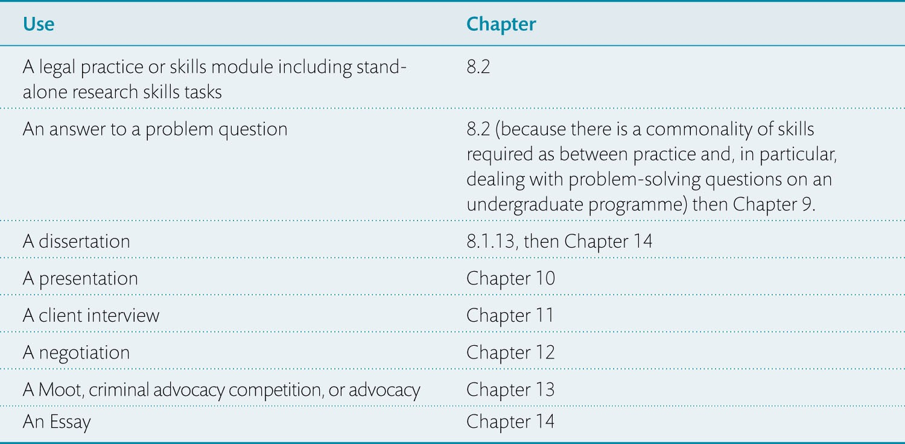
Table 8.2 Navigating your reading of Part 2 for academic output

Slide 10
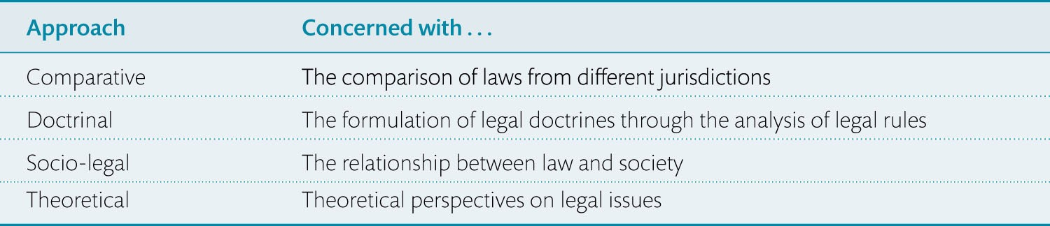
Table 8.3 Academic legal methodologies table

Slide 11
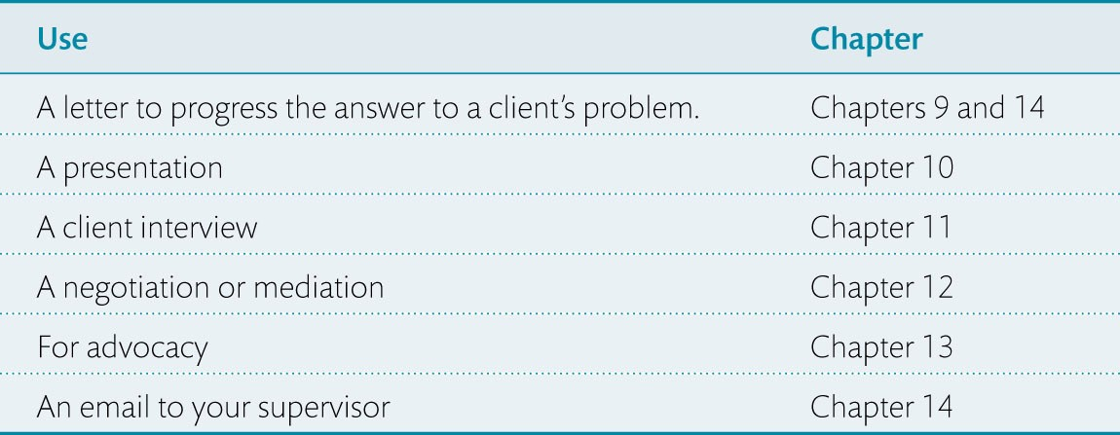
Table 8.4 Navigating your reading of Part 2 for practice-based output

