Slide 1
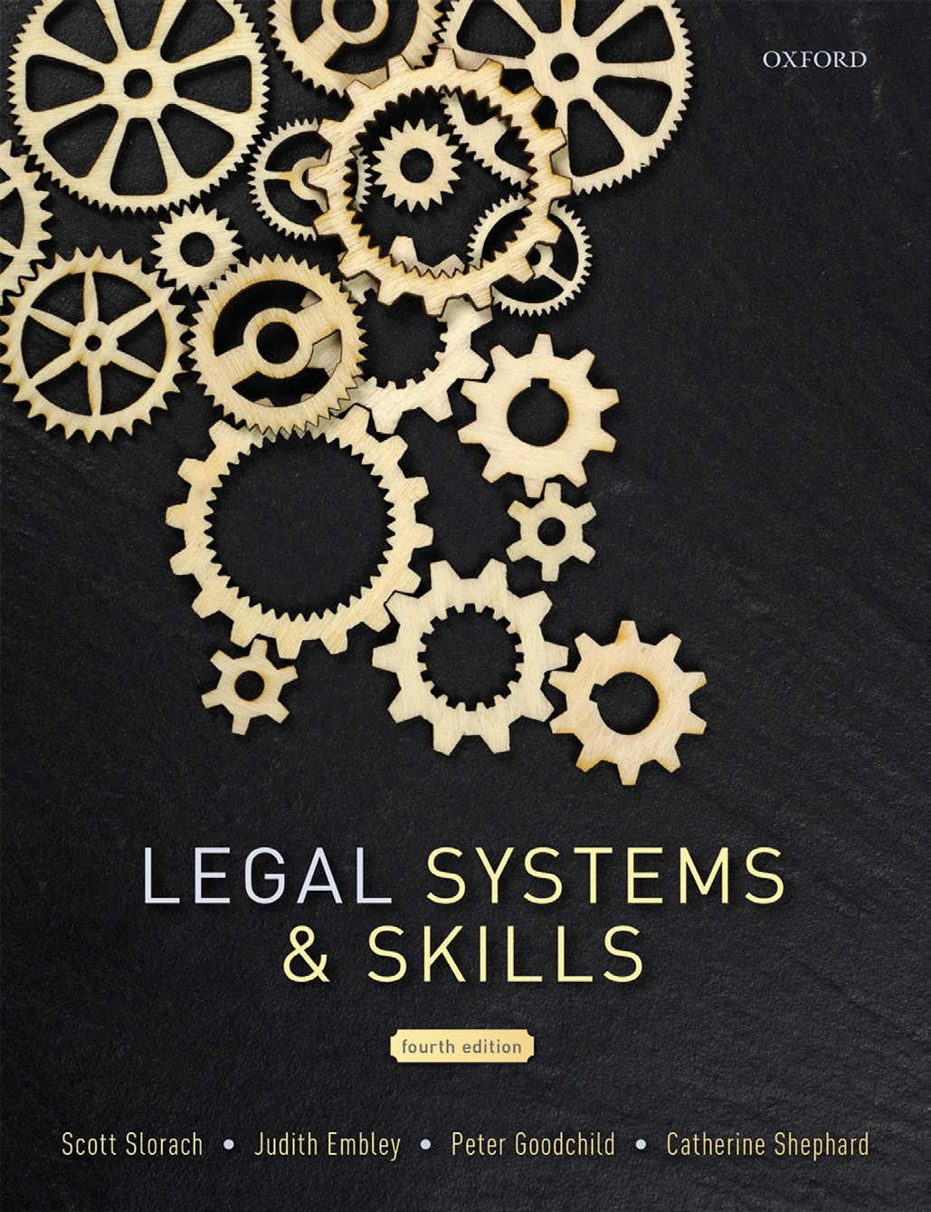
Legal Systems & Skills
by Scott Slorach, Judith Embley, Peter Goodchild and Catherine Shephard

Slide 2
Part 1
Legal Systems
Chapter 06
Legal services and the ethical lawyer

Slide 3
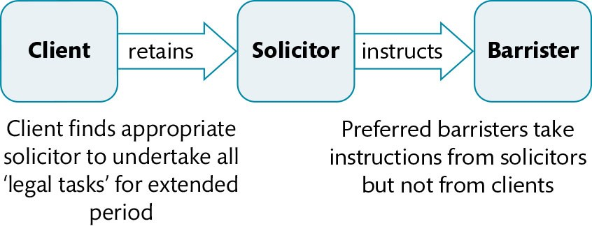
Figure 6.1 Roles of solicitors and barristers

Slide 4
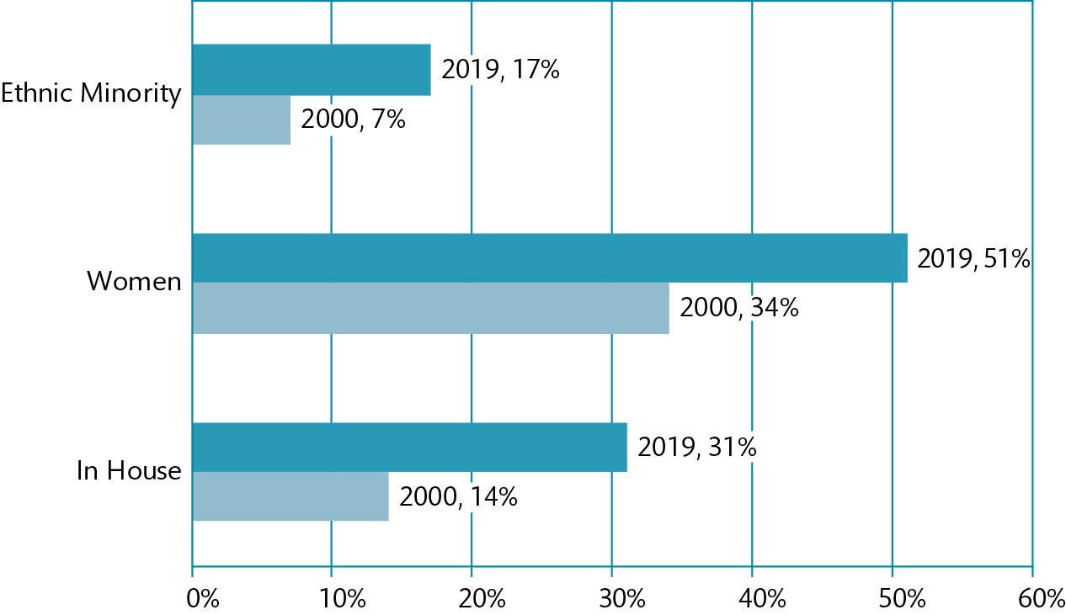
Figure 6.2 The changing social composition of the solicitors’ profession

Slide 5
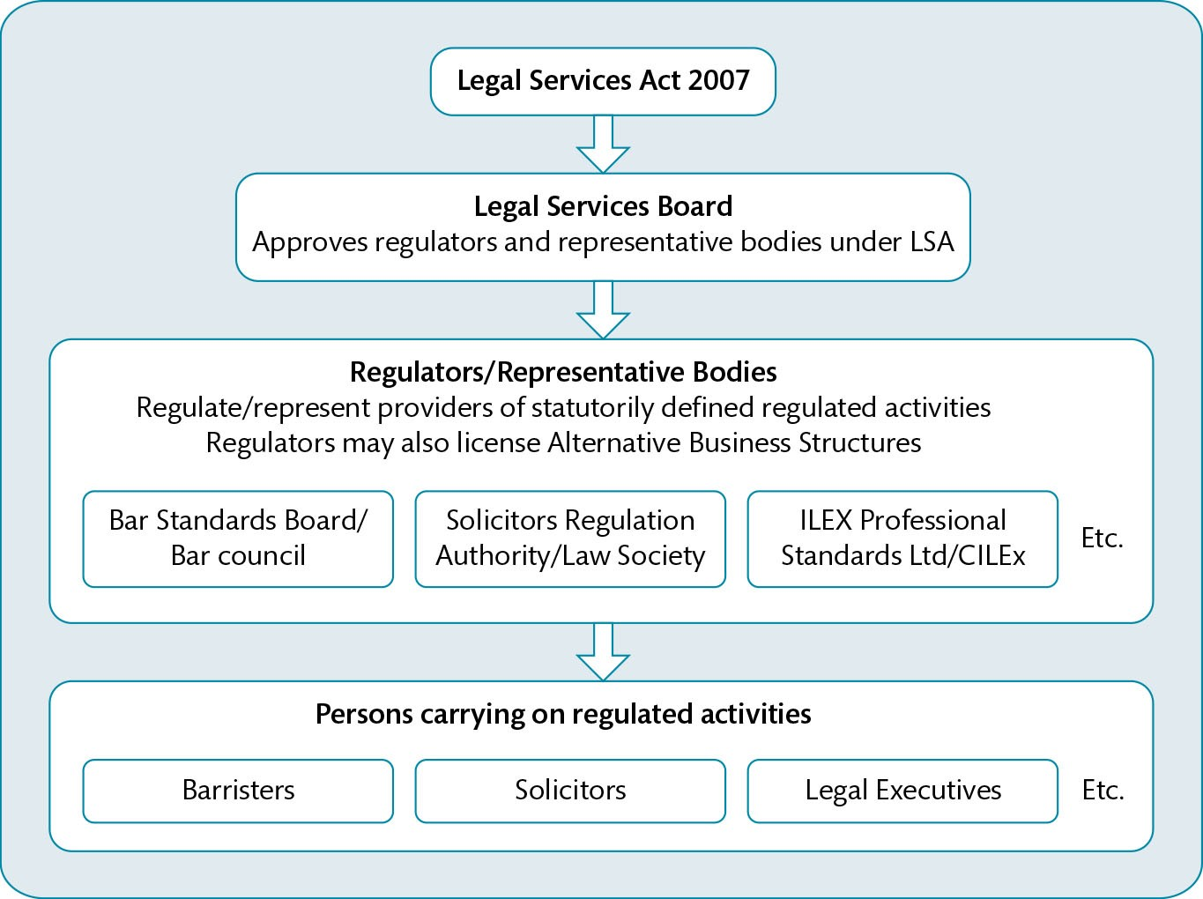
Figure 6.3 Regulation of legal services

Slide 6
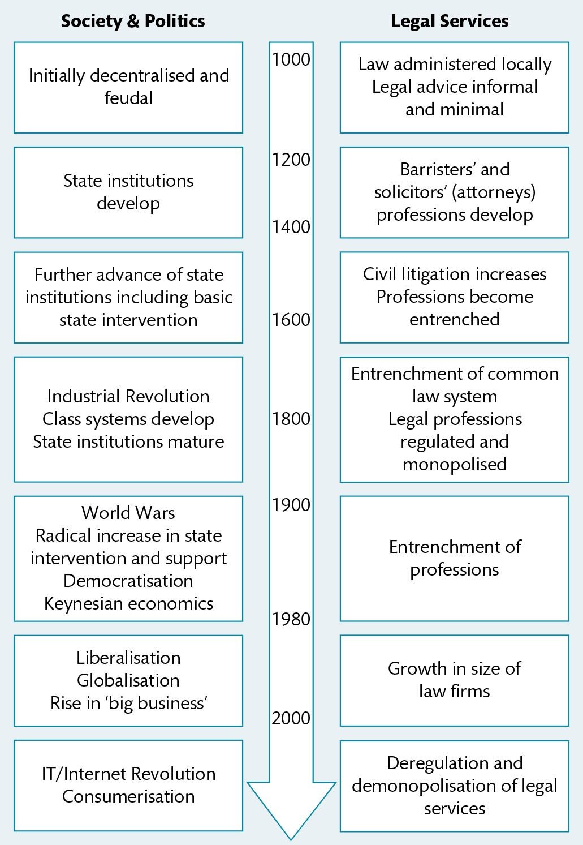
Figure 6.4 The development of legal services in context

Slide 7
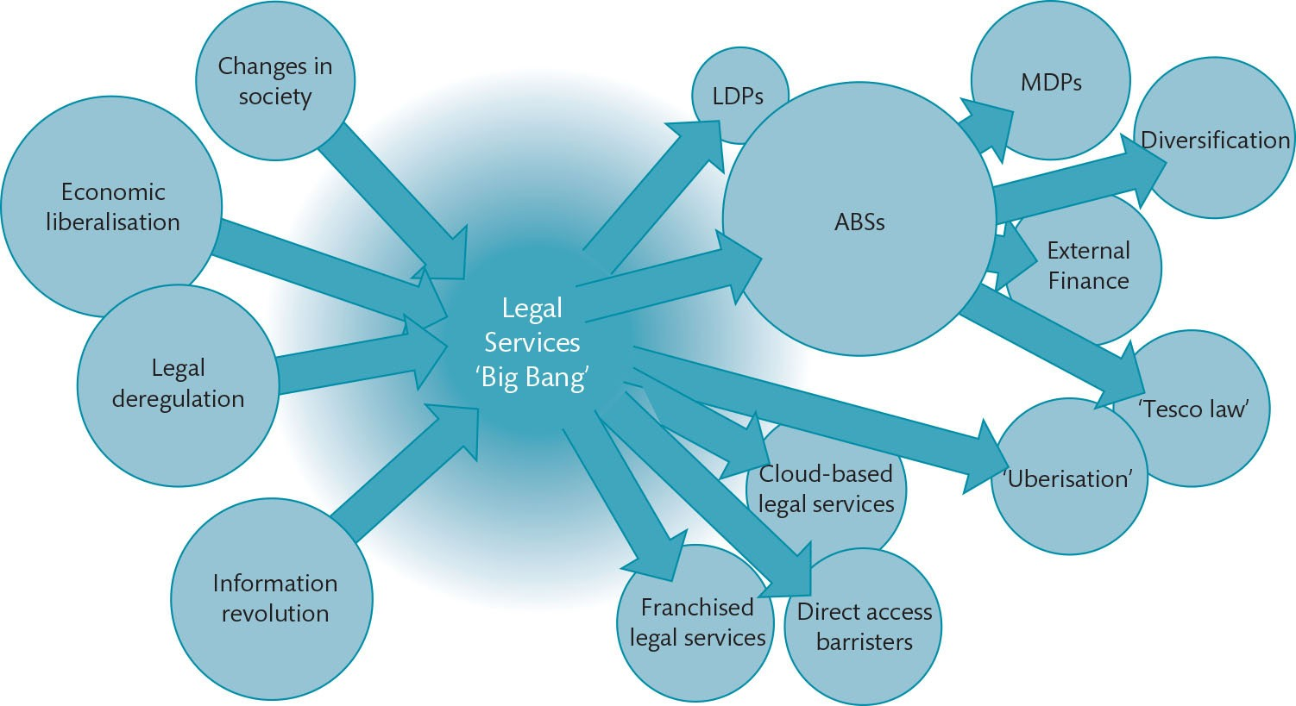
Figure 6.5 The developing legal market

Slide 8
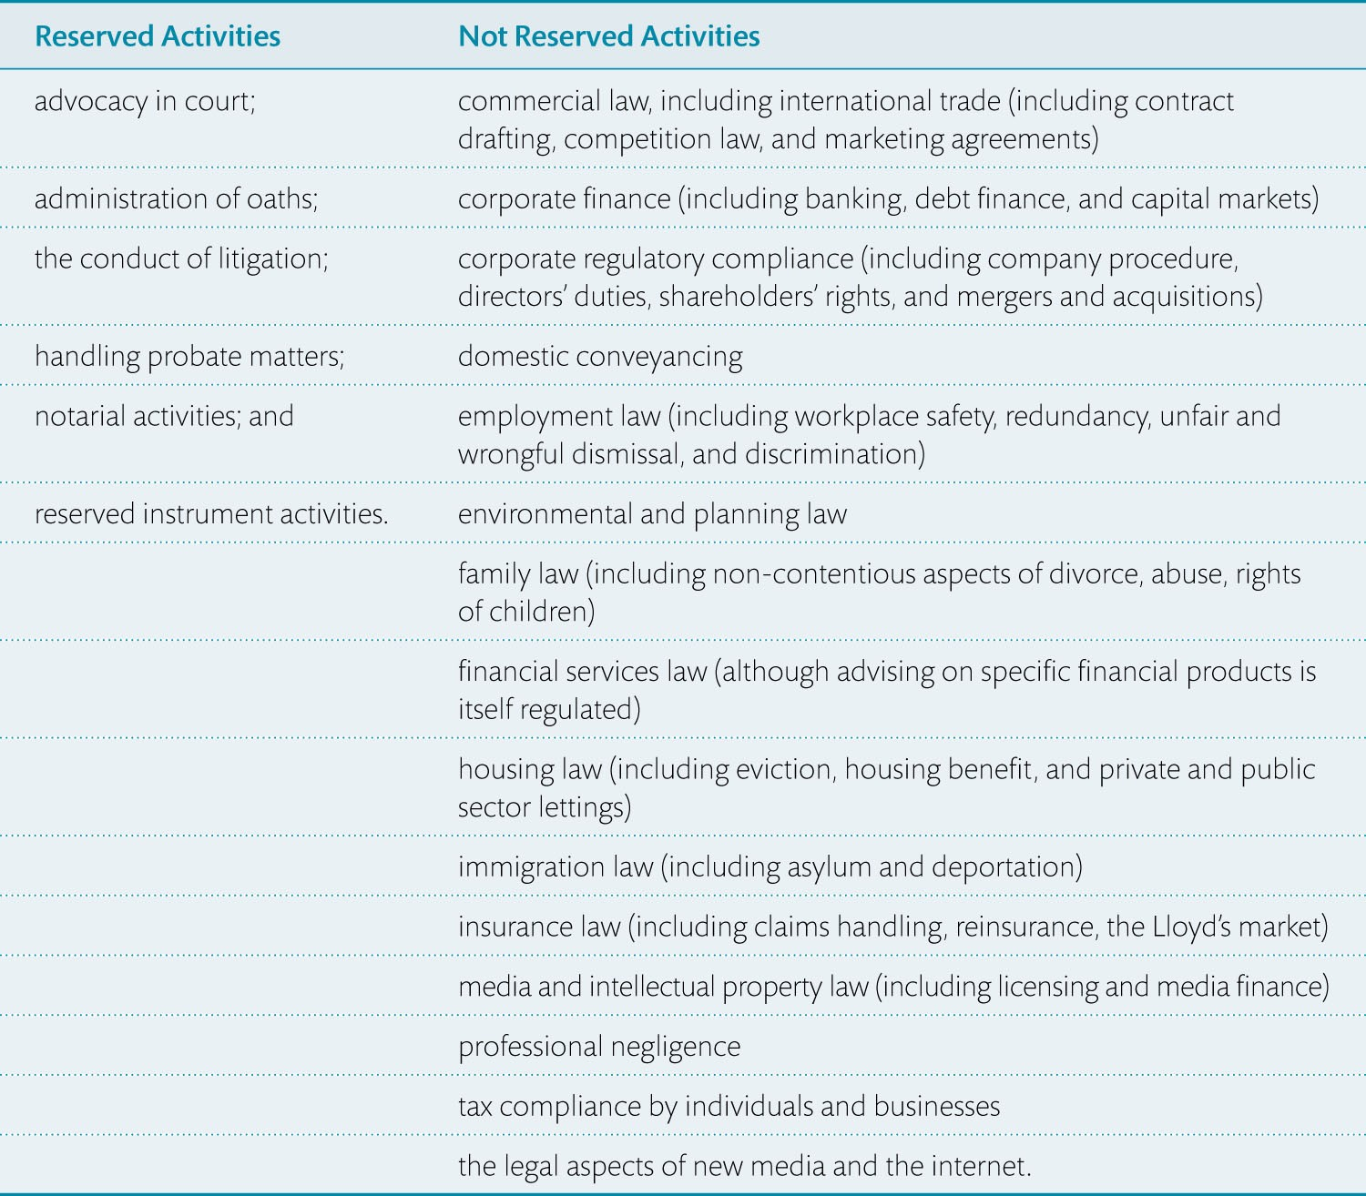
Table 6.1 Legal activities

Slide 9
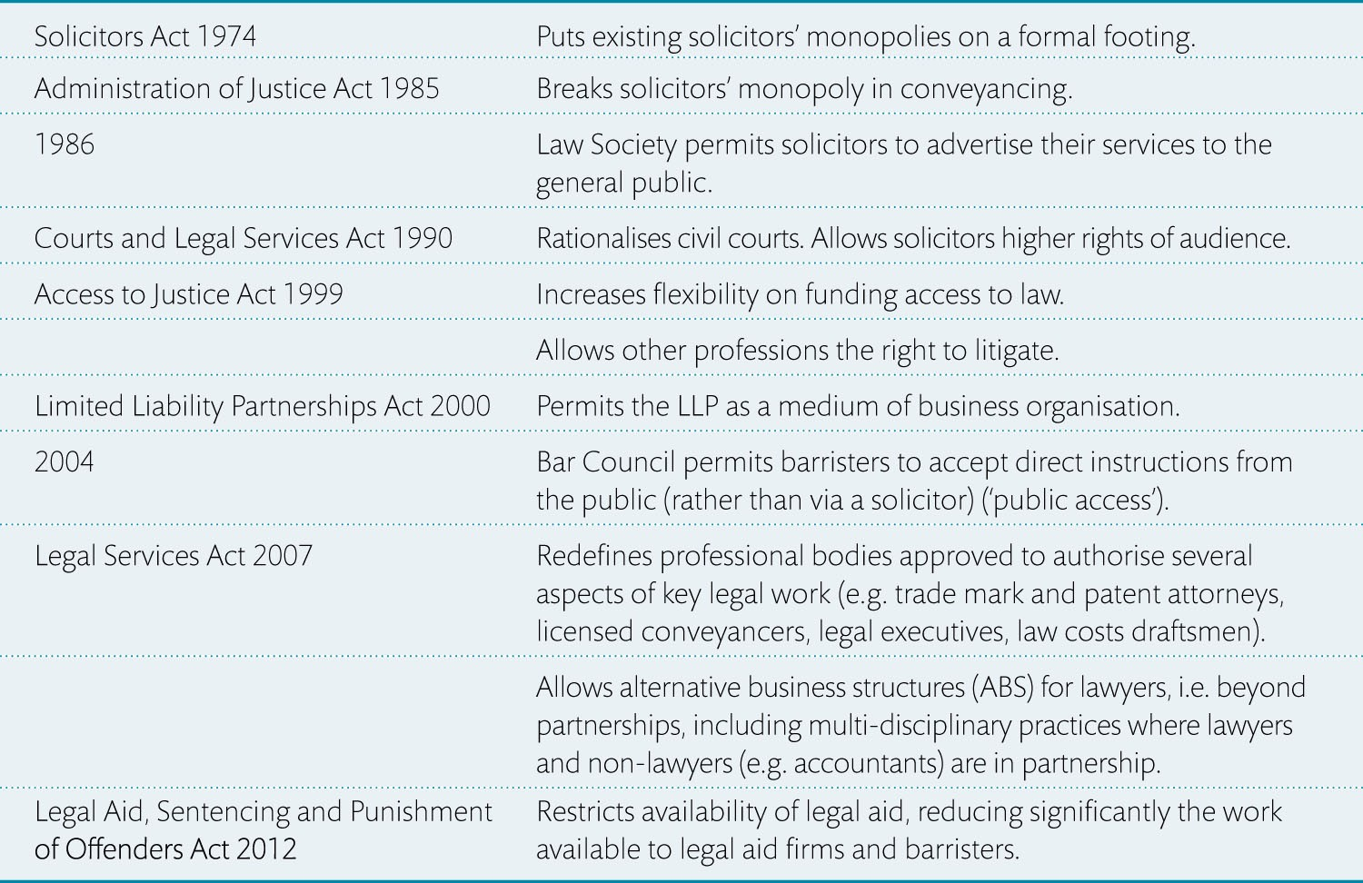
Table 6.2 Summary of reforms to legal services

Slide 10
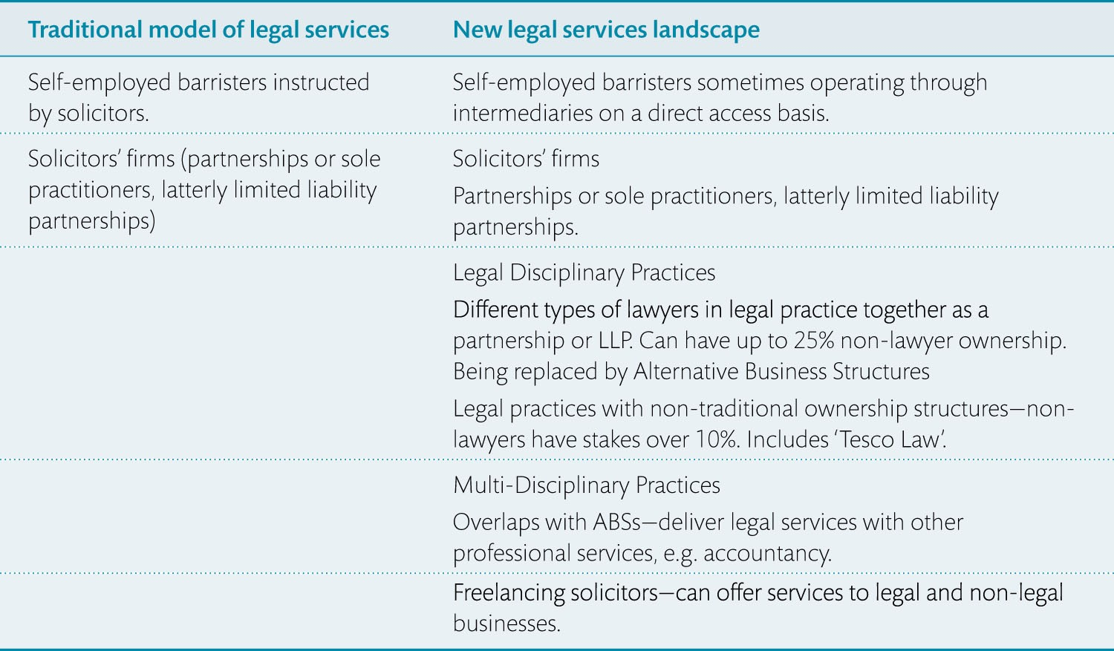
Table 6.3 Types of legal practice

Slide 11
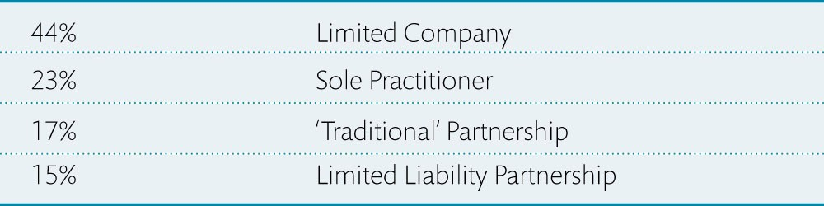
Table 6.4 Types of law firm ownership structure

Slide 12
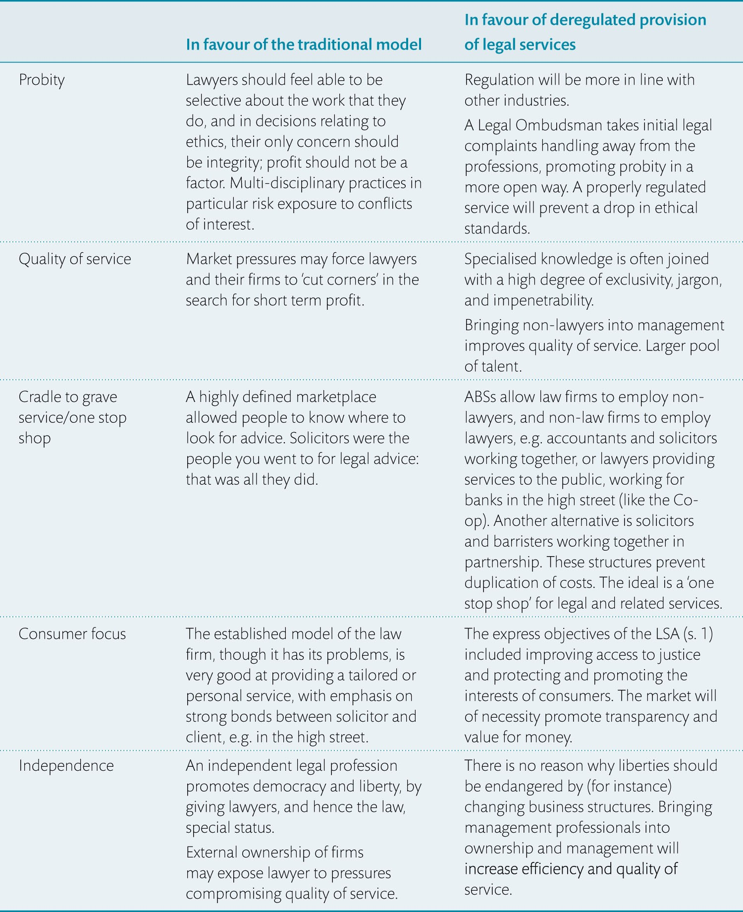
Table 6.5 Arguments for and against the liberalisation of legal services

