Slide 1
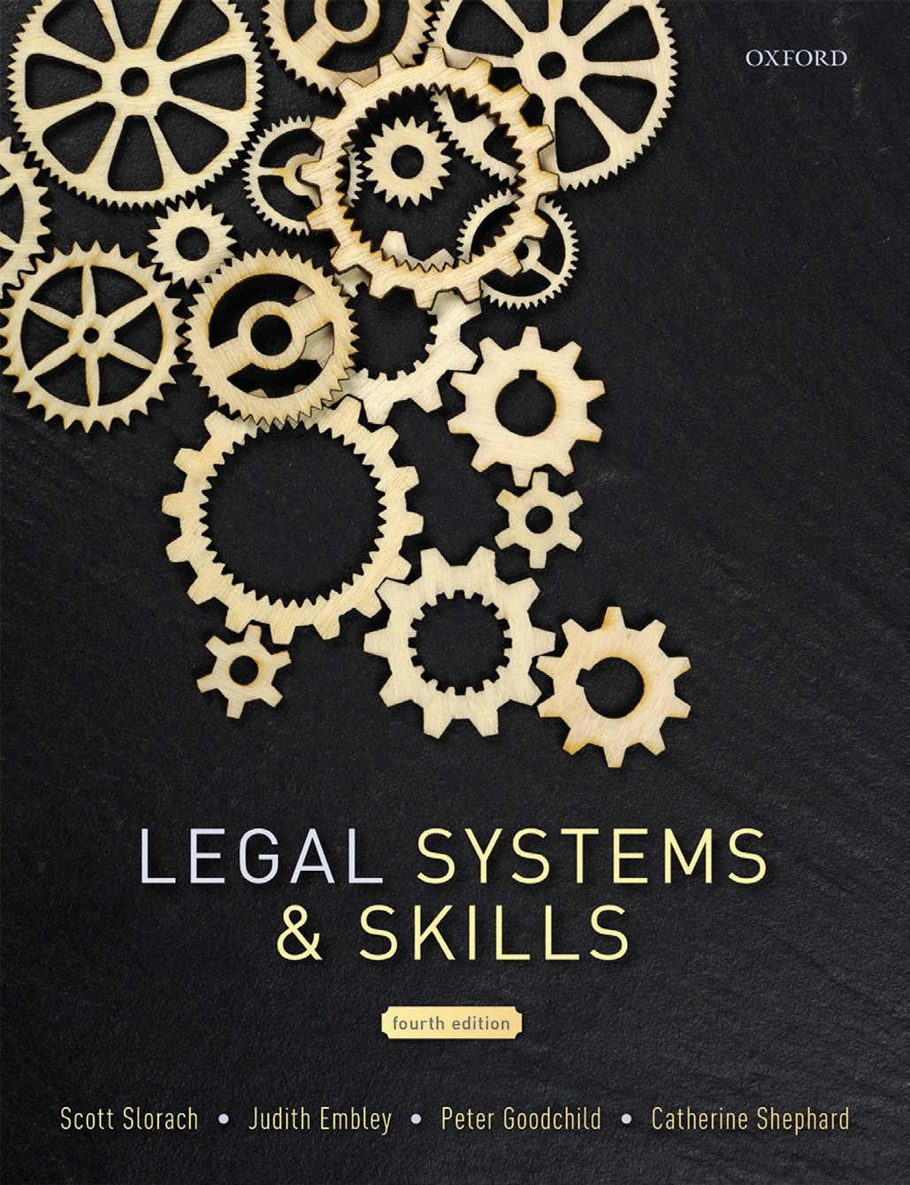
Legal Systems & Skills
by Scott Slorach, Judith Embley, Peter Goodchild and Catherine Shephard

Slide 2
Part 1
Legal Systems
Chapter 02
Legal systems and sources of law

Slide 3
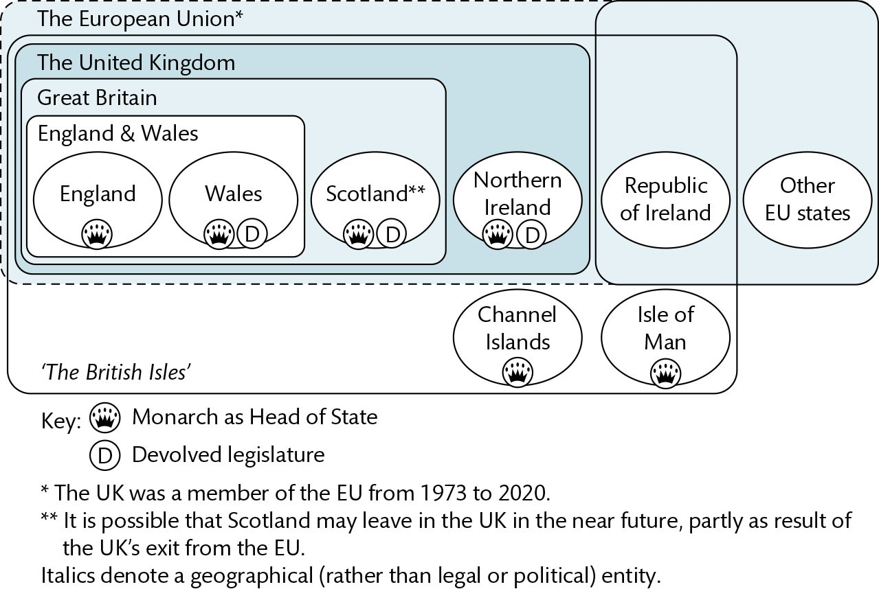
Figure 2.1 Jurisdictions within the British Isles

Slide 4
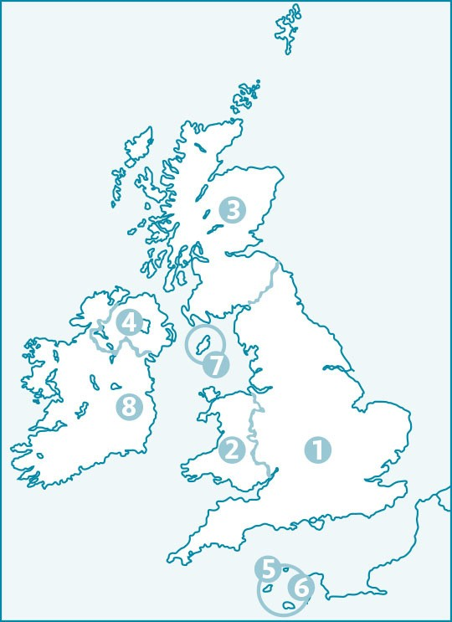
Figure 2.2 Legal map of the British Isles

Slide 5
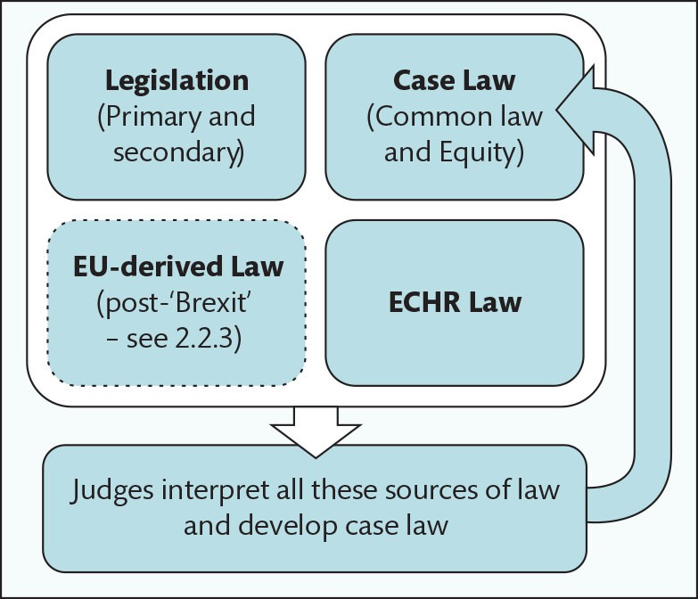
Figure 2.3 Sources of law in England & Wales

Slide 6
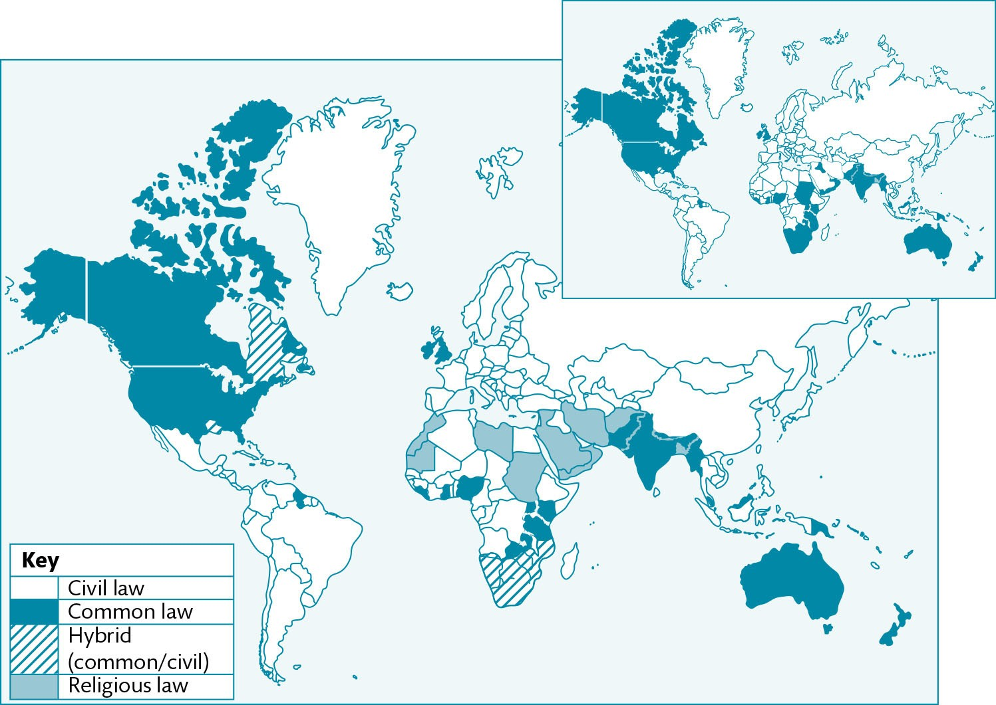
Figure 2.4 Legal systems of the world, compared with states formerly within the British Empire (inset)

Slide 7
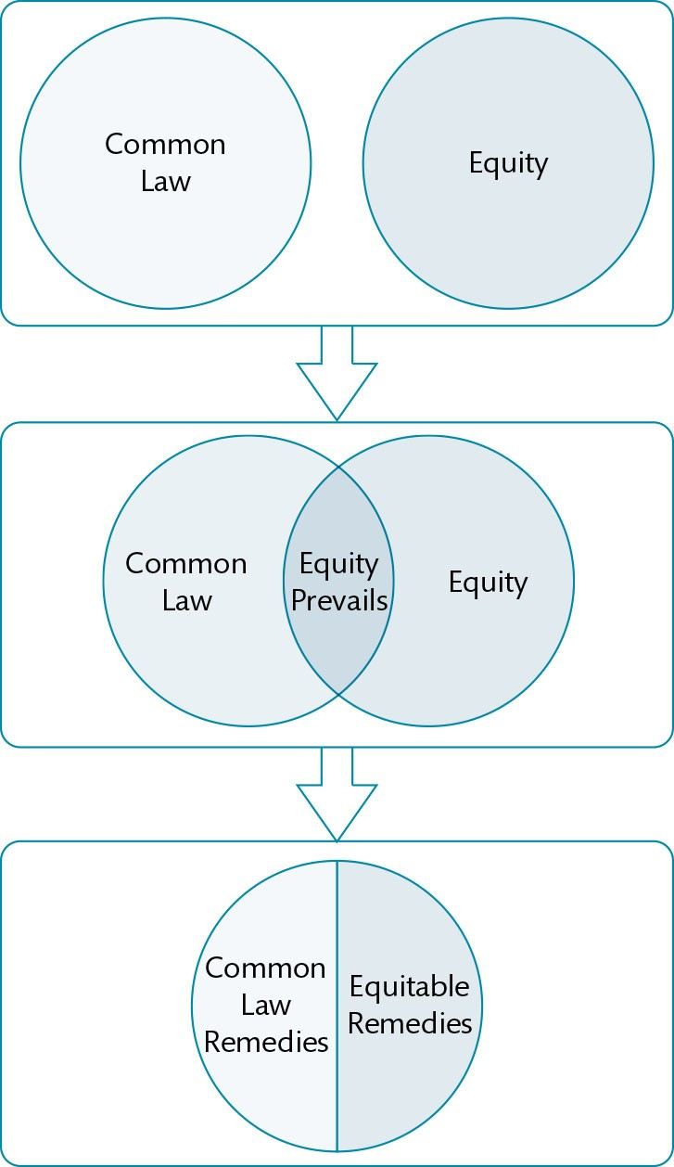
Figure 2.5 Development of the relationship between common law and equity: initially separate legal systems (top box) overlap causing conflict (middle box). The lower box illustrates the unified legal system created by the Judicature Acts.

Slide 8
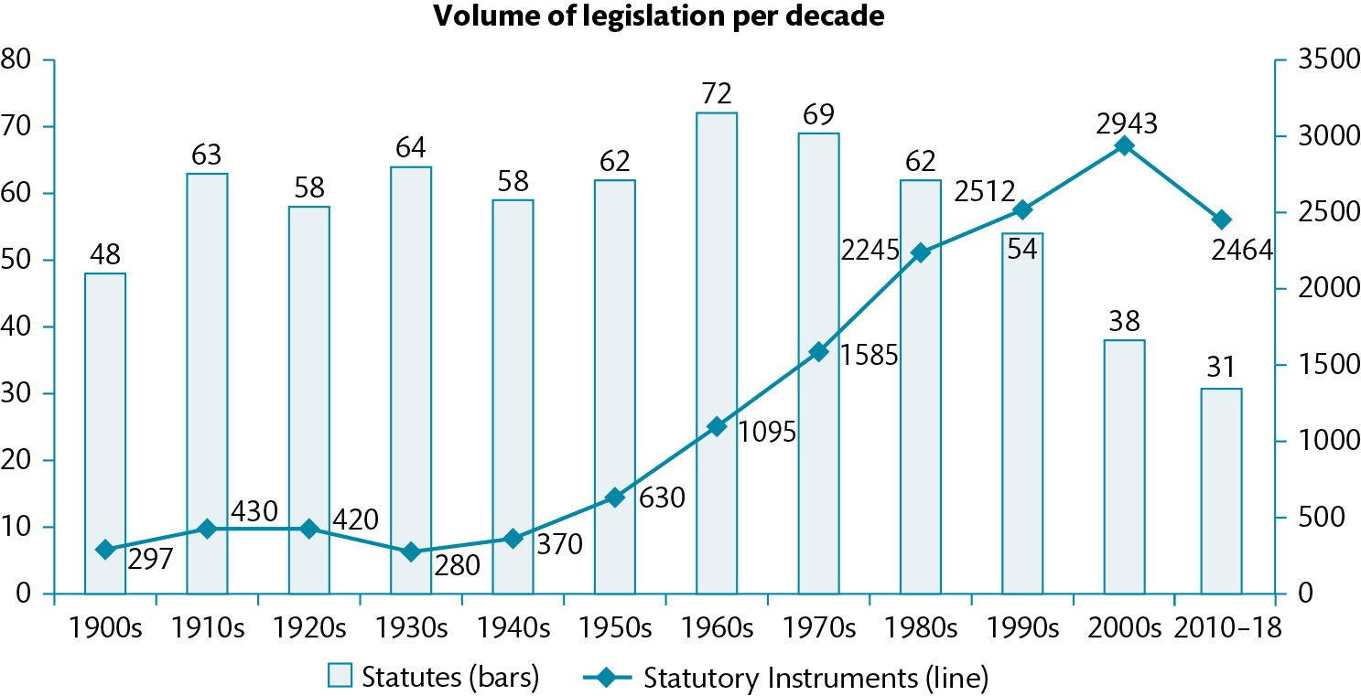
Figure 2.6 Volume of statutes, annual mean per decade

Slide 9
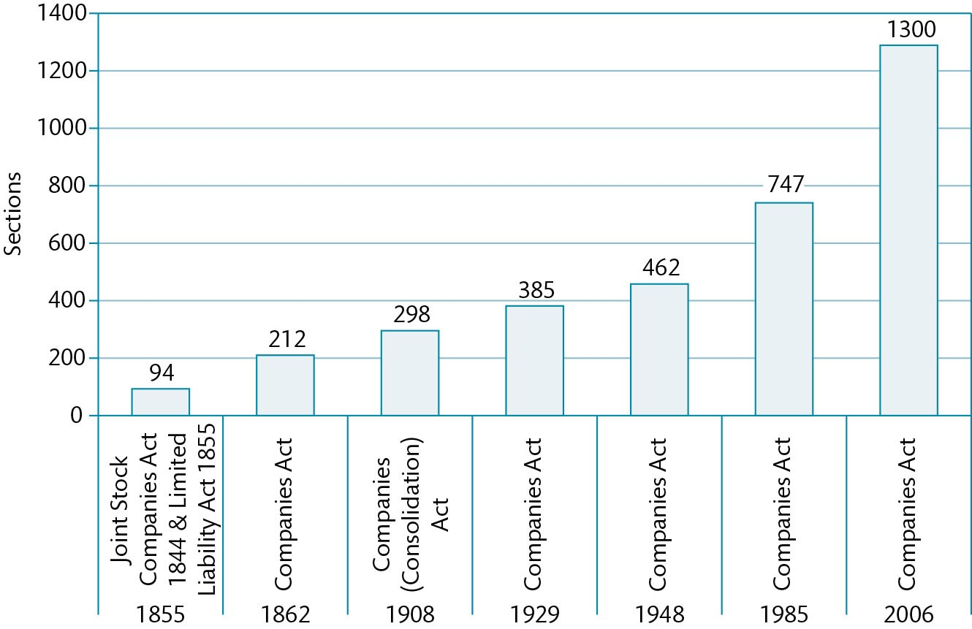
Figure 2.7 Size of the Companies Acts

Slide 10
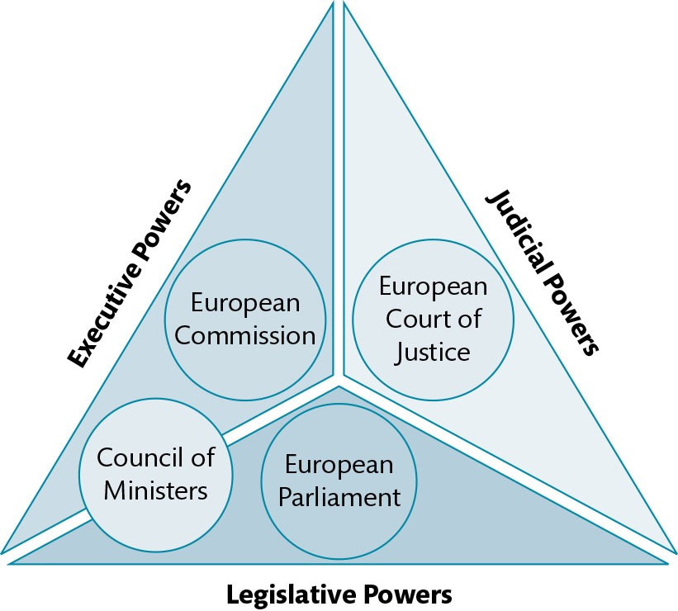
Figure 2.8 Separation of powers within the EU

Slide 11
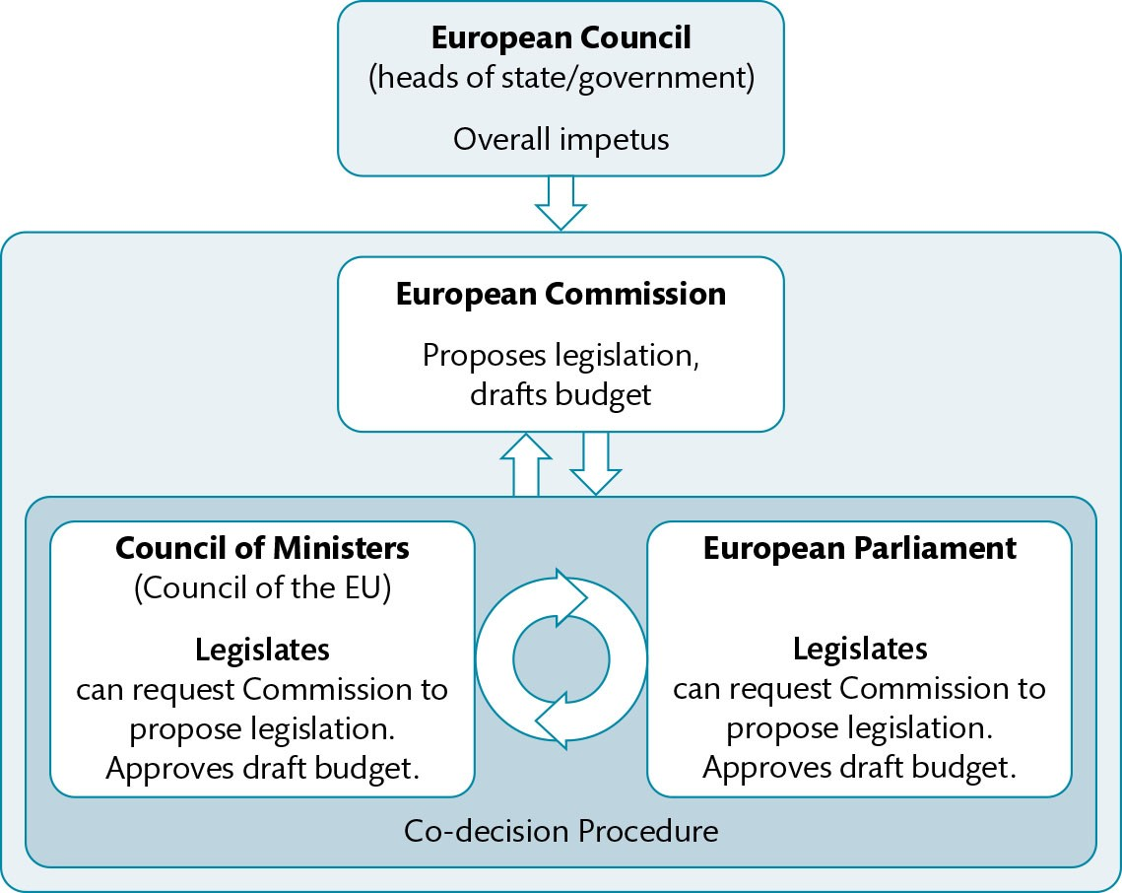
Figure 2.9 Creation of EU legislation

Slide 12
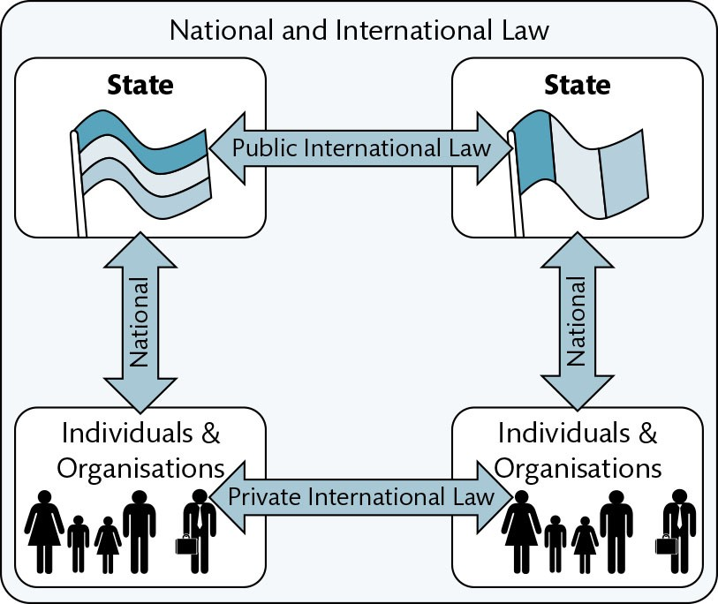
Figure 2.10 National and international law compared

Slide 13
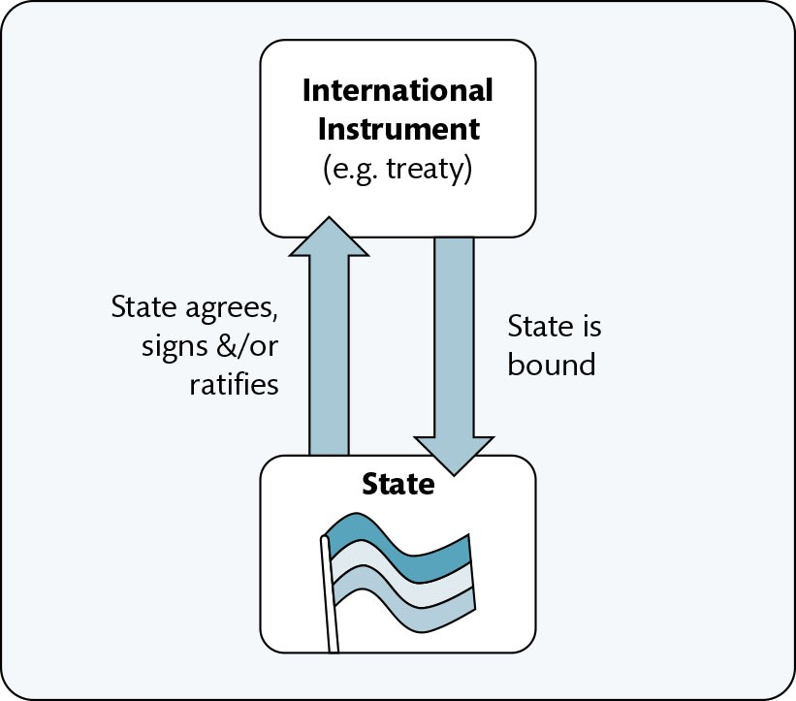
Figure 2.11 Bindingness of international law

Slide 14
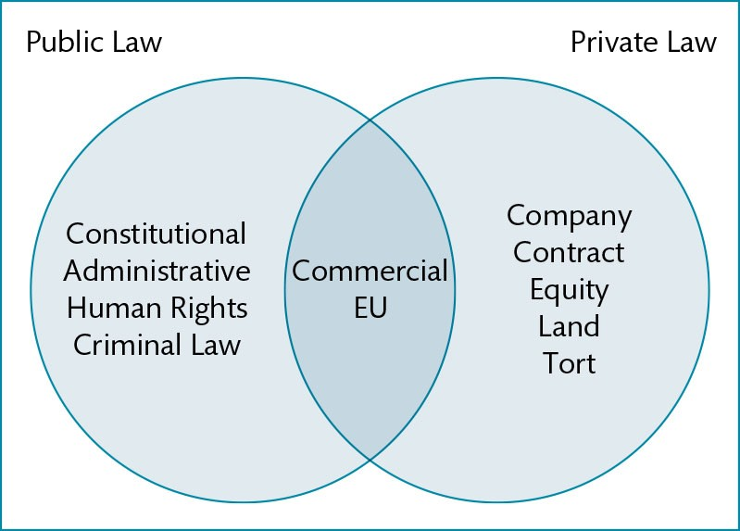
Figure 2.12 Categorisation of law in England & Wales: public and private

Slide 15
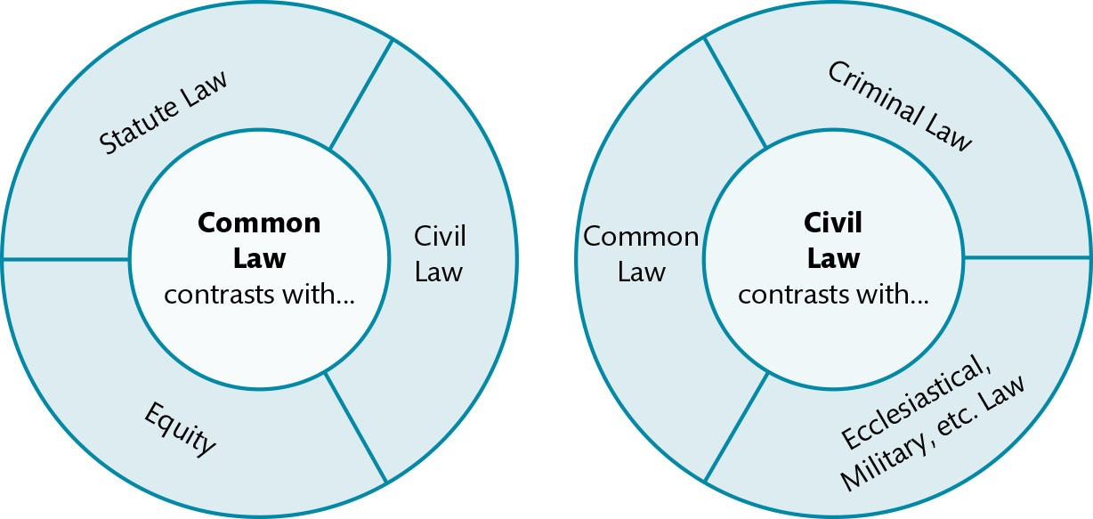
Figure 2.13 Different uses of the terms, ‘common law’ and ‘civil law’

Slide 16
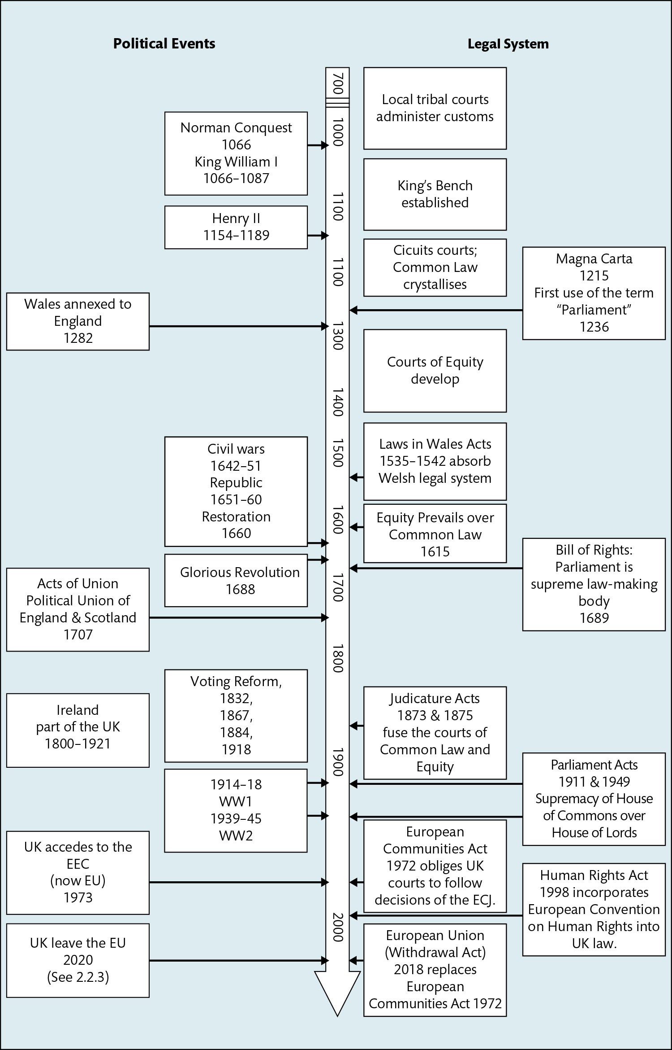
Figure 2.14 Development of the English legal system in political context

Slide 17
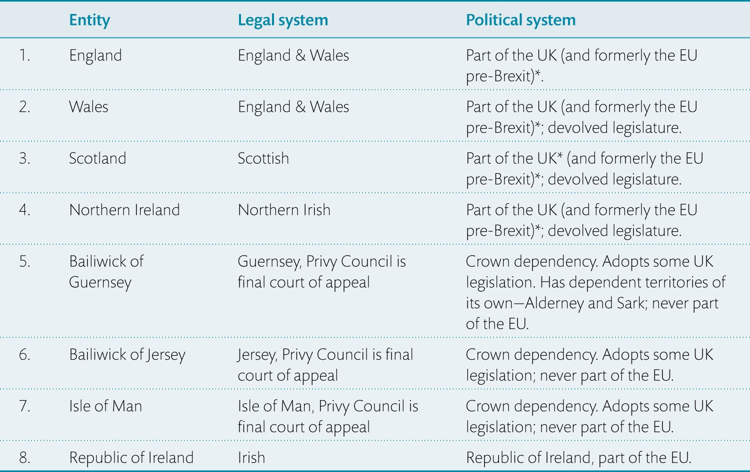
Table 2.1 Key to Figure 2.2: Legal and political systems within the British Isles

Slide 18
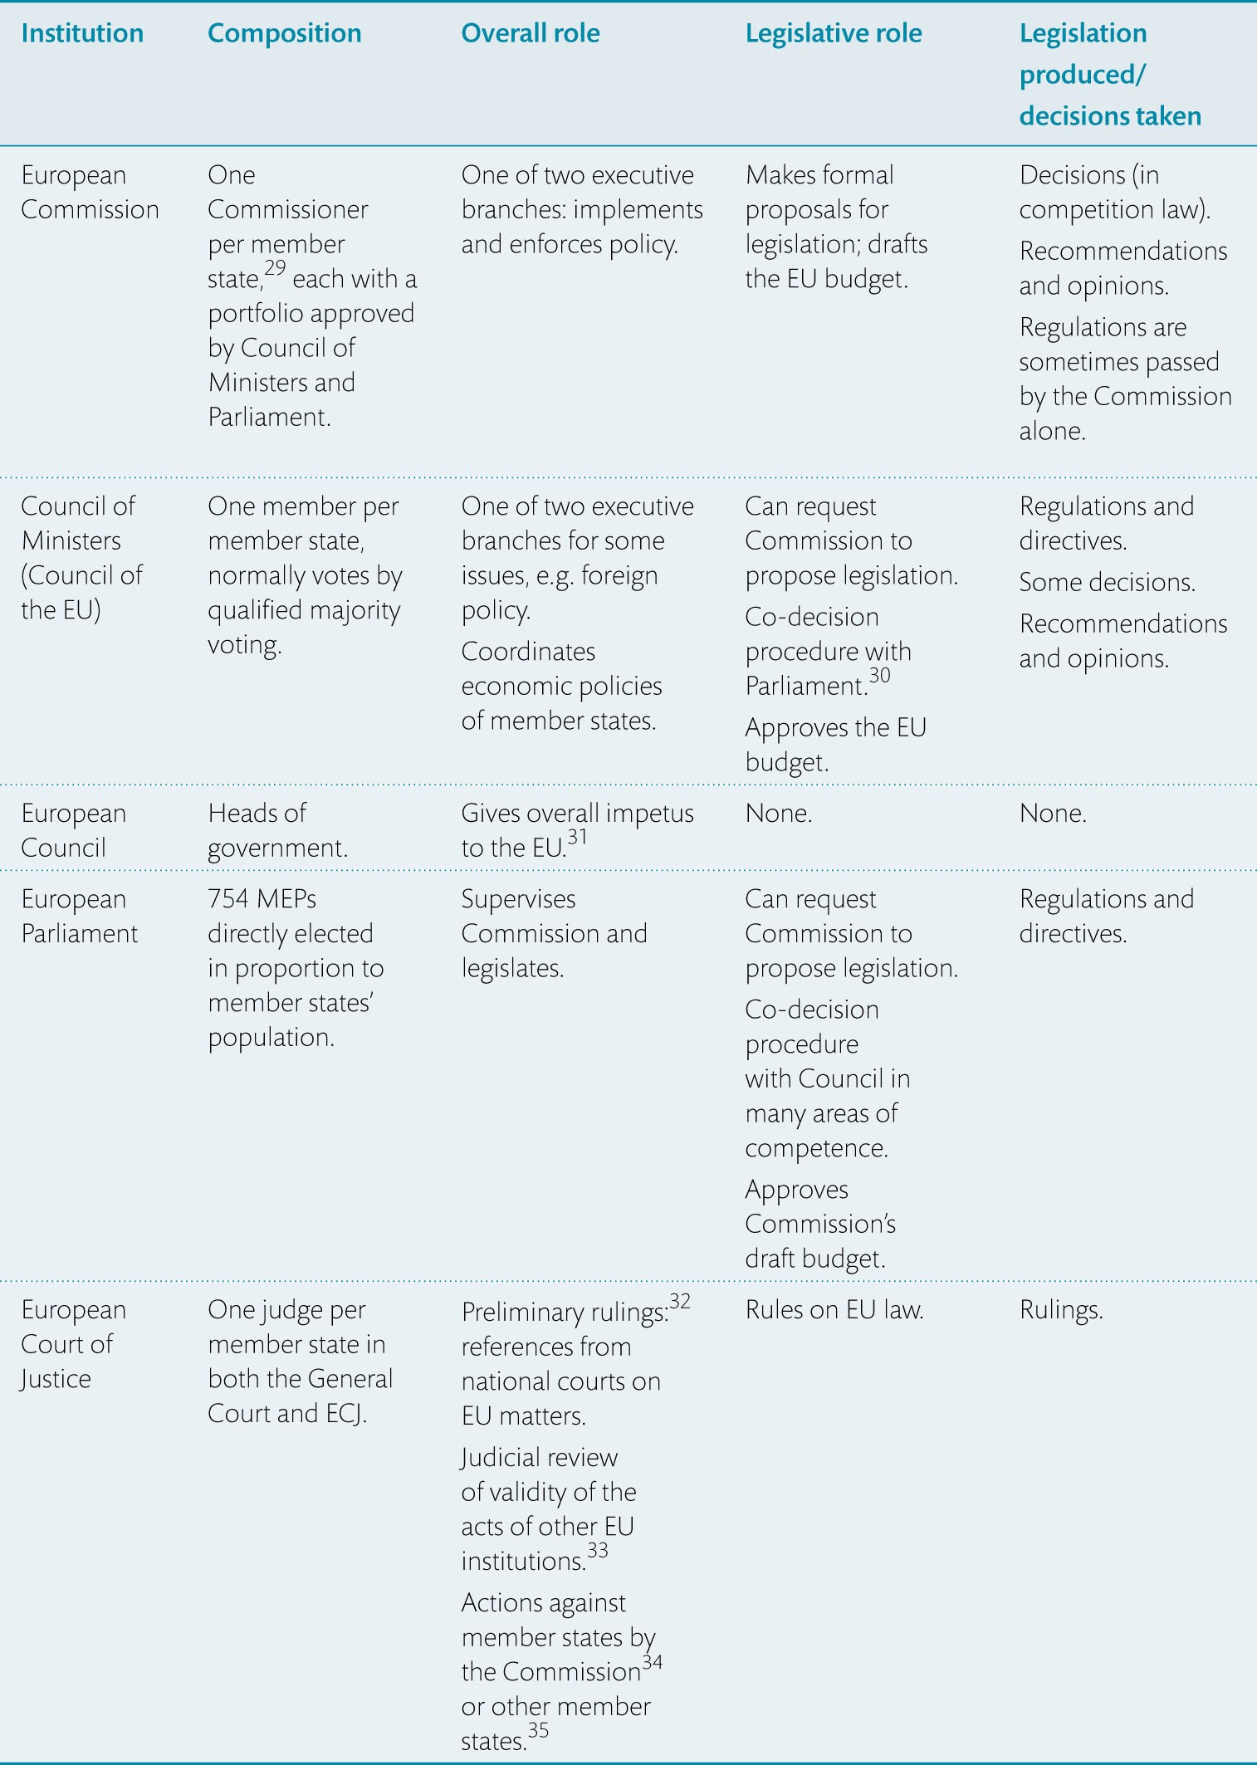
Table 2.2 Summary of EU institutions

Slide 19
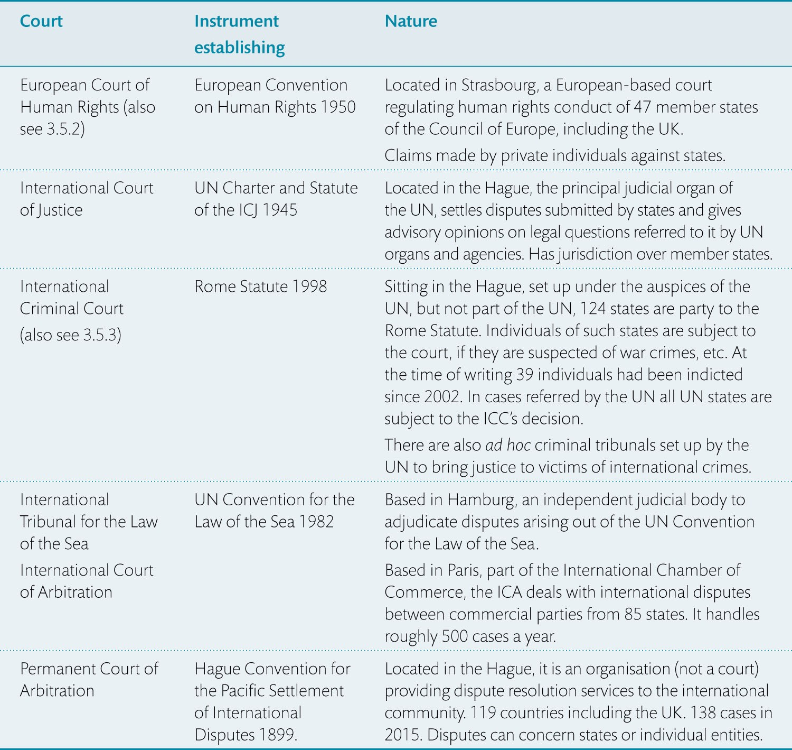
Table 2.3 Selected International Tribunals and Courts

Slide 20
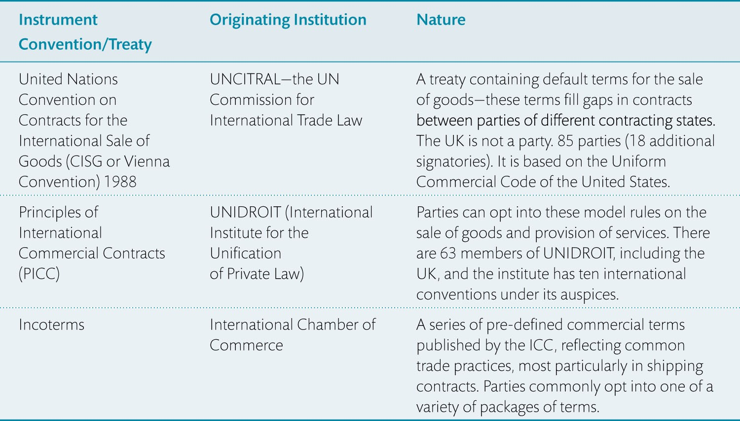
Table 2.4 Three instruments allowing trade across borders

Slide 21
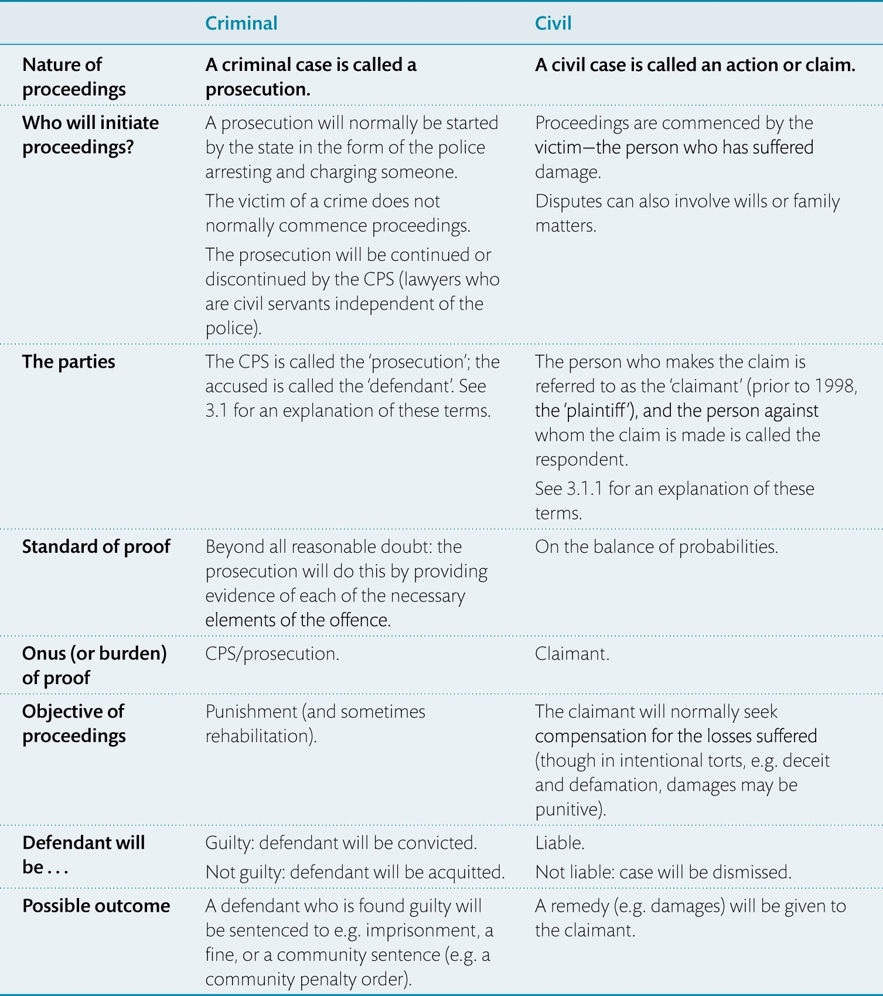
Table 2.5 Key contrasts between criminal and civil law in England & Wales

Slide 22
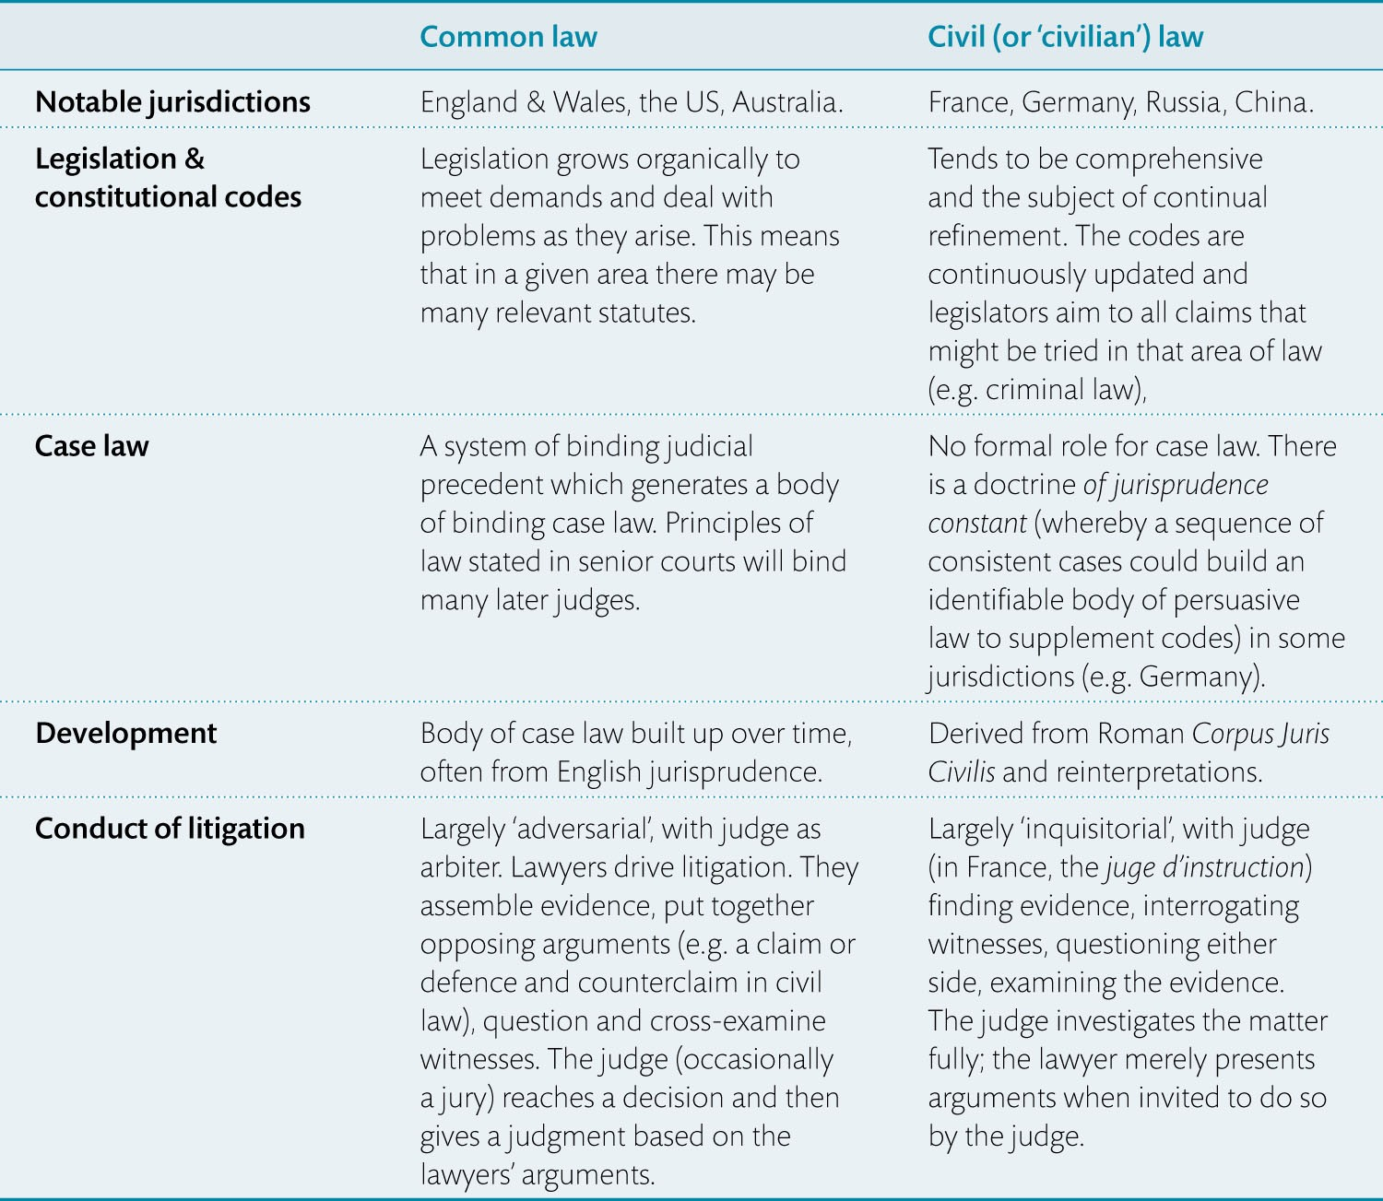
Table 2.6 Contrasting features of common and civil law systems

Slide 23
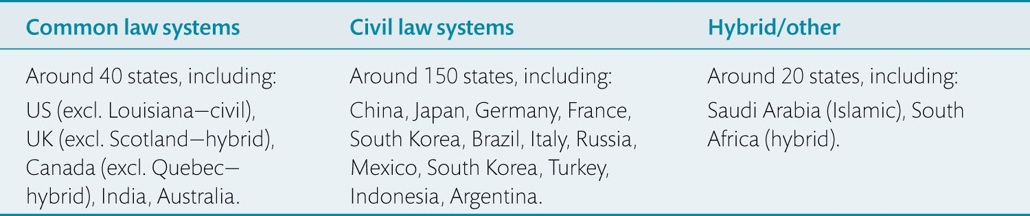
Table 2.7 States, categorised by type of legal system, in order of GDP (G20 states are named)

