Slide 1
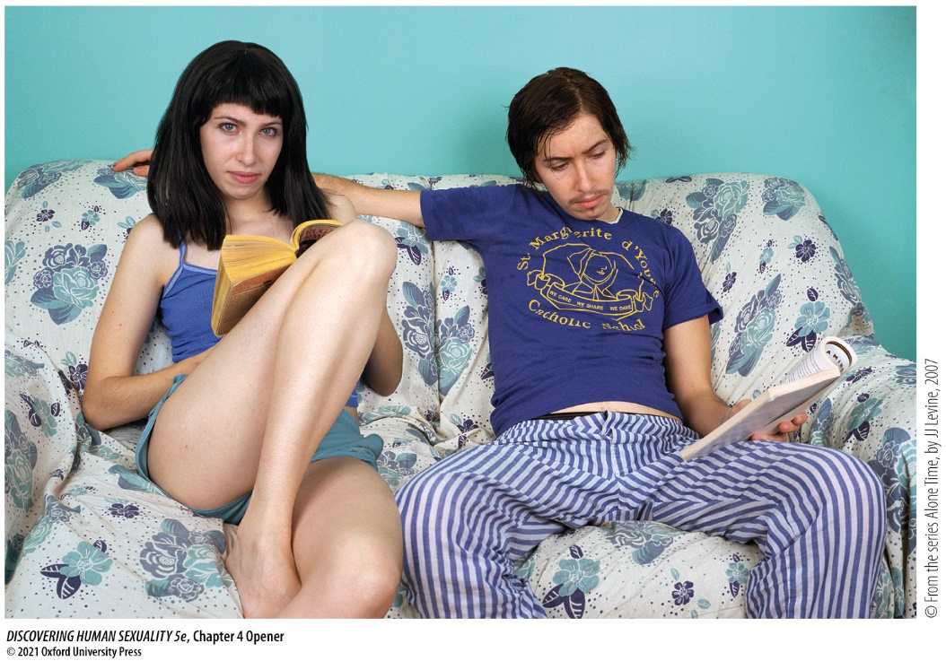
Sex Development and Diversity

Slide 2
Chapter 4: Sex Development and Diversity
4.1 Genes and Hormones Guide Sex Development
4.2 Sex Development Is Not Always Binary
4.3 There Are Sex Differences in Many Mental Traits
4.4 Biological Factors Contribute to Sex Differences
4.5 Life Experiences Mold Sex Roles
4.6 Transgender People Challenge Society’s Deepest Divide

Slide 3
4.1 Genes and Hormones Guide Sex Development
Learning Objectives:
4.1.1 Name the sex chromosomes possessed by females and males and explain how this sex difference arises.
4.1.2 Name the precursors of the female and male reproductive tracts, describe what happens to them in both sexes, and identify the hormones that control these events.
4.1.3 Identify homologous structures in the external genitals of females and males, and the common embryonic structures from which they develop.
4.1.4 Describe or sketch how sex hormone levels change from conception to old age in females and males.

Slide 4
4.1 Genes and Hormones Guide Sex Development (1)
Chromosomes: sequences of DNA. Human cells have 46, in 23 pairs.
The pairs are homologous—having copies of the same genes, except:
  Females have a homologous pair of X chromosomes; males have one X chromosome (from the mother) and one Y chromosome (from the father).

Slide 5
4.1 Genes and Hormones Guide Sex Development (2)
Sex chromosomes determine development of an embryo.
  An embryo with two X chromosomes develops as a female.
  An embryo with one Y chromosome and one X chromosome develops as a male.
The sex-determining gene SRY on the Y chromosome directs development along the male pathway. Its absence allows development along the female pathway.

Slide 6
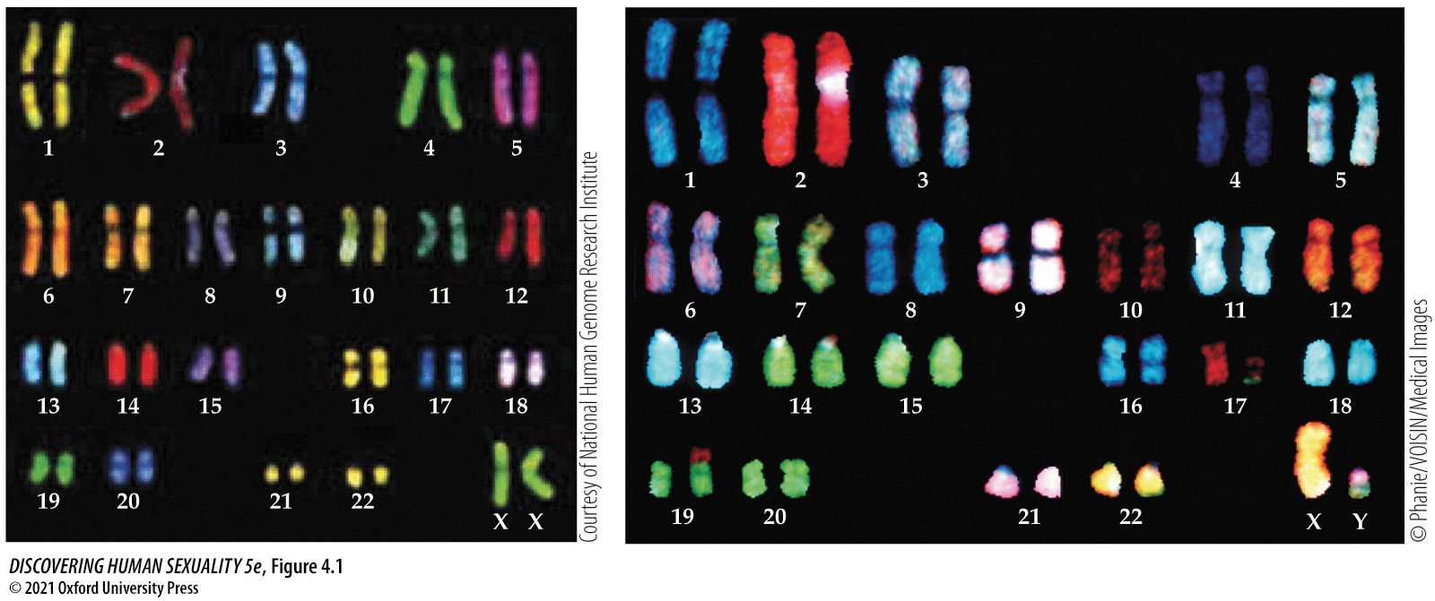
Figure 4.1 Human chromosomes in a woman (left) and a man (right)
Notes:
Figure 4.1 Human chromosomes in a woman (left) and a man (right). Women have two X chromosomes, men have one X and one Y. The other 22 pairs of chromosomes are the same. Here, the individual chromosomes have been labeled with a variety of fluorescent chemical probes, each of which binds to the DNA of a single chromosome to identify it. The differences in appearance of the chromosomes in the woman and man are not meaningful: They result from different processing.

Slide 7
4.1 Genes and Hormones Guide Sex Development (3)
Early in development, female and male embryos possess both Wolffian and Müllerian ducts.
  Wolffian ducts are precursors of the male reproductive tract.
  Müllerian ducts are precursors of the female reproductive tract.

Slide 8
4.1 Genes and Hormones Guide Sex Development (4)
In males, testes produce anti-Müllerian hormone (AMH), which causes the female ducts to regress, and testosterone, which stimulates the Wolffian ducts to produce male internal organs.
In females, absence of testosterone causes Wolffian ducts to degenerate, and absence of AMH allows Müllerian ducts to develop into the oviducts, uterus, and deeper parts of the vagina.

Slide 9
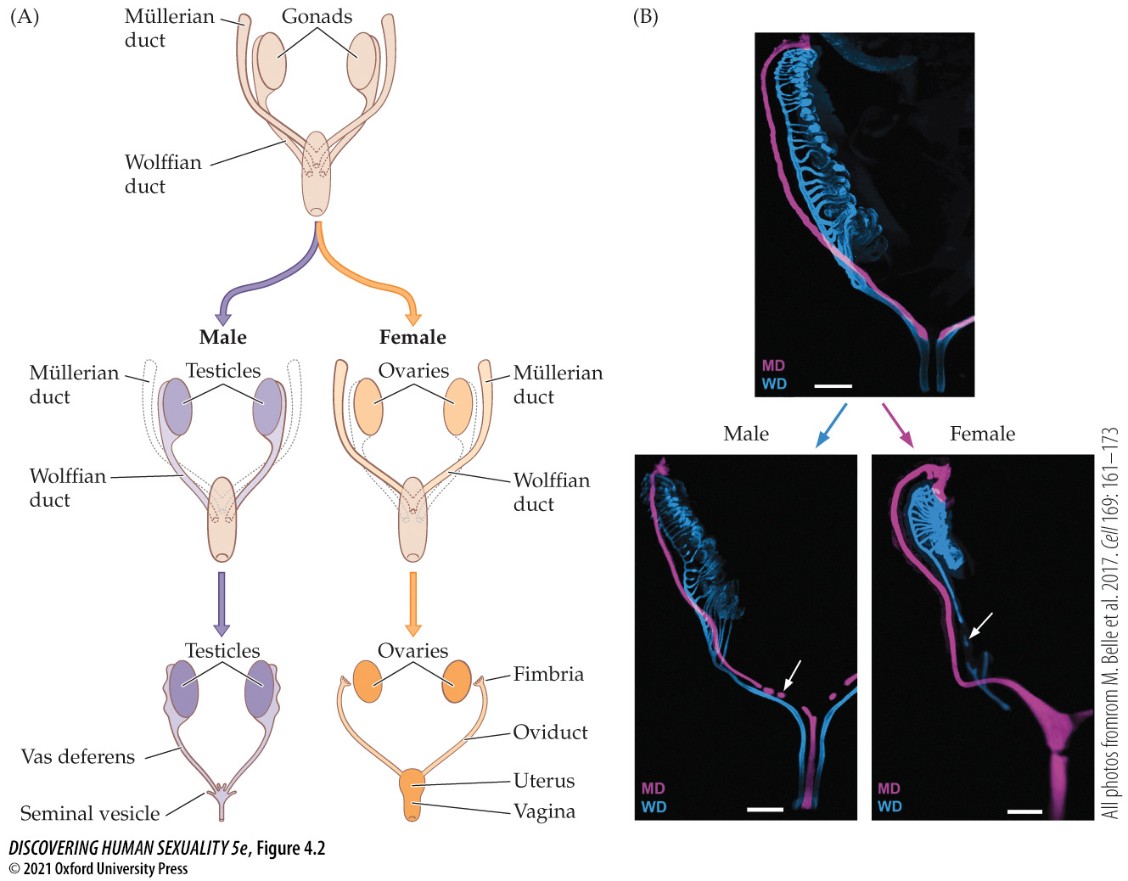
Figure 4.2 Male and female reproductive tracts develop from different precursor structures, the Wolffian and Müllerian ducts (2)
Notes:
Figure 4.2 Male and female reproductive tracts develop from different precursor structures (A), the Wolffian and Müllerian ducts. (The male and female gonads [testes and ovaries] have a common origin and do not belong to either duct system.) (See Activity 4.1: Development of the Male and Female Reproductive Tracts.) These micrographs of developing reproductive tracts in human embryos (B) are labeled with fluorescent probes. The sexually undifferentiated embryo at 9.5 weeks gestation (top) shows the presence of both Wolffian (blue) and Müllerian (pink) ducts. The male embryo at 10 weeks (bottom left) shows the Müllerian duct beginning to break up (arrow). The female embryo at 13 weeks (bottom right) shows the Wolffian duct beginning to break up (arrow). The white scale bars are 0.4 mm.

Slide 10
4.1 Genes and Hormones Guide Sex Development (5)
Female and male external genitalia develop from the same tissues.
Each embryo has a slit, the cloaca, which is flanked by two urethral folds and, outside those, the genital swelling.
At the middle of the front end of the cloaca is the genital tubercle.
The anal fold eventually becomes the anus.

Slide 11
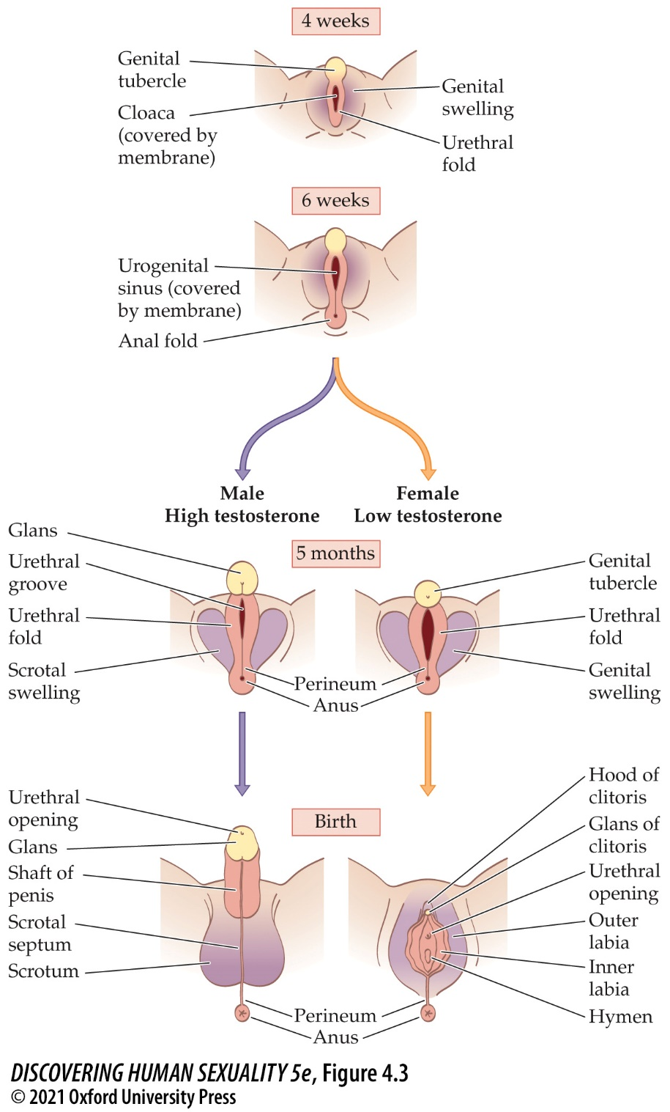
Figure 4.3 Development of the male and female external genitalia from common precursor structures
Notes:
Figure 4.3 Development of the male and female external genitalia from common precursor structures, shown at the top. In males, the urethral folds fuse at the midline to form the penile shaft and enclose the urethra. In females, they remain separate, forming the inner labia.

Slide 12
4.1 Genes and Hormones Guide Sex Development (6)
Urethral folds become
  inner labia and outer vagina in females.
  shaft of the penis in males.
Genital swellings give rise to
  outer labia in females.
  scrotum in males.
Genital tubercle develops into the glans of the clitoris or glans of the penis.

Slide 13
4.1 Genes and Hormones Guide Sex Development (7)
In both sexes, the gonads begin near the kidneys and descend as development progresses.
By 10 weeks, the gonads are near the top of the pelvis.
  In females, they stay there until birth.
  In males, the gonads continue to descend. Shortly before birth, they reach the scrotum.

Slide 14
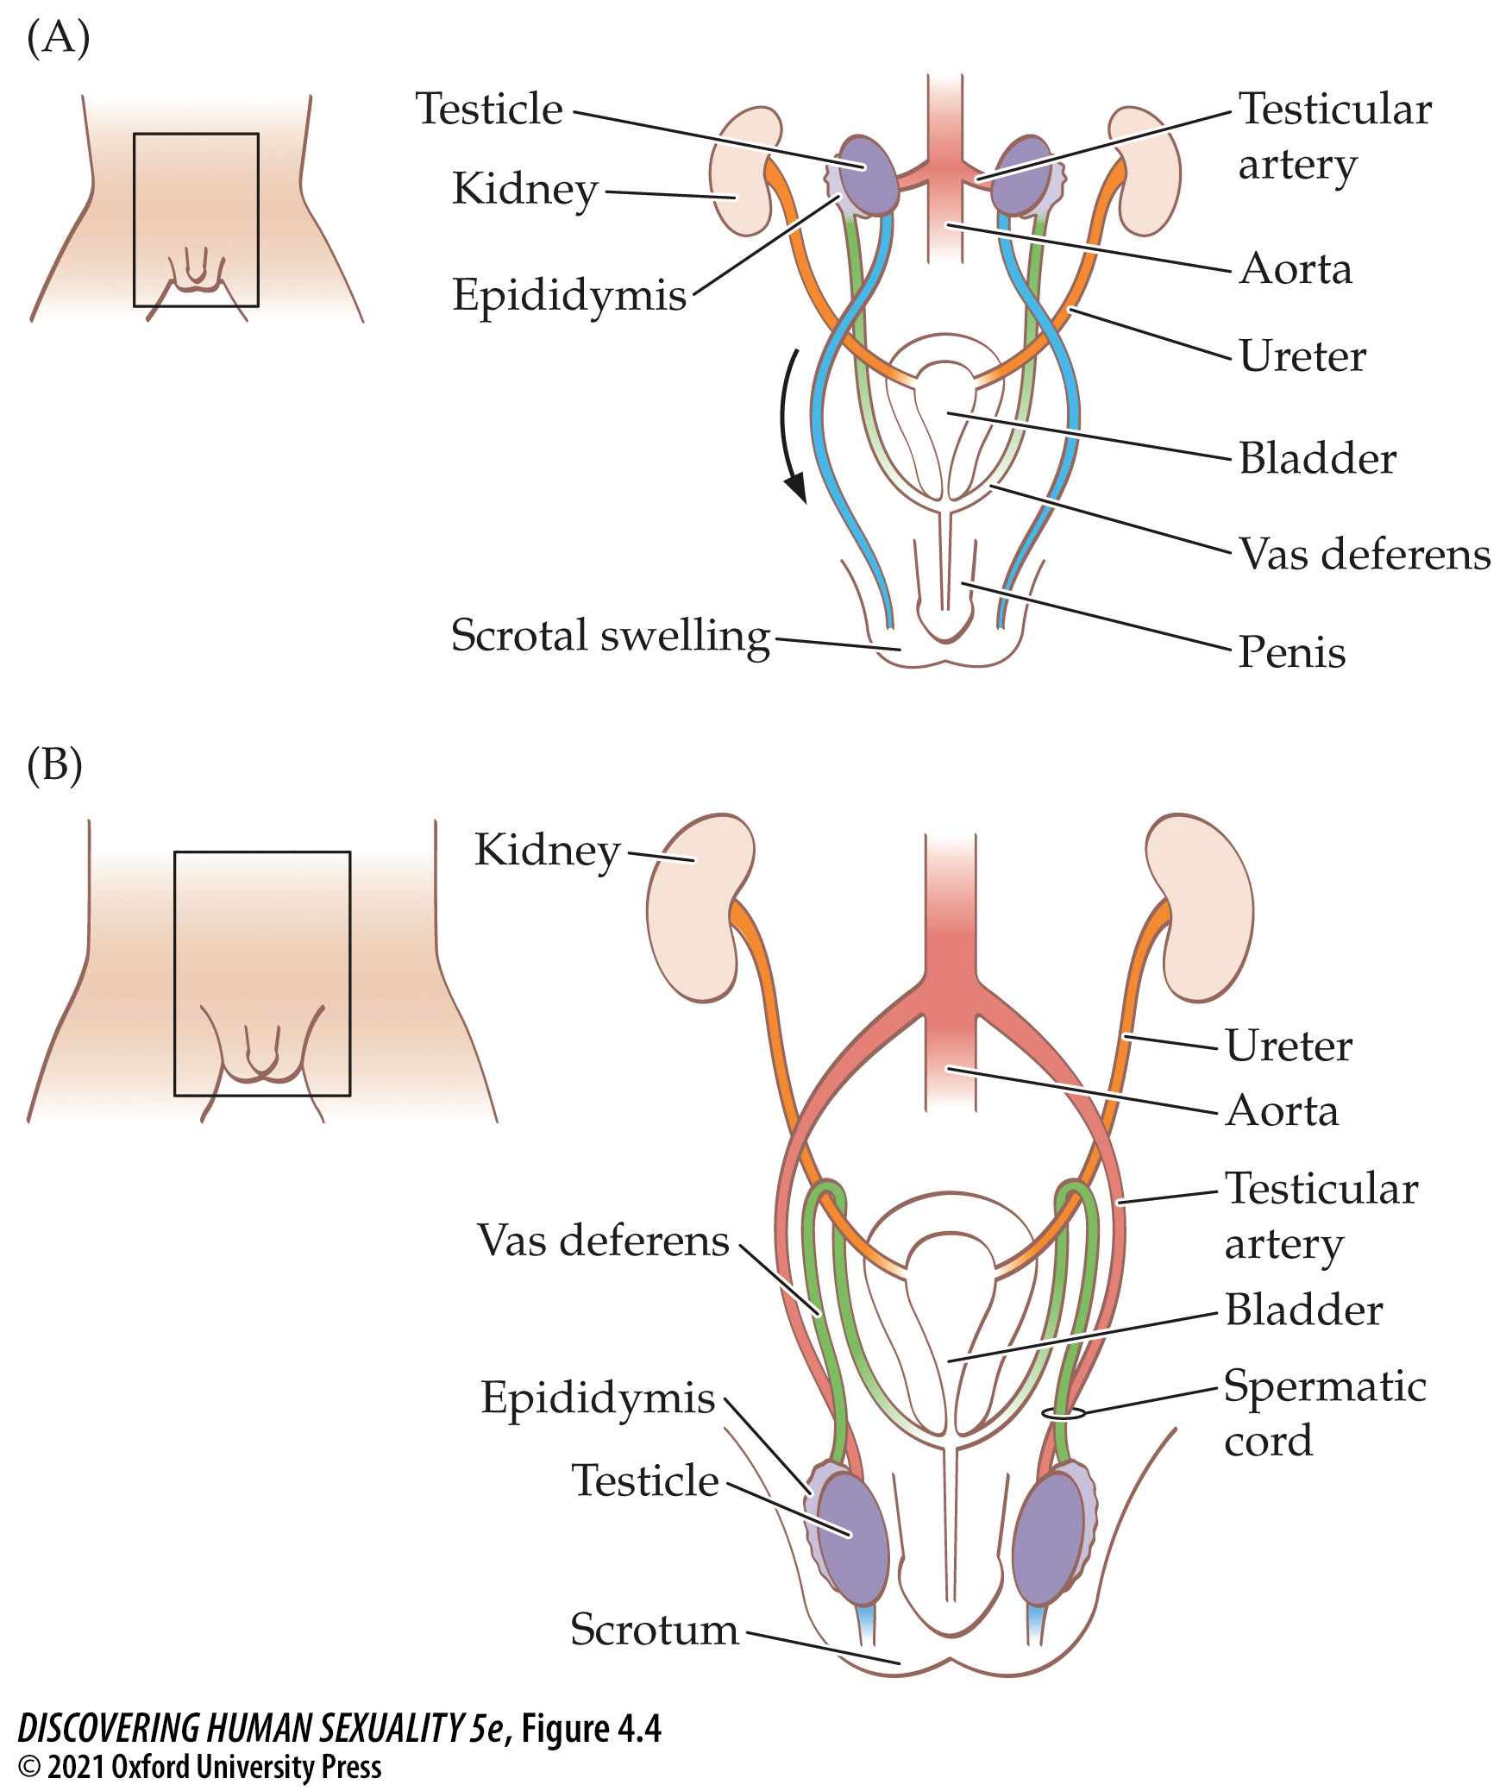
Figure 4.4 Descent of the testicles (2)
Notes:
Figure 4.4 Descent of the testicles (A) Before descent, at 10 weeks, a fibrous cord (shown here in blue) attaches each testicle to the region of the scrotal swelling. (B) As the fetal body grows, this attachment pulls each testicle down and into the scrotum. Note how the vas deferens (green) and the testicular artery (pink) are pulled after the testicle and how the vas deferens comes to loop over the ureter (the tube, shown here in orange, that carries urine from the kidney to the bladder).

Slide 15
4.1 Genes and Hormones Guide Sex Development (8)
Sex development occurs during weeks 8–24 of fetal life, when testosterone levels are high in male fetuses.
Another surge in testosterone in boys occurs during the first 6 months.
Then sex hormone levels in both sexes remain low until puberty, when testicles and ovaries begin secreting sex hormones at levels that initiate reproductive maturity.

Slide 16
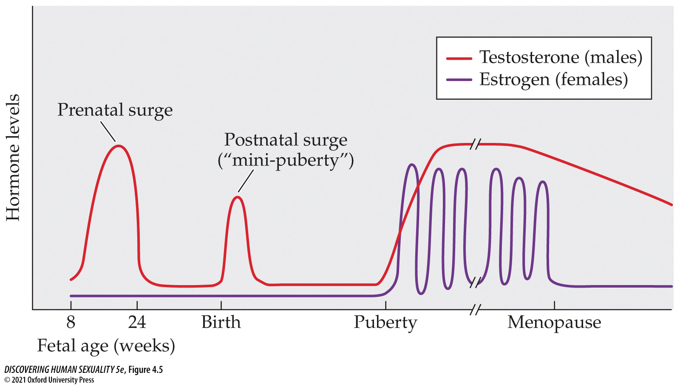
Figure 4.5 Hormones over the lifespan
Notes:
Figure 4.5 Hormones over the lifespan This is a highly schematic representation of the levels of testosterone in males and estrogen in females from conception through old age, ignoring pregnancy. Progesterone levels are not shown.

Slide 17
4.1 Genes and Hormones Guide Sex Development (9)
The brain also differentiates sexually:
  Some brain regions are larger in women; other brain regions are larger in men.
  Although there is overlap in the sizes, it is possible to tell the sex of an individual brain with 93% accuracy.
  Connections between left and right hemispheres are stronger in women; connections within each side of the brain are stronger in men.

Slide 18
4.1 Genes and Hormones Guide Sex Development (10)
  There are also differences in the metabolism of neurotransmitters such as serotonin and dopamine.
These differences are attributed to the different levels in circulating androgen between females and males during development.
Each brain cell also carries the sex chromosomes corresponding to that individual’s sex— the brain “knows” its own intrinsic sex.

Slide 19
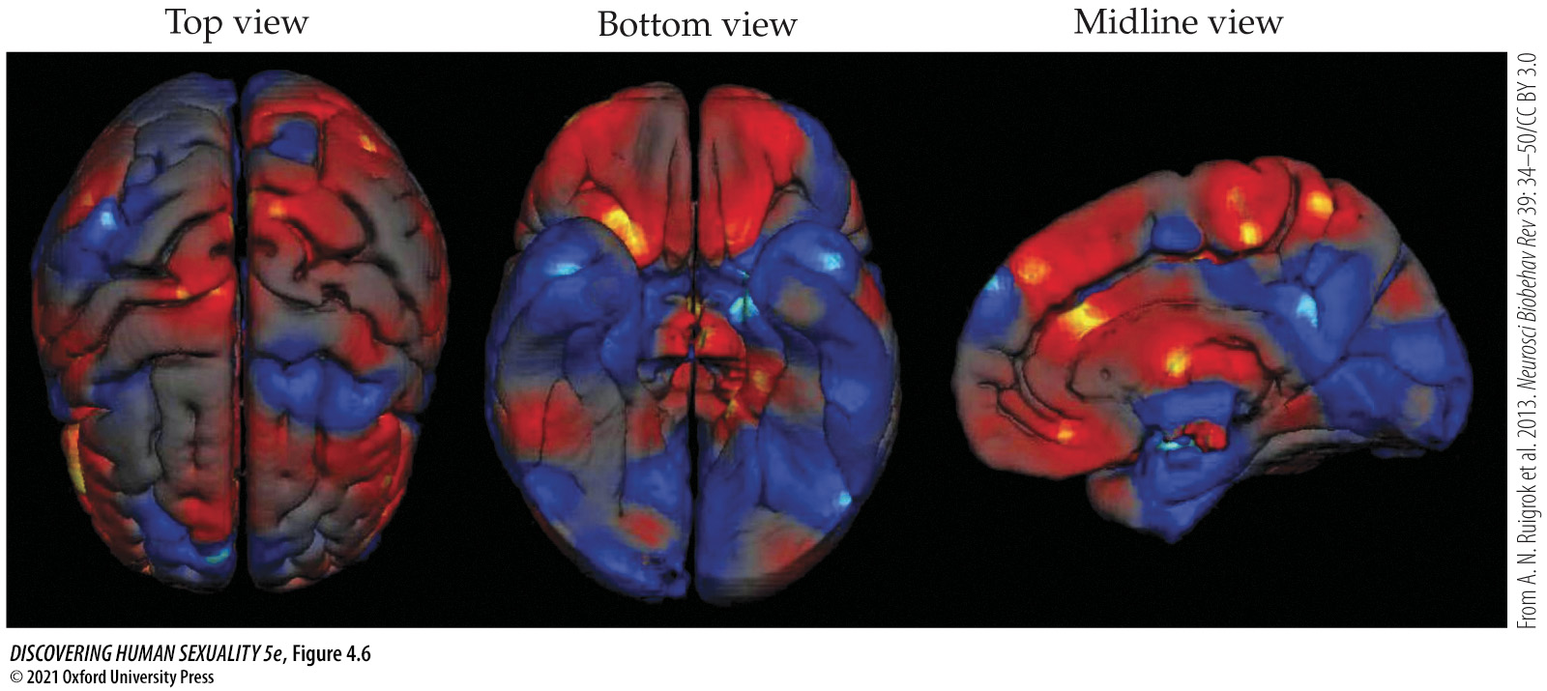
Figure 4.6 Sex differences in the cerebral cortex
Notes:
Figure 4.6 Sex differences in the cerebral cortex Regions that are larger in women are shown in red; those that are larger in men are shown in blue. Note that the sex differences are not the same in the left and right hemispheres. These images are based on a meta-analysis of numerous quantitative brain-imaging studies.

Slide 20
4.2 Sex Development Is Not Always Binary
Learning Objectives:
4.2.1 Give two examples of disorders of sex development that are caused by atypical complements of sex chromosomes, and name the chromosomal patterns that cause them.
4.2.2 Explain how a chromosomally male fetus develops if it carries a mutation that makes it insensitive to androgens.
4.2.3 Explain the possible anatomical and psychological effects of congenital adrenal hyperplasia.
4.2.4 Explain the sexual development of a chromosomally male individual that lacks the enzyme 5-alpha-reductase.

Slide 21
4.2 Sex Development Is Not Always Binary (1)
Disorders of sex development
Atypical numbers of sex chromosomes:
  Klinefelter syndrome (XXY, XXXY): male, tall, low testosterone, small genitals, low sperm count, usually infertile. Many identify as gay or bisexual.
  Turner syndrome (XO): female, short, lack normal ovaries, require assistance to enter puberty, infertile. Not intellectually disabled and excel in a variety of careers.

Slide 22

Figure 4.7 Klinefelter syndrome
Notes:
Figure 4.7 Klinefelter syndrome 13-year-old Luke is tall for his age but otherwise physically unremarkable. An interview with him is viewable online at tinyurl.com/u455ybu. People with Klinefelter syndrome vary greatly in physical appearance.

Slide 23
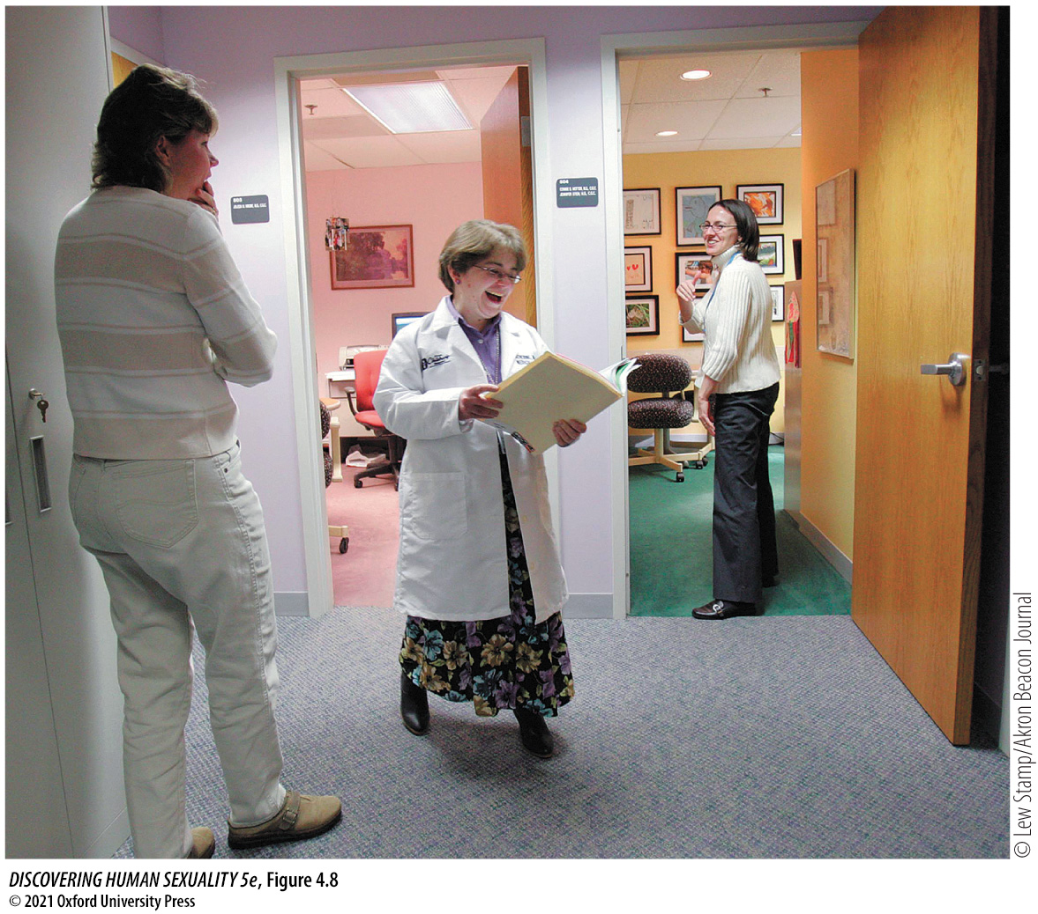
Figure 4.8 Turner syndrome
Notes:
Figure 4.8 Turner syndrome Dr. Catherine Ward-Melver is a geneticist at Akron Children’s Hospital, in Ohio, and past president of the Turner Syndrome Society. Her short stature (4 feet 8 inches, or 1.42 m) is a feature of Turner syndrome.

Slide 24
4.2 Sex Development Is Not Always Binary (2)
  XYY syndrome: male, may have genital anomalies, atypical cerebral cortex development. Intelligence tends to be low, and autism is common.
  Triple-X syndrome: female, atypical facial features, may have learning disabilities, but not all XXX girls are affected.

Slide 25
4.2 Sex Development Is Not Always Binary (3)
Gonads or genitals may be sexually ambiguous. Persons affected by such conditions may be referred to as (or describe themselves as) intersex.
Ovotesticular disorder: having both ovarian and testicular tissue, most look like and identify as women, usually infertile.

Slide 26
4.2 Sex Development Is Not Always Binary (4)
Androgen Insensitivity Syndrome (AIS): XY, but androgen receptors are completely or partially nonfunctional. The reproductive tract of either sex fails to develop; infertile.
Persons with complete AIS look like and identify as females; persons with partial AIS have variable anatomy, appearance, and sense of which sex they are.

Slide 27
4.2 Sex Development Is Not Always Binary (5)
Congenital adrenal hyperplasia (CAH): adrenal glands secrete unusually high levels of androgens. In XX fetuses, it causes a partial masculinization of the genitals; can be prevented by noninvasive prenatal testing and treatment.
5-alpha-reductase deficiency: this enzyme converts testosterone to the androgen 5α-dihydrotestosterone (DHT) required for development of external male genitals, but not the brain. Genitals appear as female until puberty.

Slide 28
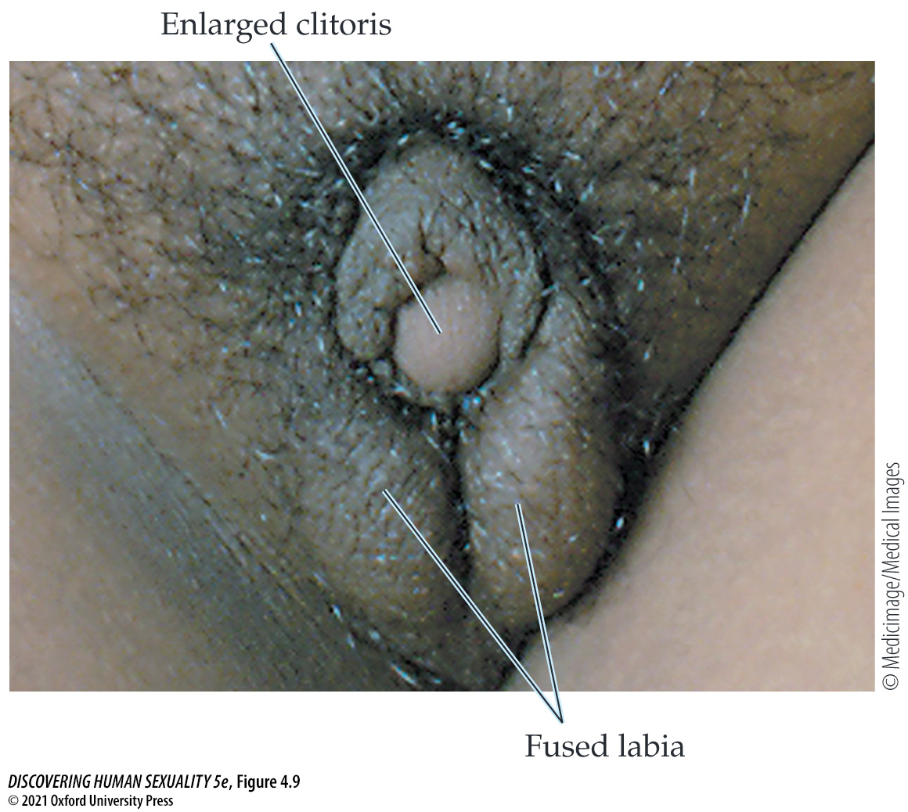
Figure 4.9 Partial masculinization of genitalia in a girl with congenital adrenal hyperplasia
Notes:
Figure 4.9 Partial masculinization of genitalia in a girl with congenital adrenal hyperplasia. Note that the fused labia resemble scrotal sacs, but they do not contain testicles.

Slide 29
4.2 Sex Development Is Not Always Binary (6)
A person’s sex can be defined by several different criteria:
  Chromosomal sex— XX, XY, or other combination.
  Gonadal sex possession of ovaries, testes, or a combination.
  Anatomical sex— refers to the external genitalia.
  Natal sex— the anatomical sex at birth.
  Assigned sex— assigned to newborns by doctors or parents; nearly always corresponds to natal sex.

Slide 30
4.2 Sex Development Is Not Always Binary (7)
For children with ambiguous genitalia, many ethical questions arise concerning what they should be told, how they should be raised, and whether the genitalia should be surgically altered.
In response to activism by intersex people, there is a movement away from early surgery, unless medically essential. Later, children can make their own informed decisions.
Intersex people may have many difficulties because of society’s insistence on rigid male/female categorization.

Slide 31
4.3 There Are Sex Differences in Many Mental Traits
Learning Objectives:
4.3.1 Give examples of gender differences in areas other than sexuality.
4.3.2 Give examples of gender differences in the area of sexuality.

Slide 32
4.3 There Are Sex Differences in Many Mental Traits (1)
Psychological sex differences are matters of degree and not absolute differences.
Gender identity is the personal sense of which sex one belongs to. For some people, gender identity does not match their anatomical sex.
Natal women who say they feel like men and natal men who say they feel like women are transgender.

Slide 33
4.3 There Are Sex Differences in Many Mental Traits (2)
Men and women differ in cognitive traits, which relate to averages; they don’t predict performance of any individual.
Females outperform males in reading and verbal skills, fine finger movements, and ability to recall facts and events (declarative memory).
Males outperform females in some visuospatial skills, such as navigation, mental rotation, and mathematics.
These differences are smaller than differences in physical traits.

Slide 34
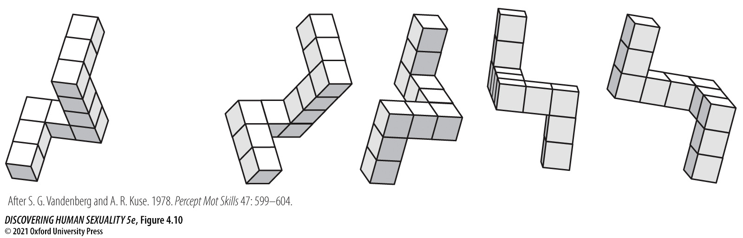
Figure 4.10 Mental rotation task
Notes:
Figure 4.10 Mental rotation task From the four images at right, a test taker is asked to select the two objects that could be rotated in space to match the object shown at left. Men generally outperform women in this kind of task. (After S. G. Vandenberg and A. R. Kuse. 1978. Percept Mot Skills 47: 599–604.)

Slide 35
4.3 There Are Sex Differences in Many Mental Traits (3)
Personality differences:
  Males score higher on assertiveness and physical aggressiveness, risk-proneness, dutifulness (rule-following), emotional stability, and openness to abstract ideas.
  Females score higher on warmth, sensitivity, compassion, anxiety, aesthetics, and openness to change.

Slide 36
4.3 There Are Sex Differences in Many Mental Traits (4)
Women’s interests are more people-related and empathetic.
Men’s interests are more thing-related.
This may incline women and men toward different occupations, but it is difficult to disentangle from the effects of social expectations and discrimination.

Slide 37
4.3 There Are Sex Differences in Many Mental Traits (5)
Sexuality differences:
  Men have a stronger sex drive.
  Women are more influenced by the earning capacity of potential partners; men are more influenced by their partners’ physical appearance and young age.
  Women are more likely to experience emotional jealousy; men are more likely to experience sexual jealousy.
  Women are less likely than men to be exclusively homosexual but more likely than men to be bisexual.

Slide 38
4.3 There Are Sex Differences in Many Mental Traits (6)
Men are more likely to be interested in unusual sexual expression (“kinks”), and to experience pathological forms of sexuality.
Men are aroused and reach orgasm faster than women. Many women but few men experience multiple orgasms.
Women’s reproductive capacity ceases abruptly at menopause; men’s declines gradually.
Reproduction is more of a “gamble” for men than for women; sexual behavior has more direct potential consequences for women.

Slide 39
4.3 There Are Sex Differences in Many Mental Traits (7)
Many gender differences arise at a young age.
  Male fetuses are more active than female fetuses.
  By about 3 months, most children show sex differences in toy preferences.
  Boys engage in more competitive, strenuous, and aggressive rough-and-tumble play.
  By about 4 years of age, most boys prefer to play with boys, and most girls with girls.
  Play is governed by different moral rules.

Slide 40
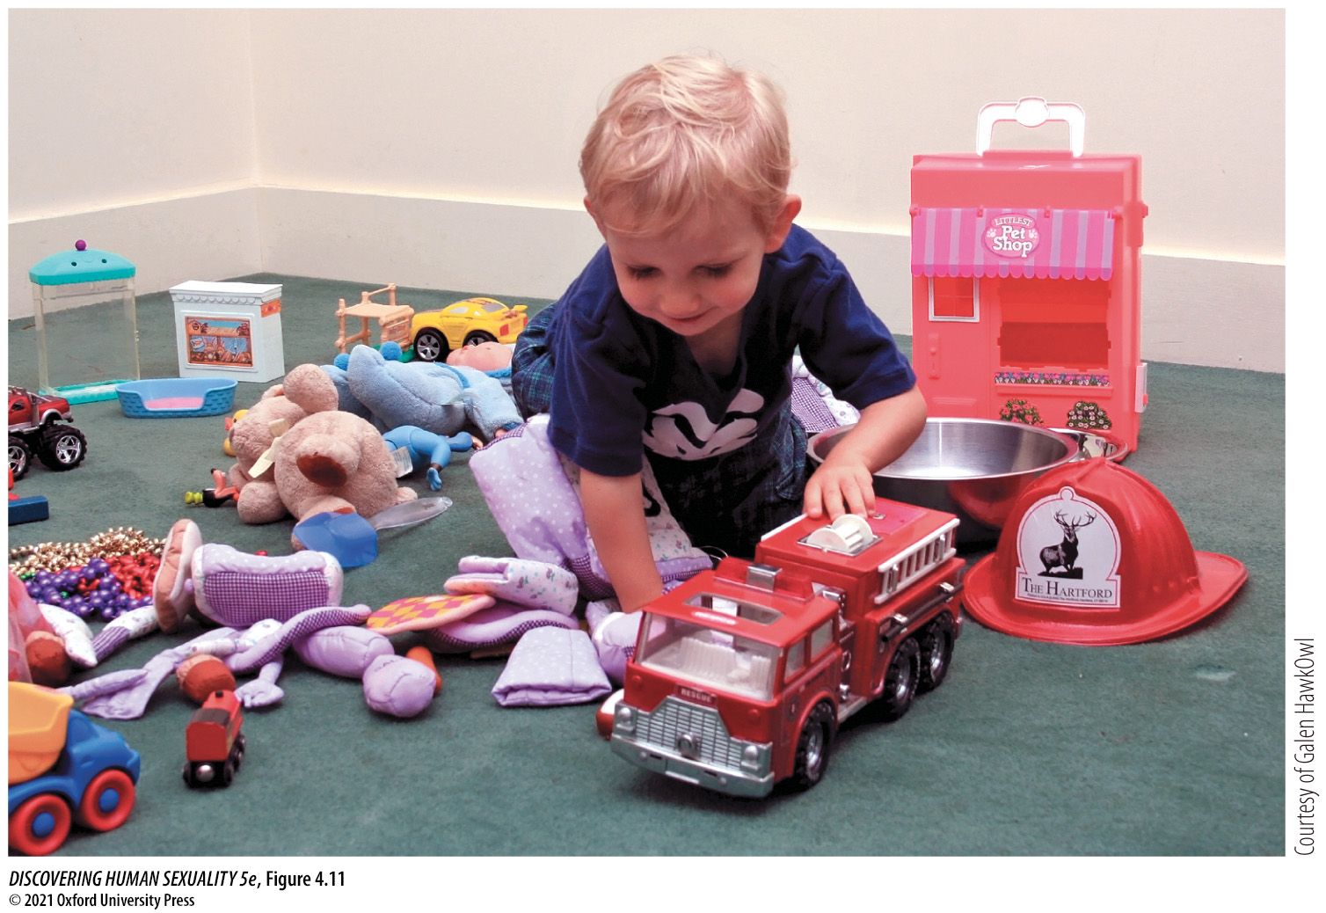
Figure 4.11 Toy preference test
Notes:
Figure 4.11 Toy preference test A child is placed within a circle of toys, and his or her play behavior is videotaped. Later, observers measure the amount of time the child spends playing with toys generally preferred by girls and those generally preferred by boys. Figure 4.13 shows examples of data from this kind of study.

Slide 41
4.4 Biological Factors Contribute to Sex Differences
Learning Objectives:
4.4.1 Give an example of how evolution has promoted gender differences.
4.4.2 Give an example of how sex hormones during development influence gender differences.

Slide 42
4.4 Biological Factors Contribute to Sex Differences (1)
Evolutionary factors
  Casual sex is less costly for men than women. Women have to invest time and resources into pregnancy and child care. Genes may have evolved that promote men’s interest in casual sex and women’s choosiness about who they mate with.
  Jealousy— men cannot be absolutely certain which children are theirs, but women are certain. This may have led to genes promoting the different styles of jealousy.

Slide 43
4.4 Biological Factors Contribute to Sex Differences (2)
  Cognitive differences may be due to long-standing division of labor, which might have favored genes for different cognitive skills, such as greater throwing and navigating skills of men, and greater hand and finger dexterity of women.

Slide 44
4.4 Biological Factors Contribute to Sex Differences (3)
Sex hormones: experiments with animals suggest they contribute to psychological sex differences.
Girls with CAH are exposed to high levels of androgens during part of their fetal life. Some behavioral traits are shifted in the masculine direction.
Studies of fetal androgen levels show that higher prenatal levels shift behaviors of girls and boys in the masculine direction.

Slide 45
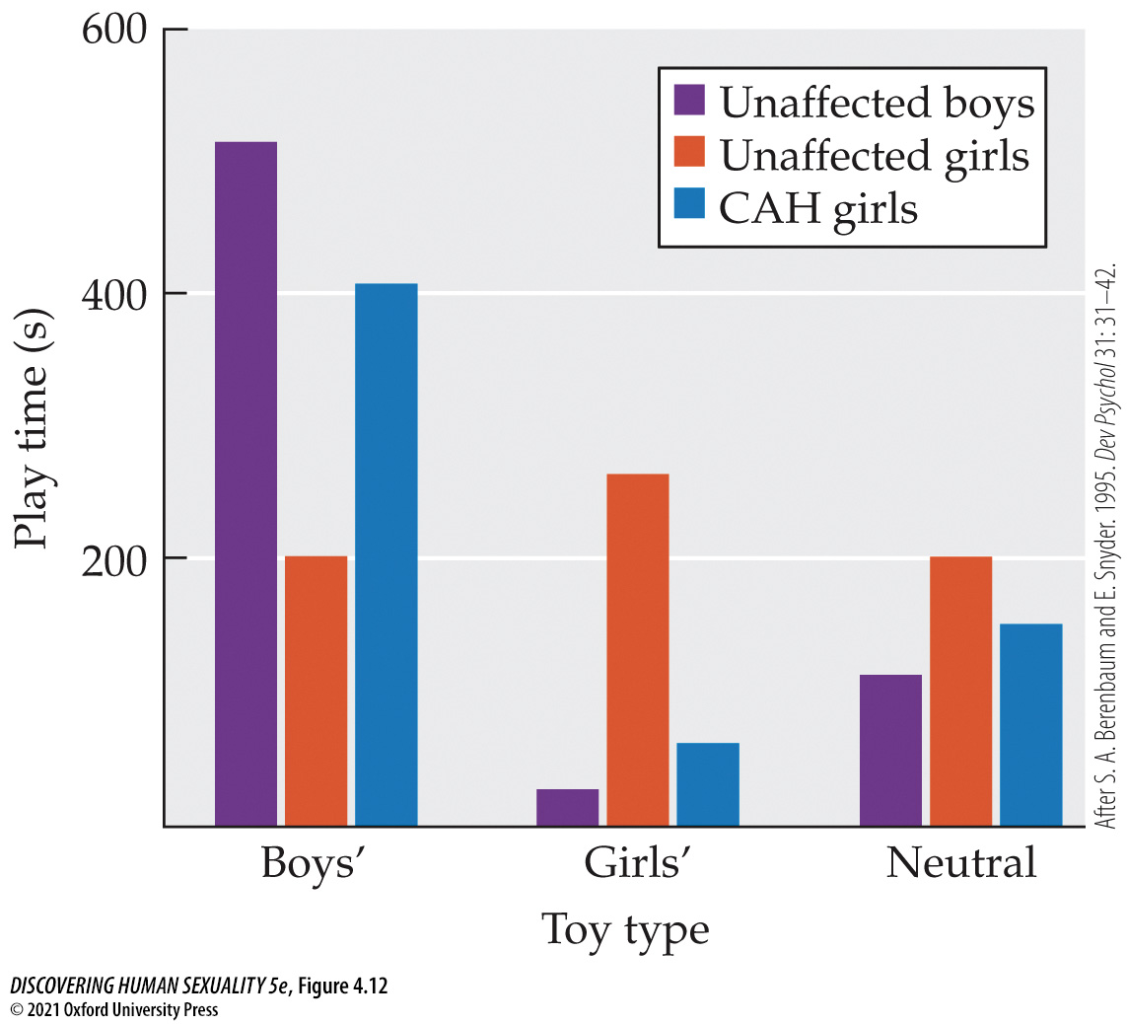
Figure 4.12 Hormones and play
Notes:
Figure 4.12 Hormones and play Exposure to androgens during fetal life influences choice of toys during childhood. Girls with congenital adrenal hyperplasia (CAH), as well as unaffected girls and boys, were observed while playing with toys. The toys available included those generally preferred by boys (e.g., trucks) and those generally preferred by girls (e.g., dolls), as well as gender-neutral toys. The toy preferences of the girls with CAH were more like those of boys than like those of unaffected girls. (After S. A. Berenbaum and E. Snyder. 1995. Dev Psychol 31: 31–42.)

Slide 46
4.4 Biological Factors Contribute to Sex Differences (4)
The ratio of index-finger length to ring-finger length is an anatomical marker in adults that may reflect the degree to which people were exposed to testosterone prenatally.
Men typically have a lower 2D:4D ratio than women.
The 2D:4D ratio correlates with many gendered characteristics.

Slide 47
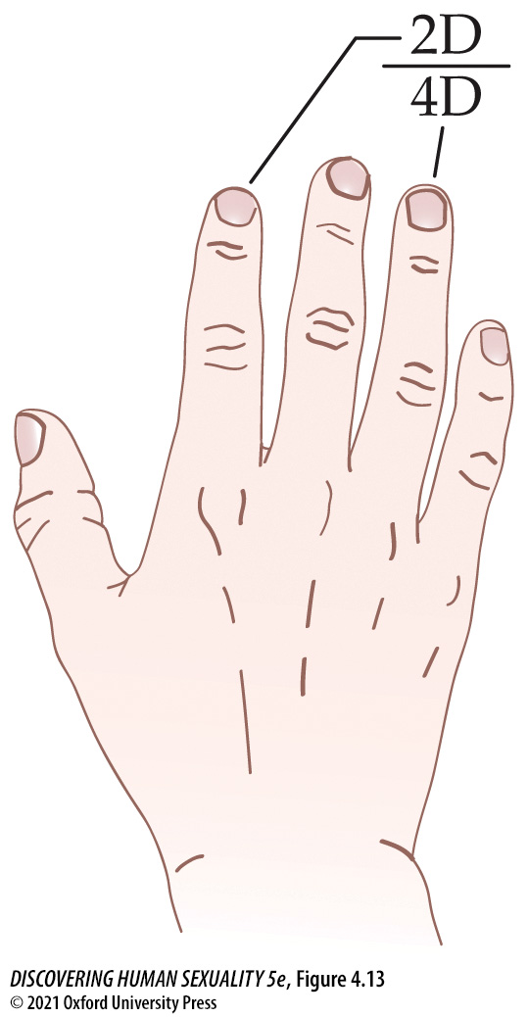
Figure 4.13 Finger length ratio and gender
Notes:
Figure 4.13 Finger length ratio and gender The 2D:4D ratio is the length of the index finger divided by the length of the ring finger. The ratio is typically lower in men than women, but it also varies with gender characteristics within each sex.

Slide 48
4.5 Life Experiences Mold Sex Roles
Learning Objectives:
4.5.1 Give an example of how socialization promotes gender differences.
4.5.2 Discuss the evidence that imitation is important in the development of gender differences.
4.5.3 Explain how “sexual scripts” influence gender differences.

Slide 49
4.5 Life Experiences Mold Sex Roles (1)
Interactions among individuals, their families, and society help create and strengthen sex roles.
Girls and boys are socialized differently, starting at birth.
Parents influence psychological development through clothing, toys, etc., and how they reward or punish behavior.
The sex of older siblings can also influence behaviors.
Children may learn sex-typical behaviors by imitating parents or peers.

Slide 50
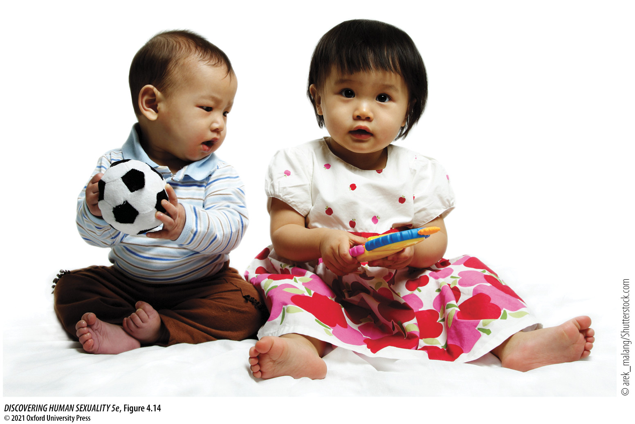
Figure 4.14 Babies enter a gendered world
Notes:
Figure 4.14 Babies enter a gendered world These children have been dressed in the pink and blue outfits that our culture deems appropriate for infant girls and boys, respectively.

Slide 51
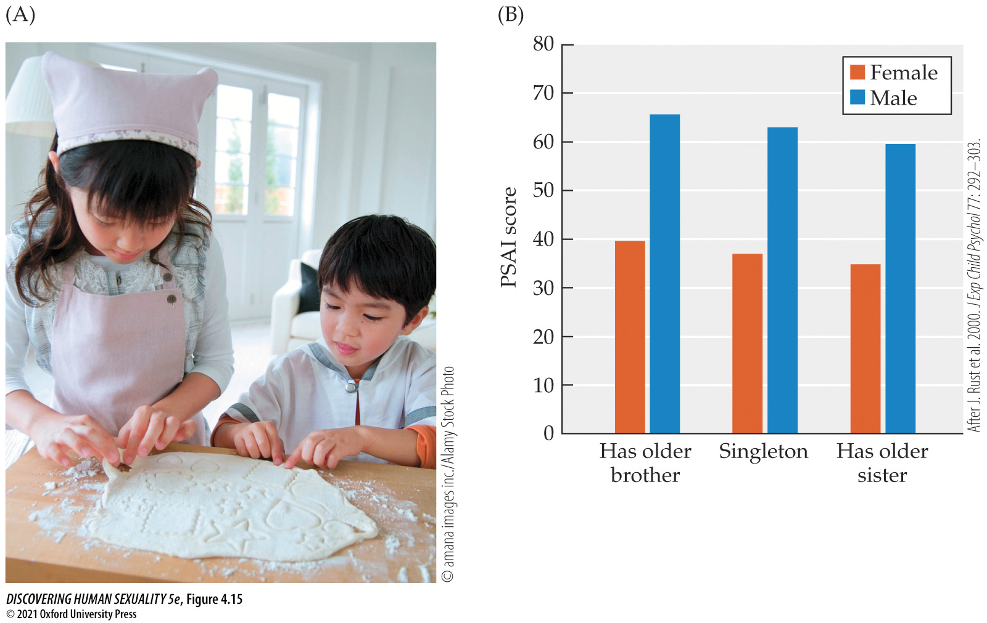
Figure 4.15 Influence of siblings on gender
Notes:
Figure 4.15 Influence of siblings on gender (A) Older siblings act as gender role models. (B) The Pre-School Activities Inventory (PSAI) score is a measure of gender-typical activities and interests in which male-typical traits score higher and female-typical traits score lower. This figure shows the PSAI score for 5,542 British 3-year-olds, broken down according to whether they are singletons or have older brothers or sisters. The children’s gender traits are slightly shifted in the direction of the sex of the older sibling. (After J. Rust et al. 2000. J Exp Child Psychol 77: 292–303.)

Slide 52
4.5 Life Experiences Mold Sex Roles (2)
Television and movies offer much for children to imitate.
One study showed that exposure to Disney princesses predicted an increase in stereotypically female ideas and behaviors in both girls and boys.
Exposure to superheroes predicted an increase in stereotypically male ideas and behaviors in both sexes.

Slide 53

Figure 4.16 The media influence gender
Notes:
Figure 4.16 The media influence gender Disney Princess and Captain America movies may promote the development of stereo­typical gender roles.

Slide 54
4.5 Life Experiences Mold Sex Roles (3)
Language facilitates learning sex roles:
Where grammar emphasizes sex, such as Hebrew, children know their own sex about a year earlier than children in Finland, where grammar doesn’t specify sex.
There is a growing trend towards non-gendered pronouns, such as the use of they (singular).
Language and verbally communicated rules: for example, “big boys don’t cry.”

Slide 55
4.5 Life Experiences Mold Sex Roles (4)
Cognitive developmental models
The sexual script theory: sexual behavior is a form of role-playing, influenced by scripts that we have learned.
Scripts can change under the influence of culture, and can influence psychosexual development.

Slide 56
4.6 Transgender People Challenge Society’s Deepest Divide
Learning Objectives:
4.6.1 Compare the life experiences of transgender people in Western and non-Western societies.
4.6.2 Compare the life histories of a typical autogynephilic and nonautogynephilic (“classical”) trans woman.
4.6.3 Evaluate different strategies for responding to a child who insists they belong to the other sex from their natal sex.
4.6.4 Evaluate the controversy about “rapid-onset gender dysphoria.”
4.6.5 Explain some of the stresses and risks to which trans people are exposed.

Slide 57
4.6 Transgender People Challenge Society’s Deepest Divide (1)
Transgender (trans): individuals whose gender identity does not fully correspond with their natal sex. It is primarily an inner state— a person’s own sense of who they are.
Cisgender: conventionally gendered women and men.
Transexual: the minority of transgender individuals who seek to change their bodies by medical means.
The terms “man” and “woman” refer to the sex the person identifies as or wants to become, not the anatomical sex in which they were born.

Slide 58
4.6 Transgender People Challenge Society’s Deepest Divide (2)
Transgender men and women have probably existed in all human societies. In many societies, they have been given special names and accorded special status— often, a spiritual or sacred one:
Mahus in Polynesia, hijras in India and Pakistan, kathoey in Thailand, two-spirit people in native Americans, “amazons” in ancient Greece.

Slide 59
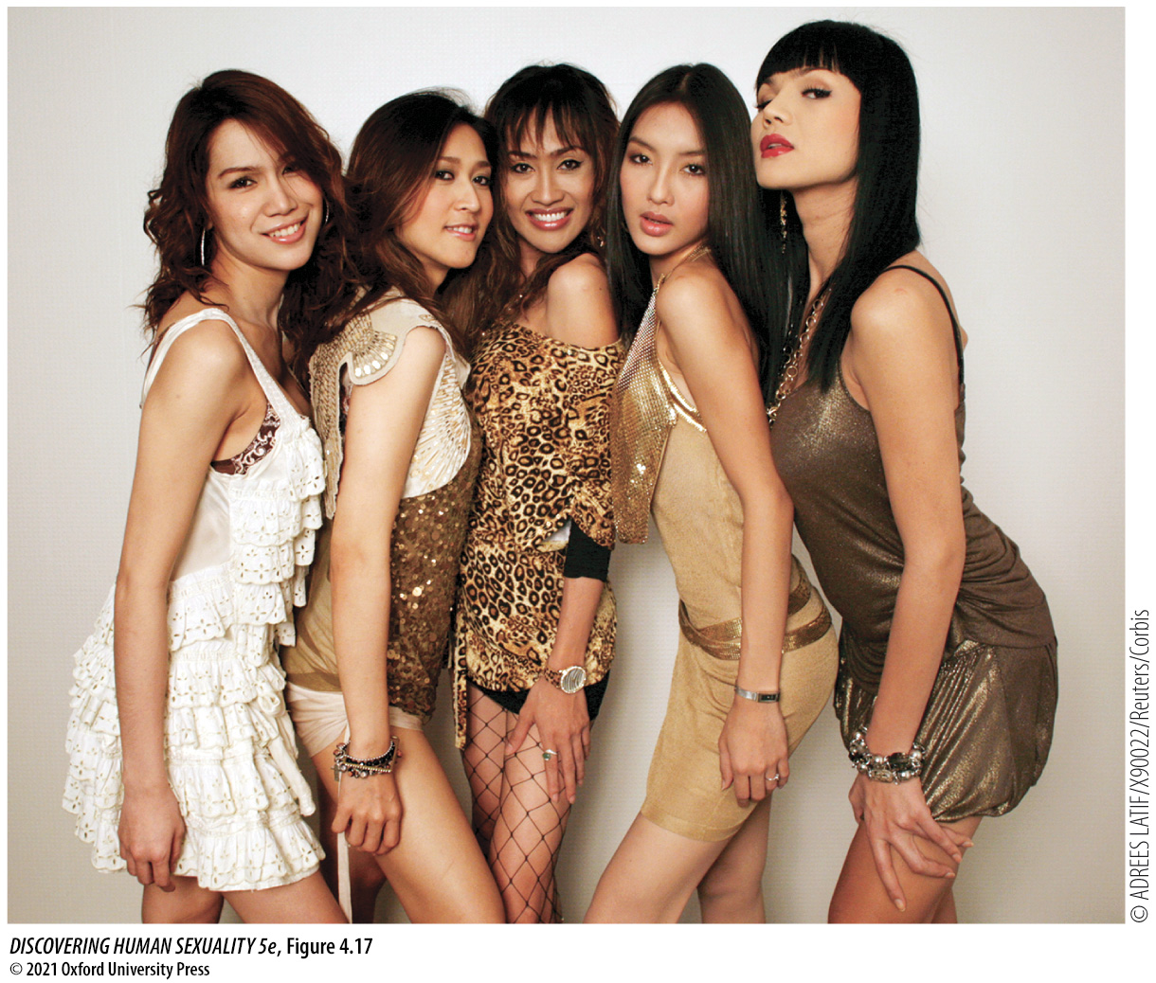
Figure 4.17 Kathoey
Notes:
Figure 4.17 Kathoey Members of the Thai kathoey (transgender) band Venus Flytrap.

Slide 60
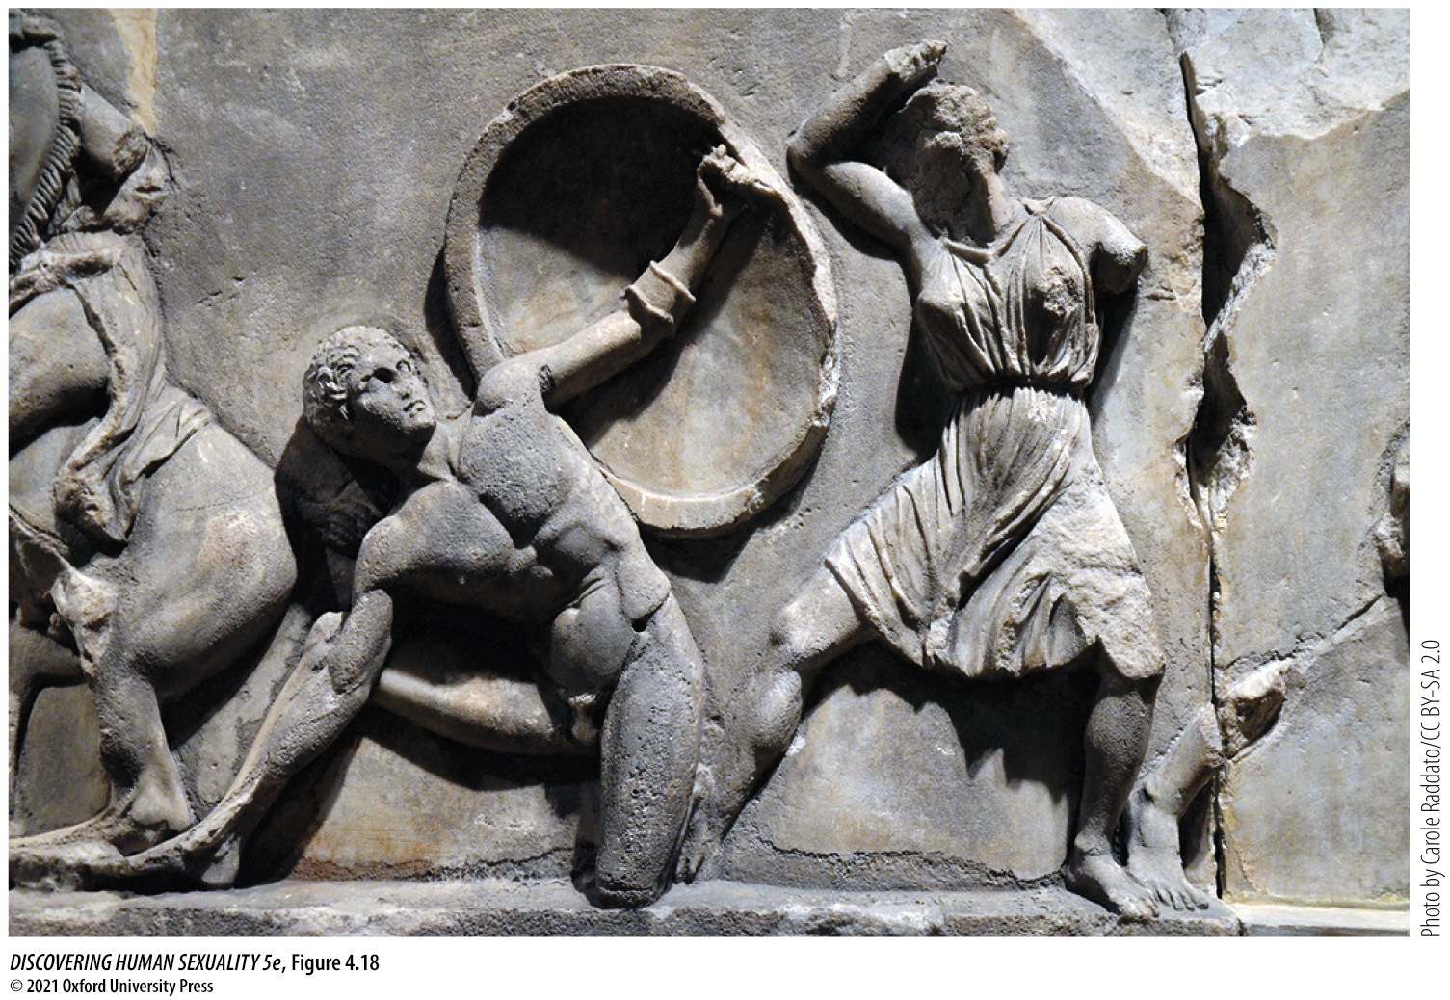
Figure 4.18 Female warrior
Notes:
Figure 4.18 Female warrior An Amazon prepares to strike a cowering Greek soldier. (Her spear is missing.) This sculpture is from the 350 BCE tomb of Mausolus at Halicarnassus (Bodrum, Turkey).

Slide 61
4.6 Transgender People Challenge Society’s Deepest Divide (3)
Non-binary (gender-fluid, genderqueer, or agender): people who reject the male/female dichotomy.
Gender dysphoria: unhappiness caused by discordance between a person’s natal sex and their gender identity.
Most trans men and women have similar life histories and feel like “a man trapped in a woman’s body” or “a woman trapped in a man’s body.”
Some trans women start by being erotically aroused by wearing women’s clothes— transvestism. Later, they desire to become a woman.

Slide 62
4.6 Transgender People Challenge Society’s Deepest Divide (4)
The causes of transexuality are not well understood.
Biological factors such as prenatal hormones or genetics may be involved.
Twin studies suggest that genes influence transexuality, but not all monozygotic twins have the same gender identity.

Slide 63
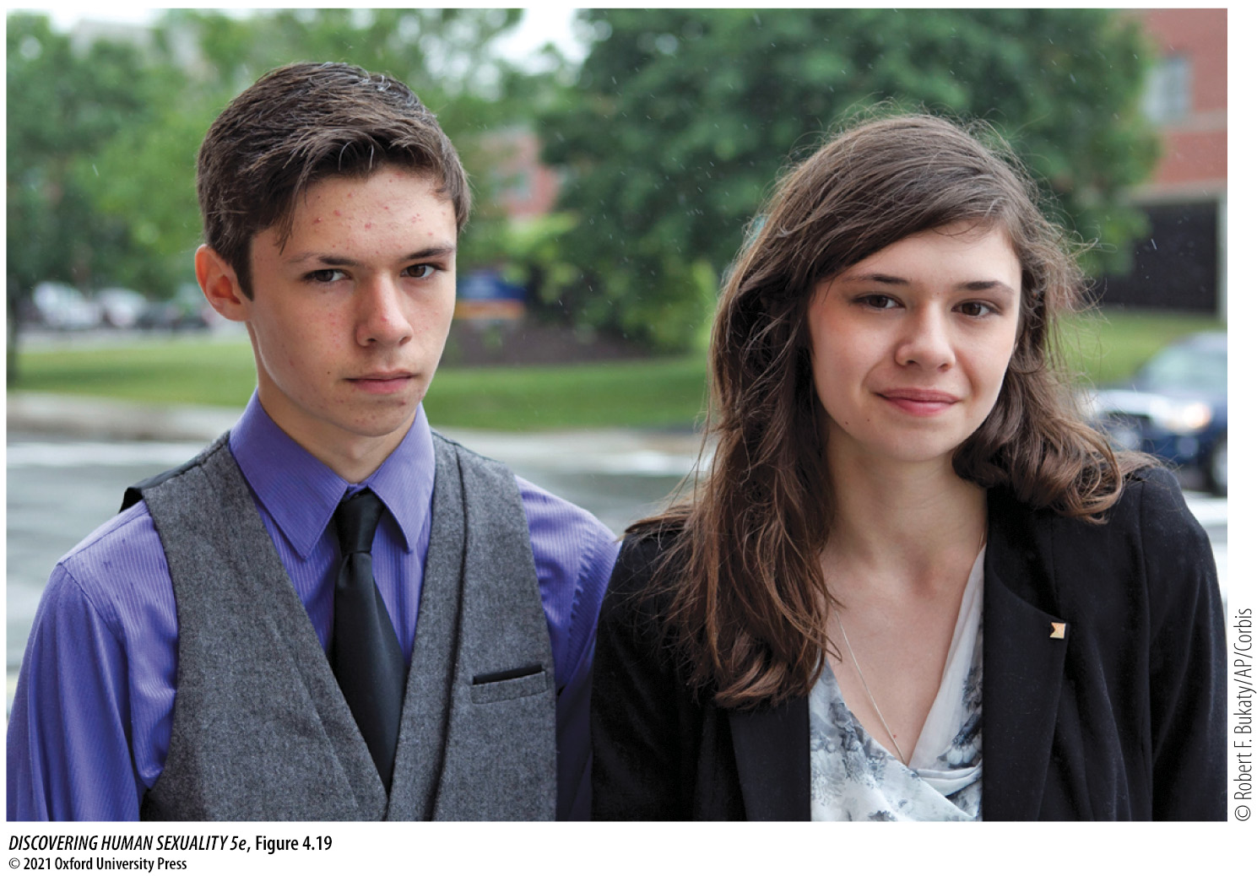
Figure 4.19 Jonas and Nicole Maines are mono­zygotic (“identical”) twins
Notes:
Figure 4.19 Jonas and Nicole Maines are mono­zygotic (“identical”) twins. Both were born male, but Nicole transitioned to female as a teenager.

Slide 64
4.6 Transgender People Challenge Society’s Deepest Divide (5)
Sex-reassignment, or transitioning, is a multistage process that involves 4 stages:
  Assessment, education, and psychotherapy
  Hormonal treatment
  Experience in the desired sex role
  Sex-reassignment surgery

Slide 65
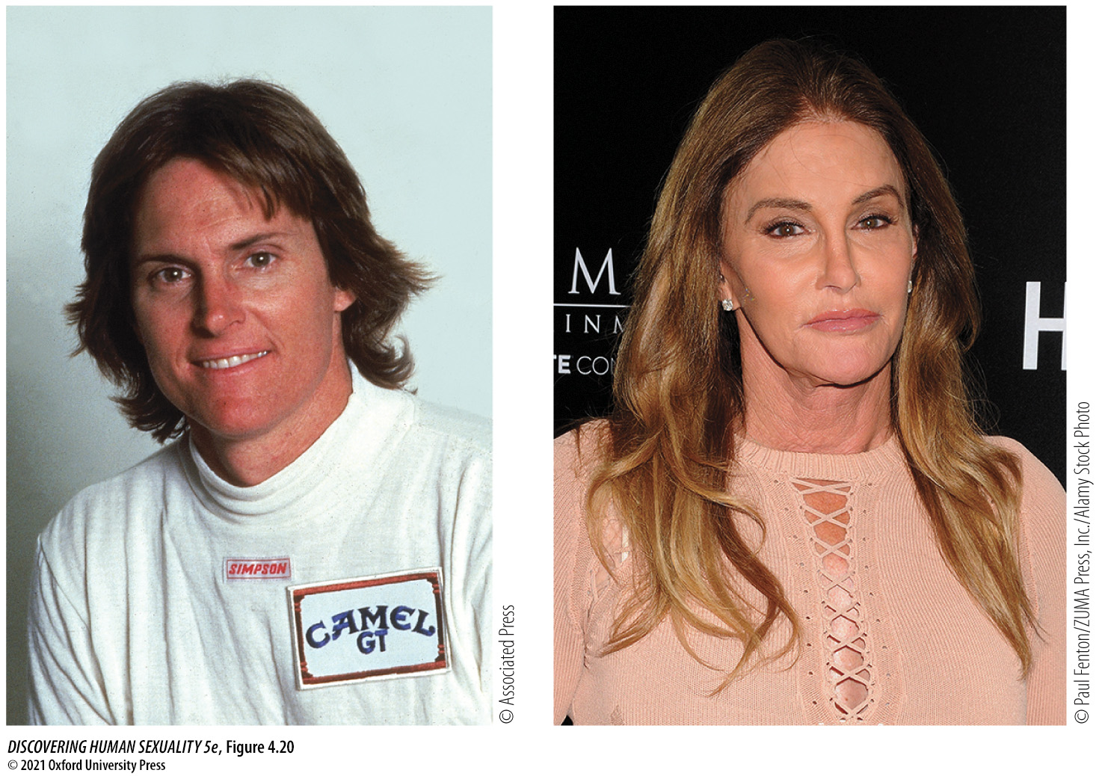
Figure 4.20 Bruce Jenner transitioned to Caitlyn Jenner between 2015 and 2017
Notes:
Figure 4.20 Bruce Jenner transitioned to Caitlyn Jenner between 2015 and 2017.

Slide 66
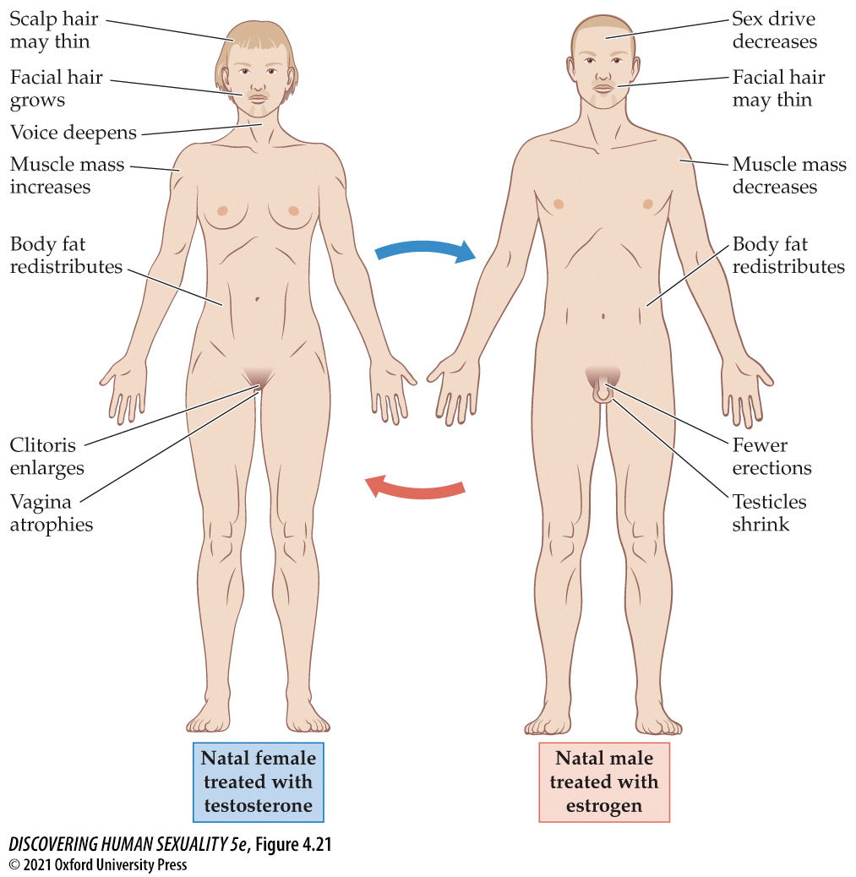
Figure 4.21 Effects of cross-sex hormones on female and male bodies
Notes:
Figure 4.21 Effects of cross-sex hormones on female and male bodies These hormones do not change stature or skeletal structure. Estrogen does not eliminate facial hair or reverse male-pattern baldness in natal males.

Slide 67
4.6 Transgender People Challenge Society’s Deepest Divide (6)
For natal men, key surgical procedures include:
  Removing penis and testicles
  Constructing vagina, labia, and clitoris
  Breast augmentation
For natal women, key surgical procedures include:
  Removing ovaries, uterus, and vagina
  Constructing scrotum and penis
  Removal of breasts

Slide 68
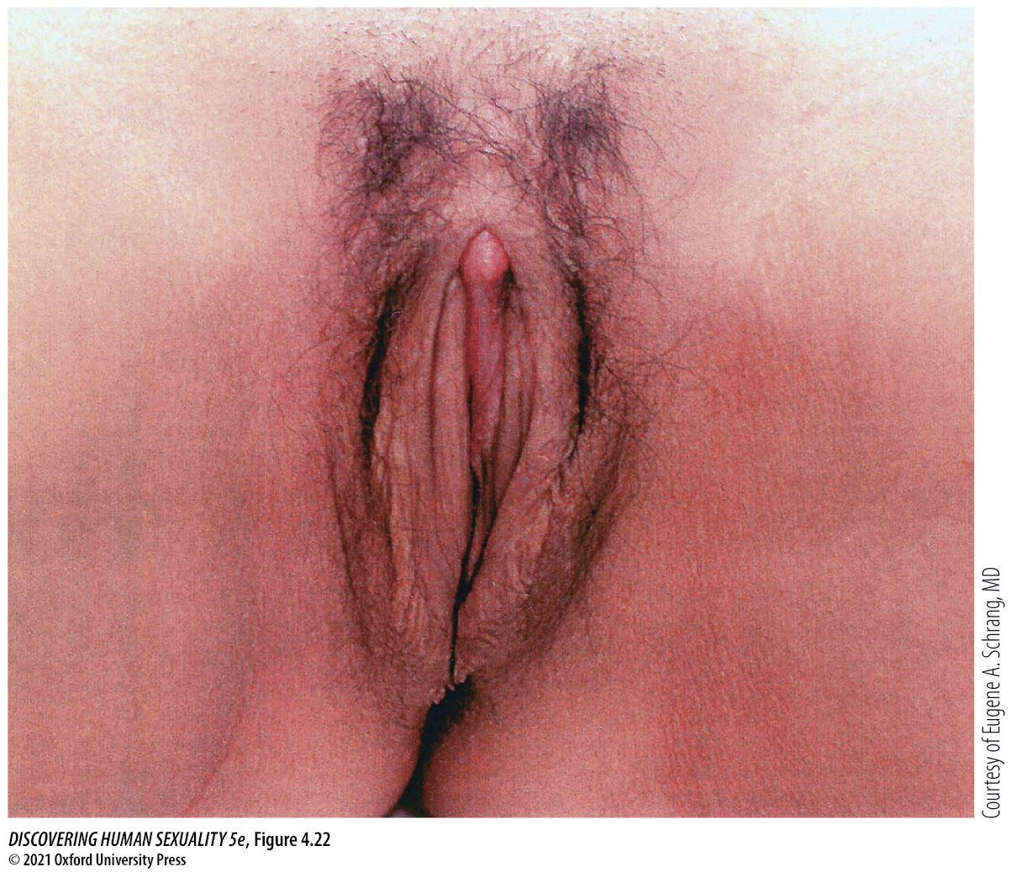
Figure 4.22 The vulva after sex-reassignment surgery
Notes:
Figure 4.22 The vulva after sex-reassignment surgery The clitoris is constructed from the top surface of the penis with its nerve supply intact and may therefore be capable of triggering orgasm. The clitoris and adjacent labial tissue are covered with mucosa derived from the penile urethra, giving them a pink color. The remainder of the penile skin, including the glans, is inverted to form the vagina. Often, additional skin must be grafted from other areas to make the vagina deep enough for coitus.

Slide 69

Figure 4.23 Trans man after transition
Notes:
Figure 4.23 Trans man after transition This man has had his breasts and ovaries removed. His penis was constructed using tissue grafted from his thigh, and he has testicular implants. The penis has erotic sensitivity but is not capable of erection. Testosterone treatments have masculinized several aspects of his appearance including facial hair and muscle development.

Slide 70
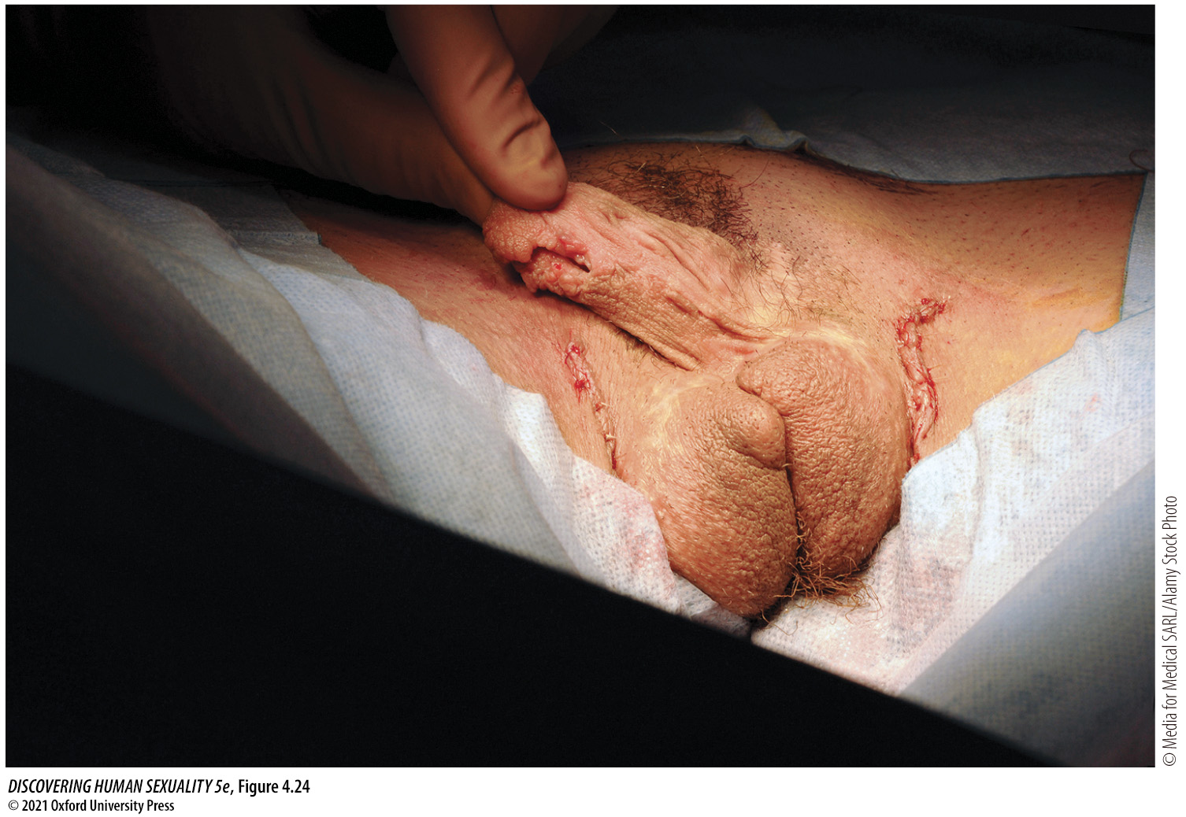
Figure 4.24 Transformation of the clitoris into a small penis by hormone treatment and surgery (metoidioplasty)
Notes:
Figure 4.24 Transformation of the clitoris into a small penis by hormone treatment and surgery (metoidioplasty). This procedure is simpler, less invasive, and less expensive than the construction of a large penis usable for penetrative sex (phalloplasty). This trans man also had a scrotum constructed from labial skin, with saline-filled implants to simulate testicles.

Slide 71
4.6 Transgender People Challenge Society’s Deepest Divide (7)
Rapid-onset gender dysphoria: a proposed diagnostic category applied to individuals who are not gender dysphoric during their childhood but who become so during adolescence.
The concept, and the best treatment options are highly controversial.
Many gender-nonconformist children—those who say they are, or want to become, members of the other sex—abandon those ideas at some point, usually around the time of puberty.

Slide 72
4.6 Transgender People Challenge Society’s Deepest Divide (8)
Trans people struggle for awareness and acceptance as a group distinct from lesbians and gay men.
Their political activism has generally taken place under the umbrella of the much larger gay rights movement.
Transphobia: hatred of transgender people. They are victimized by abuse and hate crimes at a much higher rate than are lesbians and gay men.
Only 16 states have hate crime laws that cover transgender identity.

Slide 73
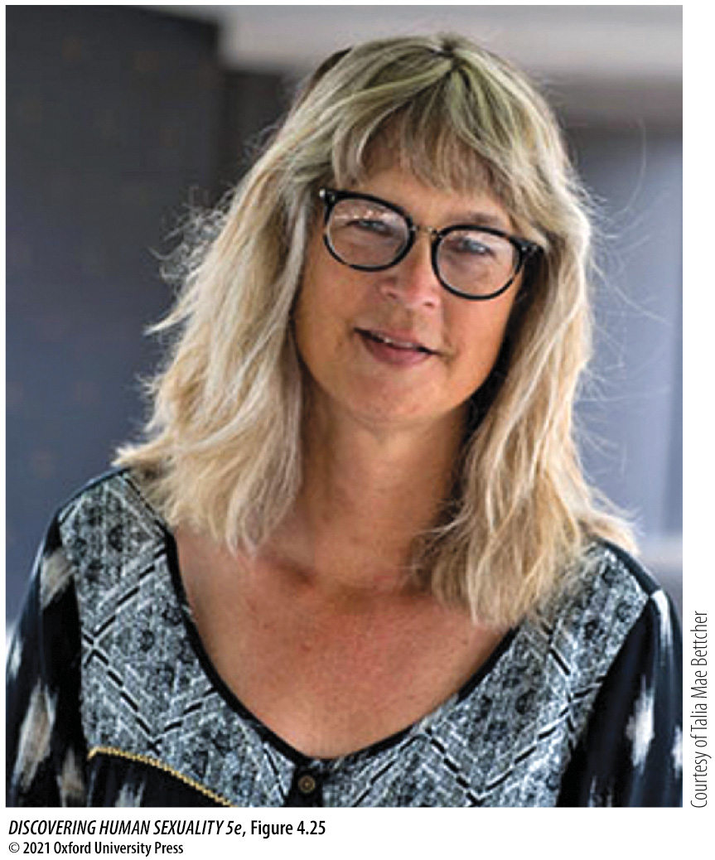
Figure 4.25 Trans philosophy professor
Notes:
Figure 4.25 Trans philosophy professor Talia Mae Bettcher of Cal State LA is also a grassroots activist for the trans community in Los Angeles.

Slide 74

Figure 4.26 Transphobic violence
Notes:
Figure 4.26 Transphobic violence 17-year-old Gwen Araujo of Newark, California (A), was beaten to death by four men who realized that she was anatomically male after two of them had sex with her. All four of the men, three of whom are shown in (B), were convicted of murder or manslaughter and sentenced to prison terms ranging from six years to life (Fraley, 2016).

Slide 75
4.6 Transgender People Challenge Society’s Deepest Divide (9)
Growing up trans or non-binary can be a very stressful experience, especially when there is a lack of family or community support.
Trans youth are exposed to many different forms of victimization.
Attempted and completed suicides are common.

