Slide 1
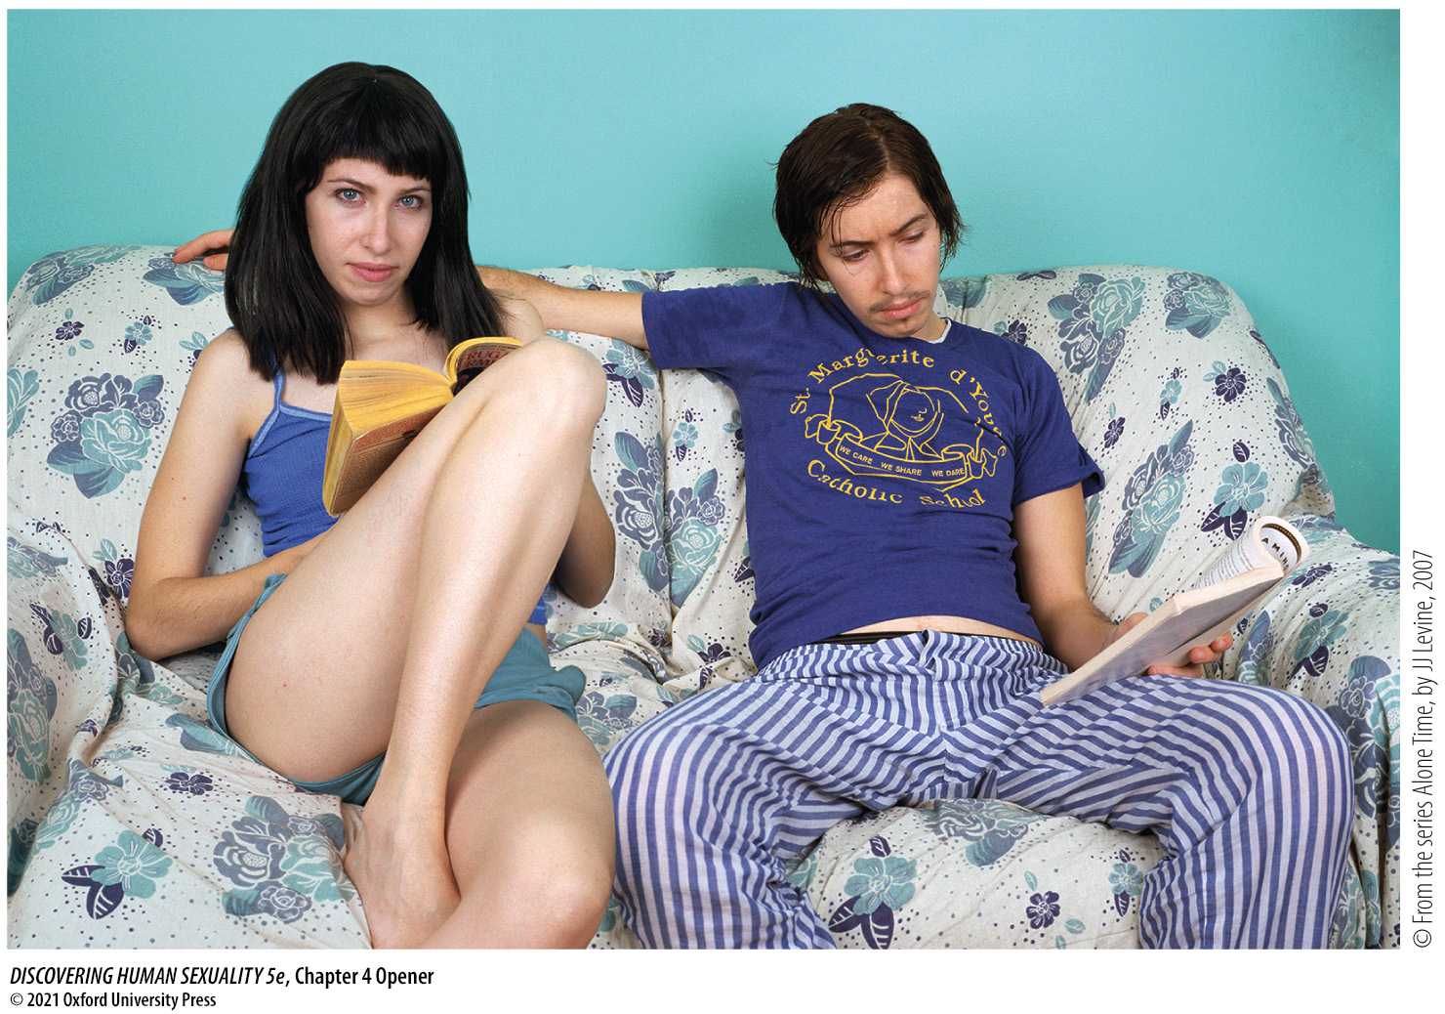
Chapter 4 Opener
Notes:
Chapter 4 Opener
Heterosexual couple? No—a single model photographed in both female and male gender roles.

Slide 2
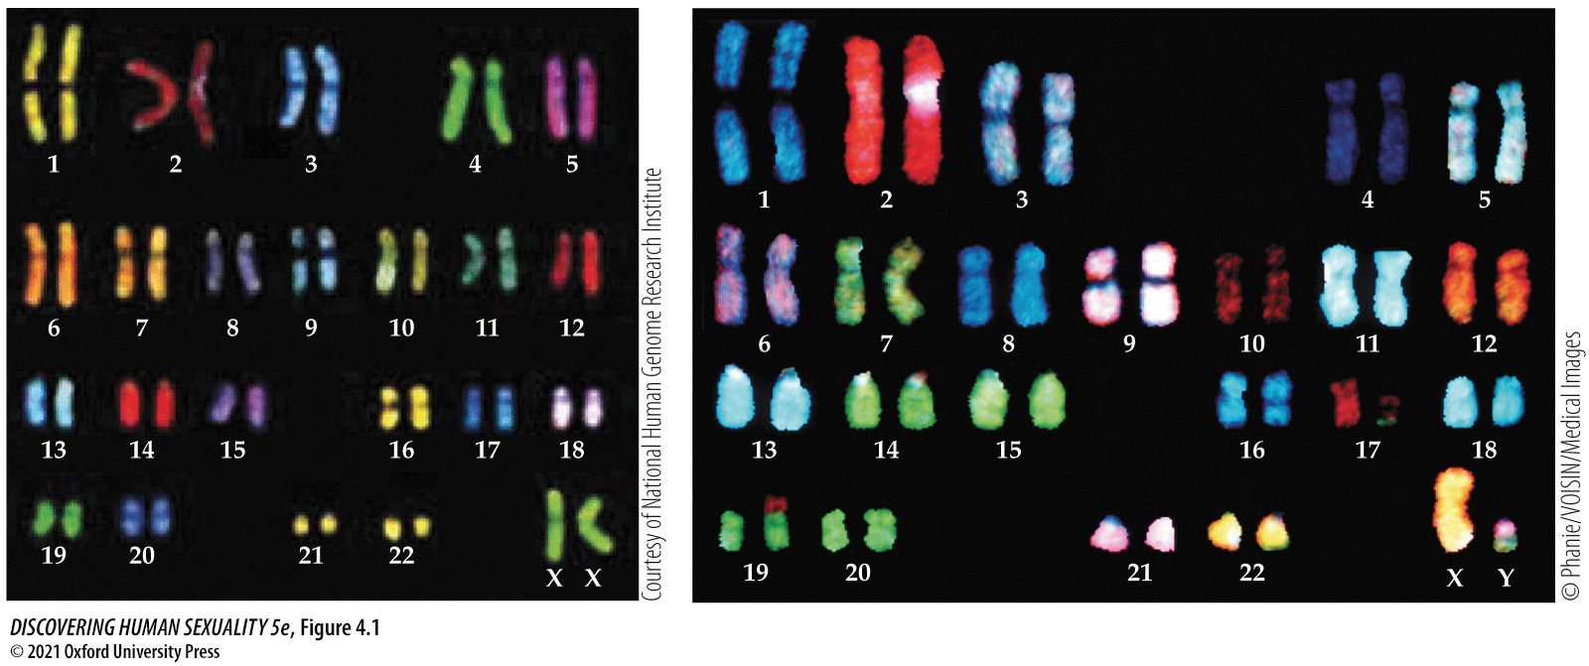
Figure 4.1 Human chromosomes in a woman (left) and a man (right)
Notes:
Figure 4.1 Human chromosomes in a woman (left) and a man (right). Women have two X chromosomes, men have one X and one Y. The other 22 pairs of chromosomes are the same. Here, the individual chromosomes have been labeled with a variety of fluorescent chemical probes, each of which binds to the DNA of a single chromosome to identify it. The differences in appearance of the chromosomes in the woman and man are not meaningful: They result from different processing.

Slide 3
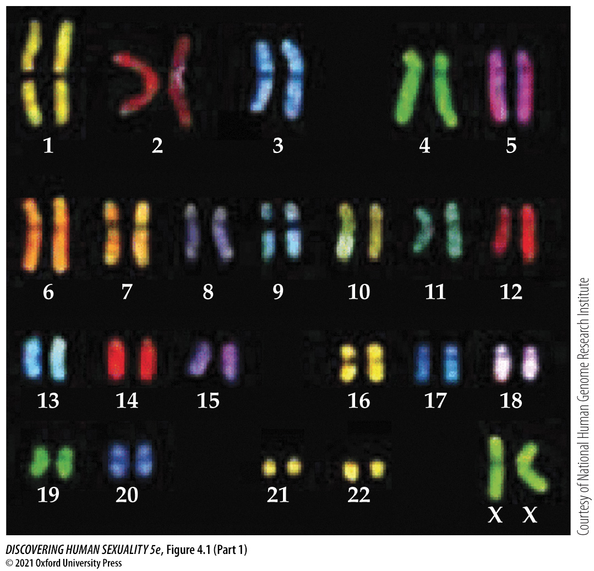
Figure 4.1 Human chromosomes in a woman (left) and a man (right) (Part 1)
Notes:
Figure 4.1 Human chromosomes in a woman (left) and a man (right). Women have two X chromosomes, men have one X and one Y. The other 22 pairs of chromosomes are the same. Here, the individual chromosomes have been labeled with a variety of fluorescent chemical probes, each of which binds to the DNA of a single chromosome to identify it. The differences in appearance of the chromosomes in the woman and man are not meaningful: They result from different processing.

Slide 4
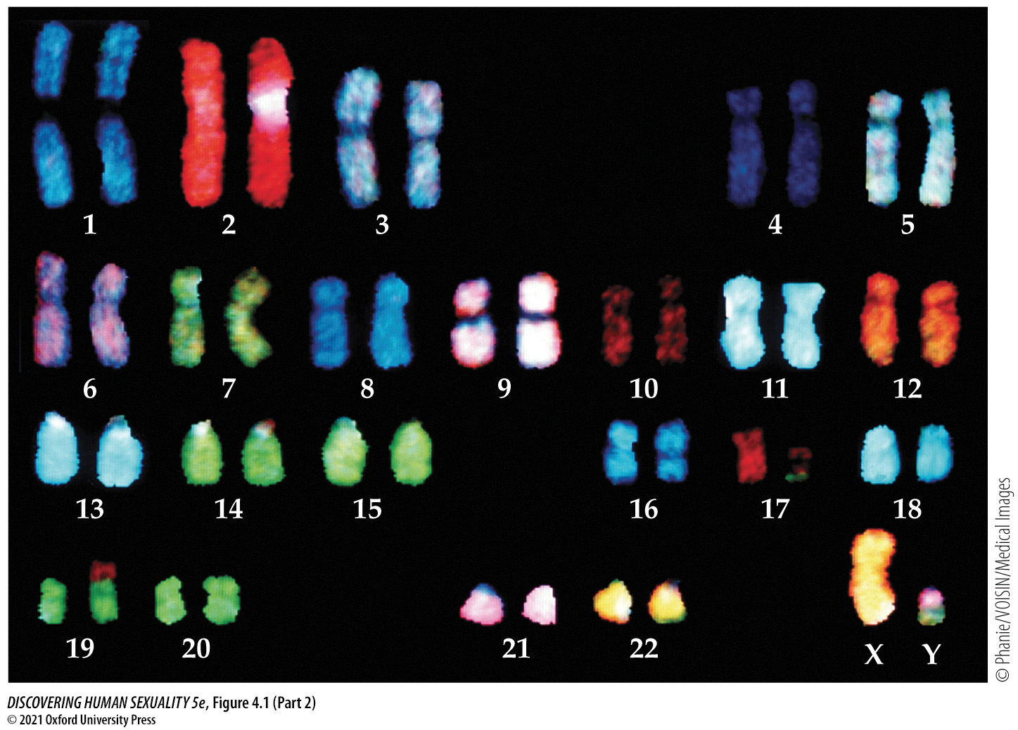
Figure 4.1 Human chromosomes in a woman (left) and a man (right) (Part 2)
Notes:
Figure 4.1 Human chromosomes in a woman (left) and a man (right). Women have two X chromosomes, men have one X and one Y. The other 22 pairs of chromosomes are the same. Here, the individual chromosomes have been labeled with a variety of fluorescent chemical probes, each of which binds to the DNA of a single chromosome to identify it. The differences in appearance of the chromosomes in the woman and man are not meaningful: They result from different processing.

Slide 5
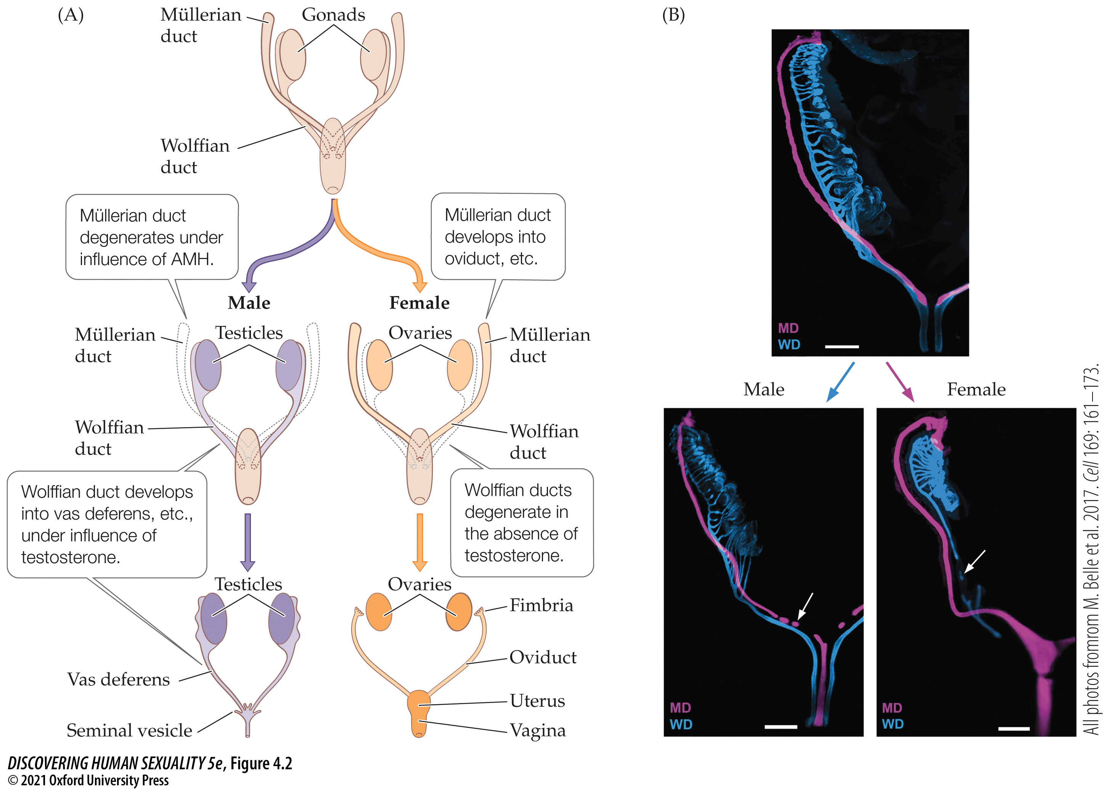
Figure 4.2 Male and female reproductive tracts develop from different precursor structures, the Wolffian and Müllerian ducts
Notes:
Figure 4.2 Male and female reproductive tracts develop from different precursor structures (A), the Wolffian and Müllerian ducts. (The male and female gonads [testes and ovaries] have a common origin and do not belong to either duct system.) (See Activity 4.1: Development of the Male and Female Reproductive Tracts.) These micrographs of developing reproductive tracts in human embryos (B) are labeled with fluorescent probes. The sexually undifferentiated embryo at 9.5 weeks gestation (top) shows the presence of both Wolffian (blue) and Müllerian (pink) ducts. The male embryo at 10 weeks (bottom left) shows the Müllerian duct beginning to break up (arrow). The female embryo at 13 weeks (bottom right) shows the Wolffian duct beginning to break up (arrow). The white scale bars are 0.4 mm.

Slide 6
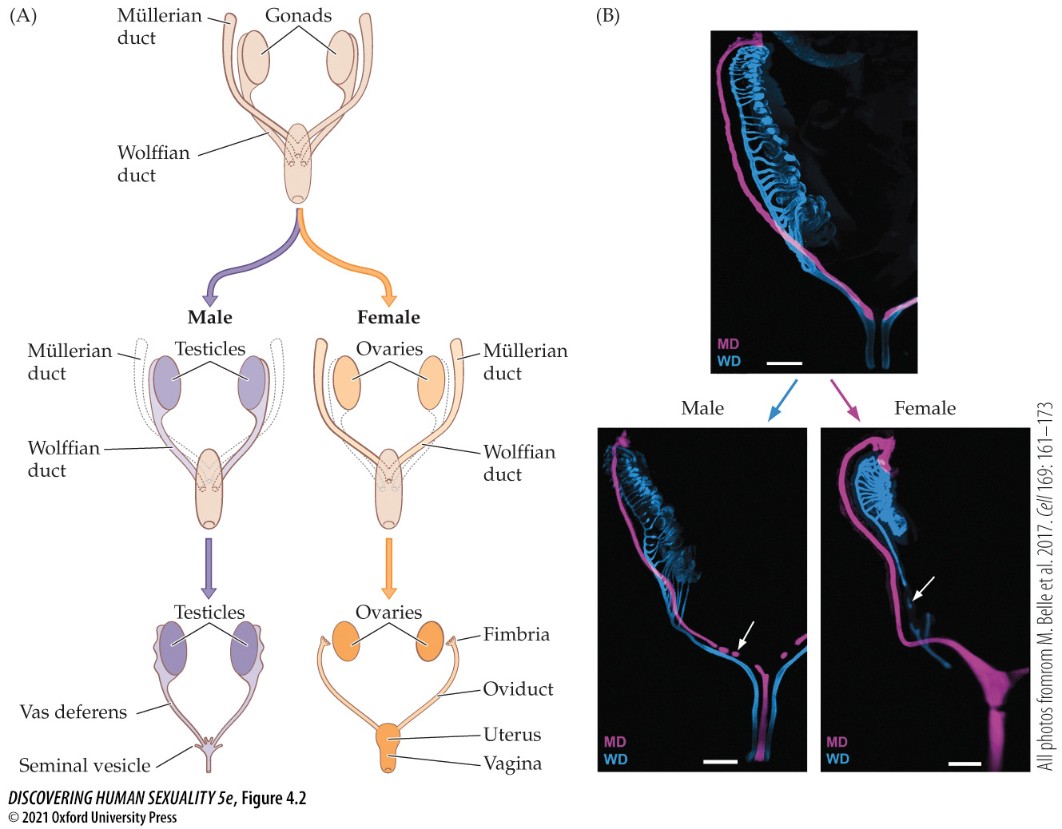
Figure 4.2 Male and female reproductive tracts develop from different precursor structures, the Wolffian and Müllerian ducts (2)
Notes:
Figure 4.2 Male and female reproductive tracts develop from different precursor structures (A), the Wolffian and Müllerian ducts. (The male and female gonads [testes and ovaries] have a common origin and do not belong to either duct system.) (See Activity 4.1: Development of the Male and Female Reproductive Tracts.) These micrographs of developing reproductive tracts in human embryos (B) are labeled with fluorescent probes. The sexually undifferentiated embryo at 9.5 weeks gestation (top) shows the presence of both Wolffian (blue) and Müllerian (pink) ducts. The male embryo at 10 weeks (bottom left) shows the Müllerian duct beginning to break up (arrow). The female embryo at 13 weeks (bottom right) shows the Wolffian duct beginning to break up (arrow). The white scale bars are 0.4 mm.

Slide 7
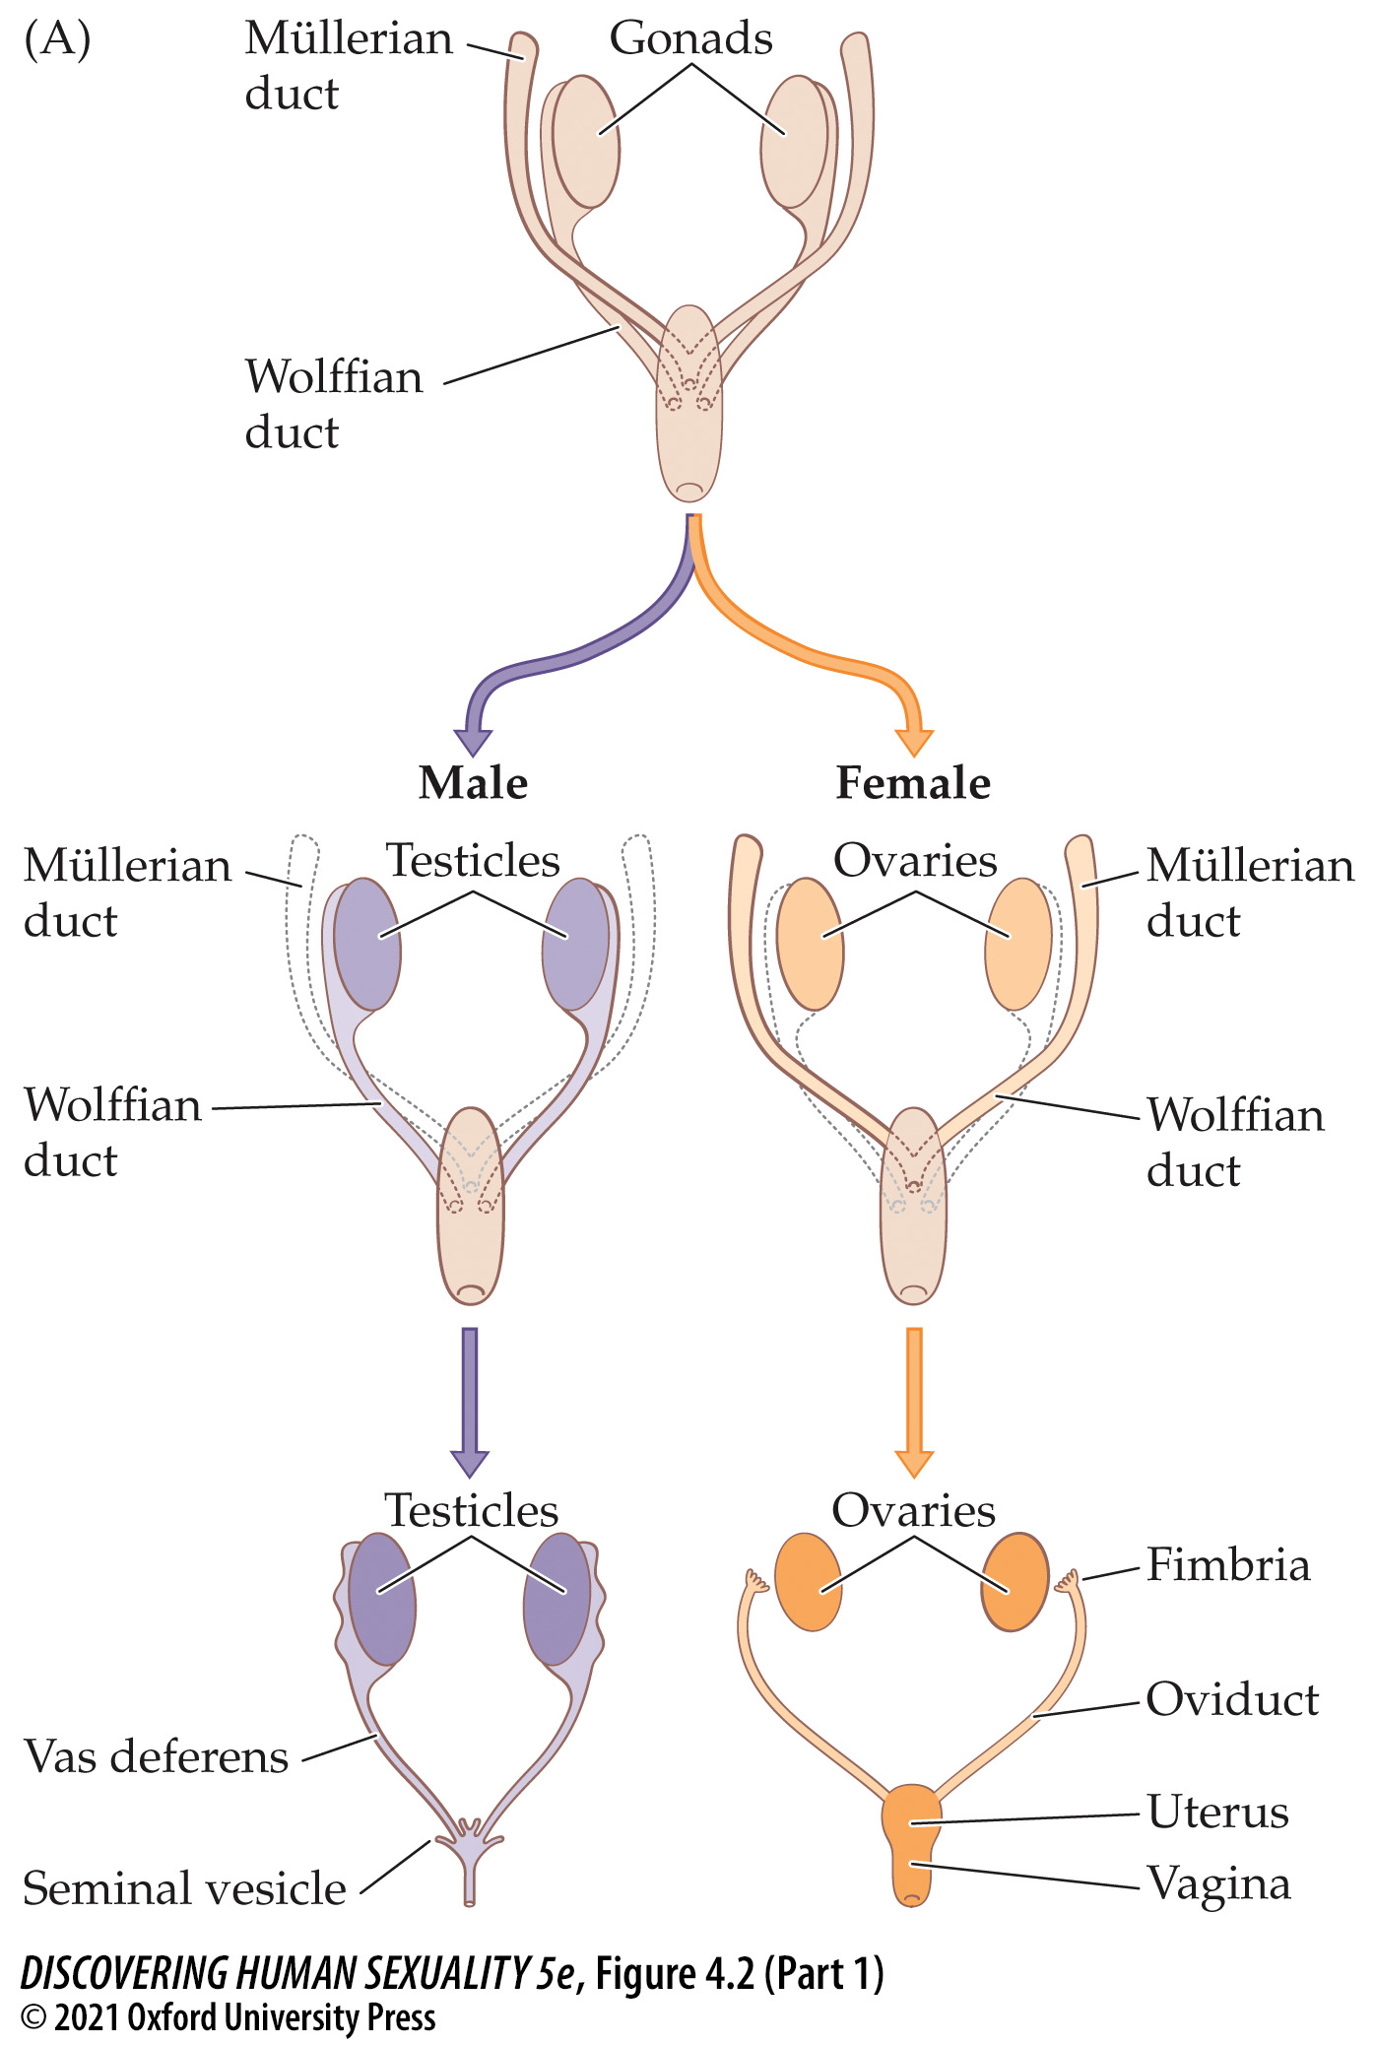
Figure 4.2 Male and female reproductive tracts develop from different precursor structures, the Wolffian and Müllerian ducts (Part 1)
Notes:
Figure 4.2 Male and female reproductive tracts develop from different precursor structures (A), the Wolffian and Müllerian ducts. (The male and female gonads [testes and ovaries] have a common origin and do not belong to either duct system.) (See Activity 4.1: Development of the Male and Female Reproductive Tracts.) These micrographs of developing reproductive tracts in human embryos (B) are labeled with fluorescent probes. The sexually undifferentiated embryo at 9.5 weeks gestation (top) shows the presence of both Wolffian (blue) and Müllerian (pink) ducts. The male embryo at 10 weeks (bottom left) shows the Müllerian duct beginning to break up (arrow). The female embryo at 13 weeks (bottom right) shows the Wolffian duct beginning to break up (arrow). The white scale bars are 0.4 mm.

Slide 8
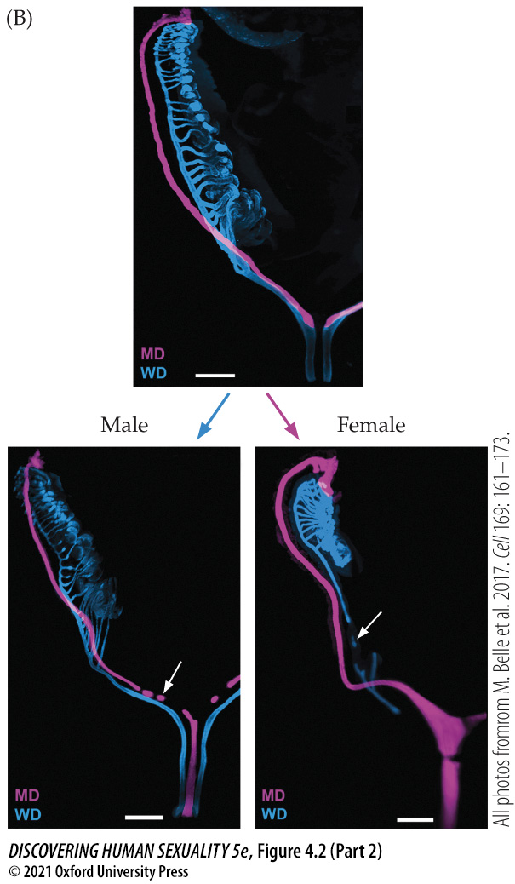
Figure 4.2 Male and female reproductive tracts develop from different precursor structures, the Wolffian and Müllerian ducts (Part 2)
Notes:
Figure 4.2 Male and female reproductive tracts develop from different precursor structures (A), the Wolffian and Müllerian ducts. (The male and female gonads [testes and ovaries] have a common origin and do not belong to either duct system.) (See Activity 4.1: Development of the Male and Female Reproductive Tracts.) These micrographs of developing reproductive tracts in human embryos (B) are labeled with fluorescent probes. The sexually undifferentiated embryo at 9.5 weeks gestation (top) shows the presence of both Wolffian (blue) and Müllerian (pink) ducts. The male embryo at 10 weeks (bottom left) shows the Müllerian duct beginning to break up (arrow). The female embryo at 13 weeks (bottom right) shows the Wolffian duct beginning to break up (arrow). The white scale bars are 0.4 mm.

Slide 9
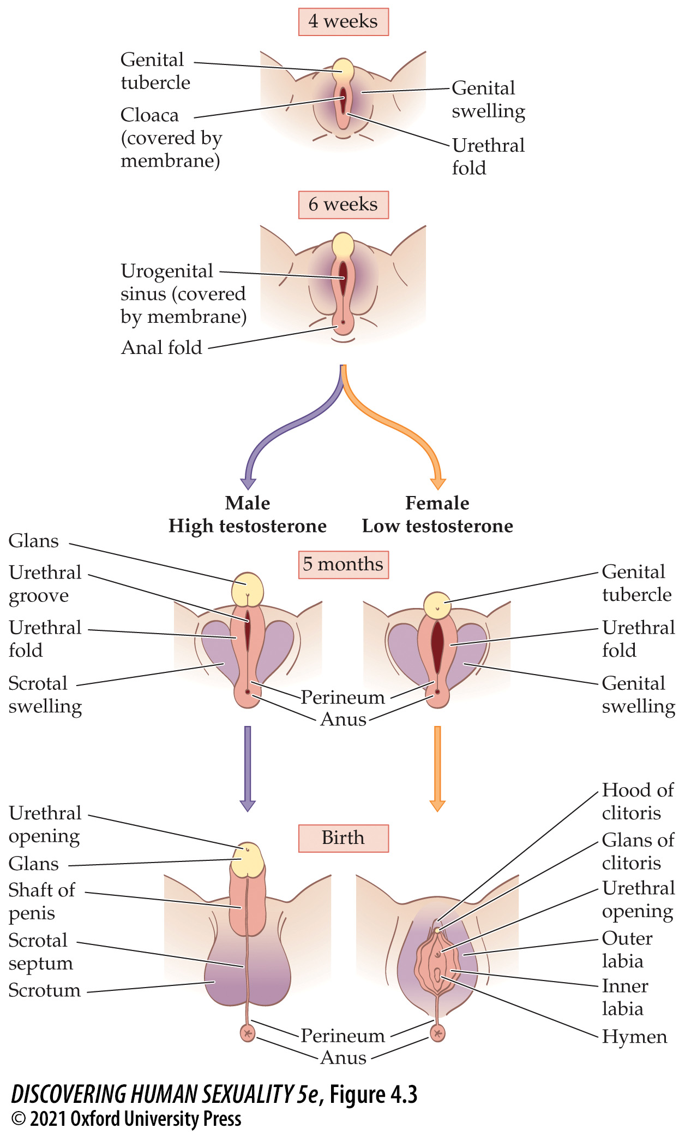
Figure 4.3 Development of the male and female external genitalia from common precursor structures
Notes:
Figure 4.3 Development of the male and female external genitalia from common precursor structures, shown at the top. In males, the urethral folds fuse at the midline to form the penile shaft and enclose the urethra. In females, they remain separate, forming the inner labia.

Slide 10
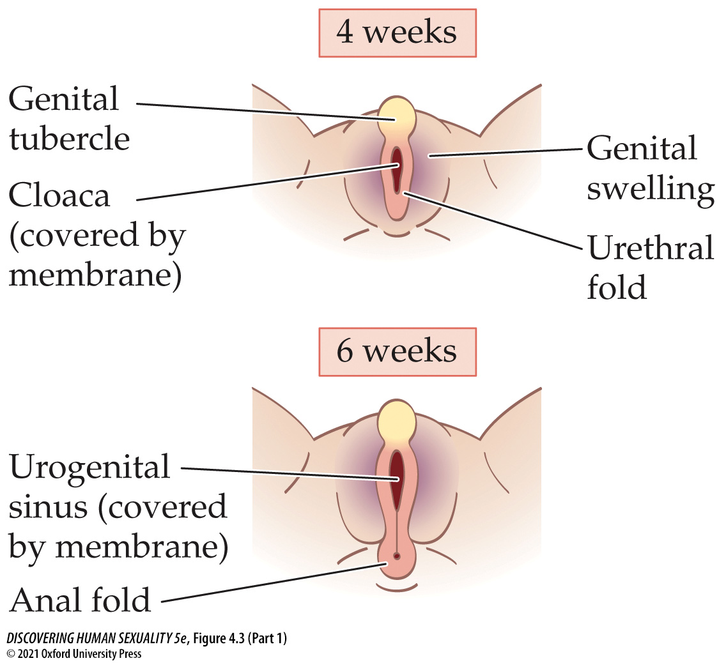
Figure 4.3 Development of the male and female external genitalia from common precursor structures (Part 1)
Notes:
Figure 4.3 Development of the male and female external genitalia from common precursor structures, shown at the top. In males, the urethral folds fuse at the midline to form the penile shaft and enclose the urethra. In females, they remain separate, forming the inner labia.

Slide 11
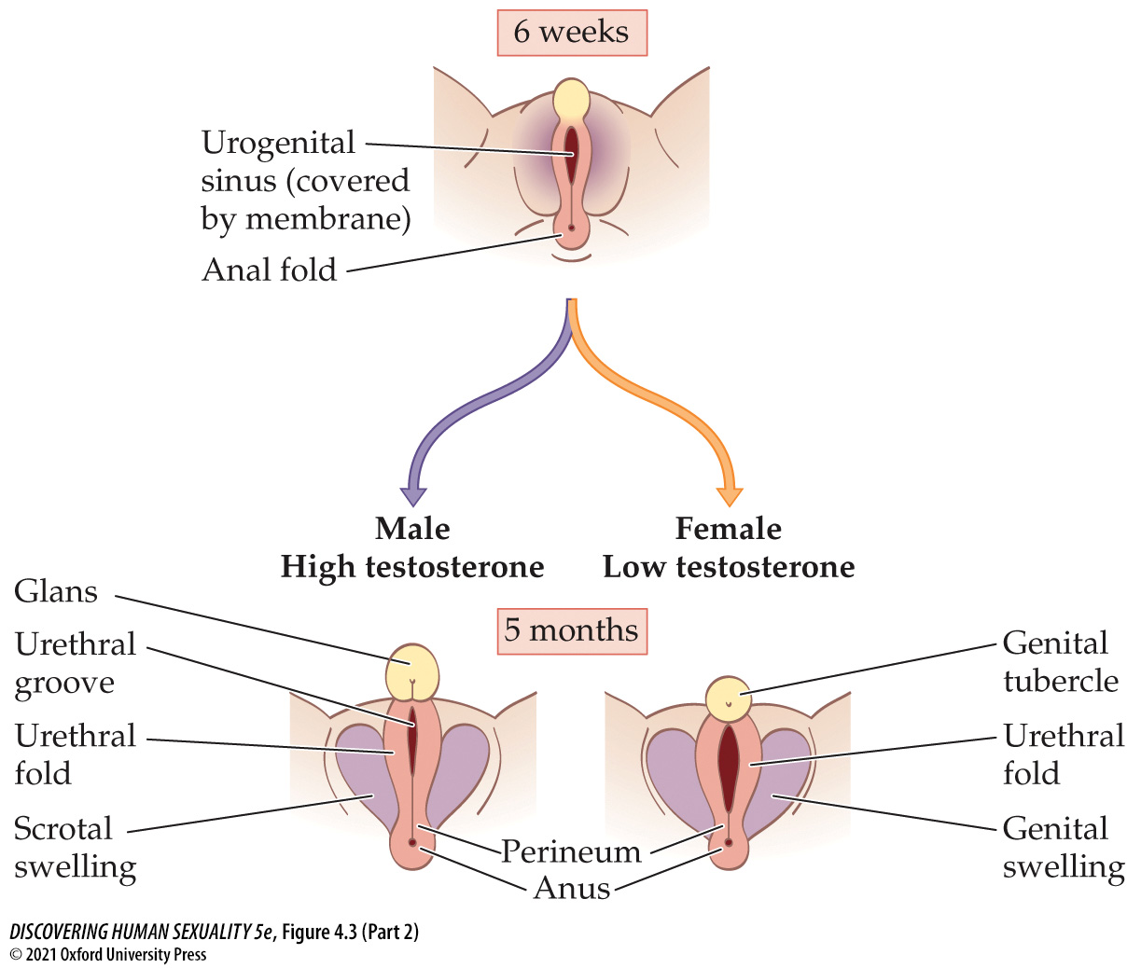
Figure 4.3 Development of the male and female external genitalia from common precursor structures (Part 2)
Notes:
Figure 4.3 Development of the male and female external genitalia from common precursor structures, shown at the top. In males, the urethral folds fuse at the midline to form the penile shaft and enclose the urethra. In females, they remain separate, forming the inner labia.

Slide 12
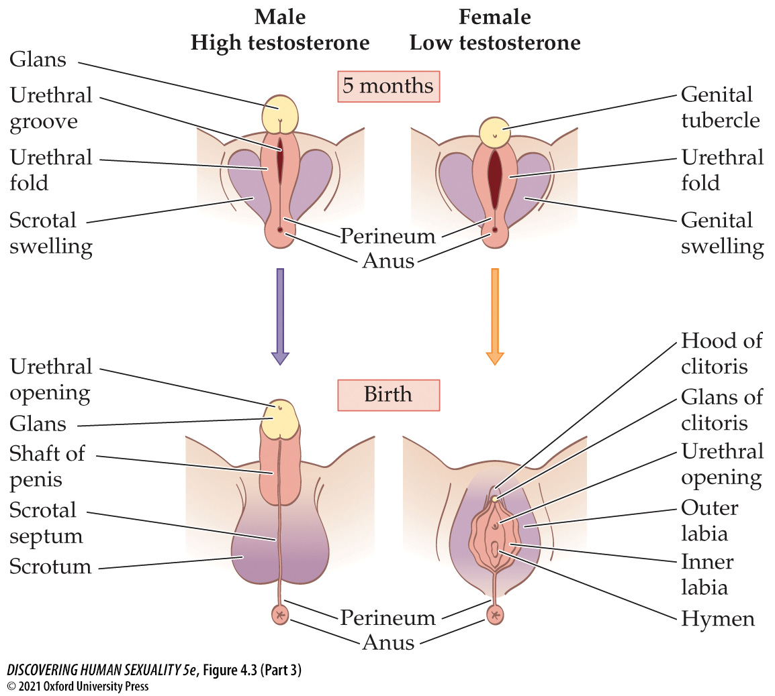
Figure 4.3 Development of the male and female external genitalia from common precursor structures (Part 3)
Notes:
Figure 4.3 Development of the male and female external genitalia from common precursor structures, shown at the top. In males, the urethral folds fuse at the midline to form the penile shaft and enclose the urethra. In females, they remain separate, forming the inner labia.

Slide 13
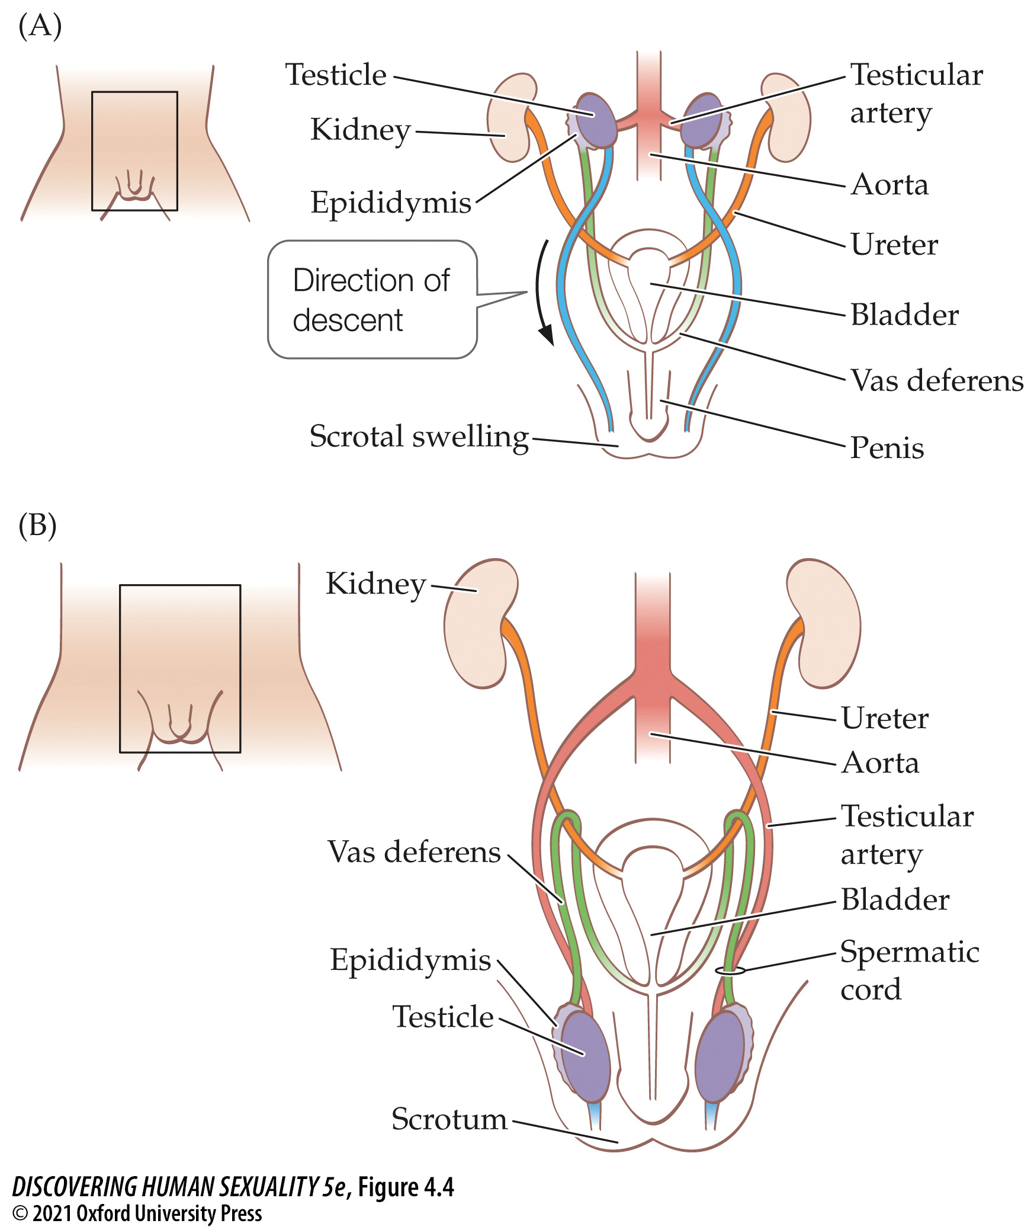
Figure 4.4 Descent of the testicles
Notes:
Figure 4.4 Descent of the testicles (A) Before descent, at 10 weeks, a fibrous cord (shown here in blue) attaches each testicle to the region of the scrotal swelling. (B) As the fetal body grows, this attachment pulls each testicle down and into the scrotum. Note how the vas deferens (green) and the testicular artery (pink) are pulled after the testicle and how the vas deferens comes to loop over the ureter (the tube, shown here in orange, that carries urine from the kidney to the bladder).

Slide 14
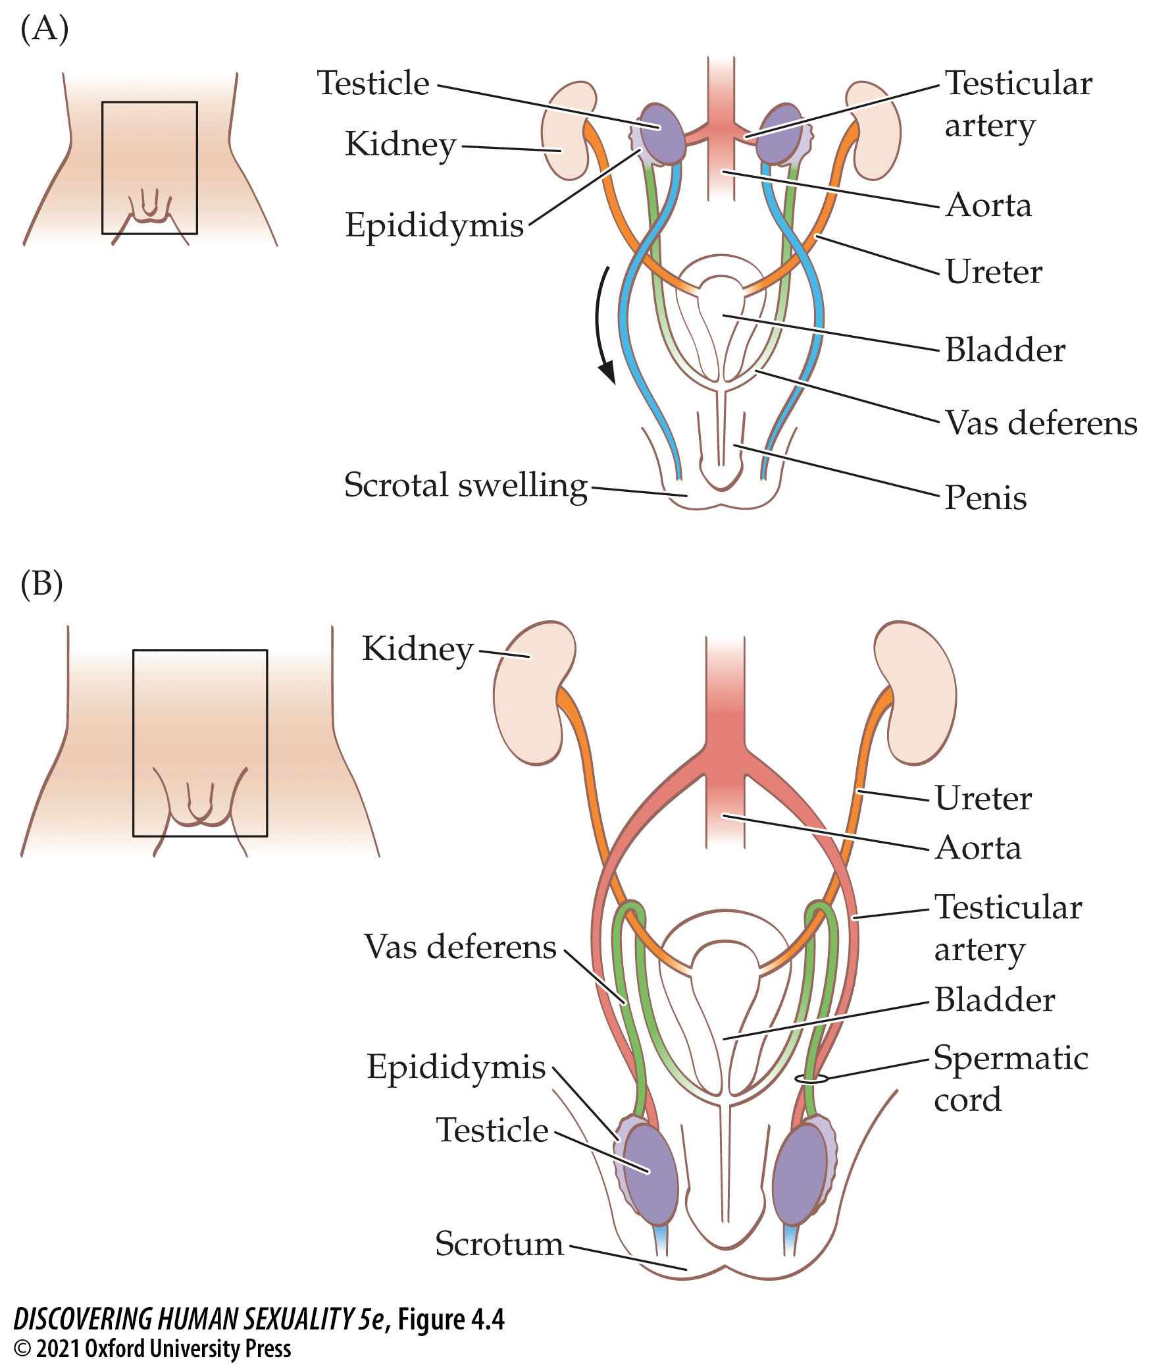
Figure 4.4 Descent of the testicles (2)
Notes:
Figure 4.4 Descent of the testicles (A) Before descent, at 10 weeks, a fibrous cord (shown here in blue) attaches each testicle to the region of the scrotal swelling. (B) As the fetal body grows, this attachment pulls each testicle down and into the scrotum. Note how the vas deferens (green) and the testicular artery (pink) are pulled after the testicle and how the vas deferens comes to loop over the ureter (the tube, shown here in orange, that carries urine from the kidney to the bladder).

Slide 15
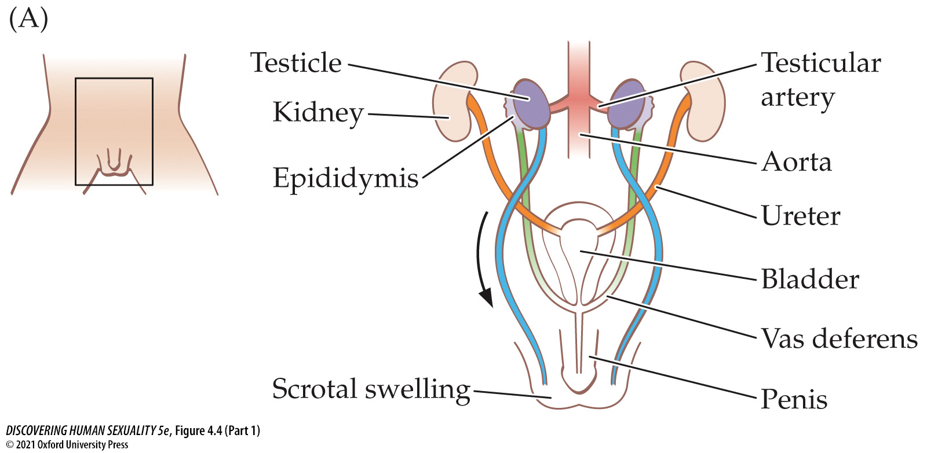
Figure 4.4 Descent of the testicles (Part 1)
Notes:
Figure 4.4 Descent of the testicles (A) Before descent, at 10 weeks, a fibrous cord (shown here in blue) attaches each testicle to the region of the scrotal swelling. (B) As the fetal body grows, this attachment pulls each testicle down and into the scrotum. Note how the vas deferens (green) and the testicular artery (pink) are pulled after the testicle and how the vas deferens comes to loop over the ureter (the tube, shown here in orange, that carries urine from the kidney to the bladder).

Slide 16
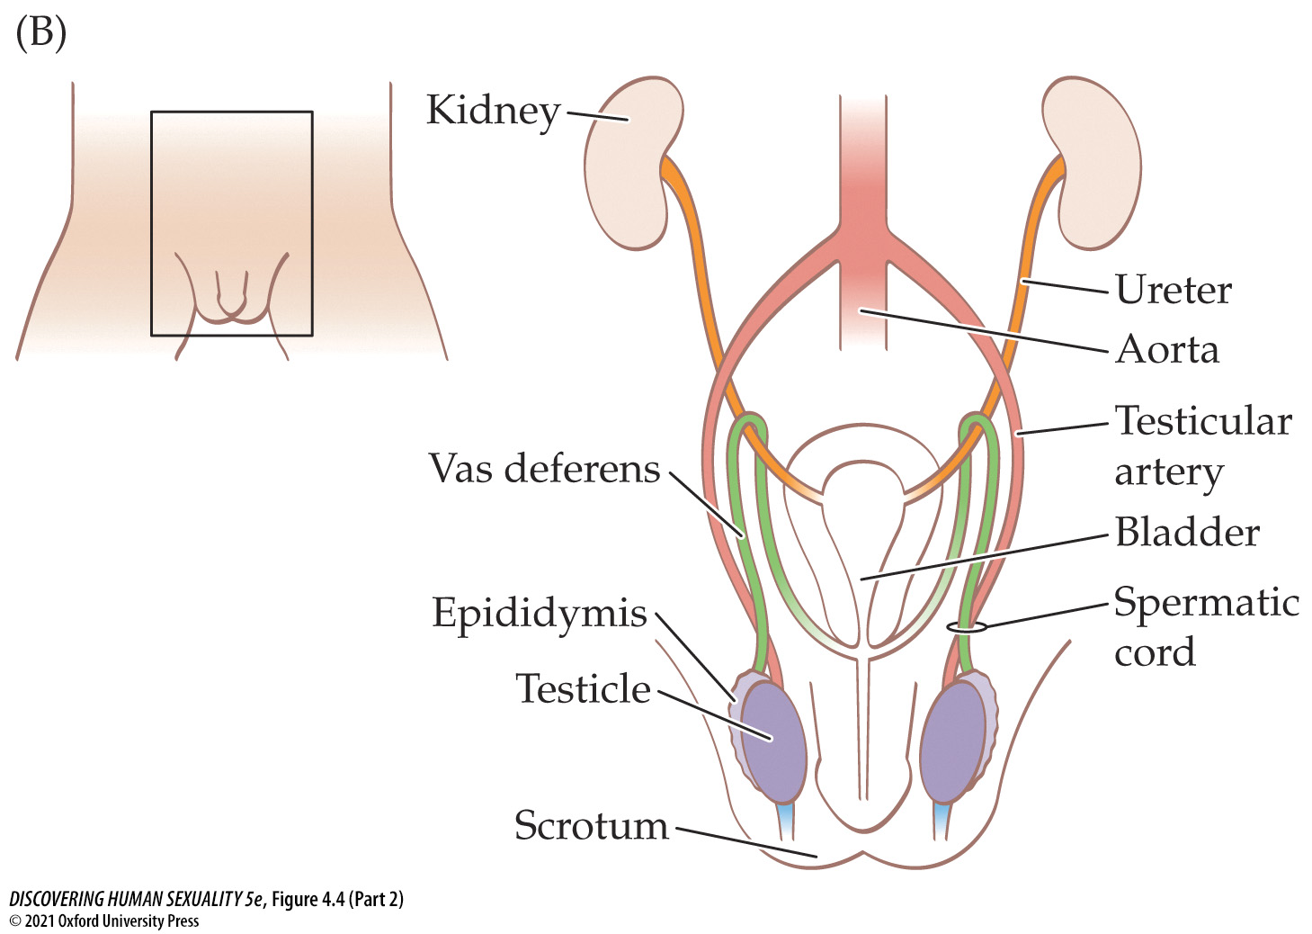
Figure 4.4 Descent of the testicles (Part 2)
Notes:
Figure 4.4 Descent of the testicles (A) Before descent, at 10 weeks, a fibrous cord (shown here in blue) attaches each testicle to the region of the scrotal swelling. (B) As the fetal body grows, this attachment pulls each testicle down and into the scrotum. Note how the vas deferens (green) and the testicular artery (pink) are pulled after the testicle and how the vas deferens comes to loop over the ureter (the tube, shown here in orange, that carries urine from the kidney to the bladder).

Slide 17
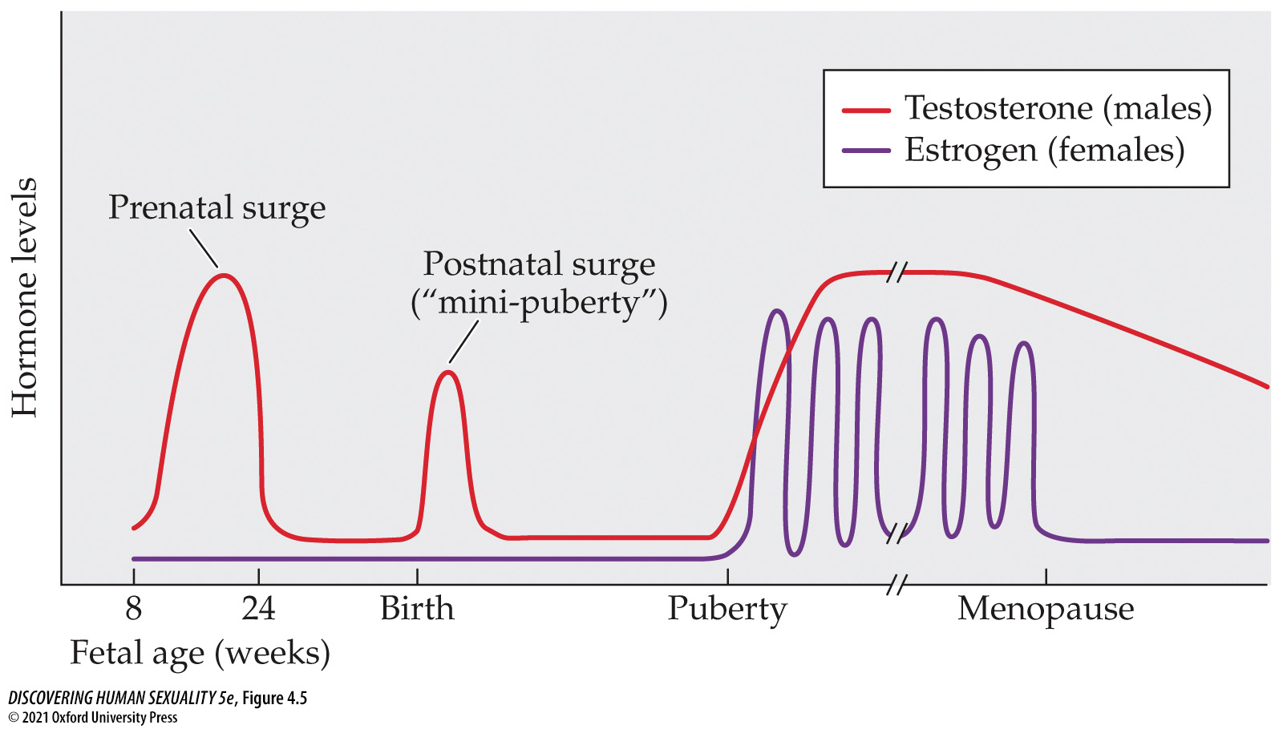
Figure 4.5 Hormones over the lifespan
Notes:
Figure 4.5 Hormones over the lifespan This is a highly schematic representation of the levels of testosterone in males and estrogen in females from conception through old age, ignoring pregnancy. Progesterone levels are not shown.

Slide 18
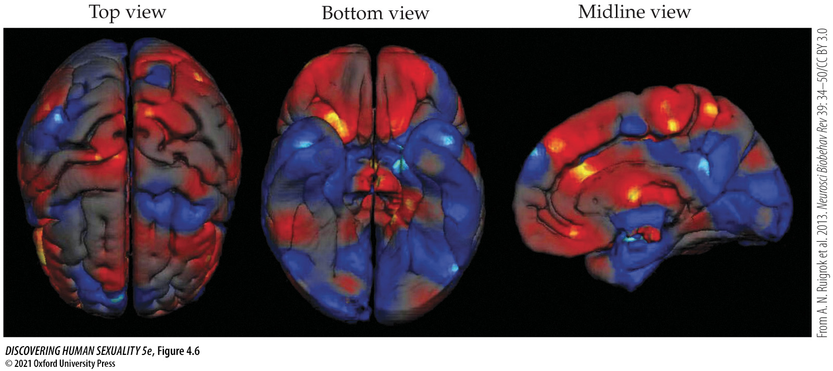
Figure 4.6 Sex differences in the cerebral cortex
Notes:
Figure 4.6 Sex differences in the cerebral cortex Regions that are larger in women are shown in red; those that are larger in men are shown in blue. Note that the sex differences are not the same in the left and right hemispheres. These images are based on a meta-analysis of numerous quantitative brain-imaging studies.

Slide 19

Figure 4.7 Klinefelter syndrome
Notes:
Figure 4.7 Klinefelter syndrome 13-year-old Luke is tall for his age but otherwise physically unremarkable. An interview with him is viewable online at tinyurl.com/u455ybu. People with Klinefelter syndrome vary greatly in physical appearance.

Slide 20
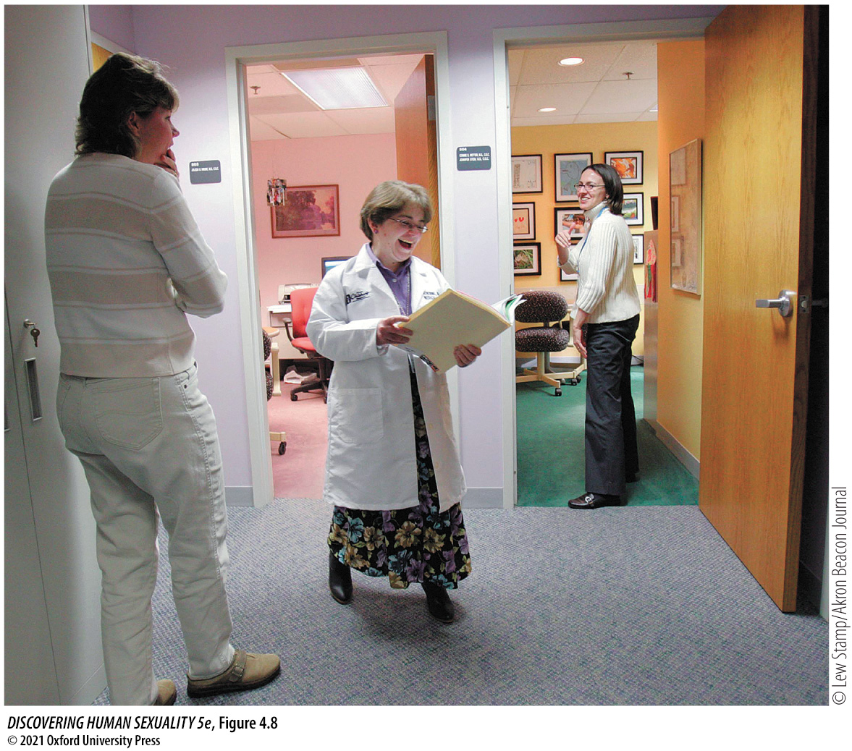
Figure 4.8 Turner syndrome
Notes:
Figure 4.8 Turner syndrome Dr. Catherine Ward-Melver is a geneticist at Akron Children’s Hospital, in Ohio, and past president of the Turner Syndrome Society. Her short stature (4 feet 8 inches, or 1.42 m) is a feature of Turner syndrome.

Slide 21
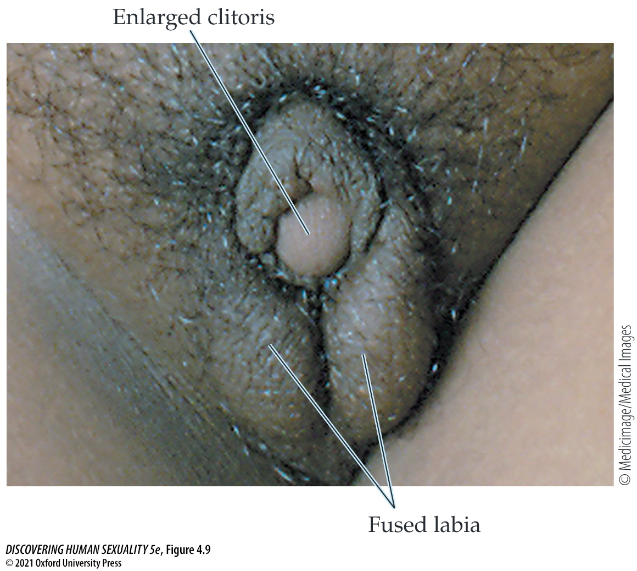
Figure 4.9 Partial masculinization of genitalia in a girl with congenital adrenal hyperplasia
Notes:
Figure 4.9 Partial masculinization of genitalia in a girl with congenital adrenal hyperplasia. Note that the fused labia resemble scrotal sacs, but they do not contain testicles.

Slide 22
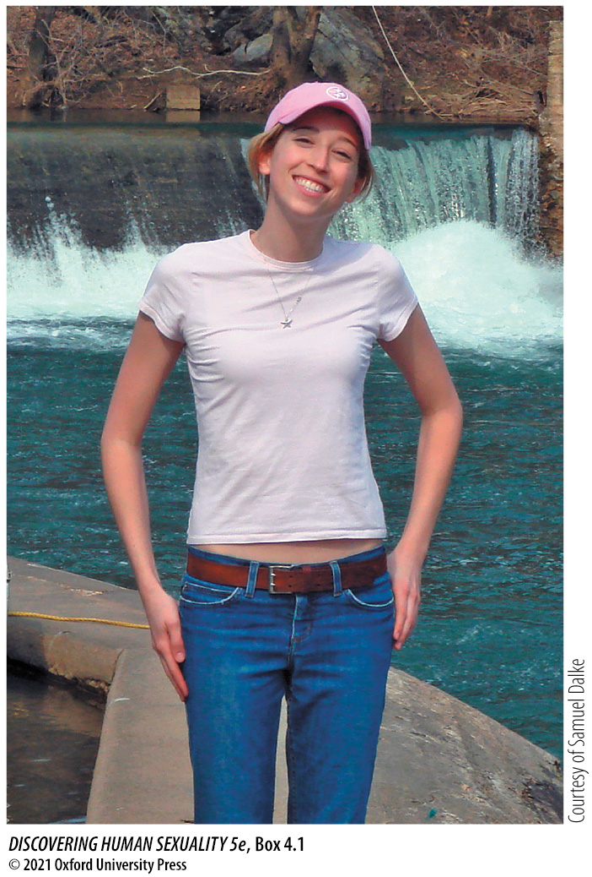
Box 4.1 My Life with Androgen Insensitivity Syndrome
Notes:
Box 4.1 My Life with Androgen Insensitivity Syndrome
Katie Baratz Dalke

Slide 23
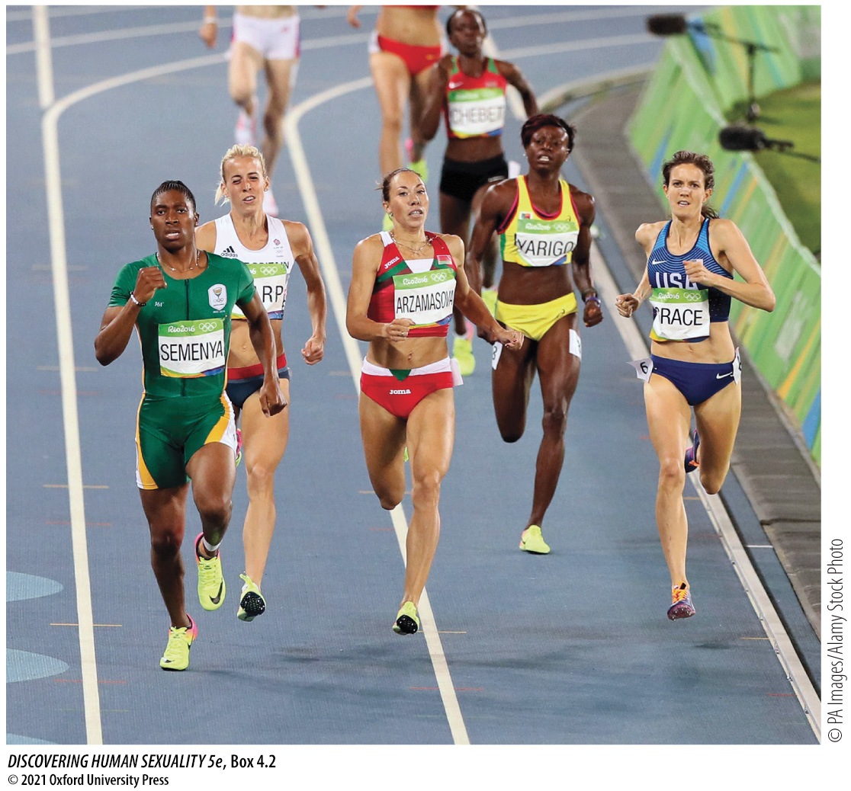
Box 4.2 Intersex and Sports
Notes:
Box 4.2 Intersex and Sports
Caster Semenya

Slide 24
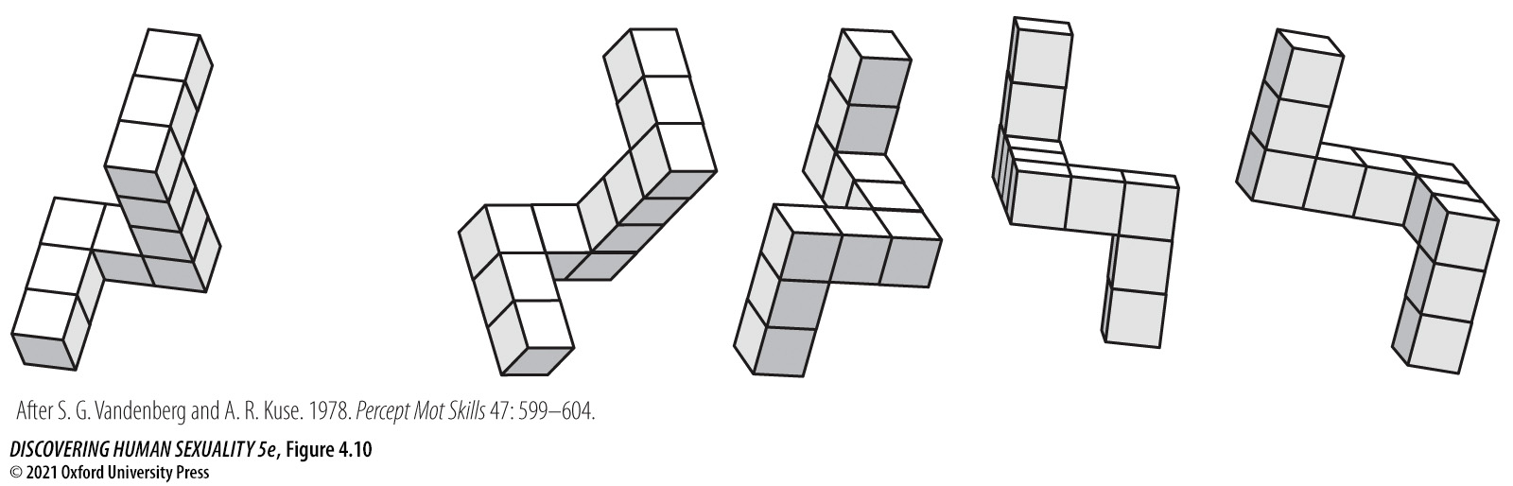
Figure 4.10 Mental rotation task
Notes:
Figure 4.10 Mental rotation task From the four images at right, a test taker is asked to select the two objects that could be rotated in space to match the object shown at left. Men generally outperform women in this kind of task. (After S. G. Vandenberg and A. R. Kuse. 1978. Percept Mot Skills 47: 599–604.)

Slide 25

In-Text Art, Ch. 4, p. 105
Notes:
In-Text Art, Ch. 4, p. 105
Wanton violence, such as soccer hooliganism, is largely a male pastime.

Slide 26
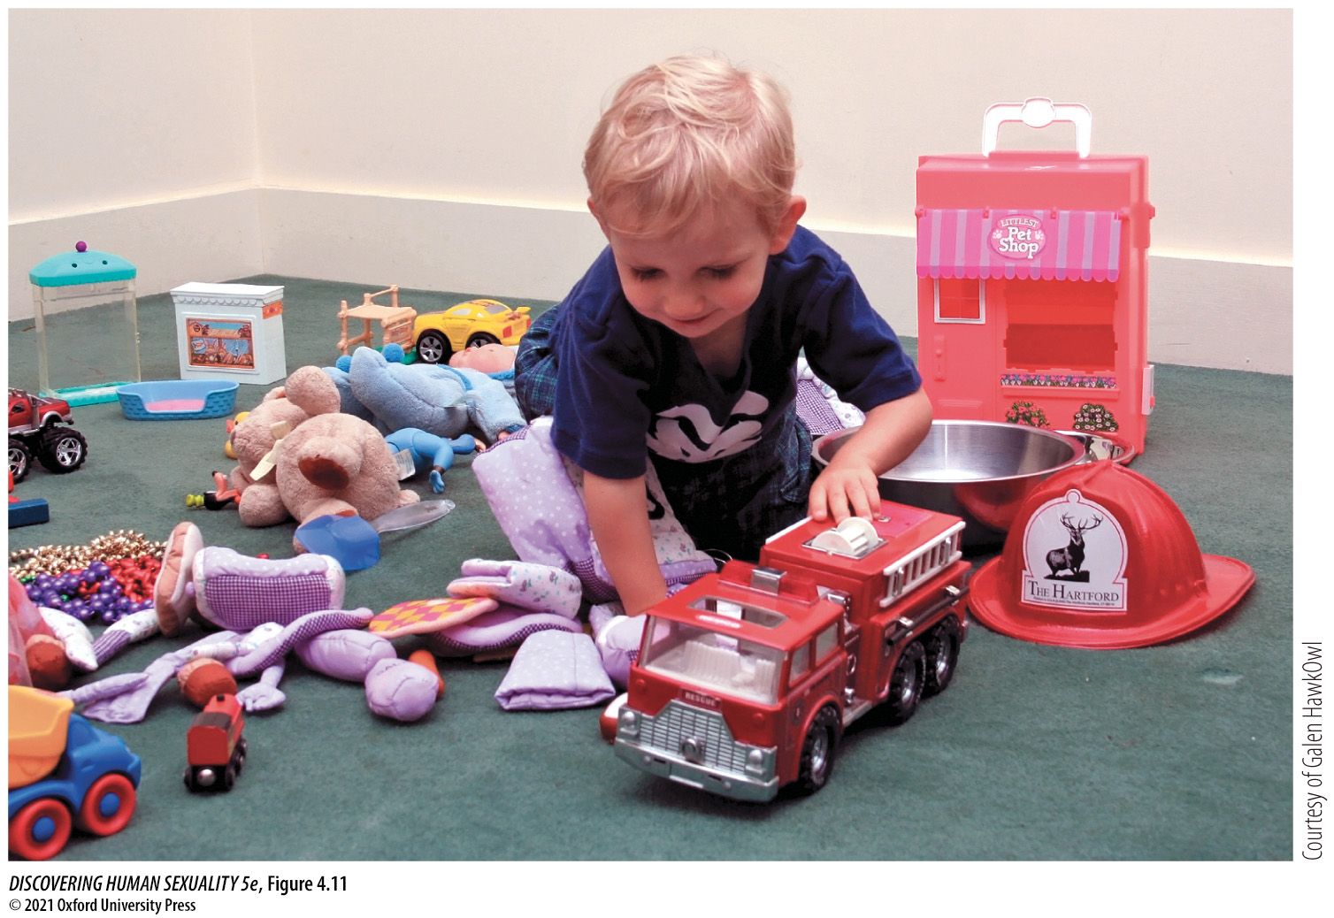
Figure 4.11 Toy preference test
Notes:
Figure 4.11 Toy preference test A child is placed within a circle of toys, and his or her play behavior is videotaped. Later, observers measure the amount of time the child spends playing with toys generally preferred by girls and those generally preferred by boys. Figure 4.13 shows examples of data from this kind of study.

Slide 27
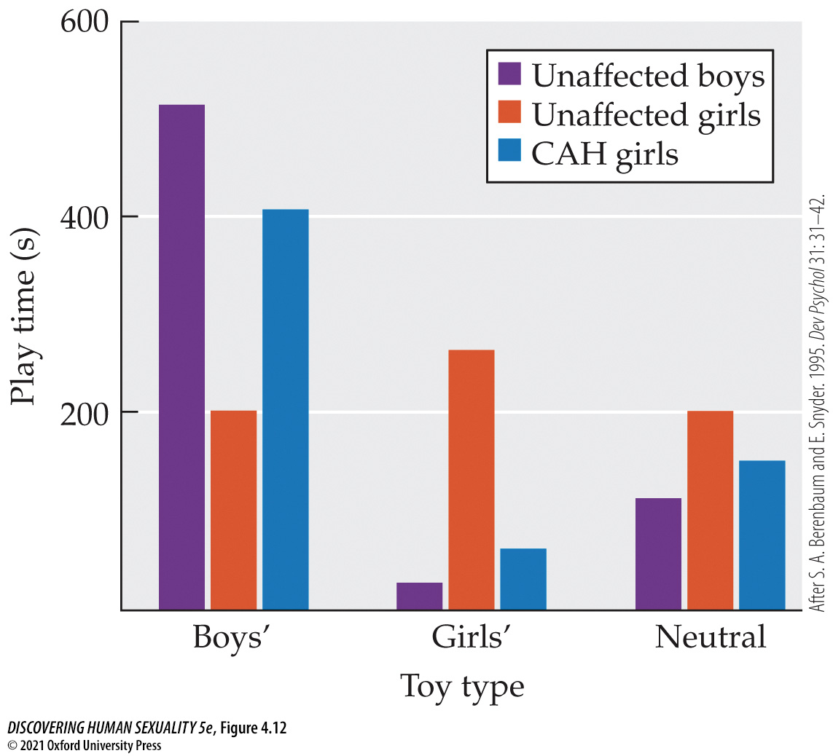
Figure 4.12 Hormones and play
Notes:
Figure 4.12 Hormones and play Exposure to androgens during fetal life influences choice of toys during childhood. Girls with congenital adrenal hyperplasia (CAH), as well as unaffected girls and boys, were observed while playing with toys. The toys available included those generally preferred by boys (e.g., trucks) and those generally preferred by girls (e.g., dolls), as well as gender-neutral toys. The toy preferences of the girls with CAH were more like those of boys than like those of unaffected girls. (After S. A. Berenbaum and E. Snyder. 1995. Dev Psychol 31: 31–42.)

Slide 28
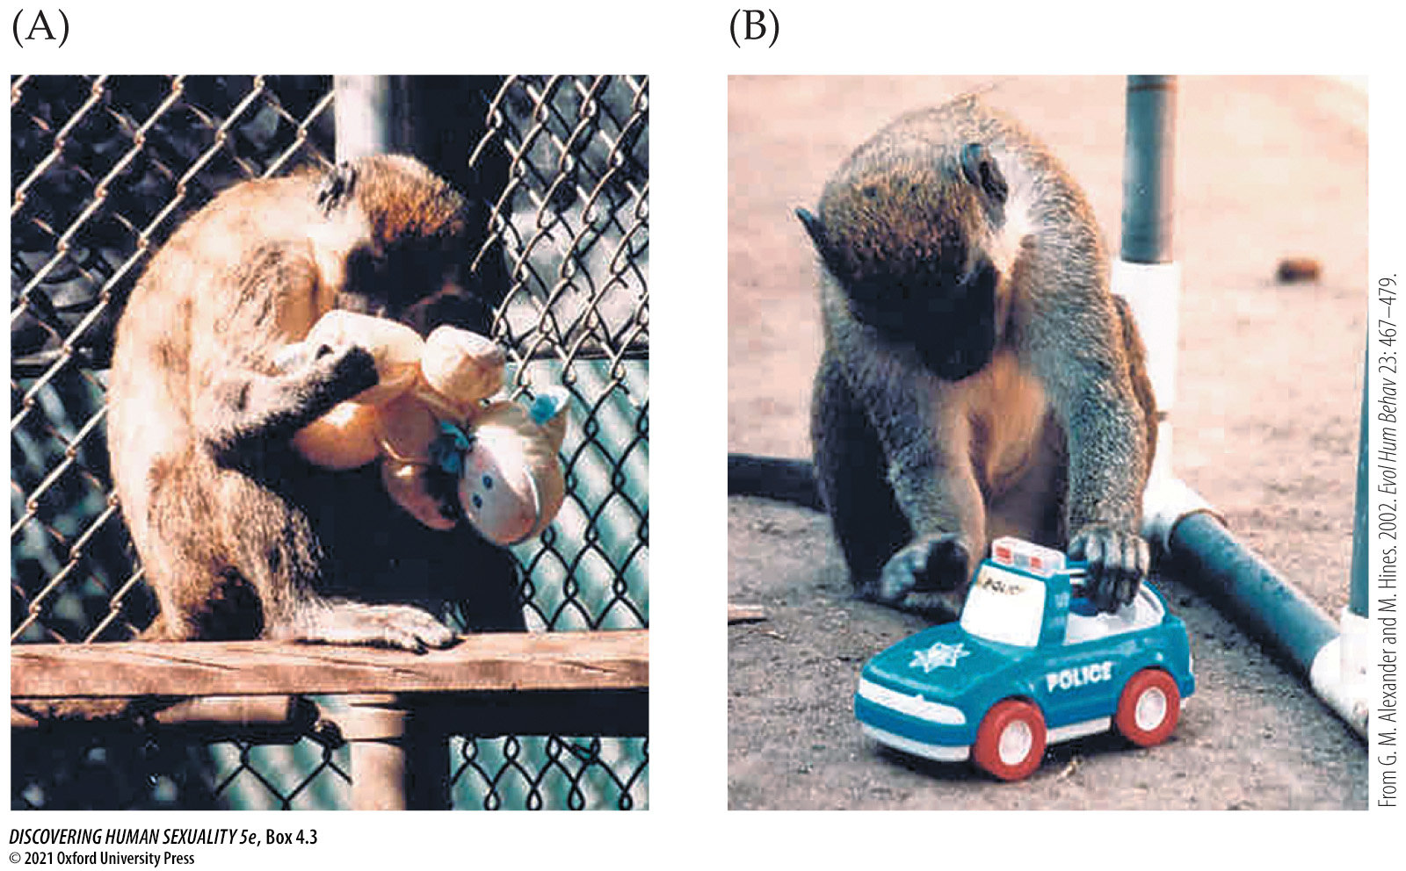
Box 4.3 Gendered Play in Primates
Notes:
Box 4.3 Gendered Play in Primates
Monkeys show human-like toy preferences. (A) A female vervet monkey plays with a doll. (B) A male monkey plays with a toy car.

Slide 29
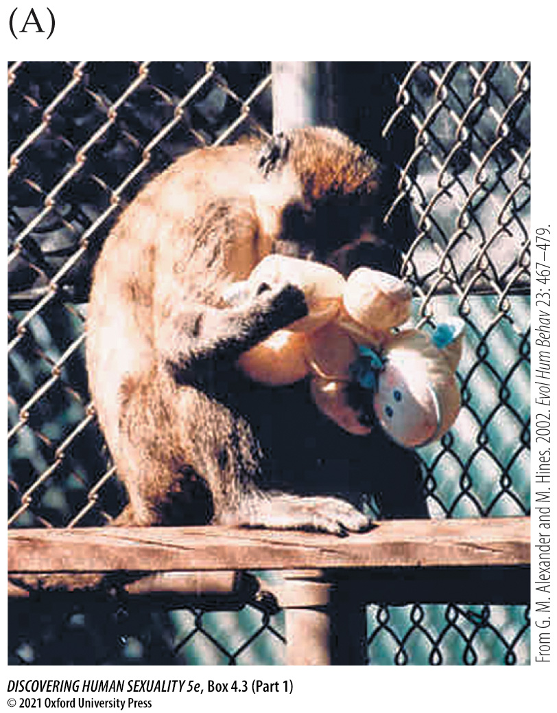
Box 4.3 Gendered Play in Primates (Part 1)
Notes:
Box 4.3 Gendered Play in Primates
Monkeys show human-like toy preferences. (A) A female vervet monkey plays with a doll. (B) A male monkey plays with a toy car.

Slide 30
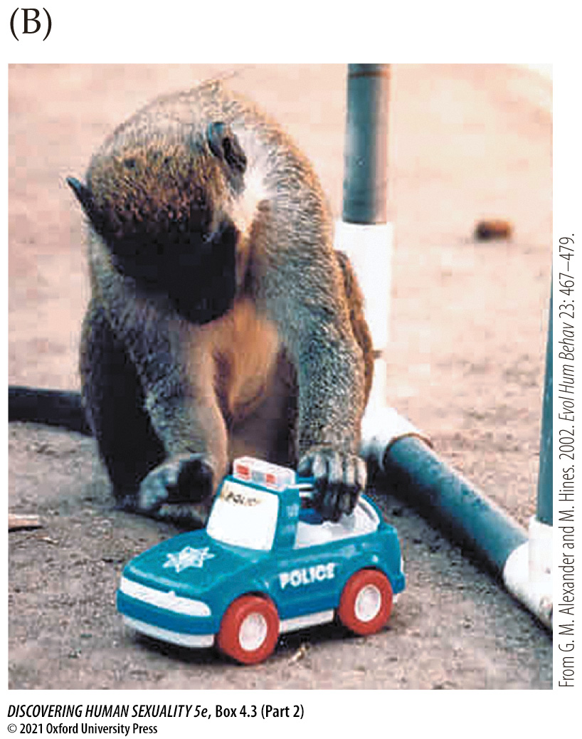
Box 4.3 Gendered Play in Primates (Part 2)
Notes:
Box 4.3 Gendered Play in Primates
Monkeys show human-like toy preferences. (A) A female vervet monkey plays with a doll. (B) A male monkey plays with a toy car.

Slide 31
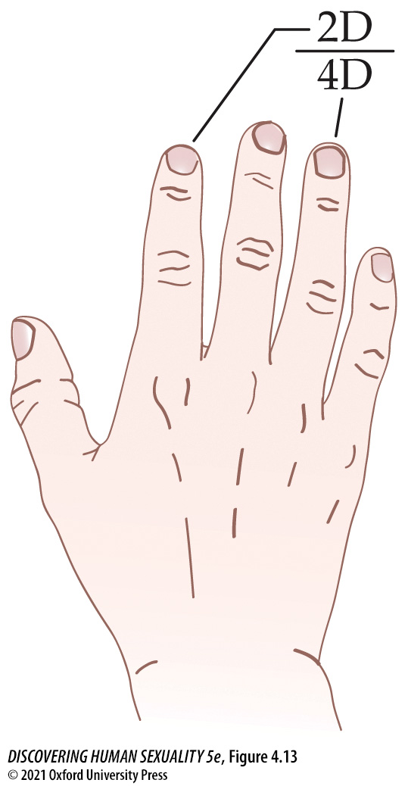
Figure 4.13 Finger length ratio and gender
Notes:
Figure 4.13 Finger length ratio and gender The 2D:4D ratio is the length of the index finger divided by the length of the ring finger. The ratio is typically lower in men than women, but it also varies with gender characteristics within each sex.

Slide 32
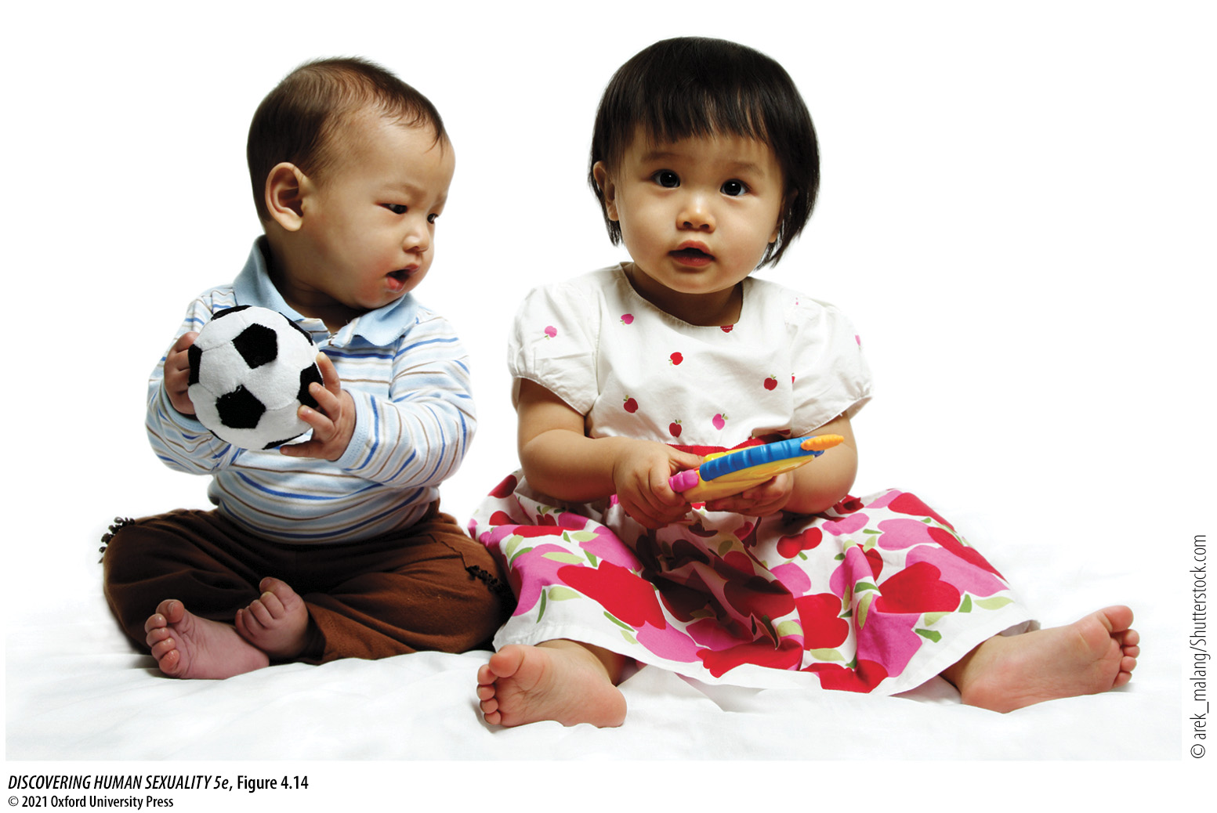
Figure 4.14 Babies enter a gendered world
Notes:
Figure 4.14 Babies enter a gendered world These children have been dressed in the pink and blue outfits that our culture deems appropriate for infant girls and boys, respectively.

Slide 33
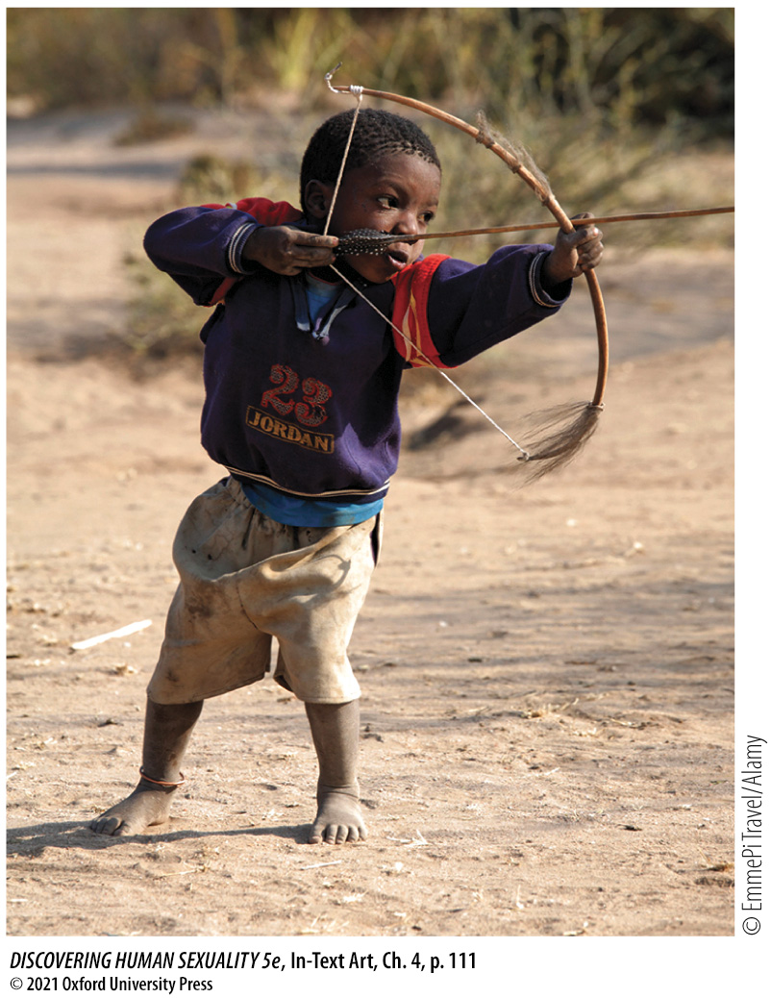
In-Text Art, Ch. 4, p. 111
Notes:
In-Text Art, Ch. 4, p. 111
Hadza boy practicing archery, Tanzania.

Slide 34
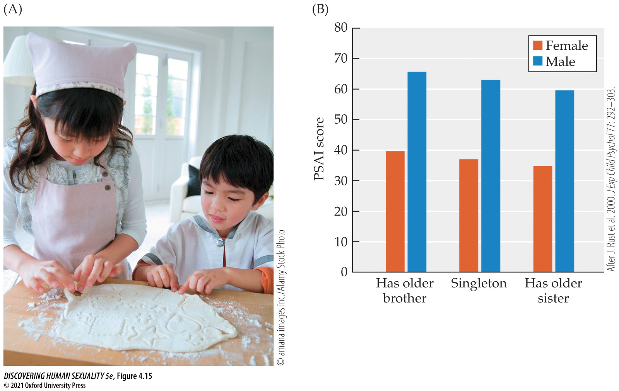
Figure 4.15 Influence of siblings on gender
Notes:
Figure 4.15 Influence of siblings on gender (A) Older siblings act as gender role models. (B) The Pre-School Activities Inventory (PSAI) score is a measure of gender-typical activities and interests in which male-typical traits score higher and female-typical traits score lower. This figure shows the PSAI score for 5,542 British 3-year-olds, broken down according to whether they are singletons or have older brothers or sisters. The children’s gender traits are slightly shifted in the direction of the sex of the older sibling. (After J. Rust et al. 2000. J Exp Child Psychol 77: 292–303.)

Slide 35
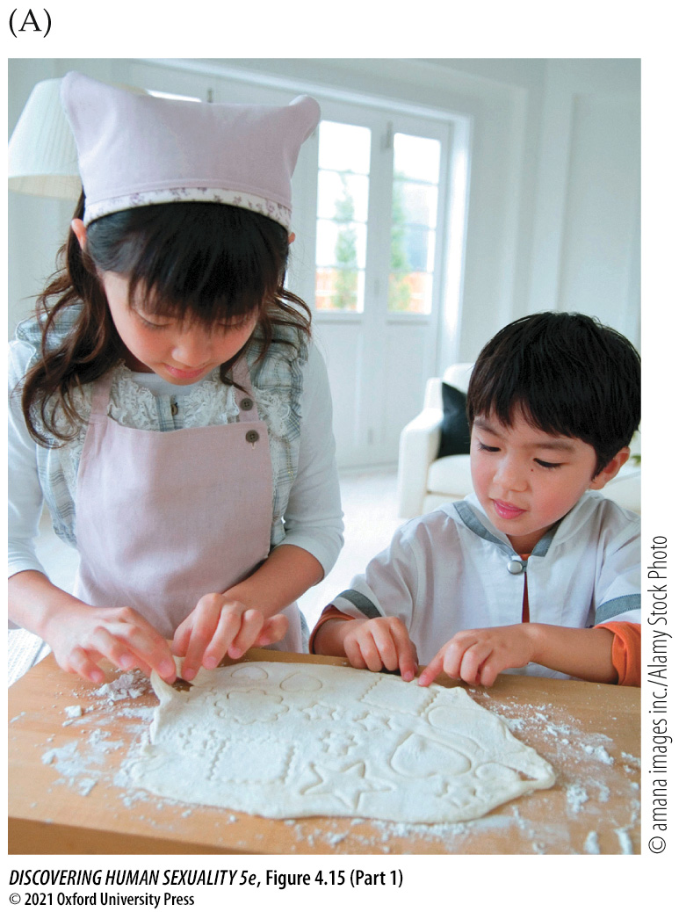
Figure 4.15 Influence of siblings on gender (Part 1)
Notes:
Figure 4.15 Influence of siblings on gender (A) Older siblings act as gender role models. (B) The Pre-School Activities Inventory (PSAI) score is a measure of gender-typical activities and interests in which male-typical traits score higher and female-typical traits score lower. This figure shows the PSAI score for 5,542 British 3-year-olds, broken down according to whether they are singletons or have older brothers or sisters. The children’s gender traits are slightly shifted in the direction of the sex of the older sibling. (After J. Rust et al. 2000. J Exp Child Psychol 77: 292–303.)

Slide 36
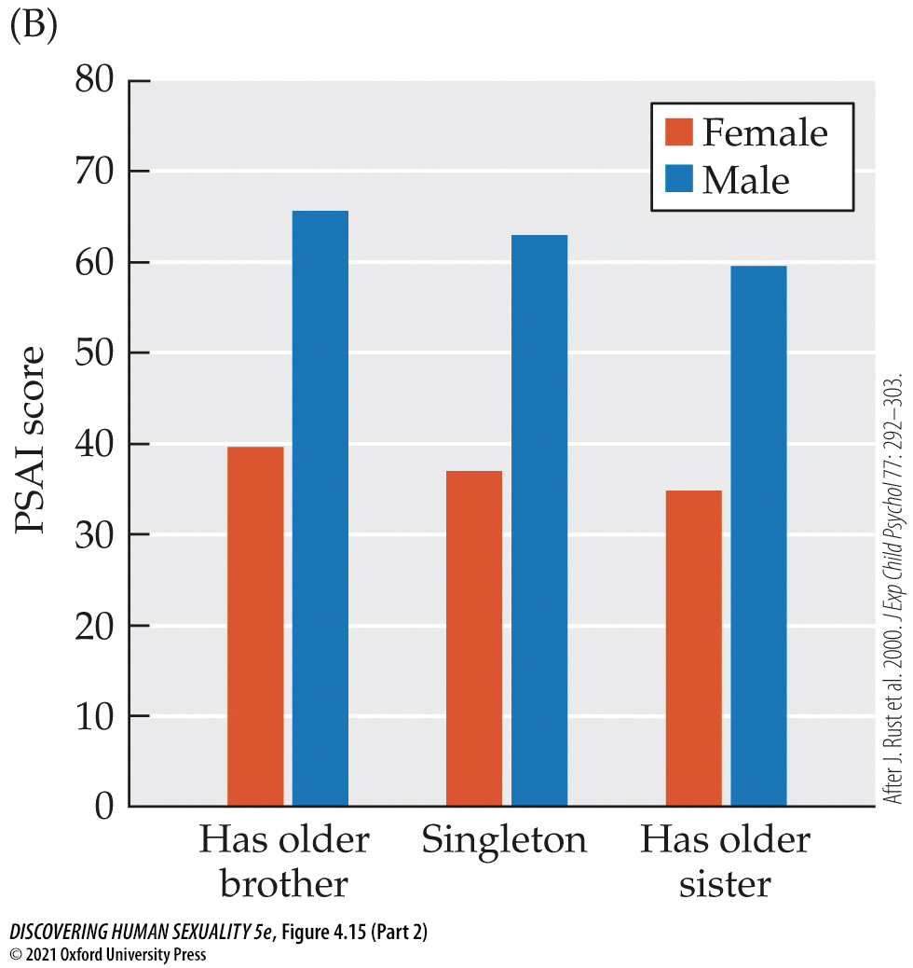
Figure 4.15 Influence of siblings on gender (Part 2)
Notes:
Figure 4.15 Influence of siblings on gender (A) Older siblings act as gender role models. (B) The Pre-School Activities Inventory (PSAI) score is a measure of gender-typical activities and interests in which male-typical traits score higher and female-typical traits score lower. This figure shows the PSAI score for 5,542 British 3-year-olds, broken down according to whether they are singletons or have older brothers or sisters. The children’s gender traits are slightly shifted in the direction of the sex of the older sibling. (After J. Rust et al. 2000. J Exp Child Psychol 77: 292–303.)

Slide 37
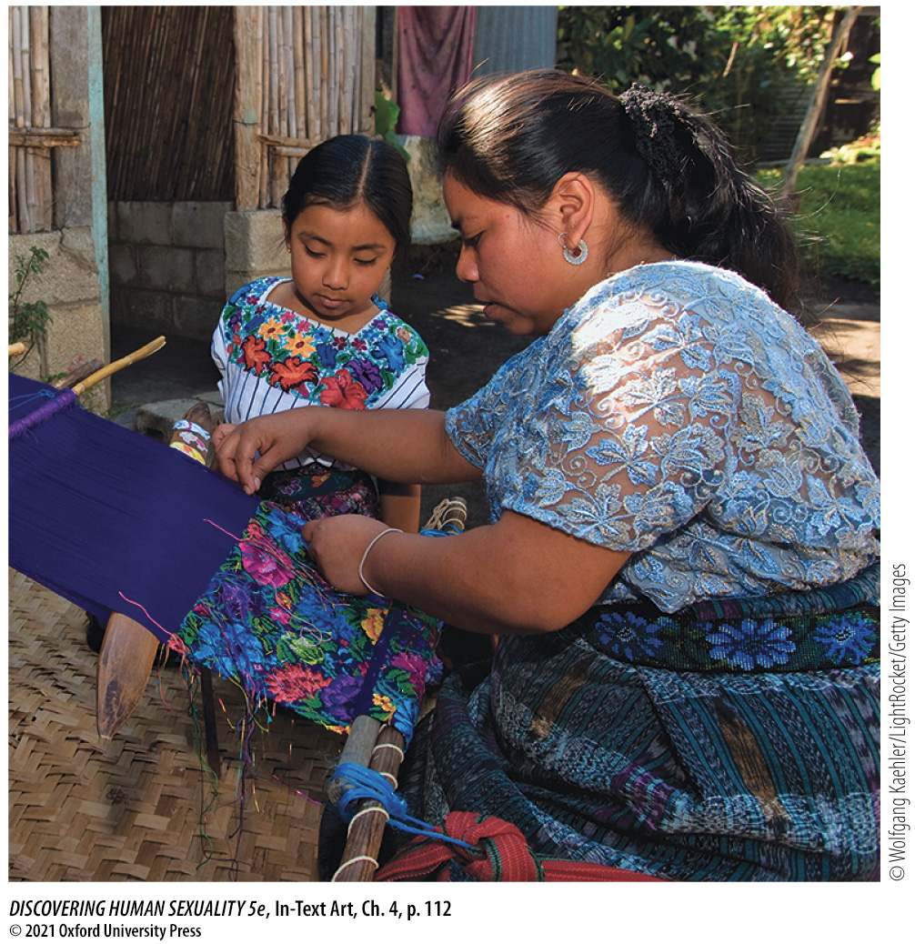
In-Text Art, Ch. 4, p. 112
Notes:
In-Text Art, Ch. 4, p. 112
Mayan mother teaches daughter to weave, Guatemala.

Slide 38

Figure 4.16 The media influence gender
Notes:
Figure 4.16 The media influence gender Disney Princess and Captain America movies may promote the development of stereo­typical gender roles.

Slide 39
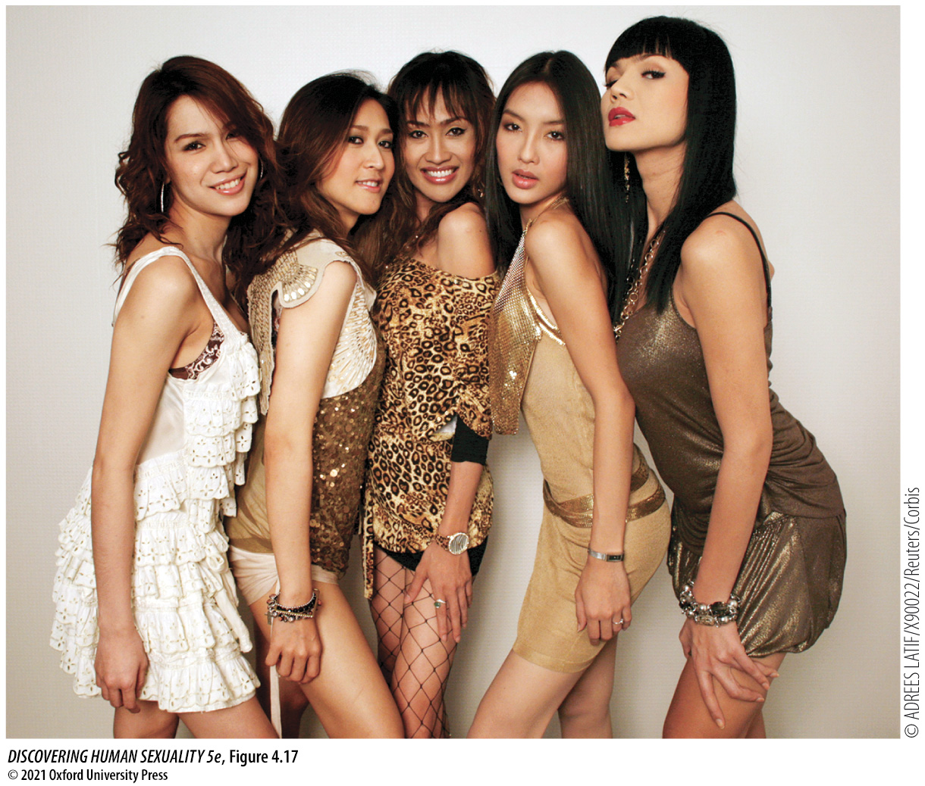
Figure 4.17 Kathoey
Notes:
Figure 4.17 Kathoey Members of the Thai kathoey (transgender) band Venus Flytrap.

Slide 40
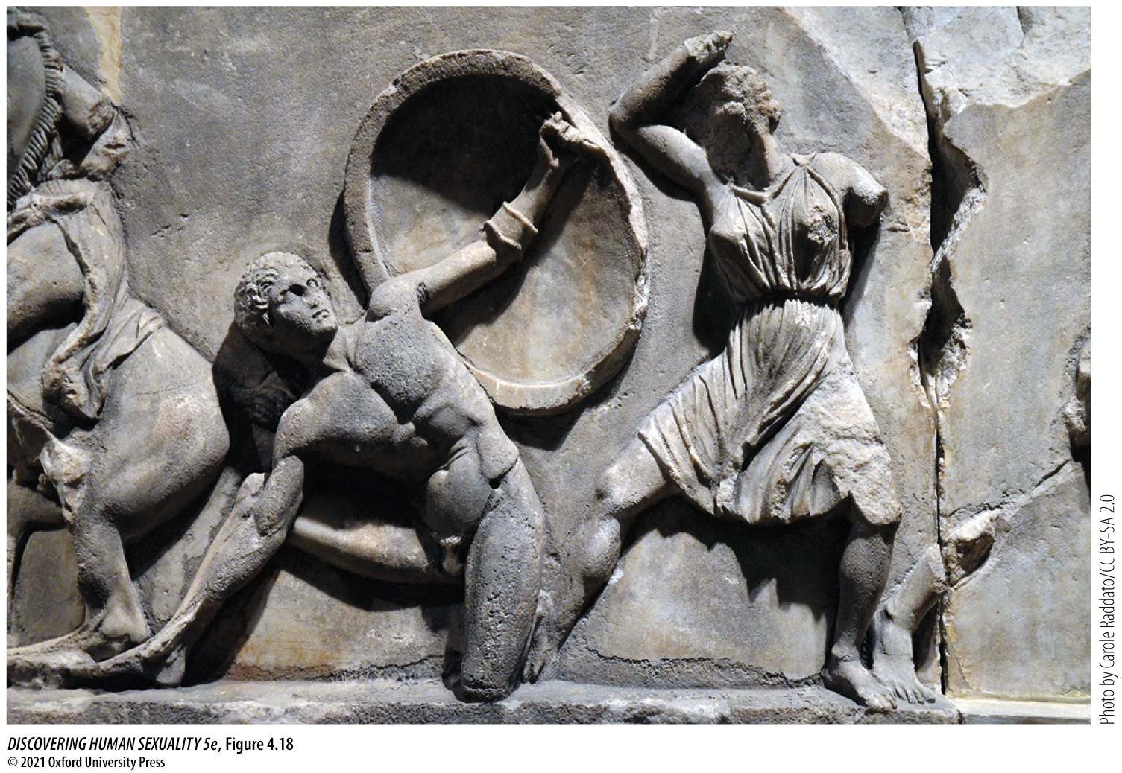
Figure 4.18 Female warrior
Notes:
Figure 4.18 Female warrior An Amazon prepares to strike a cowering Greek soldier. (Her spear is missing.) This sculpture is from the 350 BCE tomb of Mausolus at Halicarnassus (Bodrum, Turkey).

Slide 41
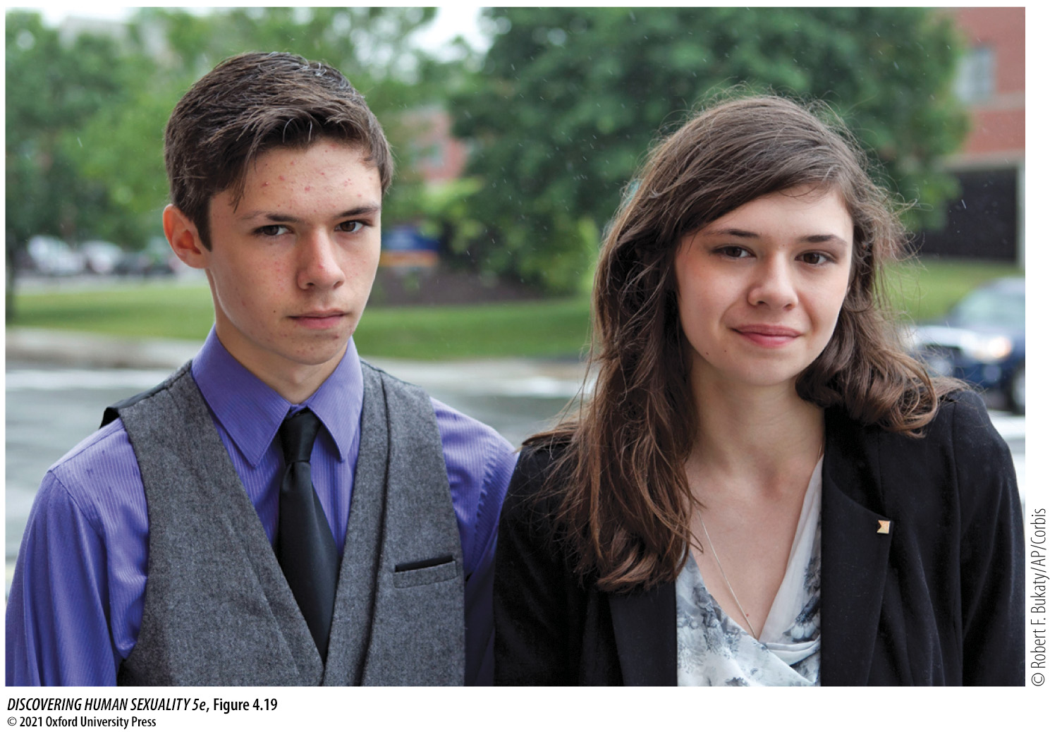
Figure 4.19 Jonas and Nicole Maines are mono­zygotic (“identical”) twins
Notes:
Figure 4.19 Jonas and Nicole Maines are mono­zygotic (“identical”) twins. Both were born male, but Nicole transitioned to female as a teenager.

Slide 42
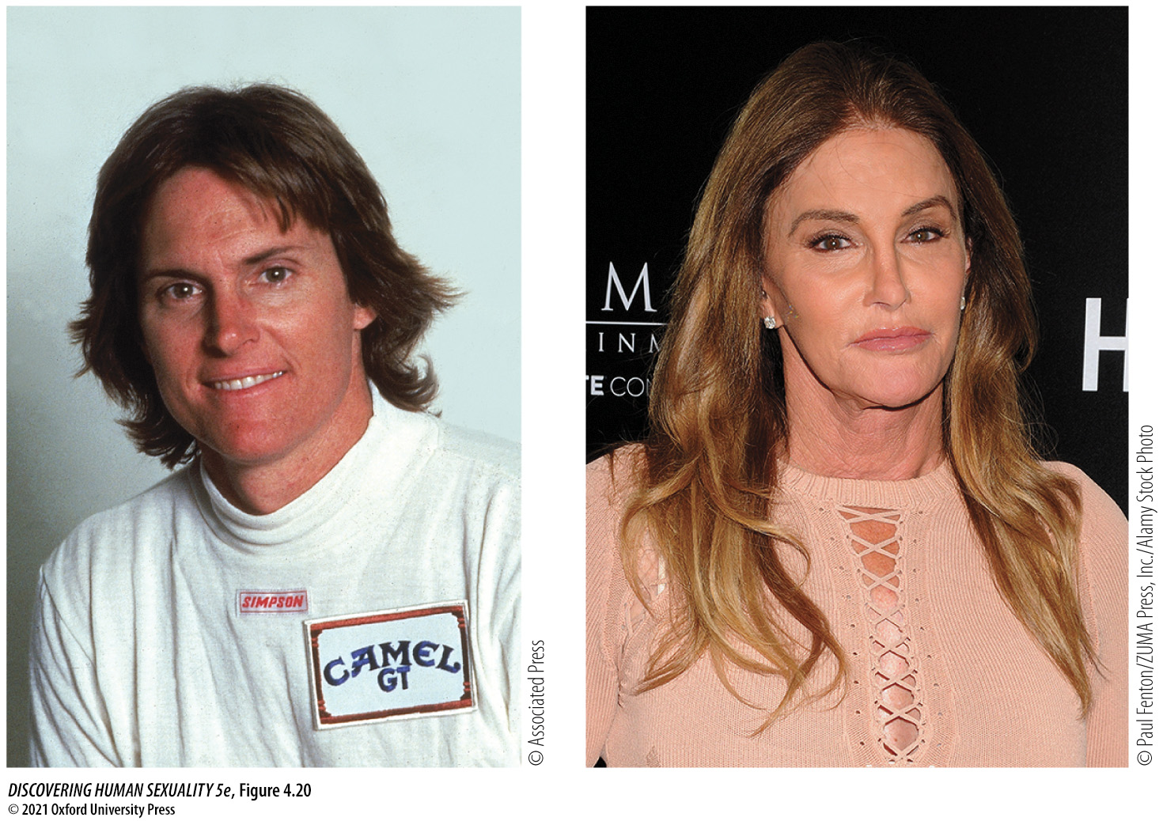
Figure 4.20 Bruce Jenner transitioned to Caitlyn Jenner between 2015 and 2017
Notes:
Figure 4.20 Bruce Jenner transitioned to Caitlyn Jenner between 2015 and 2017.

Slide 43
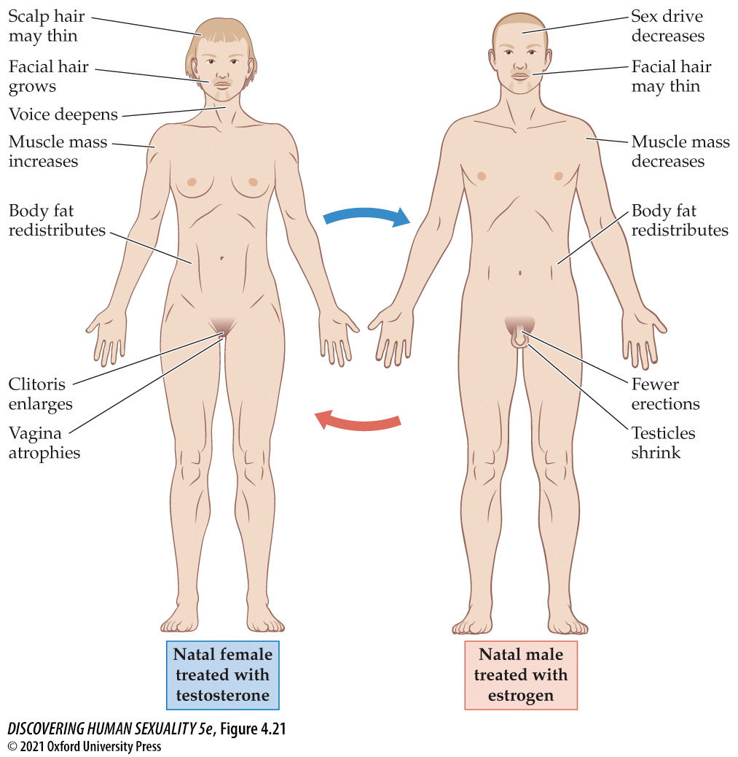
Figure 4.21 Effects of cross-sex hormones on female and male bodies
Notes:
Figure 4.21 Effects of cross-sex hormones on female and male bodies These hormones do not change stature or skeletal structure. Estrogen does not eliminate facial hair or reverse male-pattern baldness in natal males.

Slide 44
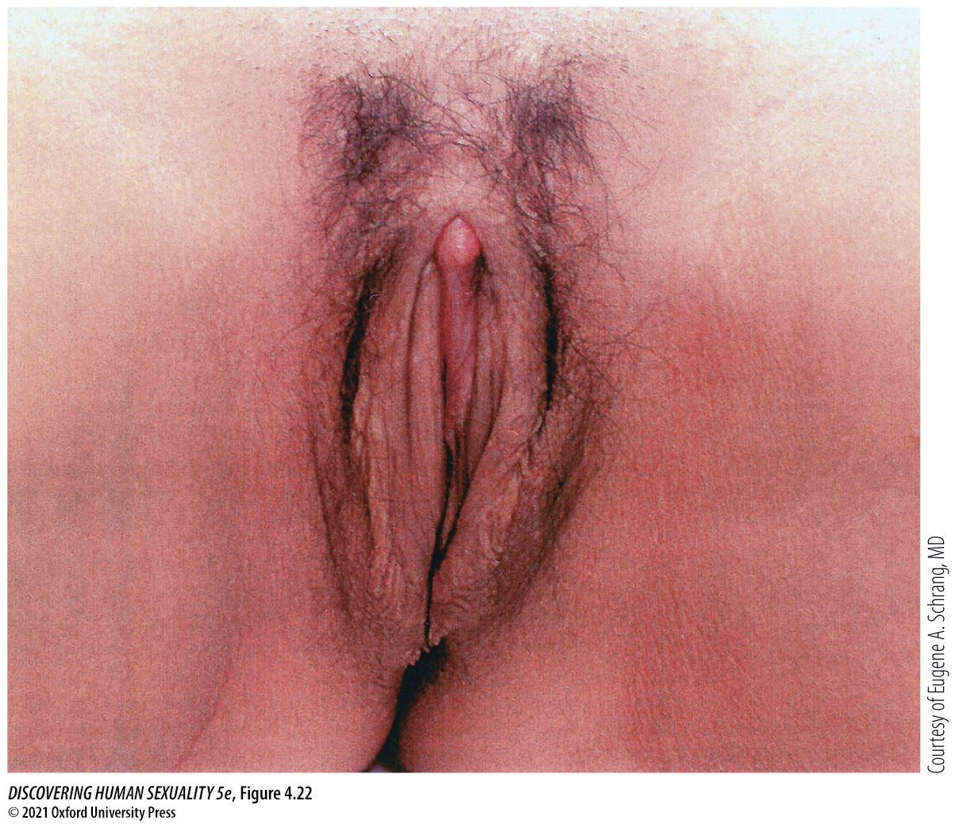
Figure 4.22 The vulva after sex-reassignment surgery
Notes:
Figure 4.22 The vulva after sex-reassignment surgery The clitoris is constructed from the top surface of the penis with its nerve supply intact and may therefore be capable of triggering orgasm. The clitoris and adjacent labial tissue are covered with mucosa derived from the penile urethra, giving them a pink color. The remainder of the penile skin, including the glans, is inverted to form the vagina. Often, additional skin must be grafted from other areas to make the vagina deep enough for coitus.

Slide 45

Figure 4.23 Trans man after transition
Notes:
Figure 4.23 Trans man after transition This man has had his breasts and ovaries removed. His penis was constructed using tissue grafted from his thigh, and he has testicular implants. The penis has erotic sensitivity but is not capable of erection. Testosterone treatments have masculinized several aspects of his appearance including facial hair and muscle development.

Slide 46
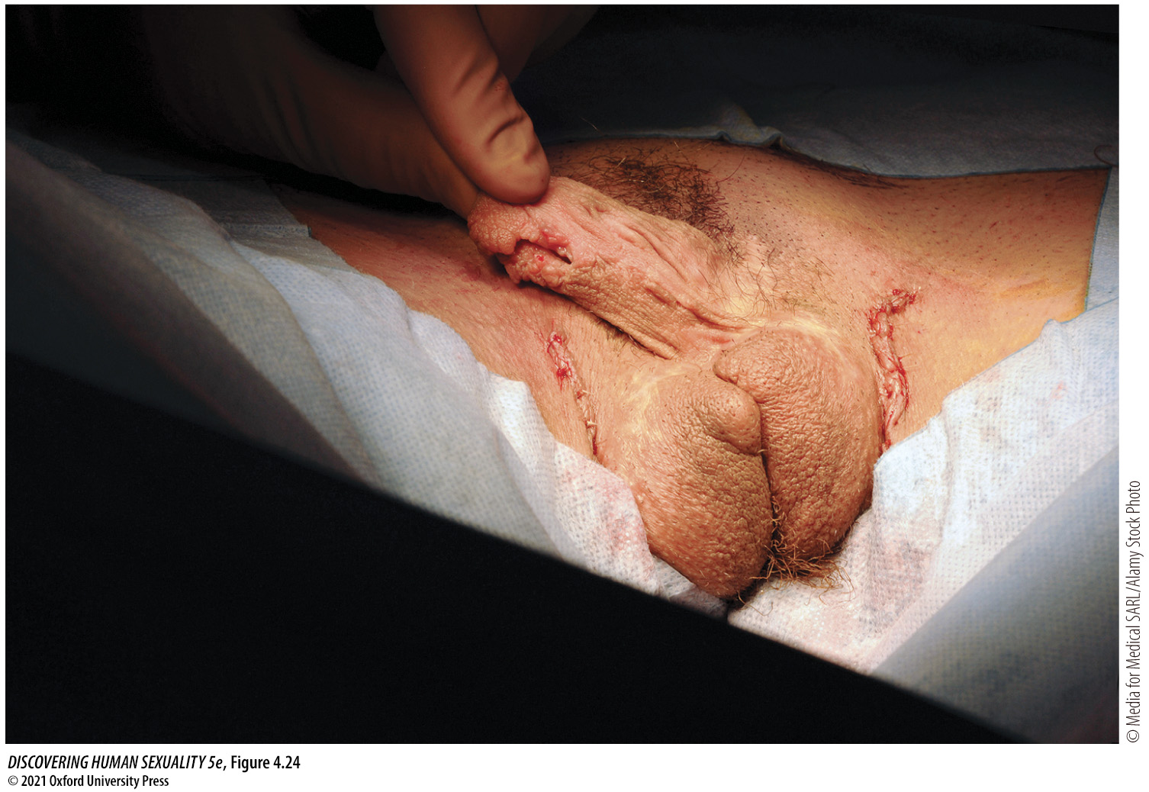
Figure 4.24 Transformation of the clitoris into a small penis by hormone treatment and surgery (metoidioplasty)
Notes:
Figure 4.24 Transformation of the clitoris into a small penis by hormone treatment and surgery (metoidioplasty). This procedure is simpler, less invasive, and less expensive than the construction of a large penis usable for penetrative sex (phalloplasty). This trans man also had a scrotum constructed from labial skin, with saline-filled implants to simulate testicles.

Slide 47
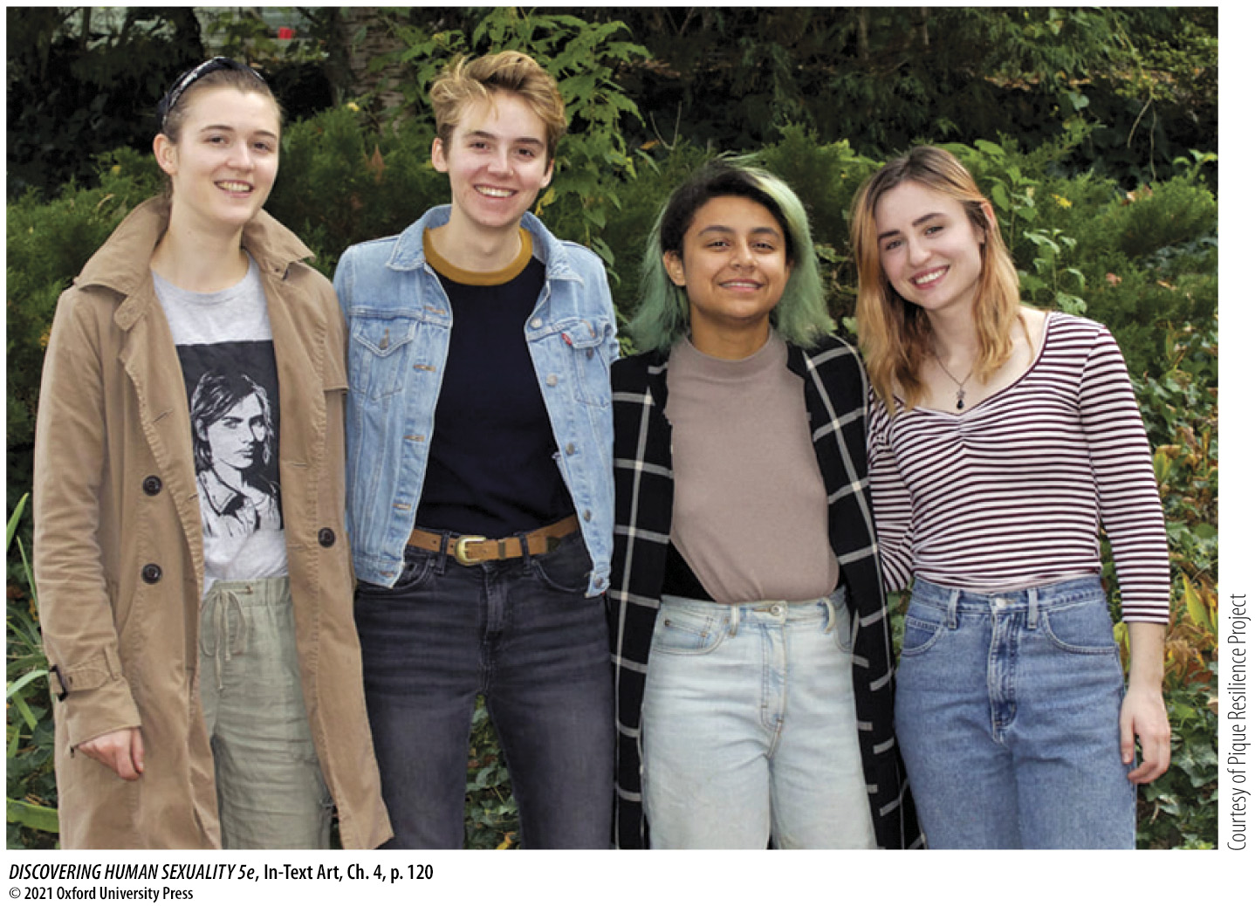
In-Text Art, Ch. 4, p. 120
Notes:
In-Text Art, Ch. 4, p. 120
These four women, members of Pique Resilience Project, experienced the onset of intense gender dysphoria during adolescence, identified as trans men, but later desisted or detransitioned.

Slide 48

Figure 4.25 Trans philosophy professor
Notes:
Figure 4.25 Trans philosophy professor Talia Mae Bettcher of Cal State LA is also a grassroots activist for the trans community in Los Angeles.

Slide 49
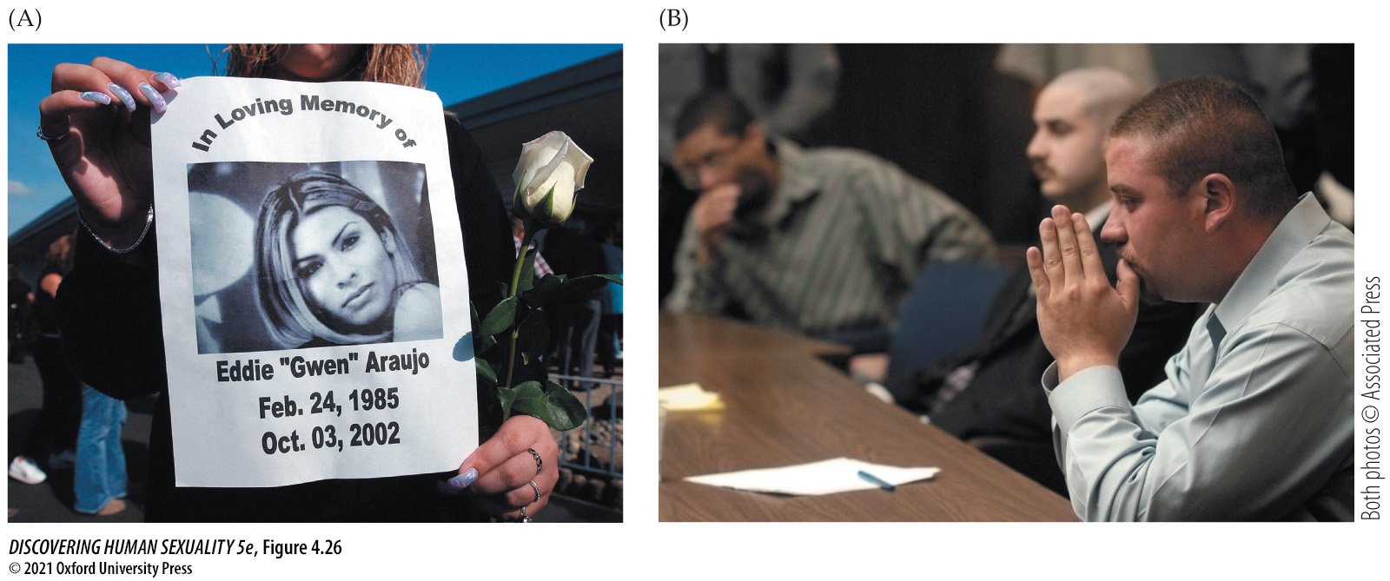
Figure 4.26 Transphobic violence
Notes:
Figure 4.26 Transphobic violence 17-year-old Gwen Araujo of Newark, California (A), was beaten to death by four men who realized that she was anatomically male after two of them had sex with her. All four of the men, three of whom are shown in (B), were convicted of murder or manslaughter and sentenced to prison terms ranging from six years to life (Fraley, 2016).

Slide 50
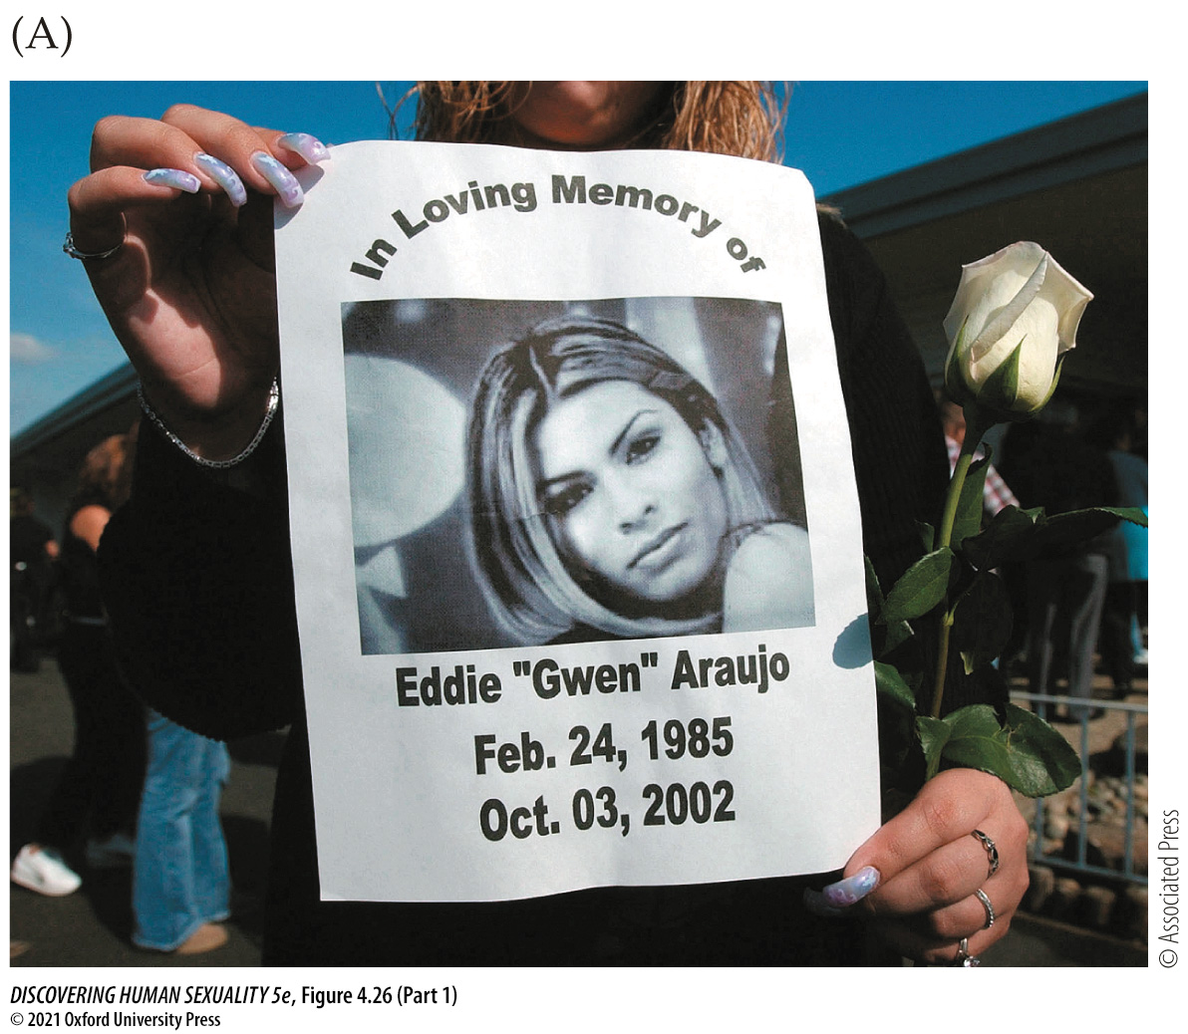
Figure 4.26 Transphobic violence (Part 1)
Notes:
Figure 4.26 Transphobic violence 17-year-old Gwen Araujo of Newark, California (A), was beaten to death by four men who realized that she was anatomically male after two of them had sex with her. All four of the men, three of whom are shown in (B), were convicted of murder or manslaughter and sentenced to prison terms ranging from six years to life (Fraley, 2016).

Slide 51
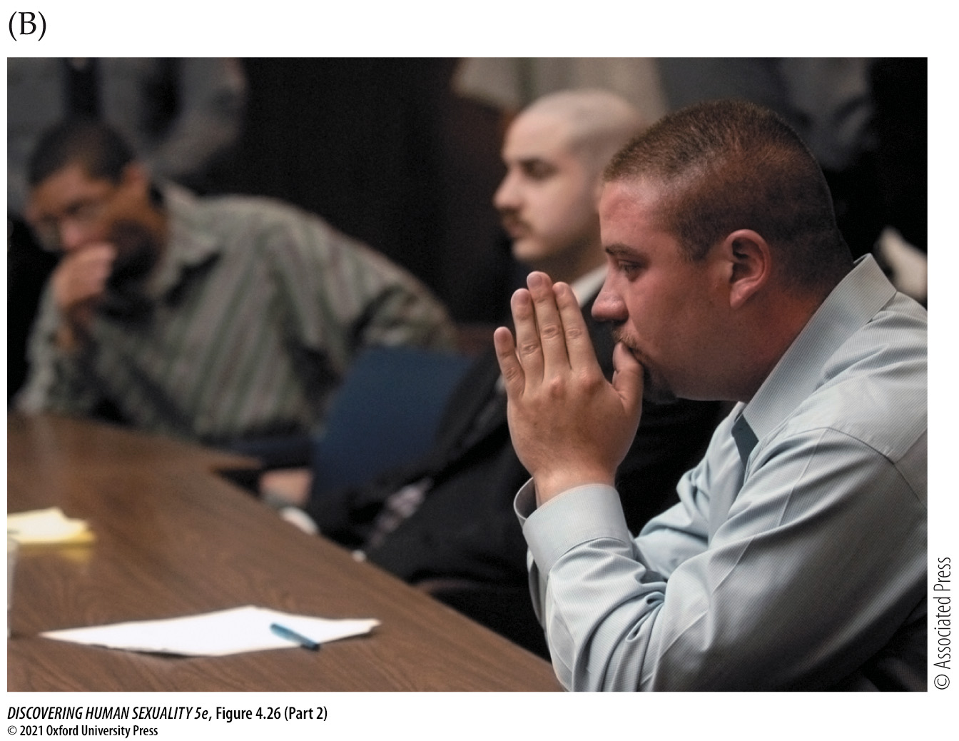
Figure 4.26 Transphobic violence (Part 2)
Notes:
Figure 4.26 Transphobic violence 17-year-old Gwen Araujo of Newark, California (A), was beaten to death by four men who realized that she was anatomically male after two of them had sex with her. All four of the men, three of whom are shown in (B), were convicted of murder or manslaughter and sentenced to prison terms ranging from six years to life (Fraley, 2016).

