Slide 1
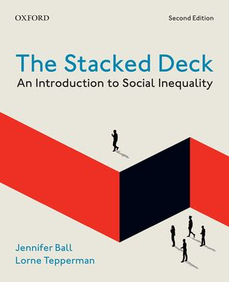
The Stacked Deck
by Jennifer Ball and Lorne Tepperman

Slide 2
Chapter 2 Populations under Discussion
Introduction
The Peopling of Canadian Society: A Thumbnail History
Colonial History and Current Issues
Racialized People in Canada
Young People in Canada
Women in Canada
Seniors in Canada
Immigrants in Canada
Indigenous Peoples in Canada
LGBTQ+ People in Canada
People with Disabilities in Canada

Slide 3
Chapter 2 Learning Objectives
To identify groups in Canada that are vulnerable to socio-economic disadvantages.
To explain the ways in which these populations are vulnerable.
To identify the ways in which these populations suffer from multiple interlocking disadvantages.
To recognize that they should not be viewed as merely victims.
To explain the ways that inequality is not unavoidable and normal.

Slide 4
Introduction
Life chances
A term credited to Max Weber, referring to the opportunities people have to gain wealth, power, and prestige
Agency
An individual’s ability to make choices

Slide 5
Colonial History and Current Issues
The National Inquiry into Murdered and Missing Indigenous Women and Girls has promoted discussion about the reasons Indigenous women and girls are disproportionately victims of death and disappearance
Early evidence suggests that these cases were largely neglected by the police
Lateral Violence
Violence directed “sideways” at peers instead of at oppressing groups or individuals

Slide 6
Consequences of Colonialism on Indigenous Peoples
A colonial mentality has “othered” Indigenous people, framing them as intrinsically different from society’s dominant social group
Colonialism is understood to be profoundly traumatic
The traumatic event which has been the most widely studied is exposure to residential schooling
Trauma is believed to be passed down via socialization or childhood learning

Slide 7
“Four Cs” of Indigenous Historical Trauma
Colonial in origin
Collectively experienced
Cumulative effects
Cross-generational impacts
Research into intergenerational trauma is highly complex

Slide 8
Low-Income People in Canada
Poverty/Low Income
The condition of not having enough of the things we need for life
Absolute Poverty: how much difficulty a person has satisfying her daily survival needs
Relative Poverty: a person’s economic condition compared to the average in her community

Slide 9
Measuring Income: the Market Basket Measure
Market Basket Measure (MBM)
The method used to measure low income in Canada that calculates how much income a household requires to meet its needs
These include subsistence needs (such as basic food and shelter) and the needs to satisfy community norms

Slide 10
Shifting to the Market Basket Measure
Some say this measure implies that Canada is moving from a relative measure of poverty to a more absolute measure of poverty
Others say it represents a shift from a focus on social comparison to a focus on physical survival

Slide 11
Racialized People in Canada
Racialized persons
People who belong to non-dominant ethno-racial communities who, through the process of racialization, experience race as a key factor in their identity and experiences of inequality
People’s skin colour is a significant aspect of racialization
Race is a continuing social construction
A term used to describe how something has meaning only because it is made up or seen as such—it is not real (or biological) in nature

Slide 12
The Term “Visible Minorities” is No Longer Used
It reinforces a problematic belief that whiteness is not visible
It may promote stigmatization of certain groups

Slide 13
Canada’s Racialized Population
22.3% identify themselves as belonging to as “visible minority” group
Increased from 19% in 2011
Canada’s racialized population is increasing much more quickly than the non-racialized population
Predicted that one in three Canadians may be a member of a racialized group by 2031
The concentration of racialized Canadians is greatest in Ontario

Slide 14
Young People in Canada
A diverse and variably defined group in Canada
It is not easy to find a job right out of school because of
A high rate of unemployment and underemployment (employment in a job that needs far less education and preparation that an individual has earned)
A general increase in short-term employment
A continuous changeover to a technical and information-based economy
Young people are now spending more years in school
Thus, they are accumulating more debt and paying increased tuition fees

Slide 15
Women in Canada
Feminization of Poverty
The overrepresentation of women among the poor
Overall, women, and single mothers in particular, are more likely to be impoverished than any other demographic group
Gender Discrimination
Carries social and psychological costs
Results in decreased self-esteem, increased depression, and other psychological problems

Slide 16
Seniors in Canada
Seniors are people over the age of 60 or 65
Physical quality declines with age because of senescence
The natural decline of physical and mental abilities during the aging process
93% of seniors lived in private residences
Most of the remainder live in group residences for senior citizens or other health care facilities

Slide 17
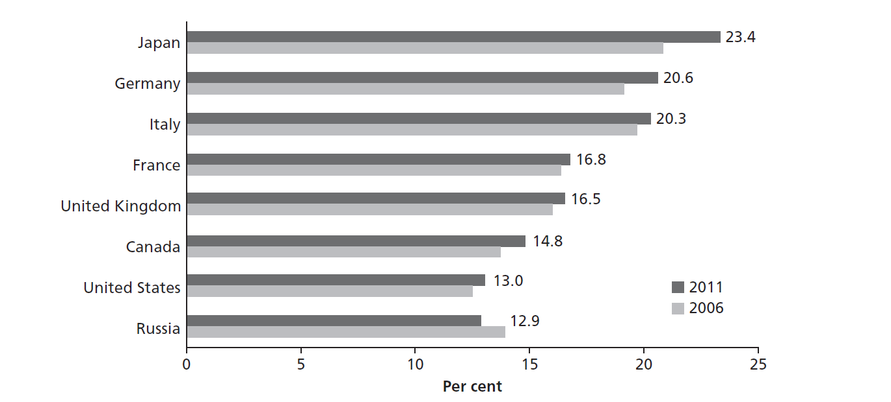
Seniors in Canada
Figure 2.2 ◆ Proportion (in Percentage) of the Population Aged 65 and Over, G8 Countries, 2006 and 2011

Slide 18
The Development of the Sandwich Generation
The population’s ageing has resulted in a sandwich generation
Middle-aged adults who are caring for both elderly parents and for their own young children

Slide 19
Aging and Disability
Aging is invariably associated with some disability
Countless studies have shown that seniors who are lower in socio-economic status (SES) have significantly higher greater disability-associated problems than their higher SES counterparts

Slide 20
Immigrants in Canada
Immigration is very important
Canada needs young families to enter the workforce and to reproduce the population, since it is a low-fertility society
Canada experiences a “brain gain,” or an influx of talented, educated, and hard-working people from around the world
Three main categories under which foreign-born people can apply to immigrate permanently to Canada:
Economic immigrants (deemed to have skills)
Family class immigrants (sponsored by close relatives, may not be skilled)
Refugees (in need of protection, may not be skilled)

Slide 21
Immigrants are an Important Source of Canada’s Population and Labour Supply
There are 7.5 million immigrants living in Canada, representing just over 20% of the total population
The largest group of immigrants came as adults, and hail from Asian countries
However, large numbers of others came from Africa, Central and South America, and the Caribbean

Slide 22
Describing Immigrants and Their Families
Certain terms are used to describe immigrants and their children
First generation: The immigrants themselves
Second generation: The children of immigrants
Third generation: The grandchildren of immigrants
Over 20 million people in Canada describe themselves as third generation immigrants

Slide 23
Indigenous Peoples in Canada
The term Indigenous comprises three different sub-populations:
First Nations (630 communities, 50 different languages)
Metis (Indigenous and non-Indigenous ancestry)
Inuit (live in Inuit Nunangat, 53 communities)
The Indigenous population is young and growing
Children aged 14 and under make up 26.8% of the Indigenous population
Registered Indians (or Status Indians)
Indigenous people who are registered with the Government of Canada and entitled to some rights and benefits as outlined in the Indian Act
Interestingly, there is no federal register for Inuit or Metis

Slide 24
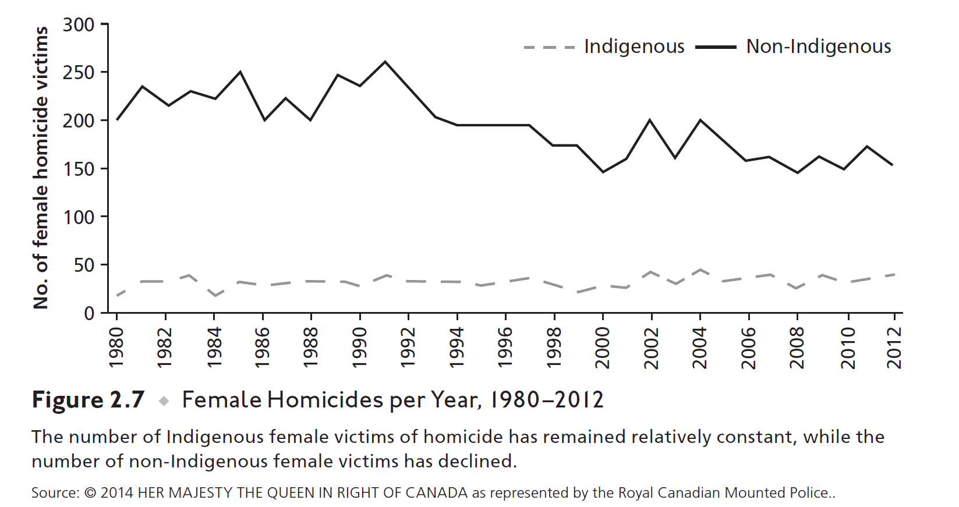

Slide 25
LGBTQ+ People in Canada
Lesbian, Gay, Bisexual
Refers to a person’s sexual orientation—that is, whether a person is attracted to members of the same sex, the opposite sex, or both
Transgender
Relates to a person’s gender identity (not their sexual orientation)
Queer
People who do not feel a part of heteronormative society and reject the broad classification of other terms
Intersex
Identifies bodies that are not male or female, but are something else or in-between
Two Spirit
In deference to sex-, gender-, or sexuality-based identities, recognized by some North American Indigenous communities

Slide 26
Census Count of LGBTQ+ People in Canada
More Canadians self-identify as LGBTQ+ today than they did in the past
The number of self-identified same-sex couples increased by 60.7% between 2006 and 2016
Half of all same-sex couples in Canada live in Montreal, Toronto, Vancouver, and Ottawa-Gatineau
Like immigrants and young people, LGBTQ+ people tend to concentrate in the nation’s largest census metropolitan areas

Slide 27
Perceptions of LGBTQ+ People in Canada
A significant problem facing LGBTQ+ Canadians is the threat of homophobic bullying
73% of LGBTQ+ students report feeling unsafe at school
Many legislative changes showed growing support for transgender Canadians
Bill C-16 (enacted in 2017) added gender identity and gender expression to the list of banned grounds of discrimination
The Criminal Code now protects against hate speech or propaganda based on gender identity or expression

Slide 28
People in Canada with Disabilities
Disability
The condition of having difficulty carrying out familiar tasks and being limited in normal daily activities due to a long-term health condition or health-related problem
For every five Canadians over the age of 15, roughly one of them reports one or more disabilities

Slide 29
Disabilities can Range from Mild to Severe
The Canadian Survey on Disability (CSD) identifies 10 types of disabilities:
Pain
Mobility
Agility
Hearing
Seeing
Learning
Psychological
Memory
Speech
Developmental

Slide 30
Fighting Inequality
Disability Rights Movement
A Canadian movement, which began in the 1960s, that spoke for the respect, full citizenship, and inclusion of disabled people in society

Slide 31
Some Facts on Canadians with Disabilities
Persons with disabilities were less likely to be employed than those without disabilities (among those aged 25-64 years)
Persons with more severe disabilities, have a decreased likelihood of being employed
Persons with more severe disabilities (aged 25 to 64 years) were more likely to be living in poverty than their counterparts without disabilities

