Slide 1

The Stacked Deck
by Jennifer Ball and Lorne Tepperman

Slide 2
Chapter 1 Theories of Social Inequality
Sociology and the Study of Social Inequalities
Sociological Approaches to Inequality
Marx and Weber: Two Main Approaches to the Struggle for Power
Sociological Approaches to Neoliberalism
Social Justice
Intersectionality and Interlocking Disadvantages

Slide 3
Chapter 1 Learning Objectives
To define social inequalities.
To recognize the importance of the historical context of social inequalities.
To understand how sociologists think about and study social inequalities.
To identify the competing theories that clarify aspects of social inequalities.
To understand the concepts of social justice, neoliberalism, intersectionality, and interlocking disadvantages.

Slide 4
Sociology and the Study of Social Inequalities
Societies vary in their openness
Open societies offer more opportunities for advancement by talented people
Open societies offer fewer impediments to upward mobility
Open societies provide equity legislation and higher education, as in Canada

Slide 5
The Sociological Imagination Helps us Understand Inequalities
C. Wright Mills’s sociological imagination
The ability to see the interconnections between individual experiences, and larger societal patterns, trends, or forces
Allows us to connect the conditions of our own lives and the larger social contexts in which we live
For example, using the sociological approach, we can begin to realize that poverty and inequality may be beyond an individual’s control

Slide 6
Sociology and the Study of Social Inequalities
Different social forms and practices contribute to the survival of society
Functional Theory of Stratification
Inequality is a healthy, necessary feature of a stable society
Criticisms:
Ignores the factor of inheritance of wealth and status
Ignores disagreements about society’s most important roles
Fails to explain anomalies

Slide 7
The Sociological Approaches: Functionalism
Different social forms and practices contribute to the survival of society
Functional Theory of Stratification
Inequality is a healthy, necessary feature of a stable society
Criticisms:
Ignores the factor of inheritance of wealth and status
Ignores disagreements about society’s most important roles
Fails to explain anomalies

Slide 8
The Sociological Approaches: Conflict Theory
Society is a collection of varied groups struggling to dominate society and its institutions
Social inequalities reflect differences in power and wealth in society
Authority has the power to preserve order and inequality
Conflict can increase social solidarity by helping opposing groups become more aware of another’s views

Slide 9
The Sociological Approaches: Symbolic Interactionism
Focuses on small micro interactions between people
Reciprocal behaviours between two or more people producing shared and evolving realities
Interested in the shared meanings, definitions and interpretations that make interaction among people possible and meaningful
Labelling theory
Asserts that people create social realities (like “crimes,” for example) when they label them as such

Slide 10
The Sociological Approaches: Feminism
Studies the ways gender inequality makes women’s lives different from men’s
Women often act out specific roles that define and shape their social activities
Roles refer to the dynamic element of status, the way in which status is performed
Feminists reject the idea that men and women’s biological differences justify their separate social roles
Patriarchy structures the way most societies work

Slide 11
Two Main Approaches to the Struggle for Power: Karl Marx
Co-authored The Communist Manifesto (1848) with Friedrich Engels
Argues that class conflict drove the history of humanity
As societies moved from one means of production to another means of production, the classes in control also changed
Controlling the means of production means controlling society

Slide 12
Key Classes in Society
Marx Identified two key classes in a capitalist industrial society:
The bourgeoisie: Those who own and control the means of production in a capitalist society
The proletariat: Those who exchange their labour for wages and work for the bourgeoisie in a capitalist society
Marx Asserted a capitalist society is built on the conflict between the bourgeoisie and the proletariat

Slide 13
The Reserve Army of Labour
The proletariat sell their time or labour power to the bourgeoisie
The bourgeoisie buy the workers’ time and labour power
By ensuring a reserve army of labour, a pool of unemployed people seeking work, their workers will accept low wages and poor working conditions upon threat of replacement

Slide 14
Class Consciousness
Marx believed that exploitation by the bourgeoisie will cause workers to inevitably fight back
Marx favoured the radical elimination of capitalism via revolutionary action, which requires the development of class consciousness
Marx asserted many forces, like false consciousness, prevent workers from mobilizing

Slide 15
Two Main Approaches to the Struggle for Power: Max Weber
Focused on the distribution of power
Viewed classes as one of many groups in society that contend for power
Believed that people could obtain power by entering influential parties and high-status groups

Slide 16
Modifications to Marx by Weber and Others
No longer necessary to own a business to control the means of production
Globalization has prevented the mass mobilization of workers
People can obtain power by entering influential parties and high-status groups
“Reserve army of labour” is much larger now

Slide 17
Neo-Marxist Approaches
Critical Theory
An analysis of politics and society, based in Marxian theory, that focuses on the historical and ideological forces that influence culture and human behaviour
Wallerstein’s World System Theory
A capitalist world order keeps some nations in continuous poverty
Core nations: Have strong governments, vast bureaucracies, and huge mercenary armies
Peripheral nations: Lack strong central governments and are controlled by other states

Slide 18
Chomsky’s Approach
The Manufacturing of Consent
Mass media are powerful ideological institutions
They reflect advertisers’ prejudice and interests, which often aligns with those of the capitalist class
They are subject to “flak” from powerful influence groups

Slide 19
Critical Race Theory: Commodity Racism
The social processes of classifying people according to their sense race or ethnicity
McClintock (1995) stated that commodity racism appealed to people’s beliefs in racial superiority and inferiority to sell products

Slide 20
Critical Race Theory: Racism Institutionalized
Critical Race Theory is a form of analysis that explores the way that beliefs about race organize all social structures
In Canada, racialized people continue to face discrimination in several domains
Racism has become institutionalized
When beliefs and behaviours are formally established in an organization and guide behaviour accordingly

Slide 21
Neo-Weberian Notable Thinker: Pierre Bourdieu
Bourdieu believed in the existence of three types of capital: Economic, cultural, and social
Cultural capital
Knowledge, material objects, and credentials that elevate status, distinguish one group from another, and perpetuate inequality
Signals class boundaries and reproduces class domination from one generation to the next

Slide 22
Bourdieu: Social Capital and Class Lifestyles
Social Capital
Advantageous relationships that enable better access to key social and economic resources
Unequal distribution of economic and cultural capital leads to the preservation of social inequality
Also means there will be distinct class subcultures and lifestyles

Slide 23
Defining Neo-liberalism
Neo-liberalism: The deregulation of global markets, largely through the reduction of state power
Under this system, people (supposedly) have the freedom to seek to satisfy their private goals
In so doing, they (supposedly) create and contribute to prosperity for everyone
Highlights equilibrium, efficiency, and integration

Slide 24
Assumptions Behind Neo-liberalism
The market is politically neutral
Democracy is irrational because it threatens the profitability of the market
The decline of the state in an inevitable result of globalization
Democracy must be limited to keep economic prosperity safe from interference from the state or the masses
Greatest good with automatically arise

Slide 25
Criticisms of Neoliberalism
Neo-liberalism’s promotion of a meritocratic society helps perpetuate inequalities
It presumes the existence of “ideal markets,” but have never and will never exist
Markets are usually not places where people can exercise their freedoms equally

Slide 26
Effects of Neo-liberalism on Inequality
Under Western neo-liberalism income inequality has increased
Jobs have been outsourced to low-income countries
The world economy was brought to a near meltdown by the Wall Street collapse in 2008

Slide 27
Conflict Theory Criticisms of Neo-liberalism
Capitalists are always looking to control or conquer other societies to manipulate markets, populations, and governments
Neo-liberalism is the economic face of modern capitalism
Globalization is an effort by multinational organizations to extend their control of wealth by seeking a larger market and cheaper labour and resources

Slide 28
Key Differences Between Conflict and Functionalist Perspectives
Functionalists: Inequality arises naturally through free market relations
Conflict theorists: Inequality arises from the efforts of capitalist and multinational corporations

Slide 29
The Concept of “Social Justice”
The fair and just treatment of members of society
All members of society have a natural right to satisfy certain basic needs
Right to satisfy needs for food, shelter, and safety
Grown to include the rights to political representation, a living wage, and unbiased treatment by the institutions of law and order
Canadian Charter of Rights and Freedoms: Guarantees Canadians’ basic rights and freedoms

Slide 30
Measuring Income Injustice: the Gini Index
The statistical representation of income inequality between the rich and the poor
Expresses inequality on a scale from 0 (perfect equality) to 1 (perfect inequality)

Slide 31
Intersectionality and Interlocking Disadvantages
Intersectionality
Coined by Crenshaw to describe the occupational implications of being both Black and a woman
Combines disadvantages of race and gender
Helps us avoid making oversimplified generalizations

Slide 32
Intersectionality and Interlocking Disadvantages
Interlocking Disadvantages
The ways in which multiple identity characteristics can overlap and intersect to worsen life chances
Concept combines social disadvantages other than (or in addition to) race and gender
Awareness of Interlocking Disadvantages creates more nuanced pictures of how people live and experience social inequality

Slide 33
Standpoint Theory
Each individual experiences the world in a subjective way, largely rooted in his or her gender, race, class or other positions of disadvantage
A person’s experience depends on their unique combination of social categories

Slide 34
The Communication Process 1 of 2
This is a slide without bullets.
This is a slide without bullets.
This is a slide without bullets.
This is a slide without bullets.
This is a slide without bullets.
This is a slide without bullets.

Slide 35
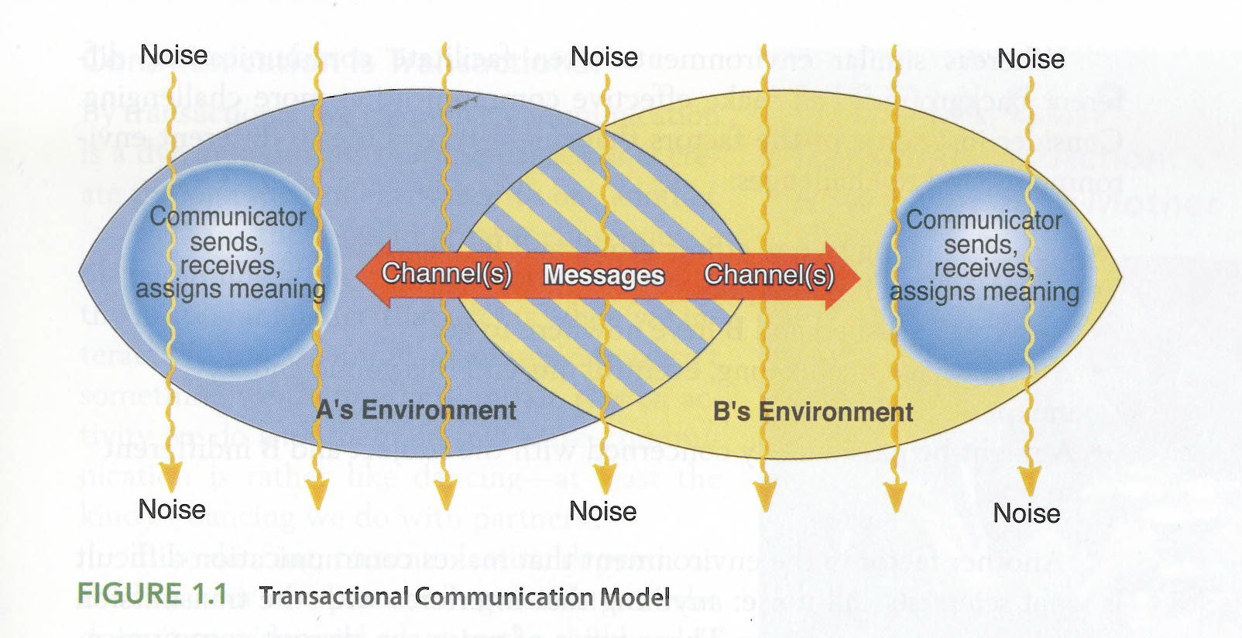
The Communication Process 2 of 2

Slide 36
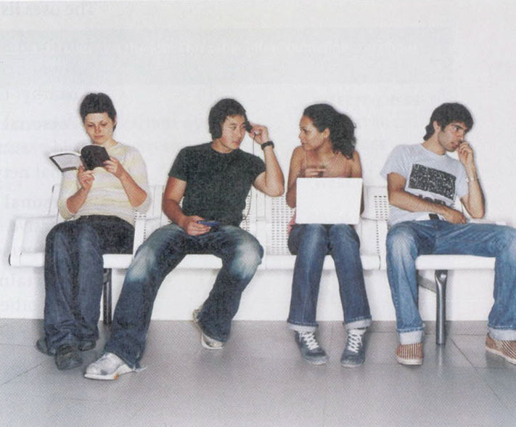
How People Use Social Media
Mediated Communication can sometimes be as rewarding a face-to-face interaction.
How does the amount and nature of your mediated communication affect your in-person relationships?

Slide 37
Table 1.x

Slide 38
Review of Learning Objectives
1.1 What needs does communication satisfy?
1.2 What is the relational, transactional nature of interpersonal communication?
1.3 What are the common traits of effective and competent communicators?
1.4 Explain the advantages and drawbacks of social media vs. face-to-face interaction.

