Slide 1
Why Study Research?
Chapter 1

Slide 2
Toward Accountability
Council on Social Work Education
  Competency 4: Engage in Practice-informed Research and Research-informed Practice
  Competency 9: Evaluate Practice with Individuals, Families, Groups, Organizations, and Communities
National Association of Social Workers
  Social workers should monitor and evaluate policies, the implementation of programs, and practice interventions.

Slide 3
Toward Accountability
  Social workers should promote and facilitate evaluation and research to contribute to the development of knowledge.
  Social workers should critically examine and keep current with emerging knowledge relevant to social work and fully use evaluation and research evidence in their professional practice.
  Social workers should report evaluation and research findings accurately. They should not fabricate or falsify results and should take steps to correct any errors later found in published data using standard publication methods.

Slide 4
Toward Accountability
  Social workers engaged in evaluation or research should be alert to and avoid conflicts of interest and dual relationships with participants, should inform participants when a real or potential conflict of interest arises, and should take steps to resolve the issue in a manner that makes participants’ interests primary.
  Social workers should educate themselves, their students, and their colleagues about responsible research practices.

Slide 5
The Five Ways of Knowing
Authority
  Questioning the Accuracy of Authority Figures
Tradition
  Sorry, That’s the Way It’s Done Around Here
  The Need to “Fit In”
Experience
Beliefs and Intuition
  Professional Ethical Concerns

Slide 6
The Five Ways of knowing
The Scientific Method
  Phases of the Scientific Method
  It Doesn’t Exist If It Can’t Be Observed and Measured
  Nothing Is Absolutely Certain Forever
  Three Purposes of Social Work Research
        To explore
        To describe
        To explain

Slide 7
Three Approaches to the Scientific Method
The Quantitative Approach
The Qualitative Approach
The Mixed-Methods Approach

Slide 8
Six Questions to Ask When Selecting a Research Approach
(Questions 1 & 2)
  What exactly am I trying to find out? Different questions require different methods to answer them.
  What kind of focus on my topic do I want to achieve? Do I want to study this phenomenon or situation in detail? Or am I mainly interested in making standardized and systematic comparisons and in accounting for variance?

Slide 9
Six Questions to Ask When Selecting a Research Approach
(Questions 3 & 4)
  How have other researchers dealt with this topic? To what extent do I wish to align my project with this literature?
  What practical considerations should sway my choice? For instance, how long might my study take, and do I have the resources to study it this way? Can I get access to the single case I want to study in depth? Are samples and data readily available?

Slide 10
Six Questions to Ask When Selecting a Research Approach
(Questions 5 & 6)
  Will I learn more about this topic using a quantitative, a qualitative, or a mixed-methods research approach? What will be the knowledge payoff of each research approach?
  What seems to work best for me? Am I committed to a particular research approach, which implies a particular methodology? Do I know what good quantitative, qualitative and mixed-methods research studies look like?

Slide 11
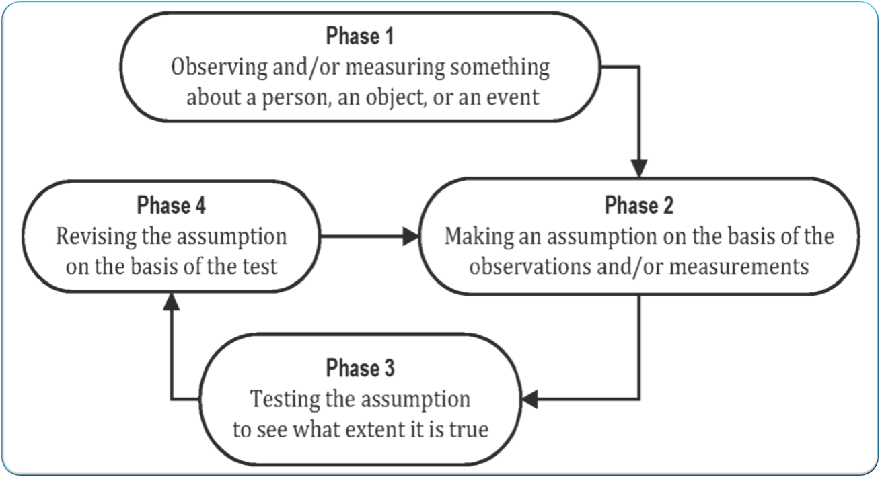
Phases of the Scientific Inquiry Process

Slide 12
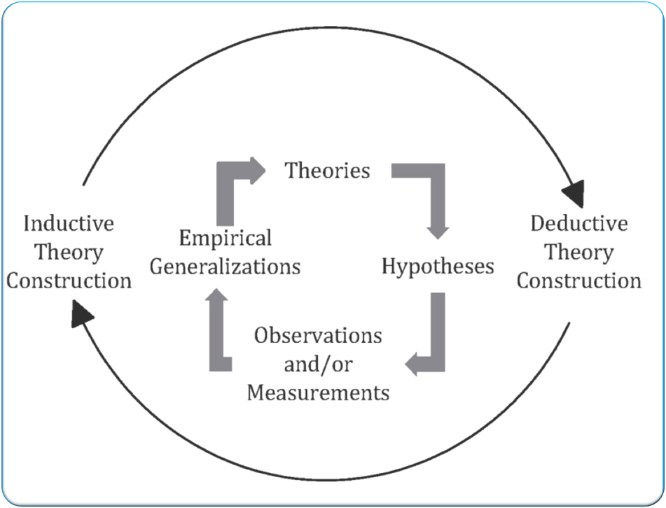
Cycle of Theory Construction

Slide 13
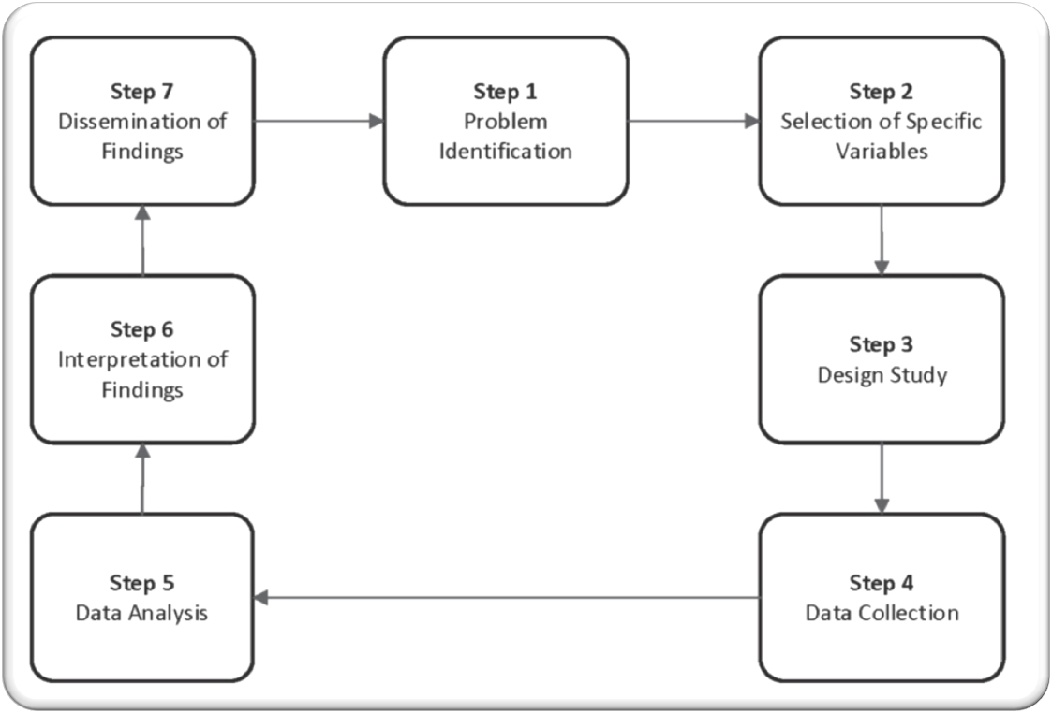
The Quantitative Research Approach

Slide 14
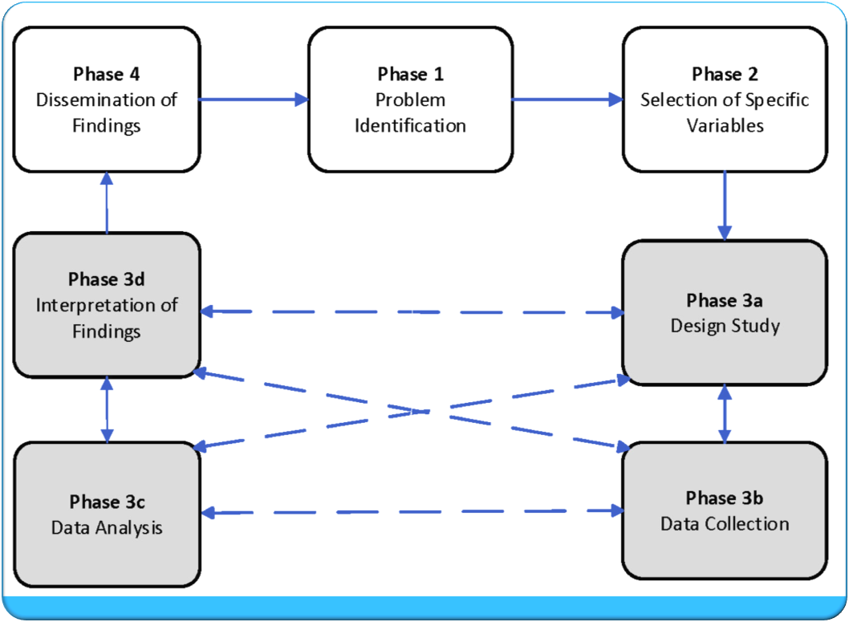
The Qualitative Research Approach

Slide 15
Pure and Applied Research Studies
Pure Research Studies
Applied Research Studies
The goal of pure research studies is to develop theory and expand our profession’s knowledge base, and the goal of applied research studies is to develop solutions for problems and applications in practice.

Slide 16
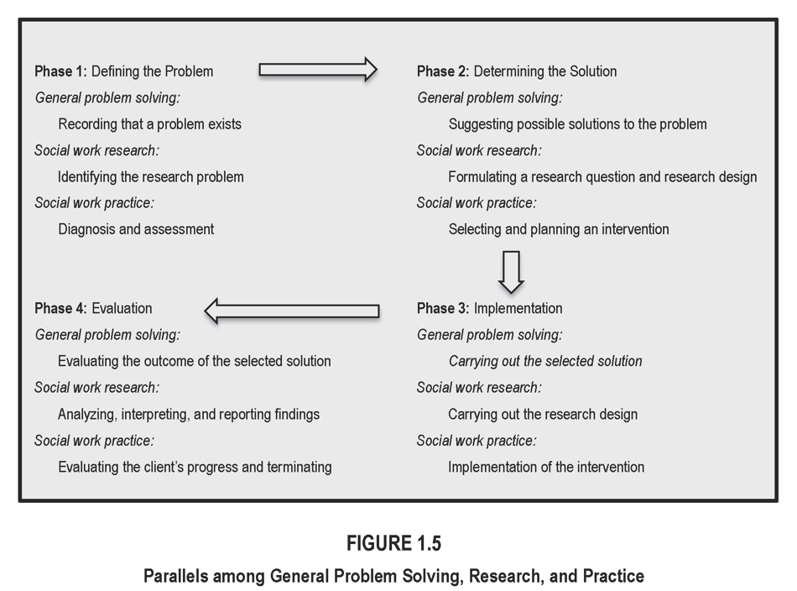
Research and Practice

Slide 17
Three Research Roles
The Research Consumer
The Creator and Disseminator of Knowledge
The Contributing Partner
Integrating the Three Research Roles

Slide 18
Four Characteristics of Researchers
Value Awareness
Skeptical Curiosity
Sharing
Honesty

Slide 19
Got Attitude?
Most people learn about the “scientific method” rather than about the “scientific attitude.” While the “scientific method” is an ideal construct, the “scientific attitude” is the way people have of looking at the world. Doing science includes many methods: what makes them scientific is their acceptance by the scientific collective.

Slide 20
Five Steps of Evidence-Based Practice
Convert your need for information about the causes of the problem, and for possible interventions, into an answerable question;
Track down the best evidence with which to answer that question;
Critically appraise that evidence for its validity, impact, and applicability;
Integrate the critical appraisal with your clinical expertise and the client’s unique values and circumstances; and
Evaluate your effectiveness and efficiency in carrying out Steps 1 to 4 and seek ways to improve your practice.

Slide 21
12 Steps to Lifelong Learning
(Steps 1 – 5)
Join the National Association of Social Workers.
Choose a professional social work conference that is relevant to your practice area, and make a commitment to attend every year.
Ask your manager or supervisor to subscribe to a professional journal(s).
Join a Listserv dedicated to critiquing knowledge in your area of practice.
Join your local library, and spend at least one day a month in professional development reading about the latest research in your area.

Slide 22
12 Steps to Lifelong Learning
(Steps 6 – 10)
Initiate a brown-bag lunch session at your workplace at which you and your colleagues discuss research.
Attend research-based training and workshops whenever possible.
Continue your formal education by taking courses online or at a university or college.
Make a presentation to share your research findings at a conference.
Evaluate your day-to-day practices; that is, evaluate if you are effective with your clients.

Slide 23
12 Steps to Lifelong Learning
(Steps 11 – 12)
Collaborate with others to evaluate the services provided by your agency or organization.
Seek employment in agencies and organizations whose culture supports using research and evaluating practice.

Slide 24
Definition of Social Work Research
Social work research is a systematic and objective inquiry that utilizes the scientific method to solve human problems and creates new knowledge that is generally applicable to the social work profession.

