Slide 1
Introduction to Global Politics, 6e
Chapter 6: Global Security, Military Power, and Terrorism Image Bank

Slide 2
Photo 6.1 The Middle East remains a region of conflict and war and the US maintains a military presence in several areas. Here the aircraft carrier USS Abraham Lincoln transits the Suez Canal in Egypt. The US sent naval vessels to the region to protect oil tankers being attacked by Iranian forces. US military dominance in this region is being challenged by new technologies an a new round of great power competition.

Slide 3
Photo 6.2 Innocent civilians are often the target of extremist groups. In this photo, school girls abducted by Boko Haram are being released. Nigerian security forces have not been very effective in stopping such criminal acts by extremists. How do armed forces protect citizens in ungoverned territories?

Slide 4
Photo 6.3 Failed or fragile states present many security challenges. In this photo, UN Peacekeepers in Kinshasa, Democratic Republic of Congo(DRC) patrol during an election campaign with a campaign poster for Joseph Kabila in the background. The government of the DRC is corrupt and failing most of its citizens-no economic, political or human security provided.

Slide 5
Photo 6.4 Russia has used “grey zone” tactics in its war with Ukraine. Grey zone tactics include cyberattacks, sabotage, subversion, sponsoring proxy wars and even military interventions. In this photo Ukrainian soldiers dig trenches as they fight Russian proxy troops.

Slide 6
Photo 6.5 Feminist views on security strive to reframe the focus of war and conflict from states and sovereignty to the individuals affected by these wars and to human security. In this photo, a severely malnourished girl is weighed at the Aslam Health Center in Yemen. She is one of the millions dying of starvation in a civil war that involves Saudi Arabia, Iran and indirectly the US. Rivals in these wars often block and form of international aid

Slide 7
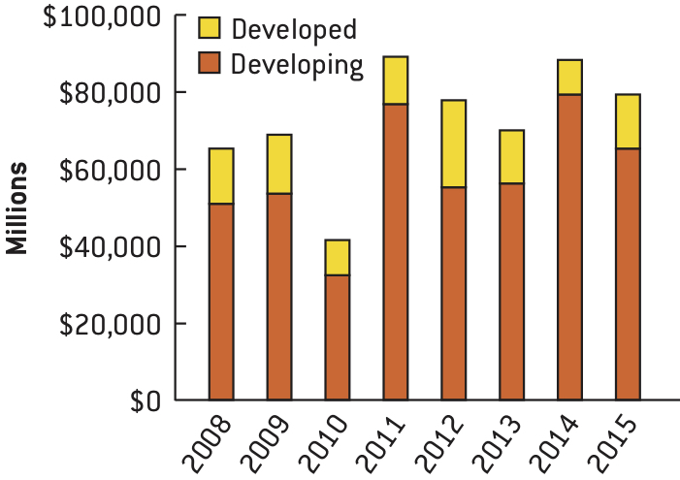
Margin Graphic 6.1 Arms Deliveries Worldwide (in Millions of Dollars). Which region accounts for the most arms delivery—the North or the South? Based on what you have studied so far in this course, how would you explain the trends you see in this graph?

Slide 8
Photo 6.6 Cooperative security can help keep the costs of war down and may even deter some aggressive states. NATO members provide security for Iceland. Here Czech JAS-39 Gripen fighter at the air base in Keflavik, Iceland. The Czech mission to protect the Icelandic airspace since Iceland has no military but provides an excellent space for watching Russian military activities.

Slide 9
Margin Graphic 6.2 Arms transfer agreements worldwide

Slide 10
Photo 6.7 The TV screens showing a photo of North Korea's weapon systems and a meeting between South Korea's Foreign Minister Kang Kyung-wha and the U.S. Special Representative for North Korea Stephen Biegun. The U.S. and South Korean militaries evaluated the two projectiles North Korea flew Thursday as short-range missiles" All of the talks of peace and halting nuclear weapons development in North Korea appear to have resulted in no positive results. What about the US efforts to create peace in the region?

Slide 11
Photo 6.8 The global war on terrorism has created a great need for counter terrorism exercises by police and members of the military. In this photo German Armed Forces are standing during an exercise with police on the military training area in Brandenburg, Germany. These kinds of cooperative projects are happening across the world as the terrorists are seen as both a law enforcement and national security problem.

Slide 12
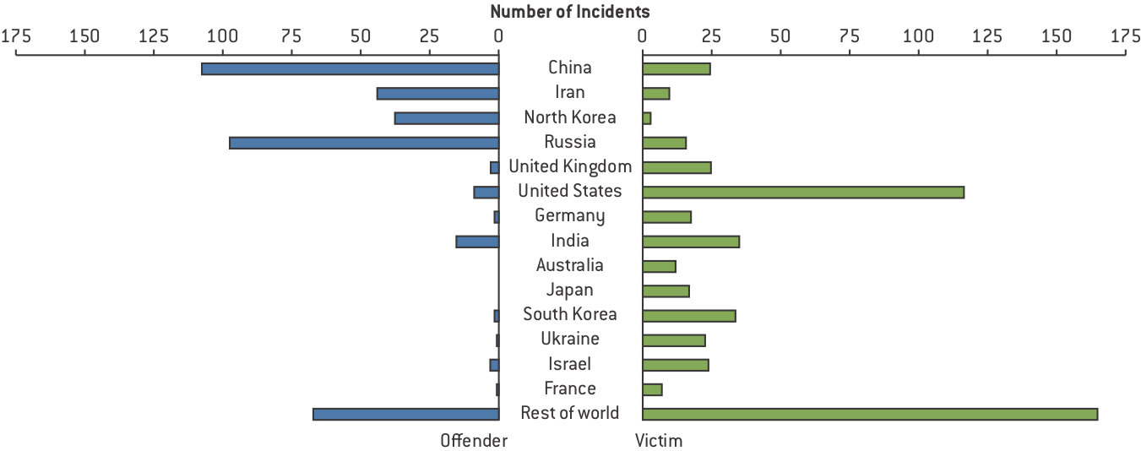
Figure 6.1 Significant Cyber Incidents

Slide 13
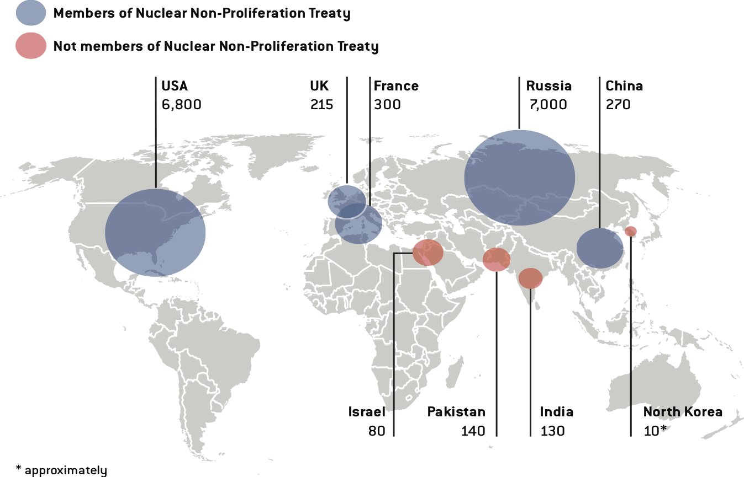
Map 6.1 Global Map of Nuclear Arsenals. All numbers are estimates because exact numbers are top secret. Size of circle proportional to number of warheads.

Slide 14
Photo 6.9 While John Bolton was President Trump’s national security advisor he was an opponent of the President’s North Korea policy but he did convince the President to take a hardline on Iran. With Bolton’s departure from office is it possible that the US will rejoin the Iran nuclear deal?

Slide 15
Photo 6.10 A military officer patrols outside the bombed St Anthony's Church, now currently under reconstruction in Colombo, Sri Lanka a one month after Islamist militants killed more than 250 people in a suicide terror attack. Terrorist attacks continue across the world and authorities seem to be unable to anticipate or prevent these attacks. What are some reasons this extremism continues?

Slide 16
Photo 6.11 With the death of Abu-Bakar-Al-Baghdadi, the leader of ISIS, and their defeat in Syria, will their terrorist activities likely subside in the Middle East or will another extremist group simply assume their activities?

Slide 17
Photo 6.12 Anti-government political forces in Afghanistan protest the US government after the military tested a massive new weapon-“the mother of all bombs”-on an empty village in eastern Afghanistan. To many in this country, the US is the terrorist not the Taliban.

Slide 18
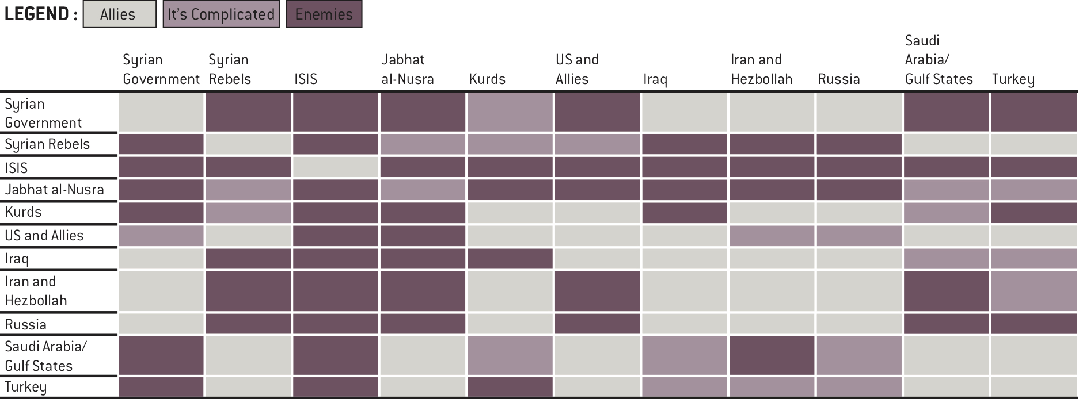
Map 6.2 Where ISIS Has Directed and Inspired Attacks. Can a nation-state respond to networks like this without global cooperation?

Slide 19
Photo 6.13 Most global sports and cultural events are potential targets for terrorists and governments spend a great deal of money trying to prevent these attacks. In this photo, Japanese security officials practice responding to chemical attacks that might disrupt the 2019 Rugby World Cup.

