Slide 1
Introduction to Global Politics Sixth Edition
by Steven Lamy and John Masker

Slide 2
Global Security, Military Power, and Terrorism
Chapter 6

Slide 3
What Is Security?
Can global security (a world without war and extremist violence) be achieved?
Level of analysis approach: Should security focus on individual, national, or international security?
During the Cold War “national security” meant “military security”
Indication of dominance of realist academic perspective
Reactions to realist perspective
From late 1980s “societal security” school, or “widening school,” of thought developed
Goal: Broaden the discourse on security to include economic, environmental, social, and political issues
From 1990s: Ethnonational security
Reaction to genocides in several multiethnic countries

Slide 4
Mainstream Approaches to National Security

Slide 5
Security: Realist and Neorealist Views
International system is anarchic, peace is temporary
States will try to balance against one another to avoid the ascension of a hegemon
Key concepts
Security dilemma: Uncertainty and lack of trust among states
Cheating: Cooperation hindered by constant fear that anther state will cheat to gain an advantage
Relative gains: States are more concerned about status as compared to other states instead of absolute status in the international system

Slide 6
Liberal Institutionalists on Global Security
International institutions help promote stability and cooperation in the international system
States investing in these institutions is evidence of their belief that they are beneficial to the international system
Institutions created after the Second World War in Western Europe have diminished concerns of a general European war
Examples: Bretton Woods regime, EU, ASEAN
Key concept: Security community
Shared values, common aversions lead to cooperation
Example: NATO
Democratic Peace Thesis

Slide 7
Security: Constructivist Perspective
Fundamental structures of the international system are social rather than material
Structure is a product of social relationships
Shared knowledge, practices, and material resources shape security relationships
Security dilemma is a social structure composed of intersubjective judgments
Security community is a different social structure: Shared knowledge can thus resolve conflicts without war

Slide 8
Alternative Views on Global Security
Critical Security Studies: Feminism
Challenge the central role of the state in security analysis
States are a source of security and insecurity
Women are affected as much or more than men in war
The use of rape as a tool of war
Majority of refugees are women and children
Masculinization of security and war
Cohn: Language, terms of war are highly gendered

Slide 9
Marxist and Radical Liberal or Utopian Approaches to Security
Support a transformation of the current economic and political system
Globalization has spread capitalist ideas
Capitalism as a source of conflict and inequality
Secular radicals

Slide 10
Changing Character of War
War is no longer the only instrument of state policy: Today war and security have been altered due to more amorphous threats such as terrorism
Asymmetrical warfare: States fighting nonstate actors
Conflicts usually occur in urban or remote rural settings
Major difference in weapon capacity and technology between state and nonstate actors in conflicts
Multidimensional battlefield: Soldier on the ground, cyberspace, satellites, drones

Slide 11
The Nature of War
Clausewitz: War as a means to an end
War is not random violence but a rational political decision
War is an act of violence to compel ones opponent to fulfill one’s will
Development of war
If war is a political decision it develops as our understanding of politics develops
Contemporary wars are local wars fought on a wider field
Television, Internet, IGOs, and NGOs have influenced the nature of war
Global media helping to induce “war fatigue”
Nature vs. character of war as described by Clausewitz and Gary

Slide 12
The Revolution in Military Affairs
Technology: advances reduce uncertainty and increase efficiencies of a fighting force
Idea introduced after “effortless” victory in the 1991 Gulf War
Overlooks nontechnological factors and creates oversimplified picture of a more complex phenomenon

Slide 13
Postmodern War
Changing modes of production and eventual outputs in advanced societies are altering the character of war
Globalization has weakened normal forms of identity (nationalism) and at the same time a resurgence of older forms of identity taken place (ethnic, clan, religious)
Changing “modes of information”
The role of broadcasting and journalists in conflicts
Journalists are no longer observers but active participants

Slide 14
Rise of Asymmetric Warfare
Insurgency and guerilla tactics to mitigate military imbalance
Met with a counterinsurgency (COIN) response with mixed results
Providing security for the local population, preventing attacks against civilians, protecting infrastructure, providing safe regions for civilians
Helping local government provide basic services shift loyalties from insurgents to local authorities

Slide 15
Rise of Asymmetric Warfare
Alternative to COIN is counterterrorism
Less expensive, less direct, and requires less commitment
Identification, tracking, and elimination of terrorist networks
Using technology to hunt and track the enemy
Sharing intelligence with other states
Targeting insurgent leadership with unmanned drones and covert operations
Bacevich: US strategy relies on two assumptions that may actually increase the amount of time wars will require
Sustained US military action is the only way of defeating terrorism
Physical presence of US troops in fragile Muslim-majority states makes them less hospitable to terrorist networks

Slide 16
Hybrid Warfare
Gray zone tactics: cyberattacks, propaganda, subversion, economic blackmail, sabotage, sponsorship of proxy wars, and at times aggressive military expansion
Used by nation-states, including Russia, China, and Iran to secure their interests
Example: Russia in the Crimea
Data breaches and malware attacks
Hybrid warfare allows inferior militaries to deter superior ones

Slide 17
Globalization and New Wars
Emergence of “new” wars since the 1980s where the conflict is characterized by the disintegration of the state
States loses control of various sectors of economy and areas of national territory
Use of child soldiers
Use of privatized military firms (PMFs)
New roles for NATO

Slide 18
Nuclear Issues

Slide 19
Proliferation and Non-Proliferation
The collapse of the Soviet Union was the only instance in which a nuclear state disintegrated
The importance of cooperative threat reduction programs and agreements
Established framework for former Cold War adversaries to handle the disintegration of the Soviet Union and the implications for its nuclear weapons
Proliferation optimism and pessimism
Nonproliferation regime: Product of first nuclear age (1950–1990)?
The NPT as a means of disarmament or a means of limiting new nuclear weapons states

Slide 20
Nature of Nuclear Weapons
Difference between nuclear weapons production and nuclear power production
For nuclear weapons a chain reaction is required, whereas for power generation a moderation of the reaction is required
Separate processes are needed for each
Nuclear weapons effects
WMD: Weapons of mass destruction
CBRN: Chemical, biological, radiological, and nuclear
Three forms of energy with a nuclear explosion: Blast, heat/thermal, and nuclear radiation

Slide 21
Nuclear Defense
U.S. National Missile Defense (NMD) Act of 1999
Brought into question the ABM Treaty
Debate in Europe over stationing of U.S. Ballistic Missile Defense in Poland and Czech Republic

Slide 22
Theorizing Nuclear Proliferation
What is nuclear proliferation?
Acquiring a nuclear weapon or the process of constructing a nuclear weapon
Why haven’t nuclear weapons been used?
Nuclear weapons only good in their nonuse (i.e., as a deterrent)

Slide 23
Nuclear Motivations
Shift from nuclear weapons being war-winning weapons to weapons of deterrence
Transnational actors and the procurement of nuclear weapons
Nuclear capabilities and intentions
Difficulty of reaching international consensus on noncompliance
Cases of Iraq and Iran highlight difficulty on both sides

Slide 24
Counter-Proliferation After Cold War
Missile Technology and Control Regime and the Hague Code of Conduct
Comprehensive Test Ban Treaty and lack of consensus
Iran
DPRK

Slide 25
Terrorism and Extremism

Slide 26
Defining Terrorism
Use of violence to achieve political goal
Historically ambiguous term
Prior to the past half-century, terrorism was state violence against citizens
Over the past half-century, terrorism has described violence by small nonstate actors in an attempt to achieve political change

Slide 27
What Is Terrorism?
Terrorism only legitimate if it meets the criteria of the “just war” tradition
Terrorist justifications and methods are not easily co-opted into international relations theory
Determining the legitimate use of force
Libya
United States and Britain

Slide 28
Typology of Terror
Left-wing terrorists
Right-wing terrorists
Ethno-nationalist or separatist terrorists
Religious or “sacred” terrorists

Slide 29
Terrorism: To Achieve Political Change
Needs broad support of population
Potentially alienate supporters
Necessity of being in the headlines to achieve goals

Slide 30
Globalization, Technology, and Terrorism
Use of Internet for communication
Chat rooms
Saved draft messages
Prepaid cell telephones
Hacked USAF drone signals
Better training, methods, equipment

Slide 31
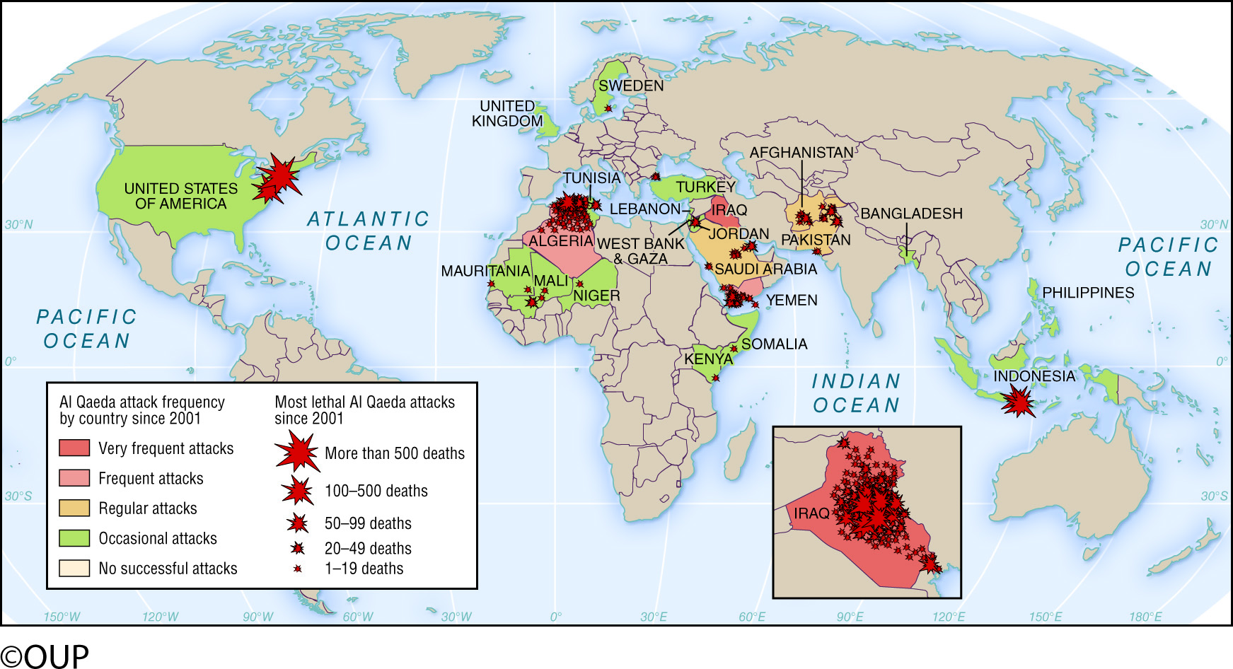
The Global Reach of Al Qaeda
Can a nation-state respond to networks like this without global cooperation?

Slide 32
Terrorism: Domestic to Global Phenomena (1968–2001)
Nineteenth-century groups relied on the railroad and telegraph
Impact rarely went beyond state borders
Goal was internal change
Used revolvers, small bombs

Slide 33
Terrorism: Domestic to Global Phenomena (1968–2001)
Three factors leading to transnational terrorism in 1968
Expansion of commercial air travel
Availability of news coverage
Political and ideological causes converged among groups

Slide 34
Terrorism: Domestic to Global Phenomena (1968–2001)
In 1980s three developments emerged concerning terrorism
Fewer but more deadly indiscriminate attacks
Increasing sophistication of attacks
Greater propensity for suicide attacks
Resources for Marxist-Leninist groups dissolved with the end of the Cold War
Militant Islamic groups developed

Slide 35
Terrorism: Explaining Militant Islam
Cultural explanation
Violence is the only manner in which to defend against Westernization and materialism
Safeguarding identity
Samuel Huntington and “clash of civilizations”

Slide 36
Terrorism: Explaining Militant Islam
Economic explanation
Defense against Western economic imperialism
Exploitation of less developed countries by World Bank, IMF, and so on
Sense of alienation and lack of opportunity in less developed countries
However, “tenuous” link between inequality and terrorism

Slide 37
Terrorism: Explaining Militant Islam
Religious explanation
Postmodern terrorism or new terrorism and the constructivist international relations theory
New terrorism as an explanation for global jihad
Infidels and apostates
Difference between secular and religious groups
Deterrence
Difficulty of coopting members out of religious groups

Slide 38
Current Challenge: Persistence of the Islamic State
Territorial caliphate no longer exists, but the organization and its strategy persist
Acted like a regular state—providing basic services, taxing the people, and providing law and order, but heavily repressive

Slide 39
Current Challenge: Persistence of the Islamic State
Use of Al Qaeda’s seven stage strategy for achieving an Islamic global caliphate
Stage I: The Awakening Stage (2000–2003)
Stage II: The Eye-Opening Stage (2003–2006)
Stage III: The Rising Up and Standing on the Feet Stage (2007–2010)
Stage IV: The Recovery Stage (2010–2013)
Stage V: Declaration of the Caliphate Stage (2013–2016)
Stage VI: The Total Confrontation (2016–2020)
Stage VII: The Definitive Stage (2020–2022)

Slide 40
Globalization, Technology & Terrorism
Proselytizing via Internet: cheap with access to large audience
Coordination
Security within organizations
Mobility
Lethality

Slide 41
Combating Terrorism
Steps taken by the UN and Interpol
ICAO, Hague Convention for the Suppression of Unlawful Seizure of Aircraft
Public Safety and Terrorism Sub-Directorate

Slide 42
Counter-Terrorism: Law Enforcement Model
Terrorism as a crime
Rule of law (domestic and international)
Multilateralism
Multiple tools: Criminal justice, diplomacy, public relations, development aid, and so on

Slide 43
Counter-Terrorism: War on Terrorism Model
Military response to act of war
Unilateral action, not restricted by multilateral institutions
Preemptive war
Aggressive pursuit of terrorism at home and abroad

